Slide 1
Weekly meeting
Yu-Siang Xiao (蕭宇翔)
2025 12/24

Slide 2
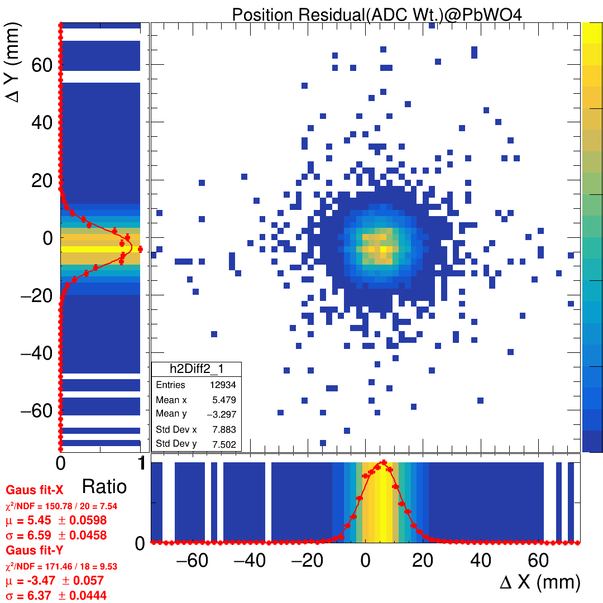
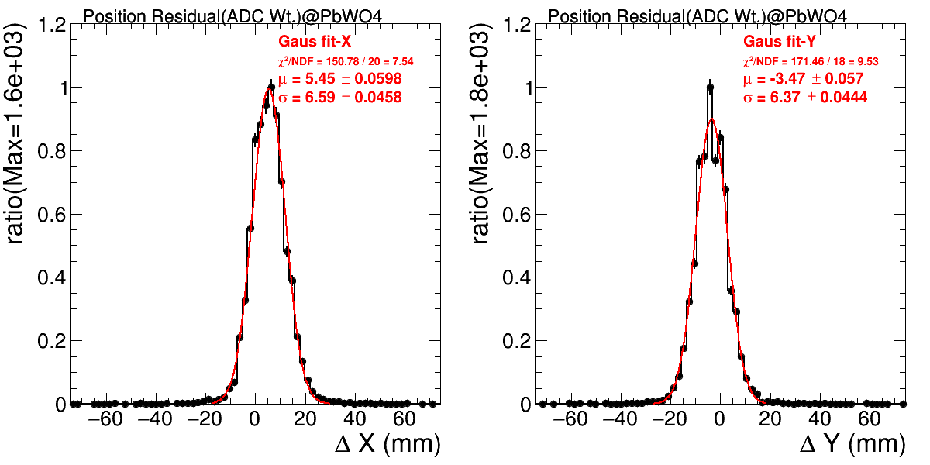
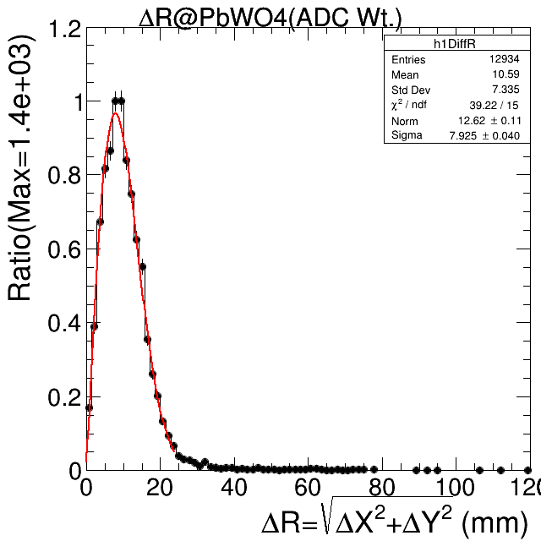
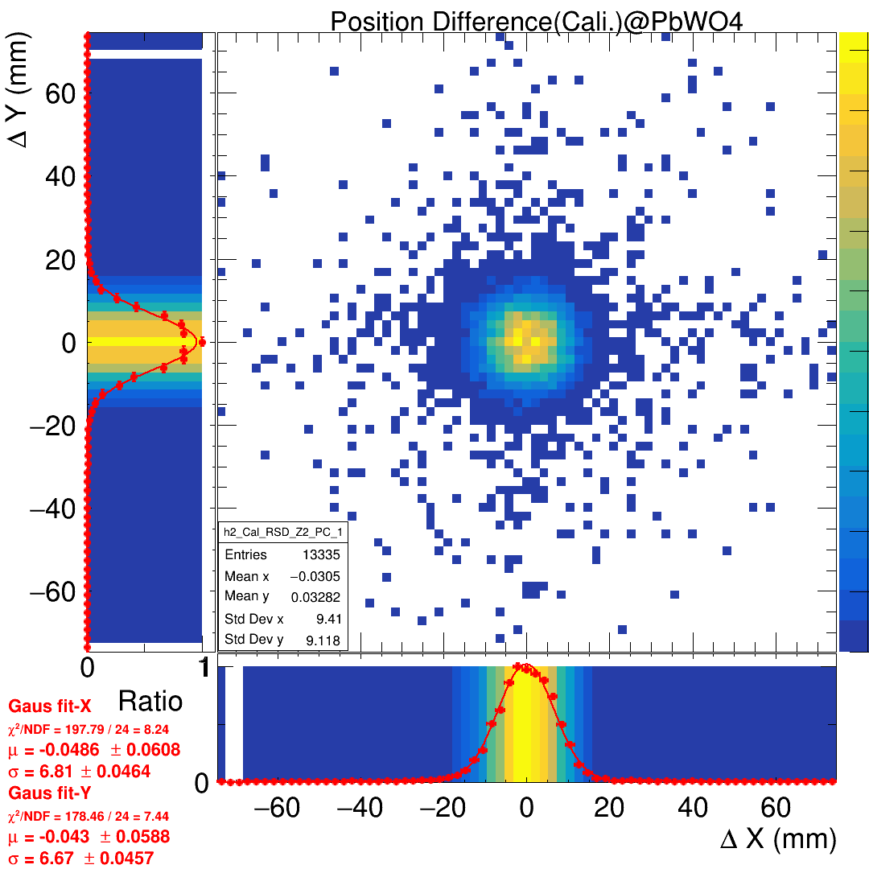
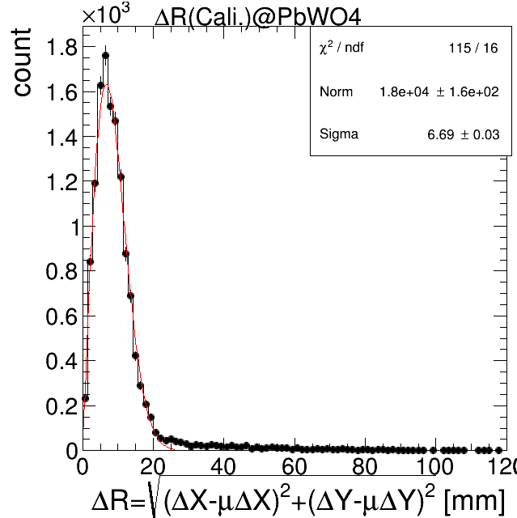
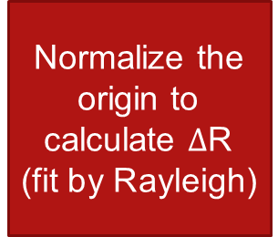
Position resolution calculation, and normalization
Draw the residual
=
=
Normalize the origin to calculate $Δ$R
(fit by Rayleigh)
=

Slide 3
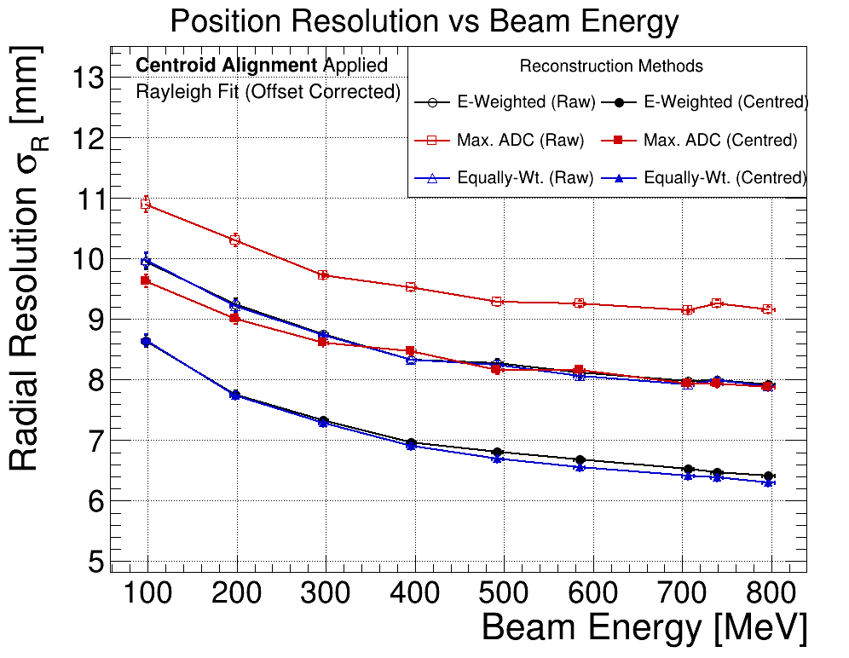

Take the fitting $σ$ from position residual, and scan by energy.
BM track method
1.ADC/Energy wt.
2.Equal. wt.
3.ADC_{max} only
Normalize or not normalize.
Energy scan
(9 energy in B.T.)
X
X
X
=
or

