Slide 1
Weekly meeting
Yu-Siang Xiao (蕭宇翔)
2025 12/24

Slide 2
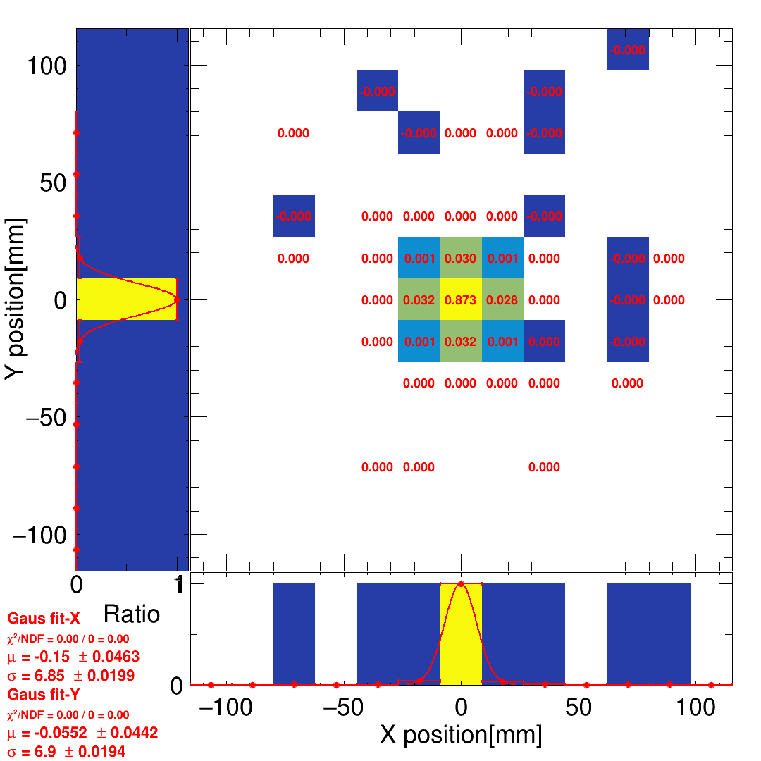
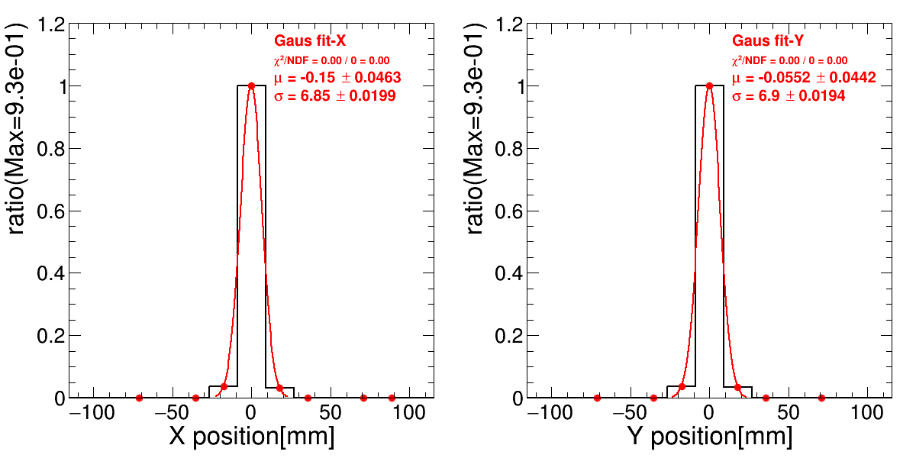
Update the algorism of ADC/Edep summation
In the past, the ADC_{max} channel will setting to be the peak channel in this event.
But in the PbWO + SiPMx2 case and the future plane, the peak channel couldn’t be the most energetic channel. It need to suming up all signal in same crystal.
I finish the code upgrade to make the calculation easier, in:
Energy summation.
BM-Track calculation.
Center of mass calculation.
Extrapolate of the BM-track.
The residual of ZDC and BM-track.
The shower spread drawing.
The shower spread

Slide 3
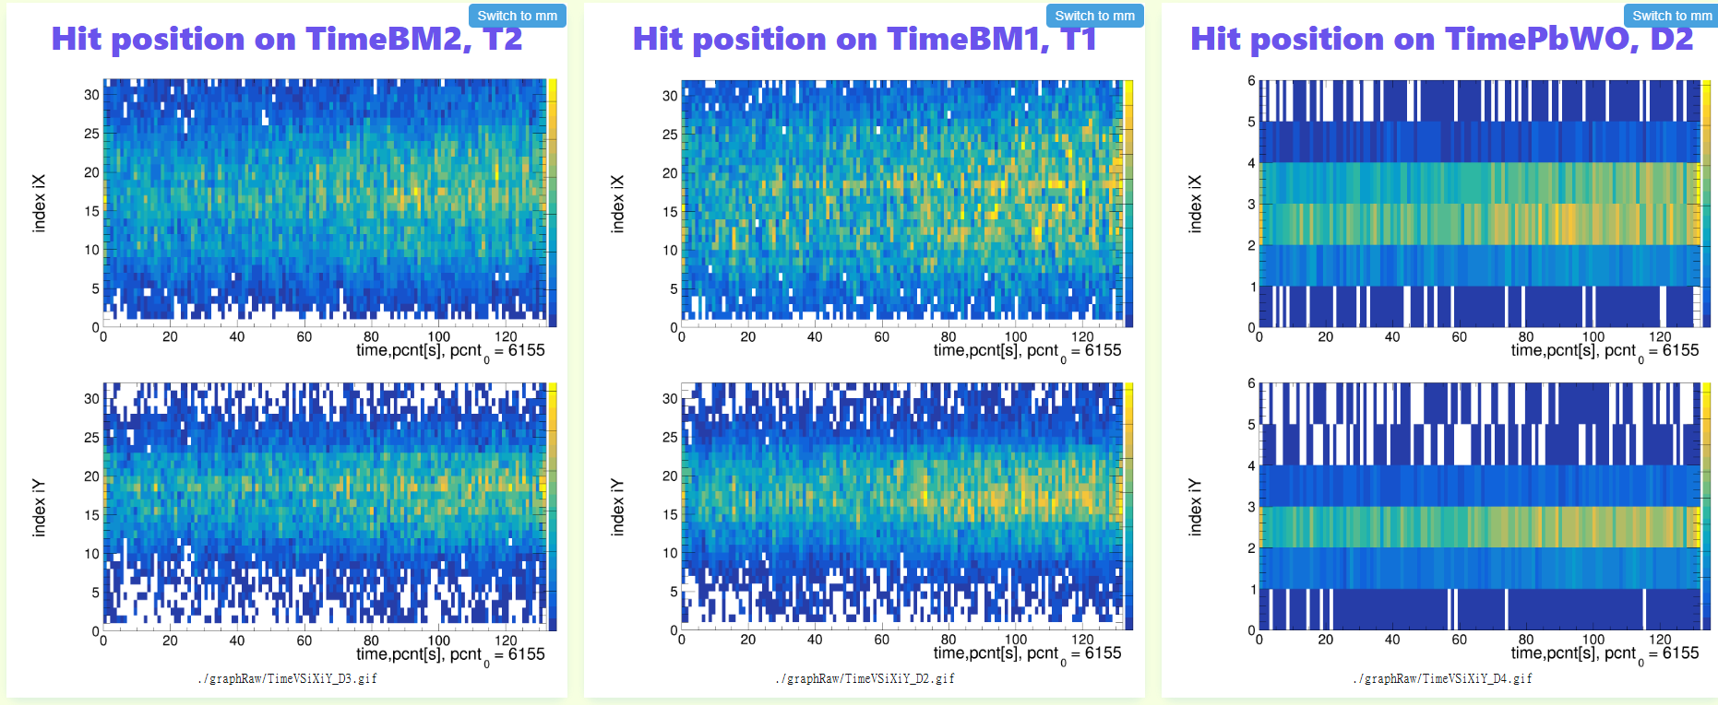
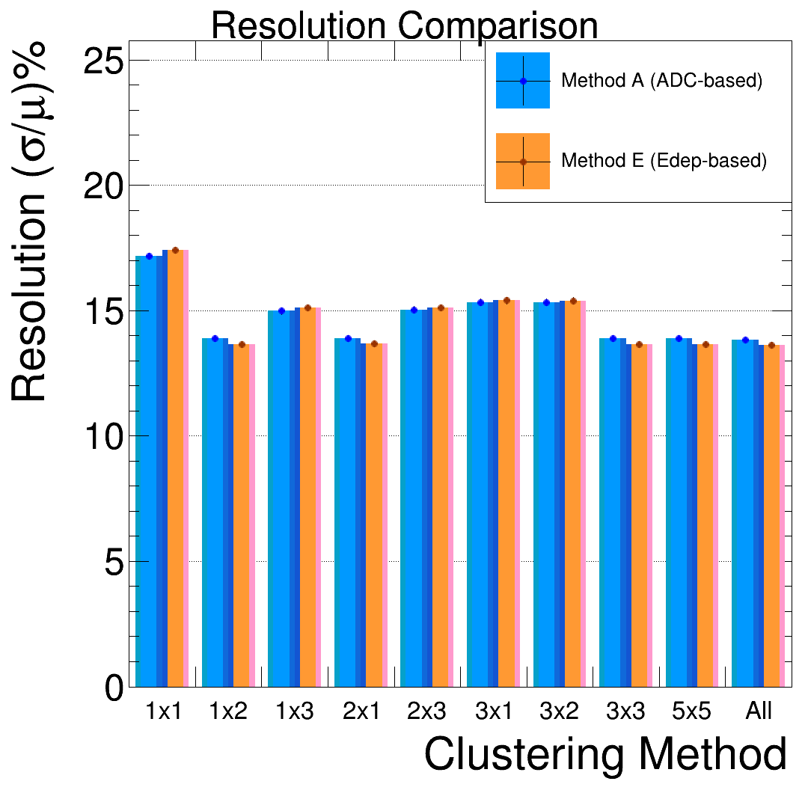
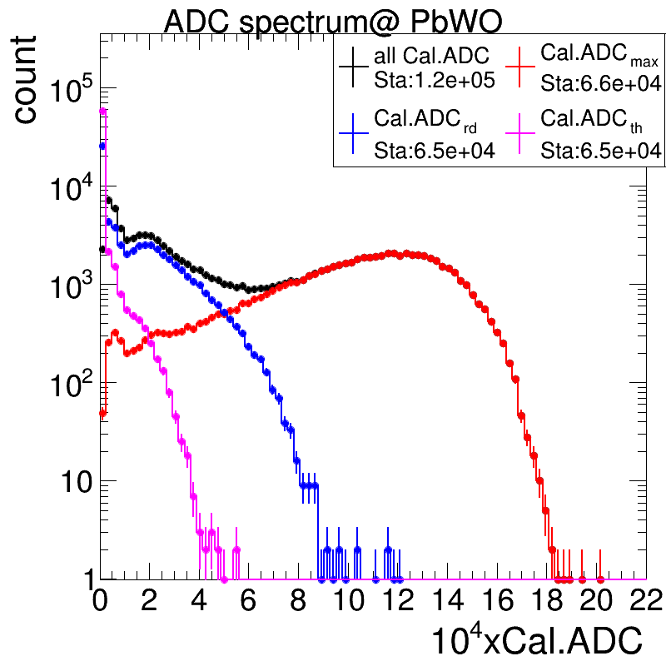
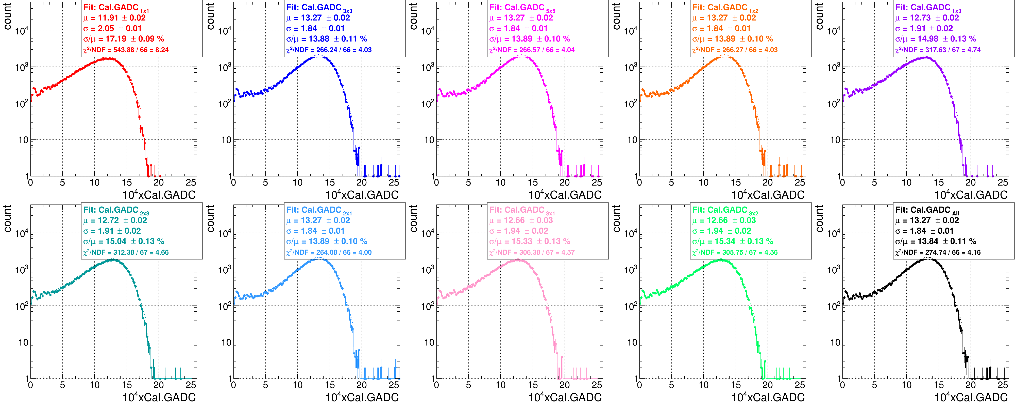
Update the online monitoring HTML
Finish the graphs insertion from reconstruction event to the calibrated event in HTML.
Add the graph: count of channel VS time to check the detector working well.
Add the energy resolution bar graph to show the energy resolution in different clustering.
Add the graph of ADC_{max} ,ADC_{3x3} ,ADC_{5x5} , and ADCs spectrum after calibration.

Slide 4
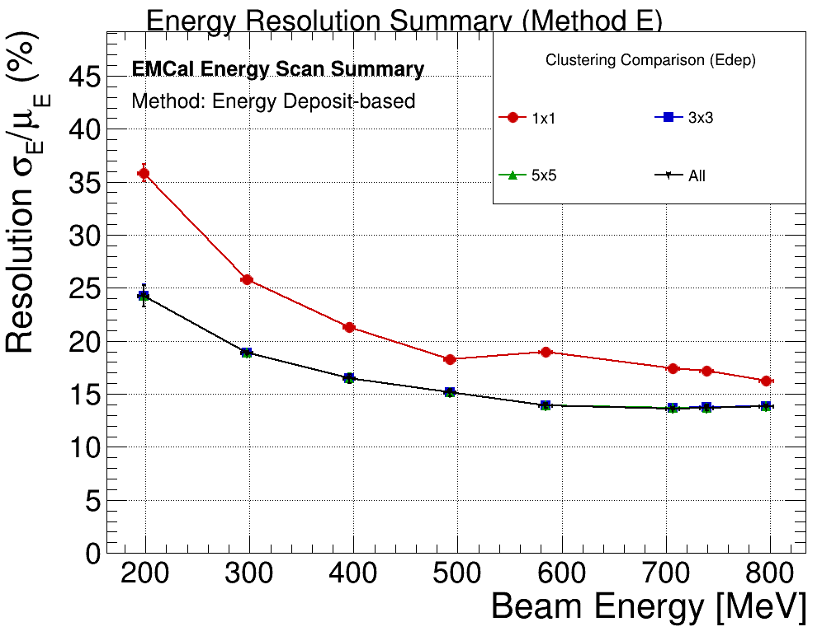
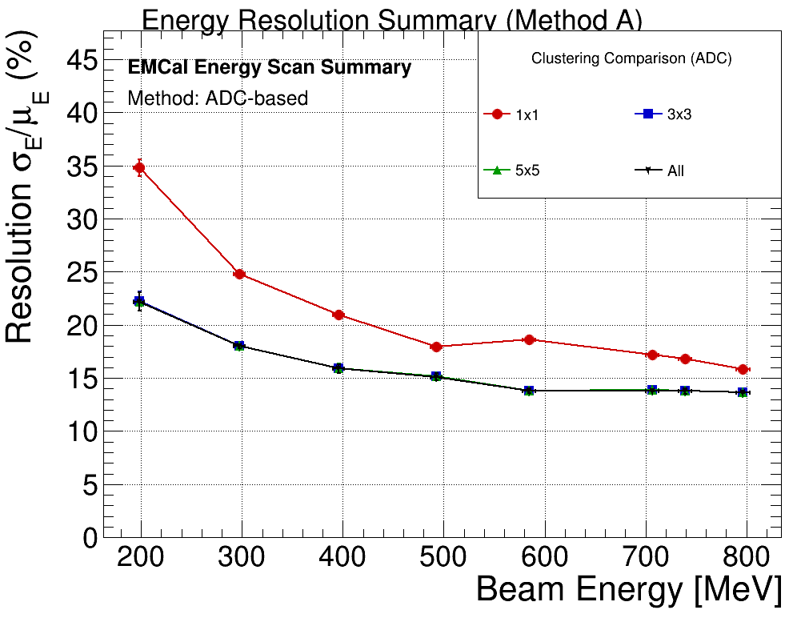
Apply the energy conversion function
After the update, the online monitoring could display in both ADC and Edep type.
(Data-771)/(MCx281.72)=1
Thus, using the beam time data to draw the energy and position resolution in beam time is easy now.

Slide 5
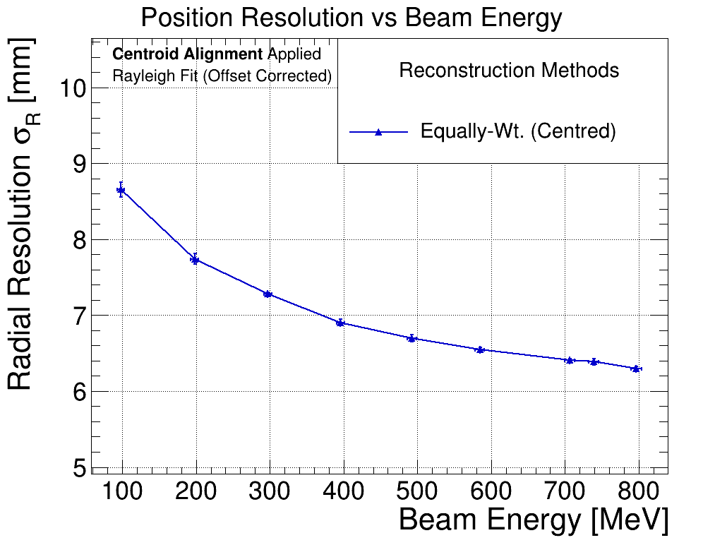
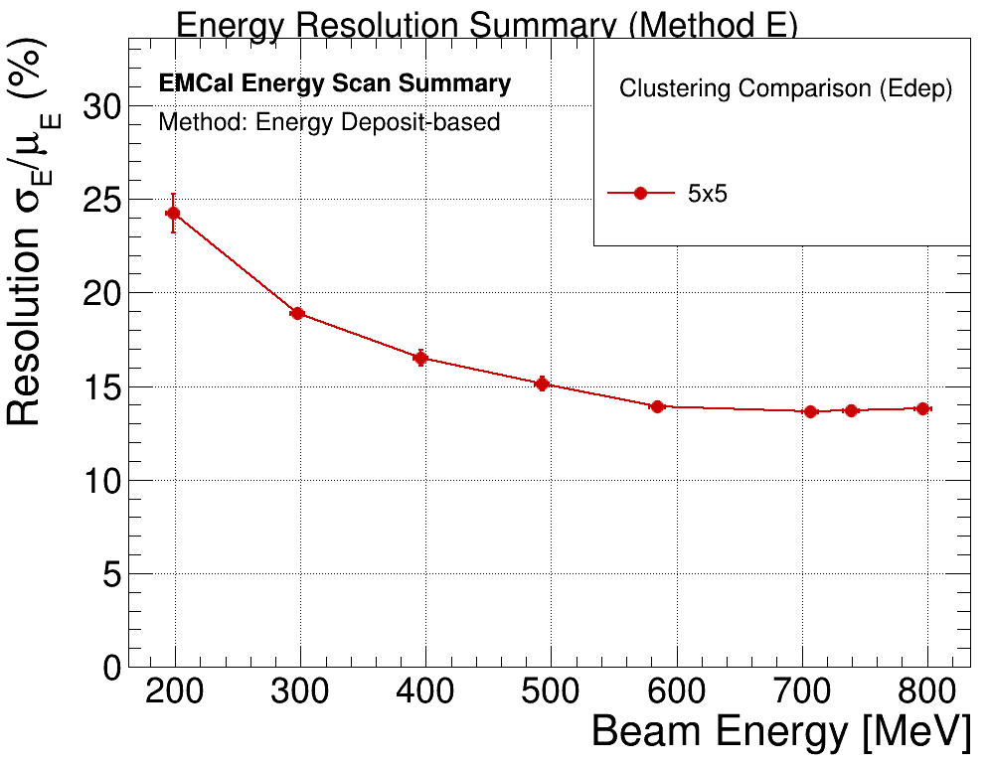
The latest result
I will show the 2 graph in ChIP.

