Slide 1
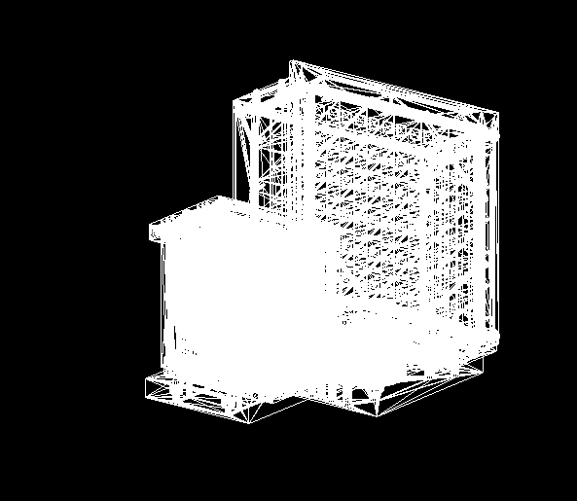
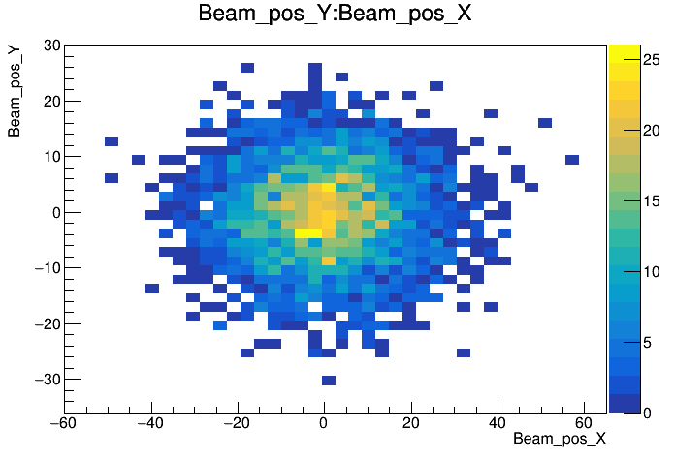
796 MeV e⁺ on PbWo4
PbWO4
MC
BM

Slide 2
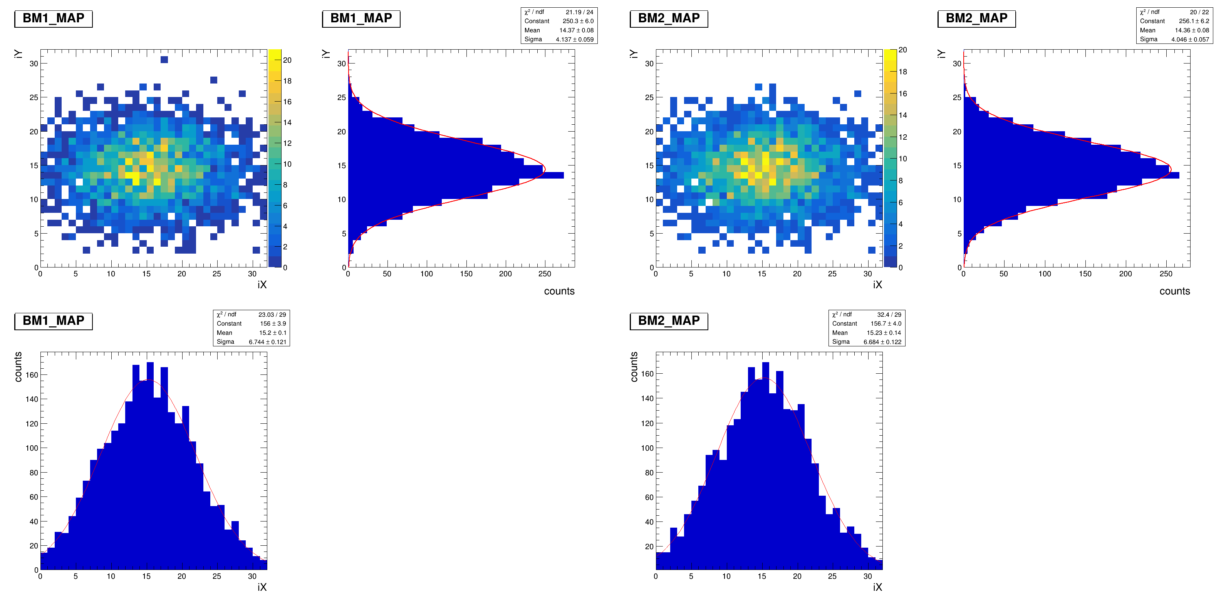
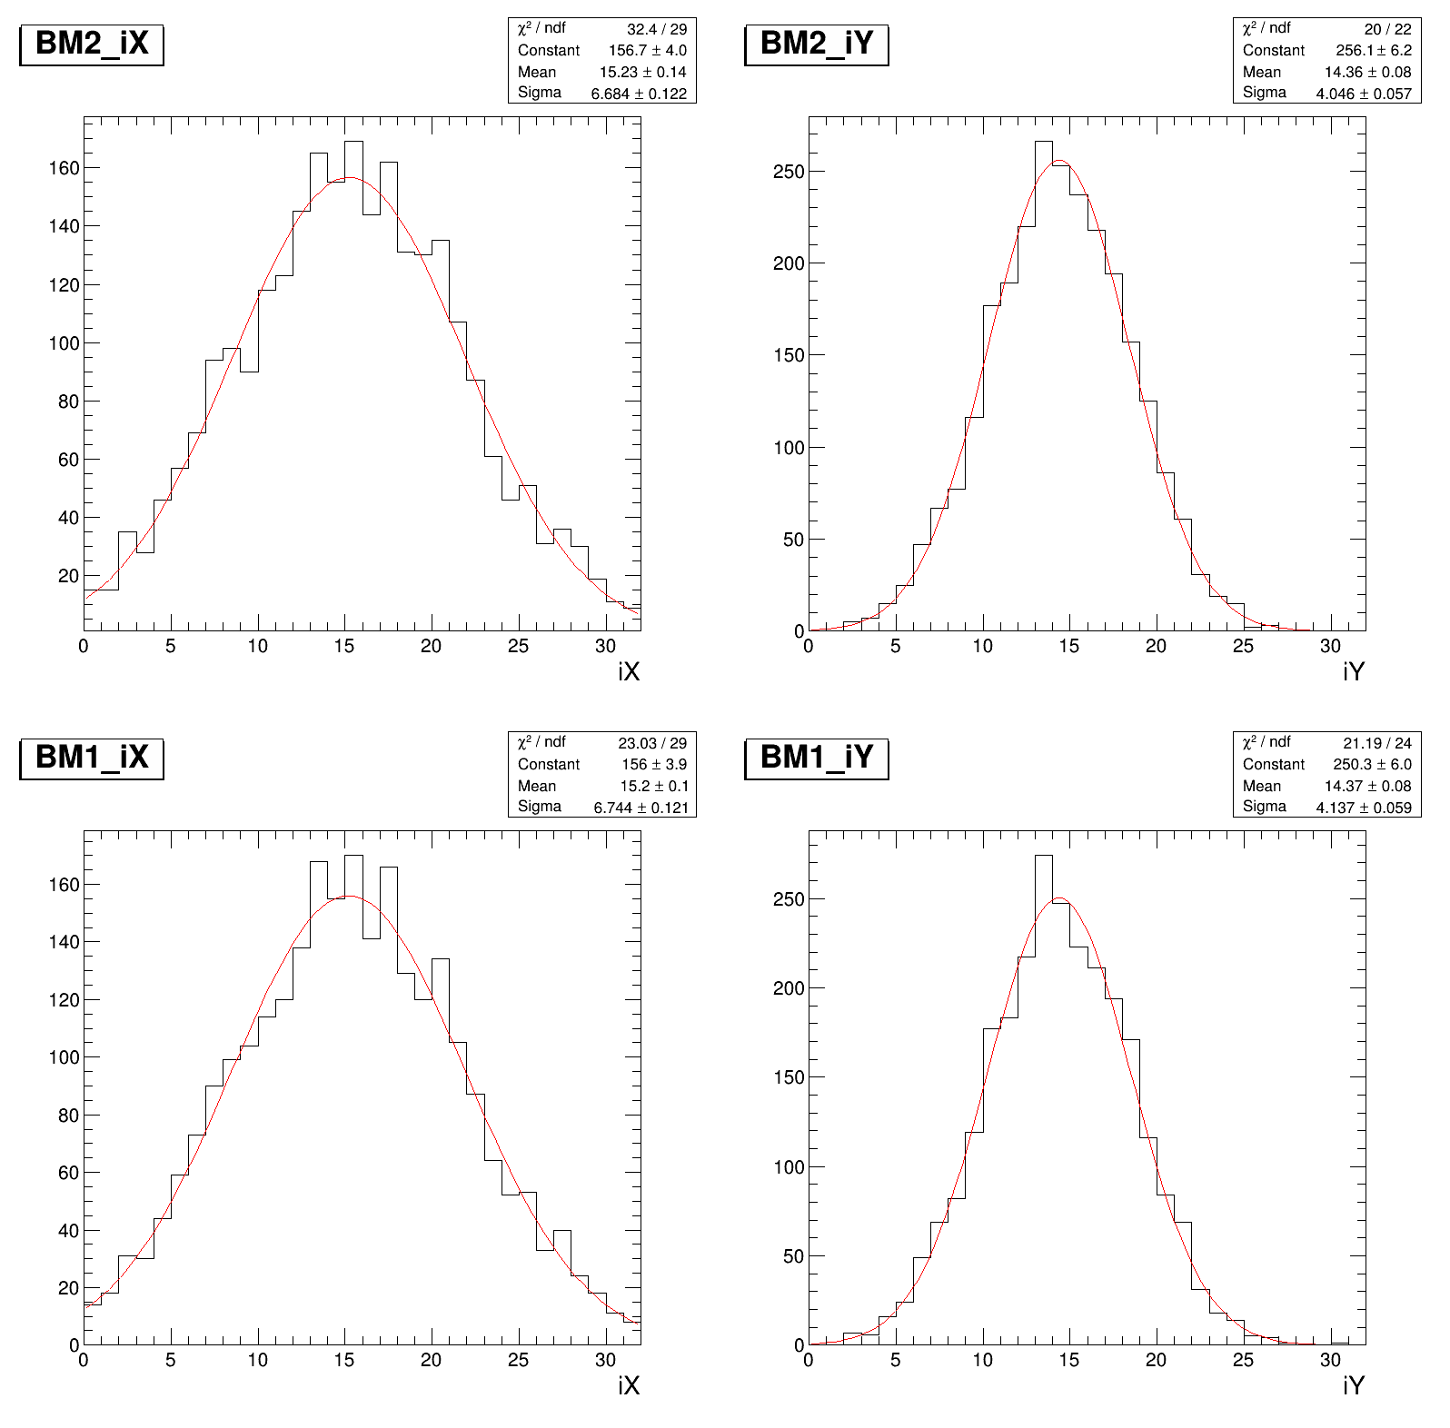
BM position(mm)
T1,T2 X 1 D/2D UNWt.

Slide 3
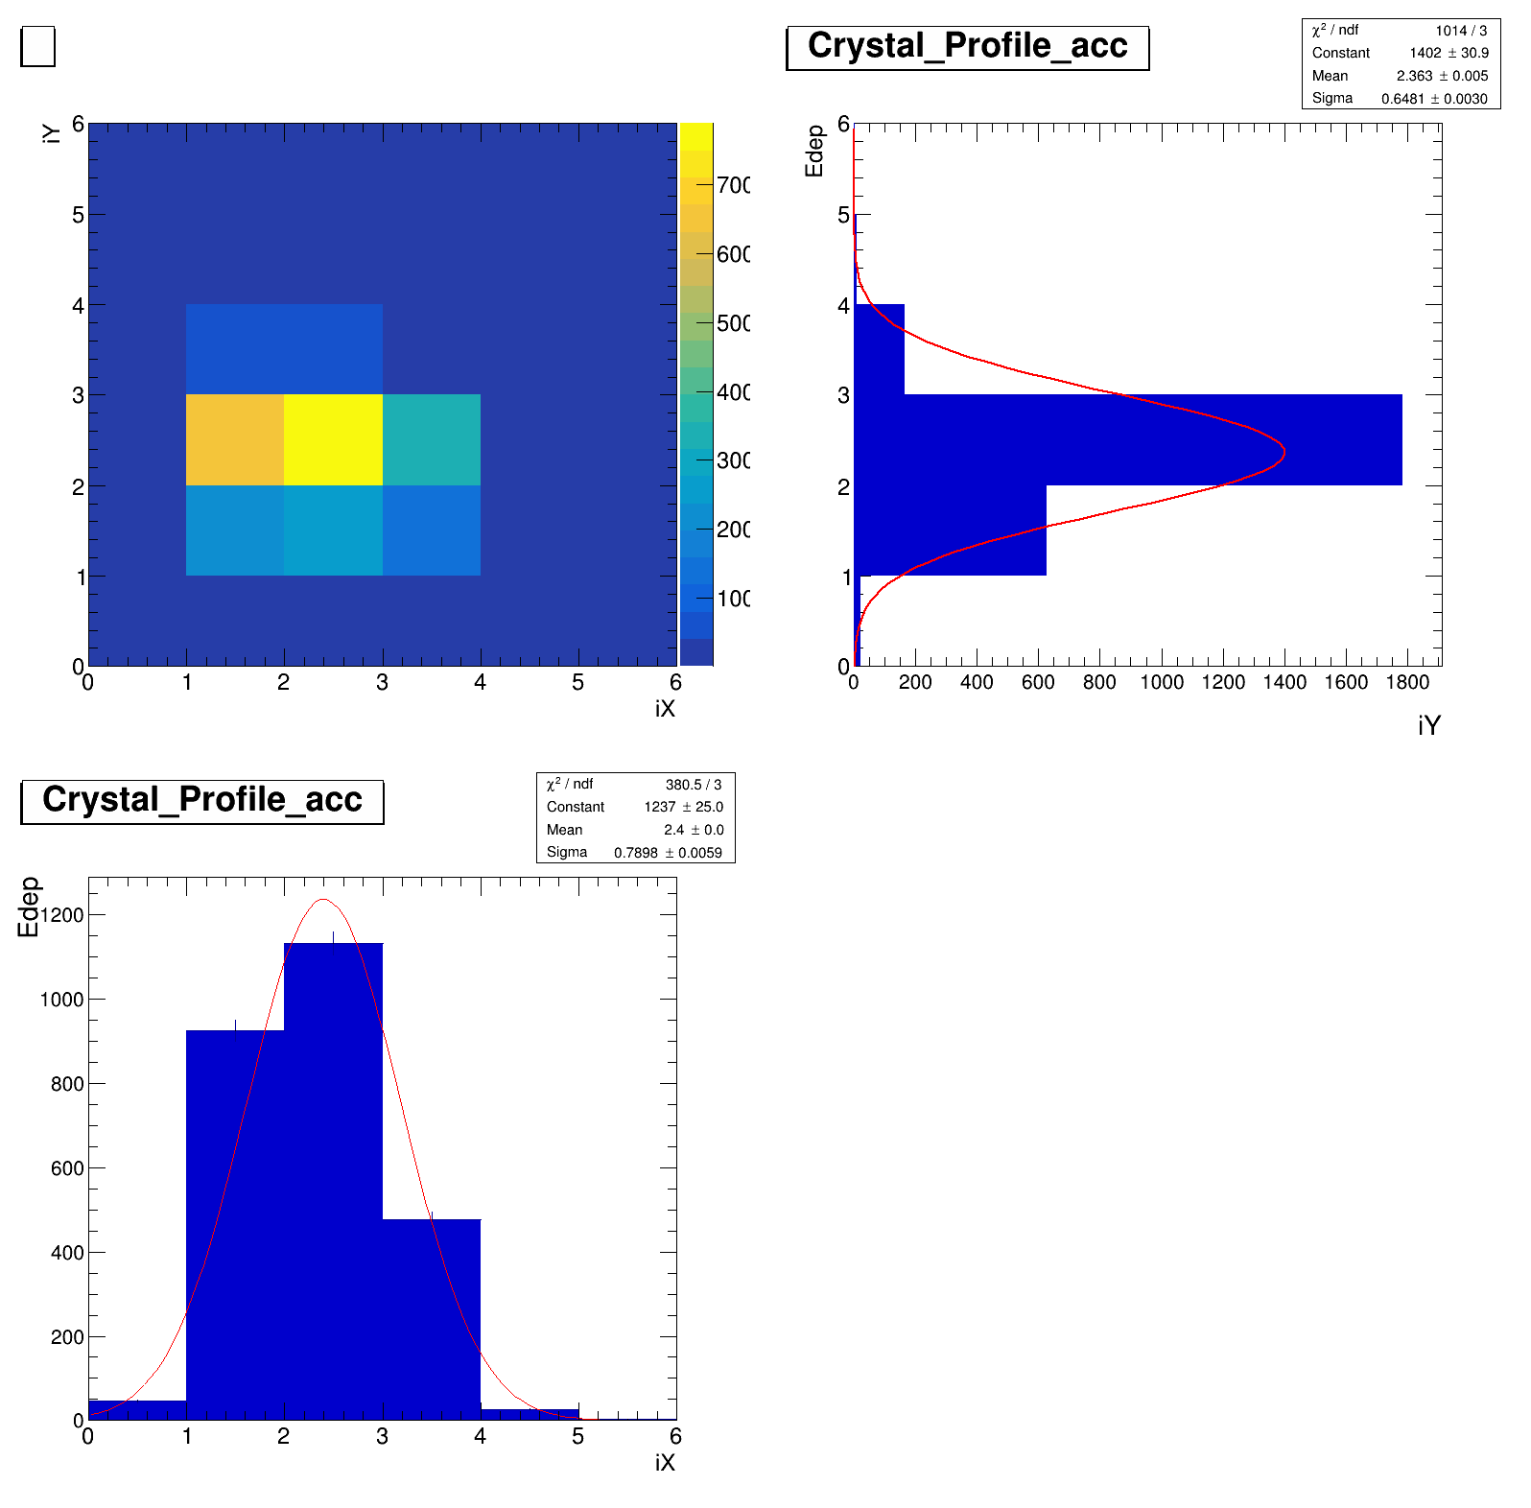
ZDC position(mm)
E-Wt

Slide 4
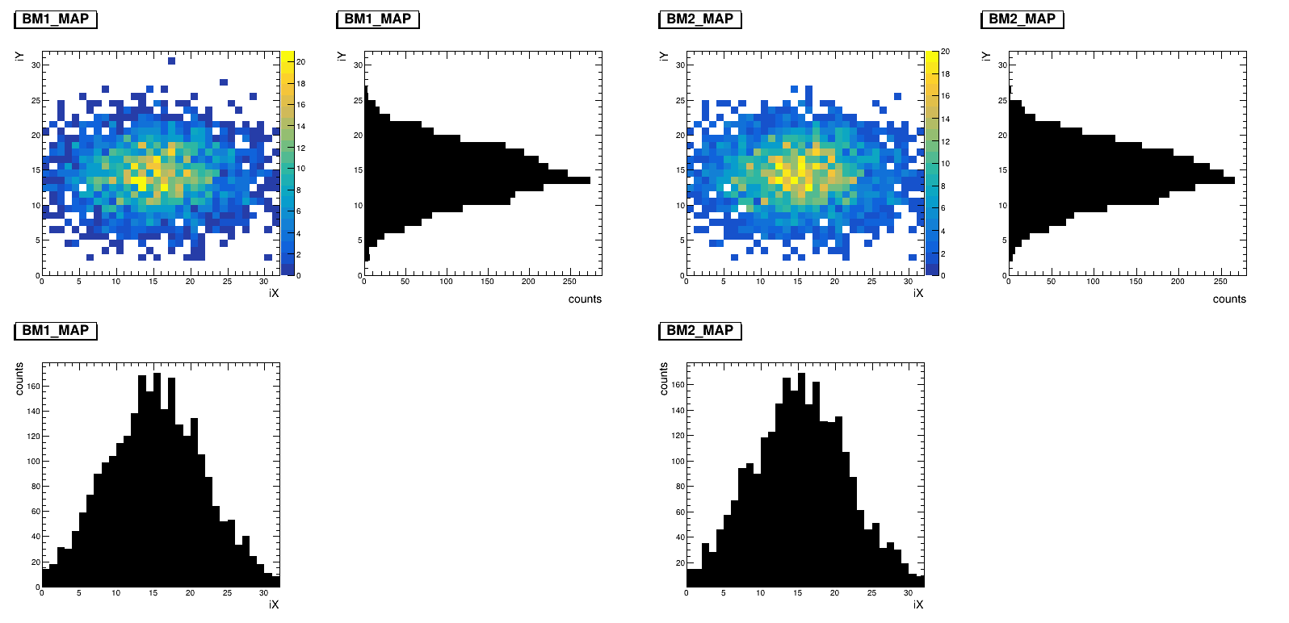
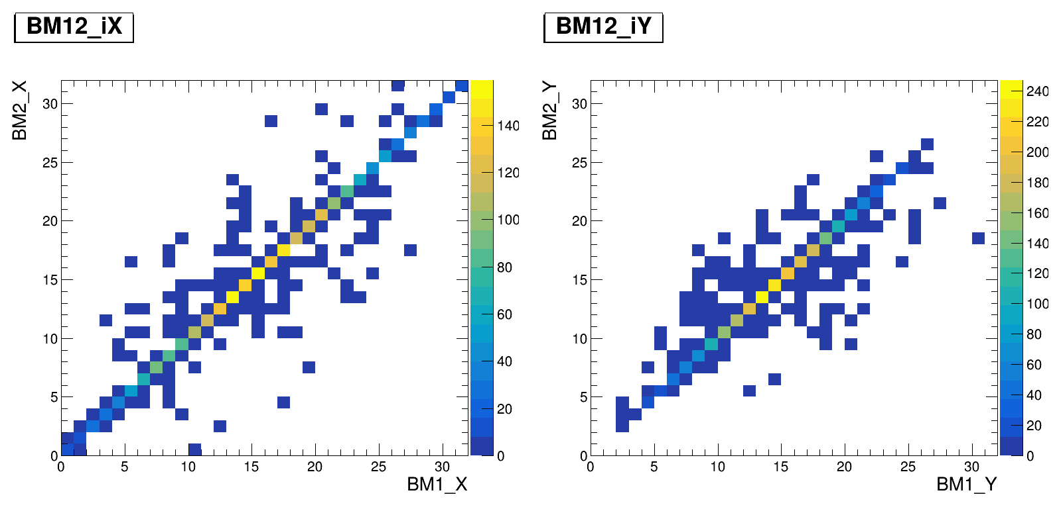
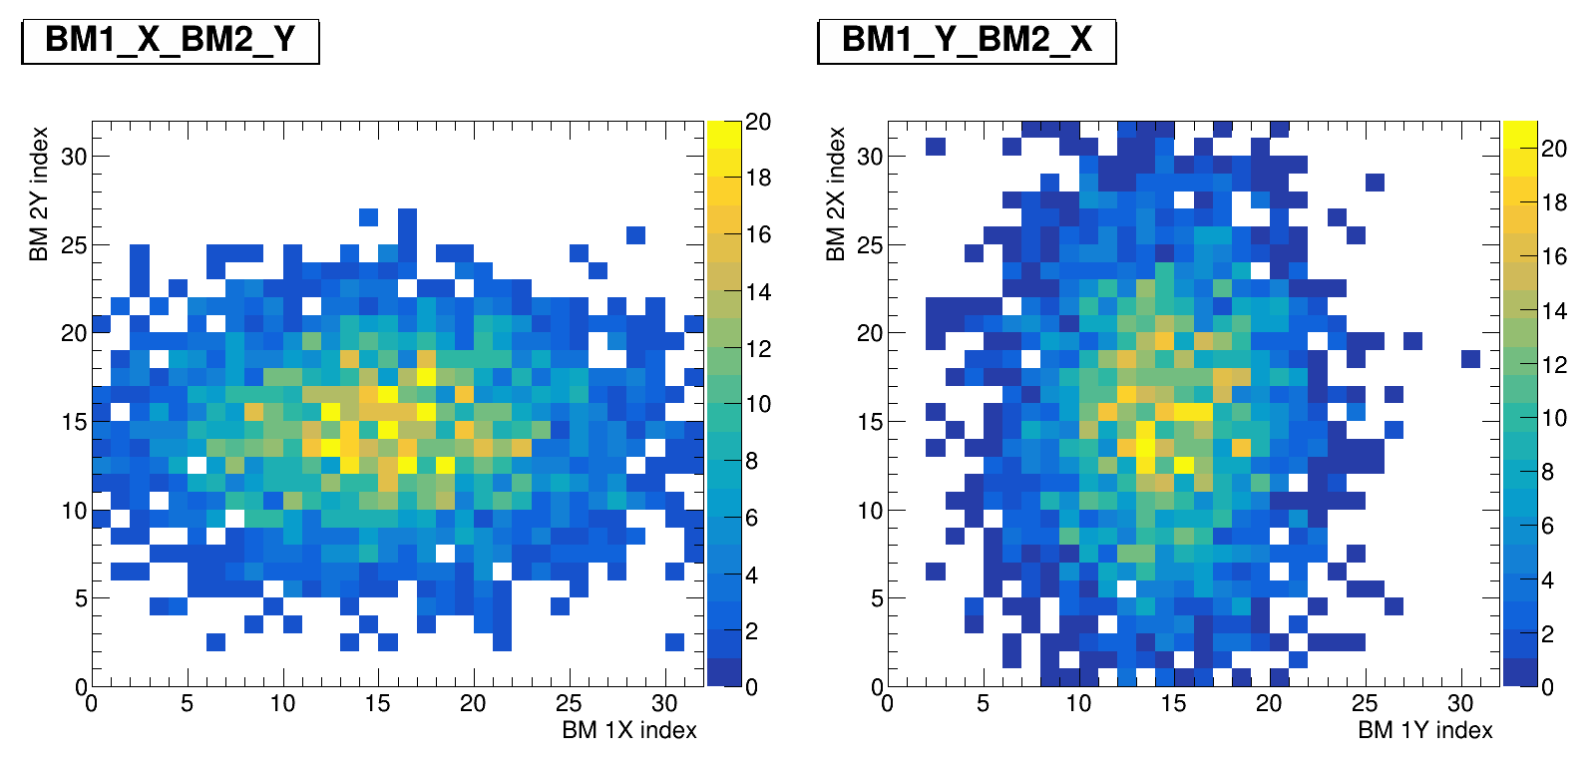
Position relationship UNW BM 1 vs BM 2
UNW BM 1 vs BM 2

Slide 5
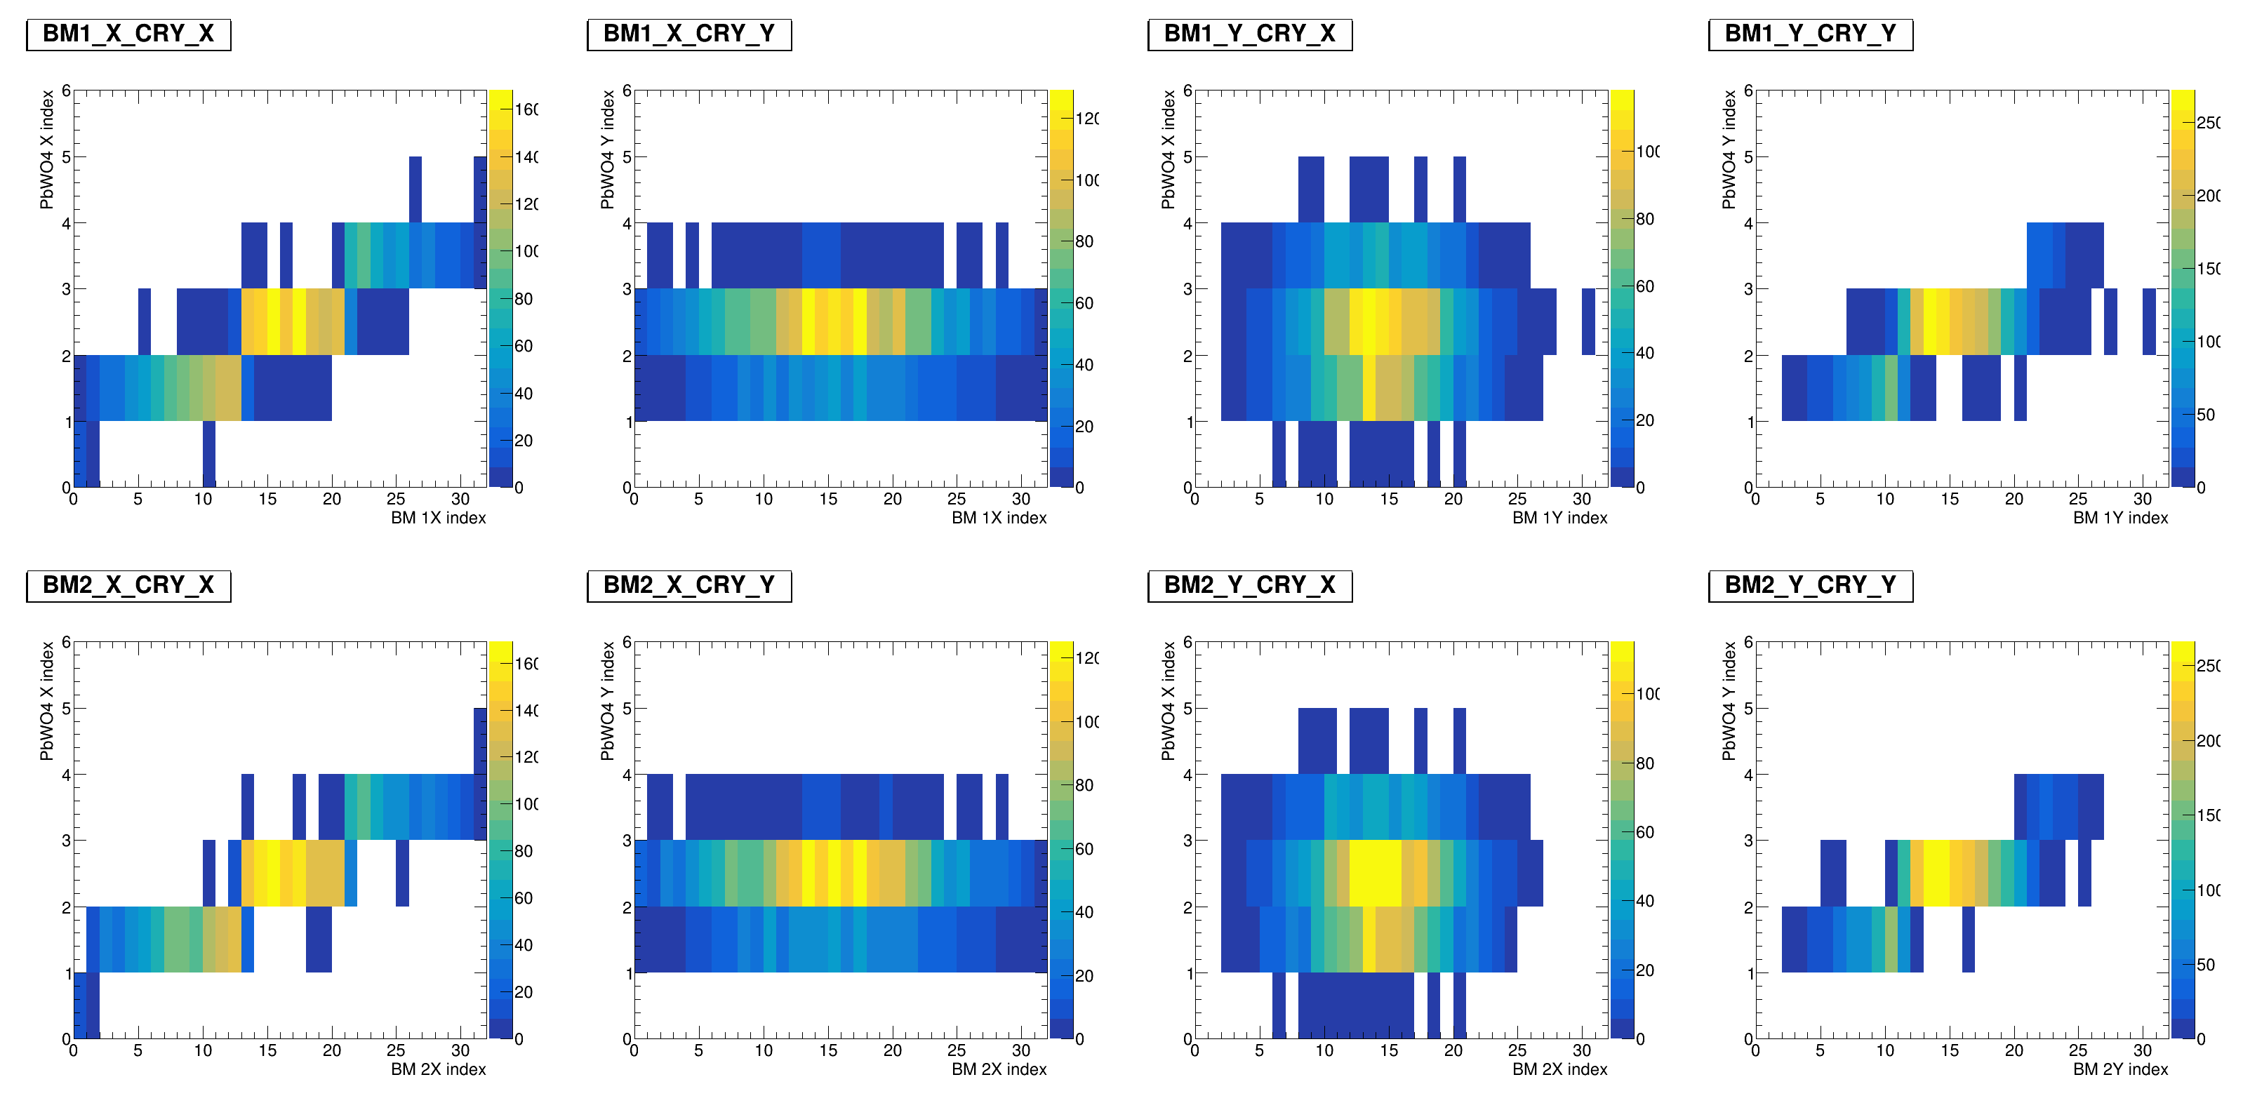
Position relationship ZDC vs BM1
ZDC
ZDC vs BM1

Slide 6
Position relationship ZDC vs BM2
ZDC
ZDC vs BM2

Slide 7
BM-track Direction
UNWt.
我還沒畫好 ☹

Slide 8
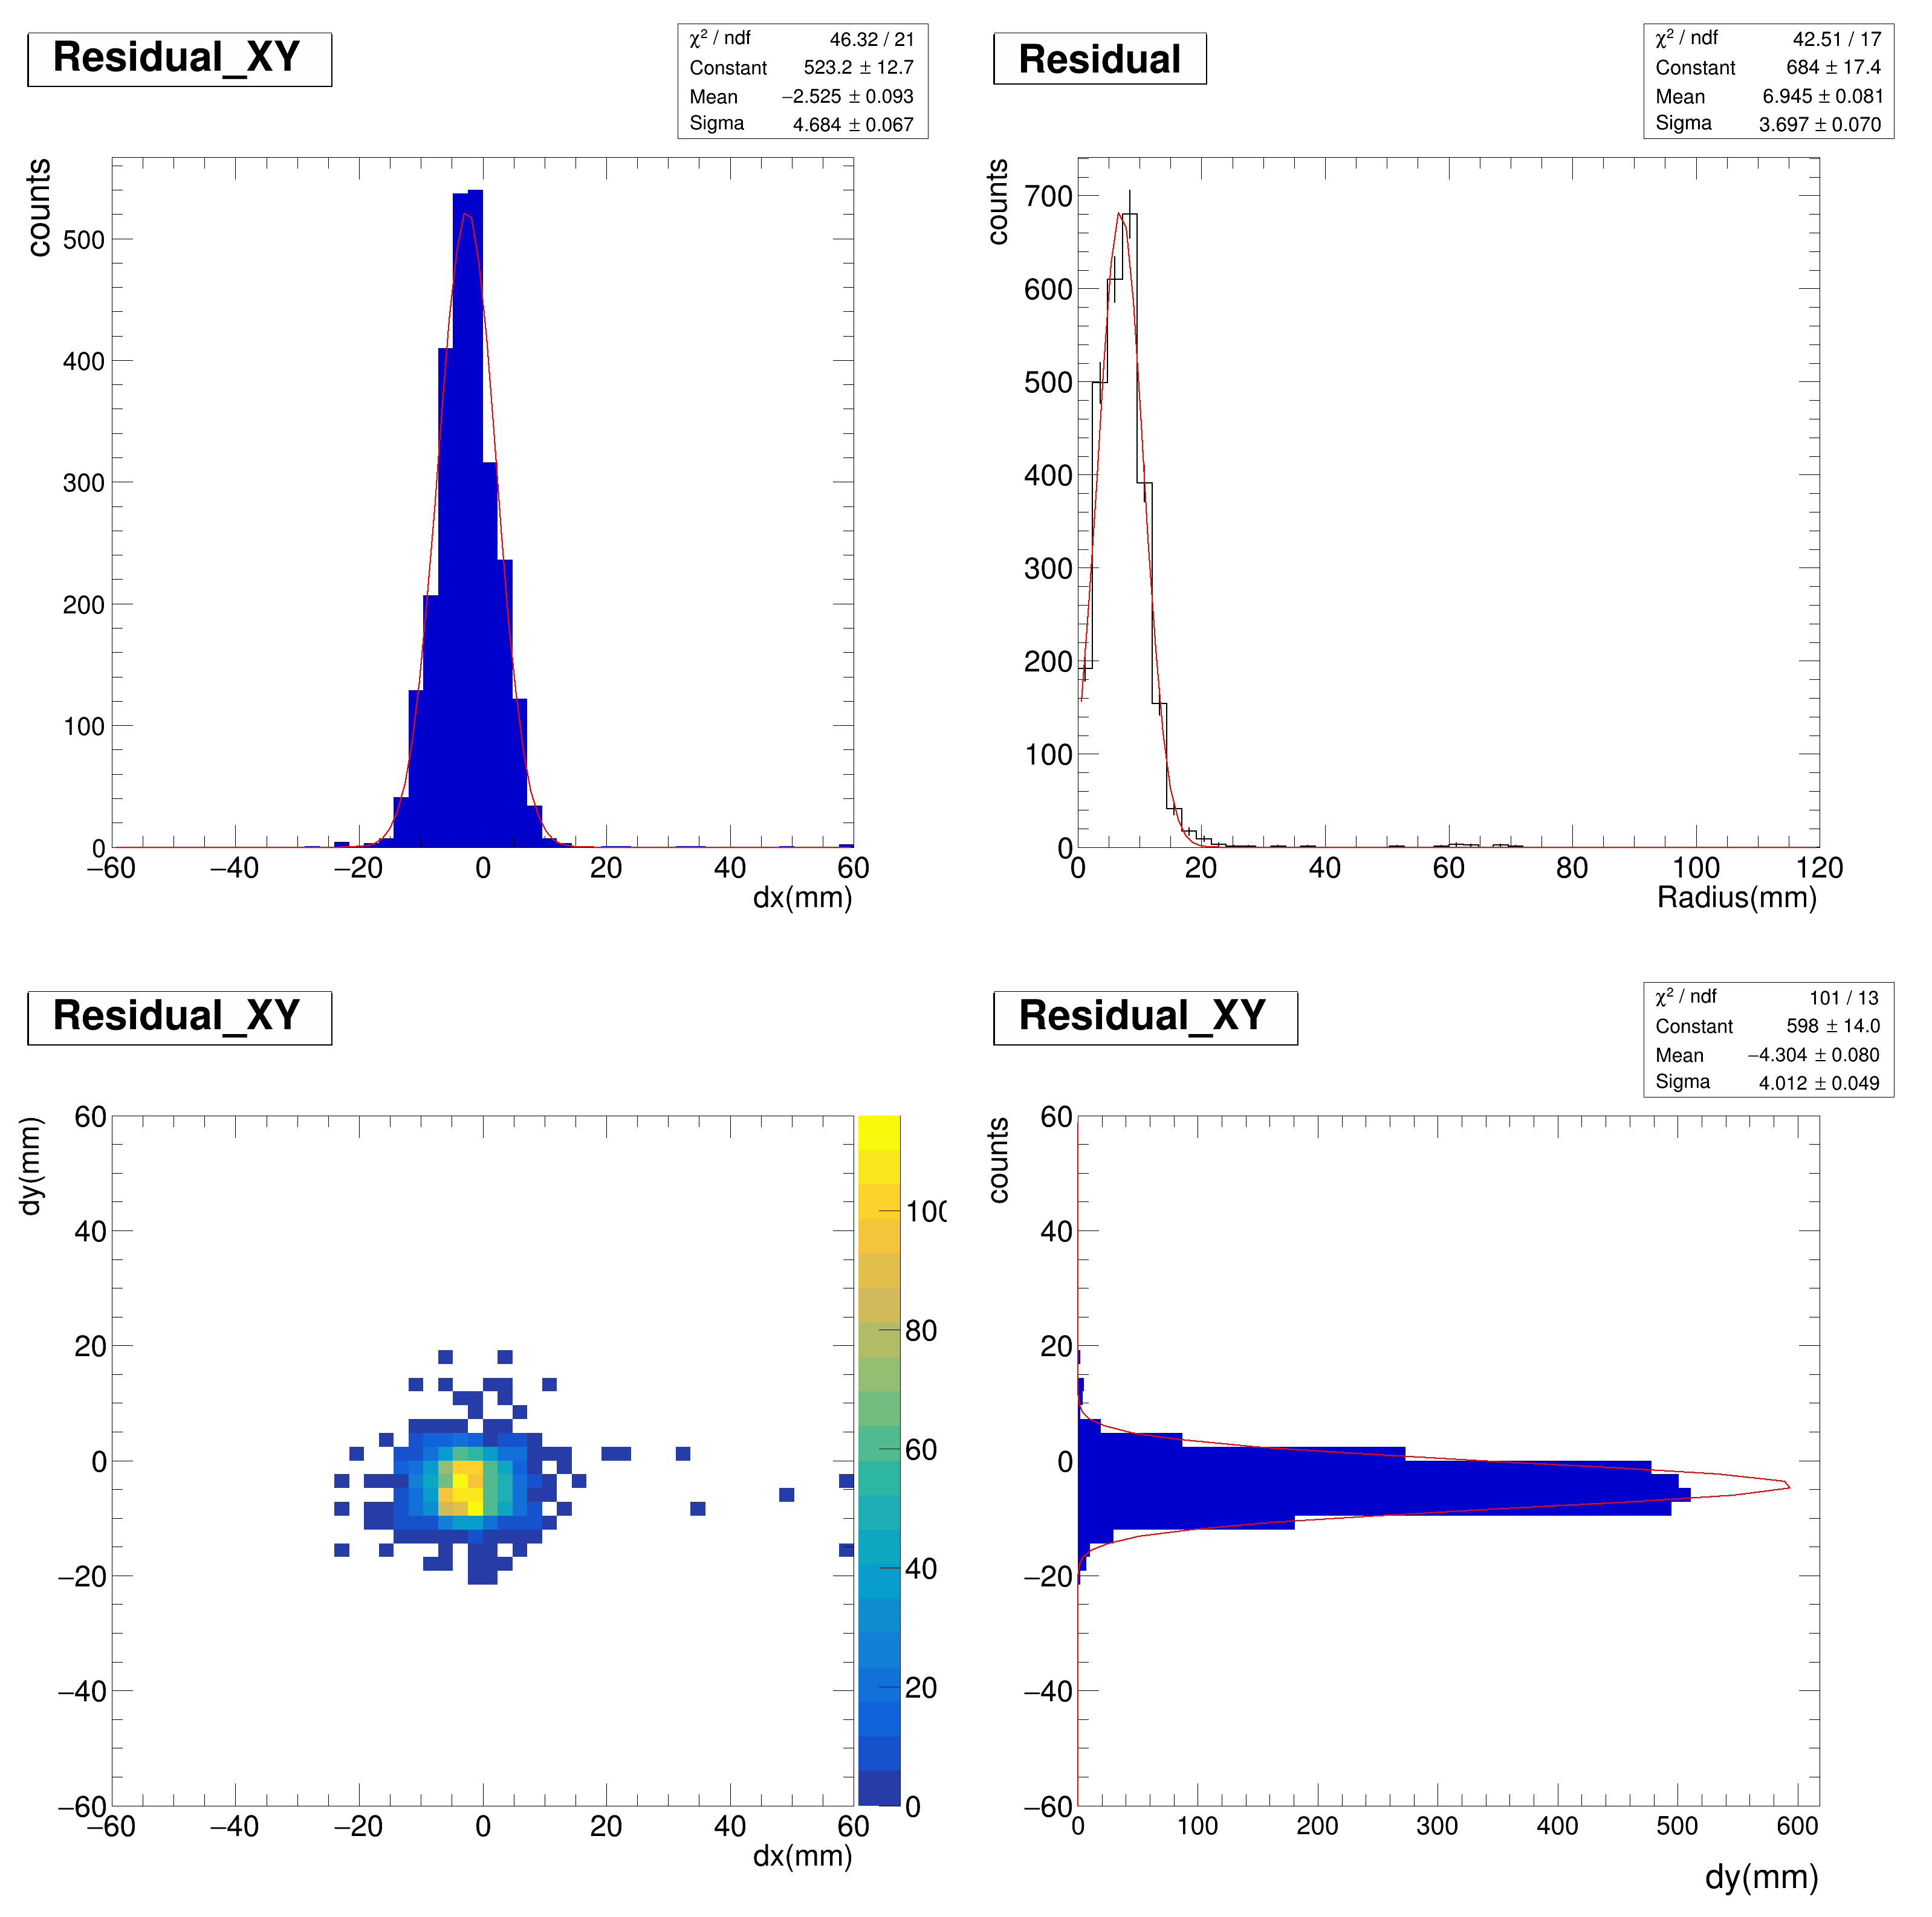
Residual on X, Y, R, UnWt.

Slide 9
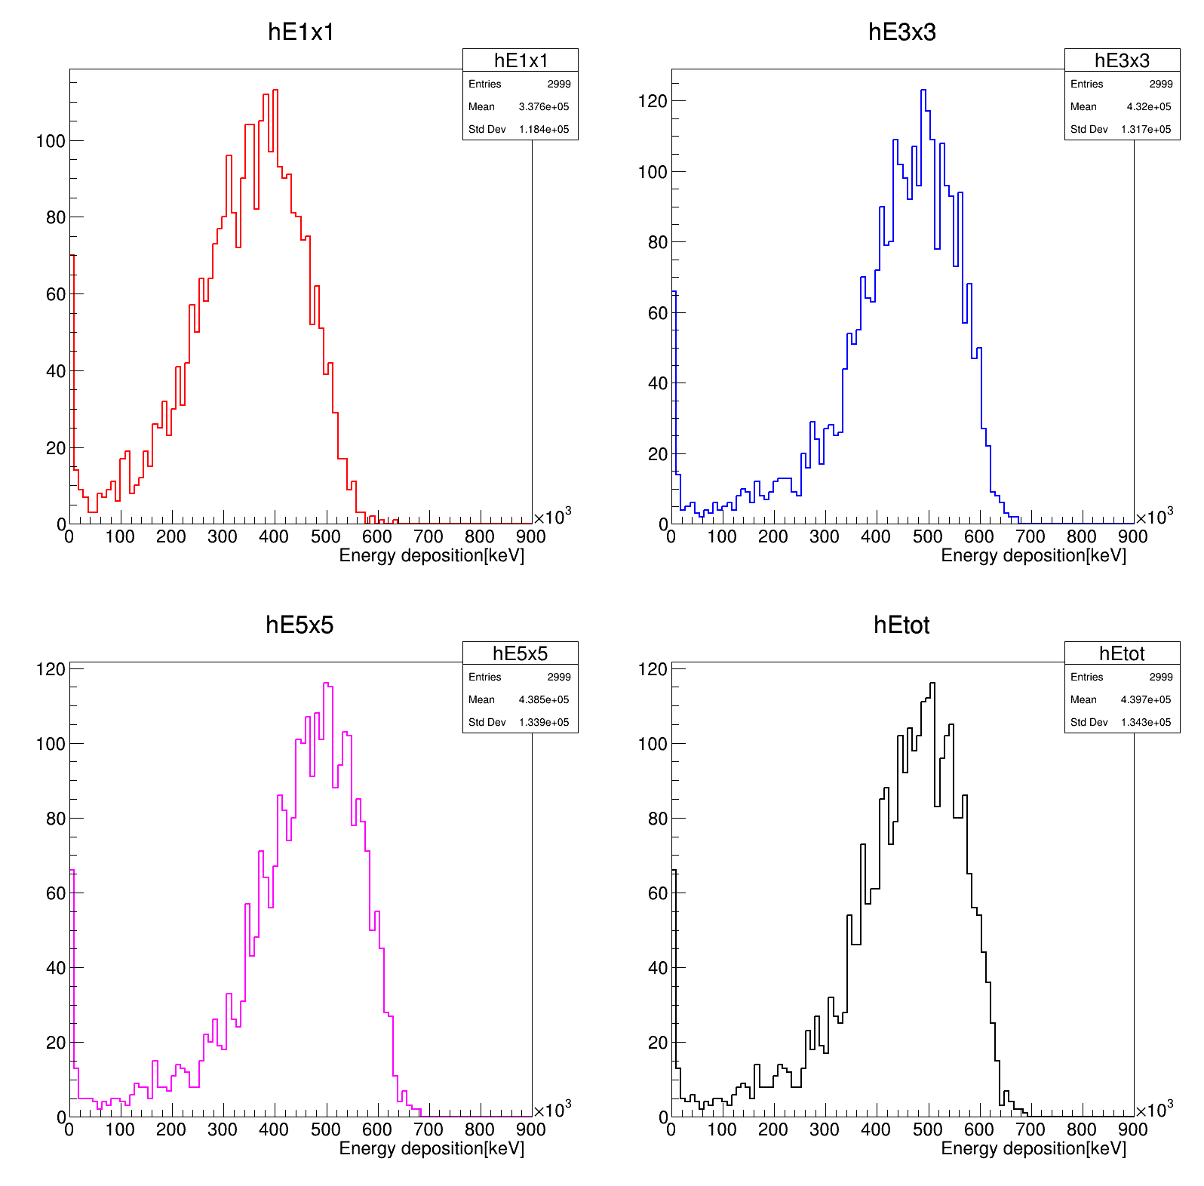
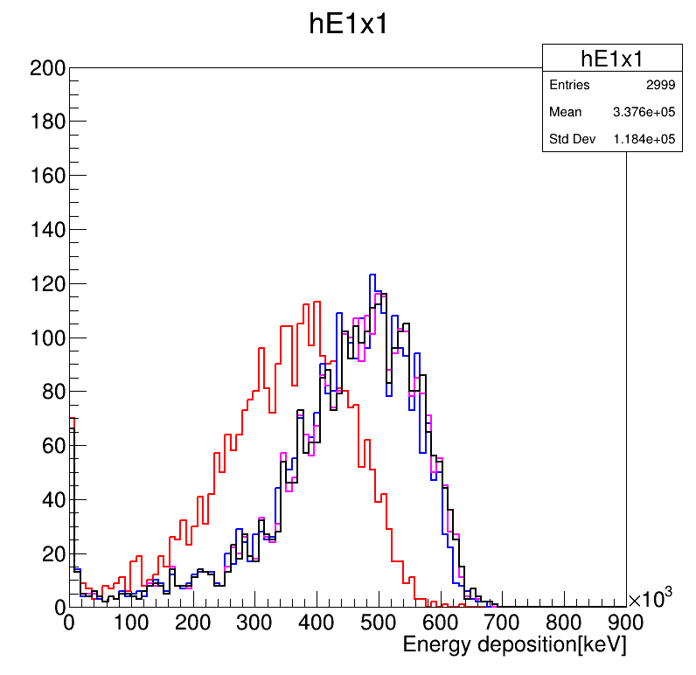
E in clustering Emax E3x3 E5x5 Eall, stack all

Slide 10
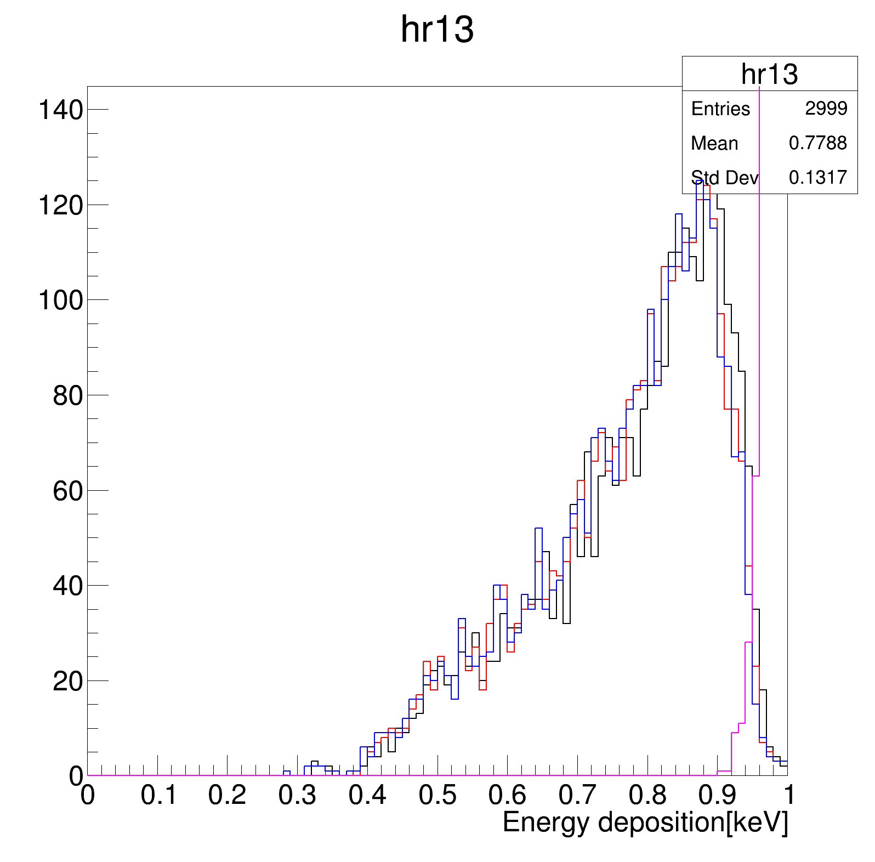
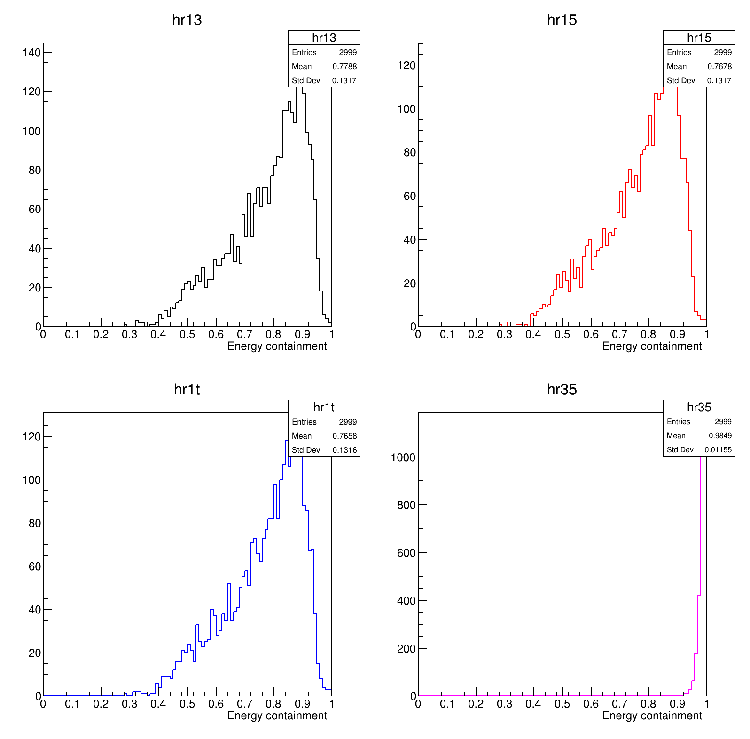
Shower shape

Slide 11
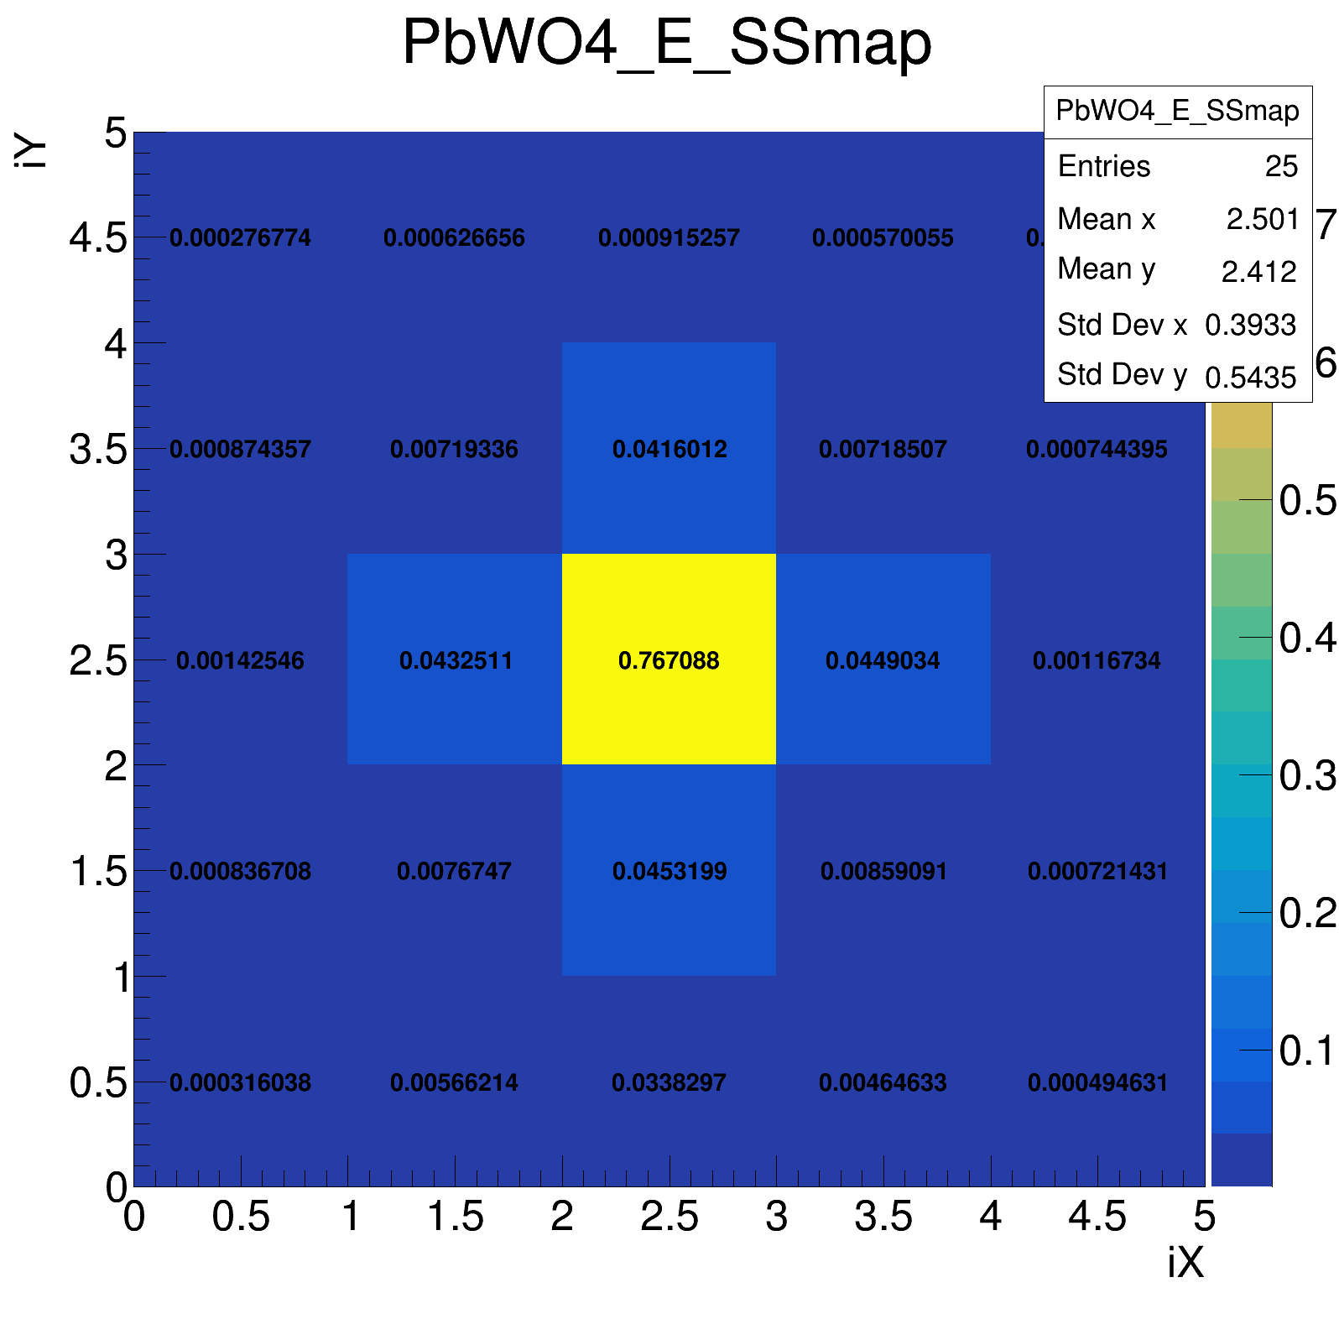
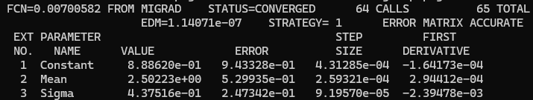
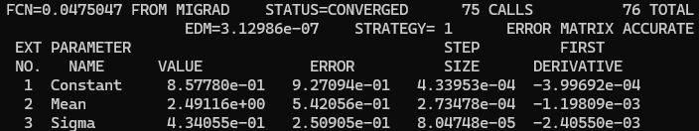
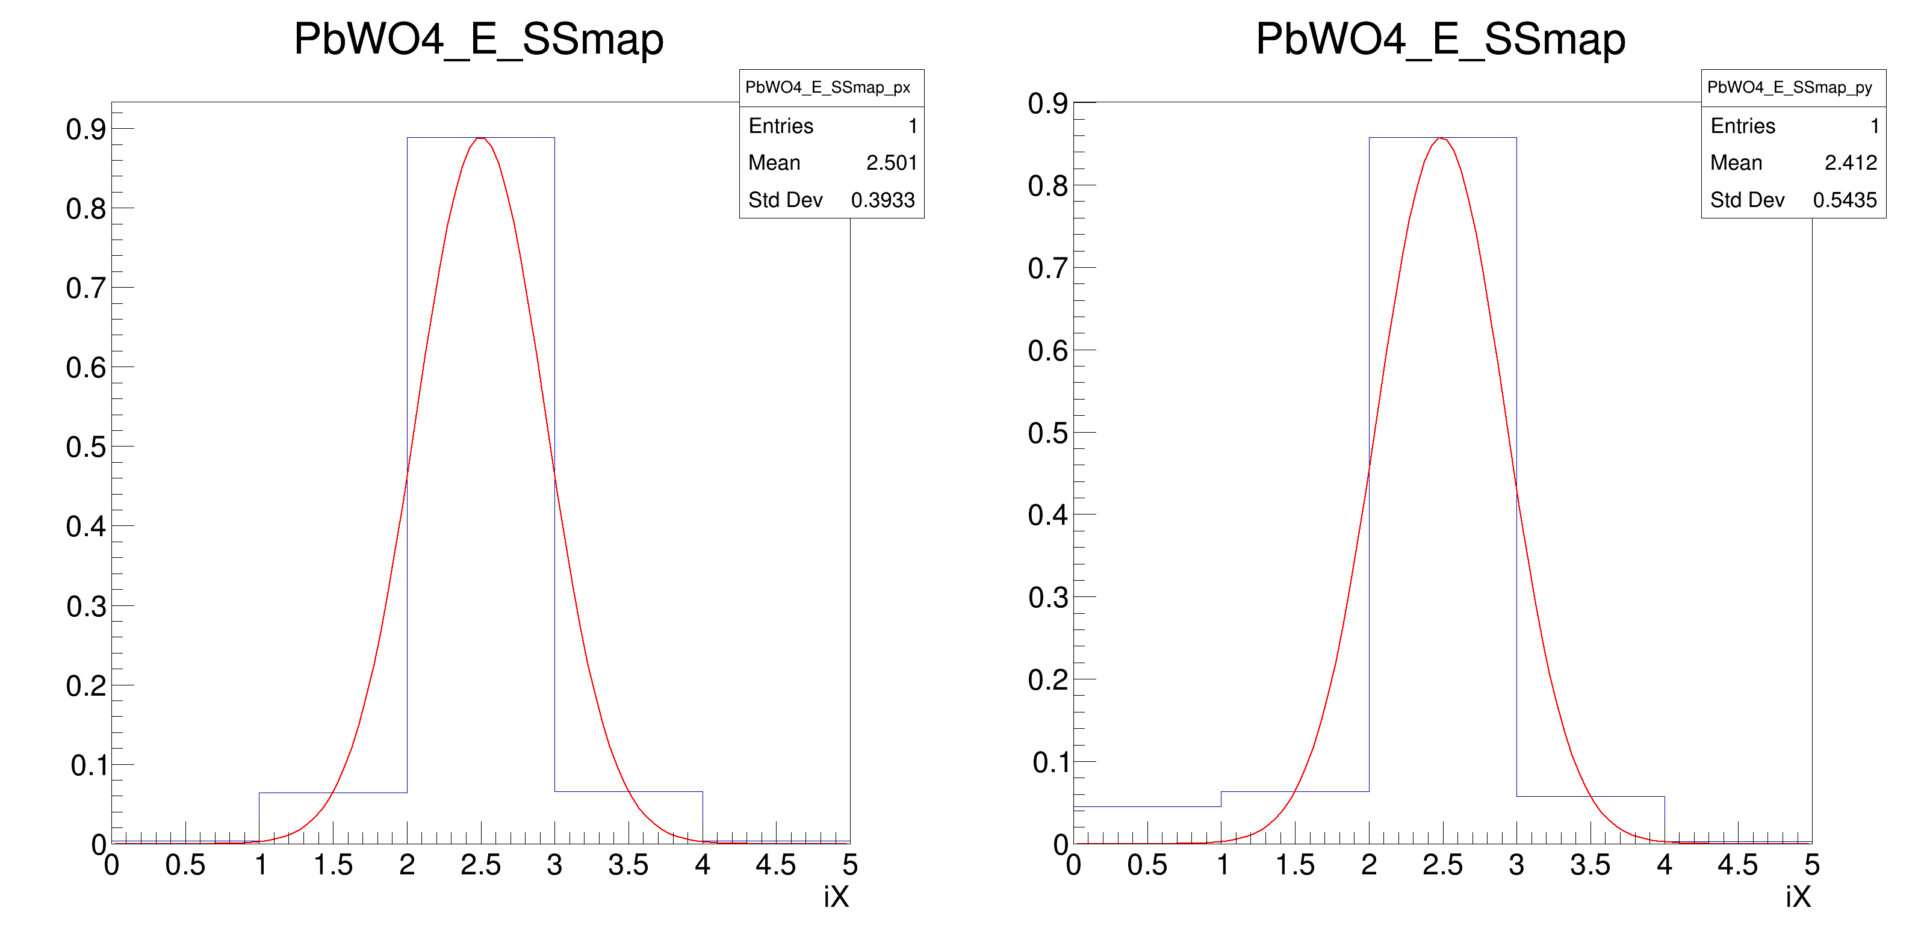
Shower spread
2X1D, 2D

