Slide 1
Weekly meeting
Yu-Siang Xiao (蕭宇翔)
2026 01/09

Slide 2
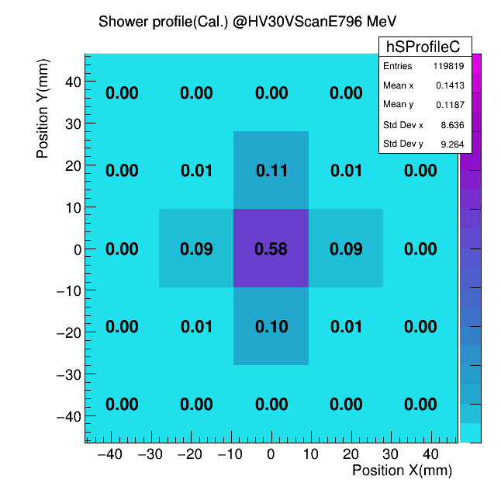
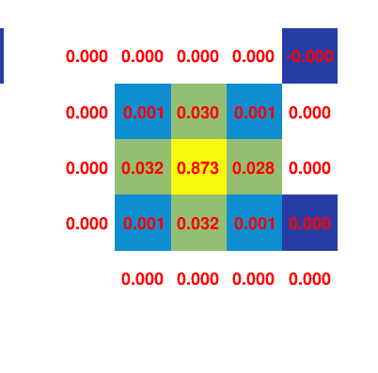
Revise the bug of shower spread calculation
I should fill the events by: Fill(ΔiX, ΔiY, E(ΔiX, ΔiY)/E_{sum} * selection conditions)
Weight: E(ΔiX, ΔiY)/E_{sum} * selection conditions = double * Boolean = double
But the weighting equation a typo to be E(ΔiX, ΔiY)/E_{sum}&(selection conditions).
Weight: E(ΔiX, ΔiY)/E_{sum} & selection conditions = double & Boolean = Boolean & Boolean = Boolean
Thus, the graph of shower spread before is going to be Equal-weight…
The shower spread, before
The shower spread, now
revise

Slide 3
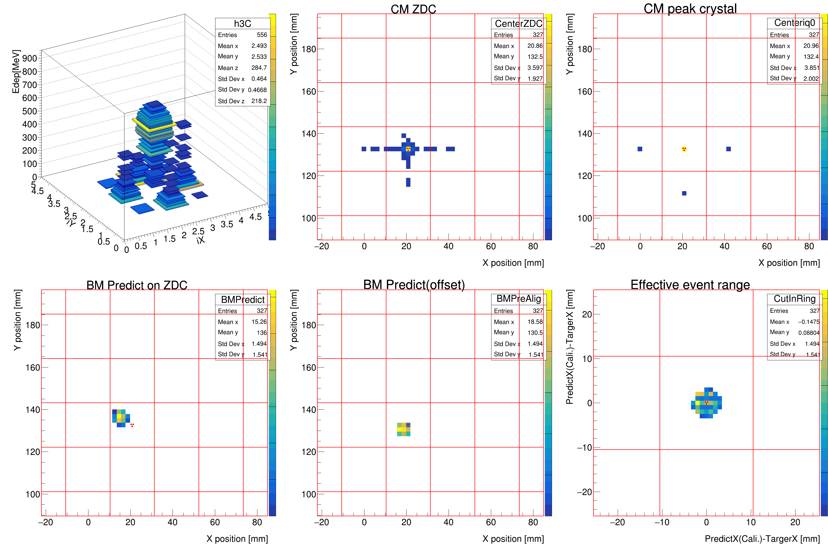
E_{max} cut with R=3, position offx=0, offy=0
1
2
1. The CM of ZDC Energy Wt.
2. Shows the E_{max} crystal CM position
3. The raw predicted position of BM-track
4. The alignment predicted position of BM-track
5. The relative position of predict - E_{max} crystal CM, after the cut. (Cut condition)
Ps: crystal position grid, and is the target point
Example: 796MeV PbWO₄
This page shows the cut:
R = 3 mm
Main channel (iX,iY) = 2,2 (crystal of Ch34, 40).
target point offset (offx,offy) = (0,0) mm
Means the center of main channel
3
4
5

Slide 4
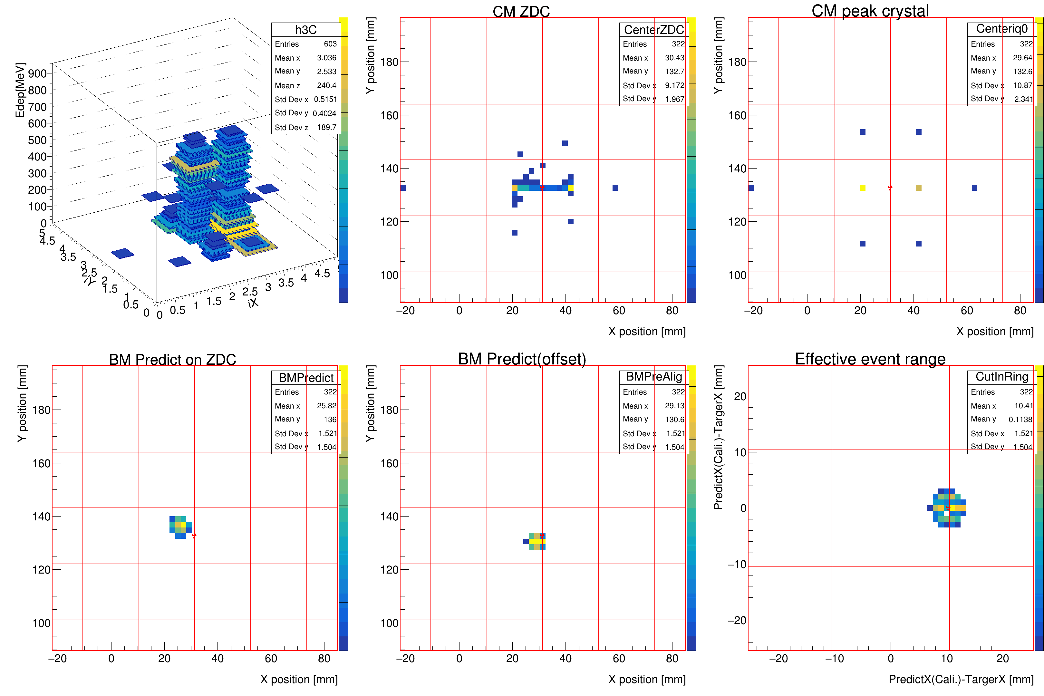
E_{max} cut with R=3, position offx=10.25, offy=0
1
2
Example: 796MeV PbWO₄
This page shows the cut:
R = 3 mm
Main channel (iX,iY) = 2,2 (crystal of Ch34, 40).
target point offset (offx,offy) = (10.25,0) mm
Means the side of main channel
3
4
5

Slide 5
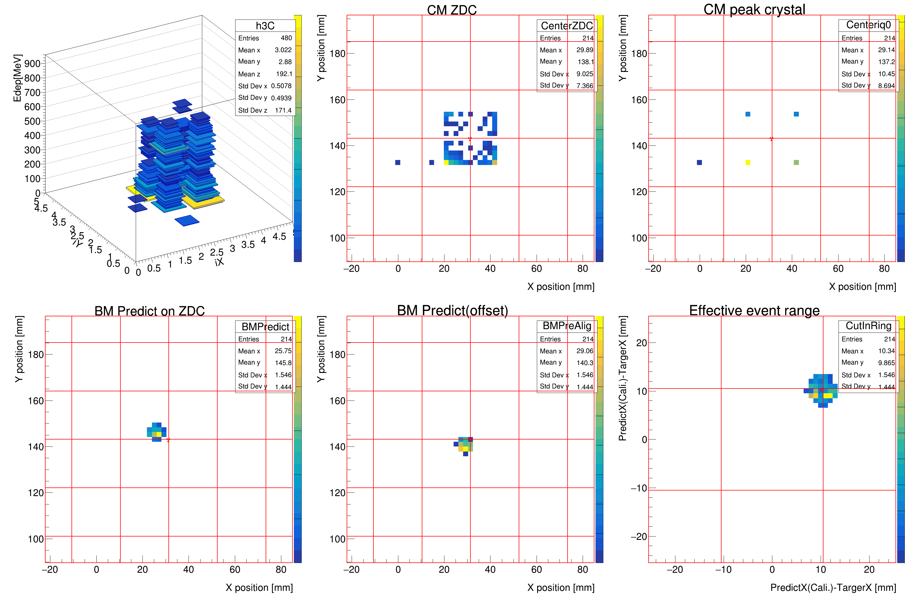
E_{max} cut with R=3, position offx=10.25, offy=10.25
1
2
Example: 796MeV PbWO₄
This page shows the cut:
R = 3 mm
Main channel (iX,iY) = 2,2 (crystal of Ch34, 40).
target point offset (offx,offy) = (10.25,10.25) mm
Means the corner of main channel
3
4
5

Slide 6
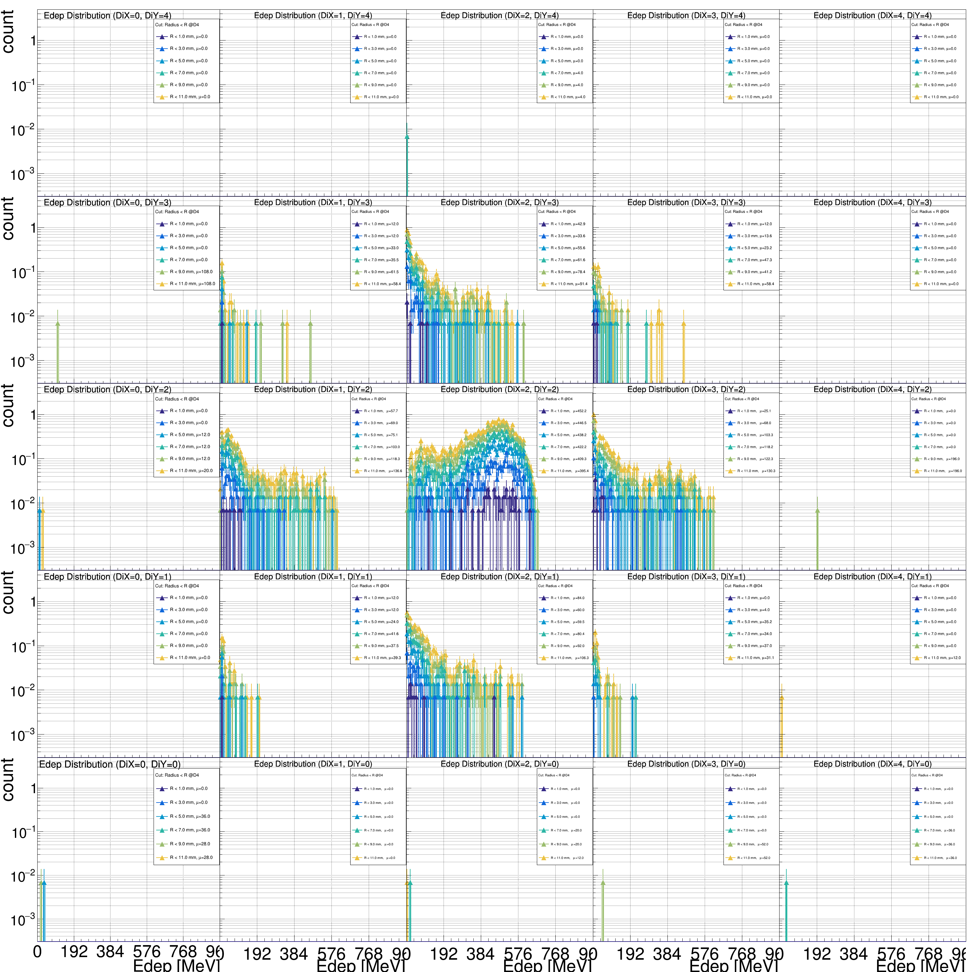
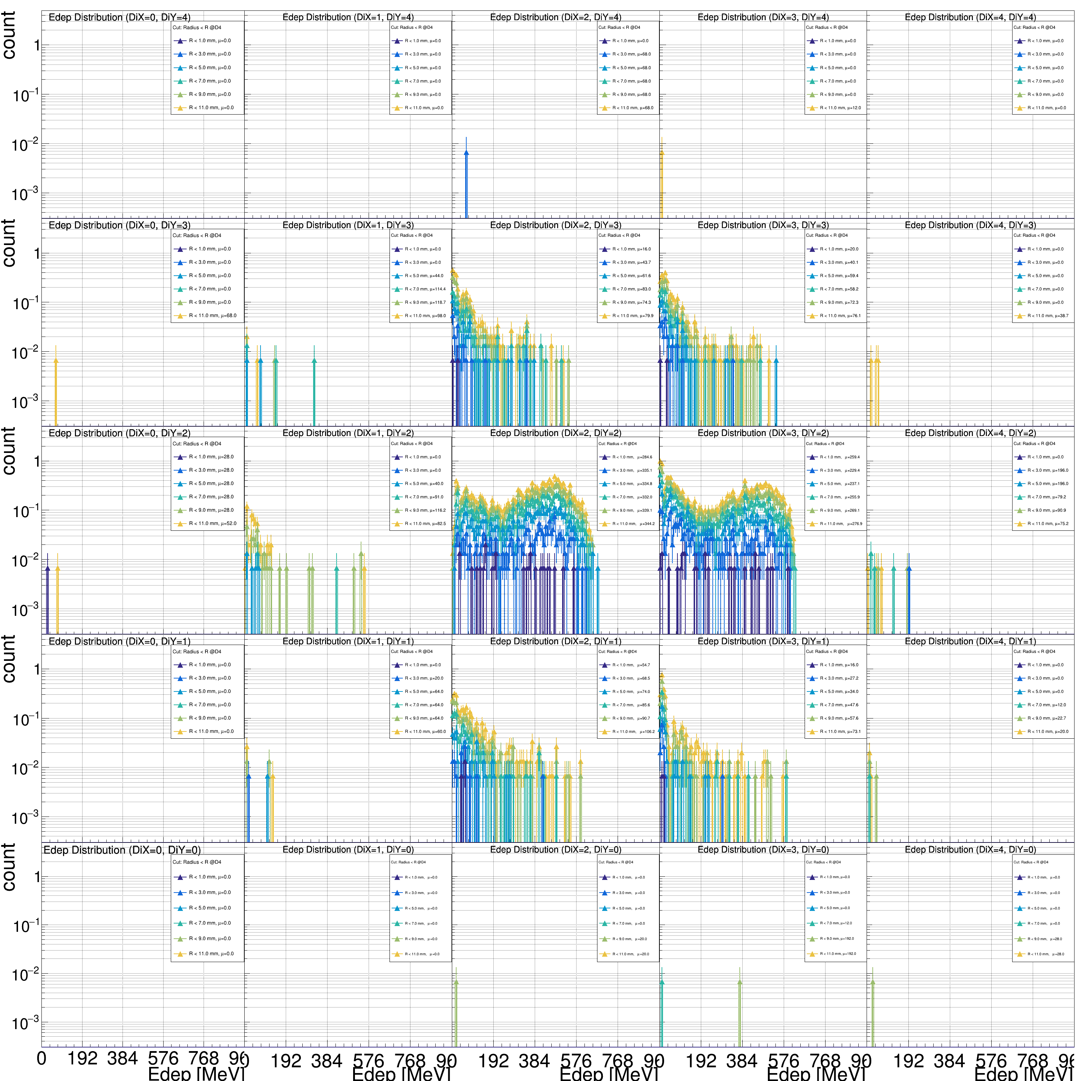
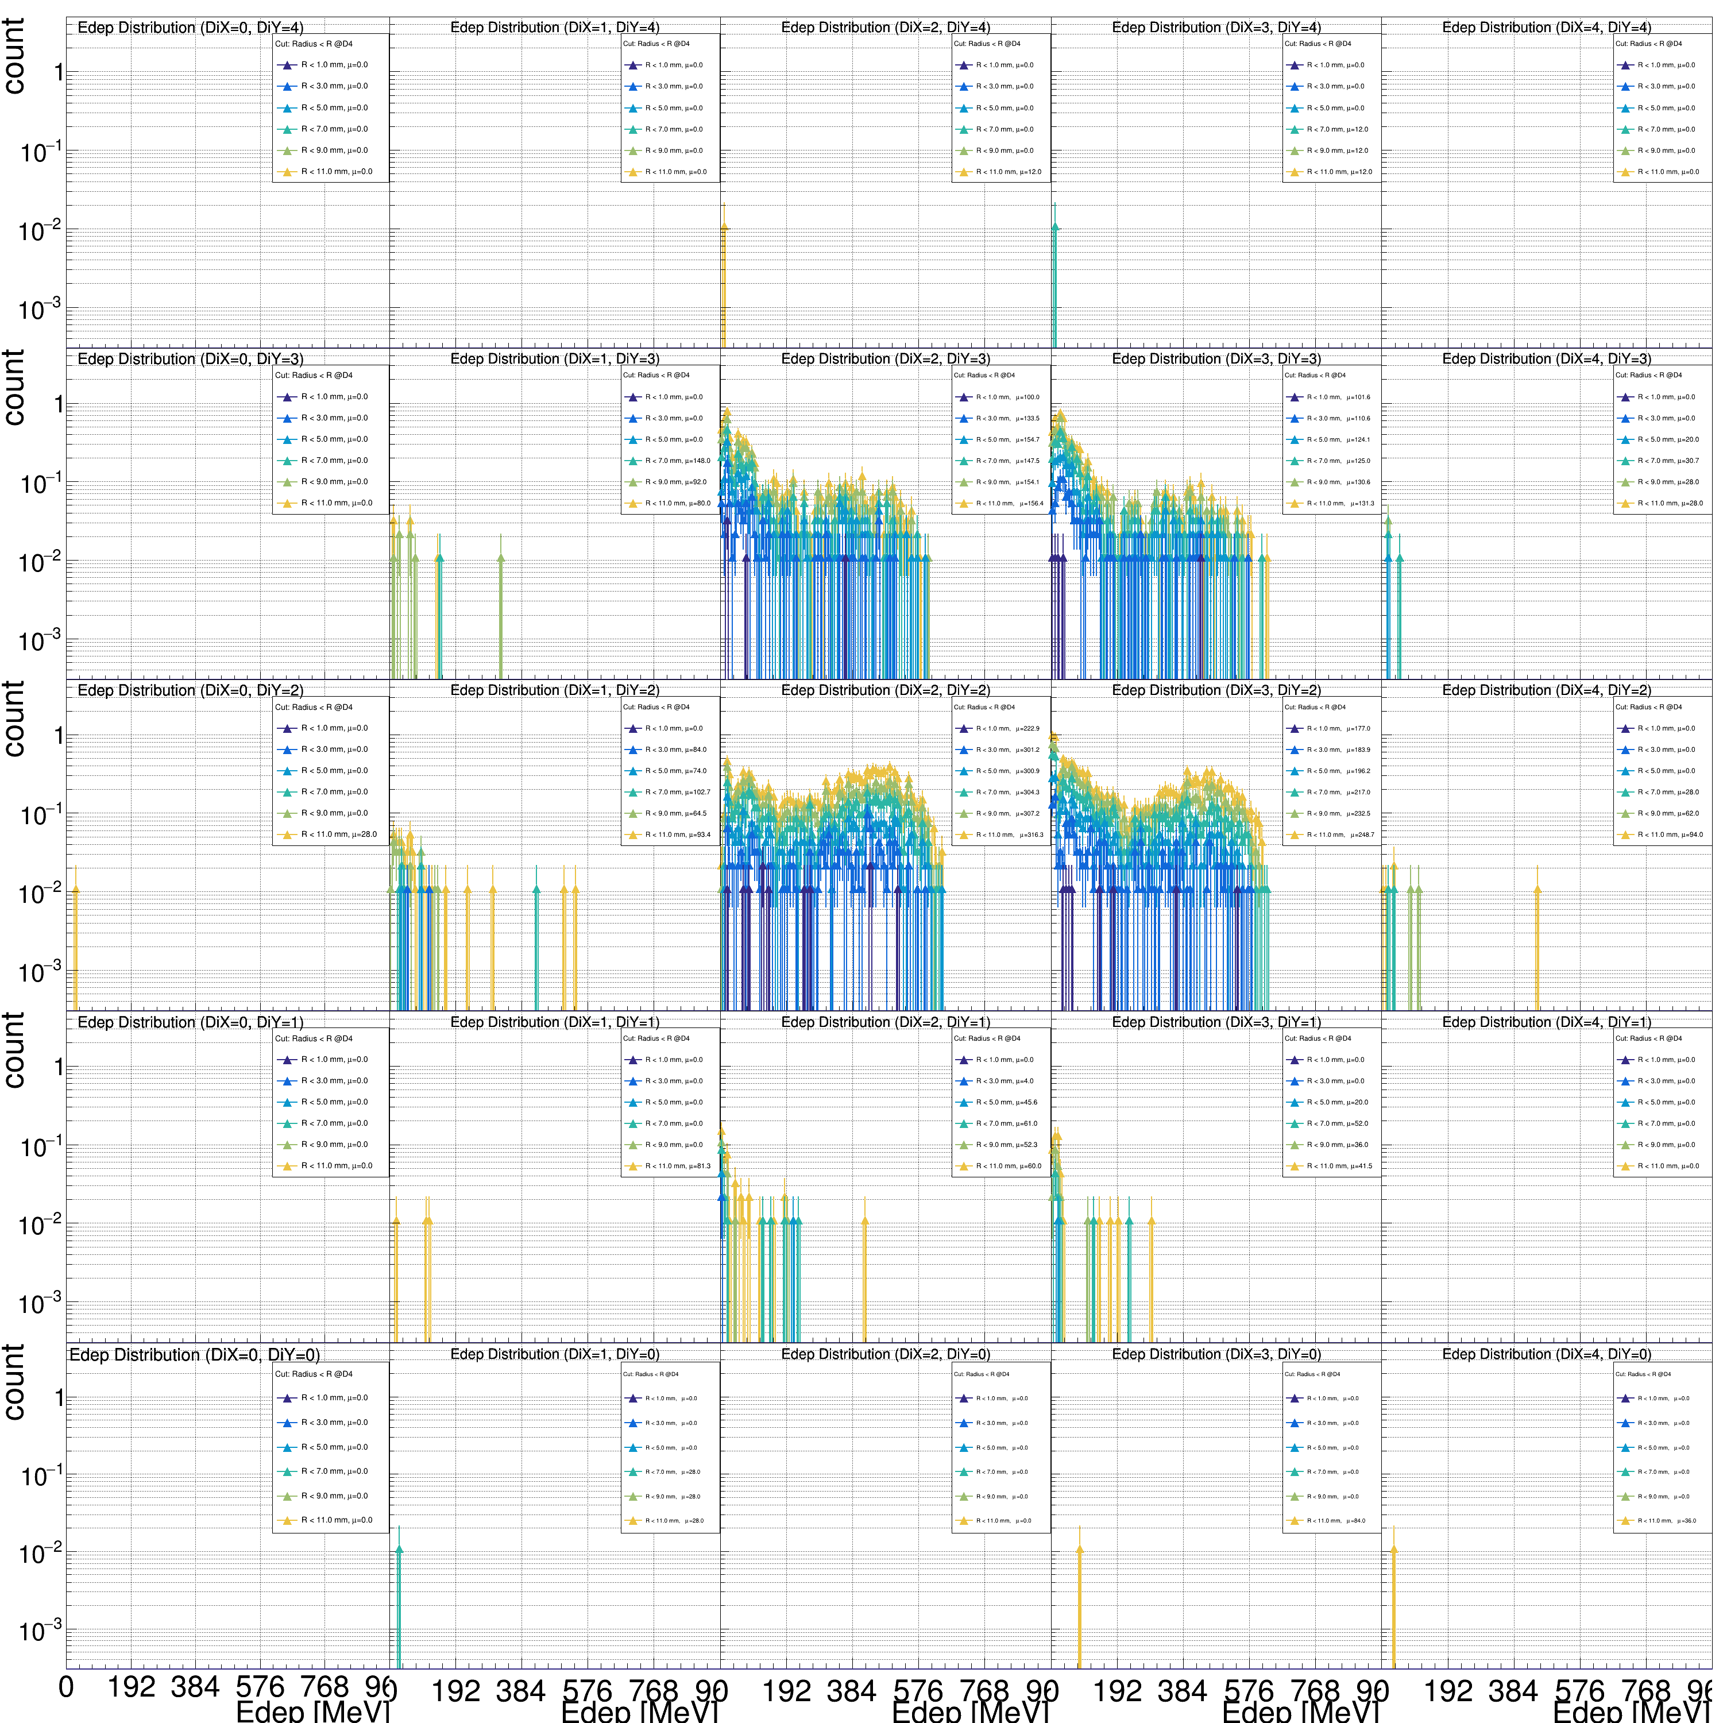
The energy spectrum of all 6x6 channel
This page shows the cut:
R = 1~11 mm
Main channel (iX,iY) = 2,2 (crystal of Ch34, 40).
Target point offset (offx,offy) = (0,0) ,(10.25,0) ,(10.25, 10.25) mm
We can observe the obviously shape change during the target point moved.
(offx,offy) = (0,0) mm
(offx,offy) =(10.25,0) mm
(offx,offy) =(10.25, 10.25) mm

Slide 7
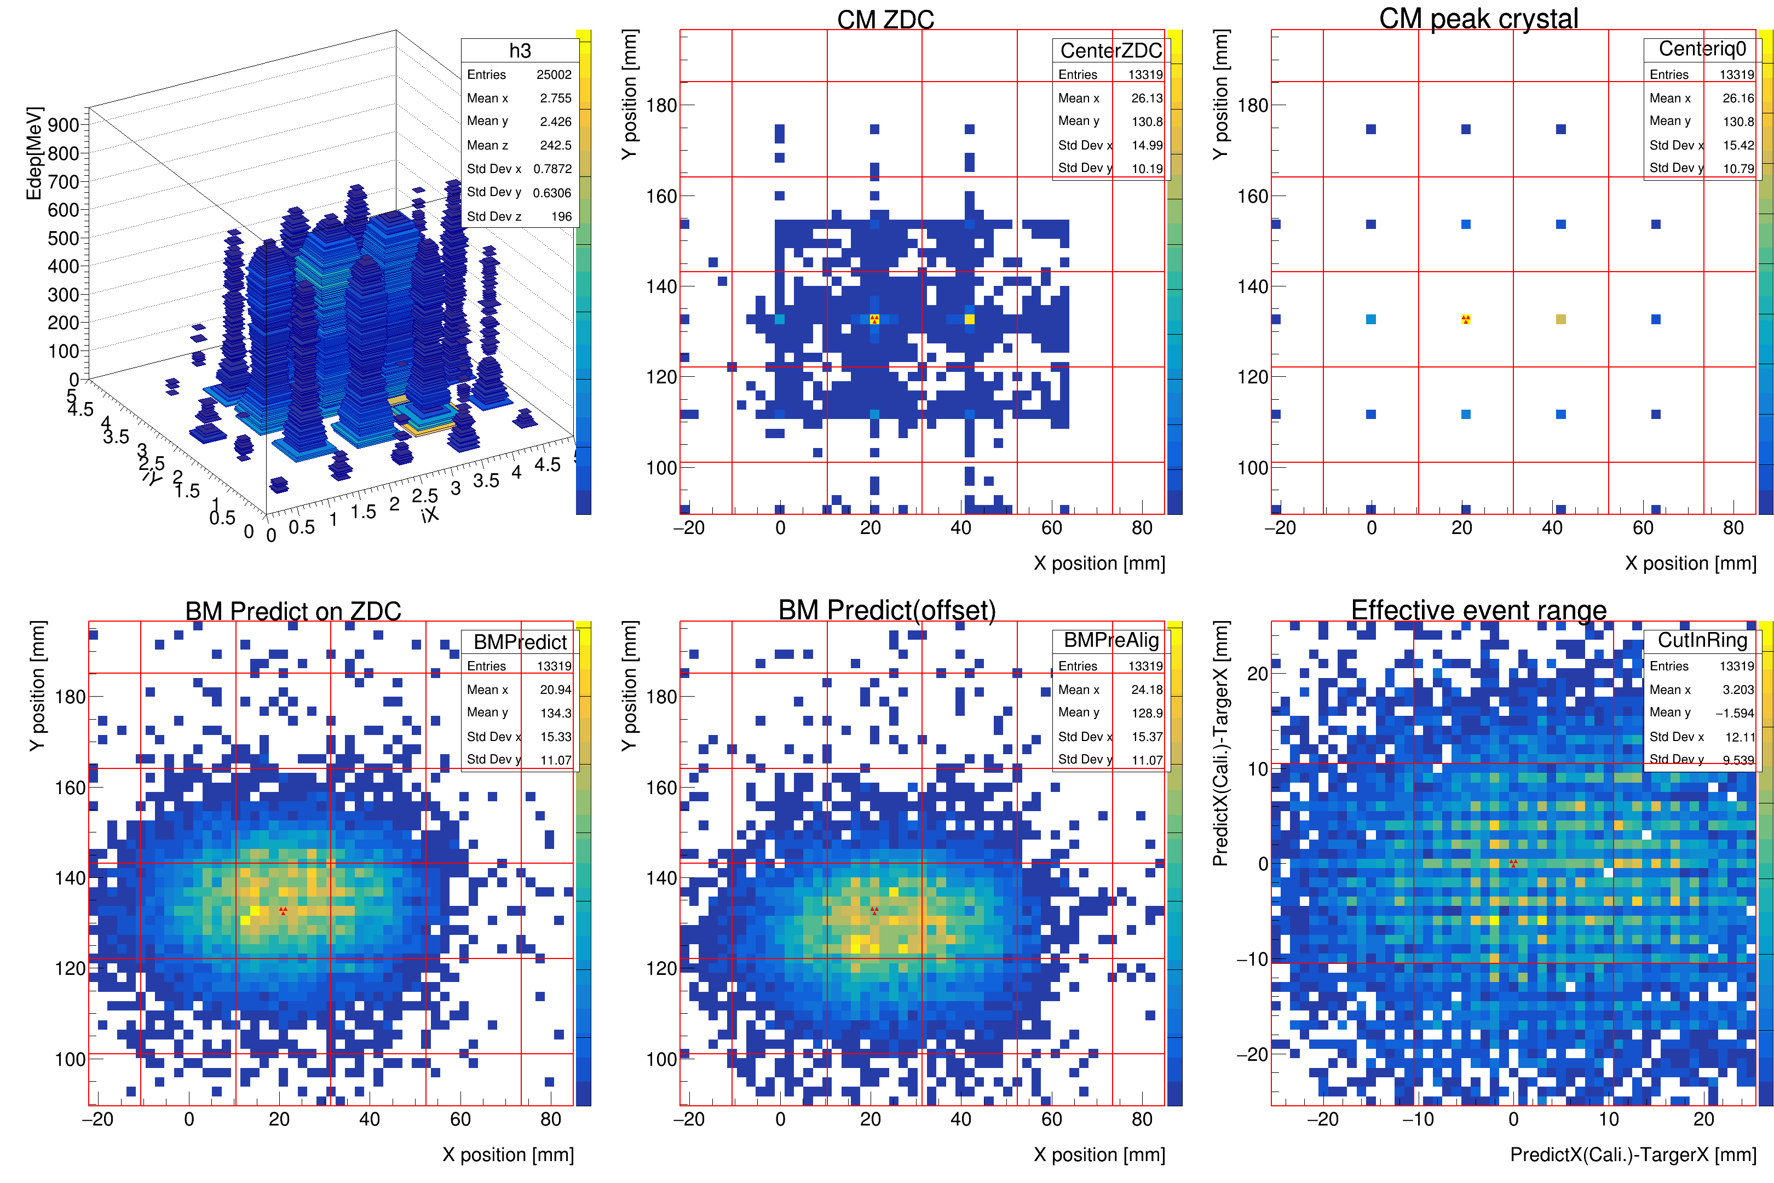
W/O cut of 796 MeV
Example: 796MeV PbWO₄
This page shows the cut:
R = -NA- mm
Main channel (iX,iY) = -NA-
target point offset (offx,offy) = -NA- mm

