Slide 1

ZDC MC Simulation 20260112
Chia-Yu Hsieh
Academia Sinica, Taiwan

Slide 2
Goal
Build up official MC framework (done)
Analysis MC output to get energy/position resolution (undergoing)
Test w/ event generators for pion and kaon structure study

Slide 3
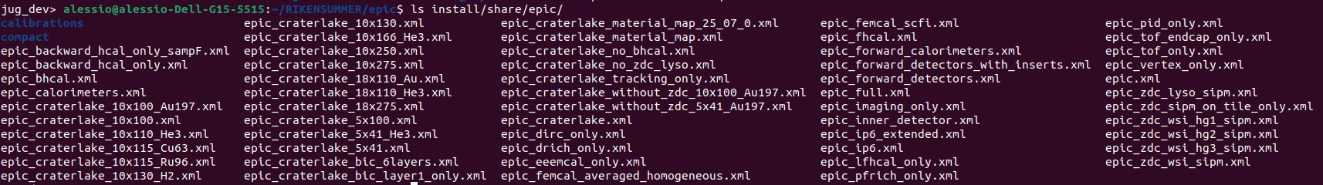
ECAL Versions
WSi Branch : https://github.com/alillari/epic-UConn-ZDC-WSi
There are 4 setting files for ECAL, one for crystal and 4 for WSi setup.
epic_zdc_lyso_sipm.xml : <include ref="${DETECTOR_PATH}/compact/far_forward/ZDC_Crystal_LYSOxml"/> epic_zdc_wsi_sipm.xml: <include ref="${DETECTOR_PATH}/compact/far_forward/ZDC_WSi_LG.xml"/>
epic_zdc_wsi_hg1_sipm.xml: <include ref="${DETECTOR_PATH}/compact/far_forward/ZDC_WSi_HG_1.xml"/> epic_zdc_wsi_hg2_sipm.xml: <include ref="${DETECTOR_PATH}/compact/far_forward/ZDC_WSi_HG_2.xml"/> epic_zdc_wsi_hg3_sipm.xml: <include ref="${DETECTOR_PATH}/compact/far_forward/ZDC_WSi_HG_3.xml"/>

Slide 4
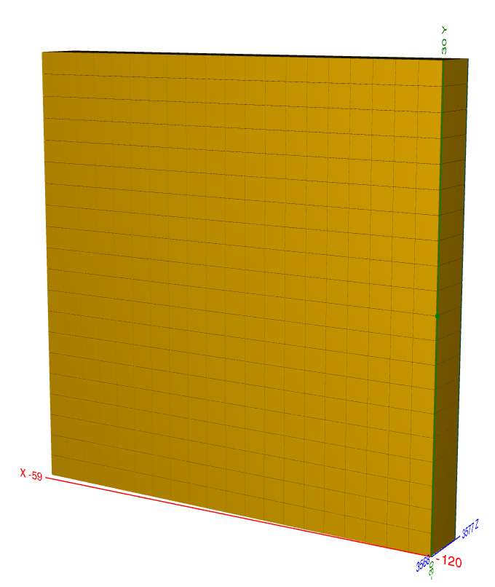
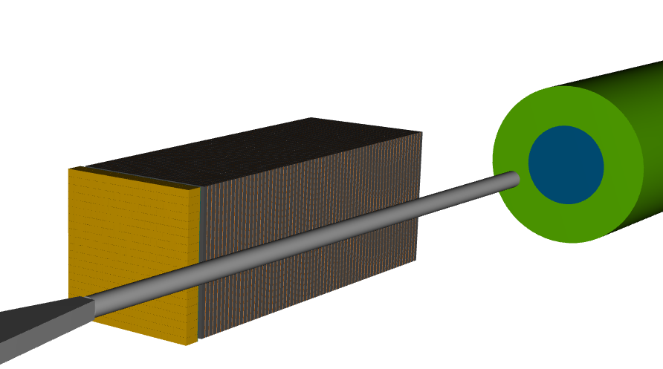
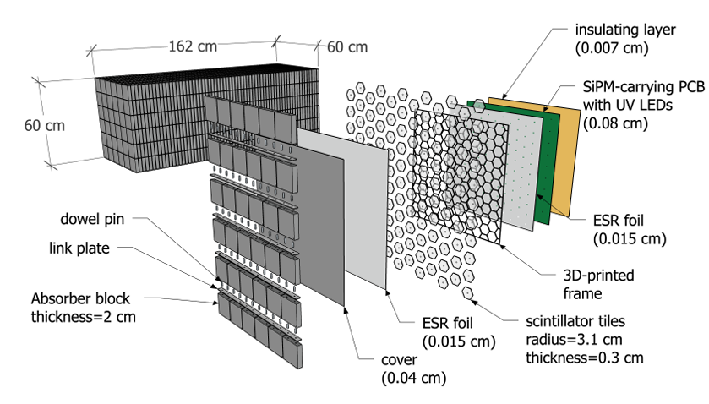
Official ZDC Design : Crystal ECAL + HCAL
ECAL
LYSO Crystal
20*20 cells
3cm*3cm*7cm / cell
60cm*60cm
7cm ~ 6.5X0 in Z
ZDC = ECAL + HCAL
Beam line
HCAL : sampling calorimeter
1 layer = steel + scintillator tile + SiPM
64 layers, 8 slice/layer
65cm in X, 60cm in Y, 163cm in Z

Slide 5
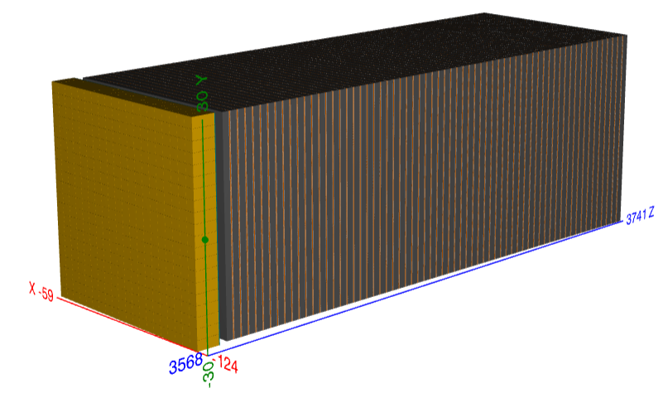
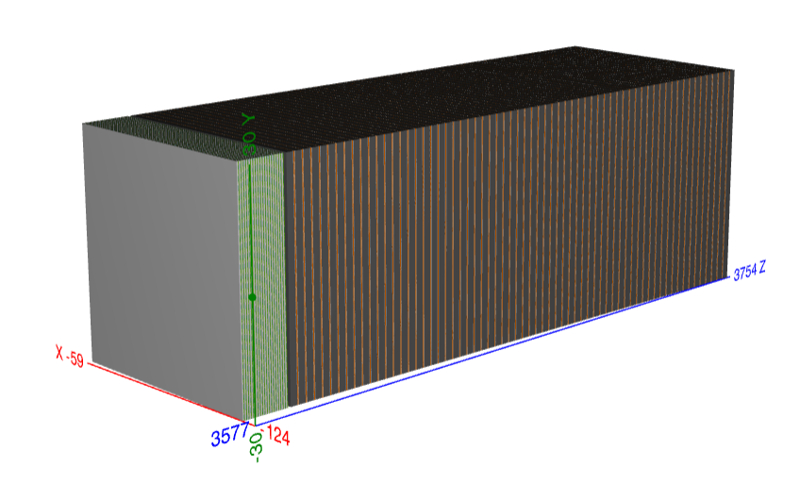
ECAL Design (1)
Crystal ECAL (epic_zdc_lyso_sipm.xml)
LYSO Crystal
20*20 cells
3cm*3cm*7cm / cell
60cm*60cm
7cm ~ 6.5X0 in Z
Wsi w/ low granularity (epic_zdc_wsi_sipm.xml)
20 pad layer, No pixel layer
20 layers “PAD” Wsi (no Pixel layer)
1 layer = W (3.5mm) + glue (0.11um, G10) + Si pad (320mm, Si) + glue (0.11um, G10) + PCB (1.6mm, PET) + Air (1mm)
Si pad = 1cm*1cm => 60 pads / layer

Slide 6
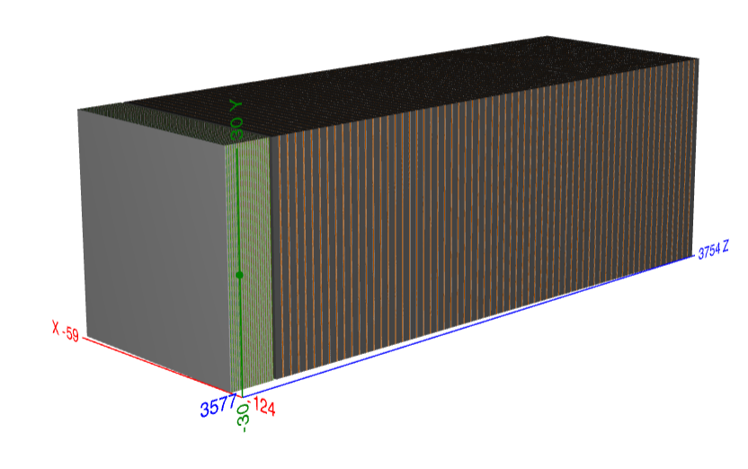
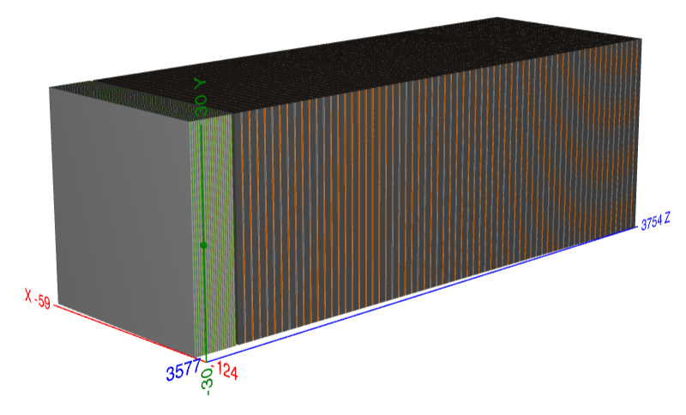
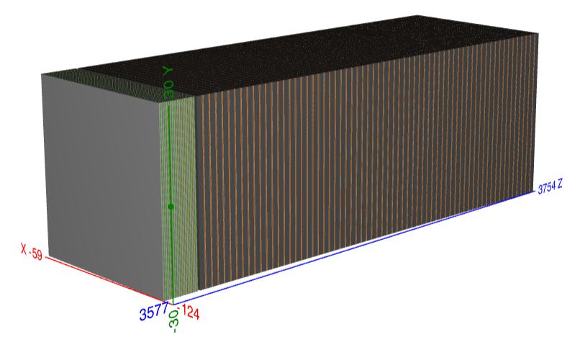
ECAL Design (2)
WSi w/ high granuarity1 (epic_zdc_wsi_hg1_sipm.xml) 17 pad + 3 pixel (3, 6, 9)
20 layer = 17 layers “PAD” Si + 3 layer “Pixel” Si
1 layer = W (3.5mm) + glue (0.11um, G10) + Si pad/pixel (320mm/300mm, Si) + glue (0.11um, G10) + PCB (1.6mm, PET) + Air (1mm)
Si pad : 1cm*1cm, 3600 pads / layer
Si pixel : 0.5mm* 0.5mm, 1,440,000 pixel / layer
WSi w/ high granuarity2 (epic_zdc_wsi_hg2_sipm.xml) : 17 pad + 3 pixel (4, 8, 12)
WSi w/ high granuarity2 (epic_zdc_wsi_hg3_sipm.xml) 17 pad + 3 pixel (5, 10, 15)

Slide 7
Analyze MC to get energy resolution
Crystal ECAL + Sampling HCAL
Code mainly developed by Shima and Po-Ju

Slide 8
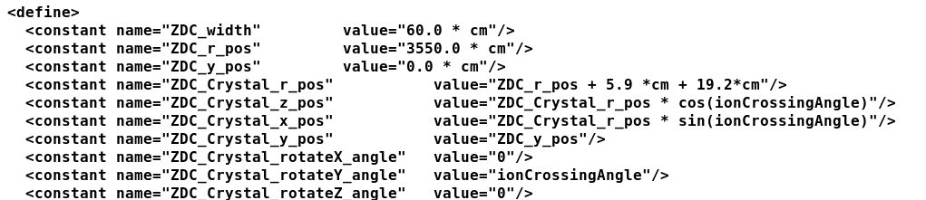
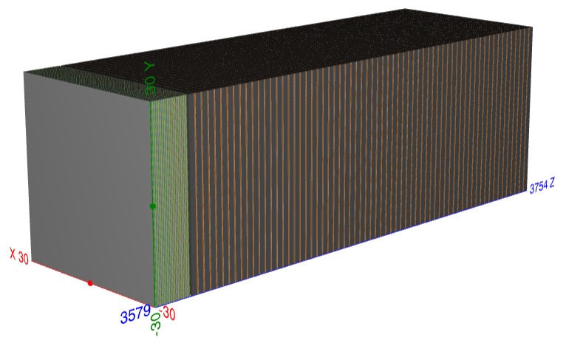
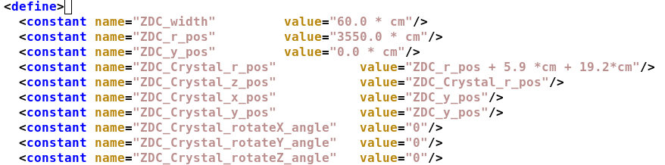
Relocate Detector and Beam Position
Put detector straight along z-dir
Shoot beam to center of ZDC crystal (shift 15mm in both x and y directions)
1GeV-40GeV gamma pencil beams shoot to the center of crystal and the detector is put straight in order to simplify the case.

Slide 9
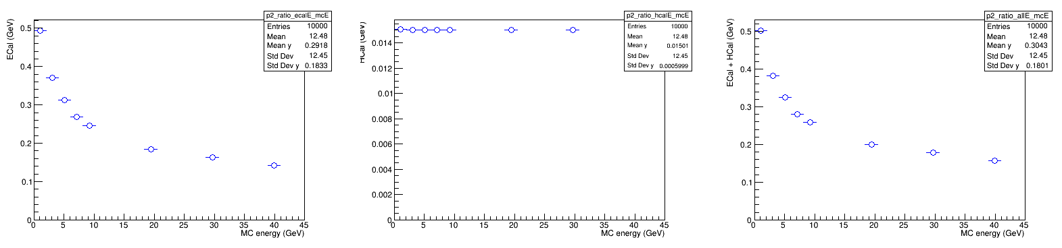
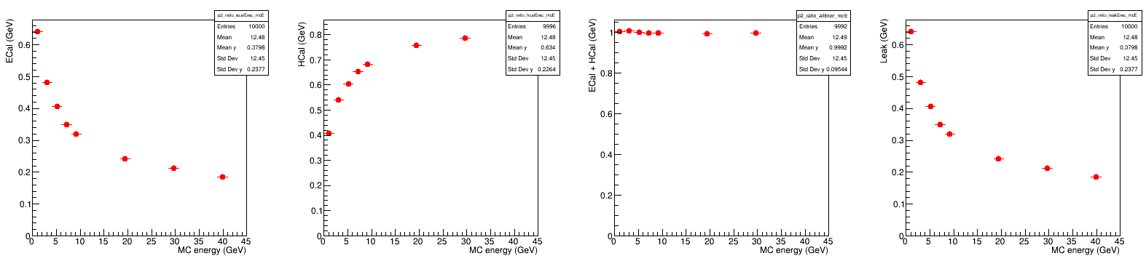
Energy Dump
Before energy regression
ECAL
HCAL
ECAL + HCAL
After energy regression (linear regression, 1 = p0 + p1*ECAL + p2*HCAL)
ECAL
HCAL
ECAL + HCAL

Slide 10
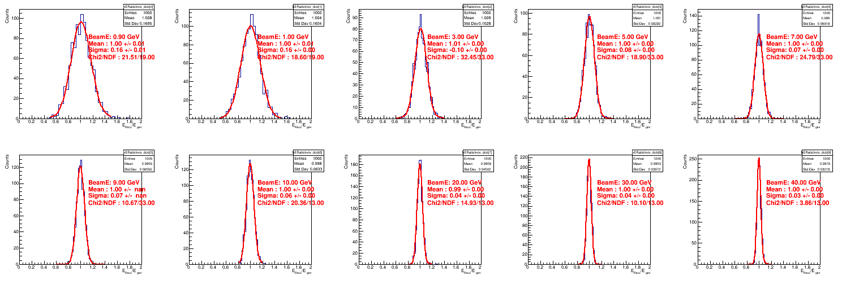
Fit Reconstructed Energy
Double-side crystal ball fit

Slide 11
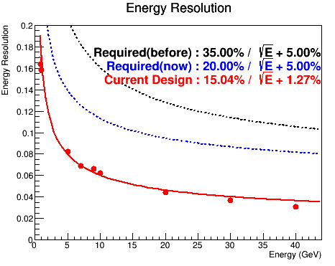
Energy Resolution for Gamma
1GeV-40GeV gamma pencil beams
LYSO-crystal ECAL+ Sampling Calorimeter HCAL
=> Satisfy the energy resolution requirement.

Slide 12
Analyze MC to get position resolution
Crystal ECAL + Sampling HCAL

Slide 13
Strategy to Access Position Resolution
MC truth is simple and expected since pencil beam is shouted @ (-15mm, -15mm, z)
Particle tracking :
layer by layer define a weighted position
(ECAL=1 layer, HCAL = 64 layers)
Fit 64 layers by polynomial1
(only HCAL is used in tracking now)
Evaluate residual (trackPos-MCPos)
Position resolution = sigma of gaussian fit of residual
Use 40GeV gamma sample to test

Slide 14
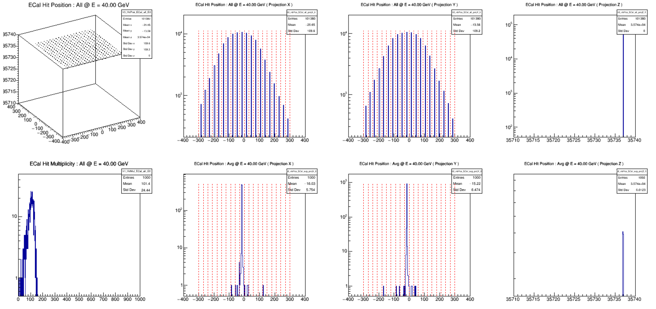
Hit Distribution of ECAL (1000 evts)
Hit position in X
=> 20 peaks/crystals
Hit position in Y
=> 20 peaks /crystals
Hit position in Z
=> 1 peak
Hit multiplicity
~ 100 hits/evt
Weighted pos in X
=> Centered ~ -15mm
Weighted pos in Y
=> Centered ~ -15mm
Weighted pos in Z

Slide 15
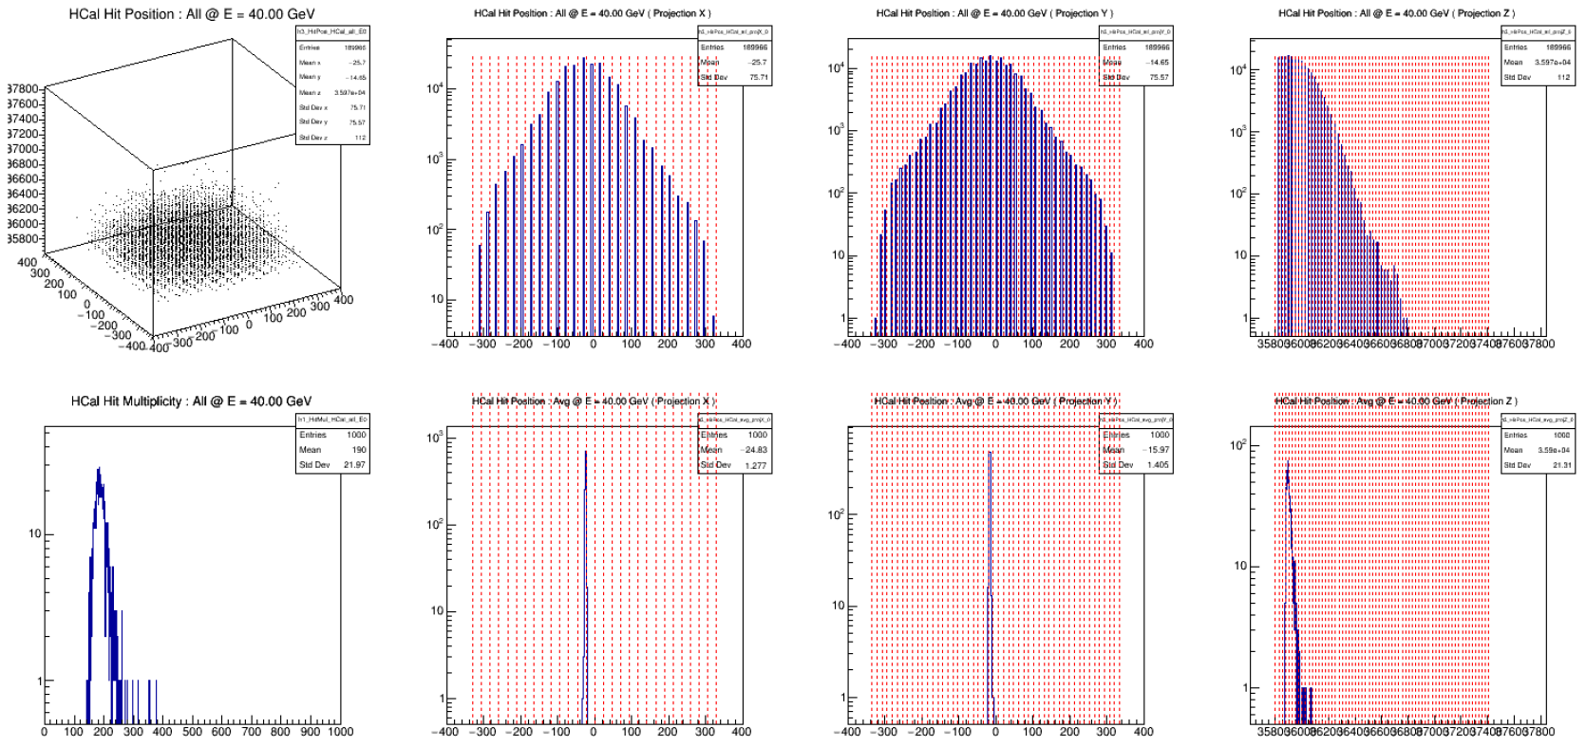
Hit Distribution of HCAL (1000 evts)
Hit position in X
=> 28 peaks
Hit position in Y
=> 49 peaks
Hit position in Z
=> 64 peak/layers
Hit multiplicity
~ 200 hits/evt
Weighted pos in X
Centered ~ -24mm(?)
Weighted pos in Y
=> Centered ~ -15mm
Weighted pos in Z
=> Peak @ 7th layer

Slide 16
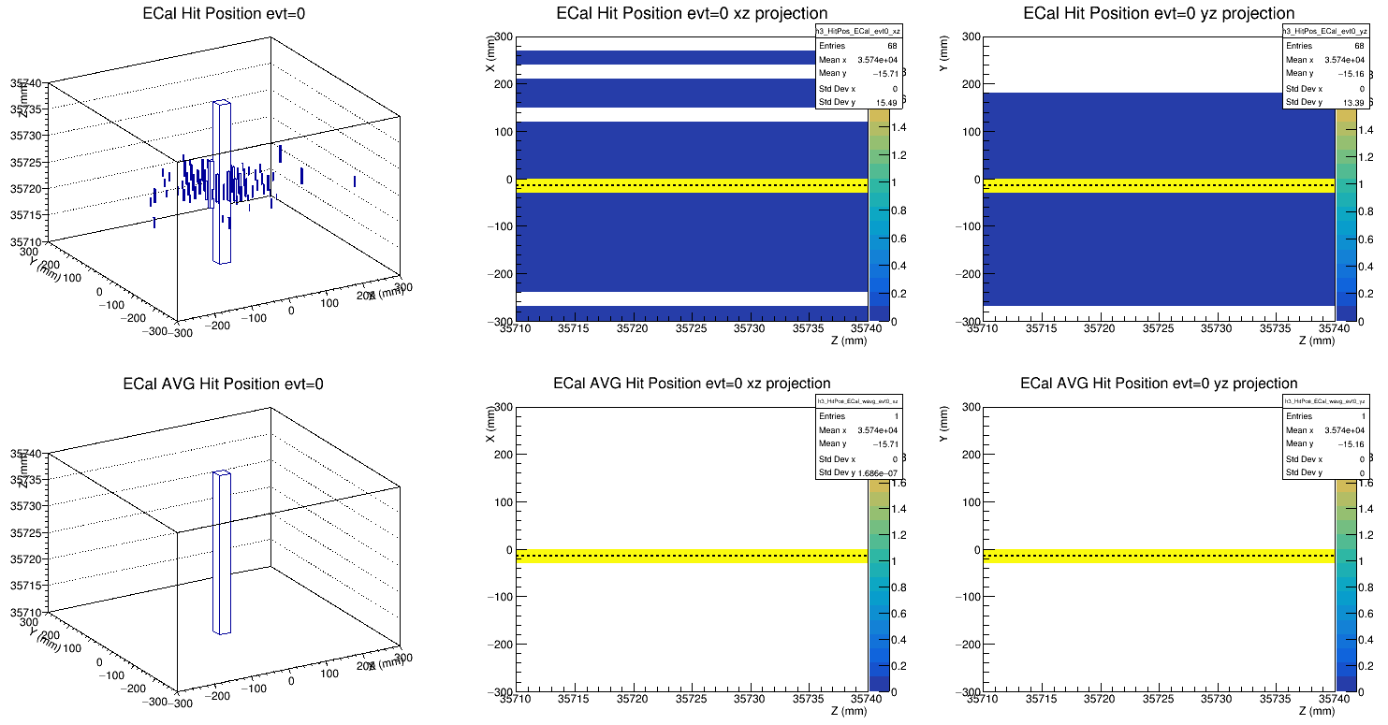
ECAL : Hits in XZ and YZ (evt#0)
Raw hit position (color is Edmp)
Energy-weighted hit position

Slide 17
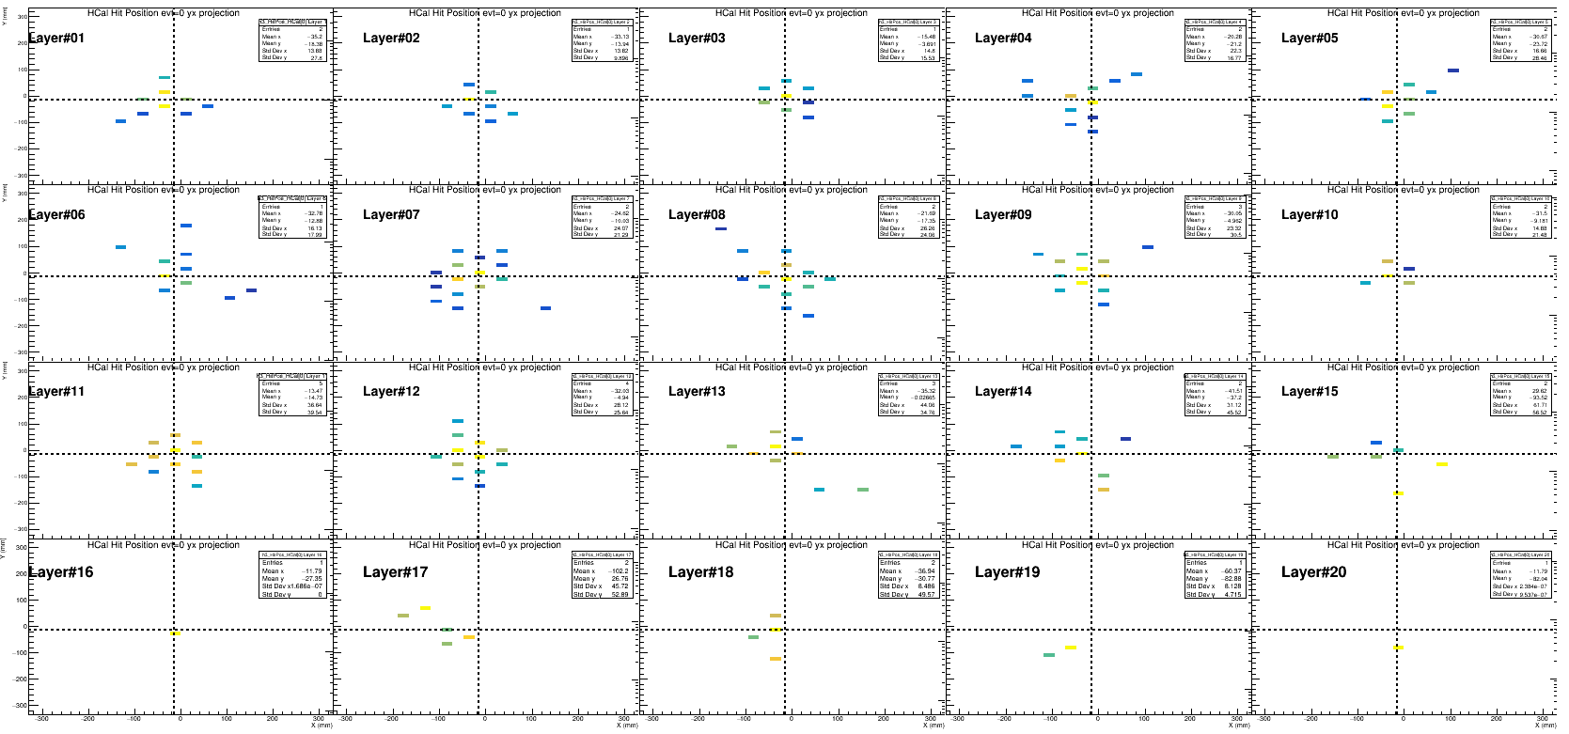
HCAL : Hits in XY (evt#0)
Center is more energy dump
Not many hits after layer#20

Slide 18
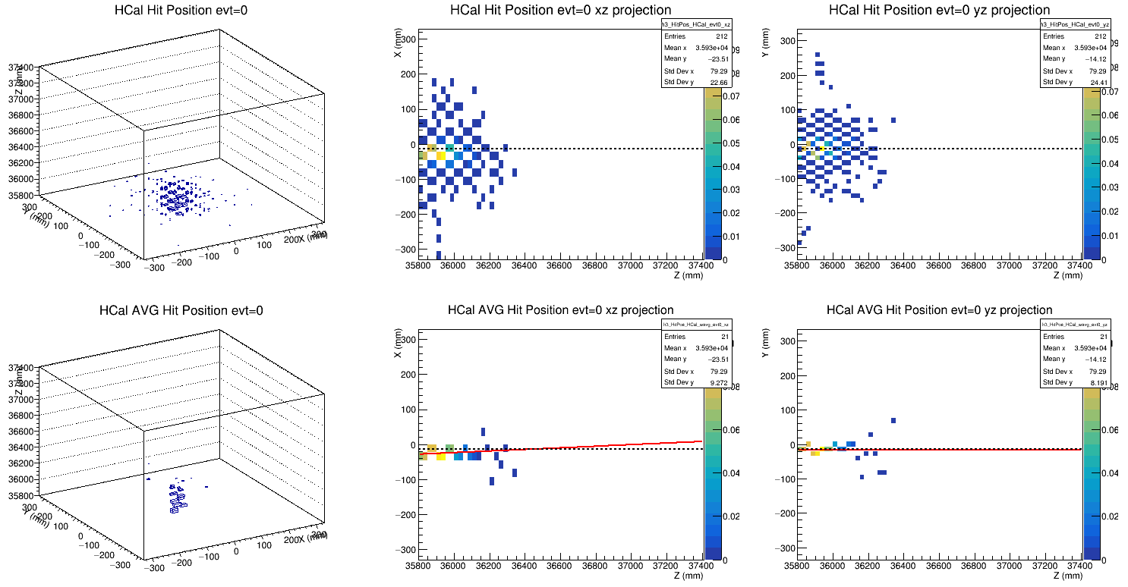
HCAL : Fit pol1 (evt#0)
Raw hits (color weighted by Edmp)
Energy-weighted hit position
Tracking on xz plane
(not along beam?)
Tracking on yz plane
(ok)

Slide 19
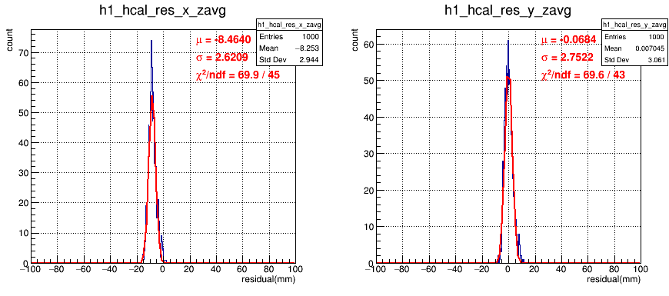
Residual @ Weighted-Z position (Only HCAL Included in Track Reconstruction)
With HCAL along, 40GeV gamma pencil beam, position resolution ~ 2.7mm

Slide 20
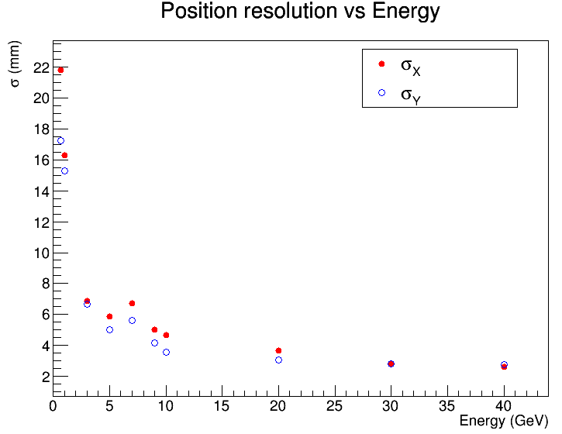
Position Resolution and Shift
Energy (GeV) | Sigma X(mm) | Sigma Y(mm)
0.7 | 21.79 | 17.25
1.0 | 16.28 | 15.29
3 | 6.87 | 6.67
5 | 5.86 | 5.01
7 | 6.72 | 5.62
9 | 5.03 | 4.18
10 | 4.68 | 3.56
20 | 3.64 | 3.06
30 | 2.82 | 2.83
40 | 2.62 | 2.75
Energy (GeV) | Mean X (mm) | Mean Y (mm)
0.7 | −13.50 | +0.17
1.0 | −10.53 | +0.68
3 | −12.06 | −0.53
5 | −11.97 | −0.68
7 | −9.26 | +1.01
9 | −9.83 | +0.24
10 | −10.40 | −0.14
20 | −8.55 | +0.17
30 | −8.65 | −0.09
40 | −8.46 | −0.07
Position resolution in Y is better than X in low energy.

Slide 21
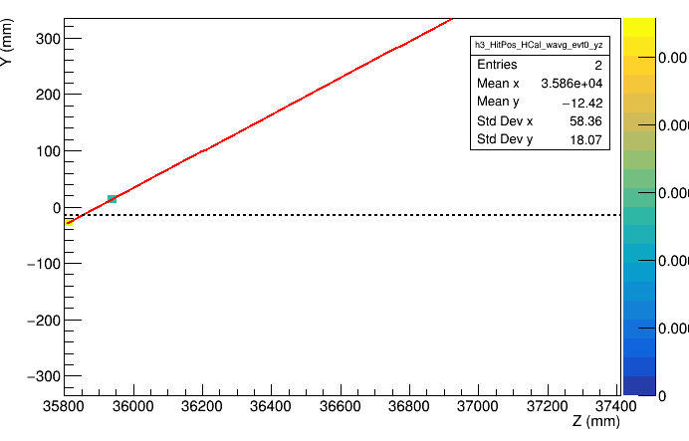
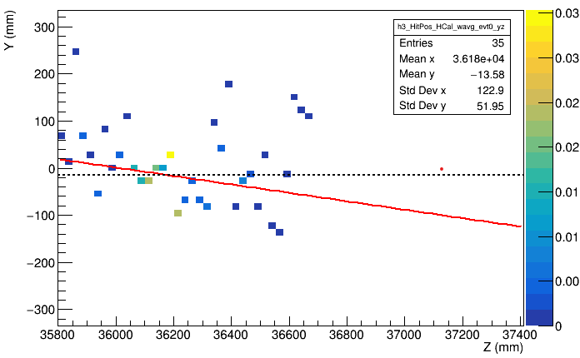
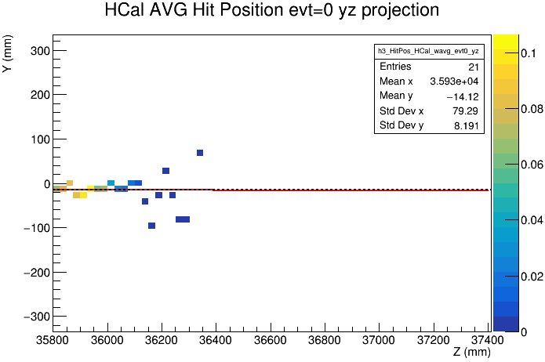
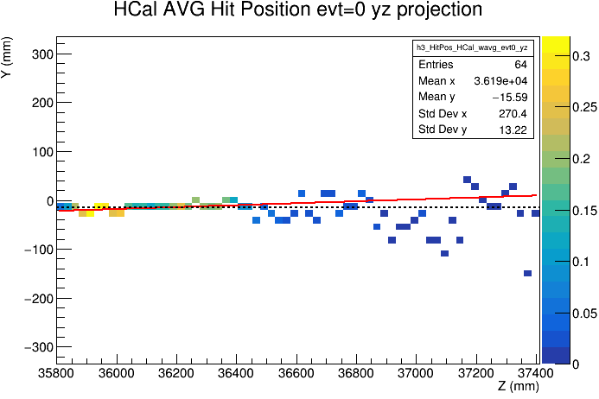
Track Reconstruction is Difficult for Low Energy Beam
0.7 GeV Gamma
1 GeV neutron
40GeV Gamma
300 GeV neutron
For gamma, energy<0.5GeV, barely hits in HCAL.
For neutron, energy~ 1GeV, shower is quite spread.

Slide 22
Neutron Beam Pencil @ (-15, -15, z) {10, 20, 50, 100, 200, 300} GeV

Slide 23
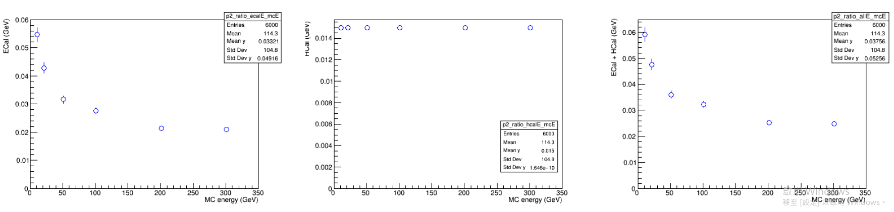
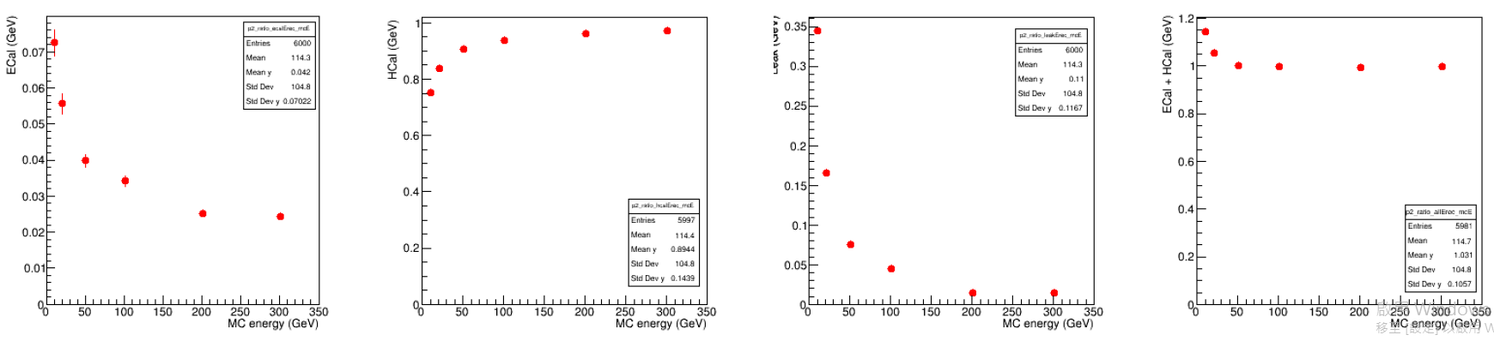
Energy Dump
Energy dump BEFORE energy regression
2%-6%
1.5 %
ECAL
HCAL
ECAL + HCAL
Energy Dump AFTER energy regression
(linear regression, y = p0 + p1*ECAL + p2*HCAL)
Leak
ECAL
+ HCAL
+ Leak
ECAL
HCAL
Energy not well reconstructed for neutron<50GeV

Slide 24
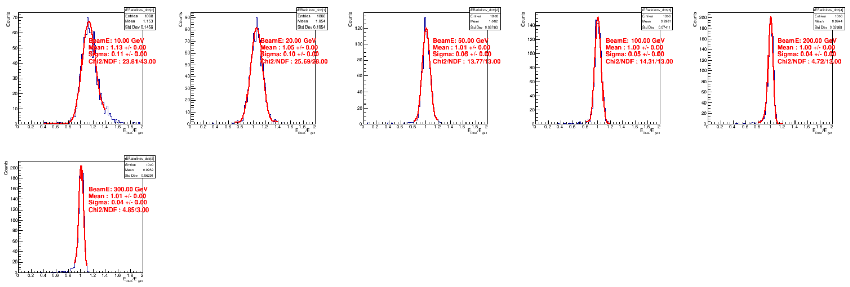
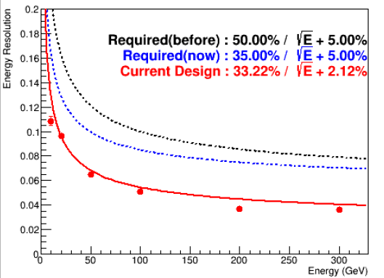
Energy Regression/Resolution
10 GeV
20 GeV
50 GeV
100 GeV
200 GeV
300 GeV
Energy resolution, ok!

Slide 25
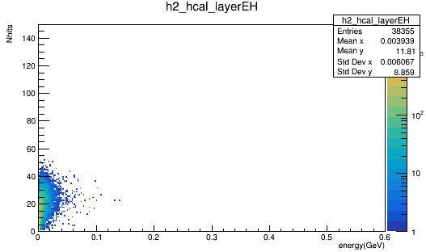
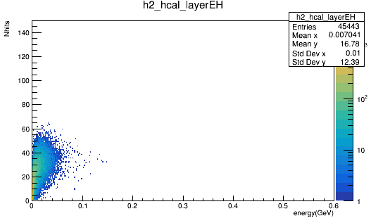
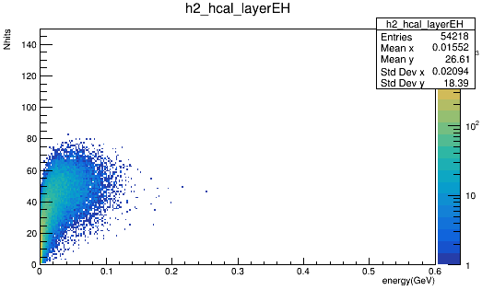
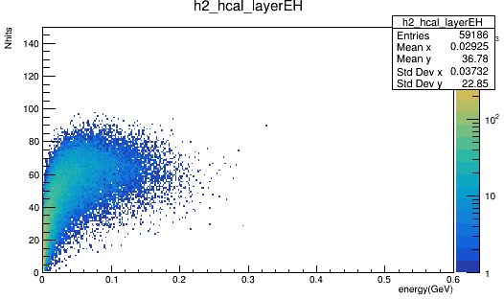
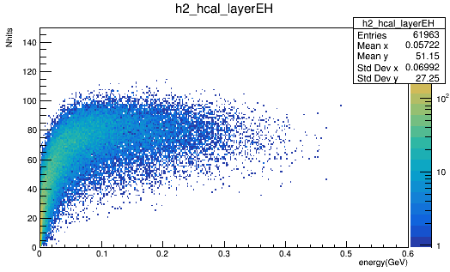
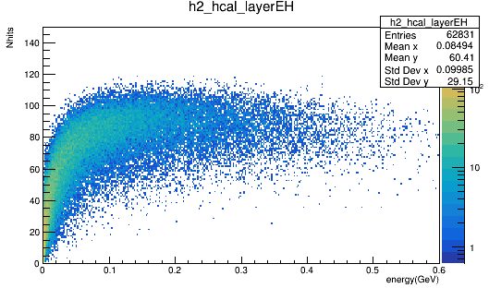
Nhits VS Energy (1 fill = 1 per Layer, 1000 evts)
10 GeV neutron
20 GeV neutron
50 GeV neutron
100 GeV neutron
200 GeV neutron
300 GeV neutron
Lower energy, less hits and less energy left in HCAL

Slide 26
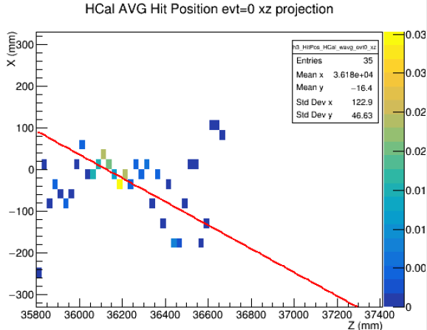
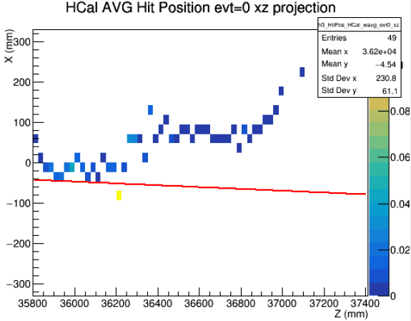
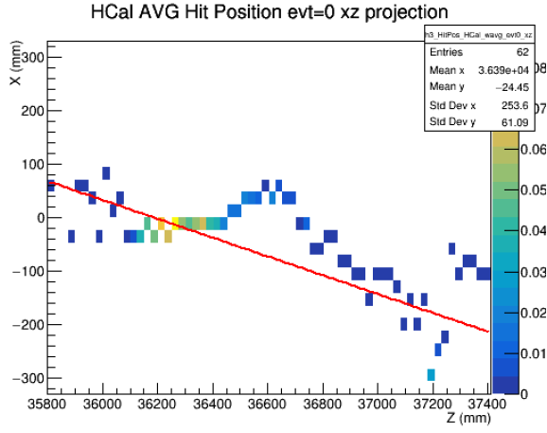
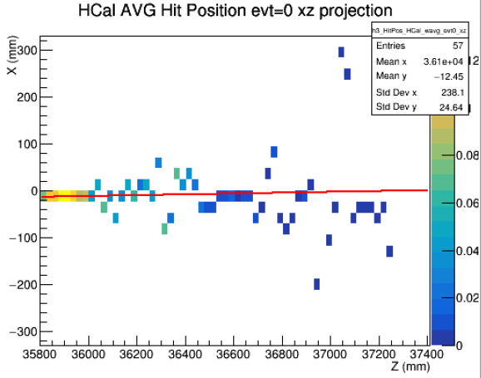
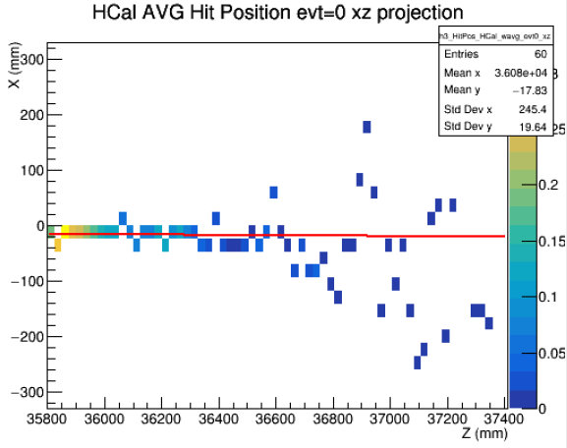
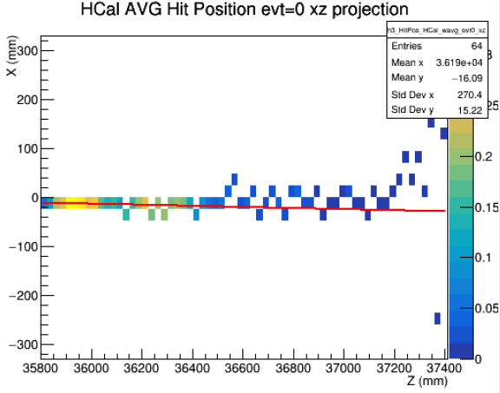
Track Reconstruction (evt#0, XZ)
10 GeV neutron
20 GeV neutron
50 GeV neutron
100 GeV neutron
200 GeV neutron
300 GeV neutron
Bad track reconstruction for low energy beam. => apply some cuts on energy or Nhits? Or weight higher energy layer more in tracking?

Slide 27
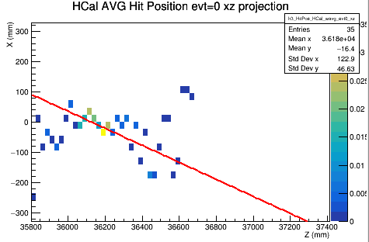
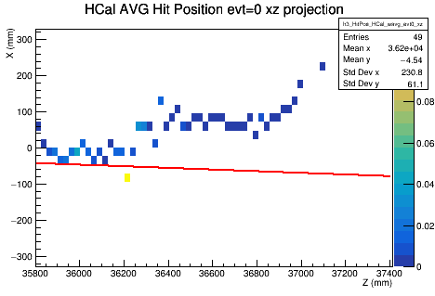
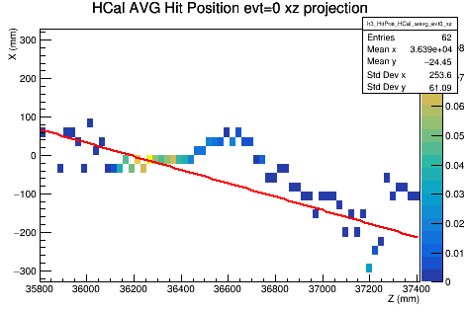
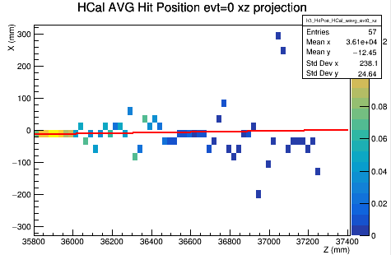
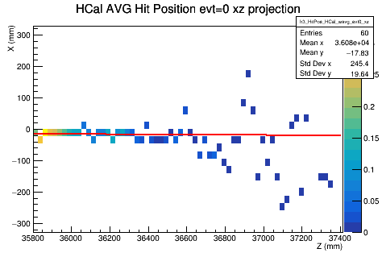
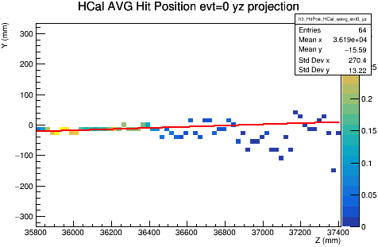
Track Reconstruction (evt#0, YZ)
10 GeV neutron
20 GeV neutron
50 GeV neutron
100 GeV neutron
200 GeV neutron
300 GeV neutron

Slide 28
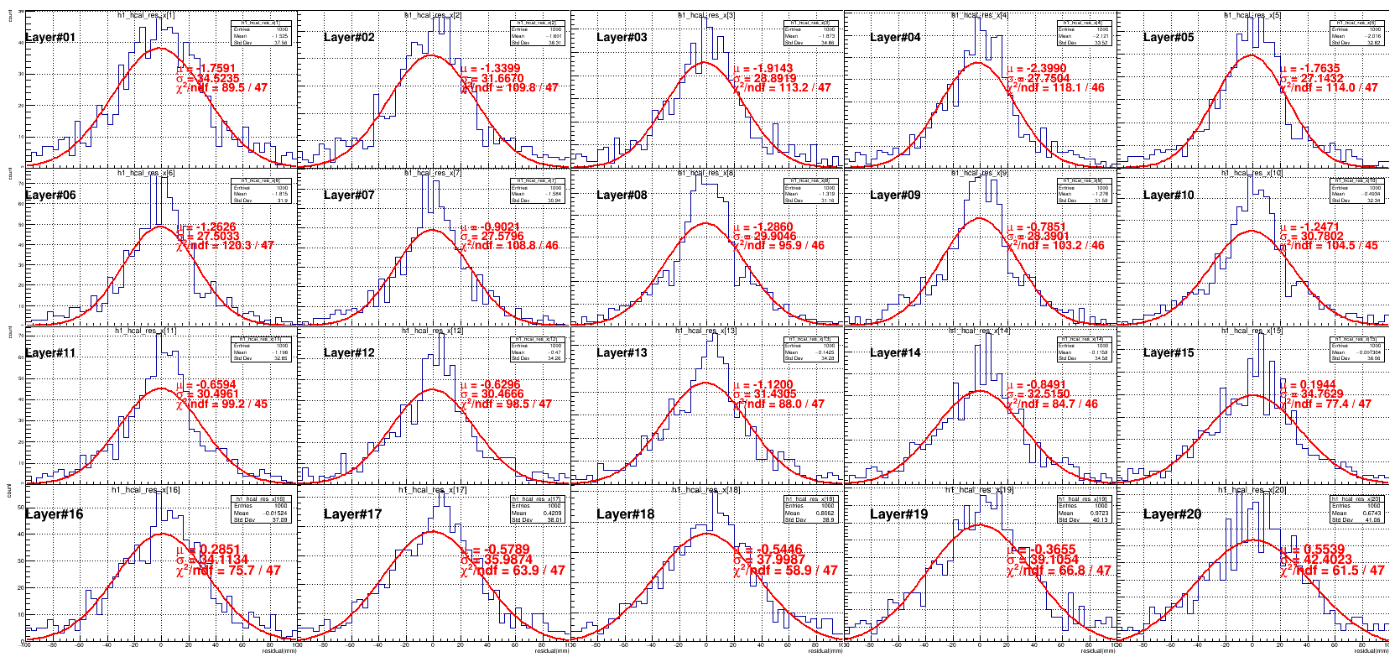
Residual Layer by Layer @ 1GeV
@XZ

Slide 29

Residual Layer by Layer @ 300GeV
@XZ

Slide 30






Residual @ Weighted-Z, XZ Plan
10 GeV neutron
20 GeV neutron
50 GeV neutron
100 GeV neutron
200 GeV neutron
300 GeV neutron

Slide 31
Residual @ Weighted-Z, YZ Plan
10 GeV neutron
20 GeV neutron
50 GeV neutron
100 GeV neutron
200 GeV neutron
300 GeV neutron

Slide 32
Mean (Bias) and Sigma (Position Resolution) of Residual
Energy (GeV) | meanX (XZ) | sigmaX (XZ) | meanY (YZ) | sigmaY (YZ)
10 | −8.65 | 21.79 | +0.80 | 17.71
20 | +0.32 | 16.79 | +0.16 | 15.79
50 | −0.20 | 13.88 | +0.64 | 13.44
100 | +0.65 | 8.45 | +0.60 | 8.70
200 | +0.77 | 5.66 | +0.56 | 5.66
300 | +0.89 | 4.85 | +0.86 | 4.86
No shift in X anymore, unlike gamma beam.
=> problem is low energy dump in HCAL and mostly in ECAL?
Higher beam energy=> better position resolution.

Slide 33


Mean (Bias) and Sigma (Position Resolution) of Residual

