Slide 1

ZDC MC Simulation
20260112
Chia-Yu Hsieh
Academia Sinica, Taiwan

Slide 2
Goal
Build up official MC framework (done)
Analysis MC output to get energy/position resolution (undergoing)
Test w/ event generators for pion and kaon structure study

Slide 3
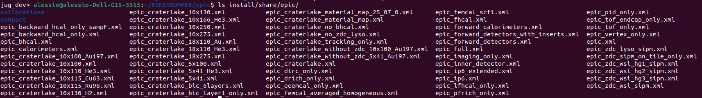
ECAL Versions
WSi Branch : https://github.com/alillari/epic-UConn-ZDC-WSi
There are 4 setting files for ECAL, one for crystal and 4 for WSi setup.
epic_zdc_lyso_sipm.xml : <include ref="${DETECTOR_PATH}/compact/far_forward/ZDC_Crystal_LYSOxml"/>
epic_zdc_wsi_sipm.xml: <include ref="${DETECTOR_PATH}/compact/far_forward/ZDC_WSi_LG.xml"/>
epic_zdc_wsi_hg1_sipm.xml: <include ref="${DETECTOR_PATH}/compact/far_forward/ZDC_WSi_HG_1.xml"/>
epic_zdc_wsi_hg2_sipm.xml: <include ref="${DETECTOR_PATH}/compact/far_forward/ZDC_WSi_HG_2.xml"/>
epic_zdc_wsi_hg3_sipm.xml: <include ref="${DETECTOR_PATH}/compact/far_forward/ZDC_WSi_HG_3.xml"/>

Slide 4
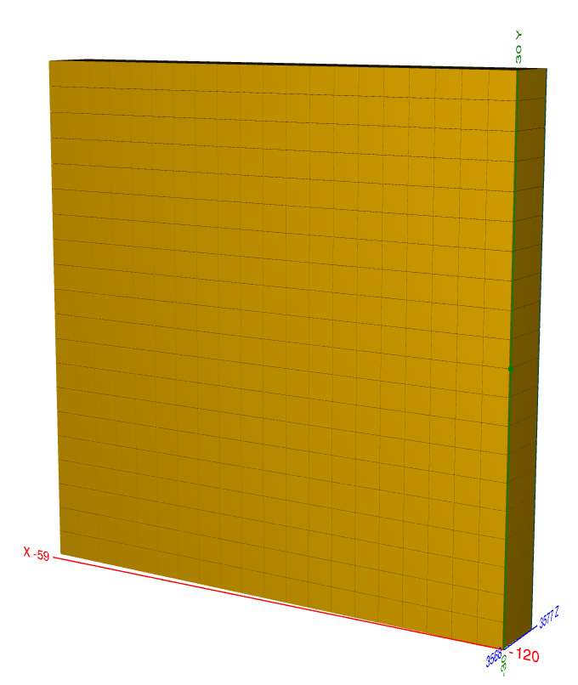
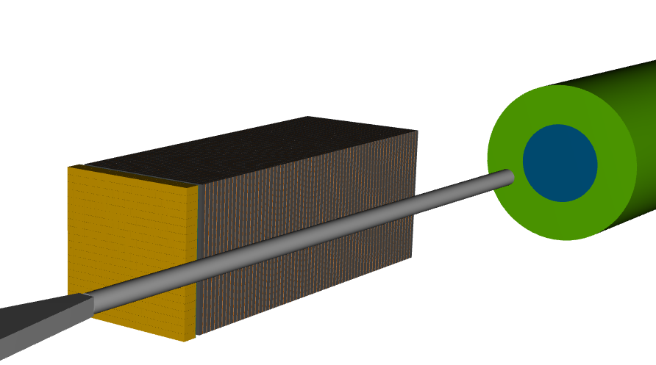
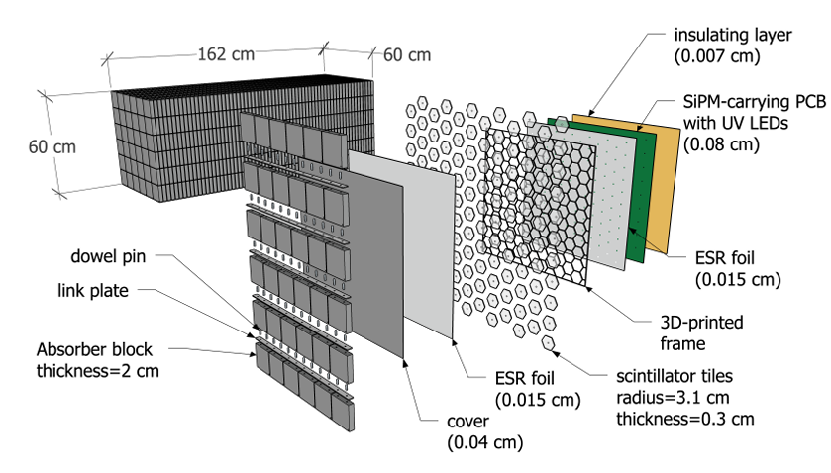
Official ZDC Design : Crystal ECAL + HCAL
ECAL
LYSO Crystal
20*20 cells
3cm*3cm*7cm / cell
60cm*60cm
7cm ~ 6.5X0 in Z
ZDC = ECAL + HCAL
Beam line
HCAL : sampling calorimeter
1 layer = steel + scintillator tile + SiPM
64 layers, 8 slice/layer
65cm in X, 60cm in Y, 163cm in Z

Slide 5
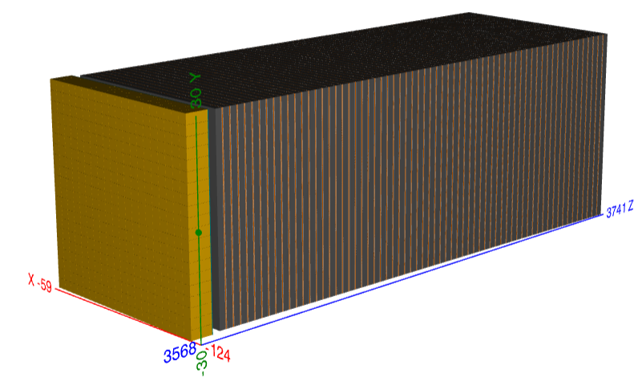
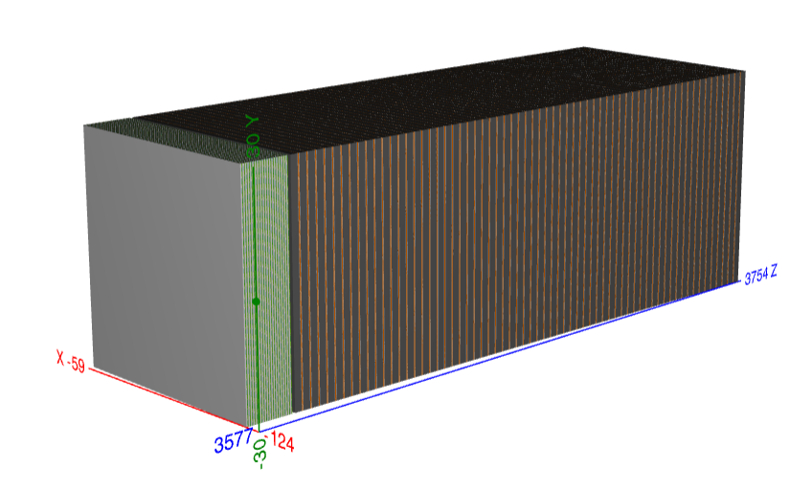
ECAL Design (1)
Crystal ECAL (epic_zdc_lyso_sipm.xml)
LYSO Crystal
20*20 cells
3cm*3cm*7cm / cell
60cm*60cm
7cm ~ 6.5X0 in Z
  Wsi w/ low granularity (epic_zdc_wsi_sipm.xml)
20 pad layer, No pixel layer
20 layers “PAD” Wsi (no Pixel layer)
1 layer = W (3.5mm) + glue (0.11um, G10) + Si pad (320mm, Si) + glue (0.11um, G10) + PCB (1.6mm, PET) + Air (1mm)
Si pad = 1cm*1cm => 60 pads / layer

Slide 6
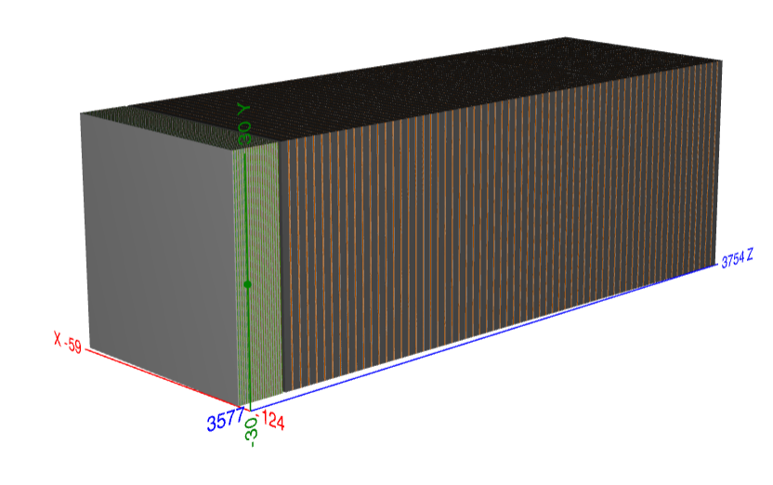
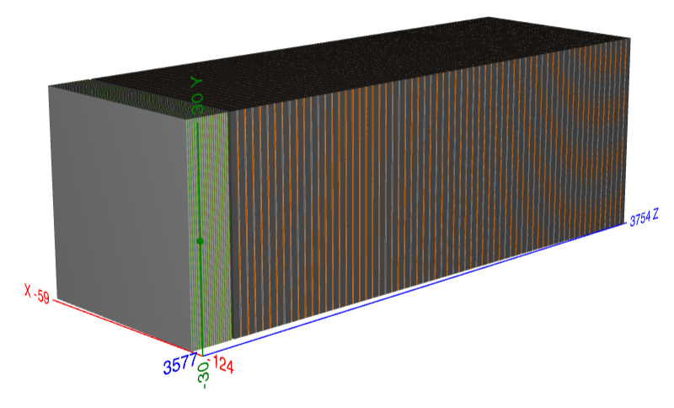
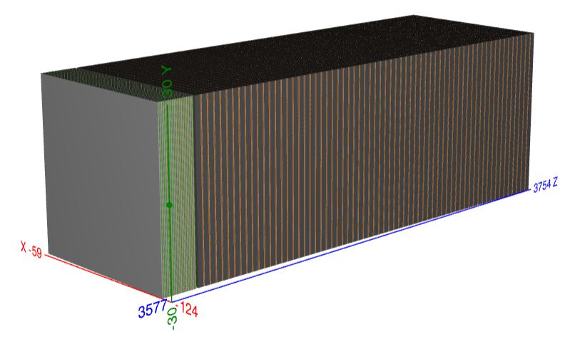
ECAL Design (2)
WSi w/ high granuarity1 (epic_zdc_wsi_hg1_sipm.xml) 17 pad + 3 pixel (3, 6, 9)
20 layer = 17 layers “PAD” Si + 3 layer “Pixel” Si
1 layer = W (3.5mm) + glue (0.11um, G10) + Si pad/pixel (320mm/300mm, Si) + glue (0.11um, G10) + PCB (1.6mm, PET) + Air (1mm)
Si pad : 1cm*1cm, 3600 pads / layer
Si pixel : 0.5mm* 0.5mm, 1,440,000 pixel / layer
WSi w/ high granuarity2 (epic_zdc_wsi_hg2_sipm.xml) : 17 pad + 3 pixel (4, 8, 12)
WSi w/ high granuarity2 (epic_zdc_wsi_hg3_sipm.xml) 17 pad + 3 pixel (5, 10, 15)

Slide 7
Analyze MC to get energy resolution
Crystal ECAL + Sampling HCAL
Code mainly developed by Shima and Po-Ju

Slide 8
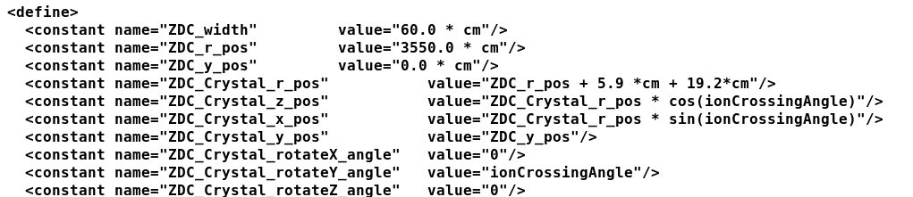
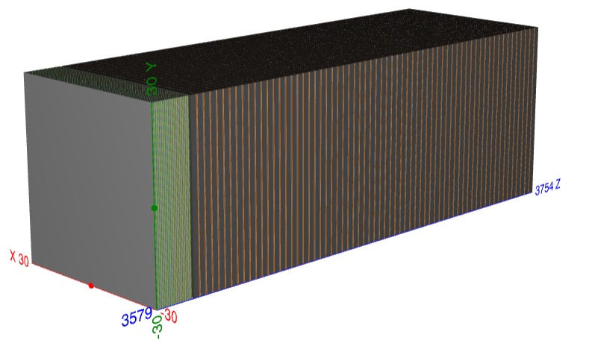
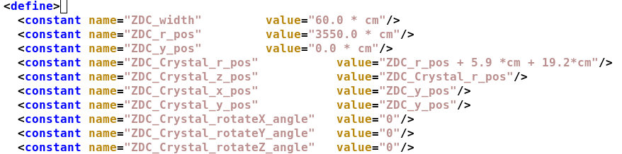
Relocate Detector and Beam Position
Put detector straight along z-dir
Shoot beam to center of ZDC crystal (shift 15mm in both x and y directions)
1GeV-40GeV gamma pencil beams shoot to the center of crystal and the detector is put straight in order to simplify the case.

Slide 9
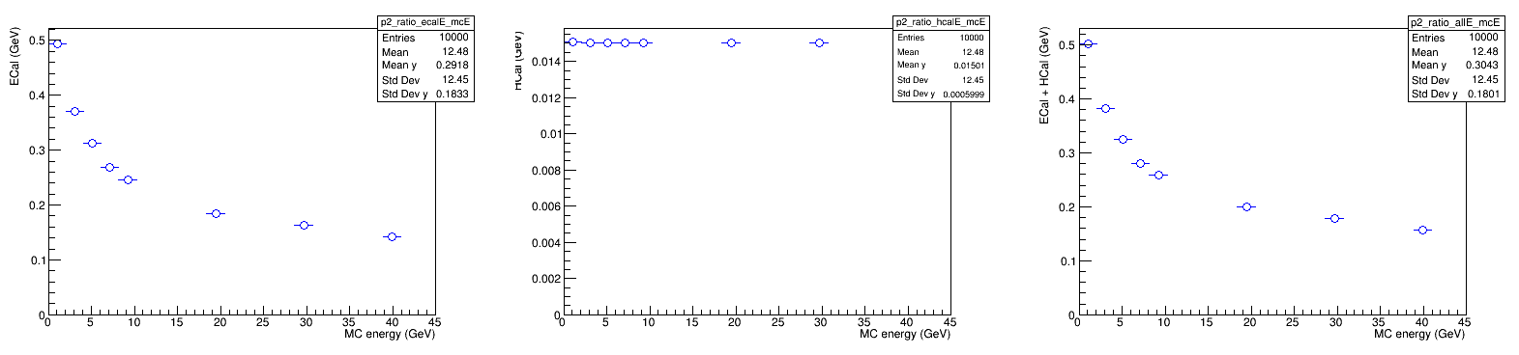
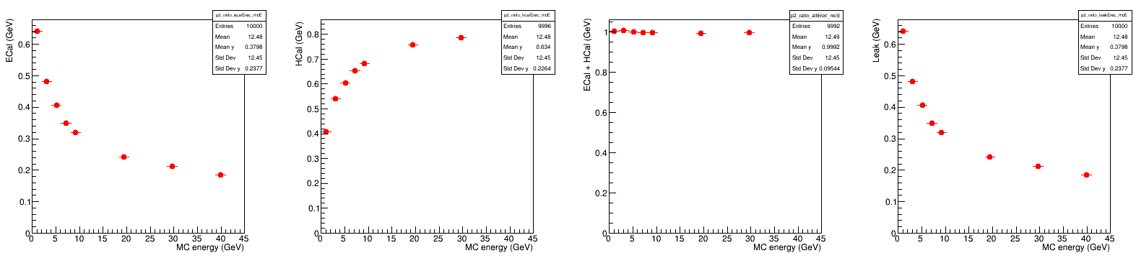
Energy Dump
Before energy regression
ECAL
HCAL
ECAL + HCAL
After energy regression (linear regression, 1 = p0 + p1*ECAL + p2*HCAL)
ECAL
HCAL
ECAL + HCAL

Slide 10
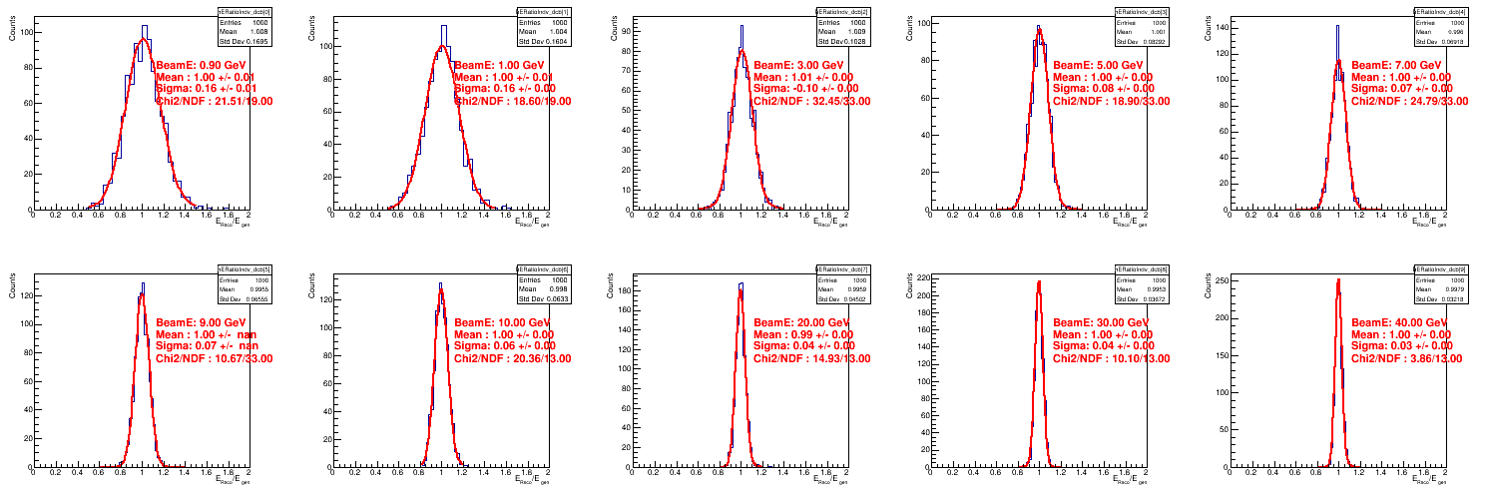
Fit Reconstructed Energy
Double-side crystal ball fit

Slide 11
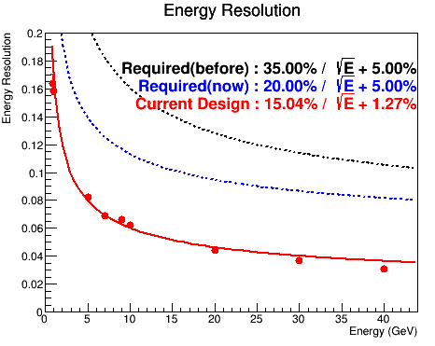
Energy Resolution for Gamma
1GeV-40GeV gamma pencil beams
LYSO-crystal ECAL+ Sampling Calorimeter HCAL
=> Satisfy the energy resolution requirement.

Slide 12
Analyze MC to get position resolution
Crystal ECAL + Sampling HCAL

Slide 13
Strategy to Access Position Resolution
MC truth is simple and expected since pencil beam is shouted @ (-15mm, -15mm, z)
Particle tracking :
layer by layer define a weighted position
(ECAL=1 layer, HCAL = 64 layers)
Fit 64 layers by polynomial1
(only HCAL is used in tracking now)
Evaluate residual (trackPos-MCPos)
Position resolution = sigma of gaussian fit of residual
Use 40GeV gamma sample to test

Slide 14
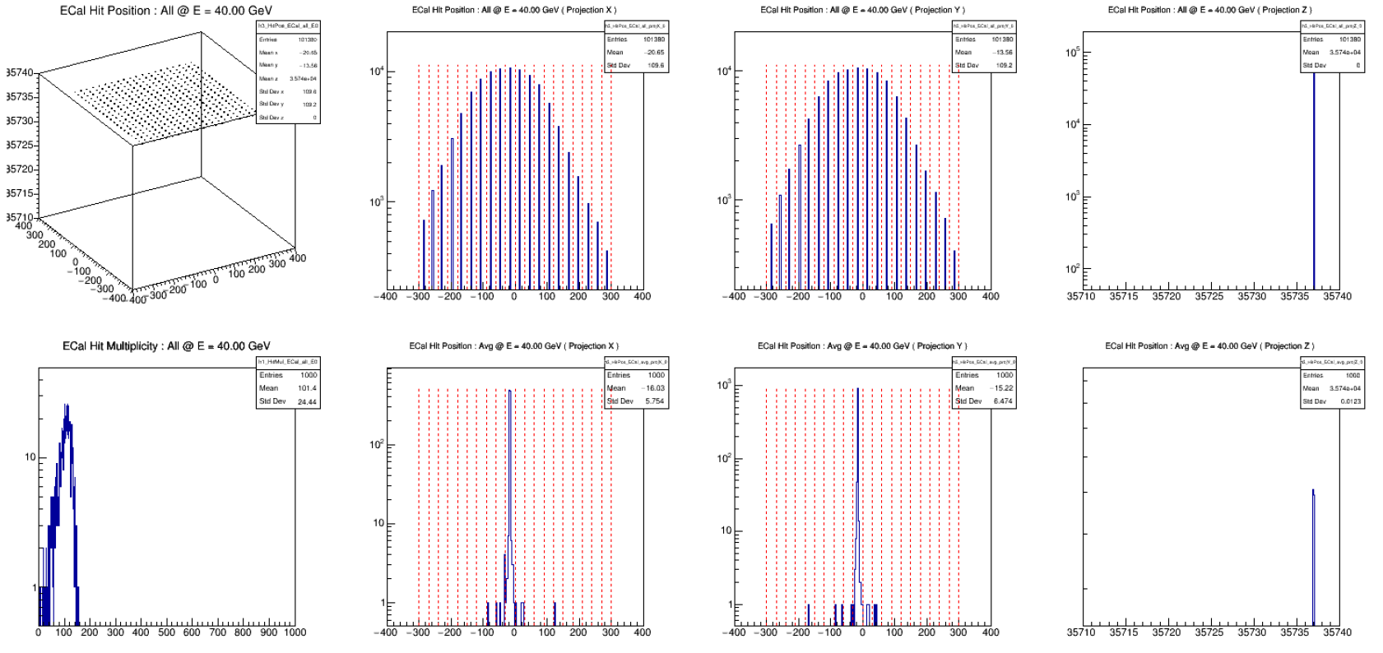
Hit Distribution of ECAL (1000 evts)
Hit position in X
=> 20 peaks/crystals
Hit position in Y
=> 20 peaks /crystals
Hit position in Z
=> 1 peak
Hit multiplicity
~ 100 hits/evt
Weighted pos in X
=> Centered ~ -15mm
Weighted pos in Y
=> Centered ~ -15mm
Weighted pos in Z

Slide 15
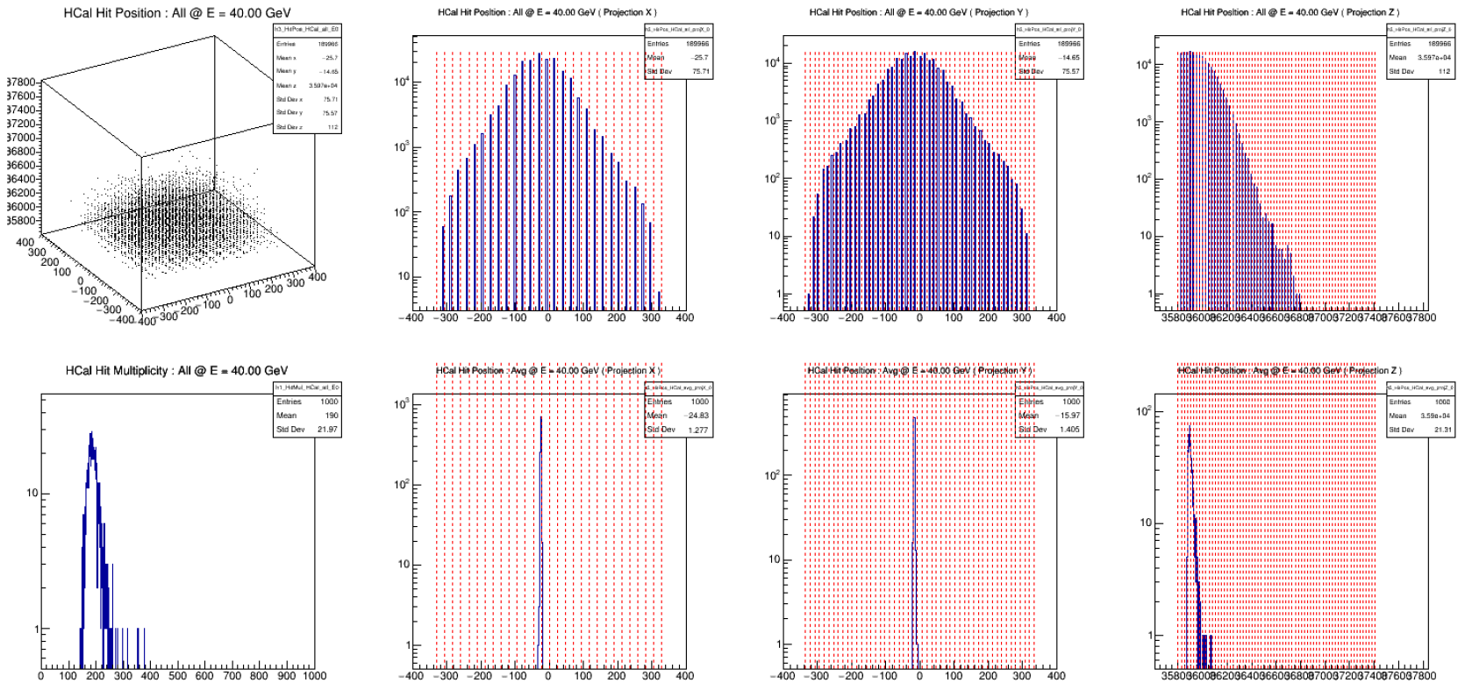
Hit Distribution of HCAL (1000 evts)
Hit position in X
=> 28 peaks
Hit position in Y
=> 49 peaks
Hit position in Z
=> 64 peak/layers
Hit multiplicity
~ 200 hits/evt
Weighted pos in X
Centered ~ -24mm(?)
Weighted pos in Y
=> Centered ~ -15mm
Weighted pos in Z
=> Peak @ 7th layer

Slide 16
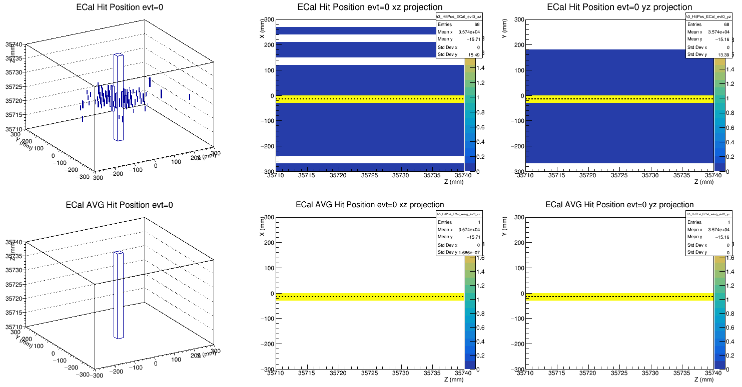
ECAL : Hits in XZ and YZ (evt#0)
Raw hit position (color is Edmp)
Energy-weighted hit position

Slide 17
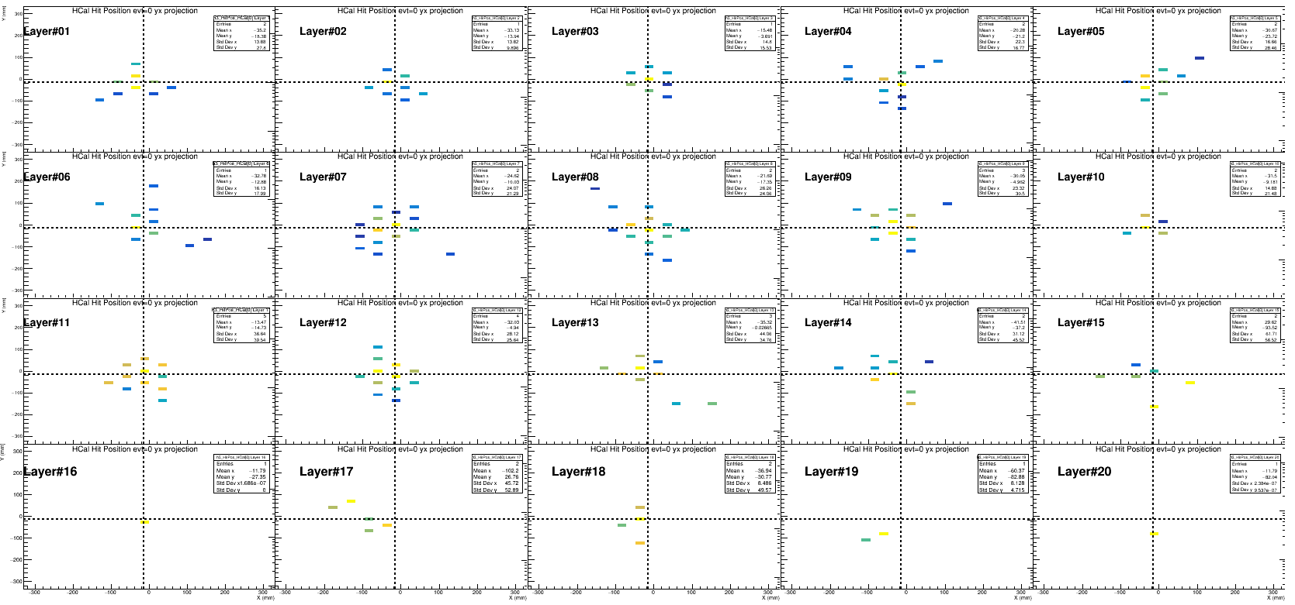
HCAL : Hits in XY (evt#0)
Center is more energy dump
Not many hits after layer#20

Slide 18
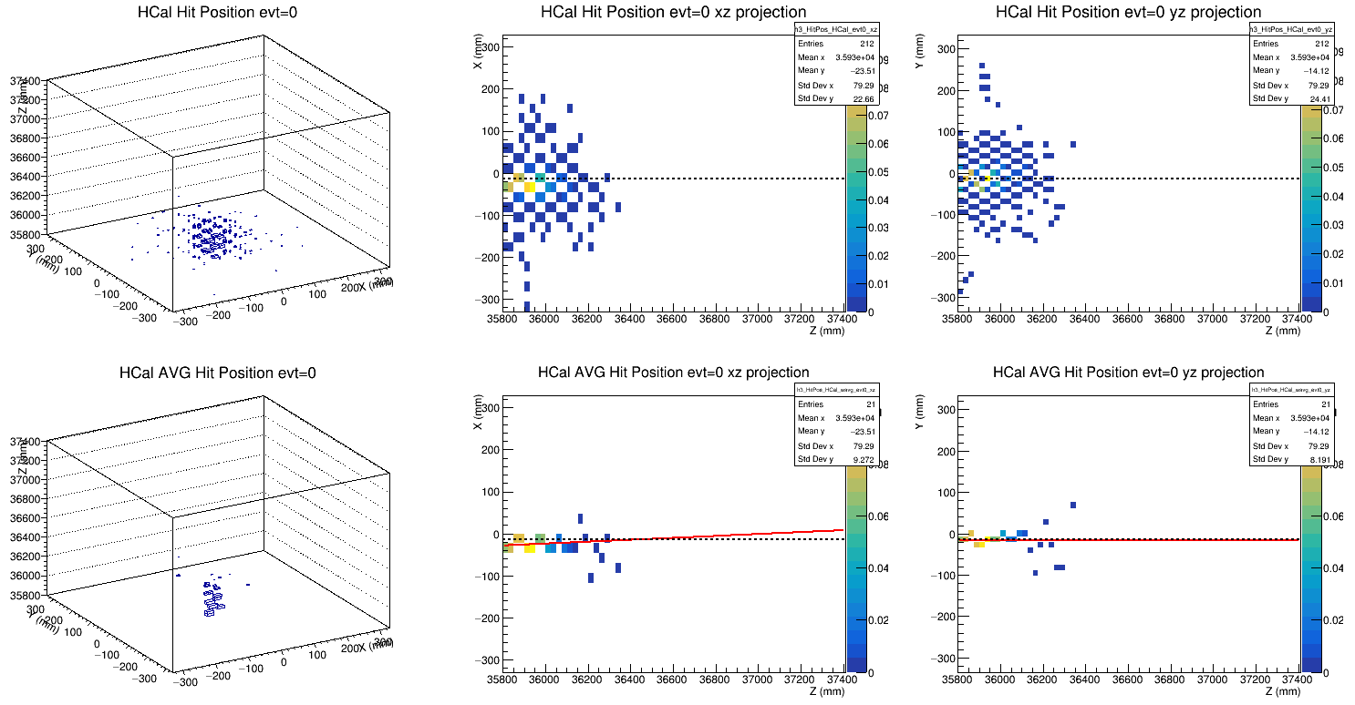
HCAL : Fit pol1 (evt#0)
Raw hits (color weighted by Edmp)
Energy-weighted hit position
Tracking on xz plane
(not along beam?)
Tracking on yz plane
(ok)

Slide 19
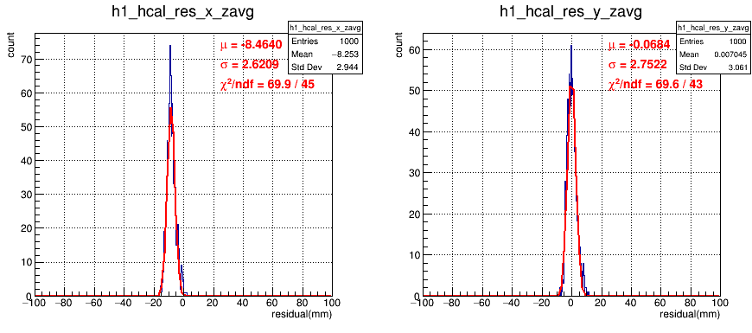
Residual @ Weighted-Z position
(Only HCAL Included in Track Reconstruction)
With HCAL along, 40GeV gamma pencil beam, position resolution ~ 2.7mm

Slide 20
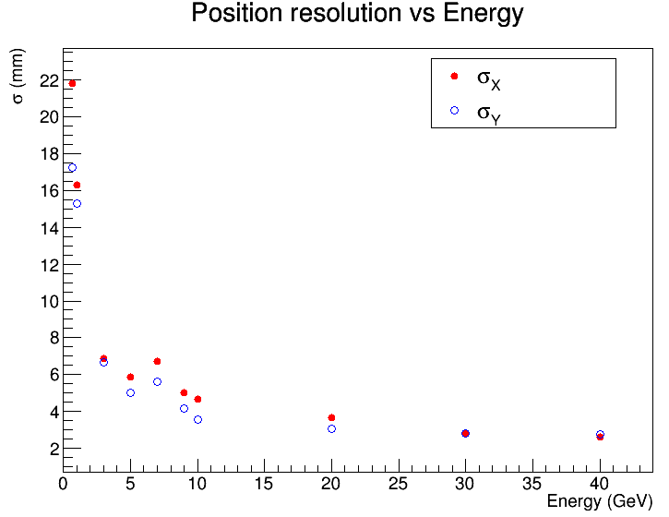
Position Resolution and Shift
Energy (GeV) | Sigma X(mm) | Sigma Y(mm)
0.7 | 21.79 | 17.25
1.0 | 16.28 | 15.29
3 | 6.87 | 6.67
5 | 5.86 | 5.01
7 | 6.72 | 5.62
9 | 5.03 | 4.18
10 | 4.68 | 3.56
20 | 3.64 | 3.06
30 | 2.82 | 2.83
40 | 2.62 | 2.75
Energy (GeV) | Mean X (mm) | Mean Y (mm)
0.7 | −13.50 | +0.17
1.0 | −10.53 | +0.68
3 | −12.06 | −0.53
5 | −11.97 | −0.68
7 | −9.26 | +1.01
9 | −9.83 | +0.24
10 | −10.40 | −0.14
20 | −8.55 | +0.17
30 | −8.65 | −0.09
40 | −8.46 | −0.07
Position resolution in Y is better than X in low energy.

Slide 21
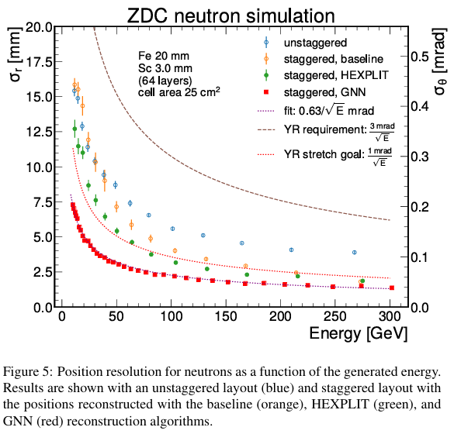
Neutron Simulation from UV Riverside
https://arxiv.org/pdf/2406.12877v1

Slide 22
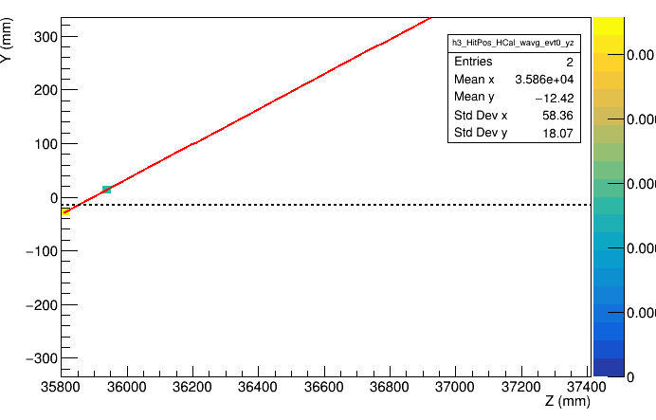
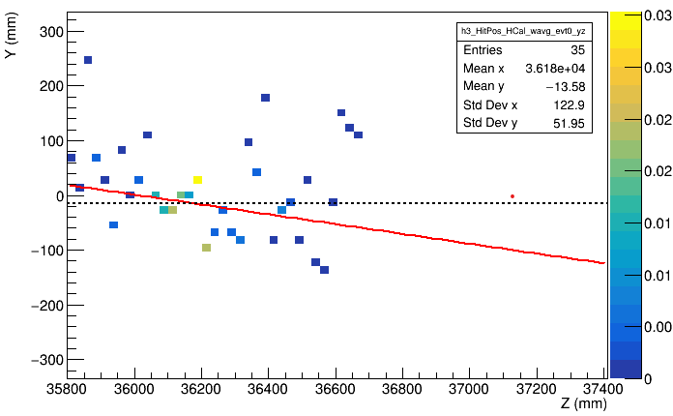
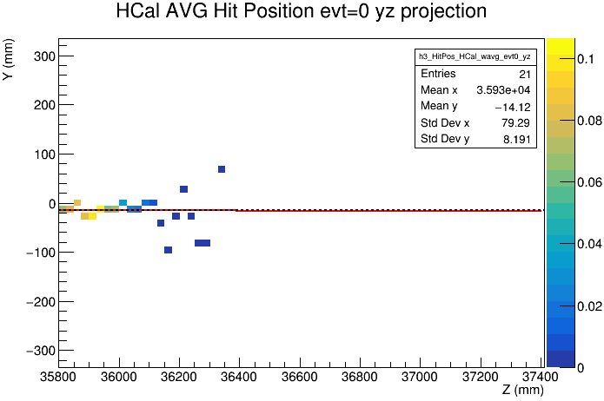
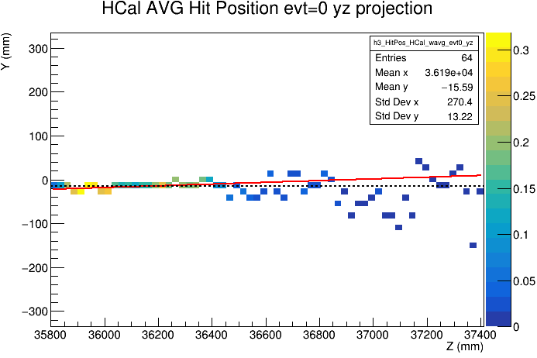
Track Reconstruction is Difficult for Low Energy Beam
0.7 GeV Gamma
1 GeV neutron
40GeV Gamma
300 GeV neutron
For gamma, energy<0.5GeV, barely hits in HCAL.
For neutron, energy~ 1GeV, shower is quite spread.

