Slide 1
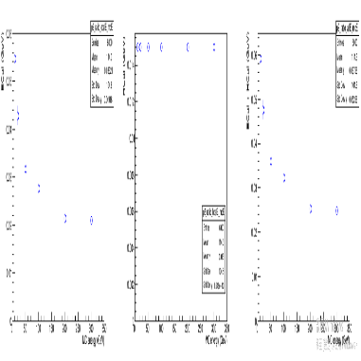
ZDC MC Simulation 20260112
Chia-Yu Hsieh
Academia Sinica, Taiwan

Slide 2
Gamma Beam Pencil @ (-15, -15, z) {0.1, 0.5, 0.3, 0.7, 1, 3, 5, 7, 9, 10, 20, 30, 40} GeV

Slide 3
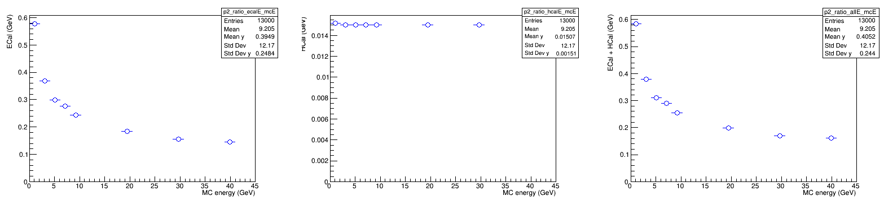
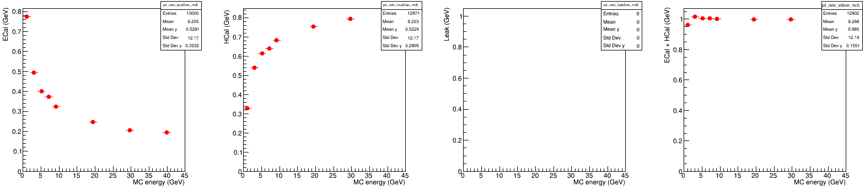
Energy Dump
Energy dump BEFORE energy regression
ECAL
HCAL
ECAL + HCAL
Energy Dump AFTER energy regression
(linear regression, y = p0 + p1*ECAL + p2*HCAL)
ECAL
+ HCAL
+ Leak
ECAL
HCAL
Leak
Low energy is always not easy (100MeV)

Slide 4
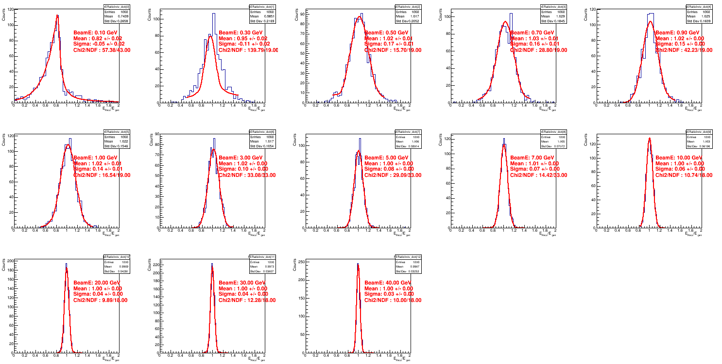
Energy Regression
0.1 GeV
0.3 GeV
0.5 GeV
0.7 GeV
0.9 GeV
1 GeV
3 GeV
5 GeV
7 GeV
10 GeV
20 GeV
30 GeV
40 GeV

Slide 5
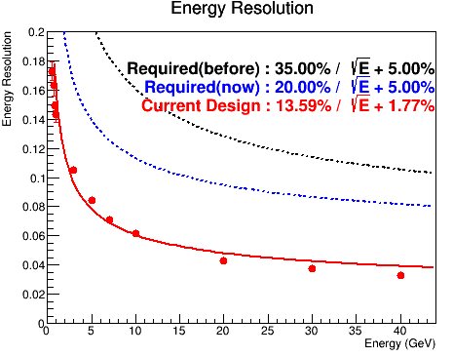
Energy Resolution

Slide 6
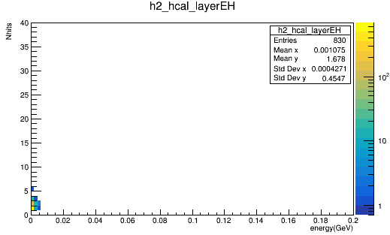
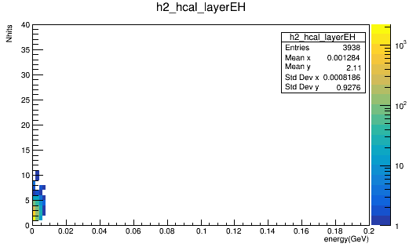

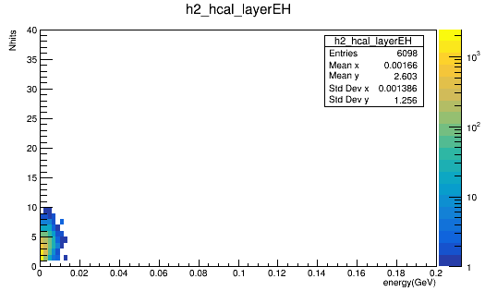
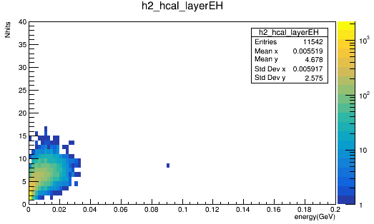
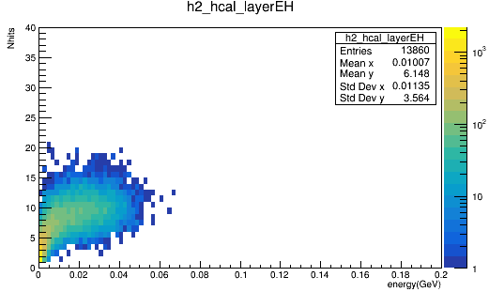
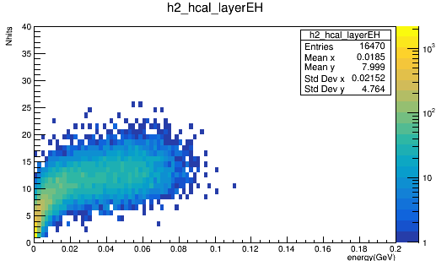
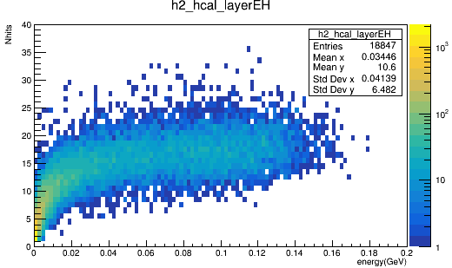
Nhits VS Energy (1 fill = 1 per Layer, 1000 evts)
0.1 GeV
0.5 GeV
0.7 GeV
1 GeV
5 GeV
10 GeV
20 GeV
40 GeV

Slide 7
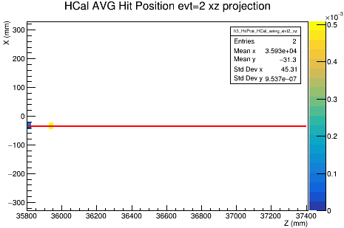
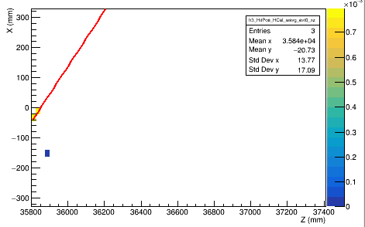
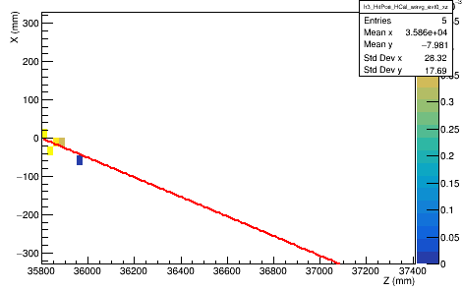
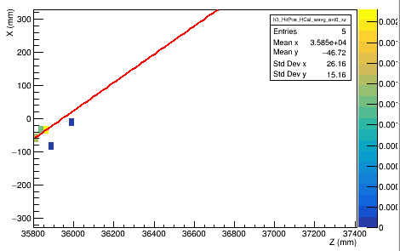
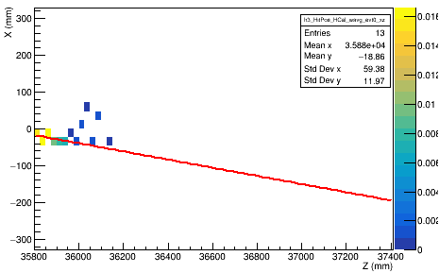
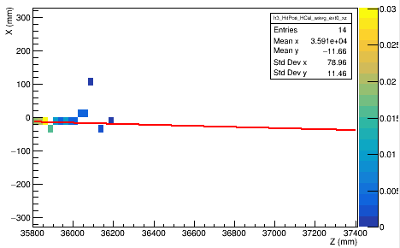
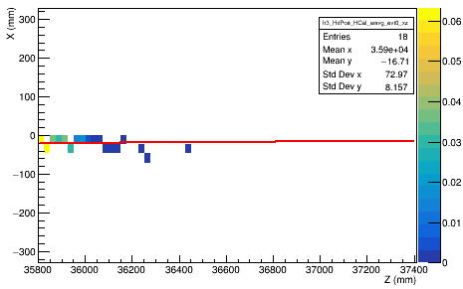
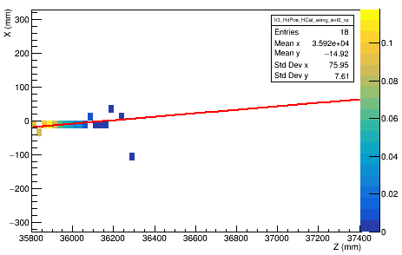
Track Reconstruction (evt#0, XZ)
0.1 GeV
0.5 GeV
0.7 GeV
1 GeV
5 GeV
10 GeV
20 GeV
40 GeV
Harder to reconstruct gamma track since most of the energy of gamma dump in ECAL.
Barely any hits < 0.5GeV

Slide 8
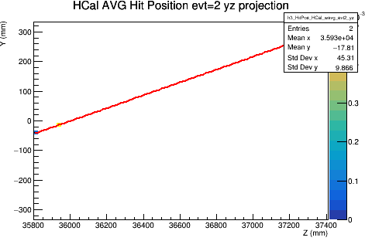
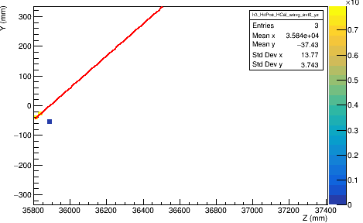
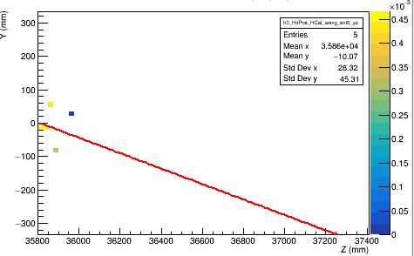
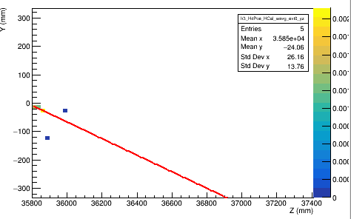
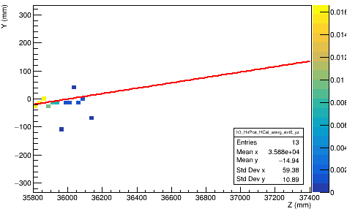
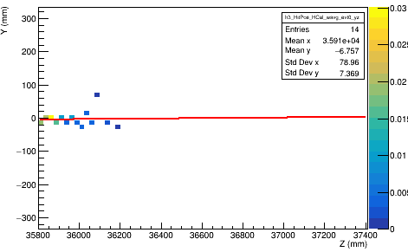
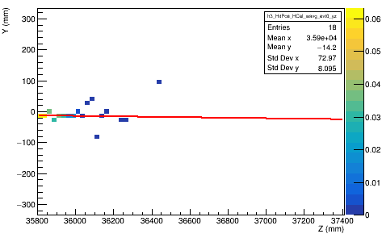
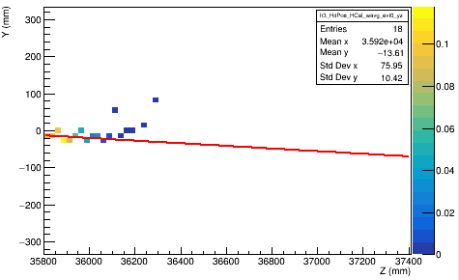
Track Reconstruction (evt#0, YZ)
0.1 GeV
0.5 GeV
0.7 GeV
1 GeV
5 GeV
10 GeV
20 GeV
40 GeV

Slide 9
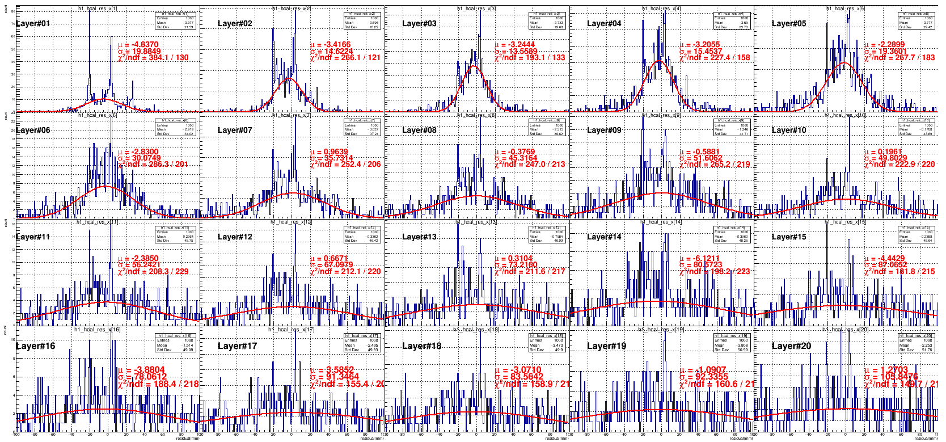
Residual Layer by Layer @ 1GeV
@XZ

Slide 10
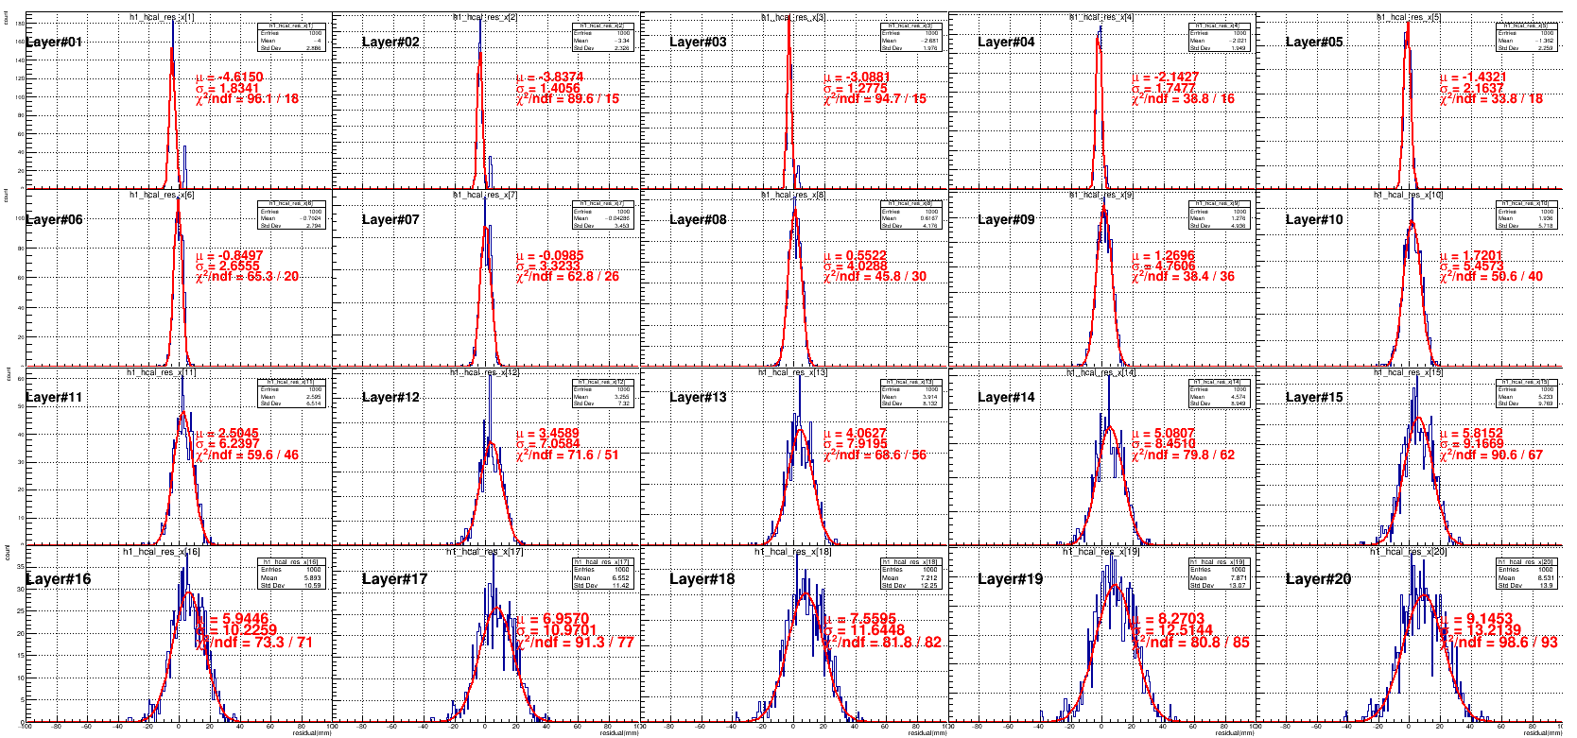
Residual Layer by Layer @ 40 GeV
@XZ

Slide 11
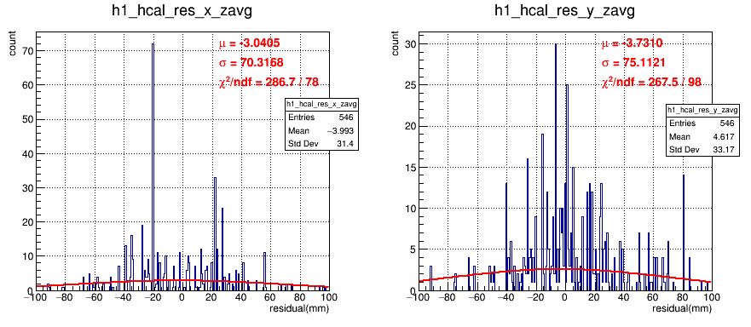
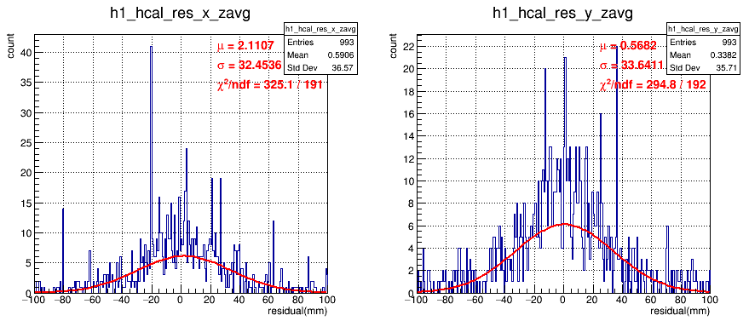
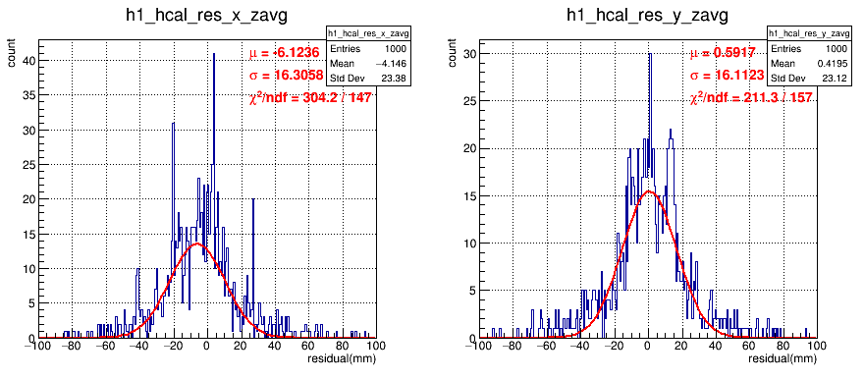
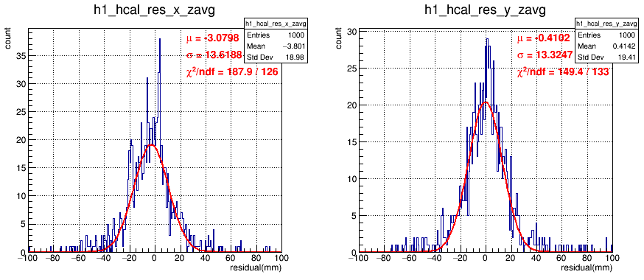
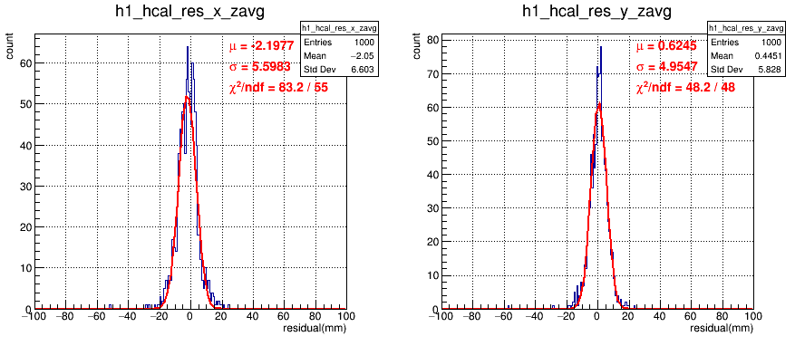
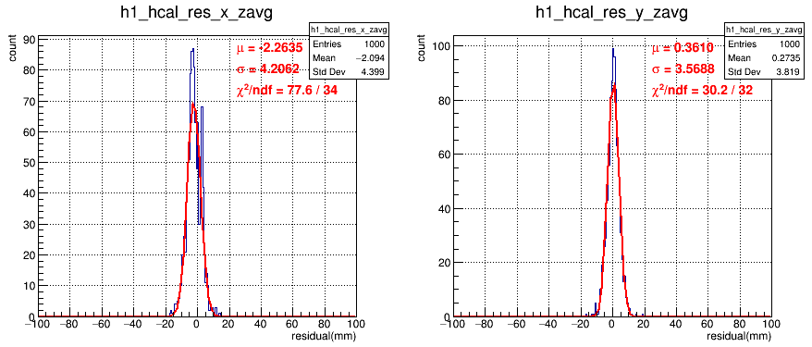
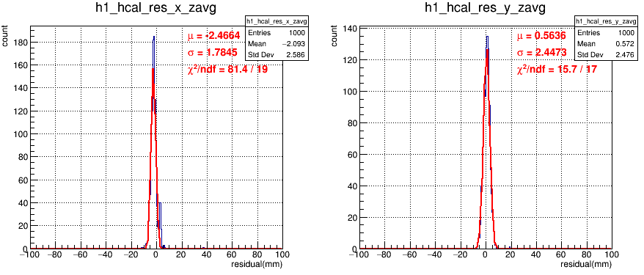
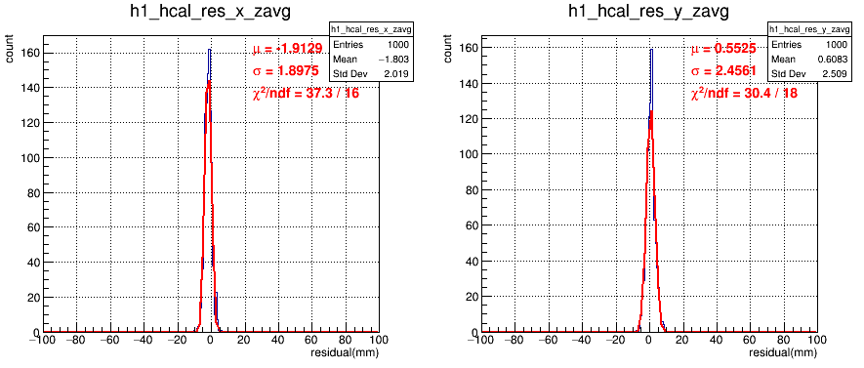
Residual @ Weighted-Z, XZ Plan
0.1 GeV
0.5 GeV
0.7 GeV
1 GeV
5 GeV
10 GeV
20 GeV
40 GeV

Slide 12
Residual @ Weighted-Z, YZ Plan
0.1 GeV
0.5 GeV
0.7 GeV
1 GeV
5 GeV
10 GeV
20 GeV
40 GeV

Slide 13
Mean (Bias/Shift) and Sigma (Position Resolution)
Energy (GeV) | meanX (XZ) | sigmaX (XZ) | meanY (YZ) | sigmaY (YZ)
0.1 | −3.0405 | 70.3168 | −3.7310 | 75.1121
0.3 | −7.1720 | 33.9919 | +0.7303 | 41.2808
0.5 | +2.1107 | 32.4536 | +0.5682 | 33.6411
0.7 | −6.1236 | 16.3058 | +0.5917 | 16.1123
0.9 | −3.2721 | 14.2671 | +0.9884 | 13.2974
1.0 | −3.0798 | 13.6188 | +0.4102 | 13.3247
3.0 | −2.3972 | 8.2587 | +0.9467 | 7.0391
5.0 | −2.1977 | 5.5983 | +0.6245 | 4.9547
7.0 | −1.8916 | 4.7931 | +0.5784 | 4.2943
9.0 | −1.5506 | 4.2398 | +0.8535 | 3.9024
10 | −2.2635 | 4.2062 | +0.3610 | 3.5688
20 | −1.8604 | 2.6835 | +0.7540 | 2.9796
30 | −2.4664 | 1.7845 | +0.5636 | 2.4473
40 | −1.9129 | 1.8975 | +0.5525 | 2.4561
Energy<1GeV, bad tracking
Shift/Bias in meanX. More bias for smaller energy.
No sghift/Bias in meanY.
Better resolution for higher energy (more hits to do tracking.)

Slide 14
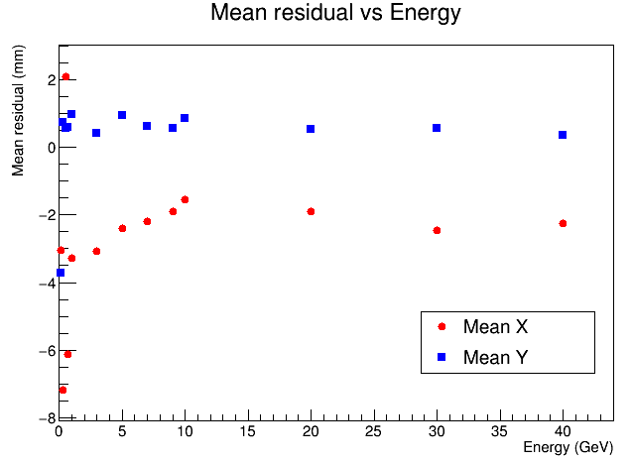
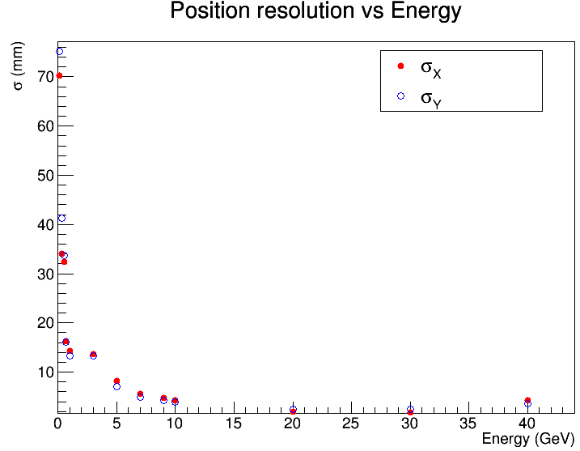
Mean (Bias/Shift) and Sigma (Position Resolution)

