Slide 1

Progress report: SIDIS and Fragmentation functions
Chung-Wen Kao
Chung-Yuan Christian University
2018.3 .16. AS

Slide 2
My recent work
Phenomenological investigation of SIDIS results of COMPASS and HERMES
(With D-J. Yang and W.-C. Chang)
“Invert jet algorithm” to obtain DiHadron Fragmentation functions
(with D-J. Yang)

Slide 3
How to extract Fragmentation functions?

Slide 5
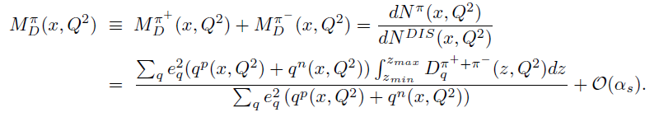
SIDIS off deuteron target
p: proton, n: neutron

Slide 6
SIDIS using deuteron target
Assume PDFs are charge symmetric:

Slide 7
SIDIS using deuteron target
D_{Q}>>D_{S}

Slide 8
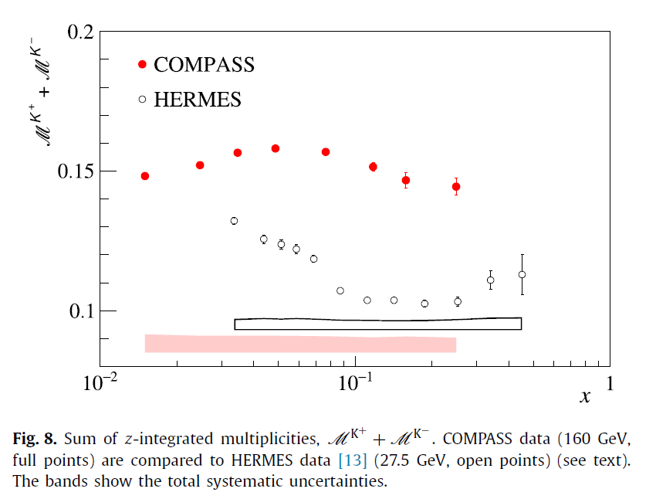
COMPASS and HERMES
The data pointes are taken at
Different Q² values.

Slide 9
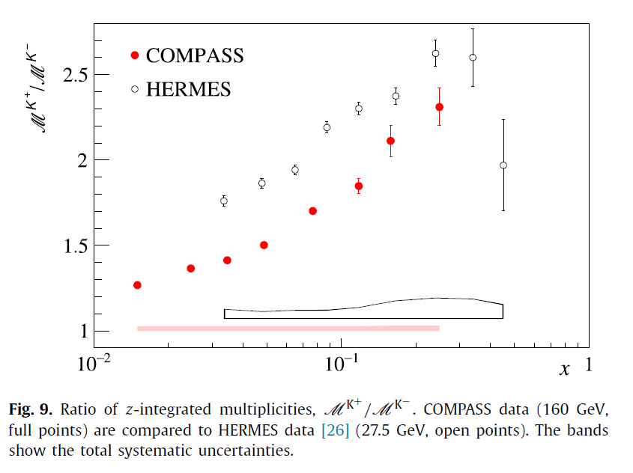
COMPASS and HERMES

Slide 10
NLO fitting

Slide 11
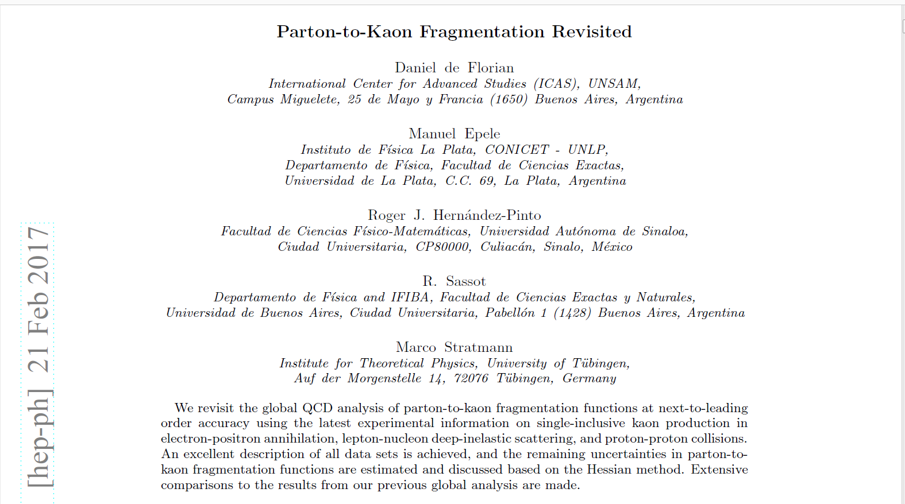
DSS 2017 fragmentation functions

Slide 12
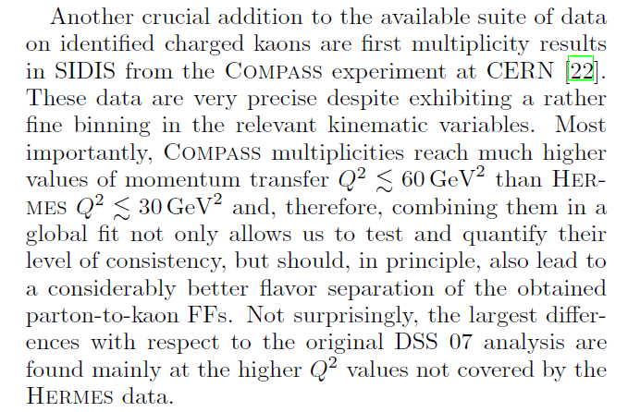
DSS 2017 fragmentation functions

Slide 13
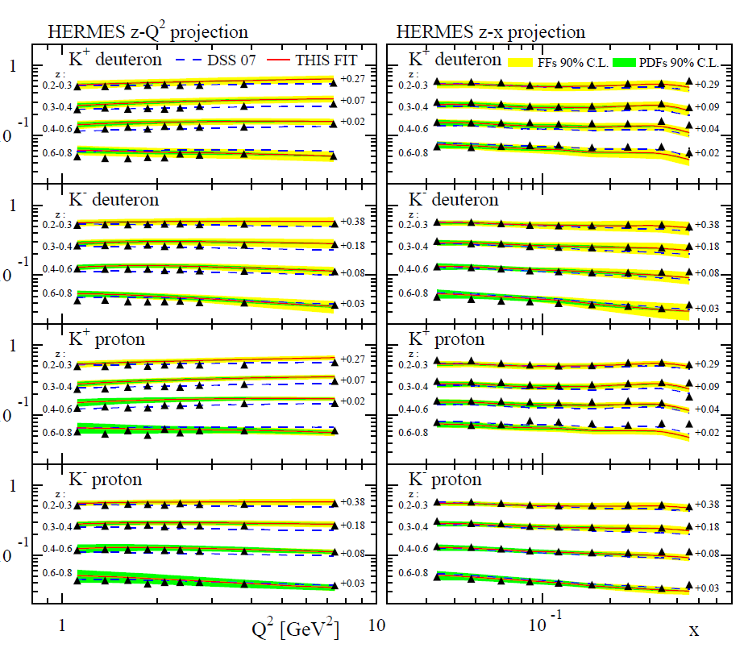
DSS 2017 fragmentation functions

Slide 14
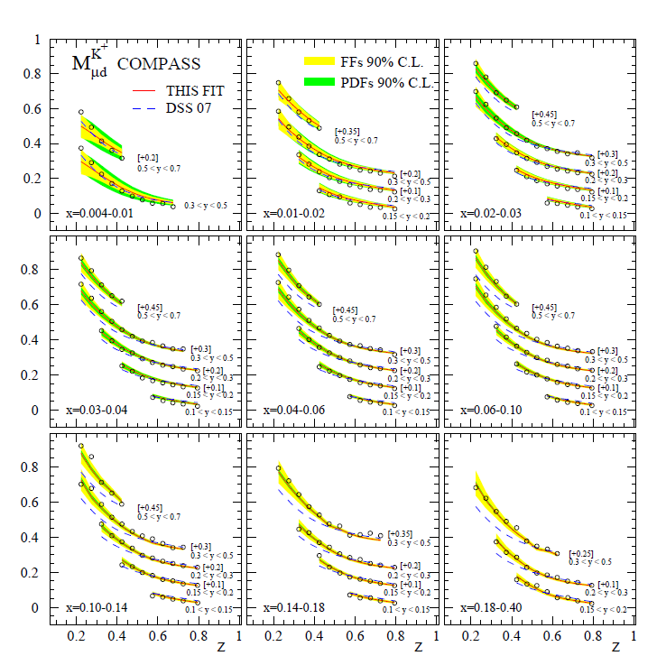
DSS 2017 fragmentation functions

Slide 15
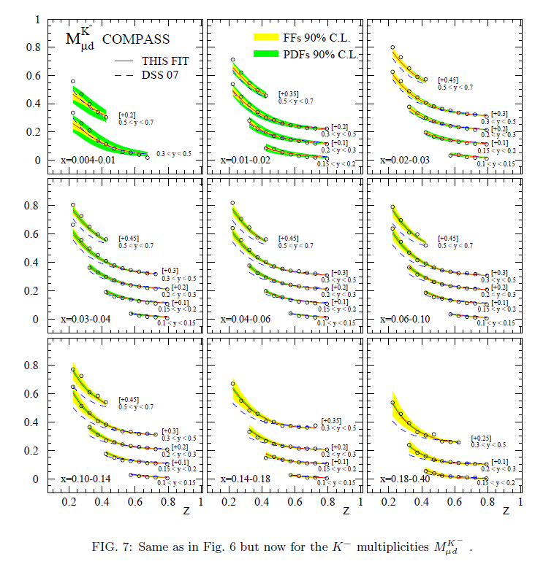
DSS 2017 fragmentation functions

Slide 16
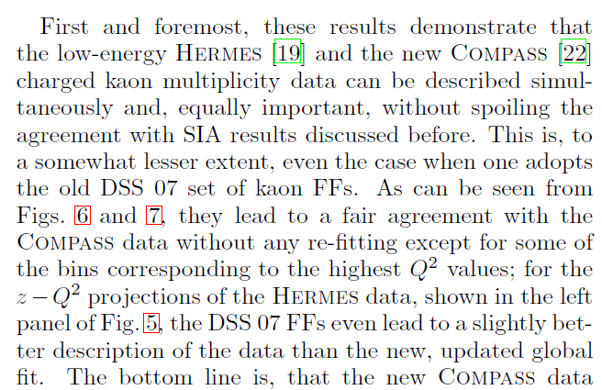

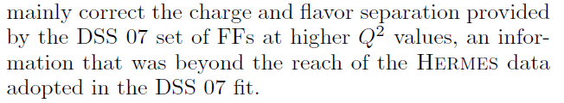
DSS 2017 fragmentation functions

Slide 17
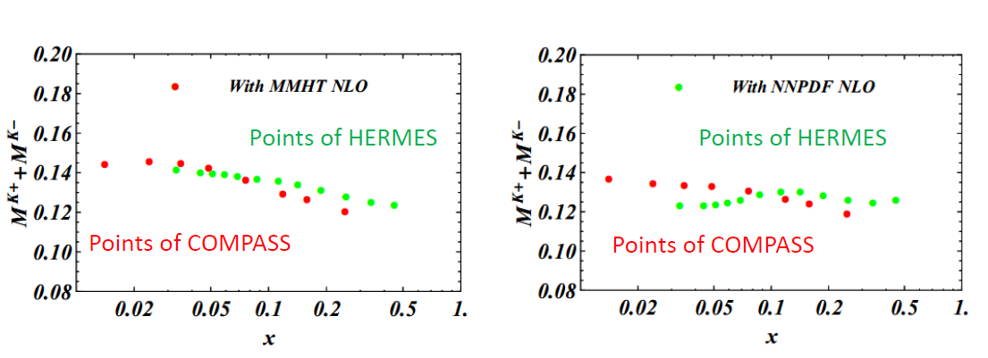
Test of DSS17 at HERMES and COMPASS kinematics
Apply DSS17 with MMHT and NNPDF at (x, Q2) of HERMES data points and
COMPASS, we find the theoretical results of both should be close.

Slide 18
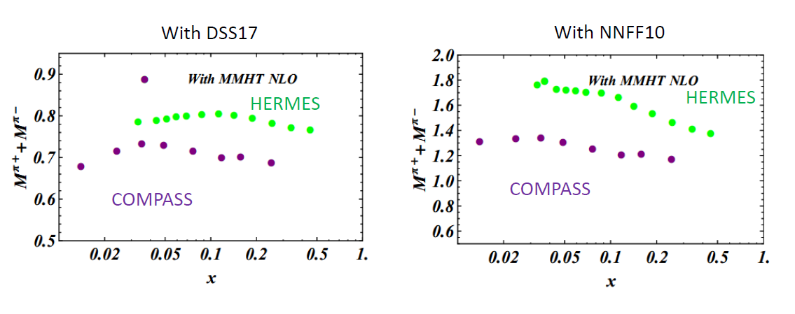
Test of DSS17 at HERMES and COMPASS kinematics
Apply DSS17 with DSS17 and NNFF10 at (x, Q2) of HERMES data points and
COMPASS, we find the theoretical results of both should be close.

Slide 19
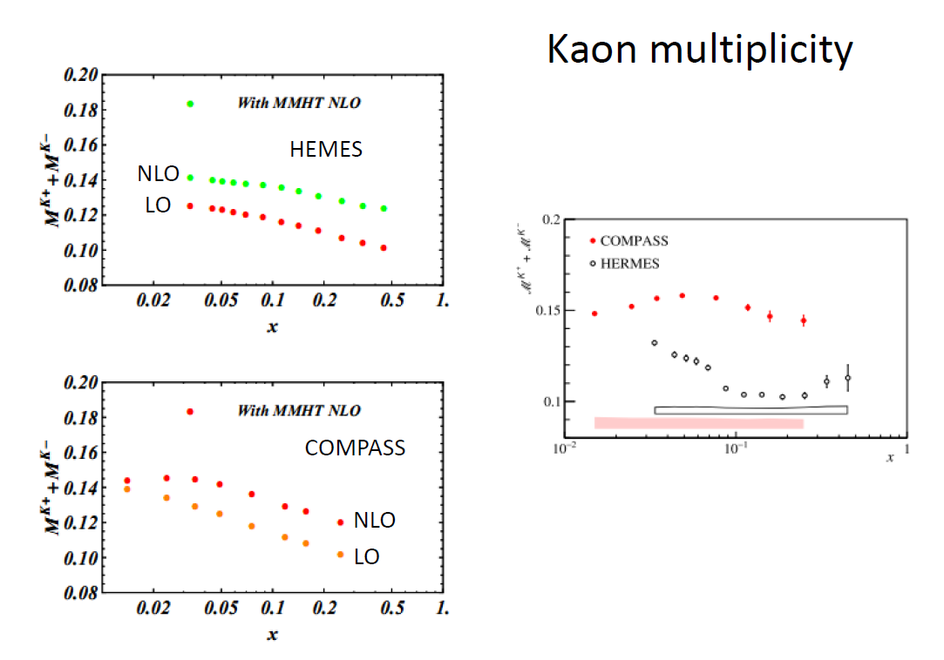
Kaon multiplicity

Slide 20
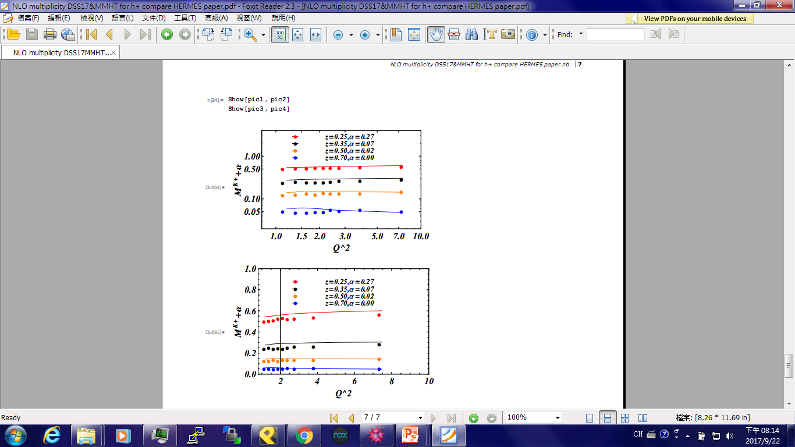
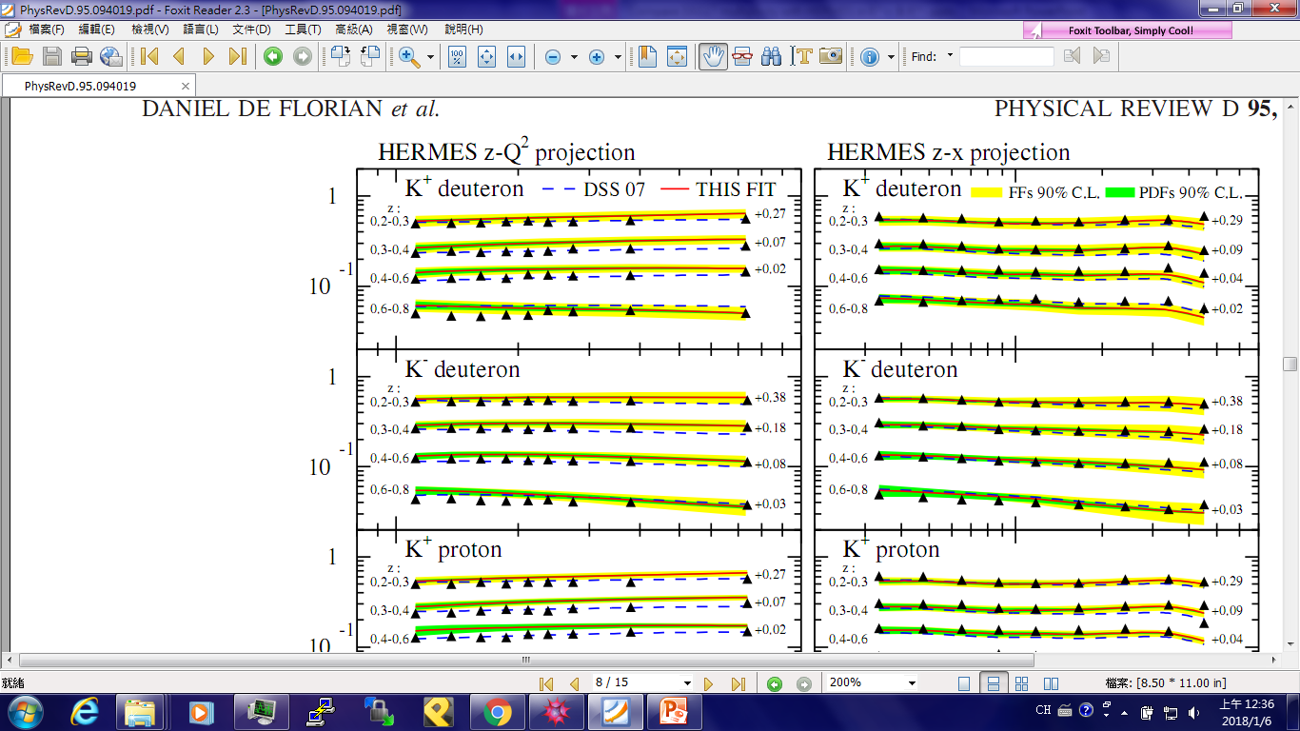
Check HERMES data K^+

Slide 21
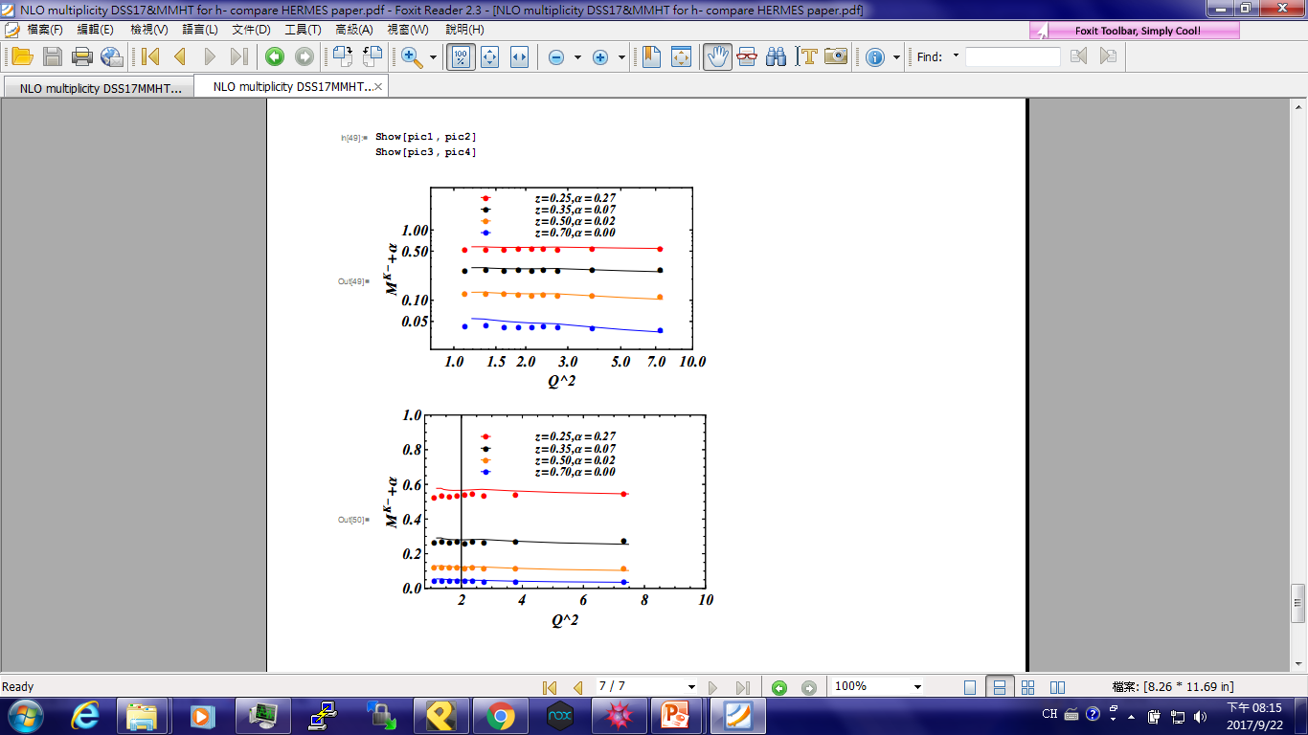
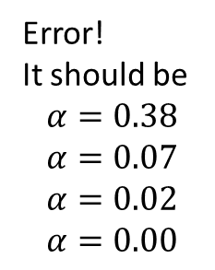
Check HERMES data K-
Error!
It should be
$$α=0.38$$
$$α=0.07$$
$$α=0.02$$
$$α=0.00$$

Slide 22
Log to Log & Linear to Linear:
Fit well?

Slide 23
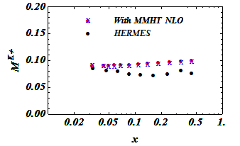
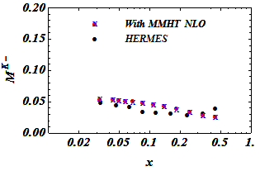
M^{K}(x, Q²)
Red point: usual integral method
Blue cross: integrate z like HERMES method
Black point: HERMES

Slide 24
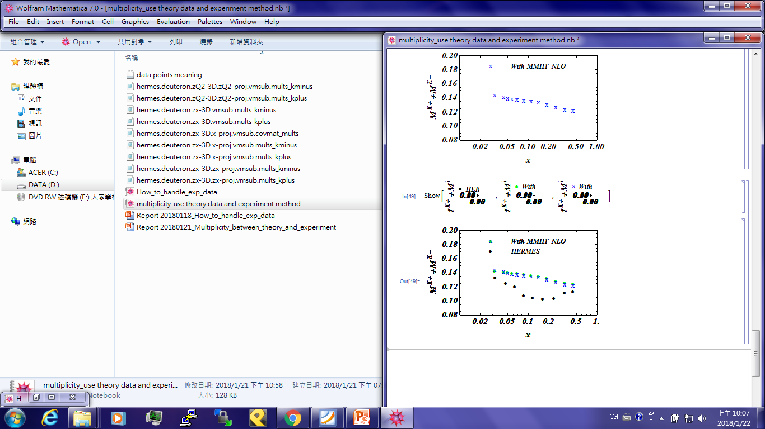

$$M^{K^{+}+K^{−}}(x,Q^{2})$$

Slide 25
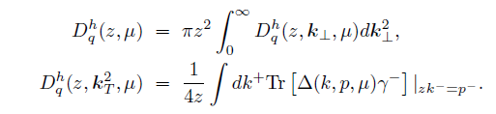
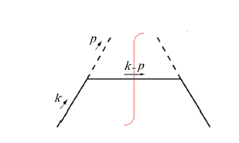


Elementary Fragmentation Functions
One step fragmentation process
q(k) →h(p)+Q(k-p)
With a vertex of quark-quark-PS meson, one can calculate the elementary FFs.

Slide 26


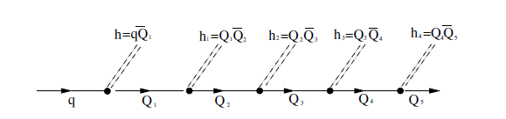

From elementary FFs to SiFFs

Slide 27
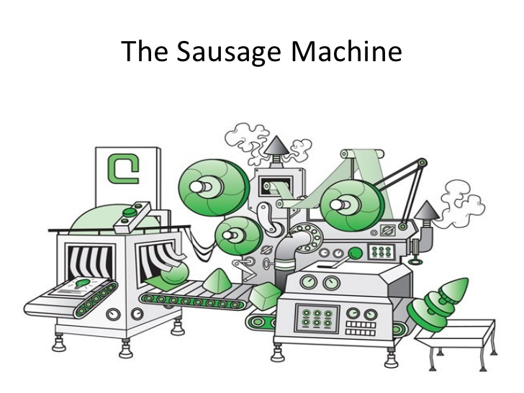
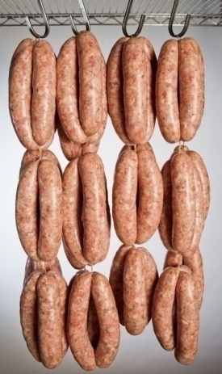



Monte-Carlo simulation
or
coupled channel integral equations

Slide 28

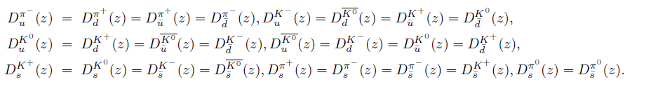
Relations between FFs
Consider the isospin symmetry and charge conjugation:
favouredt Fragmentation functions: 16→4
disfavoured Fragmentation functions:26 →7

Slide 29
QCD evolution
We employ QCDNUM 17 to evolve our result from Q²=0.36 GeV² to 4 GeV².
Compare our result with NJL result and
HKNS and DSS parameterizations.
HKNS
DSS

Slide 30
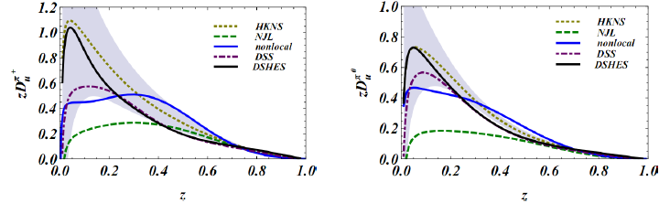
favoured Pion Fragmentation Functions
u → π⁺
u → π⁰

Slide 31
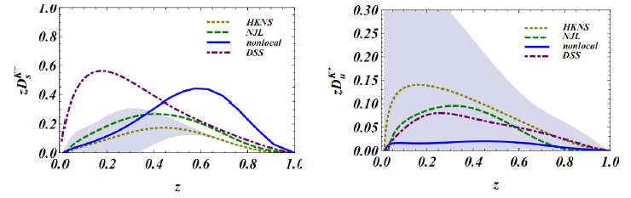
favoured Kaon Fragmentation Functions
s → K⁻
u → K⁺

Slide 32
Disfavoured pion fragmentation functions
u → π⁻

Slide 33
Disfavored pion fragmentation functions
s → π⁰
s → π+

Slide 34
Disfavoured Kaon Fragmentation Functions
u → barK⁰
u → K⁰

Slide 35
Disfavoured Kaon Fragmentation Functions
s → K⁺
u→ K⁻

Slide 36

How to calculate di-hadron FFs?
(1) Monte Carlo simulation
(2) Solving Integral equations with the SiFF as in put:

Slide 37
Inclusion of vector mesons
Vector mesons are also included.
They decay into PS mesons.
π
π
π
π
ρ
π
ρ
ω
H.H.Matevosyan, A.W.Thomas and W.Bentz, PRD 88 094022 (2013)

Slide 38

Invert the jet algorithm ?
Invert the coupled channel integral equations

Slide 39
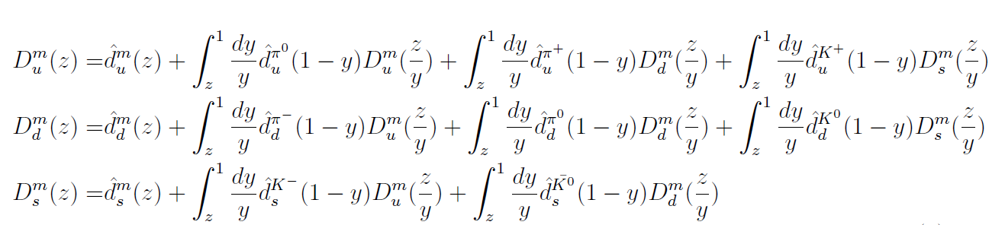
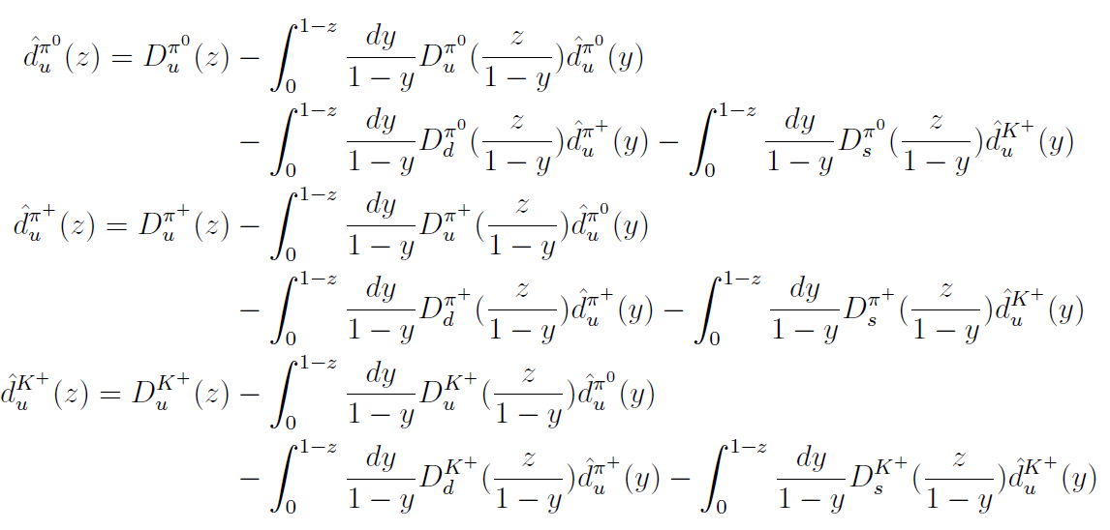

Slide 40
But it is not a easy task as thought…..
Inverting the jet algorithm seems straight forward, but it is not.
The coupled equations for the elementary
Fragmentation functions are over determined!
In the other words, the unflavored elementary FFs such as d^{π-}_{u} (z) are not necessarily identically zero as they should be!

Slide 41
How to solve this problems?
Since the parametrizations of unflavored FFs are less precise than the flavored ones.
One should only look for the elementary FFs to generate the flavored FF according to the empirical parametrizations.
Then the jet algorithm will generate the unflavored FFs.

Slide 42
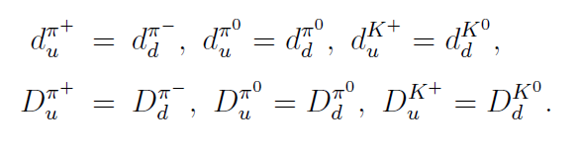
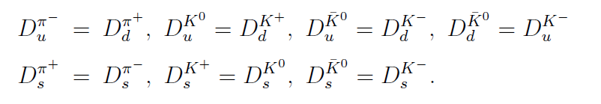
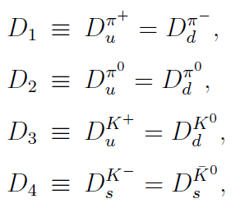
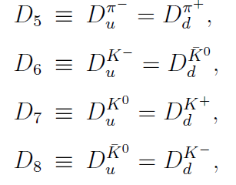
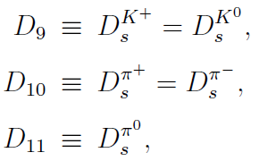
Isospin symmetry
To simplify our calculation we have made the following definitions:

Slide 43
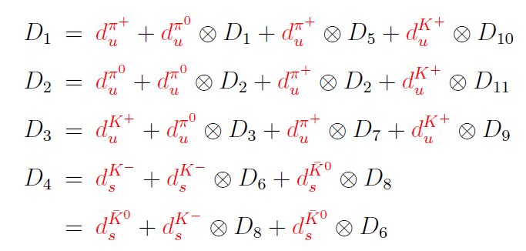
Step 1

Slide 44
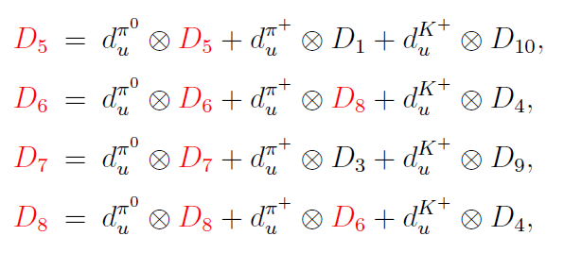
Step 2

Slide 45
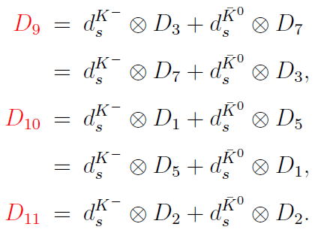
Step 3

Slide 46
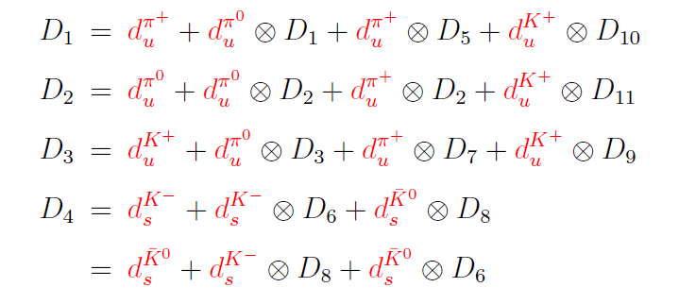
Step 4

Slide 47
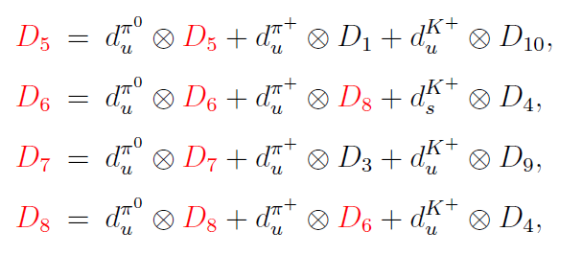
Step 5

Slide 48
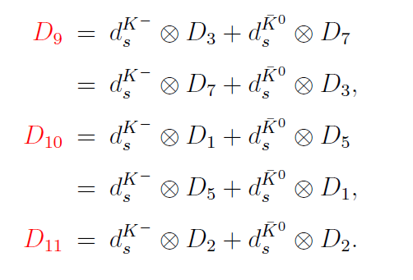
Step 6

Slide 49
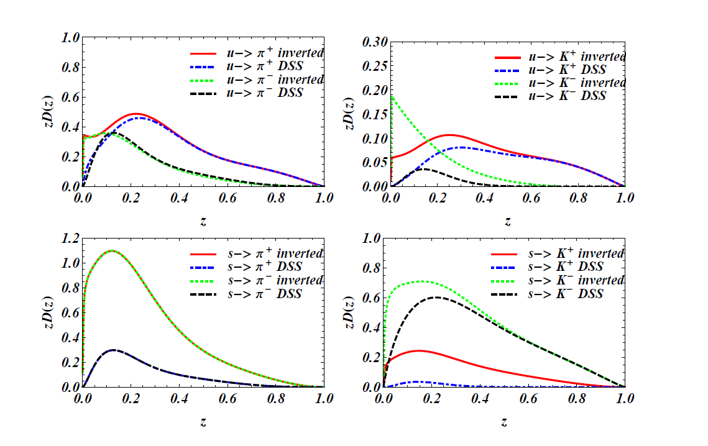
Our result based on DSS07

Slide 50
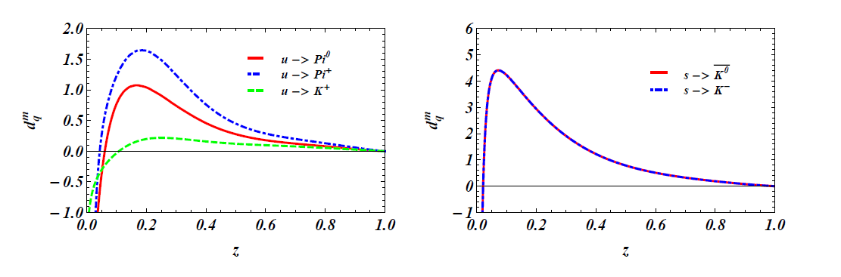


Our result based on DSS07

Slide 51
Modifications
Our aims is to find the elementary FFs which is sensible quantity, we are free to modify it as long as we obtain the FFs approximately close to the FFs of the empirical parametrization.
Multiply some function then set the negative values to be zero we obtain the following result.

Slide 52
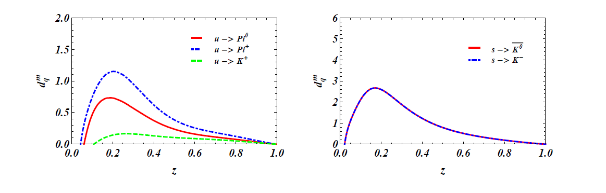
Our result of elementary FFs

Slide 53
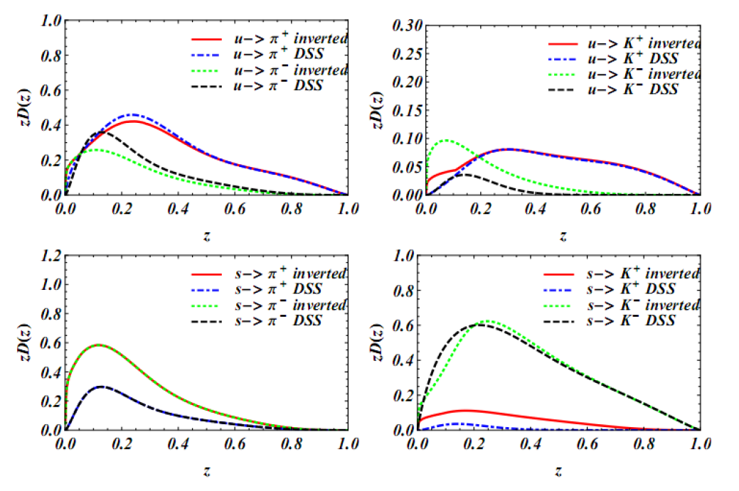
Our result from DSS07

Slide 54
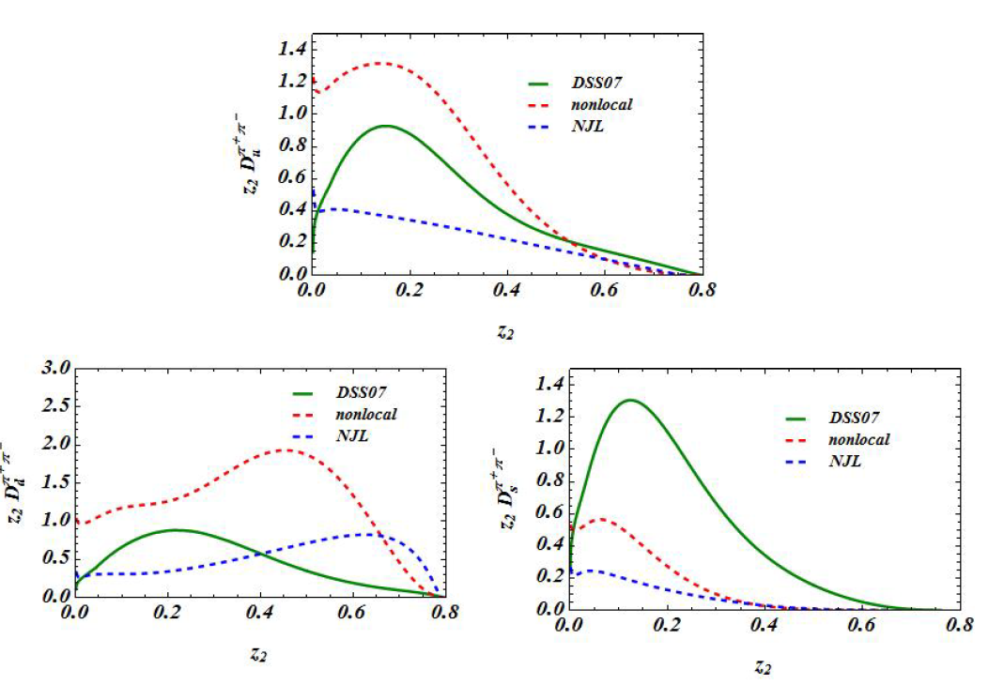
Di-Hadron FFs at 1 GeV^2

Slide 55
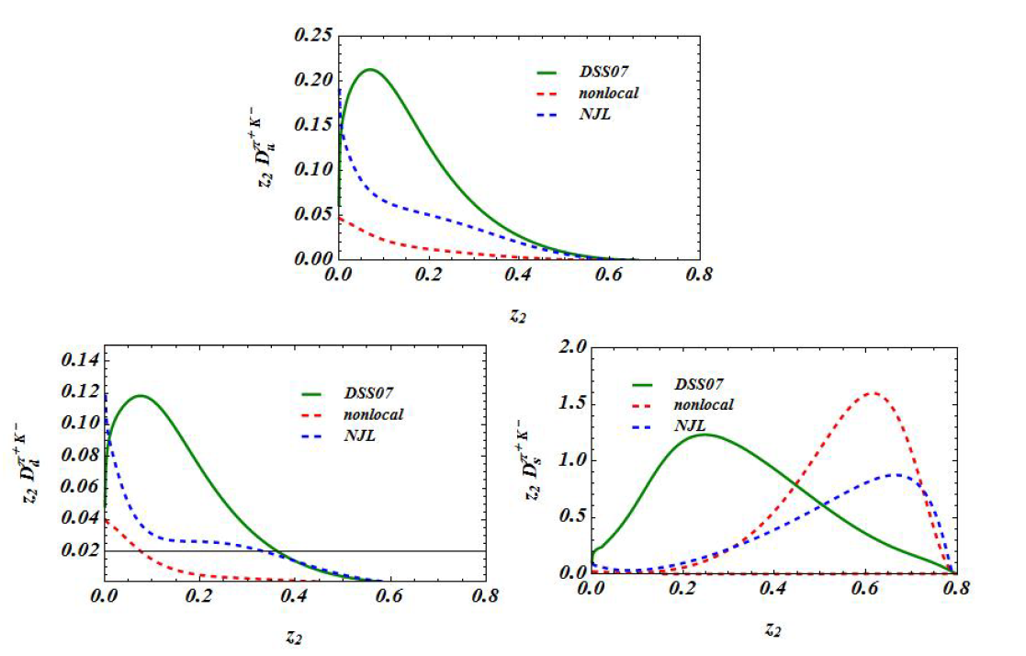
Di-Hadron FFs at 1 GeV^2

Slide 56
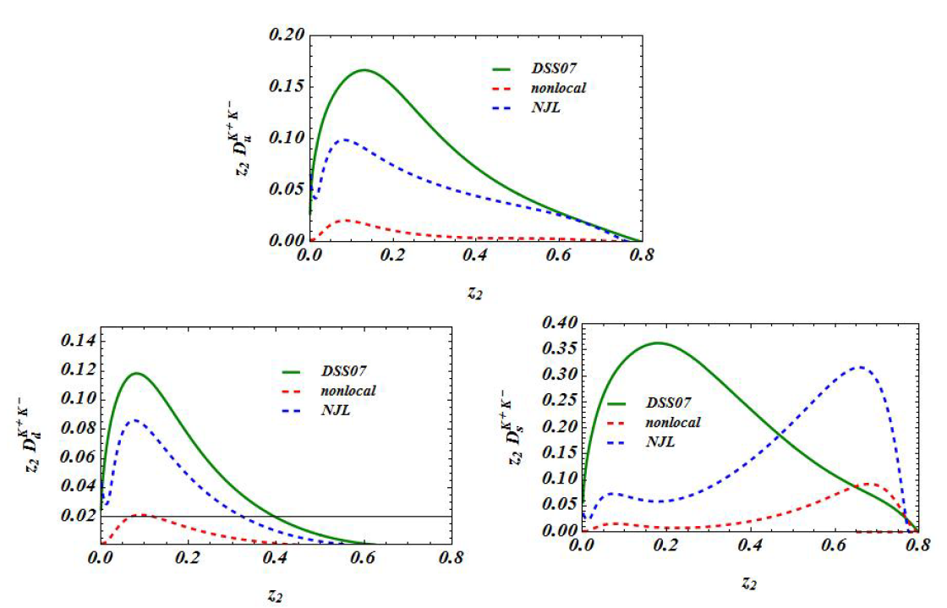
Di-Hadron FFs at 1 GeV^2

Slide 57
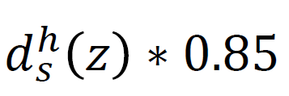
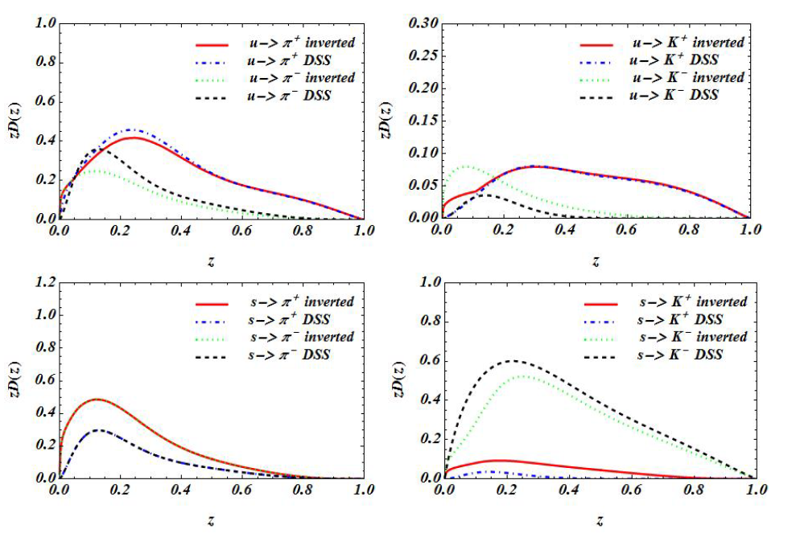

Slide 58

Di-Hadron FFs at 1 GeV^2

Slide 59

Di-Hadron FFs at 1 GeV^2

Slide 60

Di-Hadron FFs at 1 GeV^2

Slide 61

Our result from DSS17

Slide 62

Di-Hadron FFs at 1 GeV^2

Slide 63

Di-Hadron FFs at 1 GeV^2

Slide 64

Di-Hadron FFs at 1 GeV^2

Slide 65




Single FFs for DSS17
improve
Set 1
Set 2

Slide 66




Single FFs for DSS17
Set 1
Set 2
improve

Slide 67






Z1 is fixed at 0.2
Set 1
Set 2

Slide 68






Z1 is fixed at 0.2
Set 1
Set 2

Slide 69






Z1 is fixed at 0.2
Set 1
Set 2

Slide 70






Z1 is fixed at 0.5
Set 1
Set 2

Slide 71






Z1 is fixed at 0.5
Set 1
Set 2

Slide 72






Z1 is fixed at 0.5
Set 1
Set 2

Slide 73
Summary
DSS17 is not as good as they claimed?
Can one extract FFs from the current SIDIS data?
Attempt to make reasonable estimate of dihadron FFs.
Continue to work on the extended FFs with inverted jet algoritham?

