Slide 1
Exclusive e+e- → D X processes
as a probe to understand particle creation
A.Chen
National Central University
2018.03.16

Slide 2
brief review:
Jet physics (’70- ‘80)
Independent model
(Field, Feynman, Wolfram,…)
String model
(LUND, JETSET, QQ, PYTHIA, ..)
Cluster model
(popcorn, Weber, HERWIG, …)

Slide 3
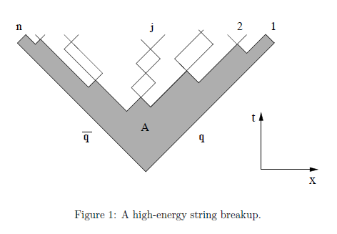
Leading particle
Leading particle
Lund string fragmentation model
(LUND, JETSET, PYTHIA)

Slide 4
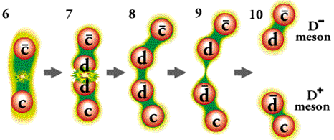
http://www.particleadventure.org/eedd.html

Slide 5
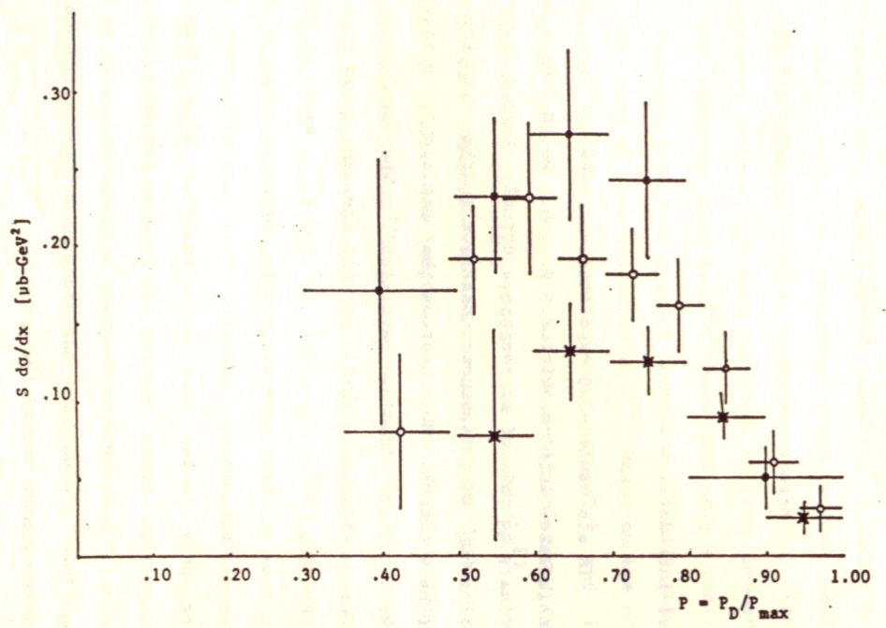
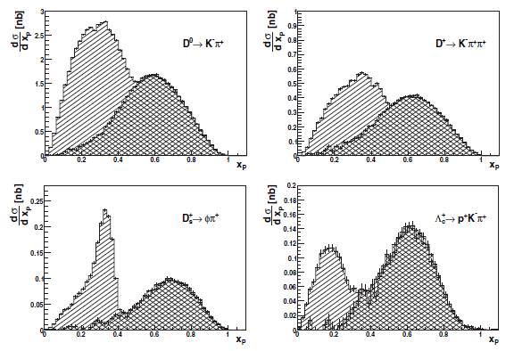
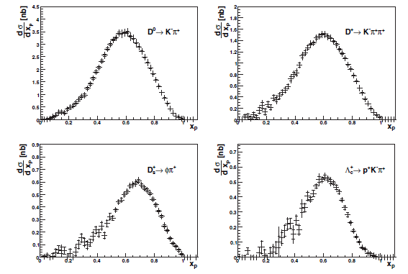
Charm fragmentation
(e+e- expt) (1985 CLEO)
JETSET + frag function
X_{p} = P_{D*}/P_{max}
2006 Belle result provides
High precision measurement

Slide 6
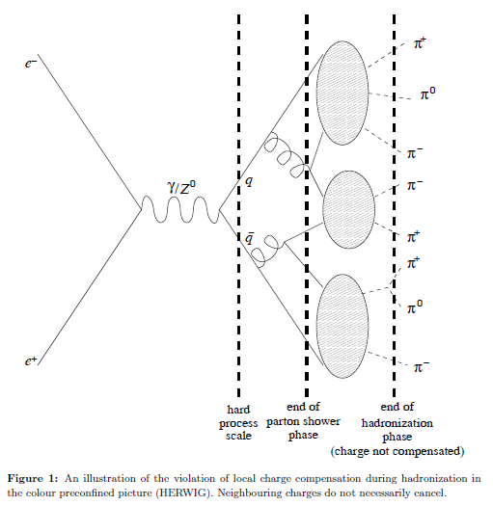
particle
Quasi-particle
particle
particle
Weber, HERWIG

Slide 7
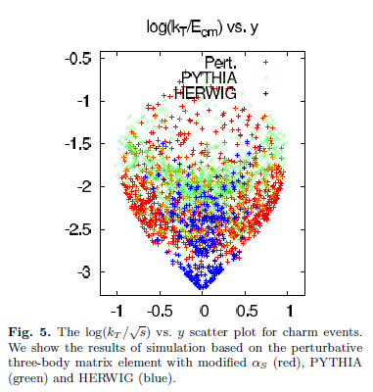
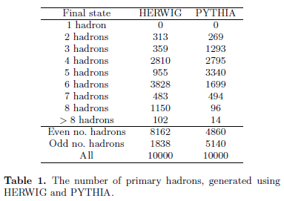
Exclusive e+e- → D X processes (simulation)
Exclusive 3-body
“Regge-cascade hadronization”
K. Odagiri arXiv:hep-ph/0606315

Slide 8
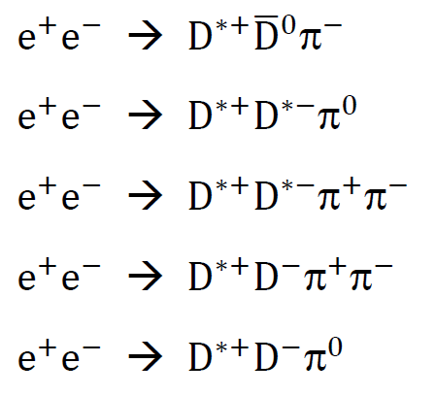
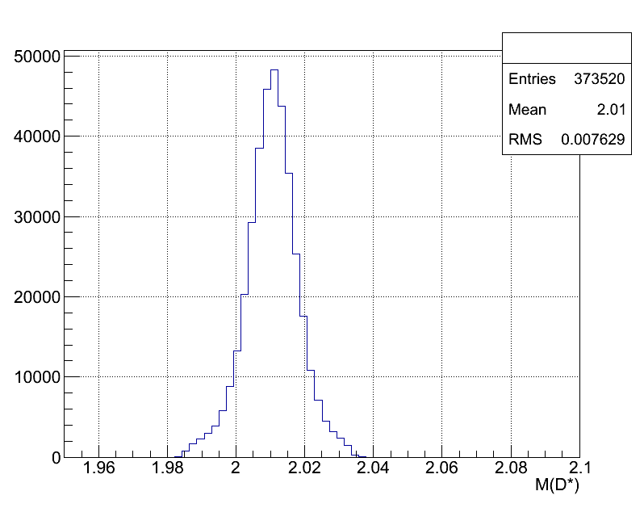
Experimental studies of
Exclusive 3-body & 4-body processes
Belle preliminary results

Slide 9
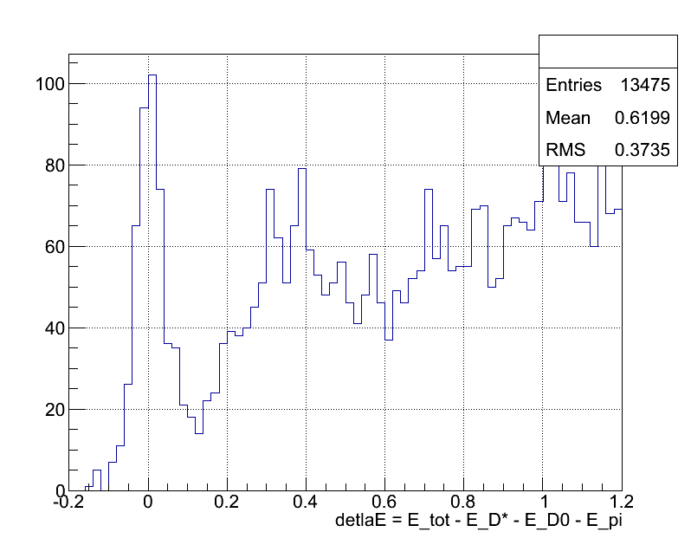
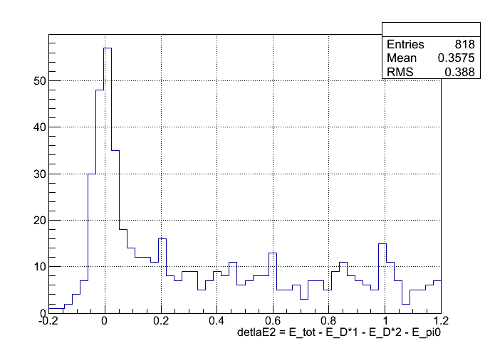
Exclusive 3-body processes
~ 0

Slide 10
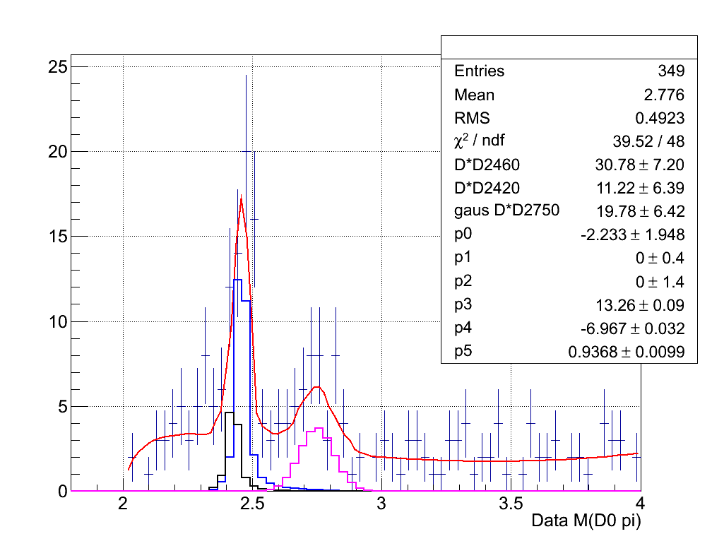
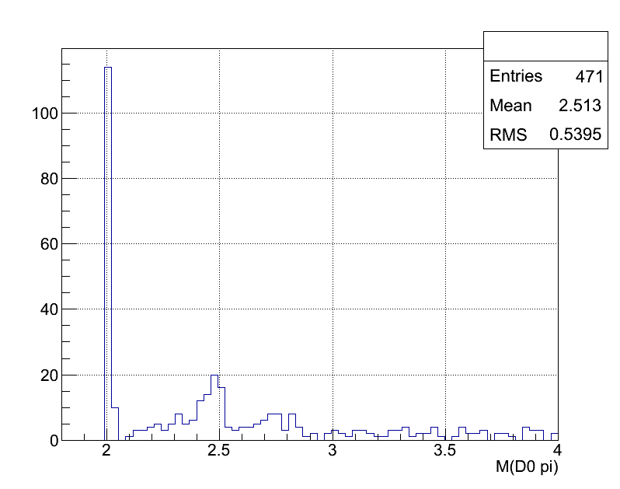
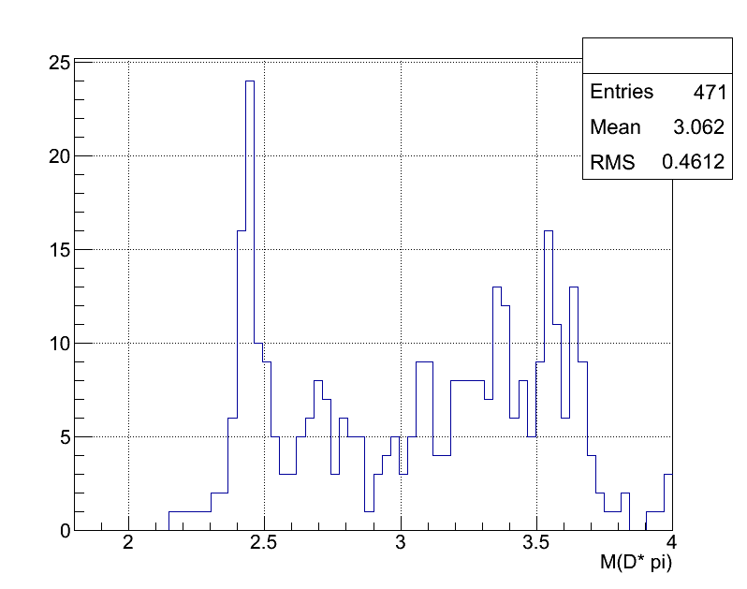
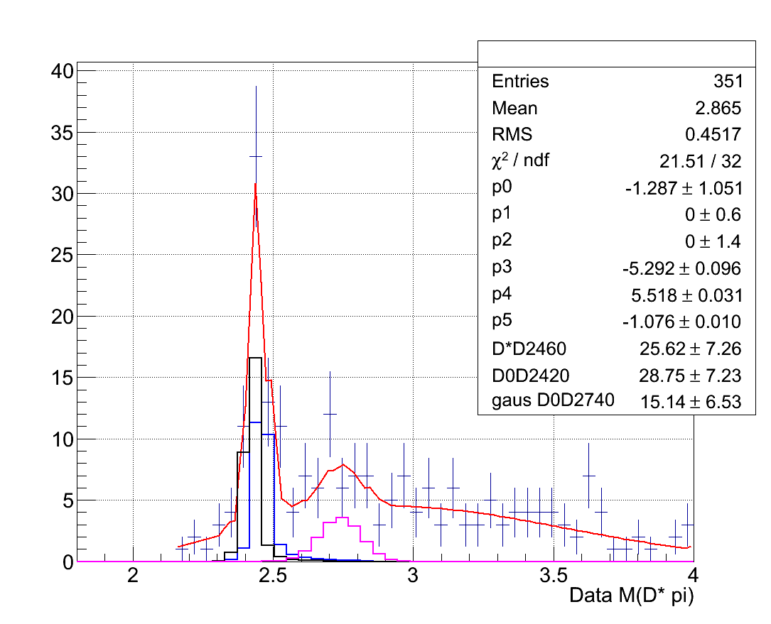
M(D0,π)
M(D0,π)
Resonances
2010
2420
2460
2750?
M(D*,π)
2420
2460
2740?
M(D*,π)

Slide 11
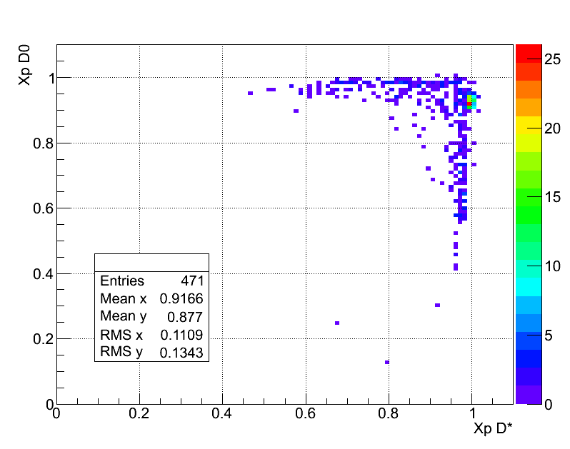
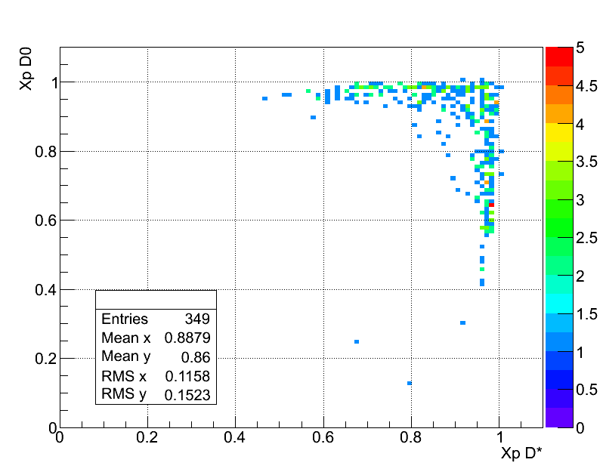
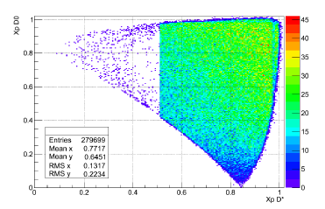
D*+D*-
X_{p}(D0)
X_{p}(D*)
X_{p} = P(D*)/P_{max}(D*)
MC
Phase space

Slide 12
Exclusive processes
consist of
1. D^{*+} D(2010)
2. D^{*+} D(2420)
3. D^{*+} D(2460)
4. D^{*+} D(2750)?
5. D⁰ D(2420)
6. D⁰ D(2460)
7. D⁰ D(2740)?
8. the rest (“quasi-Dπ”) 218
total 471 evt; resonance 253 evt; rest 218 evt

Slide 13
Preliminary result
種類 | 個數
Error from root
“quasi-DD” = total - resonances

Slide 14
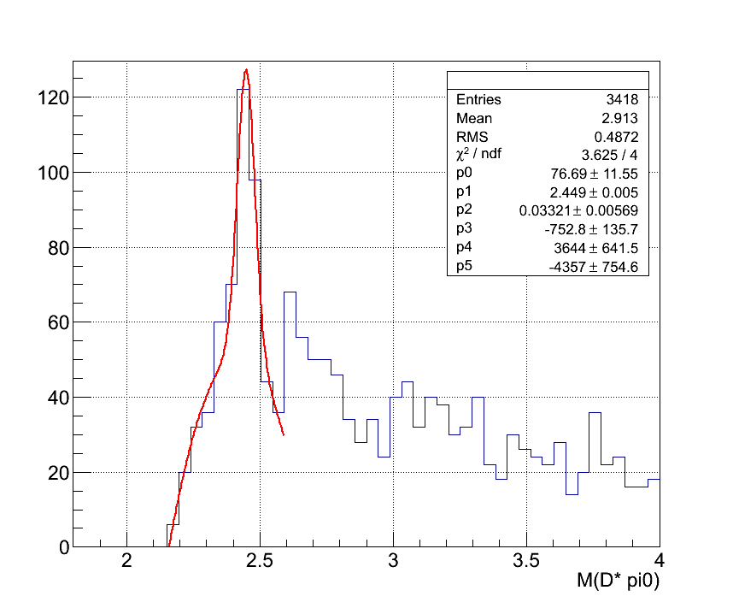
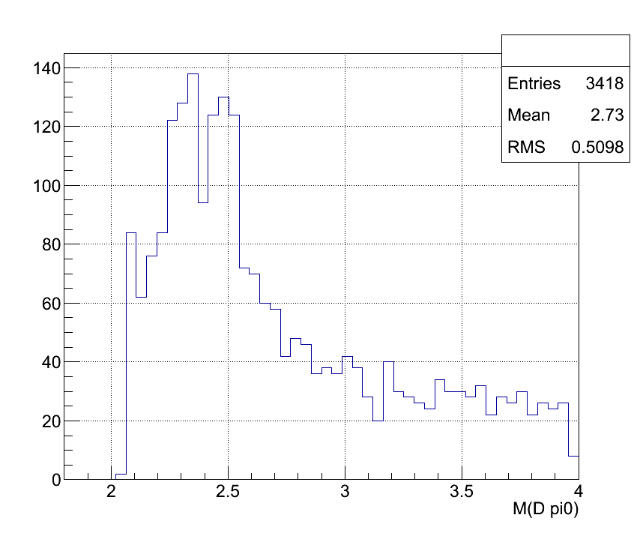
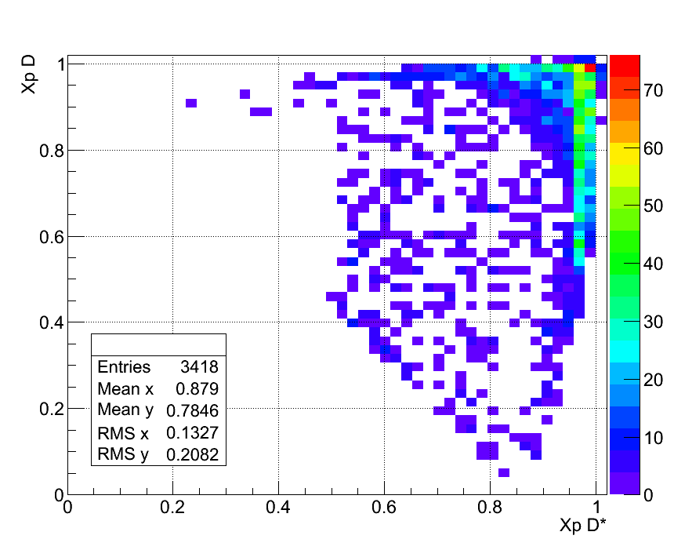
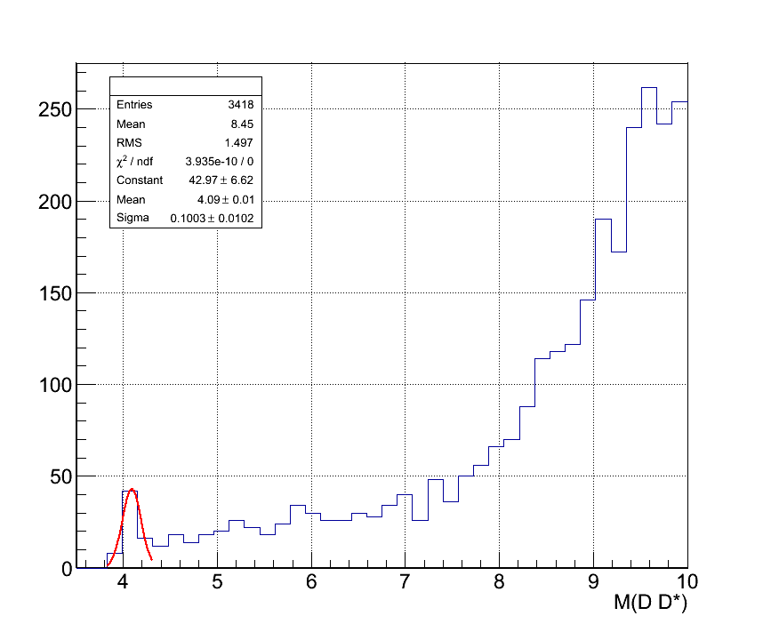
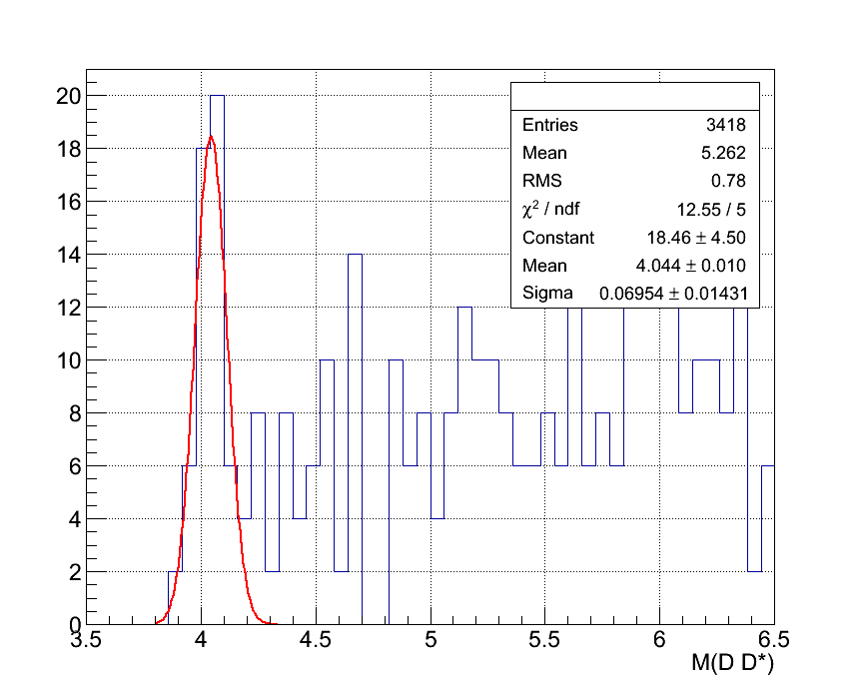
$D^{∗±}D^{∓}π^{0}$：
去除$D^{∗±}D^{∗∓}→D^{∗±}D^{∓}π^{+}$
紅色虛線為：$M\left(D^{∓}π^{0}\right)$
綠色虛線為：$M\left(D^{∗±}π^{0}\right)$
藍色虛線為：$M\left(D^{∗±}D^{∓}\right)$

Slide 15
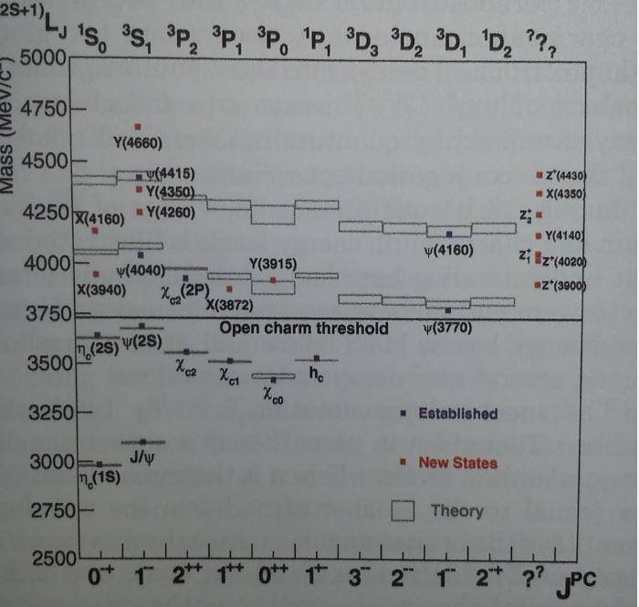

Slide 16
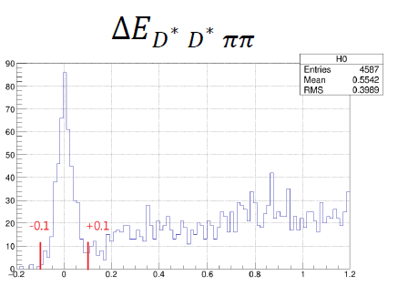
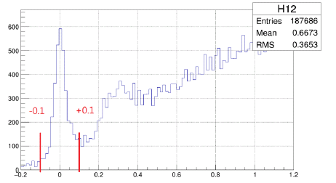
Exclusive 4-body processes

Slide 17
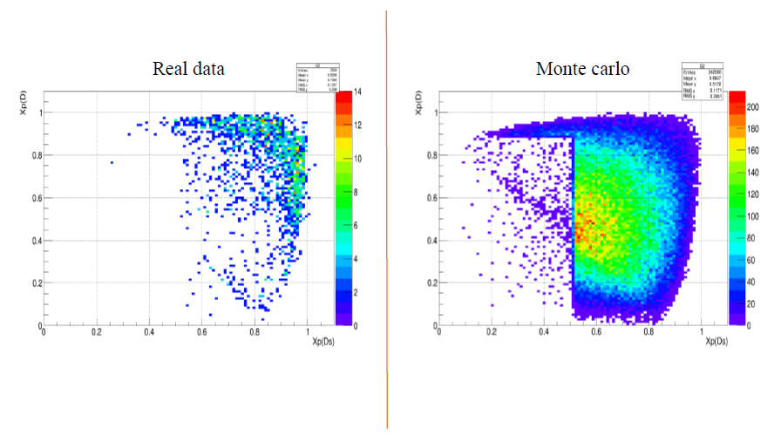
X_{p} : data vs phase space
X_{p}(D+)
X_{p}(D+)
X_{p}(D*)
X_{p}(D*)

Slide 18
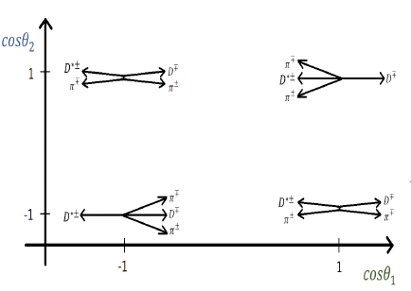
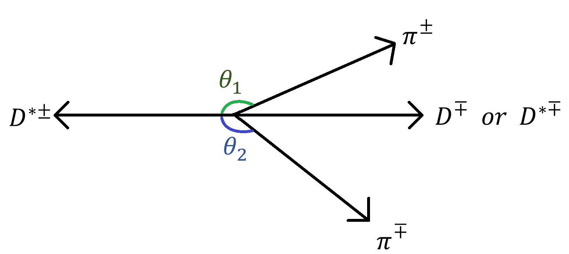
1-3 vs 2-2 topology studies
(+-)(-+)
(3,1)
(1,3)
(++)(--)
Cosq₁ vs Cosq₂

Slide 19
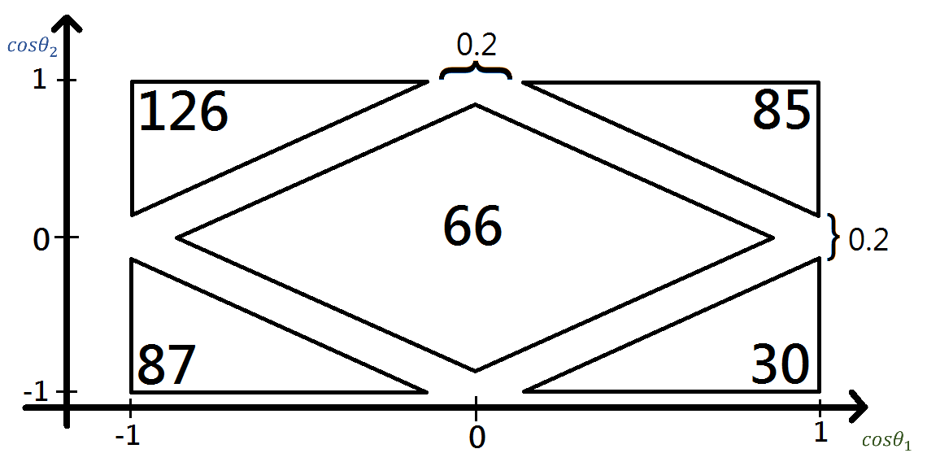
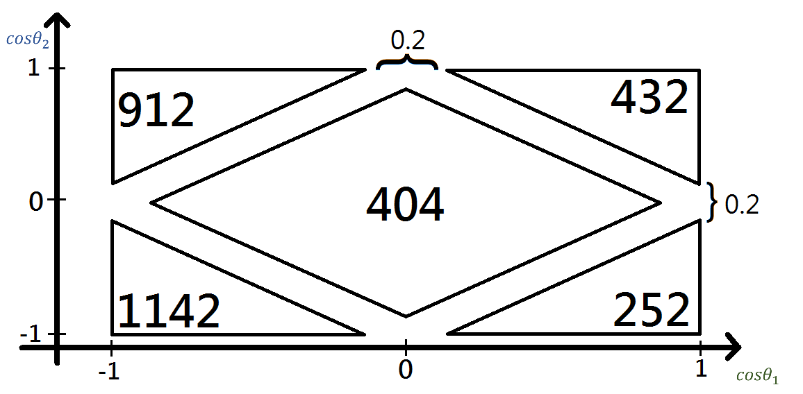
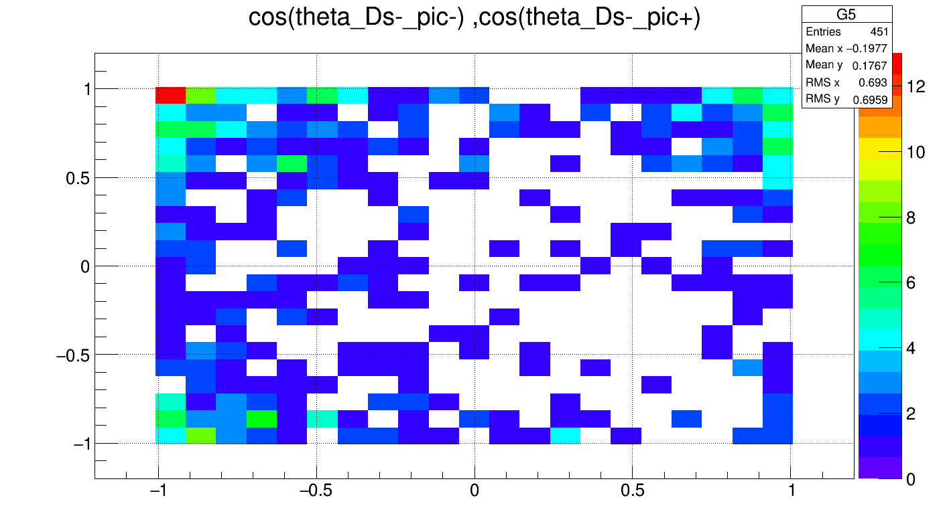
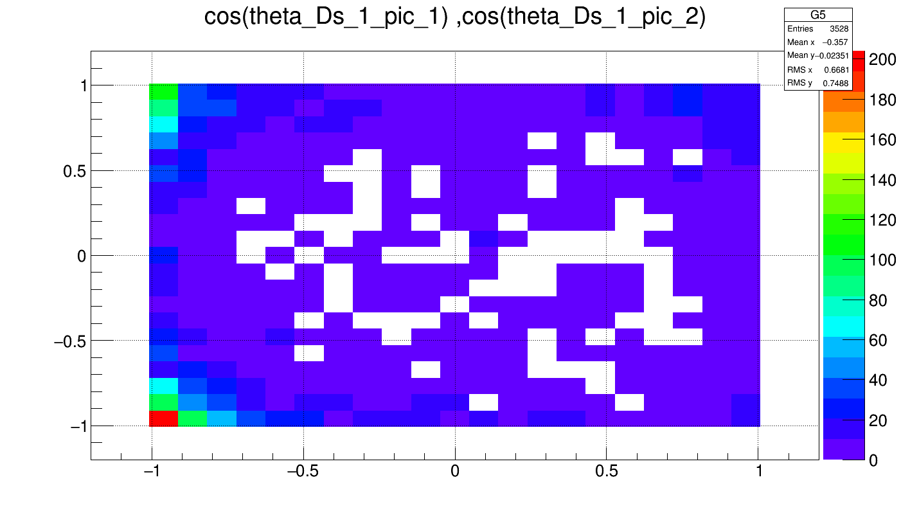
$$D^{∗}D^{∗}π π$$
$$D^{∗}D π π$$

Slide 20
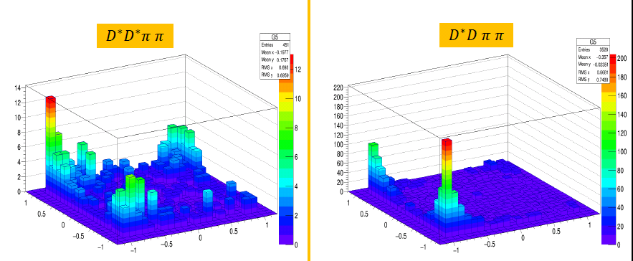
(+-)(-+)
(3,1)
(1,3)
(++)(--)

Slide 21
1-3 vs 2-2 topology
particle
Quasi-particle
Quasi-particle
particle
particle
particle
particle
particle
particle
particle

Slide 22
Exclusive 2-body

Slide 23
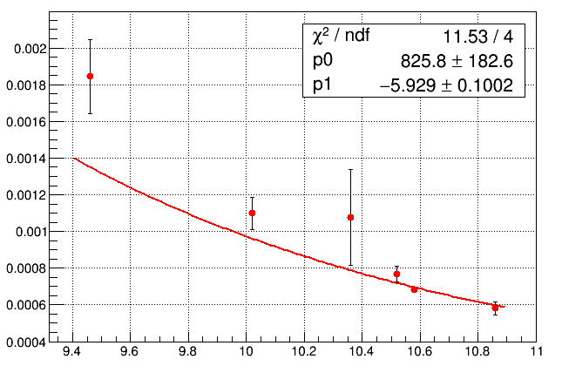
Exclusive D*D* production
Exclusive 2-body
Production angle cut : $\cos{θ}$ < 0.7
$$σ\left(D^{∗}D^{∗}\right)/σ(μμ)(fb)$$
Y(1S)
Y(2S)
Y(3S)
Y(4S)
$$\sqrt{s}$$
Fit by $p0∗{\sqrt{s}}^{p1}$

Slide 24
Summary:
Very preliminary results from Belle experiment indicate that particle-quasi particle scheme is favored.
Result of exclusive 3-body processes consists of D-D(resonances) and non-resonance (253/218), and non-resonance consists with Particle-Quasi-particle scheme. (from their Xp relation)
This is similar to B-meson decay into 3-body. (H.N. Li)
4 body processes consists of (1,3) and (2-2) topology.
Belle-II is rolling in this year, with 40x data.

Slide 25
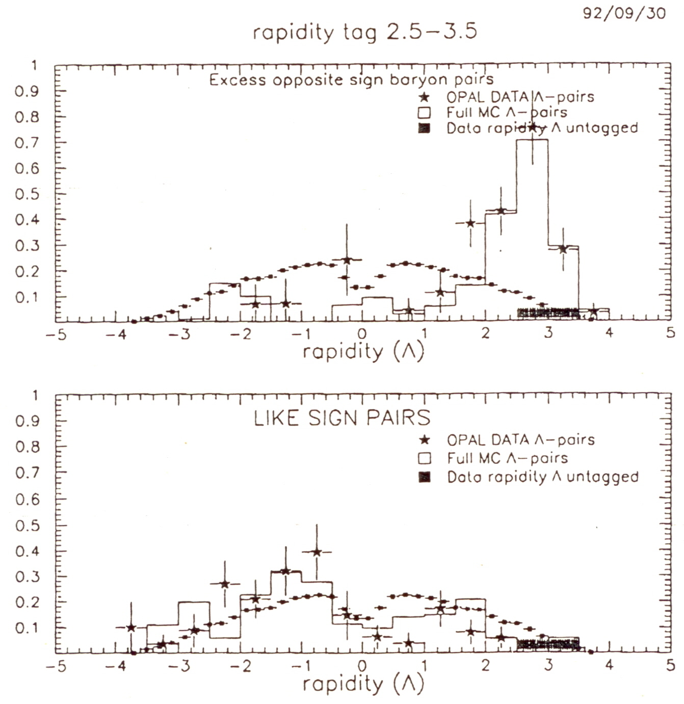
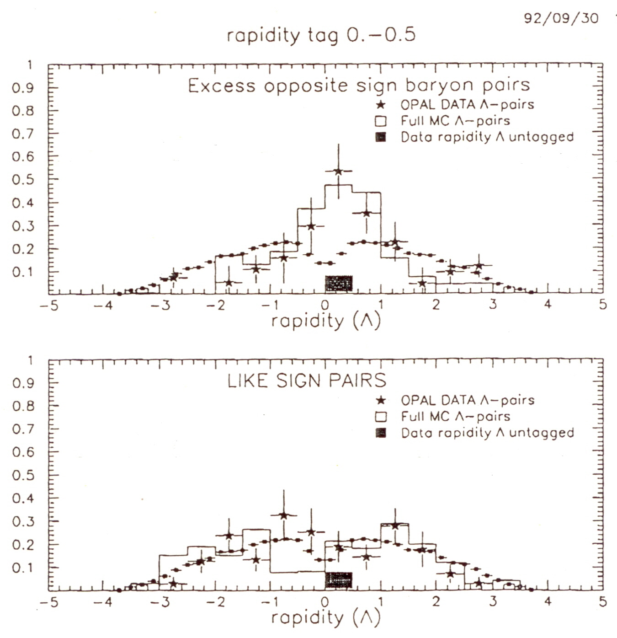
Flavor correlation in e+e- experiments
(‘90 OPAL) ΛΛ correlation

Slide 26
Exclusive Charm Mesons Production Near Threshold using ISR
$$D^{∗±}D^{∗∓}$$
$$D^{0}D^{0}$$
$$D^{±}D^{∓}$$
$$D^{±}D^{∗∓}$$
$$DD$$
PRL 98, 092001 (2007)
PRD 77, 011103 (2008)

Slide 28
Exclusive D*D* production
Exclusive 2-body

