Slide 1
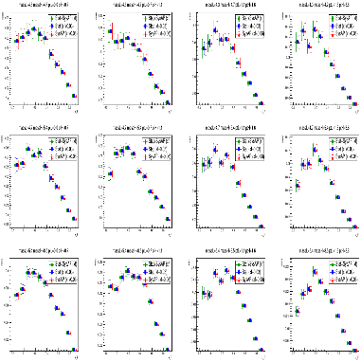
Title@Data
Chia-Yu Hsieh
Academia Sinica, Taiwan

Slide 2
Summary from Previous Study
Implemented the BLUE (Best Linear Unbiased Estimator) method to study how correlation (r) and uncertainty ratio (σ₂/σ₁) affect the combined result.
Wight :
When σ₂ = σ₁, both measurements contribute equally (w₁ = w₂ = 0.5).
When σ₂/σ₁ ≈ 1, weights become unstable and highly sensitive as r → +1 due to near-singular covariance (how to deal with strong correlated uncertainty will be further studied).
When σ₂/σ₁ ≫ 1, the estimator is dominated by the more precise measurement (smaller σ₁).
Combined mean:
The combined mean remains stable unless σ₂ ≈ σ₁ and r → +1, where overshoot to large, unphysical values can occur.
Combined uncertainty : the combined uncertainty remains smaller than the smallest individual σ.

Slide 3
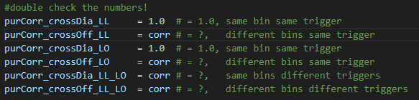
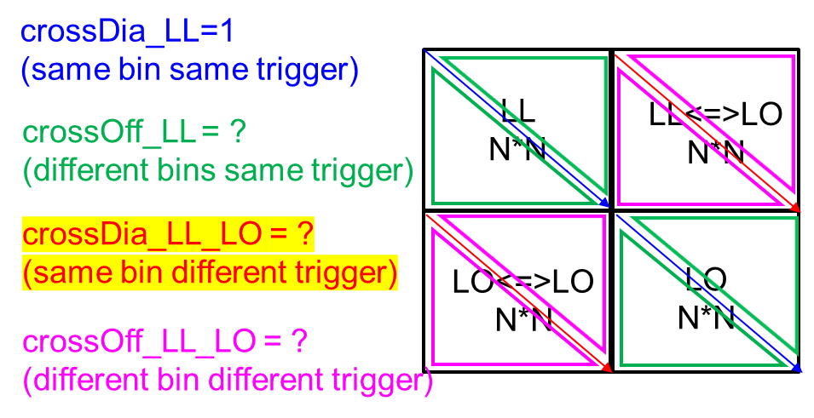
Possible Correlations
Most important question, how do we get those numbers?
Or I can do a simple test, test correlation factor 0<r<0.5 since from the study today, we know it is not good to push r->1.
What if we really have some strong correlated elements or unknown correlated elements?

Slide 4
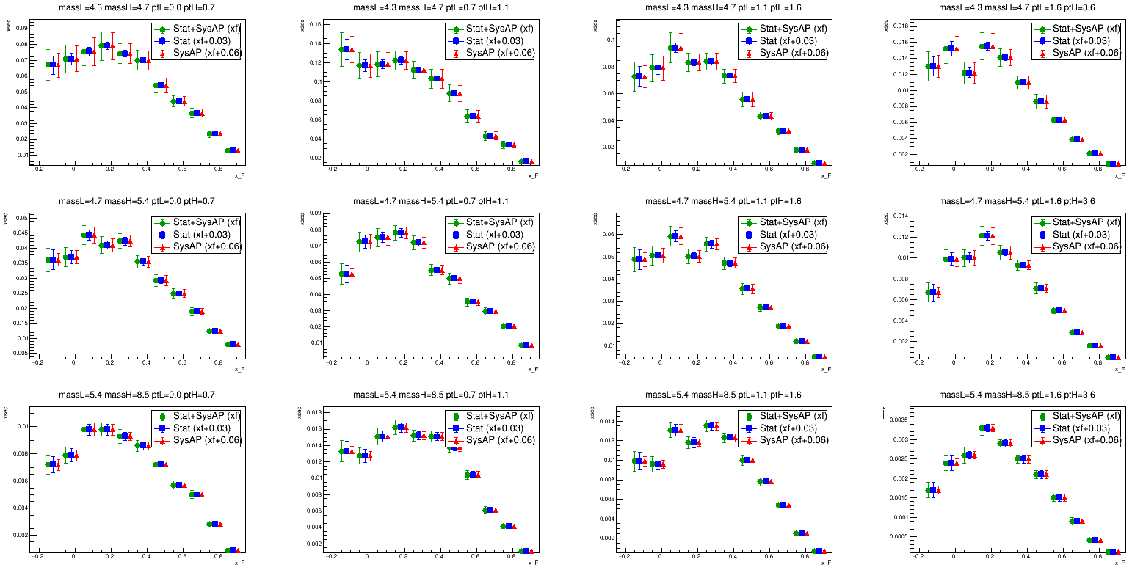
Ex. All corr = 0

Slide 5
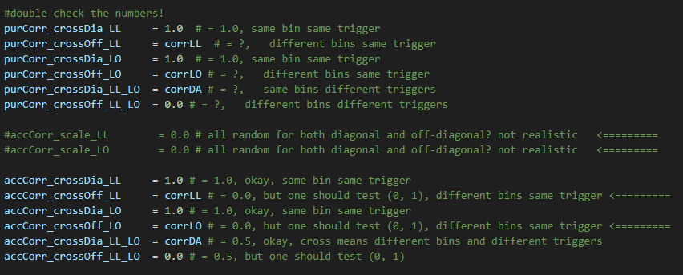
Only “same bin + different trigger” has correlation
crossDA = [0, 0.1, 0.2, …, 0.9]
crossLL = 0
crossLO = 0

Slide 6
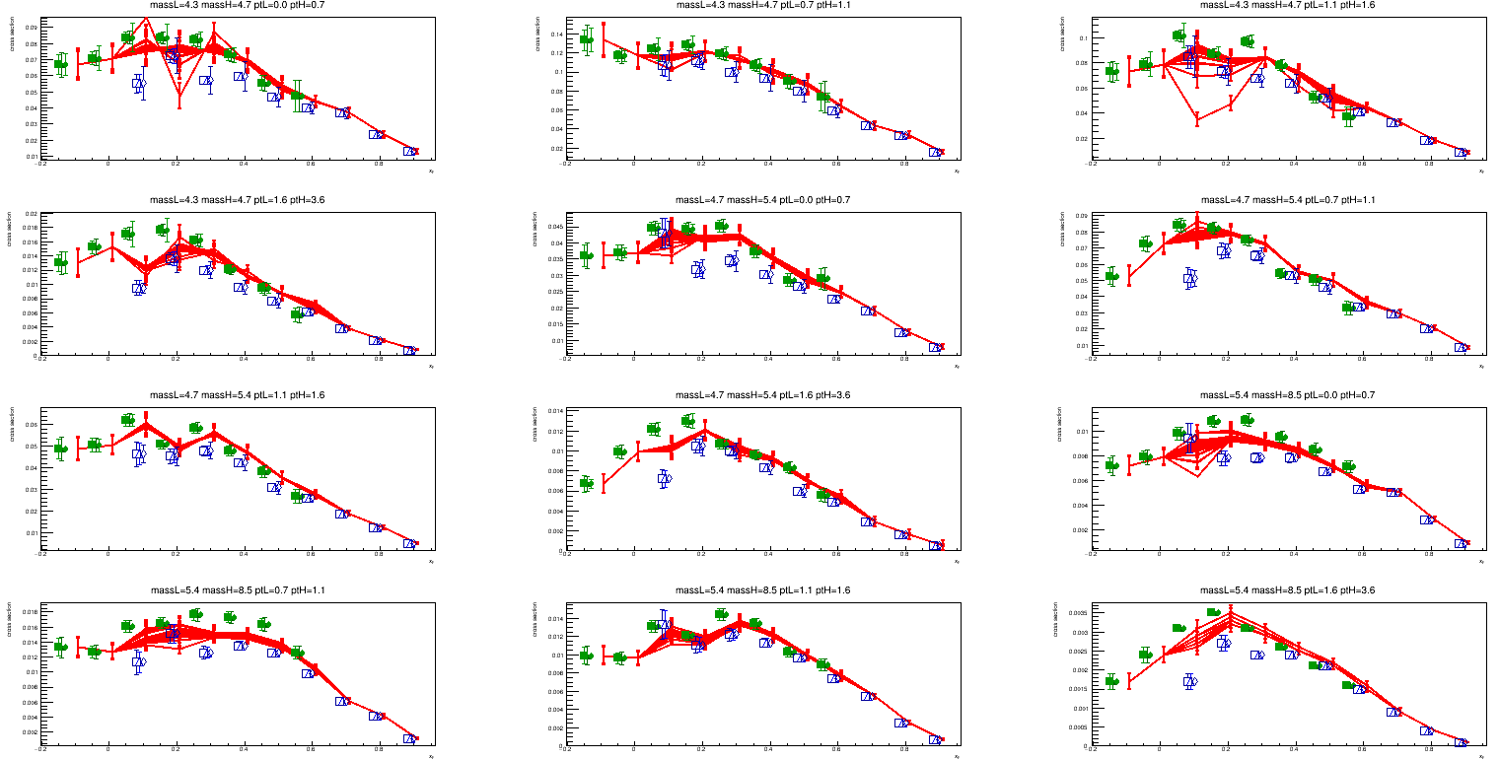
W Target
Results look reasonable.

Slide 7
Only “different bin + same trigger” has correlation
crossDA = 0
crossLL = [0, 0.1, 0.2, …, 0.9]
crossLO = [0, 0.1, 0.2, …, 0.9]

Slide 8
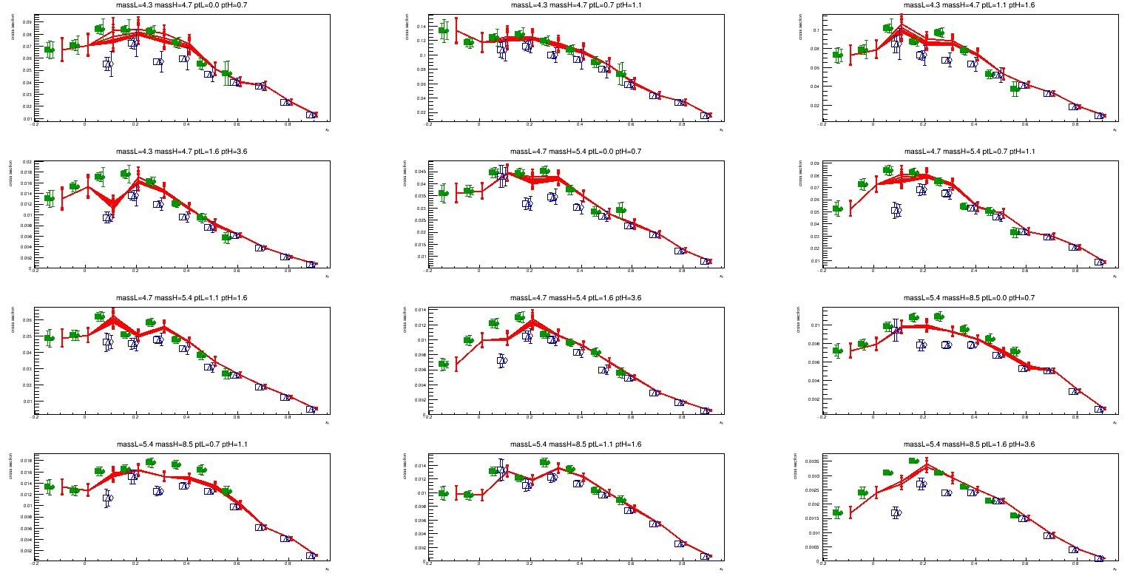
W Target
Results look reasonable.

Slide 9
Varies Everything All Together
corrLL/corrLO : correlation between bins within the same trigger (LL or LO)
crossDA : correlation between triggers within the same bin
numbers are assigned = [0, 0.3, 0.5, 0.7, 0.9], three loops

Slide 10
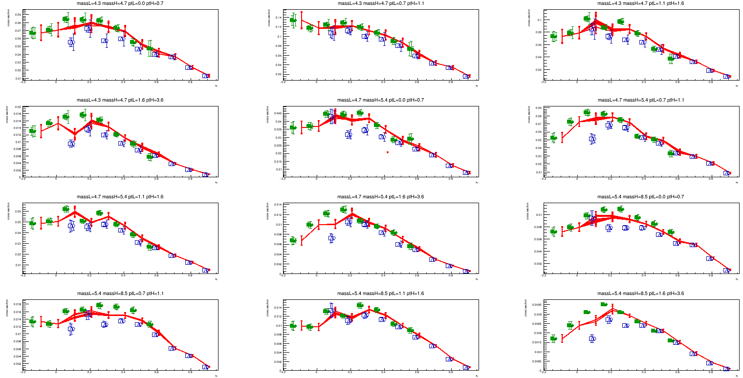
If numbers = [0, 0.3, 0.5]
reasonable

Slide 11
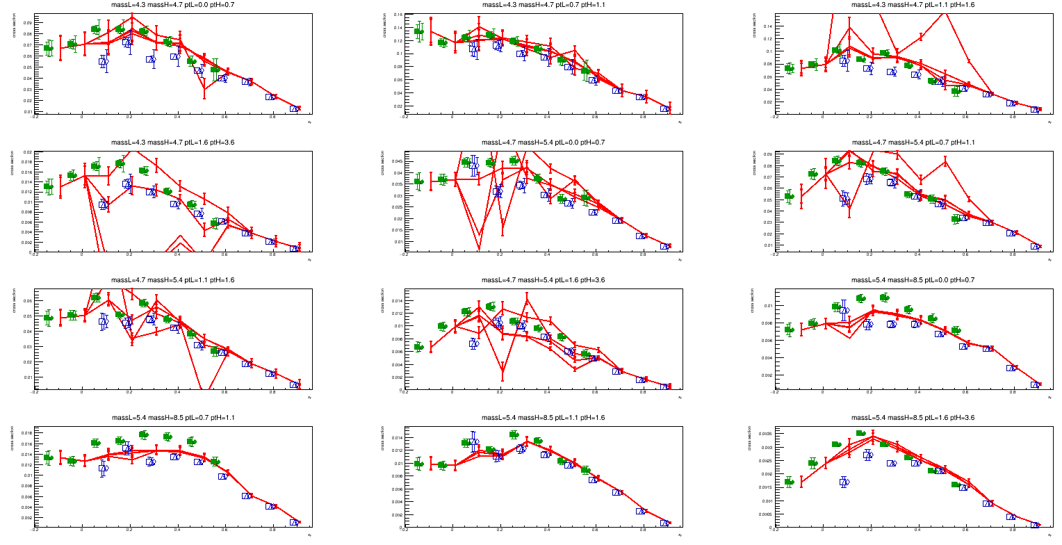
If numbers = [0.7, 0.9]
Hum…

Slide 12
Summary
Correlations
Same bin different triggers = corrLL, corrLO
Different bin same triggers = corrDA
Different bin different triggers = 0
Tested Results
If we change them individually and test the correlation from between 0 to 0.9. The combine mean values are reasonable.
If we change three of them all at the same time, for the case correlation<0.5, the combined mean is also reasonable. However, if the correlation is in between 0.7 to 0.9. Then we have the combined mean excess the range of LL and LO coverage.
Paper reading (How to deal with the case with high correlation?)
On the combination of correlated estimates of a physics observable (https://arxiv.org/abs/1402.4016)
Information and treatment of unknown correlations in the combination of measurements using the BLUE method (https://arxiv.org/abs/1307.4003)
Let’s have a meeting by Lunar new year (Feb. 17th)

Slide 13
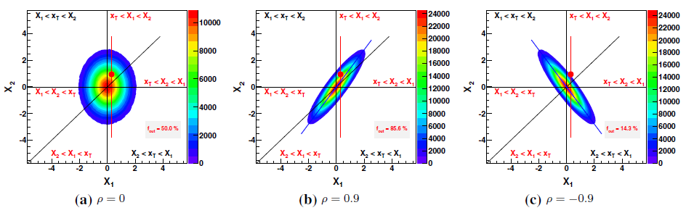
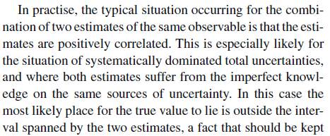

On the combination of correlated estimates of a physics observable (https://arxiv.org/abs/1402.4016)
Define
Truth : xT = 0
Measurement#1: x1 = xT + sigma* z1; z1 = random seen [0, 1]
Measurement#2 : x2 = xT + sigma2 * (rho * Z1 + s * Z2); z2 = random seed, [0, 1]
Correlation between two measurements : rho = [0, 0.9, -09]
The color distribution is all the possible combinations of [x1, x2]
One would ask a question, what is the possibility that xT = 0 which is not in between [x1, x2]
fout = percentage of events which xT is out of the range of [x1, x2]
Author ran 500, 000 events to test :
If rho = 0, fout ~ 50%
If rho = 0.9, fout ~ 85%
If rho = -0.9, fout ~ 15%
positive correlation. Mostly, the combined value is even further away from the truth

Slide 14
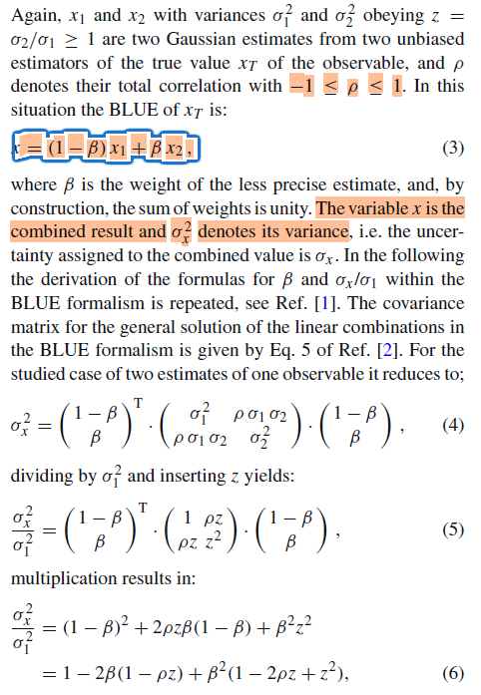
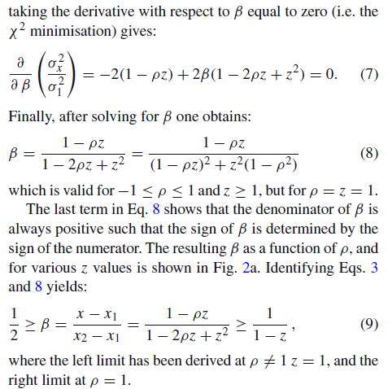
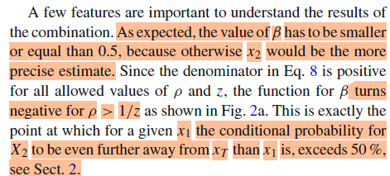
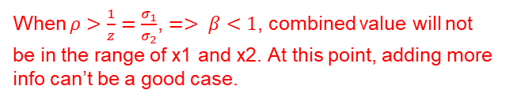
On the combination of correlated estimates of a physics observable (https://arxiv.org/abs/1402.4016)
BLUE
When $ρ>\frac{1}{z}=\frac{σ_{1}}{σ_{2}}$, $=> β<1$, combined value will not be in the range of x1 and x2. At this point, adding more info can’t be a good case.

Slide 15
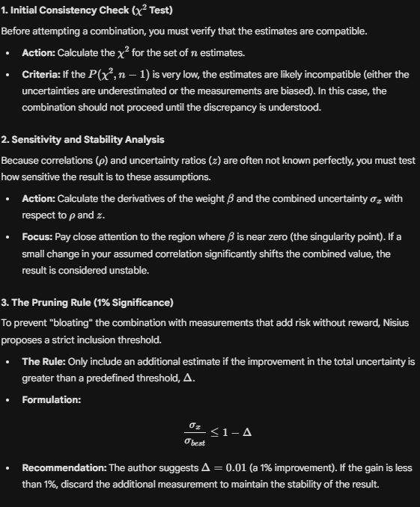
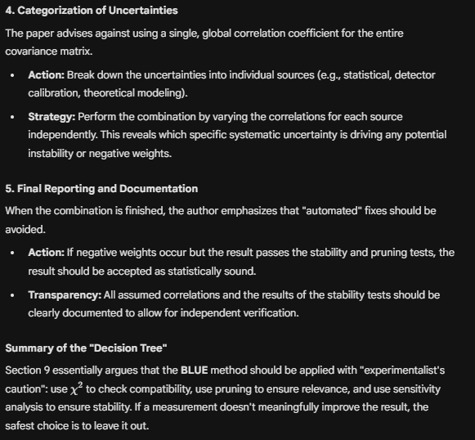
On the combination of correlated estimates of a physics observable (https://arxiv.org/abs/1402.4016)
Check if the combine is reasonable
Check if the combine is reasonable
Accept what it is even if the combed is not reasonable…
Exclude bad measurement
=> What should we do?

Slide 16
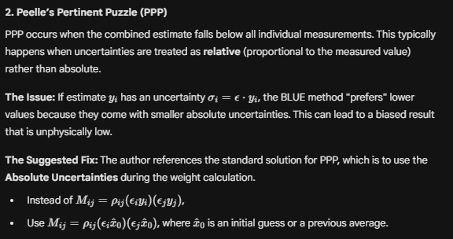
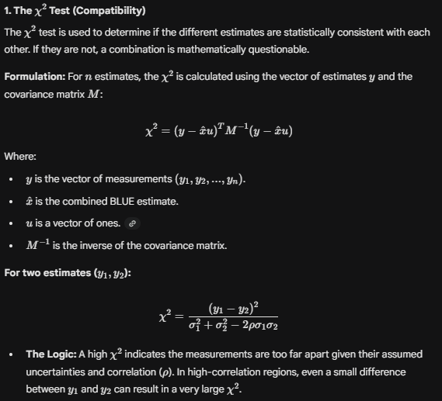
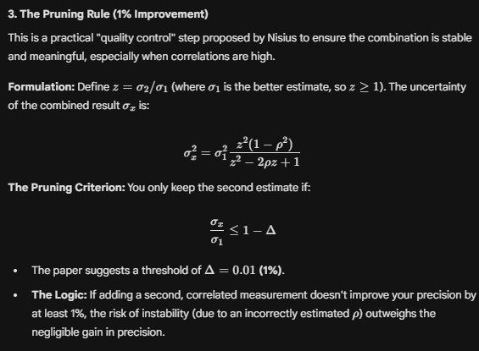
On the combination of correlated estimates of a physics observable (https://arxiv.org/abs/1402.4016)
Paper suggest :
→ stress test : loop possible rho and z
→ check compatibility : ch2 test, find points gives the combined mean is not in the range of x1 and x2
→ decide what to include : pruning rule, PPP method
?
Select measurement based on the uncertainty, can we do this?

Slide 17
Information and treatment of unknown correlations in the combination of measurements using the BLUE method (https://arxiv.org/abs/1307.4003)

Slide 18
Back up

