Slide 1
ZDC MC Simulation HCAL only 20260130
Chia-Yu Hsieh
Academia Sinica, Taiwan

Slide 2
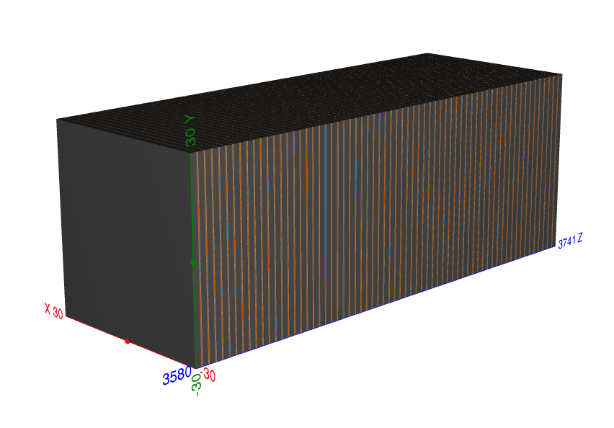
HCAL only
Can’t perform energy resolution well….Too low energy left in ECAL

Slide 3
Gamma Beam Pencil @ (-15, -15, z) {0.1, 0.3, 0.5, 0.7, 1, 3, 5, 7, 9, 10, 20, 30, 40} GeV

Slide 4
Mean and Sigma
unstable fit
Energy (GeV) | xz plane |  |  | yz plane
 | μₓ (mm) | σₓ (mm) | χ²/ndf | μᵧ (mm) | σᵧ (mm) | χ²/ndf
0.1 | −7.30 ± 6.66 | 21.91 ± 14.80 | 573.13 / 135 | −4.15 ± 0.93 | 11.18 ± 1.09 | 427.30 / 120
0.3 | −2.91 ± 0.46 | 10.36 ± 0.44 | 29.25 / 115 | +1.91 ± 0.49 | 12.94 ± 0.43 | 182.32 / 113
0.5 | −1.71 ± 0.43 | 9.82 ± 0.50 | 94.01 / 103 | −0.12 ± 0.46 | 9.84 ± 0.59 | 75.10 / 94
0.7 | −1.36 ± 0.38 | 9.40 ± 0.34 | 84.19 / 94 | −0.38 ± 0.37 | 9.71 ± 0.34 | 64.30 / 84
0.9 | −1.62 ± 0.37 | 7.42 ± 0.66 | 96.77 / 70 | +0.02 ± 0.30 | 7.49 ± 0.23 | 84.70 / 74
1.0 | −1.98 ± 0.37 | 8.18 ± 0.39 | 97.90 / 83 | +1.16 ± 0.33 | 8.15 ± 0.34 | 47.04 / 76
3.0 | −1.28 ± 0.22 | 5.79 ± 0.26 | 36.19 / 55 | +0.51 ± 0.20 | 5.22 ± 0.21 | 51.20 / 54
5.0 | −1.38 ± 0.21 | 3.43 ± 0.21 | 50.96 / 36 | +1.10 ± 0.13 | 3.60 ± 0.12 | 22.92 / 31
7.0 | −1.69 ± 0.18 | 4.49 ± 0.28 | 33.57 / 48 | +0.50 ± 0.16 | 4.30 ± 0.15 | 45.81 / 42
9.0 | −1.94 ± 0.11 | 3.17 ± 0.09 | 20.34 / 25 | +0.71 ± 0.20 | 2.83 ± 0.20 | 6.86 / 21
10 | −1.96 ± 0.12 | 3.03 ± 0.26 | 35.73 / 29 | −0.22 ± 0.14 | 2.95 ± 0.13 | 19.85 / 26
20 | −1.81 ± 0.09 | 2.76 ± 0.07 | 29.18 / 25 | +0.48 ± 0.11 | 3.16 ± 0.11 | 27.37 / 25
30 | −1.78 ± 0.08 | 2.12 ± 0.06 | 27.91 / 17 | +0.21 ± 0.09 | 2.47 ± 0.07 | 11.45 / 19
40 | −2.24 ± 0.09 | 1.37 ± 0.07 | 19.65 / 11 | +0.32 ± 0.10 | 1.77 ± 0.08 | 18.11 / 13
stable fit
Without crystal ECAL in the front, stable range enlarger (0.7GeV->0.3GeV).

Slide 5
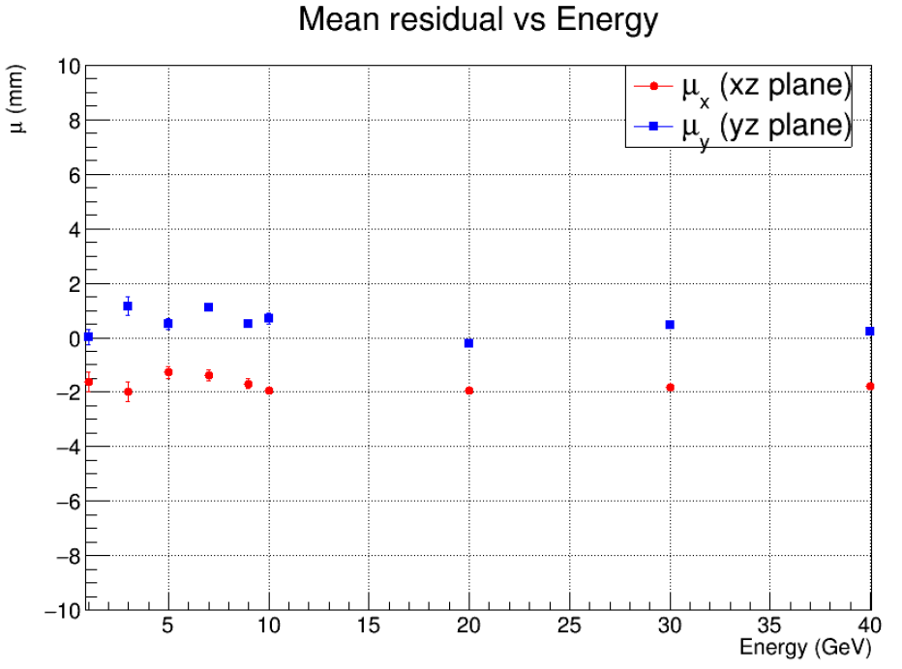
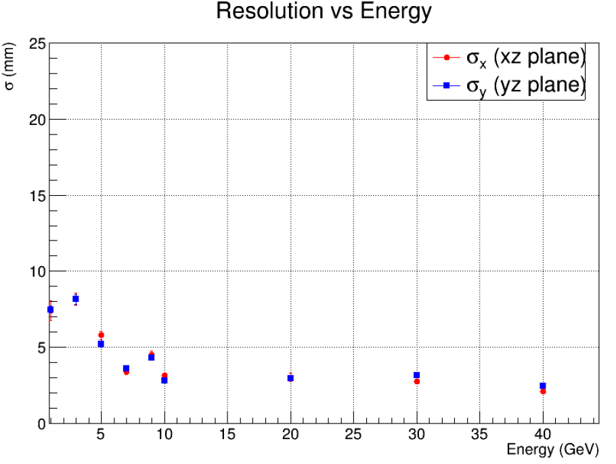
Mean and Sigma
Mean/Bias VS Energy
Sigma/Resolution VS Energy

Slide 6
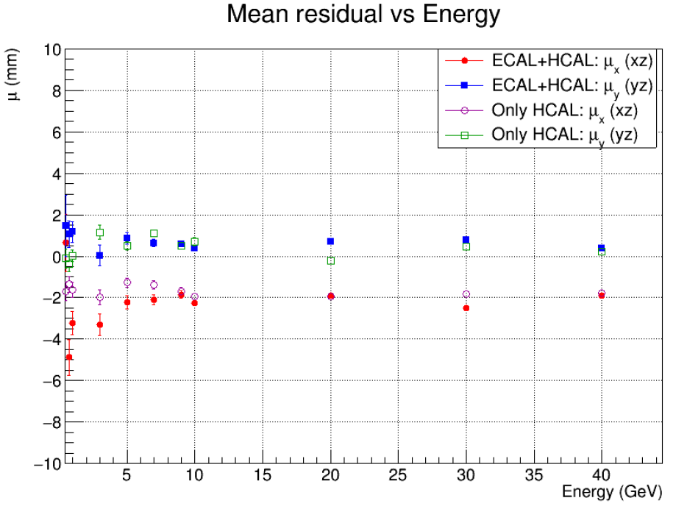
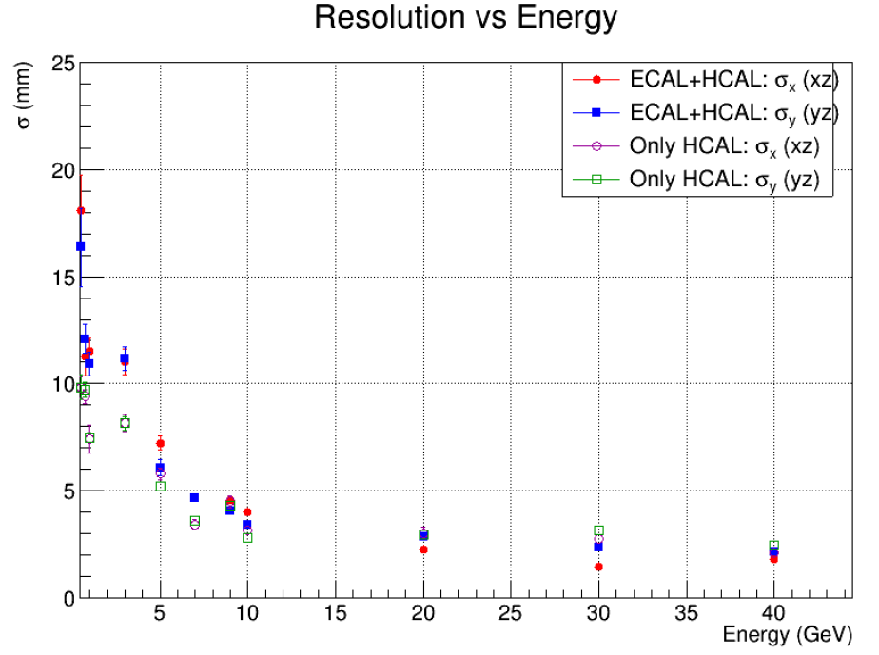
Compare
For low energy beam, better performance with only HCAL.
For higher energy beam>10GeV, no difference.
Bias in x still exist even after removing ECAL.

Slide 7
Neutron Beam Pencil @ (-15, -15, z) {10, 20, 50, 100, 200, 300} GeV

Slide 8
Mean and Sigma
Energy (GeV) | xz plane |  |  | yz plane
 | μₓ (mm) | σₓ (mm) | χ²/ndf | μᵧ (mm) | σᵧ (mm) | χ²/ndf
10 | −0.27 ± 0.98 | 17.82 ± 2.70 | 50.23 / 43 | −0.08 ± 0.88 | 18.77 ± 1.30 | 41.62 / 42
20 | −0.73 ± 0.57 | 11.30 ± 0.90 | 39.18 / 41 | −0.04 ± 0.53 | 10.11 ± 0.84 | 29.39 / 40
50 | −1.34 ± 0.54 | 8.36 ± 0.72 | 49.51 / 29 | +0.31 ± 0.40 | 8.25 ± 0.43 | 26.61 / 25
100 | −0.60 ± 0.21 | 4.28 ± 0.37 | 23.98 / 20 | −0.07 ± 0.21 | 4.63 ± 0.22 | 16.73 / 19
200 | −0.55 ± 0.23 | 4.01 ± 0.20 | 27.10 / 14 | +0.19 ± 0.22 | 3.88 ± 0.18 | 13.56 / 9
300 | −0.95 ± 0.24 | 4.73 ± 0.24 | 13.72 / 12 | +1.06 ± 0.25 | 4.72 ± 0.24 | 13.14 / 14
stable fit

Slide 9
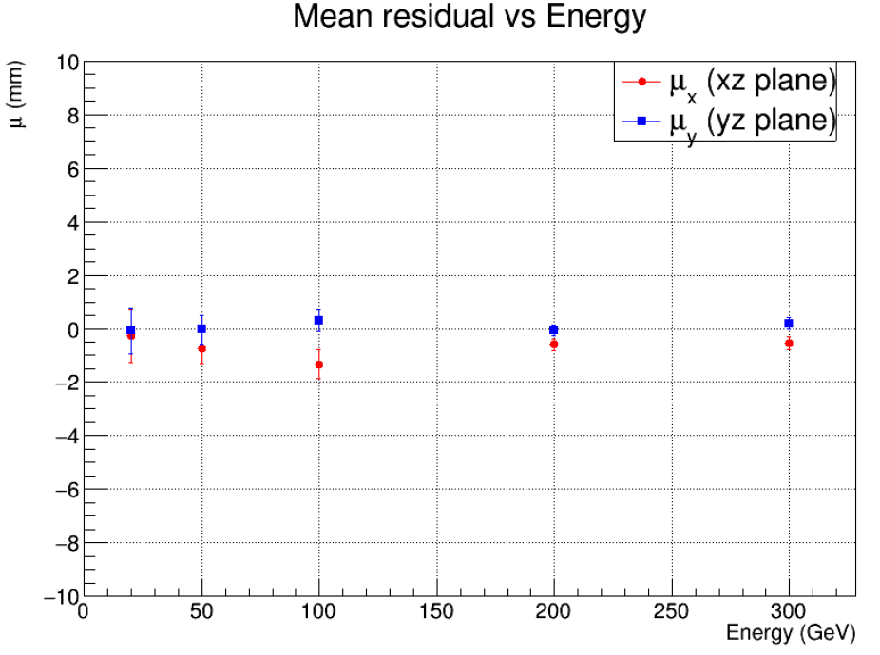
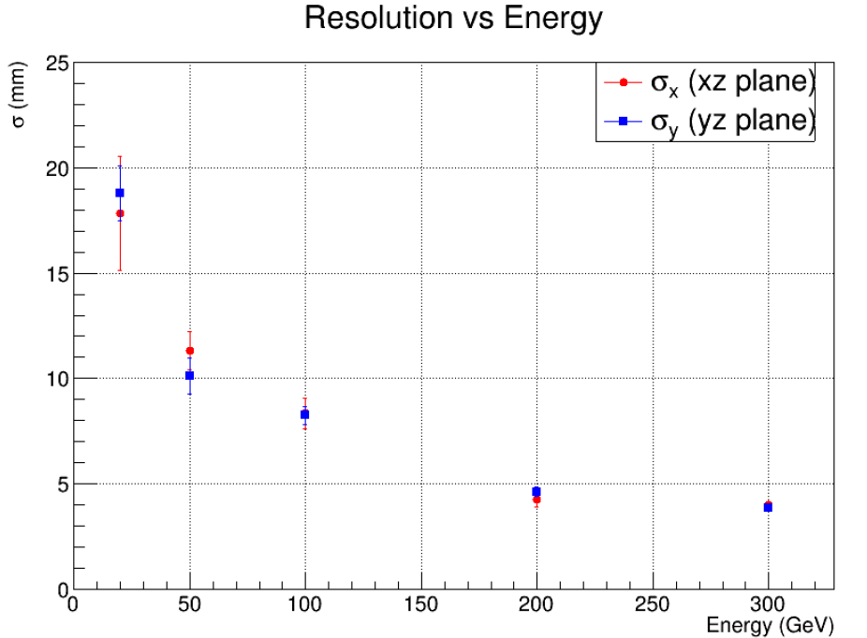
Mean and Sigma
Mean/Bias VS Energy
Sigma/Resolution VS Energy

Slide 10
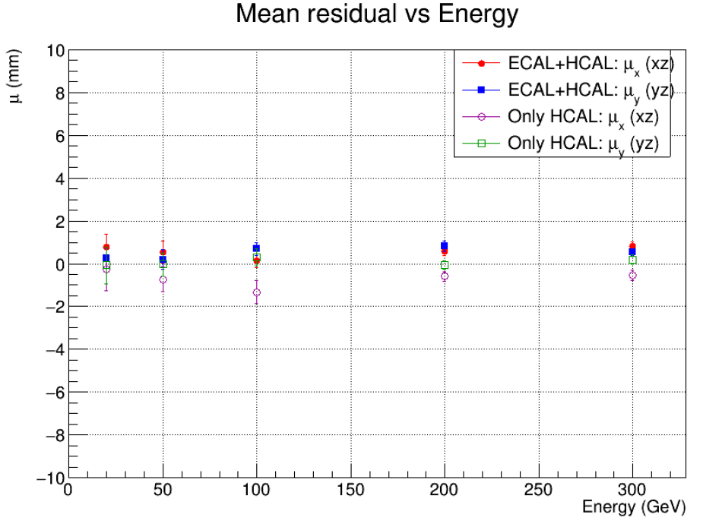
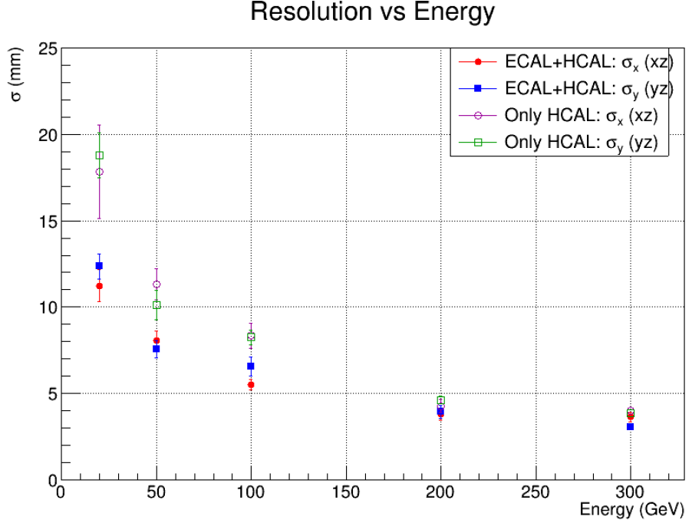
Compare
No bias
Better performance w/ ERCAL + HCAL, not sure I understand the reason.

