Slide 1
Method to Deal with Systematics
Problematic Region
20260205
Chia-Yu Hsieh
Academia Sinica, Taiwan

Slide 2
To Do
To do list :
(1) correlation test : check combined results witbins : 0.7 for h the following conditions
(1.1) Between different triggers same all the kinematics
(1.2) Between different bins same trigger : max = 0.8, but stronger for the neighboring bins
implement correlation include mass and pt bins
neighboring bins in xf : gaussian distribution with Amplitude = 0.8
neighboring bins in mass and pt : const = 0.8 (?), not sure about it. Suggestion is welcome.
(2) revisit the problem of 3D cross section integrate to 1D :
(2.1) Catarina, could you initiate it? Thank you.
(2.2) I will compare "3D integrated to 1D" with "1D" cross section in mass and pt.

Slide 3
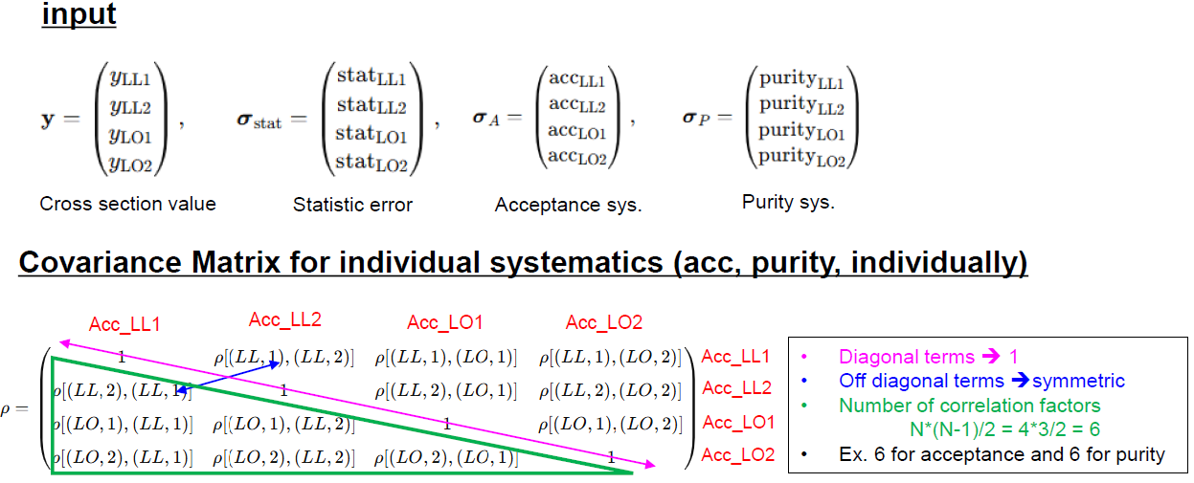
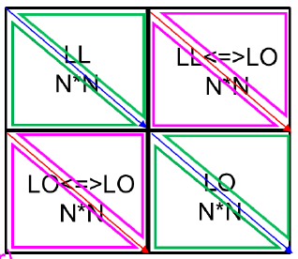
BLUE

Slide 4
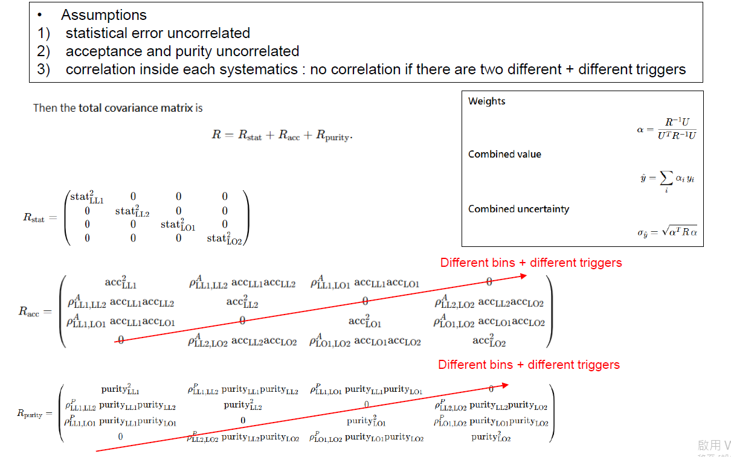
BLUE

Slide 5
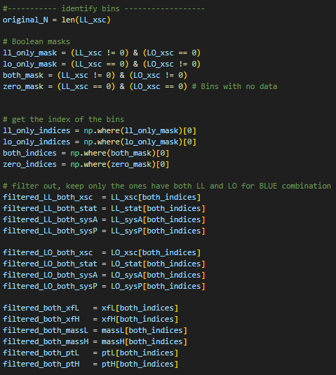
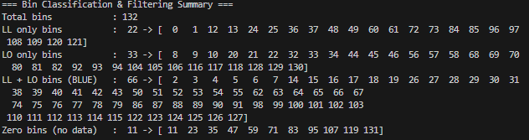
Define Matrix for the overlap region
Deal with overlap regions, 66 bins

Slide 6
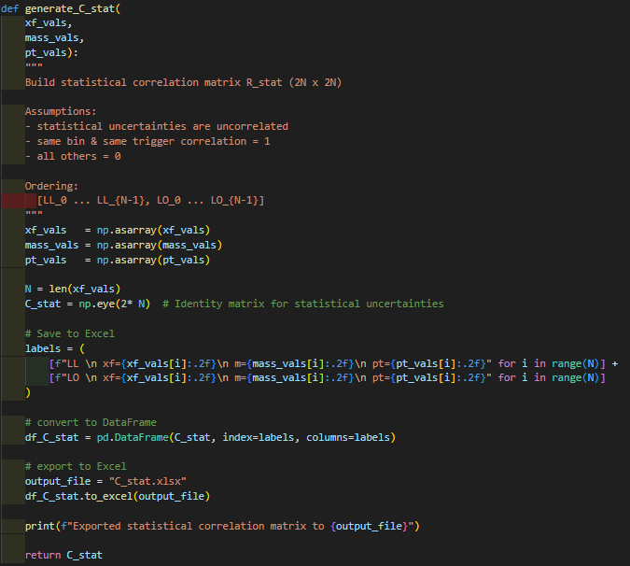
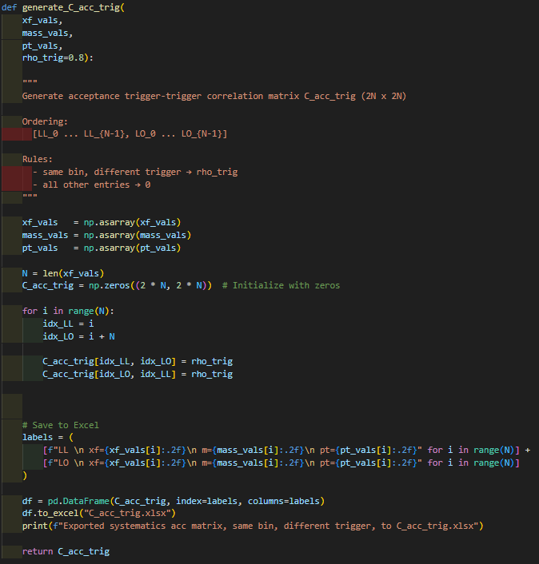
Build up Correlation Matrix
correlations
C_stat = Diagonal = 1
C_trig
Same bin, diff trig = 0.7

Slide 7
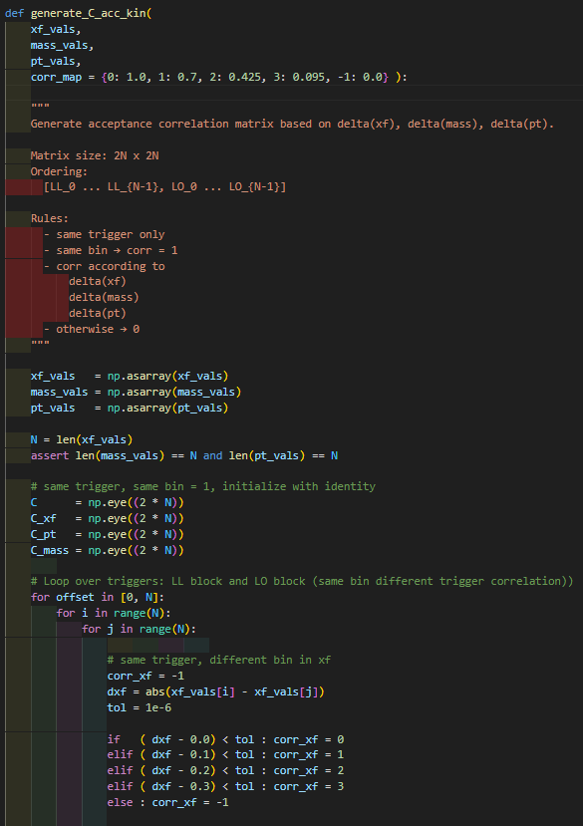
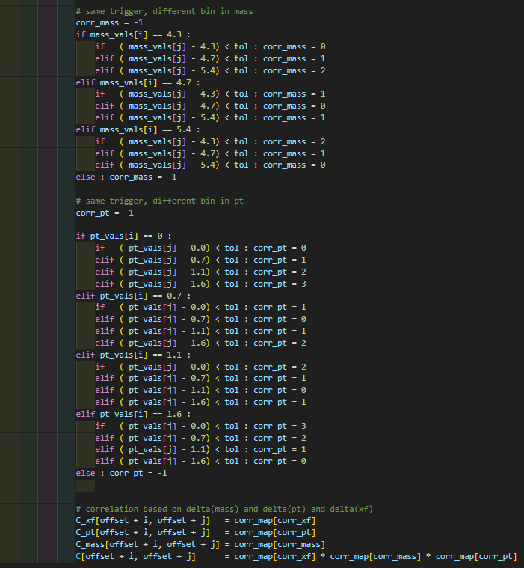
Build up Correaltion Matrix
mass
pt
1 in Diagonal
xf
C_kin = C_xf * C_pt * C_mass
DeltaBin : correlation
= {0 : 1, 1 : 0.8, 2 : 0.5, 3 : 0.1, others : 0}

Slide 8

Build up Covariance Matrix

Slide 9
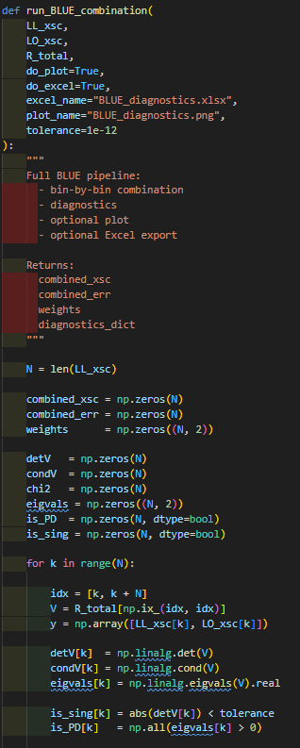
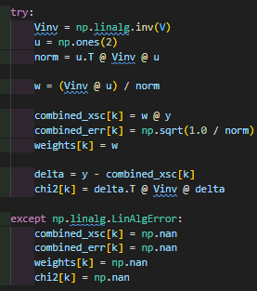
Combine LL and LO with BLUE
checks
BLUE

Slide 10
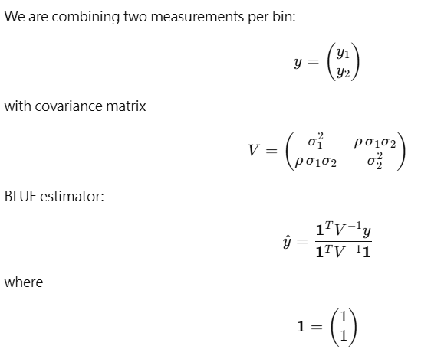
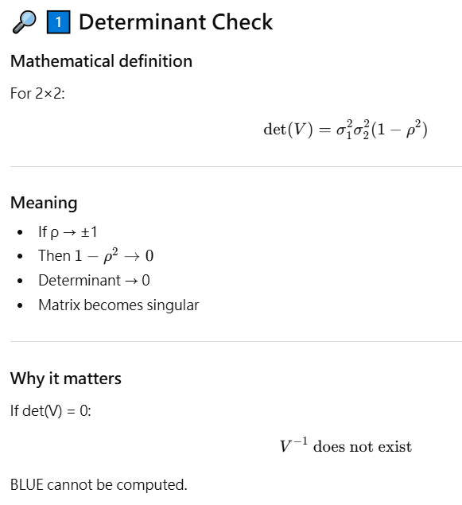
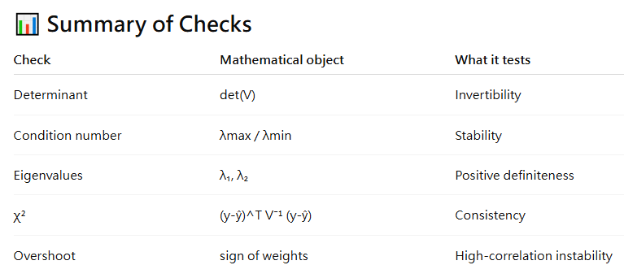
Checks

Slide 11
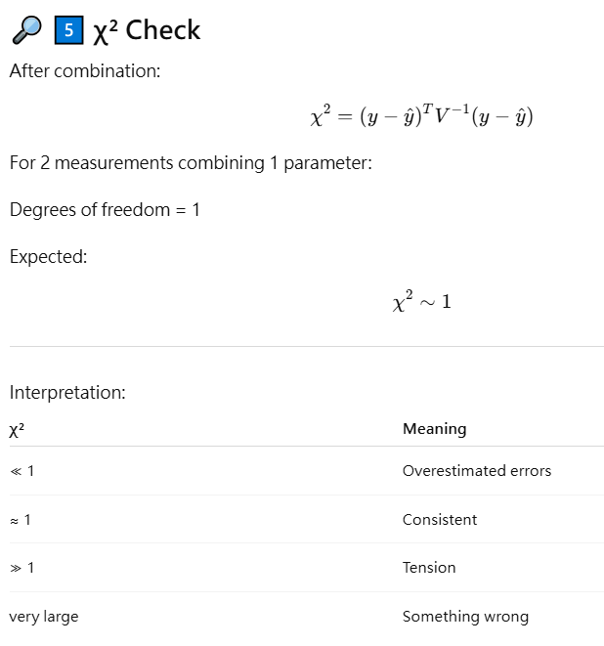
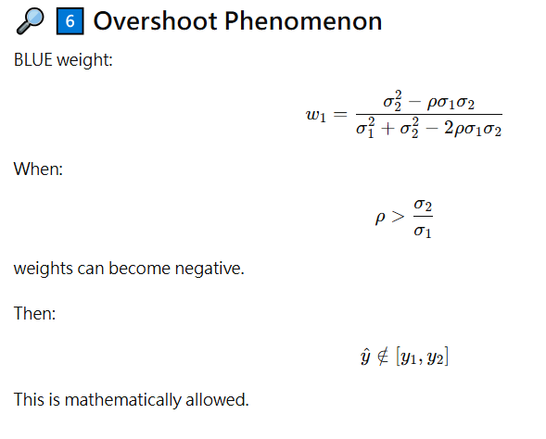
Checks
Overshoot = negative weighting
When σ₂/σ₁≈ 1 and r → +1
=> weighting<0, combined result is not in the range of y1 and y2)

Slide 12
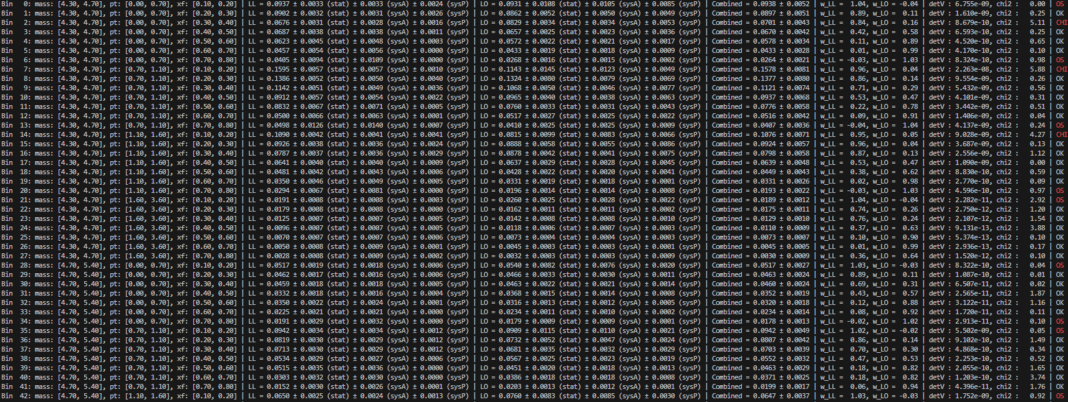
Checks

Slide 13
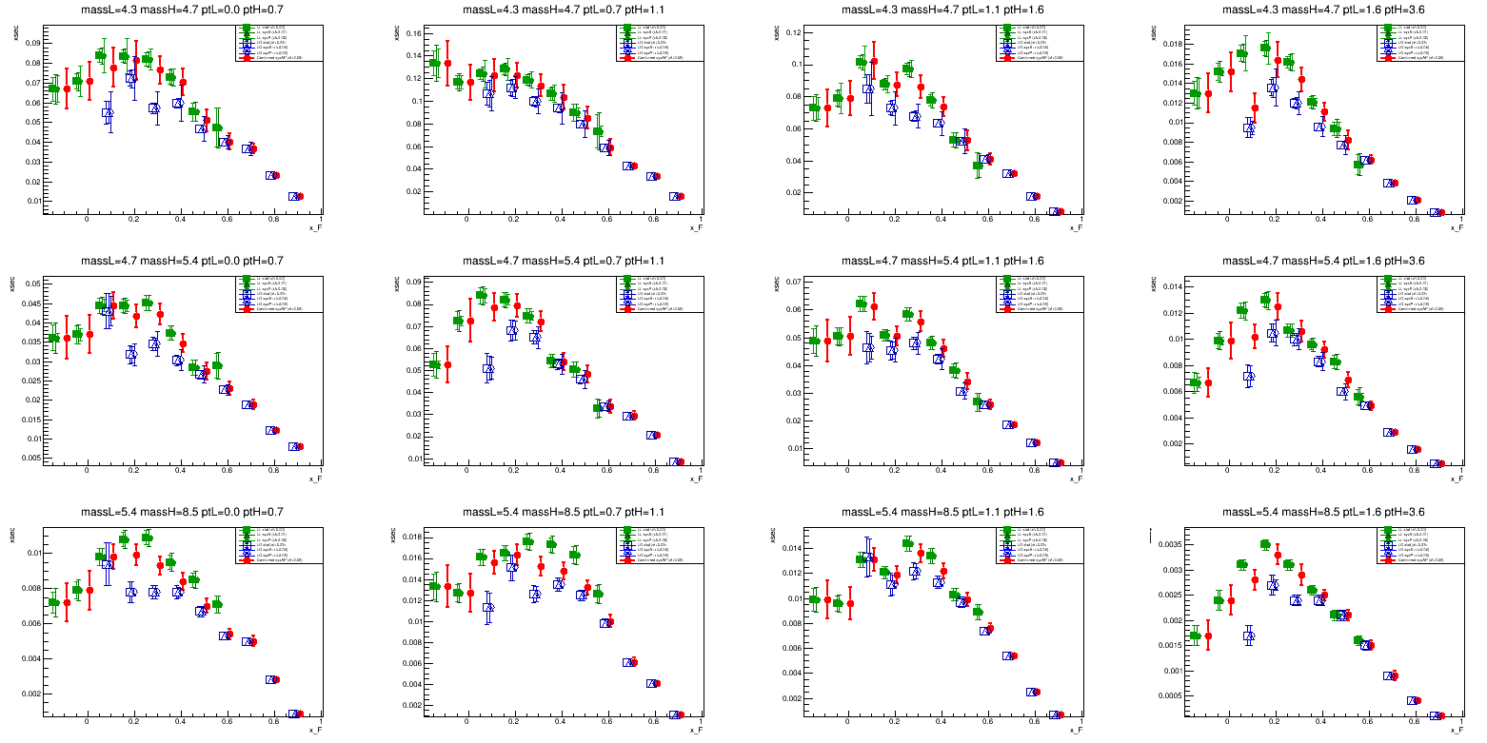
W
Overshoot
Large chi2

Slide 14
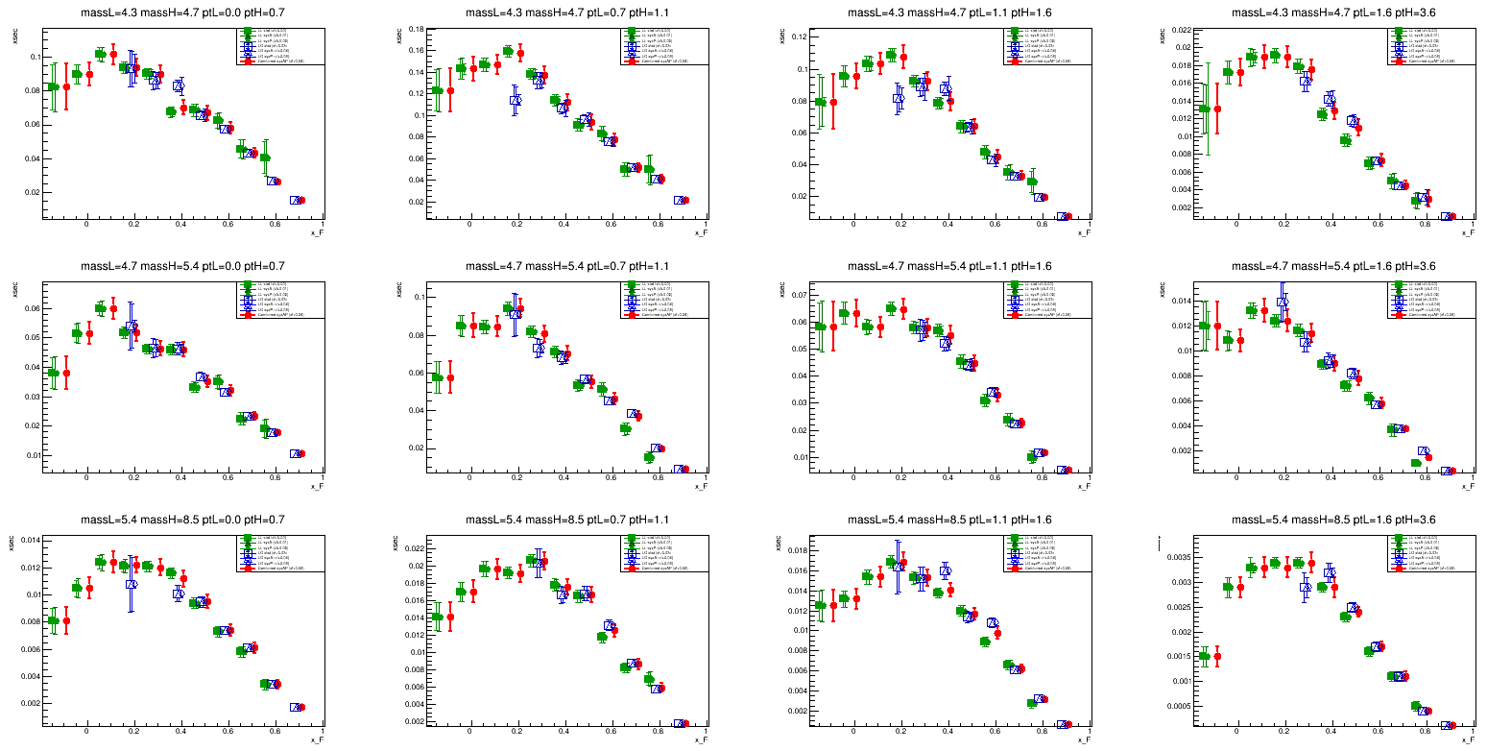
NH3

Slide 15
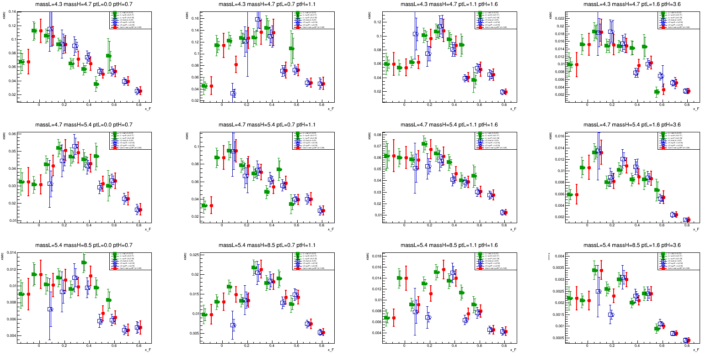
Al

Slide 16

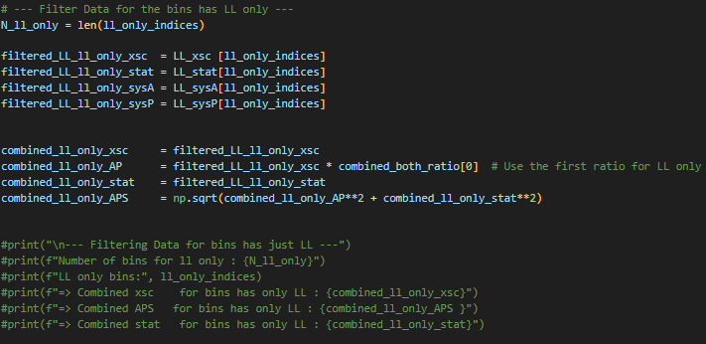
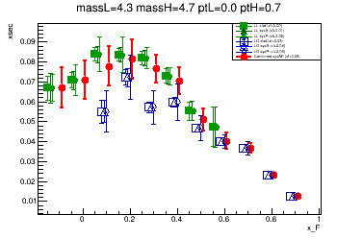
Region w/ Only LL or LO
Size of systematics error of the LL only region, is the same one s the closest bin in the over lap region
(for LO, same as the last bin in overlap region)

Slide 17
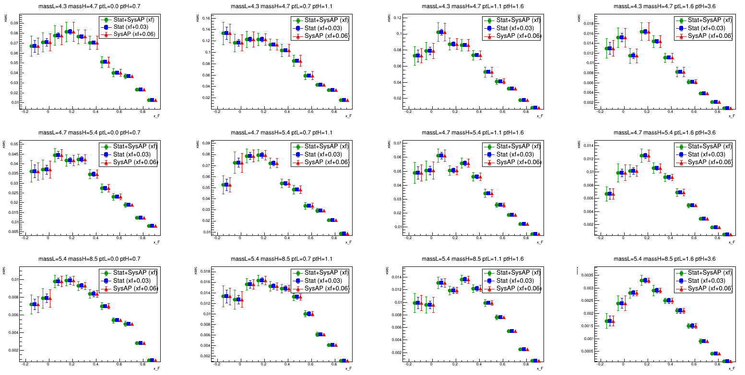
Total Error and Statistic Error
W target

Slide 18
Backup

Slide 19
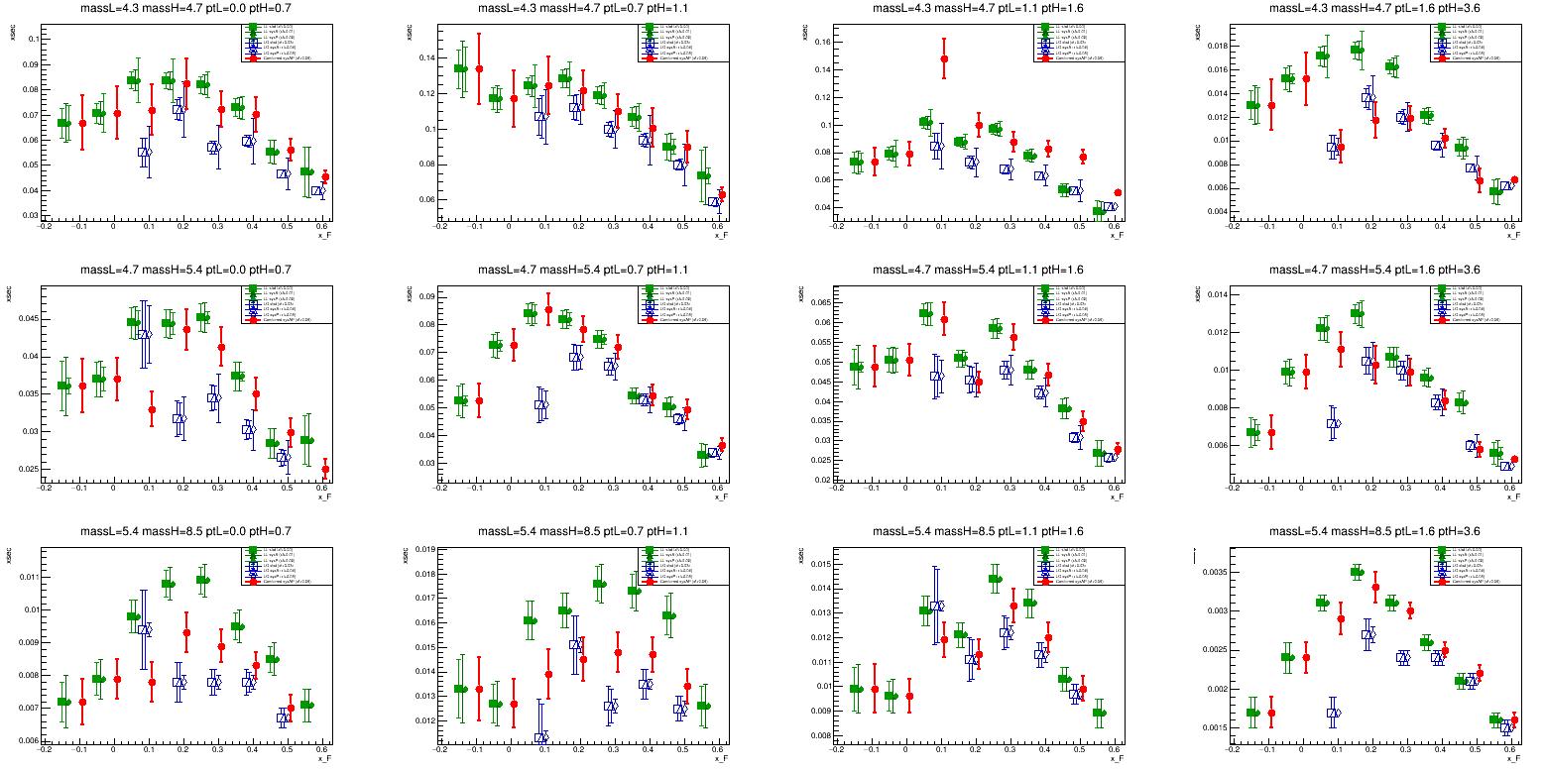
1st Test : CorrLL=CorrLO=0.8, CorrDA=0.7, uniform, only xf corr (for both Acc and Purity)
There are many non-physics points.

Slide 20
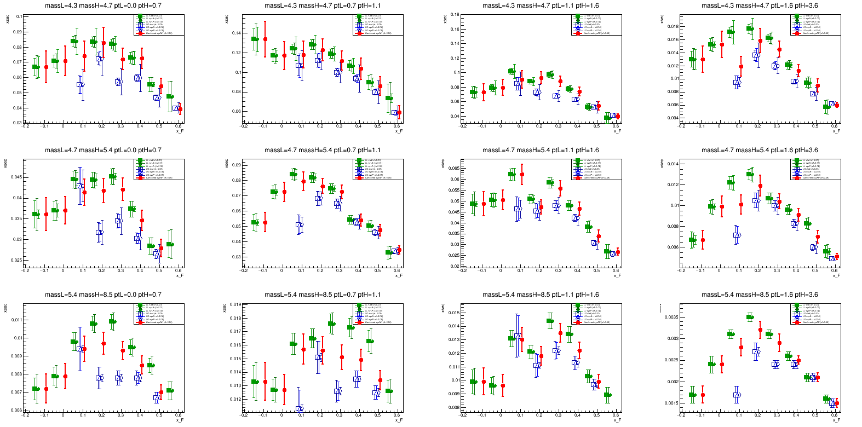
2nd Test : CorrLL=CorrLO=0.8, CorrDA=0.7, only xf corr and gaus-like (for both Acc and Purity)
Points are less jumping, nice~

Slide 21
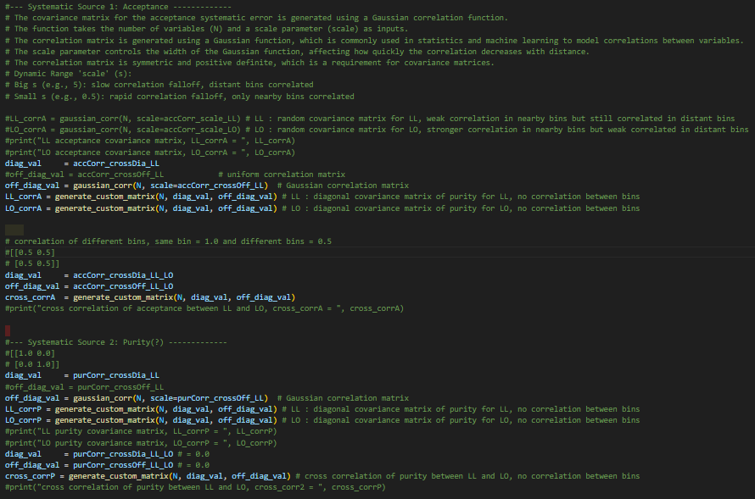
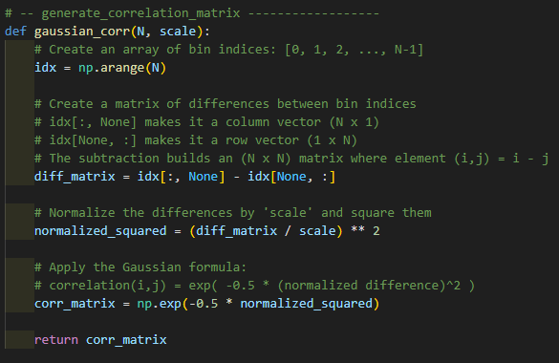
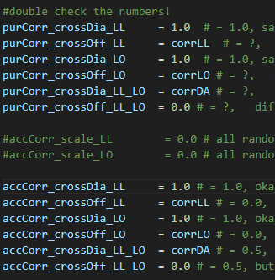
2nd Test : CorrLL=CorrLO=0.8, CorrDA=0.7, only xf corr and gaus-like (for both Acc and Purity)

Slide 22
2nd Test : CorrLL=CorrLO=0.8, CorrDA=0.7, only mass, pt, xf corr and gaus-like
(for both Acc and Purity)
Points are less jumping, nice~

