Slide 1
3-body charm production in $e^{+}e^{−}$annihilation
Student: Chih Wei Chen
Advisor : Prof. A.E. Chen
Department of Physics National Central University

Slide 2
Outline
Motivation
Belle analysis and Monte Carlo result
Cross section analysis
Non-resonance cross section
Resonance cross section
Conclusion
Future Work
References

Slide 3
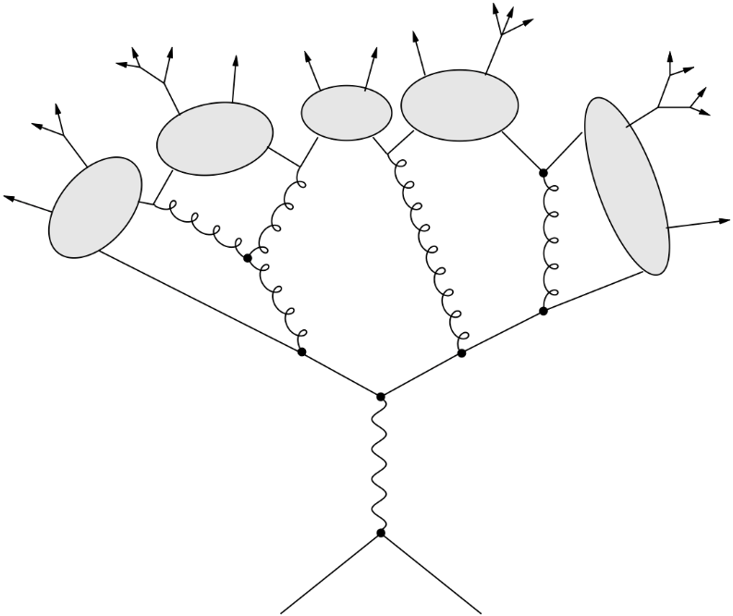
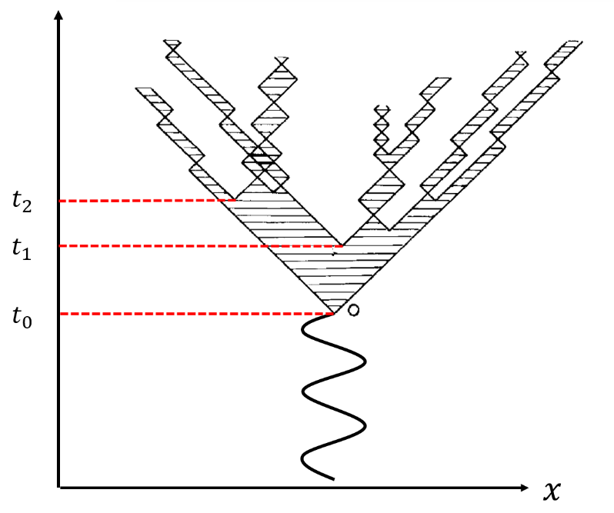
Motivation
String model(Pythia / LUND)
Cluster model(Herwig / Weber)
Nowadays, it’s common to simulate the experimental data with the Monte Carlo in the analysis of high energy physics, and in this way we can analyze much more physical meaning. There are two mathematical models in Monte Carlo to predict the generation status of particles which are Pythia and Herwig (in KEK we use Pythia),

Slide 4
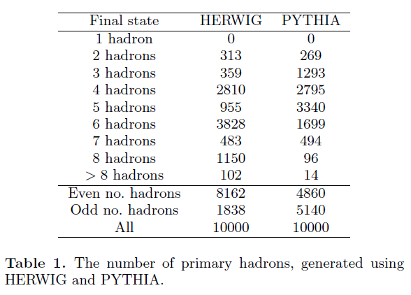
Motivation
D meson production from $e^{+}e^{−}$
 | HERWIG | PYTHIA
2 hadron | 313 | 269
3 hadron | 359 | 1293
Event number ratio | $$0.872±0.067$$ | $$0.208±0.014$$
According to table, event ratio from two body and three body production are very different, Herwing is about $\left(0.872±0.067\right)$ Pythia is $\left(0.208±0.014\right)$, so we want to know which kind of model is similar to experiment.
“Regge-cascade hadronization”
K.Odagiri arXiv:hep-ph/0505315

Slide 5
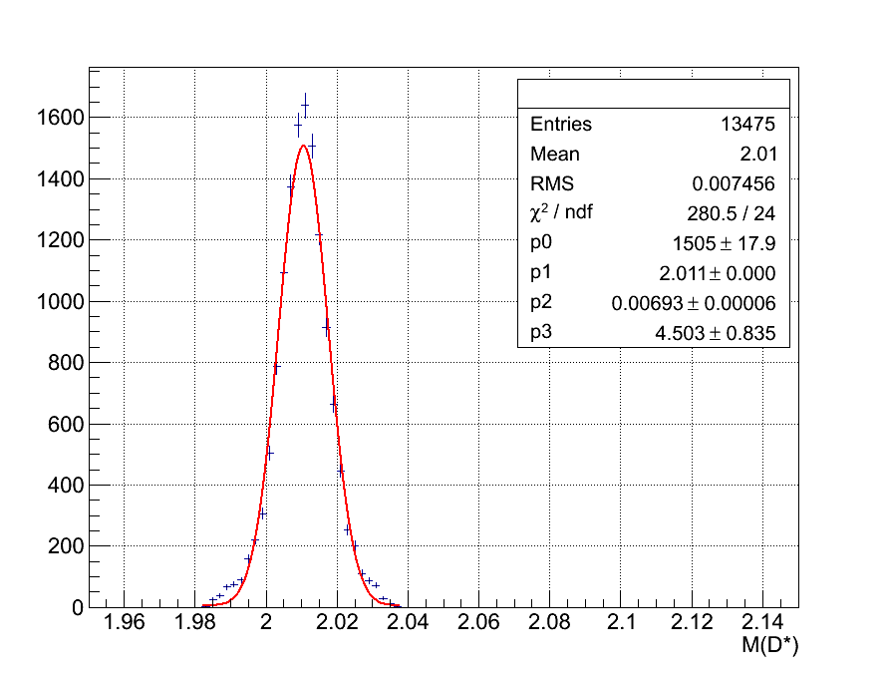
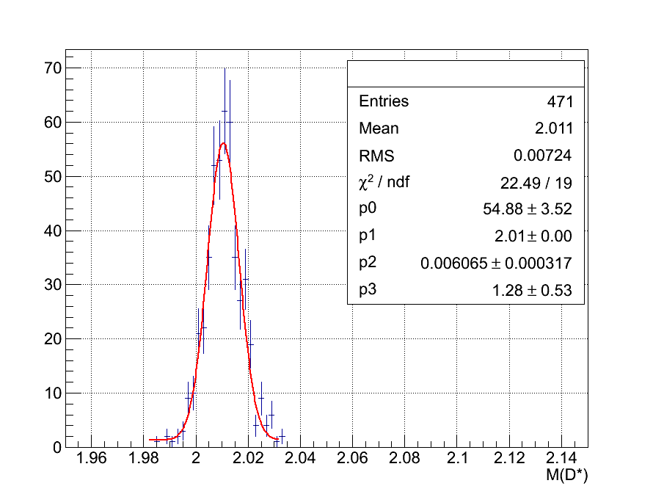
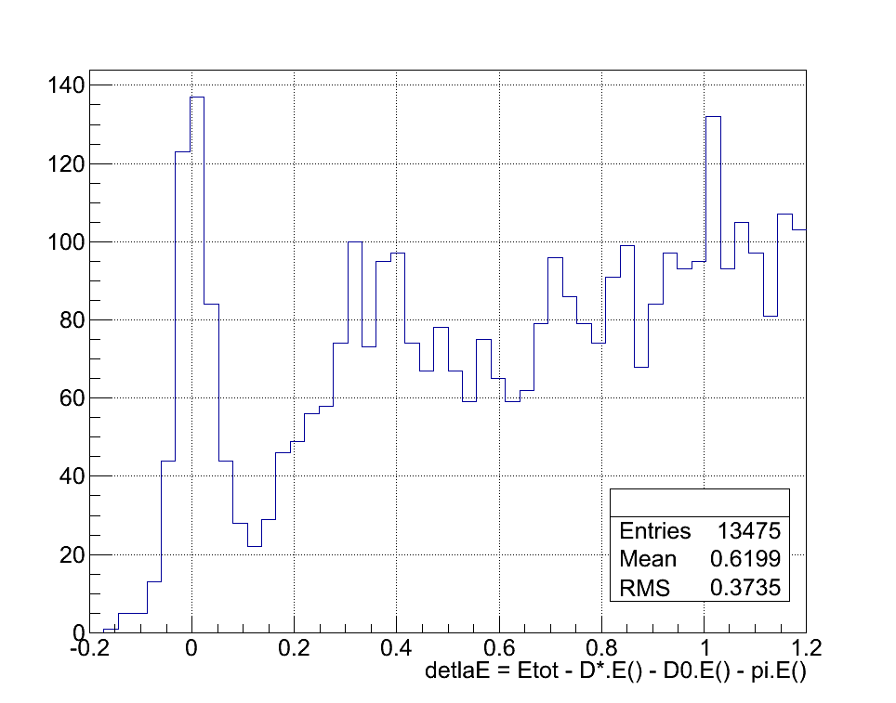
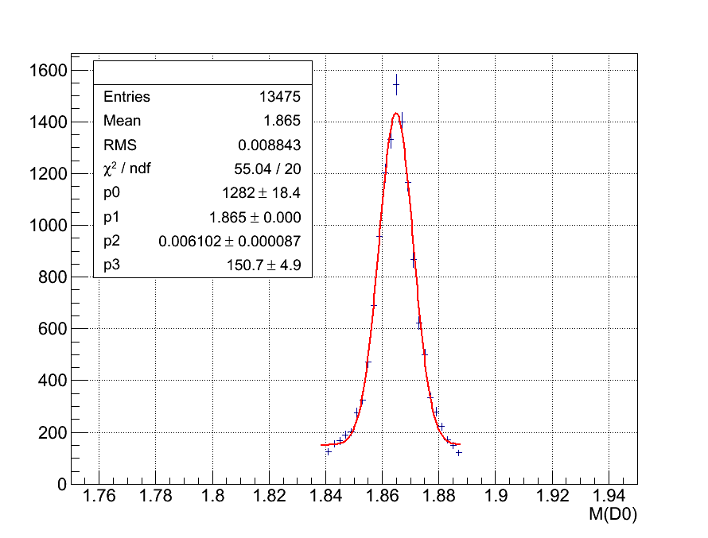
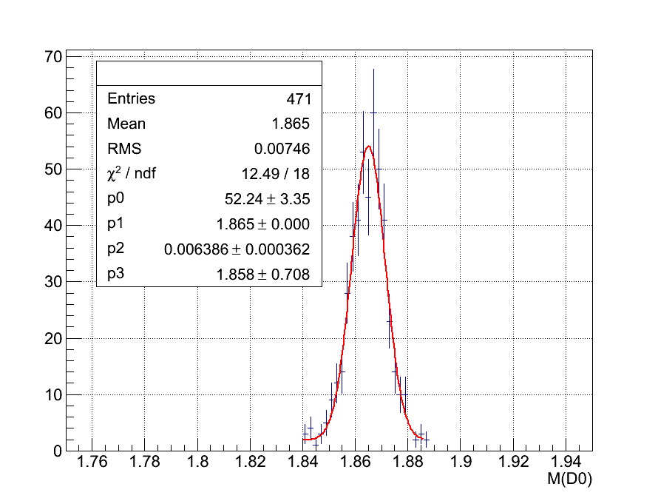
Belle data analysis Reconstruct $e^{+}e^{−}→{D^{∗−}D^{0}π^{+}}_{.cc}$
Selection and cuts of ${D^{∗−}D^{0}π^{+}}_{.cc}$
6 tracks
Decay channel ：
$D^{∗+}→D^{0}π^{+}$、$D^{0}→K^{−}π^{+}$
PID
$$atcKPI>0.6→kaon$$
$$atcKPI<0.6→pion$$
$D^{0}$ selection
$$\left|M\left(k^{∓}π^{±}\right)−1.864\right|<0.024GeV$$
$D^{∗±}$ selection
$$\left|M\left(k^{∓}π^{±}π^{±}\right)−M\left(k^{∓}π^{±}\right)−0.1455\right|<0.0045GeV$$
$D^{0}$ selection
$$\left|M\left(k^{±}π^{∓}\right)−1.864\right|<0.024GeV$$
$\left|∆E\right|<0.1Gev \left(∆E≡E_{tot}−E_{D^{∗±}}−E_{D^{0}}−E_{π^{∓}}\right)$
$$ΔE=−1GeV$$
$$ΔE=1GeV$$
$$M\left(D^{∗±}\right)$$
$$M\left(D^{∗±}\right)$$
$$∆E=E_{tot}−E_{D^{∗±}}−E_{D^{0}}−E_{π^{∓}}$$
$$M{\left(D^{0}\right)}_{.cc}$$
$$M{\left(D^{0}\right)}_{.cc}$$

Slide 6
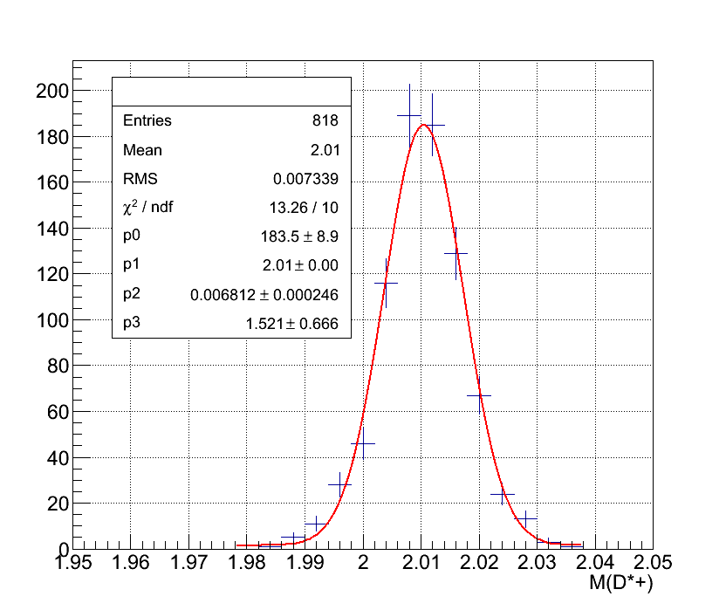
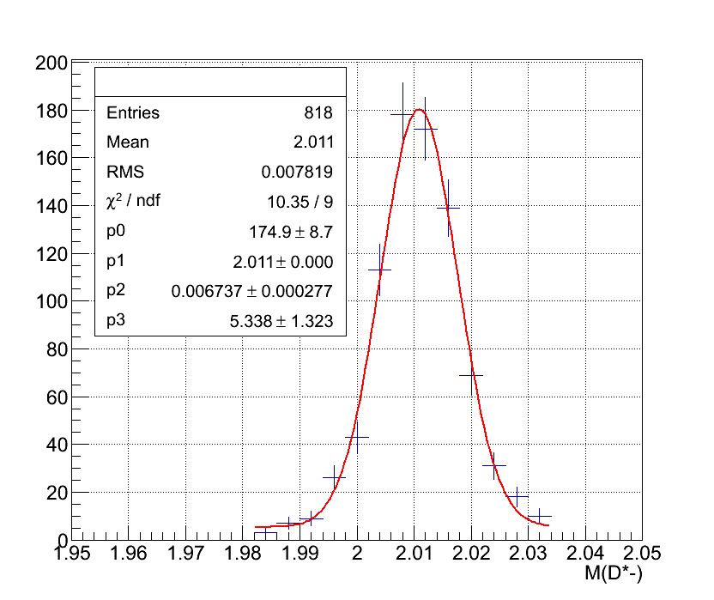
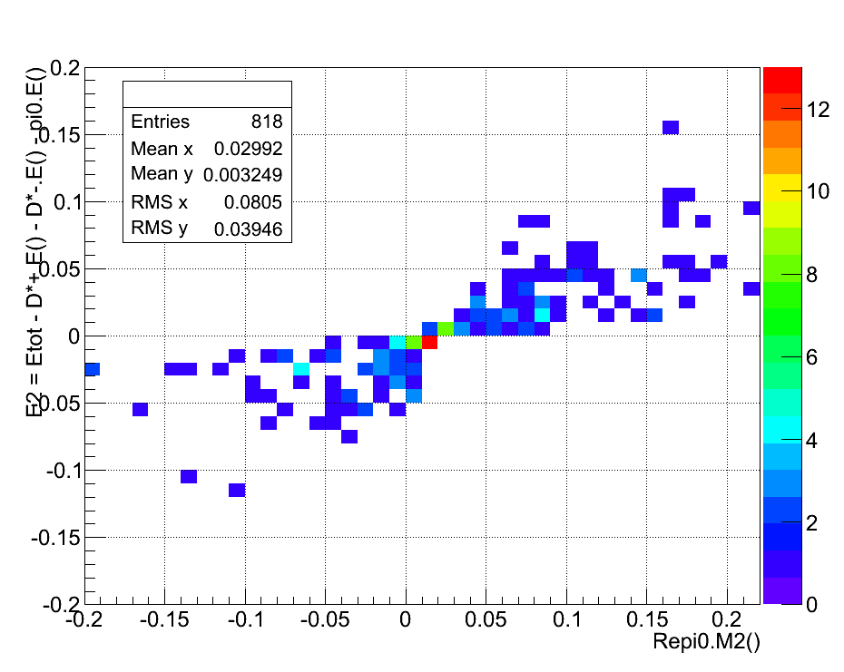
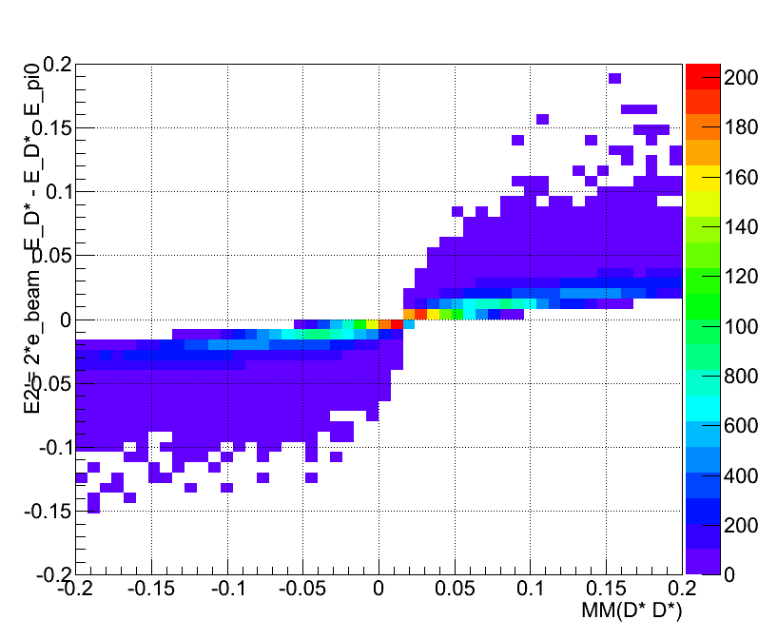
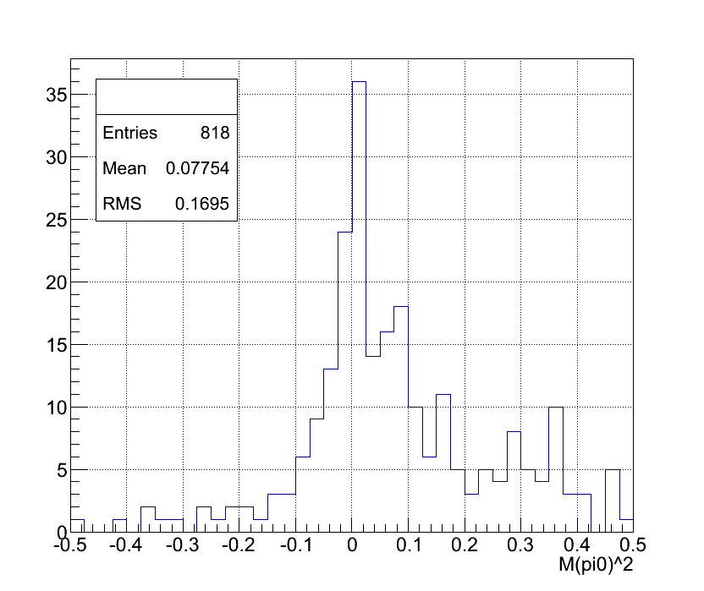
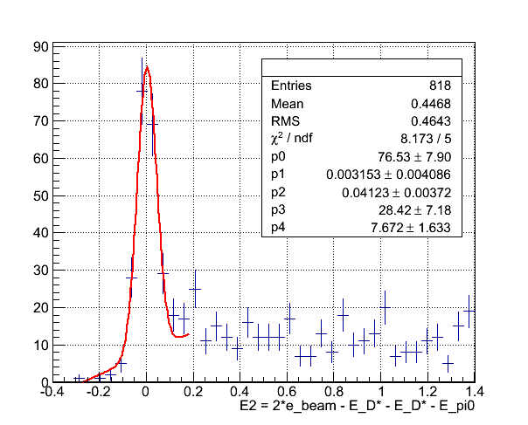
Belle data analysis Reconstruct $e^{+}e^{−}→D^{∗−}D^{∗+}π^{0}$
$${\left[{MM\left(D^{∗+}D^{∗−}\right)}^{2}\right]}^{2}+{{∆E}_{2}}^{2}<{0.1}^{2}$$
Selection & cuts of $D^{∗−}D^{∗+}π^{0}$
6 tracks
Decay channel ：
$D^{∗+}→D^{0}π^{+}$、$D^{0}→K^{−}π^{+}$
PID
$$atcKPI>0.6→kaon$$
$$atcKPI<0.6→pion$$
$D^{0}$ selection
$$\left|M\left(k^{+}π^{−}\right)−1.864\right|<0.024$$
$D^{∗−}$ selection
$$\left|M\left(k^{+}π^{−}π^{−}\right)−M\left(k^{+}π^{−}\right)−0.1455\right|<0.0045$$
${\overline{D}}^{0}$ selection
$$\left|M\left(k^{−}π^{+}\right)−1.864\right|<0.024$$
$D^{∗+}$ selection
$$\left|M\left(k^{−}π^{+}π^{+}\right)−M\left(k^{−}π^{+}\right)−0.1455\right|<0.0045$$
$\left|∆E_{1}\right|>0.1Gev \left(∆E_{1}=E_{tot}−E_{D^{∗+}}−E_{D^{∗−}}\right)$
${\left[{MM\left(D^{∗+}D^{∗−}\right)}^{2}\right]}^{2}+{{∆E}_{2}}^{2}<{0.1}^{2}$
$$\left({∆E}_{2}=E_{tot}−E_{D^{∗+}}−E_{D^{∗−}}−E_{π^{0}}\right)$$
$$∆E_{2}=E_{tot}−E_{D^{∗+}}−E_{D^{∗−}}−E_{corπ^{0}}$$
$$∆E_{2}=E_{tot}−E_{D^{∗+}}−E_{D^{∗−}}−E_{corπ^{0}}$$
$$MM{\left(D^{∗+}D^{∗−}\right)}^{2}$$
$$MM{\left(D^{∗+}D^{∗−}\right)}^{2}$$
Real Data
Monte Carlo

Slide 7
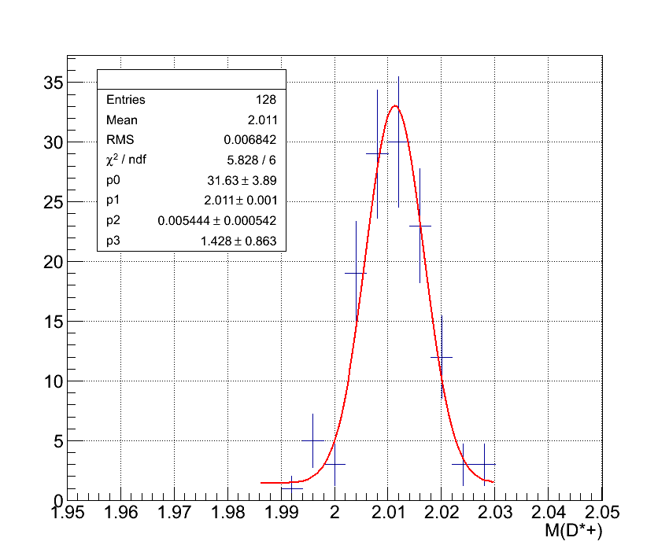
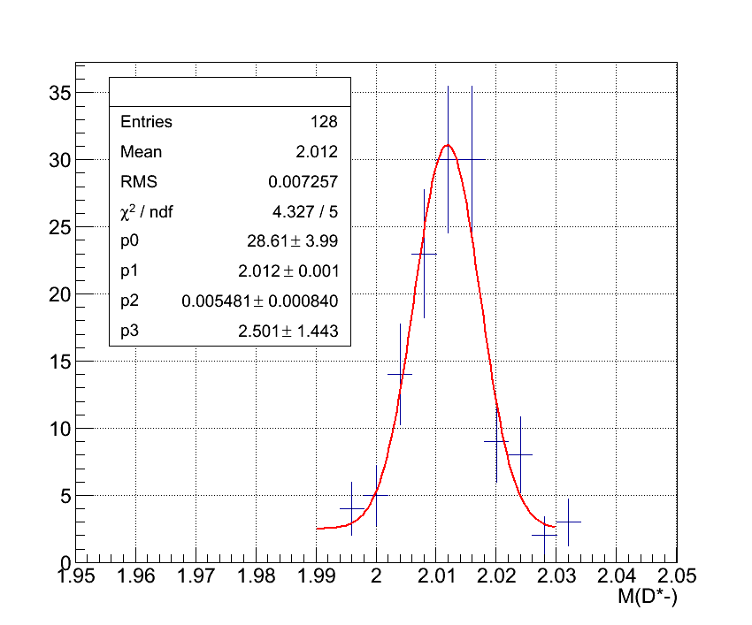
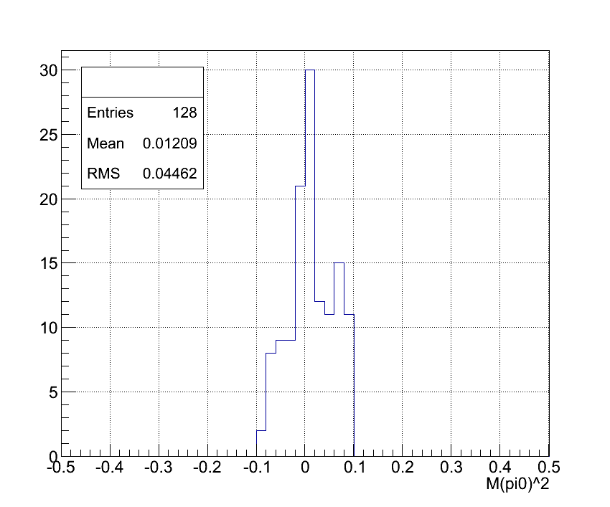
Belle data analysis Reconstruct $e^{+}e^{−}→D^{∗−}D^{∗+}π^{0}$
Before selection
Before selection
Before selection
$$M\left(D^{∗+}\right)$$
$$M\left(D^{∗−}\right)$$
$$M{\left(π^{0}\right)}^{2}$$
After selection
After selection
After selection
$$M\left(D^{∗+}\right)$$
$$M\left(D^{∗−}\right)$$
$$M{\left(π^{0}\right)}^{2}$$

Slide 8
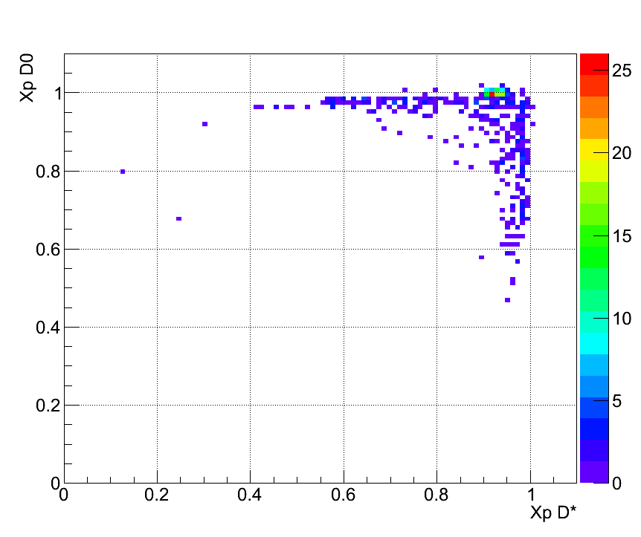
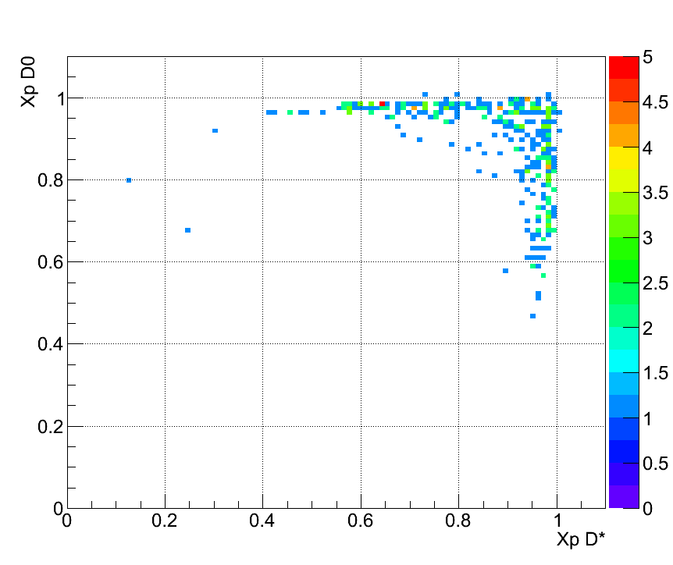
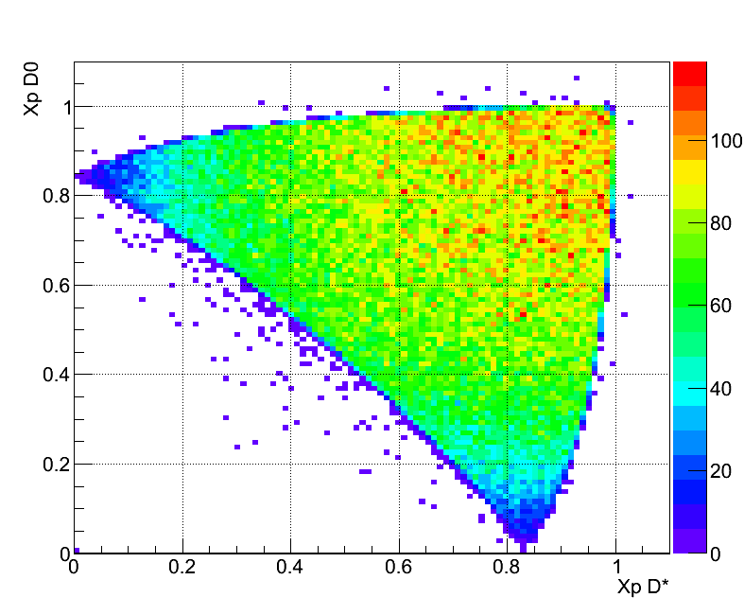
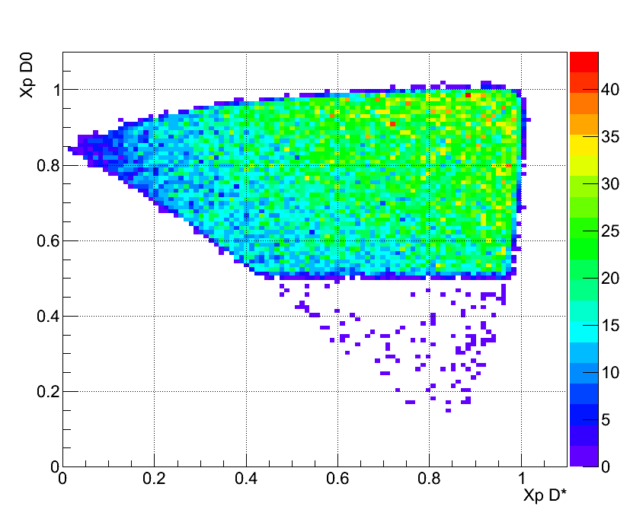
Three body kinematics Comparison $X_{p}$ of ${D^{∗−}D^{0}π^{+}}_{.cc}$ between real data and Monte Carlo
$$X_{p}D^{∗}$$
$$X_{p}D^{∗}$$
$$X_{p}≡\frac{\left|\overset{⃑}{p}\right|}{\left|{\overset{⃑}{p}}_{Max}\right|}$$
$$D^{∗∓}D^{∗±}→{D^{∗−}D^{0}π^{+}}_{.cc}$$
Real Data
Real Data
$$X_{p}D^{0}$$
$$X_{p}D^{0}$$
$$X_{p}D^{∗}$$
$$X_{p}D^{∗}$$
At least one $D^{∗}$’s momentum bigger then 2.5 GeV
$${MC}_{in}$$
$${MC}_{out}$$
$$X_{p}D^{0}$$
$$X_{p}D^{0}$$

Slide 9
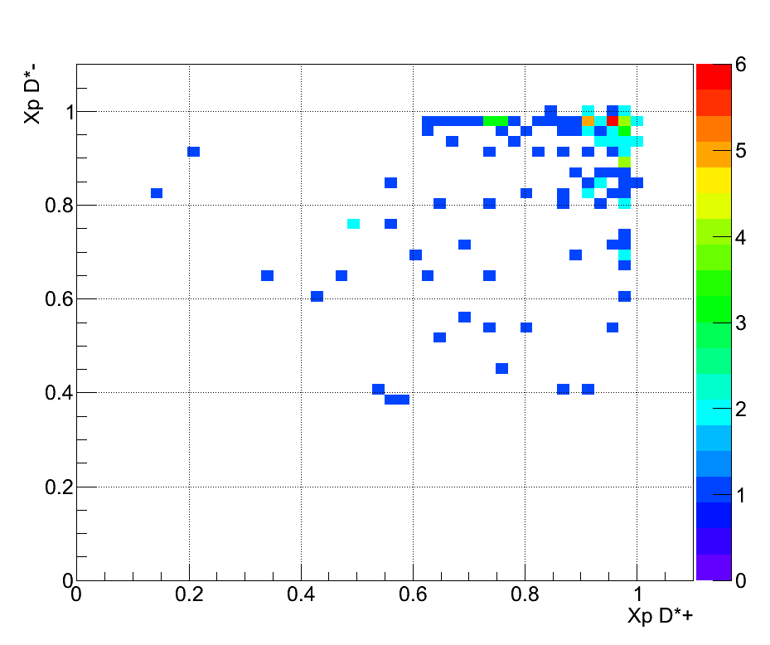
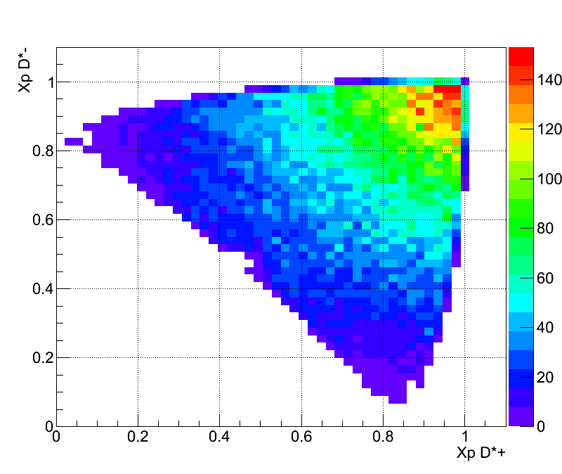
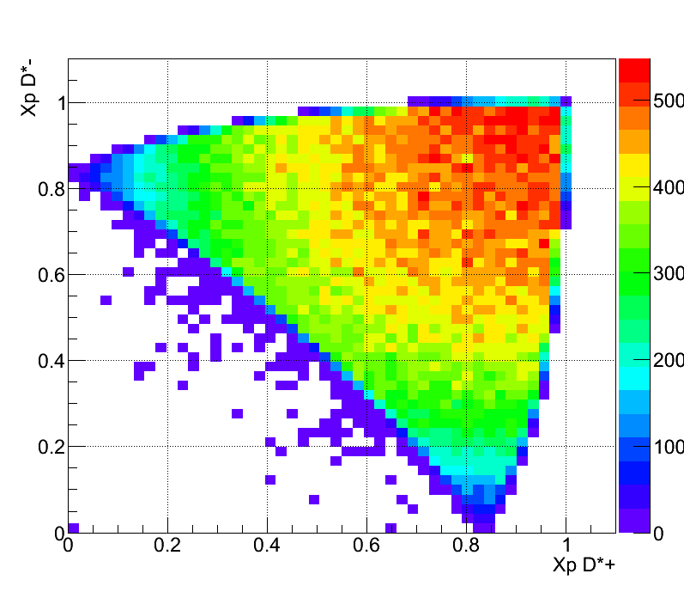
Three body kinematics Comparison $X_{p}$ of $D^{∗+}D^{∗−}π^{0}$ between real data and Monte Carlo
$$X_{p}D^{∗−}$$
$$X_{p}D^{∗−}$$
$$X_{p}D^{∗−}$$
Real Data
$$X_{p}D^{∗+}$$
$${MC}_{out}$$
$$X_{p}D^{∗+}$$
$$X_{p}D^{∗+}$$
$${MC}_{in}$$
$X_{p}$ distribution of real data and Monte Carlo are different
Monte Carlo：$\left(1，1\right)$ density is highest
${D^{∗−}D^{0}π^{+}}_{.cc}$ ：Distributed on $X_{p}D^{∗}=1$ or $X_{p}D^{0}=1$
$D^{∗+}D^{∗−}π^{0}$ ： Distributed on $X_{p}D^{∗+}=1$ or $X_{p}D^{∗−}=1$

Slide 10
Cross section analysis
According to previous slide, three body production can be separate to two case :
Non-resonance state production :
Pure three body cross section
Identify resonance from real data and count number.
Use total event number minus resonance event number to get non-resonance event number.
Analysis efficiency by Xp and decide which method is more satisfying to calculate cross section from real data.
Differential cross section
Total cross section
Resonance state production :
Resonance cross section estimate
Identify resonance in D meson mass spectra

Slide 11
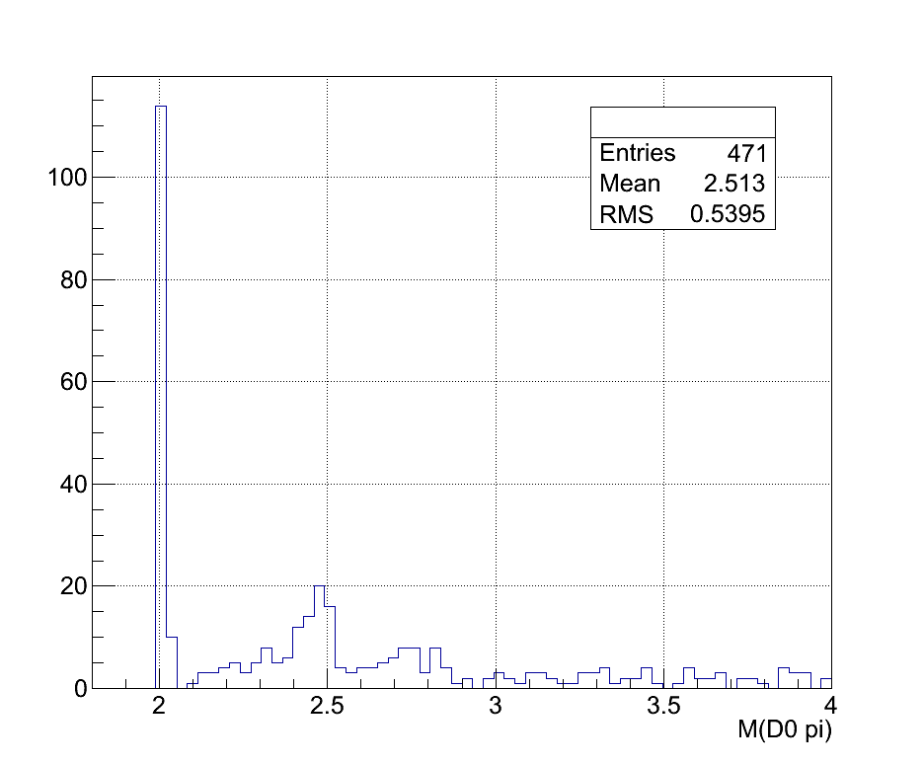
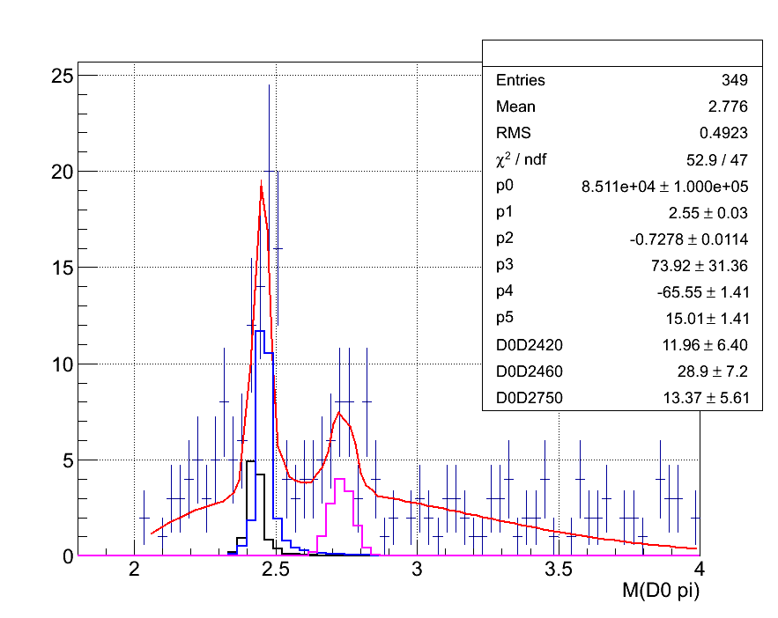
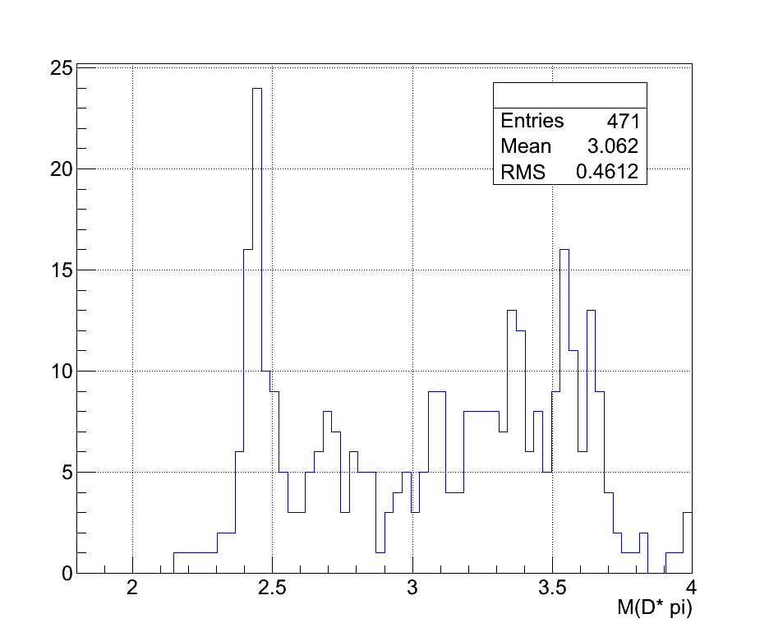
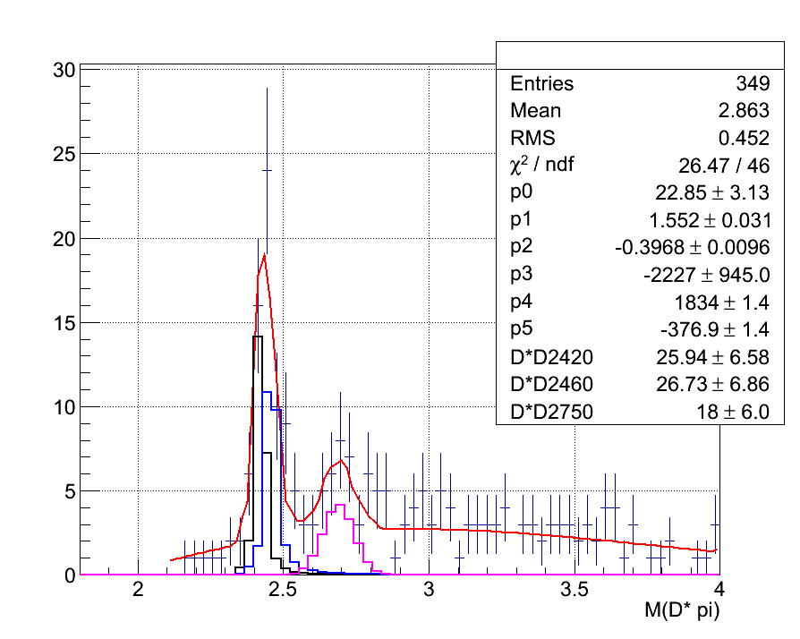
Identify resonance from ${e^{+}e^{−}→D^{∗−}D^{0}π^{+}}_{.cc}$ production
$$B\left(x\right)=P\left(x\right)×\left\{\begin{aligned}&e^{p_{1}x+p_{2}x^{2}} \\ &e^{p_{3}+p_{4}x+p_{5}x^{2}}\end{aligned}\right. {for x≤p_{0} \atop for x>p_{0}}$$
[5]
$$P\left(x\right)≡\frac{1}{2x}\sqrt{\left[x^{2}−{\left(m_{D}+m_{π}\right)}^{2}\right]\left[x^{2}−{\left(m_{D}−m_{π}\right)}^{2}\right]}$$
$$D^{∗±}D^{∗∓}$$
Type | Number
Total number | $$471±21.70$$
$${\overline{D}}^{0}D_{1}{\left(2420\right)}^{0}$$ | $$11.96±6.40$$
$${\overline{D}}^{0}D_{2}^{∗}{\left(2460\right)}^{∓}$$ | $$28.90±7.2$$
$${\overline{D}}^{0}{D\left(2750\right)}^{0}$$ | $$13.37±5.61$$
$$D^{∗}{\left(2010\right)}^{±}D^{∗}{\left(2010\right)}^{±}$$ | $$122±11.04$$
$$D^{∗}{\left(2010\right)}^{±}D_{1}{\left(2420\right)}^{∓}$$ | $$25.94±6.58$$
$$D^{∗}{\left(2010\right)}^{±}D_{2}^{∗}{\left(2460\right)}^{∓}$$ | $$26.73±8.68$$
$$D^{∗}{\left(2010\right)}^{±}{D\left(2750\right)}^{∓}$$ | $$17.99±6.04$$
Resonance state | $$246.89±38.04$$
Non-Resonance state | $$224.11±29.53$$
$$M{\left(D^{0}π^{+}\right)}_{.cc}$$
Remove $D^{∗∓}D^{∗±}$
$$M{\left(D^{0}π^{+}\right)}_{.cc}$$
$$M\left(D^{∗±}π^{∓}\right)$$
$$M\left(D^{∗±}π^{∓}\right)$$

Slide 12
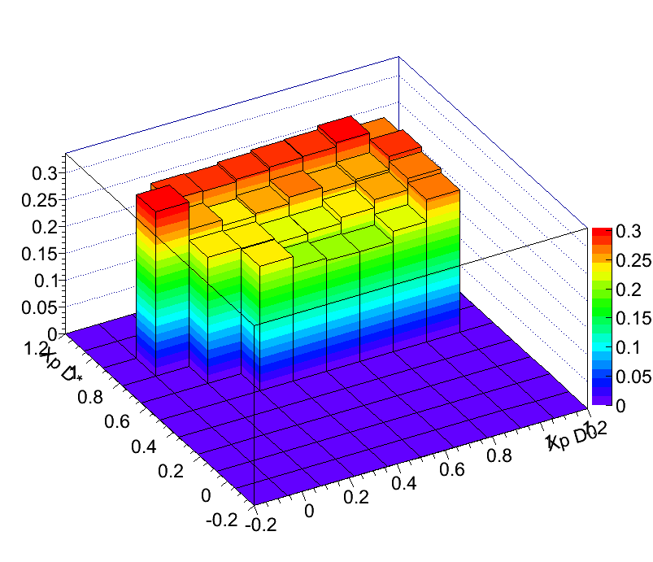
Non-resonance cross section analysis $e^{+}e^{−}→{D^{∗−}D^{0}π^{+}}_{.cc}$
$${dε_{{D^{∗−}D^{0}π^{+}}_{.cc}}}/{dX_{pD^{∗}}dX_{pD^{0}}}$$
Use Monte Carlo generate ${e^{+}e^{−}→D^{∗−}D^{0}π^{+}}_{.cc}$
$N\left(Monte Carlo Input\right)=227872$
$N\left(Monte Carlo Output\right)=56178$
$\overline{ε}≡\frac{N\left(Monte Carlo Output\right)}{N\left(Monte Carlo Input\right)}=\frac{56178}{227872}≅0.247±0.001$
Remove resonance in real data to get pure ${e^{+}e^{−}→D^{∗−}D^{0}π^{+}}_{.cc}$ event
 | value
Pure ${e^{+}e^{−}→D^{∗−}D^{0}π^{+}}_{.cc}$ number | 224.11±29.53
Efficiency | $$0.247±0.001$$
Statistics correction | 909.05±120.05
$$ℒ\left({fb}^{−1}\right)$$ | 871.77
Pure three body cross section $\left(fb\right)$ | 997.27±131.41

Slide 13
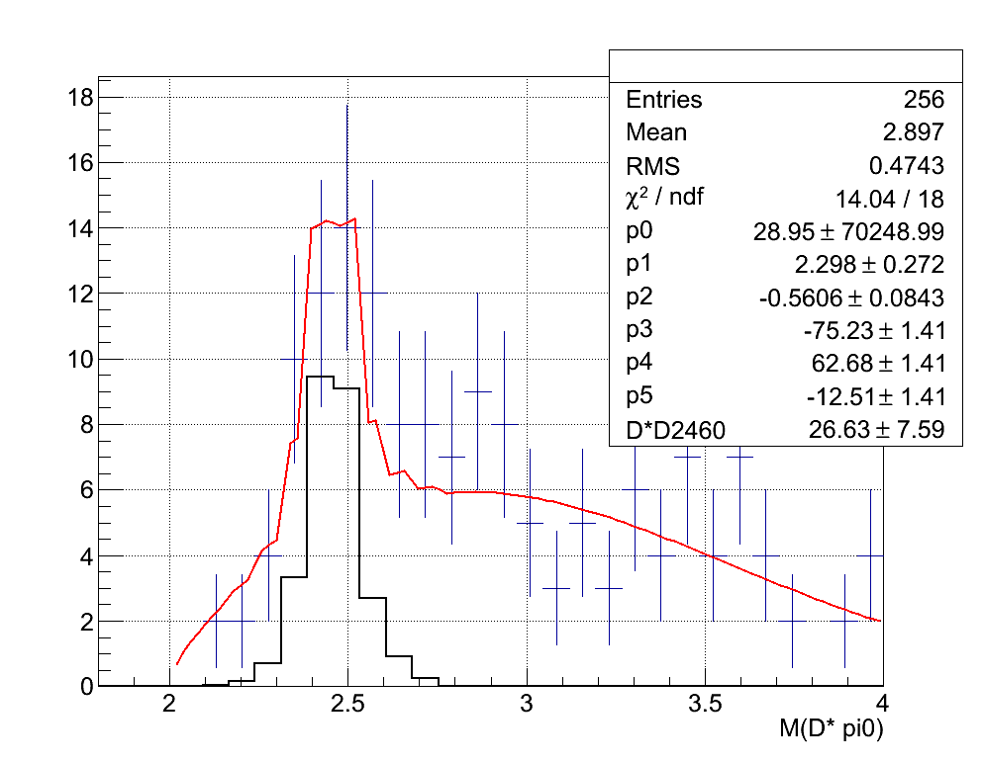
Identify resonance from $e^{+}e^{−}→D^{∗+}D^{∗−}π^{0}$ production
Type | Number
Total Number | $$128±11.31$$
$$D^{∗±}D_{2}^{∗}{\left(2460\right)}^{∓}$$ | $$26.63±7.59$$
Non-Resonance state | $$101.37±13.62$$
$$M\left(D^{∗±}π^{0}\right)$$

Slide 14
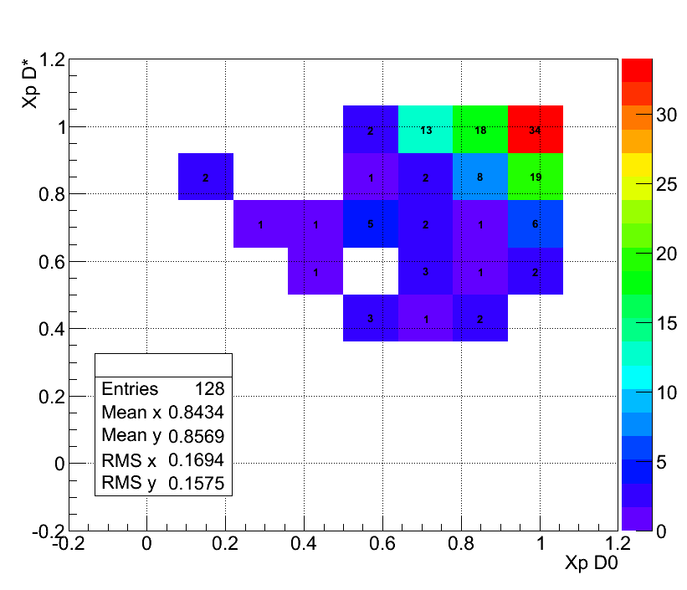
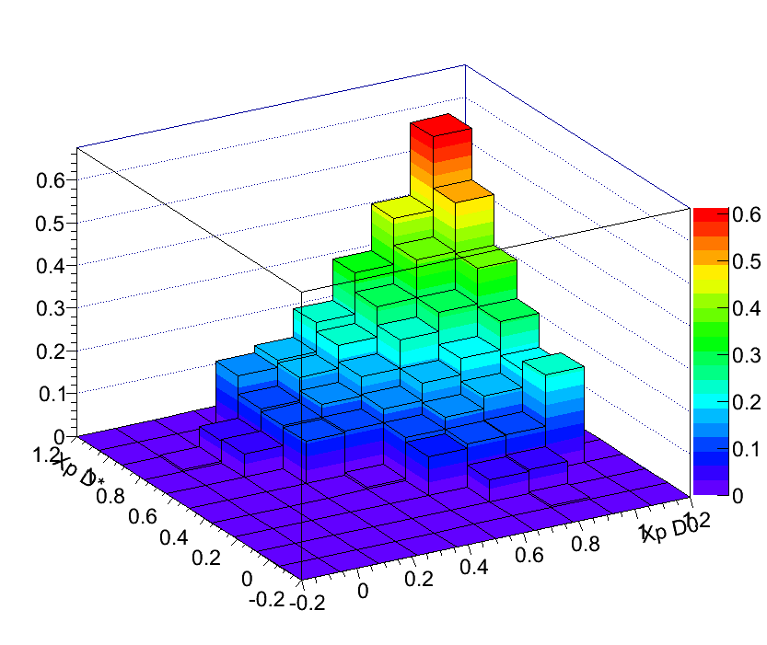
Non-resonance cross section analysis $e^{+}e^{−}→D^{∗−}D^{∗+}π^{0}$
Real Data
$${dε_{D^{∗−}D^{∗+}π^{0}}}/{dX_{pD^{∗+}}dX_{pD^{∗−}}}$$
Efficiency of each bin are very different, so we can not use average efficiency, we use different cross section.
Remove statistics in red cycle and calculate cross section bin by bin.
Remove $n\left(D^{∗±}D_{2}^{∗}{\left(2460\right)}^{±}\right)=26.63±7.59$
Statistics in this bin：$\left(7.37±9.57\right)$

Slide 15
Non-resonance cross section analysis $e^{+}e^{−}→D^{∗−}D^{∗+}π^{0}$
Differential Cross Section
$$\left(X_{pD^{∗+}},X_{pD^{∗−}}\right)$$ | Cross Section$\left(fb\right)$ | $$\left(X_{pD^{∗+}},X_{pD^{∗−}}\right)$$ | Cross Section$\left(fb\right)$
$$≅\left(1.0,1.0\right)$$ | 19.51±25.34 | $$≅\left(0.7,0.7\right)$$ | 13.29±3.90
$$≅\left(1.0,0.9\right)$$ | 62.52±4.86 | $$≅\left(0.7,0.6\right)$$ | 27.56±5.08
$$≅\left(1.0,0.7\right)$$ | 26.03±4.15 | $$≅\left(0.7,0.4\right)$$ | 12.44±4.49
$$≅\left(1.0,0.6\right)$$ | 11.49±3.36 | $$≅\left(0.6,1.0\right)$$ | 13.74±3.97
$$≅\left(0.9,1.0\right)$$ | 65.98±5.03 | $$≅\left(0.6,0.9\right)$$ | 7.52±3.49
$$≅\left(0.9,0.9\right)$$ | 34.28±4.43 | $$≅\left(0.6,0.7\right)$$ | 45.88±5.77
$$≅\left(0.9,0.7\right)$$ | 5.61±3.02 | $$≅\left(0.9,0.4\right)$$ | 47.60±6.68
$$≅\left(0.9,0.6\right)$$ | 7.56±3.50 | $$≅\left(0.4,0.7\right)$$ | 12.37±4.48
$$≅\left(0.9,0.4\right)$$ | 20.17±4.81 | $$≅\left(0.4,0.6\right)$$ | 15.81±5.06
$$≅\left(0.7,1.0\right)$$ | 63.23±5.35 | $$≅\left(0.3,0.7\right)$$ | 16.00±5.09
$$≅\left(0.7,0.9\right)$$ | 11.23±3.59 | $$≅\left(0.1,0.9\right)$$ | 63.61±8.56
Sum of cross section |  | 603.43±35.69$\left(fb\right)$

Slide 16
${D^{∗−}D^{0}π^{+}}_{.cc}$ resonance cross section analysis
Use Monte Carlo to generate：
$e^{+}e^{−}→D^{∗±}D_{1}{\left(2420\right)}^{∓}$
$e^{+}e^{−}→{{\overline{D}}^{0}D_{1}{\left(2420\right)}^{0}}_{.cc}$
$e^{+}e^{−}→D^{∗±}D_{2}^{∗}{\left(2460\right)}^{∓}$
$e^{+}e^{−}→D^{0}D_{2}^{∗}{\left(2460\right)}^{0}$
 | $$e^{+}e^{−}→{{\overline{D}}^{0}D_{1}{\left(2420\right)}^{0}}_{.cc}$$ | $$e^{+}e^{−}→{{\overline{D}}^{0}D_{2}^{∗}{\left(2460\right)}^{0}}_{.cc}$$ | $$e^{+}e^{−}→D^{∗±}D_{1}{\left(2420\right)}^{∓}$$ | $$e^{+}e^{−}→D^{∗±}D_{2}^{∗}{\left(2460\right)}^{∓}$$
Statistics | $$11.96±6.40$$ | $$28.90±7.2$$ | $$25.94±6.58$$ | $$26.73±8.68$$
Efficiency | $$0.278±0.001$$ | $$0.277±0.001$$ | $$0.278±0.001$$ | $$0.277±0.001$$
Branching Ratio | $$0.677×{0.0359}^{2}×{Br}_{D_{1}{\left(2420\right)}^{±}}$$ | $$0.677×{0.0359}^{2}×{Br}_{D_{2}^{∗}{\left(2460\right)}^{±}}$$ | $$0.677×{0.0359}^{2}×{Br}_{D_{1}{\left(2420\right)}^{0}}$$ | $$0.677×{0.0359}^{2}×{Br}_{D_{2}^{∗}{\left(2460\right)}^{0}}$$
Cross section (fb) | $$\frac{48.17±25.78}{{Br}_{D_{1}{\left(2420\right)}^{±}}}$$ | $$\frac{116.40±29.00}{{Br}_{D_{2}^{∗}{\left(2460\right)}^{±}}}$$ | $$\frac{104.48±26.50}{{Br}_{D_{1}{\left(2420\right)}^{0}}}$$ | $$\frac{107.66±28.47}{{Br}_{D_{2}^{∗}{\left(2460\right)}^{0}}}$$

Slide 17
Resonance cross section estimate $D_{2}^{∗}{\left(2460\right)}^{0}$Branching ratio estimate
Result from BaBar Collaboration (PhysRevD.82.111101)
$$\frac{B\left(D_{2}^{∗}{\left(2460\right)}^{0}→D^{+}π^{−}\right)}{B\left(D_{2}^{∗}{\left(2460\right)}^{0}→D^{∗+}π^{−}\right)}=1.47±0.03±0.16$$
Assume $D_{2}^{∗}{\left(2460\right)}^{0}$ only have four decay channel(arXiv:hep-ex/0601025 v2 18 Apr 2006(KLOE Collaboration)) :
$$D_{2}^{∗}{\left(2460\right)}^{0}→D^{∗+}π^{−}$$
$$D_{2}^{∗}{\left(2460\right)}^{0}→D^{+}π^{−}$$
$$D_{2}^{∗}{\left(2460\right)}^{0}→D^{∗0}π^{0}$$
$$D_{2}^{∗}{\left(2460\right)}^{0}→D^{0}π^{0}$$
Assume ${N\left(K_{s}^{0}→π^{+}π^{−}\right)}/{N\left(K_{s}^{0}→π^{0}π^{0}\right)}≅{N\left(γ→π^{+}π^{−}\right)}/{N\left(γ→π^{0}π^{0}\right)}≅2.255±0.005$( arXiv:hep-ex/0601025 v2 18 Apr 2006(KLOE Collaboration))
$B\left(D_{2}^{∗}{\left(2460\right)}^{0}→D^{∗+}π^{−}\right)=\left(0.280±0.120\right)$
$B\left(D_{2}^{∗}{\left(2460\right)}^{0}→D^{+}π^{−}\right)=\left(0.412±\text{0.177} \right)$
$B\left(D_{2}^{∗}{\left(2460\right)}^{0}→D^{0}π^{0}\right)=\left(0.183±0.078\right)$
$B\left(D_{2}^{∗}{\left(2460\right)}^{0}→D^{∗0}π^{0}\right)=\left(0.124±0.053\right)$

Slide 18
 | $$e^{+}e^{−}→{\overline{D}}^{0}D_{1}{\left(2420\right)}^{0}$$ | $$e^{+}e^{−}→{\overline{D}}^{0}D_{2}^{∗}{\left(2460\right)}^{0}$$ | $$e^{+}e^{−}→D^{∗±}D_{1}{\left(2420\right)}^{∓}$$ | $$e^{+}e^{−}→D^{∗±}D_{2}^{∗}{\left(2460\right)}^{∓}$$
statistics | $$11.96±6.40$$ | $$28.90±7.2$$ | $$25.94±6.58$$ | $$26.73±8.68$$
efficiency | $$0.278±0.001$$ | $$0.277±0.001$$ | $$0.278±0.001$$ | $$0.277±0.001$$
Branching ratio without error | $$0.677×{0.0359}^{2}×{Br}_{D_{1}{\left(2420\right)}^{0}}$$ | $$0.677×{0.0359}^{2}×{Br}_{D_{2}^{∗}{\left(2460\right)}^{0}}$$ | $$0.677×{0.0359}^{2}×{Br}_{D_{1}{\left(2420\right)}^{±}}$$ | $$0.677×{0.0359}^{2}×{Br}_{D_{2}^{∗}{\left(2460\right)}^{±}}$$
Cross Section $$\left(fb\right)$$ | $$\frac{48.17±25.78}{{Br}_{D_{1}{\left(2420\right)}^{0}}}$$ | $$\frac{116.40±29.00}{{Br}_{D_{2}^{∗}{\left(2460\right)}^{0}}}$$ | $$\frac{104.48±26.50}{{Br}_{D_{1}{\left(2420\right)}^{±}}}$$ | $$\frac{107.66±28.47}{{Br}_{D_{2}^{∗}{\left(2460\right)}^{±}}}$$
Branching estimate | $$Br\left(D_{2}^{∗}{\left(2460\right)}^{0}→D^{∗+}π^{−}\right)=\left(0.280±0.120\right)$$ | $$Br\left(D_{2}^{∗}{\left(2460\right)}^{0}→D^{∗+}π^{−}\right)=\left(0.280±0.120\right)$$ | $$Br\left(D_{2}^{∗}{\left(2460\right)}^{0}→D^{0}π^{0}\right)=\left(0.183±0.078\right)$$ | $$Br\left(D_{2}^{∗}{\left(2460\right)}^{0}→D^{0}π^{0}\right)=\left(0.183±0.078\right)$$
Cross Section estimate $$\left(fb\right)$$ | $$172.04±92.07±73.73$$ | $$415.71±103.57±44.39$$ | $$570.93±144.81±61.72$$ | $$588.31±155.57±66.31$$

Slide 19
Comparison between pure two body and three body
Pure two and three body cross section ratio | Value
$$\frac{σ\left(D^{∗+}D^{∗−}\right)}{σ\left(D^{∗+}D^{∗−}π^{0}\right)}$$ | $$\frac{\left(660±30\right)}{\left(603.43±35.69\right)}≅1.093±0.082$$
$$\frac{σ\left(D^{∗±}D^{∓}\right)}{σ{\left(D^{∗−}D^{0}π^{+}\right)}_{.cc}}$$ | $$\frac{\left(750±40\right)}{\left(997.27±131.41\right)}≅0.752±0.036$$
K.Odagiri simulation :
Herwig：${n\left(2 hadrons\right)}/{n\left(3 hadrons\right)={\left(313±17.69\right)}/{\left(359±18.95\right)}=}0.872±0.067$
Pythia ：${n\left(2 hadrons\right)}/{n\left(3 hadrons\right)={\left(269±16.40\right)}/{\left(1293±35.96\right)}=}0.208±0.014$
From table we learn our result are similar with Cluster model(Herwig)

Slide 20
Comparison between Vector and Pseudoscalar
Our result : pure $e^{+}e^{−}→DDπ$
T.Uglov : exclusive $e^{+}e^{−}→DD$
Production mode | Fill Cross Section
$$σ\left(e^{+}e^{−}\underset{→}{γ}D^{∗−}D^{∗+}π^{0}\right)$$ | $$603.43±35.69\left(fb\right)$$
$$σ\left(e^{+}e^{−}\underset{→}{γ}{D^{∗−}D^{0}π^{+}}_{.cc}\right)$$ | $$997.27±131.41\left(fb\right)$$
$${Vector}/{Pseudoscalar}$$ | ratio
$$\frac{σ\left(e^{+}e^{−}\underset{→}{γ}D^{∗−}D^{∗+}π^{0}\right)}{σ\left(e^{+}e^{−}\underset{→}{γ}{D^{∗−}D^{0}π^{+}}_{.cc}\right)}$$ | 0.605±0.087
Production mode | Fill Cross Section
$$σ\left(e^{+}e^{−}\underset{→}{γ}D^{∗−}D^{∗+}\right)$$ | $$660±30\left(fb\right)$$
$$σ\left(e^{+}e^{−}\underset{→}{γ}D^{∗±}D^{∓}\right)$$ | $$750±40\left(fb\right)$$
$${Vector}/{Pseudoscalar}$$ | ratio
$$\frac{σ\left(e^{+}e^{−}\underset{→}{γ}D^{∗−}D^{∗+}\right)}{σ\left(e^{+}e^{−}\underset{→}{γ}D^{∗±}D^{∓}\right)}$$ | 0.88±0.06
CLEO Collaboration Phy rev. D 70, 112001 (2004) : inclusive $e^{+}e^{−}→DX$
(assuming there is no resonance’s mass higher then $D^{∗}$)
Production mode | Cross Section
$$σ\left(e^{+}e^{−}→D^{∗0}X\right)$$ | $$616±32\left(fb\right)$$
$$σ\left(e^{+}e^{−}→D^{0}X\right)$$ | $$541±7.16\left(fb\right)$$
$${Vector}/{Pseudoscalar}$$ | Ratio
$$\frac{σ\left(e^{+}e^{−}→D^{∗0}X\right)}{σ\left(e^{+}e^{−}→D^{0}X\right)}$$ | 1.14±0.06
Production mode | Cross Section
$$σ\left(e^{+}e^{−}→D^{∗+}X\right)$$ | $$578±10\left(fb\right)$$
$$σ\left(e^{+}e^{−}→D^{+}X\right)$$ | $$455±7.16\left(fb\right)$$
$${Vector}/{Pseudoscalar}$$ | Ratio
$$\frac{σ\left(e^{+}e^{−}→D^{∗+}X\right)}{σ\left(e^{+}e^{−}→D^{+}X\right)}$$ | 1.27±0.03

Slide 21
Comparison between Vector and Pseudoscalar
Our result : pure $e^{+}e^{−}→DDπ$
$$\frac{σ\left(e^{+}e^{−}\underset{→}{γ}D^{∗−}D^{∗+}π^{0}\right)}{σ\left(e^{+}e^{−}\underset{→}{γ}{D^{∗−}D^{0}π^{+}}_{.cc}\right)}=\text{0.605±0.087}$$
T.Uglov : exclusive $e^{+}e^{−}→DD$
$$\frac{σ\left(e^{+}e^{−}\underset{→}{γ}D^{∗−}D^{∗+}\right)}{σ\left(e^{+}e^{−}\underset{→}{γ}D^{∗±}D^{∓}\right)}=\text{0.88±0.06}$$
CLEO Collaboration : inclusive $e^{+}e^{−}→DX$ (assuming there is no higher resonance)
$$\frac{σ\left(e^{+}e^{−}→D^{∗0}X\right)}{σ\left(e^{+}e^{−}→D^{0}X\right)}=\text{1.14±0.06}$$
$$\frac{σ\left(e^{+}e^{−}→D^{∗+}X\right)}{σ\left(e^{+}e^{−}→D^{+}X\right)}=\text{1.27±0.03}$$
Our result is similar to T.Uglov’s result
CLEO Collaboration ratio is bigger then our result which mean there are resonance contribution
Analysis ${Vector}/{Pseudoscalar}$ must consider higher resonance

Slide 22
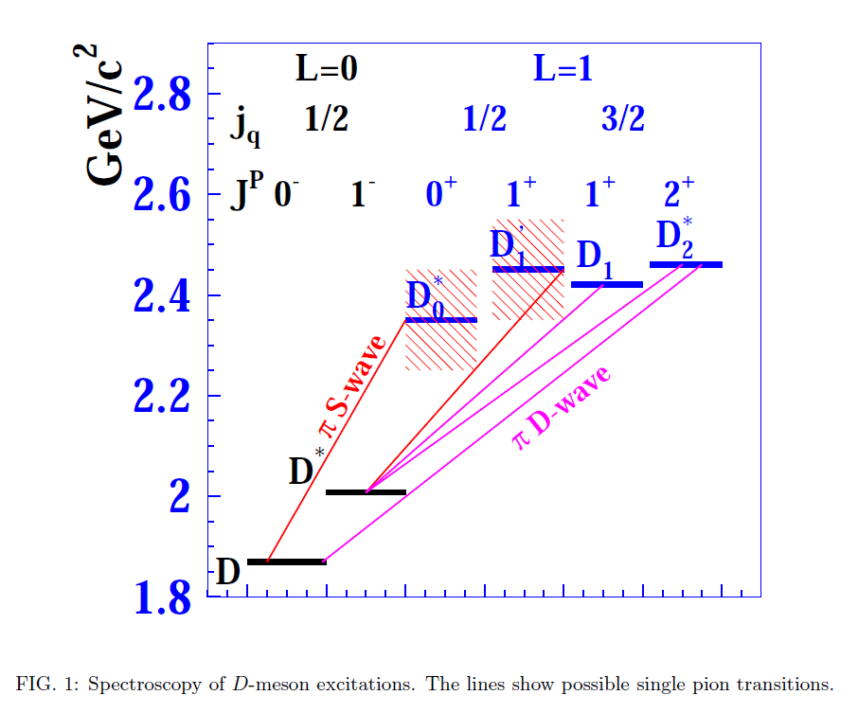
Identify resonance in D meson mass spectra
$$e^{+}e^{−}→D^{∗±}{D\left(2750\right)}^{∓}$$
$$e^{+}e^{−}→D^{0}{\overline{D}\left(2750\right)}^{0}$$
$$e^{+}e^{−}→D^{∗±}D_{2}^{∗}{\left(2460\right)}^{∓}$$
$$e^{+}e^{−}→D^{0}{\overline{D}}_{2}^{∗}{\left(2460\right)}^{0}$$
2S ?
$D_{3}^{∗}{\left(2750\right)}^{±}$ ?
$D_{3}{\left(2750\right)}^{0}$ ?
$$e^{+}e^{−}→D^{∗±}D_{1}{\left(2420\right)}^{∓}$$
$$e^{+}e^{−}→D^{0}{\overline{D}}_{1}{\left(2420\right)}^{0}$$

Slide 23
Conclusion
Non-resonance cross section
$σ_{{D^{∗−}D^{0}π^{+}}_{.cc}}=997.27±131.41\left(fb\right)$
$σ_{D^{∗+}D^{∗−}π^{0}}=603.43±35.69\left(fb\right)$
Ratio between two body production and three body is similar with Cluster model(Herwig)
In Xp 2D figure events are distributed in the direction of Xp = 1, because $π$ usually move forward together with D in center mass frame
${\text{Vector}}/{\text{Pseudoscalar}}$ ratio
Pure multi-body analysis is the better way to calculate ${\text{Vector}}/{\text{Pseudoscalar}}$ ratio
Resonance cross section estimate
$$σ_{D^{0}{\overline{D}}_{1}{\left(2420\right)}^{0}}=172.04±92.07±73.73\left(fb\right)$$
$$σ_{D^{0}D_{2}{\left(2460\right)}^{0}}=415.71±103.57±44.39\left(fb\right)$$
$$σ_{D^{∗+}D_{1}{\left(2420\right)}^{−}}=570.93±144.81±61.72\left(fb\right)$$
$$σ_{D^{∗+}D_{2}{\left(2460\right)}^{−}}=588.31±155.57±66.31\left(fb\right)$$

Slide 24
Future Work
Consider other decay channel：
$D^{0}→K^{−}π^{+}π^{−}π^{+}$(In $e^{+}e^{−}→{D^{∗−}D^{0}π^{0}}_{.cc}$ case we can have 4 times statistics)
Wait for Belle-2 result(50 times statistics)
Analysis other production mode：
$e^{+}e^{−}→D^{∗±}D^{∓}π^{0}$
$e^{+}e^{−}→{D^{−}D^{0}π^{+}}_{.cc}$
Analysis four body production, then comparison between pure two body 、three body、four body to know Mechanism of particle generation.
Analysis resonance state form factor
Identify other resonance state from $e^{+}e^{−}→DDπ$ production

Slide 25
References
[1]K. Odagiri,”Regge-cascade hadronization”, arXiv:hep-ph/0606315 v1, 30 Jun 2006
[2]K.A.Olive et al. (Particle Data Group), Chin. Phys. C, 38, 090001 (2004) and 2015 updata
[3] C. Patrignani et al. (Particle Data Group), Chin. Phys. C, 40, 100001 (2016) and 2017 update
[4] J.D. Jackson et al (LBNL) January 2000 and D.R. Tovey (Sheffield) June 2008 Revised http://pdg.lbl.gov/2017/reviews/rpp2017-rev-kinematics.pdf
[5] P.del Amo Sanchez, “Observation of new resinances decaying to $Dπ$ and $D^{∗}π$ in inclusive $e^{+}e^{−}$ collisions near $\sqrt{s}=10.58$ GeV” PHYSICAL REVIEW D 82, 11101(R) (2010)
[6] Belle official power point：http://belle.kek.jp/group/software/misc_slides/belle_ana-080902.pdf
[7] T.Uglov, (Belle note) “Measurement of $e^{+}e^{−}→D^{\left(∗\right)+}D^{\left(∗\right)−}$ cross-sections”,14 Dec 2003
[8] M. Artuso, (CLOEO Collaboration ) “Charm meson spectra in ee annihilation at 10.5 GeVcenter of mass energy ” PHYSICAL REVIEW D 70, 112001 (2004)
[9] https://upload.wikimedia.org/wikipedia/commons/c/c2/KEKB.png
[10] K. Abe, (CLOEO Collaboration ) “Study of $B→D^{∗∗0}π^{−}\left(D^{∗∗0}→D^{\left(∗\right)+}π^{−}\right)$ decays “ arXiv:hep-ex/0307021v1 9 Jul 2003

Slide 26
End~

Slide 27
Back up

Slide 28
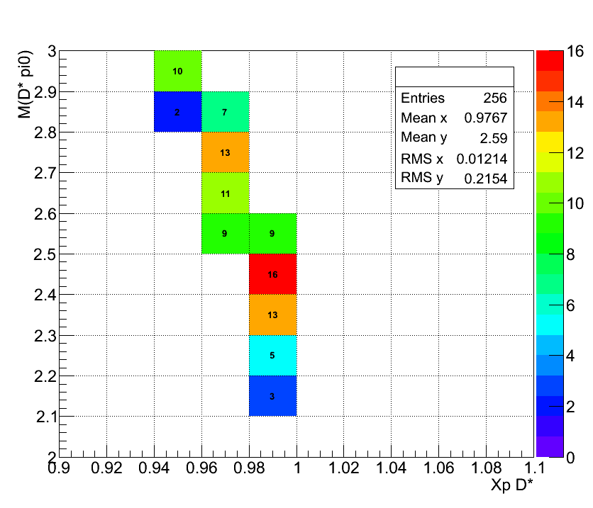
$$X_{p}D^{∗+}$$
$M\left(D_{2}^{∗}{\left(2460\right)}^{±}\right)$ is distributed in $0.92<X_{p}<1$, from $X_{p}D^{∗+}$ and $X_{p}D^{∗−}$ relationship figure, we know $D^{∗}D_{2}^{∗}{\left(2460\right)}^{±}$ two body’s event are local at $\left(1,1\right)$, so we use $D^{∗}D_{2}^{∗}{\left(2460\right)}^{±}$ two body’s statistics minus total statistics :
$$\left(34±5.83\right)−\left(26.63±7.59\right)=7.37±9.57$$
Cross Section：
$$19.51±25.34\left(fb\right)$$
$$X_{p}D^{∗−}$$

Slide 29
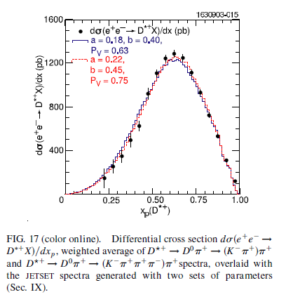
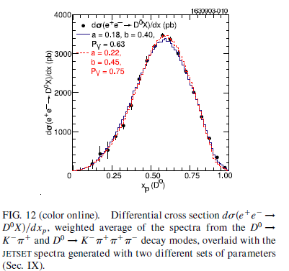
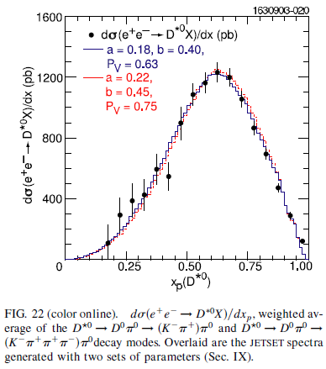
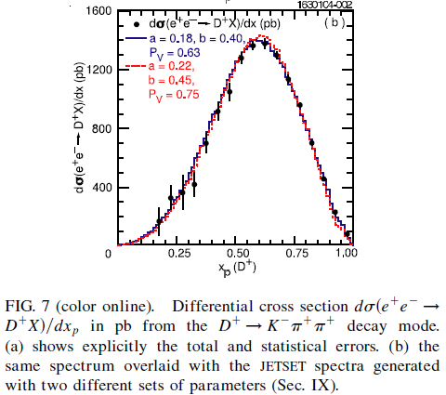
D^{*+}
D⁰
D^{*0}
D⁺

Slide 30
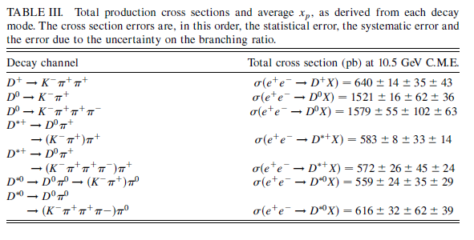

Slide 31
Inclusive Cross sections
D⁺ 640 ±14
D⁰ 1550 ± 16
D^{*+} 578 ± 10
D^{*0} 616 ± 32
Assuming there is NO higher mass resonances
Like D(2420), D(2460) ..
D^{*0} → D⁰ 100%; no D⁺
D^{*+} → D⁰ 68%; D⁺ 32%
Exclusive cross sections:
D⁺ = 640 – 578*0.32 = 455
D⁰ = 1550 – 616 – 578*0.68 = 541
$V/{Ps}$
$${D^{∗0}}/{D^{0}={\left(616±32\right)}/{\left(541±36.41\right)=\text{1.14±0.0}\text{9} }}$$
$${D^{∗+}}/{D^{+}={\left(578±10\right)}/{\left(455±14.36\right)}}=1.27±0.04$$

Slide 32
Particle | Width(MeV) | type | Mode | Fraction
$$D^{∗}{\left(2010\right)}^{+}$$ | $$0.834±1.8$$ | $$two$$ | $$D^{0}π^{+}$$ | $$\left(67.7±0.5\right)\%$$
 |  |  | $$D^{+}π^{0}$$ | $$\left(30.7±0.5\right)\%$$
 |  |  | $$D^{+}γ$$ | $$\left(1.6±0.4\right)\%$$
$$D_{0}^{∗}{\left(2400\right)}^{+}$$ | $$230±17$$ | $$two$$ | $$D^{0}π^{+}$$ | $$seen$$
$$D_{1}{\left(2420\right)}^{+}$$ | $25±$6 | $$two$$ | $$D^{0}π^{+}$$ | $$not seen$$
 |  |  | $$D^{+}ρ^{0}$$
 |  |  | $$D_{0}^{∗}{\left(2400\right)}^{0}π^{+}$$
 |  |  | $$D^{∗}{\left(2007\right)}^{0}π^{+}$$ | $$not seen$$
 |  | $$three$$ | $$D^{∗+}π^{+}π^{−}$$ | $$not seen$$
 |  |  | $$D^{+}π^{−}π^{−}$$ | $$seen$$
$$D_{2}^{∗}{\left(2460\right)}^{+}$$ | $$46.7±1.2$$ | $$two$$ | $$D^{0}π^{+}$$ | $$seen$$
 |  |  | $$D^{∗0}π^{+}$$ | $$seen$$
 |  | $$three$$ | $$D^{+}π^{−}π^{−}$$ | $$not seen$$
 |  |  | $$D^{∗+}π^{−}π^{−}$$ | $$not seen$$

Slide 33
Particle | Width(MeV) | type | Mode | Fraction
$$D_{0}^{∗}{\left(2400\right)}^{0}$$ | $$267±40$$ | $$two$$ | $$D^{+}π^{−}$$ | $$seen$$
$$D_{1}{\left(2420\right)}^{0}$$ | $$31.7±2.5$$ | $$two$$ | $$D^{∗}{\left(2010\right)}^{+}π^{−}$$ | $$seen$$
 |  |  | $$D^{+}π^{−}$$ | $$not seen$$
 |  |  | $$D^{0}ρ^{0}$$
 |  |  | $$D^{0}f_{0}\left(500\right)$$
 |  |  | $$D_{0}^{∗}{\left(2400\right)}^{+}π^{−}$$
 |  | $$three$$ | $$D^{0}π^{+}π^{+}$$ | $$seen$$
 |  |  | $$D^{∗0}π^{+}π^{+}$$ | $$not seen$$
$$D_{1}{\left(2430\right)}^{0}$$ | $$384±74$$ | $$two$$ | $$D^{∗}{\left(2010\right)}^{+}π^{−}$$ | $$seen$$
$$D_{2}^{∗}{\left(2460\right)}^{0}$$ | $$47.5±1.1$$ | $$two$$ | $$D^{+}π^{−}$$ | $$seen$$
 |  |  | $$D^{∗}{\left(2010\right)}^{+}π^{−}$$ | $$seen$$
 |  | $$three$$ | $$D^{0}π^{+}π^{−}$$ | $$not seen$$
 |  |  | $$D^{∗0}π^{+}π^{−}$$ | $$not seen$$
$$D{\left(2740\right)}^{0}$$ | $$73.2±13.4$$ | $$two$$ | $$D^{∗+}π^{−}$$ | $$seen$$
$$D_{3}^{∗}\left(2750\right)$$ | $$66±5$$ | $$two$$ | $$D^{0}π^{+}$$ | $$seen$$
 |  |  | $$D^{∗+}π^{−}$$ | $$seen$$

Slide 34
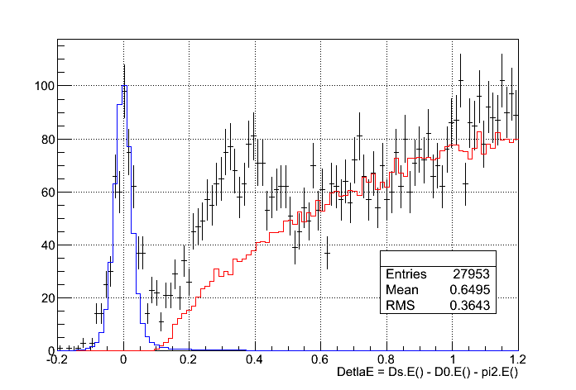
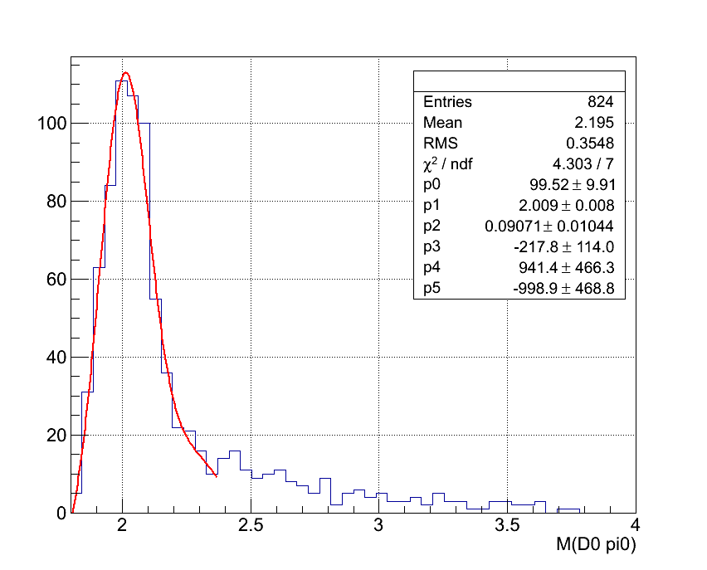
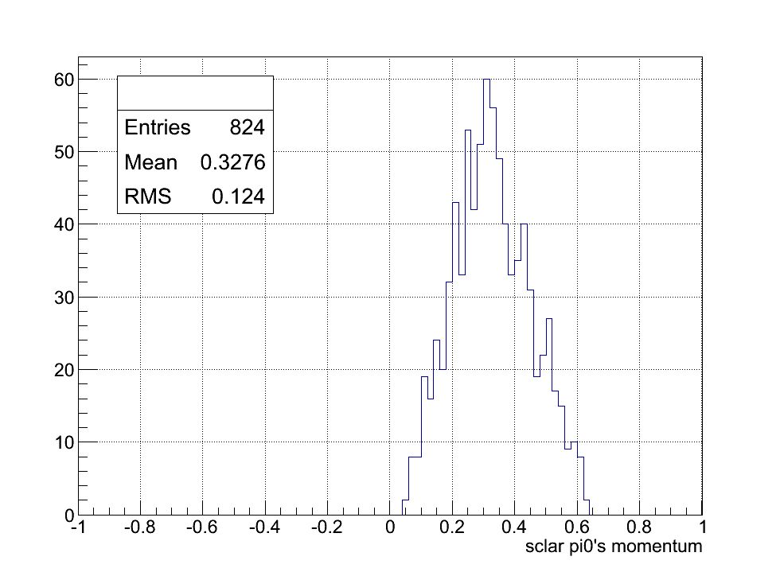
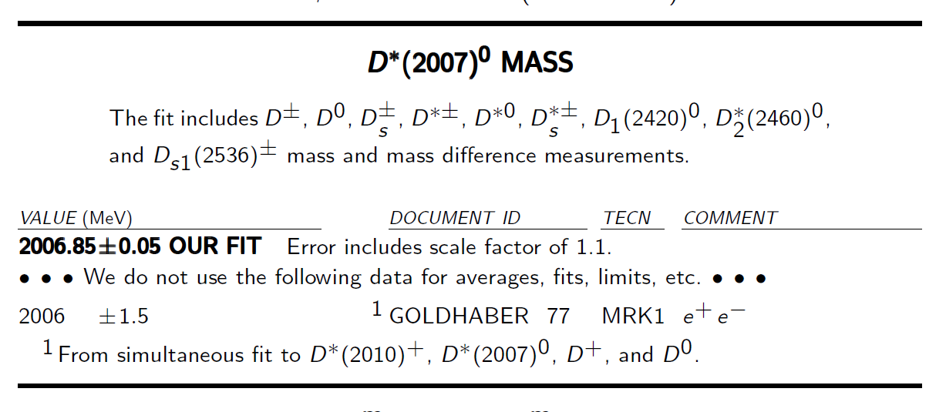
$$\left|{\overset{⃑}{P}}_{π^{0}}\right|$$

Slide 38
動機：
了解Pythia與Herwig哪一個比較接近實驗數據
D meson spectra：
利用三體分析找到的共振態有哪些，一一點名
未來展望：
找出其他的粒子，或沒出現粒子的原因
分析三體：
$$e^{+}e^{−}→{D^{∗−}D^{0}π^{+}}_{.cc}$$
$$e^{+}e^{−}→D^{∗+}D^{∗−}π^{0}$$
有共振態的出現顯示以往利用inclusive來計算${Vector}/{Pseudoscalar}，$的方法會有問題，利用exclusive的計算方法比較正確
共振態：
未來展望，計算$DD_{H}$的form factor
三體動力學
發現三體的生成部分會先形成共振態在形成三體事件
非共振態：
純粹三體的反應截面
結論
比較二體與三體的反應截面得知粒子生成的模式比較接近於Herwig

Slide 39
動機：
與三體分析比較，驗證粒子生成是否比較接近於Herwig
分析四體生成：
$$e^{+}e^{−}→D^{∗+}D^{∗−}π^{+}π^{−}$$
$$e^{+}e^{−}→D^{∗±}D^{∓}π^{+}π^{−}$$
四體的topology
Resonance
找出$\left(1，3\right)$與$\left(3，1\right)$中所有的共振態
了解共振態之間的關係
找出$\left(2，2\right)$電中性與帶+2電兩種情形的共振態
4 body kinematics
Pure 4 body cross section

