Slide 1
To Do
How to define systematic of purity, acceptance, and trigger?
Purity : Vincent will do bootstrapping and provide us the input files! Review purity extraction(pending)
Acceptance(pending)
Trigger(pending)
Correlation between different systematics
Trig VS Acc (pending)
Purity VS Acc (pending)
BLUE, only sta error, input file update xsc w/ Vincent’s input
Trigger rho=1
trigger systematic error same for LL and LO
New binning for the convenience of integration (pending)
Combine at 2D and 1D level and compare.
Next meeting : April 23th (Thursday)
Check slides : https://twiki.cern.ch/twiki/pub/Compass/Drell_Yan/Subgroupmeeting/Andrieux_20240123.pdf

Slide 2
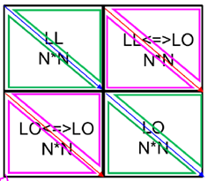
Correlations
C_stat :
Same bin, same trig : 1
others: 0
C_sys_acc (sys_acc = 3* MC_stat)
Same bin, same trig : 1
others: 0
C_sys_purity
Same bin, same trig : 1
others = 0
C_sys_trig (W : 13%, Al : 5%, NH3 : 0%, etc)
Same bin, same trig : 1
others = 0
trigSys_LL = xscLL *13%
trigSys_LO = xscLO * 13%

Slide 3
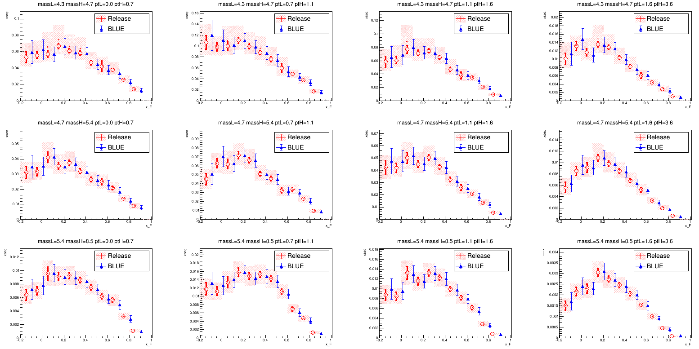
Released VS BLUE in 3D w/o Corr
Reasonable

Slide 4
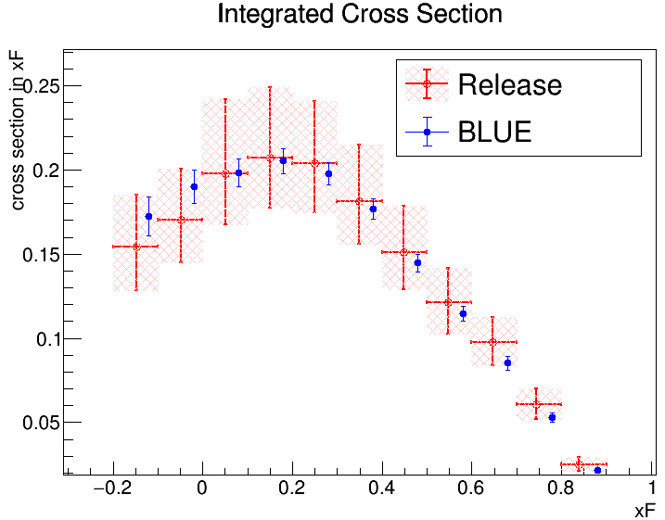
BLUE integration is smaller than release

Slide 5
Correlations
C_stat :
Same bin, same trig : 1
others: 0
C_sys_acc (sys_acc = 3* MC_stat)
Same bin, same trig : 1
others: 0.8
C_sys_purity
Same bin, same trig : 1
others = 0.8
C_sys_trig (W : 13%, Al : 5%, NH3 : 0%, etc)
Same bin, same trig : 1
Same bin, different trigger : -1 => [0.8, 1.0]
Different bin, same trigger : 1 => [0.8, 1.0]
Different bin, different trigger : -1 => [0.8, 1.0]
trigSys = [(xscLL + xscLO)/2.0] *13% => same for LL and LO

Slide 6
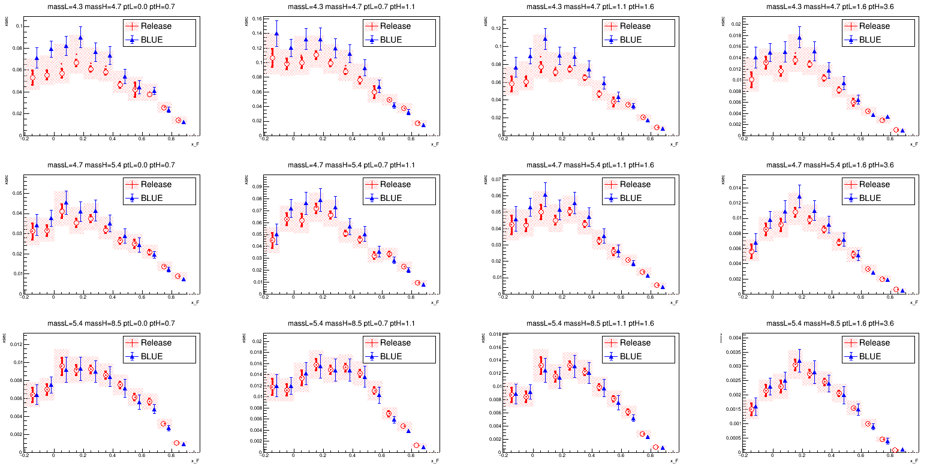
Released VS BLUE in 3D w/ Corr
Trigger rho = 0.8
Mean of BLUE is much shifted towards to LL

Slide 7
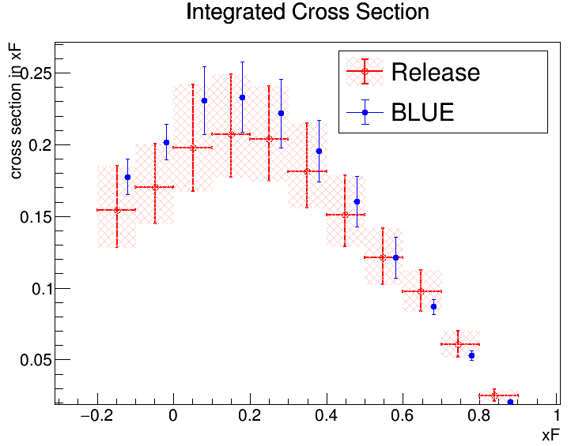
If we add correlation 0.8 for acc, purity, trigger, then systematic size between release and BLUE are more consistent. But the mean value are quite different.

Slide 8
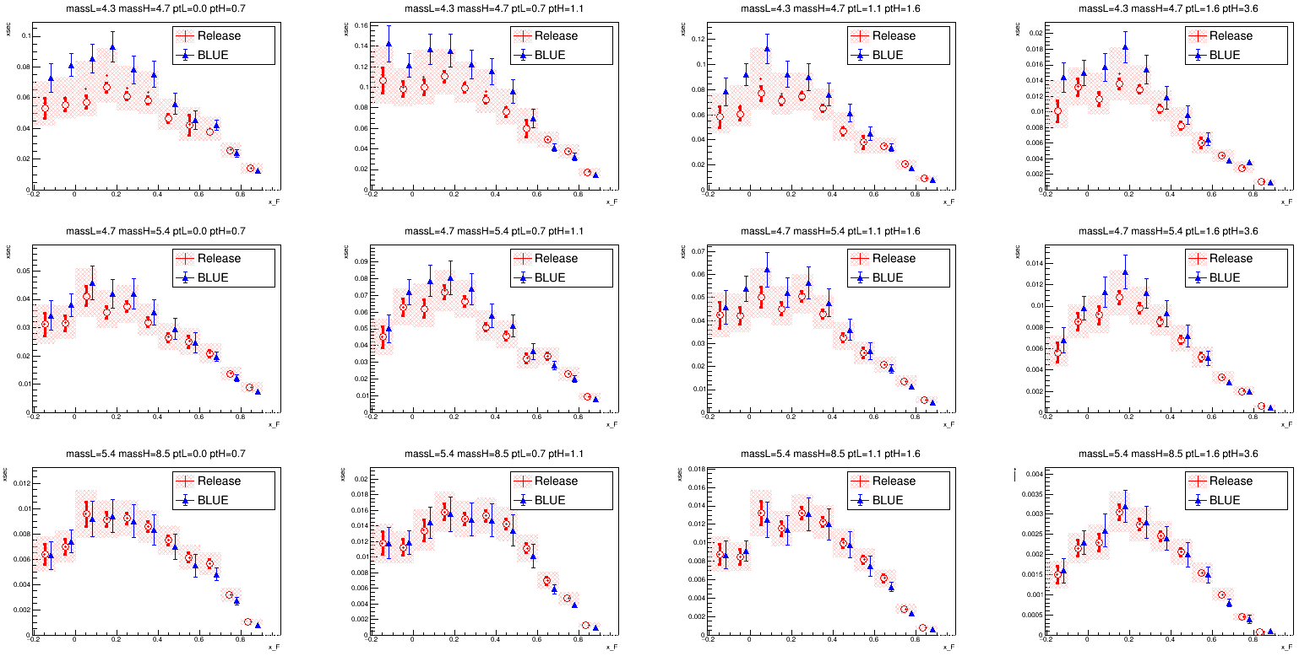
Released VS BLUE in 3D w/ Corr
Trigger rho = 1.0

Slide 9
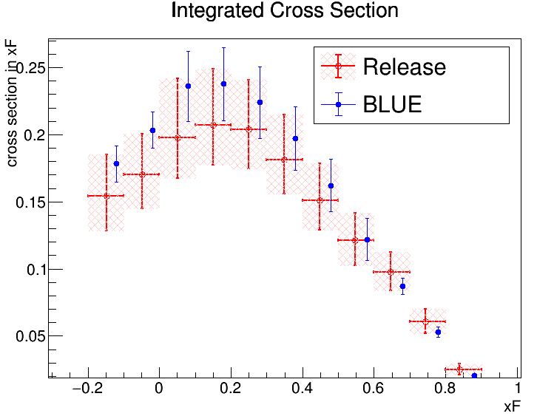

Slide 10
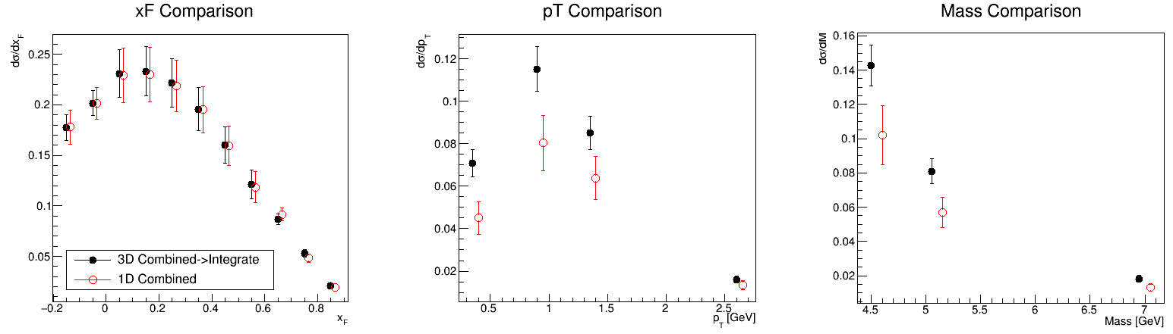
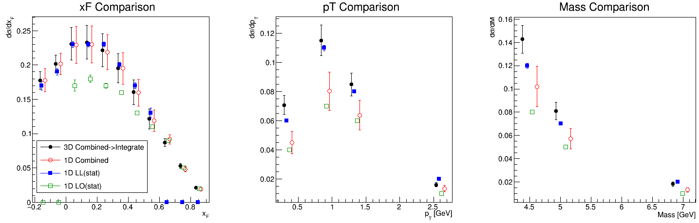
3D combine(integrate to 1D)
VS 1D combine

Slide 11
To Do
How to define systematic of purity, acceptance, and trigger?
Purity : Vincent will do bootstrapping and provide us the input files! Review purity extraction(pending)
Acceptance(pending)
Trigger(pending)
Correlation between different systematics
Trig VS Acc (pending)
Purity VS Acc (pending)
Combine in xf always => 2D combine => integrate to 1D
Fit BLUE combined results w/ xFitter?

Slide 12
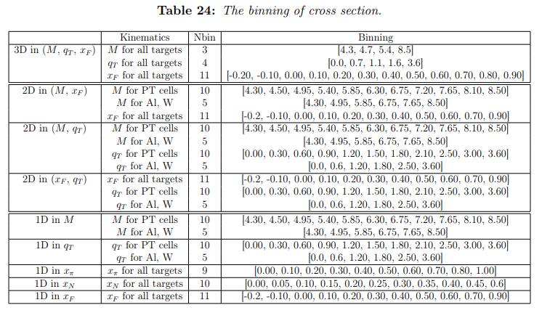
Release Binning
Binning in 2D => 配合 1D
2D combine VS 3D combine
But only combine in xf

Slide 13
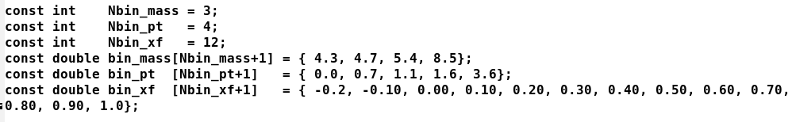
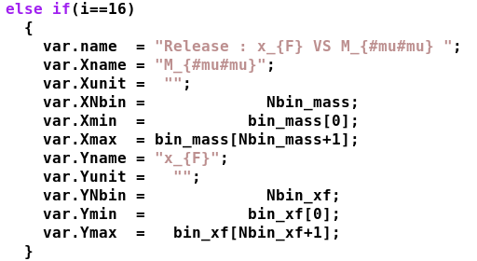
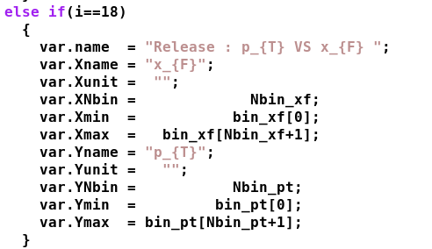
2D binning in xf, i_2D = {16, 18}

Slide 14

1D binning, i_bin= {19, 20, 21}

Slide 15
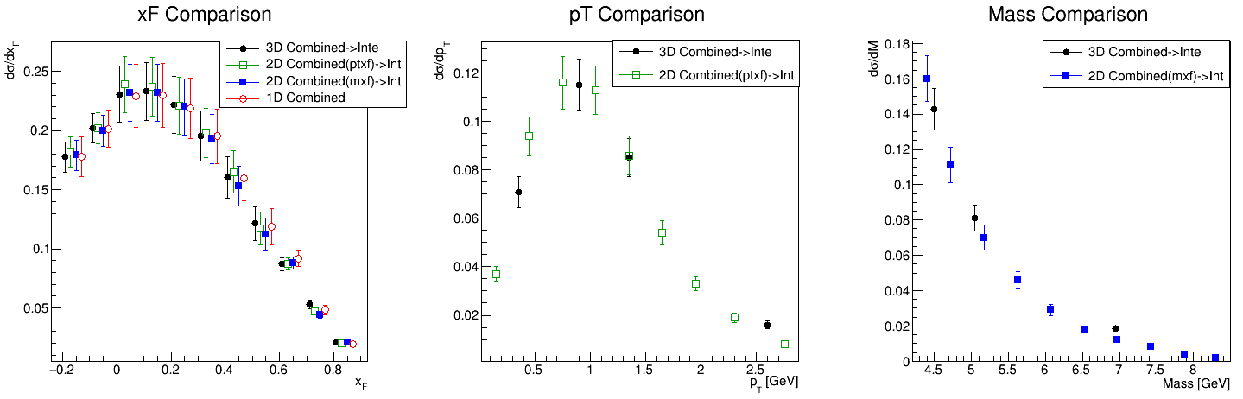
3D combine(integrate to 1D)
VS 2D combine(integrate to 1D) VS 1D combine

Slide 16
Back up

Slide 17
3D integrate to 1D in mass, xf, pt
=== Integrated xF Distribution === (11 bins)
xf bin: [ -0.20, -0.10] | Integrated xsc = 1.776251e-01 1.259622e-02
xf bin: [ -0.10, 0.00] | Integrated xsc = 2.018340e-01 1.249839e-02
xf bin: [ 0.00, 0.10] | Integrated xsc = 2.308465e-01 2.366985e-02
xf bin: [ 0.10, 0.20] | Integrated xsc = 2.332028e-01 2.447013e-02
xf bin: [ 0.20, 0.30] | Integrated xsc = 2.218077e-01 2.404128e-02
xf bin: [ 0.30, 0.40] | Integrated xsc = 1.955835e-01 2.136030e-02
xf bin: [ 0.40, 0.50] | Integrated xsc = 1.603870e-01 1.779420e-02
xf bin: [ 0.50, 0.60] | Integrated xsc = 1.213231e-01 1.426525e-02
xf bin: [ 0.60, 0.70] | Integrated xsc = 8.693997e-02 5.404200e-03
xf bin: [ 0.70, 0.80] | Integrated xsc = 5.296392e-02 3.496608e-03
xf bin: [ 0.80, 0.90] | Integrated xsc = 2.078458e-02 1.698594e-03
=== Integrated pT Distribution === (4 bins)
pT bin: [ 0.00, 0.70] | Integrated xsc = 7.082041e-02 6.426400e-03
pT bin: [ 0.70, 1.10] | Integrated xsc = 1.152575e-01 1.057686e-02
pT bin: [ 1.10, 1.60] | Integrated xsc = 8.500339e-02 7.837219e-03
pT bin: [ 1.60, 3.60] | Integrated xsc = 1.607542e-02 1.516189e-03
=== Integrated Mass Distribution === (3 bins)
Mass bin: [ 4.30, 4.70] | Integrated xsc = 1.427249e-01 1.183032e-02
Mass bin: [ 4.70, 5.40] | Integrated xsc = 8.099335e-02 7.360594e-03
Mass bin: [ 5.40, 8.50] | Integrated xsc = 1.824017e-02 1.885234e-03

Slide 18
1D Xsc in LL and LO
binL, binH, xsc_LL, stat_LL, sysP_LL, sysA_LL, xsc_LO, stat_LO, sysP_LO, sysA_LO
M_{#mu#mu}
4.30 4.70 0.12 0.002156 0.009514 0.003002 0.08 0.001196 0.011833 0.001556
4.70 5.40 0.07 0.001133 0.002299 0.001579 0.05 0.000936 0.004199 0.001000
5.40 8.50 0.02 0.000246 0.000079 0.000352 0.01 0.000267 0.000242 0.000279
p_{T}
0.00 0.70 0.06 0.001179 0.002470 0.001437 0.04 0.000918 0.004104 0.000894
0.70 1.10 0.11 0.001871 0.003814 0.002358 0.07 0.001490 0.005547 0.001465
1.10 1.60 0.08 0.001345 0.002776 0.001643 0.06 0.001228 0.004507 0.001124
1.60 3.60 0.02 0.000254 0.000508 0.000314 0.01 0.000224 0.000539 0.000207
x_{F}
-0.20 -0.10 0.17 0.006581 0.009554 0.006374 0.00 0.000000 0.000000 0.000000
-0.10 0.00 0.19 0.004697 0.009316 0.004229 0.00 0.000000 0.000000 0.000000
0.00 0.10 0.23 0.004147 0.012971 0.003773 0.17 0.008372 0.017804 0.006286
0.10 0.20 0.23 0.003758 0.010569 0.003307 0.18 0.005397 0.017033 0.004202
0.20 0.30 0.23 0.003867 0.007034 0.003409 0.17 0.003689 0.014789 0.002866
0.30 0.40 0.20 0.003894 0.003866 0.003392 0.16 0.002814 0.014942 0.002190
0.40 0.50 0.17 0.004433 0.001523 0.003832 0.13 0.002239 0.012731 0.001702
0.50 0.60 0.13 0.006979 0.001761 0.005524 0.11 0.001880 0.004564 0.001466
0.60 0.70 0.00 0.000000 0.000000 0.000000 0.09 0.001622 0.001955 0.001290
0.70 0.80 0.00 0.000000 0.000000 0.000000 0.05 0.001306 0.000145 0.001060
0.80 0.90 0.00 0.000000 0.000000 0.000000 0.02 0.000928 0.000265 0.000725
0.90 1.00 0.00 0.000000 0.000000 0.000000 0.00 0.000000 0.000000 0.000000

Slide 19
Combine LL and LO in 1D, xf, 1D[21]
3D integrate
xf bin: [ -0.20, -0.10] | Integrated xsc = 1.776251e-01 1.259622e-02
xf bin: [ -0.10, 0.00] | Integrated xsc = 2.018340e-01 1.249839e-02
xf bin: [ 0.00, 0.10] | Integrated xsc = 2.308465e-01 2.366985e-02
xf bin: [ 0.10, 0.20] | Integrated xsc = 2.332028e-01 2.447013e-02
xf bin: [ 0.20, 0.30] | Integrated xsc = 2.218077e-01 2.404128e-02
xf bin: [ 0.30, 0.40] | Integrated xsc = 1.955835e-01 2.136030e-02
xf bin: [ 0.40, 0.50] | Integrated xsc = 1.603870e-01 1.779420e-02
xf bin: [ 0.50, 0.60] | Integrated xsc = 1.213231e-01 1.426525e-02
xf bin: [ 0.60, 0.70] | Integrated xsc = 8.693997e-02 5.404200e-03
xf bin: [ 0.70, 0.80] | Integrated xsc = 5.296392e-02 3.496608e-03
xf bin: [ 0.80, 0.90] | Integrated xsc = 2.078458e-02 1.698594e-03
1D combine
4.3 8.5 0.0 3.6 -0.20 -0.10 0.1700 0.0066 0.0096 0.0191 0.0111 0.0001 100.0000 100.0000 300.0000 0.0111 0.1779 0.0066 0.0156 0.0169 0.10 1.00
4.3 8.5 0.0 3.6 -0.10 0.00 0.1900 0.0047 0.0093 0.0127 0.0124 0.0001 100.0000 100.0000 300.0000 0.0124 0.2016 0.0047 0.0150 0.0157 0.32 1.00
4.3 8.5 0.0 3.6 0.00 0.10 0.2300 0.0041 0.0130 0.0113 0.0260 0.1700 0.0084 0.0178 0.0189 0.0260 0.2294 0.0037 0.0267 0.0269 2.49 0.65
4.3 8.5 0.0 3.6 0.10 0.20 0.2300 0.0038 0.0106 0.0099 0.0267 0.1800 0.0054 0.0170 0.0126 0.0267 0.2298 0.0031 0.0267 0.0269 2.09 0.62
4.3 8.5 0.0 3.6 0.20 0.30 0.2300 0.0039 0.0070 0.0102 0.0260 0.1700 0.0037 0.0148 0.0086 0.0260 0.2187 0.0027 0.0257 0.0258 2.56 0.59
4.3 8.5 0.0 3.6 0.30 0.40 0.2000 0.0039 0.0039 0.0102 0.0234 0.1600 0.0028 0.0149 0.0066 0.0234 0.1951 0.0023 0.0231 0.0232 1.54 0.62
4.3 8.5 0.0 3.6 0.40 0.50 0.1700 0.0044 0.0015 0.0115 0.0195 0.1300 0.0022 0.0127 0.0051 0.0195 0.1597 0.0020 0.0193 0.0194 1.74 0.57
4.3 8.5 0.0 3.6 0.50 0.60 0.1300 0.0070 0.0018 0.0166 0.0156 0.1100 0.0019 0.0046 0.0044 0.0156 0.1186 0.0018 0.0155 0.0156 0.49 0.27
4.3 8.5 0.0 3.6 0.60 0.70 0.0001 100.0000 100.0000 300.0000 0.0059 0.0900 0.0016 0.0020 0.0039 0.0059 0.0916 0.0016 0.0063 0.0065 0.05 -0.00
4.3 8.5 0.0 3.6 0.70 0.80 0.0001 100.0000 100.0000 300.0000 0.0033 0.0500 0.0013 0.0001 0.0032 0.0033 0.0482 0.0013 0.0037 0.0039 0.14 -0.00
4.3 8.5 0.0 3.6 0.80 0.90 0.0001 100.0000 100.0000 300.0000 0.0013 0.0200 0.0009 0.0003 0.0022 0.0013 0.0191 0.0009 0.0017 0.0020 0.10 -0.00

Slide 20
Combine LL and LO in 1D, pt, 1D[20]
3D combine
pT bin: [ 0.00, 0.70] | Integrated xsc = 7.082041e-02 6.426400e-03
pT bin: [ 0.70, 1.10] | Integrated xsc = 1.152575e-01 1.057686e-02
pT bin: [ 1.10, 1.60] | Integrated xsc = 8.500339e-02 7.837219e-03
pT bin: [ 1.60, 3.60] | Integrated xsc = 1.607542e-02 1.516189e-03
1D combine
4.3 8.5 0.0 0.7 -0.20 0.90 | 0.0600 0.0012 0.0025 0.0043 0.0065 | 0.0400 0.0009 0.0041 0.0027 0.0065 | 0.0450 0.0007 0.0076 0.0077 3.65 0.49 0.51
4.3 8.5 0.7 1.1 -0.20 0.90 | 0.1100 0.0019 0.0038 0.0071 0.0117 | 0.0700 0.0015 0.0055 0.0044 0.0117 | 0.0803 0.0012 0.0131 0.0131 4.87 0.42 0.58
4.3 8.5 1.1 1.6 -0.20 0.90 | 0.0800 0.0013 0.0028 0.0049 0.0091 | 0.0600 0.0012 0.0045 0.0034 0.0091 | 0.0638 0.0009 0.0101 0.0101 2.36 0.50 0.50
4.3 8.5 1.6 3.6 -0.20 0.90 | 0.0200 0.0003 0.0005 0.0009 0.0019 | 0.0100 0.0002 0.0005 0.0006 0.0019 | 0.0134 0.0002 0.0020 0.0021 11.30 0.39 0.61

Slide 21
Combine LL and LO in 1D, mass, 1D[19]
3D combine
Mass bin: [ 4.30, 4.70] | Integrated xsc = 1.427249e-01 1.183032e-02
Mass bin: [ 4.70, 5.40] | Integrated xsc = 8.099335e-02 7.360594e-03
Mass bin: [ 5.40, 8.50] | Integrated xsc = 1.824017e-02 1.885234e-03
1D combine
4.3 4.7 0.0 3.6 -0.20 0.90 | 0.1200 0.0022 0.0095 0.0090 0.0130 | 0.0800 0.0012 0.0118 0.0047 0.0130 | 0.1021 0.0010 0.0172 0.0172 2.40 0.45 0.55
4.7 5.4 0.0 3.6 -0.20 0.90 | 0.0700 0.0011 0.0023 0.0047 0.0078 | 0.0500 0.0009 0.0042 0.0030 0.0078 | 0.0571 0.0007 0.0088 0.0088 2.42 0.49 0.51
5.4 8.5 0.0 3.6 -0.20 0.90 | 0.0200 0.0002 0.0001 0.0011 0.0019 | 0.0100 0.0003 0.0002 0.0008 0.0019 | 0.0132 0.0002 0.0020 0.0020 11.47 0.43 0.57

