Slide 1
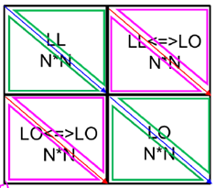
Where we were : Correlations
C_stat :
Same bin, same trig : 1
others: 0
C_sys_acc (sys_acc = 3* MC_stat)
Same bin, same trig : 1
others: 0.8
C_sys_purity
Same bin, same trig : 1
others = 0.8
C_sys_trig (W : 13%, Al : 5%, NH3 : 0%, etc)
Same bin, same trig : 1
Same bin, different trigger : -1 => [0.8, 1.0]
Different bin, same trigger : 1 => [0.8, 1.0]
Different bin, different trigger : -1 => [0.8, 1.0]
trigSys = [(xscLL + xscLO)/2.0] *13% => same for LL and LO

Slide 2
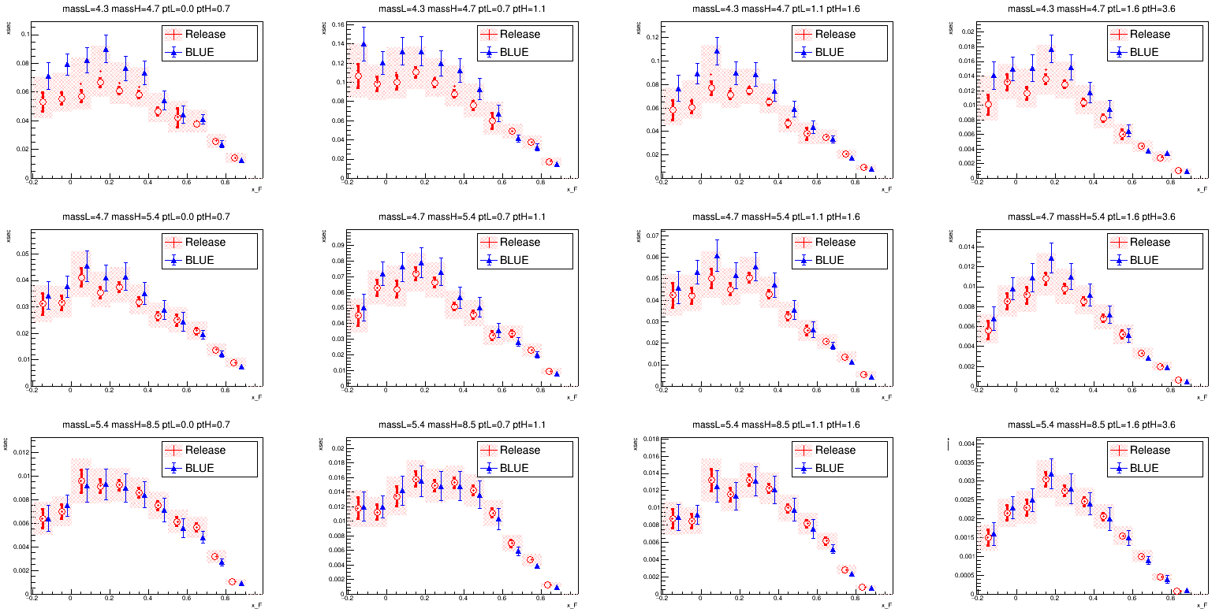
Released VS BLUE in 3D
Mean of BLUE is much shifted towards to LL
Mean : Release results force the mean value in between LL and LO. BLUE decides the mean value naturedly.
Systematics : Comparable

Slide 3
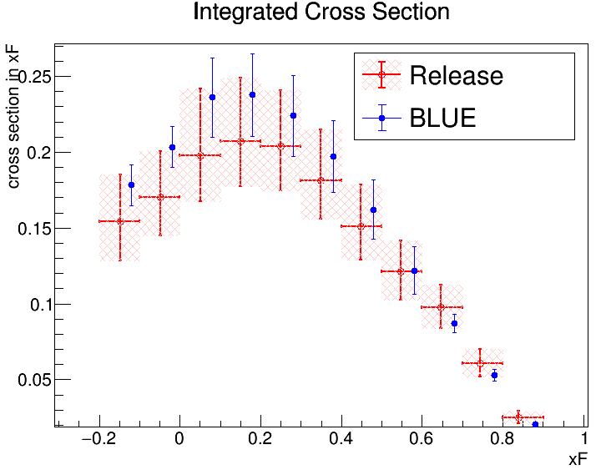
Released VS BLUE in 3D
Same conclusion as 3D

Slide 4
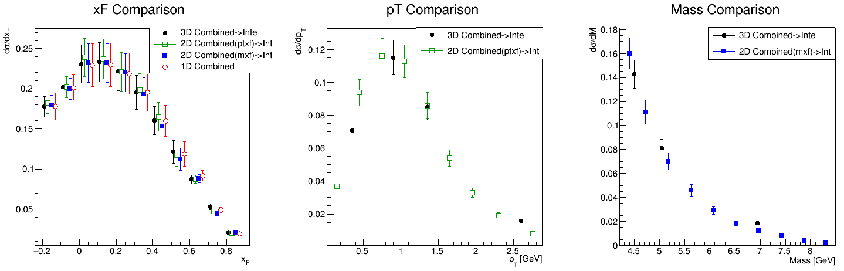
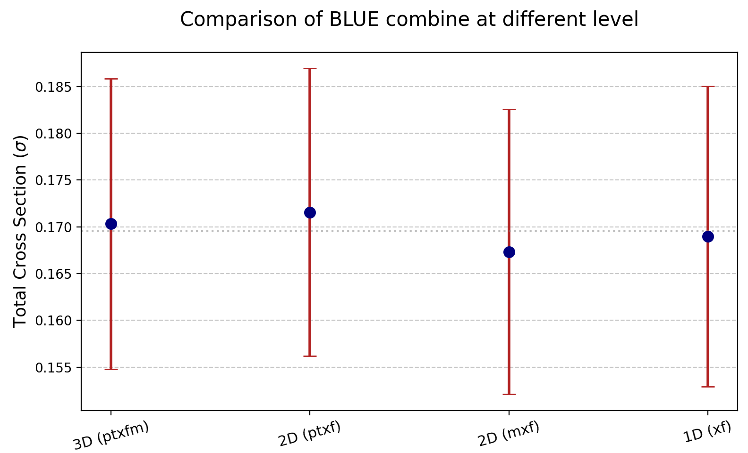
BLUE Combine in different dimensions
(Considerations of rho in * dimensions)
W
The consistency between 2D, 3D and 1D combine in BLUE are comparable.

Slide 5
To Do
https://docs.google.com/document/d/1RANY0-G8v7JsBg6vcyVTTX0N6OD3O04ShqOp34YLw5w/edit?tab=t.0
Acc sys
Purity sys
Trigger sys
Zvtx dep?
Systematic correlations

Slide 6
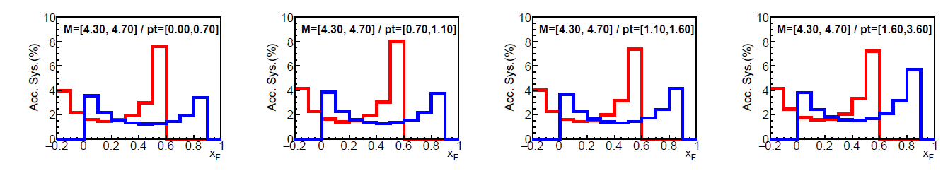
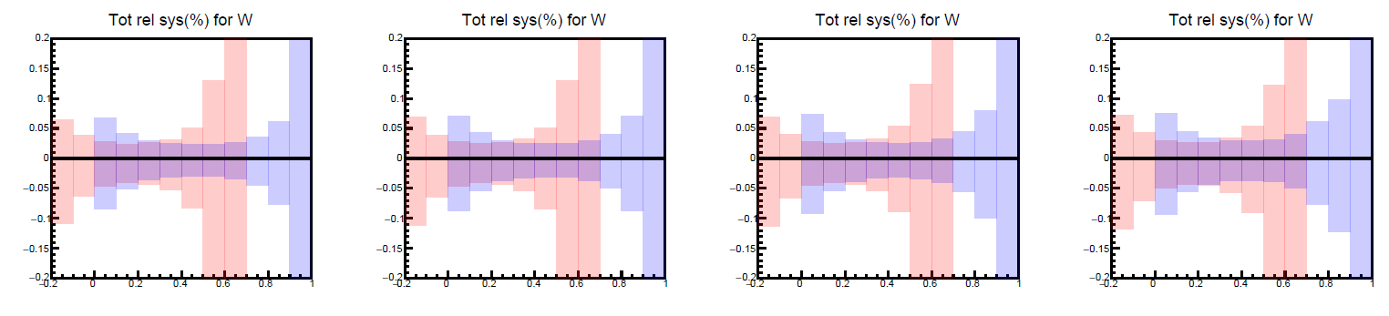
Acceptance systematics (Past)
Example : W target / LL trigger
Source#1 : statistical uncertainty of acceptance
Source#2 : Uncertainty of trigger efficiency and detector efficiency
The size of Source#2 is twice of Source#1 => Total size of acceptance systematic is three times of source#1.

Slide 7
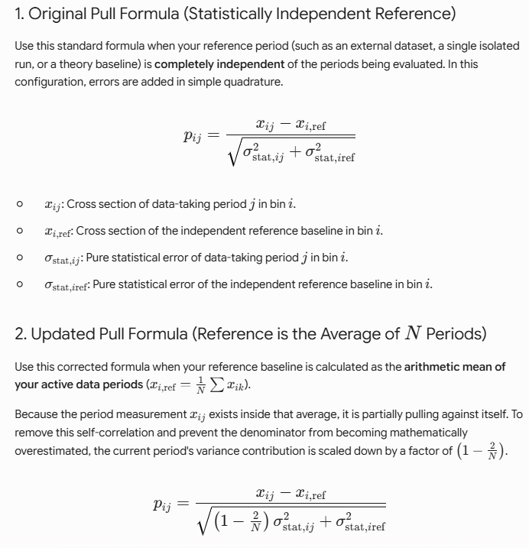
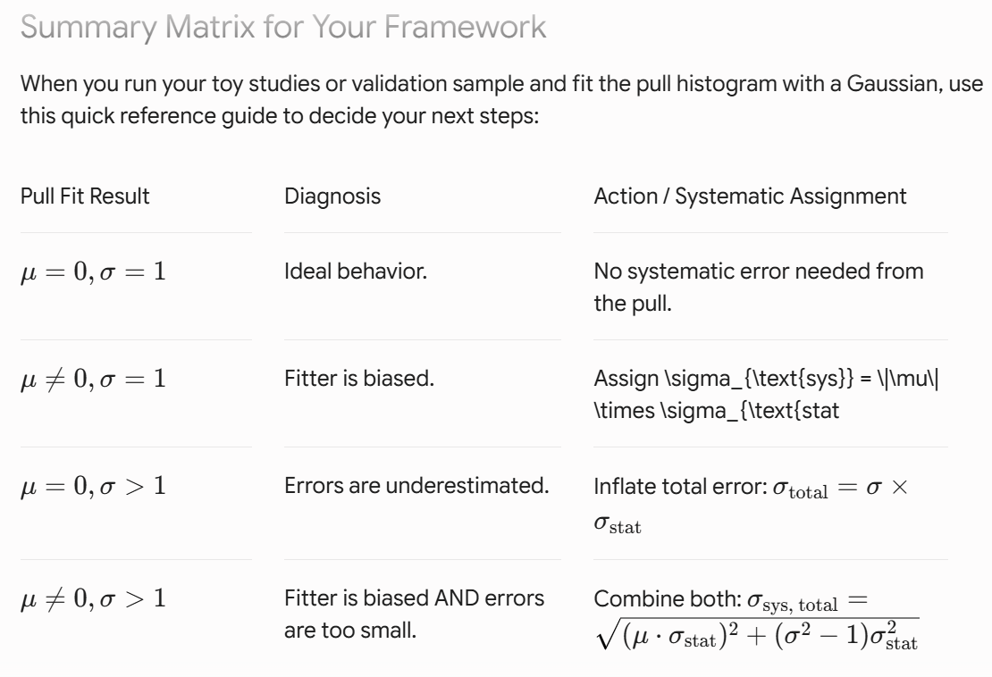
Pull
Systematics of data can be decided by pull distribution
N = 8 in our case

Slide 8
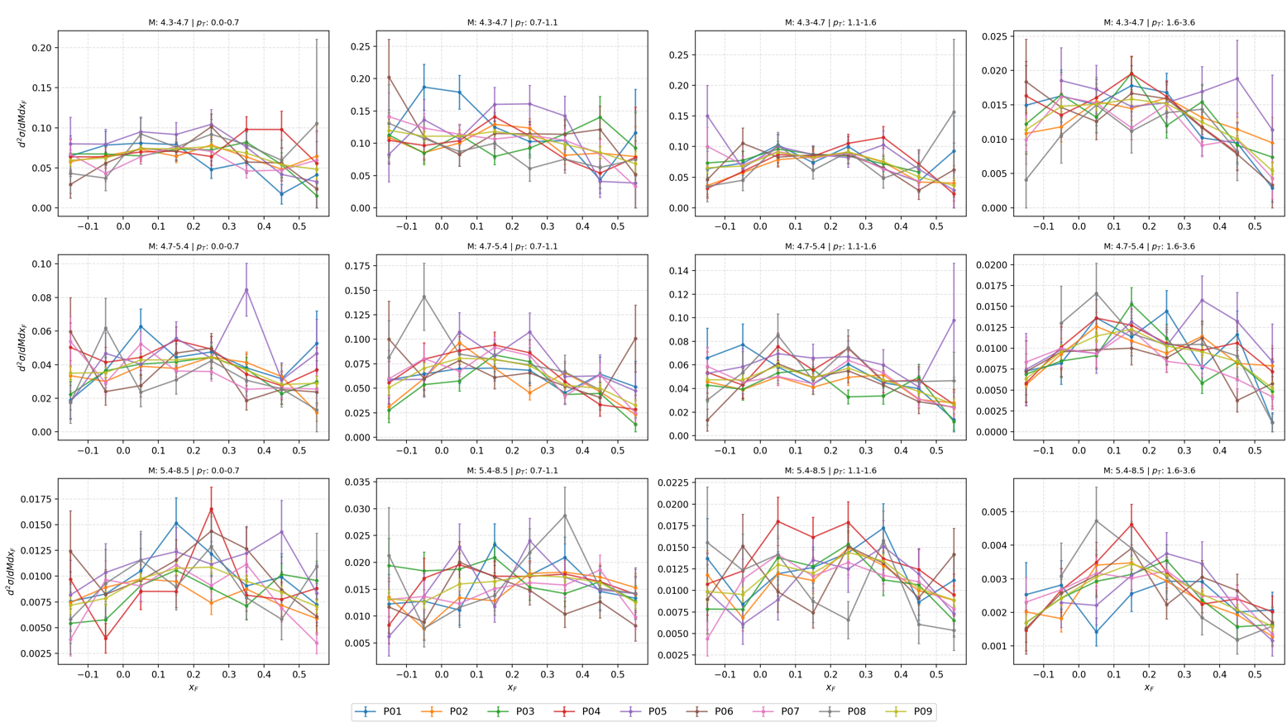
Acceptance systematics (by Pull)
3D systematics for all the period
W target

Slide 9
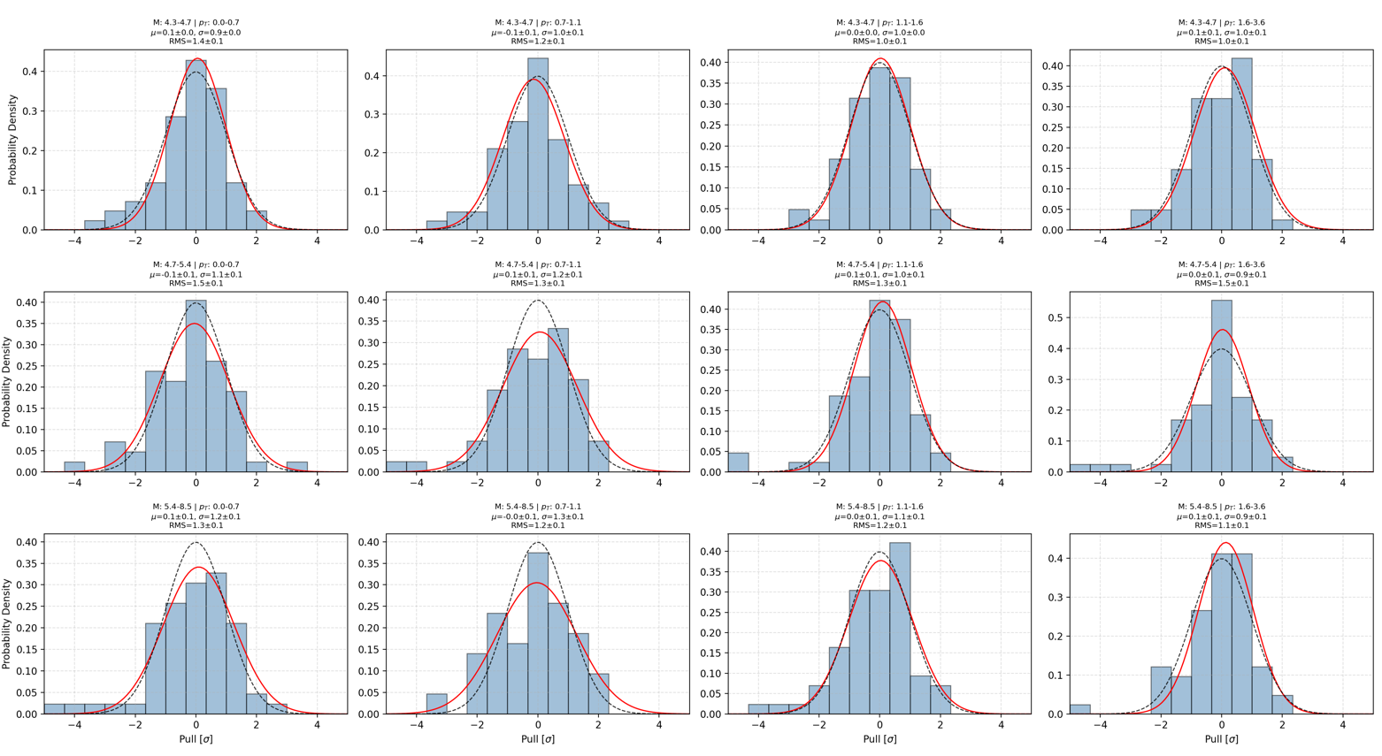
Pull with only Statistic Error
One pull distribution for one mass and pt bin (11 xf bins * 8 periods = one pull distribution)

Slide 10
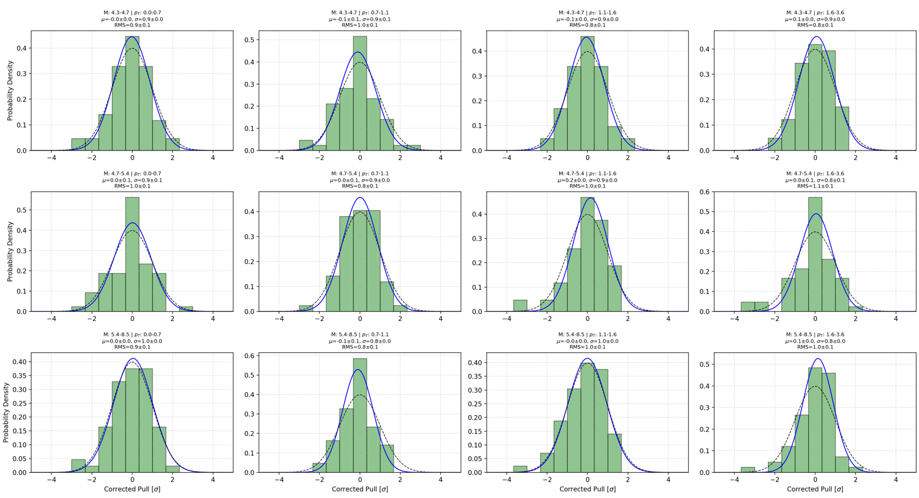
Pull with Stat + Sys Error

Slide 11
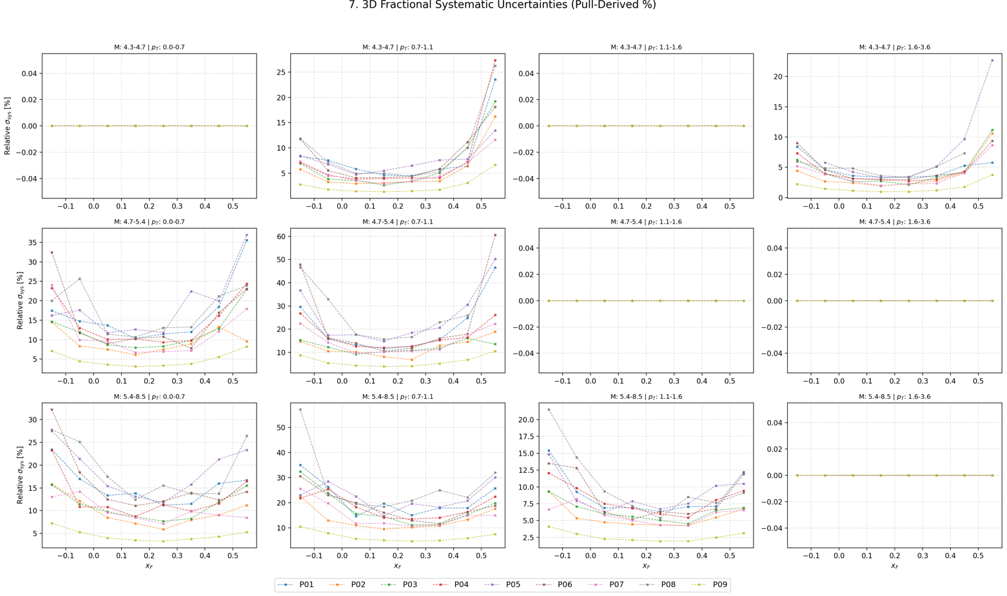
Size of Systematics Error

Slide 12
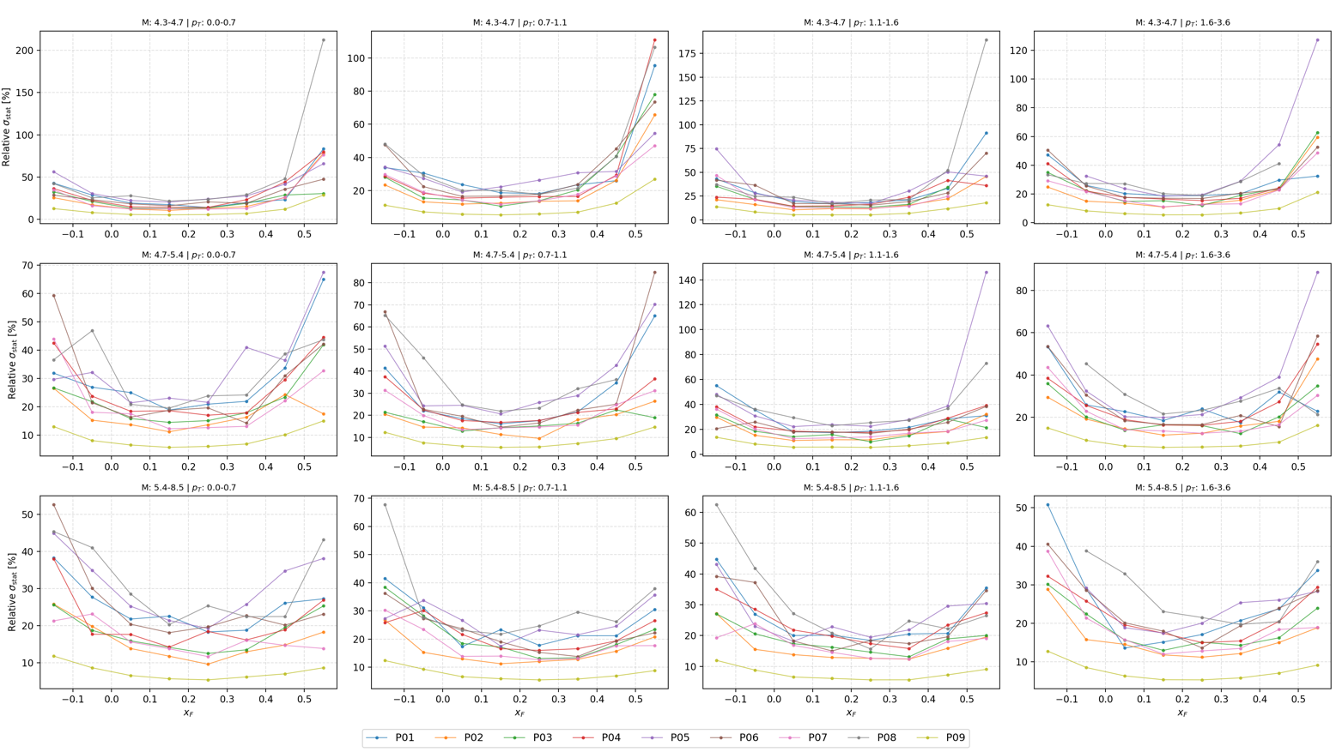
Size of Statistic Error

Slide 13
Week Consistency in 1D
Still debugging….

