Slide 1
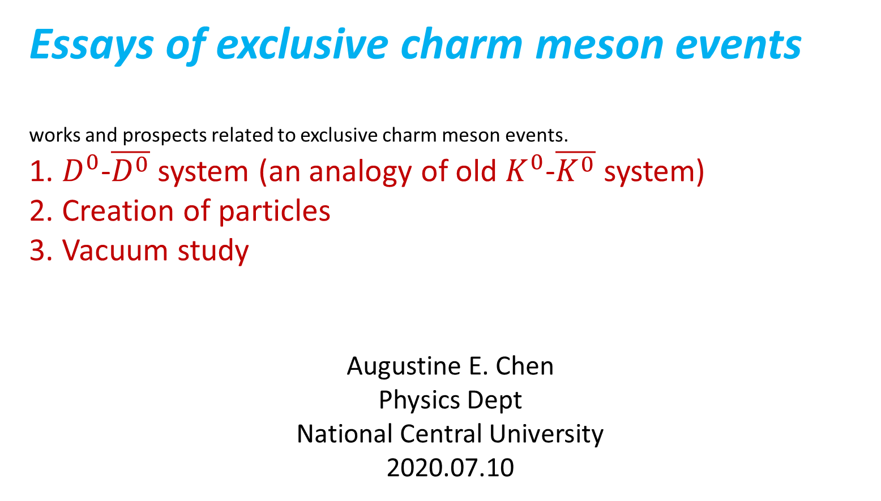
Essays of exclusive charm meson events
works and prospects related to exclusive charm meson events.
1. $D^{0}$-$\overline{D^{0}}$ system (an analogy of old $K^{0}$-$\overline{K^{0}}$ system)
2. Creation of particles
3. Vacuum study
Augustine E. Chen
Physics Dept
National Central University
2020.07.10

Slide 2
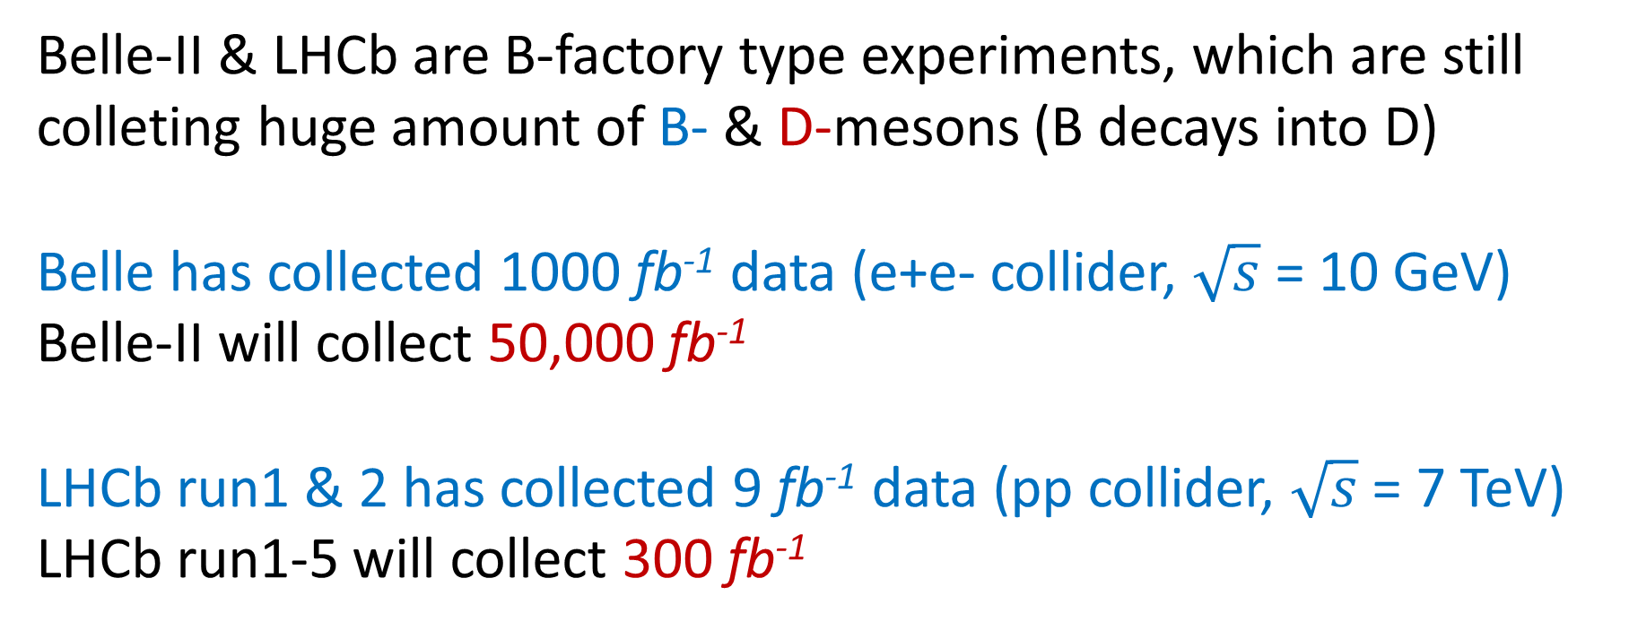
Belle-II & LHCb are B-factory type experiments, which are still colleting huge amount of B- & D-mesons (B decays into D)
Belle has collected 1000 fb⁻¹ data (e+e- collider, $\sqrt{s}$ = 10 GeV)
Belle-II will collect 50,000 fb⁻¹
LHCb run1 & 2 has collected 9 fb⁻¹ data (pp collider, $\sqrt{s}$ = 7 TeV)
LHCb run1-5 will collect 300 fb⁻¹

Slide 3
LHCb integrated luminosity (from 10 to 300 fb-1)
Belle II

Slide 4
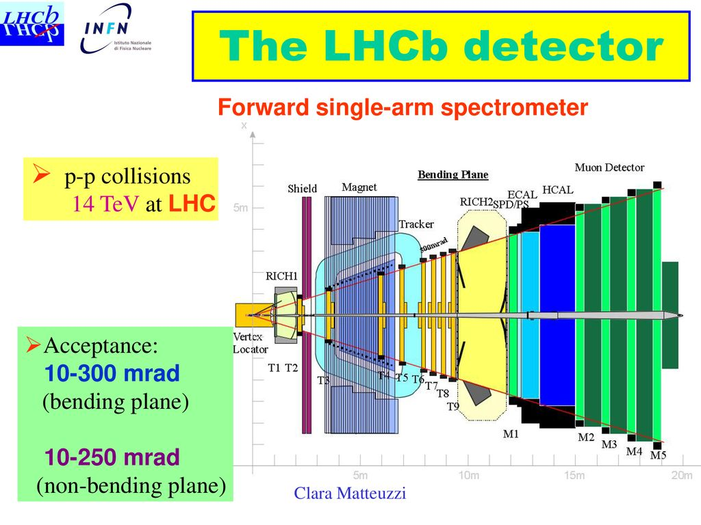
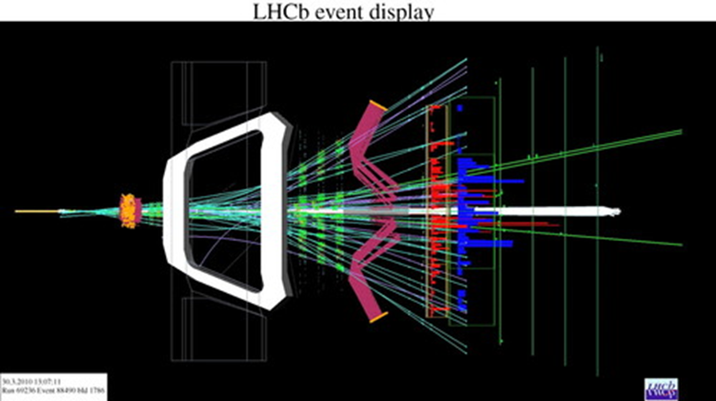

Slide 5
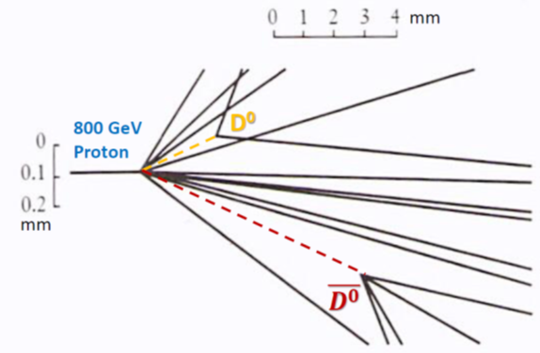
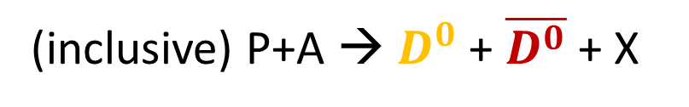



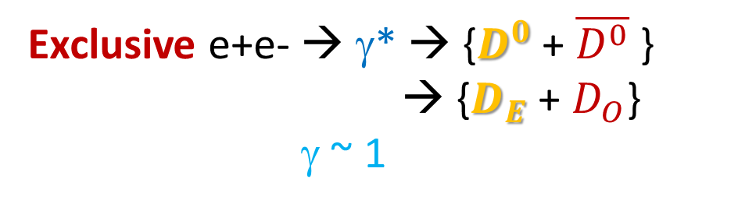
Lorentz boost at LHCb favors
time evolution study
K⁺
Belle/Belle-II
LHCb
K⁻
$$D_{E}$$
$$D_{O}$$
T₀
$D_{O}$??
T₁
π⁺
T₂
π⁻
(inclusive) P+A → $D^{0}$+ $\overline{D^{0}}$ + X
Exclusive e+e- → γ* → {$D^{0}$+ $\overline{D^{0}}$ }
→ {$D_{E}$+ $D_{O}$}
γ ~ 1
τ_{D0} = 0.41x10⁻¹² sec; cτ = 120 μm
γ = 10, E_{D0} = mγ = 20 GeV, cτγ=1.2 mm

Slide 6
< 5 μm resolution

Slide 7
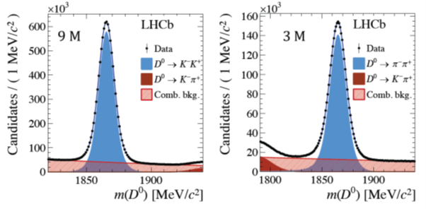
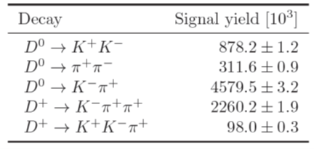
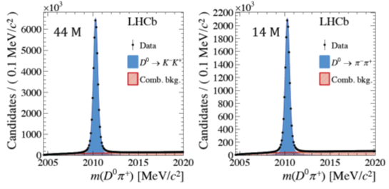
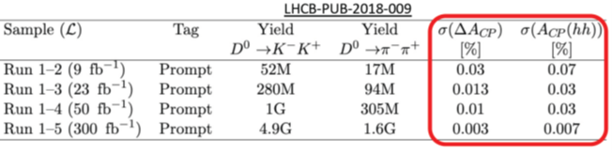
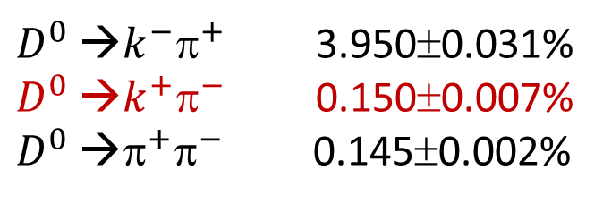
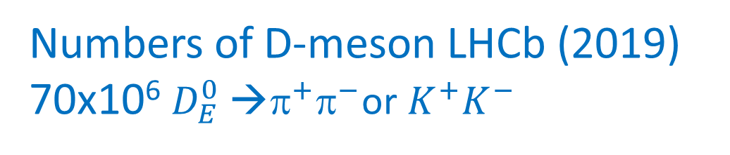
Numbers of D-meson LHCb (2019) 70x10⁶ $D_{E}^{0}$ →$^{+}^{−}$or $K^{+}K^{−}$
Inclusive D⁰
D⁰ in B-decay
D⁰ as D^{*+} → D⁰ π⁺
$D^{0}$ →$k^{−}^{+}$ 3.950±0.031%
$D^{0}$ →$k^{+}^{−}$ 0.150±0.007%
$D^{0}$ →$^{+}^{−}$ 0.145±0.002%
Wrong-sign

Slide 8
300 fb-1
(B-meson)
(B-meson)

Slide 9
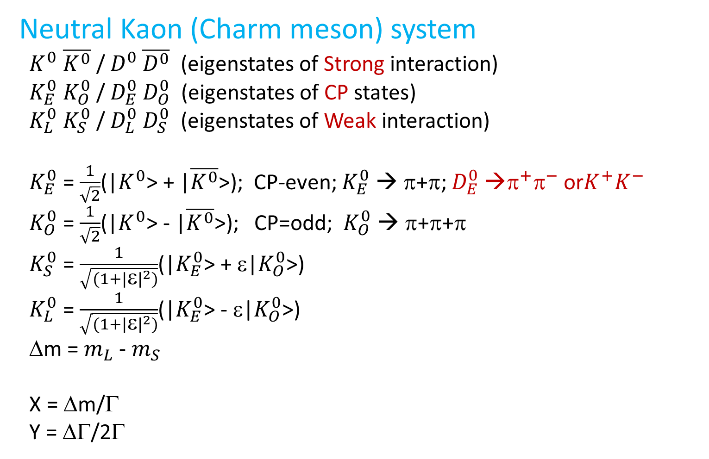
Neutral Kaon (Charm meson) system
$K^{0}$ $\overline{K^{0}}$ / $D^{0}$ $\overline{D^{0}}$ (eigenstates of Strong interaction)
$K_{E}^{0}$ $K_{O}^{0}$ / $D_{E}^{0}$ $D_{O}^{0}$ (eigenstates of CP states)
$K_{L}^{0}$ $K_{S}^{0}$ / $D_{L}^{0}$ $D_{S}^{0}$ (eigenstates of Weak interaction)
$K_{E}^{0}$ = $\frac{1}{\sqrt{2}}$(|$K^{0}$> + |$\overline{K^{0}}$>); CP-even; $K_{E}^{0}$ → π+π; $D_{E}^{0}$ →$^{+}^{−}$ or$K^{+}K^{−}$
$K_{O}^{0}$ = $\frac{1}{\sqrt{2}}$(|$K^{0}$> - |$\overline{K^{0}}$>); CP=odd; $K_{O}^{0}$ → π+π+π
$K_{S}^{0}$ = $\frac{1}{\sqrt{(1+{|ε|}^{2})}}$(|$K_{E}^{0}$> + ε|$K_{O}^{0}$>)
$K_{L}^{0}$ = $\frac{1}{\sqrt{(1+{|ε|}^{2})}}$(|$K_{E}^{0}$> - ε|$K_{O}^{0}$>)
Δm = $m_{L}$ - $m_{S}$
X = Δm/Γ
Y = ΔΓ/2Γ

Slide 10
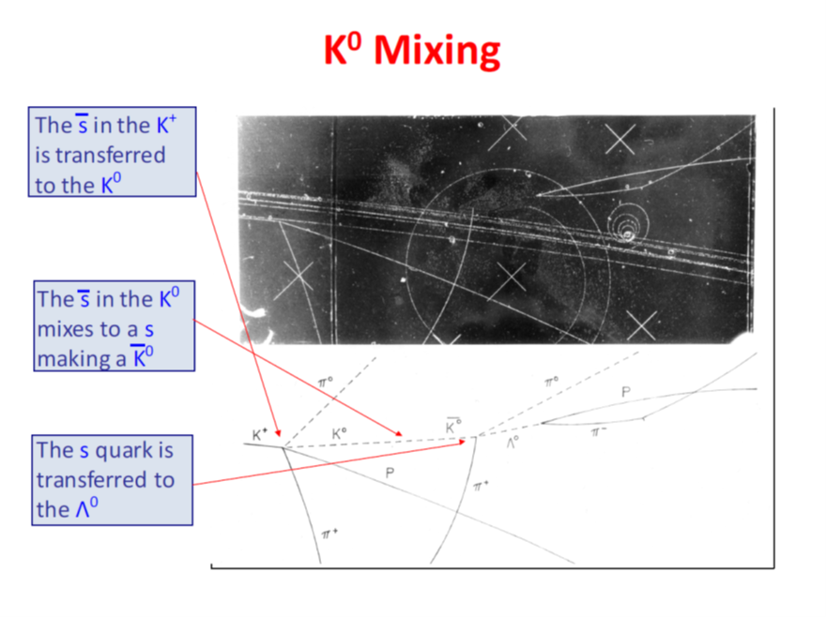




oscillation
$$\overline{K^{0}}$$
$$☹^{0}$$
$$K^{+}$$
$$K^{0}$$

Slide 11
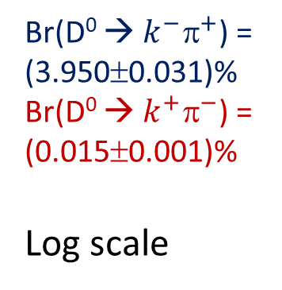




Time evolution
Starting with pure K0/D0
$$D^{0}{\text{→}k}^{+}π^{−}$$
Br(D⁰ → $k^{−}^{+}$) = (3.950±0.031)%
Br(D⁰ → $k^{+}^{−}$) =
(0.015±0.001)%
Log scale
$D^{0}$ →$k^{+}^{−}$
$$\overline{K^{0}}$$
$D^{0}$ → $\overline{D^{0}}$ →$k^{+}^{−}$
P($\overline{K^{0}}$,t) = |<$\overline{K^{0}}$|$K^{0}$(t) >|² = |$\frac{q}{p}$|² [$\frac{1}{4}e^{−t/τs}$ + $\frac{1}{4}e^{−t/τL}$ - $\frac{1}{2}e^{−\frac{1}{2}\left(\frac{1}{τs} + \frac{1}{τL}\right)t}cos\frac{Δmt}{h}$]

Slide 13
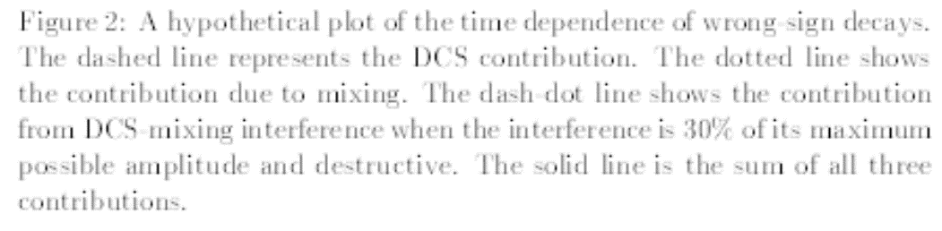


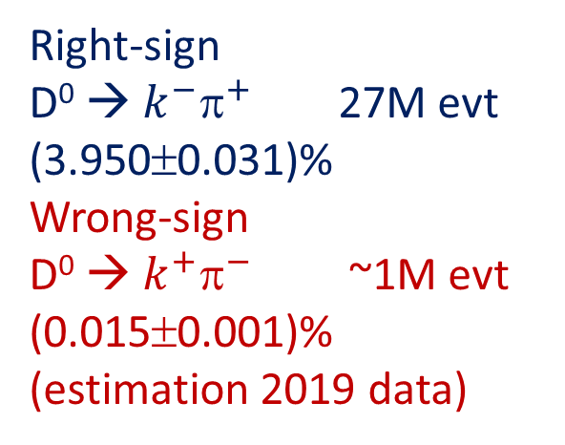
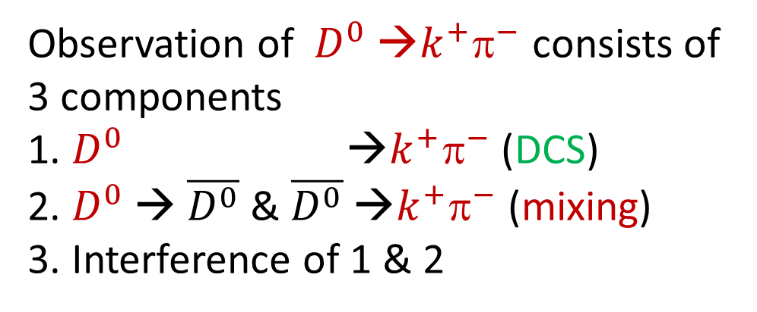
Time evolution of Wrong-sign decay $D^{0}$ →$k^{+}^{−}$
D0 life time
τ = 0.41x10⁻¹² ps
Observation of $D^{0}$ →$k^{+}^{−}$ consists of 3 components
1. $D^{0}$ →$k^{+}^{−}$ (DCS)
2. $D^{0}$ → $\overline{D^{0}}$ & $\overline{D^{0}}$ →$k^{+}^{−}$ (mixing)
3. Interference of 1 & 2
Tag $D^{∗+}$→$D^{0}$ $^{+}$
DCS
MIXing
interference
Right-sign
D⁰ → $k^{−}^{+}$ 27M evt
(3.950±0.031)%
Wrong-sign
D⁰ → $k^{+}^{−}$ ~1M evt
(0.015±0.001)%
(estimation 2019 data)
τ($D^{0}$) = 0.41x10⁻¹² sec
P($\overline{K^{0}}$,t) = |<$\overline{K^{0}}$|$K^{0}$(t) >|² = |$\frac{q}{p}$|² [$\frac{1}{4}e^{−t/τs}$ + $\frac{1}{4}e^{−t/τL}$ - $\frac{1}{2}e^{−\frac{1}{2}\left(\frac{1}{τs} + \frac{1}{τL}\right)t}cos\frac{Δmt}{h}$]

Slide 14
Ratios of time evolutions KK/Kπ, ππ/Kπ (2019 LHCb PRL)
X = Δm/Γ
Y = ΔΓ/2Γ

Slide 15
CPV study of asymmetry in angular distribution
CPV study of Bs → φ Ψ → (K+K-) (μ+μ-)
CPV study of Ds → φ ρ → (K+K-) (π⁺π⁰)

Slide 16
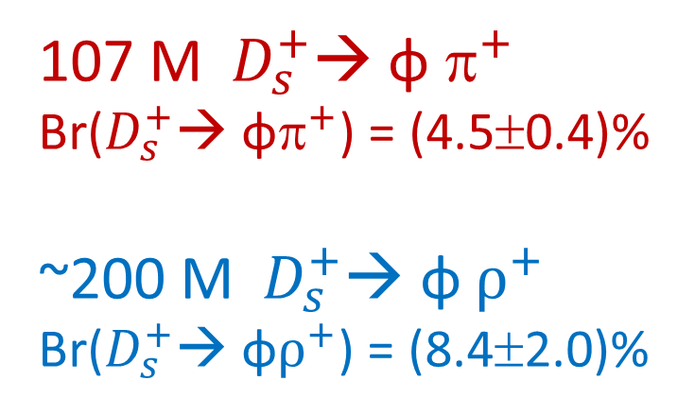
107 M $D_{s}^{+}$→ φ $^{+}$
Br($D_{s}^{+}$→ φ$^{+}$) = (4.5±0.4)%
~200 M $D_{s}^{+}$→ φ $ρ^{+}$
Br($D_{s}^{+}$→ φ$ρ^{+}$) = (8.4±2.0)%

Slide 17
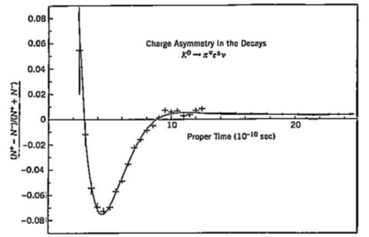
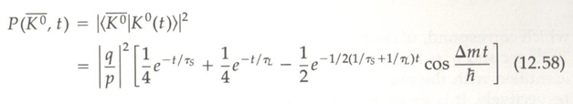
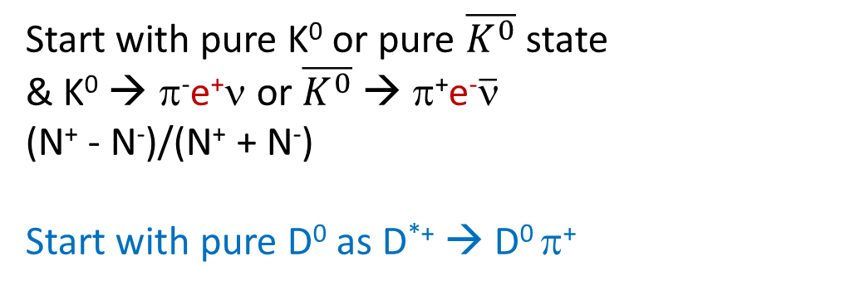
Strangeness oscillation
Start with pure K⁰ or pure $\overline{K^{0}}$ state
& K⁰ → π⁻e⁺ν or $\overline{K^{0}}$ → π⁺e⁻$\overline{ν}$
(N⁺ - N⁻)/(N⁺ + N⁻)
Start with pure D⁰ as D^{*+} → D⁰ π⁺

Slide 18
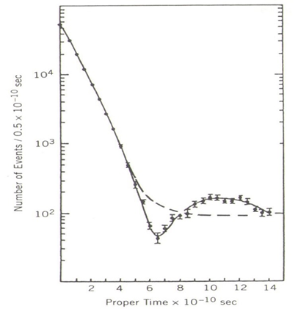
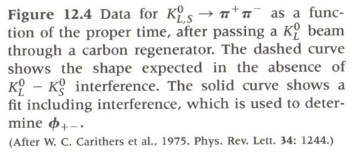

Slide 19
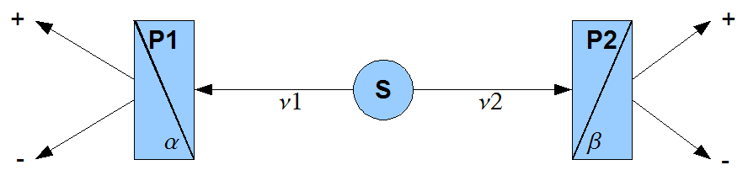
Aspect’s experiment of EPR paradox (quantum correlation)
Ca*
γ₁
γ₂
The source used is a calcium radiative cascade, excited with a krypton laser.
(sequential processes, not a simultaneous process )
γ₁ & γ₂ leave Krypton sequentially

Slide 20
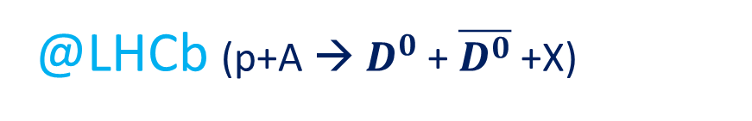
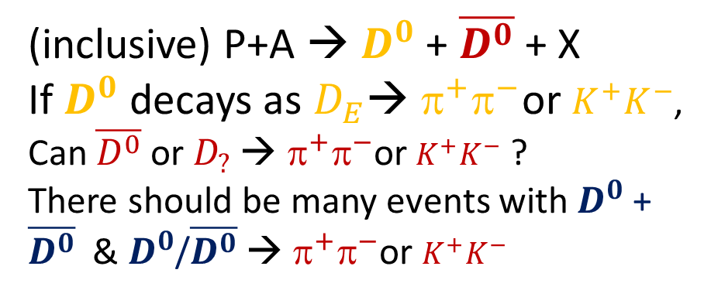



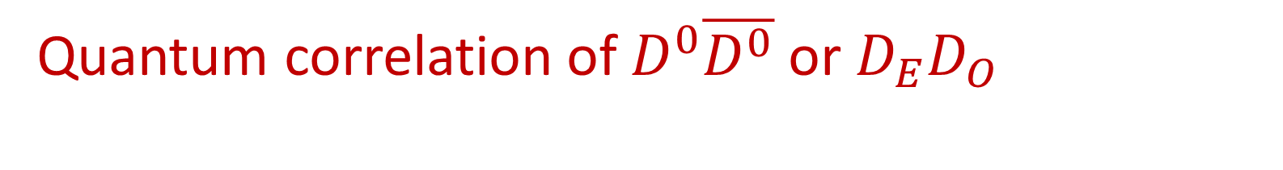
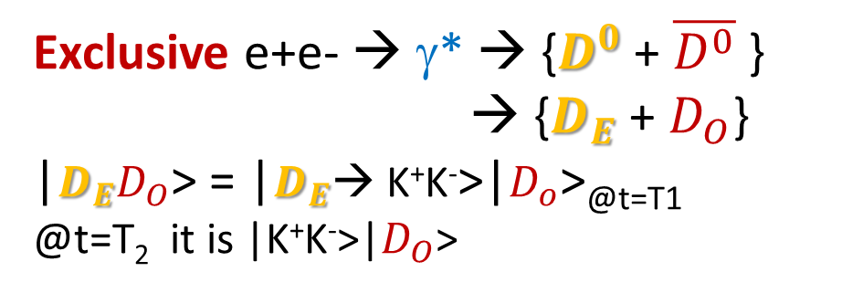
Quantum correlation of $D^{0}\overline{D^{0}}$ or $D_{E}D_{O}$
@Belle/Belle-II
K⁺
@LHCb (p+A → $D^{0}$+ $\overline{D^{0}}$ +X)
K⁻
EVEN
$$D_{E}$$
$$D_{O}$$
T₁
$D_{O}$??
ODD/
EVEN
π⁺
T₂
π⁻
(inclusive) P+A → $D^{0}$+ $\overline{D^{0}}$ + X
If $D^{0}$ decays as $D_{E}$→ $^{+}^{−}$or $K^{+}K^{−}$,
Can $\overline{D^{0}}$ or $D_{?}$ → $^{+}^{−}$or $K^{+}K^{−}$ ?
There should be many events with $D^{0}$+ $\overline{D^{0}}$ & $D^{0}$/$\overline{D^{0}}$ → $^{+}^{−}$or $K^{+}K^{−}$
Exclusive e+e- → γ* → {$D^{0}$+ $\overline{D^{0}}$ }
→ {$D_{E}$+ $D_{O}$}
|$D_{E}D_{O}$> = |$D_{E}$→ K⁺K⁻>|$D_{o}$>_{@t=T1}
@t=T₂ it is |K⁺K⁻>|$D_{O}$>

Slide 21



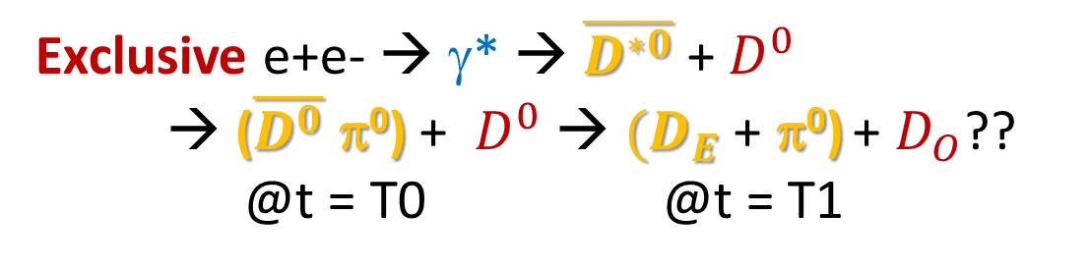





Quantum correlation (@Belle or Belle II)
Exclusive e+e- → γ* → $\overline{D^{∗0}}$ + $D^{0}$
→ ($\overline{D^{0}}$ π⁰) + $D^{0}$→ ${(D}_{E}$+ π⁰) + $D_{O}$??
@t = T0 @t = T1
K⁺
K⁺
K⁻
K⁻
π⁰
T₁
$$D_{E}$$
$$D_{E}$$
$\overline{D^{∗0}}$
$$D_{O}$$
T₁
$$D_{O}$$
T₀
$D_{O}$??
$D_{O}$??
π⁺
T₂
π⁺
T₂
$D_{O}$ & $D_{E}$ do not leave origin simultaneously
π⁻

Slide 22
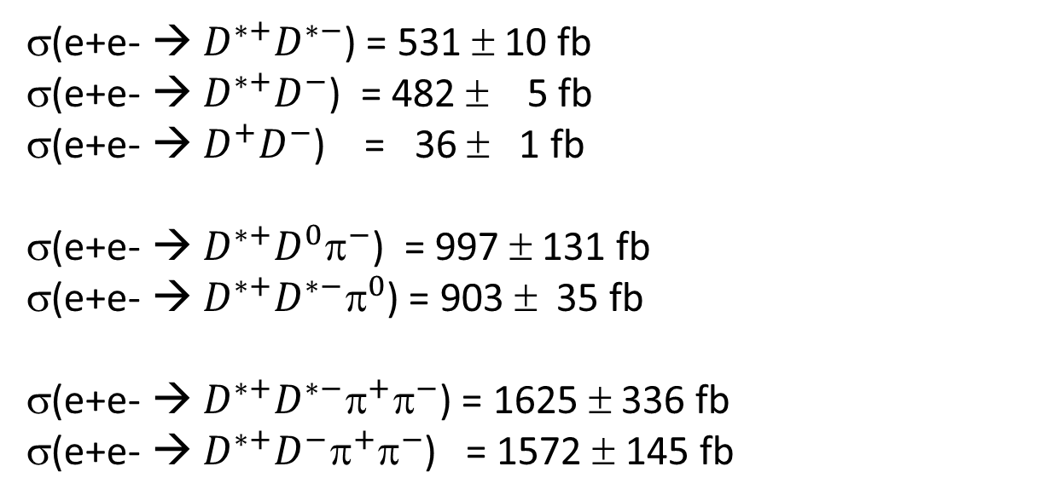
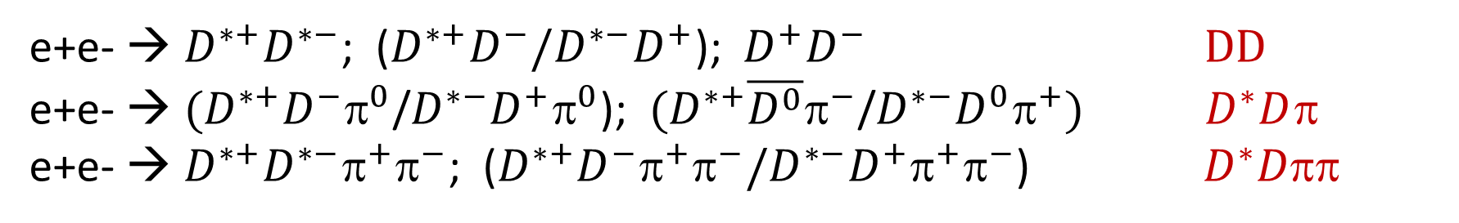
Belle experiment: preliminary results of
Exclusive charm events (particle creation)
e+e- → $D^{∗+}D^{∗−}$; ($D^{∗+}D^{−}/D^{∗−}D^{+}$); $D^{+}D^{−}$ $DD$
e+e- → $(D^{∗+}D^{−}^{0}$/$D^{∗−}D^{+}^{0}$); $(D^{∗+}\overline{D^{0}}π^{−}$/$D^{∗−}D^{0}^{+})$ $D^{∗}D^{}$
e+e- → $D^{∗+}D^{∗−}^{+}^{−}$; ($D^{∗+}D^{−}^{+}^{−}/D^{∗−}D^{+}^{+}^{−}$) ${ D}^{∗}D$
σ(e+e- → $D^{∗+}D^{∗−}$) = 531 ± 10 fb
σ(e+e- → $D^{∗+}D^{−}$) = 482 ± 5 fb
σ(e+e- → $D^{+}D^{−}$) = 36 ± 1 fb
σ(e+e- → $D^{∗+}D^{0}^{−}$) = 997 ± 131 fb
σ(e+e- → $D^{∗+}D^{∗−}^{0}$) = 903 ± 35 fb
σ(e+e- → $D^{∗+}D^{∗−}^{+}^{−}$) = 1625 ± 336 fb
σ(e+e- → $D^{∗+}D^{−}^{+}^{−}$) = 1572 ± 145 fb

Slide 23
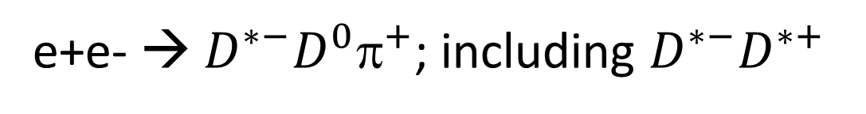
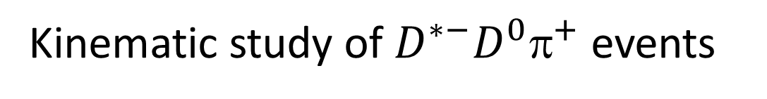
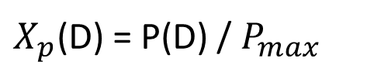


e+e- → $D^{∗−}D^{0}^{+}$; including $D^{∗−}D^{∗+}$
$X_{p}$($D^{∗}$)
D
D
π
$X_{p}$(D) = P(D) / $P_{max}$
D
π
D
$X_{p}$($D^{0}$)
Kinematic study of $D^{∗−}D^{0}^{+}$ events

Slide 24
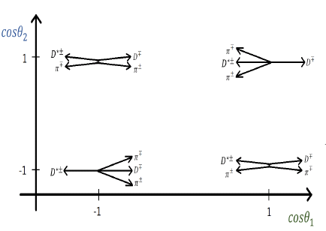
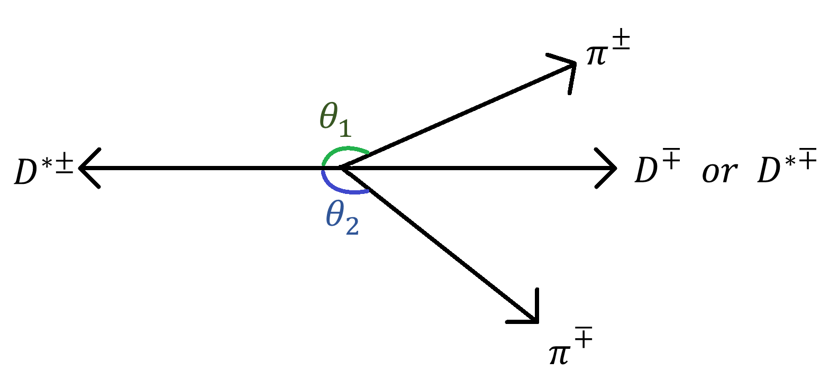
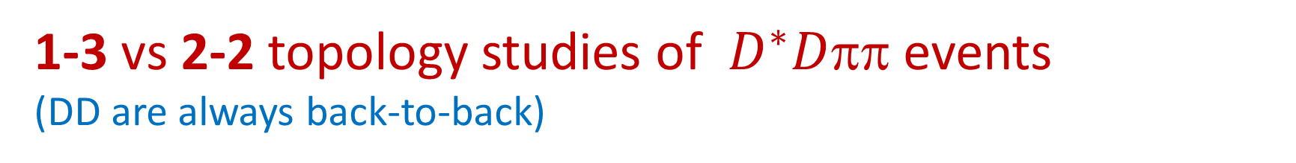
1-3 vs 2-2 topology studies of ${ D}^{∗}D$ events
(DD are always back-to-back)
(+-)(-+)
(3,1)
(1,3)
(++)(--)
Cosq₁ vs Cosq₂

Slide 25
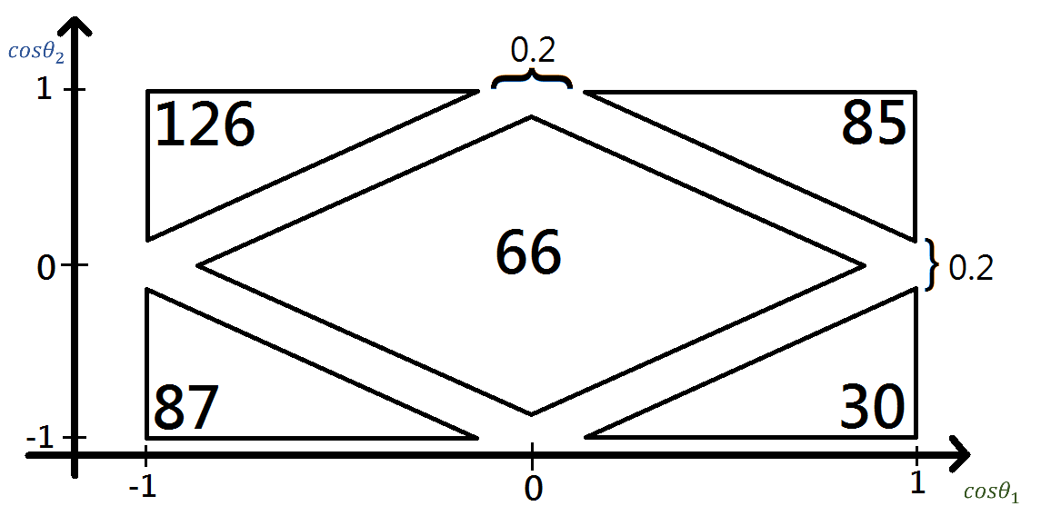
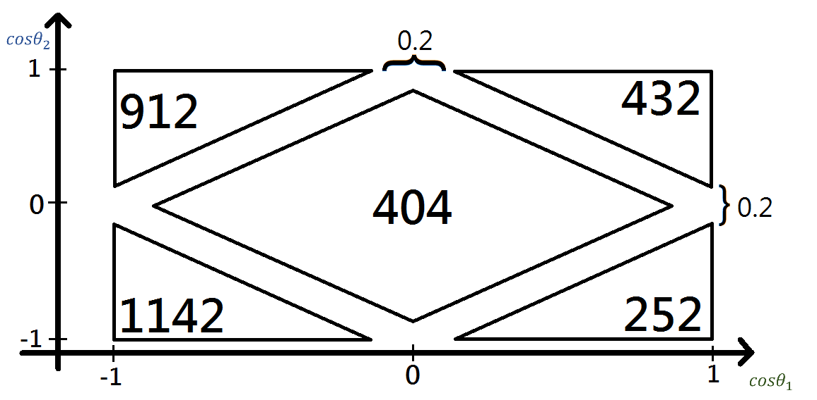
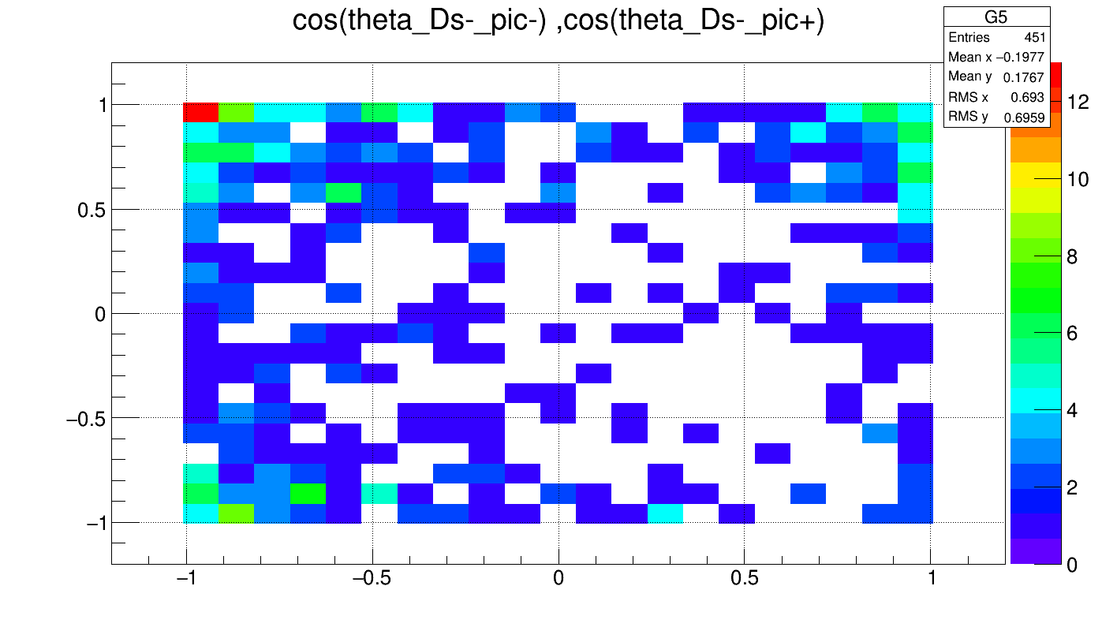
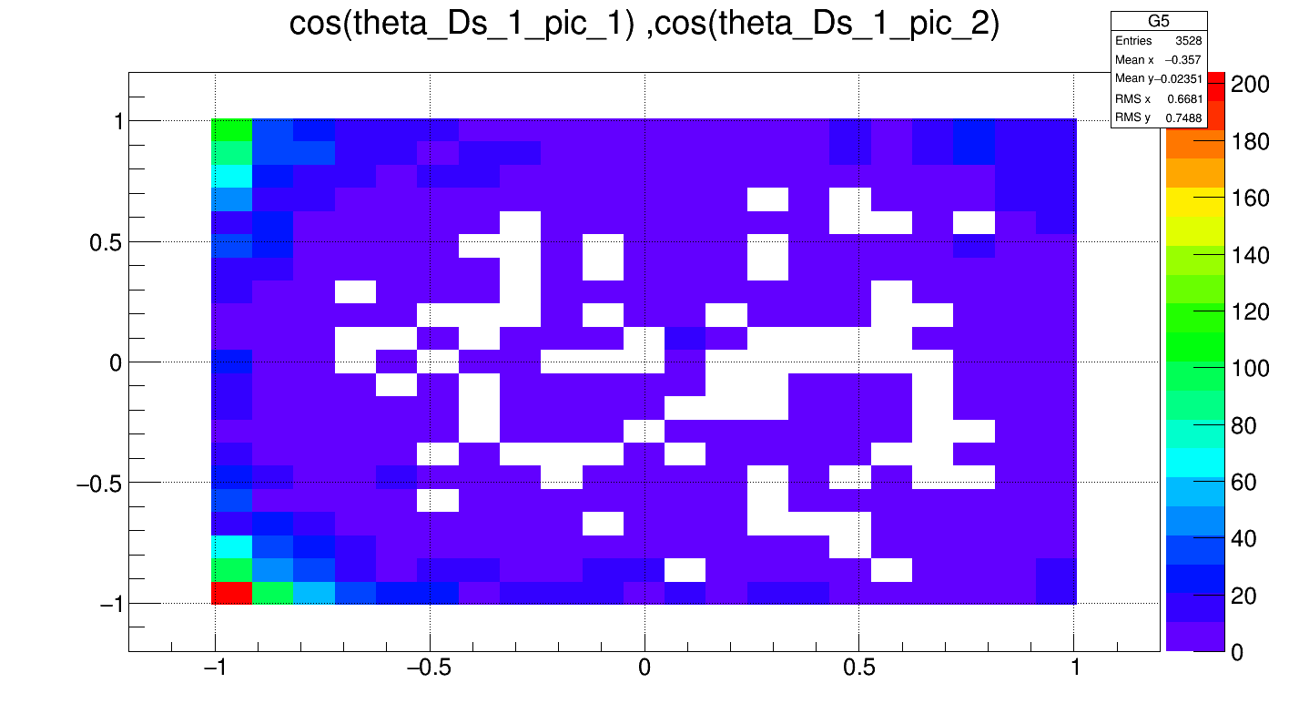


(3,1)
(+-)(-+)
(1,3)
(++)(--)
$$D^{∗}D^{∗}π π$$
$$D^{∗}D π π$$

Slide 26
1-3 vs 2-2 topology
particle
Quasi-particle
Quasi-particle
particle
particle
particle
particle
particle
particle
particle

Slide 27
1-3 topology
particle
Quasi-particle
particle
Quasi-particle
Quasi-particle
particle
particle
particle
particle
particle
particle

Slide 28

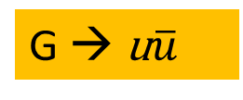
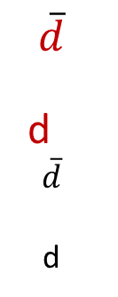

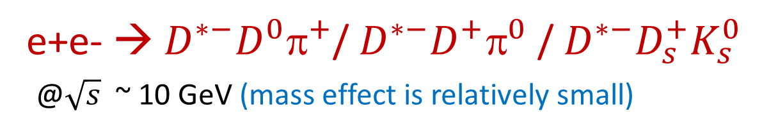
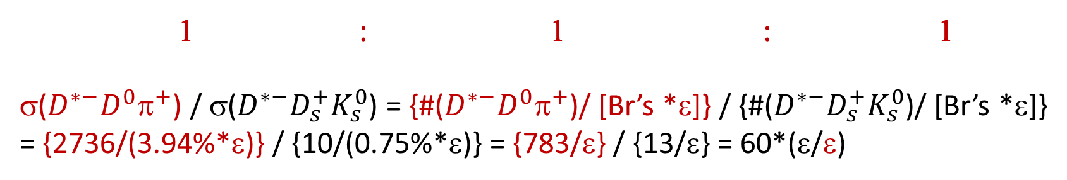


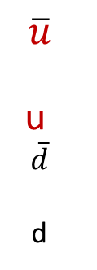
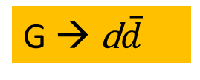




e+e- → $D^{∗−}D^{0}^{+}$/ $D^{∗−}D^{+}^{0}$ / $D^{∗−}D_{s}^{+}K_{s}^{0}$
@$\sqrt{s}$ ~ 10 GeV (mass effect is relatively small)
C
$$D^{0}$$
$$^{+}$$
$$D^{∗−}$$
C
$$D^{+}$$
$$^{0}$$
$$D^{∗−}$$
e+
$$\overline{u}$$
u
$$\overline{d}$$
d
e+
$$\overline{d}$$
d
$$\overline{d}$$
d
C
$$D_{s}^{+}$$
$$K_{s}^{0}$$
$$D^{∗−}$$
e+
$$\overline{s}$$
s
$$\overline{d}$$
d
e-
e-
e-
$$\overline{C}$$
$$\overline{C}$$
$$\overline{C}$$
G → u$\overline{u}$
G → d$\overline{d}$
G → s$\overline{s}$
1 : 1 : 1
σ($D^{∗−}D^{0}^{+}$) / σ($D^{∗−}D_{s}^{+}K_{s}^{0}$) = {#($D^{∗−}D^{0}^{+}$)/ [Br’s *ε]} / {#($D^{∗−}D_{s}^{+}K_{s}^{0}$)/ [Br’s *ε]}
= {2736/(3.94%*ε)} / {10/(0.75%*ε)} = {783/ε} / {13/ε} = 60*(ε/ε)

Slide 29
    Gluon split ? di-quark
Cross section measurements render information of gluon spits into quark pair & di-quark pair

Slide 30
Summary
LHCb & Belle/Belle-II will dominate flavor physics in the coming 10 years.
These are two different types of experiments.
1. Time evolution studies of Charm → Δm. CPV?
2. Quantum correlation (EPR type experiment)
3. Vacuum (QCD) / particle creation

Slide 36






Quantum correlation
EPR type experiment
CPLEAR experiment
K⁻ (s$\overline{u}$) -- K⁰ ($\overline{s}$d)
$K^{0}$& $K^{−}^{+}$ leave origin simultaneously

