Slide 1
Dump Data
20250724 slides

Slide 2
Purity Systematics
Example : W target / LL trigger
Xsection +/- statisticErr = Weighted average of Vincent’s purity and Catarina’s purity
Systematics of purity = size of difference of two method * 0.5

Slide 3
Acceptance Systematics
Source#1 : statistical uncertainty of acceptance
Source#2 : Uncertainty of trigger efficiency and detector efficiency
Vincent’s study shows that the size of Source#2 is twice of Source#1.
Example : W target / LL trigger
Source#1
Source#2

Slide 4
Acceptance Systematics
Example : W target / LL trigger
Systematic of acceptance of Source#1 can be easily obtained.
The total size of acceptance systematic is three times of source#1.

Slide 5
Study BLUE
Slides of 20251003, 20251117

Slide 6
Correlated Uncertainties
How to get weight from covariance matrix
How to get combined mean
For example
Sum(weight)=1
Covariance matrix for two measurements
Combined error

Slide 7
Formulation from AI
Define variables
different trigger same bin
different trigger different bin
not exit in our case?

Slide 8
Correlation matrix
Correlation between acceptance and purity
not exit in our case?
Correlation between acc and purity, zero in case
Diagonal term, A and B
same trigger correlation
A for LL and B for LO
Off-diagonal term, C
correlation between different triggers

Slide 9
Combined mean and sigma
0<rho<1 in our case

Slide 10
Example

Slide 11
Formulation(1) : Full Case
input
Cross section value
Statistic error
Acceptance sys.
Purity sys.
Covariance Matrix for individual systematics (acc, purity, individually)
Acc_LL1
Acc_LL2
Acc_LO1
Acc_LO2
Acc_LL1
Diagonal terms ➔ 1
Off diagonal terms ➔symmetric
Number of correlation factors
N*(N-1)/2 = 4*3/2 = 6
Ex. 6 for acceptance and 6 for purity
Acc_LL2
Acc_LO1
Acc_LO2
Covariance Matrix for individual systematics (between acc and purity)
Acc_LL1
Acc_LL2
Acc_LO1
Acc_LO2
Purity_LL1
Purity_LL2
Purity_LO1
Purity_LO2

Slide 12
Formulation(2) : Simplified Case
Assumptions
statistical error uncorrelated
acceptance and purity uncorrelated
correlation inside each systematics : no correlation if there are two different + different triggers
Different bins + different triggers
Different bins + different triggers

Slide 13
Possible Correlations
Most important question, how do we get those numbers?
Or I can do a simple test, test correlation factor 0<r<0.5 since from the study today, we know it is not good to push r->1.
What if we really have some strong correlated elements or unknown correlated elements?

Slide 14
Short Summary of Simple BLUE Test
Implemented the BLUE (Best Linear Unbiased Estimator) method to study how correlation (r) and uncertainty ratio (σ₂/σ₁) affect the combined result.
Wight :
  When σ₂ = σ₁, both measurements contribute equally (w₁ = w₂ = 0.5).
  When σ₂/σ₁ ≈ 1, weights become unstable and highly sensitive as r → +1 due to near-singular covariance (how to deal with strong correlated uncertainty will be further studied).
  When σ₂/σ₁ ≫ 1, the estimator is dominated by the more precise measurement (smaller σ₁).
Combined mean:
  The combined mean remains stable unless σ₂ ≈ σ₁ and r → +1, where overshoot to large, unphysical values can occur.
Combined uncertainty : the combined uncertainty remains smaller than the smallest individual σ.

Slide 15
BLUE
Combine
err_cy_txtFile_allCorr4.py

Slide 16
1 · BLUE Formulation
2
Goal: combine the two trigger measurements (LL and LO) of the same 3D bins into one best estimate, accounting for statistical and systematic correlations.
Measurement vector (length 2N — LL stacked on LO):
y = [ y_{LL} , y_{LO} ] U = [ I ; I ] (2N × N, maps N combined bins → 2N measurements)
BLUE estimator (per bin):
R̂ = ( Uᵀ R⁻¹ U )⁻¹ (combined covariance)
α = R̂ Uᵀ R⁻¹ (BLUE weights, N × 2N)
ŷ = α y (combined cross section)
Combined error per bin: σ_{comb} = √ diag(R̂). Run three times — with R_{stat}, R_{sys}, R_{total} — to split stat and sys.
combined_xsc_sta, combined_err_sta, ... = combine_blue_with_checks(y, R_stat)
combined_xsc, combined_err, ... = combine_blue_with_checks(y, R_total)

Slide 17
1 · From Correlations to Covariance
3
Each uncertainty source becomes a covariance via R = diag(σ) · C · diag(σ) , then summed:
R_stat = diag(stat) @ C_stat @ diag(stat)
R_sysA = diag(sysA) @ C_sys_acc @ diag(sysA)
R_sysP = diag(sysP) @ C_sys_purity @ diag(sysP)
R_sysT = diag(sysT) @ C_sys_trig @ diag(sysT)
R_sys = R_sysA + R_sysP + R_sysT
R_total = R_stat + R_sys
Built-in diagnostics per bin
Local χ²
BLUE weights
Total χ²/ndf
(yLL − ŷ)²/σ²LL + (yLO − ŷ)²/σ²LO per bin — LL/LO tension.
diagonal of α sub-blocks → how much LL vs LO each bin uses.
overall consistency of the two triggers across all bins.

Slide 18
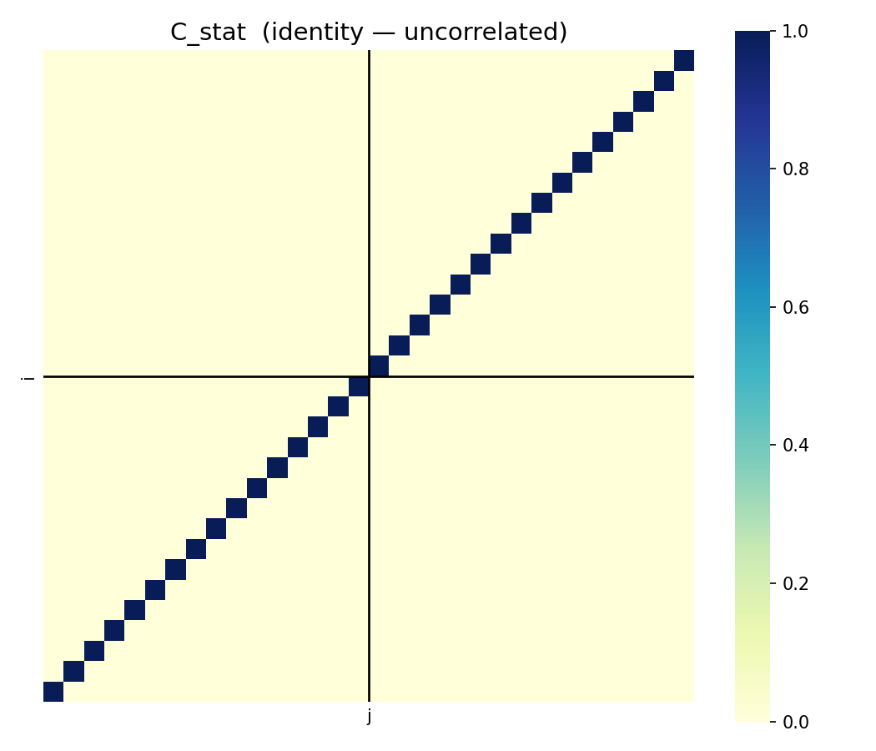
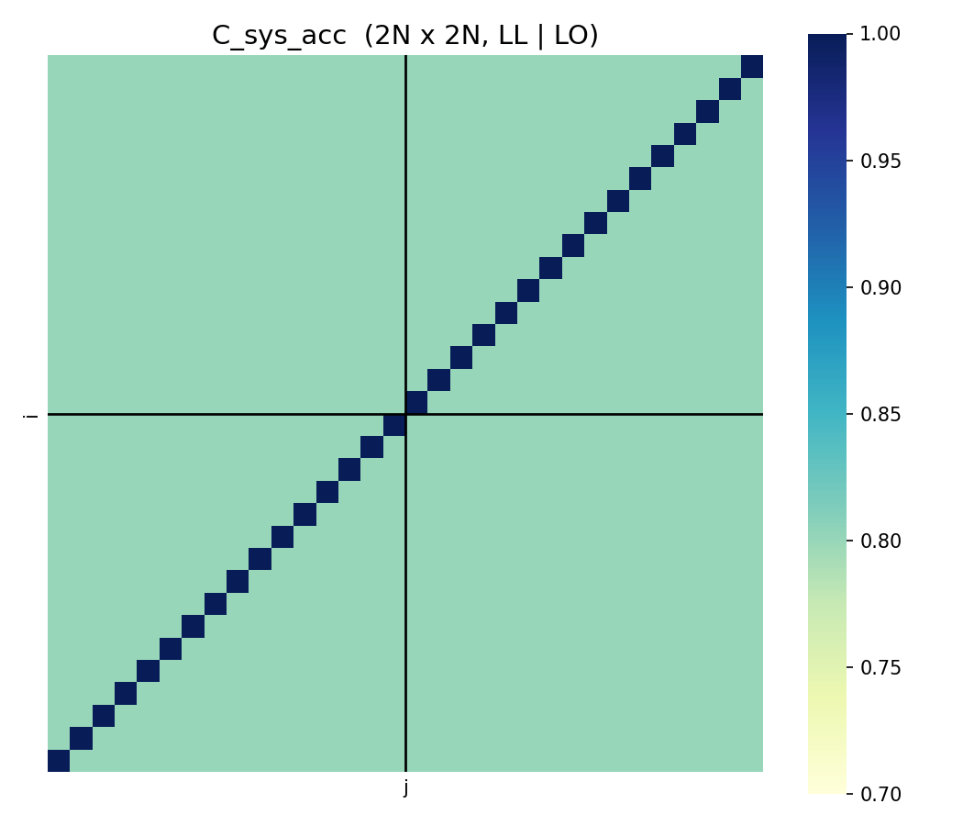
2 · Correlation Matrices
4
Each systematic's 2N×2N correlation matrix is assembled from two builders:
generate_C_SameTrig
Within LL–LL and LO–LO blocks: ρ=1 same bin, ρ=0.8 different bin.
generate_C_DiffTrig
Across LL–LO blocks: ρ=1 (or 0.8) same bin, ρ=0.8 different bin.
C_sys = SameTrig + DiffTrig · C_stat = identity (uncorrelated)
C_stat
C_sys_acc (purity & trigger share the structure)

Slide 19
3 · Final Results
5
The BLUE combination outputs, per 3D (mass, pT, xF) bin:
combined_xsc best-estimate cross section ŷ = α y
combined_err_sta statistical error (BLUE with R_stat)
combined_err_sys systematic error (BLUE with R_sys)
Written to: ./data/{infilename}_{flag}_{row_start}_{row_end}.txt
Visualised by three figure sets
Before vs After
Uncertainty sizes
Correlation matrices
LL & LO vs combined, 4×3 (mass,pT) panels vs xF.
stat / sysP / sysA / sysT for LL, LO, combined.
purity, acceptance, trigger heatmaps.
Next: integrate_3d_to_1d / _0d project the combined result (with full R̂) down to xF and total yield.

Slide 20
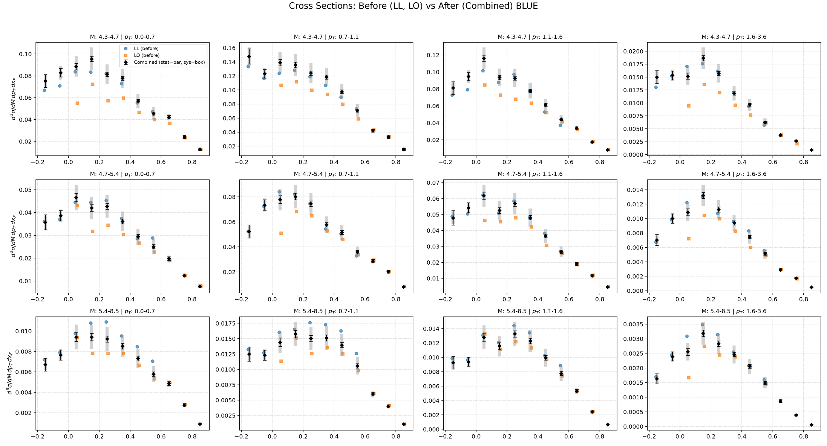
W

Slide 21
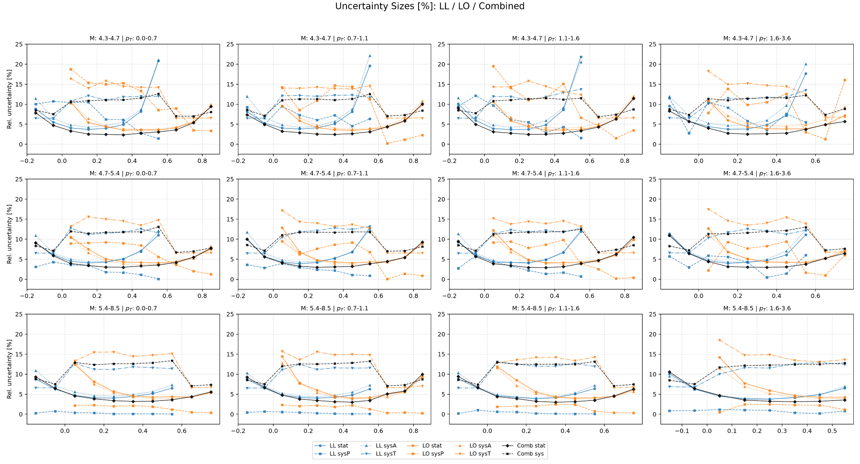

Slide 22
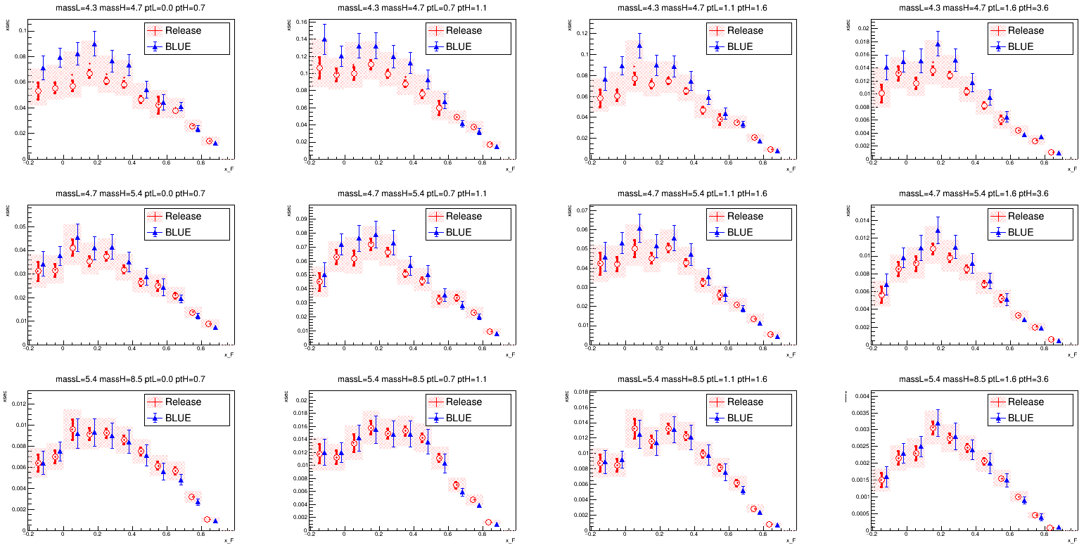
Released VS BLUE in 3D w/ Corr
Trigger rho = 0.8
Mean of BLUE is much shifted towards to LL

Slide 23
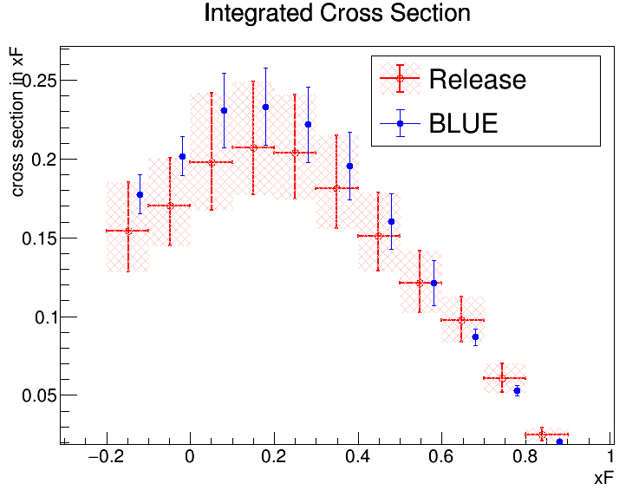
If we add correlation 0.8 for acc, purity, trigger, then systematic size between release and BLUE are more consistent. But the mean value are quite different.

Slide 24
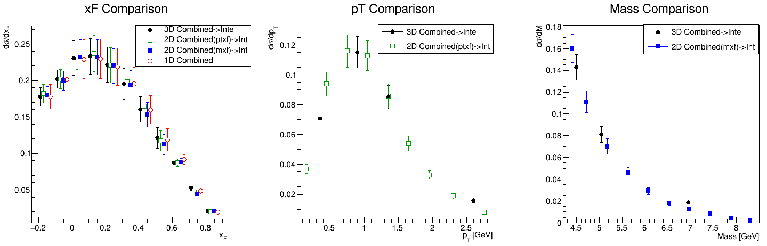
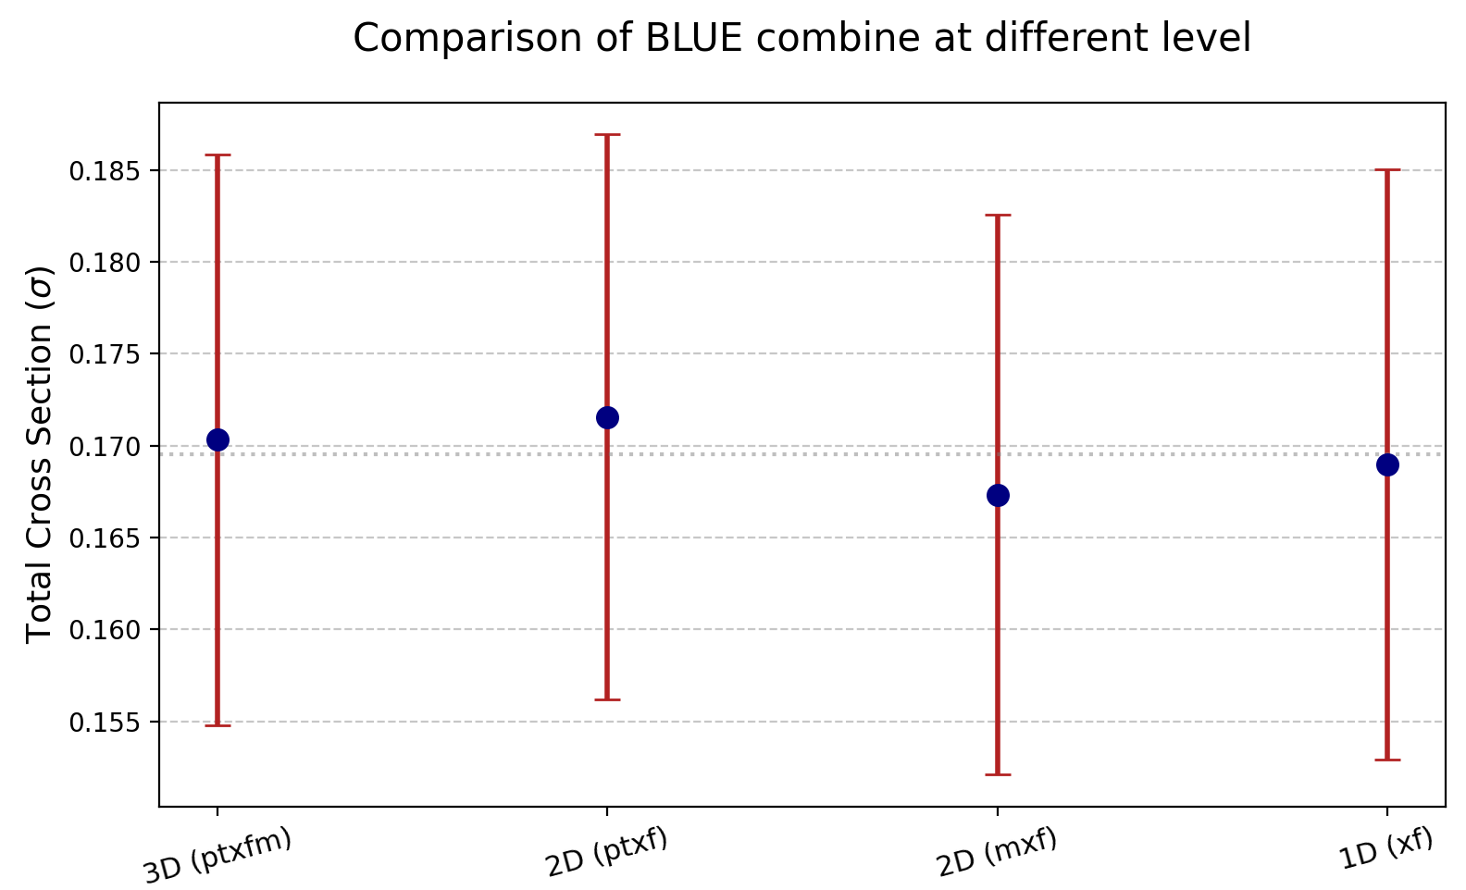
3D combine(integrate to 1D)
VS 2D combine(integrate to 1D) VS 1D combine
W
Total cross section
3D combined in ptxfm : 1.703298e-01 +/- 1.551382e-02
2D combined in ptxf : 1.715618e-01 +/- 1.537146e-02
2D combined in mxf : 1.673365e-01 +/- 1.520843e-02
1D combined in xf : 1.689780e-01 +/- 1.604824e-02

Slide 25
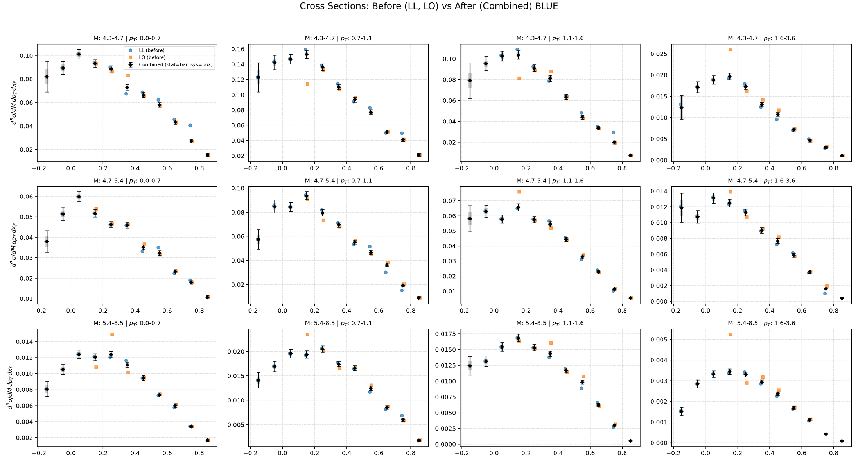
NH3

Slide 26
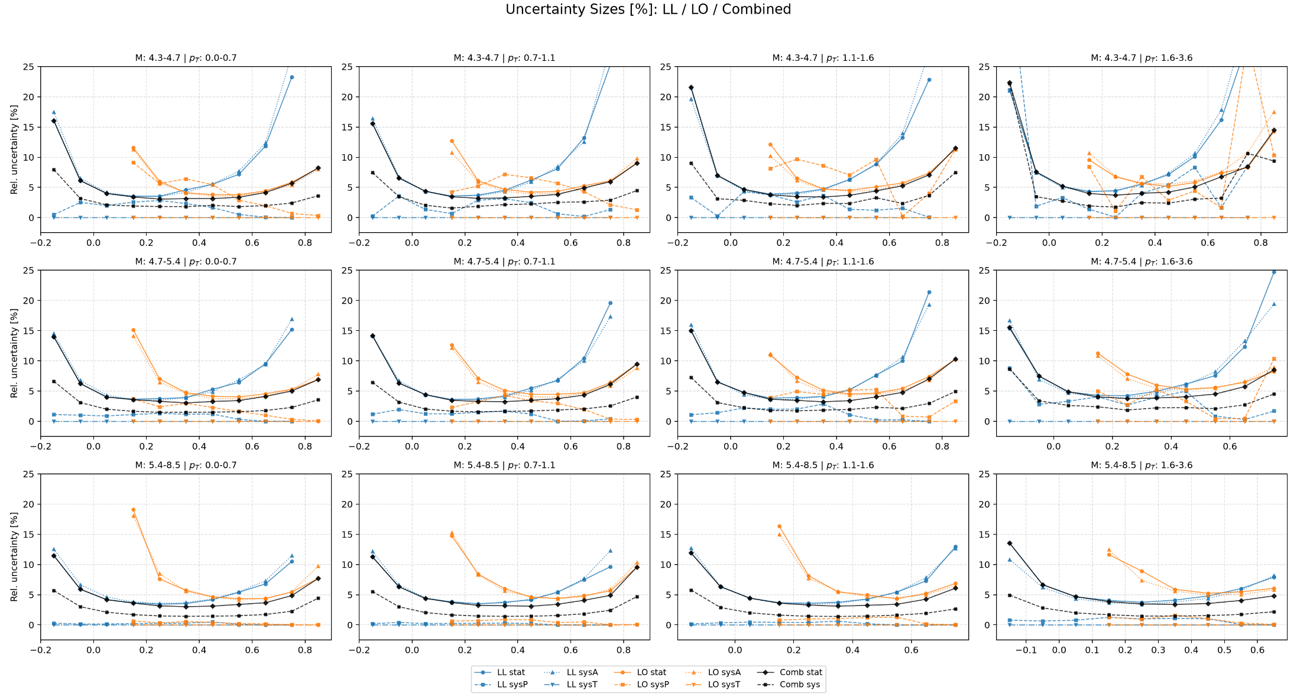

Slide 27
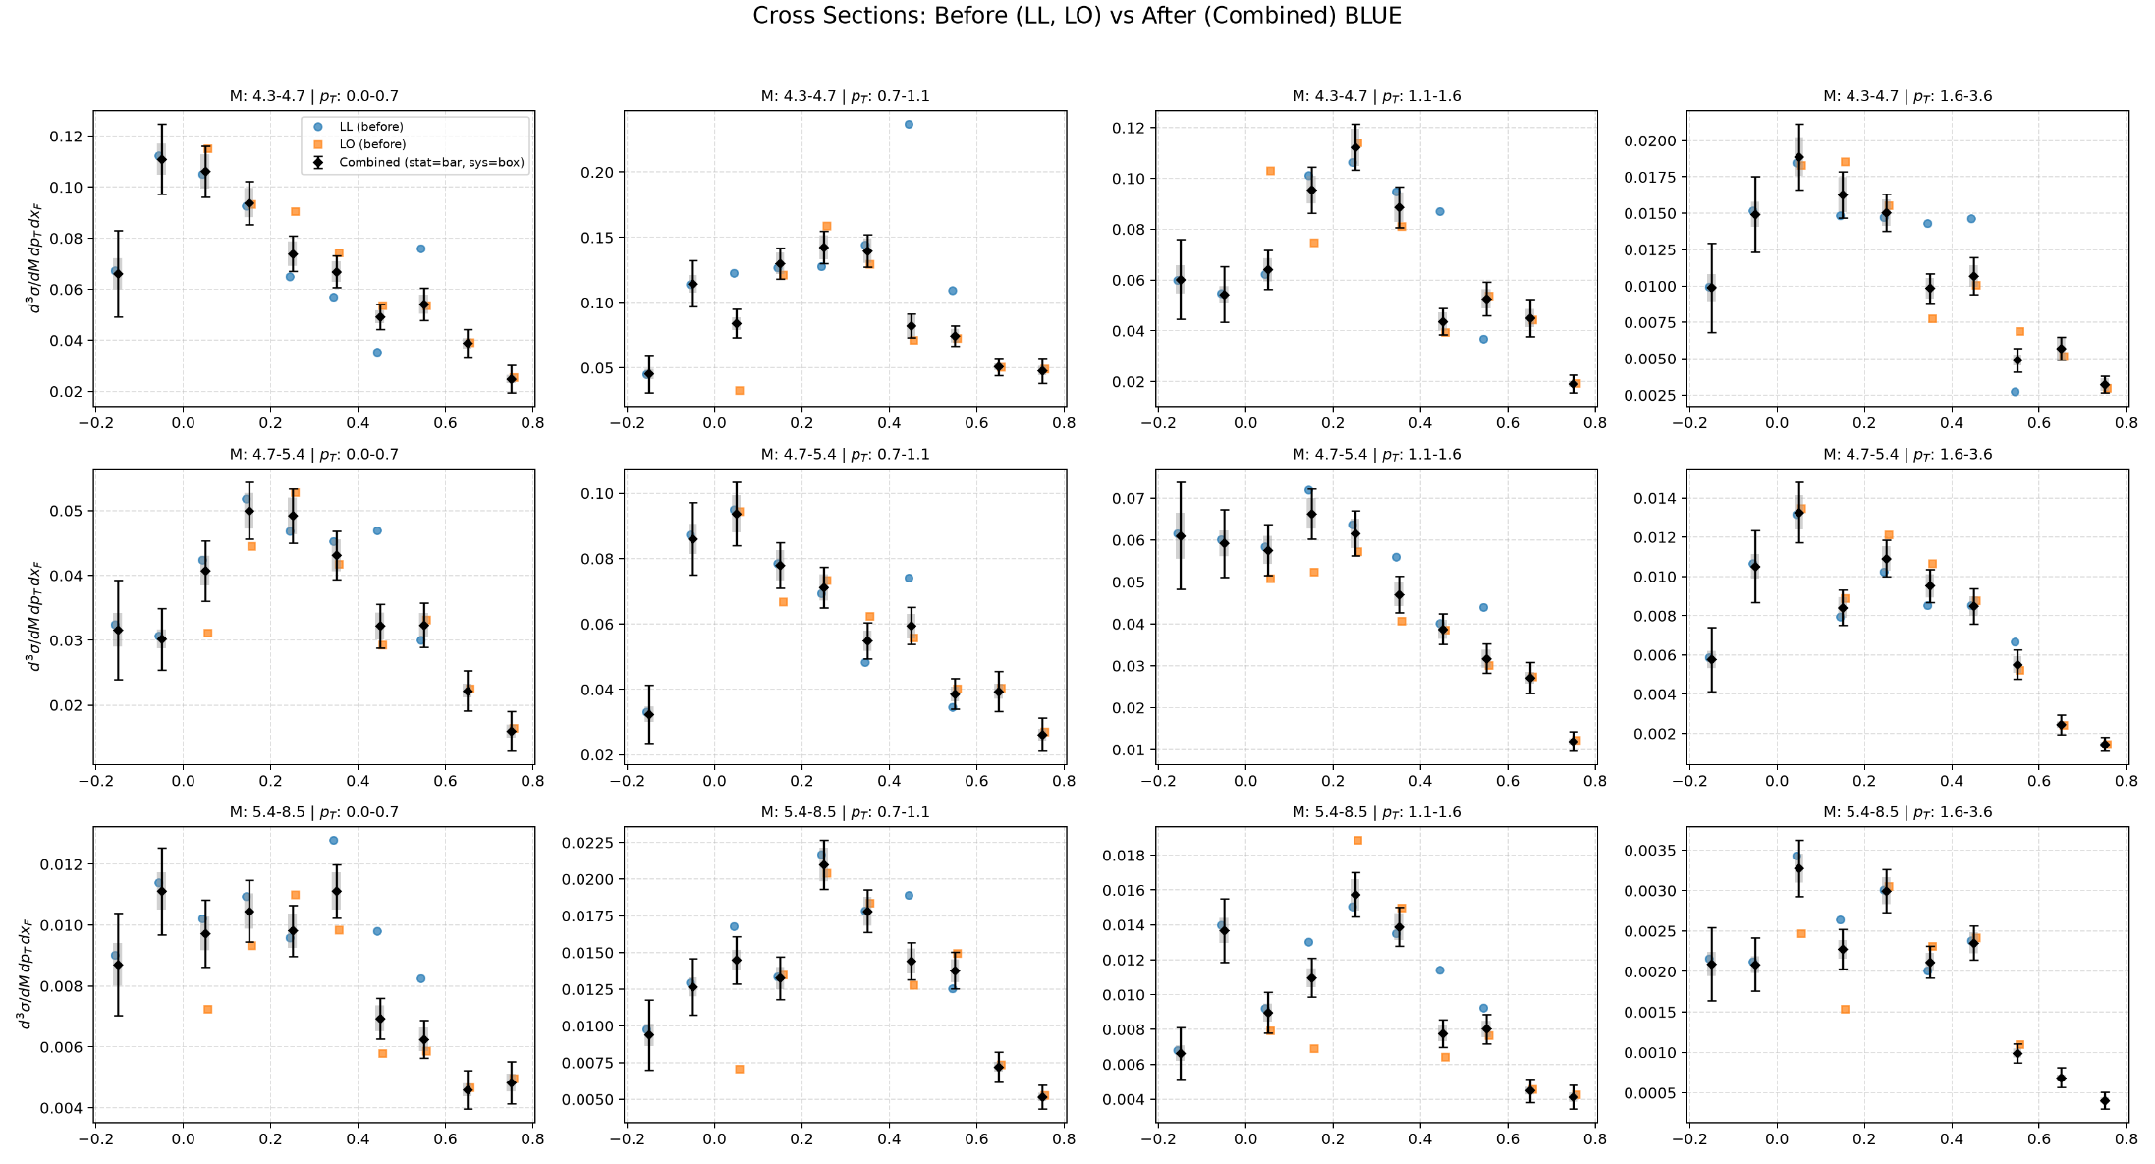
Al

Slide 28
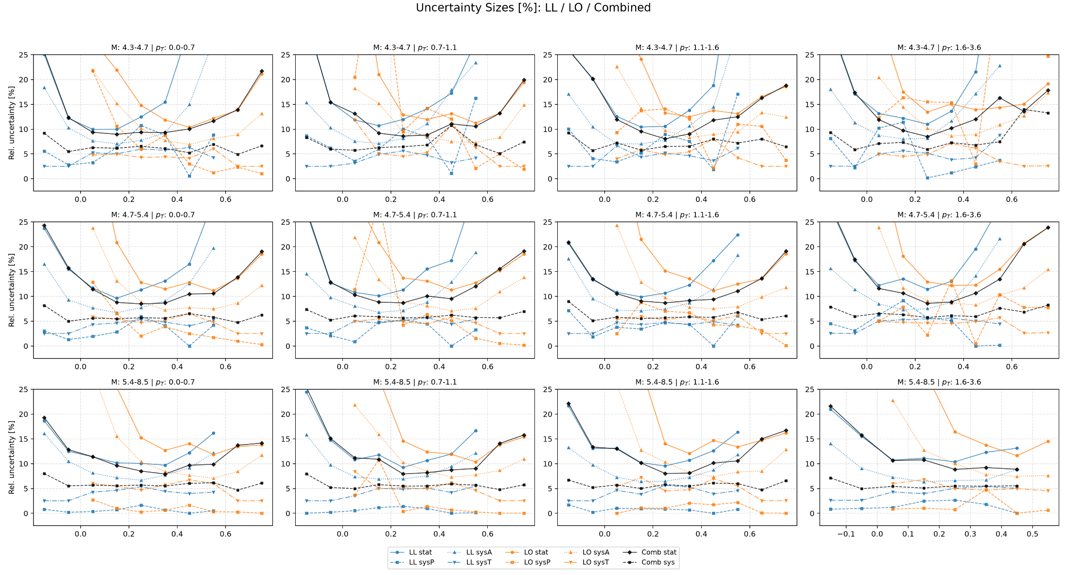

Slide 29
More realistic sys and corr
https://docs.google.com/document/d/1RANY0-G8v7JsBg6vcyVTTX0N6OD3O04ShqOp34YLw5w/edit?tab=t.0

Slide 30
Acc Sys

Slide 31
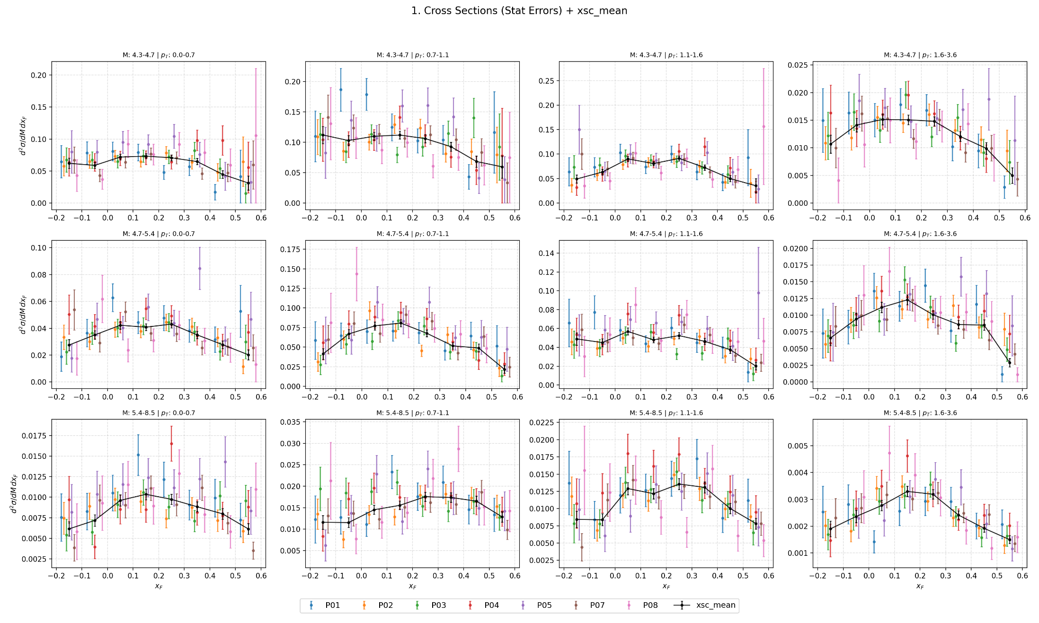
3D Xsc

Slide 32
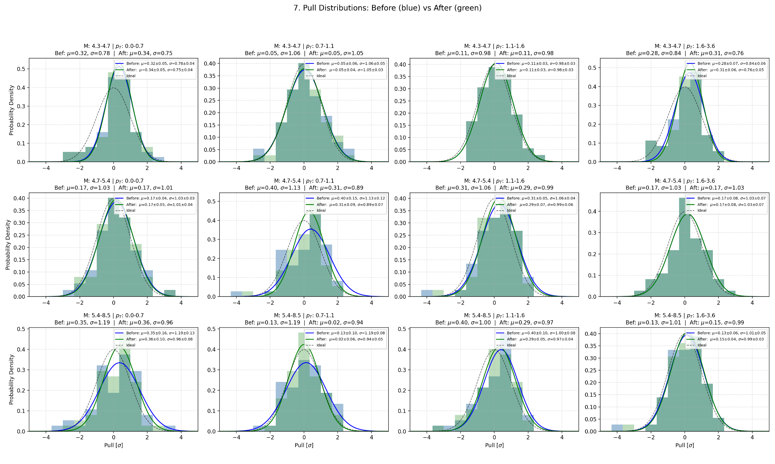
3D Xsc
Pull : Before(stat) VS After (sqrt(stat^2+sys^2))

Slide 33
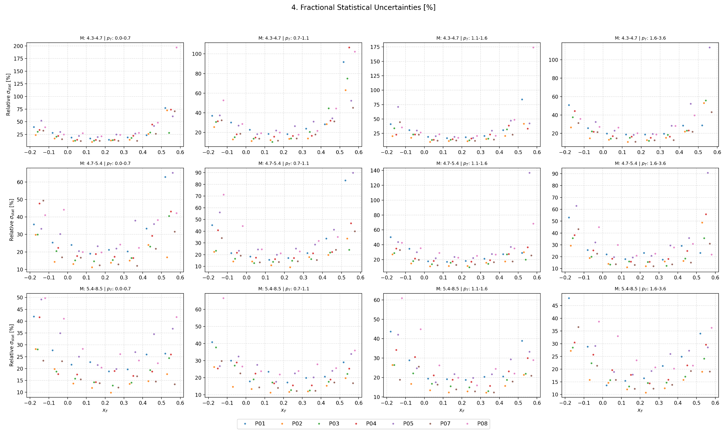
3D Xsc : Size of Sat

Slide 34
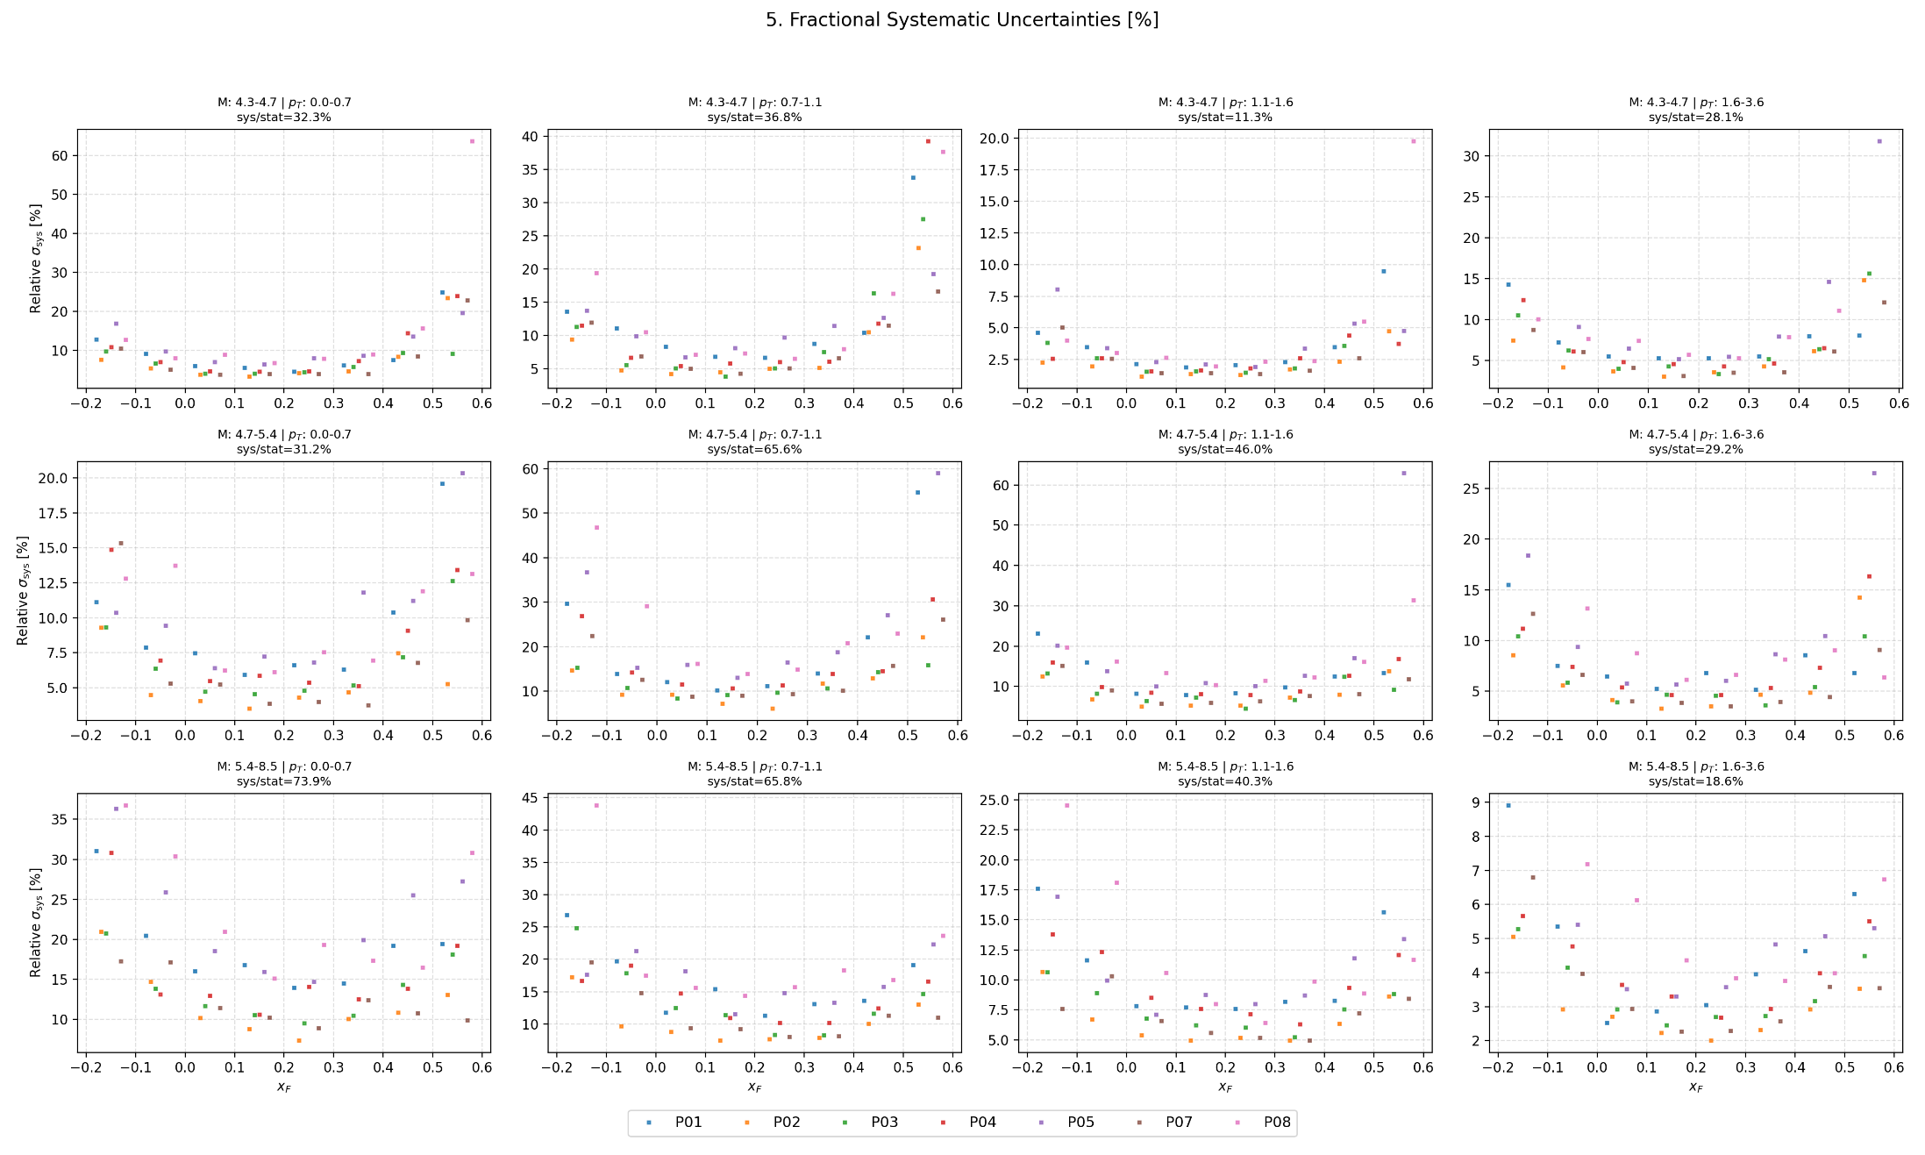
3D Xsc : Size of Sys

Slide 35
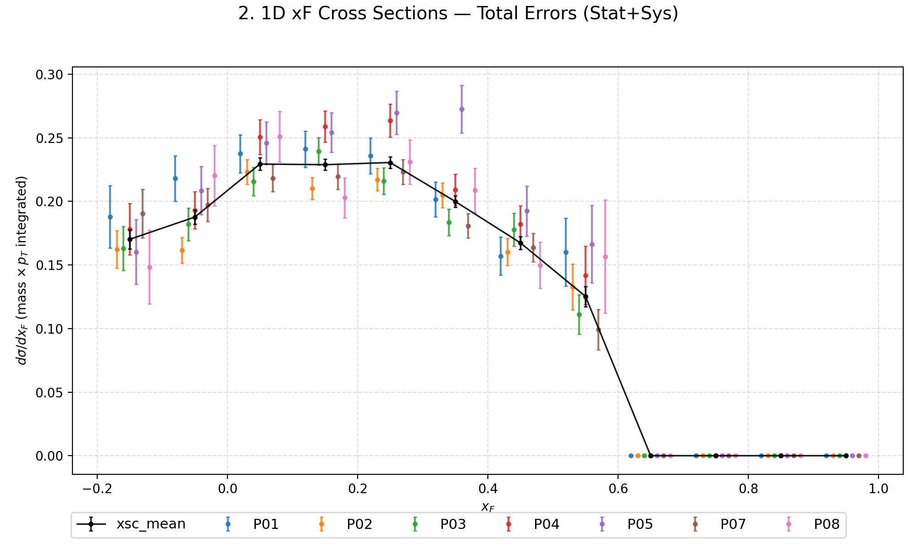
Integration : 1D Xsc (sqrt(stat^2+sys^2))

Slide 36
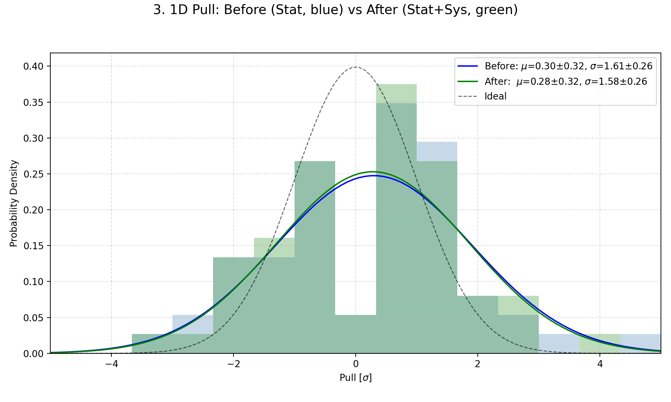
1D Xsc : Pull Before VS After

Slide 37


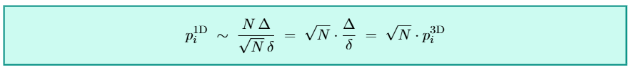
Pull Integration (only Stat.)
https://drive.google.com/file/d/1-JT__N_IfMRxxKecJcVHepgKrzbaKKOM/view?usp=sharing
Definition of pull
Pull after integration to 1D
Numerator is growing faster than denominator
Pull in 1D is mathematically larger than pull in 3D
Access systematics in 3D and apply to 1D, idea-wise doesn’t work.
We also see the prove through our excise.
Numerator (linear sum)
Denominator (quadratic sum)

Slide 38
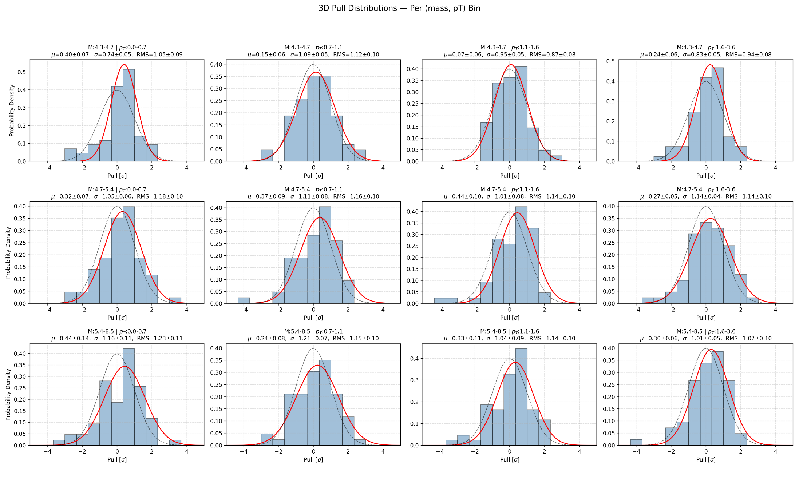
Pull per bin in 3D (only stat)

Slide 39
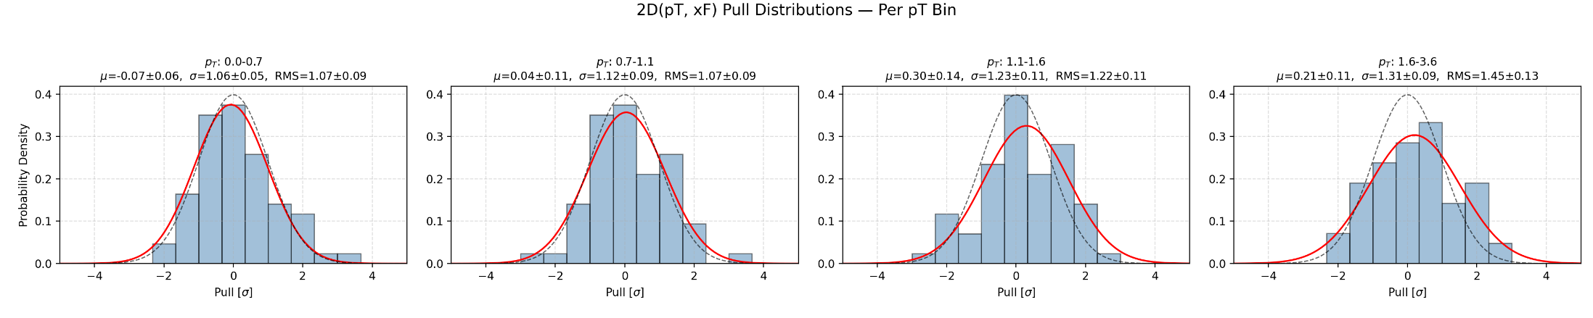
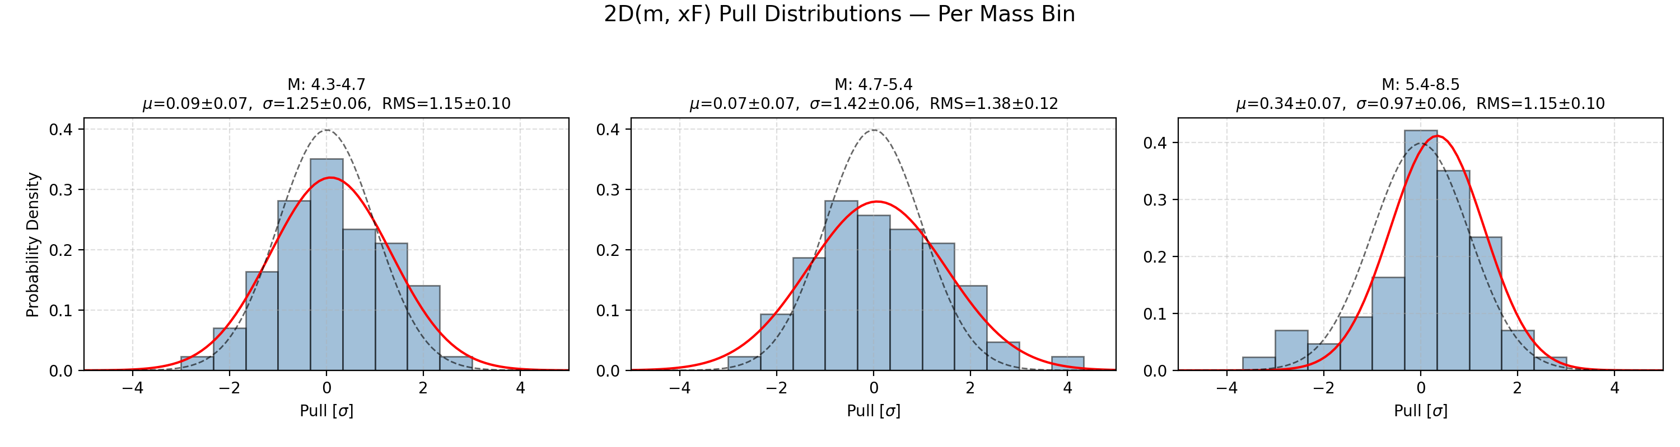
Pull per bin in 2D (only stat)

Slide 40
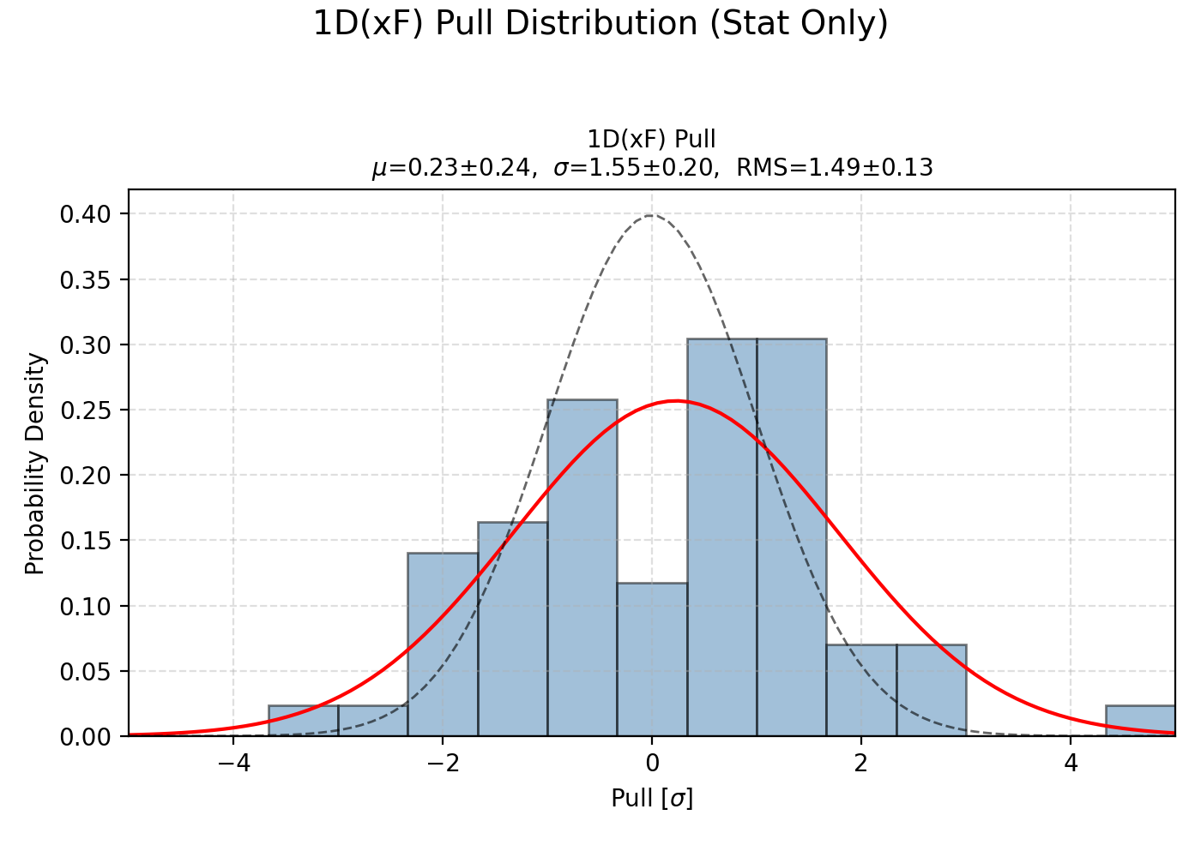
Pull per bin in 1D (only stat)

Slide 41
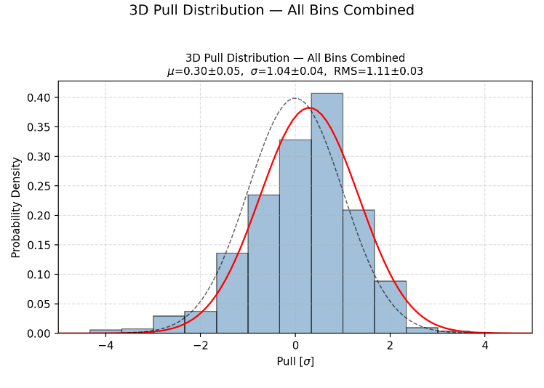
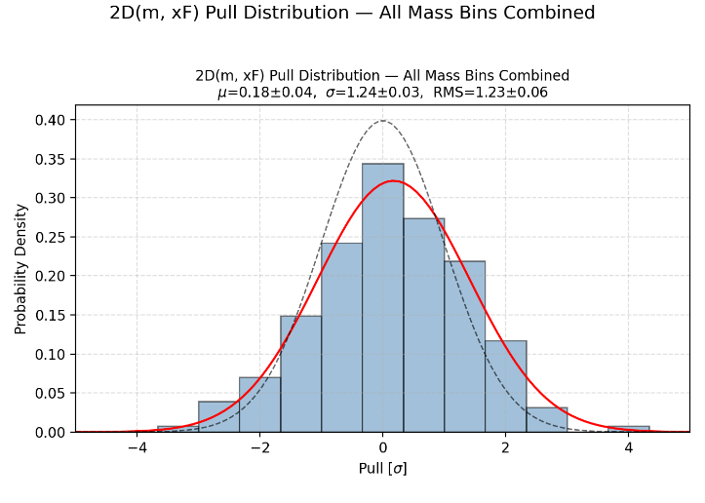
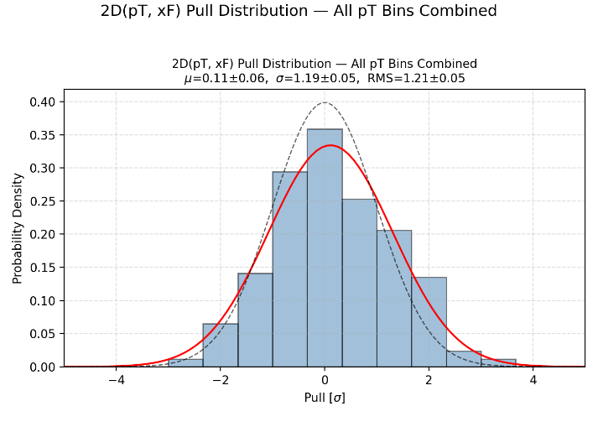
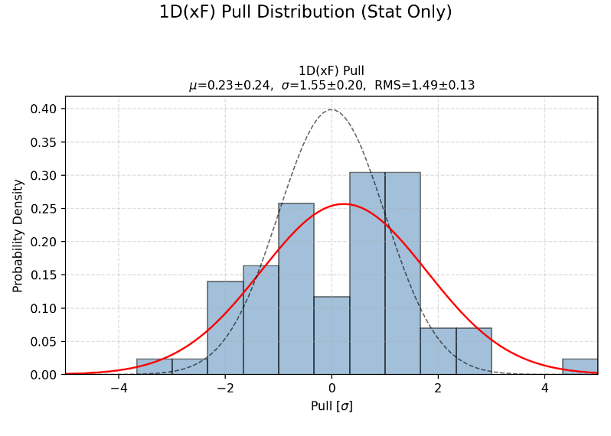
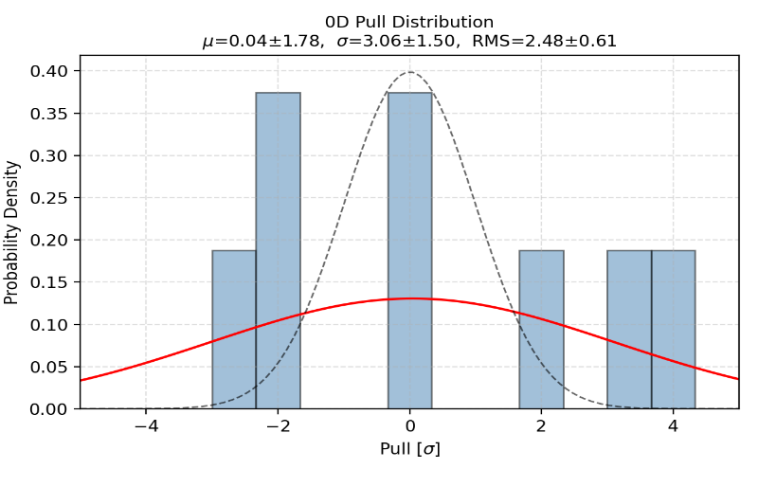
Pull combined in 3/2/1/0D
3D (m, xf, pt)
2D (m, xf)
2D (m, pt)
1D (xf)
Separate into different period
0D
Pull sigma is growing larger and large after the integration

Slide 42
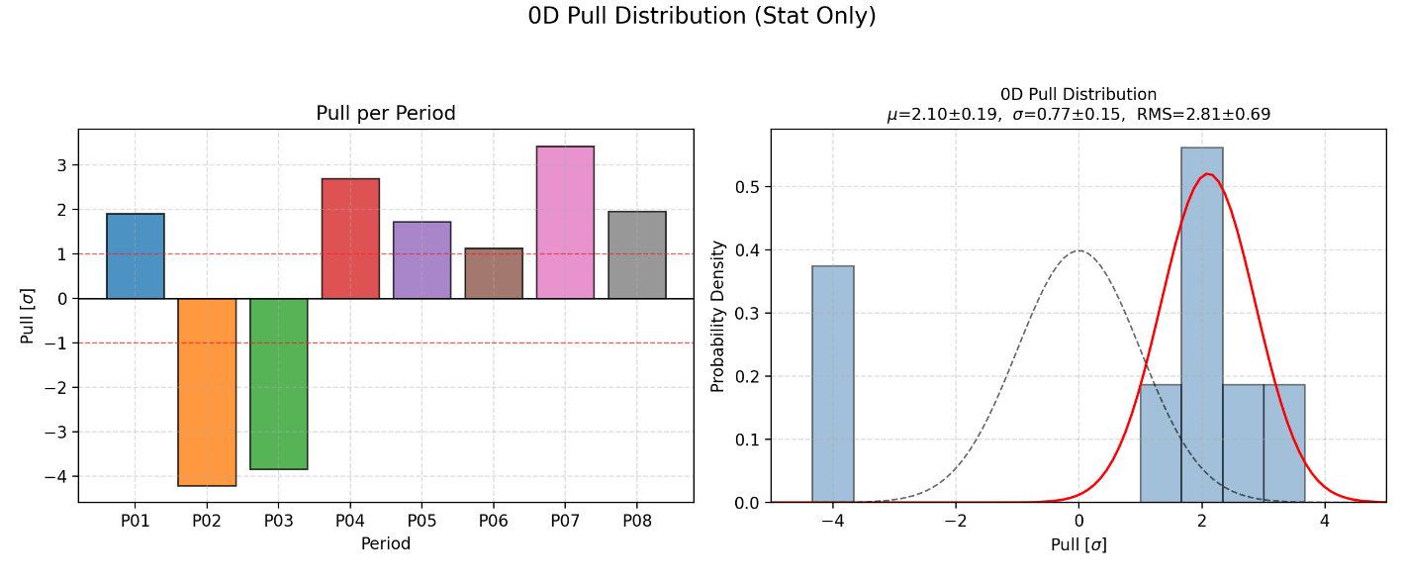
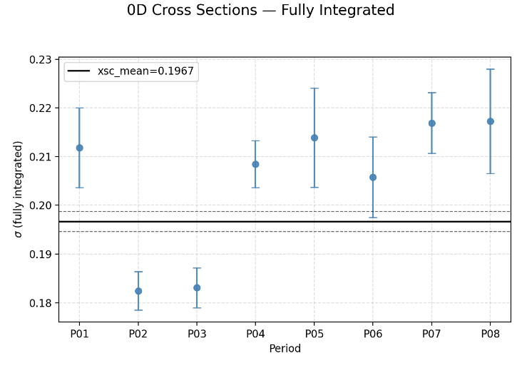
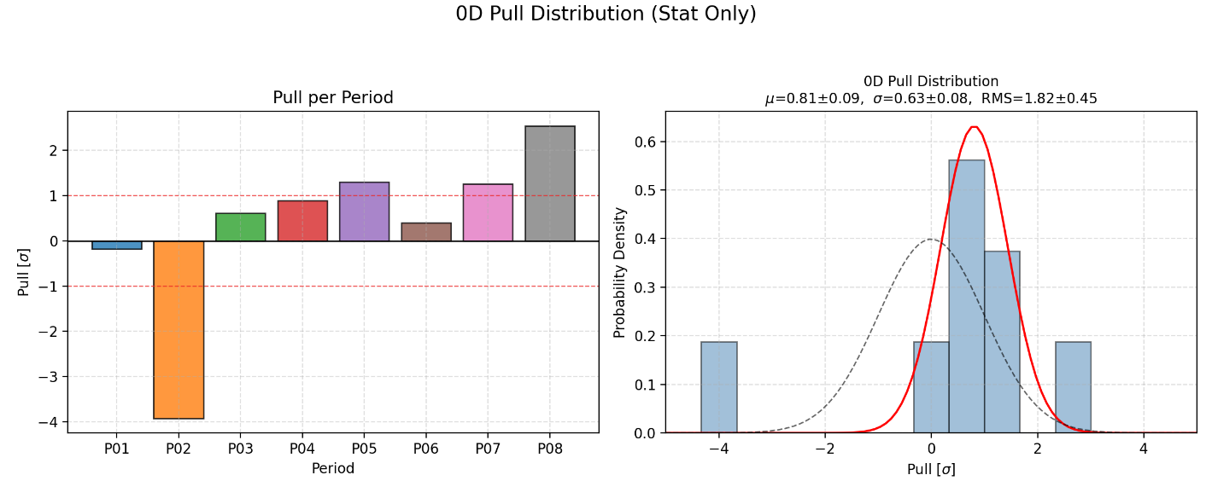
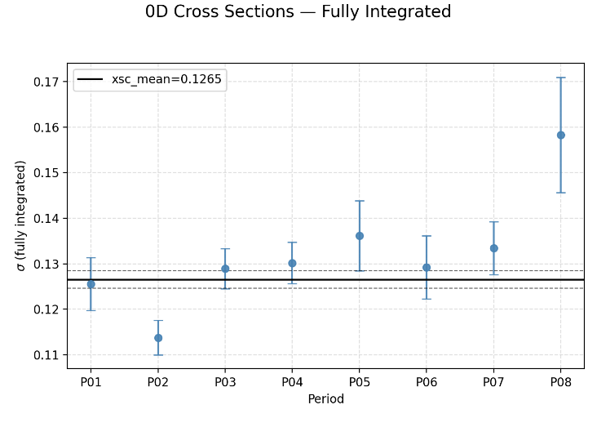
Pull 0D : NH3

Slide 43

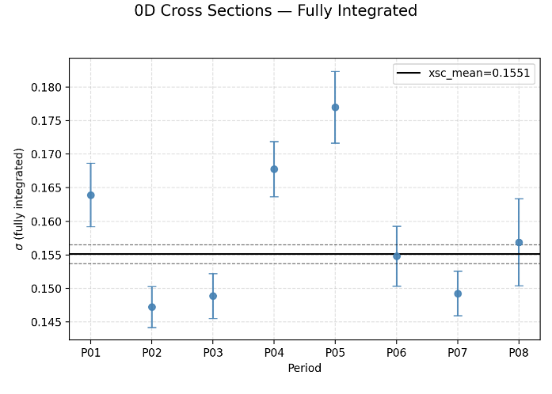
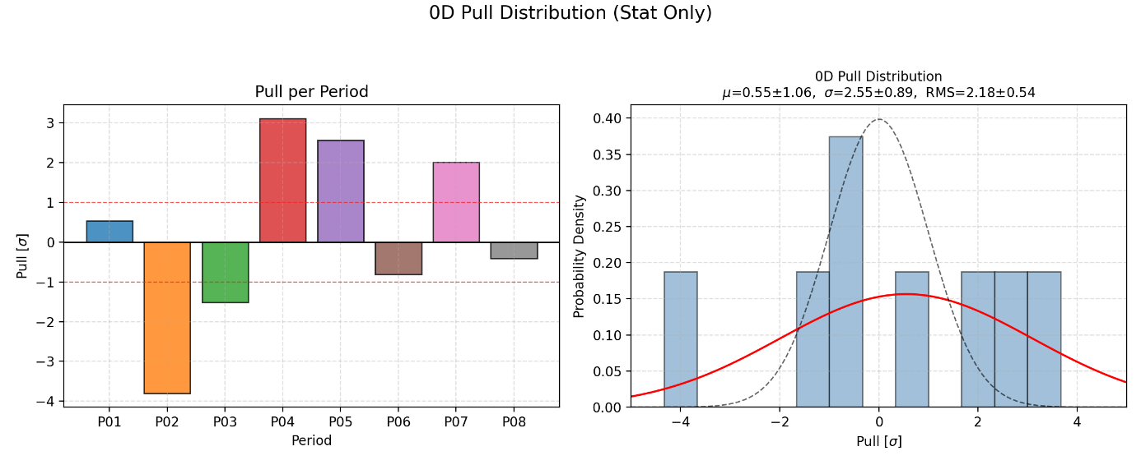
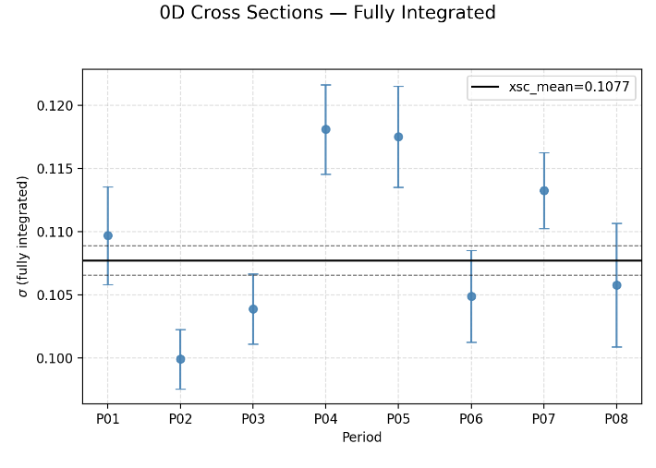
Pull 0D : W

