Slide 1
Renormalon in Quasi- Parton Distributions
Wei-Yang Liu, Jiunn-Wei Chen
National Taiwan University
Oct. 10, 2020
TQCD Meeting @ ASIoP, Taiwan

Slide 2
Outline
Large momentum effective theory (LaMET)
Quasi parton distribution function (quasi-PDF)
Renormalon ambiguity
Bubble chain contribution in fixed order perturbation
R-scheme
Summary
Wei-Yang Liu
Oct. 14, 2020 @ TQCD (ASIoP)

Slide 3
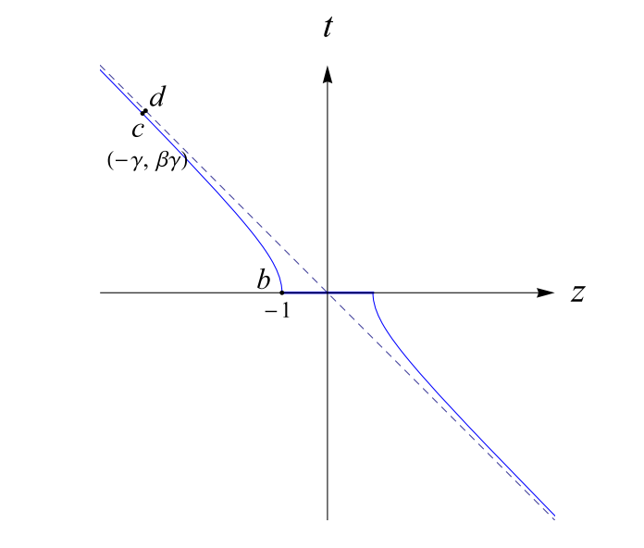
Large Momentum Effective Theory
Parton physics: the physics on light cone can be related to a set of static operators under the idea of LaMET
The static operators measured in infinite momentum frame have the identical configuration as the light front operators measured in any finite momentum frame
$$|P_{∞}⟩=U(∞)|P⟩$$
$$U^{†}(∞)\overset{̂}{O}(\overset{⃗}{x})U(∞)=\overset{̂}{O}(zn^{μ})$$
$$⟨P_{∞}|\overset{̂}{O}(\overset{⃗}{x})|P_{∞}⟩→⟨P|\overset{̂}{O}(zn^{μ})|P⟩$$
Wei-Yang Liu
Oct. 14, 2020 @ TQCD (ASIoP)

Slide 4
Quasi Parton Distribution Function
Large momentum factorization
Higher-twist corrections have also a similar convolution to the leading-twist.
The short distance physics is encoded in $Z$ and $Z_{2n}$ while the long distance physics is encoded in $q(x)$ and $q_{2n}(x)$.
Higher twist suppressed by powers of Pz
$$\overset{˜}{q}(x,P_{z},Λ^{′})=∫_{-1}^{1}\frac{dy}{|y|}Z\left(\frac{x}{y},yP_{z},Λ^{′},Λ\right)q(y,Λ)+O(\frac{1}{P_{z}^{2}})$$
$$\overset{∞}{\underset{n=2}{∑}}Z_{2n}(Λ^{′},Λ)⊗\frac{q_{2n}(Λ)}{P_{z}^{2n}}$$
Wei-Yang Liu
Oct. 14, 2020 @ TQCD (ASIoP)
Notes:
Distance compared with 1/Λ
Since IMF show the equivalence to the light cone, starting with a large but finite momentum, we can expand the quasi-PDF in powers of Pz

Slide 5
Renormalon Ambiguity
Expanding $Z(ξ)$ as a perturbative series in terms of renormalized $α_{s}(μ)$
In $\overline{\text{MS}}$, scale separation is not complete.
$$Z(ξ)=δ(1-ξ)+\overset{∞}{\underset{n=1}{∑}}{\left(\frac{α_{s}}{4π}\right)}^{n}z_{n}(ξ)$$
$z_{n}(ξ)$ renormalized in dim reg scheme only contains logarithmic dependence in $μ$
→
Low energy non-perturbative physics could still exist in $Z(ξ)$, slowing down the convergence of the perturbative computation.
Wei-Yang Liu
Oct. 14, 2020 @ TQCD (ASIoP)

Slide 6
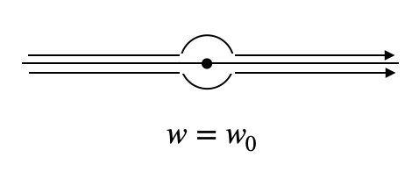
Renormalon Ambiguity
The source of slow convergence can be identified as renormalon effect, which can be seen in Borel plane.
Borel series
Inverse Borel transform
$$B[Z(ξ)]=β_{0}δ(1-ξ)δ(w)+\overset{∞}{\underset{n=0}{∑}}{\left(\frac{w}{β_{0}}\right)}^{n}\frac{z_{n}(ξ)}{n!}$$
$$Z(ξ)=∫_{0}^{∞}\frac{dw}{β_{0}}e^{-\frac{4πw}{β_{0}α_{s}}}B[Z(ξ)]$$
$$w=w_{0}$$
where $β_{0}=\frac{11}{3}N_{c}-\frac{2}{3}n_{f}$
Wei-Yang Liu
Oct. 14, 2020 @ TQCD (ASIoP)

Slide 7
Renormalon Ambiguity
Full order summation is needed → bubble chain insertion
$$Π(k^{2})=-\frac{α_{s}(μ)}{4π}β_{0}\left(ln\frac{-k^{2}}{μ}-\frac{5}{3}\right)$$
Gluon vacuum polarization
$$\frac{α_{s}}{-k^{2}}\left(1+Π+Π^{2}+⋯\right)=\frac{α_{s}}{-k^{2}}\frac{1}{1-Π}=\frac{4π}{-k^{2}}∫_{0}^{∞}\frac{dw}{β_{0}}e^{-\frac{4πw}{β_{0}α_{s}}+\frac{5}{3}w}{\left(\frac{μ^{2}}{-k^{2}}\right)}^{w}$$
Wei-Yang Liu
Oct. 14, 2020 @ TQCD (ASIoP)

Slide 8
Renormalon Ambiguity
At quark level, the Borel series of quasi-PDF:
PDF can be achieved by taking $p_{z}→∞$ before the transverse momenta is integrated.
$$B[\overset{˜}{q}(x,ρ)]=4ζC_{F}{\left(\frac{μ^{2}e^{5/3}}{p_{z}^{2}}\right)}^{w}\frac{Γ(1/2+w)}{\sqrt{π}Γ(1+w)}\overset{˜}{f}(x,ρ,w)_{+}$$
$$B[q(x,ρ)]=4ζC_{F}{\left(\frac{μ^{2}e^{5/3}}{-x(1-x)p^{2}}\right)}^{w}\frac{Γ(w+ϵ)}{Γ(1+w)}f(x,ϵ,\frac{μ^{2}}{-p^{2}},w)_{+}$$
where $ρ=-p^{2}/p_{z}^{2}$ is the off-shell IR regulator
Wei-Yang Liu
Oct. 14, 2020 @ TQCD (ASIoP)

Slide 9
Renormalon Ambiguity
Renormalon ambiguity at w=1 pole in Borel plane
Extended to nucleon level, the matching kernel can be rewritten as a matching formula
$$-\frac{π}{β_{0}}e^{-\frac{4π}{β_{0}α_{s}}}Res[B[\overset{˜}{q}(x),0]]|_{w=1}=2ζC_{F}\frac{π}{β_{0}}e^{5/3}\frac{Λ_{QCD}^{2}}{p_{z}^{2}}{\left[\frac{θ(x)θ(1-x)}{1-x}\right]}_{+}$$
$$δ{\overset{˜}{q}}_{ren}(x,P_{z})=\frac{π}{β_{0}}e^{5/3}C_{F}\frac{Λ_{QCD}^{2}}{P_{z}^{2}}∫_{-1}^{1}\frac{dy}{|y|y^{2}}{\left[\frac{θ(1-\frac{x}{y})θ(\frac{x}{y})}{(1-\frac{x}{y})}\right]}_{+}q(y)$$
$$=\frac{π}{β_{0}}e^{5/3}C_{F}\frac{Λ_{QCD}^{2}}{x^{2}P_{z}^{2}}∫_{0}^{1}dξ\frac{1}{(1-ξ)}\left[ξq(x/ξ)-q(x)\right]∼O\left(\frac{Λ_{QCD}^{2}}{x^{2}P_{z}^{2}}\right)$$
Wei-Yang Liu
Oct. 14, 2020 @ TQCD (ASIoP)

Slide 10
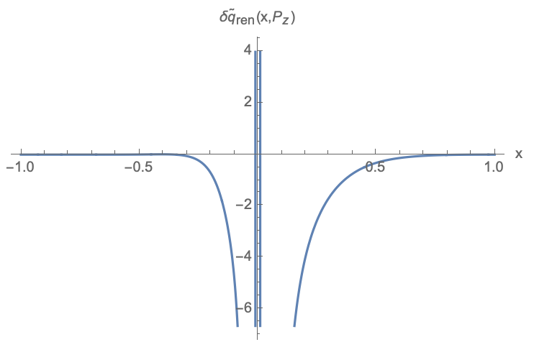
Renormalon Ambiguity
A proper IR regularization $q(x)→q(x)θ(x-|\overline{ϵ}|)$, $\overline{ϵ}=0.01$
Particle number is conserved: $∫_{-∞}^{∞}dxδ{\overset{˜}{q}}_{ren}(x,P_{z})=0$
Wei-Yang Liu
Oct. 14, 2020 @ TQCD (ASIoP)

Slide 11
Bubble chain in fixed order perturbation
The nth-order matching kernel can be obtained from Borel series
$$Z^{(n+1)}(ξ)={\left(\frac{α_{s}}{4π}\right)}^{n+1}β_{0}^{n}\frac{d^{n}}{dw^{n}}B[Z(ξ)](w)|_{w=0}$$
$${\overset{˜}{q}}_{MS}(x)$$
$${\overset{˜}{q}}_{RIMOM}(x)$$
α_{s} = 0.283, P_{z} = 1.5 GeV, μ = 3 GeV, μ_{R} = 2.4 GeV, p^{z}_{R} = 1.201 GeV
Wei-Yang Liu
Oct. 14, 2020 @ TQCD (ASIoP)

Slide 12
R-scheme
R-scheme designed to remove the leading renormalon ambiguity which is proportional to $1/{P_{z}^{2}}$
$$\overset{˜}{q}(x,P_{z},μ)=∫_{-1}^{1}\frac{dy}{|y|}\left[\frac{Z(\frac{x}{y},\frac{μ}{P_{z}})-\frac{P_{z}^{′2}}{P_{z}^{2}}Z(\frac{x}{y},\frac{μ}{P_{z}^{′}})}{1-\frac{P_{z}^{′2}}{P_{z}^{2}}}\right]q(y,μ)+O(α_{s}lnP_{z}/P_{z}^{2},1/P_{z}^{4})$$
Wei-Yang Liu
Oct. 14, 2020 @ TQCD (ASIoP)

Slide 13
R-scheme
Consistent with the expectation that R-scheme is reduced to the MS to MS matching when Pz′ = 0
More effective with larger P_{z}
$${\overset{˜}{q}}_{MSR}(x)$$
$${\overset{˜}{q}}_{MSR}(x)$$
Pz′ = 1 GeV
Wei-Yang Liu
Oct. 14, 2020 @ TQCD (ASIoP)

Slide 14
Summary
Renormalon ambiguity with bubble chain insertion is an twist-4 effect of order $O(\frac{Λ_{QCD}^{2}}{x^{2}P_{z}^{2}})$, significant at small x.
Particle number is conserved in $δ{\overset{˜}{q}}_{ren}(x)$ with a proper treatment to identify the delta function contributions in numerical calculation.
Excellent convergence at three-loops for the RIMOM to $\overline{\text{MS}}$matching kernel is found.
R-scheme improves the convergence of matching kernel at three-loops.
Wei-Yang Liu
Oct. 14, 2020 @ TQCD (ASIoP)

Slide 15
Thanks for Listening

Slide 16
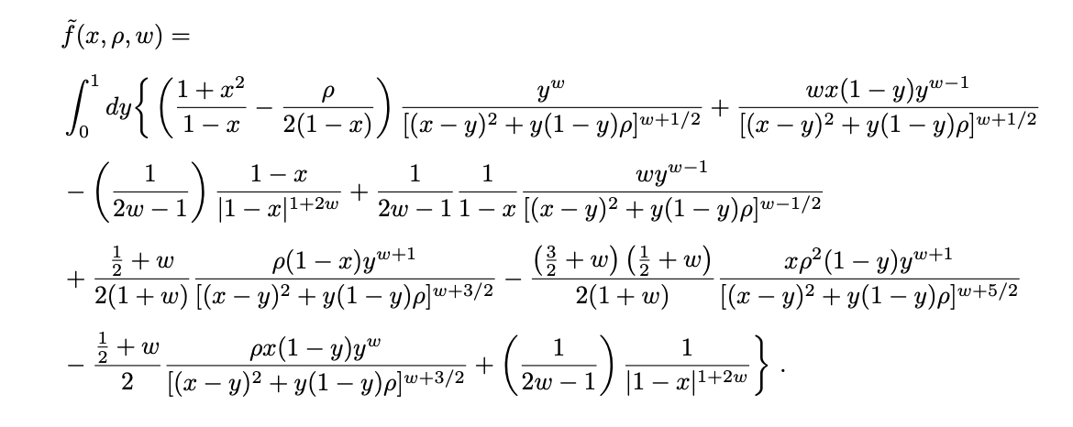
Results
Wei-Yang Liu
Oct. 14, 2020 @ TQCD (ASIoP)

Slide 17
Results
Wei-Yang Liu
Oct. 14, 2020 @ TQCD (ASIoP)

