Slide 1
Weekly meeting
Yu-Siang Xiao (蕭宇翔)
2026 01/09

Slide 2
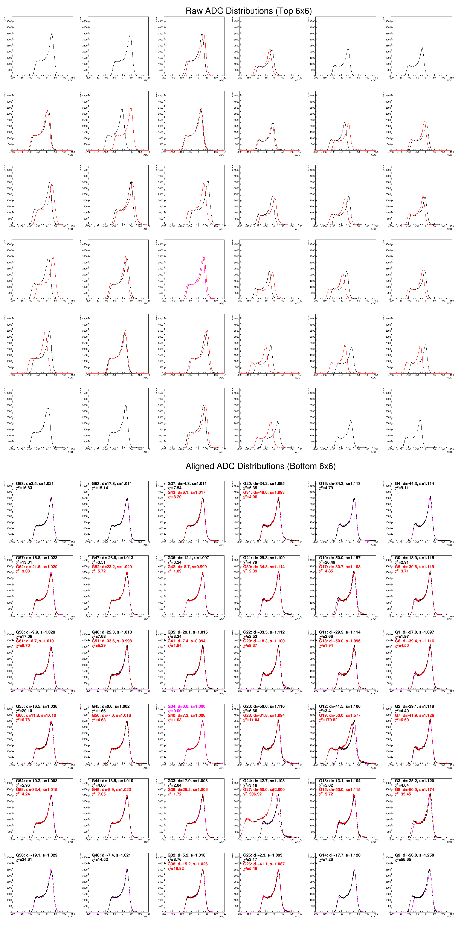
Channels gain and ADC offset alignment in 11F background
Take center channel(TH1)
to be reference line(TF1)
PS: TF1= A * TH1(S_{x}(x-Off_{x}))
Fit the channels(TH1)
or channels(TH1)
by reference line(TF1)
Find the best fit to align the TH1s, and scan for all of the channels.
I take run 5664 of test data.
Size: 80MB / 15GB in 25/12/02
In the case only 2 channel could not fitting well (Ch19/27)
The fitting problem come from the noise tail is going up.
The other channel going through the same shape.
This study tell us that, we may do the roughly gain calibration through using the background data.
/home/yusiang/TestCosMicZDC

Slide 3
Channels gain and ADC offset alignment in 11F background

Slide 4
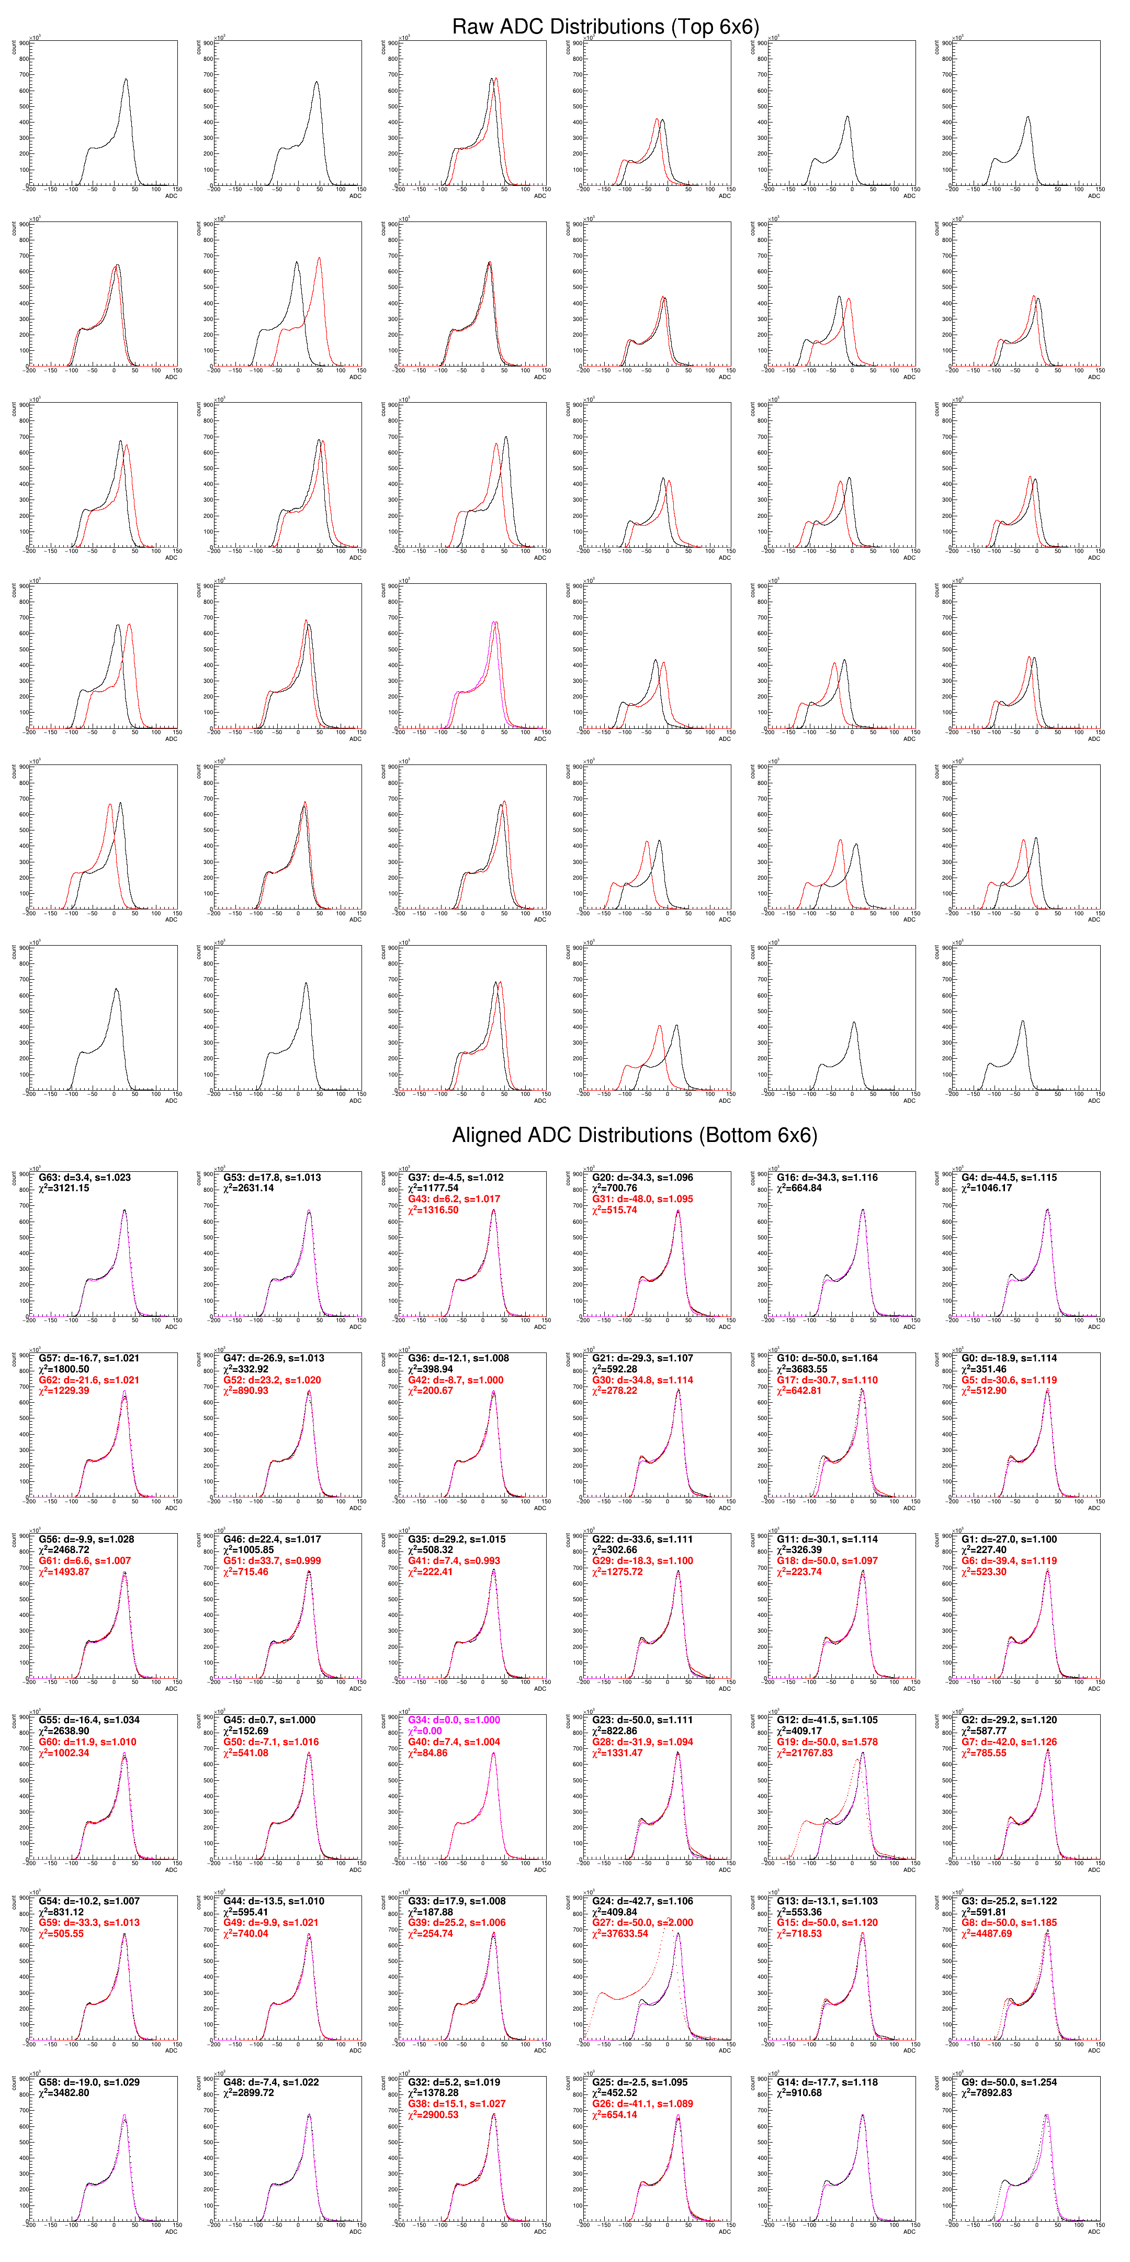
Using the full 2025/12/02 data(15 GB)
1

