Slide 1

ZDC MC Simulation 20260119
Chia-Yu Hsieh
Academia Sinica, Taiwan

Slide 2
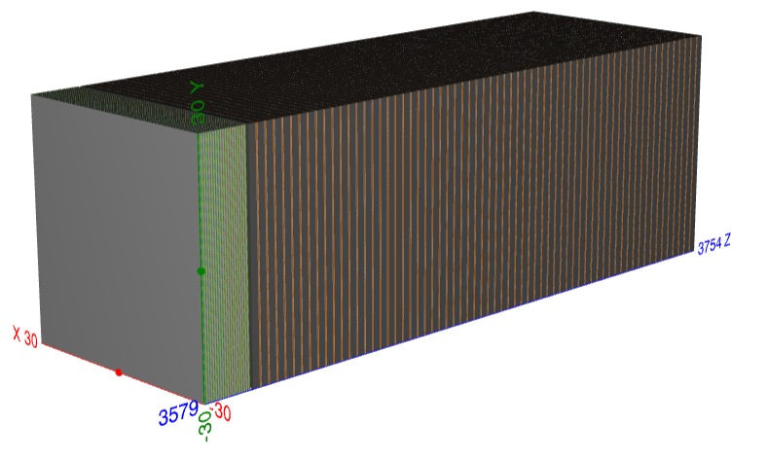
Relocate Detector and Beam Position
pencil beam
Put detector straight along z-dir
Shoot beam along z-dir @ (-15mm, -15mm, z)
1GeV - 40GeV gamma (pencil beam)
10GeV – 300GeV neutron beam (pencil beam)

Slide 3
Gamma Beam Pencil @ (-15, -15, z) {0.1, 0.5, 0.3, 0.7, 1, 3, 5, 7, 9, 10, 20, 30, 40} GeV

Slide 4
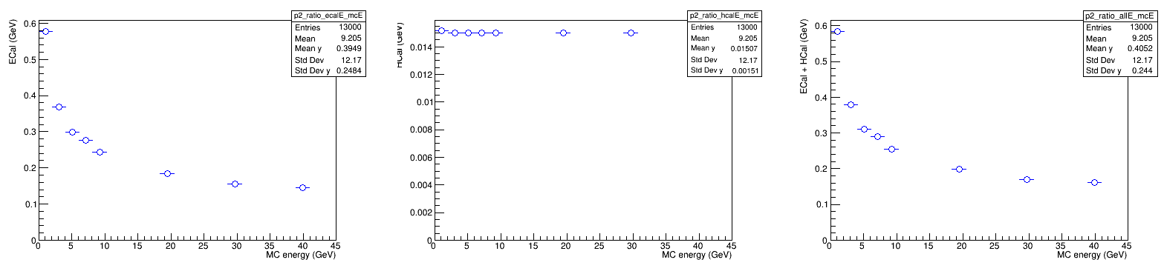
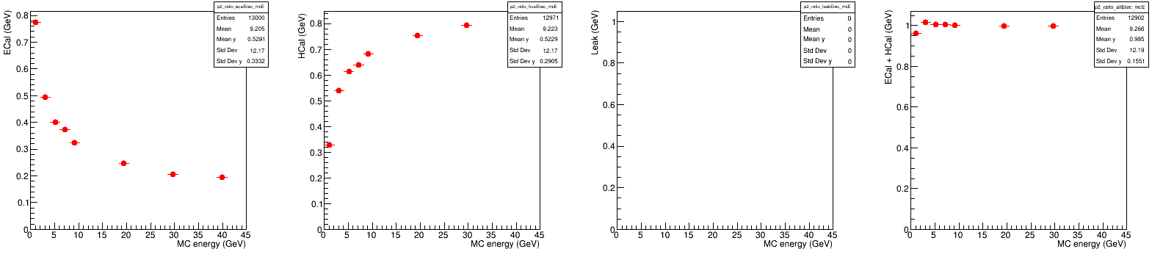
Energy Dump
Energy dump BEFORE energy regression
ECAL
HCAL
ECAL + HCAL
Energy Dump AFTER energy regression
(linear regression, y = p0 + p1*ECAL + p2*HCAL)
ECAL
+ HCAL
+ Leak
ECAL
HCAL
Leak
Low energy is always not easy (100MeV)

Slide 5
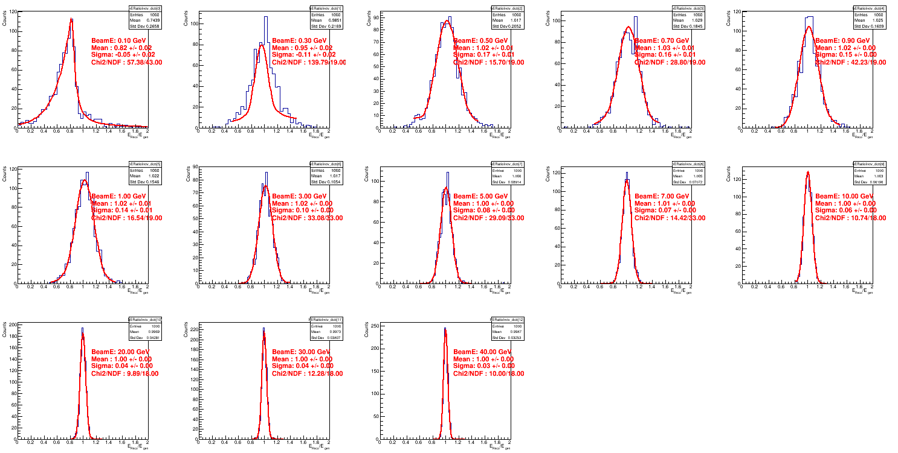
Energy Regression
0.1 GeV
0.3 GeV
0.5 GeV
0.7 GeV
0.9 GeV
1 GeV
3 GeV
5 GeV
7 GeV
10 GeV
20 GeV
30 GeV
40 GeV

Slide 6
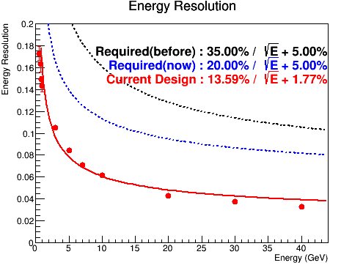
Energy Resolution

Slide 7
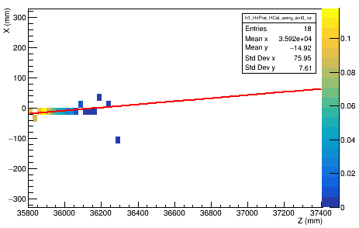
Track Reconstruction
Method
A straight trajectory in three-dimensional space can be reconstructed as the intersection of two orthogonal projections in the XZ and YZ planes.
By fitting linear functions to the hit distributions in these two planes, x(z) = a + b*z, y(z) = c + d*z, the track parameters are determined.
For any given z position, the predicted track coordinates (x,y) are obtained directly from these two fitted relations.
40GeV gamma, evt#0, xz plane
Steps
Step 1 — Layer by layer weighted position For each detector layer, a single representative hit position is calculated by averaging all hit positions in that layer, weighted by their deposited energy.
Step 2 — Energy-weighted layer Each layer contributes one position to the track fit, with a weight proportional to the total energy deposited in that layer. As a result, layers with larger energy deposition have a stronger influence on the fit.
Step 3 — Fitting xz and yz planes Linear fits (pol1) are performed independently in the XZ and YZ planes to obtain the track parameters.
Only HCAL is included in track reconstruction for now.

Slide 8
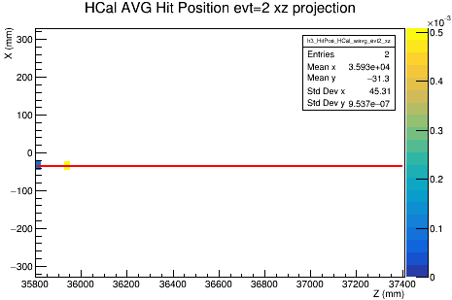
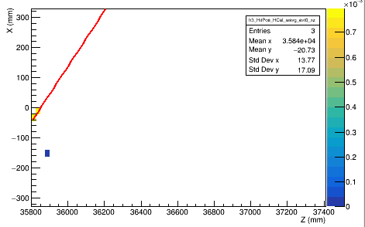
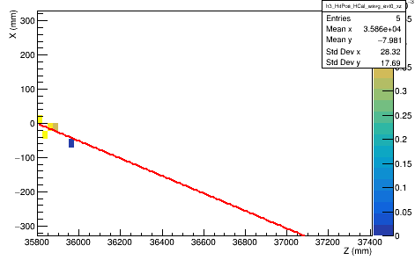
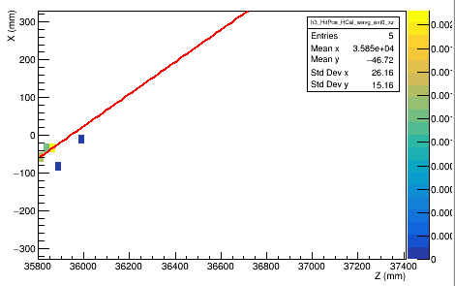
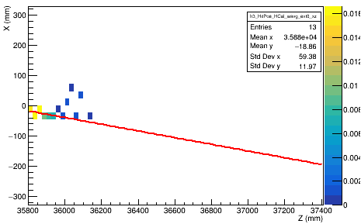
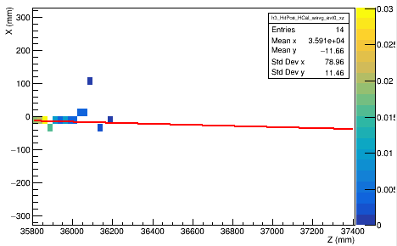
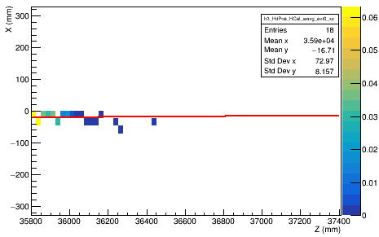
Track Reconstruction (evt#0, XZ)
0.1 GeV
0.5 GeV
0.7 GeV
1 GeV
5 GeV
10 GeV
20 GeV
40 GeV
Barely any hits < 1GeV. Hard to reconstruct track.

Slide 9
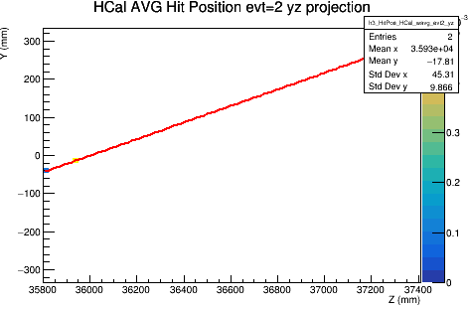
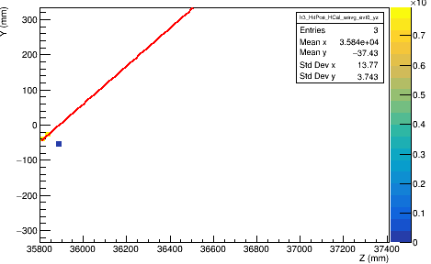
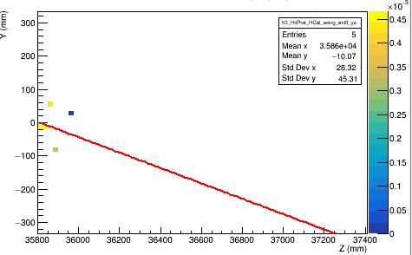
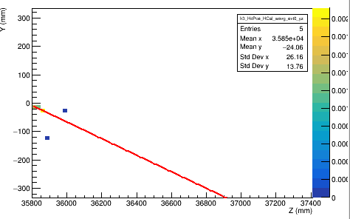
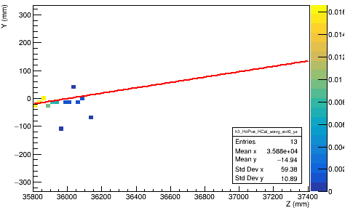
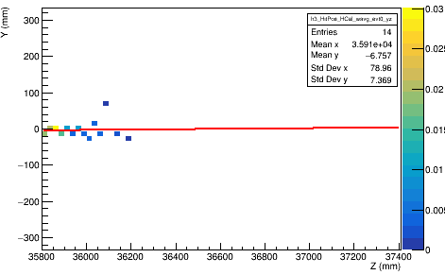
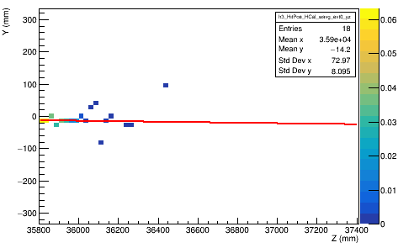
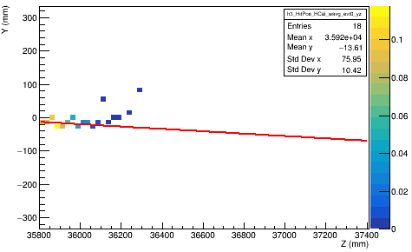
Track Reconstruction (evt#0, YZ)
0.1 GeV
0.5 GeV
0.7 GeV
1 GeV
5 GeV
10 GeV
20 GeV
40 GeV
Barely any hits < 1GeV. Hard to reconstruct track.

Slide 10
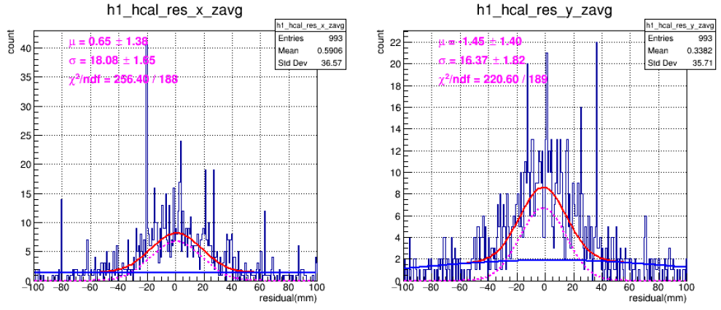
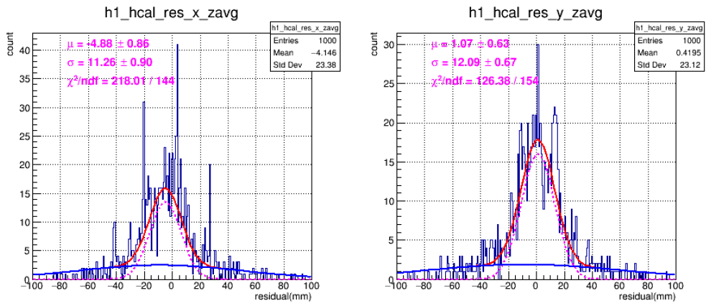
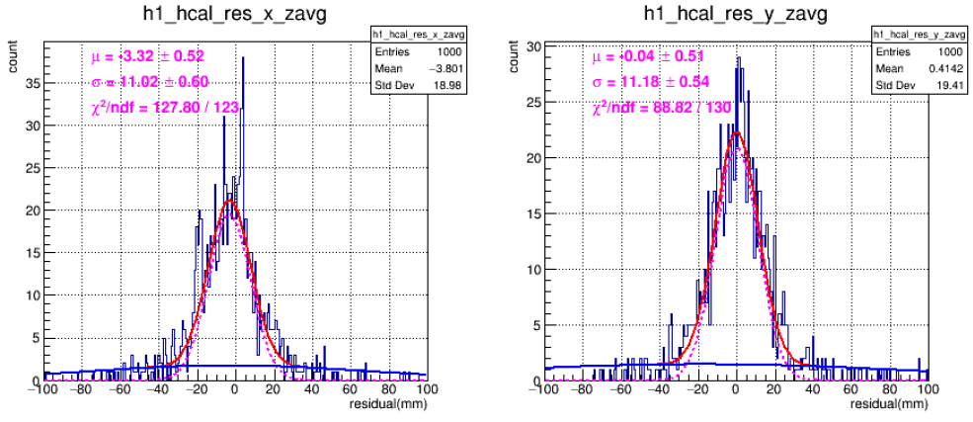
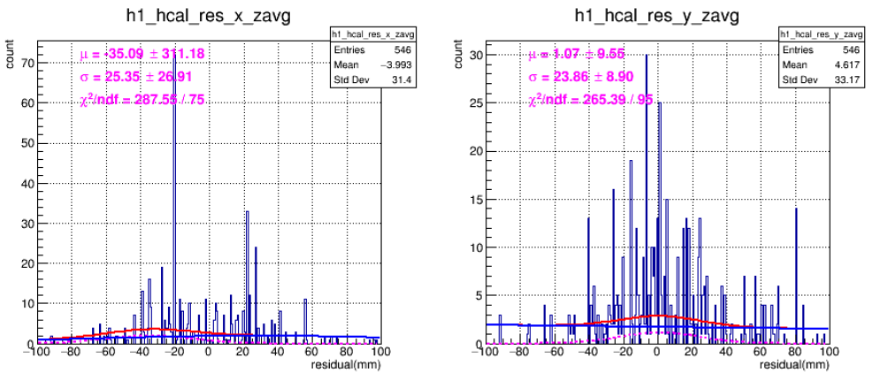
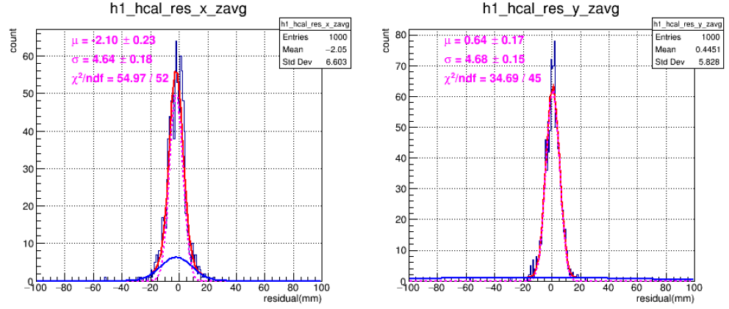
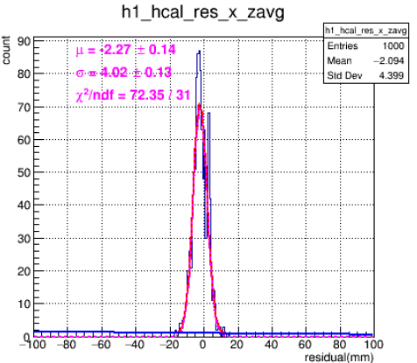
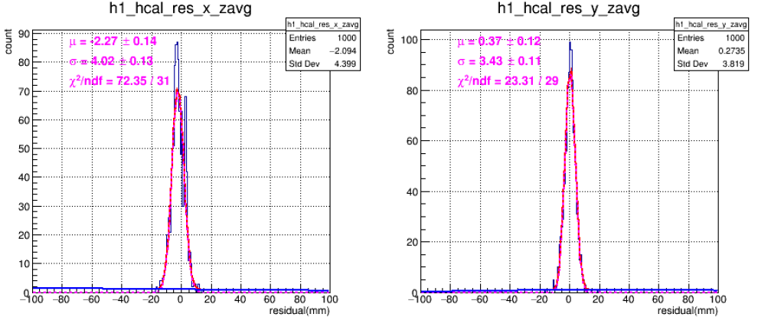
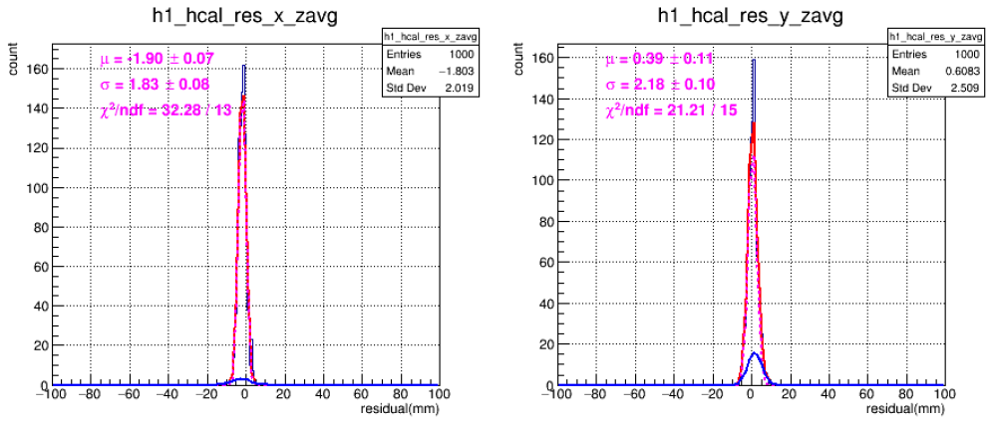
Residual @ Weighted-Z, XZ Plan
0.1 GeV
0.5 GeV
0.7 GeV
1 GeV
5 GeV
10 GeV
20 GeV
40 GeV
Strange spikes for energy < 1GeV.

Slide 11
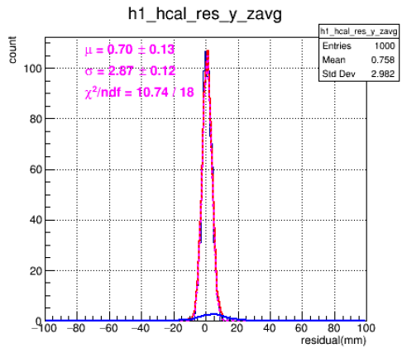
Residual @ Weighted-Z, YZ Plan
0.1 GeV
0.5 GeV
0.7 GeV
1 GeV
5 GeV
10 GeV
20 GeV
40 GeV

Slide 12
Mean and Sigma
unstable fit
Energy (GeV) | xz plane |  |  | yz plane
 | μₓ (mm) | σₓ (mm) | χ²/ndf | μᵧ (mm) | σᵧ (mm) | χ²/ndf
0.1 | −35.09 ± 31.18 | 25.35 ± 26.91 | 287.5 / 75 | +1.07 ± 9.55 | 23.86 ± 8.90 | 265.4 / 95
0.3 | −9.20 ± 2.67 | 19.17 ± 4.47 | 407.8 / 148 | +1.27 ± 42.67 | 31.41 ± 21.31 | 418.0 / 156
0.5 | +0.65 ± 1.38 | 18.08 ± 1.65 | 256.4 / 188 | +1.45 ± 1.49 | 16.37 ± 1.82 | 220.6 / 189
0.7 | −4.88 ± 0.86 | 11.26 ± 0.90 | 218.0 / 144 | +1.07 ± 0.63 | 12.09 ± 0.67 | 126.4 / 154
1.0 | −3.24 ± 0.56 | 11.53 ± 0.58 | 129.8 / 122 | +1.17 ± 0.51 | 10.92 ± 0.54 | 104.4 / 131
3.0 | −3.32 ± 0.52 | 11.02 ± 0.60 | 127.8 / 123 | +0.04 ± 0.51 | 11.18 ± 0.54 | 88.8 / 130
5.0 | −2.21 ± 0.32 | 7.24 ± 0.34 | 84.7 / 78 | +0.87 ± 0.27 | 6.08 ± 0.38 | 97.5 / 68
7.0 | −2.10 ± 0.23 | 4.64 ± 0.18 | 55.0 / 52 | +0.64 ± 0.17 | 4.68 ± 0.15 | 34.7 / 45
9.0 | −1.85 ± 0.17 | 4.54 ± 0.15 | 46.3 / 40 | +0.59 ± 0.15 | 4.08 ± 0.13 | 27.7 / 36
10 | −2.27 ± 0.14 | 4.02 ± 0.13 | 72.35 / 31 | 0.37 ± 0.12 | 3.43 ± 0.11 | 23.31 / 29
20 | −1.89 ± 0.10 | 2.27 ± 0.09 | 43.26 / 21 | 0.70 ± 0.13 | 2.87 ± 0.12 | 10.74 / 18
30 | −2.51 ± 0.07 | 1.48 ± 0.06 | 42.50 / 16 | 0.78 ± 0.13 | 2.35 ± 0.10 | 15.20 / 14
40 | −1.90 ± 0.07 | 1.83 ± 0.08 | 32.28 / 13 | 0.39 ± 0.11 | 2.18 ± 0.10 | 21.21 / 15
stable fit

Slide 13
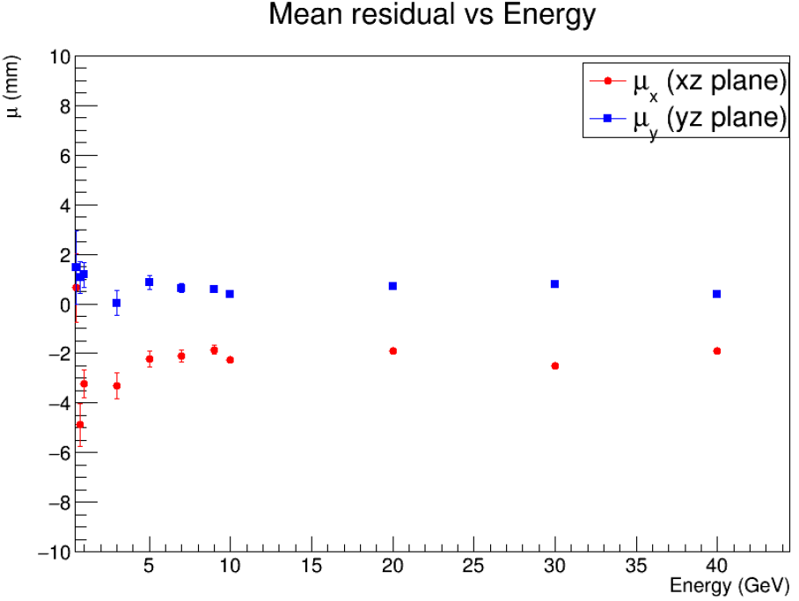
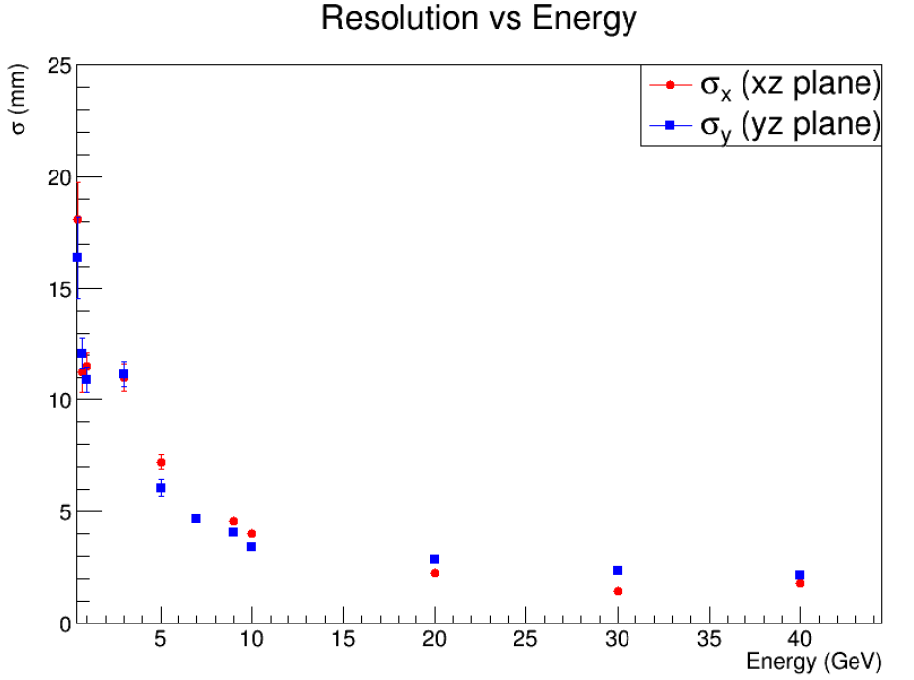
Mean and Sigma
Mean/Bias VS Energy
Sigma/Resolution VS Energy
Only events with energy > 0.5 GeV are shown.
A small bias of approximately 2 mm is observed in the x direction, while no significant bias is seen in y.
The position resolution is similar in x and y, at about 2 mm.

Slide 14
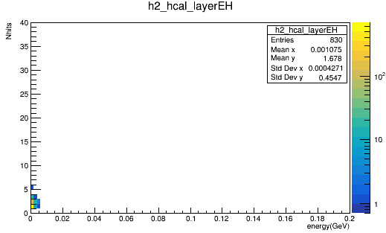
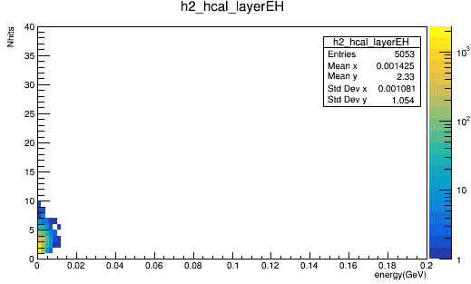
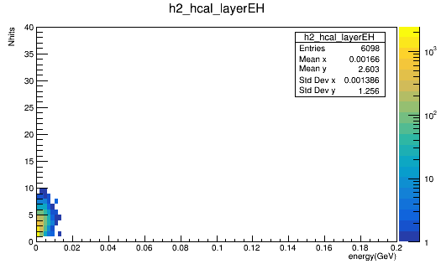
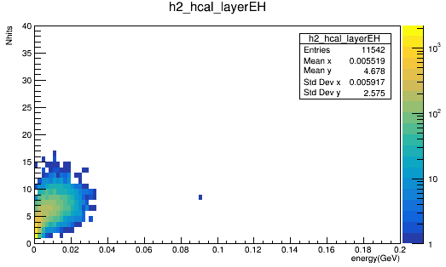
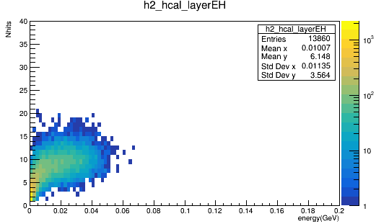
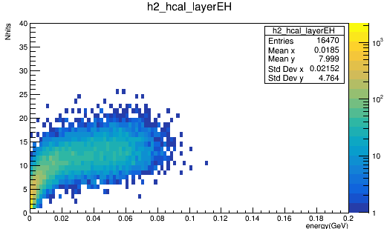
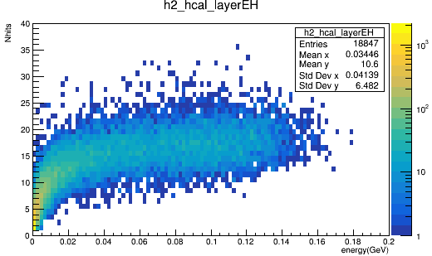
Nhits VS Energy (1 fill = 1 per Layer, 1000 evts)
0.1 GeV
0.7 GeV
1 GeV
5 GeV
10 GeV
20 GeV
40 GeV
We still need a better reconstruction strategy for low-energy beams—simple selection cuts don’t seem to be possible.
I will think about clustering and how to weight the importance of layers by referring to the work done by UC riverside.
https://www.sciencedirect.com/science/article/pii/S0168900225004140?via%3Dihub
https://www.sciencedirect.com/science/article/abs/pii/S0168900223010446?via%3Dihub
https://indico.bnl.gov/event/20186/contributions/79637/attachments/49243/83986/The%20EIC%20Zero-Degree%20Calorimeter%20and%20the%20HEXPLIT%20algorithm%20(5).pdf

Slide 15
Neutron Beam Pencil @ (-15, -15, z) {10, 20, 50, 100, 200, 300} GeV

Slide 16
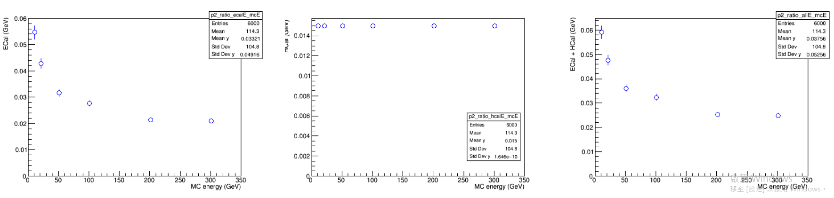
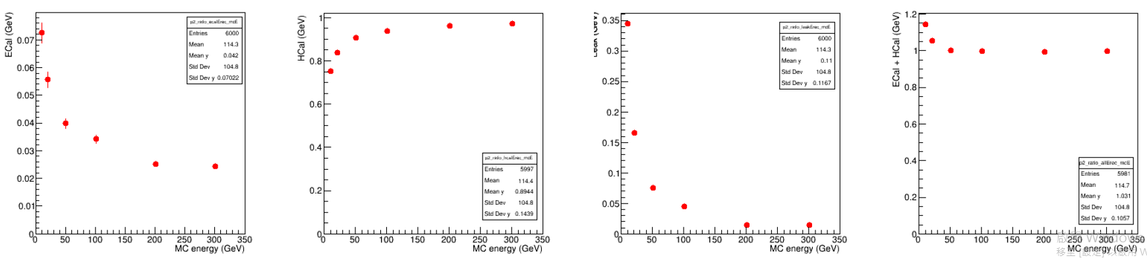
Energy Dump
Energy dump BEFORE energy regression
2%-6%
1.5 %
ECAL
HCAL
ECAL + HCAL
Energy Dump AFTER energy regression
(linear regression, y = p0 + p1*ECAL + p2*HCAL)
Leak
ECAL
+ HCAL
+ Leak
ECAL
HCAL
Energy not well reconstructed for neutron<50GeV

Slide 17
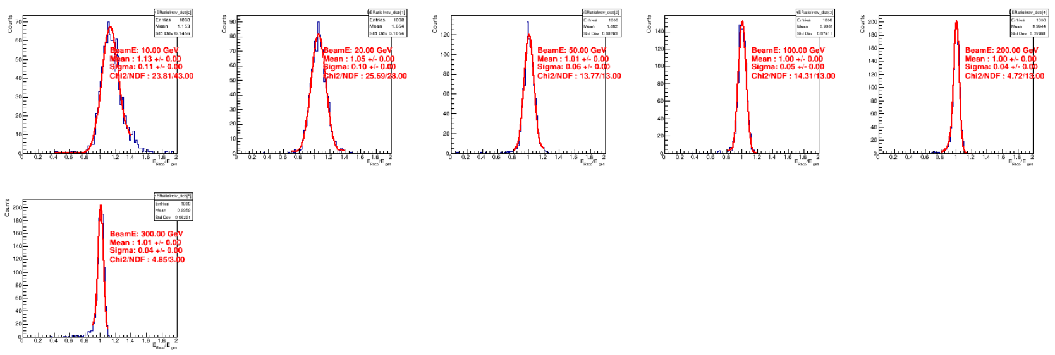
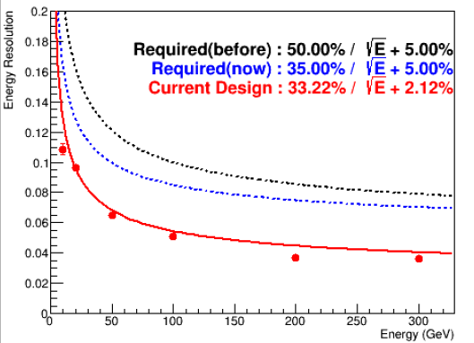
Energy Regression/Resolution
10 GeV
20 GeV
50 GeV
100 GeV
200 GeV
300 GeV

Slide 18
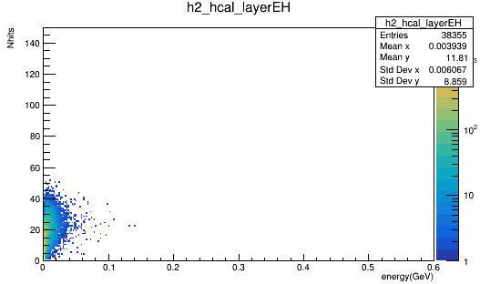
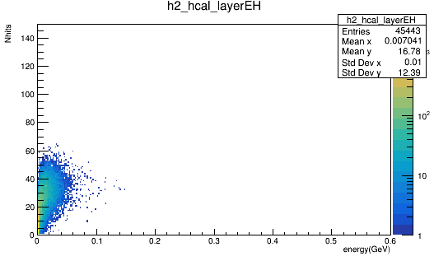
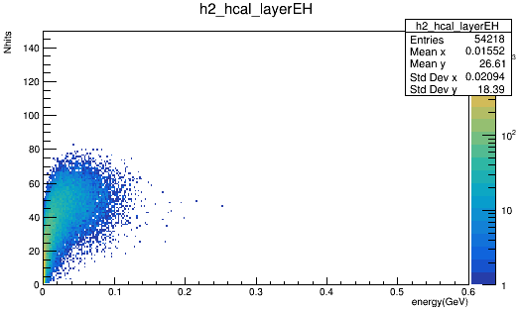
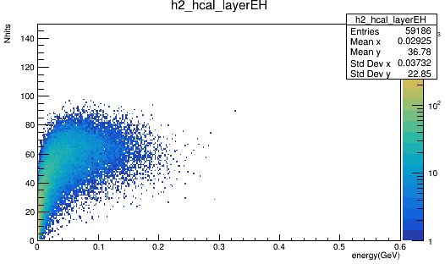
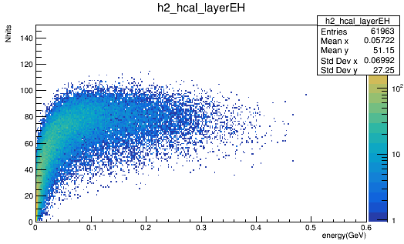
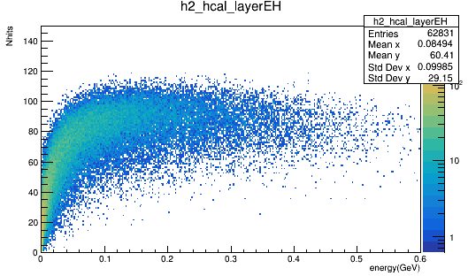
Nhits VS Energy (1 fill = 1 per Layer, 1000 evts)
10 GeV neutron
20 GeV neutron
50 GeV neutron
100 GeV neutron
200 GeV neutron
300 GeV neutron

Slide 19
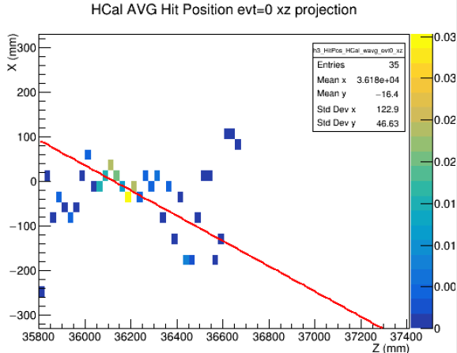





Track Reconstruction (evt#0, XZ)
10 GeV neutron
20 GeV neutron
50 GeV neutron
100 GeV neutron
200 GeV neutron
300 GeV neutron

Slide 20
Track Reconstruction (evt#0, XZ)
10 GeV neutron
20 GeV neutron
50 GeV neutron
100 GeV neutron
200 GeV neutron
300 GeV neutron
More hits for neutron compare to gamma.
Still bad track reconstruction for low energy beam (<100GeV neutron).

Slide 21






Track Reconstruction (evt#0, YZ)
10 GeV neutron
20 GeV neutron
50 GeV neutron
100 GeV neutron
200 GeV neutron
300 GeV neutron

Slide 22






Residual @ Weighted-Z, XZ Plan
10 GeV neutron
20 GeV neutron
50 GeV neutron
100 GeV neutron
200 GeV neutron
300 GeV neutron

Slide 23
Residual @ Weighted-Z, YZ Plan
10 GeV neutron
20 GeV neutron
50 GeV neutron
100 GeV neutron
200 GeV neutron
300 GeV neutron

Slide 24
Mean and Sigma
unstable fit
Energy (GeV) | xz plane |  |  | yz plane
 | μₓ (mm) | σₓ (mm) | χ²/ndf | μᵧ (mm) | σᵧ (mm) | χ²/ndf
10 | −5.38 ± 5.43 | 53.39 ± 1.13 | 55.56 / 44 | +7.36 ± 6.35 | 50.47 ± 33.77 | 41.15 / 44
20 | +0.79 ± 0.58 | 11.24 ± 0.92 | 34.41 / 41 | +0.28 ± 0.52 | 12.37 ± 0.73 | 34.35 / 38
50 | +0.54 ± 0.51 | 8.06 ± 0.58 | 51.86 / 33 | +0.19 ± 0.46 | 7.58 ± 0.49 | 31.05 / 31
100 | +0.14 ± 0.31 | 5.53 ± 0.30 | 25.14 / 20 | +0.69 ± 0.30 | 6.56 ± 0.57 | 21.48 / 22
150 | +0.81 ± 0.56 | 9.77 ± 0.61 | 36.29 / 25 | +0.94 ± 0.53 | 9.69 ± 0.52 | 21.75 / 26
200 | +0.57 ± 0.19 | 3.80 ± 0.34 | 10.56 / 11 | +0.83 ± 0.23 | 3.95 ± 0.37 | 15.49 / 11
300 | +0.82 ± 0.21 | 3.64 ± 0.29 | 16.65 / 10 | +0.55 ± 0.17 | 3.04 ± 0.14 | 6.73 / 7
stable fit
Similar bias in x and y, different from gamma beam.

Slide 25


Mean and Sigma
Mean/Bias VS Energy
Sigma/Resolution VS Energy
Only events with energy > 10 GeV are shown.
A small bias of approximately 0.5 mm is observed in both x and y direction.
The position resolution is similar in x and y ~ 3 mm with 300GeV neutron beam.

Slide 26


Compare w/ UC Riverside
UC Riverside
This work
https://www.sciencedirect.com/science/article/pii/S0168900225004140?via%3Dihub
Similar results if we compared w/ staggered baseline (orange).
Will study HEXPLIT method.

Slide 27
Summary and To Do
MC simulation condition :
ZDC configuration : crystal ECAL + sipm-on-tile HCAL
ZDC rotates straight along z and beam shoot at (-15mm, -15mm, z)
Two types of pencil beams with fixed angle : 0.1GeV - 40 GeV gamma and 10 GeV – 300 GeV neutron.
0.1 GeV - 40 GeV gamma
Energy resolution : achieve the requirement.
Position resolution :
the reconstruction is more reasonable when energy > 0.5GeV.
A small bias of approximately 2 mm is observed in the x direction, while no significant bias is seen in y.
The position resolution is similar in x and y, at about 2 mm.
10 GeV - 300 GeV neutron
Energy resolution : achieve the requirement.
Position resolution :
the reconstruction is more reasonable when energy > 10 GeV.
A small bias of approximately 0.5 mm is observed in both x and y direction.
The position resolution is similar in x and y ~ 3 mm with 300GeV neutron beam.
To do :
study track reconstruction w/ low energy beam (clustering, fitting, etc).
Beam with angles
Move to other configuration w/ Wsi ECAL.

Slide 30
Back up

