Slide 1
Our learning experience on Deep Learning in learning the 3D protein structures from cryo-EM images
I-Ping Tu
Institute of Statistical Science, AS
2022.04.22

Slide 2
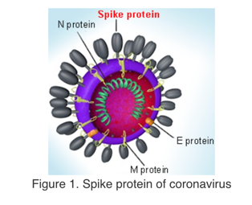
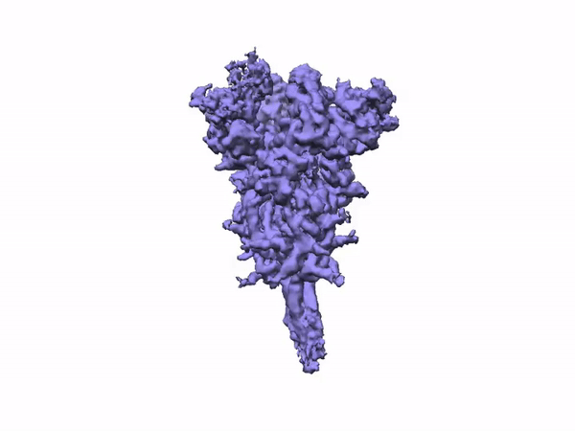
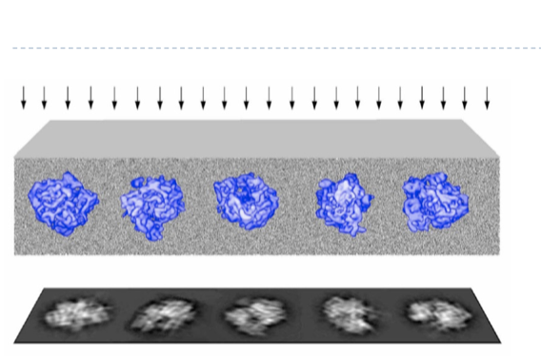
Why Cryo-Electron Microscopy
A solution for emergent problems
Single Particle cryo-EM

Slide 3
Brief History of cryo-EM

Slide 4
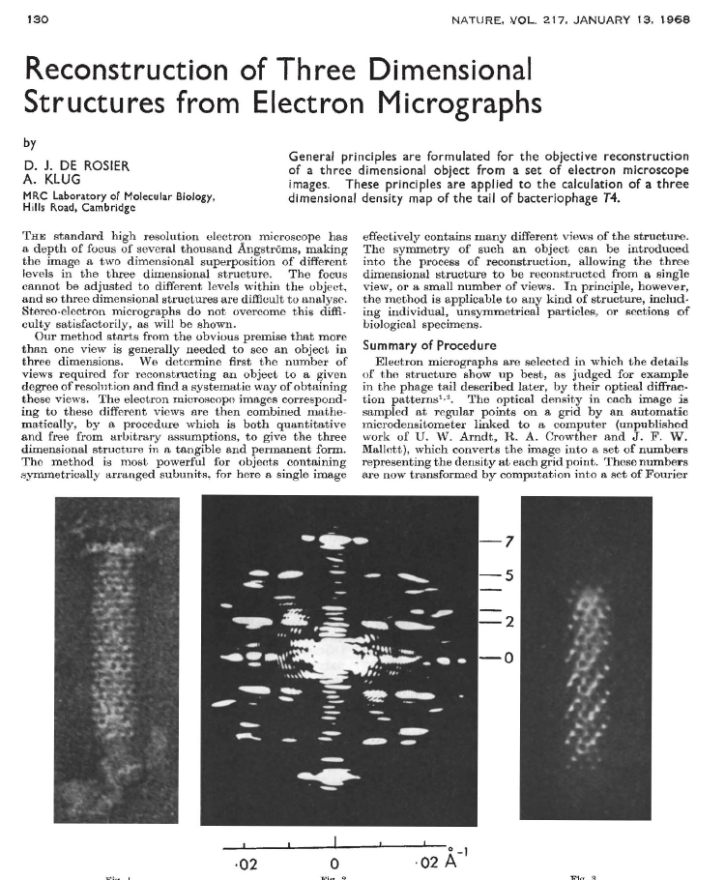
Brief History of cryo-EM

Slide 5
Brief History of cryo-EM

Slide 6
Brief History of cryo-EM

Slide 7
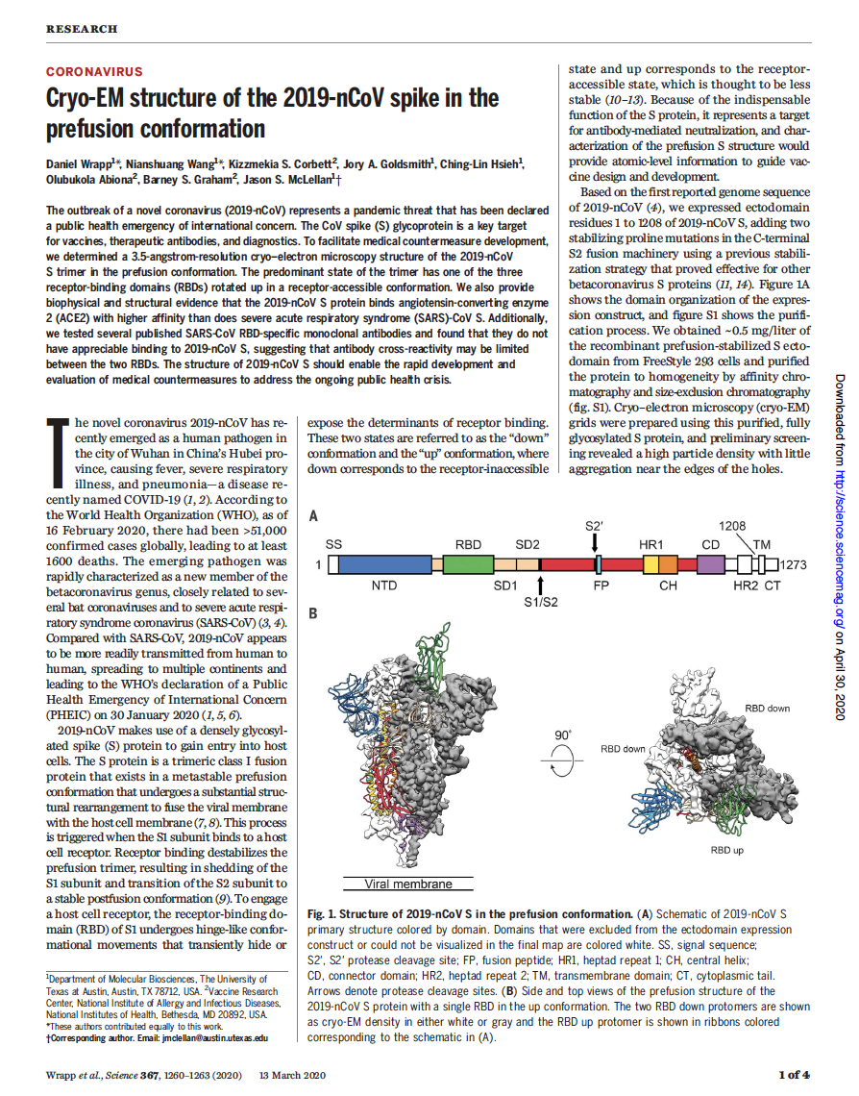
Brief History of cryo-EM

Slide 8
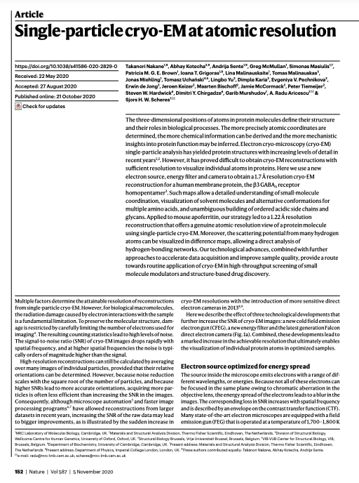
Brief History of cryo-EM

Slide 9
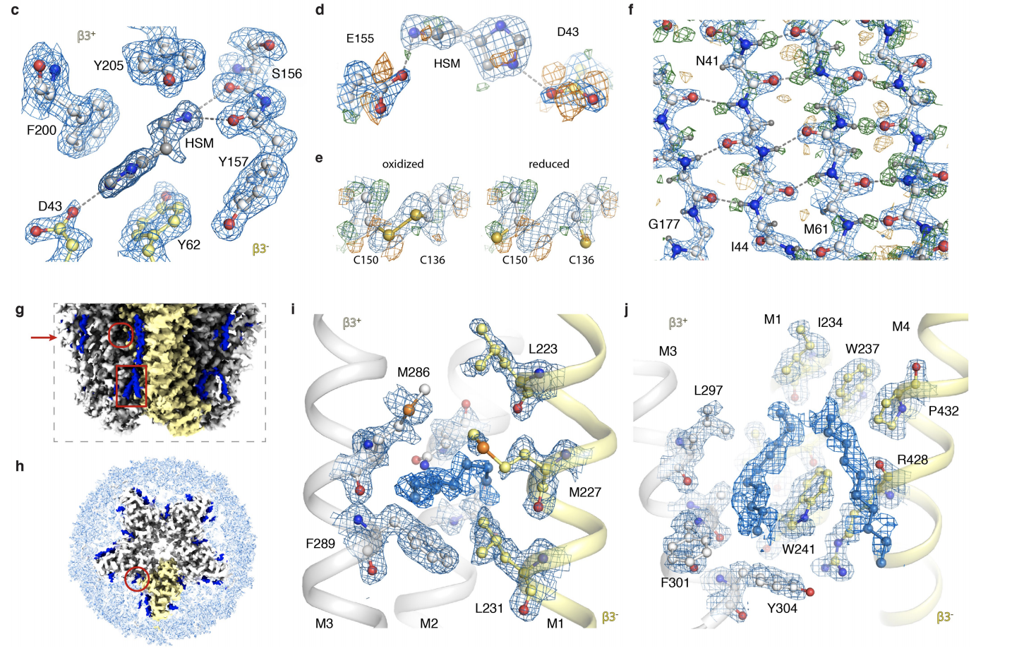

Slide 10
Challenges
Large Data Set (Thousands of movies)
High Dimension (Pixel number)
Heavy Noise
Heterogeneous Conformations
Missing Value Problem

Slide 11
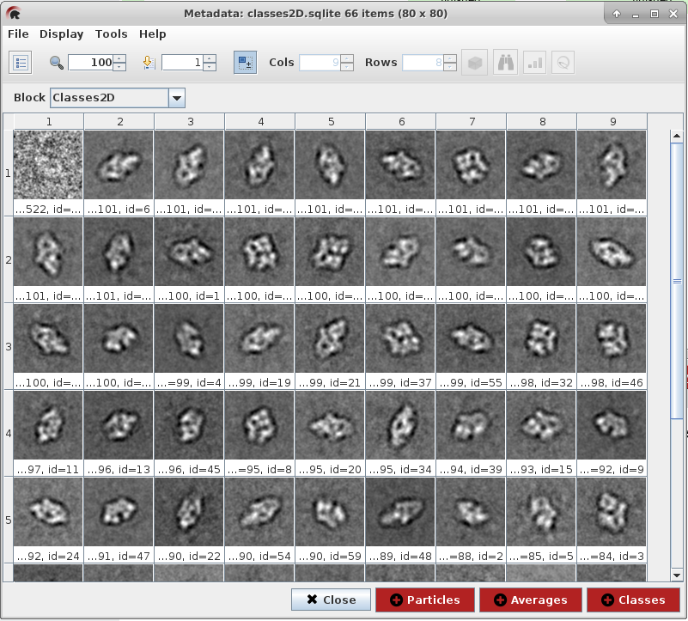
We employ CNN to classify 2D clustering averages.
cryoEM data
Particle picking
2D clustering
3D structure
Notes:
我們的2D clustering image 是來自流程的這一步，而我們主要要做的事是2D clustering，進入3D structure 的資料處理，因為我們希望進入3D structure 做 particle 的模型時不受雜質的影響，導致不準確，
將已經看見的冰塊的水痕、雜質、兩顆 partcle 在 同一張影像、較差的影像刪除。

Slide 12
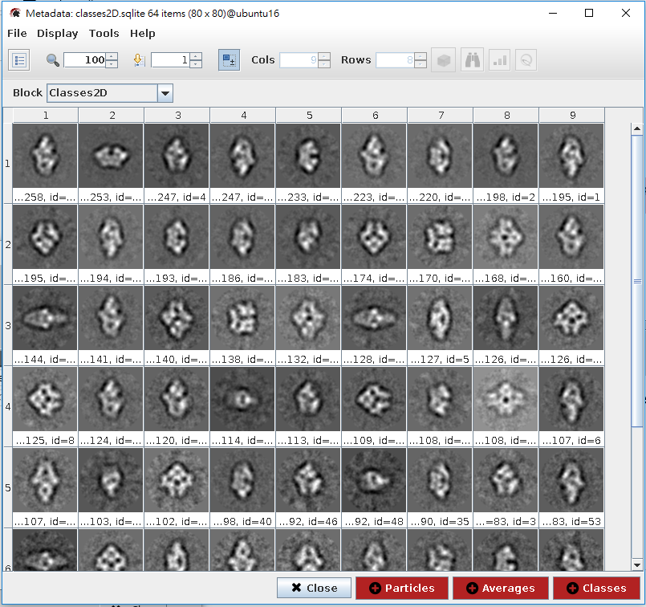
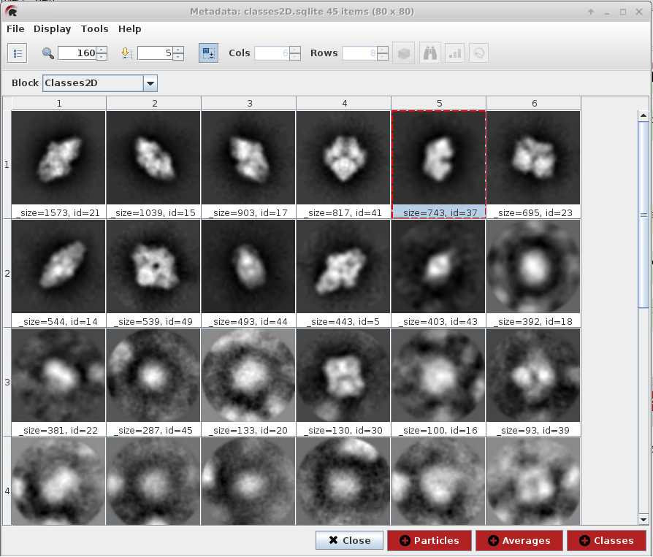
One important function of 2D clustering is to sift valid particle images. It is manually executed!
ISAC
cl2d
relion
Notes:
而產生 2D clustering 影像的計算方法，方法有這三種cl2d、relion、ISAC，大家可以看一下這三種方法，在同一顆 cryo-EM particles之下，
這三種計算方法產生的影像結果其實不太一樣。當然你就會想，那我拿看起來比較好的方法用就好了，為什麼還要其他用方法，
因為這三者的計算時間不同的、產生結果也不太一樣，所以說都有人在使用。

Slide 13
Classification for 2D clustering averages
Accept for 3D structure
Discard
Notes:
接下來我們來判斷 2D clustering image 好壞，很明顯的………..，這些是好的particle ，而…………，這些是不好的影像，所以不選入 3D structure。
最後這顆 particle 該選還是不該選?......... 這顆是要選的，

Slide 14
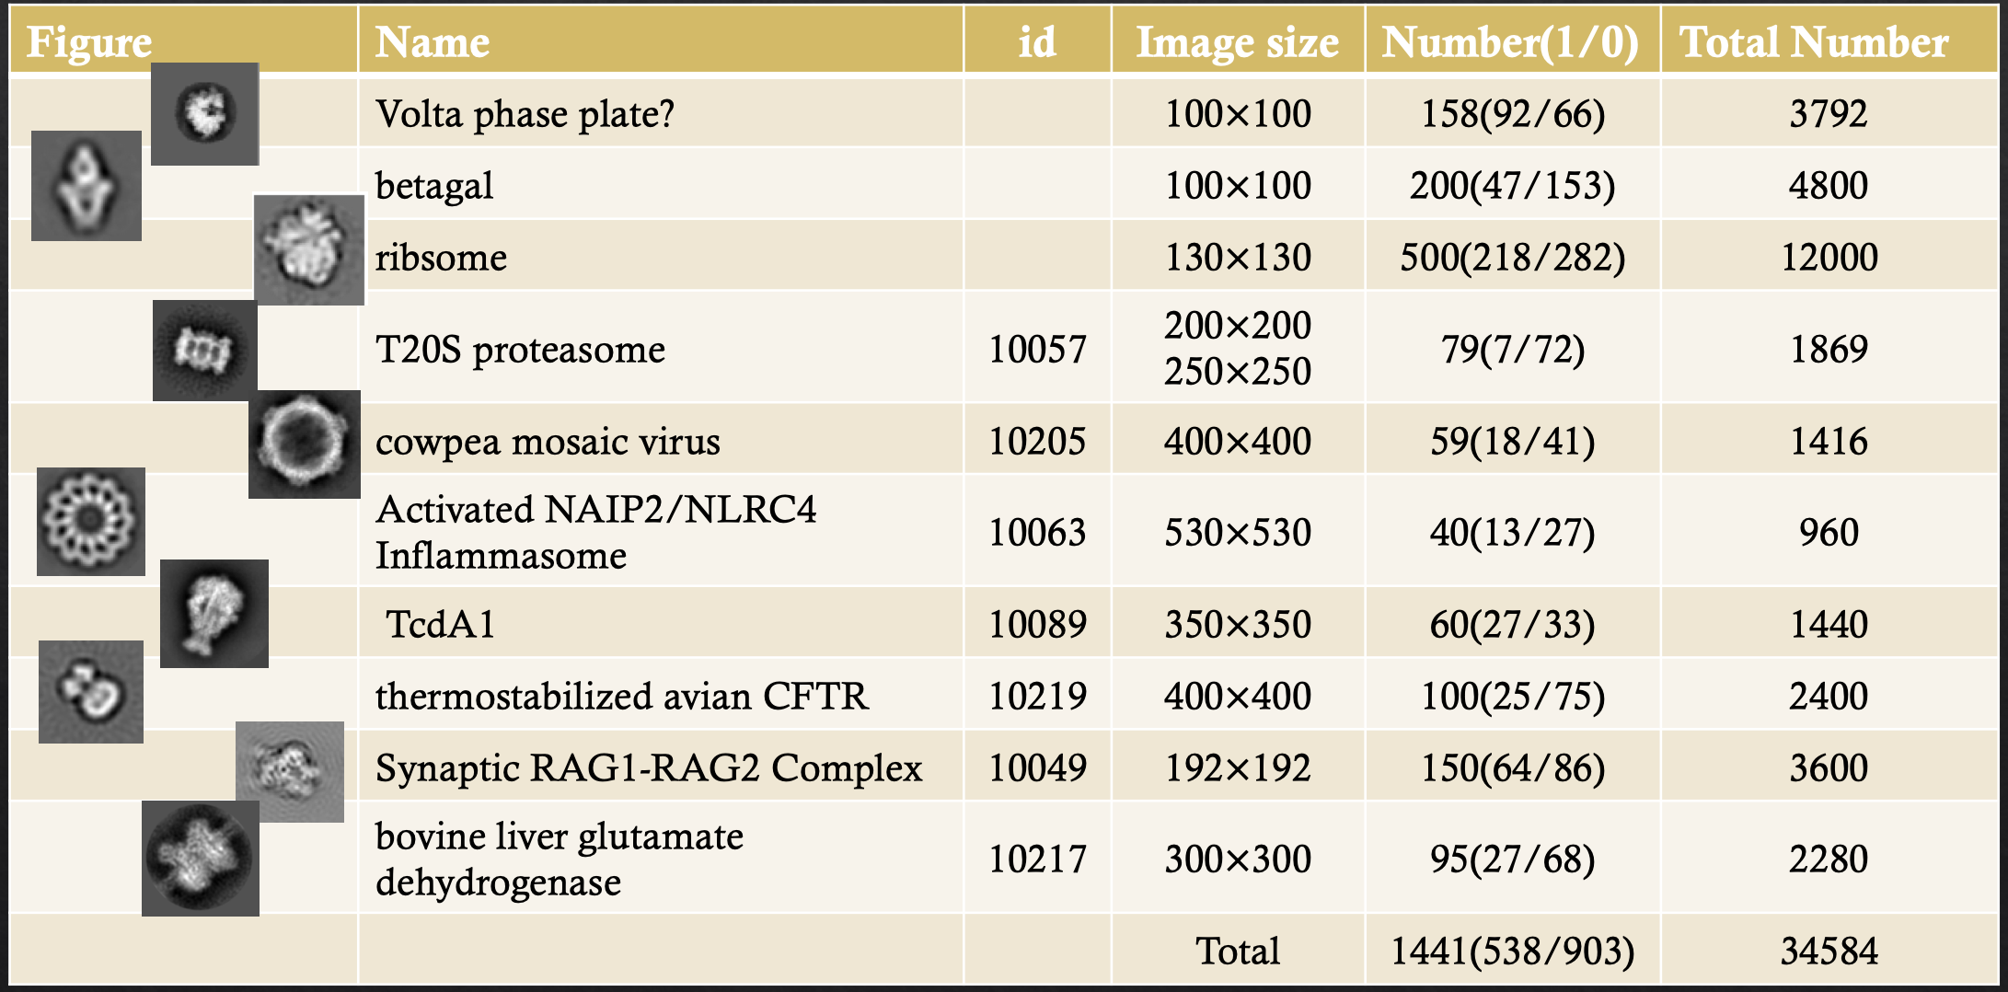
Training Set

Slide 15
Model
def BuildModel(training, training_label, size, num_filter,name):
model=Sequential()
model.add(Conv2D(filters=20,kernel_size=(30,30),input_shape=(100,100,1),activation='sigmoid',padding='same'))
model.add(Conv2D(filters=20,kernel_size=(20,20),padding='same'))
model.add(MaxPooling2D(pool_size=(10,10)))
model.add(BatchNormalization())
model.add(Activation( 'relu' ))
model.add(Flatten())
model.add(Dense(100,activation='sigmoid'))
model.add(Dense(1,activation='sigmoid'))
model.compile(optimizer='adam',loss='binary_crossentropy',metrics=['accuracy'])
checkpoint = ModelCheckpoint(name+'model-{epoch:03d}.h5', verbose=1, monitor='val_loss',save_best_only=True, mode='auto')
model.fit(training,training_label,epochs=20,batch_size=500,verbose=1, validation_data=val_set, callbacks=[checkpoint])
Notes:
這是我們所有的模型，

Slide 16
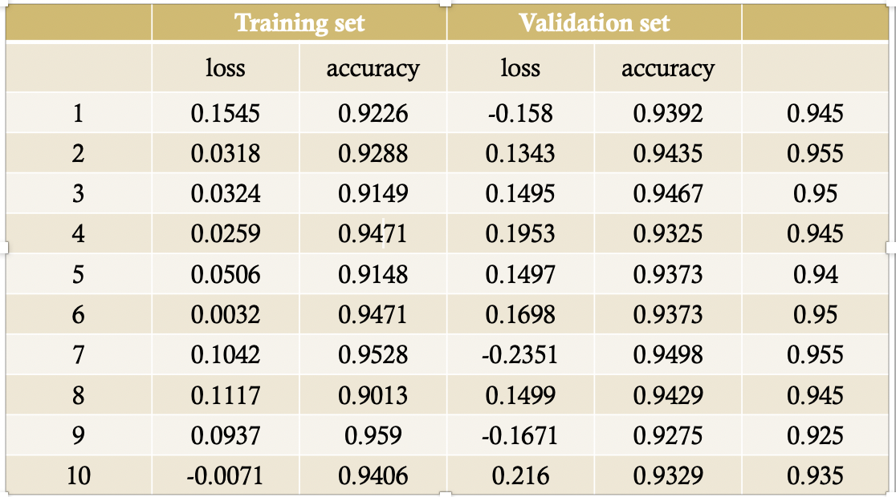
Training & validation

Slide 17
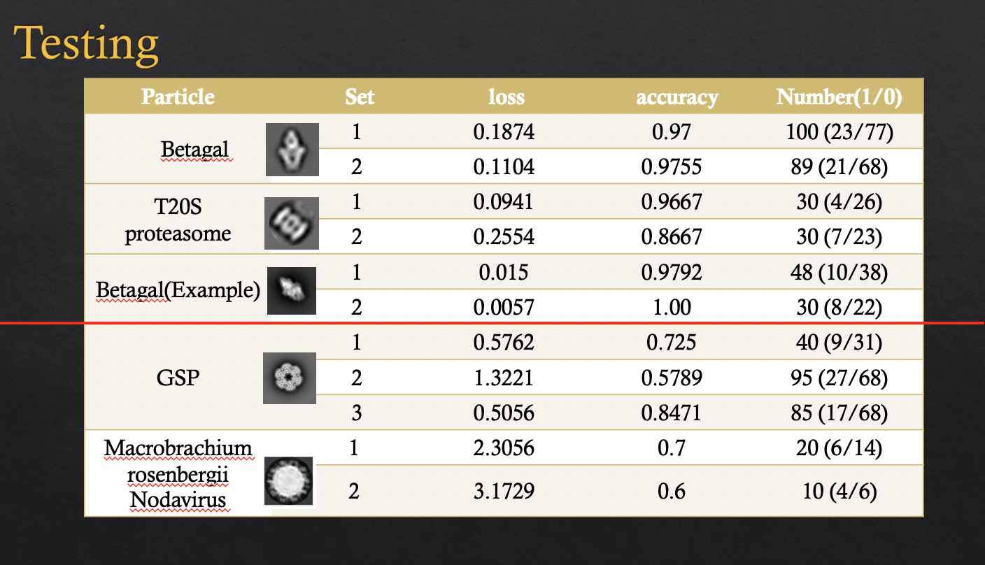

Slide 18
The performance of DCGAN model on single frame image super-resolution (SR).
We can see that DCGAN achieves slightly lower mean PSNR on the test set than the conventional bicubic method. However, if examining closely into the results of the DCGAN based superresolution images (2c), we can see that, even with some distortion, DCGAN provides finer details on the resulting images, which actually agrees more with human recognizing conventions.

Slide 19
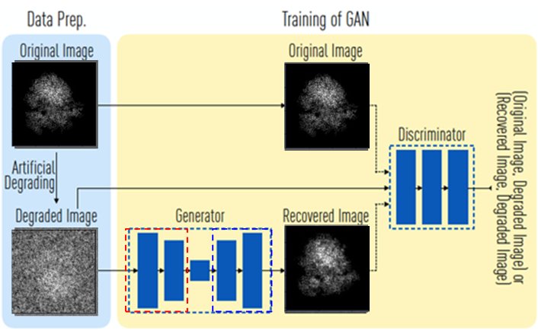
An ambitious project: Pushing the resolution by GAN, collaborated with SW Chen.

Slide 20
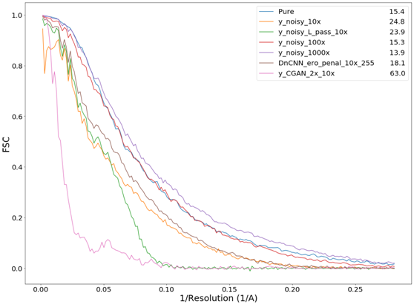
3D reconstruction using GAN de-noised images is not as expected,

Slide 21
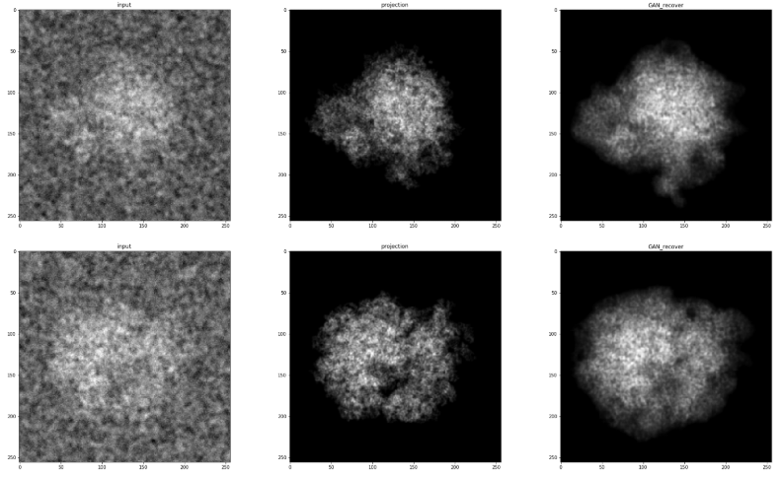
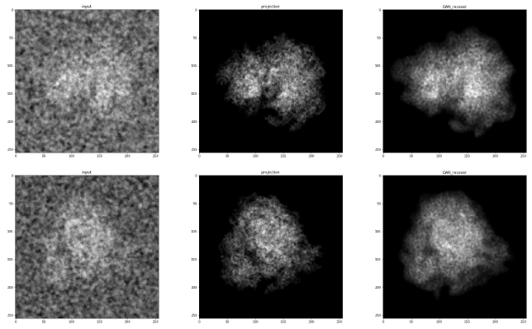
cGAN Approach: 2D de-noised images look great!
Training set
231 projections of ribosome plus Poisson noise
8251 paired data
Testing set
720 images
Input
Ground Truth
Input
Ground Truth

Slide 22
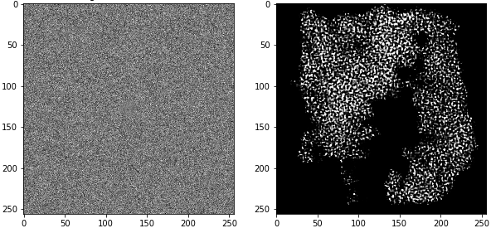
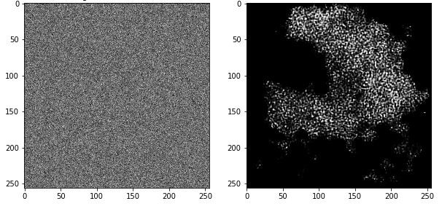
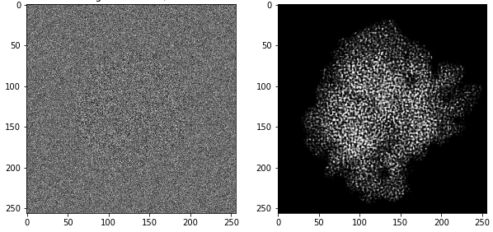
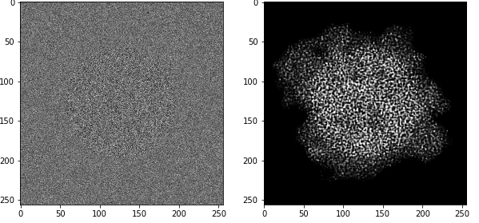
Is this real science? cGAN is so powerful that it can transforms purely noise images.
The output images by cGAN could not yield reasonable 3D structure reconstruction.
Pure or nearly noise images may also output likely particle images.
It is dangerous to use in field like Cryo-EM where the image SNR is low.
Input
Random Noise
Input
Random Noise
Notes:
There are many high SNR images correspond to low SNR images

Slide 23
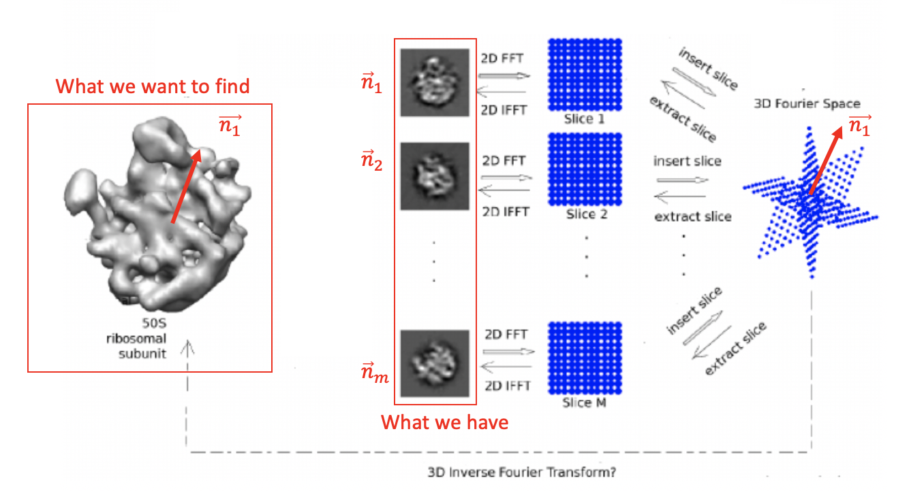
Domain Knowledge: Fourier Slice Theorem and Common Line. Common Line implicitly holds the particle images as a structure, but neglected in Deep Learning.

Slide 24
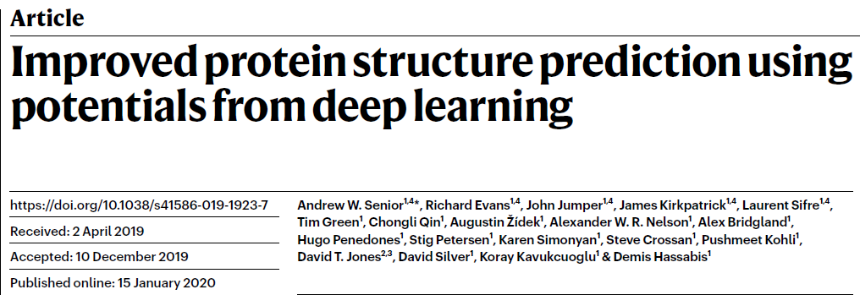
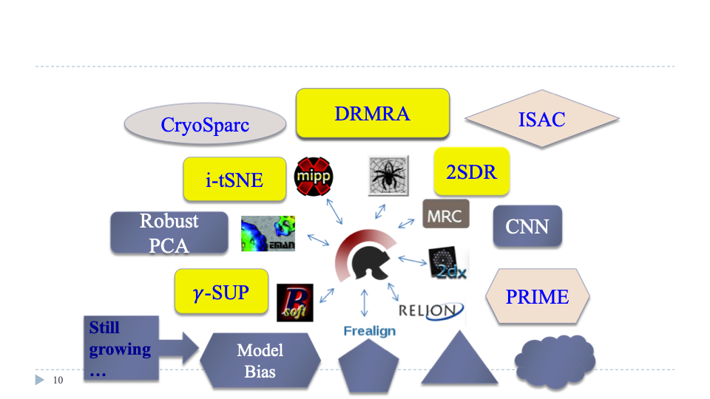
Future work: Integration of AlphaFold and ASCEP
AlphaFold
ASCEP: We employ Scipion to integrate competitive
algorithms to process experimental cryo-EM data. challenges

Slide 25
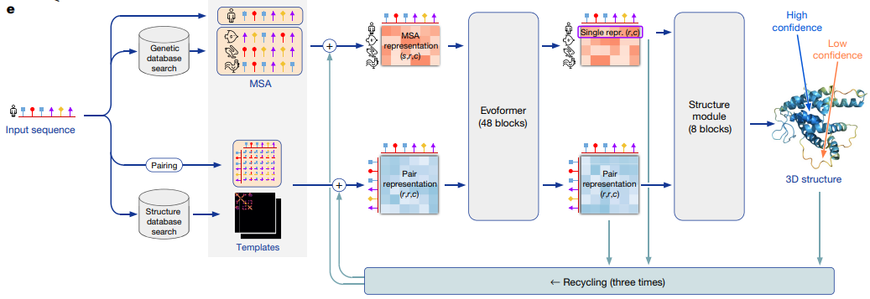
AlphaFold 2

Slide 26
ASCEP’ approach is to develop
Efficient Dimension Reduction Method to subdue the noise impact and save computation complexity.
Robust Clustering Algorithm to reduce the iteration times yet output comparable results (if not better).
Distributed Computation Algorithms.
Interactive Visualization Tool.
Mathematical Modeling for better interpretation.
🞂

Slide 27
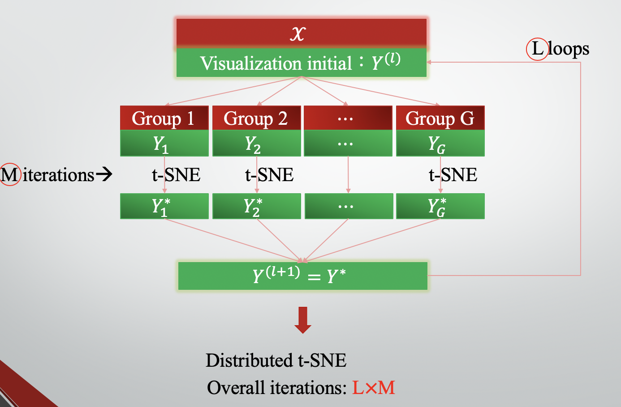
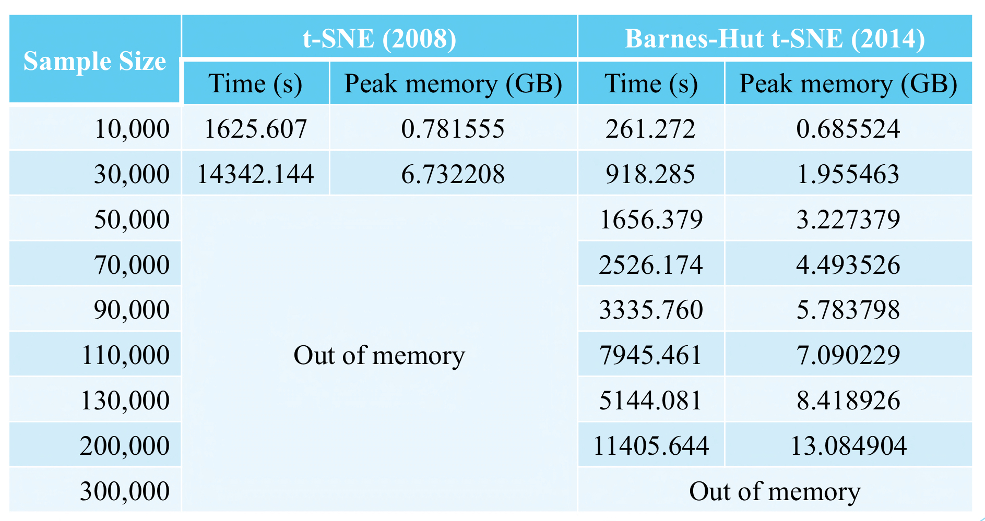
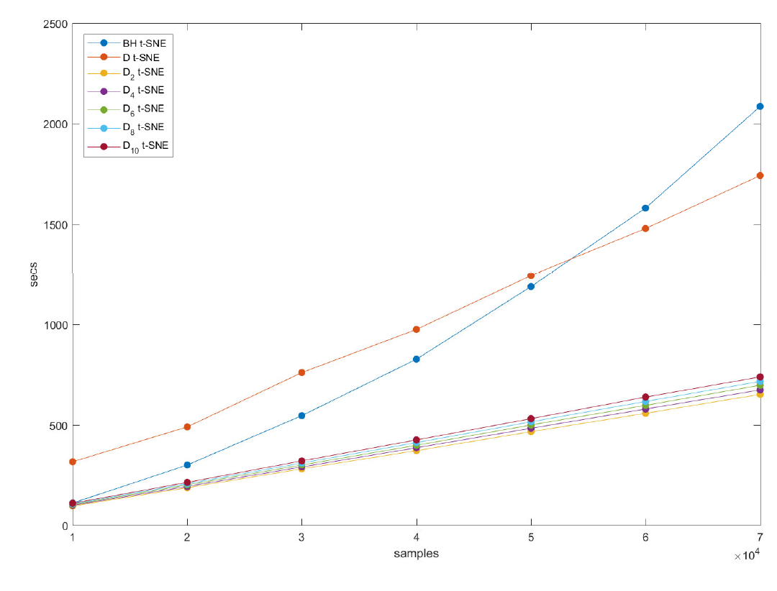
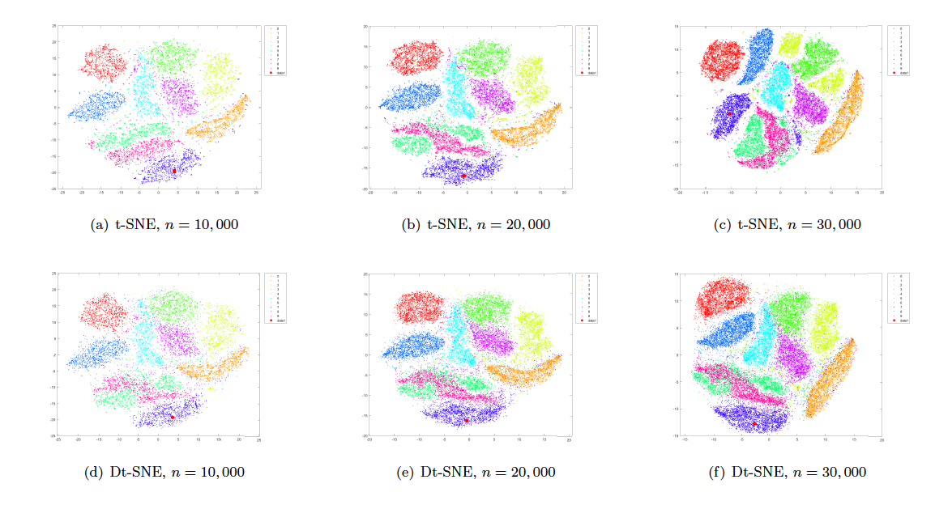
Distributed t-SNE Szu-Han Lin, Ting-Li Chen* and I-Ping Tu (in preparation)

Slide 28
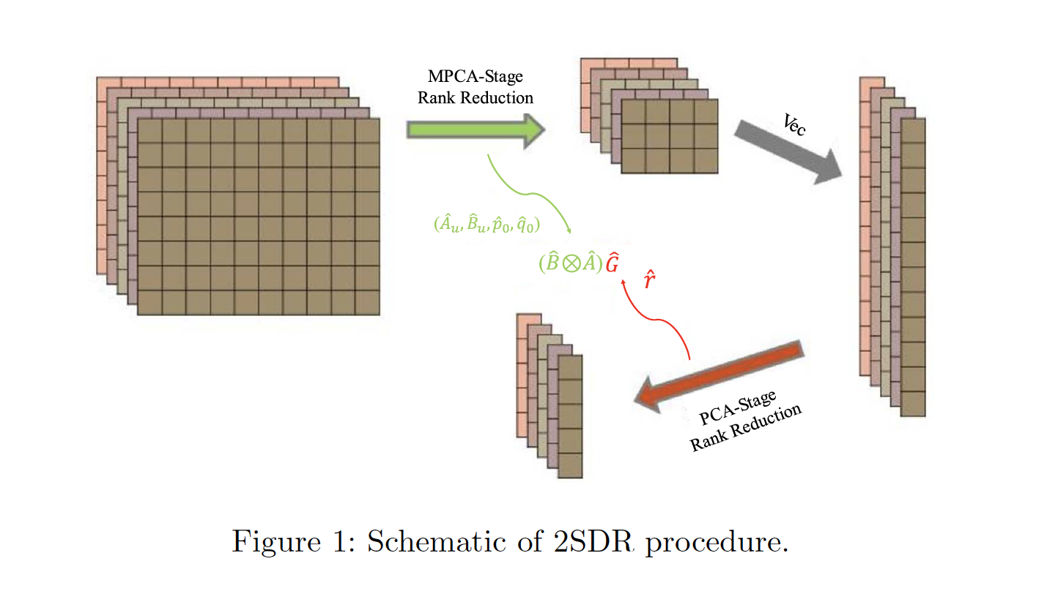
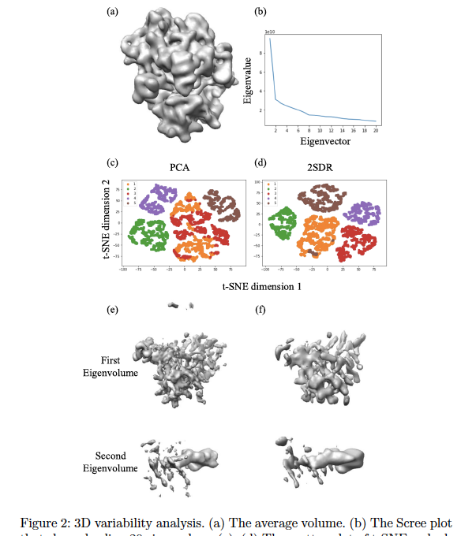
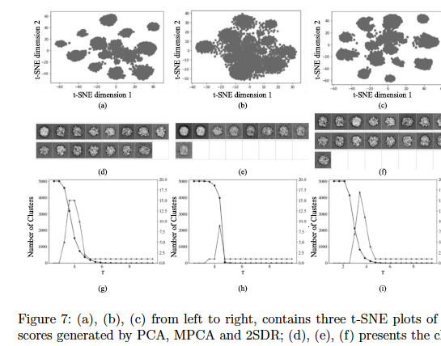
Szu-Chi Chung, Shao-Hsuan Wang, Po-Yao Niu, Su-Yun Huang, Wei-Hau Chang and I-Ping Tu* (2020). “Two-stage dimension reduction for noisy high-dimensional images and application to Cryogenic Electron Microscopy”. Annals of Mathematical Sciences and Applications 5, 283-316.

Slide 29
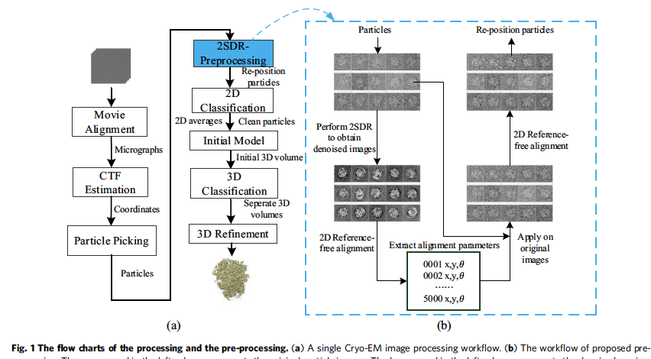
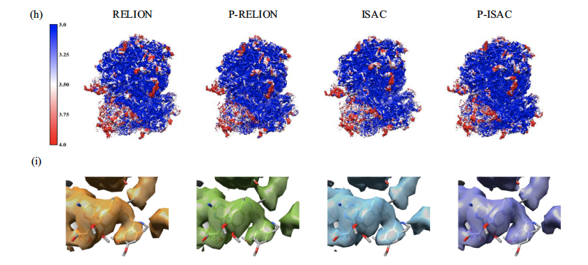
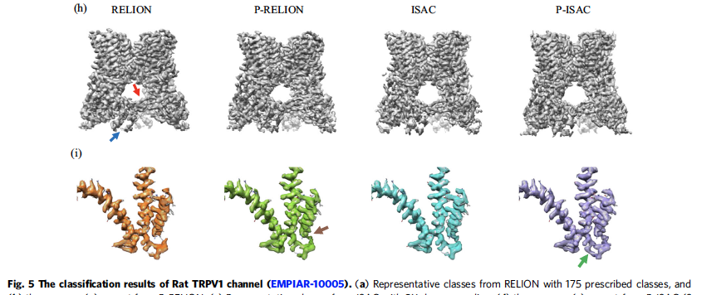
Szu-Chi Chung, Hsin-Hung Lin, Po-Yao Niu, Shih-Hsin Huang, I-Ping Tu* and Wei-Hau Chang* (2020). “Pre-pro is a fast pre-processor for single-particle cryo-EM by enhancing 2D classification”. Communications Biology 3, 508.

Slide 30
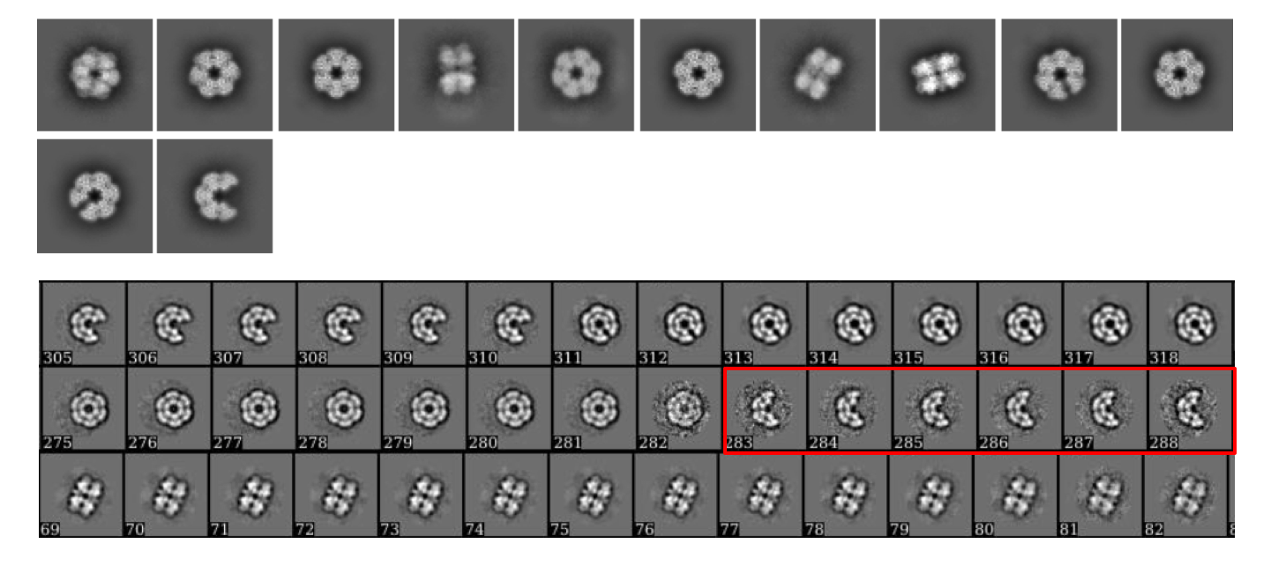
DRMRA: We have successfully found a hidden conformation Szu-Chi Chung, Hsin-Hung Lin, Tien-You Liu, Kuen-Phon Wu, Ting-Li Chen, Wei-Hau Chang*, and I-Ping Tu*, (2022), “Distributed Rapid Multi Reference Alignment (DRMRA) for accelerating single particle cryo-EM analysis”, (in preparation).

Slide 31
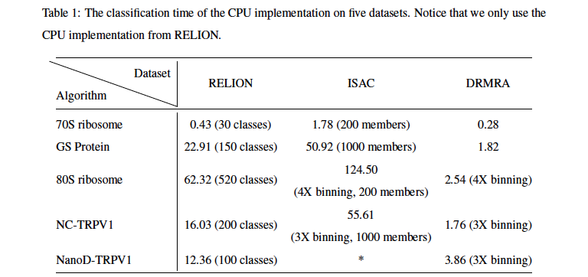
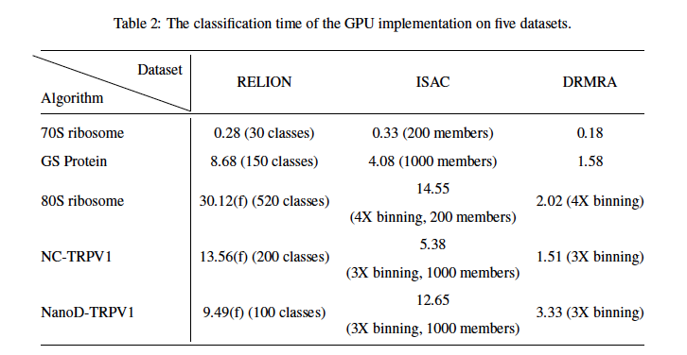

Slide 32
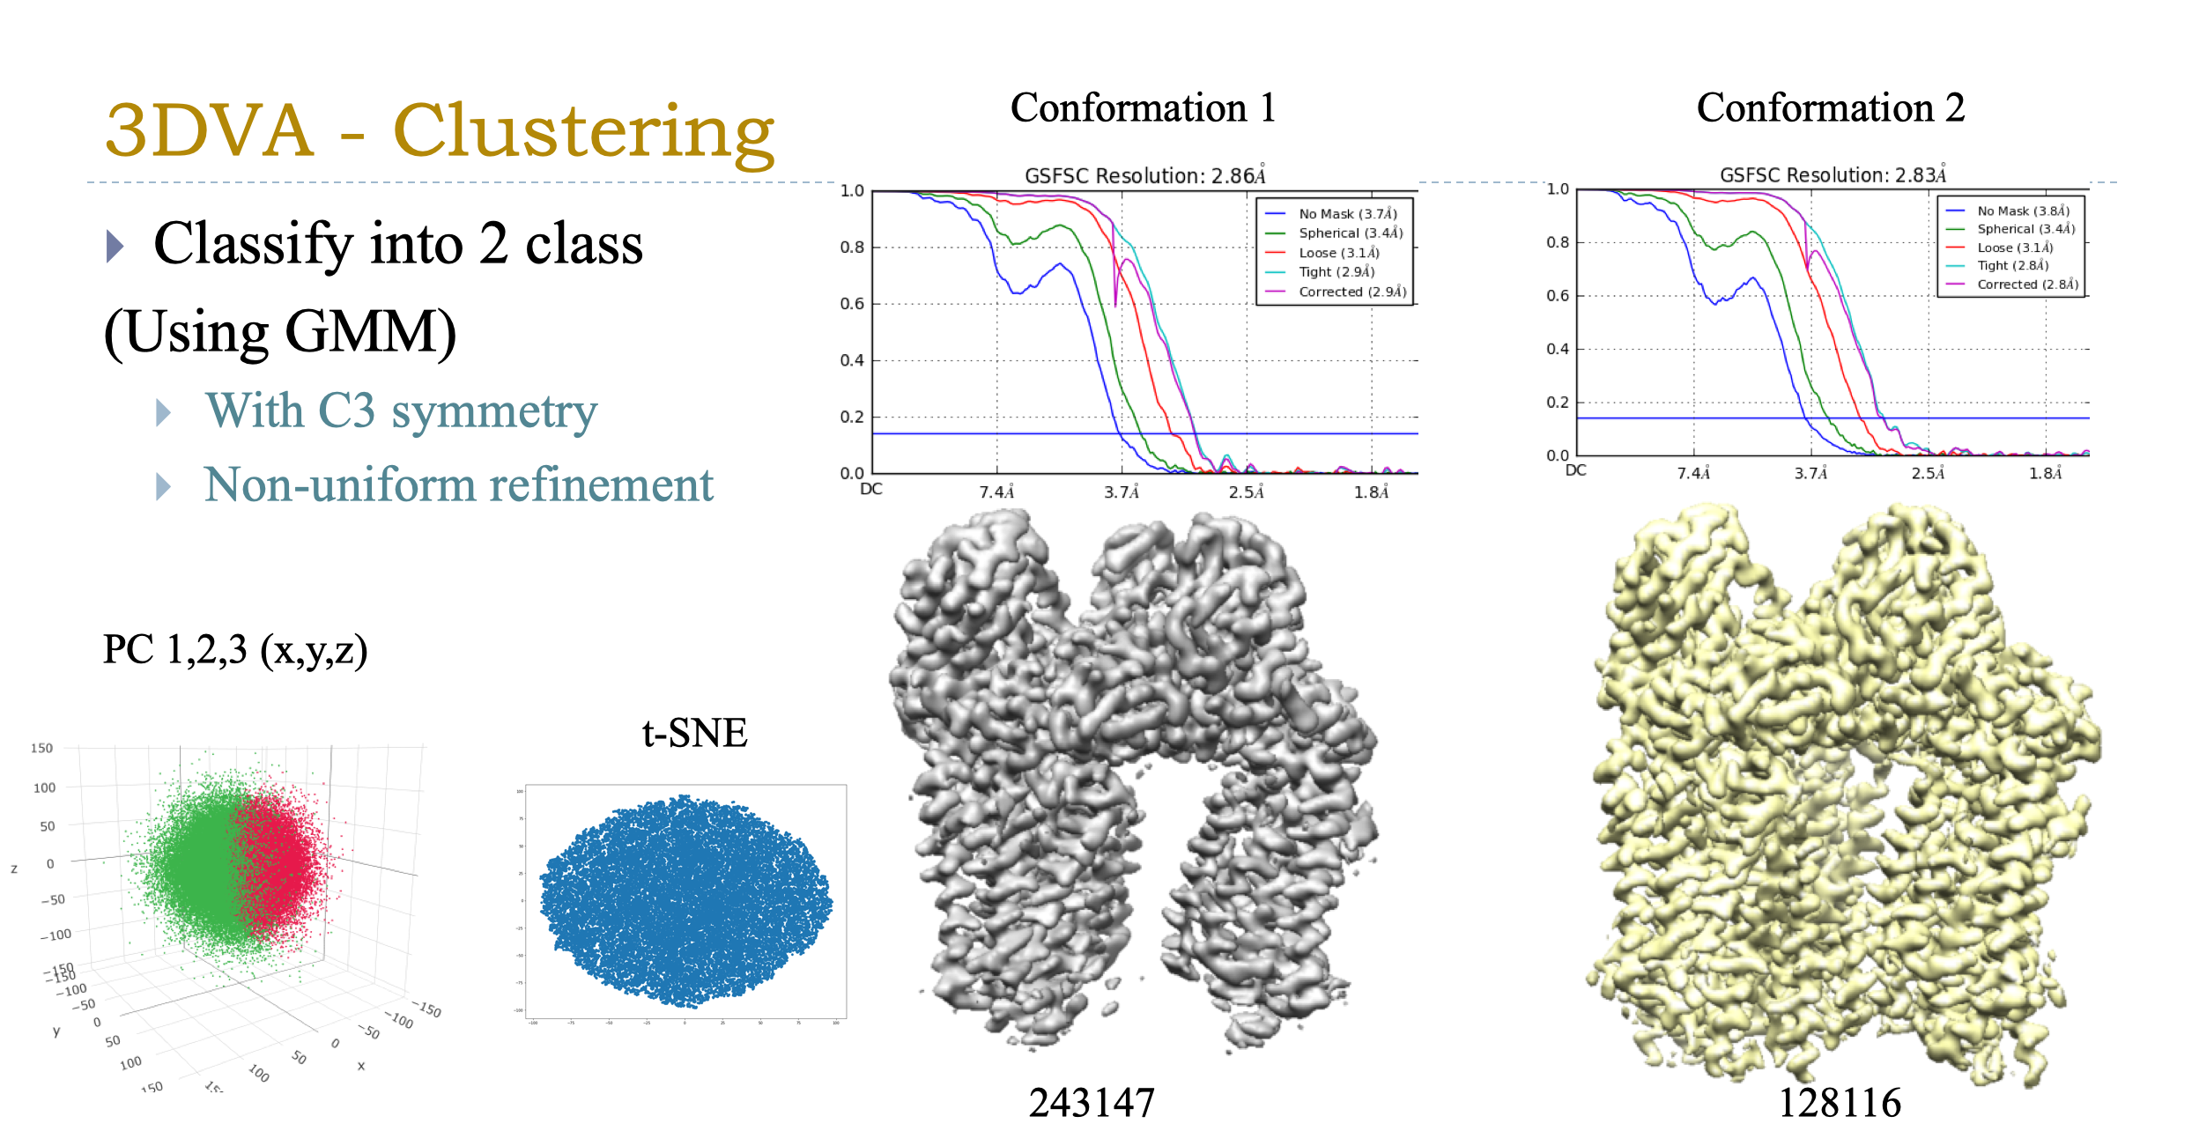
2.5 Å cryo-EM structure of particulate methane monooxygenase Wei-hau Chang*, I-Kuen Tsai, Shih-Hsin Huang, Hsin-Hung Lin, Szu-Chi Chung, I-Ping Tu, Steve S.-F. Yu* & Sunney I. Chan* (2021) Cryo-EM structures of the functional particulate methane monooxygenase (pMMO) from Methylococcus capsulatus (Bath) reveals the sites of the copper centers. Journal of American Chemical Society (accepted).
🞂

Slide 33
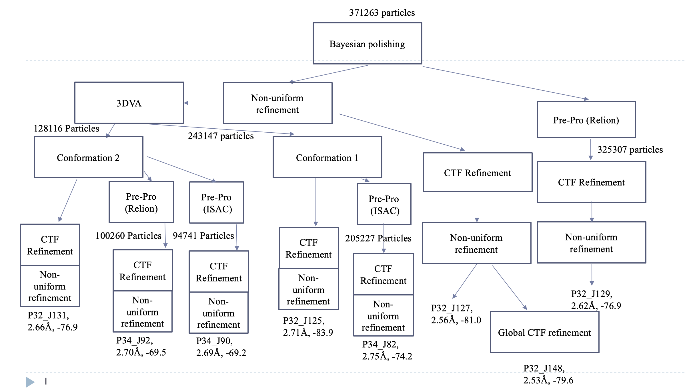
Finished within a week in one server
We have saved a lot of energy!

Slide 34
Acknowledgements Collaborators and Grants
Institute of Statistical Science Institute of Chemistry
Cheng-Yu Hung Hsin-Hung Lin
Huei-Lun Siao Wei-Hau Chang
Szu-Han Lin Institute of Biological Chemistry
Yu-Hsiang Lien Kuen-Phon Wu
Tien-Yu Liu
Po-Yao Niu NSYSU, Applied Math
PI Szu-Chi Chung
Yi-Ching Yao
Ting-Li Chen NCU, Institute of Statistics
Su-Yun Huang Shao-Hsuan Wang
Investigator Award, Academia Sinica, 2021-2025
Grand Challenge Seed Program, 2018, 2019 and 2020

