Slide 1
How Deep Learning Helps in the Electron Identification with AMS-02 Electromagnetic Calorimeter
April 22, 2022
Hsin-Yi Chou
Institute of Physics, Academia Sinica

Slide 2
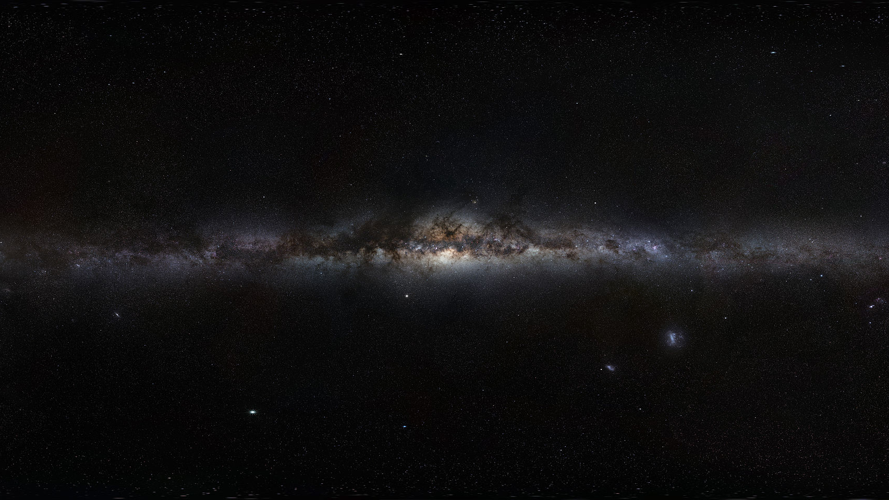
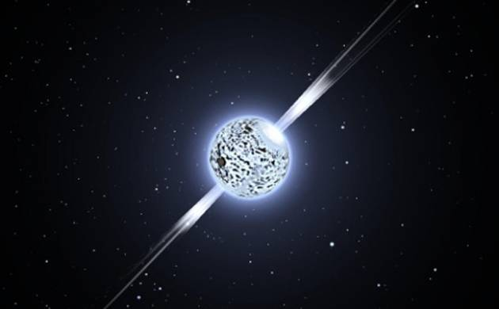
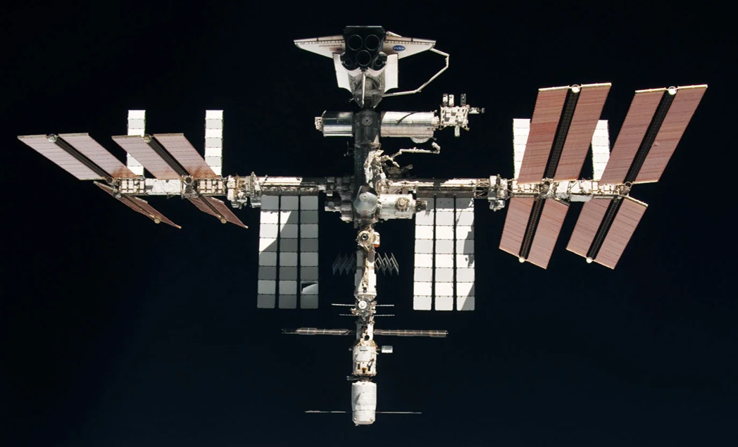
On the Origins of Cosmic Antimatters
New Astrophysical Sources: Pulsars, …
Supernovae
Positrons, … from Pulsars
Interstellar Medium (ISM)
Protons, Electrons, …
Dark Matter
Antiprotons, Positrons, …
from Collisions
Protons, Electrons, …
Antiprotons, Positrons, ...
from Dark Matter Collisions
Magnetic field lines
AMS on the ISS
Dark Matter
Four elementary particles (Protons Electrons Antiprotons Positrons) are stable and could travel through the Galaxy. They carry information of the origin and propagation history of cosmic rays.
Notes:
The most important task for AMS is to study antimatter.
These antimatter may come from new source like dark matter or pulsars.
For example, when DM annihilate with each other, they could produce equal amount of particles and anti-particles, including antiprotons and positrons.
Why do we think antiparticles are more important? Because traditional astrophysical sources like Supernovae Remnants produce a large amount of matter at high energies, but they don’t produce a lot of anti-particles.
To look for new physics, the antimatter spectra have low background from traditional physics.

Slide 3
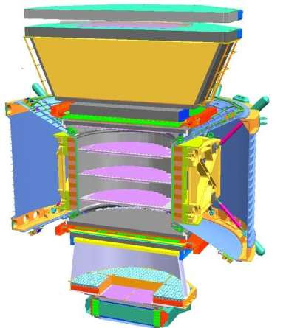
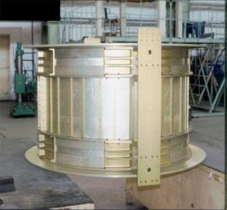
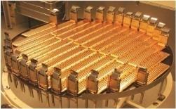
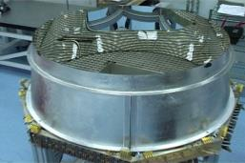
AMS (A TeV precision, multipurpose magnetic spectrometer)
Transition Radiation Detector (TRD)
Identify $p^{±}$/$e^{±}$
The charge ($Z$) and energy ($E$) or rigidity ($R≡P/Z$) are measurement independently by several detectors
Time of Flight (TOF)
$$Z, β$$
Absolute Charge $|Z|$ Tracker & TOF
Energy of $e^{±}$
ECAL
Charge-Sign Rigidity $R$ Tracker with Magnet
Velocity $β=v/c$ TOF & RICH
$p^{±}$/$e^{±}$ identification TRD & ECAL
1
TRD
Magnet (∼0.14 Tesla) $$±Z$$
Silicon Tracker (Tracker) $$Z, P$$
TOF
2
3-4
5-6
Tracker
7-8
TOF
Ring Imaging Cherenkov (RICH) $$Z,β$$
RICH
Electromagnetic Calorimeter (ECAL)
$E$ of $e^{±}$ and Identify $p^{±}$/$e^{±}$
9
ECAL
1m
Volume: 5m x 4m x 3m Weight: 7.5 tons

Slide 4
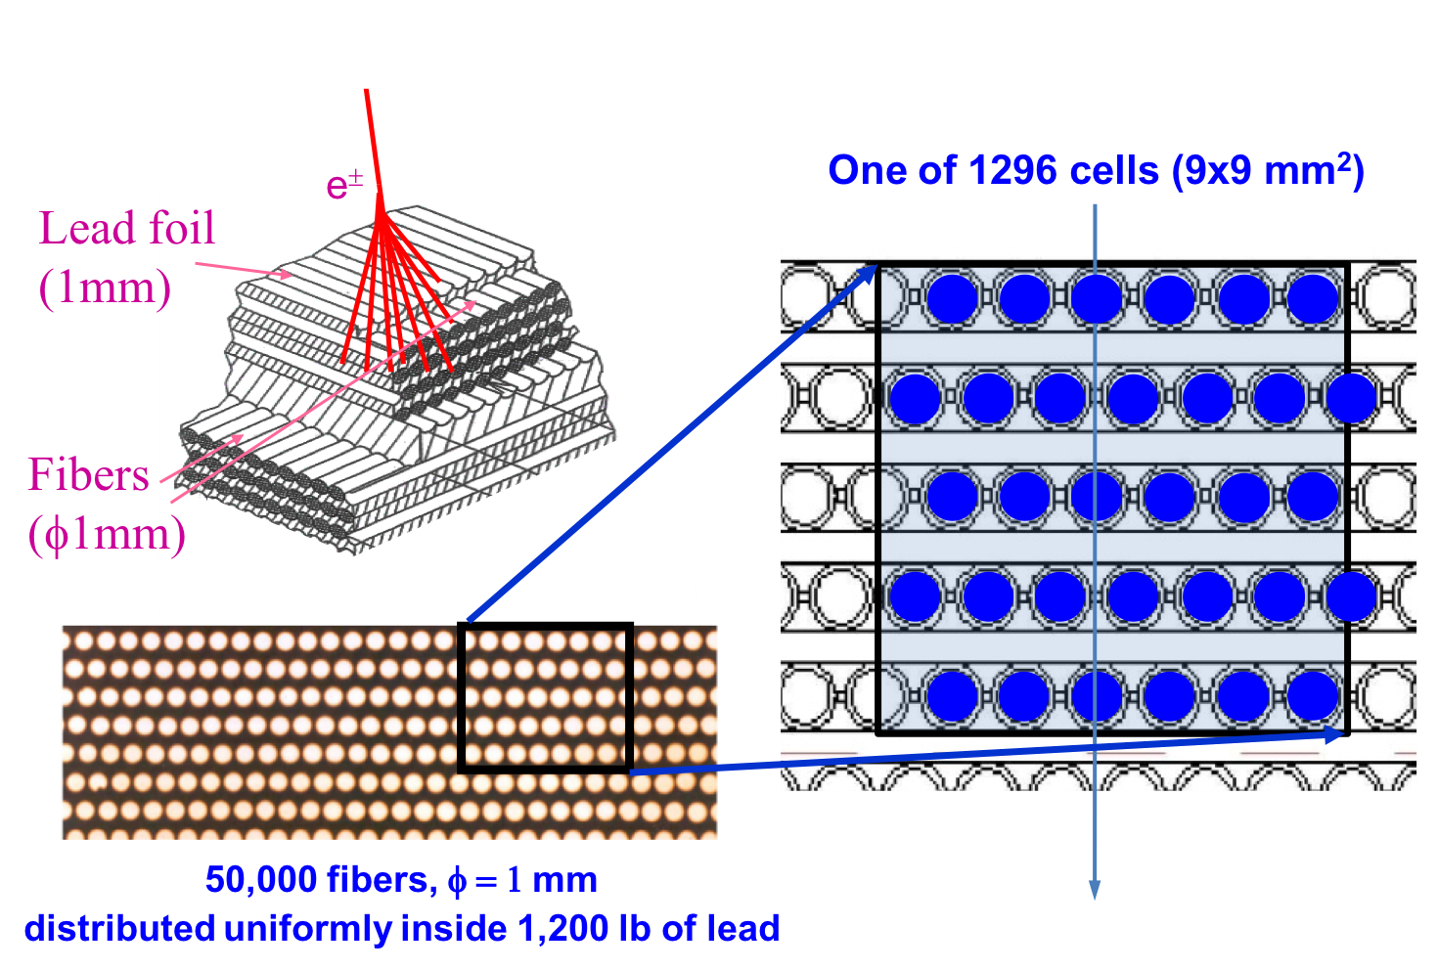
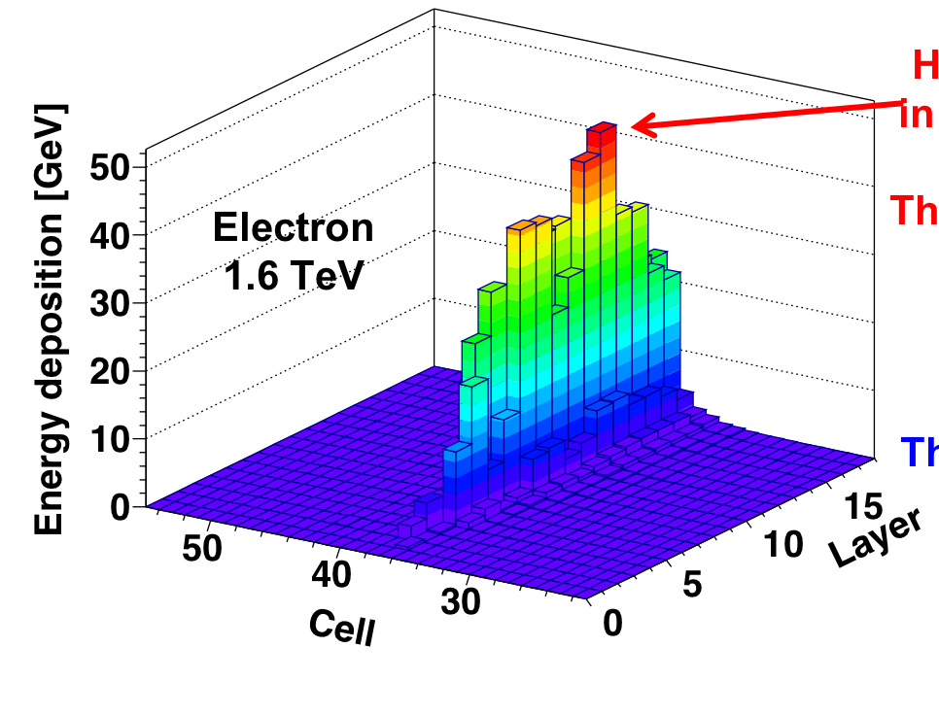
AMS Electromagnetic Calorimeter (ECAL)
Highest enegy cells are in the core of the shower.
Electromagnetic shower
1296 cells = 72 cells/layer x 18 layers
Direction Projection of Layers (10 in Z-Y, 8 in Z-X)
Y | Y | X | X | Y | Y | X | X | Y | Y | X | X | Y | Y | X | X | Y | Y
Notes:
In total there are 1296 cells segmented into 18
layers longitudinally, two per layer, with 72 transverse cells in each
layer providing a fine granularity 3D shower sampling.

Slide 5
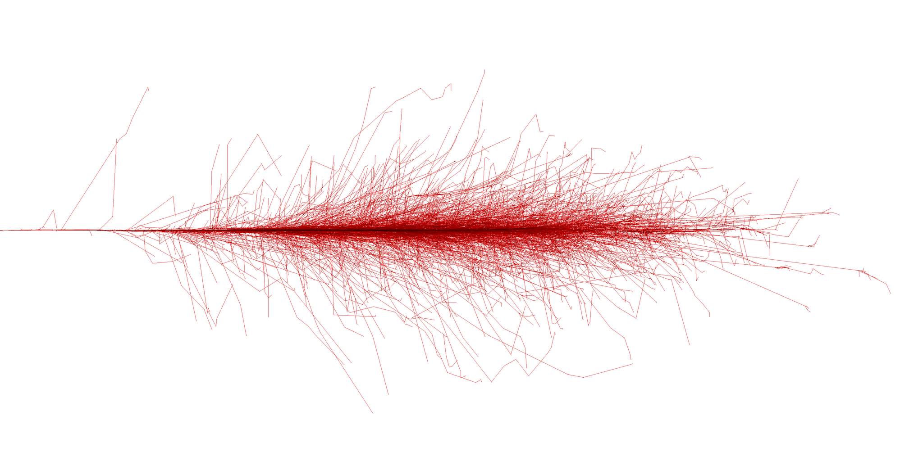
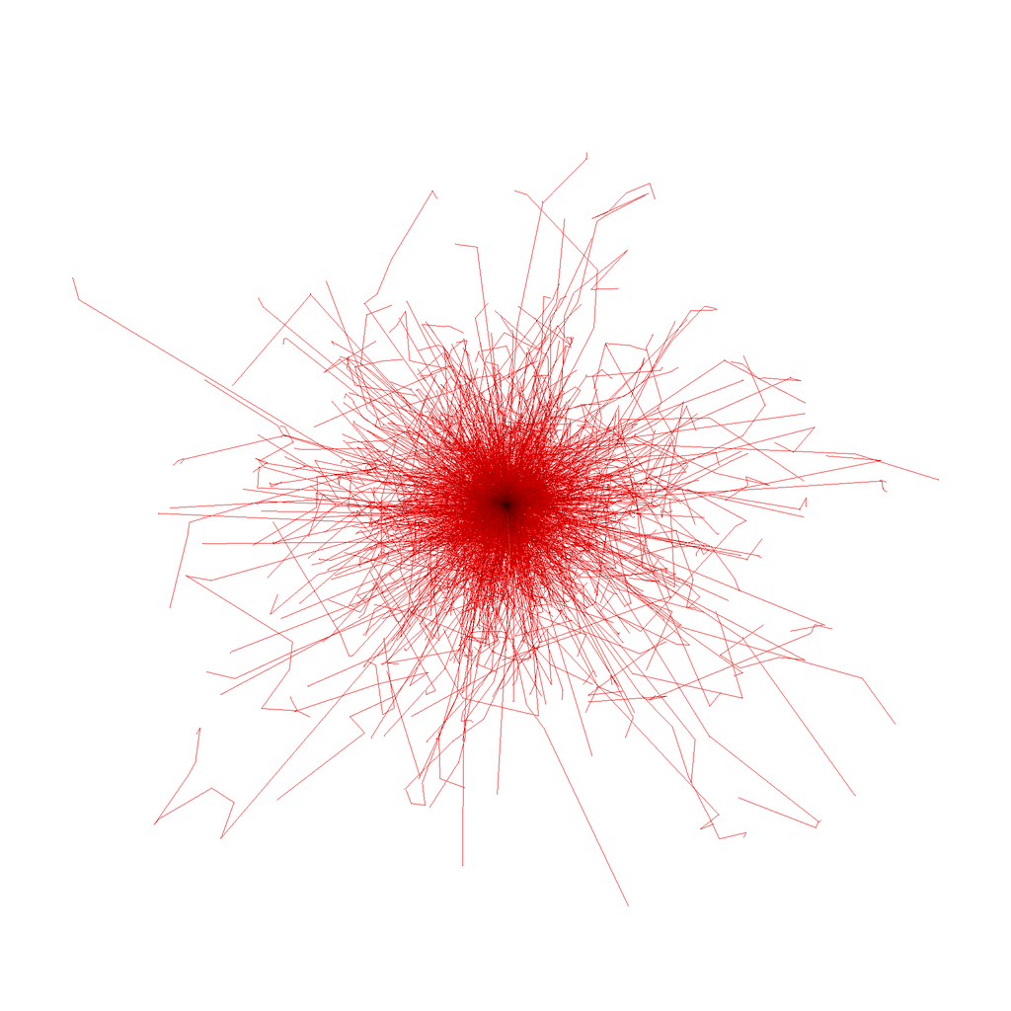
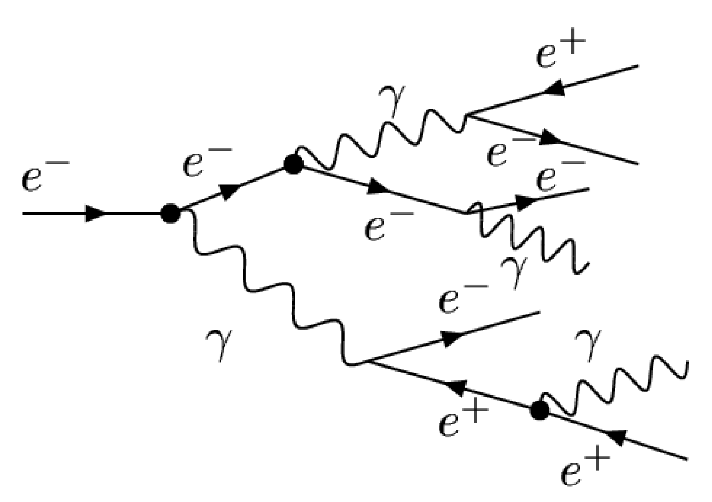
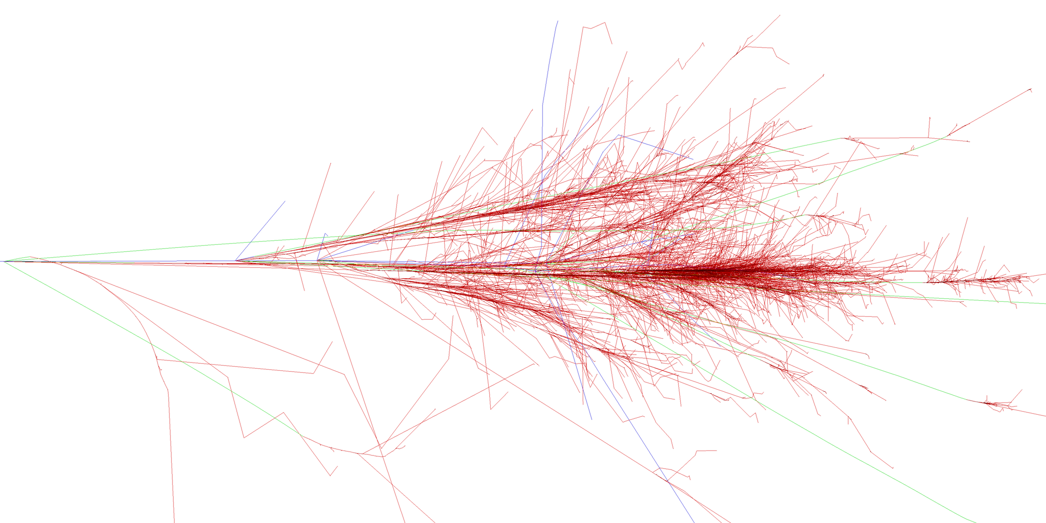
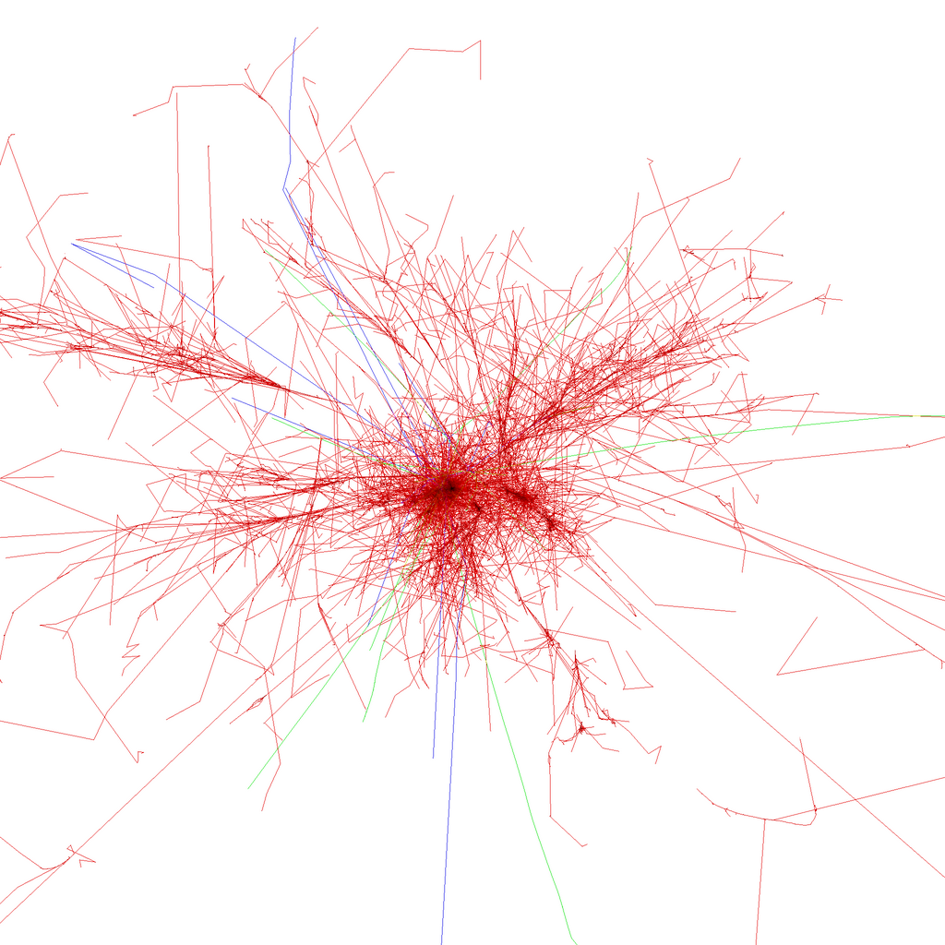
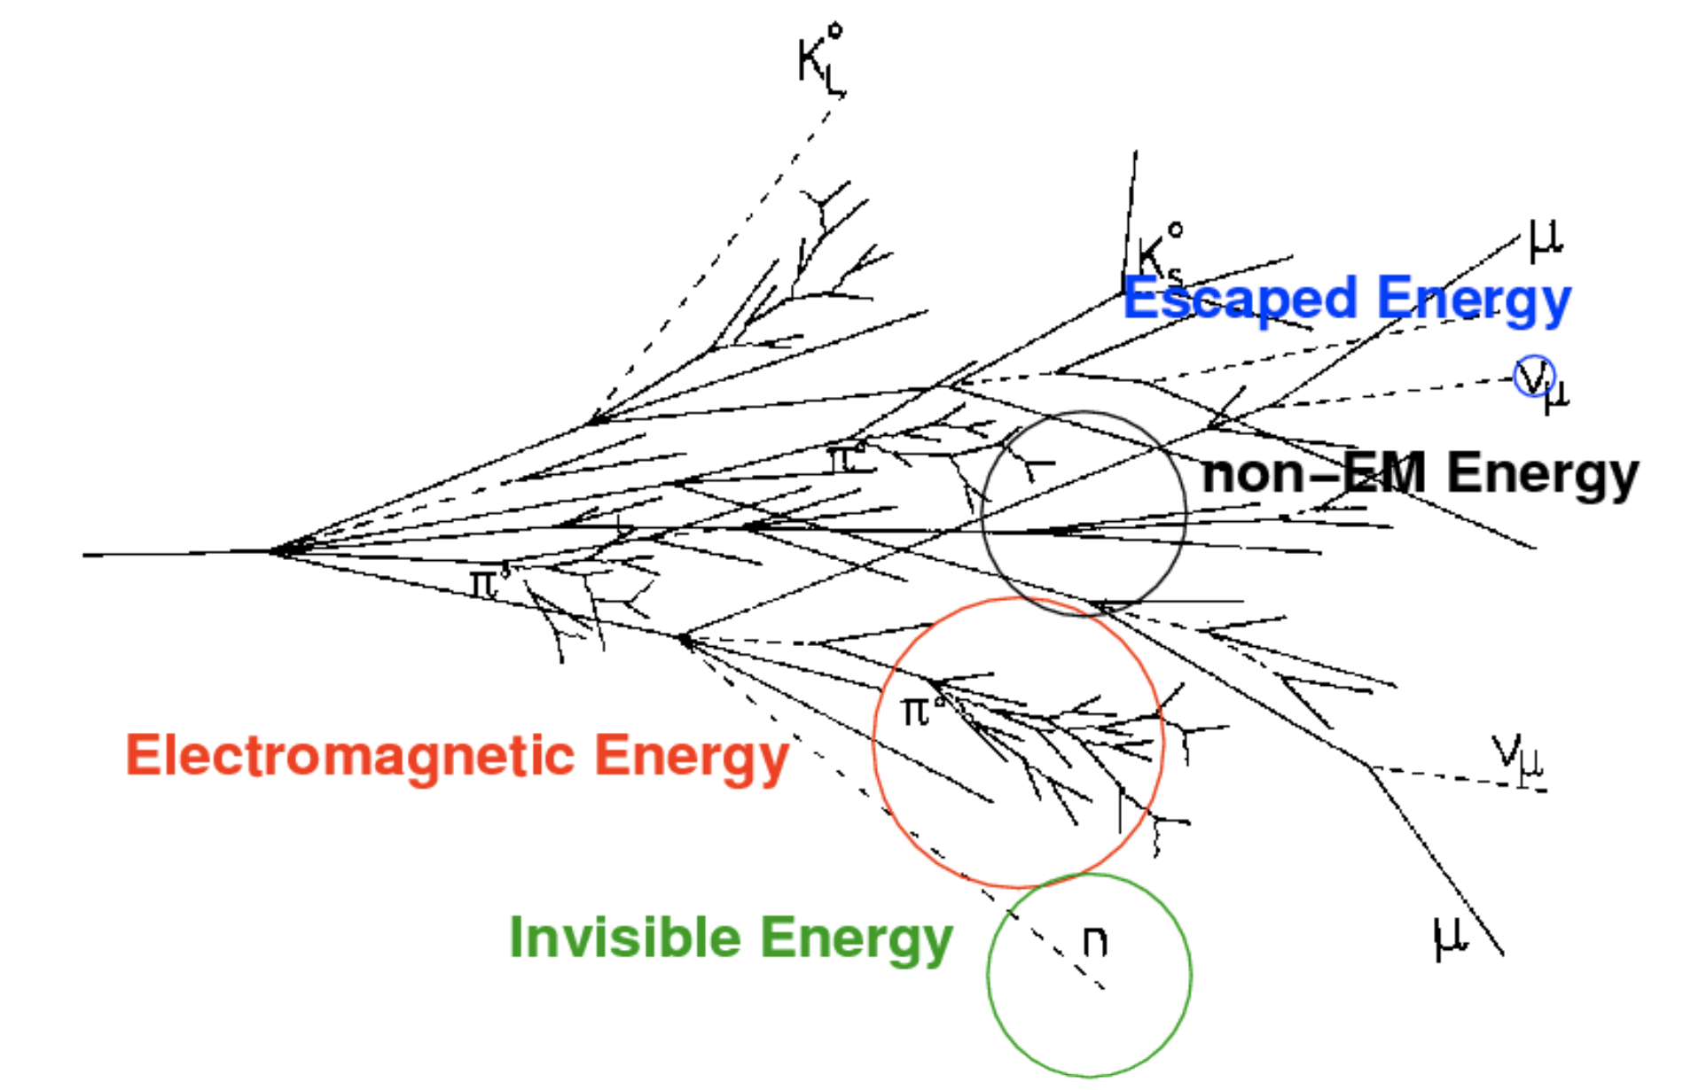
Electromagnetic (EM) Shower ($e^{±}$)
Bremsstrahlung
Pair production
X-Y Projection
Z-X Projection
Hadron Shower ($p^{±}$)
X-Y Projection
Z-X Projection

Slide 6
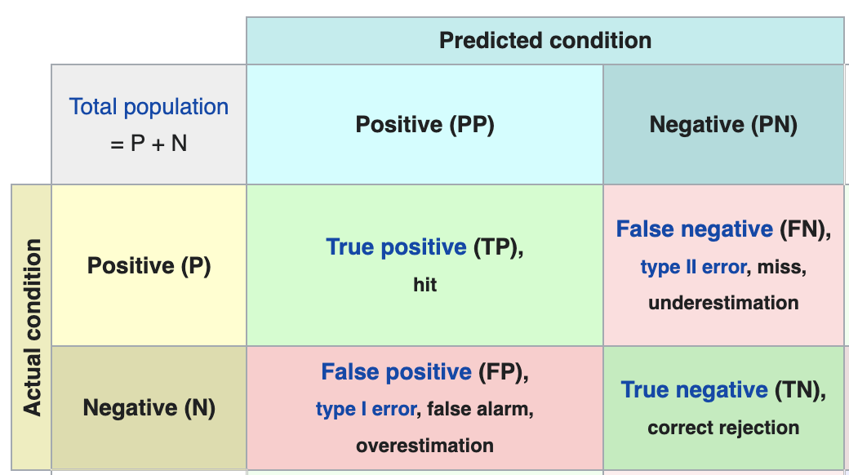
Two-class Prediction Problem
Consider Two-class prediction problem (binary classification), in which the outcomes are labeled either as positive (P) or negative (N). There are four possible outcomes from a binary classifier.
$$e^{±}$$
$$p^{±}$$
$$e^{±}$$
A shower image
Electromagnetic
Showers
$$p^{±}$$
Hadron Shower
Binary Classifier
(Model)
(Predicted)
$$p^{±}$$
$$e^{±}$$
A predicted value (x)
(Is it like an electron or EM shower?)

Slide 7
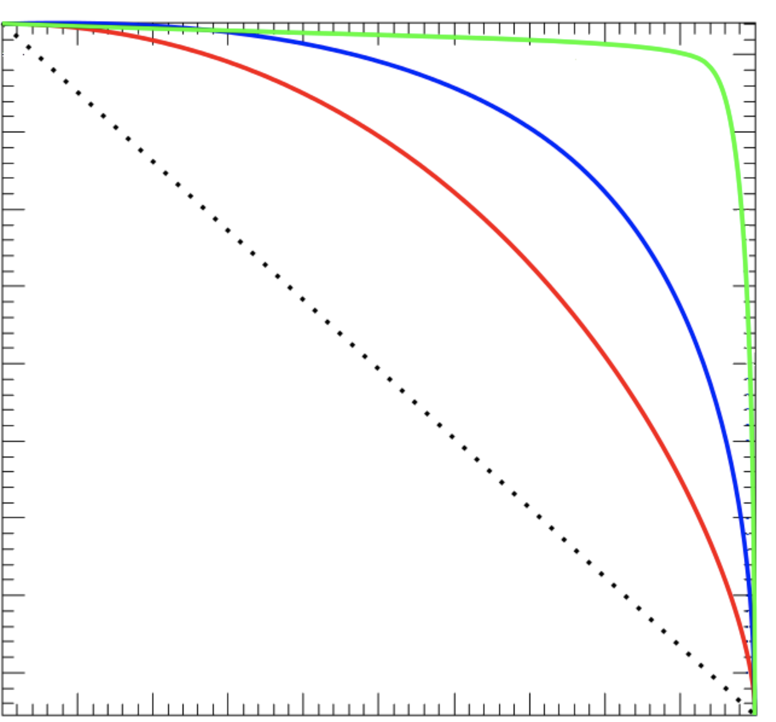
Receiver Operating Characteristic (ROC) Curves
ROC curves are a good way to illustrate the performance of given classifier
Shows the negative rejection over the positive rate of the remaning sample
Best classifier can be identified by the largest area under curve (AUC)
1
Best
Better
Worse
True Negative Rate (TN=1-FP)
Random classifier
$$p^{±}$$
$$e^{±}$$
0
0
True Positive Rate (TR)
1

Slide 8
Electron Identification by Machine Learning
Training images
Classifier
Loss function $ℒ$
(Binary Classifier)
Minimization Optimation: Pick the “best” parameters of the classifier
Shower images
Using Classifier with the “best” parameters
Identify electrons through
predicted values from the classifier

Slide 9
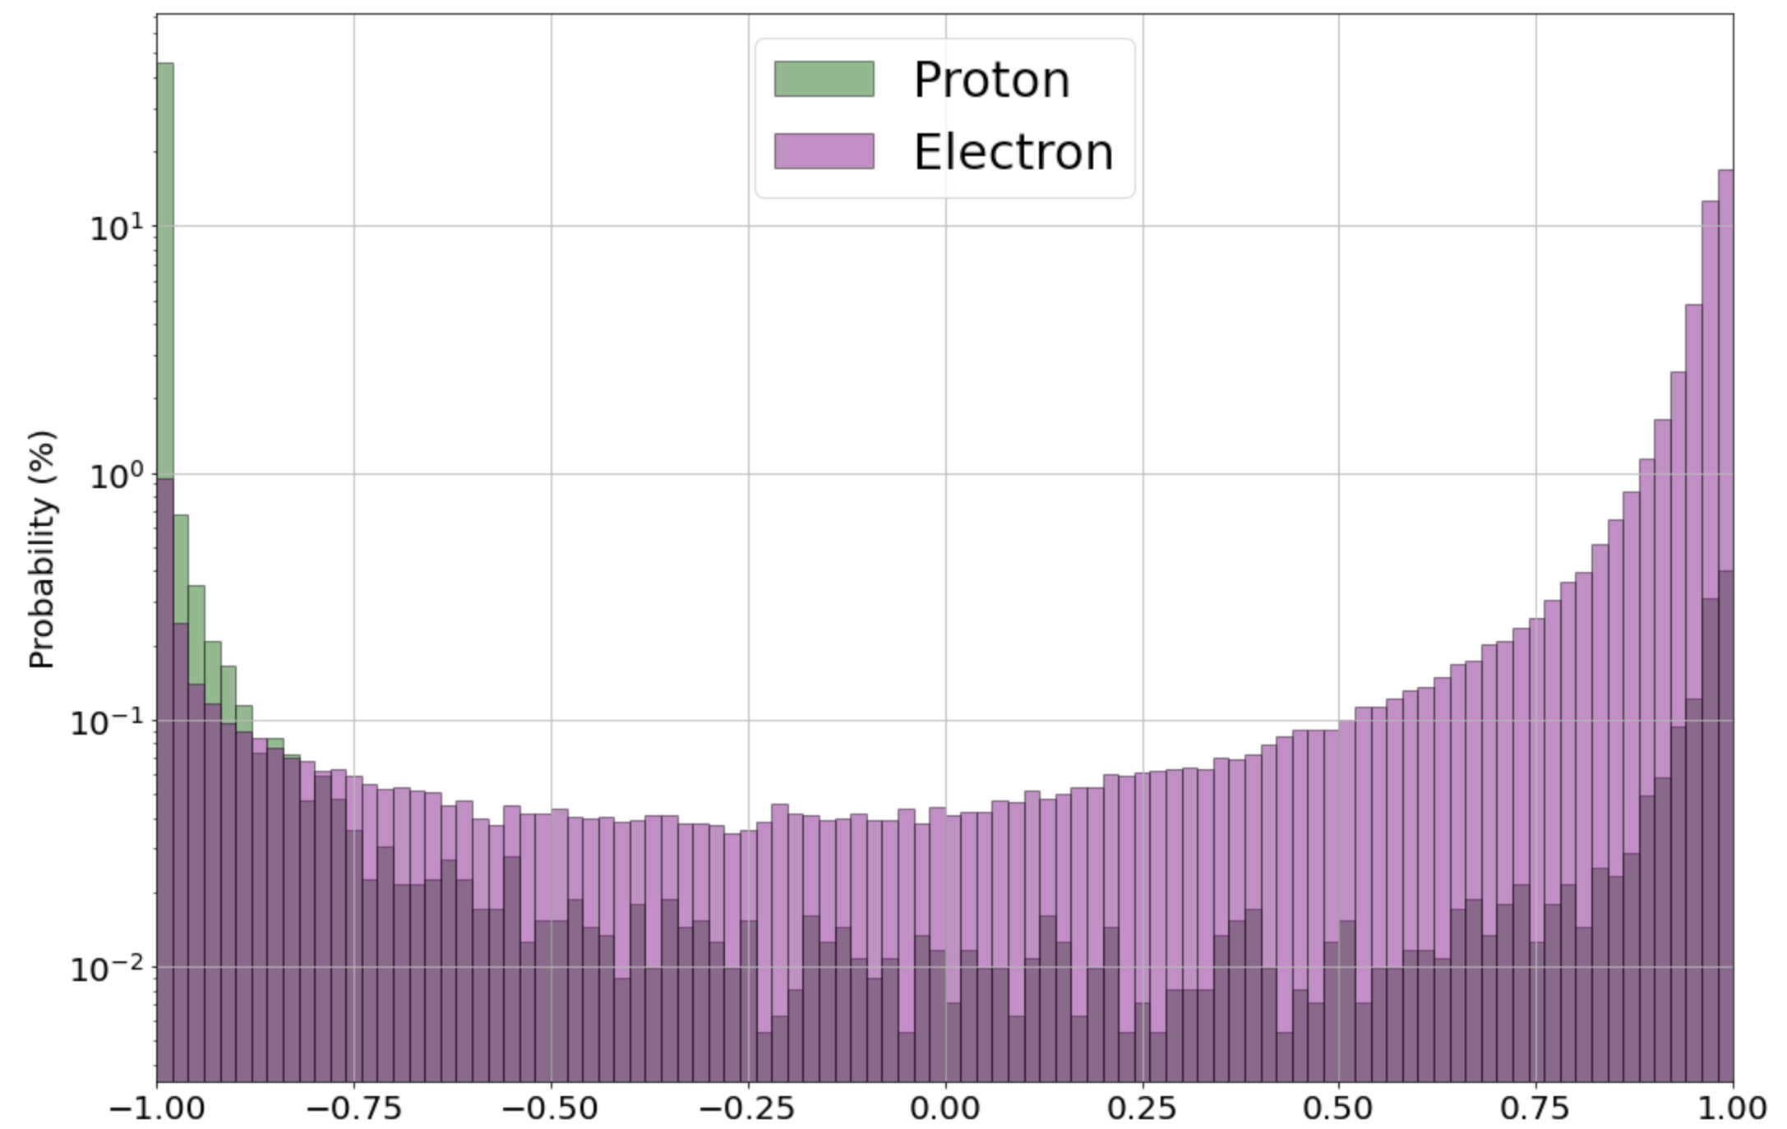
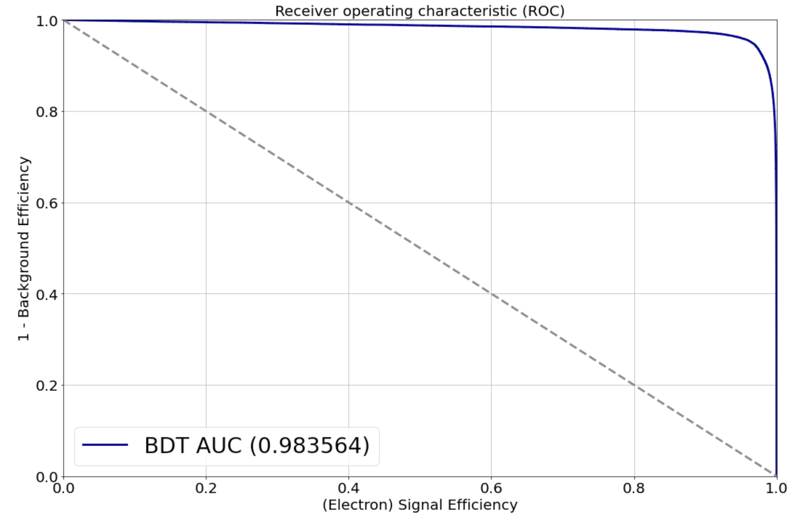
Binary Classifier: Boost Decision Tree (BDT)
Boost decision tree (BDT) is most popular machine learning method in the high energy physics experiment.
An example of a decision is composed of nodes, edges, and the leaves. The nodes are related to different features of the input, and the edges suggests the feature assignments. The nodes at the last level of this tree are called leaves, which give the answer to the classification. The final classifier would be the weighted summary of these decision trees.
edge
Background(B)
Signal(S)

Slide 10
Binary Classifier: Deep Neural Network (DNN)
Learn abstract features and concepts from raw image pixels
Learn high-level features by increasing non-linear relations between features
Feature Learning
(Convolution NN)
Classification
(Dense NN)
$$p_{e^{±},i}+p_{p^{±},i}=1$$
$e^{±}$
$p^{±}$
Shower Images
$$y_{i}=1, if e^{±}$$
$$y_{i}=0, if p^{±}$$
Loss function: Binary Cross Entropy
$$ℒ=−\frac{1}{N}\sum_{i=1}^{N}{\left[y_{i}∙\ln\left(p_{e^{±},i}\right)+\left(1−y_{i}\right)∙\ln\left(p_{p^{±},i}\right)\right]}$$
Binary cross entropy compares each of the predicted probabilities to actual class output which can be either 0 or 1. It then calculates the score that penalizes the probabilities based on the distance from the expected value. That means how close or far from the actual value.

Slide 11
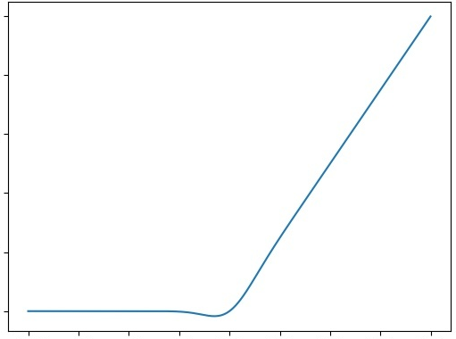
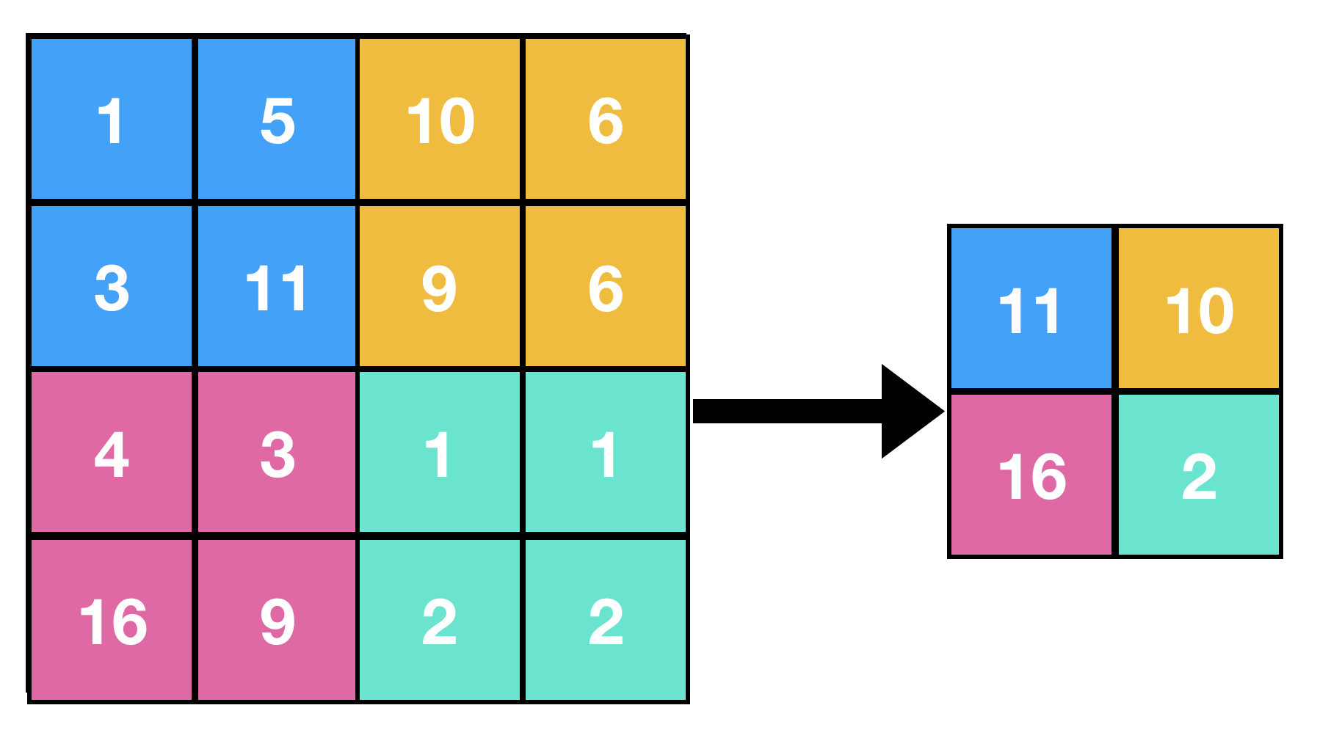
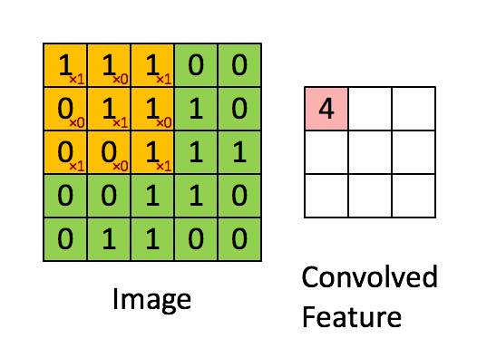
Feature Learning (Convolution Neural Network)
Shower
Image
Full-connected
Pooling
Convolution
Normalization
Activation Function
Convolution Filter (3 X 3)
Channels = # of filters
Instance Norm
Max Pooling (2 X 2)
1 | 0 | 1
0 | 1 | 0
1 | 0 | 1
10
Gaussian Error
Linear Units function
Output
0
Normalize values per each channel and image
-10
0
10
Input

Slide 12
Classification (Dense Neural Network)
$$p_{e^{±},i}+p_{p^{±},i}=1$$
Activation
Function
Normalization
Softmax
$e^{±}$
$p^{±}$
O O O O O
$$p_{j,i}=\frac{e^{x_{j,i}}}{\sum_{j}{e^{x_{j,i}}}}$$
$$y=xA^{T}$$
$$x is input channels$$
$$y is output channels$$
$$A is a weight matrix$$
Batch Norm
10
Gaussian Error
Linear Units function
Output
0
-10
0
10
Input

Slide 13
Classifier
Channels (C)
Layers (Z) Cells (XY)
Channels=8, (Z=1, XY=1)
Filter (Z=2, XY=5) Stride=(2 X 1)
(C=8, Z=4, X=32)
(C=8, Z=5, Y=32)
(C=8, Z=3, X=16)
(C=8, Z=4, Y=16)
Filter (Z=1, XY=3)
(C=8, Z=2, X=8)
(C=8, Z=3, Y=8)
Filter (Z=1, XY=3)
(Z=2, XY=3)
(Z=2, XY=3)
Z-X Projection
(Channels=1, Z=8, X=72)
Z-Y Projection
(Channels=1,
Z=10, Y=72)
(Z=1, XY=3)
(Z=1, XY=3)
(Z=2, XY=3)
MaxPool
(Z=1, XY=2)
(Z=1, XY=3)
(Z=1, XY=3)
MaxPool
(Z=1, XY=2)
MaxPool
(Z=1, XY=2)
(Z=1, XY=3)
(Z=1, XY=3)
MaxPool
(Z=1, XY=2)
Chaneels=8 for Z-X
72 cells/layer x 18 layers
Z-X Projection
(C=8, Z=1, X=4)
Z-Y Projection
(C=8, Z=2, Y=4)
Average Pool
(Z=1, X=4)
Feature Learning (Convolution NN)
Average Pool
(Z=2, Y=4)
C=20
(8+8+4)
Channels=8 for Z-Y
Z-(YY XX YY XX YY XX YY XX YY)
C=20
Channels=4, (Z=1)
(C=4, Z=8)
C=8
Channels=2
(Z=3)
(Z=3)
(C=4, Z=4)
Channels=4 for Z
C=2
$e^{±}$
$p^{±}$
Z Projection
(Channels=1,
Z=18)
MaxPool
(Z=2)
MaxPool
(Z=2)
Softmax
(Z=3)
Average Pool
(Z=4)
Classification (Dense NN)

Slide 14
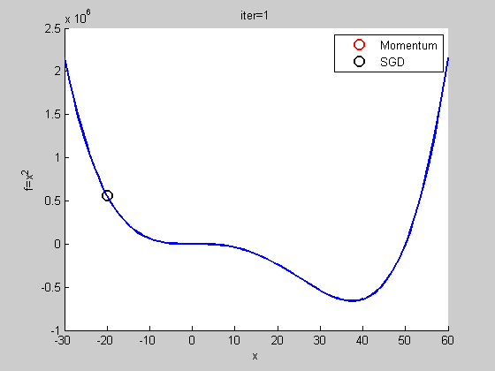
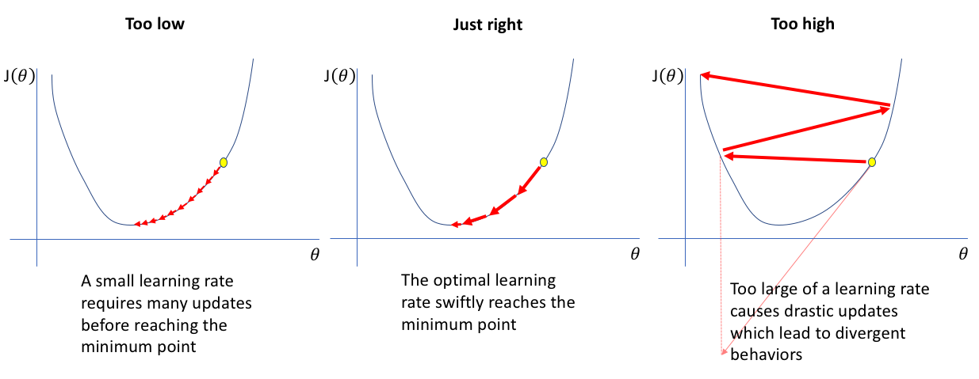
Optimization: Stochastic Gradient Descent (SGD)
$$θ_{s+1}=θ_{s}−\left(η_{s}∙g\left(θ_{s}\right)+m∙η_{s−1}∙g\left(θ_{s−1}\right)\right)$$
$$g\left(θ_{s}\right)=\frac{1}{N}\sum_{i=1}^{N}{∇ℒ_{i}\left(θ_{s}\right)}$$
$ℒ_{i}\left(θ_{s}\right)$: loss value of sample $i$ at step $s$
$g\left(θ_{s}\right)$: gradient at step $s$
$θ_{s}$: model parameters at step $s$
$η_{s}$: learning rate at step $s$
$m$: momentum
$N$: batch size
$$ℒ\left(θ\right)$$
$$ℒ\left(θ\right)$$
$$ℒ\left(θ\right)$$

Slide 15
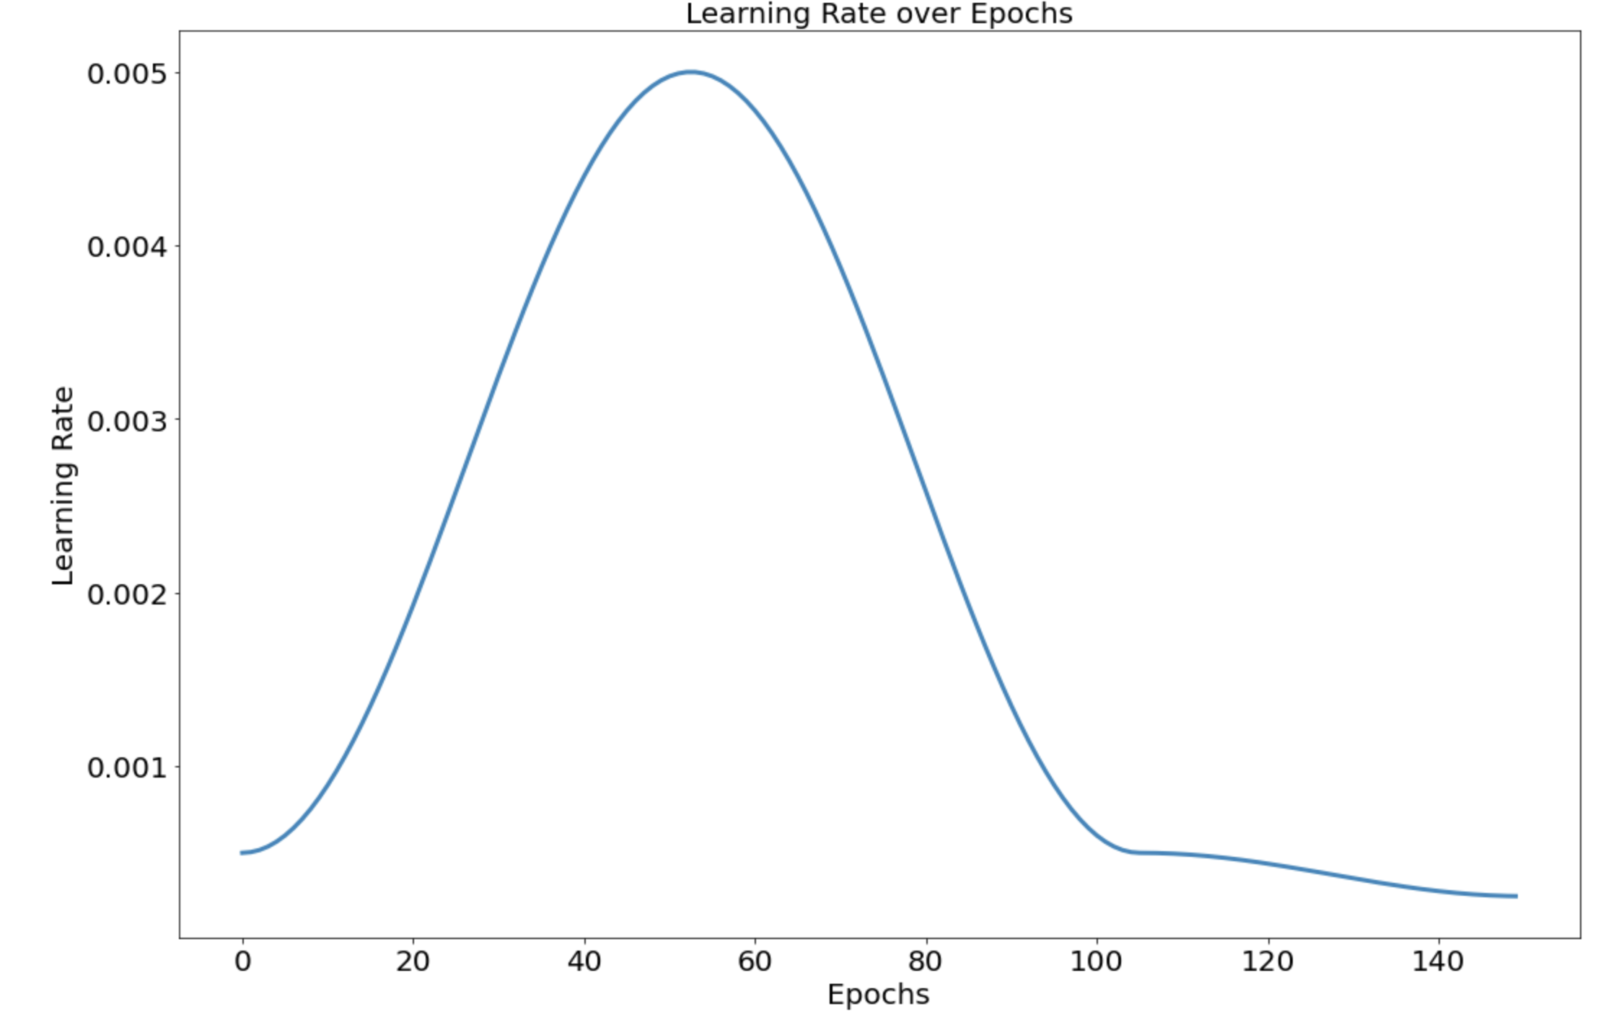
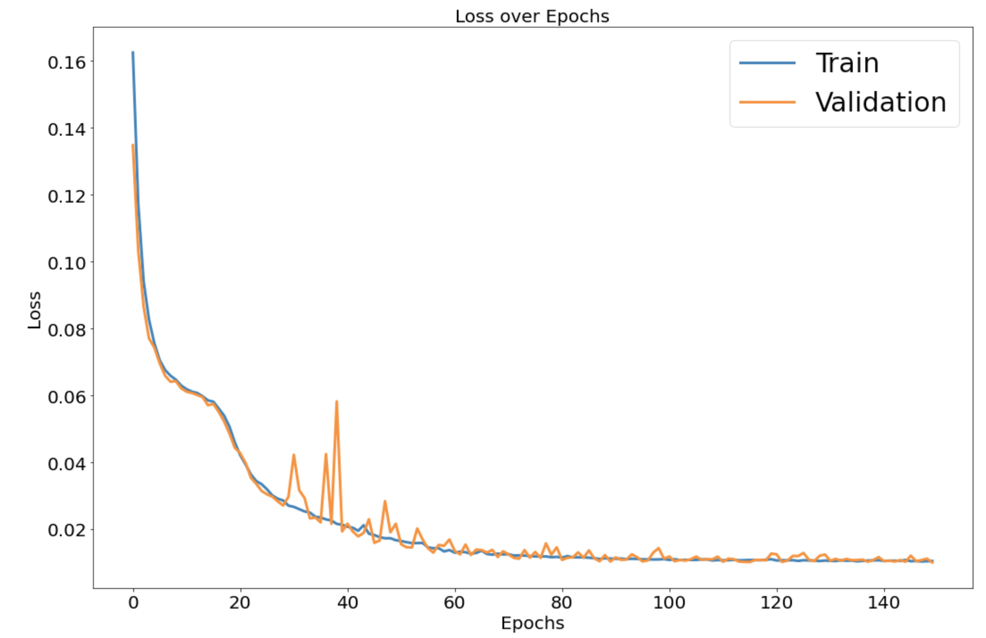
One Cycle Learning Rate Policy
Super-Convergence: Very Fast Training of Neural Networks Using Large Learning Rates (arXiv:1708.07120v3)
Model parameters are initial to random numbers.
The gradient is large in beginning iterations, which causes the gradient to be not smooth enough.
The small learning rate is used in beginning iterations.
The large learning rate is used to accelerate learning.
The final small learning rate is used to converge the minimum loss.
$g\left(θ_{s}\right)≈g\left(θ_{s−1}\right)$
Train images
Test images
warn-up
cool-down
annihilation phase
for large minibatches (e.g., 8k) the linear scaling rule breaks down when the network is changing rapidly, which commonly occurs in early stages of training. We find that this issue can be alleviated by a properly designed warmup [16], namely, a strategy of using less aggressive learning rates at the start of training.
簡單說就是在一開始訓練模型的時候，模型權重的梯度(或是loss)較不穩定。
有訓練過深度學習模型的讀者應該有發現一開始的loss通常都比較大，然後在慢慢收斂。因為在模型一開始訓練的初始值為隨機生成(可參考weight initialization)的，模型對於訓練資料分布的理解度為零，因此第一個epoch的每次模型更新的時候，每筆資料對於模型來說都是全新的，基本上loss都很大。第一個epoch通常每筆資料都伴隨著有較大的loss(相對就是較大的梯度)，因此較大的梯度使得模型權重每次改變都較大，這樣就容易讓學習一開始就往該筆資料的分佈方向修正，可能導致此筆資料的overfitting，後續要靠data random shuffle和多次訓練才能將資料分布拉回來。

Slide 16
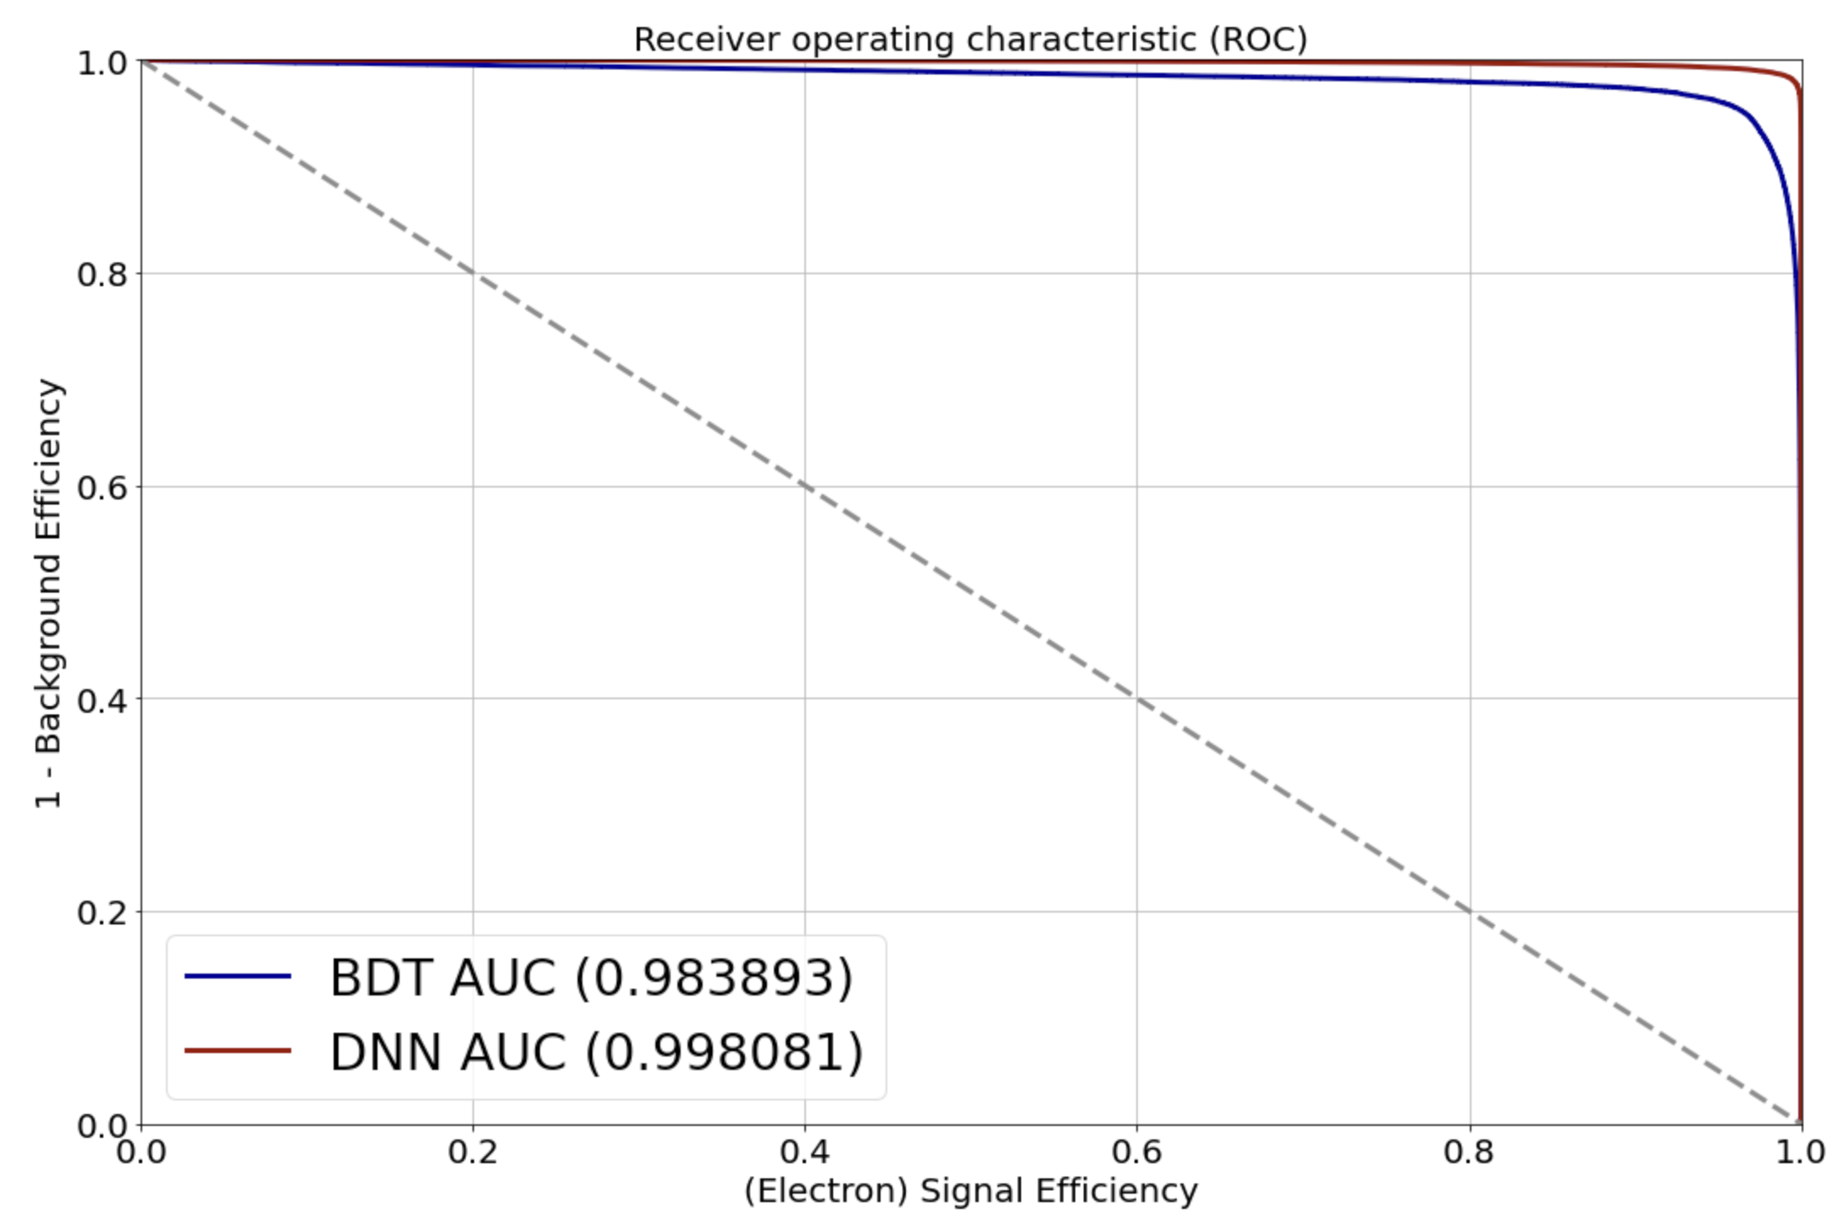
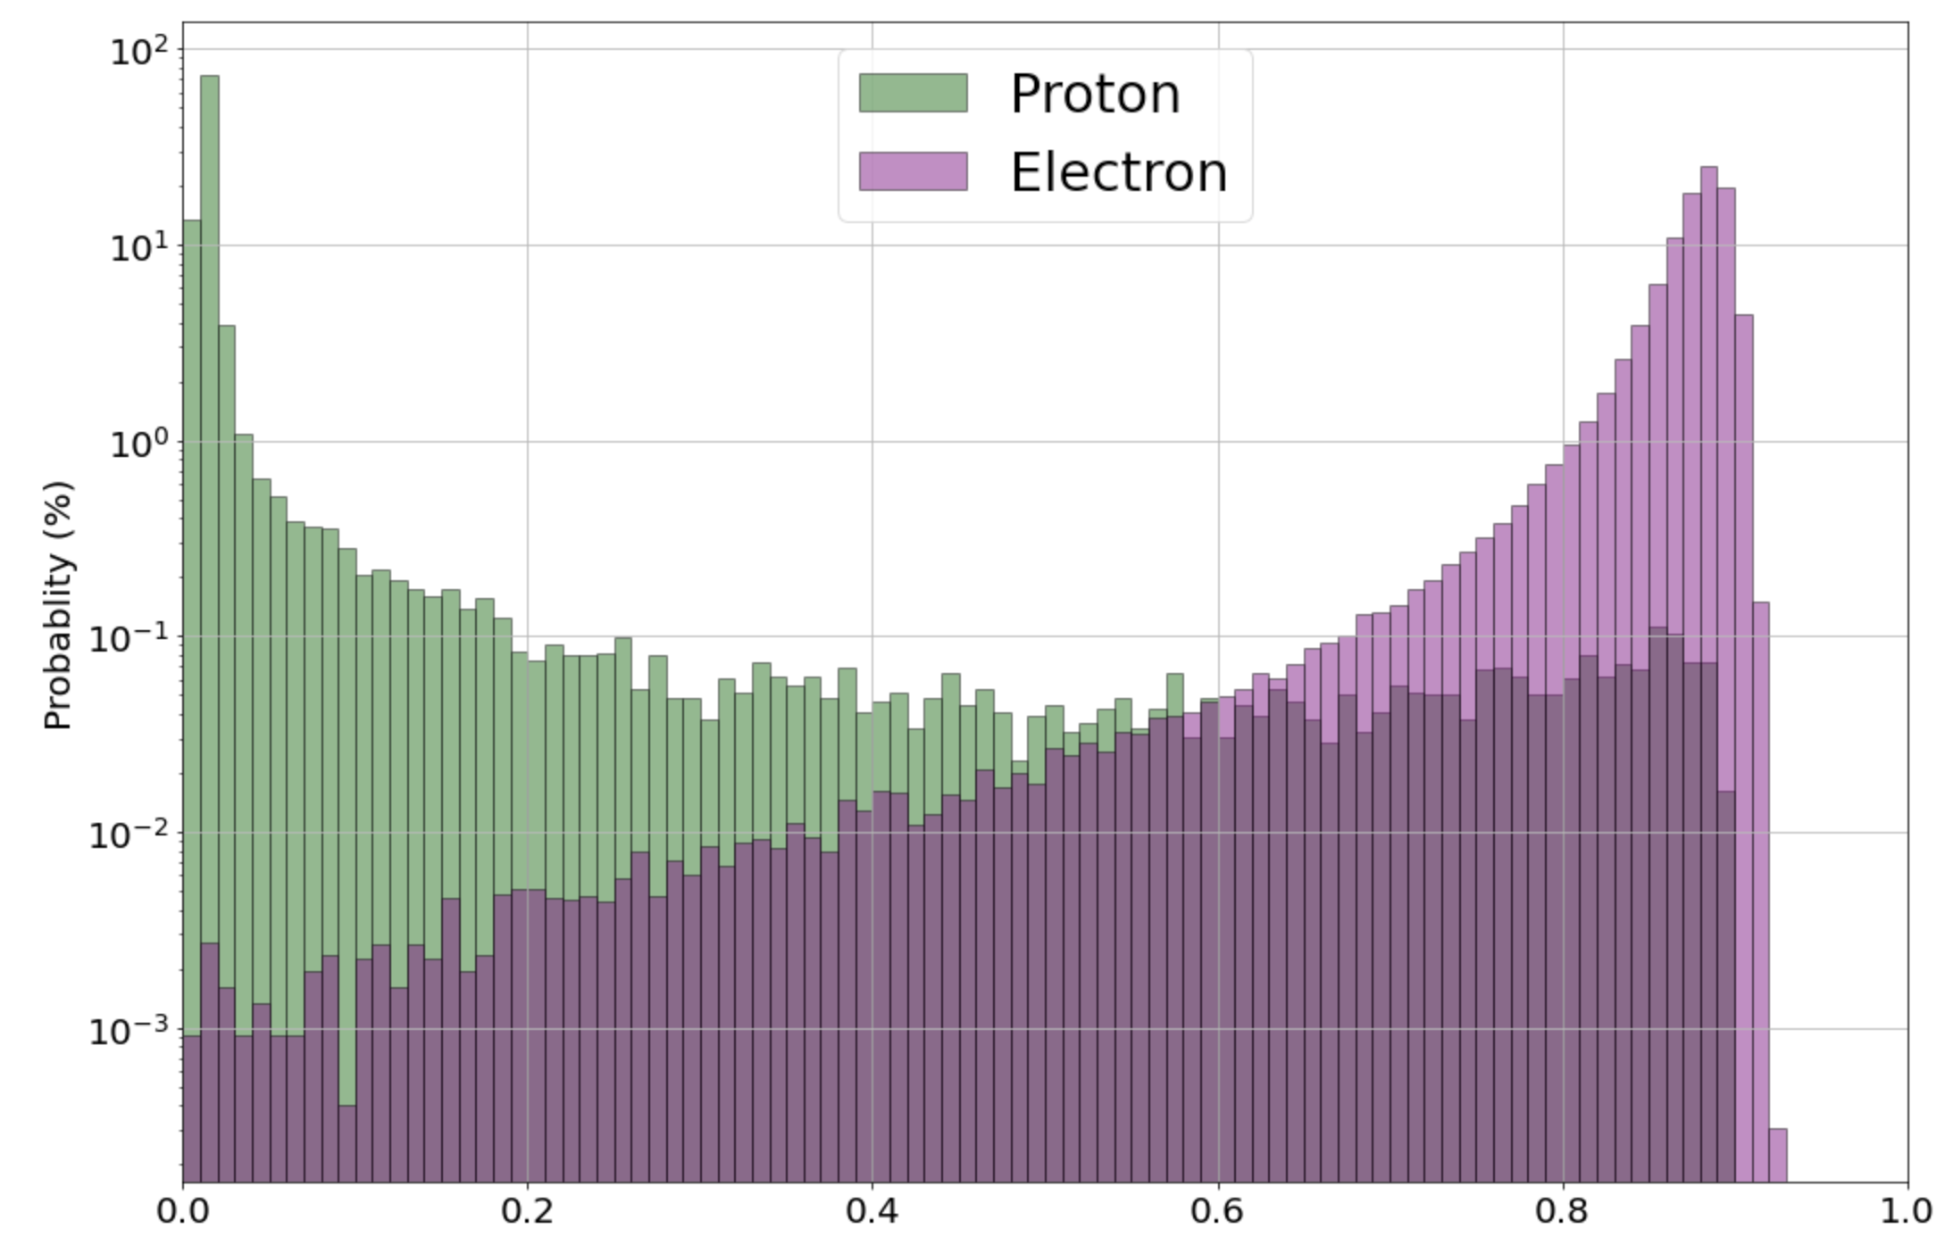
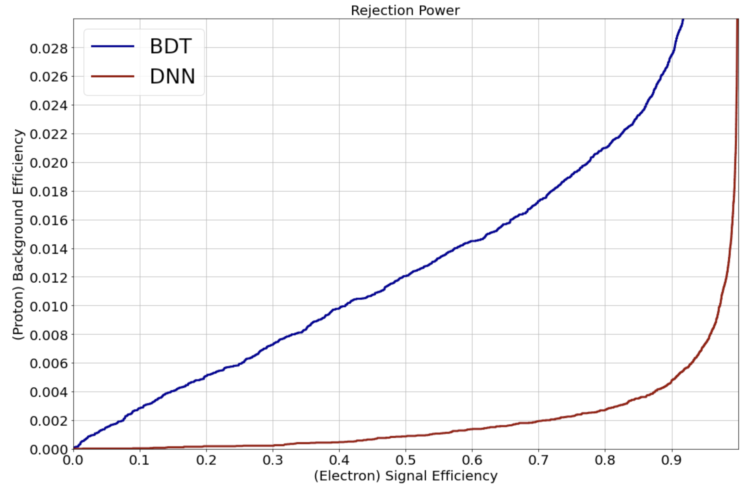
Results and Conclusion
DNN shows 95% signal efficiency at 1% background remaining, and it is better than 40% from BDT.
Deep Learning is useful in the electron identification with AMS-02 electromagnetic calorimeter.
Deep Neural Network (DNN)
40%
95%
1%
$$p_{e^{±}}$$

