Slide 1
Our Support to TiDC
ASGC (Academia Sinica Grid Computing)
Mechanical Parts Production in the workshop of IoP, Academia Sinica:
In 2025, ~ 40 fabrication requests mainly from NTU, NCU and AS.
1,300+ parts produced.
Total cost: ~ NTD 2M
50% covered by IoP, AS and 50% covered by TiDC
Radiation Tests:
Maintain strong collaboration and good relationships with radiation test facilities in Taiwan.
Provide hands-on support and training for research institutes and private companies on planning and conducting radiation tests for electronic components and materials.
Explore and evaluate heavy-ion irradiation test opportunities outside Taiwan to expand testing capabilities.
Completed one heavy-ion radiation test campaign at Texas A&M University in 2025.

Slide 2
TASA’s SERMI Project Radiation Monitoring in Space
Chih-hsun Lin
Institute of Physics, Academia Sinica
Taiwan

Slide 3
Goal of SERMI
Space Mission trends:
Build smaller satellites with less resources but maintain high performance
The use of commercial parts (COTS) in current space missions has become unavoidable.
Radiation testing is essential to ensure mission success and reliability.
How to use (limited) radiation test data to
predict in-orbit performance (failure rate)
Notes:
Not a particle detector.

Slide 4
Goal of SERMI
Establish and Verify correlations between
Ground radiation test results and SEE measurements of
modern ICs in space.
Link the in-orbit observation with ground test data.
Space Radiation measurement with reasonable precision.
Particle fluence above large LET value [ ~ few MeV*cm²/mg]
Total dosage measurement up to at least 5-10 krad (> 3 years)
A small space radiation monitoring instrument/design suitable for all kinds of missions.
Individual payloads
Part of satellite electronics
Minimum resource requirements.

Slide 5
Design Solution
Particle fluence detector ↓ Random-access memory (RAM)
TID detector ↓ Devices (MOSFET) built by the CMOS process.
Many radiation tests are required.
*“The LHC accelerator radiation monitoring system,” J. Proc. Sci. [Online]
*”A New RadMon Version for the LHC and its Injection Lines”, IEEE TRANSACTIONS ON NUCLEAR SCIENCE, VOL. 61, NO. 6, DECEMBER 2014

Slide 6
SRAM Selection and Qualification
The parallel bus Static RAM was selected:
Straightforward upset identification and recovery.
Simplest address decoding and R/W logics. Upsets in the address decoder could be ignored.
Wide availability of commercial devices.
Three 1Mbit SRAMs with different part numbers were selected initially for the qualification.
Qualification criteria:
No SEL observed in the proton beam tests.
Low SEL cross-sections.
Sufficient SEU cross-sections but low enough to avoid double bit flips.
200 MeV
Proton beam tests
Heavy Ion
Beam Test
15 MeV - 150 MeV
Proton Beam Test

Slide 7
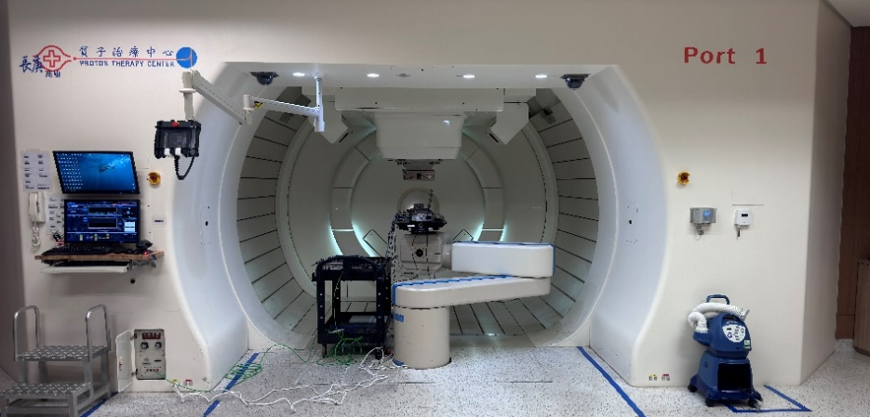
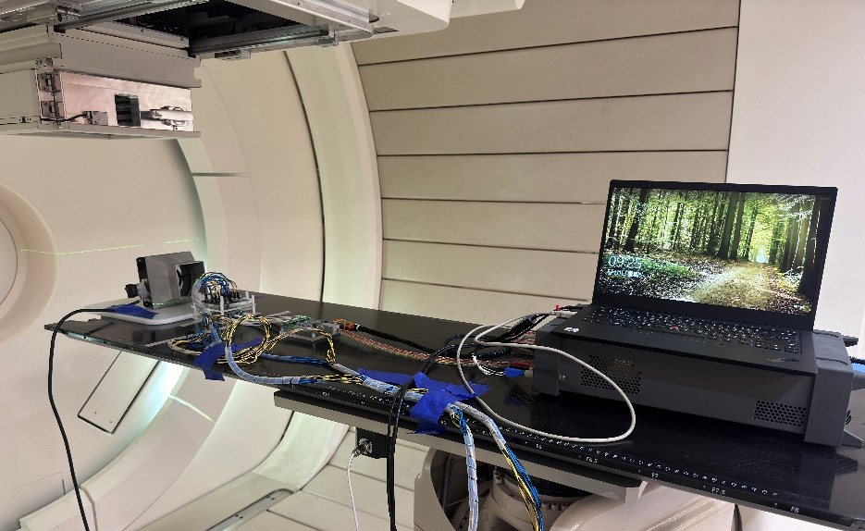
200 MeV Proton Beam Test
Kaohsiung Chang Gung Memorial Hospital, Taiwan
200 MeV Scanning Proton Beam (10 cm x 10 cm)
Three different fluxes
4.54x10⁷ p/(cm²*sec)
3.03x10⁷ p/(cm²*sec)
8.32x10⁷ p/(cm²*sec)
Total Fluence=2.78x10¹¹ p/cm² Total Dose = 16.15 kRad

Slide 8
SRAM SEE Detection Method
Single Event Latch up (over current):
Current limit protect by the power supply
Continuous current monitoring for SEL detection.
Manual power switch
Single Event Upsets:
Test pattern = “11110000” for all addresses
After the initialization, the continuous dynamitic SEU test loop is
Read  Compare  Write

Slide 9
SRAM Proton Test Results
4.54x10⁷
3.03x10⁷
8.32x10⁷
Only one type [SRAM#C] met requirements, No SEL observed.
Average SEU Cross-sections at 200 MeV: σ(01)=3.19±0.31 x 10⁻⁷cm²/chip, σ(10)=4.63±0.37 x 10⁻⁷cm²/chip

Slide 10
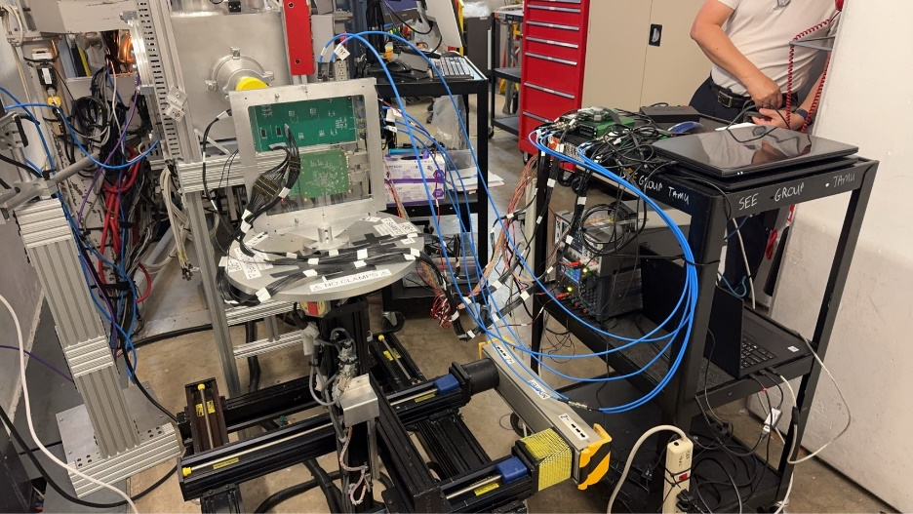
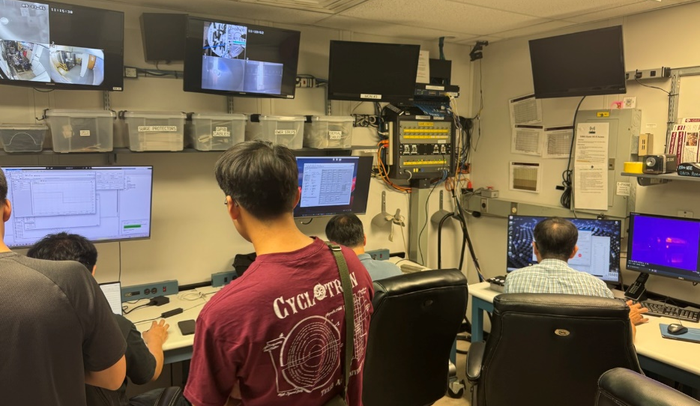
Heavy Ion Beam Test
Radiation Effects Facility in TAMU Cyclotron Institute, USA
Beam Energy = 24.8 MeV/u
5 test boards (10 SRAMs in total) were tested.
Four to Six SRAMs were verified at each LET value.
Ion Selections
40Ar, 63Cu, 84Kr, 129Xe
LETs values (MeV*cm²/mg) = 5.59, 9.5, 13.3, 16, 19.9, 26, 32, 41.8, 40, 60
SEUs were observed across all tested LET values.
SELs were first observed at LET = 16 MeV*cm2/mg.

Slide 11
SRAM Soft and Hard SELs
Alaways 6.2% of memory bits being stuck at either “0” or “1”
82 mA -> 102 mA for a SEL of one SRAM
No permanent damage was observed.

Slide 12
SRAM Soft+Hard SELs – Weibull Fit and Estimated LEO Rate
σ(x)=A(1-exp{-[(x-x₀)/W]^{S}})
Use OMERE v5.9.1
Orbit parameters:
Apogee = Perigee = 800 km, Inclination = 98º
Cosmic ray model: GCR ISO 15390, Solar minimum
2 mm Al shield
Estimated SEL orbital rate:
Weibull Fit = 0.44x10⁻⁶/day per chip
Worse Case = 6.30x10⁻⁶/day per chip

Slide 13
SRAM SEUs
Excluding samples #1–3, the chip-to-chip variation is about ±25%.
Take: #2-2 as the worse condition. #6-3 as the best condition.

Slide 14

SRAM SEU – Curve Fitting
$$σ\left(E\right)={\left(B/A\right)}^{14}{\left[\text{1−}\text{exp}\left({−0.18y}^{0.5}\right)\right]}^{4}$$
$$\text{y}\left(E\right)=\left(E−A\right){\left({18}/A\right)}^{0.5} \text{if} \text{E}>A$$
σ(x)=A(1-exp{-[(x-x₀)/W]^{S}})
Proton beam tests at low energies are planned.
Worse
Mean
Best
A = 15 MeV (assumption)
B = 39.0 calculated from measurement.

Slide 15
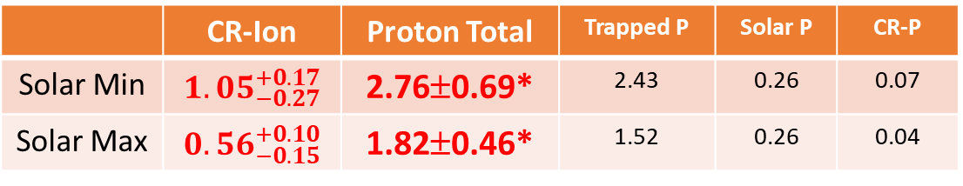
SRAM SEUs – estimated LEO Rate
Use OMERE v5.9.1
Orbit parameters:
Apogee = Perigee = 800 km, Inclination = 98º
Models:
Trapped Proton : AP8
Solar Proton : ECSS 10-04
Cosmic Ray : GCR ISO 15390
2 mm Al shield
Estimated SEU orbital rate (/device/day):
Sufficient to make the ground-space correlation.
Good for the monitoring of long-term variations and solar events. The sensitivity is improved by multi chips and missions.
 | CR-Ion | Proton Total | Trapped P | Solar P | CR-P
Solar Min | $${1.05}_{−0.27}^{+0.17}$$ | 2.76±0.69* | 2.43 | 0.26 | 0.07
Solar Max | $${0.56}_{−0.15}^{+0.10}$$ | 1.82±0.46* | 1.52 | 0.26 | 0.04
*Assume 25% chip-to-chip variations for Proton SEU

Slide 16
TID Sensors
VT01 from Varadis
MOSFETs with 400 nm oxide thickness MOSFETs.
Two MOSFETs in one package.
TID ranges up to 100 krad, Max sensitivity = 0.55 mV/rad (TID dependent).
Require constant 10μA current source and ADC circuits.
One time usage.
FGD-03F from sealicon
Floating Gate (FG) capacitor.
Two sensors in one package.
Integrated IC with an SPI interface.
Rechargeable, Sensitivity ~ 1.5-2.0 mRad
RadNan-XK from 27G
Two sensors in one package.
Integrated IC with an UART interface.
TID ranges up to 10 krad, Sensitivity = 0.1 mRad.
One time usage.

Slide 17
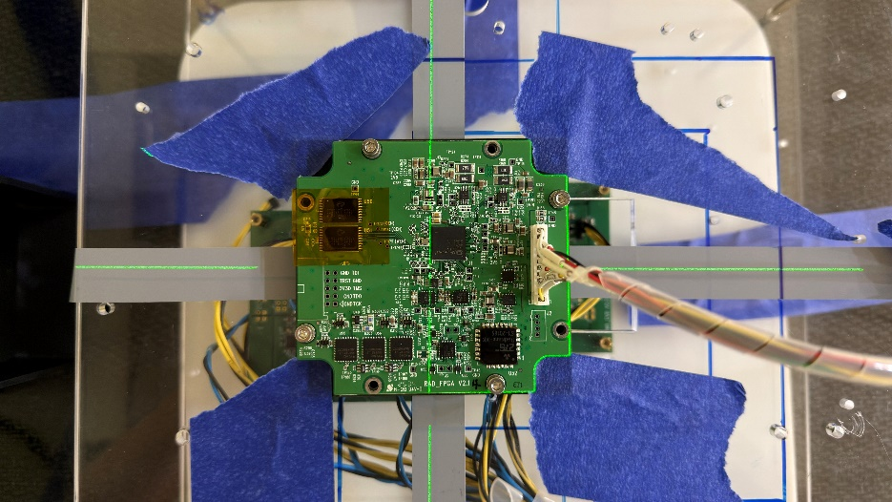
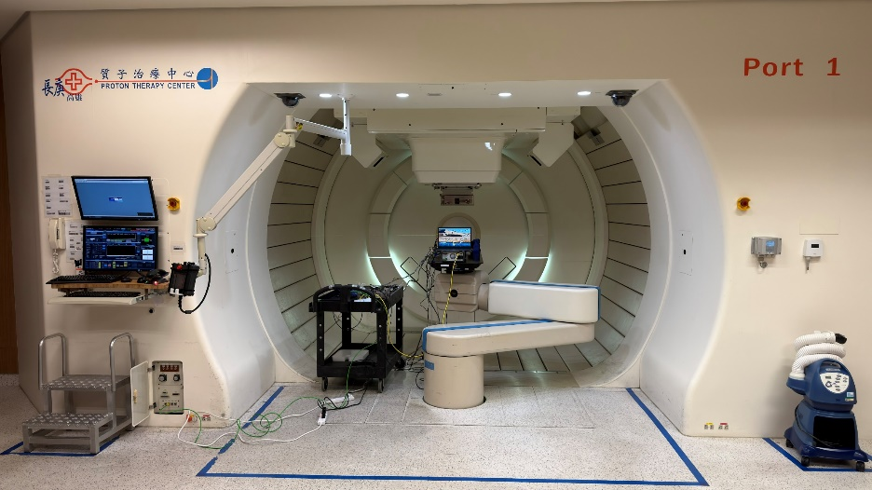
200 MeV Proton Radiation Test
Kaohsiung Chang Gung Memorial Hospital, Taiwan on 2025/11/15.
200 MeV Scanning Proton Beam (15 cm x 15 cm)
53 (49) runs in total Flux = 1.116x10⁷ p/(cm² *sec) Fluence = 5.694x10¹⁰ p/cm²
Total Dose = 3.305 kRad (at least 3-5 years in LEO)
Dose per run = 64.61±2% Rad

Slide 18
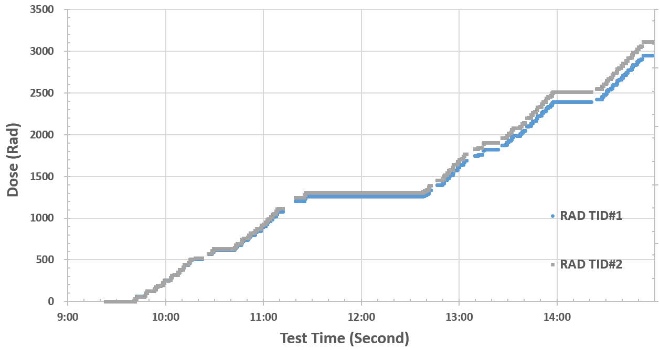
RadNano-XK TID Measurement
30 seconds per measurement
Dose = 64.61±2% Rad per run

Slide 19
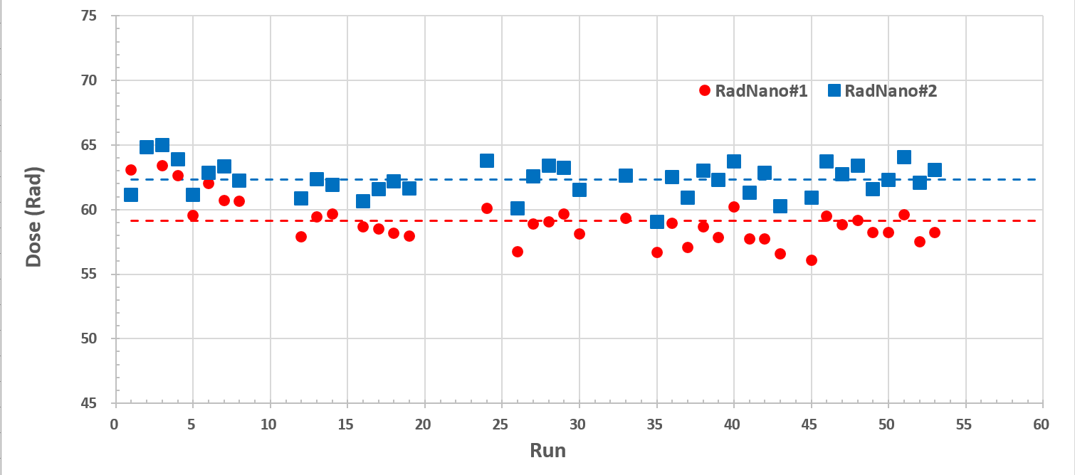
RadNano-XK TID Measurement
RadNano#1 : 59.14±1.91 Rad (92%)
RadNano#2 : 62.32±1.30 Rad (96%)
LSB = 0.1 mRad

Slide 20
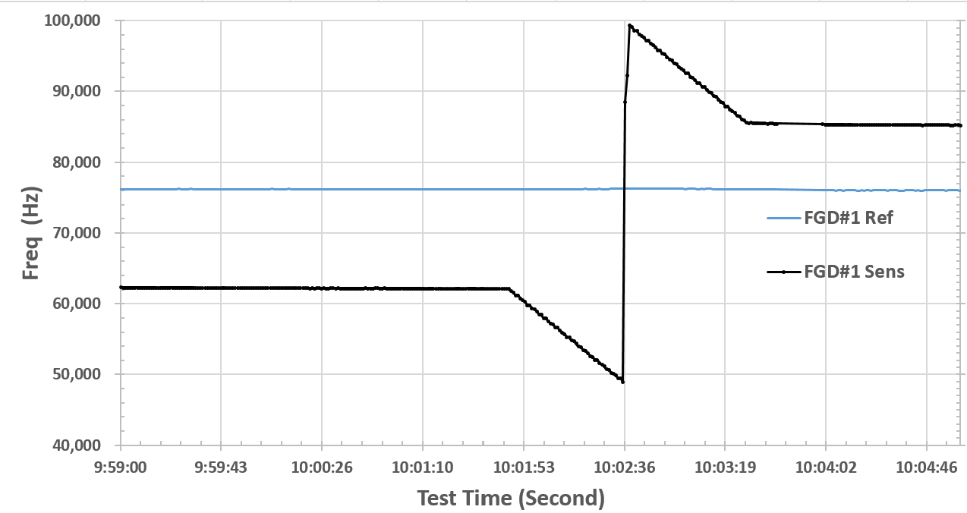
FGD-03F TID Measurement
Target = 90 kHz, Threshold = 50 kHz
Charging time ~ 3 seconds

Slide 21
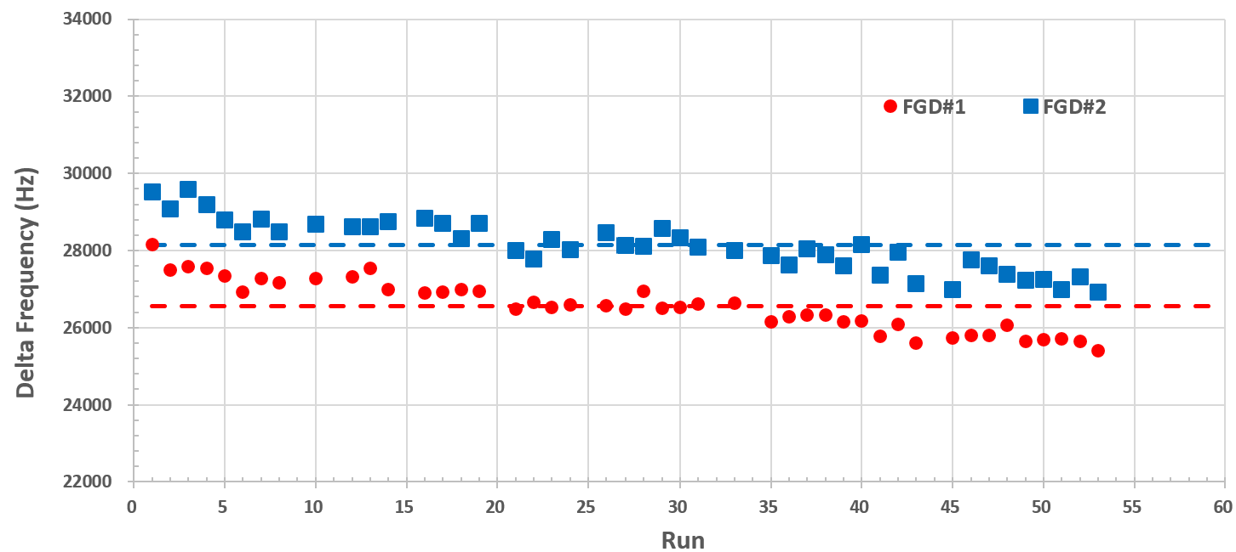
FGD-03F TID Measurement
Dose = 64.61±2% Rad per run
FGD#1: 2.43±0.06 mRad/Hz, FGD#2: 2.30±0.06 mRad/Hz
Additional tests are required to confirm the accumulated dose/dose rate dependence effect

Slide 22
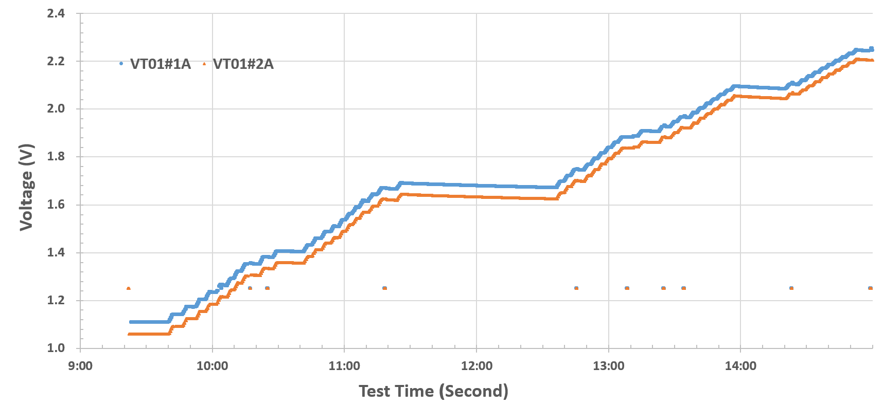
VT01 TID Measurement
Noticeable discharging effects were clearly observed during the measurements.

Slide 23
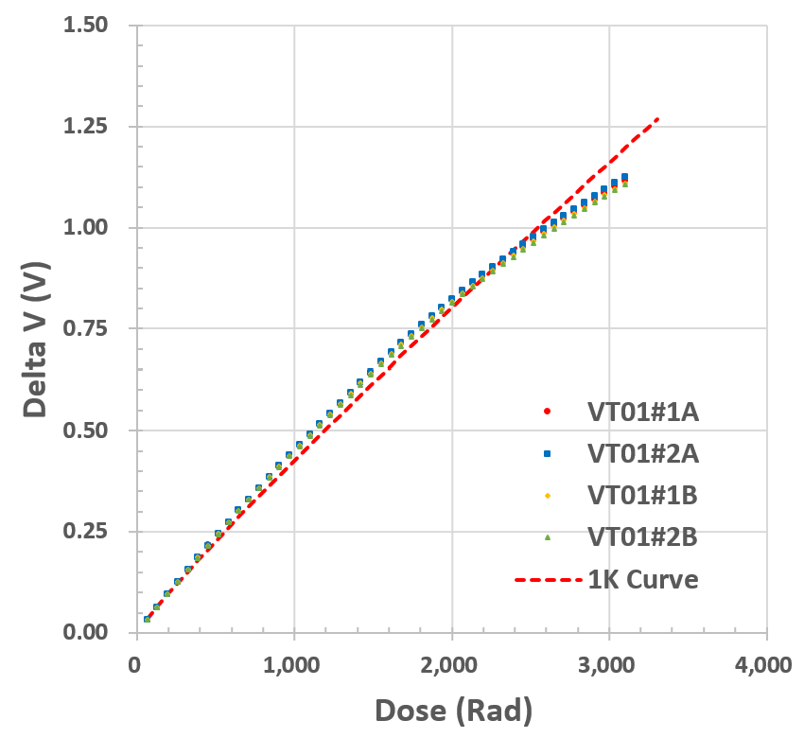
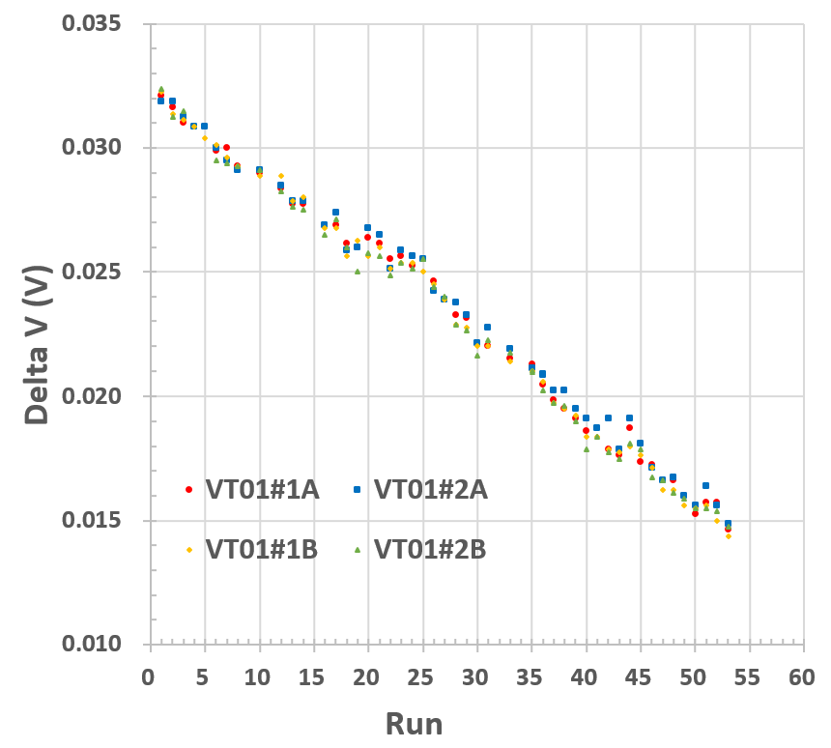
VT01 TID Measurement
Dose = 64.61±2% Rad per run
Sum of ΔV between irradiation
Good agreement with the calibration curve was observed with the non-linear response:
LSB ~ 49.3 mRad at the beginning.
LSB ~ 105.2 mRad after 3.3 kRad irradiation.
Only sensitive to solar events.

Slide 24
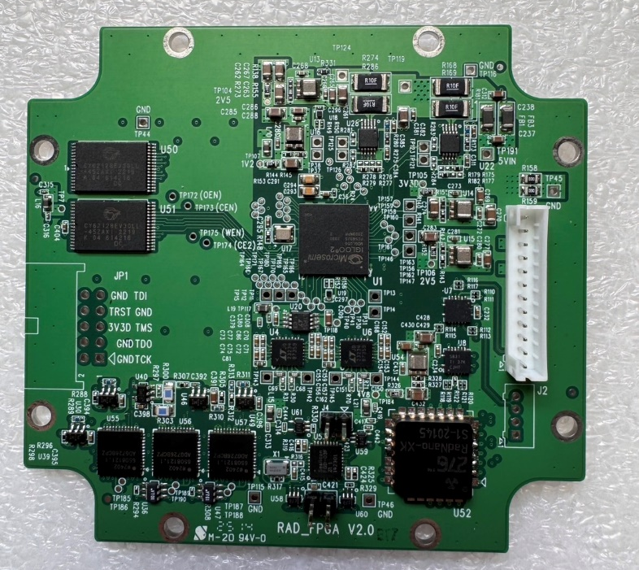
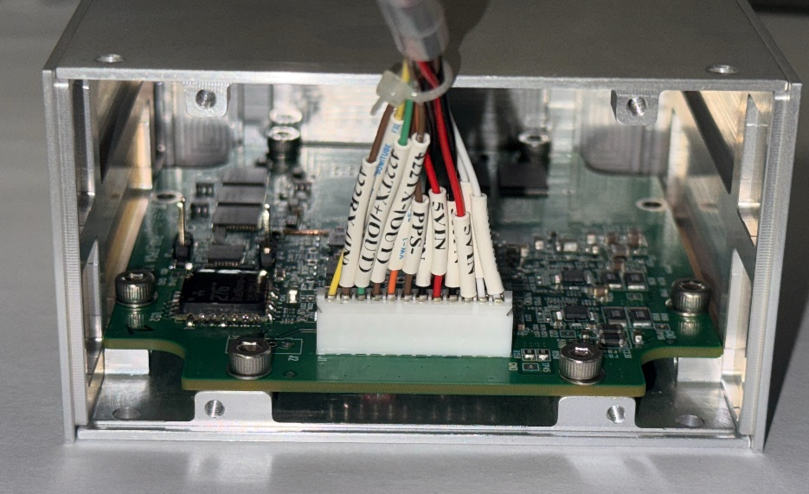
SERMI for CubeSat Missions
10 cm
P & T
Monitor
SRAM
SRAM
FPGA
Power
TMTC
PPS
JTAG
ADC for VT01
RADNano
VT01
FGD
Input power = 15-5V, Average Power = 0.37W
UART with RS422 for TM/TC.
PPS with RS422 for the measurement time.

Slide 25
Summary
The SERMI payload for the CubeSat mission has been completed.
Launch is planned on two CubeSats later this year.

