Slide 1
ZDC crystal part : online monitoring
20251205
Chia-Yu Hsieh On
Behalf on Taiwan ZDC crystal group

Slide 2
Preparation for Next Test Beams
PbWO4 + old SiPM board + CITIROC : reduce noise and test again
  Data analysis (online plot) : Done, Yu-Siang Xiao
  Data and MC comparison : Done, Shao-Yang Lu
  New mechanical support : Undergoing, 朱家聖
  Noise test : Done, Chia-Yu Hsieh
  BM calibration : Done, Kai-Yu Cheng
  CR test : Analysis undergoing, not yet at the level to report (Data taking.)
PbWO4 + old SiPM board + H2GCROC : 1st try to use H2GCROC
  Data analysis (online plot) : Undergoing, Shi-Hong Yao
  Laser test : Undergoing, Shi-Hong Yao
  External trigger from two BM systems : Undergoing, Dr. Che-Sheng Lin (beginning of Feb)
  Mechanical support : Undergoing, 朱家聖
  Radiation source test (End of Feb.)
  CR test : not yet starting (March)
There are reports from the ones labeled blue.

Slide 3
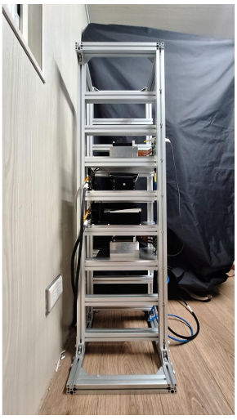
Noise Test of PbWO4 + oldSiPM + CITIROC
Mk4
Data
Laptop
CR test setup @ NCU
BM1/BM2
LYSO/PbWO4
GTM (2*CITIROCs)
UART
Control
Power supply(12V)
BM1/BM2/LYSO/PbWO4 all have several components need to be grounded.
Box for crystal/scintillators
Ground of SiPM board
Ground of GTM board (CITIROC)
Box of MK4 module (data stream)
Box of UART module (slow control)
Support frame
Grounding choices
Negative bias of power supply
Ground of power supply
Ground from the wall
BM1
LYSO
PbWO4
BM2
Best case : noise level to 12 MeV ~ 18MeV
(During 2025 test beam, it was 50 MeV)
Most of them are connected to power supply ground.
Except for MK4 and support frame.
Others are not connected.
We will follow this logic in the next test beam.
How much resolution we can push, thres. 50MeV -> 12/18 MeV? MC test

Slide 4
Plan for PbWO4 + old SiPM + H2GCROC
April
2 pcs SiPM/crystal * (?) => 64 ch
1 H2GCROC, 1 protoboard , 1 Xillinx
2* H2GCROC/protoboard
4* H2GCROC/2*protoboard/Xillinx
We have 3*protoboards and 1*Xillinx now.
In March, we will have +1 Xillinx.
Next version, Carol is coming this year. No
June
4*4 pcs SiPMs per crystal * 6*6 crystal = 576 ch
576 ch / 128ch ~ 5 protoboards => 3 Xilinxs
128*4 (6*5 arrarys) ~ 4 protoboards => 2* Xilinx (borrow 1 protoboard)

Slide 5
BM Calibration
Add one more BM?
Wrap scintillator bar?
Energy loss : compare MC and calculation
Mechanical support : reduce material (use tape?)

Slide 6
Mechanical Support

