Slide 1
Weekly meeting
Yu-Siang Xiao (蕭宇翔)
2026 01/30

Slide 2
The Fast Online Monitoring Program
Signal convert to ADC in ROC
Data stream
Notebook: LabView saving Data and some online monitoring graph
Auto upload to NAS and Drive

Slide 3
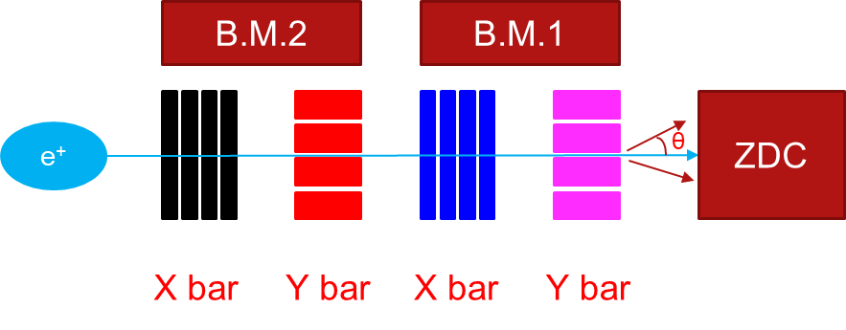
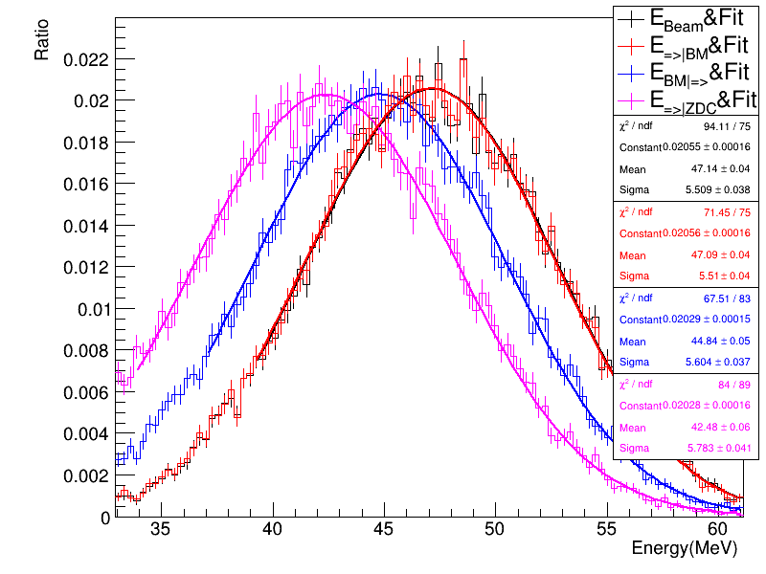
Energy Spectrum of positron
The momentum spectrum in difference slice of path @ 47.MeV.
The beam going to B.M. is almost not loss the momentum.
After pass through the B.M. momentum loss around 5.7%.
The moment going to crystal loss ~ 10.8% momentum.
E_{Beam}
E_{=>|BM}
E_{BM|=>}
E_{=>|ZDC}
Slice | P(MeV) | σP(MeV) | Loss (MeV) | $\frac{Loss}{Ebeam}$(%)
E_{Beam} | 47.15(4) | 5.52(3) | - | -
E_{=>|BM} | 47.10(0) | 5.43(2) | 0.05(4) | 0.1(1)
E_{BM|=>} | 44.45(3) | 5.69(3) | 2.70(5) | 5.7(1)
E_{=>|ZDC} | 42.05(3) | 5.93(2) | 5.10(5) | 10.8(1)

Slide 4
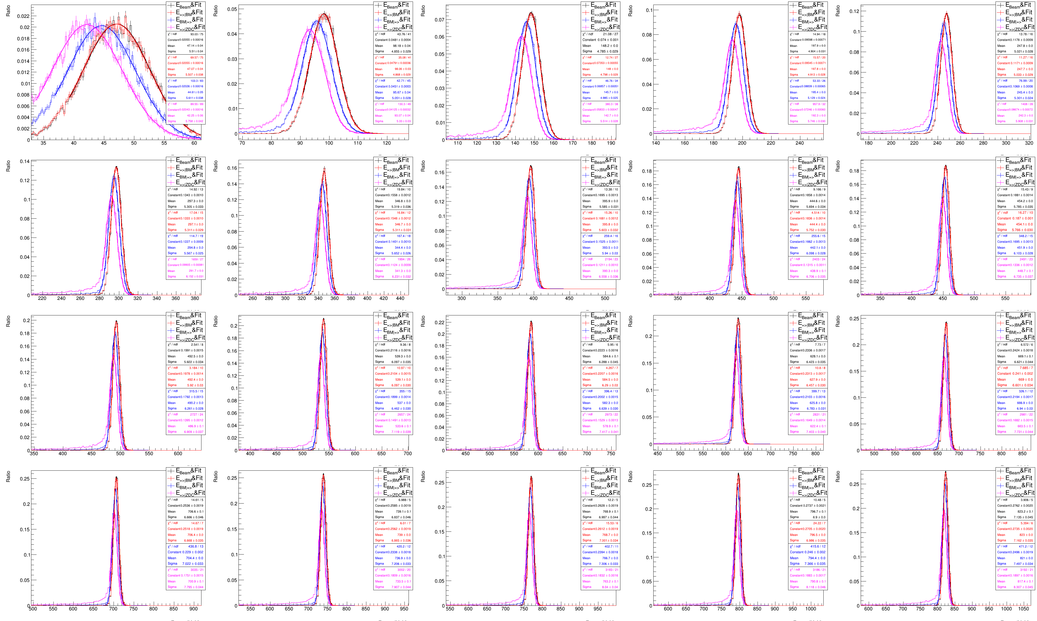
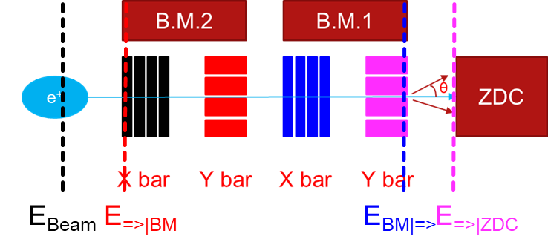
Detail of Eslice fit
Set X Range of Ebeam(x):
X in [0.7Ebeam,1.3Ebeam]
Fit range: base on RMS
[μ-1.5RMS,μ+4 RMS]
The hit ZDC case:
[μ-1.5σ,μ+4σ] fit again.

Slide 5
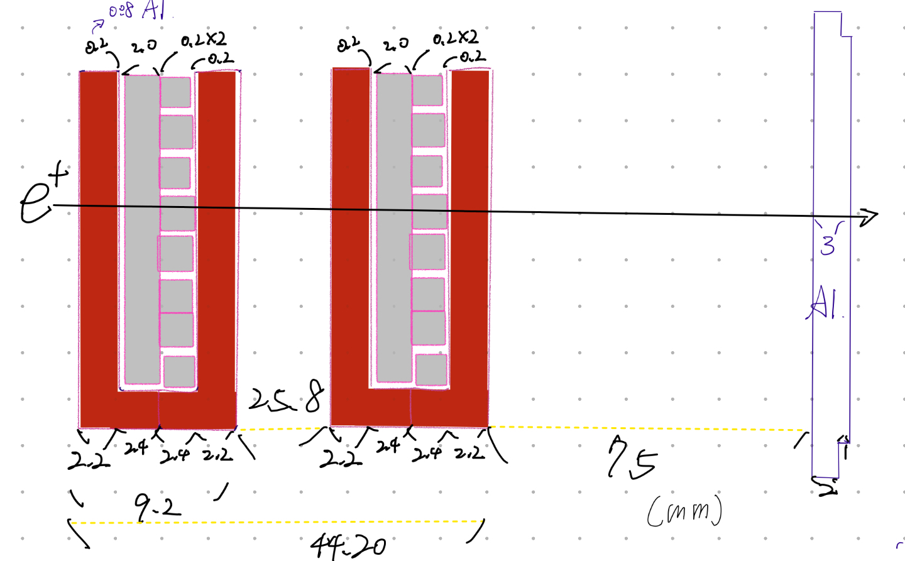
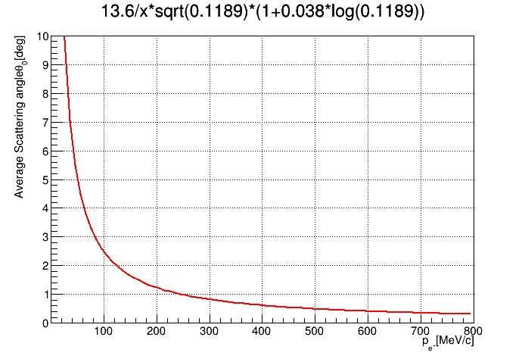
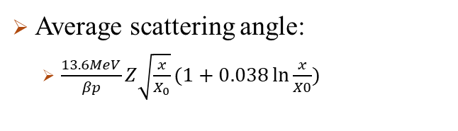
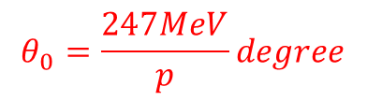
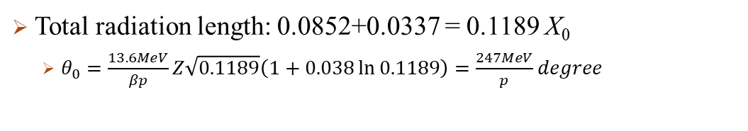
Energy loss before hit ZDC by simple theory
Average scattering angle:
$\frac{13.6MeV}{βp}Z\sqrt{\frac{x}{X_{0}}}(1+0.038\ln{\frac{x}{X0}})$
β = v/c, in position beam ~ 1
p = momentum of particle, ~E
Z is charge of particle = +1
x/X₀ = material thickness normalize by radiation .
The material on the Path
material | X₀(mm)
Teflon(C²F⁴_{n}) | 155
Aluminum(Al) | 88.9
Plastic Scintillator | 424
Material | Tef | AL | PS | AL | PS | AL | Tef | x2 B.M. | Shell-AL
Thickness (mm) | 2.2 | 0.08 | 2.24 | 0.16 | 2.24 | 0.08 | 2.2 | - | 3
x/X₀ | 0.0142 | 0.0009 | 0.0053 | 0.0018 | 0.0053 | 0.0009 | 0.0142 | Sum = 0.0852 | 0.0337
Total radiation length: 0.0852+0.0337 = 0.1189 X₀
$θ_{0}=\frac{13.6MeV}{βp}Z\sqrt{0.1189}\left(1+0.038\ln{0.1189}\right)=\frac{247MeV}{p}degree$
$$θ_{0}=\frac{247MeV}{p}degree$$
p [MeV] | 50 | 100 | 250 | 500 | 800
θ₀ [degree] | 5.0 | 2.5 | 1.0 | 0.5 | 0.3

Slide 6
HTML convertor for single file I/O
We need to download all the directory, .html, and graphs to observe the run data.
Not useful to transfer the file!
Convert HTML file which the url-link graph into a MIME HTML(.mthml).
By downloading only the .mhtml file, we can observe the run data, now.
With the auto upload system, our group could access by the Drive.

Slide 7
☹ data8 crash
I use some cache to rescue my code, but some code couldn’t operation, now.
The almost data and even some run table is take a vacation…
Maybe, I can to download the raw data backup from the OneDrive.

