Slide 1
Geant4 simulation and data comparison
Shao-Yang Lu

Slide 2
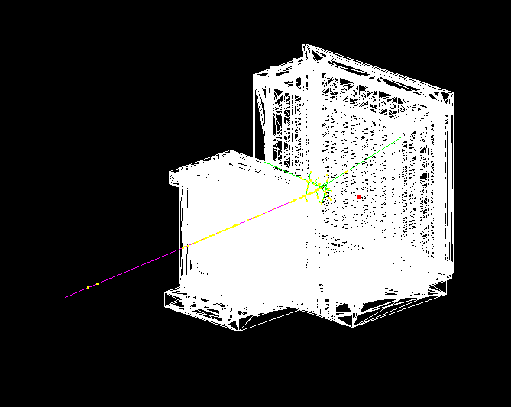
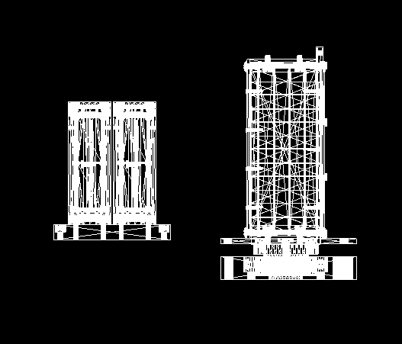
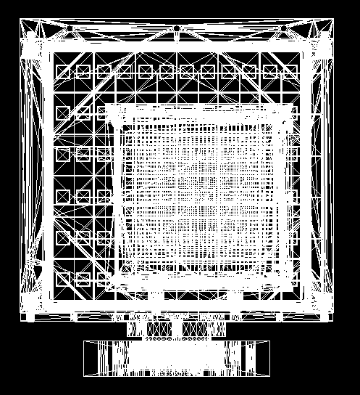
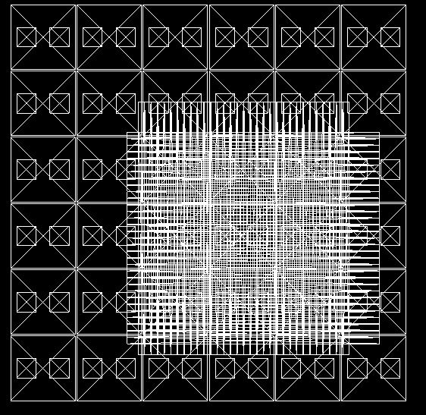
Simulation setup
Beam Monitor
y
z
PbWO4 array
Event display
Side view
y
Origin
x
Front view
Front view with only crystals & bars

Slide 3
Simulation setting:
Beam setting:
50MeV - 796MeV positron … note 440e-2
X: Gauss random(-2, 14.1)*mm Y: Gauss random(8, 8.93)*mm θ: 5° uniform random φ: 360° uniform random
Geometry:
Beam Monitor composed by scintillator bars
EM calorimeter composed by PbWO4 crystal array
Physics list:
FTFP_BERT_EMZ
Optical simulation is off.
Origin
Beam Center

Slide 4
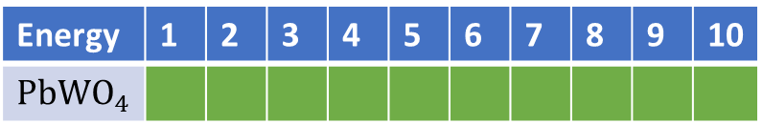
Simulation progress:
50MeV
796MeV
Energy | 1 | 2 | 3 | 4 | 5 | 6 | 7 | 8 | 9 | 10
$${PbWO}_{4}$$
11 | 12 | 13 | 14 | 15 | 16 | 17 | 18 | 19
50MeV - 796MeV positron … note 440e-2
60k events per run
At least 500k events at each energy set is available.

Slide 5
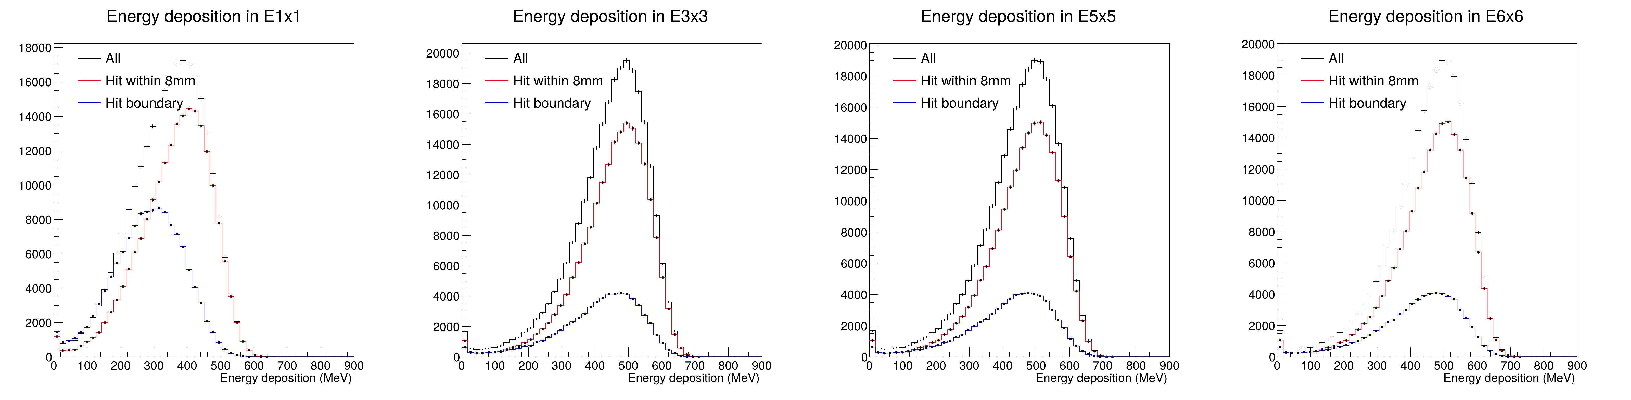
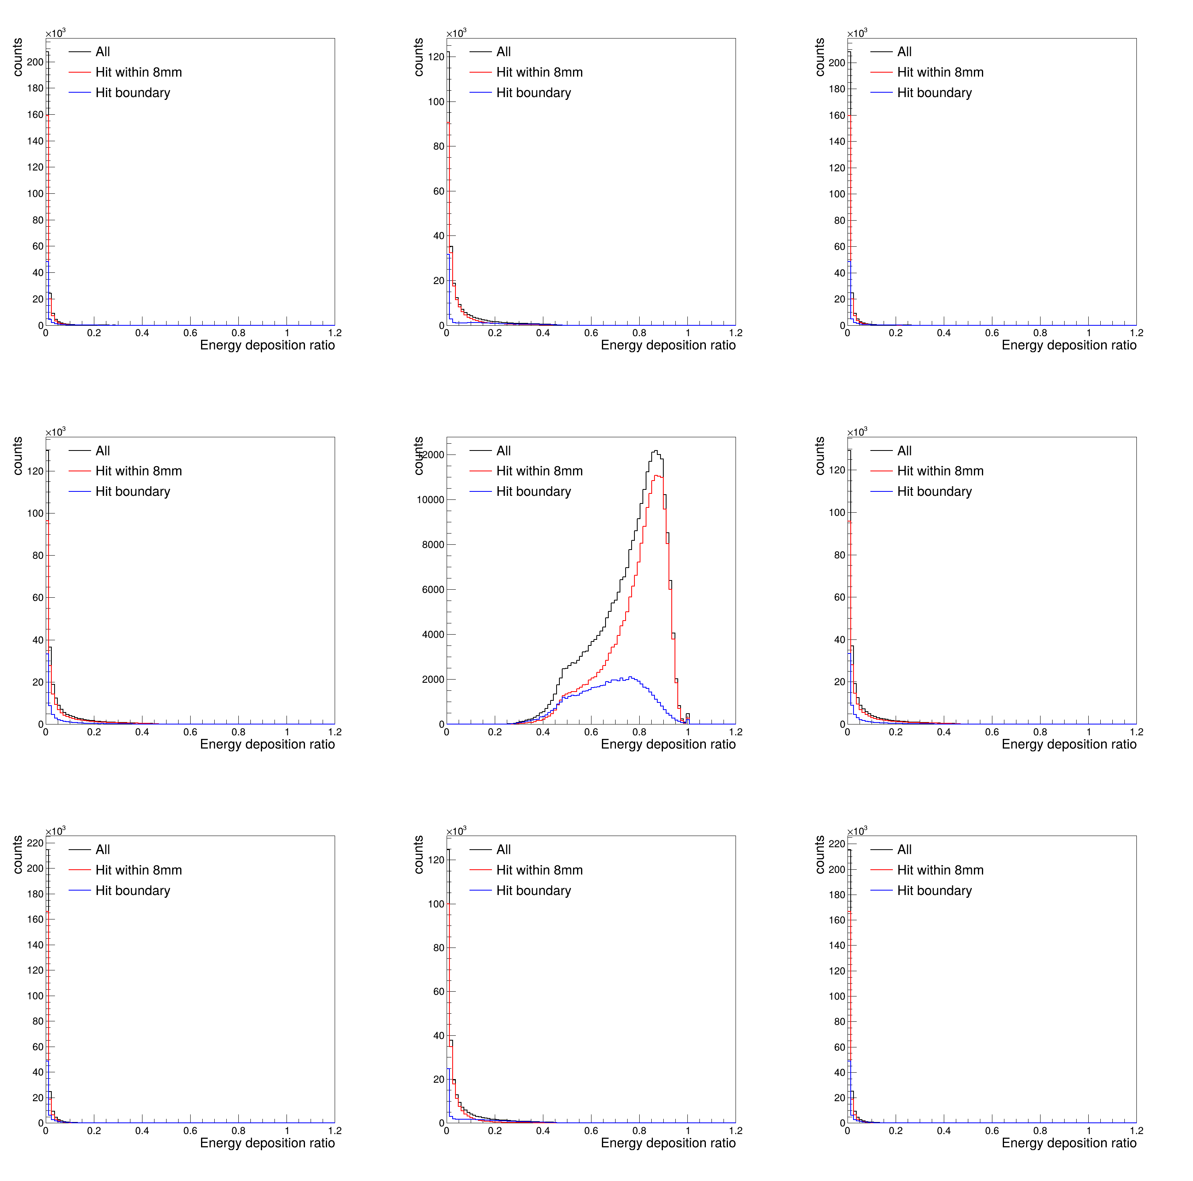
Simulation results
The true position is used to do the boundary selection.
Choosing position hit on most energetic crystal.
16mm
Energy containment in 3x3
20mm
*This page shows is the correct one. The slides shown at Feb 3. are at page 12. Those plots are event-selected which require the true hits on the calorimeter match the Emax channel.

Slide 6
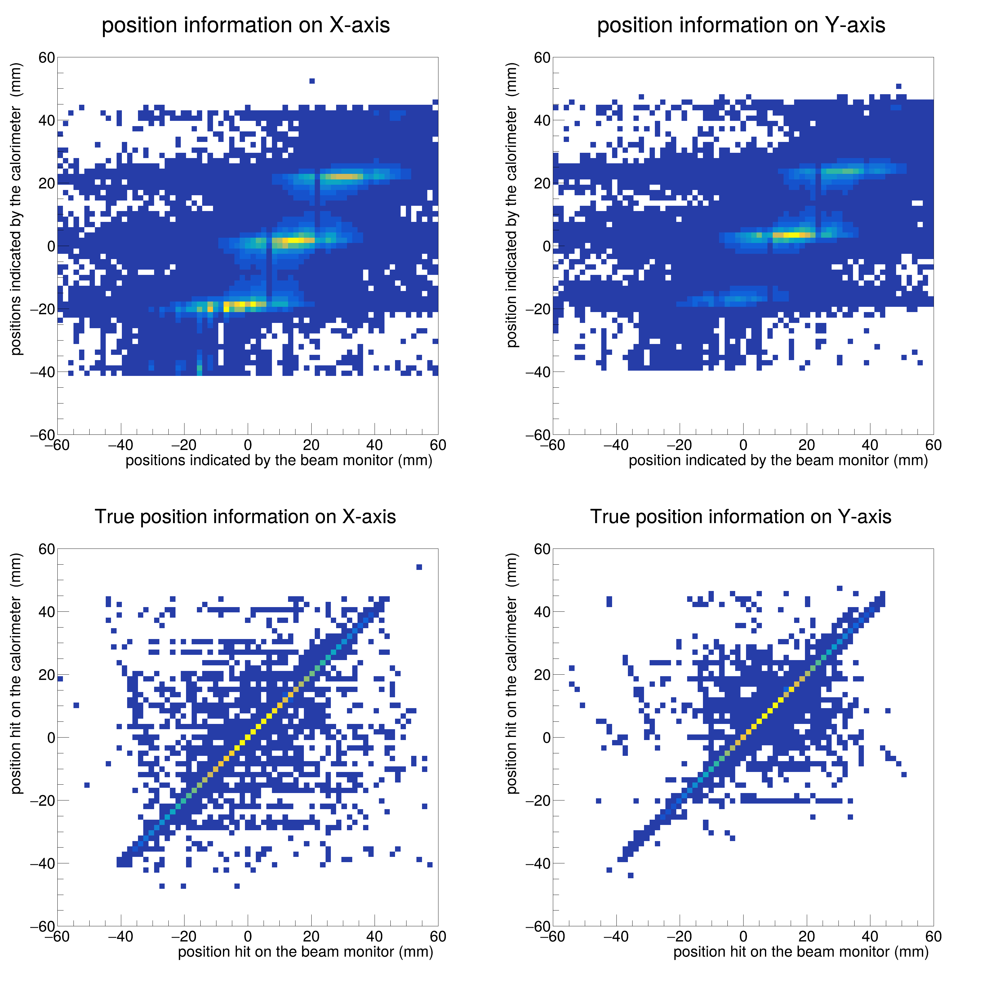
Simulation results
The position indicated by the beam monitor in X and Y have fluctuation at certain position indicated by the calorimeter and might come from the size of the PbWO4 crystal which is 20mm*20mm; while plots with true position are linear relation.
*This page shows is the correct one. The slides shown at Feb 3. are at page 13. Those plots are event-selected which require the true hits on the calorimeter match the Emax channel.

Slide 7
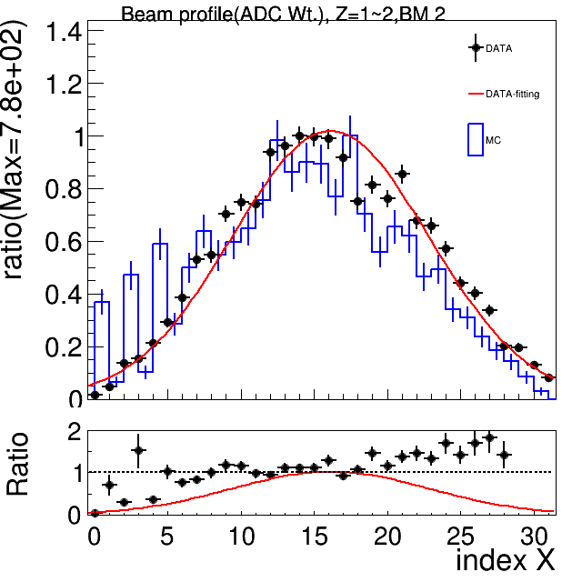
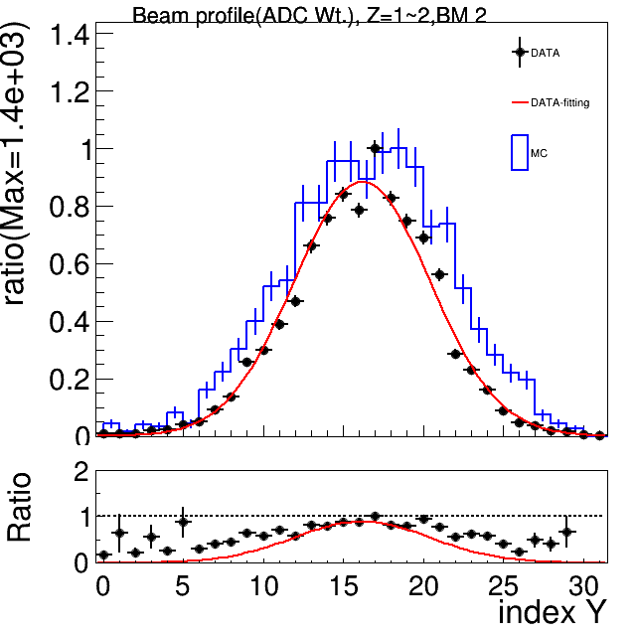
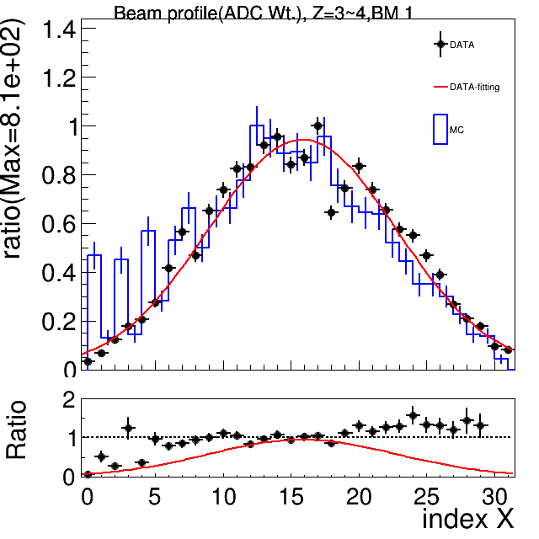
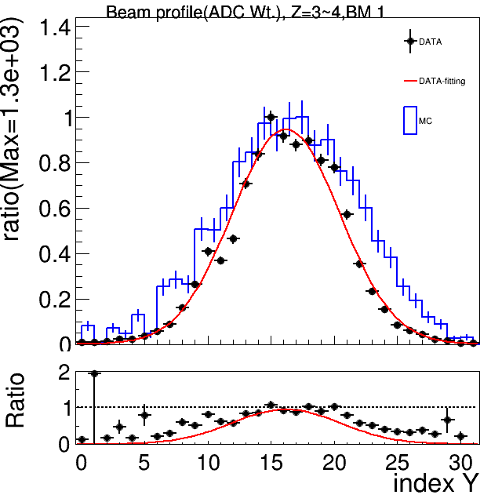
Simulation results and Data comparison
Beam Profile on Beam Monitor

Slide 8
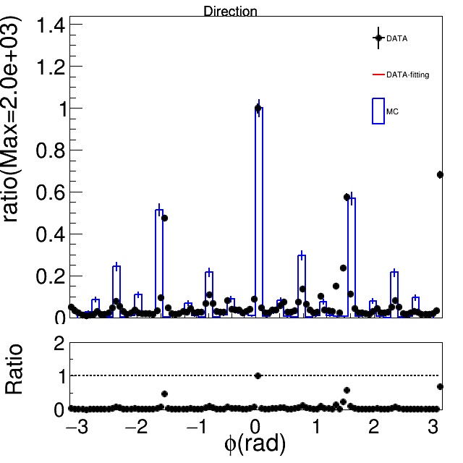
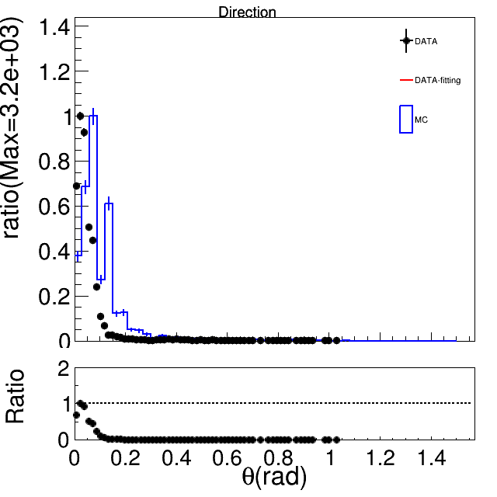
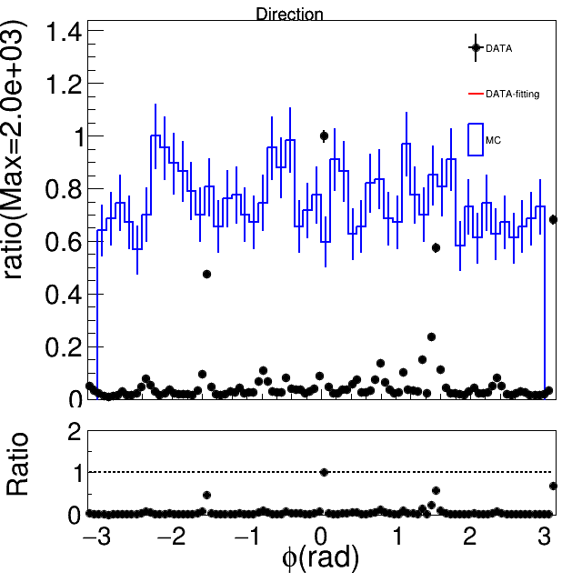
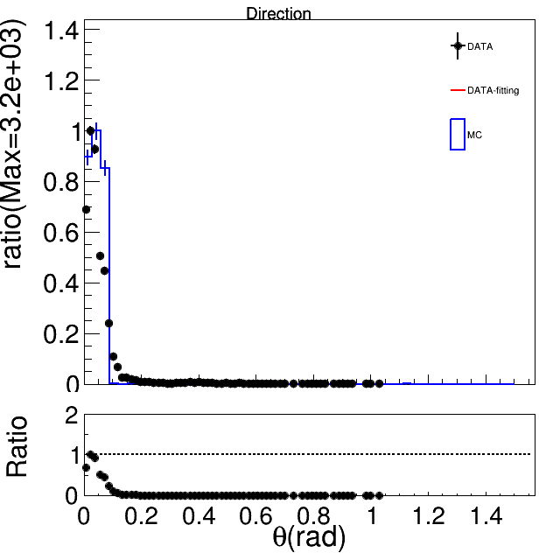
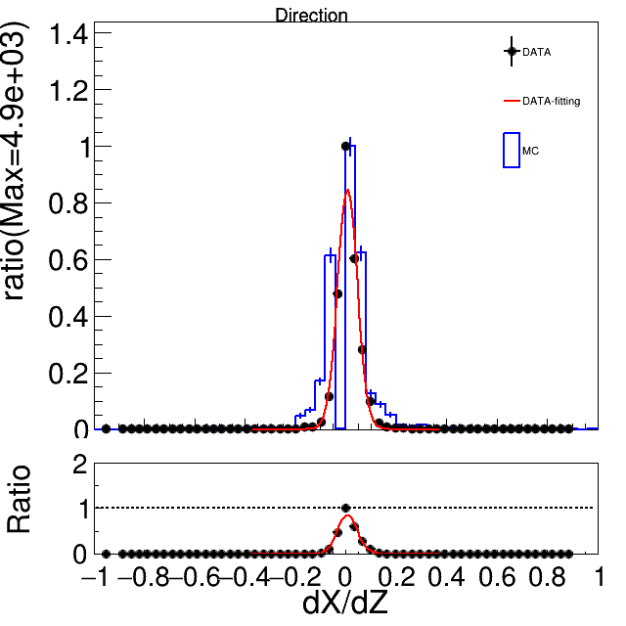
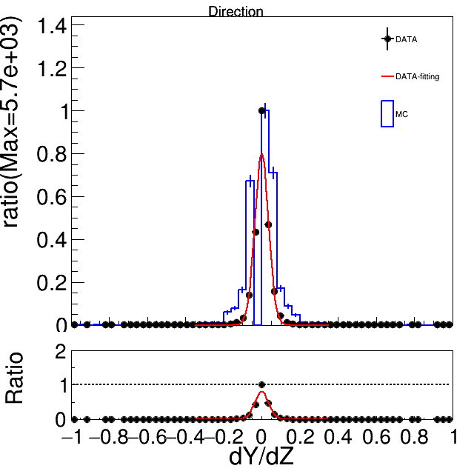
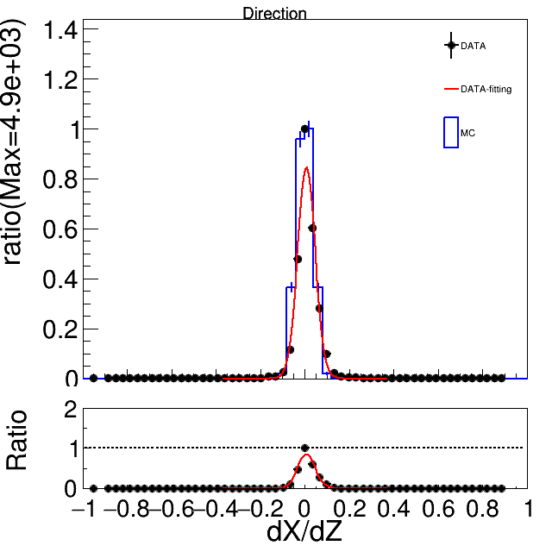
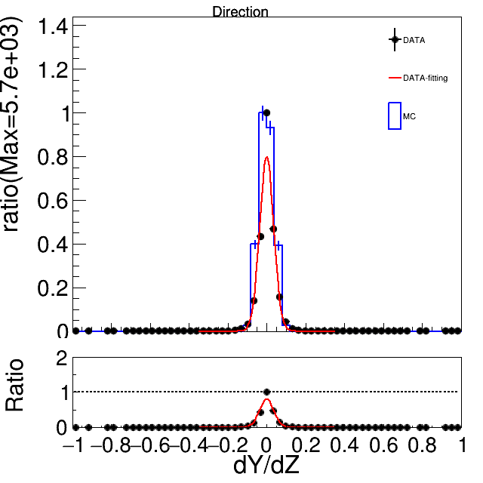
Simulation results and Data comparison
Beam direction reconstructed on Beam Monitor and true direction
MC with Track reconstruction
MC with Track information

Slide 9
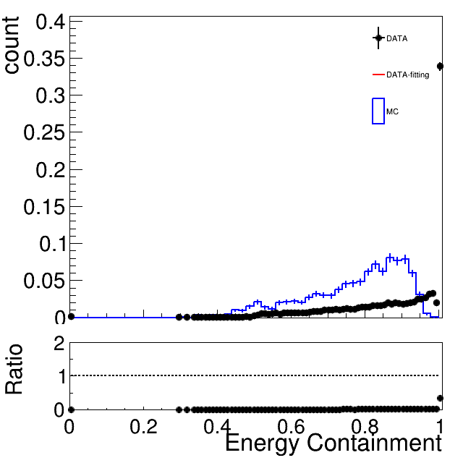
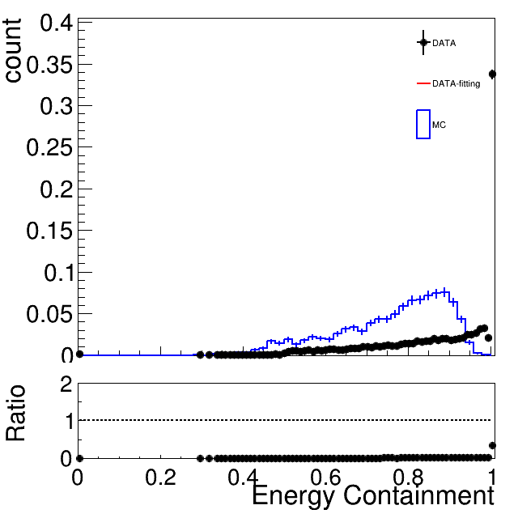
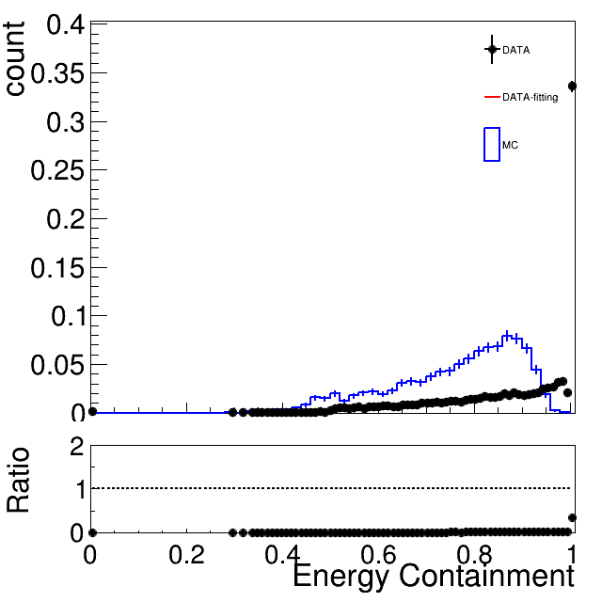
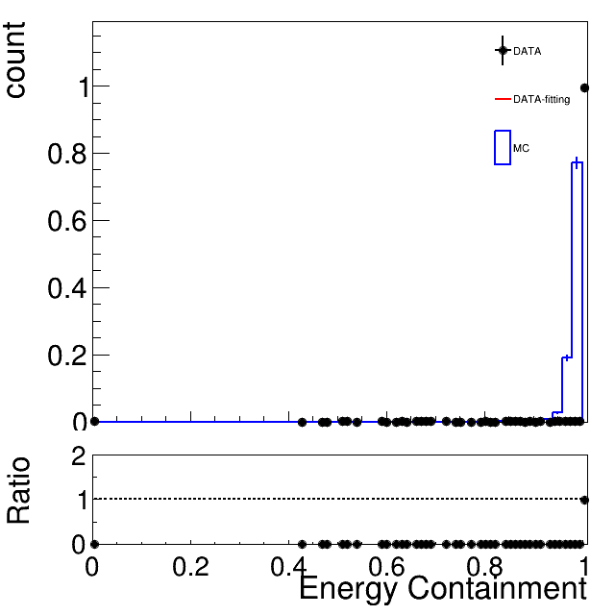
Simulation results and Data comparison
Energy containment on PbWO4 array
E1x1/E3x3
E1x1/E5x5
E1x1/E6x6
E3x3/E5x5
The plots are not look alike. Maybe is the threshold cut on the data not applied to MC.

Slide 10
Summary
The simulation is ready. At least 500k event for each energy set.
Other DATA-MC comparison plots on Yu-Siang’s report are not ready but soon.

Slide 12
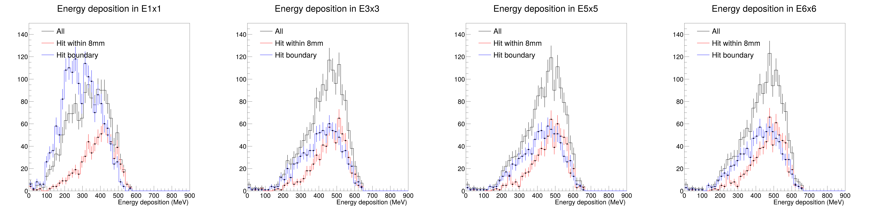
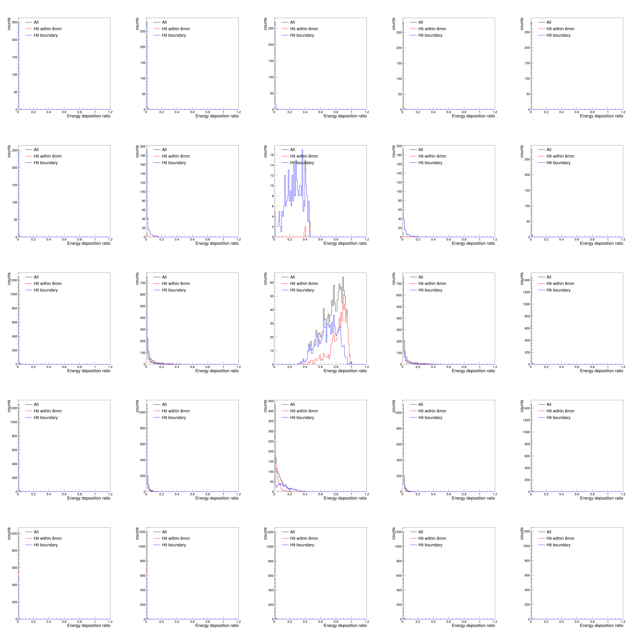
Simulation results
The true position is used to do the boundary selection.
Choosing position hit on most energetic crystal.
16mm
Energy containment in 3x3
20mm
*using 60k event

Slide 13
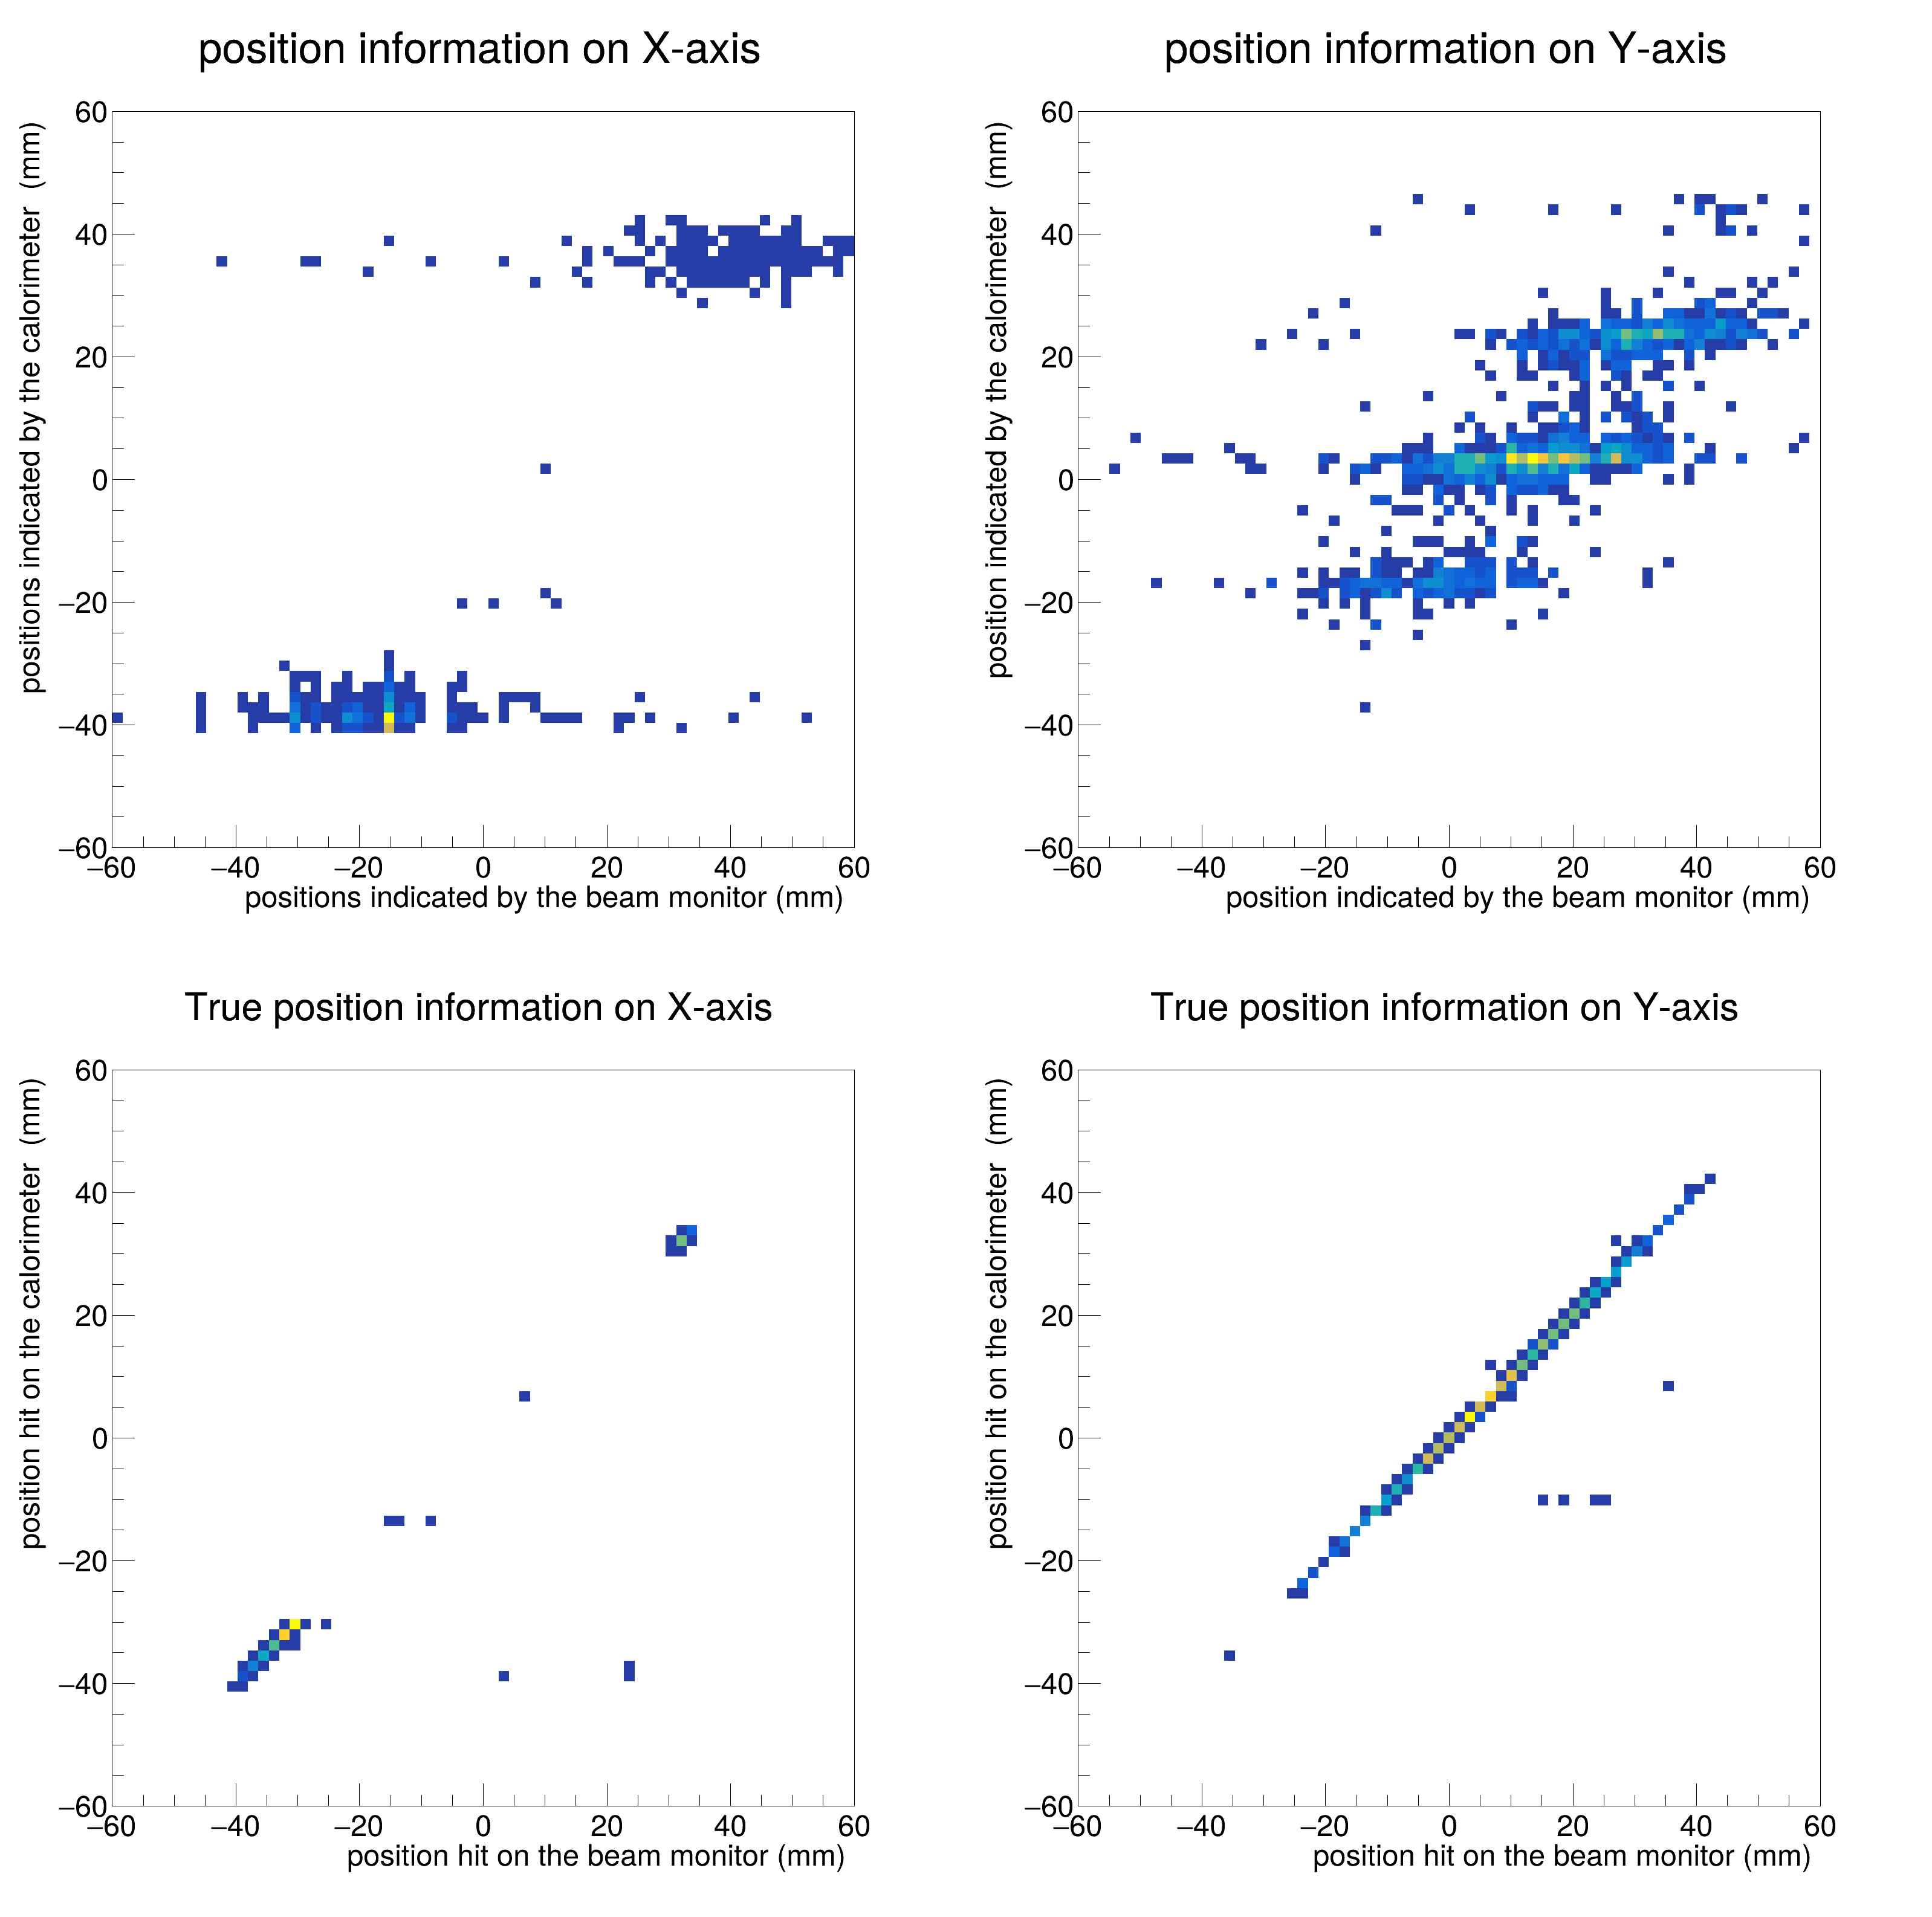
Simulation results
The position indicated by the beam monitor in X and Y have fluctuation at certain position indicated by the calorimeter; while plots with true position are linear relation.
*using 60k event

Slide 14
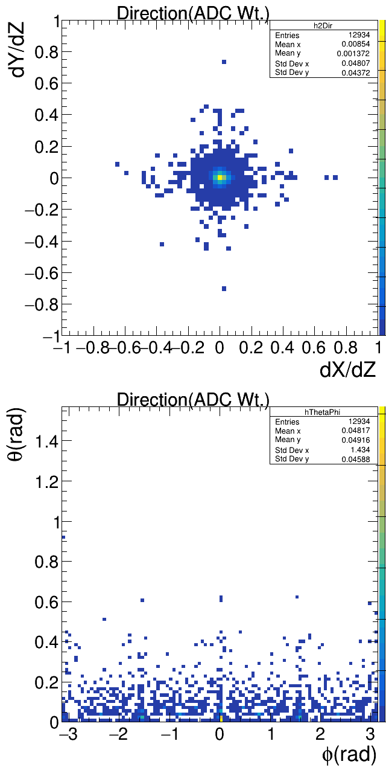
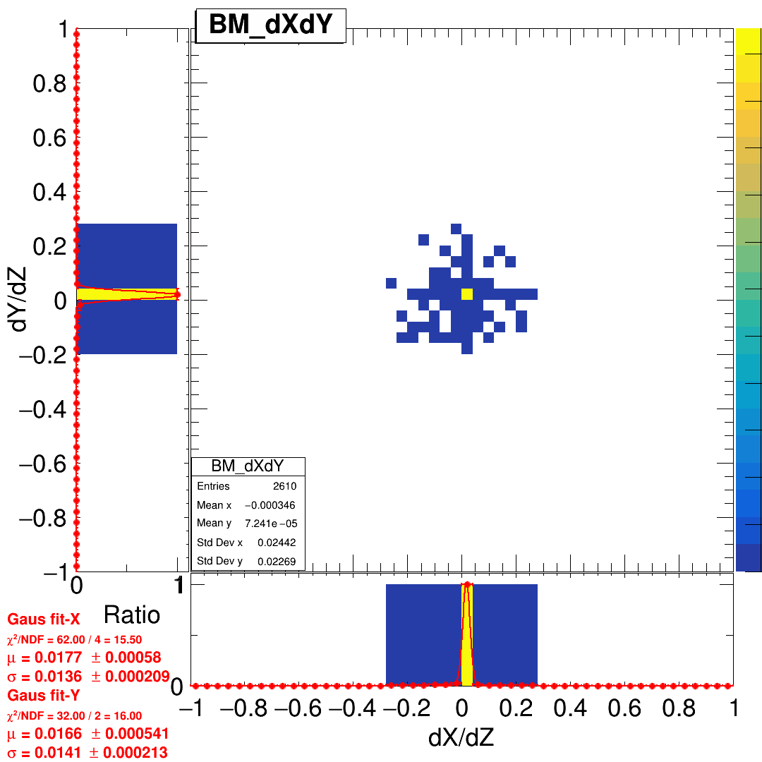
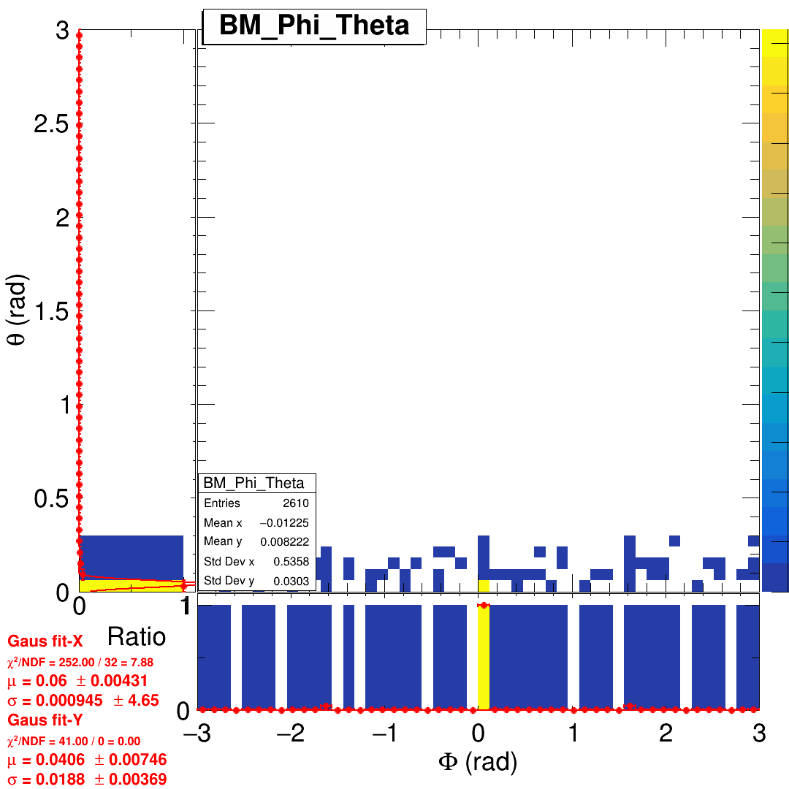
Before story
DATA
With perpendicular beam simualtion
A little angel of beam direction in theta should be added.
θ

Slide 15
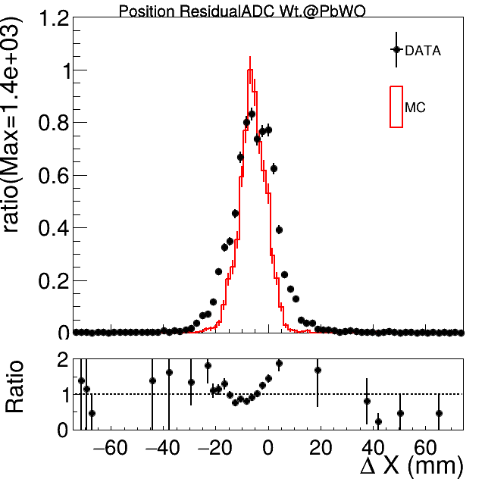
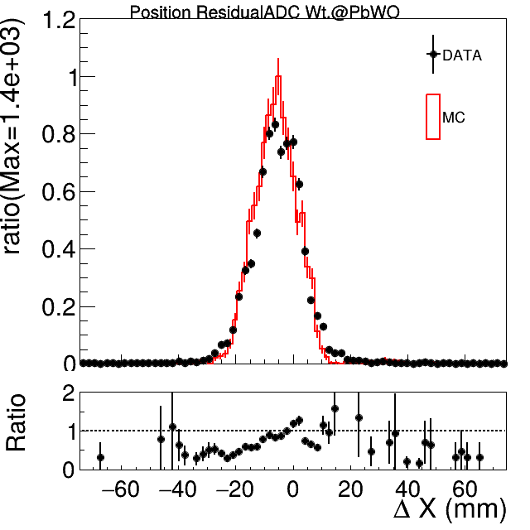
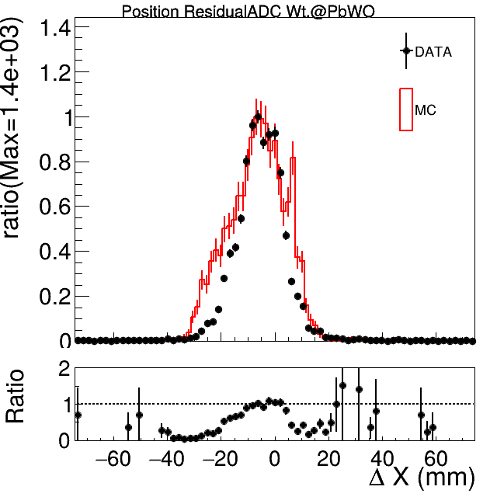
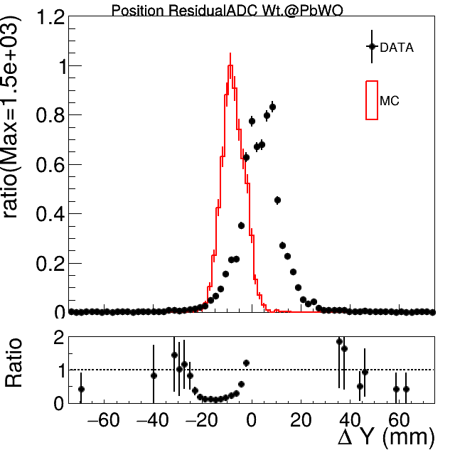
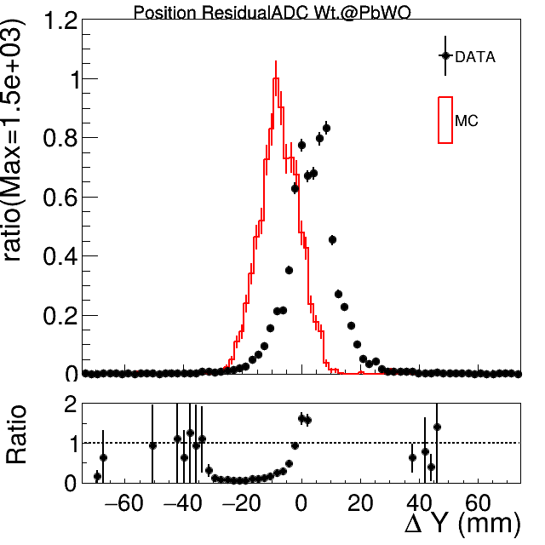
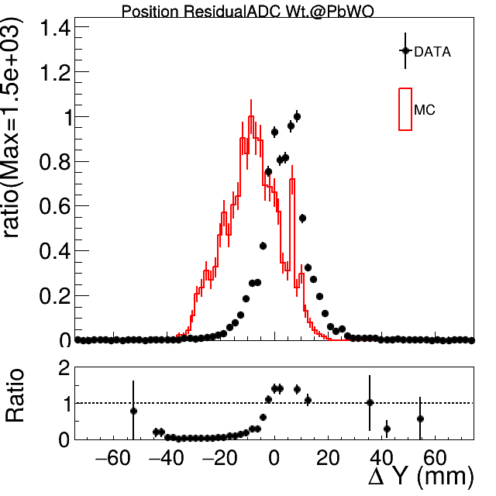
2°
5°
10°
5° is a better choice.
Always have some shifting inY .

Slide 16
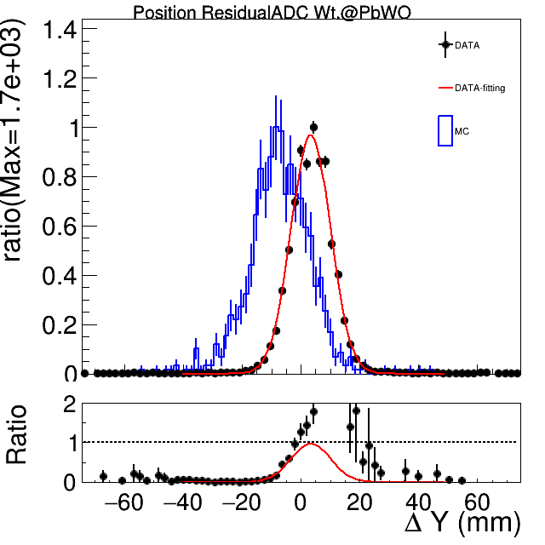
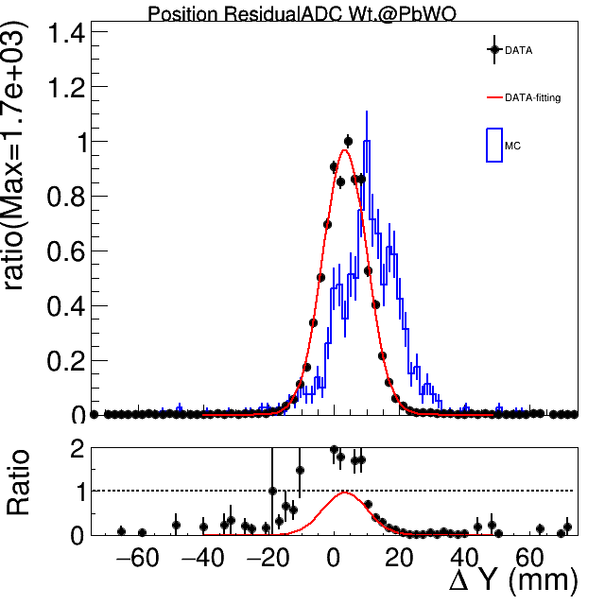
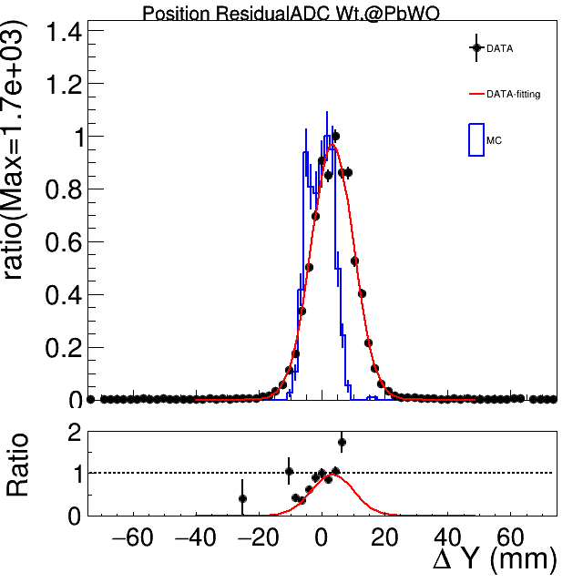
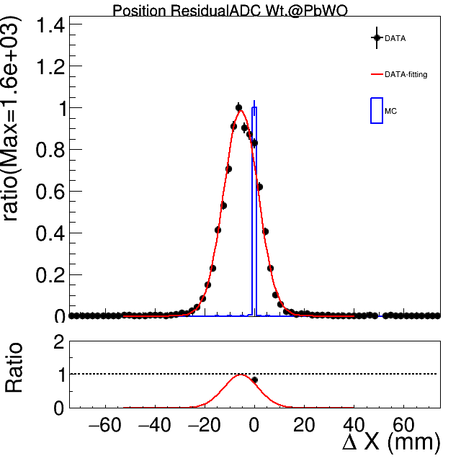
Position residual in Y
Residual
BeamMonitor track reconstruction and extrapolating point on Crystal - Crystal showering center base on Energy deposition
BeamMonitor track reconstruction and extrapolating hit point on Crystal - True track hit point
Crystal showering center base on Energy deposition -
True track hit point
True track hit point
Center of BeamMonitor is higher than PbWO4 array.

Slide 17
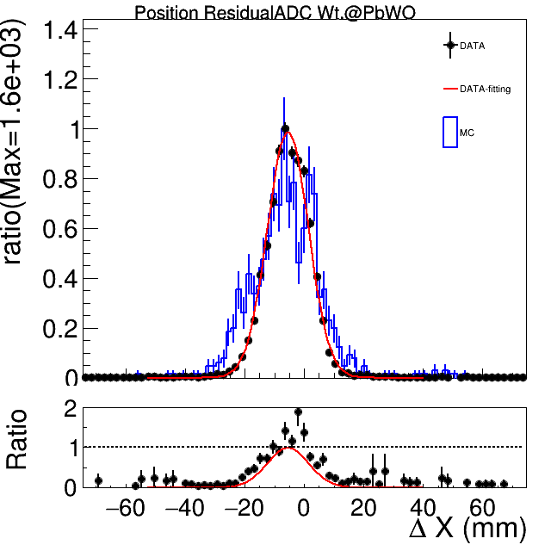
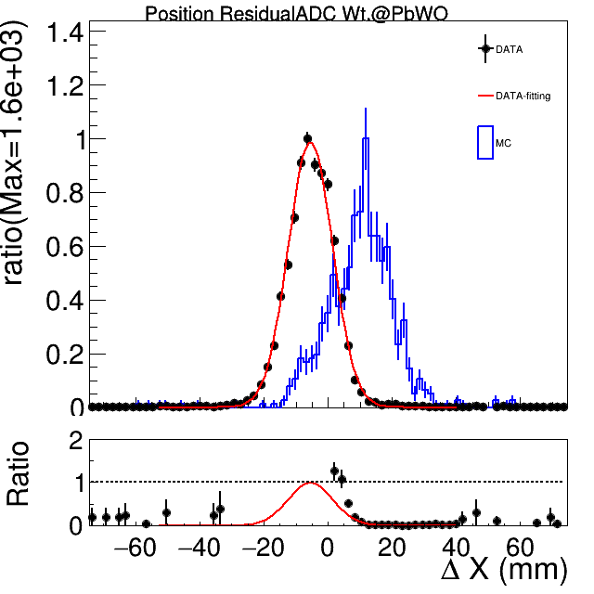
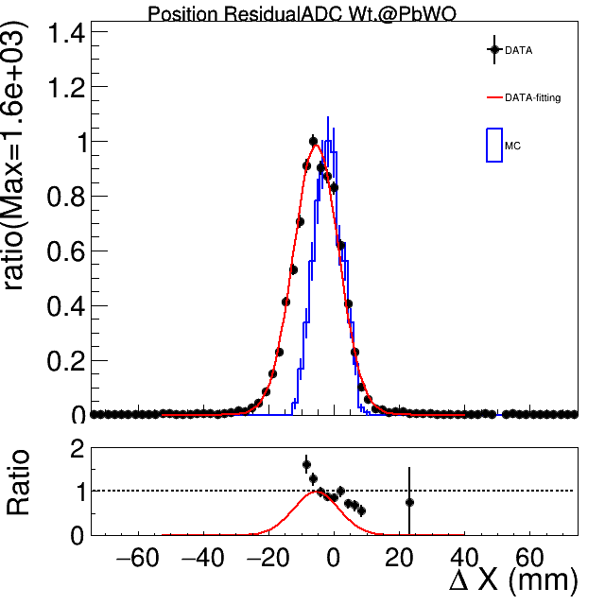
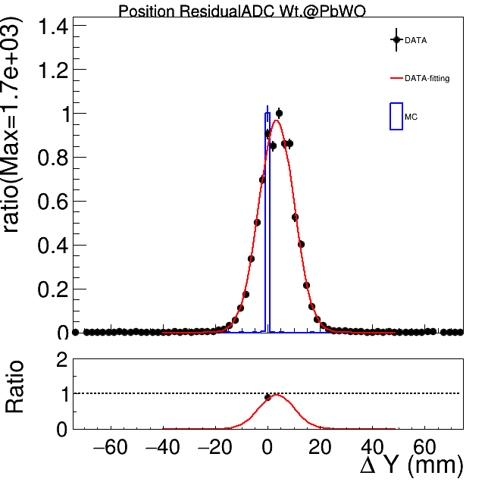
Position residual in X
Residual
BeamMonitor track reconstruction and extrapolating point on Crystal - Crystal showering center base on Energy deposition
BeamMonitor track reconstruction and extrapolating hit point on Crystal - True track hit point
Crystal showering center base on Energy deposition -
True track hit point
True track hit point
全部能量 residual-X&Y,E1x1, E3x3, E5x5, E->residual, E->resolution
MC Status 準備多少 Geometry,

Slide 18
shifting inY ☹
track reconstruction and extrapolating
True track
BeamMonitor track reconstruction and extrapolating hit point on Crystal - True track hit position

Slide 19
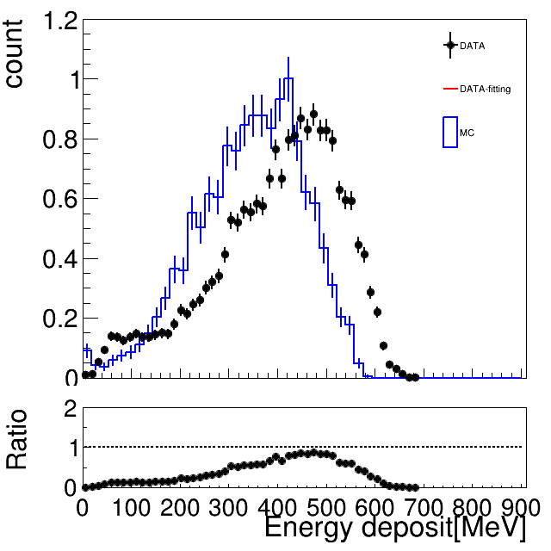
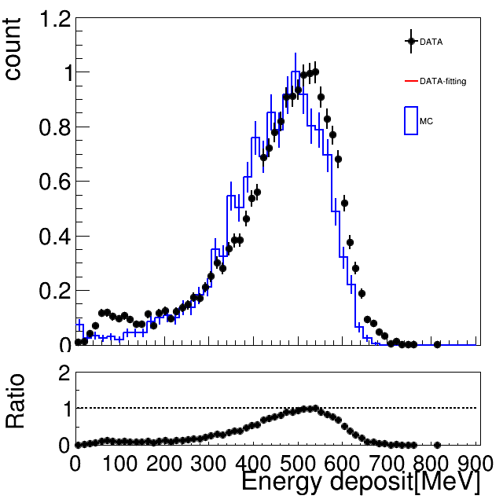
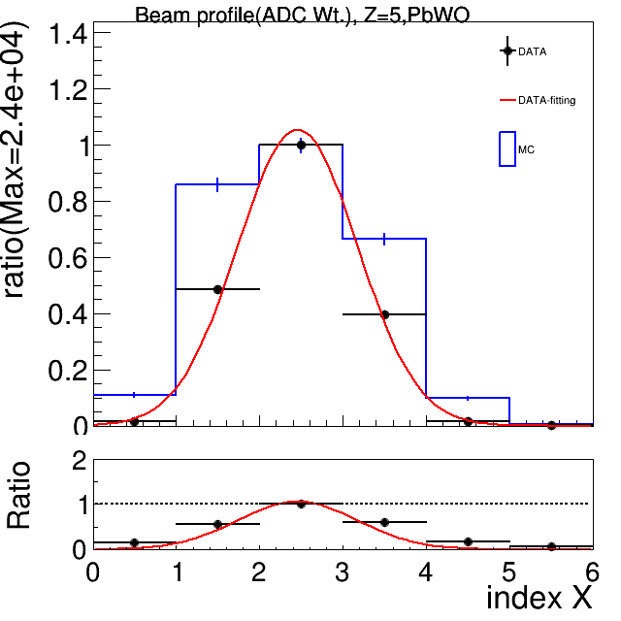
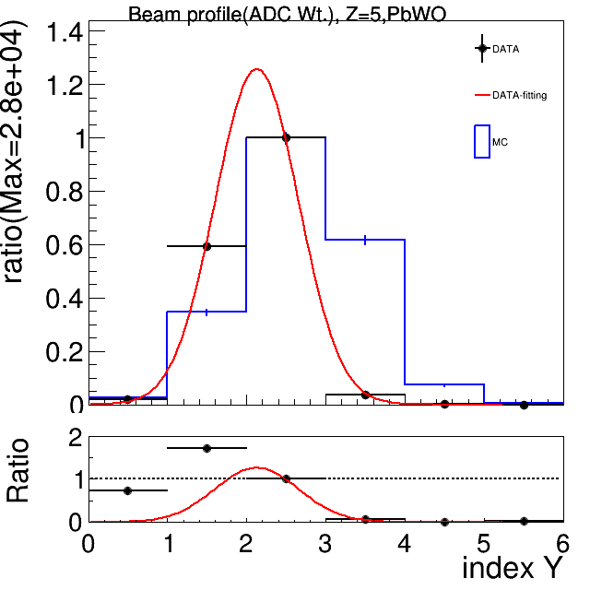
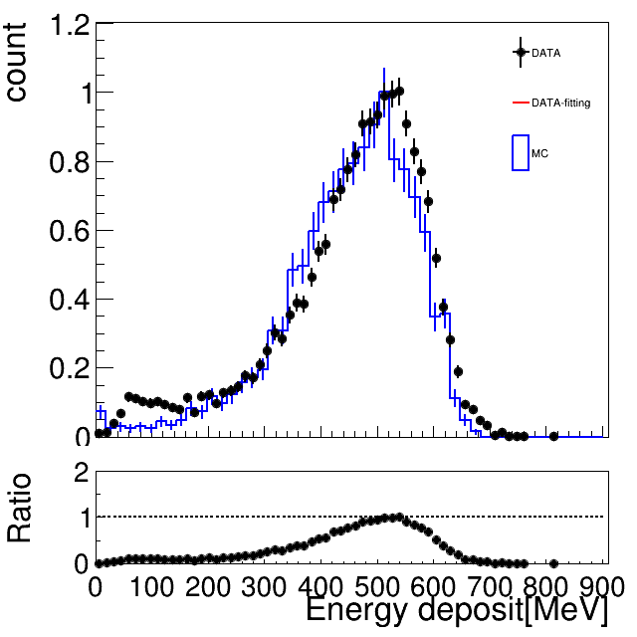
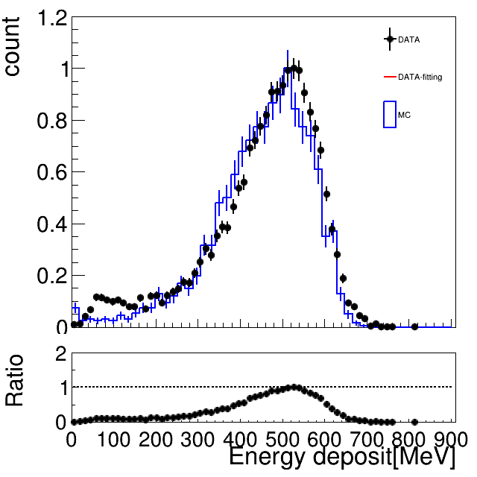
Crystal Profile & E1x1,E3x3,E5x5,Etot
E1x1
E3x3
E5x5
Etot
Somehow fitting line shows up ☹ I will remove it

Slide 20
Simulation results
16mm
20mm

