Slide 1


Grant no. 12135007
Craig Roberts … http://inp.nju.edu.cn/
Insights into the
Emergence of Hadron Mass and Structure
Notes:
25+5

Slide 2









Basic Questions for 21st Century Science
How Does the Mass of the Nucleon Arise?
How Does the Spin of the Nucleon Arise?
What Are the Emergent Properties of Dense Systems of Gluons?
Response … International community is operating, building, and planning facilities with the potential for delivering answers
Notes:
20+5

Slide 3
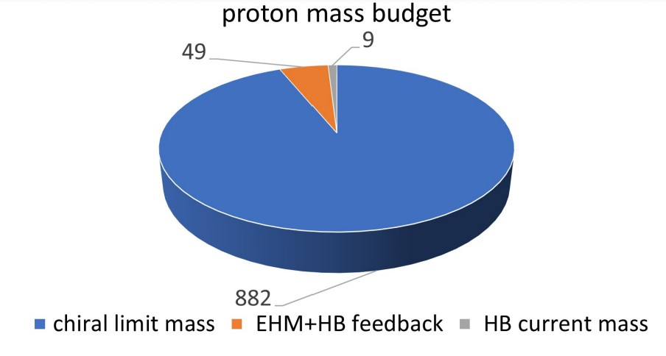
Emergence of Hadron Mass
Standard Model of Particle Physics has one obvious mass-generating mechanism
= Higgs Boson … impacts are critical to evolution of Universe as we know it
Proton mass budget … only 9 MeV/939 MeV is directly from Higgs
Evidently, there is another phenomenon in Nature that is extremely effective in producing mass:
Emergent Hadron Mass (EHM)
  Alone, it produces 94% of the proton’s mass
  Remaining 5% is generated by constructive interference between EHM and Higgs-boson
What is EHM?
Does it have a reductionist explanation,
i.e. like a Swiss watch, can it be explained by mere “mechanics”
If so, what is it and does it lie within the Standard Model?

Slide 4
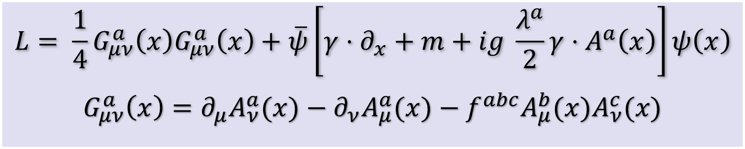

Quantum Chromodynamics
Current mass
generated by
Higgs boson
couplings into QCD
$$L= \frac{1}{4}G_{μν}^{a}\left(x\right)G_{μν}^{a}\left(x\right)+\overline{ψ}\left[γ⋅∂_{x}+m+ig \frac{λ^{a}}{2}γ⋅A^{a}\left(x\right)\right]ψ\left(x\right)$$
$$G_{μν}^{a}\left(x\right)=∂_{μ}A_{ν}^{a}(x)−∂_{ν}A_{μ}^{a}(x)−f^{abc}A_{μ}^{b}{(x)A}_{ν}^{c}(x)$$
No mass term
for gluons
One-line Lagrangian – expressed in terms of
massless gluon ($A_{μ}^{a}$) and Higgs-mass quark ($ψ$) partons
Which are NOT the degrees-of-freedom measured in detectors
Gluon and Quark Confinement
Advantages of the Color Octet Gluon Picture,
H. Fritzsch, Murray Gell-Mann, H. Leutwyler, Phys. Lett. B 47 (1973) 365-368
“The quarks come in three "colors," but all physical states and interactions are supposed to be singlets with respect to the SU(3) of color. Thus, we do not accept theories in which quarks are real, observable particles; nor do we allow any scheme in which the color non-singlet degrees of freedom can be excited.”

Slide 5

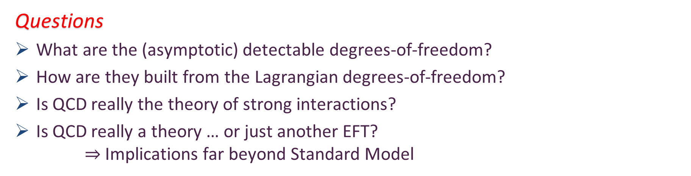
Quantum Chromodynamics
Current mass
generated by
Higgs boson
couplings into QCD
$$L= \frac{1}{4}G_{μν}^{a}\left(x\right)G_{μν}^{a}\left(x\right)+\overline{ψ}\left[γ⋅∂_{x}+m+ig \frac{λ^{a}}{2}γ⋅A^{a}\left(x\right)\right]ψ\left(x\right)$$
$$G_{μν}^{a}\left(x\right)=∂_{μ}A_{ν}^{a}(x)−∂_{ν}A_{μ}^{a}(x)−f^{abc}A_{μ}^{b}{(x)A}_{ν}^{c}(x)$$
No mass term
for gluons
One-line Lagrangian – expressed in terms of
massless gluon ($A_{μ}^{a}$) and Higgs-mass quark ($ψ$) partons
Which are NOT the degrees-of-freedom measured in detectors
Gluon and Quark Confinement
Questions
What are the (asymptotic) detectable degrees-of-freedom?
How are they built from the Lagrangian degrees-of-freedom?
Is QCD really the theory of strong interactions?
Is QCD really a theory … or just another EFT?
$⇒$ Implications far beyond Standard Model
Hadrons
= protons, pions, etc.

Slide 6

Emergent Hadron Mass (EHM)
In quantum field theory, mass and length^{–1} are effectively the same thing
Thus, asking for the origin of 99% of visible mass in the Universe
is the same as asking what is the source of the proton’s size
Confinement scale
Confinement is far more than the statement that Nature
contains only colour-singlet combinations of gluons and quarks
  Those combinations have fm-scale sizes
  This is crucial
  It wouldn’t be confinement if the scales were Å size
Confinement …
  If one can’t measure them, what are the gluons and quarks in the SM Lagrangian?
  Are they anything more than a theoretical “trick”; useful things for calculations in perturbation theory, but practically irrelevant when resolving detectable hadrons?
  What degrees-of-freedom should be used to compute and understand hadron properties?

Slide 7

Basic Questions in Nature …

Slide 8

Basic Questions in Nature … that insightful physics might answer in foreseeable future
What is the origin of the nuclear-physics mass scale
$m_{p}=$ proton mass$≈1$GeV
that characterises all visible matter?
Whatever it is, why is the pion seemingly oblivious: $m_{π}≈\frac{1}{7}m_{p}$?
How is this phenomenon expressed in measurable quantities?
  The expressions are (almost) certainly system specific!
Answers should be frame and scale invariant

Slide 9
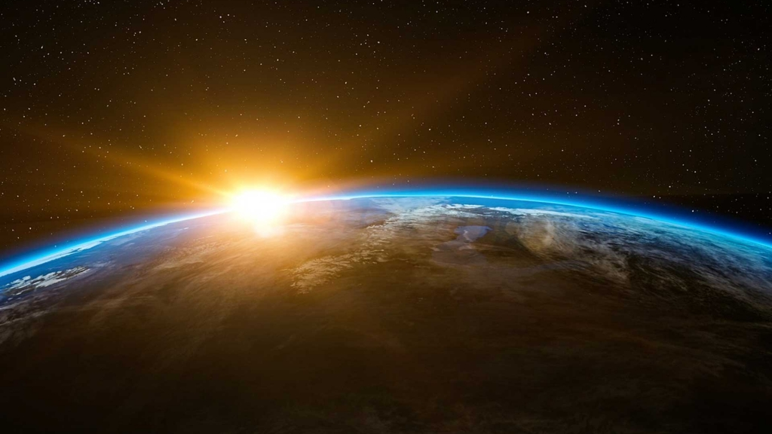
Origin of Mass:
The Frontier of Physics

Slide 10
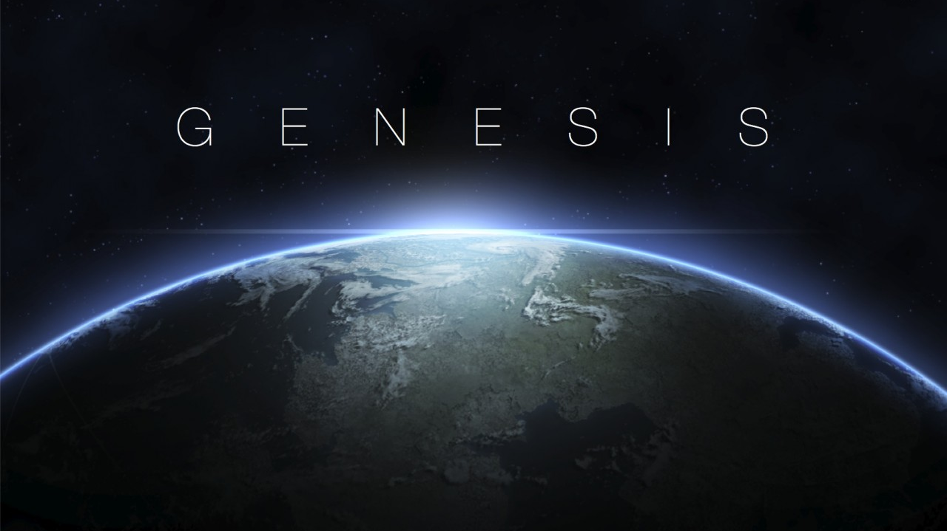

In the Beginning…

Slide 11
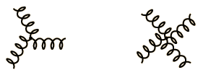
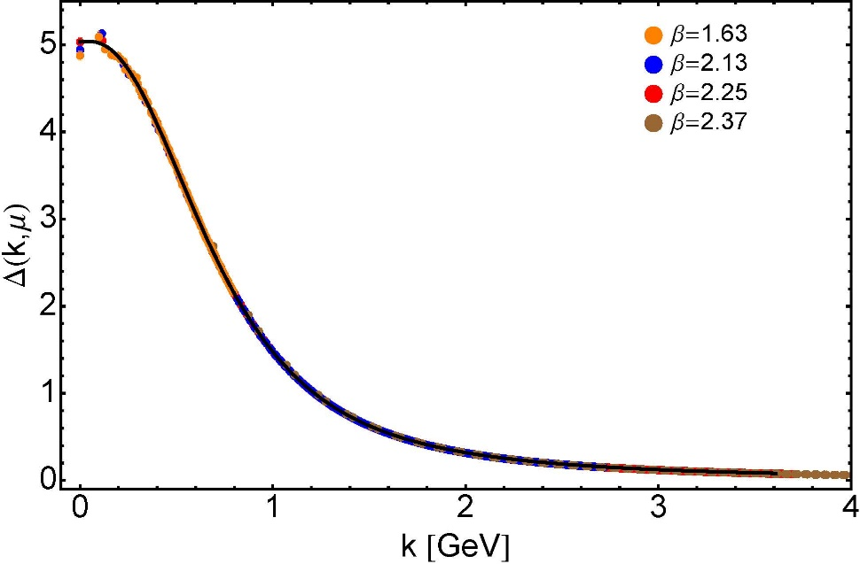

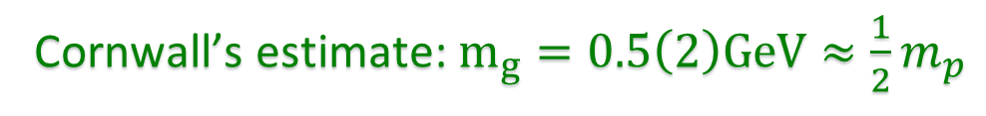

Ancient History
Cornwall’s estimate: $m_{g}=0.5\left(2\right)GeV≈\frac{1}{2}m_{p}$
$≈$ 45 years ago
  Dynamical mass generation in continuum quantum chromodynamics,
  J.M. Cornwall, Phys. Rev. D 26 (1981) 1453 … $>1100$ citations
Owing to strong self-interactions, gluon partons $⇒$ gluon quasiparticles,
described by a mass function that is large at infrared momenta
3-gluon vertex
4-gluon vertex
$$\frac{1}{m_{g}^{2}}$$
Truly mass from nothing
An interacting theory, written in terms of massless gluon fields, produces dressed gluon fields that are characterised by a mass function that is large at infrared momenta
Gluon propagator … continuum and lattice QCD agree
QCD fact
Continuum theory and lattice simulations agree
Empirical verification?

Slide 12

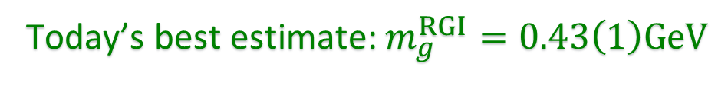

Ancient History
D. Binosi, Emergent Hadron Mass in Strong Dynamics, Few Body Syst. 63 (2022) 42.
M. N. Ferreira, J. Papavassiliou, Gauge Sector Dynamics in QCD, Particles 6 (1) (2023) 312–363.
Today’s best estimate: $m_{g}^{RGI}=0.43\left(1\right)GeV$
Gauge Invariance and Mass,
J. S. Schwinger
Phys. Rev. 125 (1962) 397-398
It is argued that the gauge invariance of a vector field does not necessarily imply zero mass for an associated particle if the current vector coupling is sufficiently strong.
EHM means
Gluons are massive via Schwinger Mechanism
More than 40 years ago
  Dynamical mass generation in continuum quantum chromodynamics,
  J.M. Cornwall, Phys. Rev. D 26 (1981) 1453 … $∼1050$ citations
Owing to strong self-interactions, gluon partons $⇒$ gluon quasiparticles,
described by a mass function that is large at infrared momenta
3-gluon vertex
4-gluon vertex
$$\frac{1}{m_{g}^{2}}$$
Truly mass from nothing
An interacting theory, written in terms of massless gluon fields, produces dressed gluon fields that are characterised by a mass function that is large at infrared momenta
Gluon propagator … continuum and lattice QCD agree
QCD fact
Continuum theory and lattice simulations agree
Empirical verification?

Slide 13

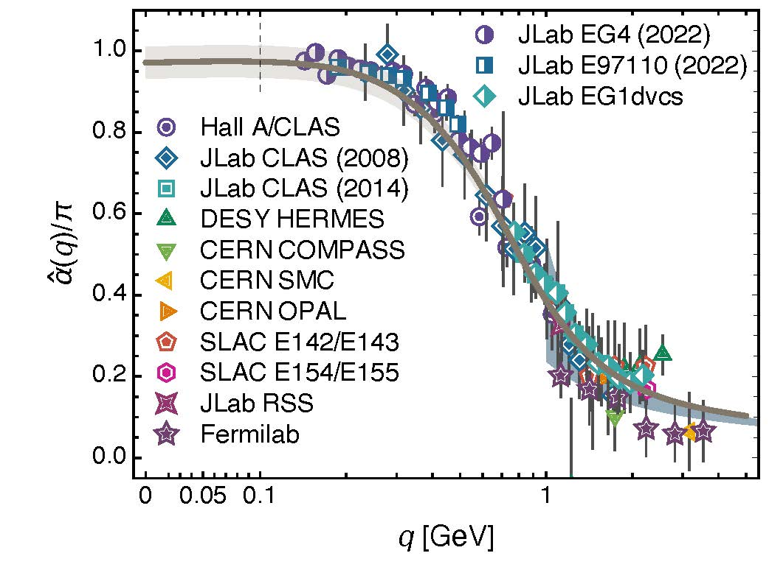
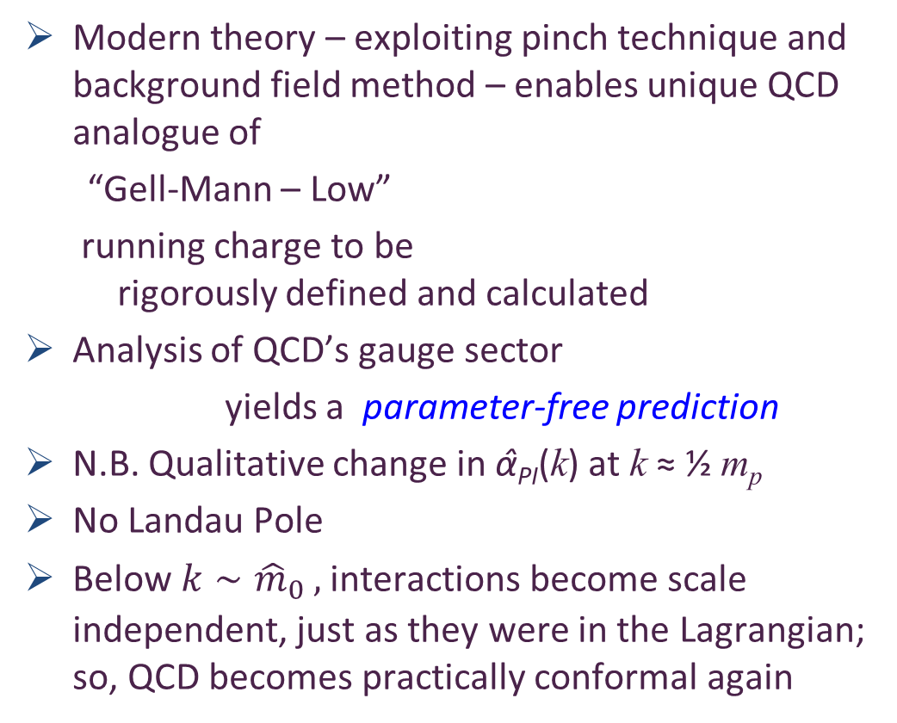

Process independent effective charge = running coupling
W orkshop on Dyson-Schwinger Equations in Modern Mathematics
and Physics (DSEMP2014) Trento, Italy, September 22-26, 2014
Effective charge from lattice QCD, Zhu-Fang Cui, Jin-Li Zhang et al.,
NJU-INP 014/19, arXiv:1912.08232 [hep-ph], Chin. Phys. C 44 (2020) 083102/1-10
$3673$ total downloads
Modern theory – exploiting pinch technique and background field method – enables unique QCD analogue of
“Gell-Mann – Low”
  running charge to be
  rigorously defined and calculated
Analysis of QCD’s gauge sector
  yields a parameter-free prediction
N.B. Qualitative change in α̂_{PI}(k) at k ≈ ½ m_{p}
No Landau Pole
Below $k∼{{\hat{m}}_{0}}_{ },$interactions become scale independent, just as they were in the Lagrangian; so, QCD becomes practically conformal again
Process independent strong running coupling
Daniele Binosi et al., arXiv:1612.04835 [nucl-th], Phys. Rev. D 96 (2017) 054026/1-7
Experimental determination of the QCD effective charge α_{g1}(Q).
A. Deur; V. Burkert; J.-P. Chen; W. Korsch, Particles 5 (2022) 171
QCD Running Couplings and Effective Charges, Alexandre Deur, Stanley J. Brodsky and Craig Roberts, e-Print: 2303.00723 [hep-ph], Prog. Part. Nucl. Phys. 134 (2024) 104081

Slide 14

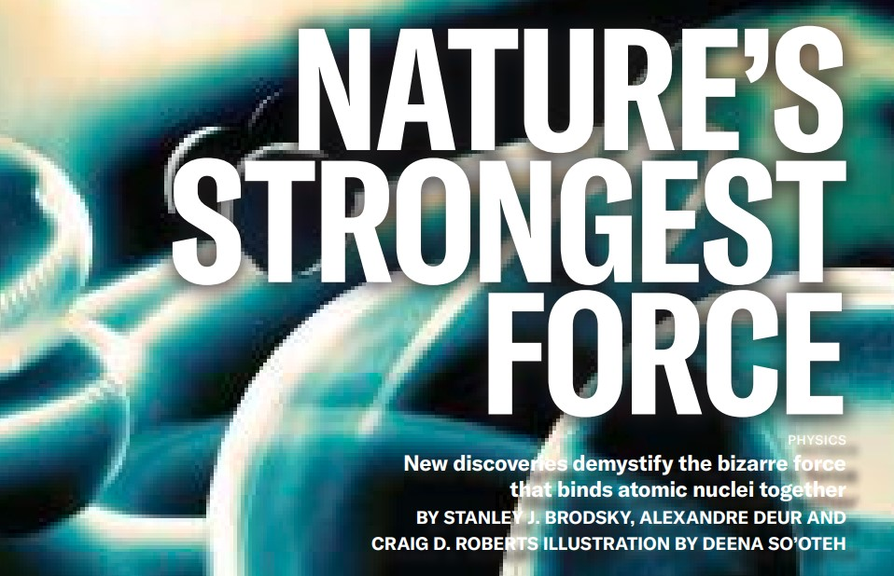
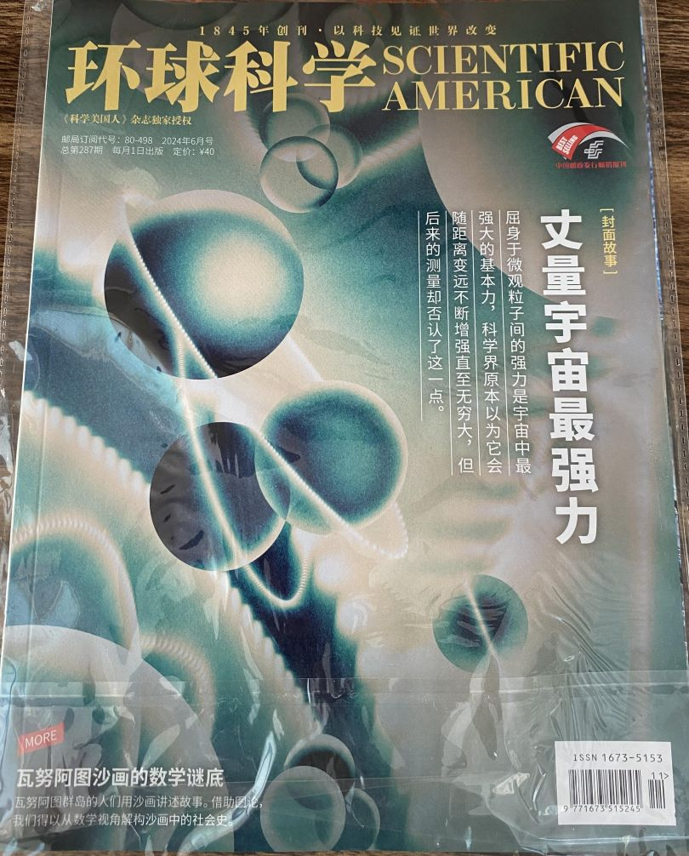
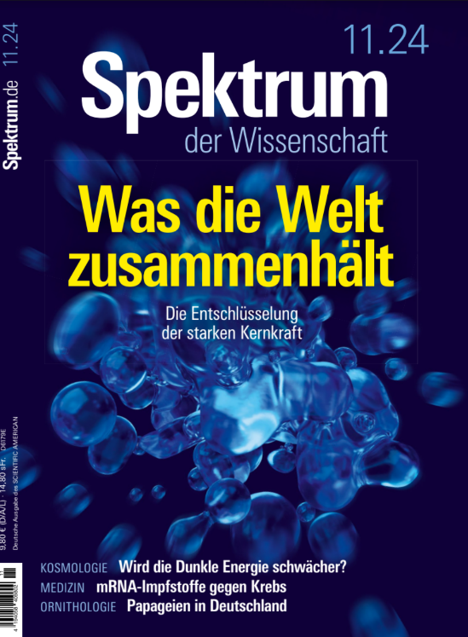

Process-independent Effective Charge
https://1drv.ms/b/s%21Apbnb6VLY1RplPRdL0J4Wm-tlzQd-Q?e=hdZxHH
May 2024
Most-read article in the May 2024 issue of SciAm
Translated into Chinese, French, German, Italian
Cover story on Chinese and German editions
SciAm is one of the Top-5 popular science magazines in the world.
International circulation that exceeds 10,000,000 readers per month in subscriptions and millions more via social media etc.

Slide 15
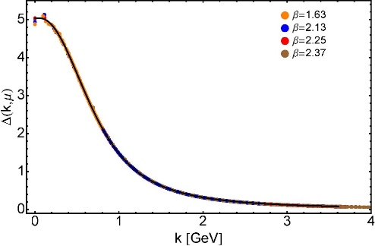

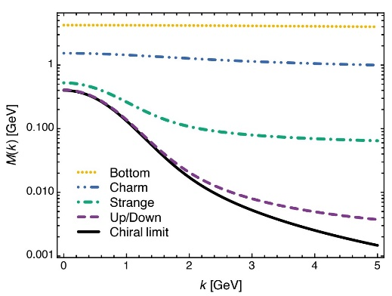
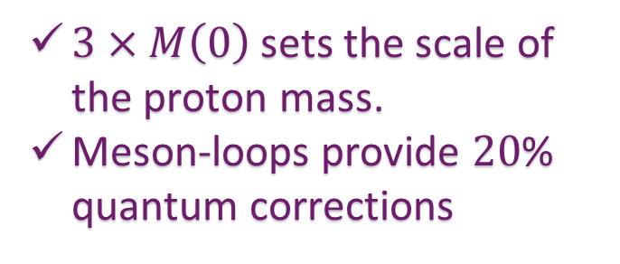
EHM Basics
Can’t build a Theory of Everything
before status of QCD is decided
Absent Higgs boson couplings, QCD Lagrangian is scale invariant
Yet …
  Massless gluons become massive
  A momentum-dependent charge is produced
  Massless quarks become massive
EHM is expressed in
    EVERY strong interaction observable
Challenge to Theory =
    Elucidate all observable consequences of these phenomena
    and highlight the paths to measuring them
Challenge to Experiment =
    Test the theory predictions so that
    the boundaries of the Standard Model can finally be drawn
Three pillars of EHM
$3×M\left(0\right)$ sets the scale of the proton mass.
Meson-loops provide $20$% quantum corrections

Slide 16


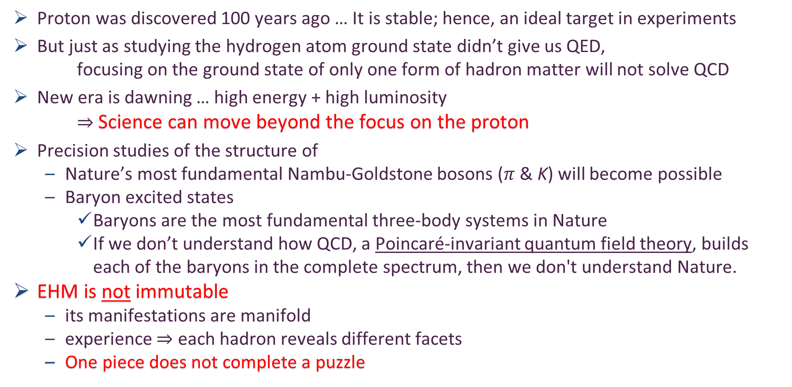
Charting EHM
Proton was discovered 100 years ago … It is stable; hence, an ideal target in experiments
But just as studying the hydrogen atom ground state didn’t give us QED,
focusing on the ground state of only one form of hadron matter will not solve QCD
New era is dawning … high energy + high luminosity
$⇒$ Science can move beyond the focus on the proton
Precision studies of the structure of
  Nature’s most fundamental Nambu-Goldstone bosons ($π$ & K) will become possible
  Baryon excited states
    Baryons are the most fundamental three-body systems in Nature
    If we don’t understand how QCD, a Poincaré-invariant quantum field theory, builds each of the baryons in the complete spectrum, then we don't understand Nature.
EHM is not immutable
  its manifestations are manifold
  experience $⇒$ each hadron reveals different facets
  One piece does not complete a puzzle
AMBER @ CERN
EIC
EicC & SCT & CEPC
JLab12 & JLab20+
QCD @ FAIR

Slide 17
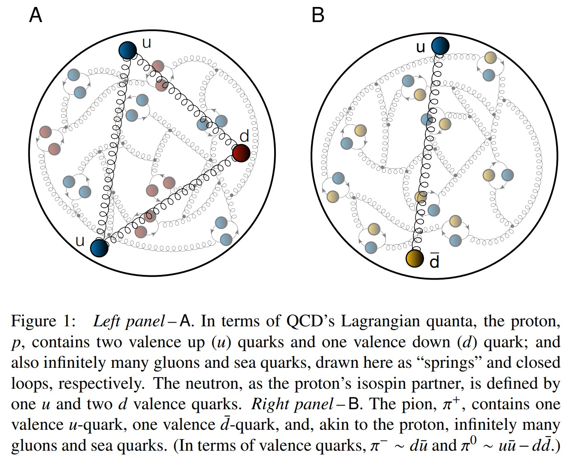
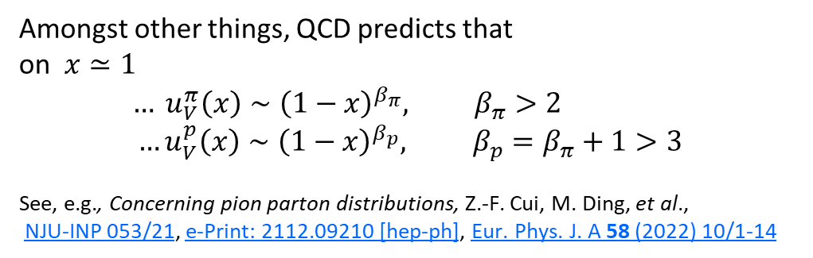
Proton and pion distribution functions in counterpoint
Proton and pion distribution functions in counterpoint, Ya Lu (陆亚) et al.,
NJU-INP 056/22, e-Print: 2203.00753 [hep-ph], Phys. Lett. B 830 (2022) 137130/1-7
massive
almost massless
Today, despite enormous expense of time and effort, much must still be learnt before proton and pion structure may be considered understood in terms of DFs
Most simply –
  What are the differences, if any, between the distributions of partons within the proton and the pion?
The question of similarity/difference between proton and pion DFs has particular resonance today as science seeks to explain EHM
How are obvious macroscopic differences between protons and pions expressed in the structural features of these two bound-states?
proton
pion
Amongst other things, QCD predicts that
on $x≃1$
$$… u_{V}^{π}\left(x\right)∼{\left(1−x\right)}^{β_{π}}, β_{π}>2$$
$$…u_{V}^{p}\left(x\right)∼{\left(1−x\right)}^{β_{p}}, β_{p}=β_{π}+1>3$$
See, e.g., Concerning pion parton distributions, Z.-F. Cui, M. Ding, et al.,
NJU-INP 053/21, e-Print: 2112.09210 [hep-ph], Eur. Phys. J. A 58 (2022) 10/1-14

Slide 18
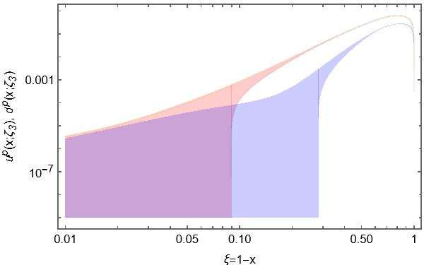
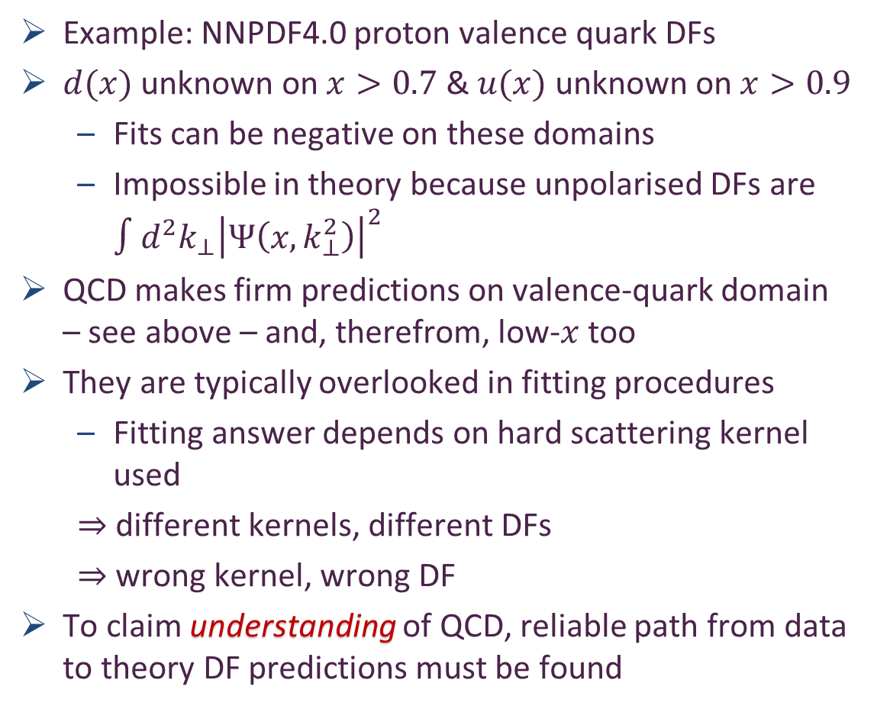
Phenomenology – global fits – of proton valence quark DFs
Example: NNPDF4.0 proton valence quark DFs
$d(x)$ unknown on $x>0.7$ & $u(x)$ unknown on $x>0.9$
  Fits can be negative on these domains
  Impossible in theory because unpolarised DFs are $∫d^{2}k_{⊥}{\left|Ψ\left(x,k_{⊥}^{2}\right)\right|}^{2}$
QCD makes firm predictions on valence-quark domain – see above – and, therefrom, low-$x$ too
They are typically overlooked in fitting procedures
  Fitting answer depends on hard scattering kernel used
  $⇒$ different kernels, different DFs
  $⇒$ wrong kernel, wrong DF
To claim understanding of QCD, reliable path from data to theory DF predictions must be found
Far valence domain

Slide 19
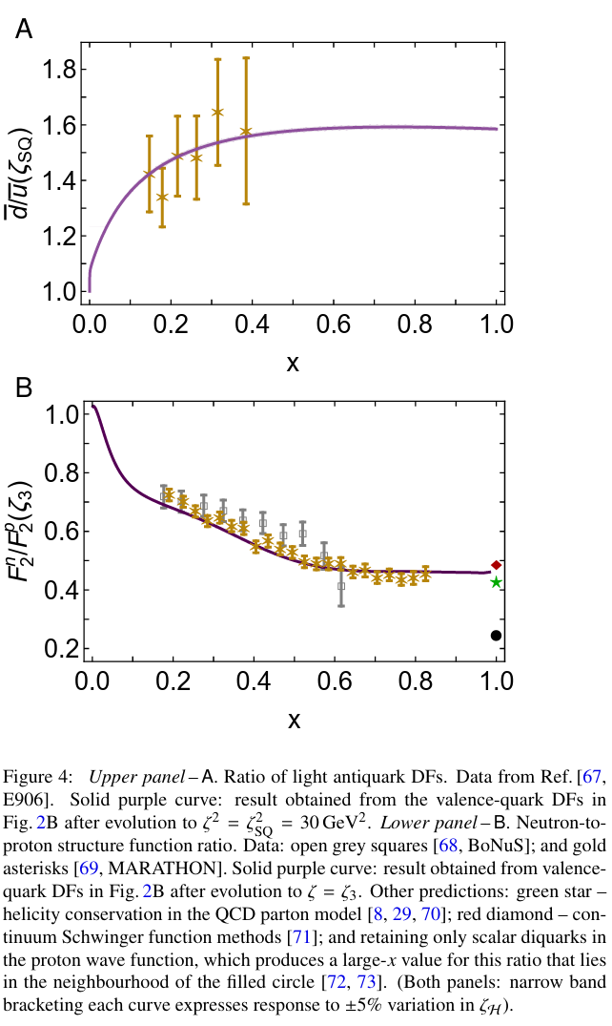
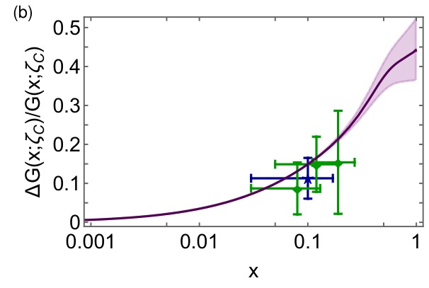
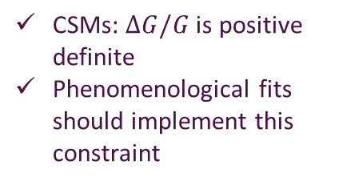
Parton Distribution Functions
CSMs for QCD
  unified and unifying set of predictions for helicity-independent pion, kaon, proton DFs
  helicity-dependent proton DFs also available
  all DFs, i.e., all species … valence, sea, glue
  express all QCD constraints
Now available for general use
  LHAPDF https://www.lhapdf.org/pdfsets.html
    9900 ... CoSMAO22Pion
    9950 ... CoSMAO22Kaon
    10000 ... CoSMAO22Proton
CSMs: $ΔG/G$ is positive definite
Phenomenological fits should implement this constraint

Slide 20
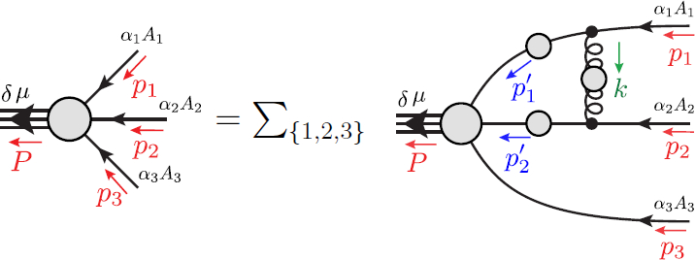
Faddeev Equation for Baryons
Nucleon mass from a covariant three-quark Faddeev equation
G. Eichmann et al., Phys. Rev. Lett. 104 (2010) 201601
Poincaré-covariant analysis of heavy-quark baryons
Si-Xue Qin (秦思学) et al., Phys.Rev. D 97 (2018) 114017/1-13
Nucleon Gravitational Form Factors,
Z.-Q. Yao (姚照千) et al., Eur. Phys. J. A 61 (2025) 92/1-13

Slide 21
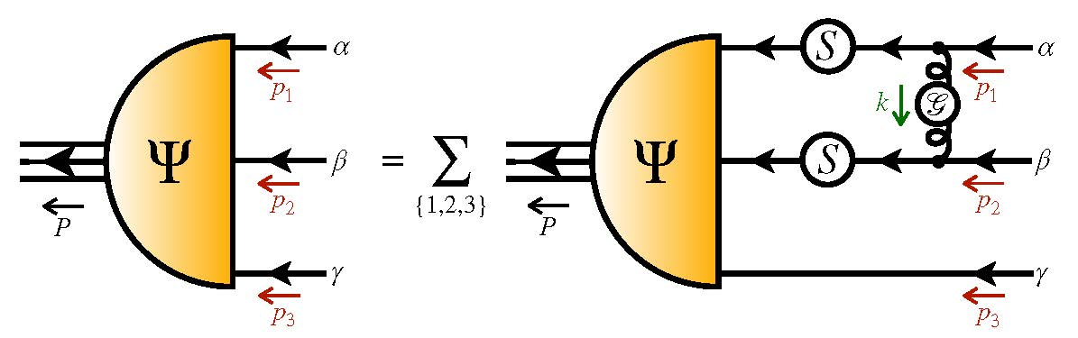
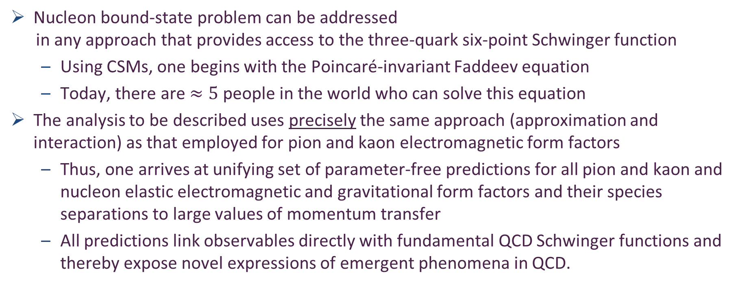
Nucleon as a Bound State
Nucleon charge and magnetisation distributions: flavour separation and zeroes,
Zhao-Qian Yao (姚照千), e-Print: 2403.08088 [hep-ph], Fund. Res. (2025) in press.
Nucleon bound-state problem can be addressed
in any approach that provides access to the three-quark six-point Schwinger function
  Using CSMs, one begins with the Poincaré-invariant Faddeev equation
  Today, there are $≈5$ people in the world who can solve this equation
The analysis to be described uses precisely the same approach (approximation and interaction) as that employed for pion and kaon electromagnetic form factors
  Thus, one arrives at unifying set of parameter-free predictions for all pion and kaon and nucleon elastic electromagnetic and gravitational form factors and their species separations to large values of momentum transfer
  All predictions link observables directly with fundamental QCD Schwinger functions and thereby expose novel expressions of emergent phenomena in QCD.

Slide 22
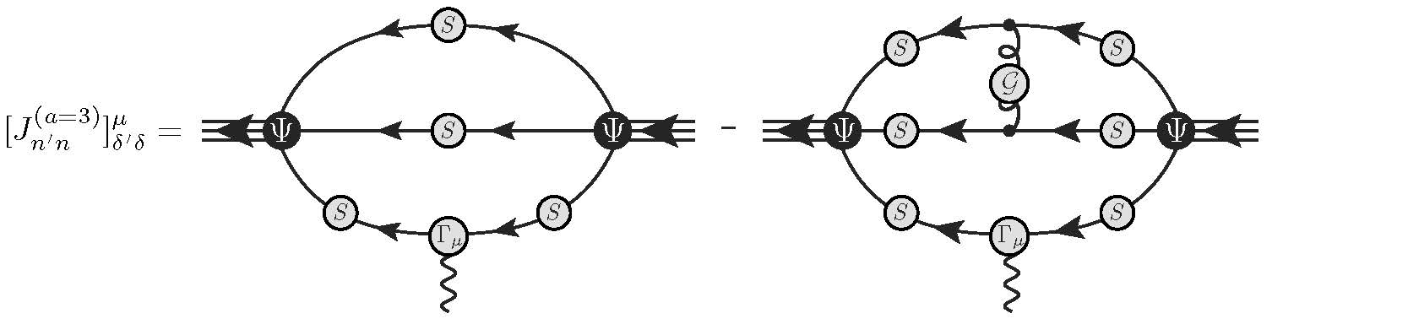
Electromagnetic Current
Nucleon mass from a covariant three-quark Faddeev equation
G. Eichmann et al., Phys. Rev. Lett. 104 (2010) 201601
Nucleon charge and magnetisation distributions: flavour separation and zeroes,
Zhao-Qian Yao et al., e-Print: 2403.08088 [hep-ph]

Slide 23
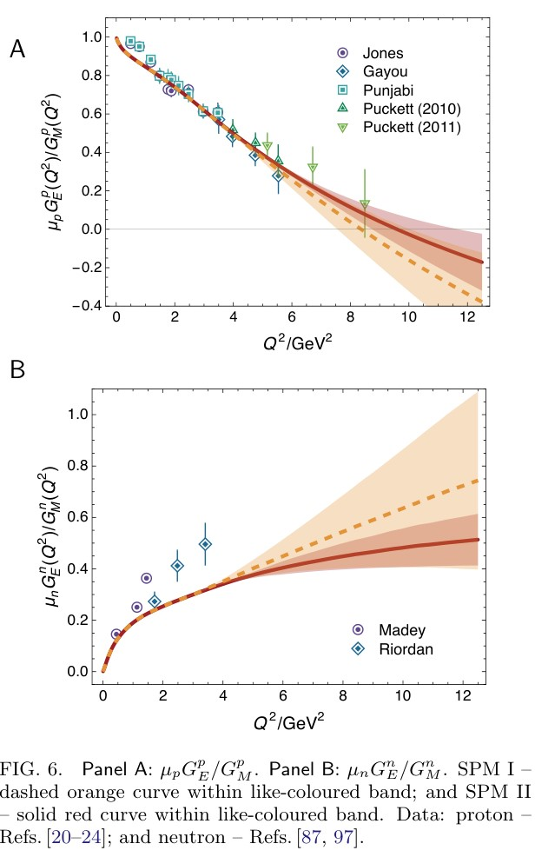
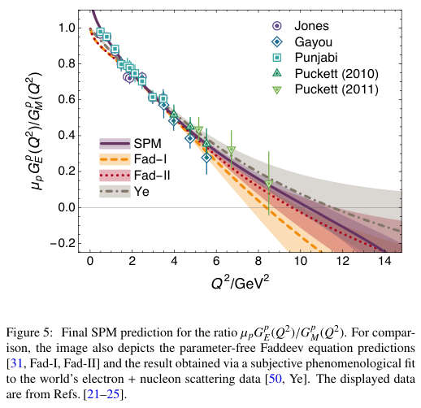
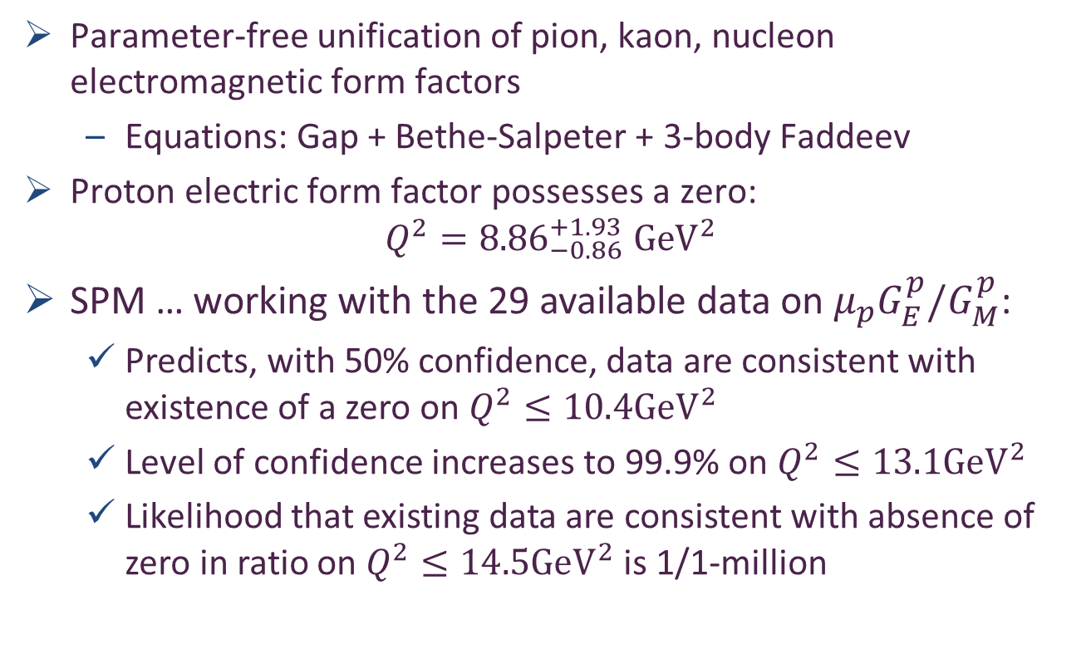
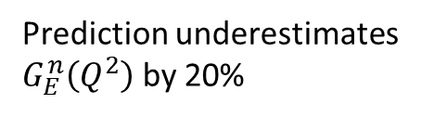
Nucleon charge and magnetisation distributions: zeroes and flavour separation
Parameter-free unification of pion, kaon, nucleon electromagnetic form factors
  Equations: Gap + Bethe-Salpeter + 3-body Faddeev
Proton electric form factor possesses a zero:
$$Q^{2}={8.86}_{−0.86}^{+1.93} GeV^{2}$$
SPM … working with the 29 available data on $μ_{p}G_{E}^{p}/G_{M}^{p}$:
  Predicts, with 50% confidence, data are consistent with existence of a zero on $Q^{2}≤10.4GeV^{2}$
  Level of confidence increases to 99.9% on $Q^{2}≤13.1GeV^{2}$
  Likelihood that existing data are consistent with absence of zero in ratio on $Q^{2}≤14.5GeV^{2}$is 1/1-million
Prediction underestimates
$G_{E}^{n}\left(Q^{2}\right)$ by 20%
Likelihood of a zero in the proton elastic electric form factor, Peng Cheng (程鹏), Zhao-Qian Yao (姚照千) et al., NJU-INP 095/24, e-Print: 2412.10598 [hep-ph], Phys. Lett. B 862 (2025) 139323/1-6
Nucleon charge and magnetisation distributions: flavour separation and zeroes, Zhao-Qian Yao et al., e-Print: 2403.08088 [hep-ph], Fund.Res (2025) in press

Slide 24
Hadron Gravitational Form Factors
Forces inside hadrons: pressure, surface tension, mechanical radius, and all that,
M. V. Polyakov, P. Schweitzer, Int. J. Mod. Phys. A 33 (2018) 26
  “The physics related to the form factors of the energy momentum tensor spans a wide spectrum of problems, and includes
  gravitational physics,
  hard exclusive reactions,
  hadronic decays of heavy quarkonia,
  and the physics of exotic hadrons described as hadroquarkonia.
  It also provides access to the “last global unknown property:” the D-term.
  We review the physics associated with the form factors of the energy-momentum tensor and the D-term, their interpretations in terms of mechanical properties, their applications, and the current experimental status.”

Slide 25
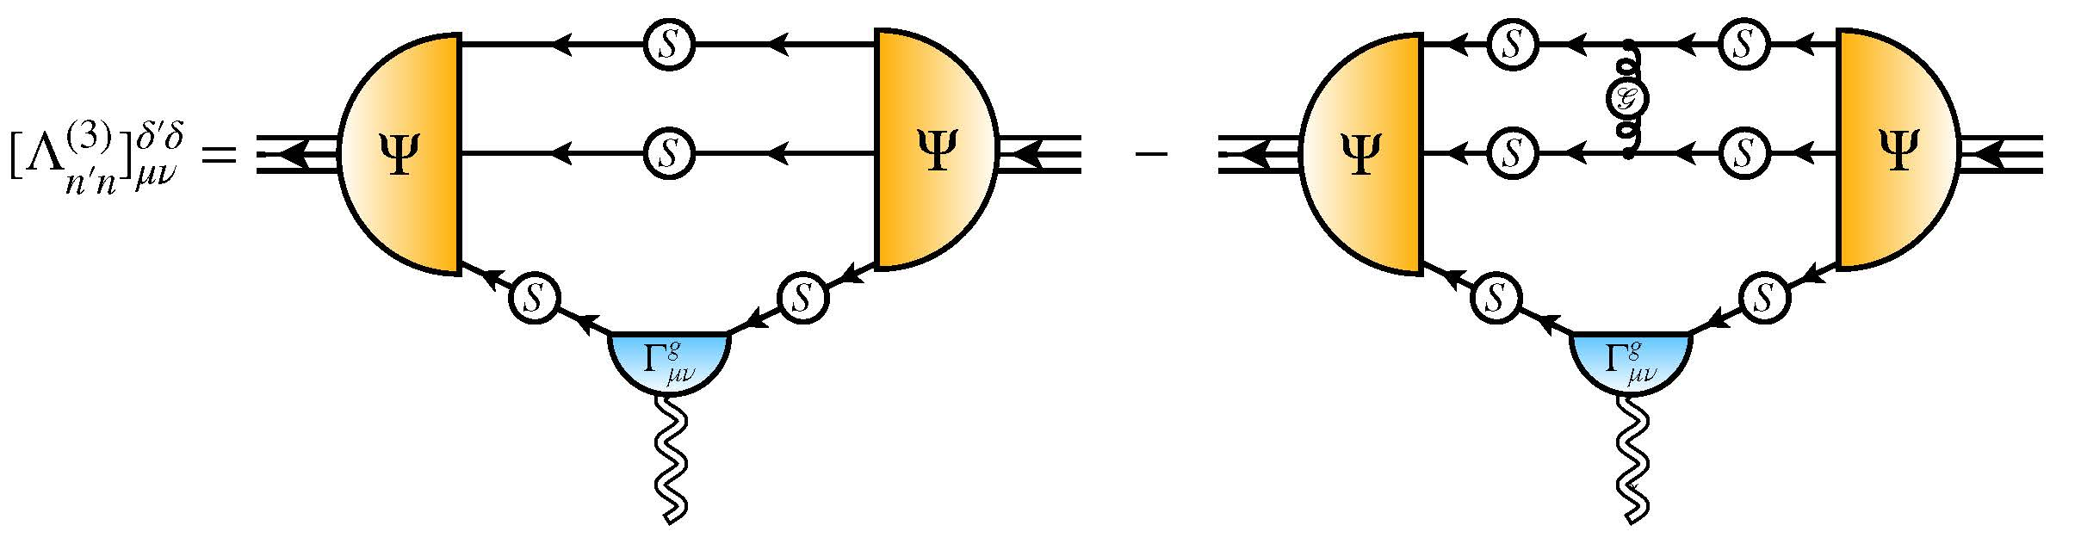
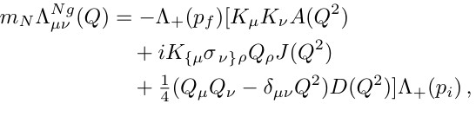

Nucleon Gravitational Form Factors
Current … completing solution of Faddeev equation, then all elements are known
Current …
$A(Q^{2})$ mass distribution form factor
$$A\left(Q^{2}=0\right)=1$$
$J(Q^{2})$ spin distribution form factor
$$J\left(Q^{2}=0\right)=1/2$$
$D(Q^{2})$ pressure distribution form factor
$$D\left(Q^{2}=0\right)=?$$
Last unknown/unmeasured global property of nucleon
Nucleon Gravitational Form Factors, Z.-Q. Yao (姚照千) et al., e-Print: 2409.15547 [hep-ph], Eur. Phys. J. A 61 (2025) 92/1-13

Slide 26
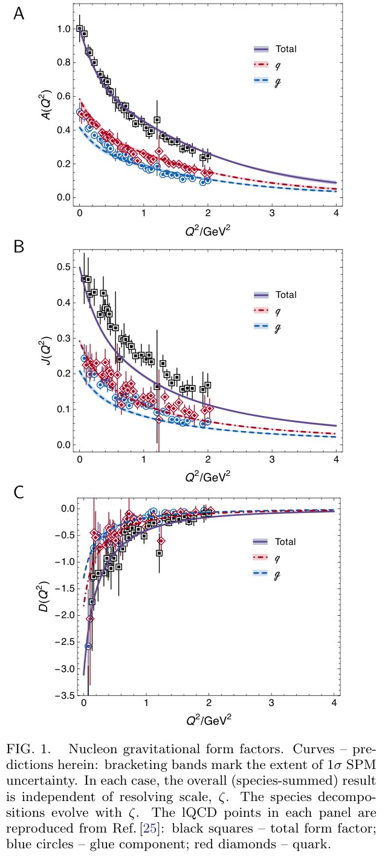
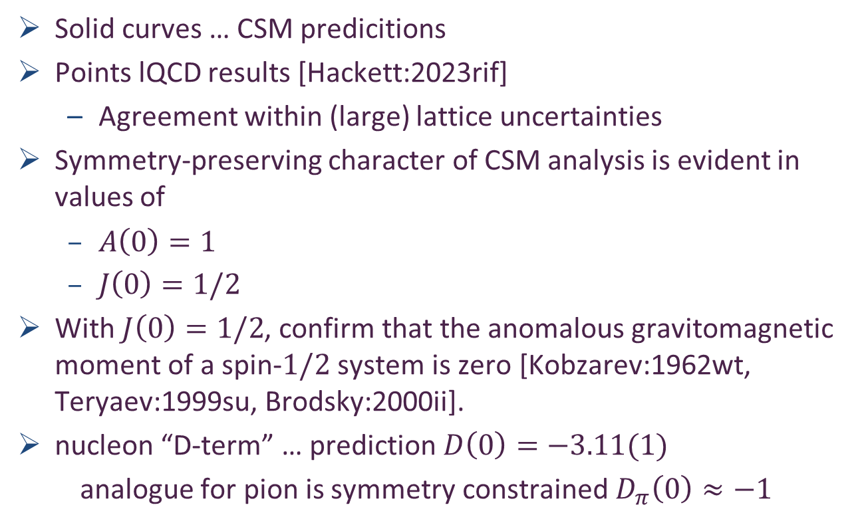
Predicted GFFs
Solid curves … CSM predicitions
Points lQCD results [Hackett:2023rif]
  Agreement within (large) lattice uncertainties
Symmetry-preserving character of CSM analysis is evident in values of
  $A\left(0\right)=1$
  $J\left(0\right)=1/2$
With $J\left(0\right)=1/2$, confirm that the anomalous gravitomagnetic moment of a spin-$1/2$ system is zero [Kobzarev:1962wt, Teryaev:1999su, Brodsky:2000ii].
nucleon “D-term” … prediction $D\left(0\right)=−3.11(1)$
analogue for pion is symmetry constrained $D_{π}\left(0\right)≈−1$

Slide 27
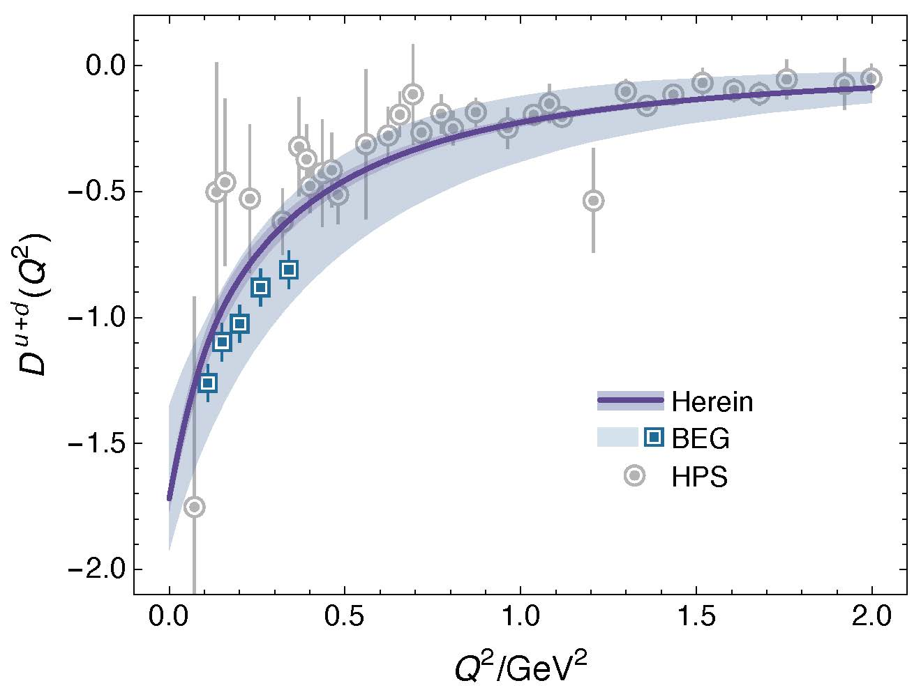
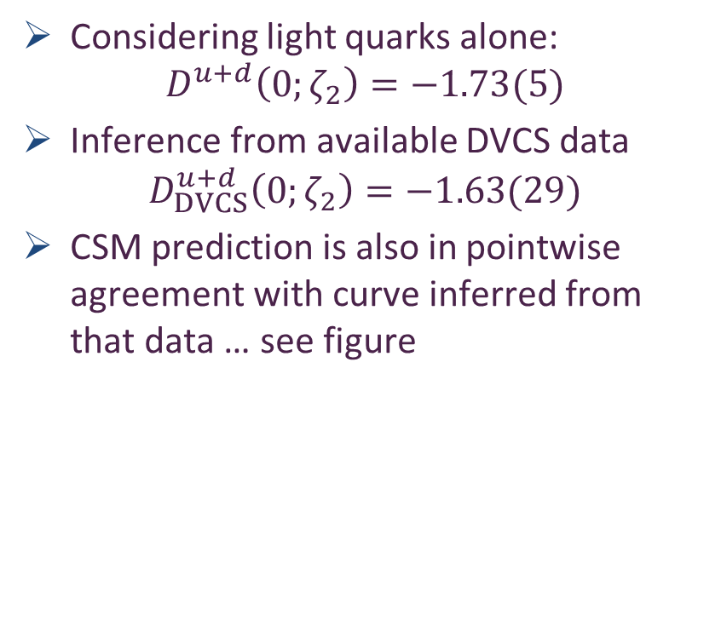
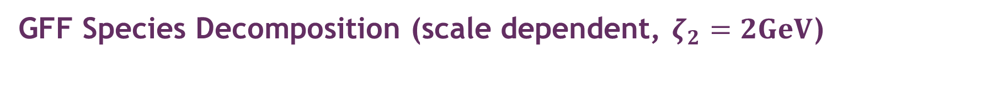
GFF Species Decomposition (scale dependent, $ζ_{2}=2GeV$)
Considering light quarks alone:
$$D^{u+d}\left(0;ζ_{2}\right)=−1.73(5)$$
Inference from available DVCS data
$$D_{DVCS}^{u+d}\left(0;ζ_{2}\right)=−1.63(29)$$
CSM prediction is also in pointwise agreement with curve inferred from that data … see figure
BEG: Inference from existing DVCS data
V. D. Burkert, L. Elouadrhiri, F.-X. Girod, The pressure
distribution inside the proton, Nature 557 (7705) (2018) pp. 396–399.

Slide 28
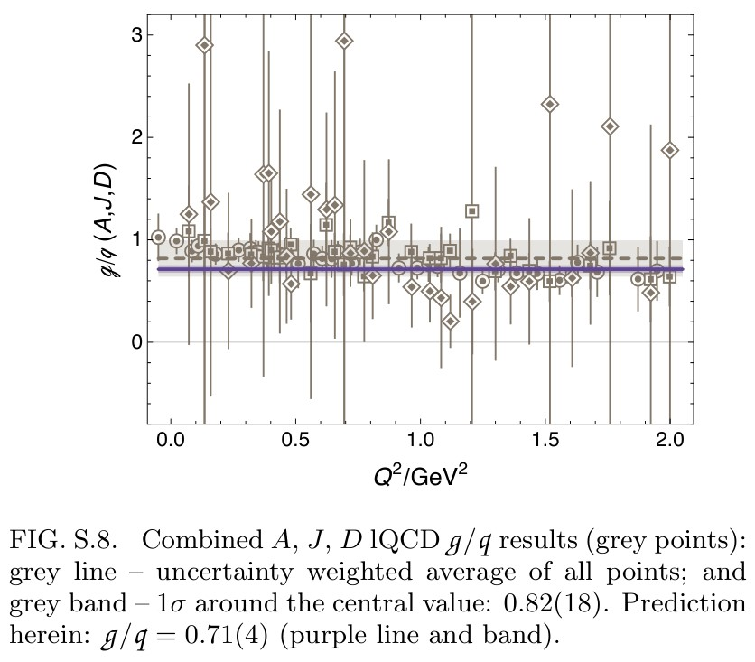
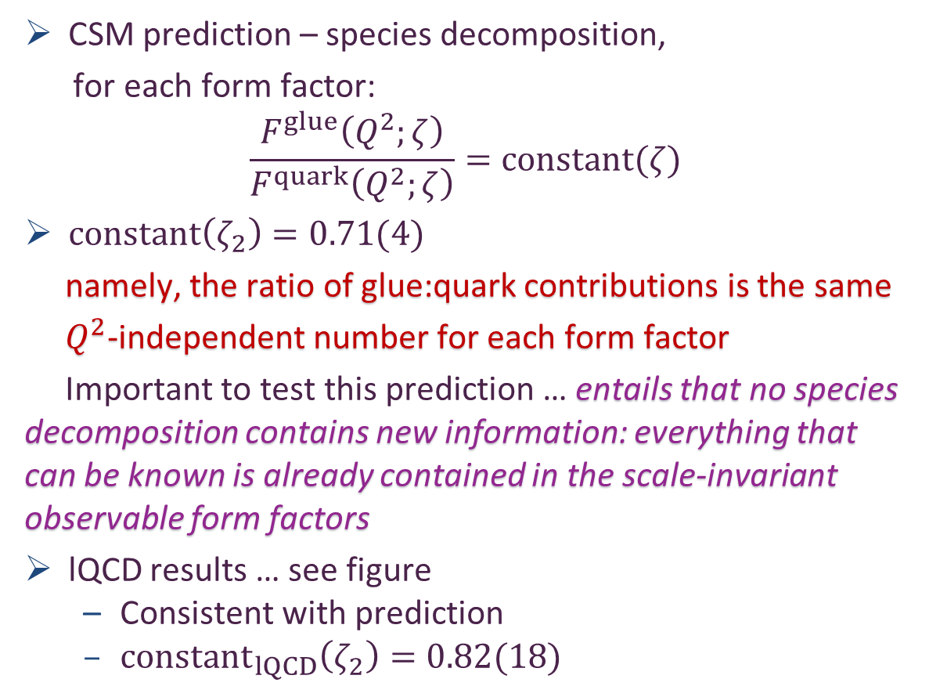
GFF Species Decomposition (scale dependent, $ζ_{2}=2GeV$)
CSM prediction – species decomposition,
for each form factor:
$$\frac{F^{glue}\left(Q^{2};ζ\right)}{F^{quark}\left(Q^{2};ζ\right)}=constant(ζ)$$
$constant\left(ζ_{2}\right)=0.71(4)$
namely, the ratio of glue:quark contributions is the same
$Q^{2}$-independent number for each form factor
Important to test this prediction … entails that no species decomposition contains new information: everything that can be known is already contained in the scale-invariant observable form factors
lQCD results … see figure
  Consistent with prediction
  ${constant}_{lQCD}\left(ζ_{2}\right)=0.82(18)$

Slide 29
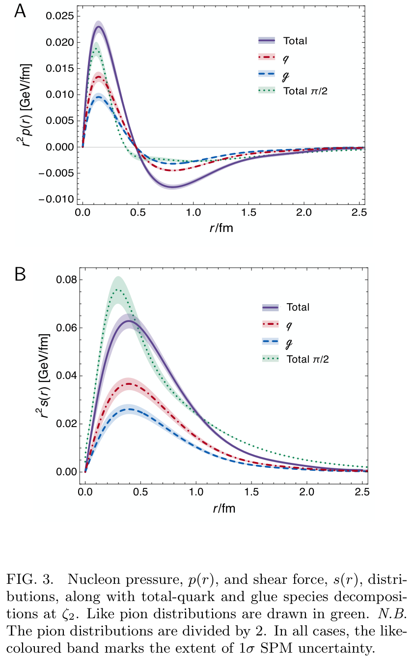
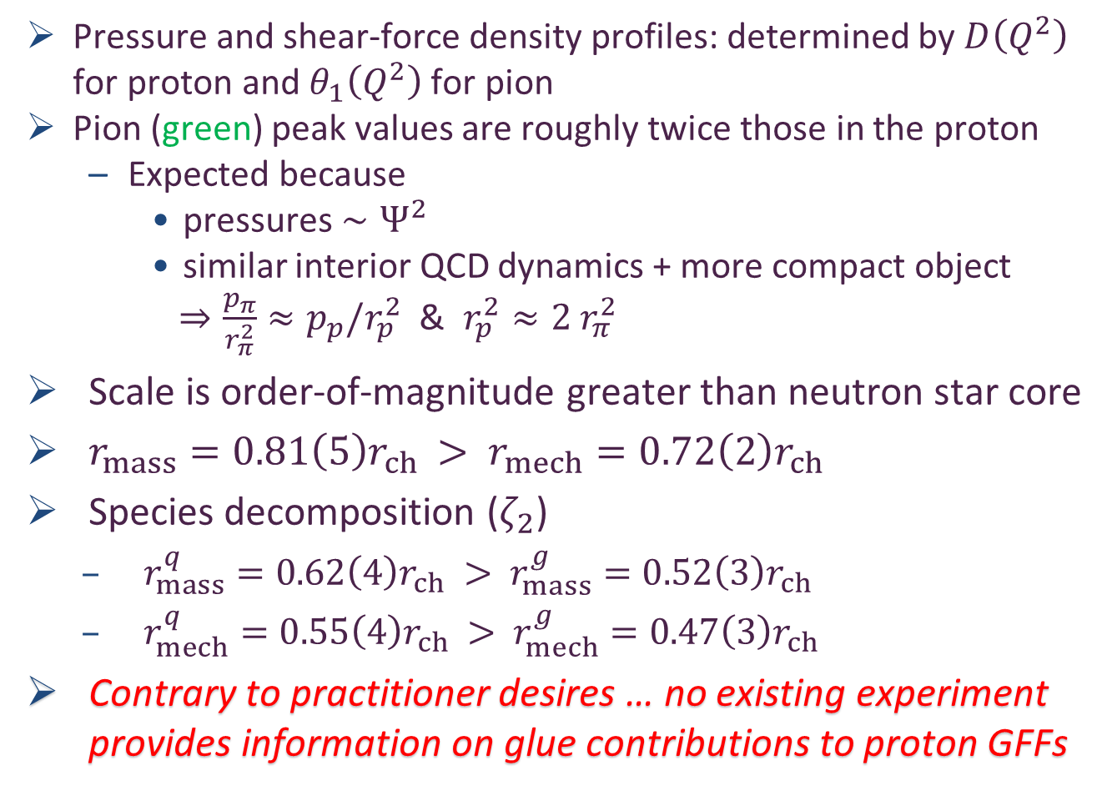
Proton Pressure Profiles
Pressure and shear-force density profiles: determined by $D\left(Q^{2}\right)$ for proton and $θ_{1}\left(Q^{2}\right)$ for pion
Pion (green) peak values are roughly twice those in the proton
  Expected because
    pressures $∼Ψ^{2}$
    similar interior QCD dynamics + more compact object
    $⇒\frac{p_{π}}{r_{π}^{2}}≈p_{p}/r_{p}^{2}$ & $r_{p}^{2}≈2{ r}_{π}^{2}$
Scale is order-of-magnitude greater than neutron star core
$r_{mass}=0.81\left(5\right)r_{ch}$ $>$ $r_{mech}=0.72\left(2\right)r_{ch}$
Species decomposition ($ζ_{2}$)
  $r_{mass}^{q}=0.62\left(4\right)r_{ch}$ $>$ $r_{mass}^{g}=0.52\left(3\right)r_{ch}$
  $r_{mech}^{q}=0.55\left(4\right)r_{ch}$ $>$ $r_{mech}^{g}=0.47\left(3\right)r_{ch}$
Contrary to practitioner desires … no existing experiment provides information on glue contributions to proton GFFs
J/ψ photoproduction: threshold to very high energy, Lin Tang (唐淋) et al.,
e-Print: 2405.17675 [hep-ph], Phys. Lett. B 856 (2024) 138904/1-7

Slide 30
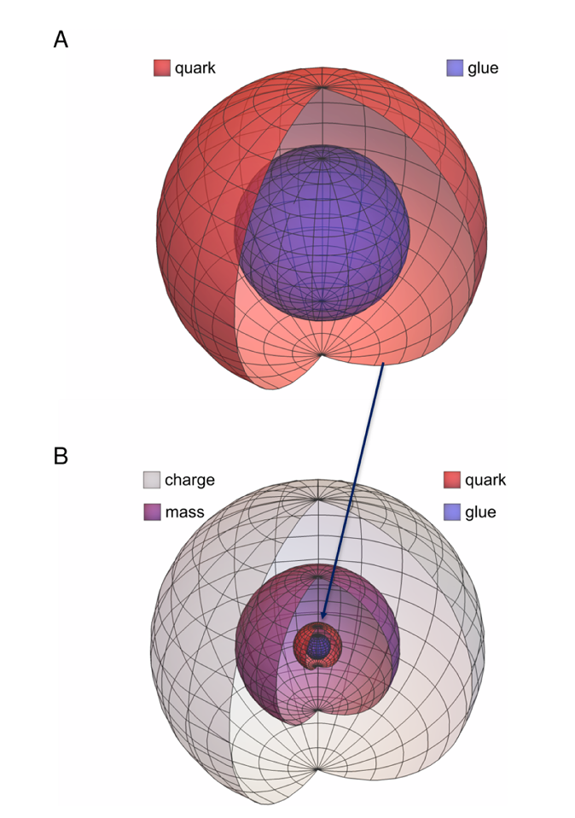
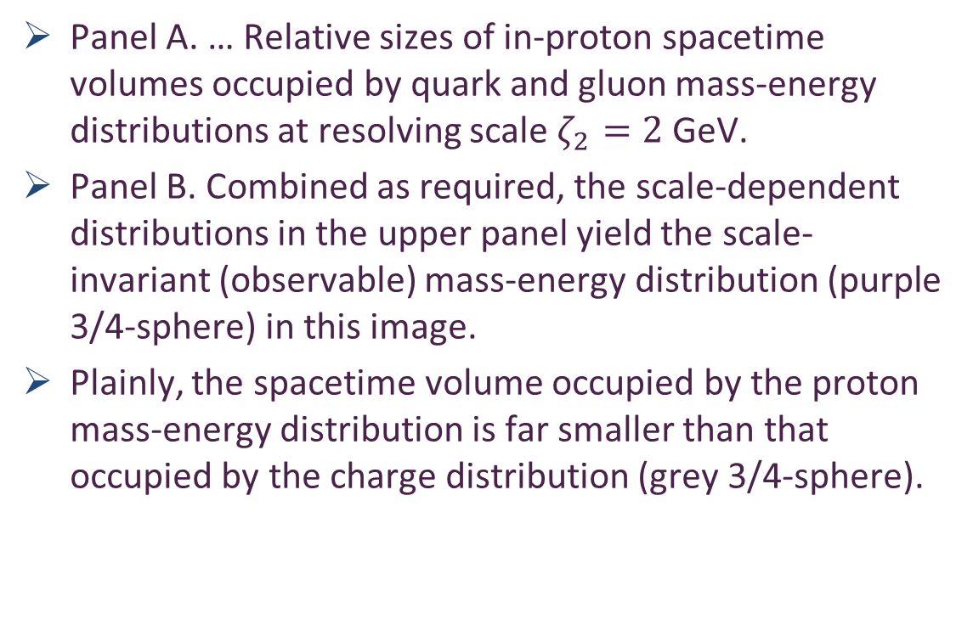
Relative Spacetime Volumes
Panel A. … Relative sizes of in-proton spacetime volumes occupied by quark and gluon mass-energy distributions at resolving scale $ζ_{2}=2$ GeV.
Panel B. Combined as required, the scale-dependent distributions in the upper panel yield the scale-invariant (observable) mass-energy distribution (purple 3/4-sphere) in this image.
Plainly, the spacetime volume occupied by the proton mass-energy distribution is far smaller than that occupied by the charge distribution (grey 3/4-sphere).

Slide 31


Synergy of Experiment, Phenomenology, Theory
Gather all pieces of the puzzle … Reveal the source of Nature’s basic mass-scale
Continuum strong interaction theory is maturing
  Expanding array of parameter-free predictions for the nucleon – yes
  And all the other hadrons whose properties express the full meaning of QCD
    Structure of Nature’s most fundamental Nambu-Goldstone bosons
    Structure of baryons, e.g.,
    $Q^{2}$-dependence of nucleon resonance transition form factors
      Spectrum is insufficient – many models give same spectrum, but transition form factors discriminate between pictures.
Understanding how QCD’s simplicity explains the emergence of hadron mass and structure requires investment in facilities that can deliver precision data on much more than one of Nature’s hadrons.
AMBER@CERN, CEPC, EIC, EicC, JLab22, LHeC, QCD@FAIR, STCF, could …
  Deliver precise structure data on a wide range of hadrons with distinctly different quantum numbers
  Thereby move Science into a new realm of understanding.

Slide 32
Emergent Hadron Mass
Grant no. 12135007
QCD is unique amongst known fundamental theories of natural phenomena
  The degrees-of-freedom used to express the scale-free Lagrangian are not directly observable
  Massless gauge bosons become massive, with no “human” interference
  Gluon mass ensures a stable, infrared completion of the theory through the appearance of a running coupling that saturates at infrared momenta, being everywhere finite
  Massless fermions become massive, producing
    Massive baryons and simultaneously Massless mesons
These emergent features of QCD are expressed in every strong interaction observable
They can also be revealed via
EHM interference with Nature’s other known source of mass = Higgs
We are capable of building facilities that can validate these concepts, proving QCD to be
the 1st well-defined four-dimensional quantum field theory ever contemplated
This may open doors that lead far beyond the Standard Model

Slide 33


Can’t build a Theory of Everything
before status of QCD is decided
$${\text{L}}_{Nature}= ?$$
There are theories of many things,
But is there a theory of everything?
Thankyou

Slide 34


Slide 35


Our Universe
Nuclear-scale mass emerged 1$μ$s after
Big Bang
Its appearance was crucial to the formation of the Universe as we know it

Slide 36


Nucleon charge and magnetisation distributions: zeroes and flavour separation
Parameter-free unification of pion, kaon, nucleon electromagnetic form factors
  Equations: Gap + Bethe-Salpeter + 3-body Faddeev
Proton electric form factor possesses a zero:
$$Q^{2}={8.86}_{−0.86}^{+1.93} GeV^{2}$$
Neutron electric form factor is positive definite
$⇒G_{E}^{n}\left(Q^{2}\right)>G_{E}^{p}\left(Q^{2}\right)$ on $Q^{2}≥4.7 GeV^{2}$
  On this domain, electric form factor of charge-neutral neutron is larger than that of charge-one proton
  Verification is within JLab reach
Prediction underestimates
$G_{E}^{n}\left(Q^{2}\right)$ by 20%
Nucleon charge and magnetisation distributions: flavour separation and zeroes, Zhao-Qian Yao et al., e-Print: 2403.08088 [hep-ph], Fund.Res (2025) in press

Slide 37




All-orders evolution
All-Orders Evolution of Parton Distributions: Principle, Practice, and Predictions
Pei-Lin Yin (尹佩林), NJU-INP 075/23, e-Print: 2306.03274 [hep-ph]
P1 – In the context of Refs. [73, 74], there exists at least one effective charge, $α_{1ℓ}(k^{2})$, which, when used to integrate the leading-order perturbative DGLAP equations, defines an evolution scheme for parton DFs that is all-orders exact.
CSM Process-Independent charge serves this purpose
Hadron scale, $ζ_{H}$
  Scale at which all properties of a given hadron are carried by valence degrees-of-freedom

Slide 38

AO Evolution
Principle
  Hadron scale, $ζ_{H}$, is rigorously defined in connection with a Grunberg charge, in terms of which leading-order DGLAP evolution is promoted to the status of an all-orders exact procedure.
  The AO scheme is not a model, and neither is $ζ_{H}$.
  Instead, the AO approach, involving and defining $ζ_{H}$, is complete by definition.
As explained by Grunberg, there is always an effective (process-dependent) effective charge for which the AO propositions are true.
  Consequently, there is no room for doubt about the existence of $ζ_{H}$.
Crucially, such a Grunberg effective charge is
  consistent with the renormalization group;
  renormalization scheme independent;
  everywhere analytic and finite;
  and supplies an infrared completion of any standard running coupling.

Slide 39

AO Evolution
Crucially, such a Grunberg effective charge is
  consistent with the renormalization group;
  renormalization scheme independent;
  everywhere analytic and finite;
  and supplies an infrared completion of any standard running coupling.
These features entail that all calculations of a DF at a scale within a domain of pQCD applicability are compatible with this effective charge.
Moreover, and especially important, is the fact that one does not need to know the pointwise form of the effective charge
  Its existence alone is sufficient to deliver
  the definition of $ζ_{H}$ and all attendant consequences
  N.B. glue and sea DFs are identically zero at $ζ_{H}$

Slide 40
AO Evolution
The potential issue with a Grunberg effective charge is
that reference to a specific process may make it globally useless
We know that is not the case
  The class of process-dependent (Grunberg) charges,
    defined in connection with the AO scheme,
    may be characterized by our unique, predicted process-independent effective charge
Thus far, the AO class of charges – in particular, our PI charge – has served in the same form for all known parton DFs
  Namely, for a large array of structure functions and fragmentation processes.
This is a very broad domain of applicability for one single Grunberg charge.

Slide 41



Hadron Gravitational Form Factors
Forces inside hadrons: pressure, surface tension, mechanical radius, and all that,
M. V. Polyakov, P. Schweitzer, Int. J. Mod. Phys. A 33 (2018) 26
    “The most natural way to probe EMT form factors, scattering off gravitons – see left image – is also the least practical one.
    A practical opportunity to access EMT form factors emerged with the advent of generalized parton distributions (GPDs), which describe hard-exclusive reactions, such as deeply virtual Compton scattering – see right image.”
This is because the in-hadron expectation value of the QCD energy momentum tensor … $⟨H|T_{μν}|H⟩$
  appears in the operator product expansion of the in-hadron matrix element of two vector currents … $⟨H|J_{μ}J_{ν}|H⟩$
X. D. Ji, Phys. Rev. Lett. 78, 610 (1997)
To use OPE, one of the photons, $γ^{∗}$, must be far off-shell (large $Q^{2})=$ deeply virtual Compton Scattering

Slide 42




Gravitational Form Factors
Mass, Spin, Pressure Distributions
Prediction built from
  Zhao-Qian’s results
Lattice results in left panel from [Hackett:2023rif]
Authors acknowledge these are first results.
Statistical errors are very large.
Results on only one lattice spacing & one lattice volume are available.
Only one unphysical pion mass is used.
Renormalisation scheme is not gauge invariant and renormalisataion constants were calculated on a different lattice from the one used to compute the GFFs.
No other computed observable is available on the lattice setup the authors used.
Follows, inter alia, that the systematic errors on [Hackett:2023rif] are completely unknown and therefore uncontrolled.
Hence, no one can know whether it is better to agree or disagree with the lQCD results – Nevertheless, authors claimed “benchmark for future”
CSM prediction (parameter-free) in precise agreement with inference from $ππ, K\overline{K}$ scattering data [Cao:2024zlf]

Slide 43
Gravitational Form Factors
Mass, Spin, Pressure Distributions
Prediction built from
  Zhao-Qian’s results
CSM prediction (parameter-free) in precise agreement with inference from $ππ, K\overline{K}$ scattering data [Cao:2024zlf]
CSM results
Systematic errors considered and controlled
Statistical errors associated with numerical algorithms small
Parameter-free unification of nucleon gravitational form factors with data-consistent predictions for pion, kaon, and nucleon electromagnetic form factors [Yao:2024drm, Yao:2024uej]
CSM predictions are fully benchmarked

Slide 44
Gravitational Form Factors
Mass, Spin, Pressure Distributions
Prediction built from
  Zhao-Qian’s results
CSM prediction (parameter-free) in precise agreement with inference from $ππ, K\overline{K}$ scattering data [Cao:2024zlf]
My position
Breadths of application & success of the parameter-free framework employed suggest that predictions delivered should serve as benchmarks for future phenomenology and theory.
No improvement on CSM study can be anticipated before lattice-QCD analyses have simultaneously delivered infinite-volume, continuum-limit, carefully renormalised, physical pion mass studies of all physical properties discussed, viz. pion, kaon, nucleon electromagnetic and gravitational FFs.
CSM predictions are truly setting the standard against which future calculations/inferences should be judged

Slide 45


Trace Anomaly Form Factor
Some practitioners imagine that objective access to in-proton expectation value of trace of QCD energy momentum tensor
$$⟨p_{k_{2}}|T_{μν}\left(Q\right)|p(k_{1}⟩$$
  possible via photoproduction from proton of vector mesons that share no valence degrees of freedom in common with the proton
Consequently, extensive new data available on
$$γ+p→J/ψ+p$$
Desire to calculate/predict the trace anomaly form factor
Also, its species decomposition
  In misguided attempt to decide whether the gluon parton density extends further than the proton charge radius
VMD assumption

Slide 46




Trace Anomaly Form Factor
Mass-energy density form factor
  Nonnegative function = good for a mass distribution
In-proton expectation value of QCD trace anomaly:
$θ(Q^{2})$ is not positive definite
  species decompositions have same feature.
Unusual outcome for global property of a nucleon mass distribution
Distributions of charge involve positive and negative charge carriers, hence can possess domains of negative support
All physical mass is positive definite, so there is no good reason why a form factor definitive of mass should become negative.
Somewhat arbitrary outcome: just $D_{M}→3D_{θ}$

Slide 47


Trace Anomaly Form Factor
Mass-energy density form factor
  Nonnegative function = good for a mass distribution
In-proton expectation value of QCD trace anomaly:
$θ(Q^{2})$ is not positive definite
  species decompositions have same feature.
Unusual outcome for global property of a nucleon mass distribution
Distributions of charge involve positive and negative charge carriers, hence can possess domains of negative support
All physical mass is positive definite, so there is no good reason why a form factor definitive of mass should become negative.
Somewhat arbitrary outcome: just $D_{M}→3D_{θ}$
Objective interpretation of this result = one particular combination of proton gravitational form factors has a larger slope than another chosen combination of electromagnetic form factors.
No sense in which this means that gluons are distributed over a larger spacetime volume than quarks because total form factor, being scale invariant, does not express information about a subjective species decomposition.

