Slide 1



使用ZDC在EIC和LHC上研究新物理
East Asia Workshop on QCD and Hadron Structure, May 26
Michael Murray

Slide 2
How ZDCs enable physics
The main way that ZDCs enable physics is by characterizing different kinds of events
For the LHC experiments ZDCs are essential for triggering on nucleus-nucleus, proton-nucleus, photon-nucleus and photon-photon events.
At the EIC the ZDCs will probably be even more important since they are vital to characterize exclusive and semi-inclusive results.
So far the LHC experiments have not be able to measure forward photons with the ZDCs.
Precision photon measurements could increase the physics reach of the ZDCs at both the LHC and EIC.

Slide 3
Towards hermetic coverage with CMS
In 2025 for proton-Oxygen collisions CMS ran with
Forward Show Counters (FSCs) measure charged particles with very different momentum from the beam’s momentum.
Zero Degree Calorimeter (ZDC) measures very forward neutrons and photons.
Precision Proton Spectrometer (PPS) measures diffractive protons.

Slide 4
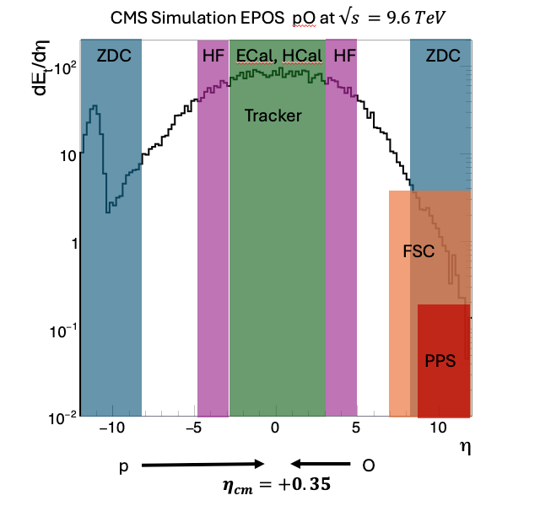
CMS acceptance for pO run

Slide 5
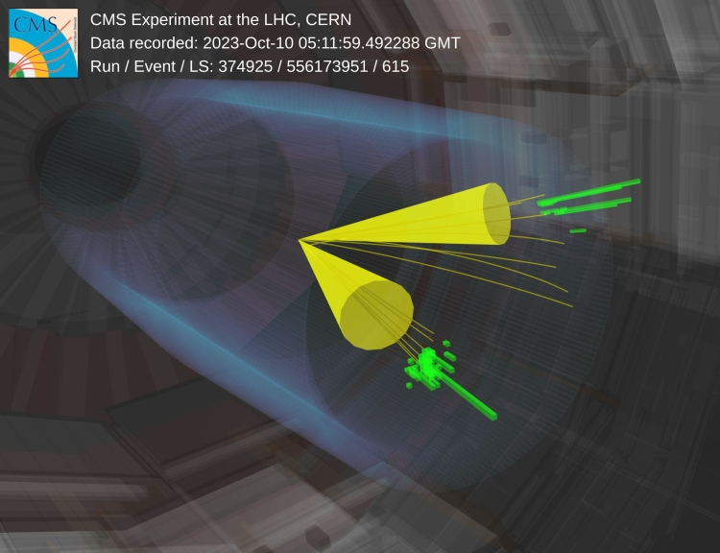
ZDCs enable photon nucleus physics
To collect large samples of $γγ→c cbar$ZDCs is essential

Slide 6
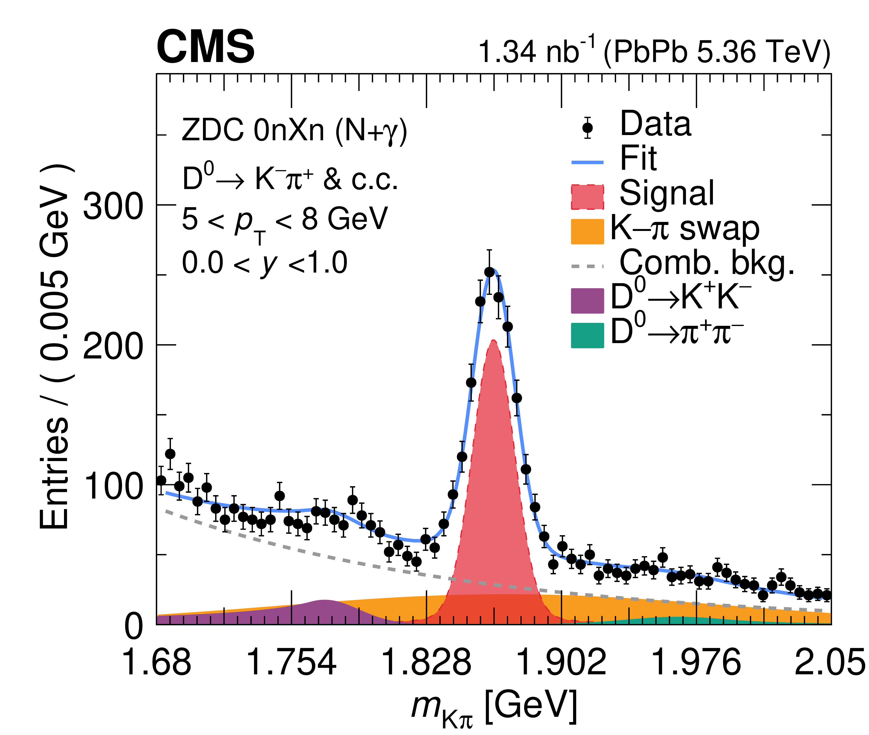
Photo-production of d mesons

Slide 7
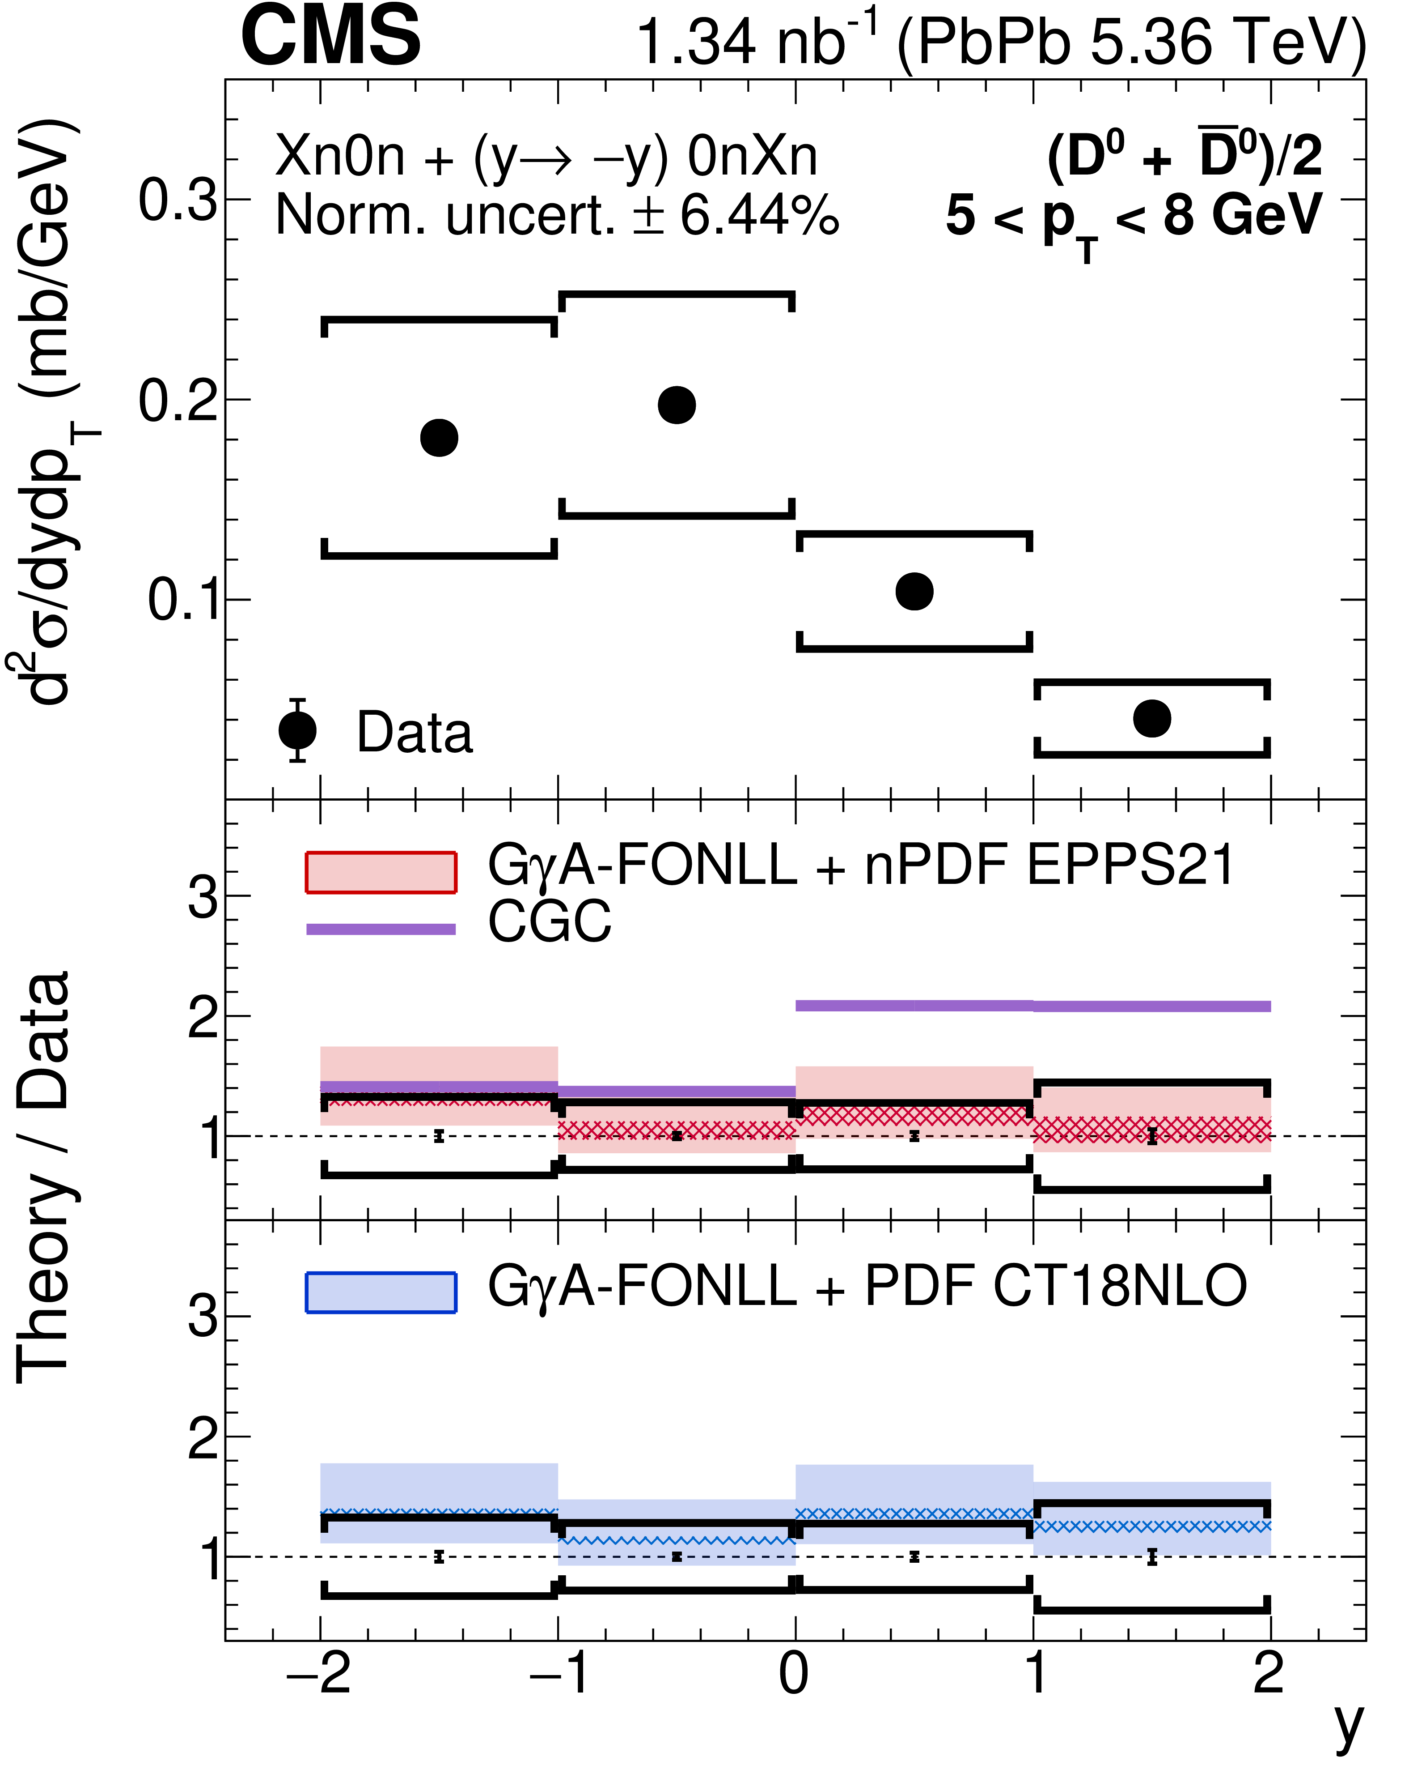
Photo-production of d mesons

Slide 8
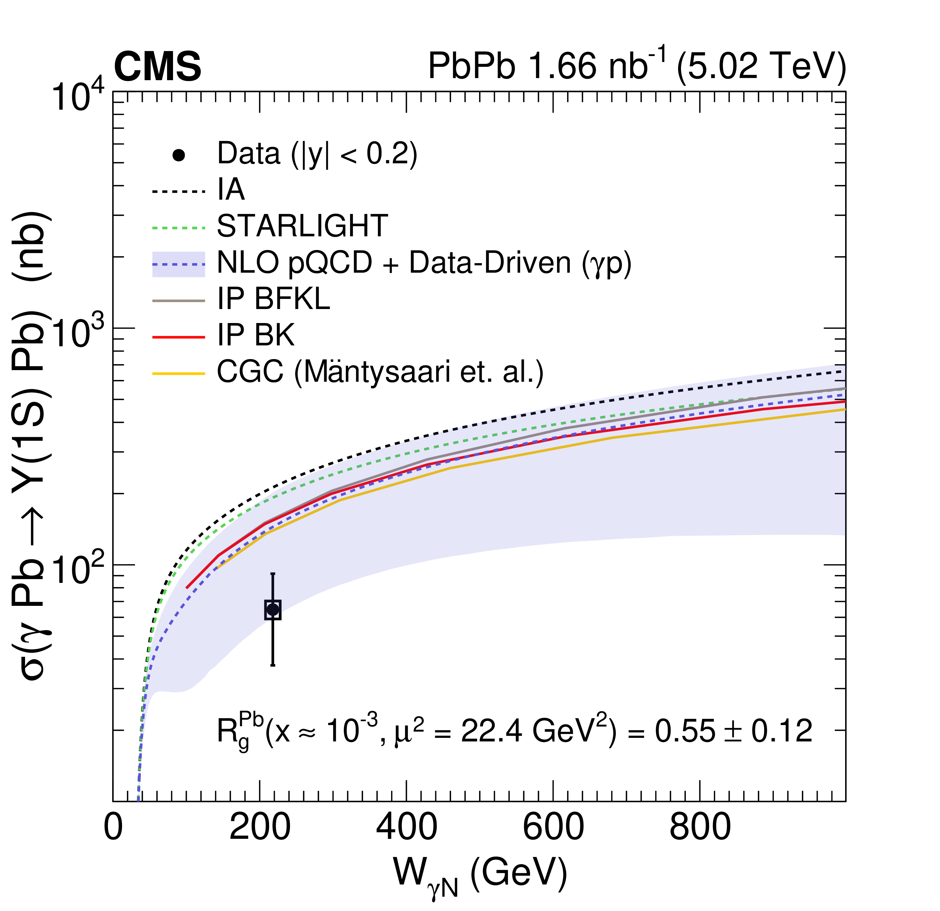
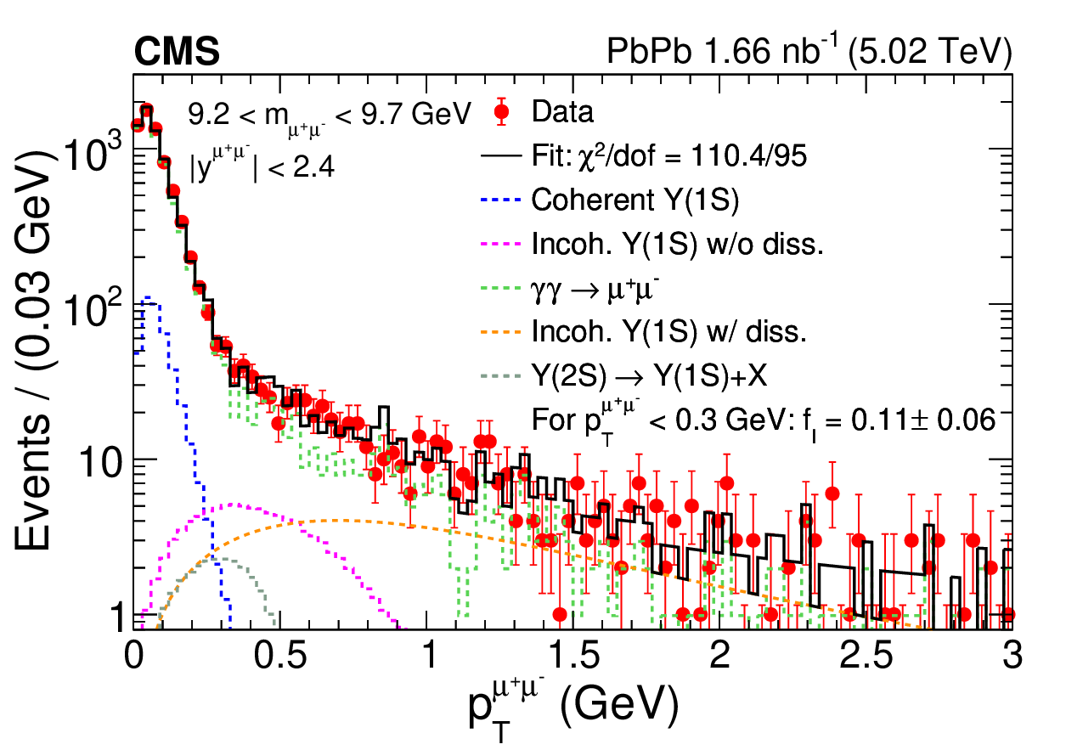
Coherent Upsilon production
Submitted to PRL

Slide 9
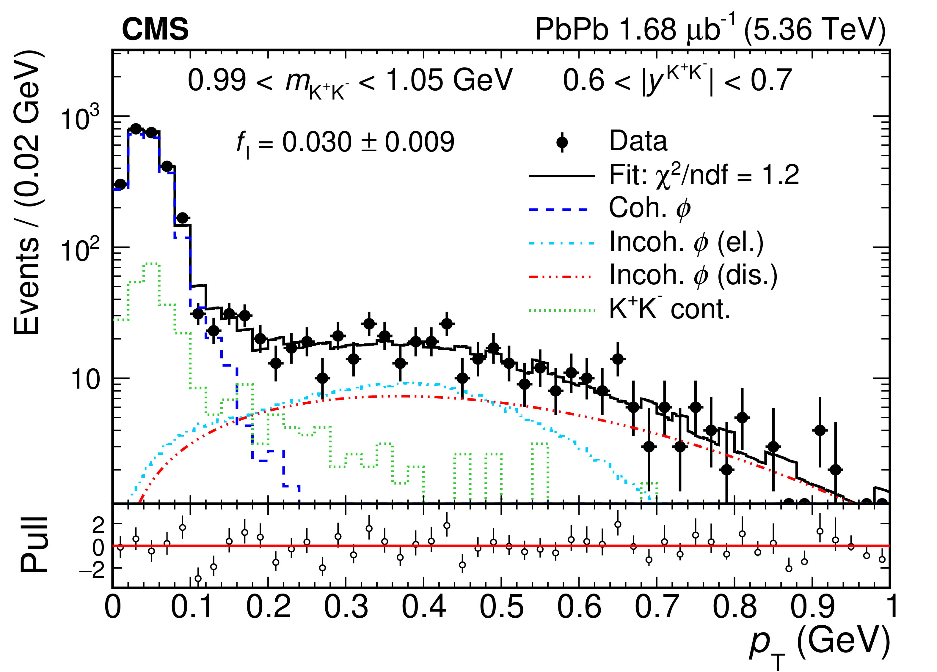
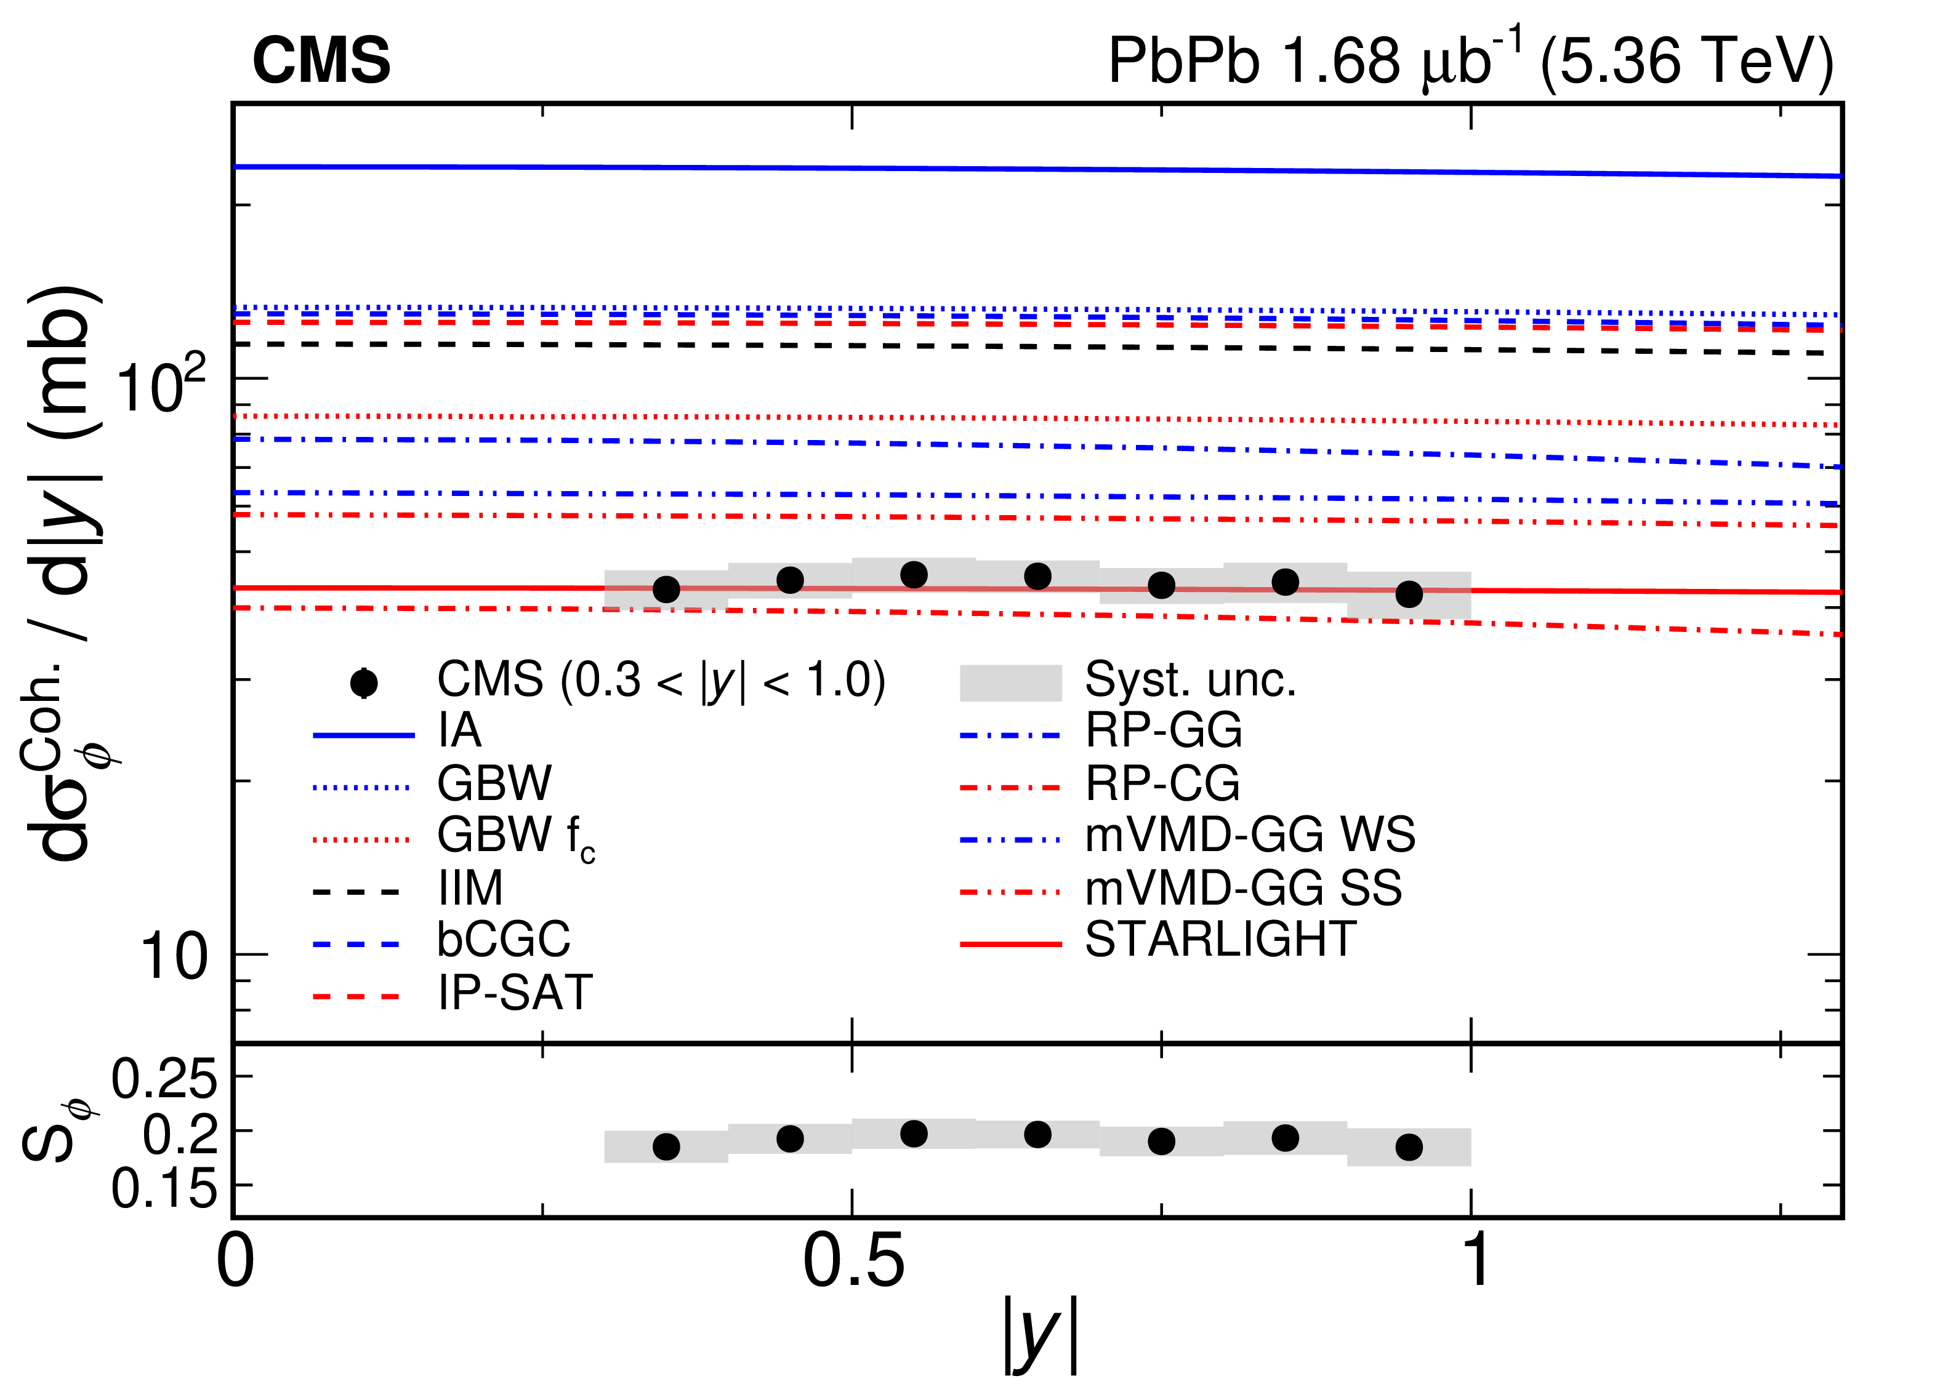
Coherent rho production
Phys. Rev. Lett. 135 (2025) 262301

Slide 10
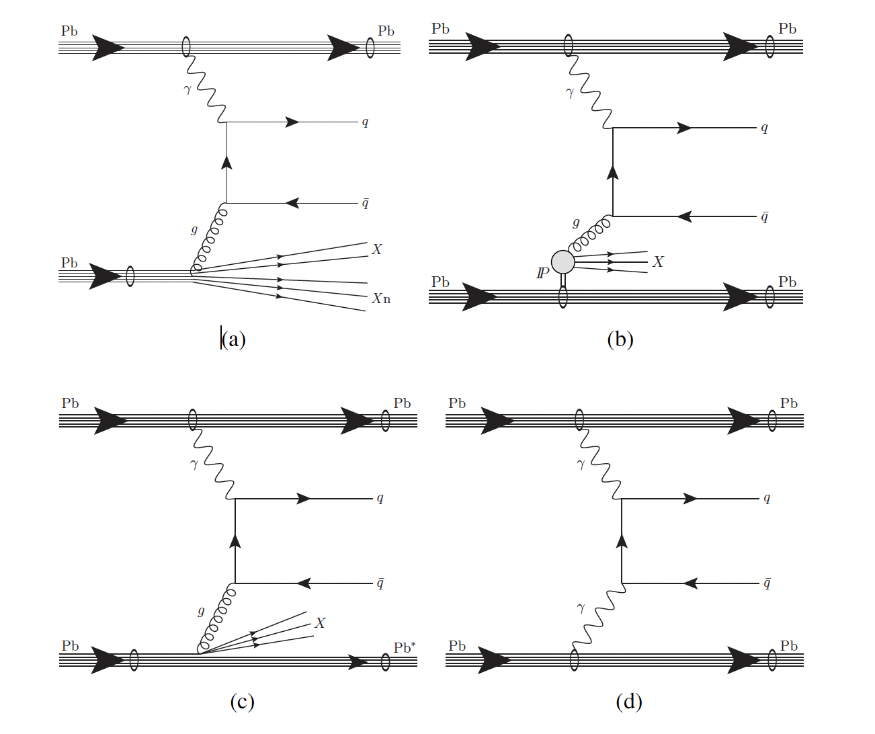
ATLAS UPC jet production

Slide 11
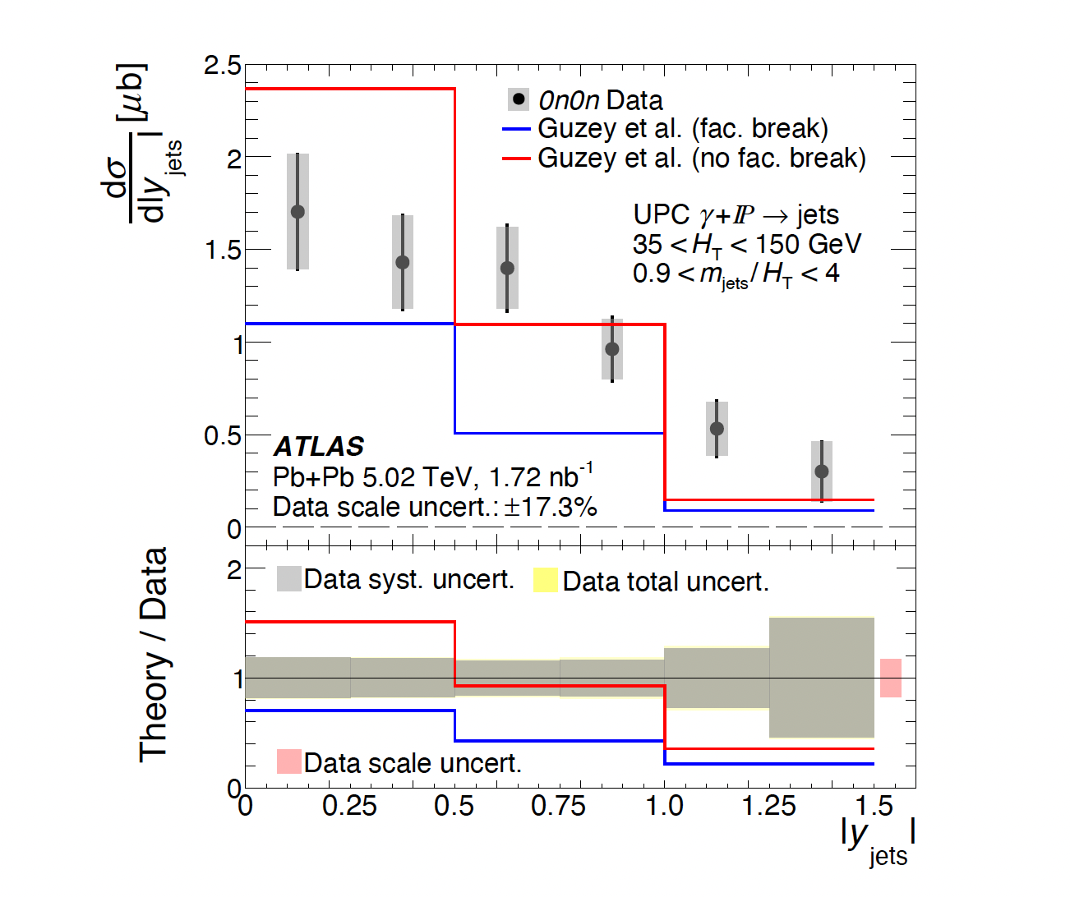

ATLAS: $γPomeron→Jets$
Data have sensitivity to factorization breaking in the models.

Slide 12
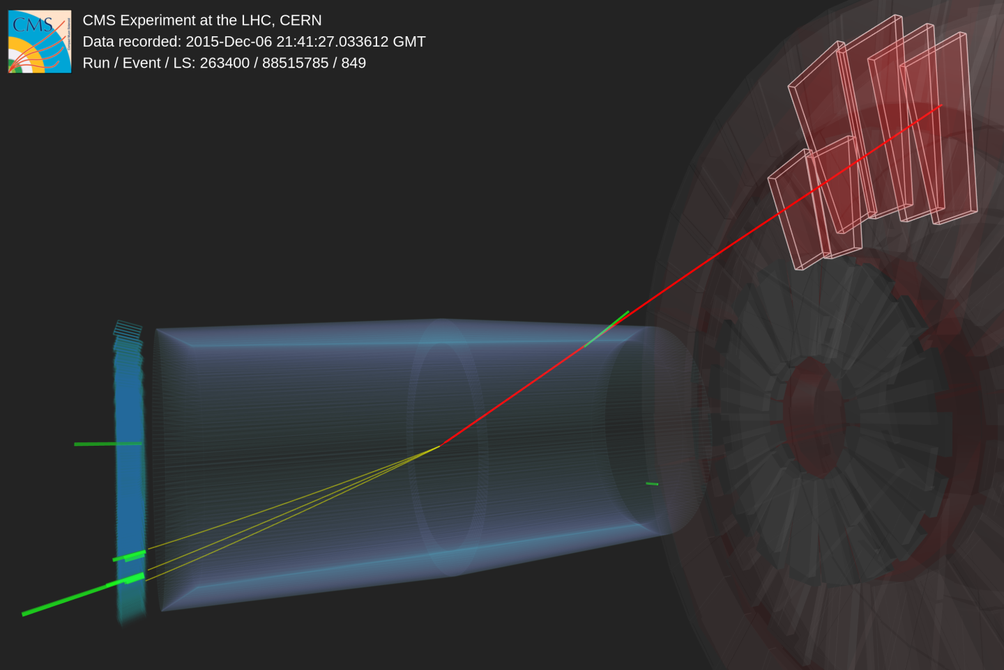


ZDCs also help capture $γγ$ physics
$$γγ→τ^{+}τ^{−}$$

Slide 13
g-2 is ratio magnetic moment to spin
Swinger derived NLO correction = 0.016
g-2 for the electron is the most precise measurement in physics.
Recently the muon g-2 measured to be consistent with lattice QCD calculations.
Many models of new physics predict deviation of g-2 that scales with mass²
Tau may point us to new physics.

Slide 14
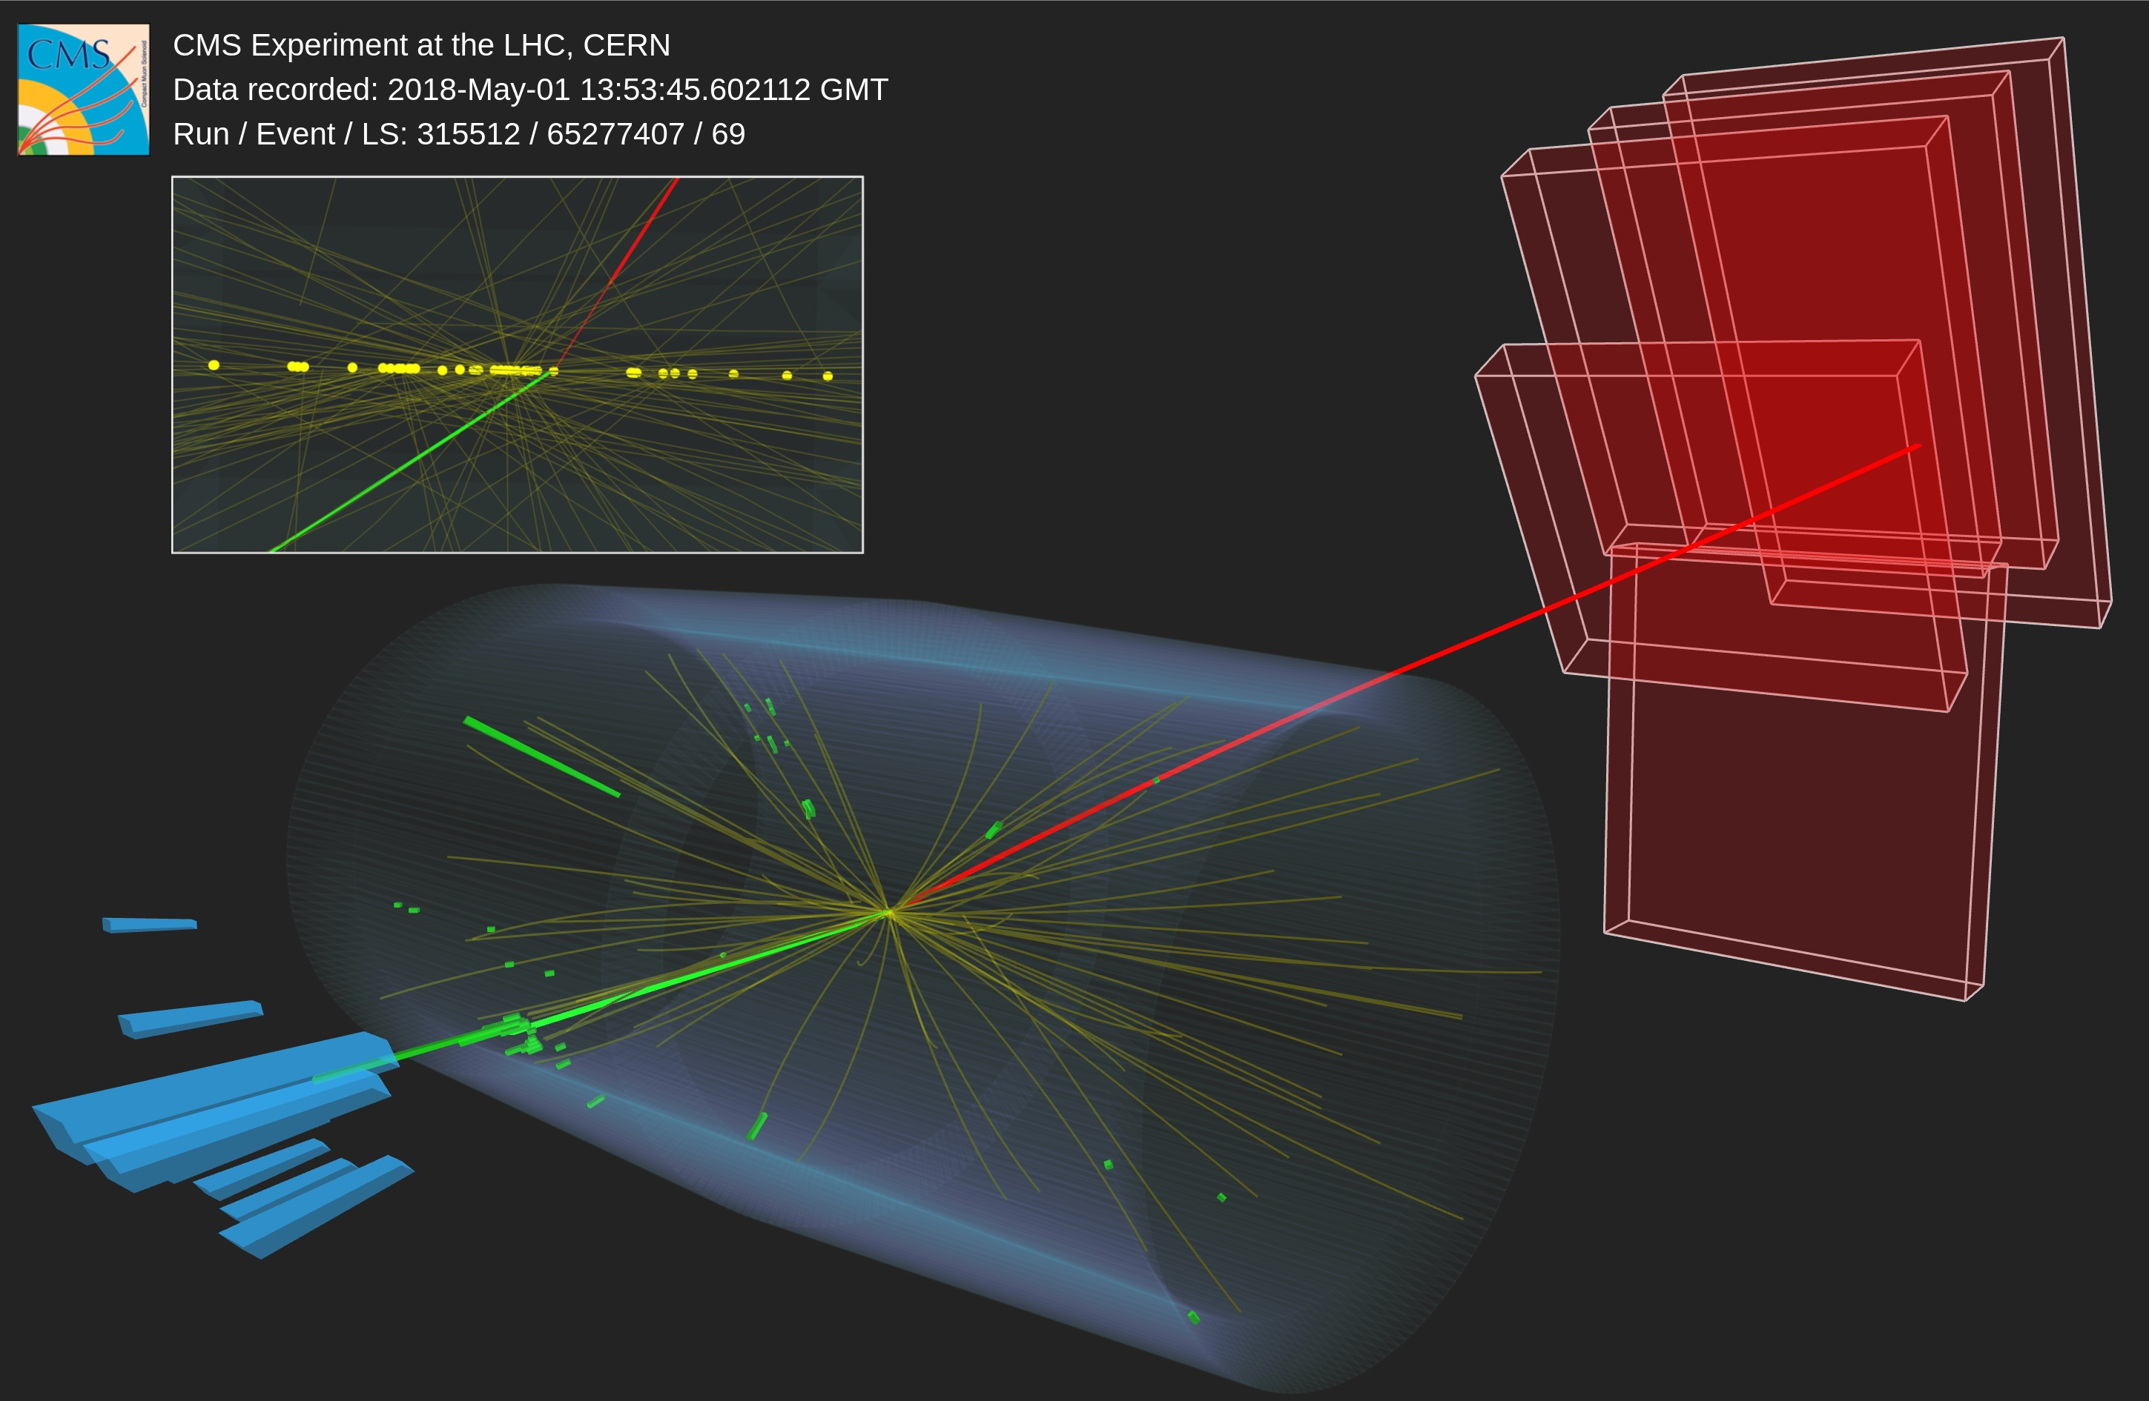


$γγ→ττ$ in CMS for pp with PPS
$γγ→ττ$ in CMS
𝜏– → 𝜇–
𝜏⁺ → 𝜋⁺𝜋–𝜋⁺
interactive
Notes:
Zooming out, the even looks like this, with a muon, and hadrons
Using CMS’s excellent tracking, we can clean the event to remove all pileup up tracks, shown in yellow
~4m wide, ~2m
press:
https://cerncourier.com/a/cms-closes-in-on-tau-g-2/
https://twitter.com/CERNCourier/status/1770094581985542277
https://cms.cern/news/disclosing-quantum-corrections-electromagnetic-interactions-tau-leptons
https://twitter.com/CMSExperiment/status/1772317017476940223)\]
https://home.web.cern.ch/news/news/experiments/first-observation-photons-taus-proton-proton-collisions-cms
https://twitter.com/CERNpress/status/1772295468426396116
event display:
https://cms3d.web.cern.ch/SMP-23-005-embedded/
https://cms3d.web.cern.ch/SMP-23-005/

Slide 15
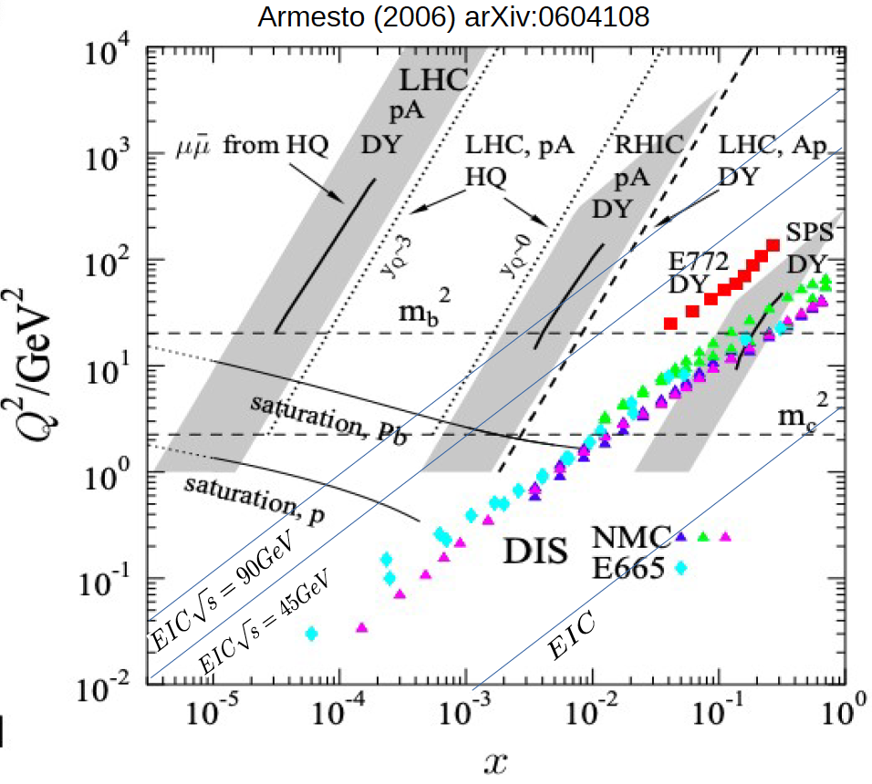
EIC 和 LHC 是否互補？
Running light ions in the 2030s would allow LHC to compare to EIC early science
This would be very helpful for saturation studies.
Notes:
Are the EIC and LHC complementary?

Slide 16
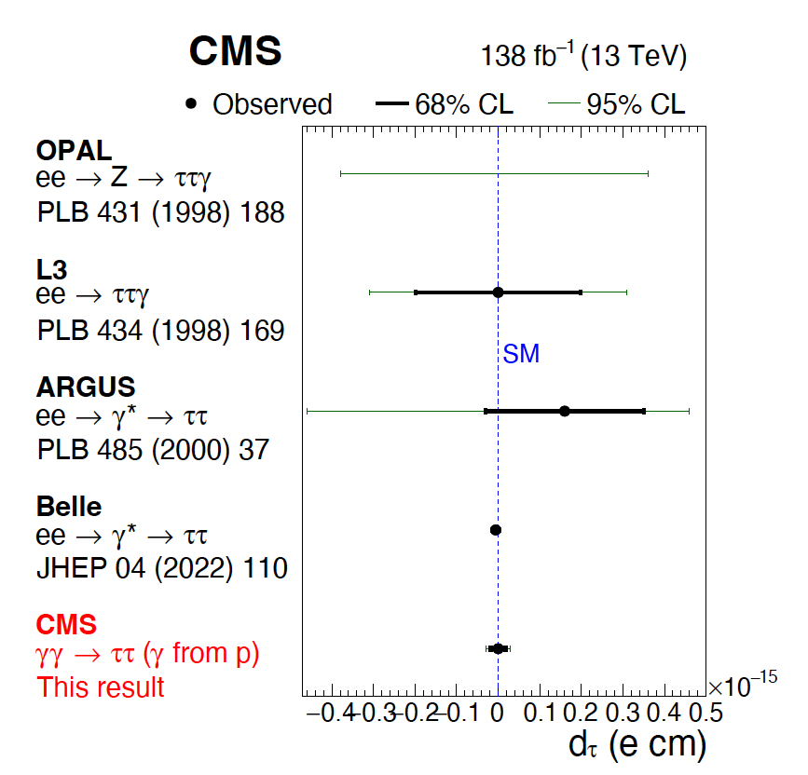
Results for tau electric dipole moment
Proton-Proton data is at a mass scale of 100s of GeV
Pb-Pb UPC is at a mass of 10 GeV
EIC would allow us to measure at very low mass.

Slide 17





Q² vs x for UPCs
$$Υ(1S)$$
$$ψ(2S)$$
$$J/ψ$$
saturation Pb
$$ϕ$$
$$ρ^{0}$$
saturation p

Slide 18
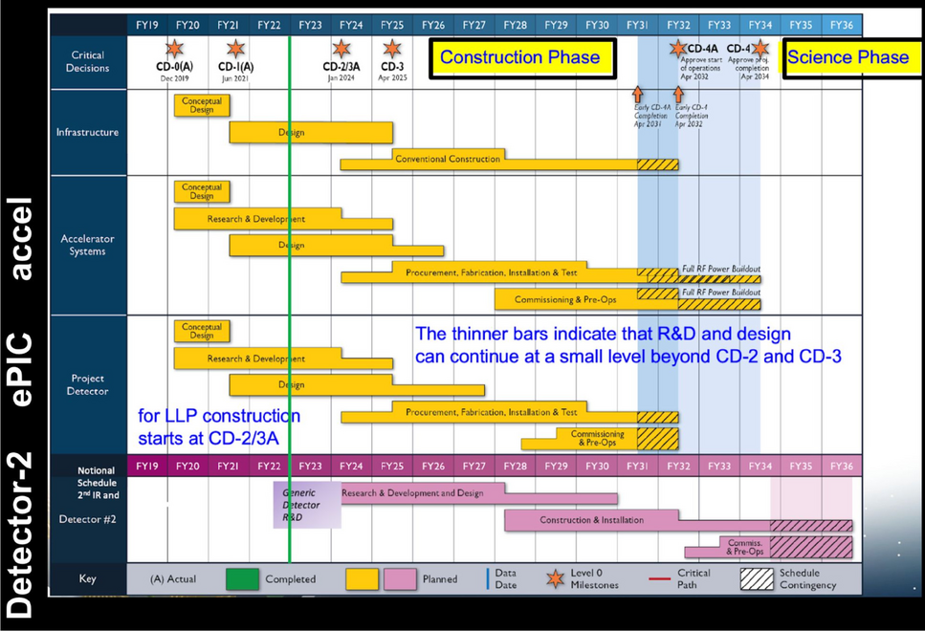
EIC will start doing science in 2035

Slide 19
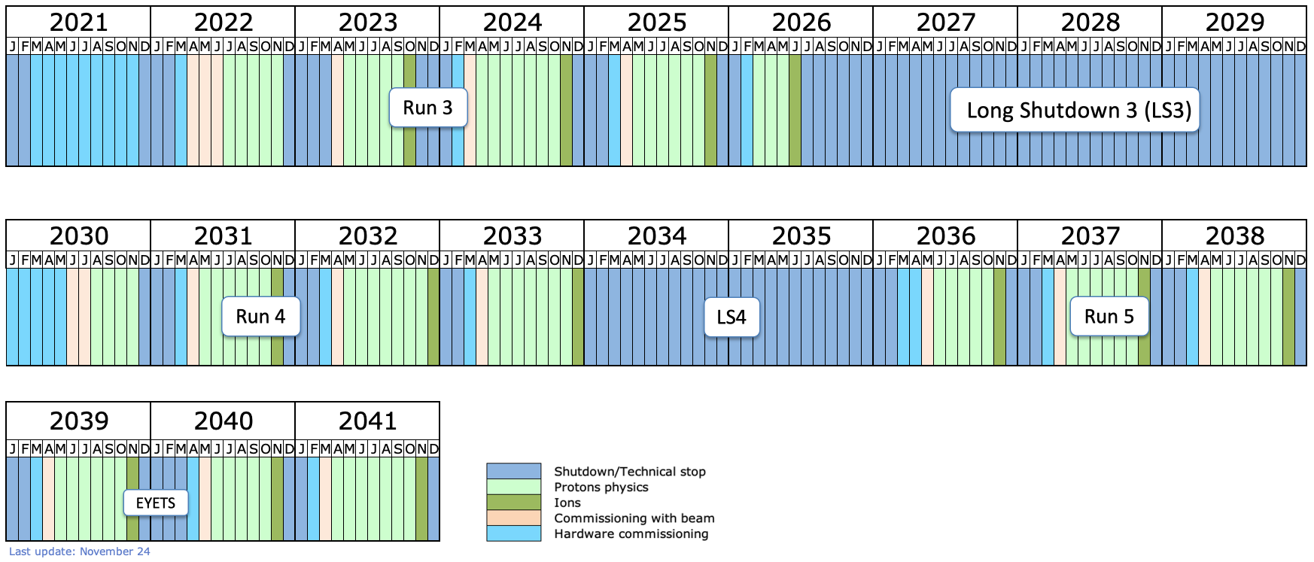
LHC and EIC will overlap from 2036
$γγ→ττ$ in CMS
EIC science period
Notes:
Zooming out, the even looks like this, with a muon, and hadrons
Using CMS’s excellent tracking, we can clean the event to remove all pileup up tracks, shown in yellow
~4m wide, ~2m
press:
https://cerncourier.com/a/cms-closes-in-on-tau-g-2/
https://twitter.com/CERNCourier/status/1770094581985542277
https://cms.cern/news/disclosing-quantum-corrections-electromagnetic-interactions-tau-leptons
https://twitter.com/CMSExperiment/status/1772317017476940223)\]
https://home.web.cern.ch/news/news/experiments/first-observation-photons-taus-proton-proton-collisions-cms
https://twitter.com/CERNpress/status/1772295468426396116
event display:
https://cms3d.web.cern.ch/SMP-23-005-embedded/
https://cms3d.web.cern.ch/SMP-23-005/

Slide 20
EIC and LHC have complementary phase space

Slide 21

EIC需要設立ZDC嗎？
At the EIC it is crucial to identify exclusive, and semi-inclusive processes.
The ZDC is vital to identify very forward neutrons and photons.
For example, the LHC experiments have so far not identified photons from nuclei excited in Pb nuclei.
It will be very difficult to identify such processes without a ZDC.
Notes:
Alternatively, “EIC需要ZDC嗎？” means “Does the EIC need a ZDC?”

Slide 22
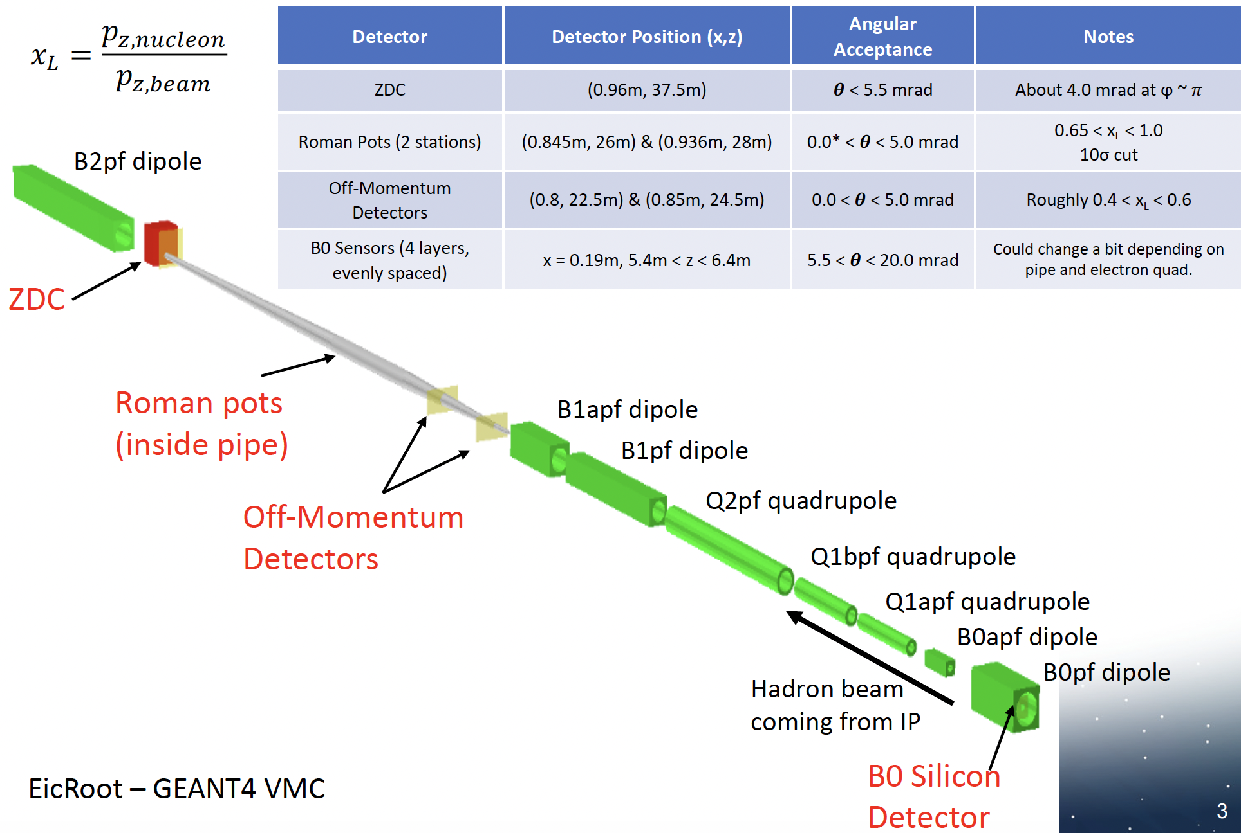
EIC with have almost hermetic coverage

Slide 23

“But Ailene we can’t afford all this!”
ZDCs at both EIC and HL-LHC are significant investments.
However, they enable a huge range of physics.
The investment is worth the cost.

Slide 24
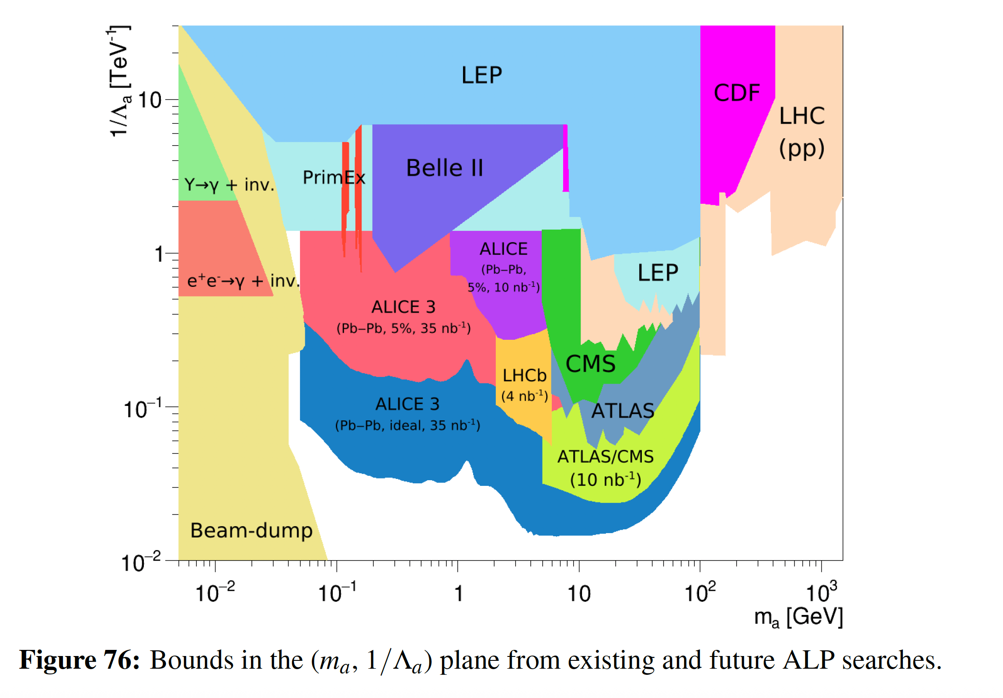
Great potential to find axions

