Slide 1
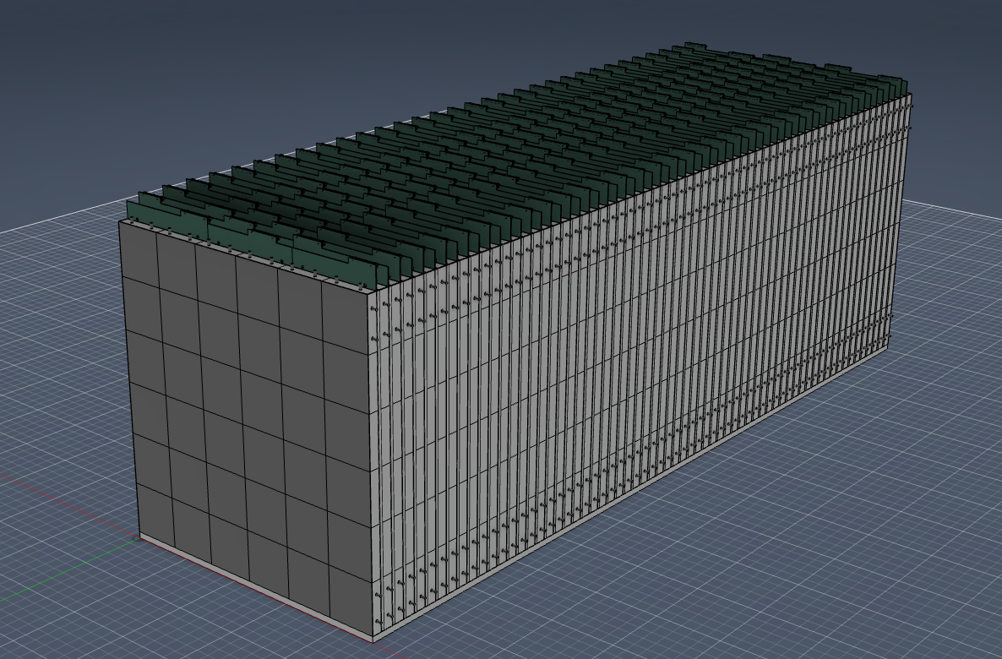

ePIC ZDC HCAL
Sean Preins
University of California, Riverside

Slide 2
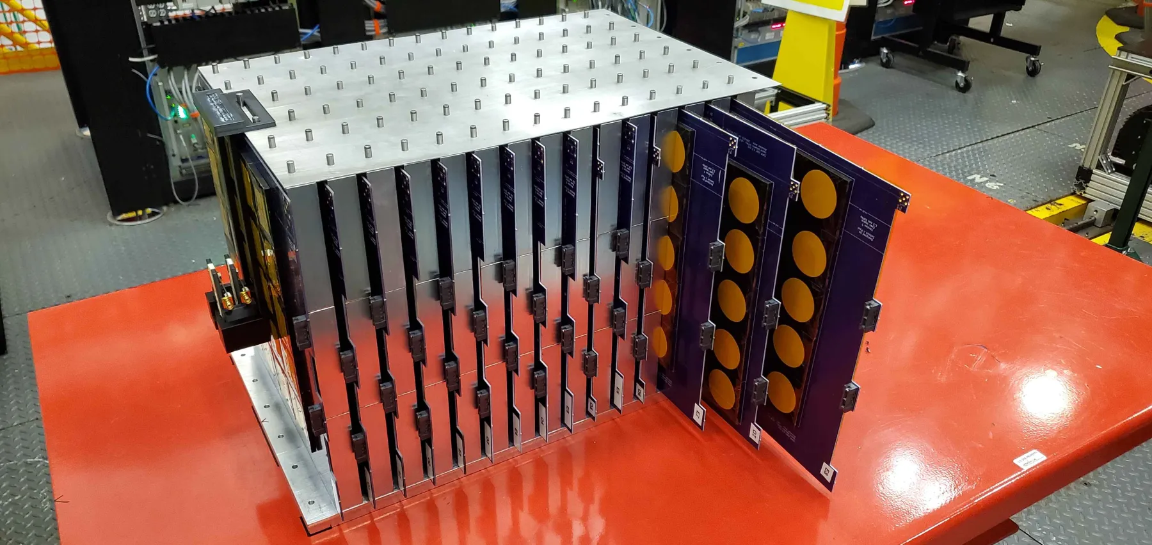
Outline
Design Overview
ZDC HCAL Requirements
SiPM-on-tile R&D Studies
Construction, QA, and Assembly

Slide 3
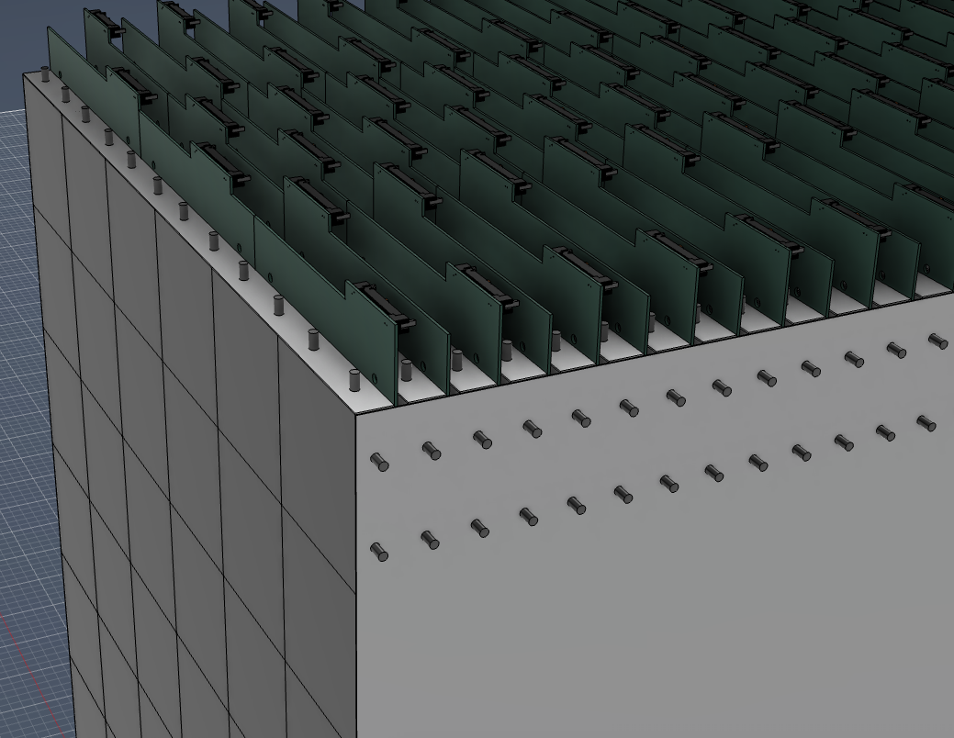
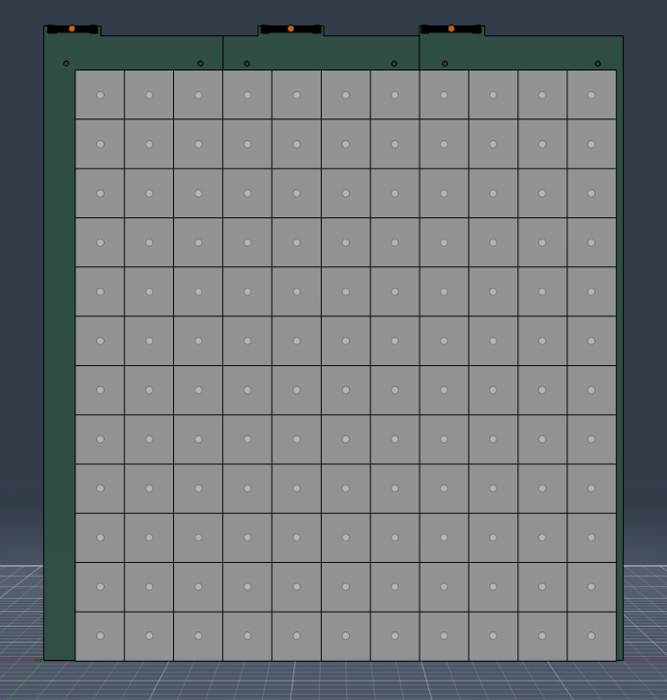
ZDC HCAL Design Overview
64-layer SiPM-on-tile sampling calorimeter
ASIC-away-of-SiPM readout to reduce cooling and space requirements
1.3 mm SiPMs, 48.8mm x 48.8mm tiles same as forward HCAL
576 mm x 600 mm x 1755 mm
121 / 132 channels per layer, 8096 channels
Every second layer is offset by half a cell width in each direction to increase effective granularity
Layers are removable to allow for SiPM annealing to mitigate radiation damage

Slide 4
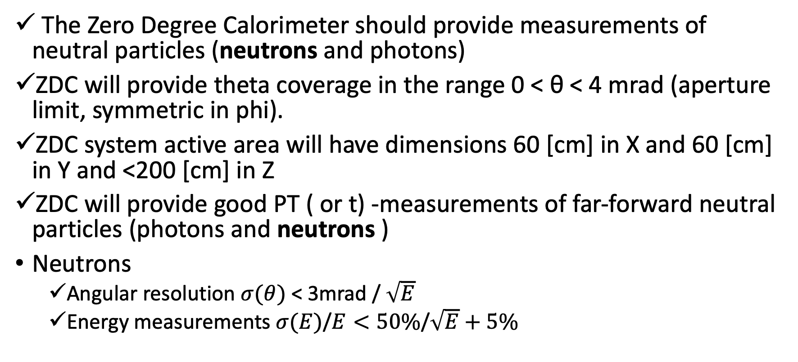
ZDC HCAL Requirements
https://eic.jlab.org/Requirements/
The Zero Degree Calorimeter should provide measurements of neutral particles (neutrons and photons)
ZDC will provide theta coverage in the range 0 < θ < 4 mrad (aperture limit, symmetric in phi).
ZDC system active area will have dimensions 60 [cm] in X and 60 [cm] in Y and <200 [cm] in Z
ZDC will provide good PT ( or t) -measurements of far-forward neutral particles (photons and neutrons )
Neutrons
Angular resolution $σ(θ)$ < 3mrad / $\sqrt{E}$
Energy measurements $σ(E)$/$E<50\%$/$\sqrt{E}+5\%$

Slide 5
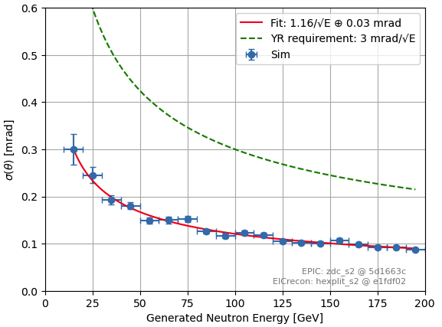
ZDC HCAL Requirements, Angular Resolution
Simulation was updated from using hexagonal tiles to square tiles
Updated model shows angular resolution is still well below the YR requirement
Angular resolution can likely be improved further via GNN reconstruction

Slide 6
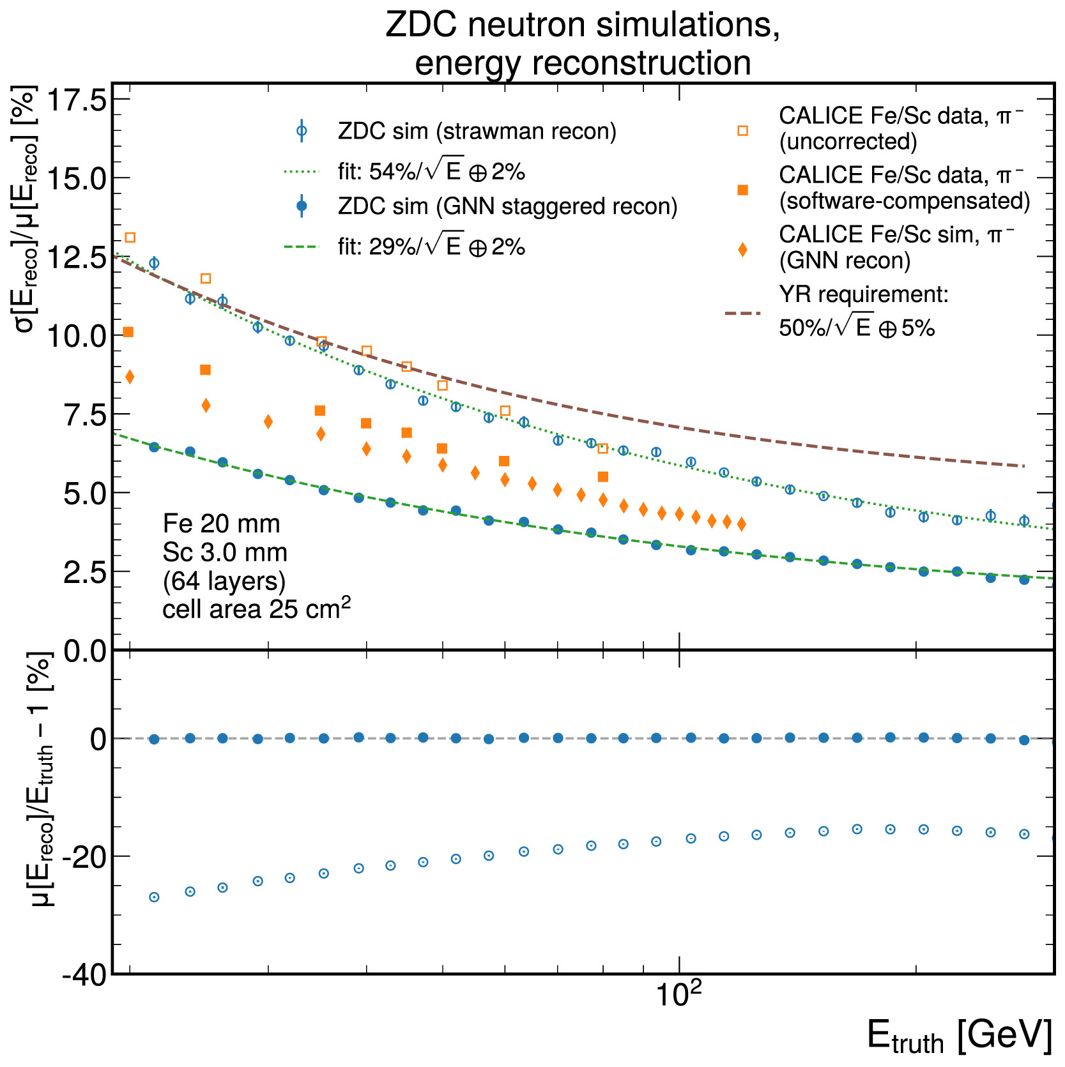
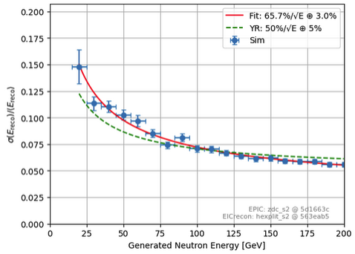
ZDC HCAL Requirements, Energy Resolution
Updated simulation has a comparable resolution to the strawman reconstruction when using hexagonal tiles
As before, the energy resolution is expected to go below the YR requirement after a GNN reconstruction
Hexagonal Tiles
R. Milton, S. J. Paul, B. Schmookler, M. Arratia, P. Karande, A. Angerami, F. Torales Acosta, and B. Nachman, “Design and simulation of a sipm-on-tile zdc for the future eic, and its performance with graph neural networks,” Nuclear Instruments and Methods in Physics Research Section A: Accelerators, Spectrometers, Detectors and Associated Equipment 1079 (2025) 170613. https://www.sciencedirect.com/science/article/pii/S0168900225004140.
Square Tiles

Slide 7
R&D Studies
M. Arratia, L. Garabito Ruiz, J. Huang, S. J. Paul, S. Preins, and M. Rodriguez, “Studies of time resolution, light yield, and crosstalk using sipm-on-tile calorimetry for the future electron-ion collider,” Journal of Instrumentation 18 no. 05, (May, 2023) P05045.
M. Arratia, B. Bagby, P. Carney, J. Huang, R. Milton, S. J. Paul, S. Preins, M. Rodriguez, and W. Zhang, “Beam Test of the First Prototype of SiPM-on-Tile Calorimeter Insert for the EIC Using 4 GeV Positrons at Jefferson Laboratory,” Instruments 7 no. 4, (2023) 43.
W. Zhang, S. Preins, J. Huang, S. J. Paul, R. Milton, M. Rodriguez, P. Carney, R. Tsiao, Y. Abdelkadous, and M. Arratia, “First-ever deployment of a sipm-on-tile calorimeter in a collider: a parasitic test with 200 gev p p collisions at rhic.,” Journal of Instrumentation 20 no. 06, (Jun, 2025).
J. Huang, S. Preins, R. Tsiao, M. Rodriguez, B. Schmookler, and M. Arratia, “Measurement of sipm dark currents and annealing recovery for fluences expected in epic calorimeters at the electron-ion collider,” 2025. https://arxiv.org/abs/2503.14622.
W. Zhang, X. Liang, S. Preins, and M. Arratia, “Calibration of an Irradiated Prototype for the EIC Zero-Degree Calorimeter,” arXiv:2512.20852 [physics.ins-det].
S. Preins, W. Zhang, R. Tsiao, M. Macias, B. Saunders, L. Preet, and M. Arratia, “Beam test of a sipm-on-tile zdc prototype with 5.3 gev positrons at Jefferson laboratory,” arXiv:2603.14167 [phys.ins-det].

Slide 8
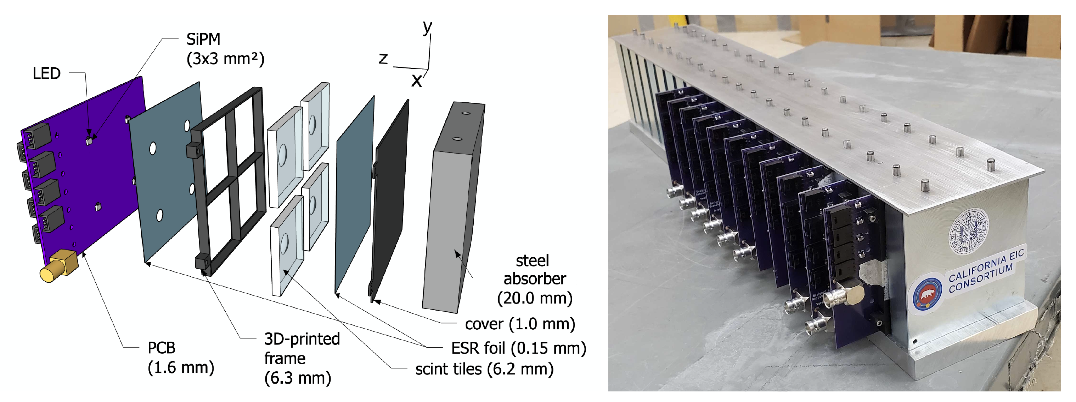
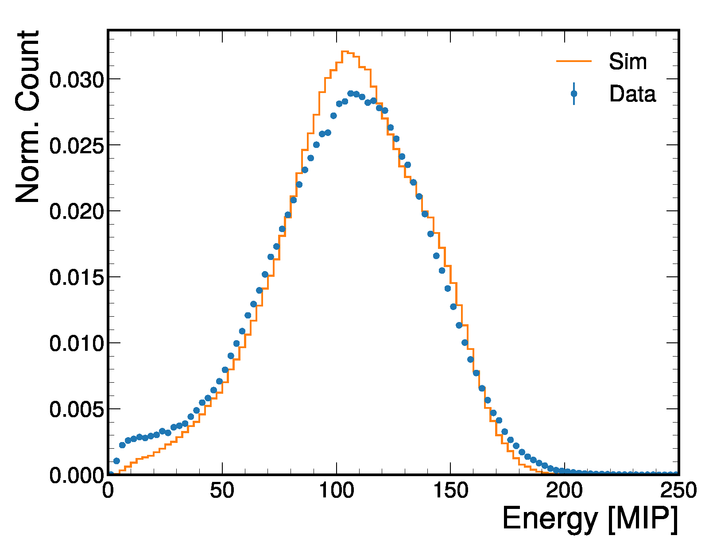
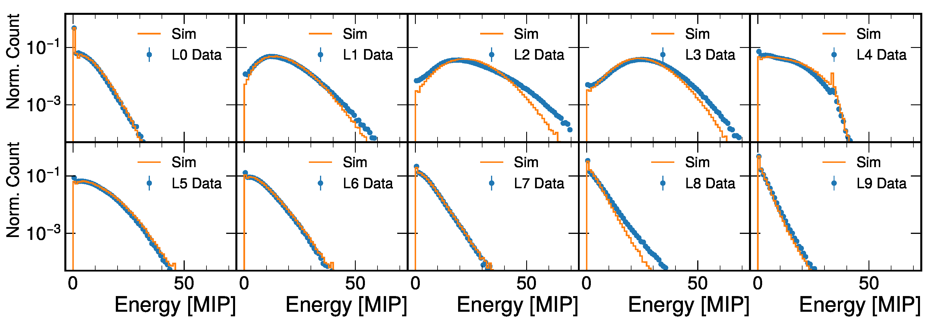
Generation I Prototype
40 channel, 10-layer SiPM-on-tile prototype tested at Jefferson Lab in Jan 2023
Detector response showed good match with GEANT4 simulations
M. Arratia, B. Bagby, P. Carney, J. Huang, R. Milton, S. J. Paul, S. Preins, M. Rodriguez, and W. Zhang, “Beam Test of the First Prototype of SiPM-on-Tile Calorimeter Insert for the EIC Using 4 GeV Positrons at Jefferson Laboratory,” Instruments 7 no. 4, (2023) 43.

Slide 9
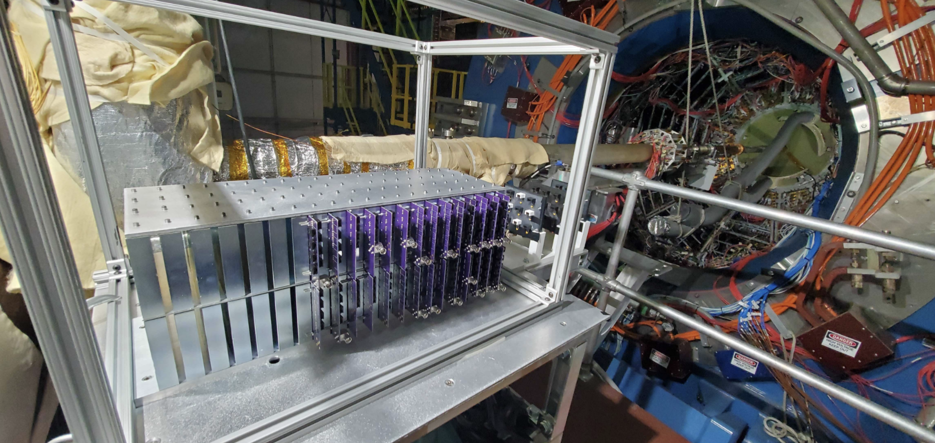
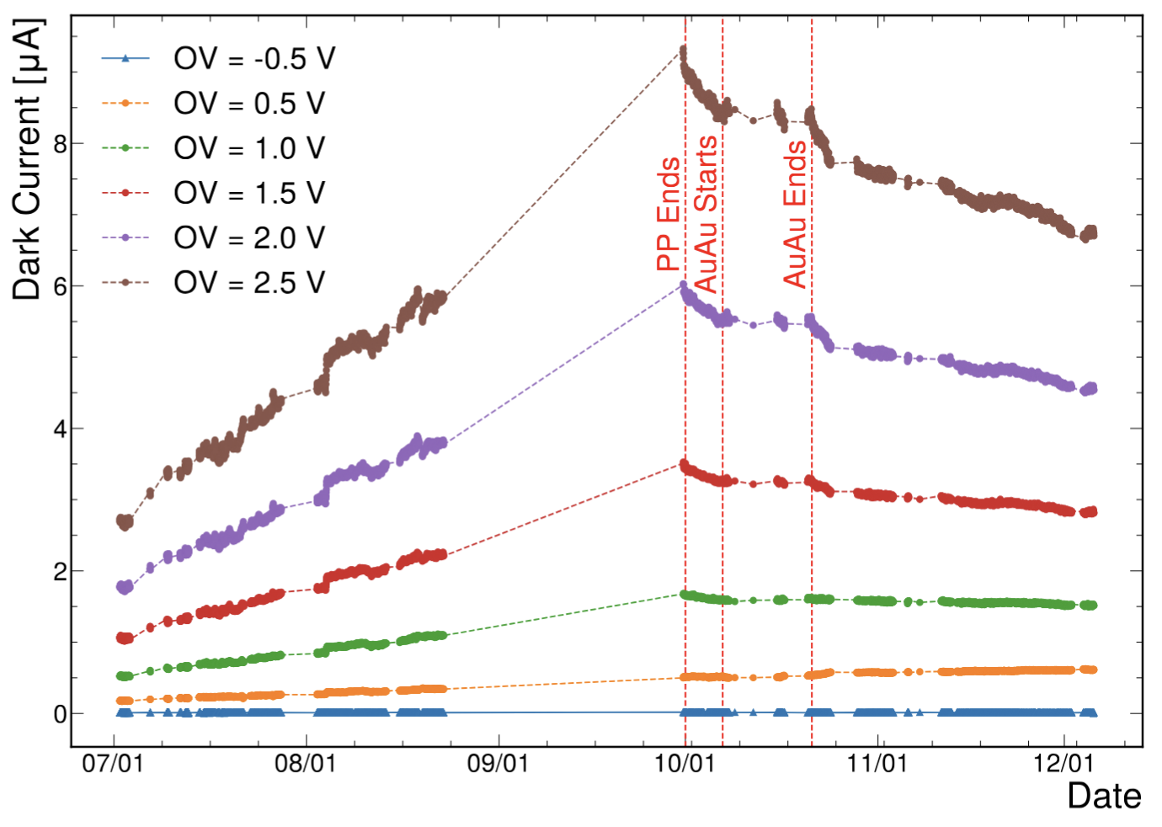
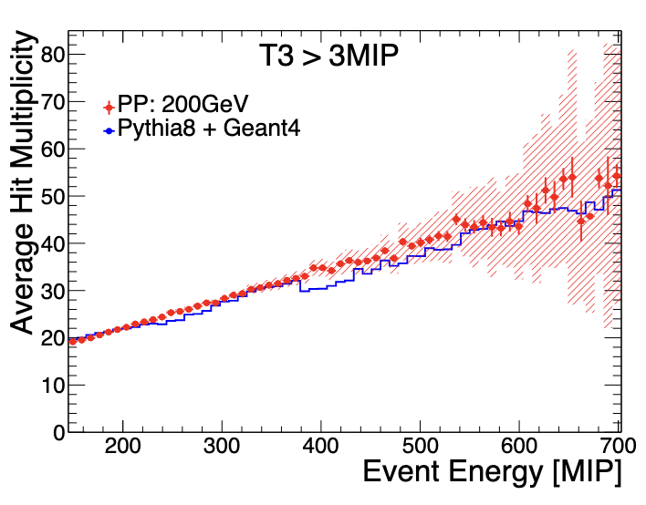
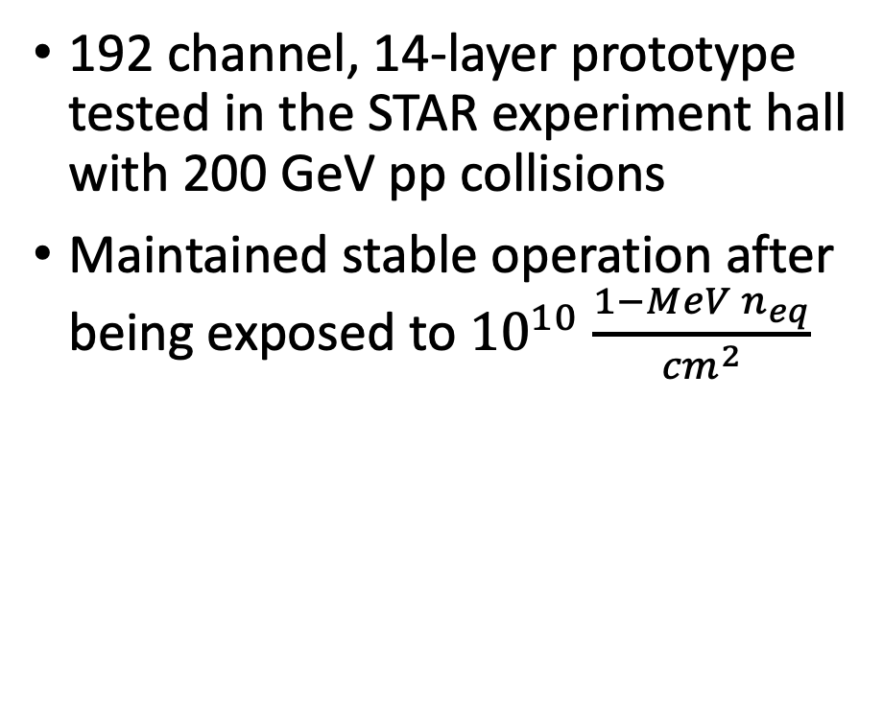
Generation II Prototype
192 channel, 14-layer prototype tested in the STAR experiment hall with 200 GeV pp collisions
Maintained stable operation after being exposed to ${10}^{10}$ $\frac{{1−MeV n}_{eq}}{{cm}^{2}}$
W. Zhang, S. Preins, J. Huang, S. J. Paul, R. Milton, M. Rodriguez, P. Carney, R. Tsiao, Y. Abdelkadous, and M. Arratia, “First-ever deployment of a sipm-on-tile calorimeter in a collider: a parasitic test with 200 gev p p collisions at rhic.,” Journal of Instrumentation 20 no. 06, (Jun, 2025).

Slide 10
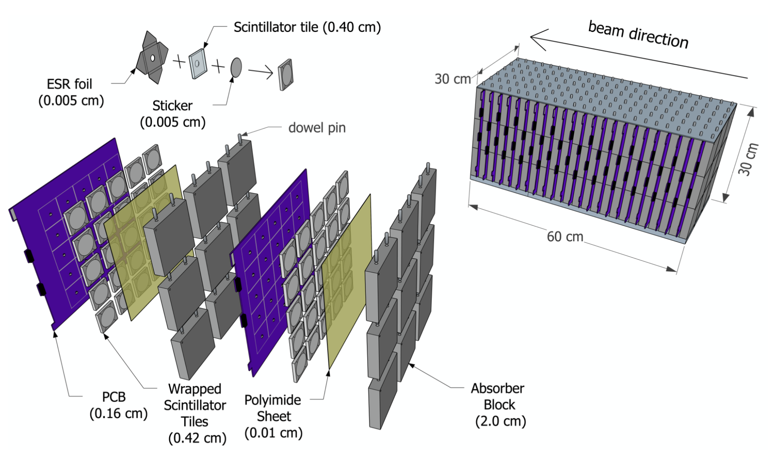
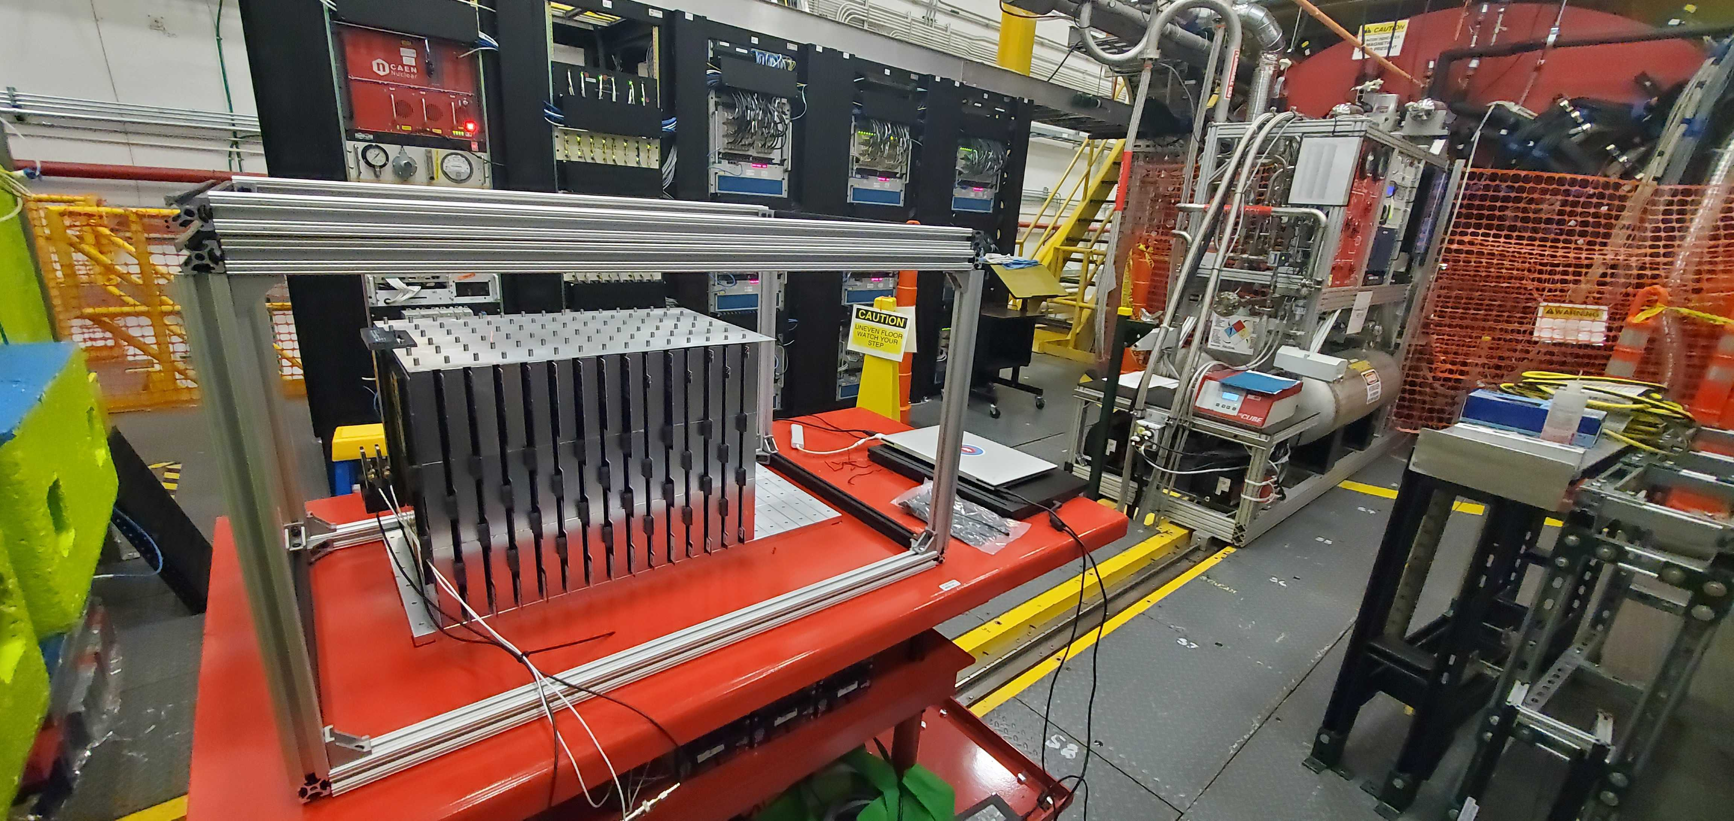
Generation III Engineering Test Module
370/563 channel SiPM-on-tile calorimeter mimicking the final ZDC design
5x5 grid of 4 mm thick tiles per layer, with staggered layers
Tested with 5.3 GeV positrons at Jefferson Lab, and irradiated at NSRL
Provided valuable insight into the design, construction, operation, and calibration for the full ZDC

Slide 11
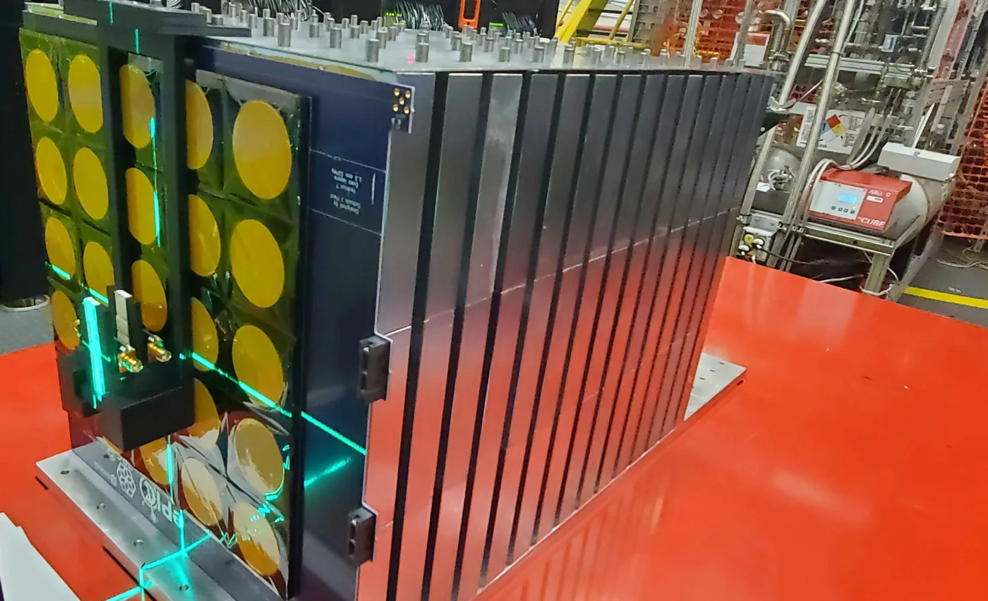
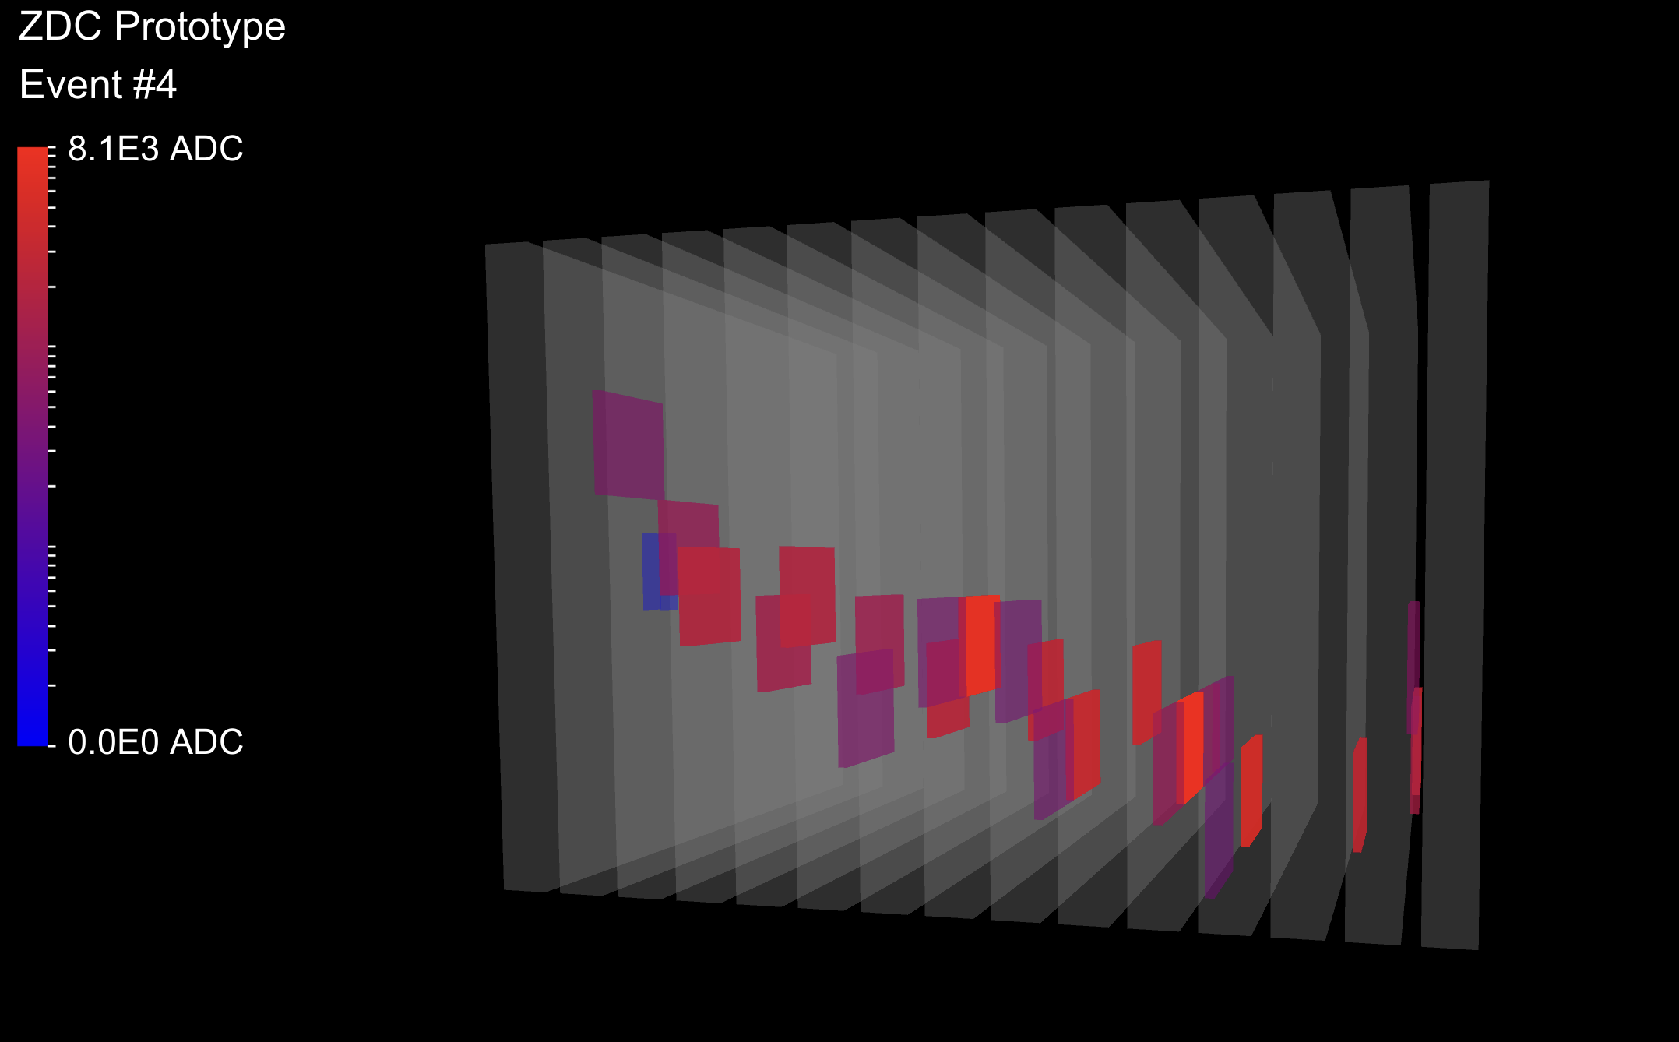
JLab Beam Test
Before the radiation test at NSRL, the detector was tested at the Hall-D Pair Spectrometer at Jefferson Lab with 5.3 GeV positrons
Operated with 370 channels, 25 channels per layer, 15 layers
Used the same SiPM model, tile geometry, and absorbers envisioned for the final ZDC HCAL
Measured position and energy response
S. Preins, W. Zhang, R. Tsiao, M. Macias, B. Saunders, L. Preet, and M. Arratia, “Beam test of a sipm-on-tile zdc prototype with 5.3 gev positrons at Jefferson laboratory,” arXiv:2603.14167 [phys.ins-det].

Slide 12
Generation III Engineering Test Module (JLab)
Measured EM response and compared to simulation, energy and position resolution
Differences may be attributed to detector effects not included in simulation (electrical cross-talk, non-ideal equalization)
Design, QA procedures, and operation were refined for the final ZDC design
S. Preins, W. Zhang, R. Tsiao, M. Macias, B. Saunders, L. Preet, and M. Arratia, “Beam test of a sipm-on-tile zdc prototype with 5.3 gev positrons at Jefferson laboratory,” arXiv:2603.14167 [phys.ins-det].

Slide 13
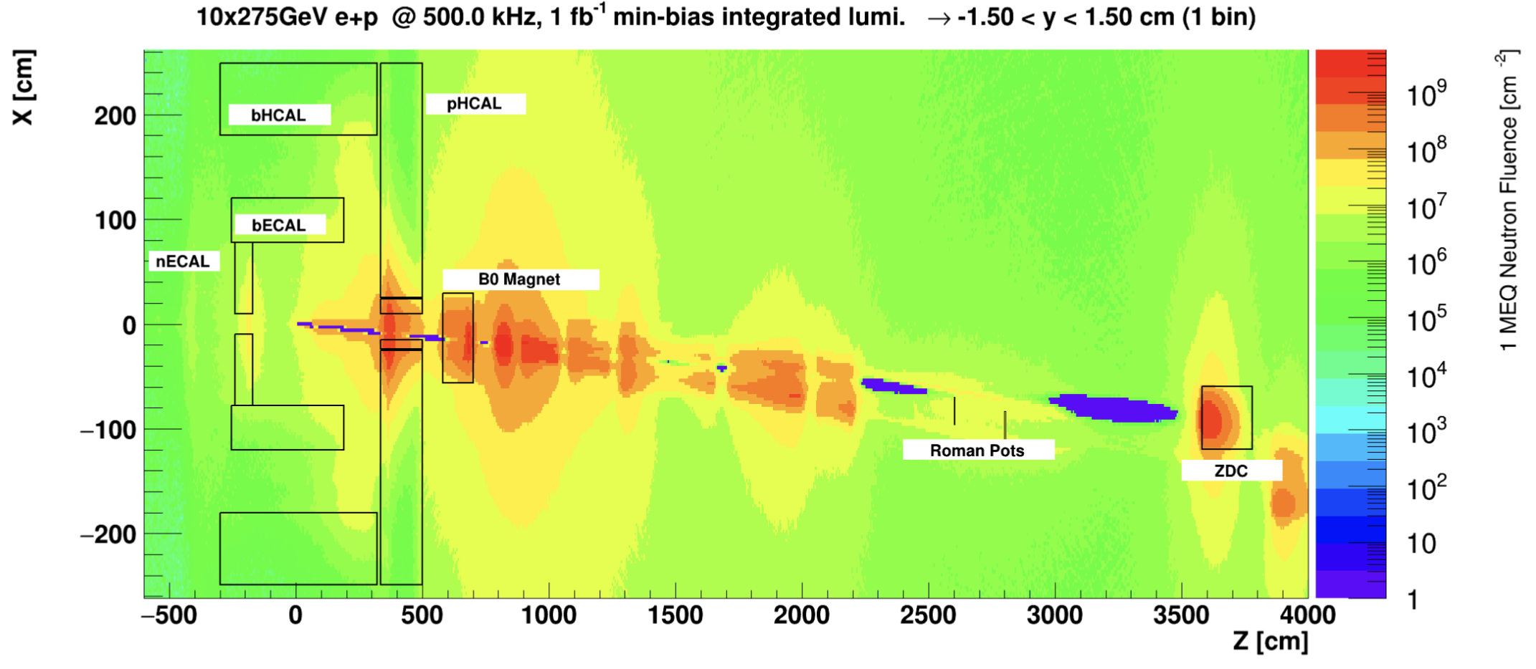
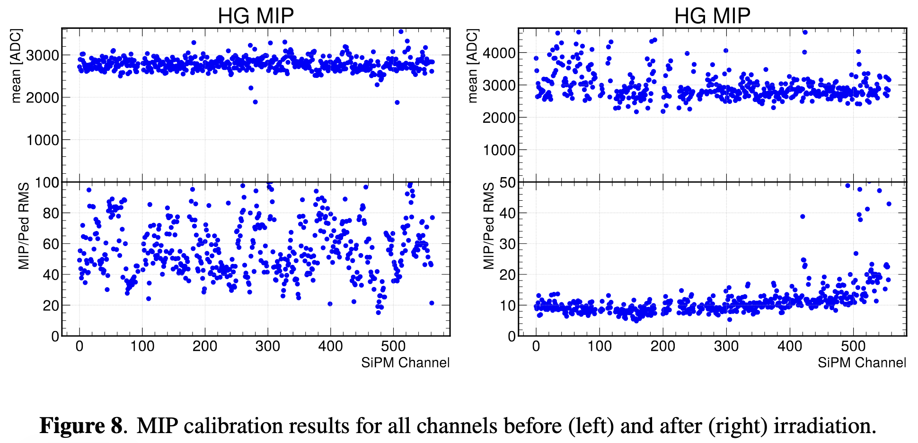

Generation III Engineering Test Module (NSRL)
At NSRL, the detector was exposed to up to ${10}^{10.8}\frac{{1−MeV n}_{eq}}{{cm}^{2}}$, exceeding the expected radiation fluence for the ZDC after 1 year of operation at the EIC
The MIP signal-to-noise ratio reduced from ~60 to ~5, but MIP calibration could still be performed.
W. Zhang, X. Liang, S. Preins, and M. Arratia, “Calibration of an Irradiated Prototype for the EIC Zero-Degree Calorimeter,” arXiv:2512.20852 [physics.ins-det]. Accepted in JINST.

Slide 14
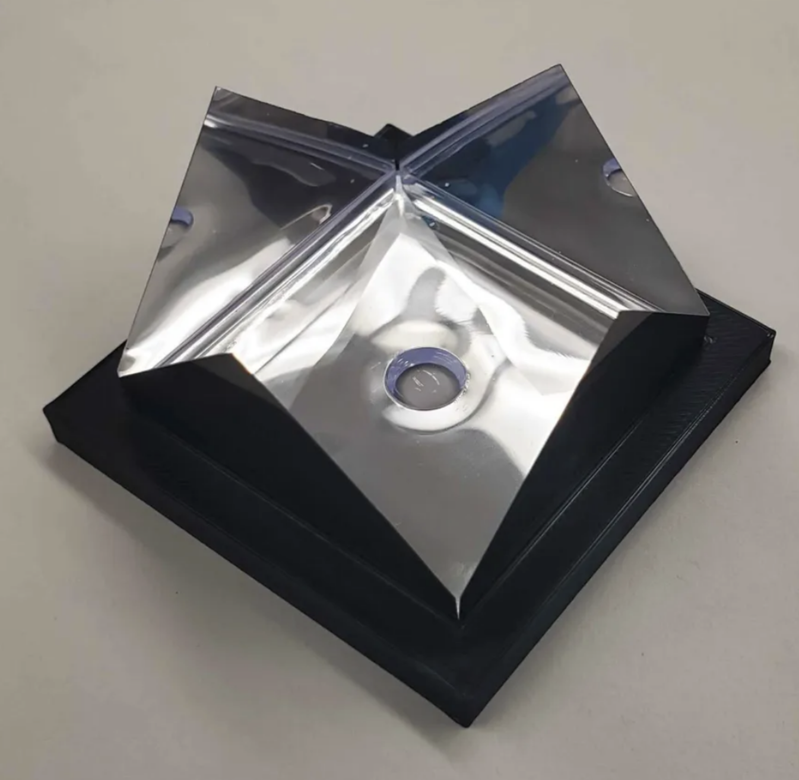
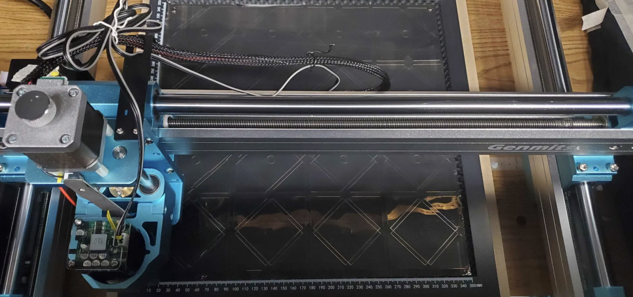
Construction, QA, and Assembly Foils
ESR foil sheets are cut for individual tiles using a 400 cm x 400 cm CNC 500 mW laser cutter, able to cut for 16 tiles at a time
Foils are folded around tiles using a 3D-printed frame, and secured with a sticker

Slide 15
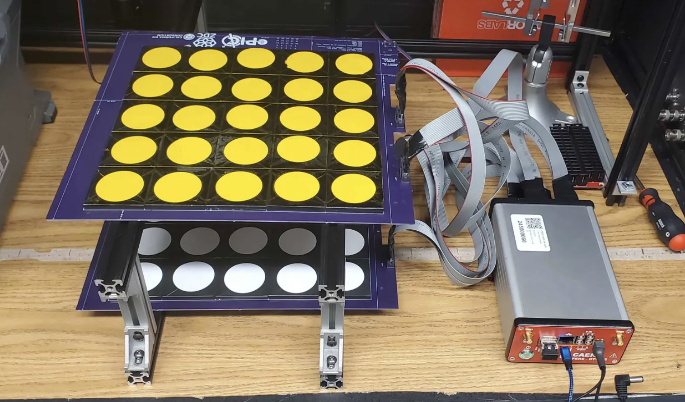
Construction, QA, and Assembly Layers (SiPMs)
PCB is first tested for continuity with a multimeter
Solder SiPMs and card connectors to pad locations with solder paste + stencil using an IR oven / hot plate
Perform an IV scan on each channel using a Keithley 2450 unit
Perform a short cosmic ray test with tiles placed on board, but not affixed

Slide 16
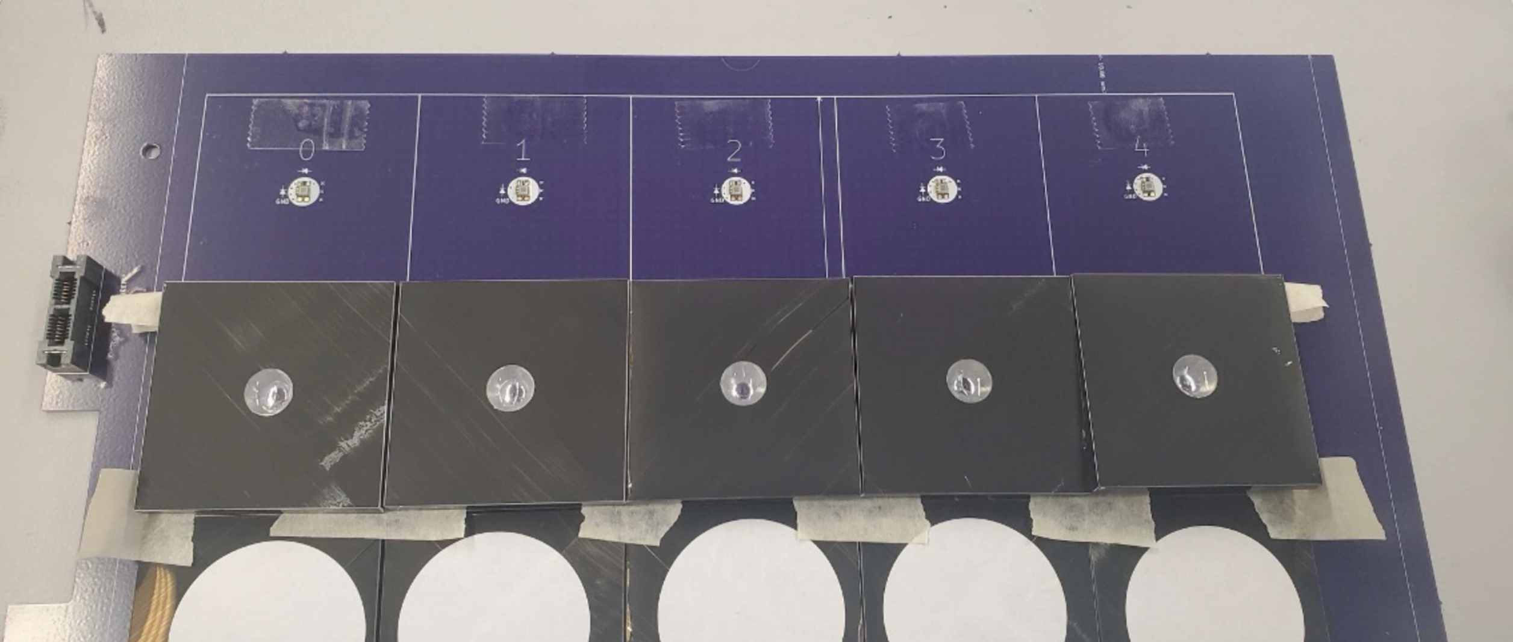
Construction, QA, and Assembly: Layers (Tiles)
Place tiles on the board and align them to the printed grid, and use masking tape to hold them in place relative to each other
Fold a row of tiles down, and affix them to the board with double-sided tape
Place a sheet of polyimide film on the front and back as a protective coating

Slide 17
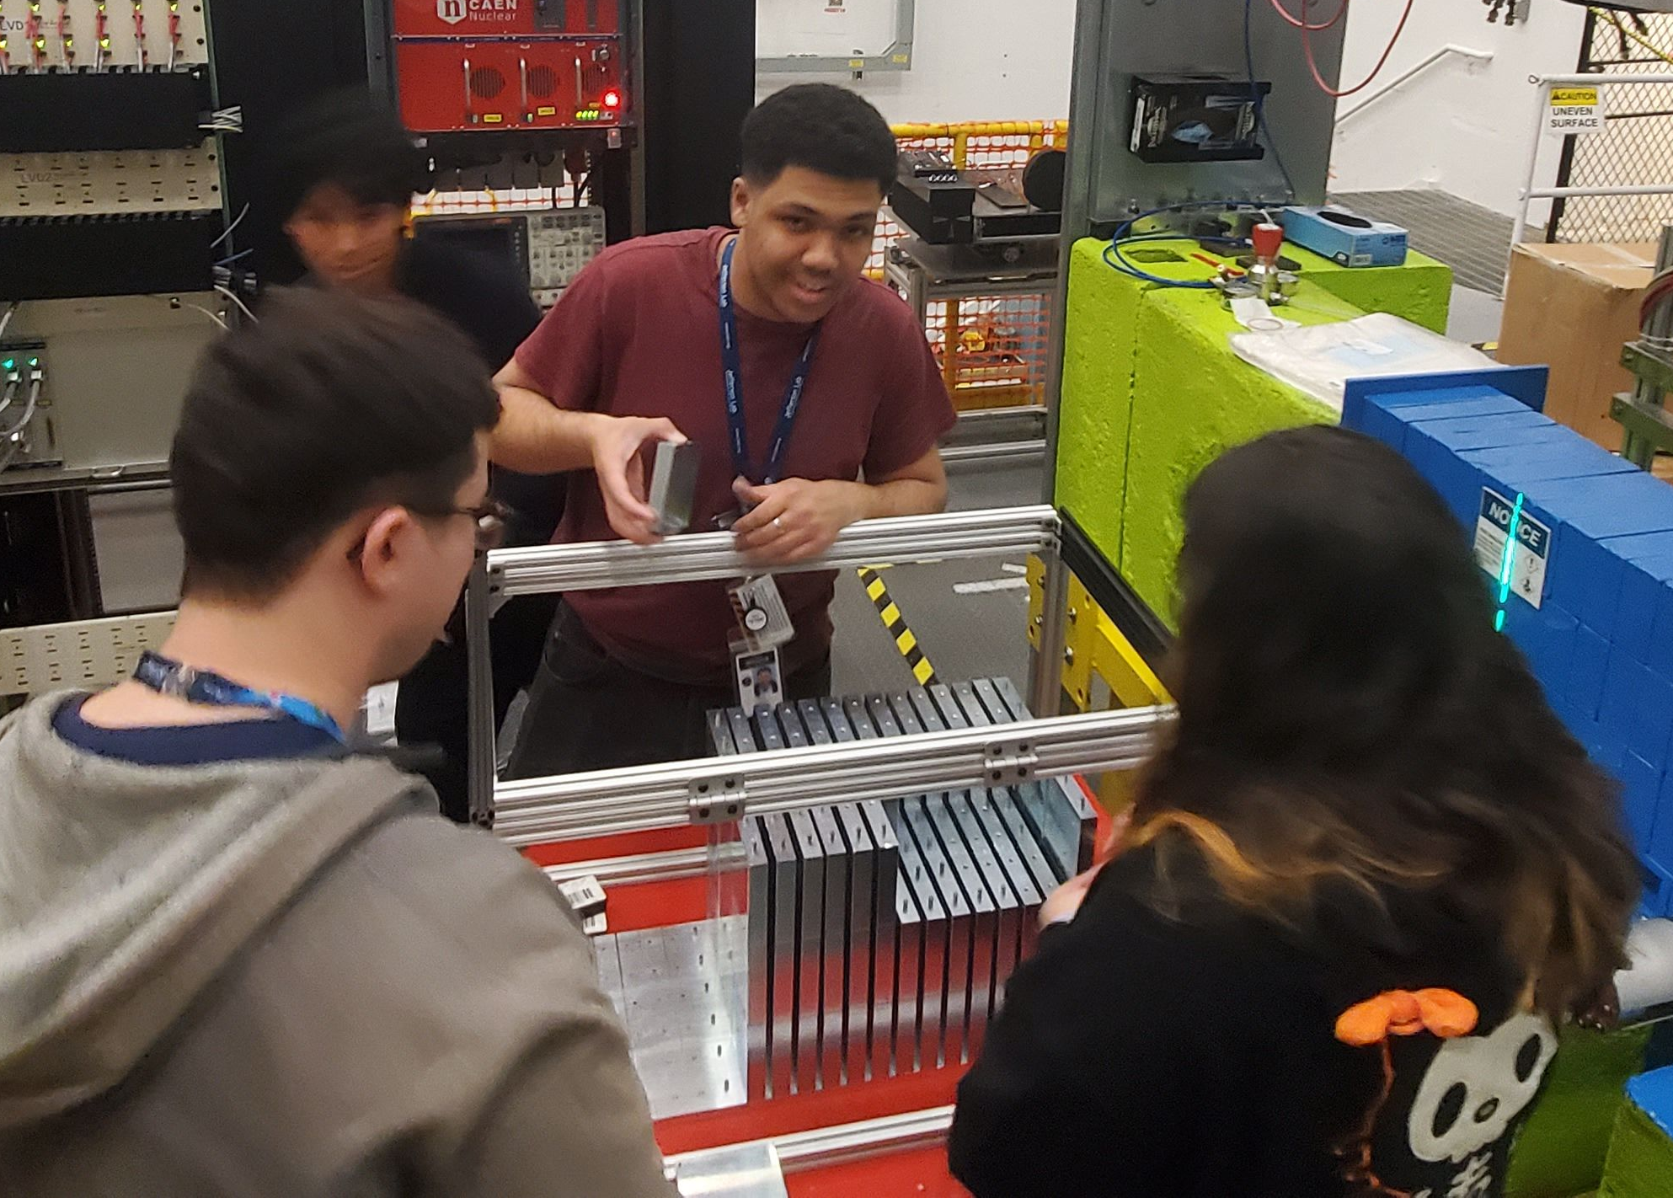
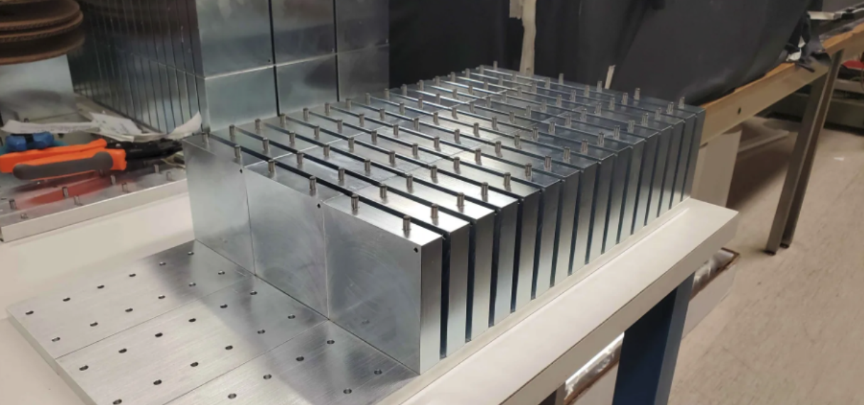
Construction, QA, and Assembly: Cables and Iron
28 AWG shielded ribbon cables are soldered to custom edge card connector PCBs, tested via multimeter
Iron layers consist of blocks recycled from the STAR FMS
Iron is stacked together like LEGO blocks, and active layers can be slid in after construction

Slide 18
Summary and To-Do
Summary
The ZDC HCAL has reached a stage of development nearing completeness for the final design
Simulation studies demonstrate that the final ZDC design is likely to achieve the technical performance requirements outlined in the EIC Yellow Report
Performance studies have informed the design, fabrication methods, QA tests, and operation of the ZDC
To-Do
Perform a GNN reconstruction on the updated square tile ZDC design
Design final printed circuit boards

