Slide 1
Weekly meeting
Yu-Siang Xiao (蕭宇翔)
2026 02/06

Slide 2
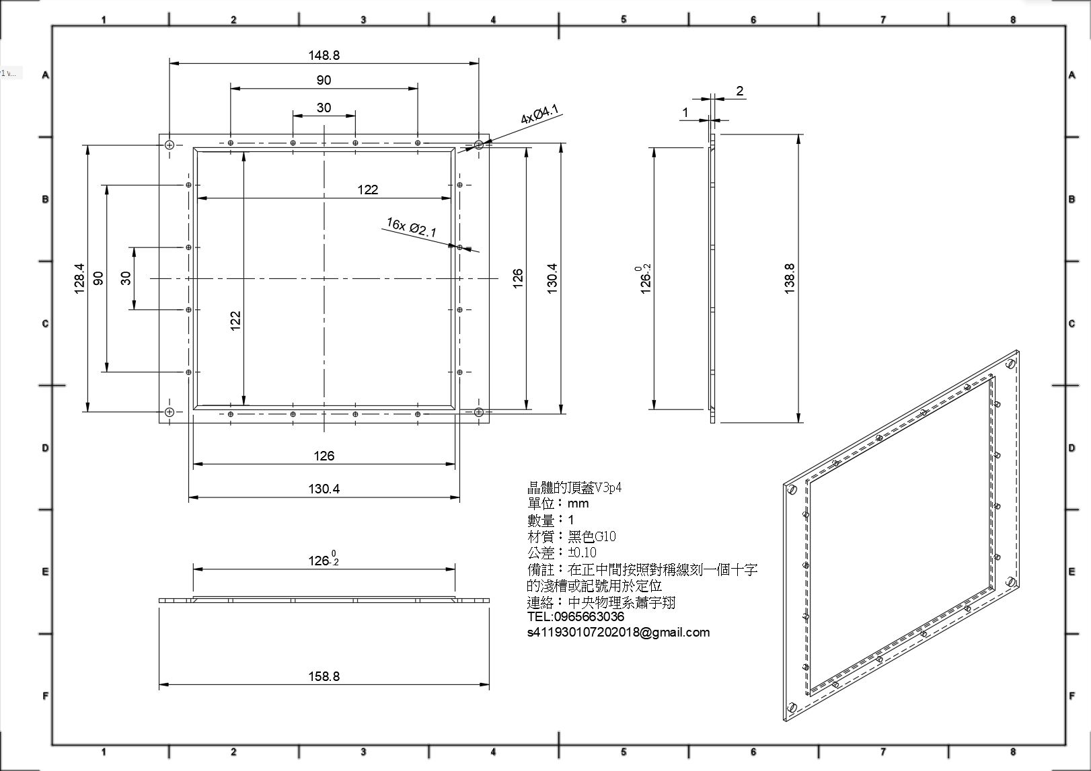
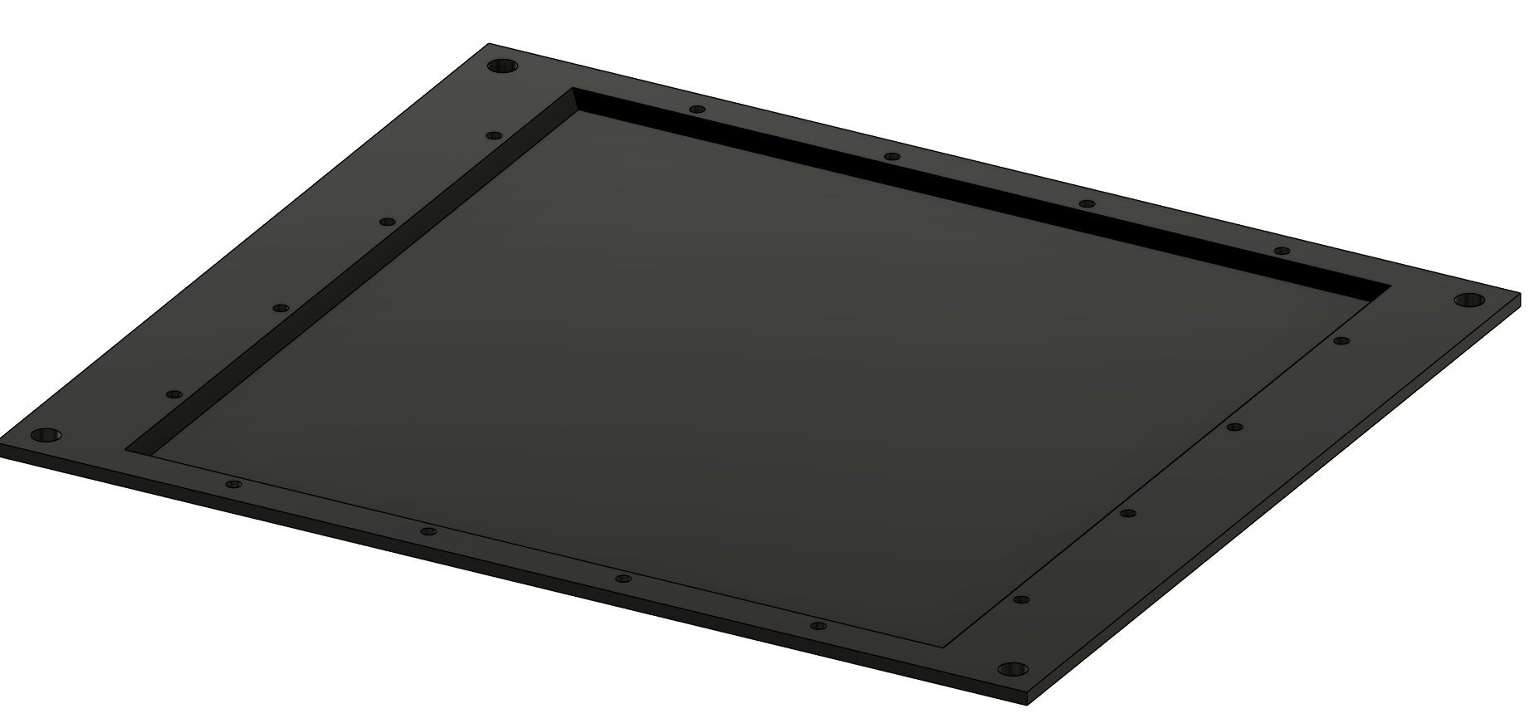
The G10 front shell of PbWO4
During the interaction length of “not crystal part” should smaller.
Choose G10 and make it thinner to reduce the interaction length in front of crystal.
Meterial | density (ρ)[g/cm³] | Radiation length(X0​) [cm] | Interaction length / X0
Old: 0.3cm Aluminum (Al, Z=13) | 2.70 | 8.89 | 0.0337
New: 0.1cm G10 (FR4) | ~1.85 | 19.4 | 0.0052
1/6.48!

Slide 3
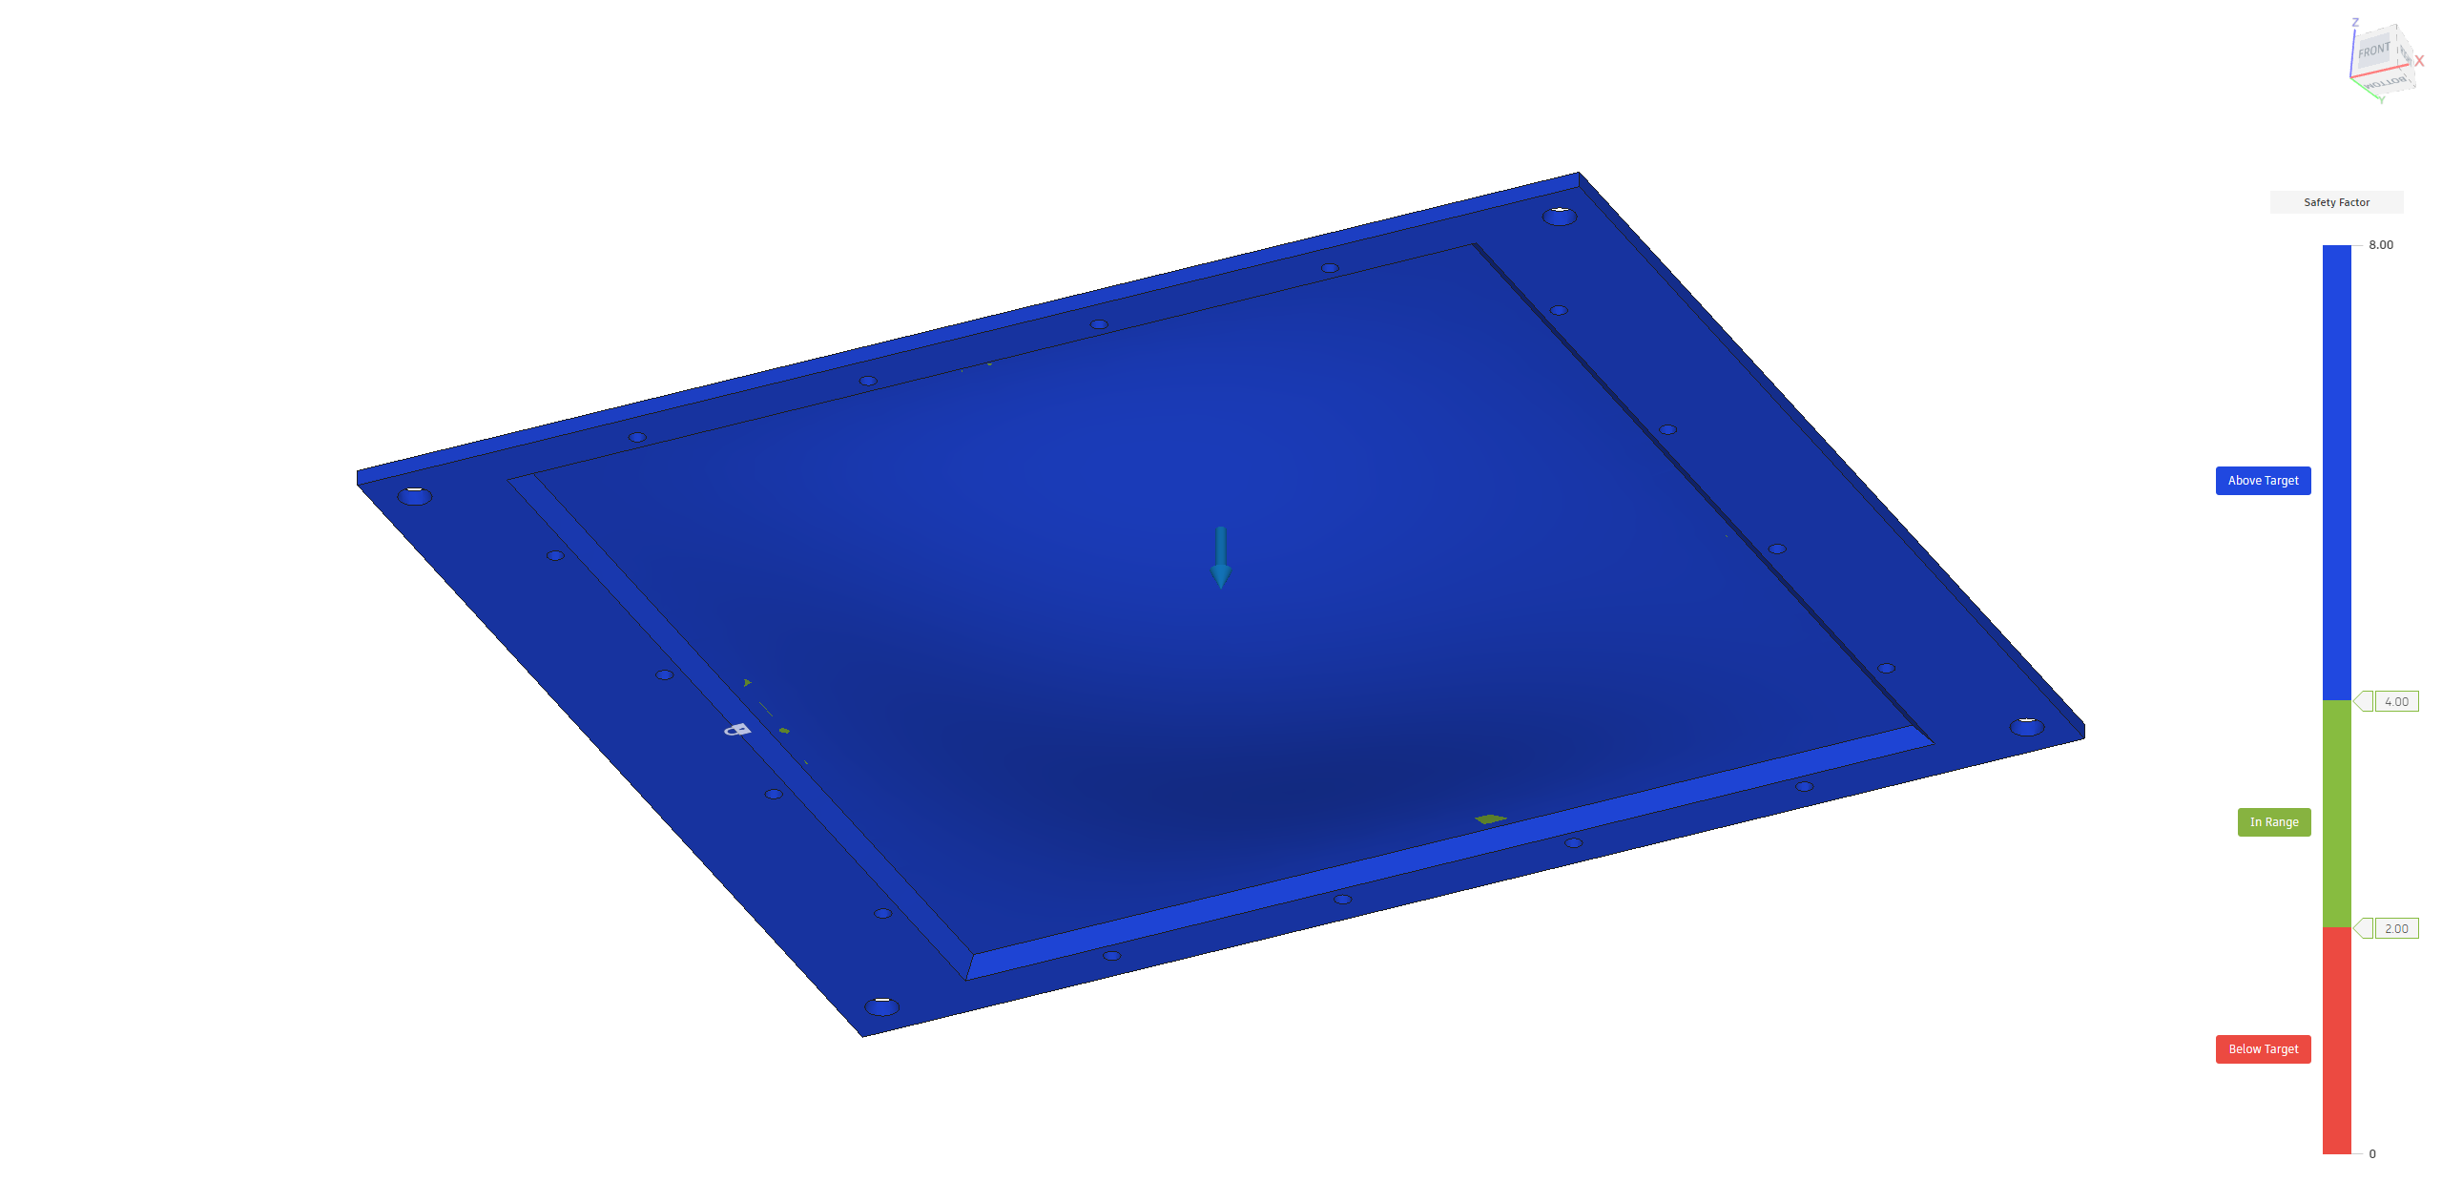
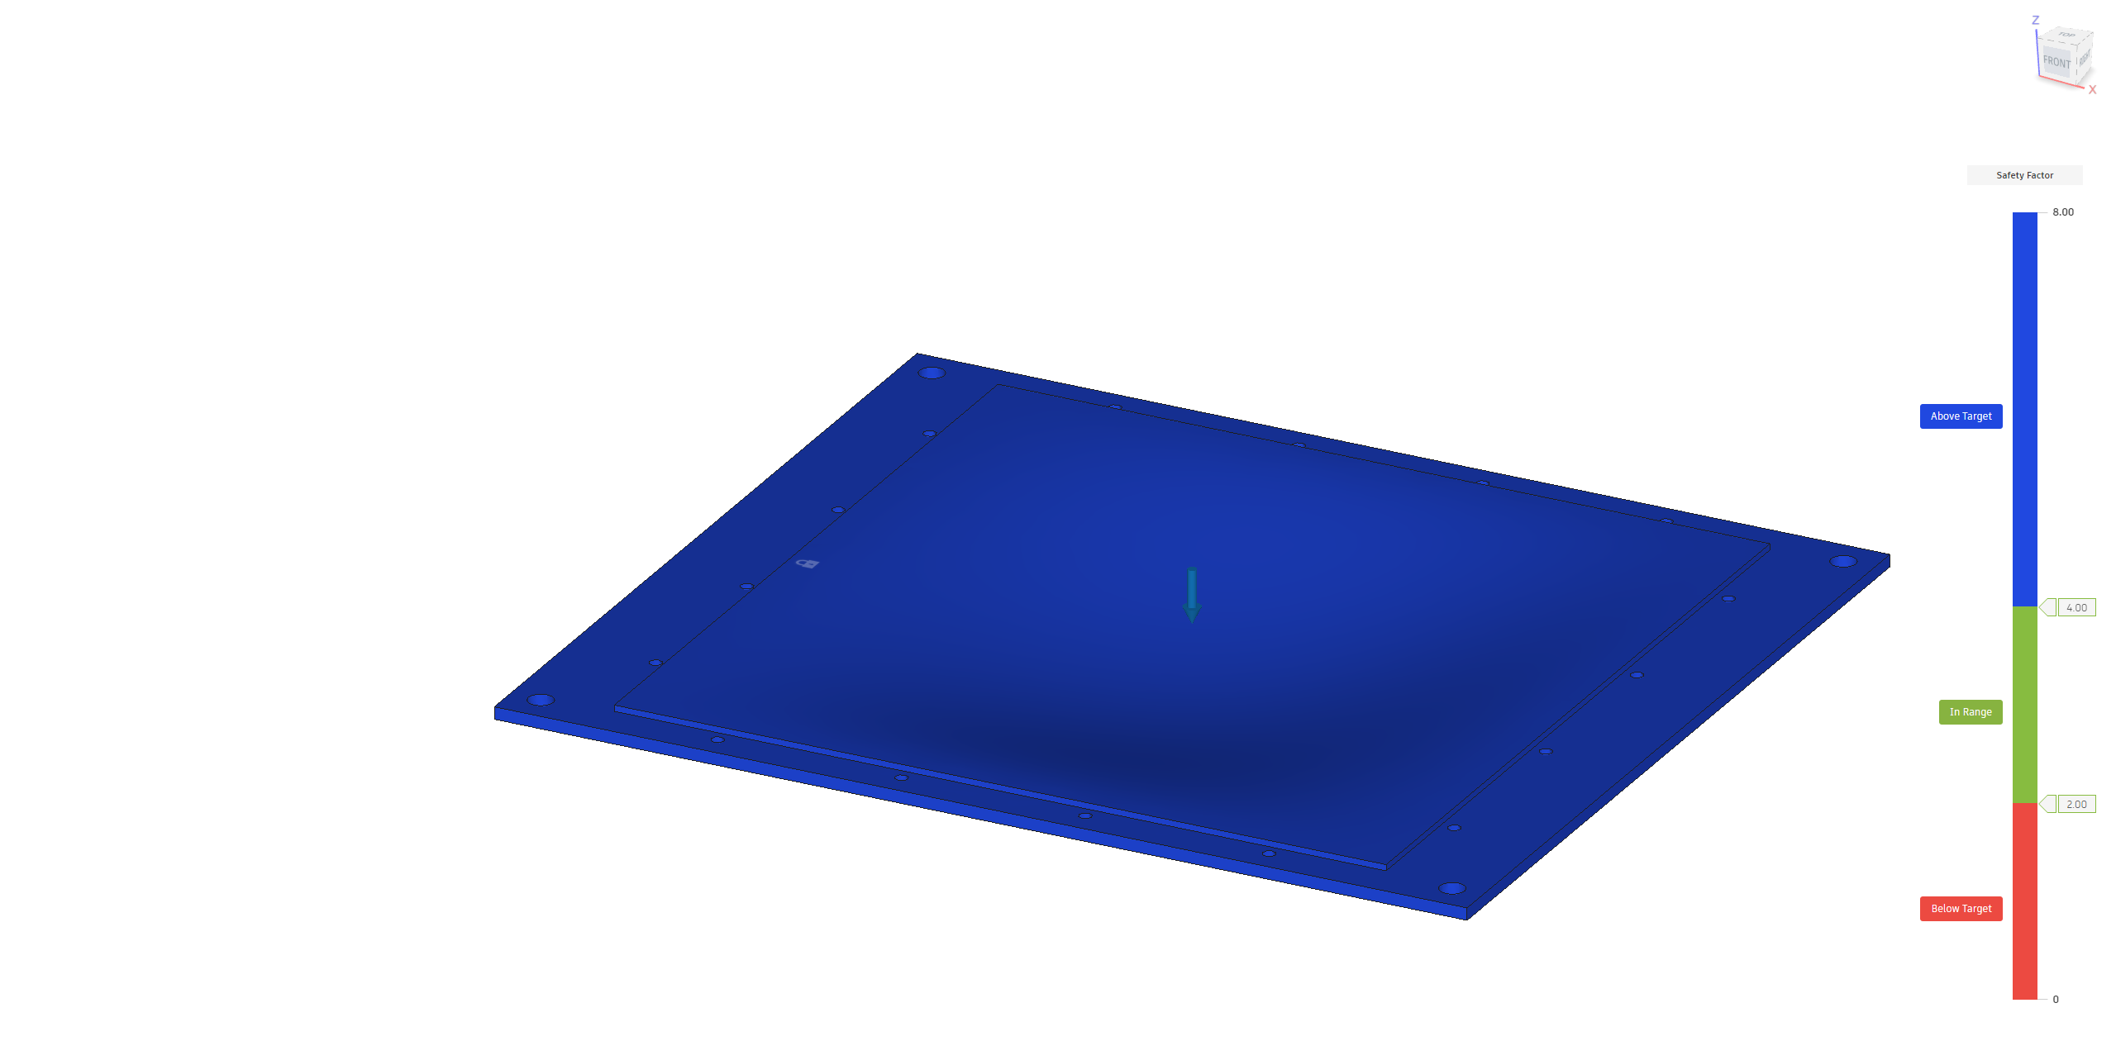
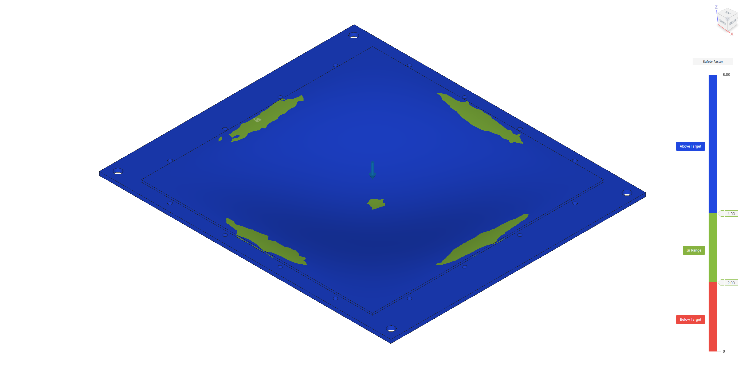
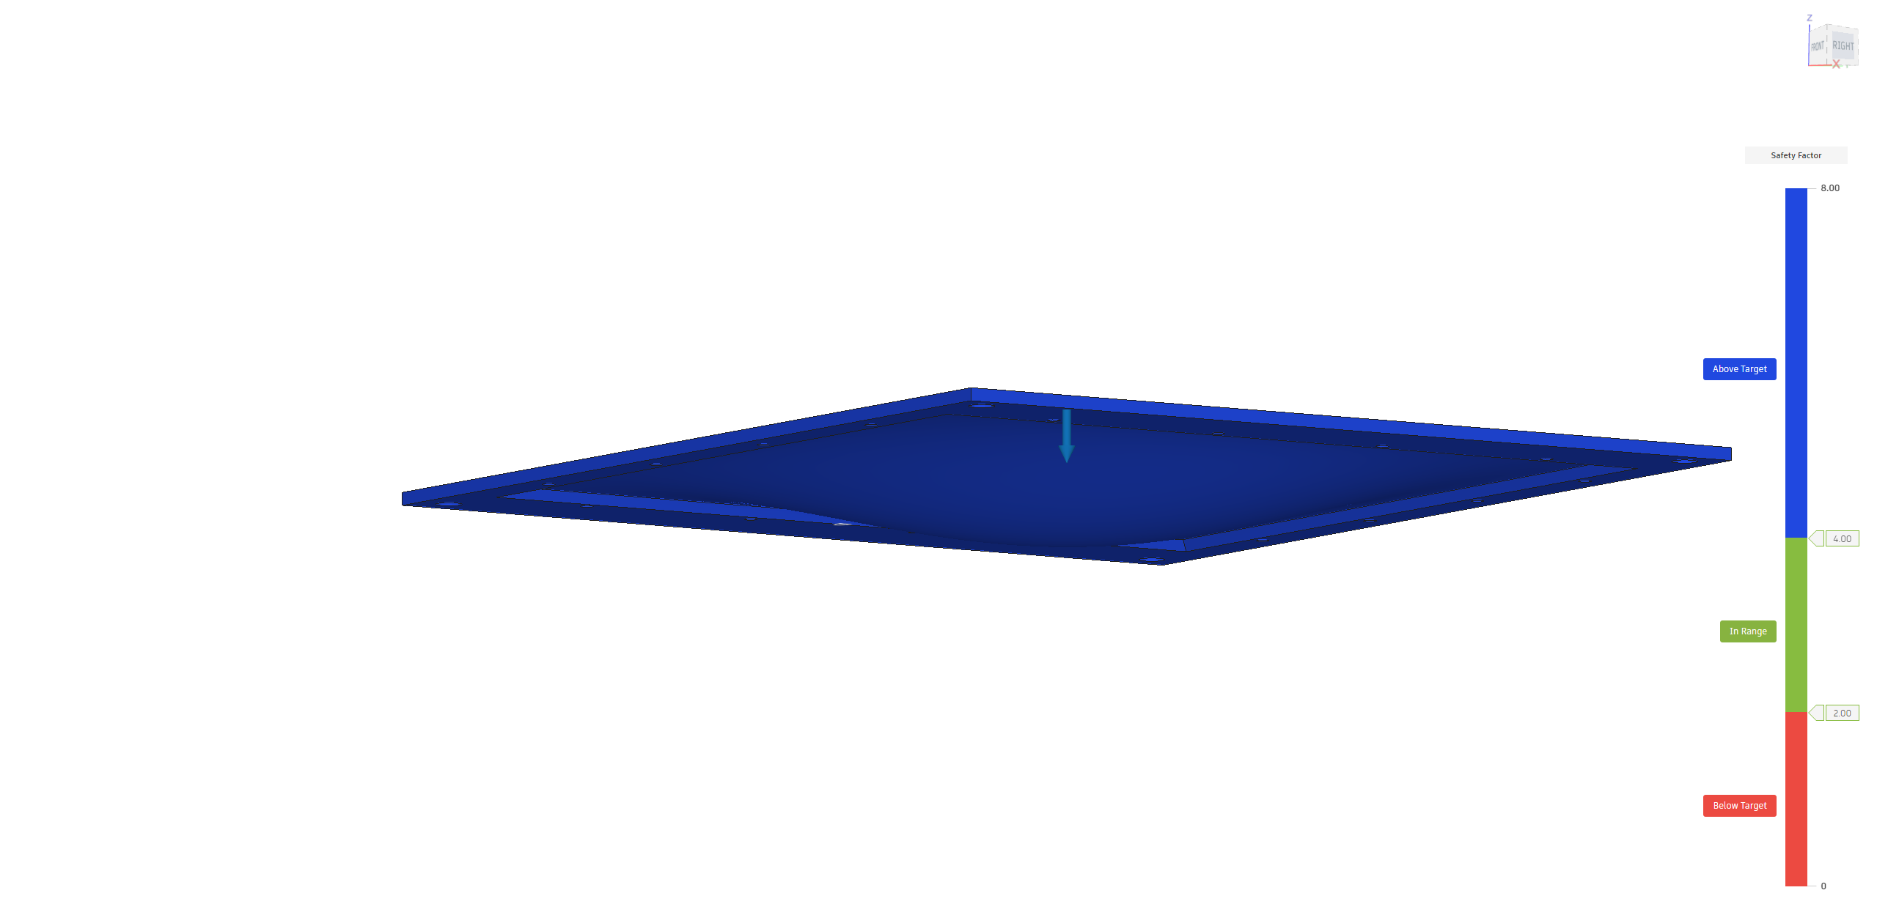
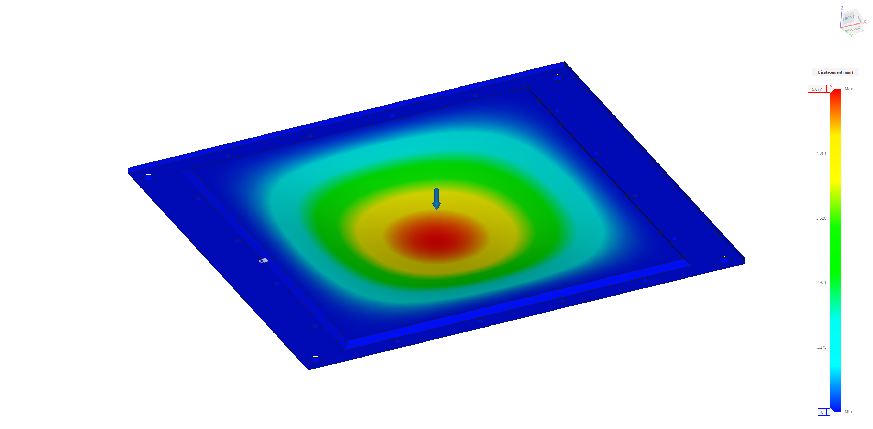
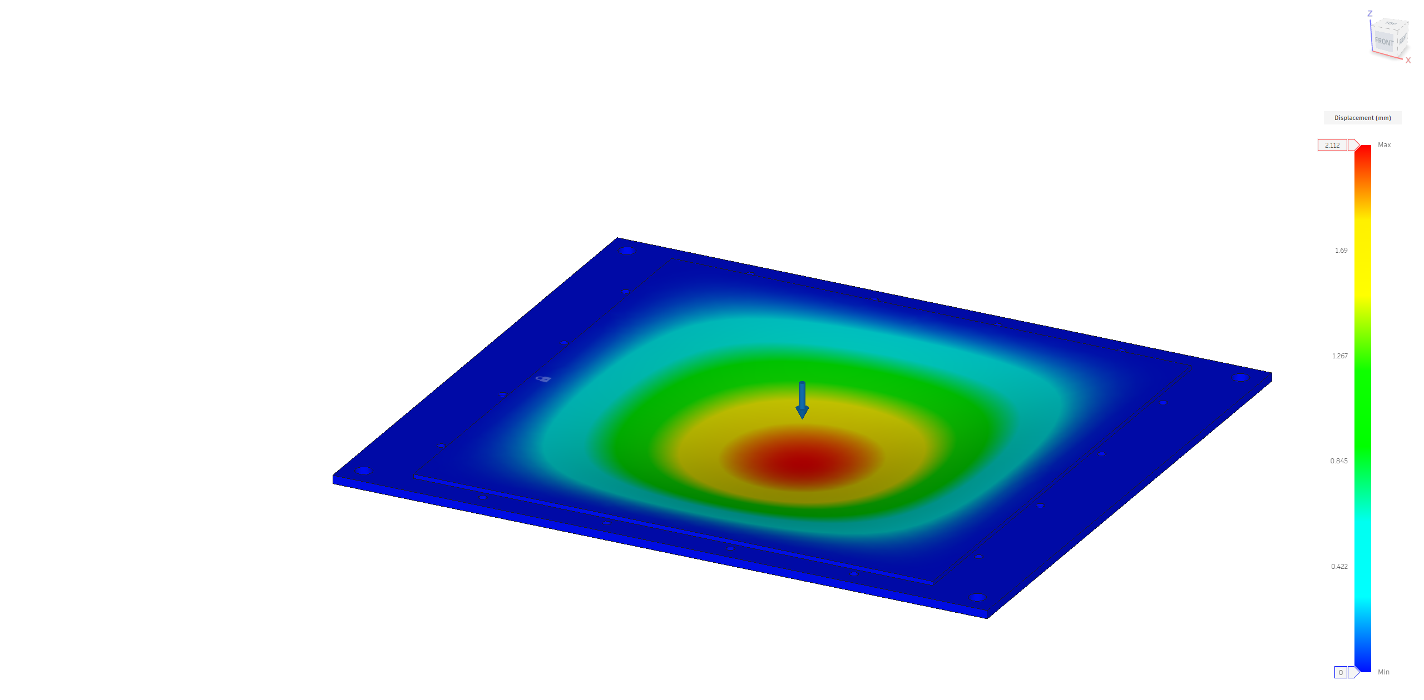
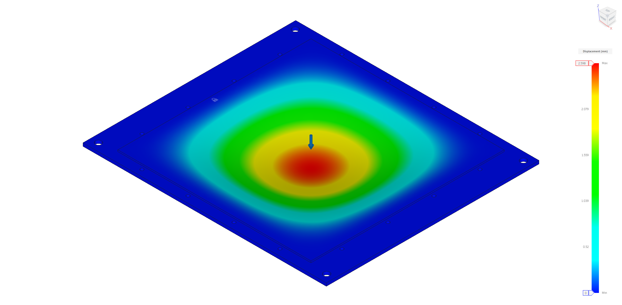
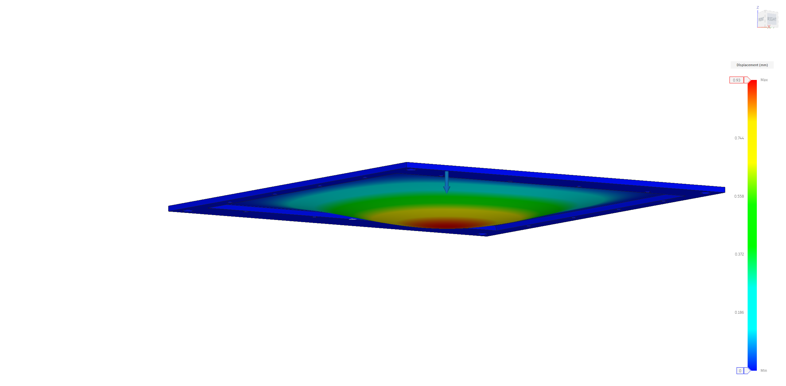
List of Material simulation
The 1.6 mm G10/FR4 is loadable for the 6.38 kg PbWO4 x 1.3G = 81N. PS: 1.3G for airplane heavy landing☹.
Design the front lid for the loading situation! I take 100 N(1.6G) to simulate the Safety factor.
In the assemble process, the deformation of front lid could make some problem, need to be smaller! Using 63N to simulate.
Shows the situation of POM(塑鋼), Bakelite(電木Phenolic Resin) under 1 or 1.5 mm.
The X0 of 2 kind of material is not deferent too much: POM/PR = 31.5/29.6
Judgment through simulation, the 1.5mm Bakelite is better material during the displacement, and 1/1.5 mm POM better in the SF.
POM 1.0mm
POM 1.5mm
Bakelite 1.0mm
Bakelite 1.5mm
SF=3.4@100N
SF=4.2@100N
SF=2.5@100N
SF=3.0@100N
ΔΧ=3.72mm@63N
ΔΧ=1.32mm @63N
ΔΧ=1.64mm @63N
ΔΧ=0.59mm @63N

Slide 4
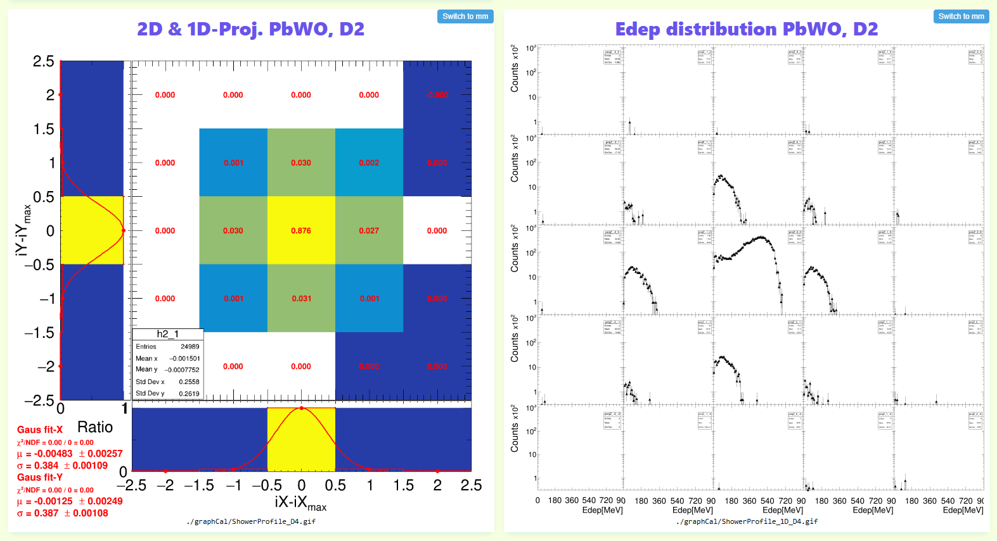
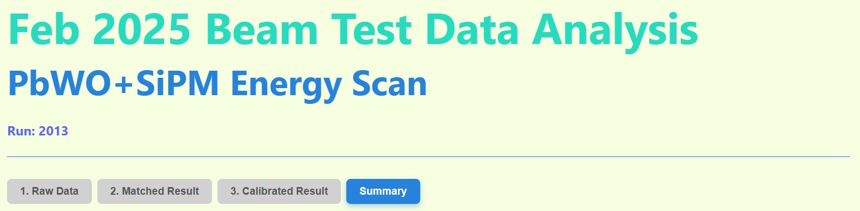
Update HTML layout
Add the shower profile!
Separate the raw / matching / calibrated result into 3 page, and add a page for the summary.
To do:
  Add the index bar for faster searching, the summary graph and some table.
  Add the fitting result number in the page to shows the performance.
  Add some standard line by MC prediction for the faster comparison.

Slide 5
The Fast Online Monitoring Program
Data stream
Signal convert to ADC in CITIROC
PC: LabView saving Data and simple online monitoring graph
Auto upload to NAS and Drive
Space wire…
Network
Auto decoding and analyze the data
Decode the Raw binary data
`
Run analysis report
RunDisplay.html
Parallel process
100 kHit/s
each process
Cost ~3 sec
BM 1 .bin
Matching the events by the clock with all detectors.
Save by *Recon.root
Cost ~10sec
Do the Gain calibration by Feb25 ADC/MeV result
Cost ~5sec
BM 2 .bin
…
Auto upload to Drive
Crystal.bin
Drawing the Run analysis result with Cal. data.
Drawing the analysis result without calibration.
Drawing the raw data information(ADC/Position)

Slide 6
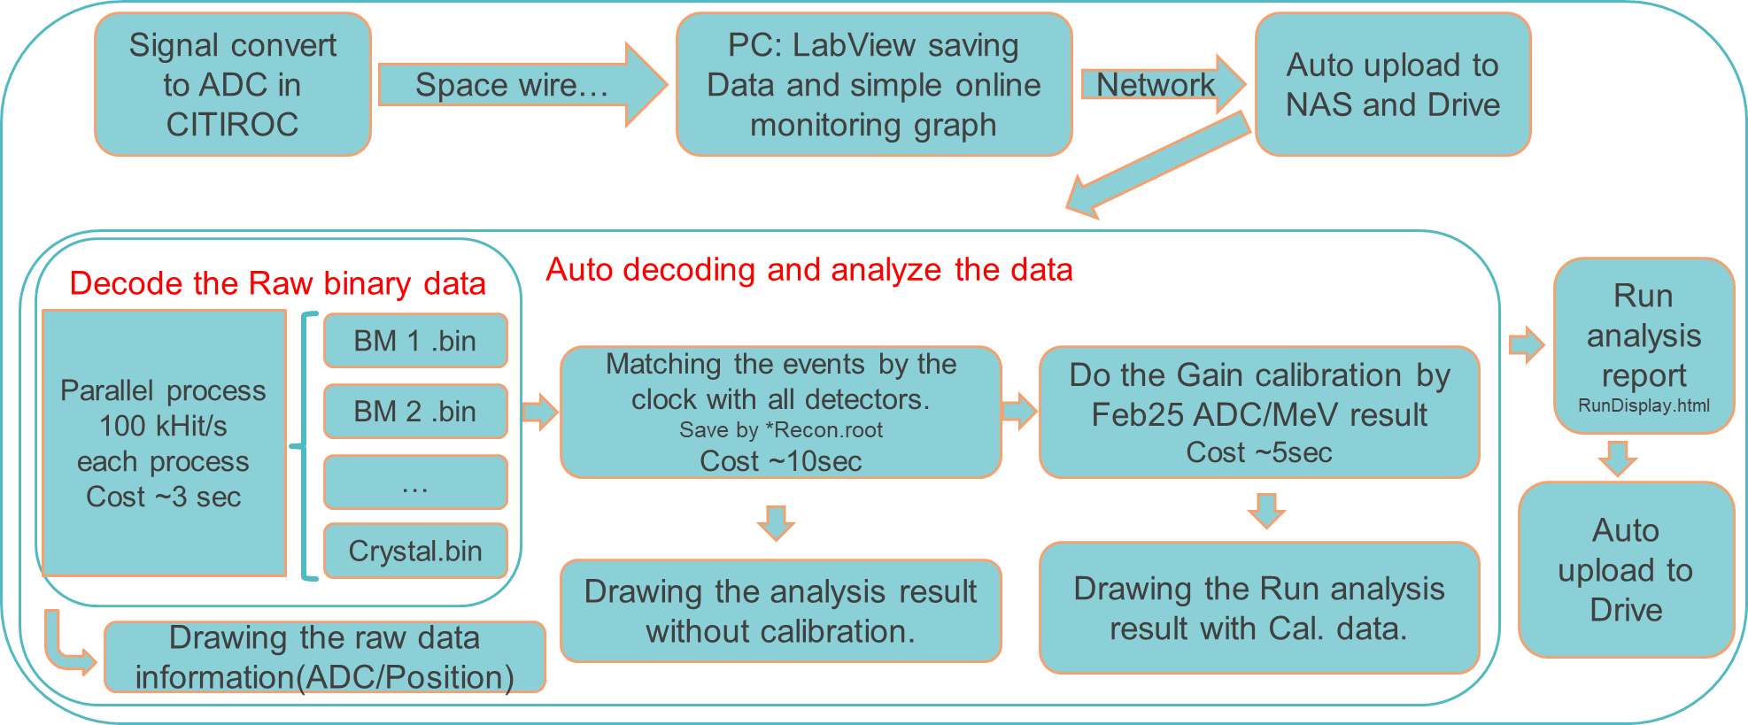
The auto analysis data stream
Need to develop the:
  Auto data generator (for simulate the beam test data tacking)
  Auto upload system(data)
  Auto analysis system
  Auto upload system2(result)
Almost complete
The fake data could to decoding/analysis…
Under developing
The most timing cost process in full data stream is:
All Chs. ADC distribution filling
Correlation plots
This part take ~30sec for ~20k event

