Slide 1
Weekly meeting
Yu-Siang Xiao (蕭宇翔)
2026 02/11

Slide 2
The Fast Online Monitoring Program
Data stream
Signal convert to ADC in CITIROC
PC: LabView saving Data and simple online monitoring graph
Auto upload to NAS and Drive
Space wire…
Network
Auto decoding and analyze the data
Decode the Raw binary data
`
Run analysis report
RunDisplay.html
Parallel process
100 kHit/s
each process
Cost ~3 sec
BM 1 .bin
Matching the events by the clock with all detectors.
Save by *Recon.root
Cost ~10sec
Do the Gain calibration by Feb25 ADC/MeV result
Cost ~5sec
BM 2 .bin
…
Auto upload to Drive
Crystal.bin
Drawing the Run analysis result with Cal. data.
Drawing the analysis result without calibration.
Drawing the raw data information(ADC/Position)

Slide 3
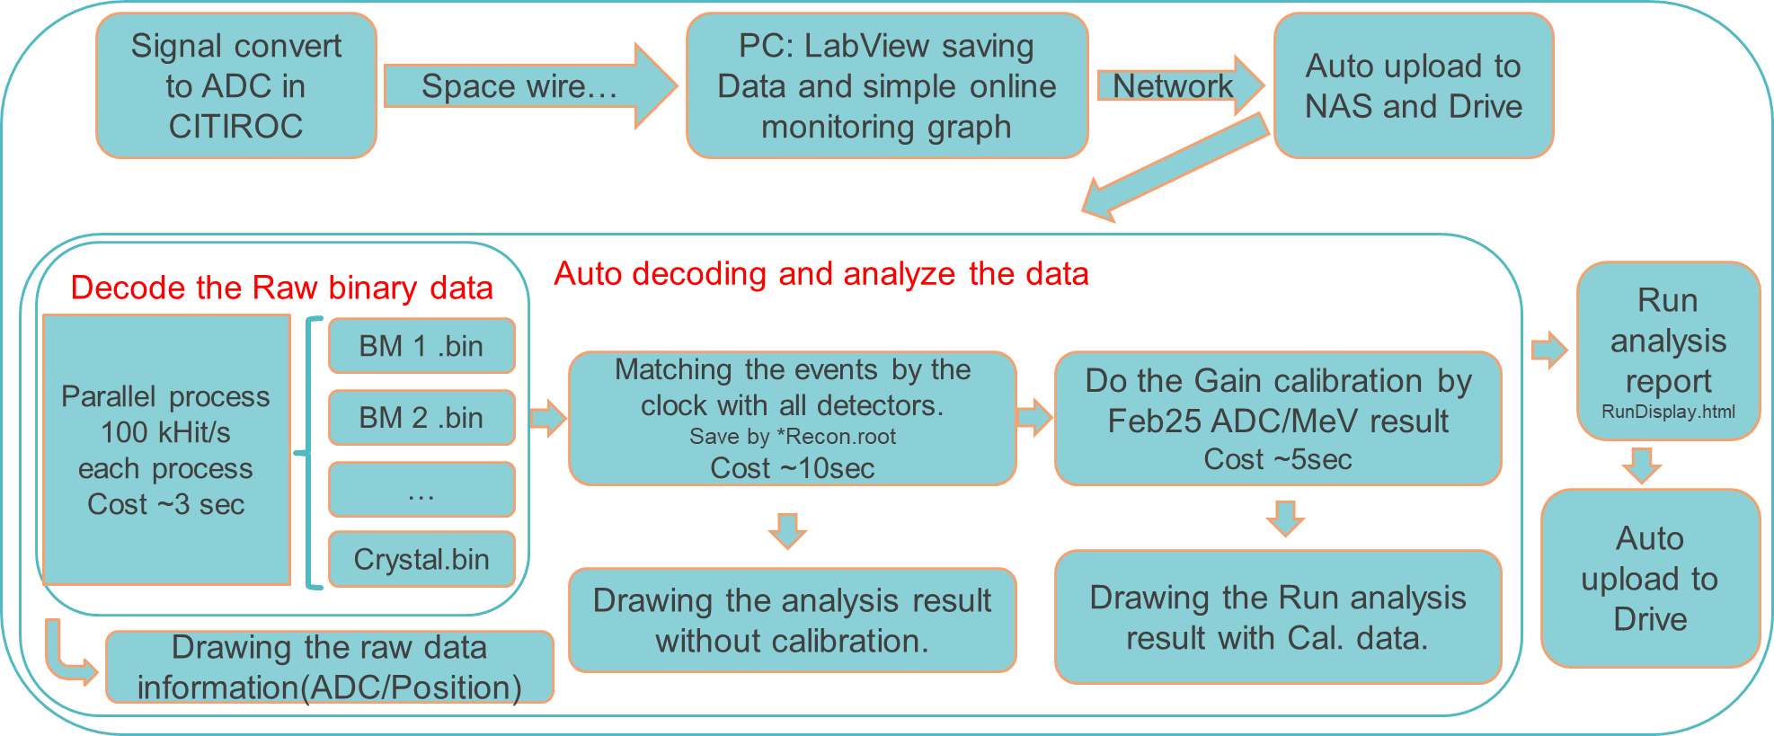
The auto analysis data stream
Need to develop the:
Auto data generator (for simulate the beam test data tacking)
Auto upload system(data)
Auto analysis system
Auto upload system2(result)
Completed
Completed
Under developing

Slide 4
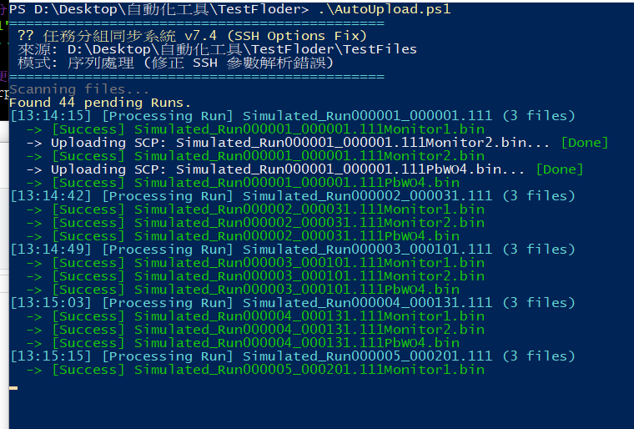
Auto upload system(data)
Setting the config before the operation.
Execute the AutoUpload.ps1 on the data taking PC.
The program could upload the file to the
1. SSH host(setting SSH config)
2. Google Drive(Using Google Drive App on PC)
During the upload:
The program will wait T(default = 5) for new file check.
The program only upload the files which are unlock.
If scp upload failed, the program will try again until success.
After upload, using MD5 hash to check the file correctness.

Slide 5
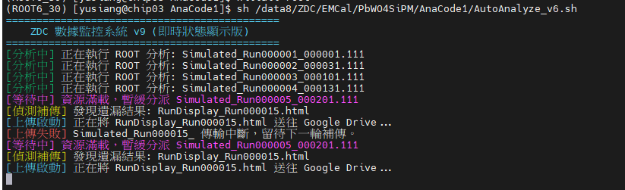
Auto analysis system
Auto analyze the runs which are haven’t done in target folder.
Parallel operate the analysis code(run by run).
Using the job number counter to prevent CPU overload.
… forget to having a screenshot the during the normal program operation…

Slide 6
Auto upload system2(result)
Get the API from the Google Drive.
Use “rclone” to uploading the analysis report to the Drive.
It have some problem, keep going on the development.

