Slide 1
Weekly meeting
Yu-Siang Xiao (蕭宇翔)
2026 02/11

Slide 2
The Fast Online Monitoring Program
Data stream
Signal convert to ADC in CITIROC
PC: LabView saving Data and simple online monitoring graph
Auto upload to NAS and Drive
Space wire…
Network
Auto decoding and analyze the data
Decode the Raw binary data
`
Run analysis report
RunDisplay.html
Parallel process
100 kHit/s
each process
Cost ~3 sec
BM 1 .bin
Matching the events by the clock with all detectors.
Save by *Recon.root
Cost ~10sec
Do the Gain calibration by Feb25 ADC/MeV result
Cost ~5sec
BM 2 .bin
…
Auto upload to Drive
Crystal.bin
The speed of drawing need to be improve!!
Drawing the analysis result without calibration.
Drawing the Run analysis result with Cal. data.
Drawing the raw data information(ADC/Position)

Slide 3
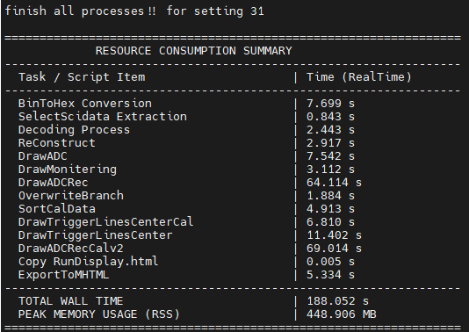
Analysis speed improve
Skip I/O time without changing the decoding result at all.
Solve the problem during drawing ADC distribution of B.M.s, the canvas and drawing setting problem.
Improve the reading of tree and the loops.
Cost too large space to save the temperate file, and using too much time to do the IO of the files.
=>concentrate to be 2 step in 1 script.
Cost too much time during the drawing process.
=>improve the tree reading(set the default mode of branch -> 0), and fix the bug of drawing canvas.

Slide 4
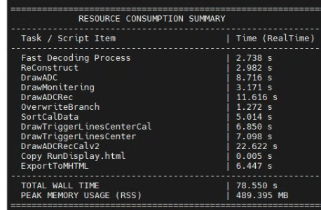
Analysis speed improve
Skip I/O time without changing the decoding result at all.
Solve the problem during drawing ADC distribution of B.M.s, the canvas and drawing setting problem.
Improve the reading of tree and the loops.

Slide 5
The cosmic ray test
Finish the configuration of the Cosmic ray runs for the program, which like the channels mapping, the drawing mapping/ setting…
Finish the test of reconstructing the event by detectors.
Keep going on the ADC cut(offline threshold), and the algorithm development for the full readout mode.

Slide 6
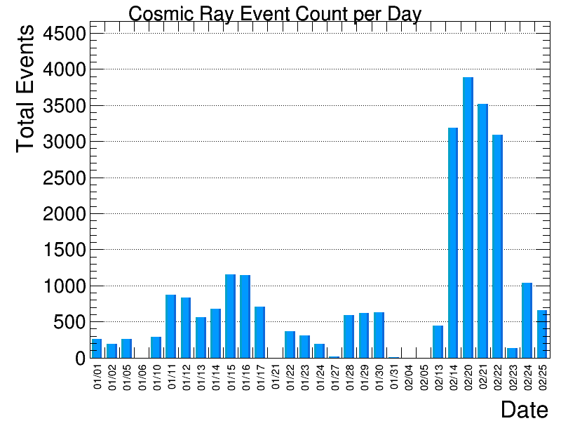
Cosmic ray event reconstruction
Using the data from 2026/01/01 to 2026/02/25.
Total data taking time in data set = 31 days
According to the geometry and flux calculation of muon, we may take 645 event per day.
The event count will be use the operation time to get the normalized histogram.
The 2/14 ,2/20~2/22 have some problem, with too much event!

Slide 7
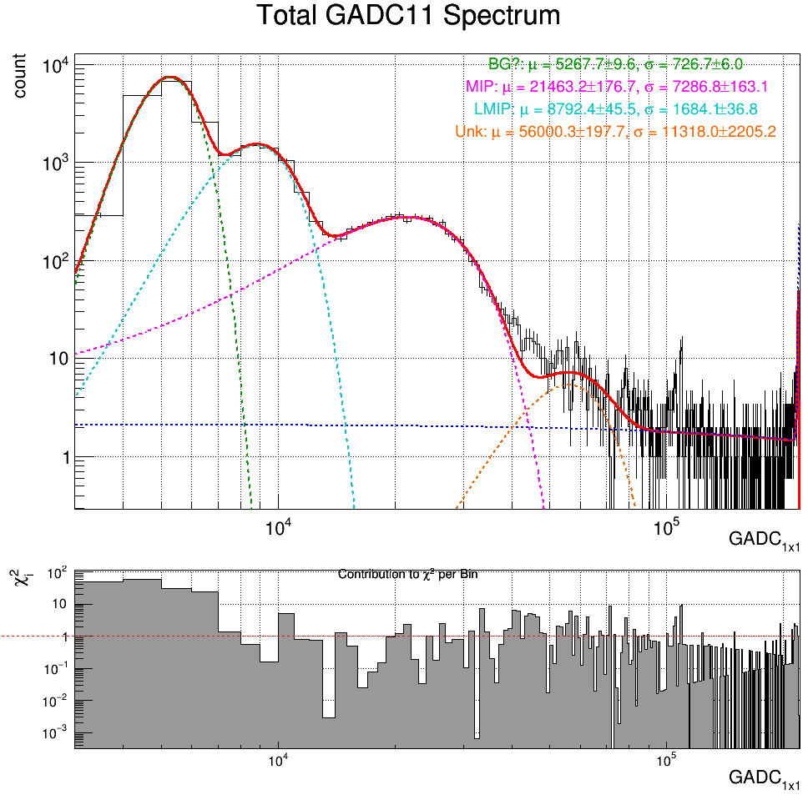
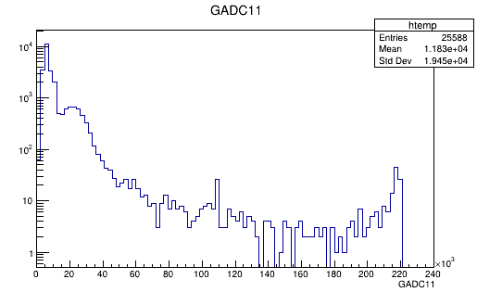

Cosmic ray data ADC_{1x1}, E_{1x1}
The peak of ADC_{1x1} is ~21463 ADC.
According to the E = (ADC-771)/281.72:
  21463 ADC~73.45 MeV which is approach the MIP value.
    MIP(6X₀ PbWO_{4,} 3GeV$μ$)~82.75MeV
Zoom in

Slide 8

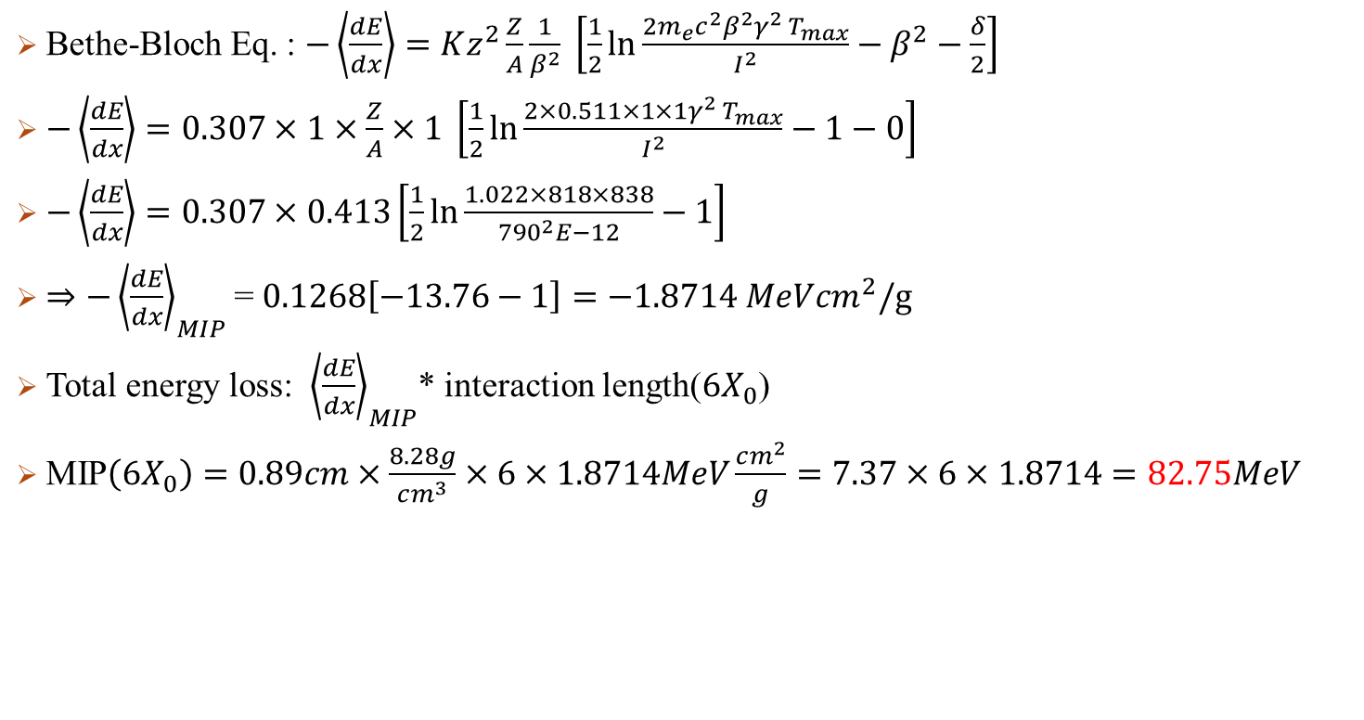
MIP Calculation
Bethe-Bloch Eq. : $−\left\langle \frac{dE}{dx}\right\rangle =Kz^{2}\frac{Z}{A}\frac{1}{β^{2}} \left[\frac{1}{2}\ln{\frac{2m_{e}c^{2}β^{2}γ^{2} T_{max}}{I^{2}}}−β^{2}−\frac{δ}{2}\right]$
$−\left\langle \frac{dE}{dx}\right\rangle =0.307×1×\frac{Z}{A}×1 \left[\frac{1}{2}\ln{\frac{2×0.511×1×1γ^{2} T_{max}}{I^{2}}}−1−0\right]$
$−\left\langle \frac{dE}{dx}\right\rangle =0.307×0.413\left[\frac{1}{2}\ln{\frac{1.022×818×838}{{790}^{2}E−12}}−1\right]$
$⇒−{\left\langle \frac{dE}{dx}\right\rangle }_{MIP}$= $0.1268\left[−13.76−1\right]=−1.8714 MeVcm^{2}/g$
Total energy loss: ${\left\langle \frac{dE}{dx}\right\rangle }_{MIP}$* interaction length($6X_{0}$)
MIP$\left(6X_{0}\right)=0.89cm×\frac{8.28g}{cm^{3}}×6×1.8714MeV\frac{cm^{2}}{g}=7.37×6×1.8714=82.75MeV$
$$K=0.307MeV cm^{2}/g$$
$$z=1(muon)$$
$$Z,A:Properity of meterial, for PbWO4=0.413$$
$$δ:density revise factor \sim 0\sim 0.1$$
$$T_{max}\left(3GeVμ\right)=2m_{e}c^{2}β^{2}γ^{2}\sim 838MeV$$
$β:For GeV level muon, 0.999…\sim 1$
$$γ\left(3GeVμ\right)=28.6$$
$$I:Mean Excitation Energy:790eV$$

Slide 9
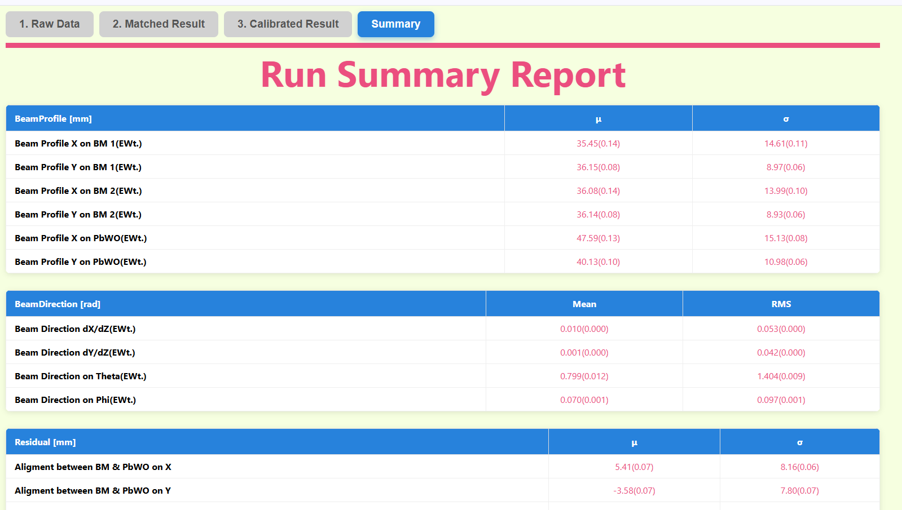
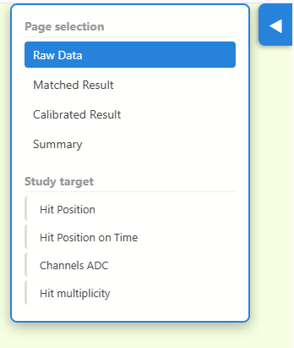
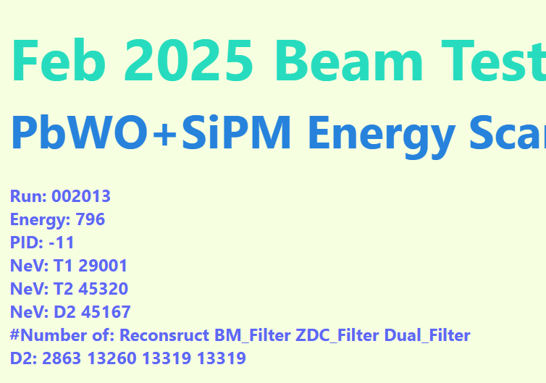
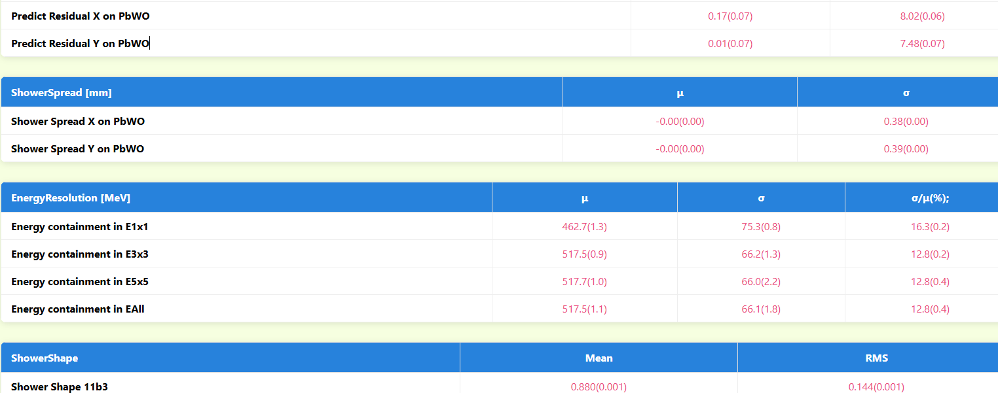
The HTML report
Add the run event counter, and event pass the filter.
Add the small window for faster going to the page/title.
Add the summary page with most important information/graphs.

Slide 10
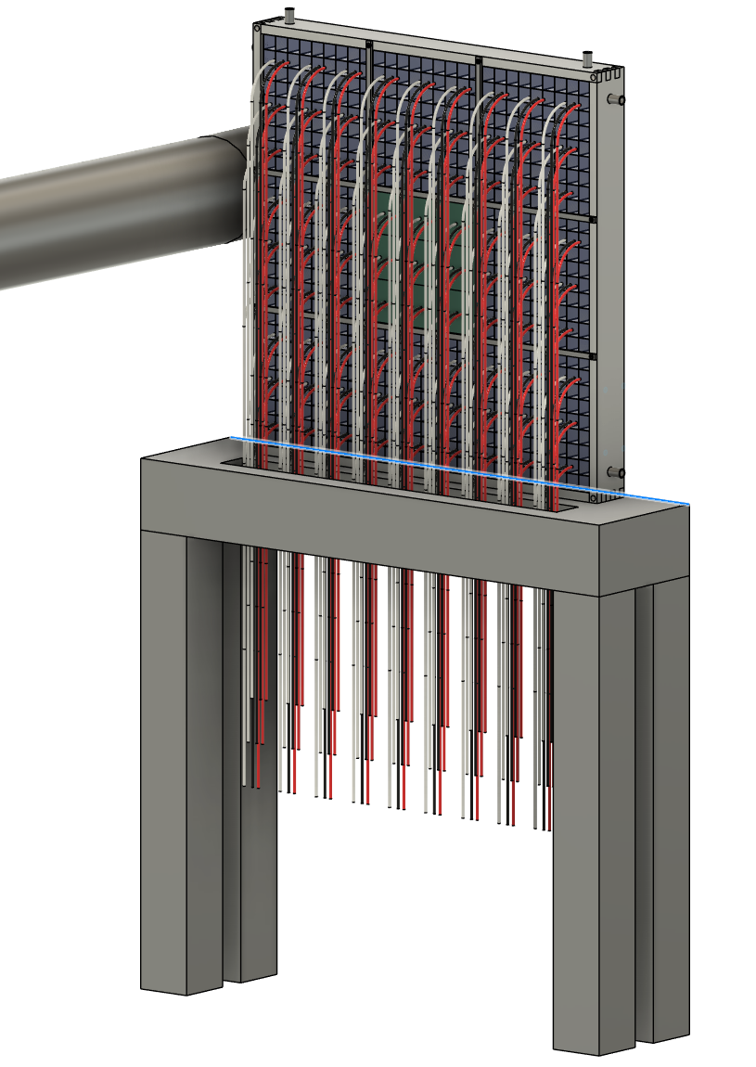
ZDC EMCal design
60 cm
T=6 cm
Here shows the EMCal with the:
Crystal PbWO₄ array:.
  Crystal size 20.5 × 20.5 × 6X₀
  Take more ~0.5mm for reflector and crystal wrapping.
  9x9 crystal = 1 Super Module
  Take 1mm stainless for the wrapping of SM.
  SM size : (21.0×9+2)² cm²
  Full array: 3x3 SM = (3×191)² cm²
  Total crystal module: 3x3x3x3 = 729
SiPM: S14160-3015PS_HAMAMATSU
  16 MPPC channel for each crystal.
  Total number of MPPC channel: 11664.
Support design + Cooling design by aluminum.
  Use thickness 13mm AL. plate.
The wire routing.
  Go down and penetrate the table.
60 cm
80 cm
20 cm

Slide 11
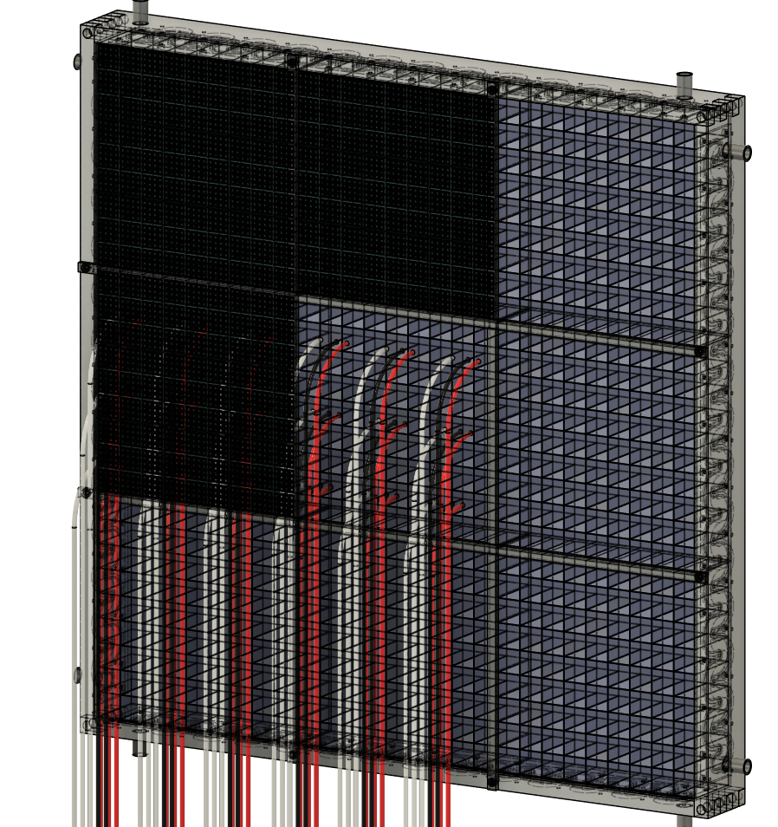
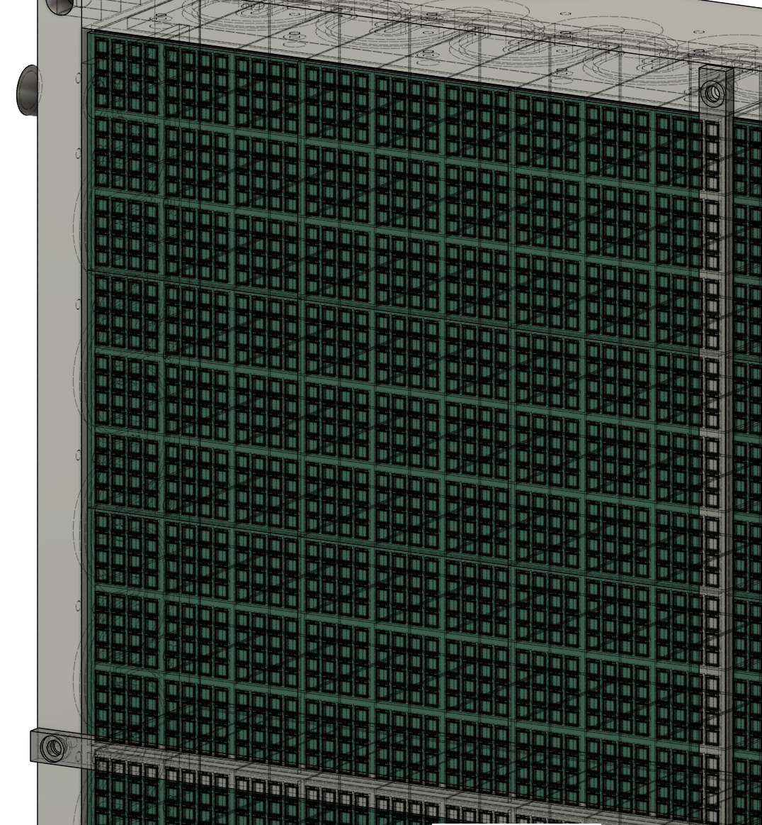
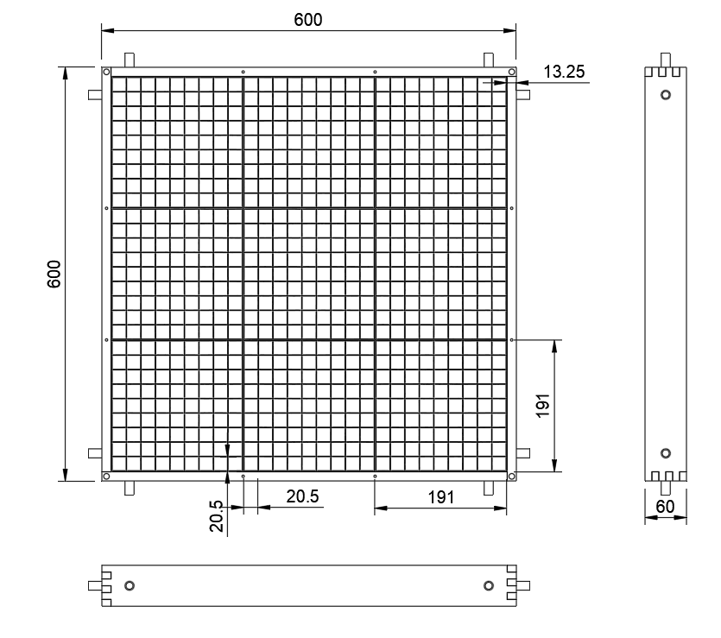
Supper module
1 SM contains :
  9x9 PbWO₄ crystals.
  16 x 9x9 SiPM channels = 1296 channels.
Zoom in

Slide 12
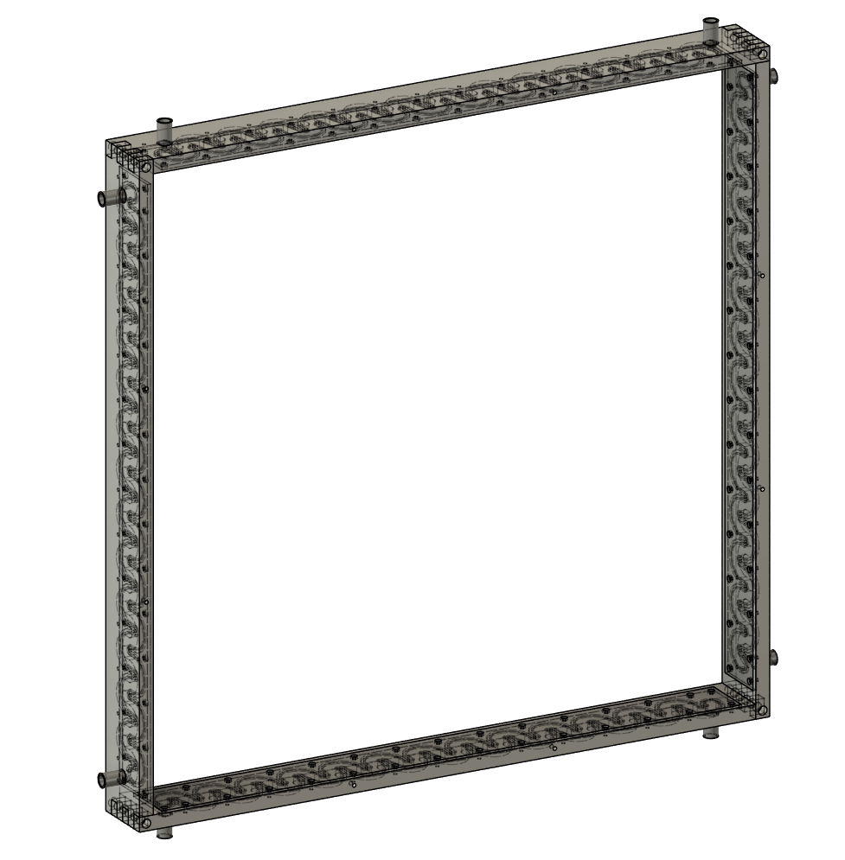
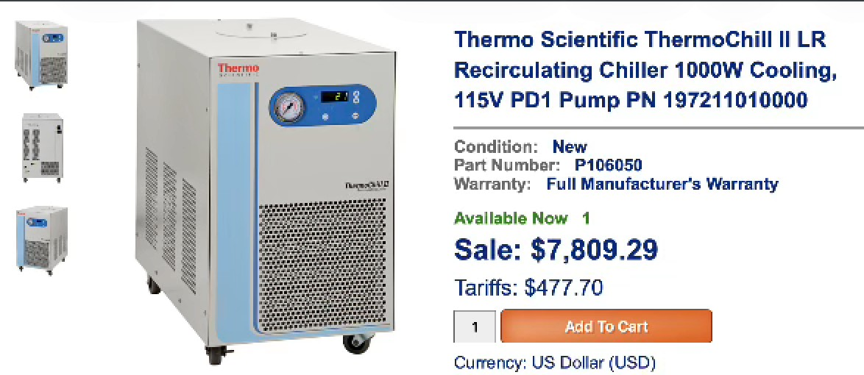
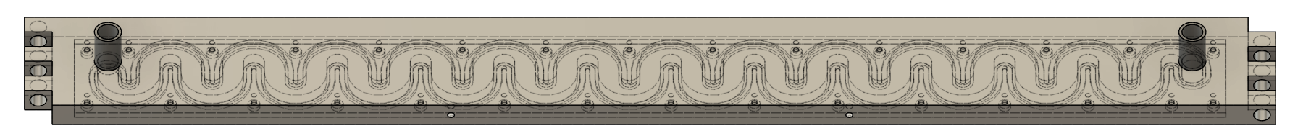
Cooling & support system
Use 4 cooling module to collect the heat from SiPM.
Using O-ring and screw to seal the cooling modules

Slide 13
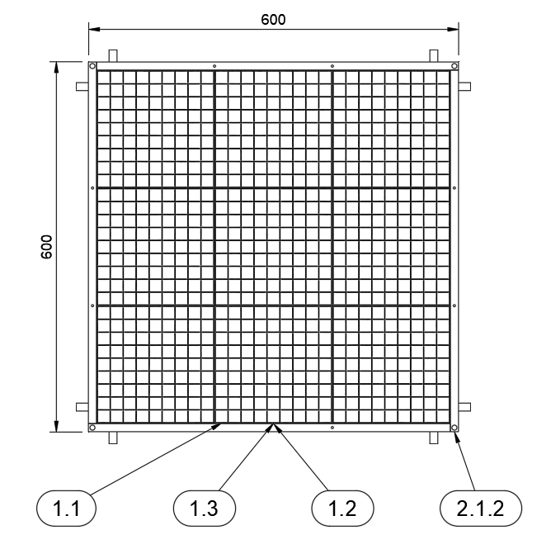
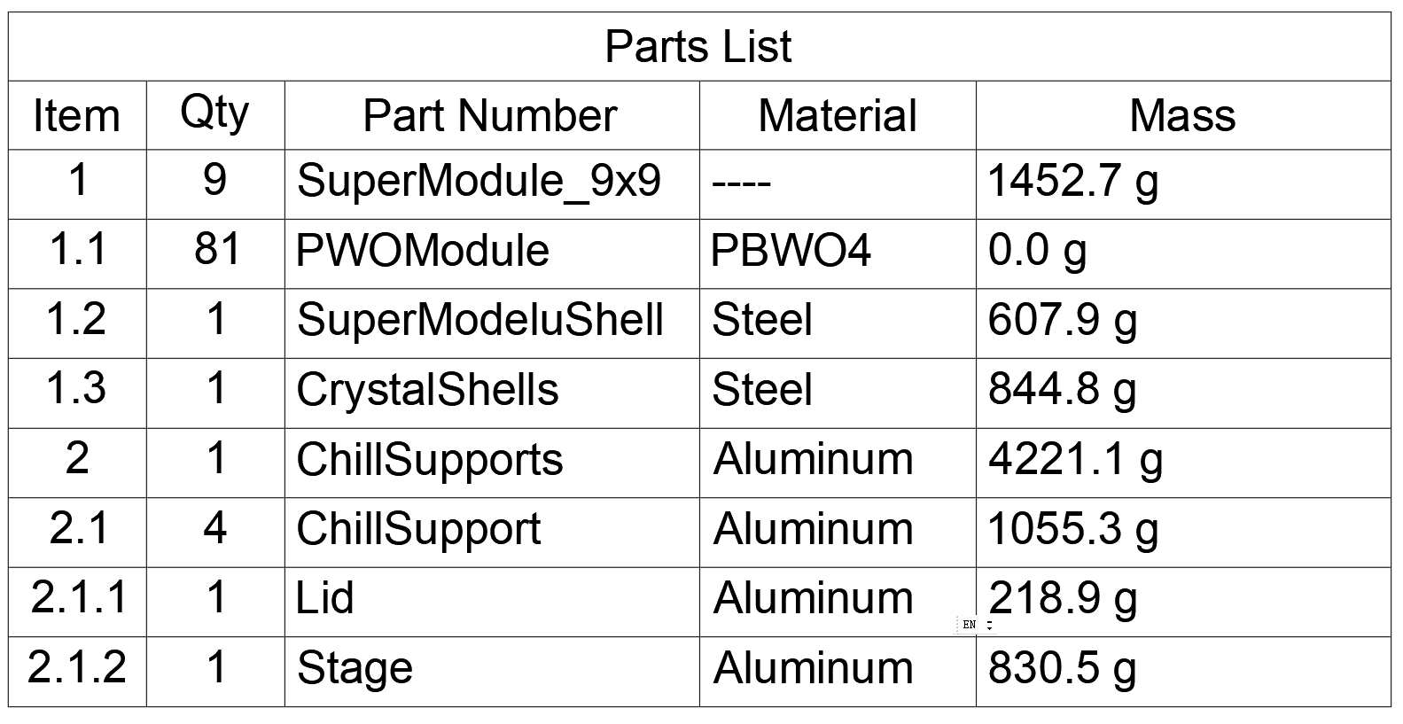
Mass calculation
Super Module = 16.4kg
Chill support = 4.2 kg
Total = 16.4*9 +4.2 = 151.8 kg
Not calculate the cables, PCBs, yet.
16405.3 g
184.6 g

