Slide 1
Combine DY Cross Section w/ LL and LO Trigger w/ Correlation of Systematics
20260206
Chia-Yu Hsieh
Academia Sinica, Taiwan

Slide 2
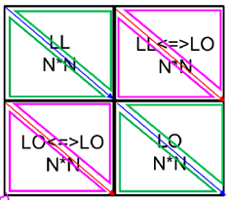
Correlations
C_stat : ok
C_sys_acc (sys_acc = 3* MC_stat)
Same bin, same trig : 1
Same bin, different trigger : 0.8 (trigger efficiency test in MC)
Different bin, same trigger
Different bin, different trigger
C_sys_purity
Same bin, same trig : 1
Same bin, different trigger
Different bin, same trigger
Different bin, different trigger
+ C_sys_trig (W : 13%, Al : 5%, NH3 : 0%, etc)
Same bin, same trig : 1
Same bin, different trigger : -1
Different bin, same trigger : 1
Different bin, different trigger : -ratio?

Slide 3
C_stat (OK)
2N * 2N Matrix
LL (N)
LO (N)
C_stat
Same bin, same trig : 1
Same bin, different trigger : 0
Different bin, same trigger : 0
Different bin, different trigger : 0
LL (N)
LL x LL (NxN)
LO x LL (NxN)
LO (N)
M_stat = { stat_LL(N) , stat_LO(N) }
R_stat = M_stat x C_stat x M_stat
LL x LO (NxN)
LO x LO (NxN)

Slide 4
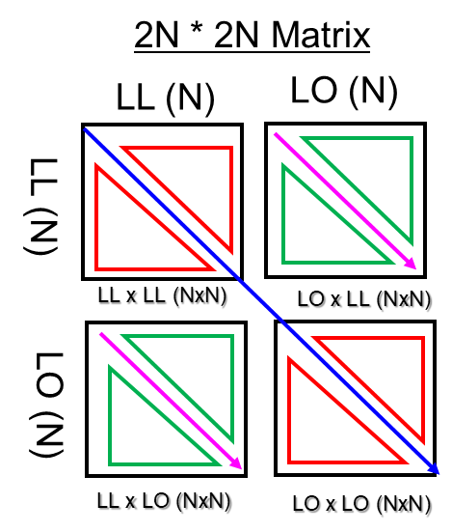
C_sys_acc
C_sys_acc (sys_acc = 3* MC_stat)
Same bin, same trig : 1
Others = 0.8 (no differentiation on kinematics)

Slide 5
C_sys_purity (OK?)
C_sys_purity
Same bin, same trig : 1
Others = Rand(0.7, 0.9), now I use 0.8 for all

Slide 6
C_sys_trig
C_sys_trig
Same bin, same trig : 1
Same bin, different trigger : -1
Different bin, same trigger : 1
Different bin, different trigger : -1
size = W : 13%, Al : 5%, NH3 : 0%
sys_trig_LL = size * Xsection_LL
sys_trig_LO = size * Xsection_LO

Slide 7
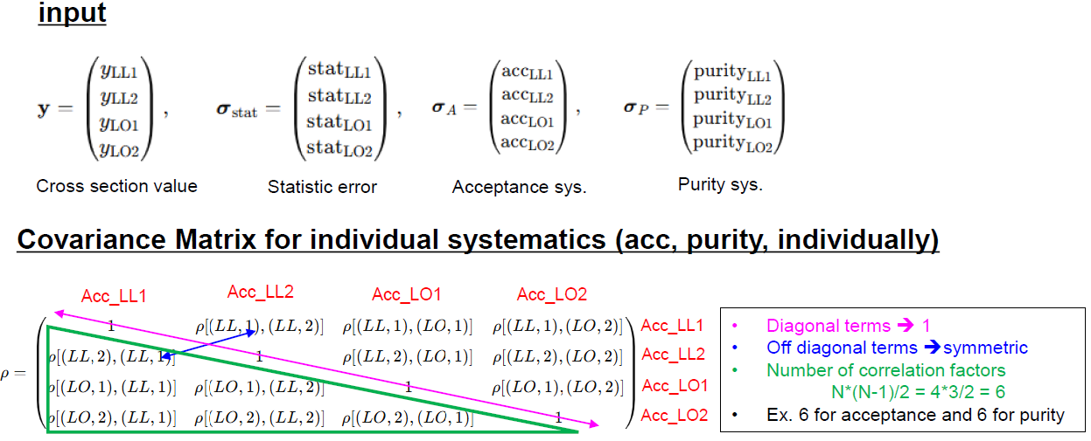
LL and LO overlap region : BLUE

Slide 8
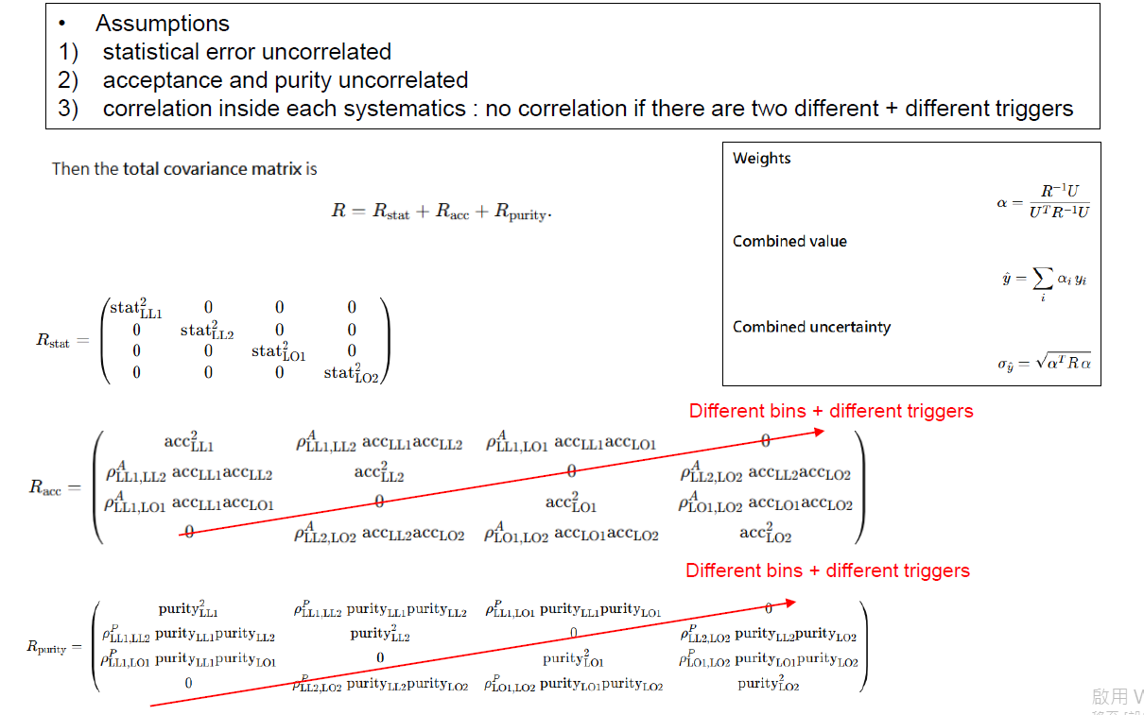
LL and LO overlap region : BLUE

Slide 9
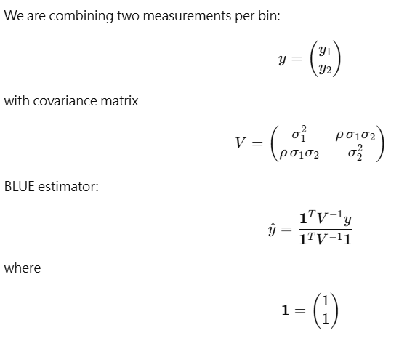
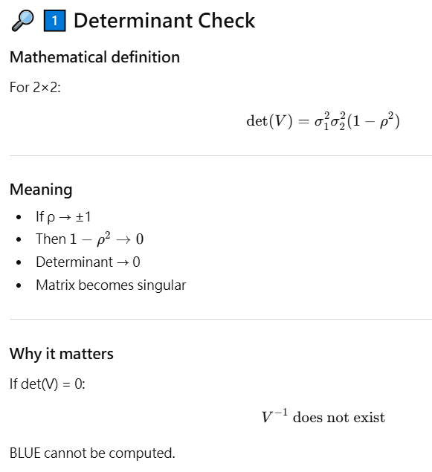
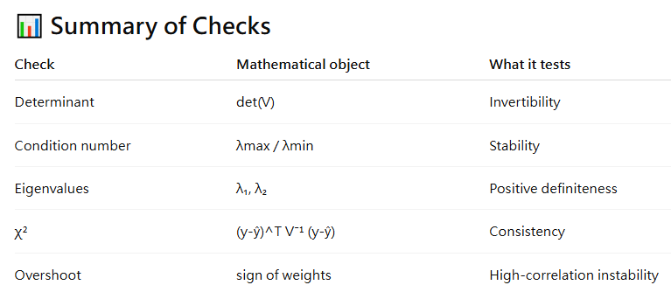
Checks

Slide 10
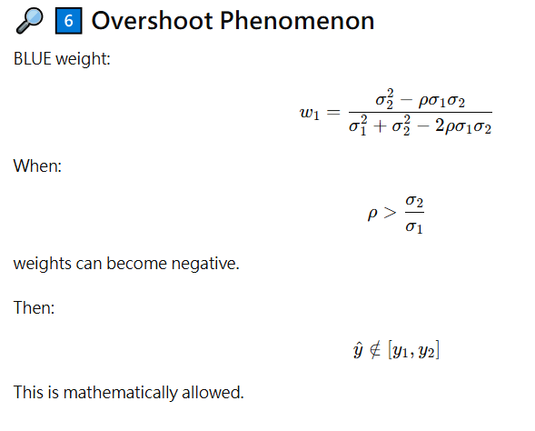
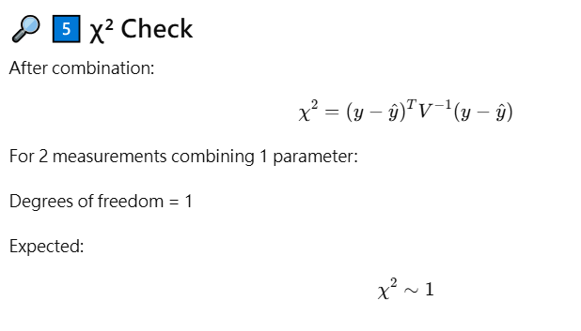
Checks
Overshoot = negative weighting
When σ₂/σ₁≈ 1 and r → +1
=> weighting<0, combined result is not in the range of y1 and y2)

Slide 11
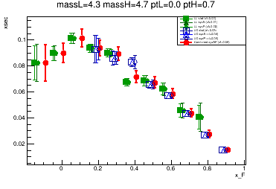
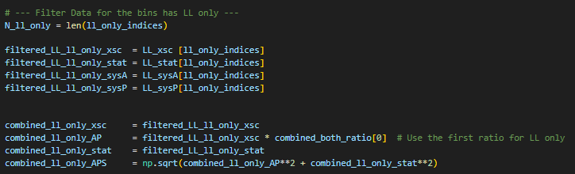
For Regions with only LL or LO
Extrapolate the size of systematic error from the previous combined bin

Slide 12
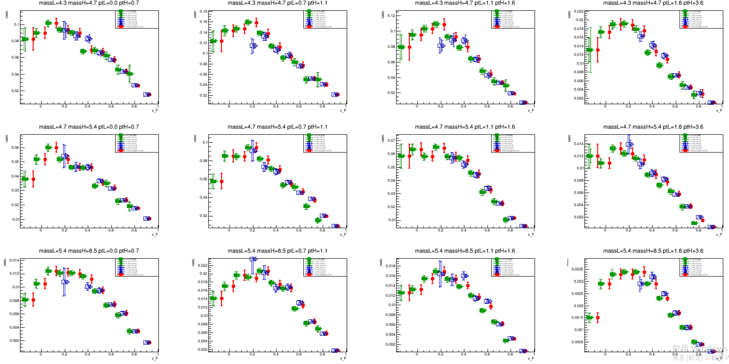
NH3

Slide 13
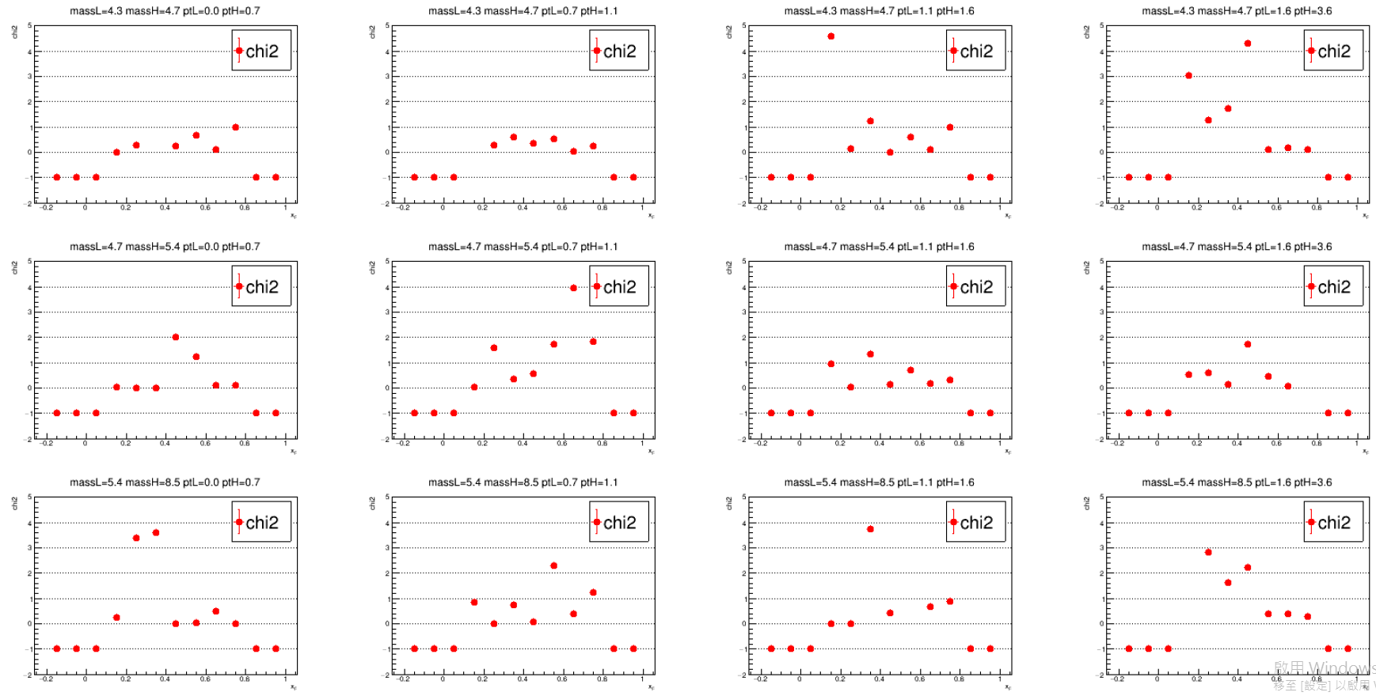
Chi2 (=-1, simply only LL or LO)

Slide 14
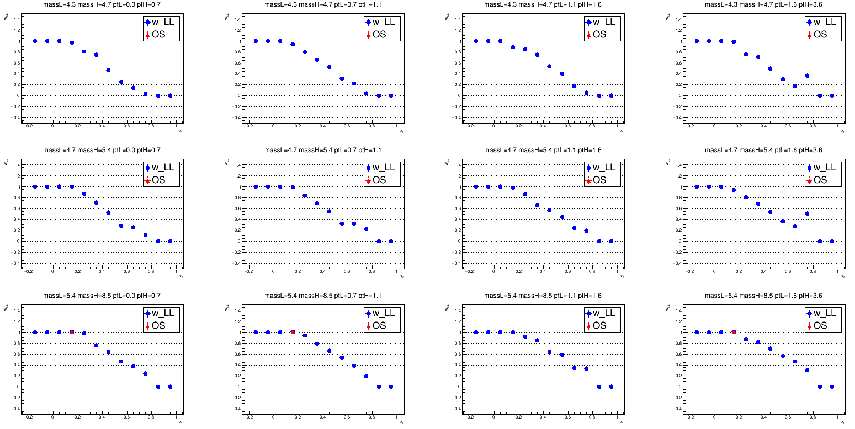
Weight_LL (=1, only LL; =0, only LO; >1 or < 0, overshoot)

Slide 15
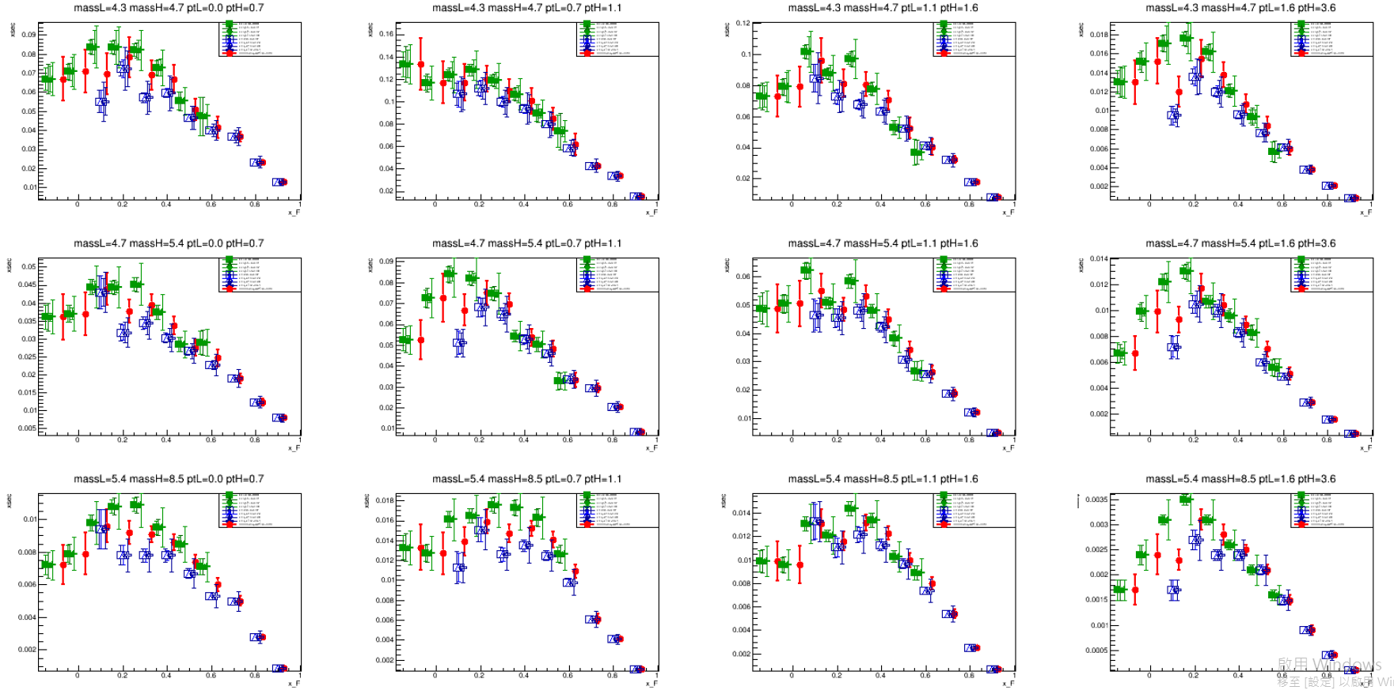
W

Slide 16
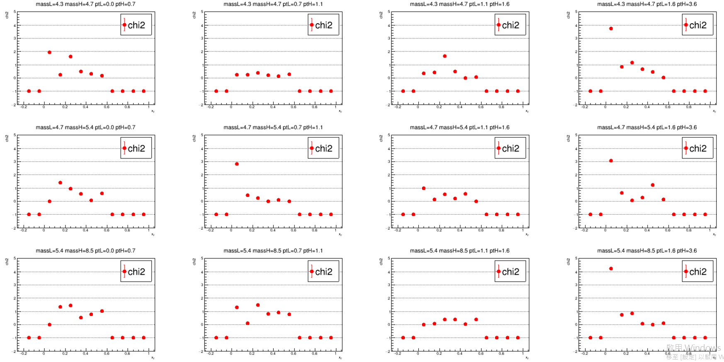
Chi2 (=-1, simply only LL or LO)

Slide 17
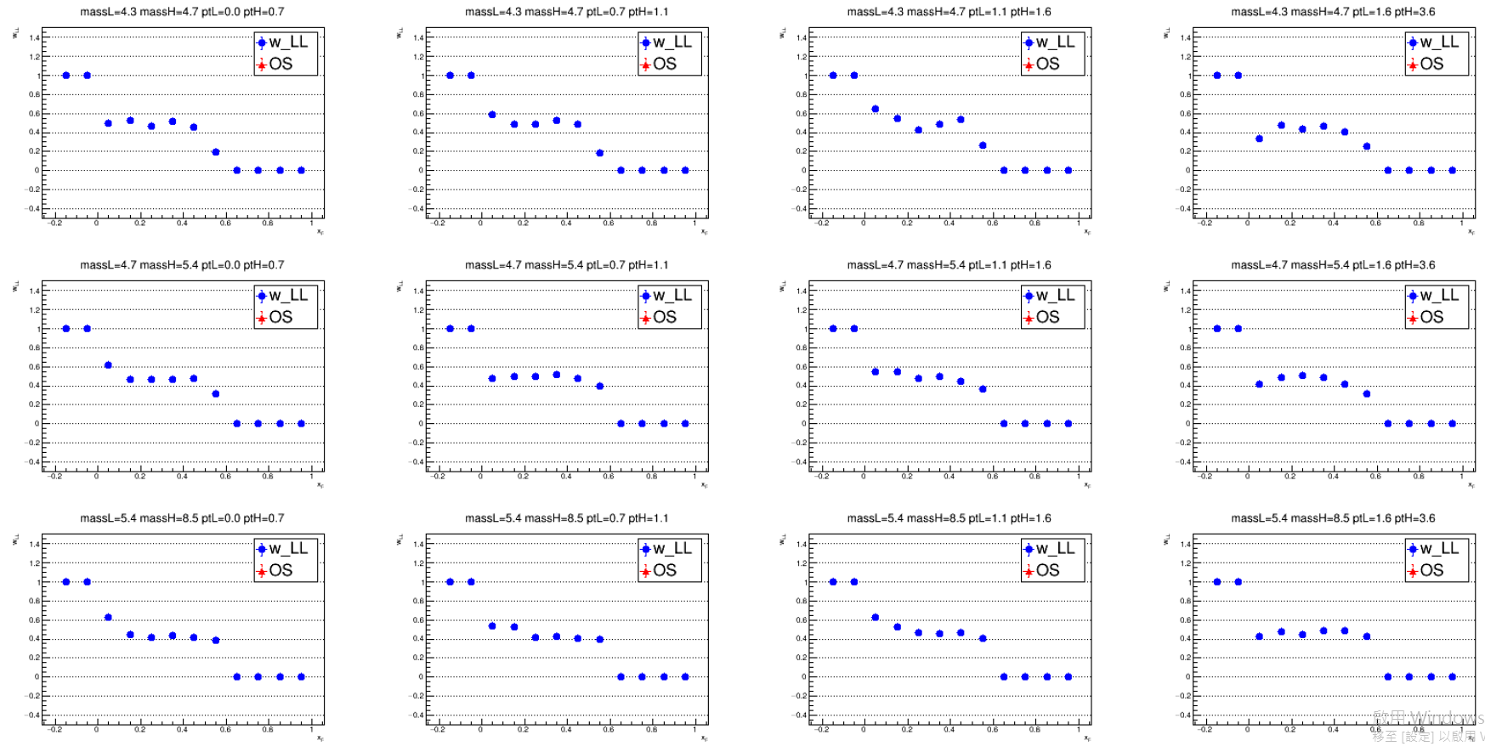
Weight_LL (=1, only LL; =0, only LO; >1 or < 0, overshoot)

Slide 18
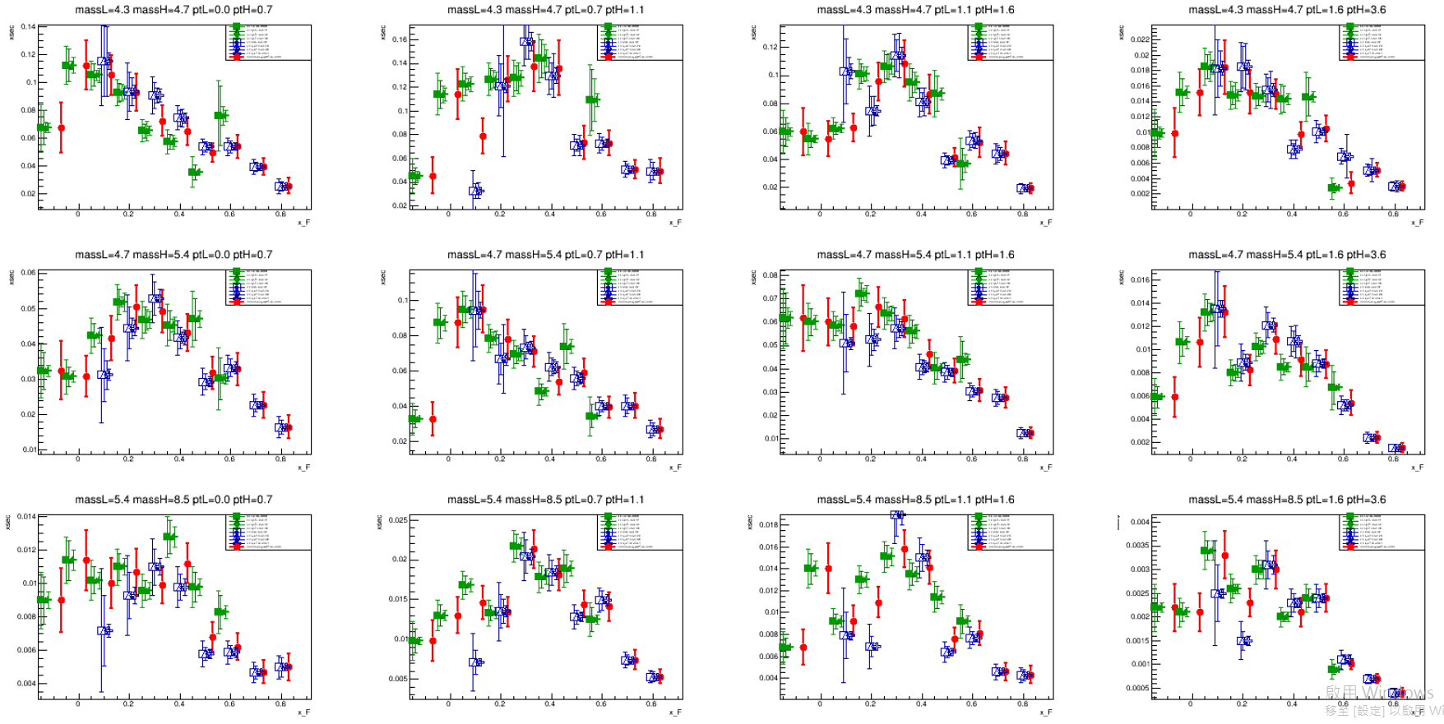
Al

Slide 19
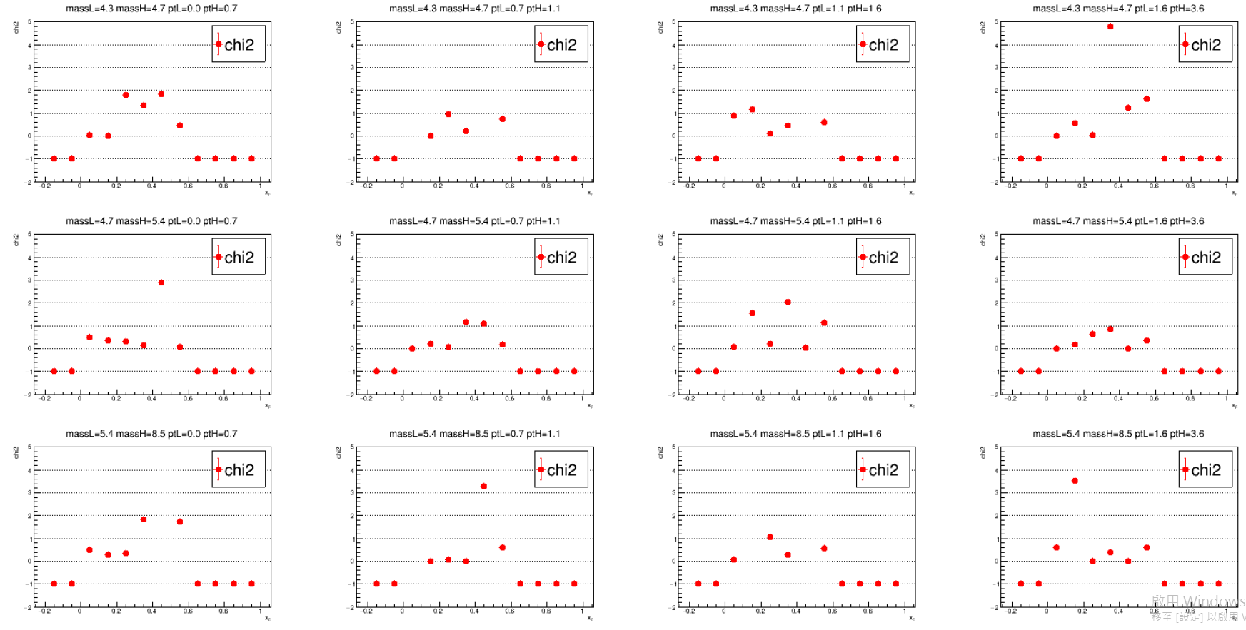
Chi2 (=-1, simply only LL or LO)

Slide 20
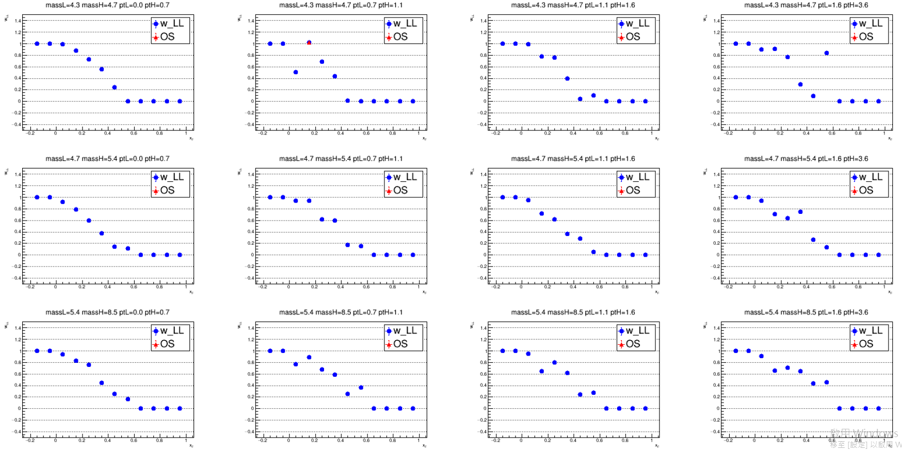
Weight_LL (=1, only LL; =0, only LO; >1 or < 0, overshoot)

Slide 21
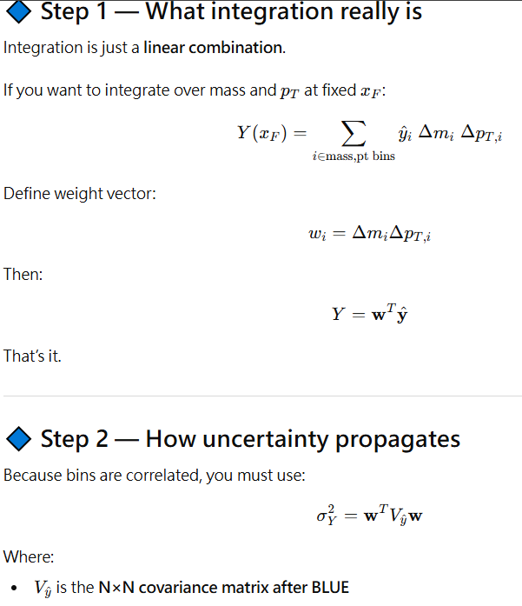
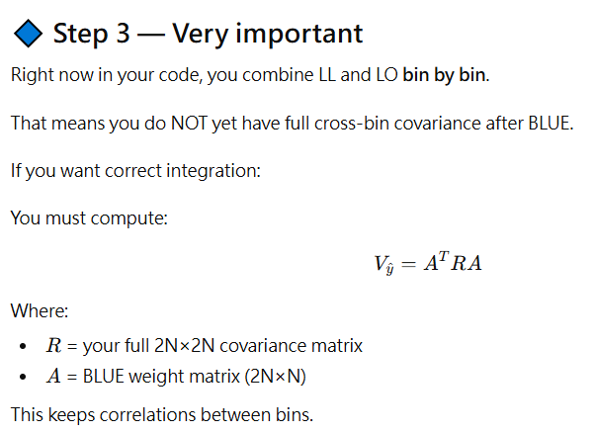



Integration to 1D in xF (Math)
Linear integration for mean
Correlation only affect sigma
Error propagation
I ask AI to generate code for me, sanity check not yet done!

Slide 22
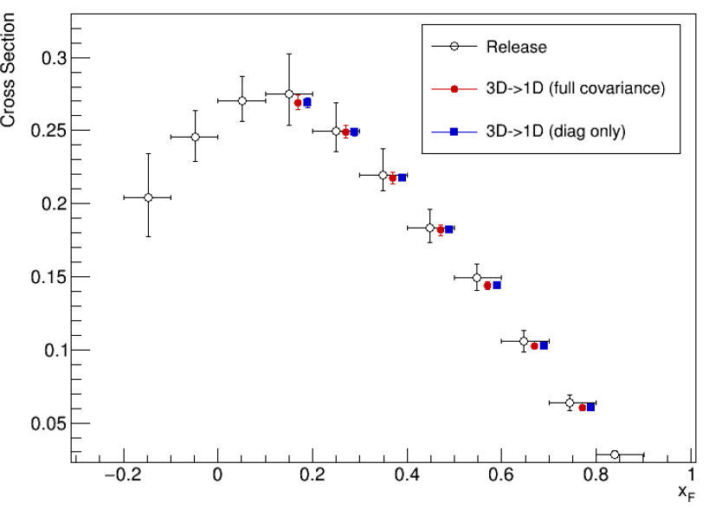
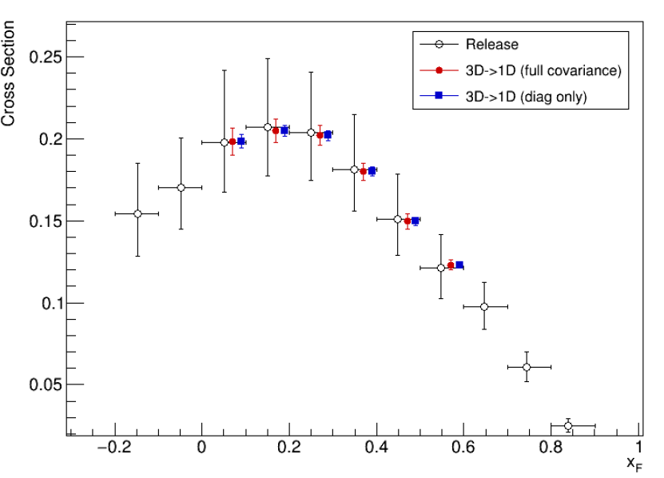
Integrate to 1D in xF (Results)
😱
W
NH3
Release 1D :
Fill event by event into 1D histogram with factor
1*purity/( acc* DAQ_LT* Veto_LT * tarAtt *rhoT)
where purity and acc are 5D histogram (target, trig, mass, pt, xf).
Release 3D apply the same idea for release 1D, just event by event fill into 3D histogram.
3D->1D : integrate 3D xsc over mass and pt, considering covariance matrix.
3D->1D : integrate 3D xsc over mass and pt, DO NOT considering covariance matrix.

Slide 23
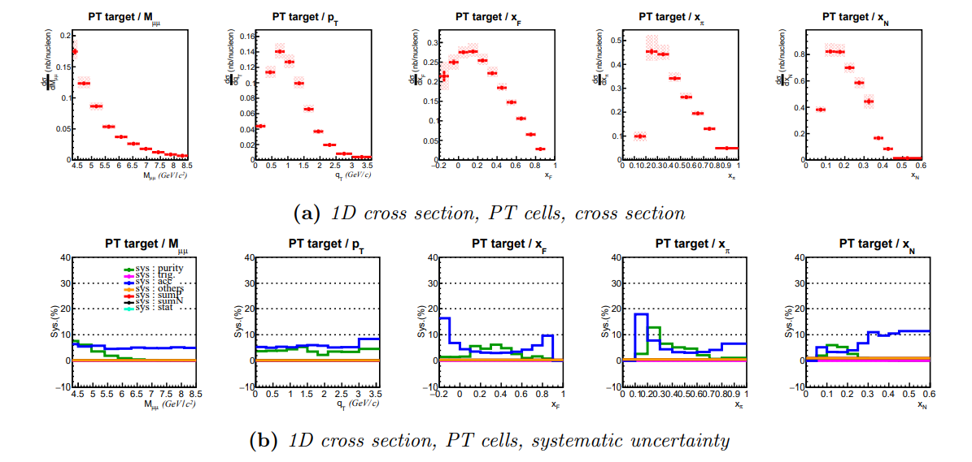
Release 1D (NH3)

Slide 24
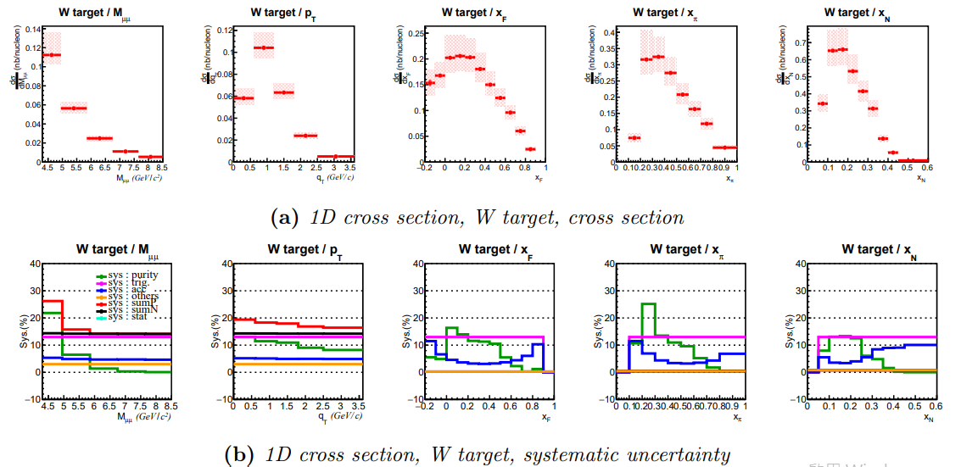
Release 1D (W)

Slide 25
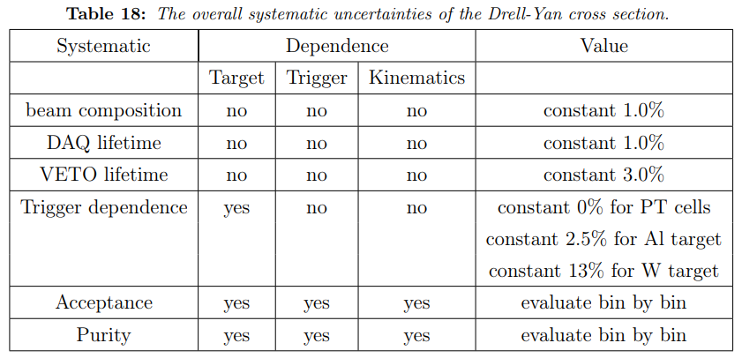
Systematics Source
Systematic of beam composition, DAQ lifetime, and Veto lifetime are constant values cross kinematics and targets. However, systematics of acceptance and purity are kinematic dependent and possibly correlated. Also, we have very different results LL and LO trigger, especially for W target.

Slide 26
Systematics Source
Systematic of beam composition, DAQ lifetime, and Veto lifetime are constant values cross kinematics and targets. However, systematics of acceptance and purity are kinematic dependent and possibly correlated. Also, we have very different results LL and LO trigger, especially for W target.

Slide 27
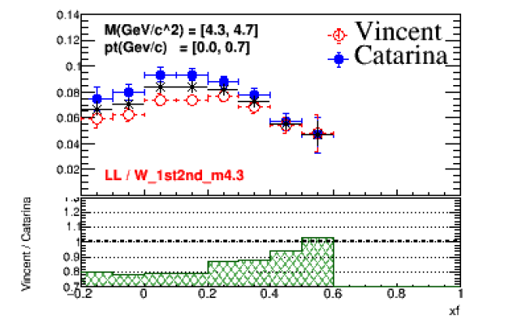
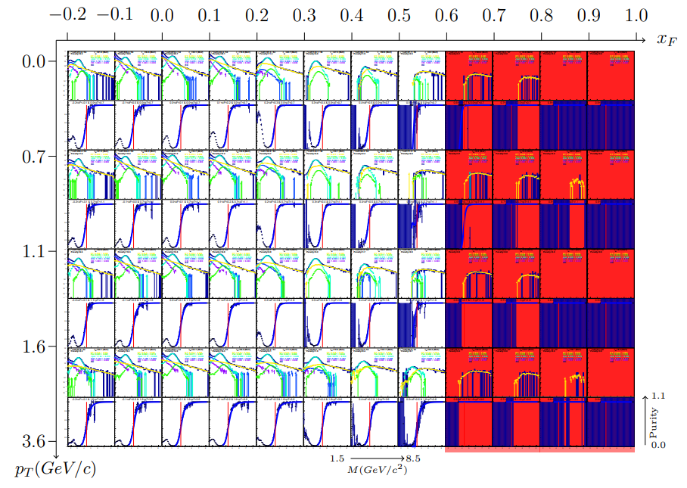
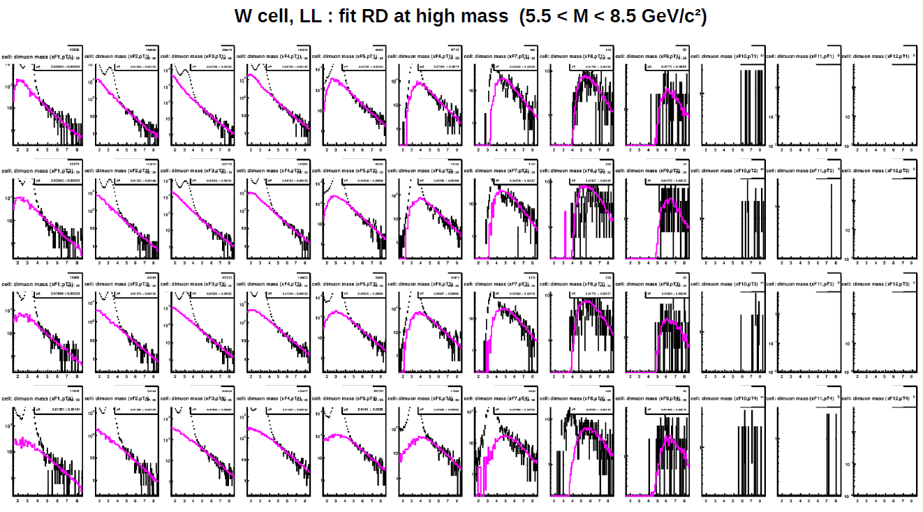
Purity Systematics
W, LL trigger
Cocktail Fit (Vincent)
Jpsi, OpenCharm, HMDY, BG, etc.
Simple Fit (Catarina)
HMDY + BG

Slide 28
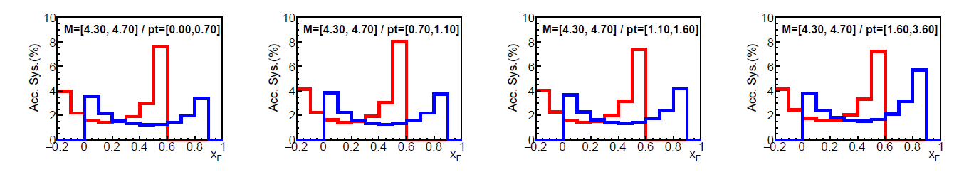
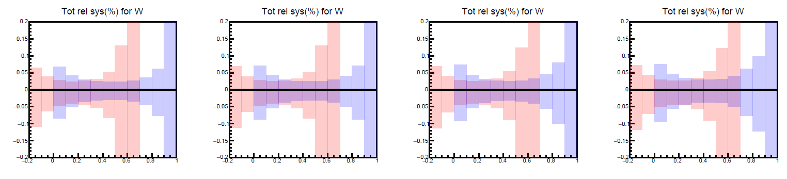
Acceptance Systematics
Example : W target / LL trigger
Source#1 : statistical uncertainty of acceptance
Source#2 : Uncertainty of trigger efficiency and detector efficiency
The size of Source#2 is twice of Source#1 => Total size of acceptance systematic is three times of source#1.

