Slide 1
Weekly meeting
Yu-Siang Xiao (蕭宇翔)
2026 03/13

Slide 2
The cosmic ray test(last week)
Finish the configuration of the Cosmic ray runs for the program, which like the channels mapping, the drawing mapping/ setting…
Finish the test of reconstructing the event by detectors.
Keep going on the ADC cut(offline threshold), and the algorithm development for the full readout mode.

Slide 3
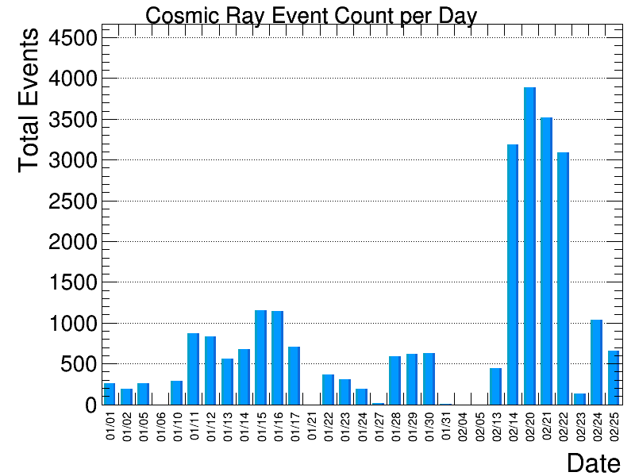
Cosmic ray event reconstruction
Using the data from 2026/01/01 to 2026/02/25.
Total data taking time in data set = 31 days
According to the geometry and flux calculation of muon, we may take 645 event per day.
The event count will be use the operation time to get the normalized histogram.
The 2/14 ,2/20~2/22 have some problem, with too much event!

Slide 4
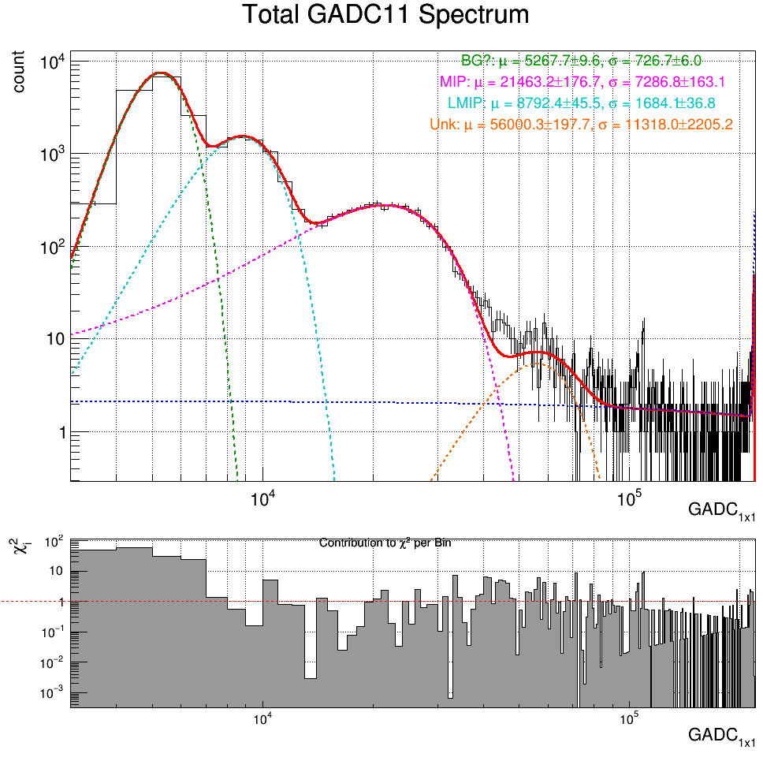
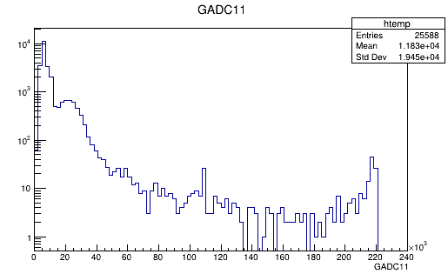

Cosmic ray data ADC_{1x1}, E_{1x1}
The peak of ADC_{1x1} is ~21463 ADC.
PS: The channel didn’t do the gain calibration in program, yet.
According to the E = (ADC-771)/281.72:
21463 ADC~73.45 MeV which is approach the MIP value.
MIP(6X₀ PbWO_{4,} 3GeV$μ$)~82.75MeV
Zoom in

Slide 5
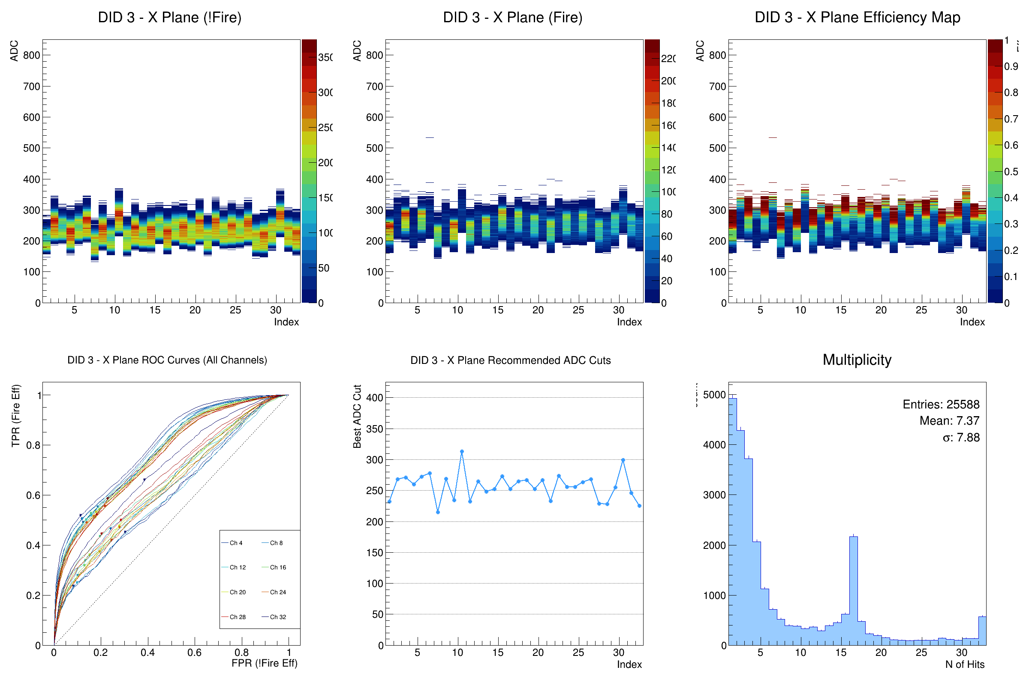
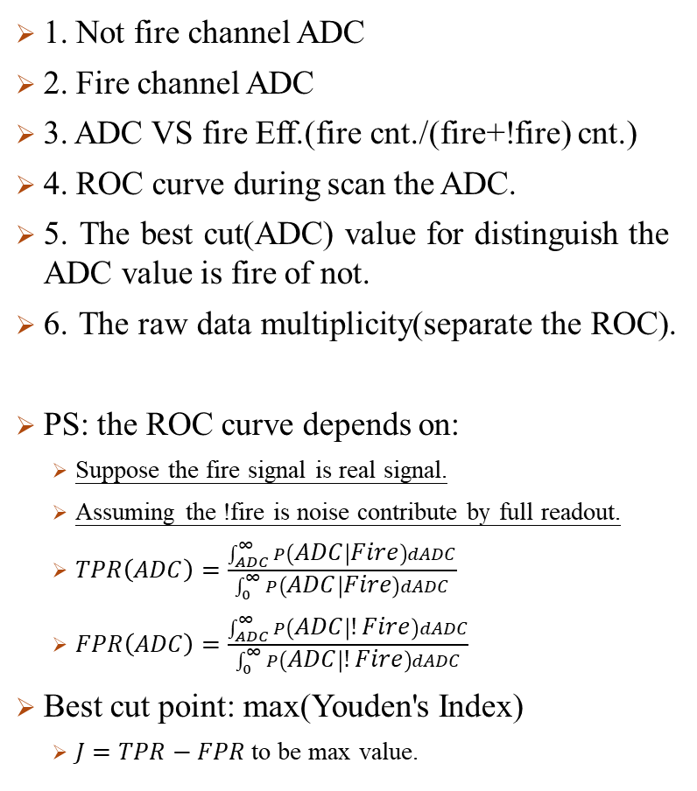
The DAQ cut issue
1. Not fire channel ADC
2. Fire channel ADC
3. ADC VS fire Eff.(fire cnt./(fire+!fire) cnt.)
4. ROC curve during scan the ADC.
5. The best cut(ADC) value for distinguish the ADC value is fire of not.
6. The raw data multiplicity(separate the ROC).
PS: the ROC curve depends on:
Suppose the fire signal is real signal.
Assuming the !fire is noise contribute by full readout.
$TPR\left(ADC\right)=\frac{\int_{ADC}^{∞}{P\left(ADC | Fire\right)dADC}}{\int_{0}^{∞}{P\left(ADC | Fire\right)dADC}}$
$FPR\left(ADC\right)=\frac{\int_{ADC}^{∞}{P\left(ADC | !Fire\right)dADC}}{\int_{0}^{∞}{P\left(ADC | !Fire\right)dADC}}$
Best cut point: max(Youden's Index)
$J=TPR−FPR$ to be max value.

Slide 6
The DAQ cut BM 2 – X(1st layer)
Some 16 channel is more easier to be fire than other channels.

Slide 7
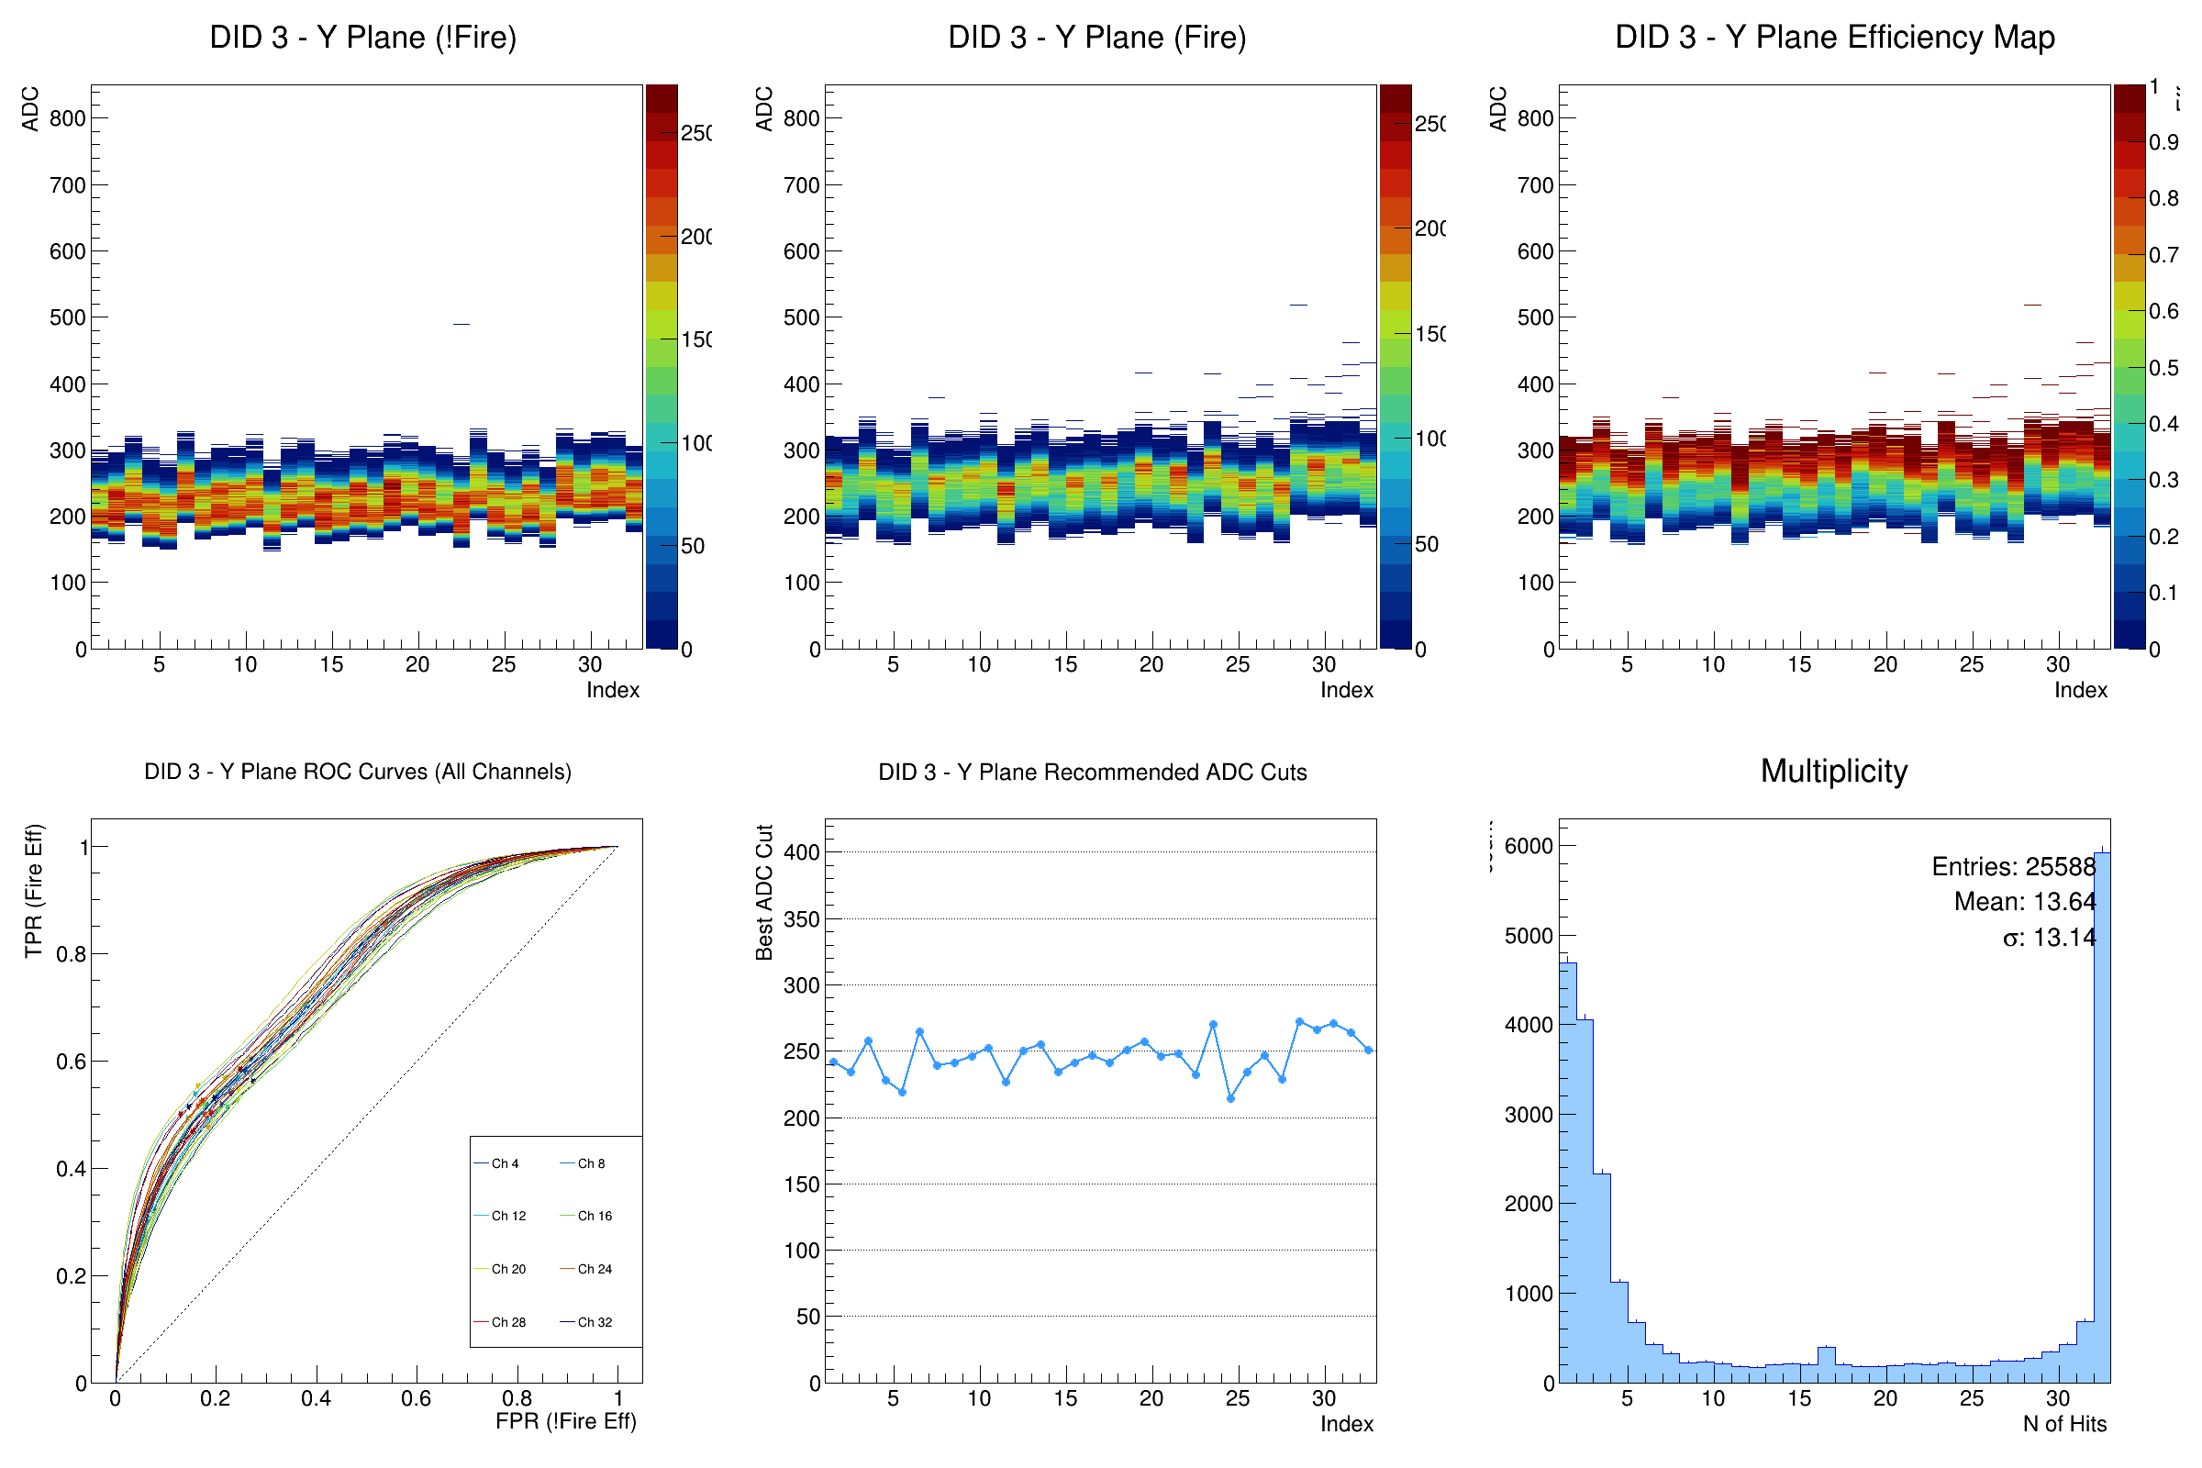
The DAQ cut BM 2 – Y(2nd layer)
The channels is more uniform than X plane.

Slide 8
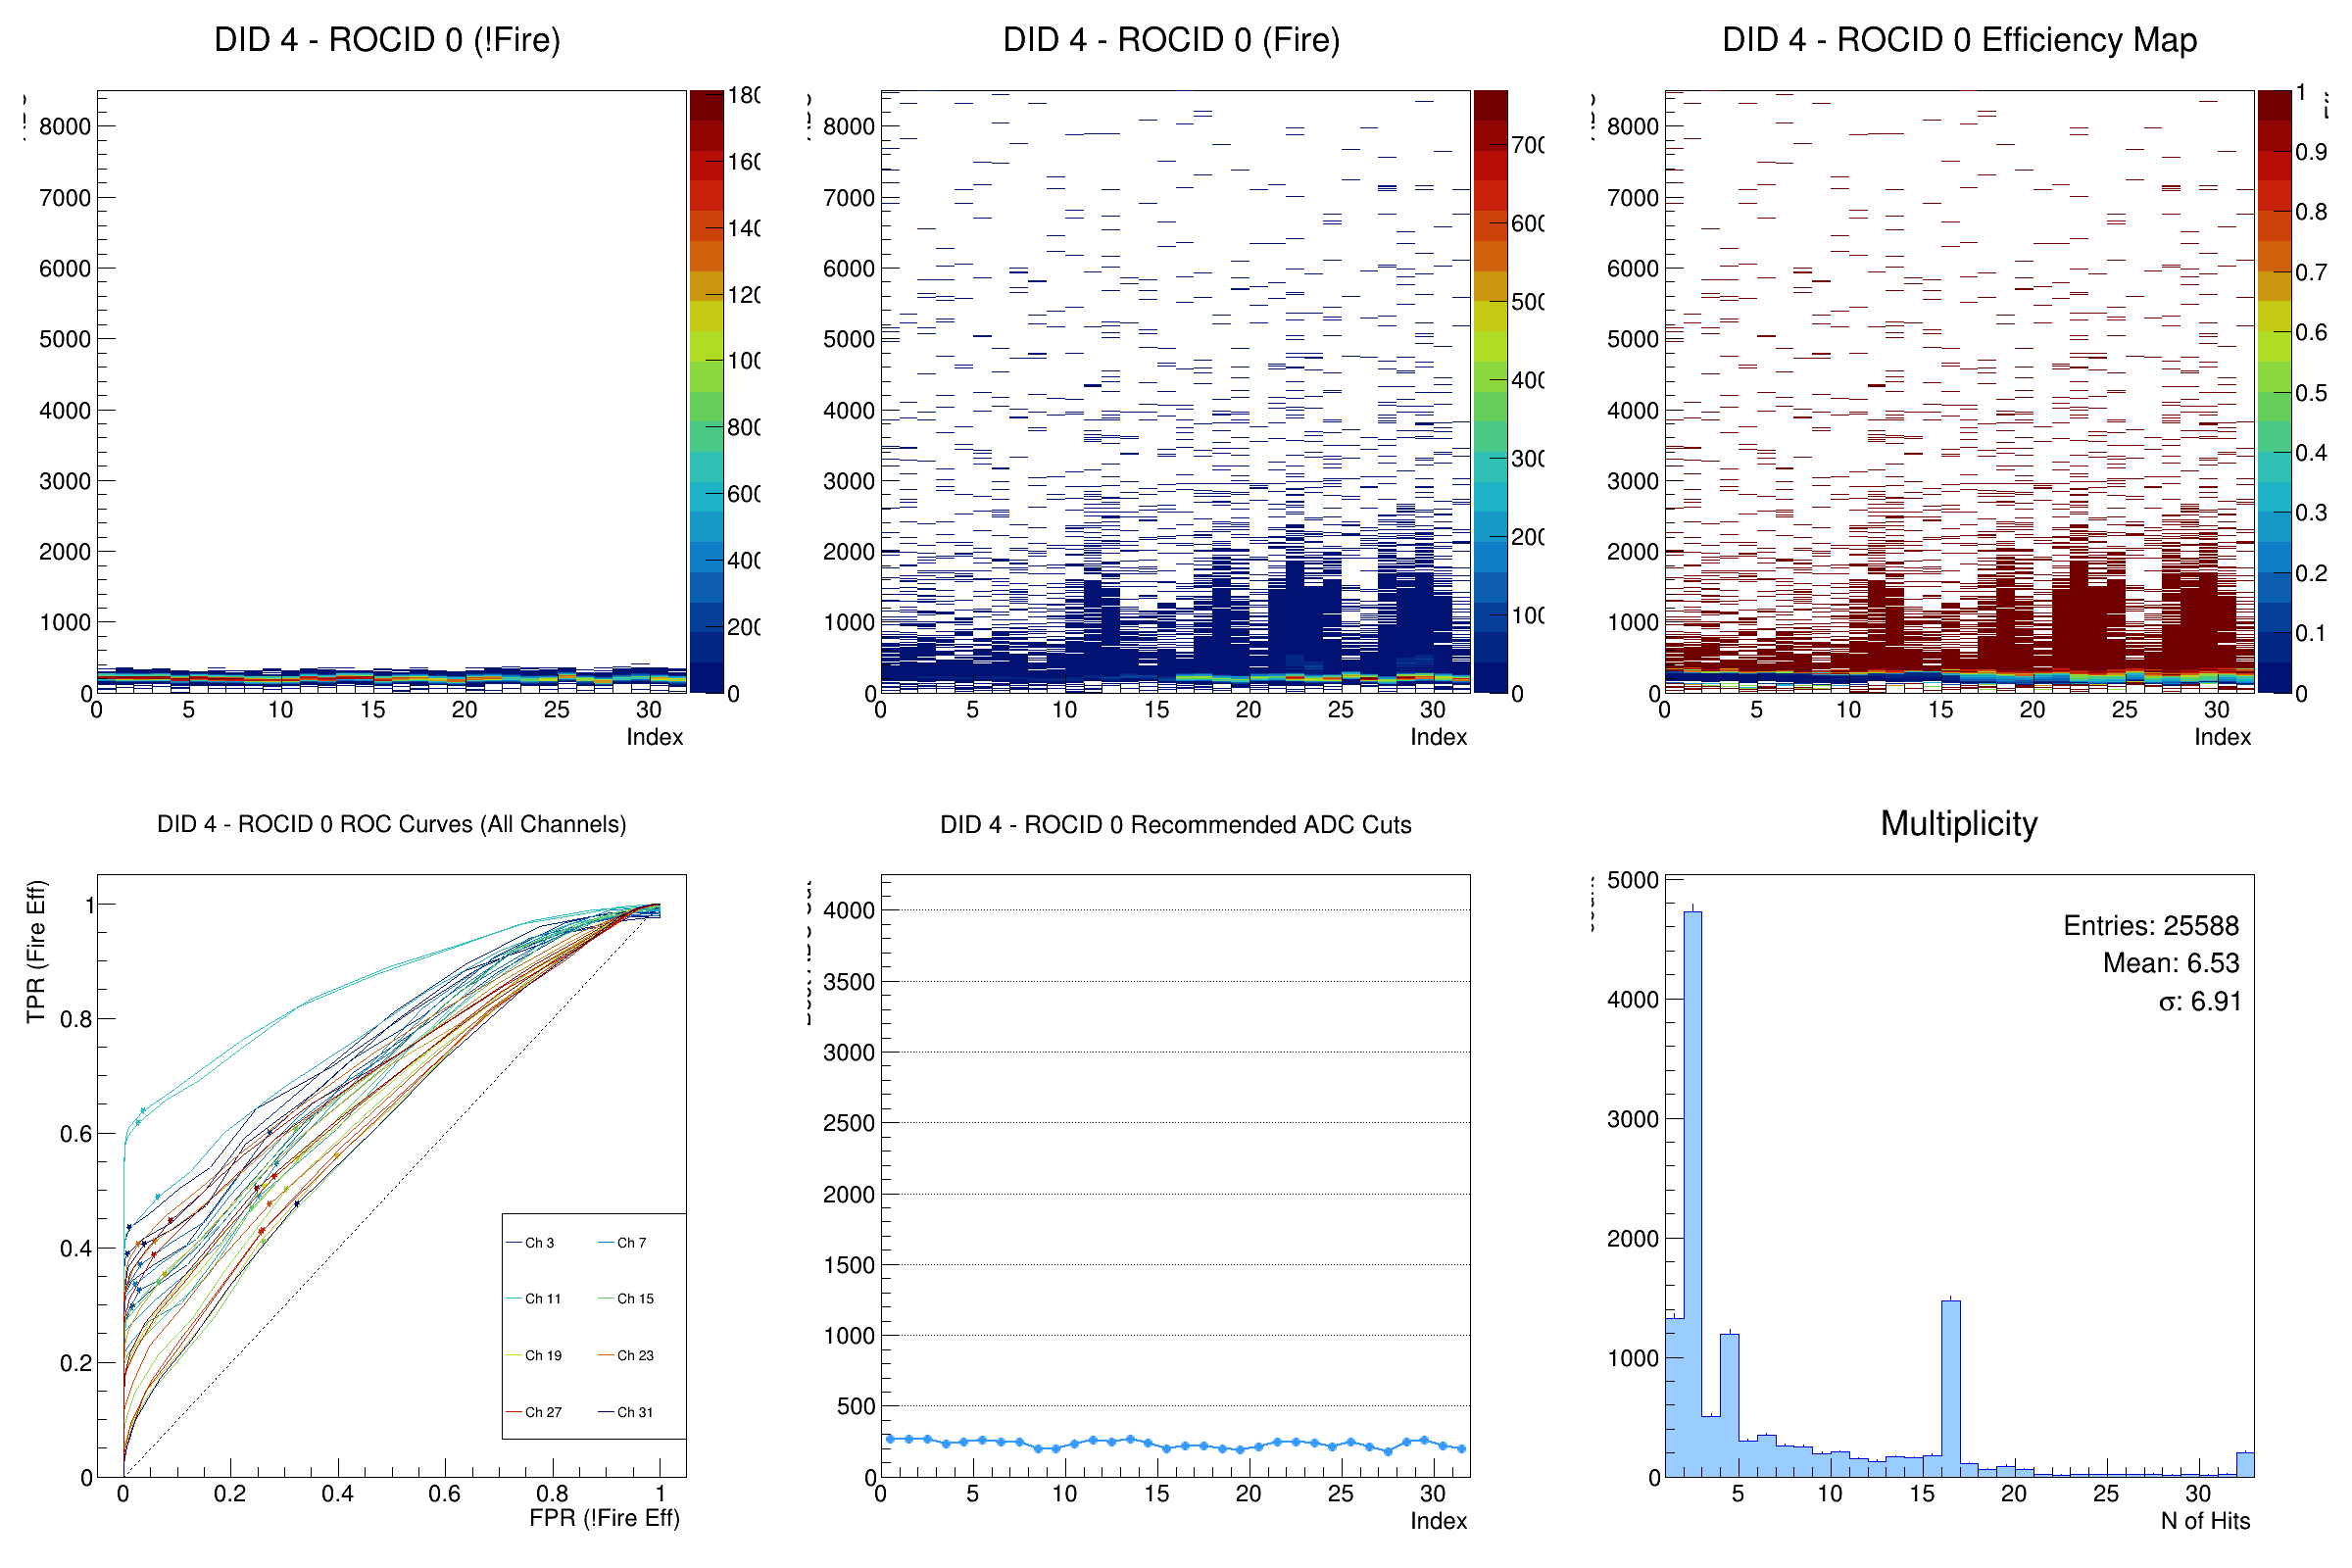
The DAQ cut PbWO4– ROCA(4th layer)
A larger dynamic range(MIP).
The multiplicity has a 16 hits peak, means maybe some noise make the half channels fire. It’s also tell use the DAQ cut is not the best.

Slide 9
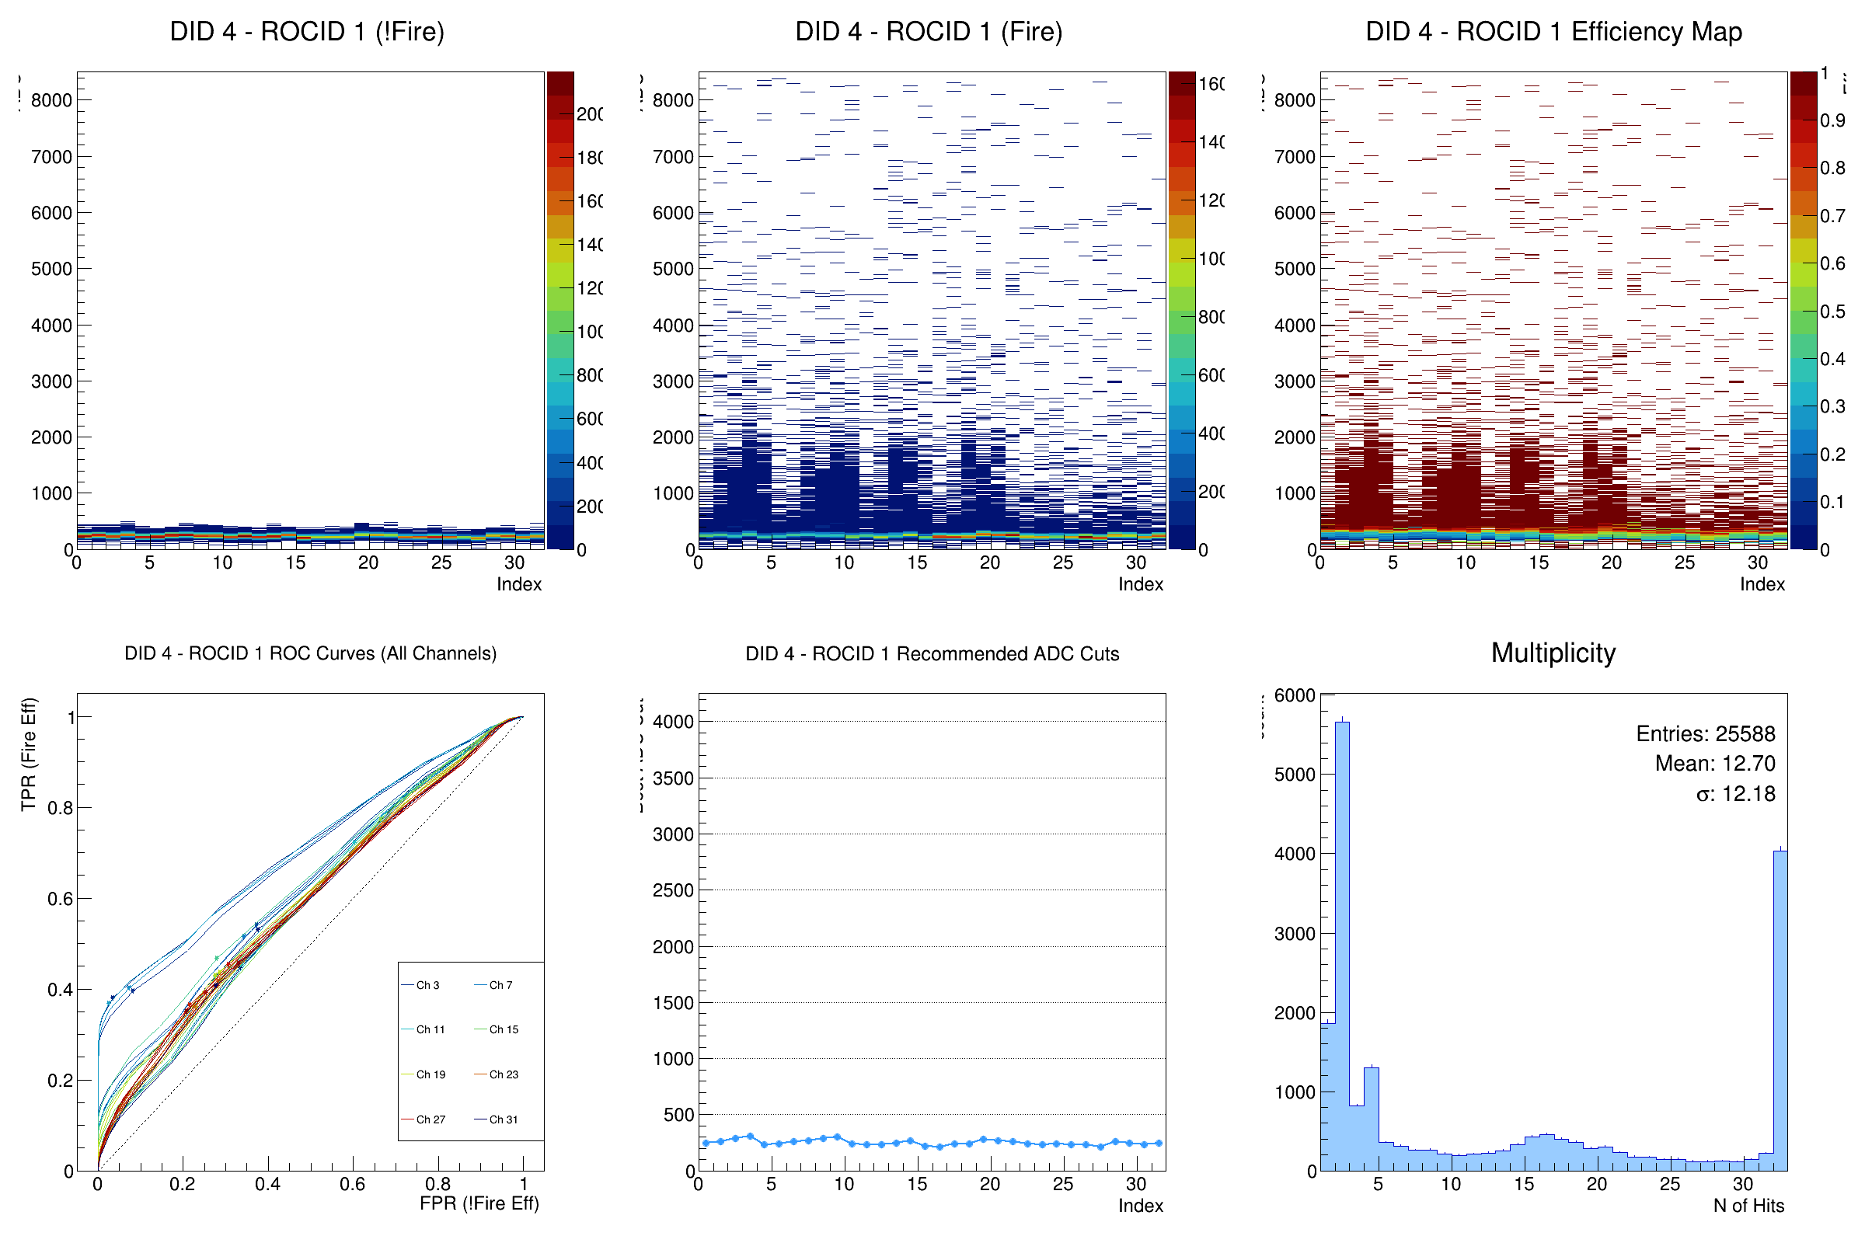
The DAQ cut PbWO4– ROCB(4th layer)
A larger dynamic range(MIP).
Same as the ROCA, but the nHits shows the DAQ cut is more less to make all of the channel fire by the noise together(nHits=32).

Slide 10
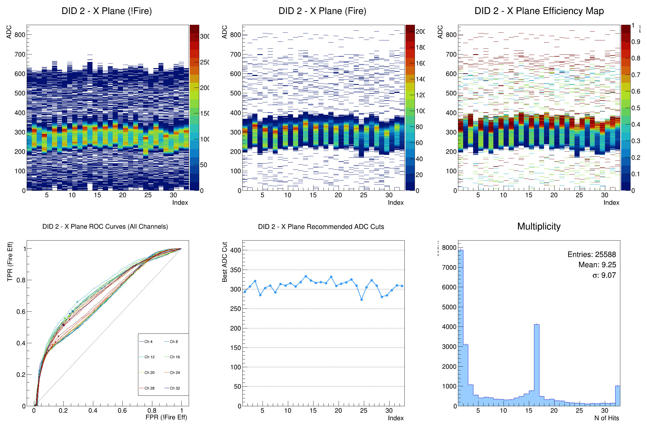
The DAQ cut BM 1 – X(5rd layer)
Don’t know why the signal have a large separation, when we compare to the BM2.

Slide 11
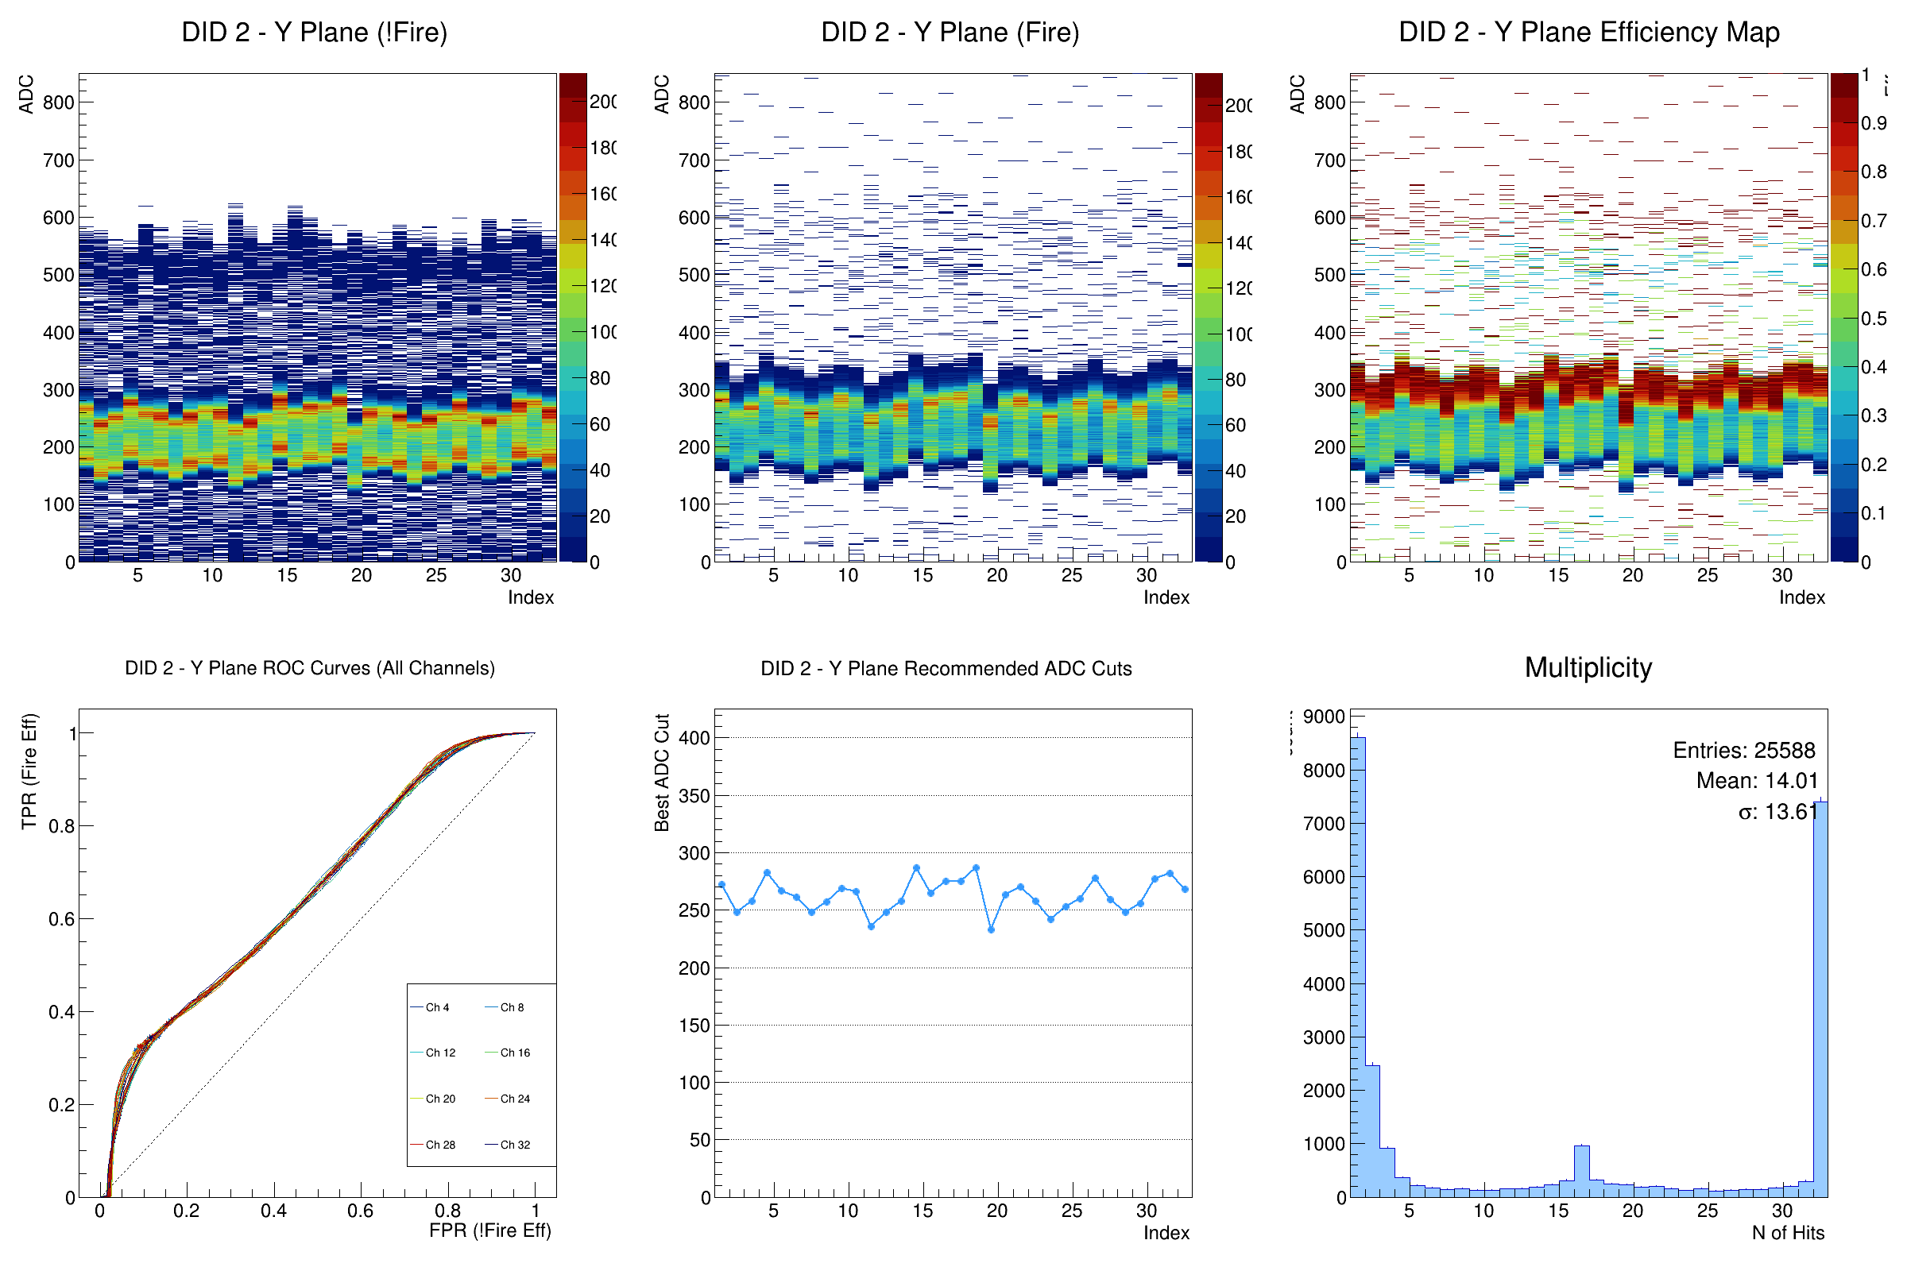
The DAQ cut BM 1 – Y(6th layer)
Sama situation as BM1 X plane.
But the channel feature is more uniform than X plane.

Slide 12
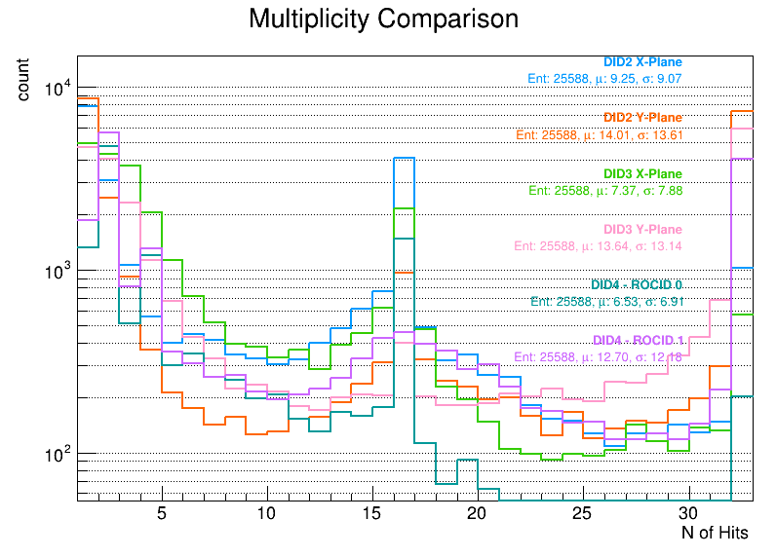
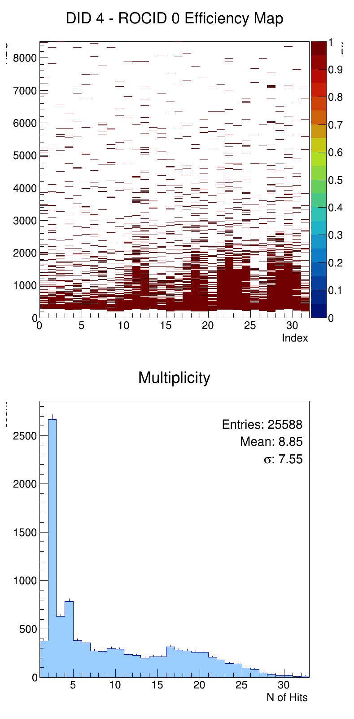
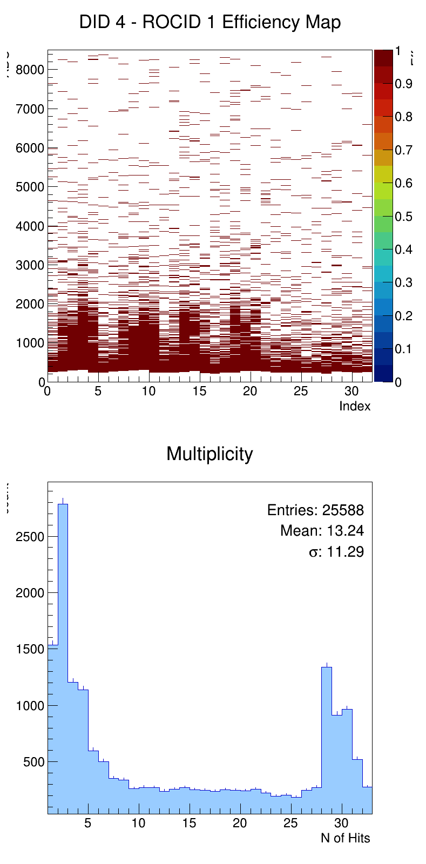
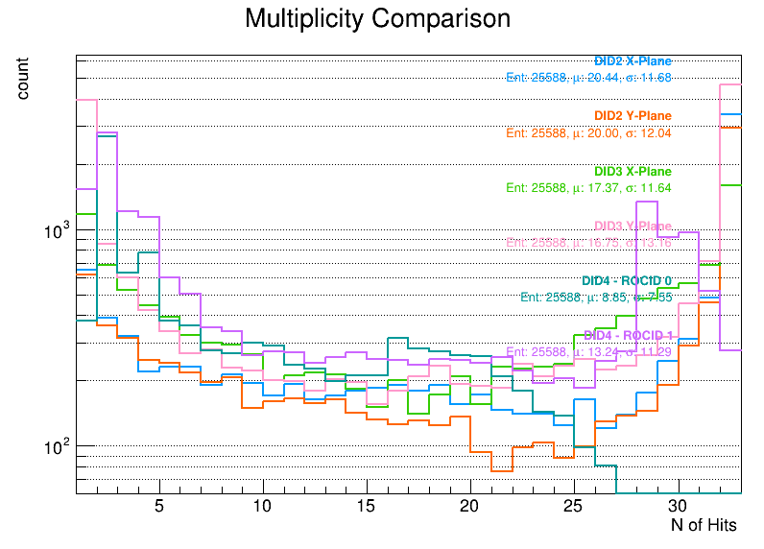
Apply the best ADC cut value on matching data.
Take PbWO4 data for example:
The new cut make the raw data look better.
ROC A: The peak (nHits=16) become flat.
Could mean the signal is not large enough could be calculate in containment.
ROC A&B: The peak (nHits=2) is lower.
The event which is the single crystal under high cut could be solve.
Best cut
ROCA
Best cut
ROCB
Best cut

Slide 13
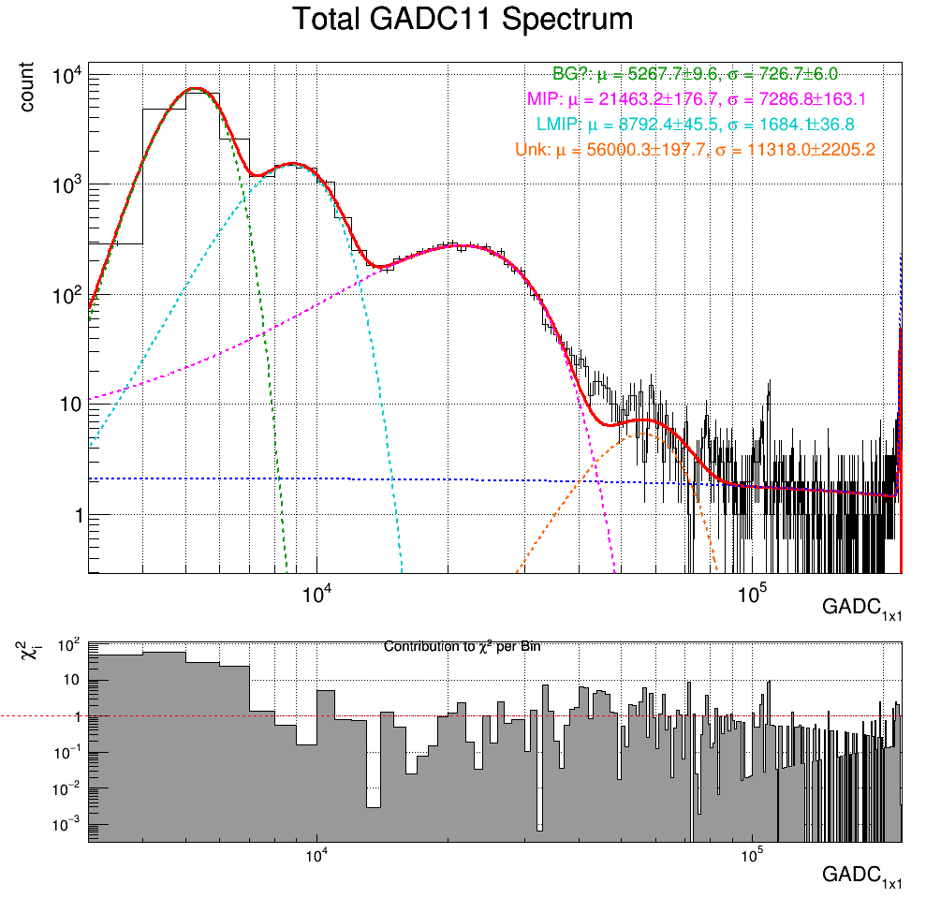
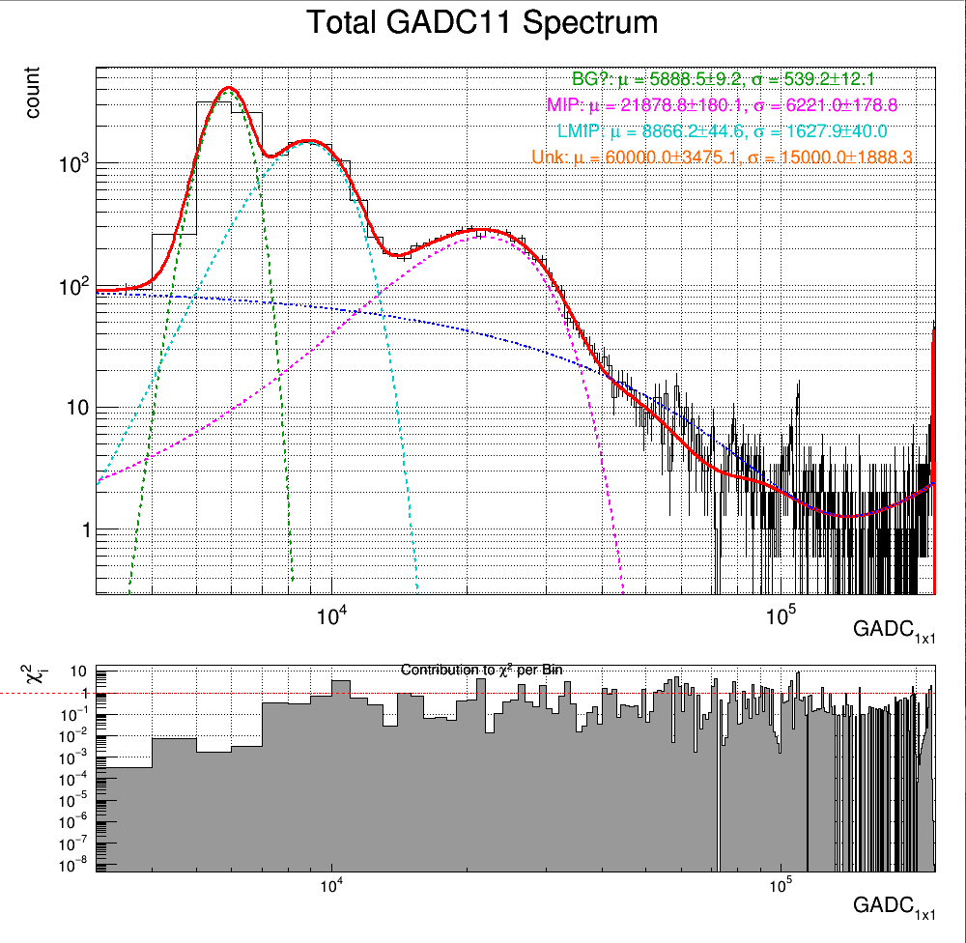
The GADC11 after cut
The fitting peak of MIP: 21463->21878 ADC, 73.5-> 74.9 MeV, Sigma: 25.9->22.1MeV
The $\frac{χ^{2}}{NDF}$ = 2.10->0.82(over fitting because the parameter is too much to fit the best cut data.)
Best cut

Slide 14
The cosmic ray moun analysis to do
Remove the data from Feb. 14~24(the low THR cause higher event rate, and matching rate).
PS: the high fire rate noise should not increase too much event like the data.
Using the best cut result data to do the reconstruction and selection of timing matching data.

Slide 15
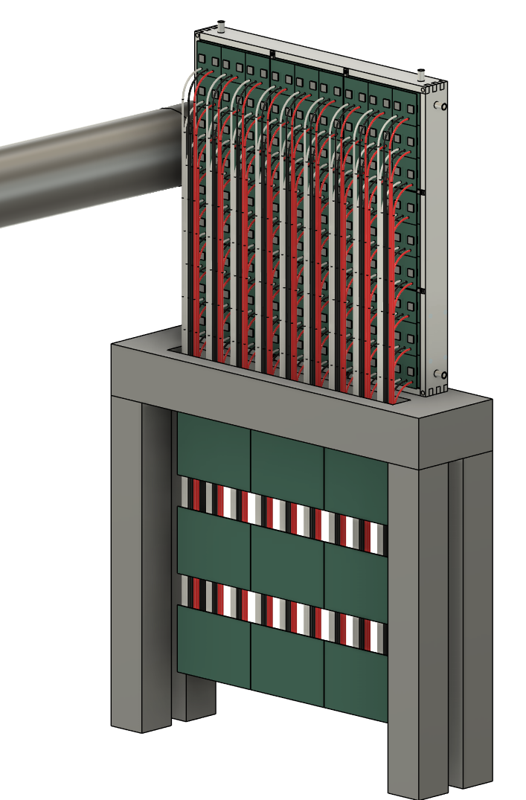
ZDC EMCal Design
60 cm
6 cm
The EMCal is shown with the following specifications:
PbWO₄ crystal array：
Crystal size 20.5 mm × 20.5 mm × 6X₀
Allow an additional ~0.5mm for the reflector and crystal wrapping
One Super Module (SM)：9 × 9 crystals
Allow 1mm of stainless for the SM wrapping.
SM size : (21.0×9+2)² cm²
Full array: 3x3 SM = (3×191)² cm²
Total number of crystal modules： 3x3x3x3 = 729
SiPM： S14160-3015PS_HAMAMATSU
16 MPPC channels for each crystal
Total number of MPPC channels： 11,664
Support and Cooling design： aluminum + copper tube
Use a 13mm thick aluminum plate
Coolant is circulated through copper tubing.
Cable routing：
The cables go downward and pass through the table
60 cm
80 cm
20 cm
Super Module readout hubs

Slide 16
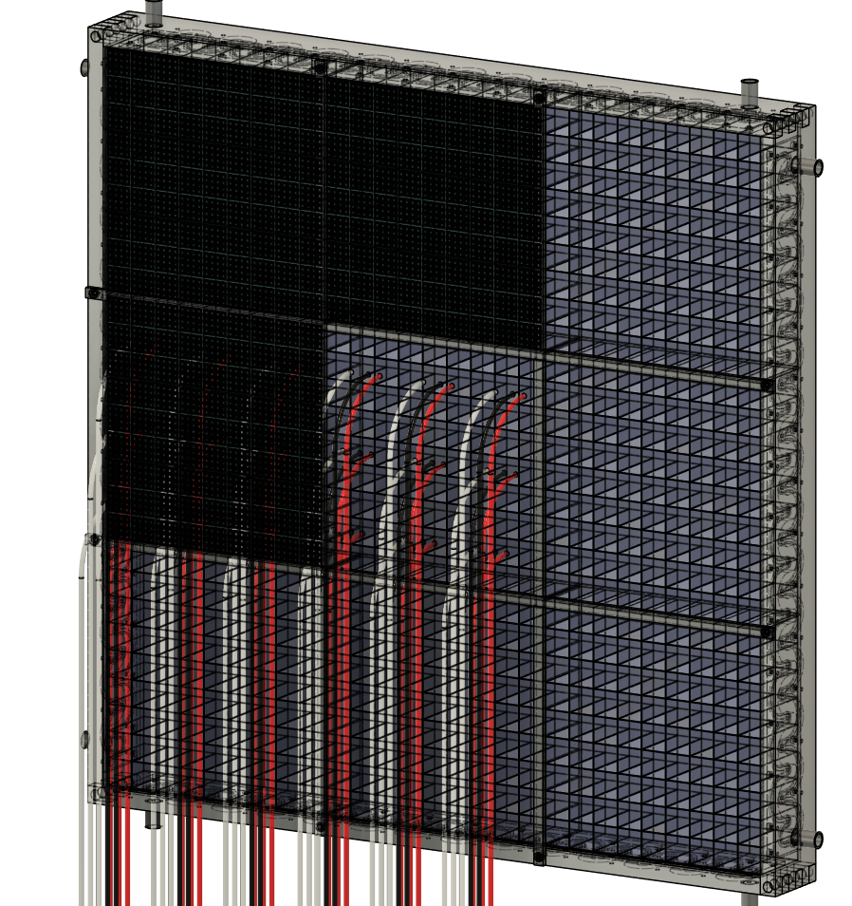
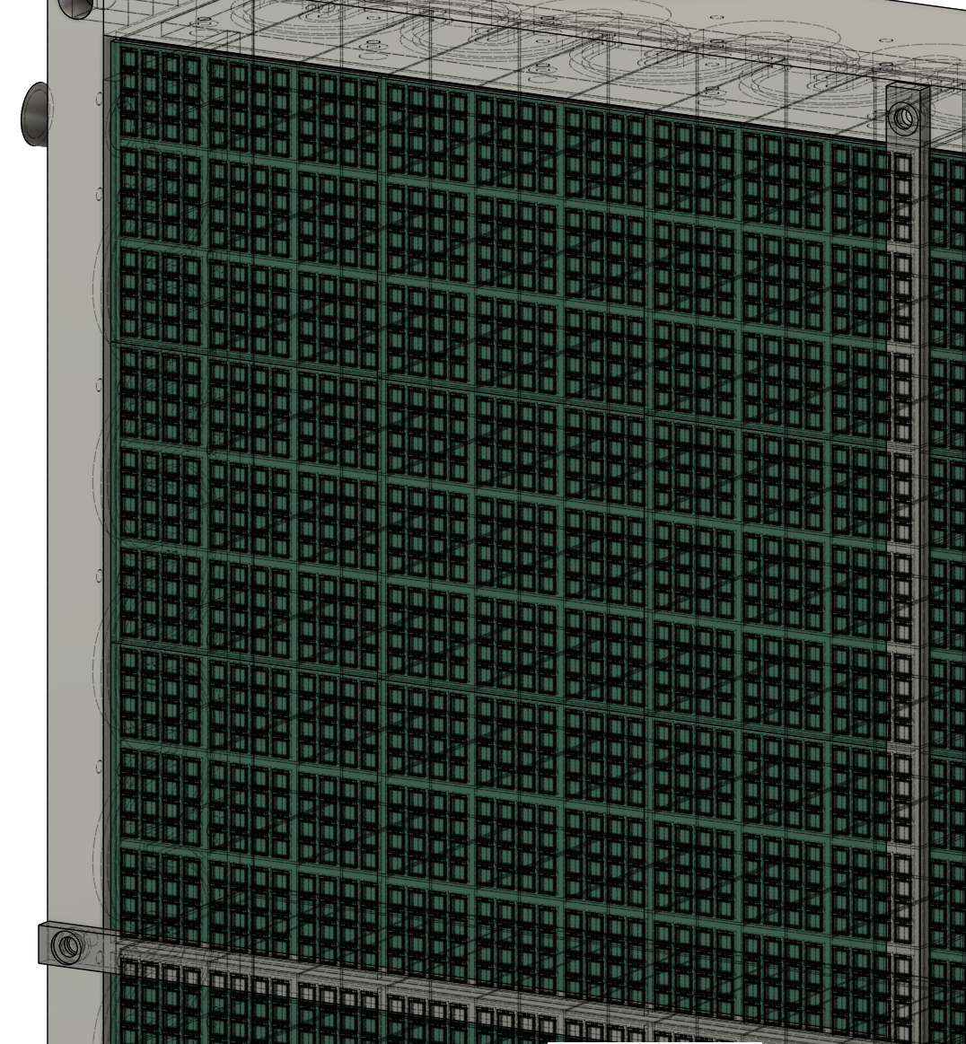
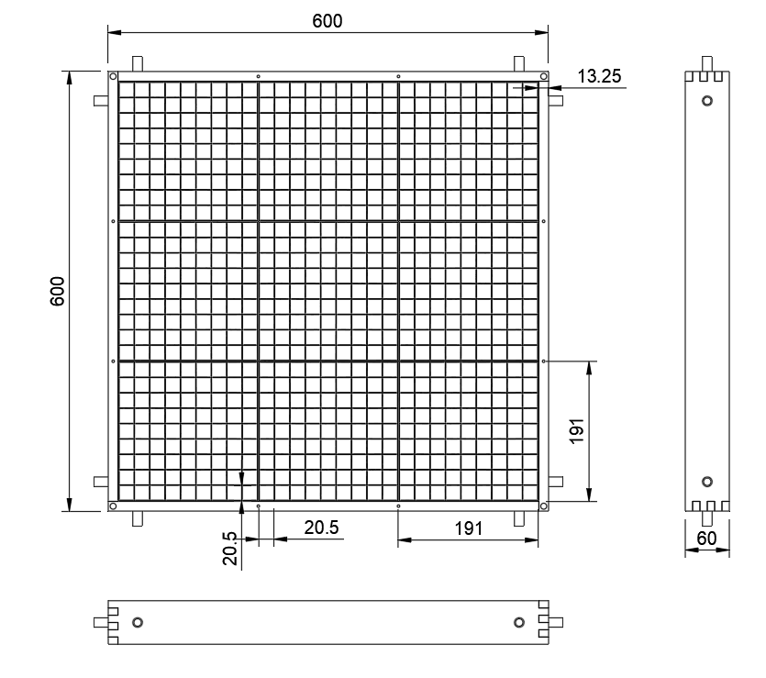
Supper Module
One SM contains :
9 × 9 PbWO₄ crystals
16 × 9 × 9 SiPM channels = 1,296 channels
Zoom in

Slide 17
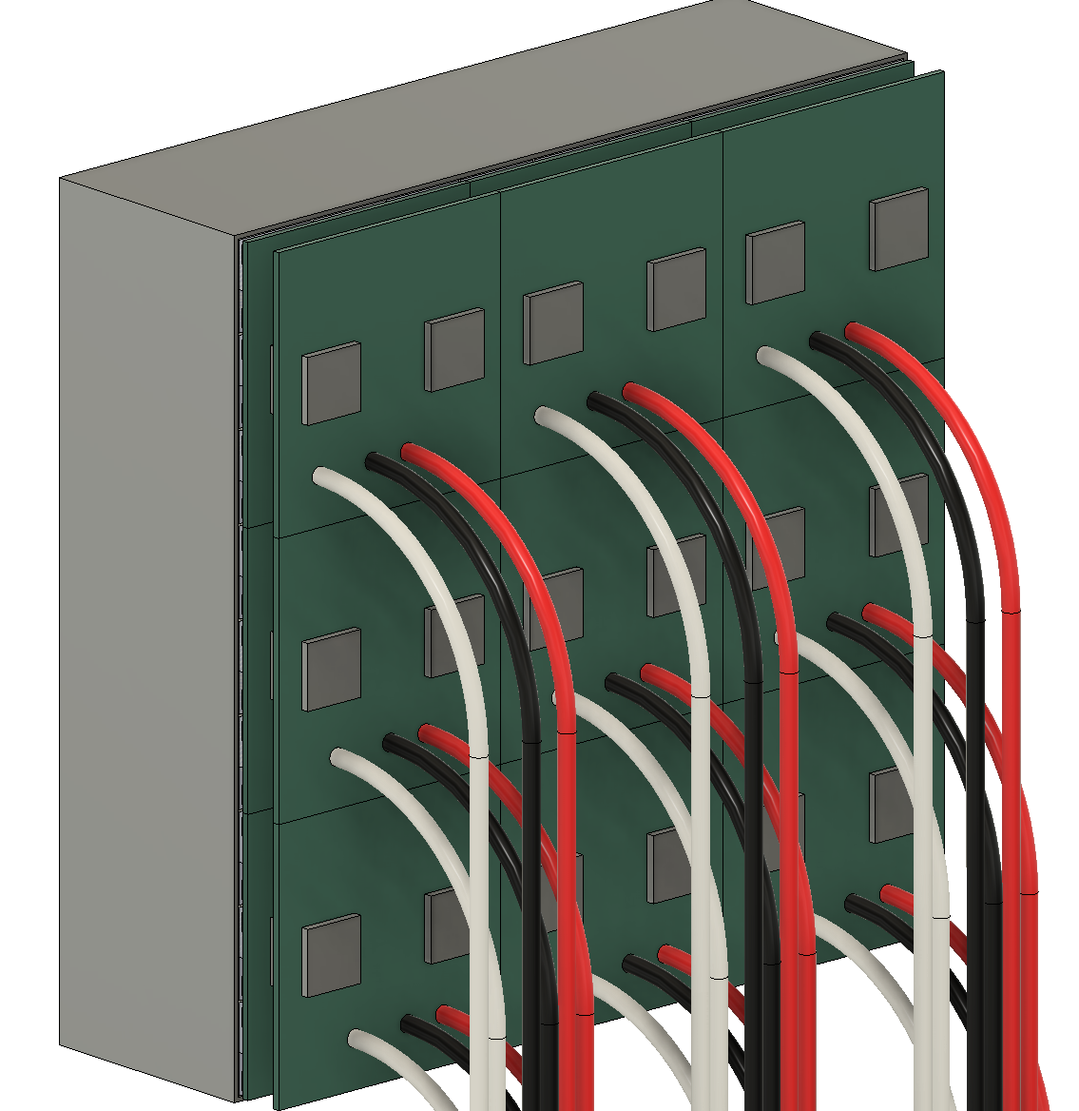
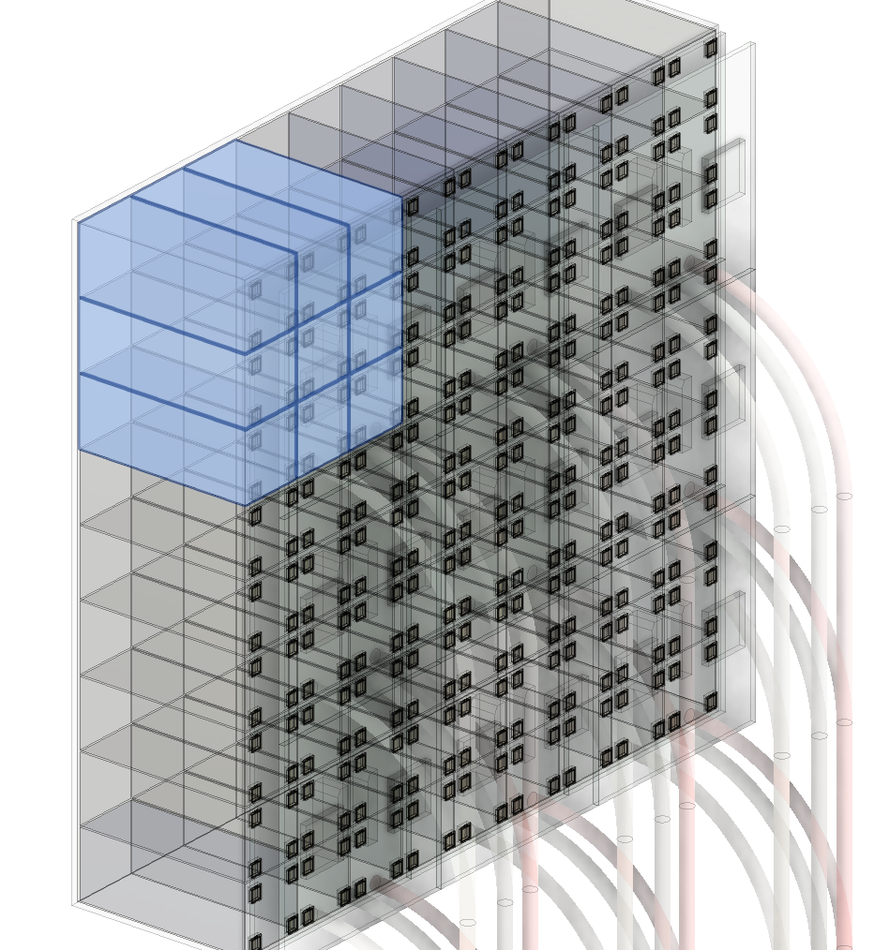
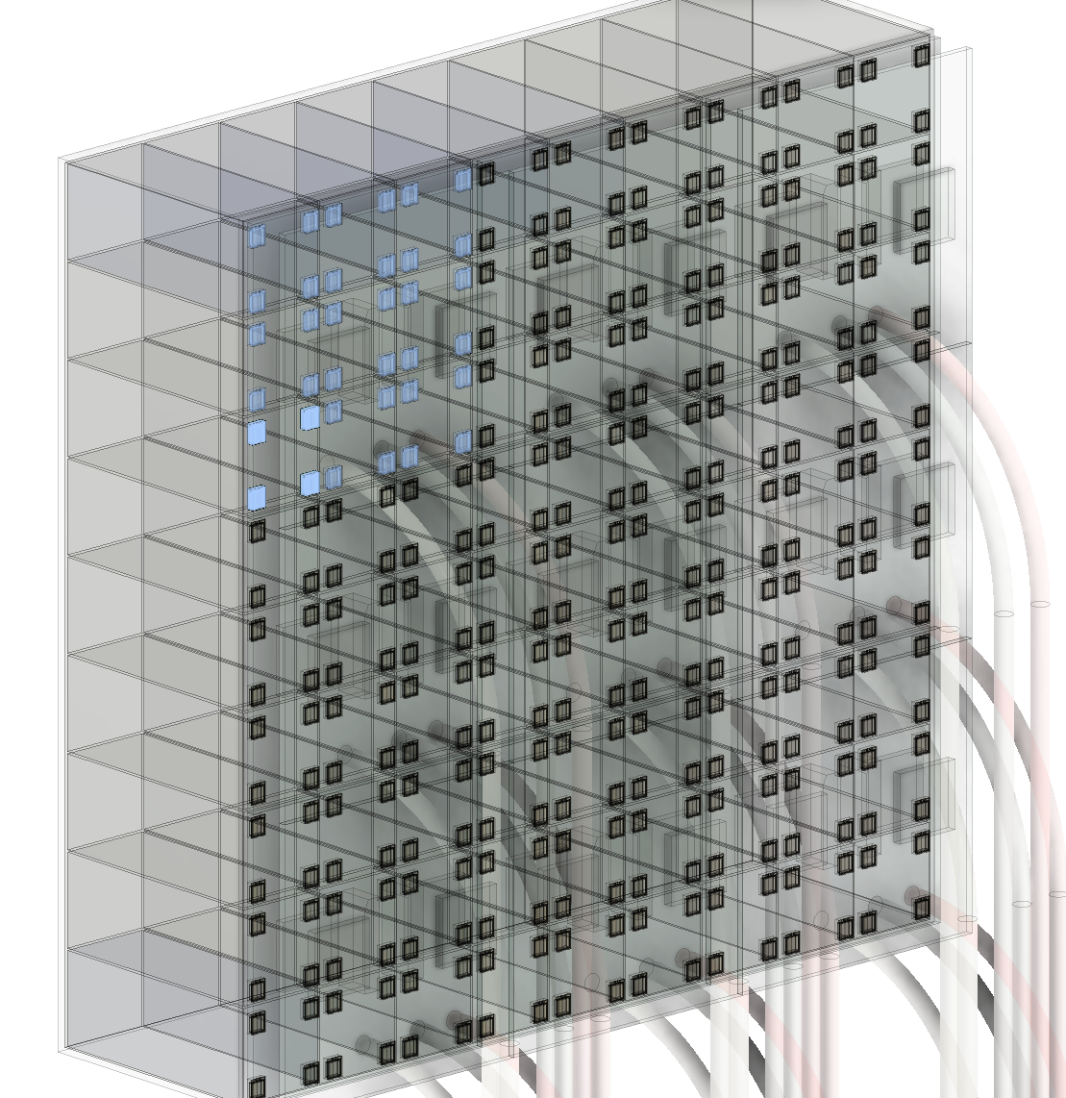
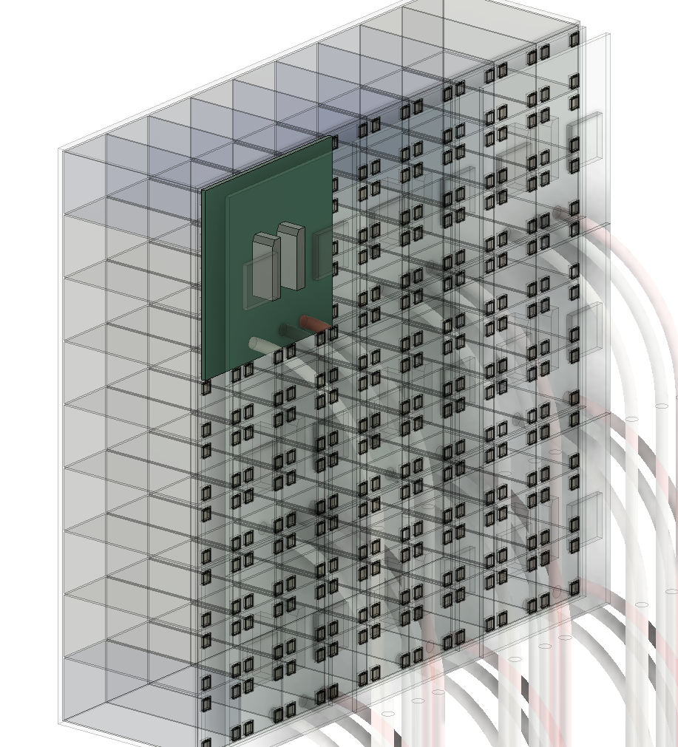
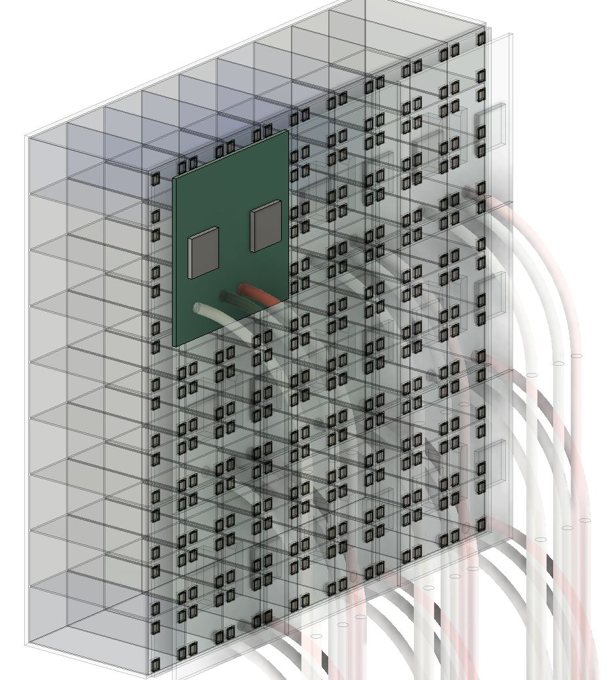
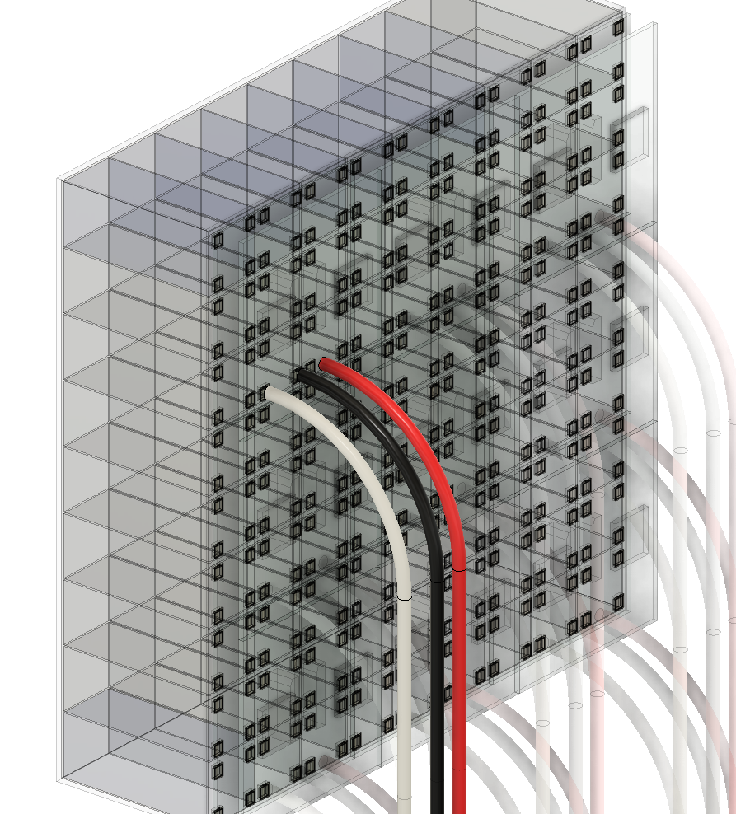
SiPM Readout Module
63 cm
1 Super Module
The current design contains 3 × 3 readout modules per Super Module
One readout module contains :
144 MPPC channels
2 ROCs
Thermal contact
63 cm
Readout module
1
3 × 3 = 9 crystals (reduce the display size by 75%)
(4×4)×3×3 = 144 MPPCs
SiPM module readout board
SiPM module readout board
2 ROCs: (72 × 2=144 channels)
HV, GND, and Signal
cables

Slide 18
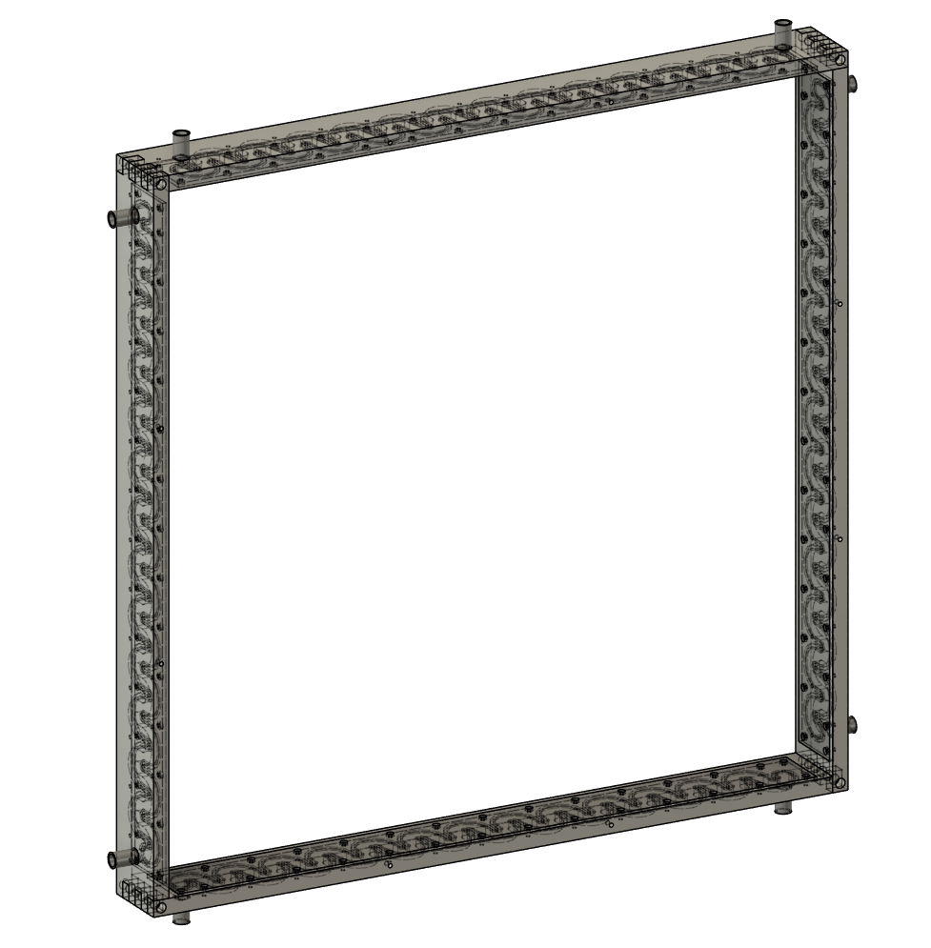
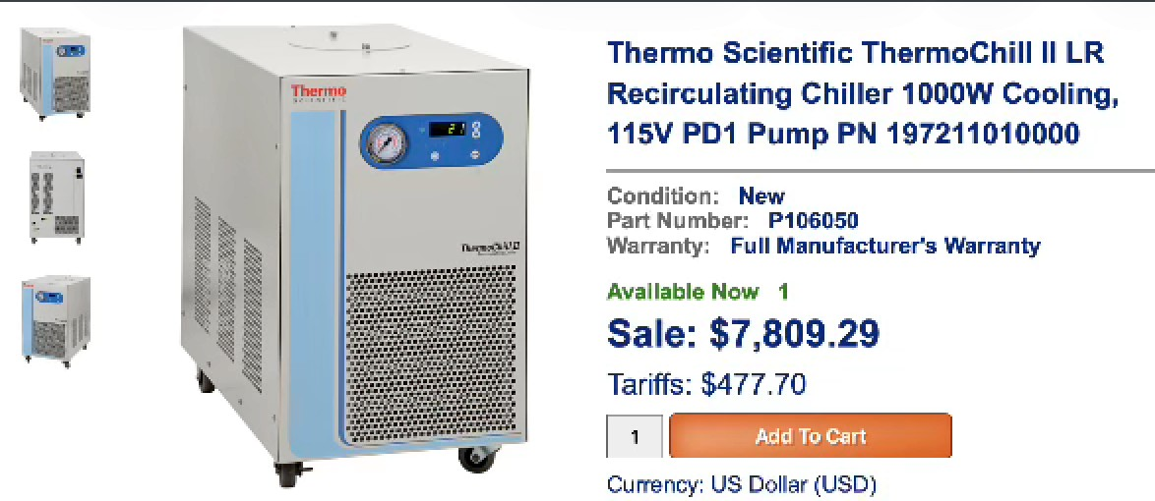
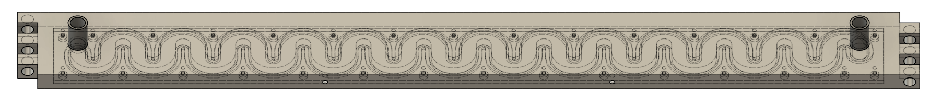
Cooling & Support System
Use 4 cooling modules to collect the heat from SiPMs
The coolant circulates through copper tubing

Slide 19
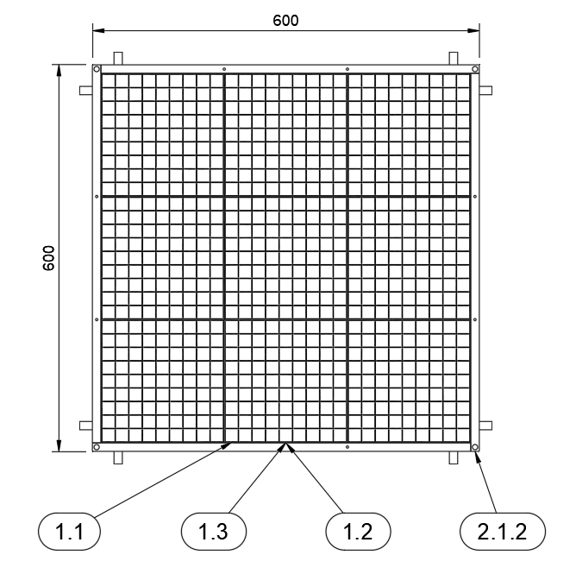
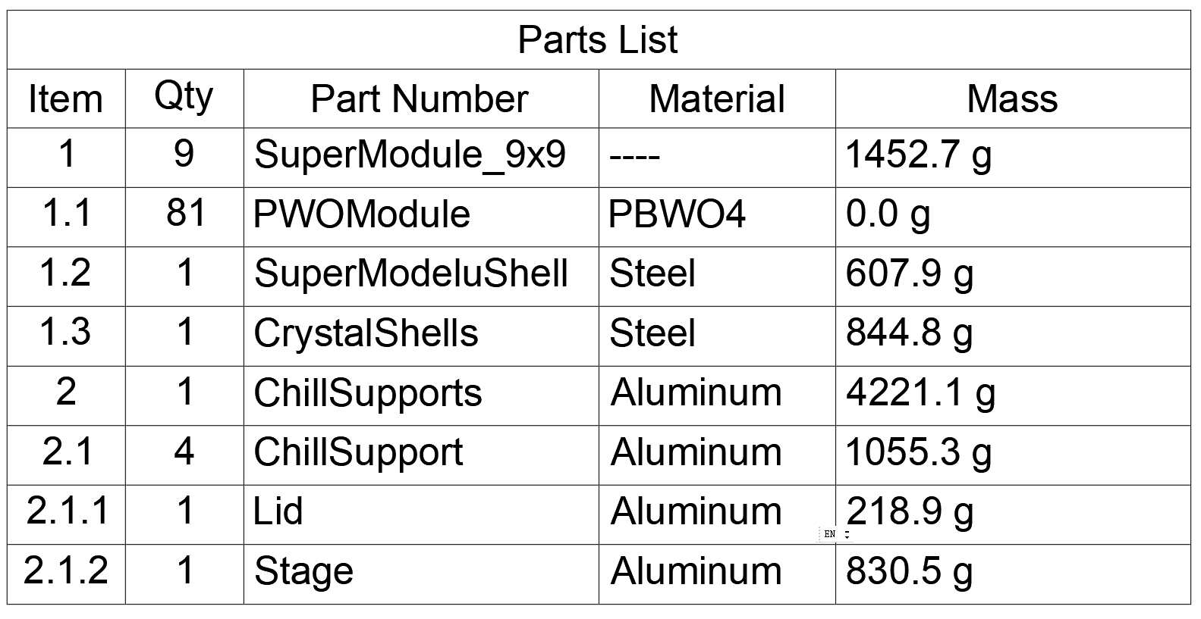
Mass Calculation
Super module： 16.4 kg
Cooling support： 4.2 kg
Total ： 16.4 × 9 + 4.2 = 151.8 kg
Cables and PCBs have not yet been included in the calculation
16405.3 g
184.6 g

Slide 20
End

Slide 21
backup

Slide 22

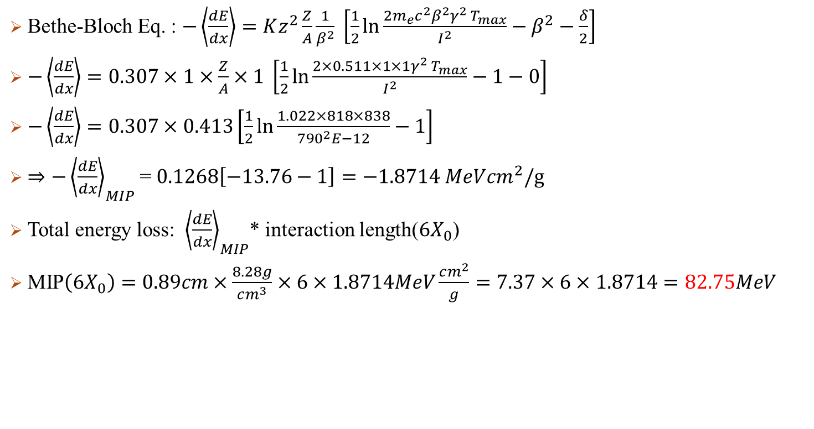
MIP Calculation
Bethe-Bloch Eq. : $−\left\langle \frac{dE}{dx}\right\rangle =Kz^{2}\frac{Z}{A}\frac{1}{β^{2}} \left[\frac{1}{2}\ln{\frac{2m_{e}c^{2}β^{2}γ^{2} T_{max}}{I^{2}}}−β^{2}−\frac{δ}{2}\right]$
$−\left\langle \frac{dE}{dx}\right\rangle =0.307×1×\frac{Z}{A}×1 \left[\frac{1}{2}\ln{\frac{2×0.511×1×1γ^{2} T_{max}}{I^{2}}}−1−0\right]$
$−\left\langle \frac{dE}{dx}\right\rangle =0.307×0.413\left[\frac{1}{2}\ln{\frac{1.022×818×838}{{790}^{2}E−12}}−1\right]$
$⇒−{\left\langle \frac{dE}{dx}\right\rangle }_{MIP}$= $0.1268\left[−13.76−1\right]=−1.8714 MeVcm^{2}/g$
Total energy loss: ${\left\langle \frac{dE}{dx}\right\rangle }_{MIP}$* interaction length($6X_{0}$)
MIP$\left(6X_{0}\right)=0.89cm×\frac{8.28g}{cm^{3}}×6×1.8714MeV\frac{cm^{2}}{g}=7.37×6×1.8714=82.75MeV$
$$K=0.307MeV cm^{2}/g$$
$$z=1(muon)$$
$$Z,A:Properity of meterial, for PbWO4=0.413$$
$$δ:density revise factor \sim 0\sim 0.1$$
$$T_{max}\left(3GeVμ\right)=2m_{e}c^{2}β^{2}γ^{2}\sim 838MeV$$
$β:For GeV level muon, 0.999…\sim 1$
$$γ\left(3GeVμ\right)=28.6$$
$$I:Mean Excitation Energy:790eV$$

