Slide 1
Weekly meeting
Yu-Siang Xiao (蕭宇翔)
2026 03/13

Slide 2
The cosmic ray test(last week)
Finish the configuration of the Cosmic ray runs for the program, which like the channels mapping, the drawing mapping/ setting…
Finish the test of reconstructing the event by detectors.
Keep going on the ADC cut(offline threshold), and the algorithm development for the full readout mode.

Slide 3
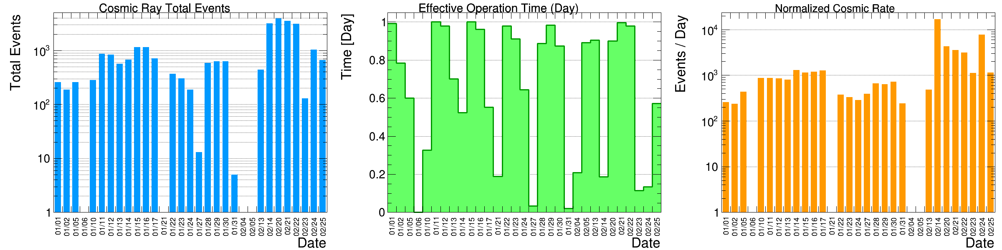
Cosmic ray event reconstruction
Using the data from 2026/01/01 to 2026/02/25.
Total data taking time in data set = 31 days
The “count of event” come from matching.
According to the geometry and flux calculation of muon, we may take 645 event per day.
Now, I remove the high rate data: Feb14~Feb24.
And do the tracking by the “Hit” channel which identify by “DAQ” system.
remove

Slide 4
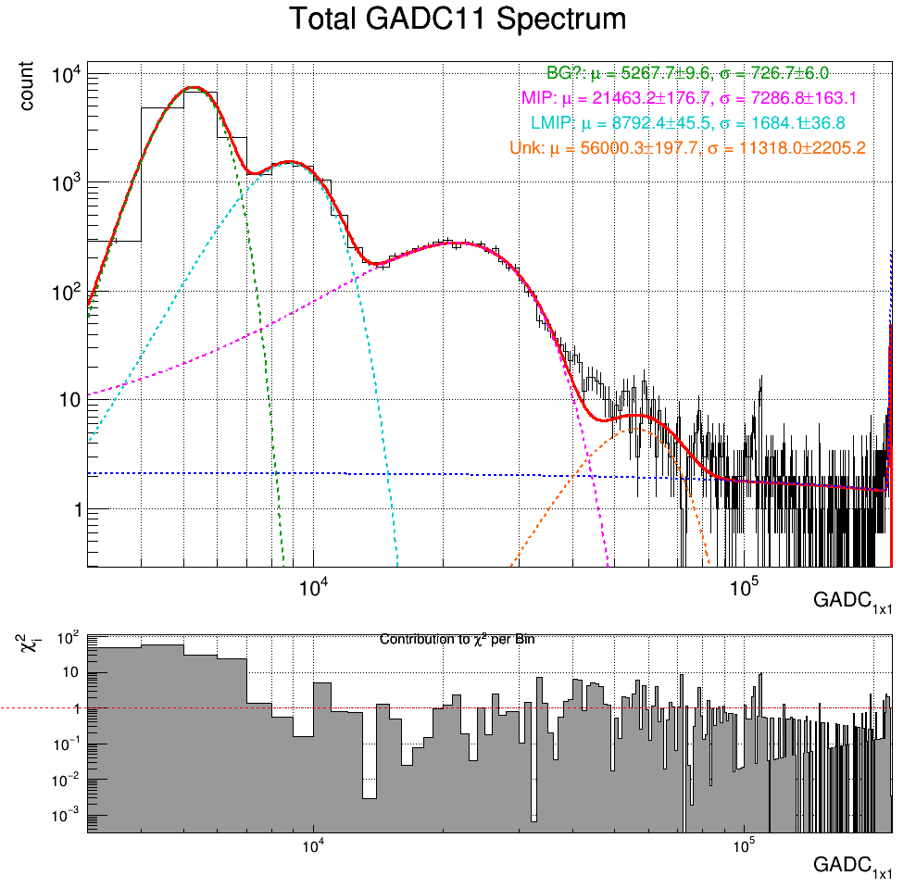
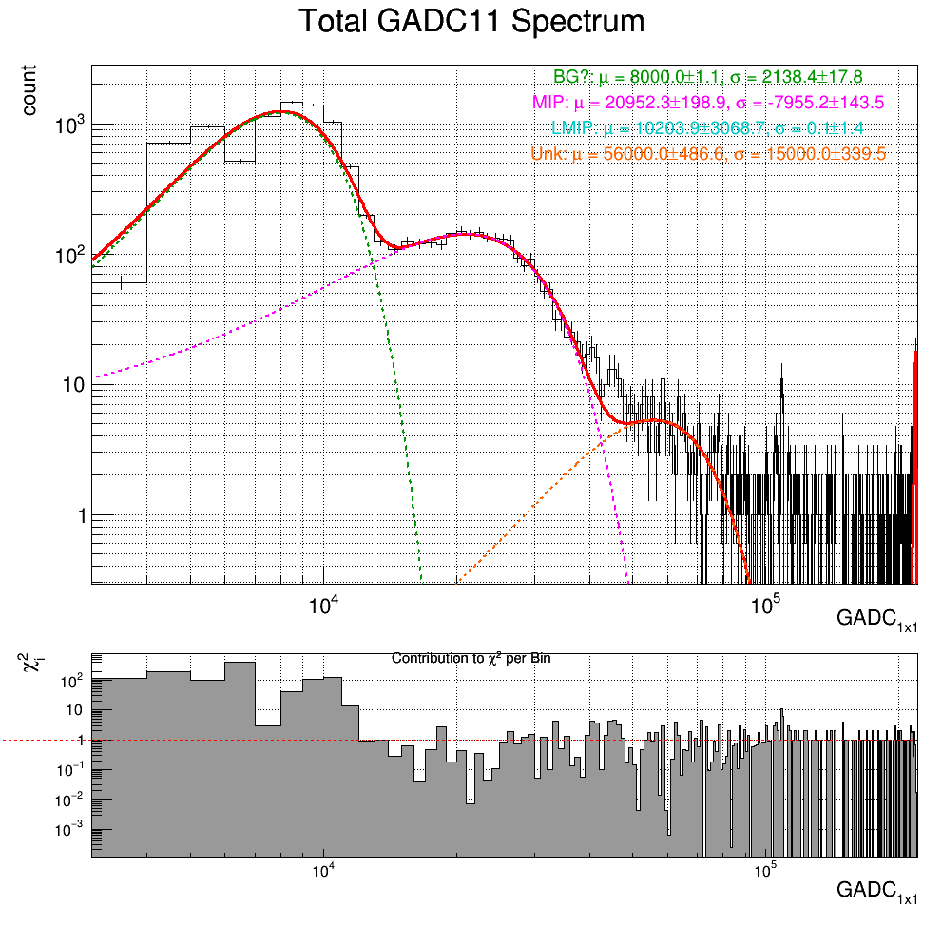
The GADC11 after cut
Removing the abnormal data make the spectrum clearly than before.
Not apply the analysis cut and gain calibration, yet.
Filt Data

Slide 5
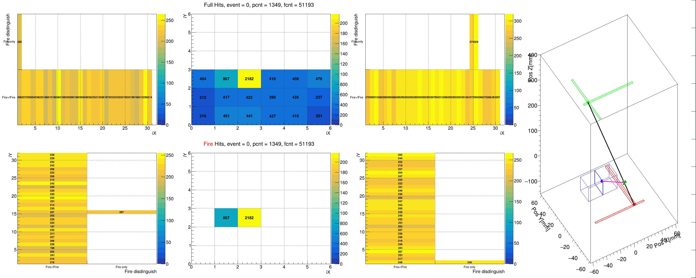
The tracking process & residual
Interpolate of BM COGs = track and predict.
Residual = COG - Interpolate predict
The star marker means the Center Of Gravity(COG) of layers.
Hit ID for BM1 X
Without ID PbWO
Hit ID for BM2 X
BM2 layer
Without ID BM1 X
Without ID BM2 X
BM2 COG
Track
Hit ID PbWO
PbWO layer
Interpolate predict
PbWO COG
Residual
Without ID BM1 Y
Hit ID BM1 Y
Without ID BM1 Y
Hit ID BM2 Y
BM1 COG
BM1 layer

Slide 6
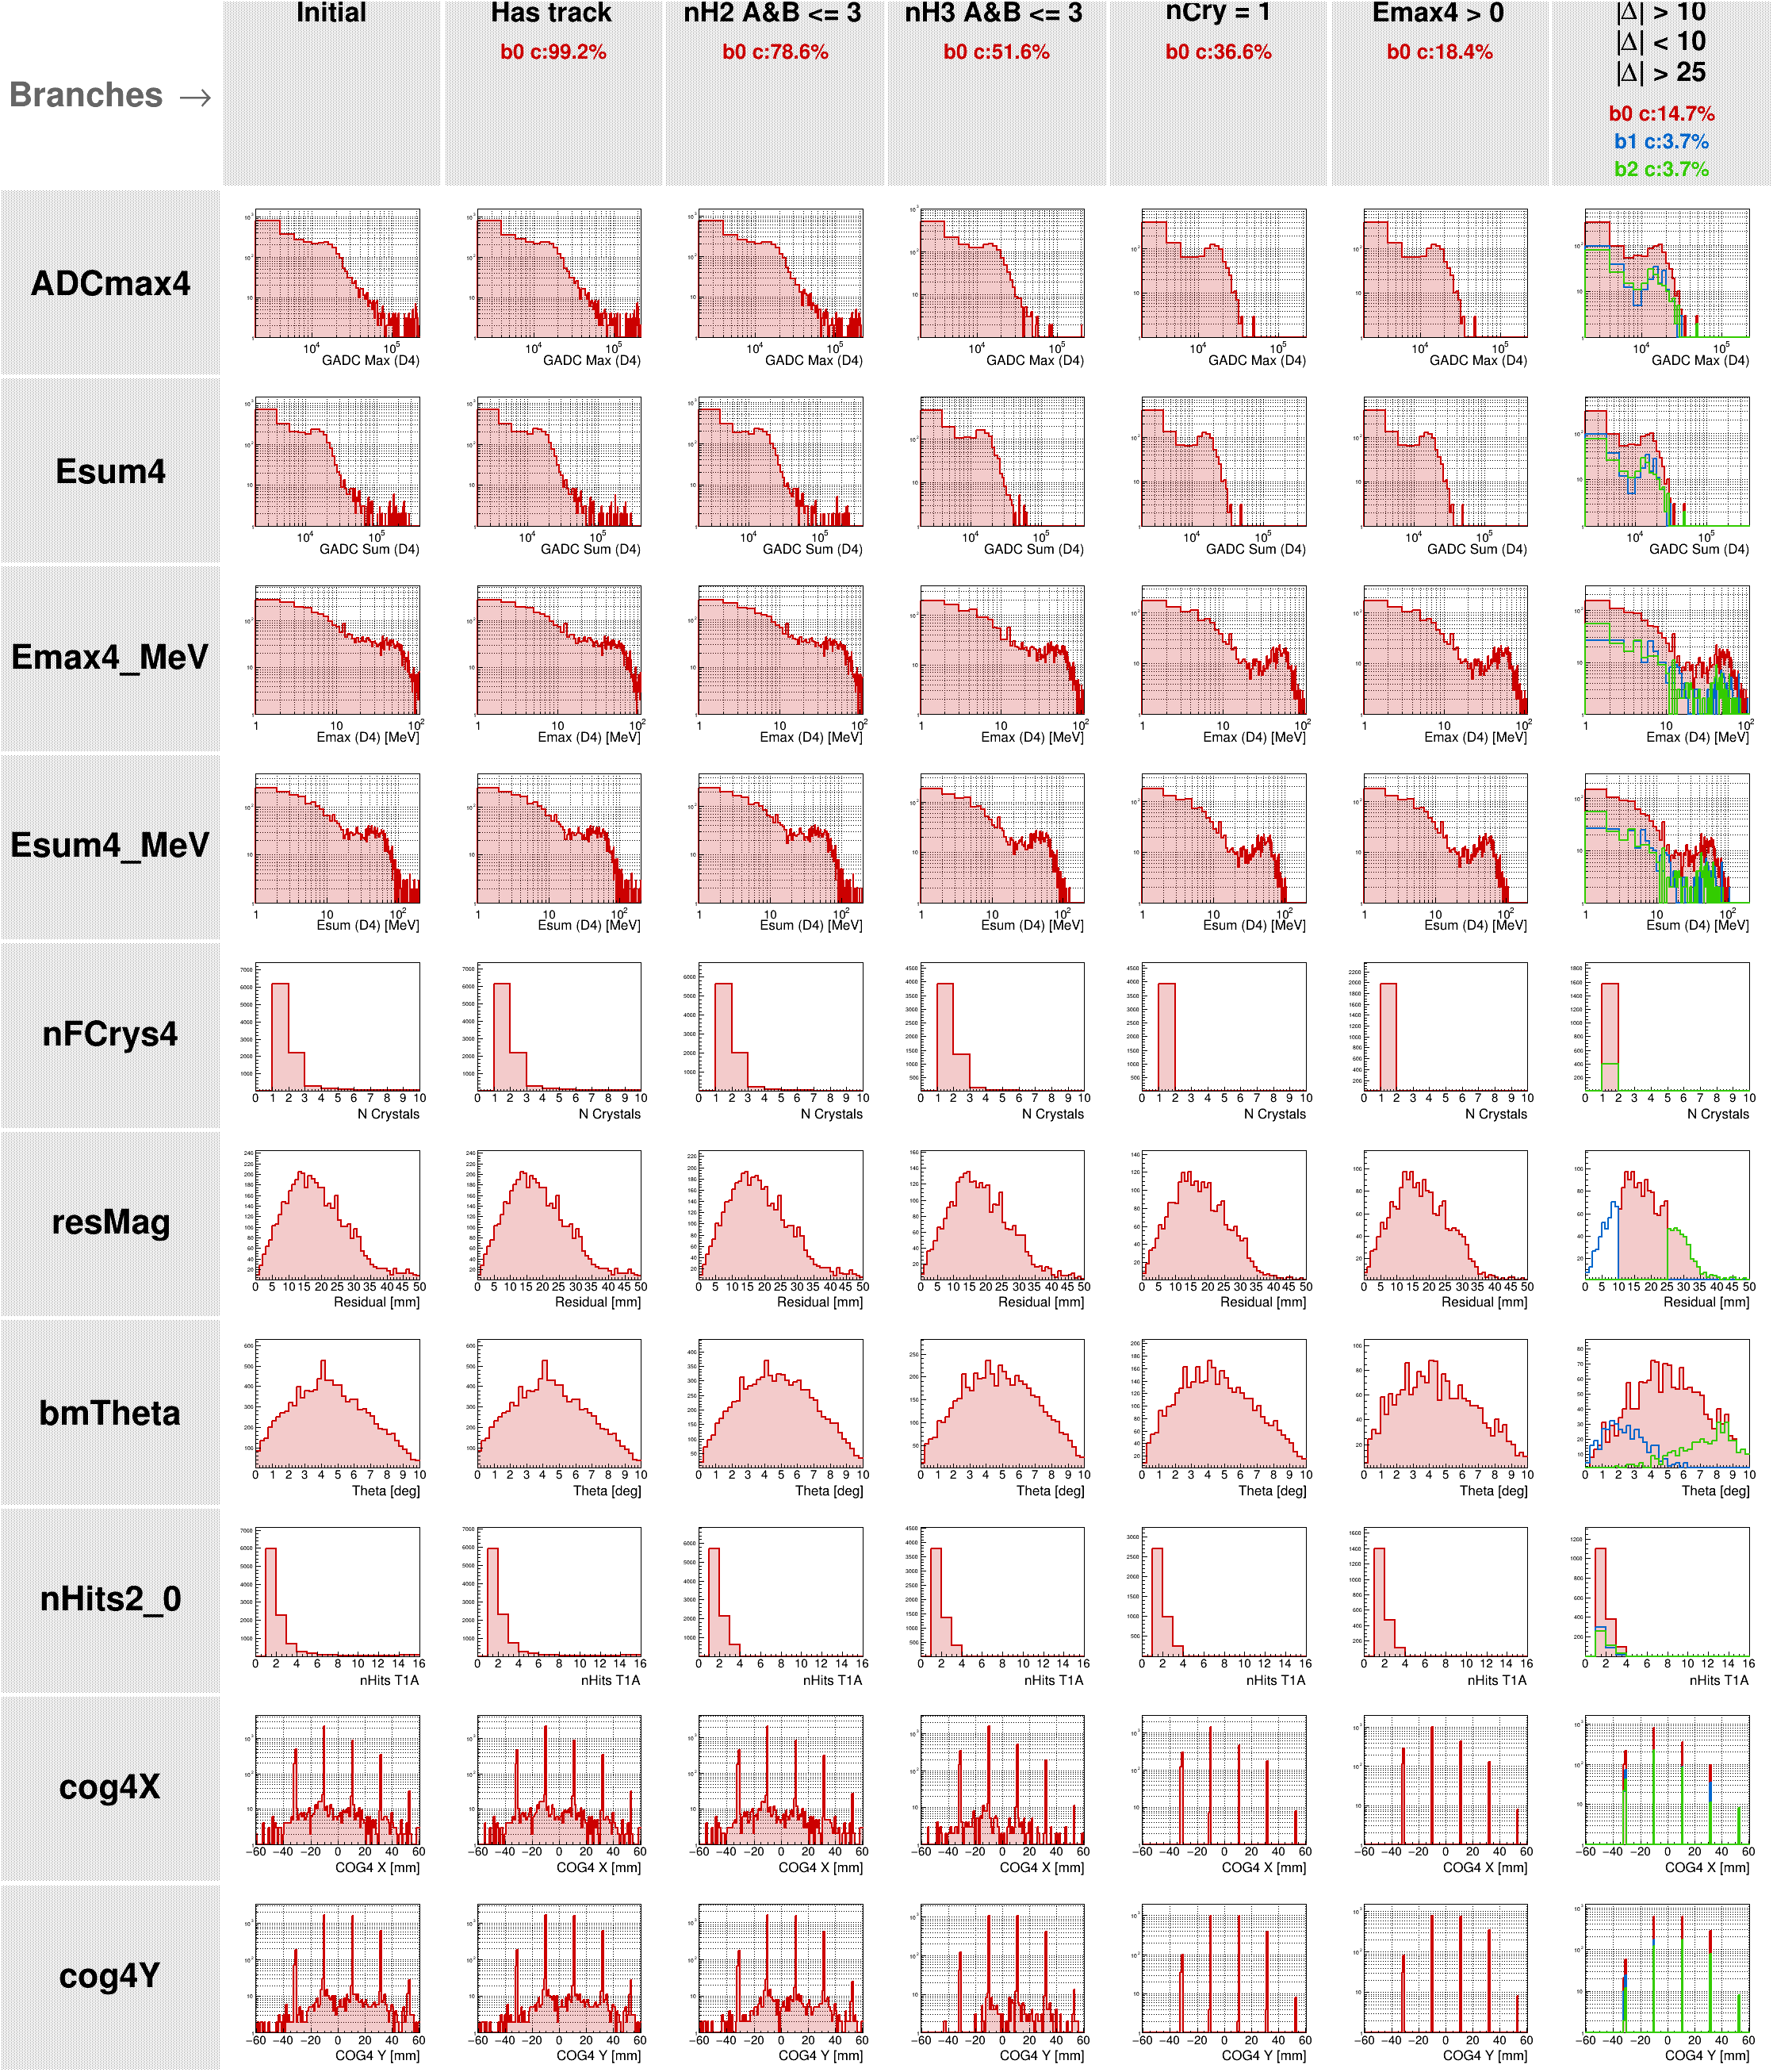
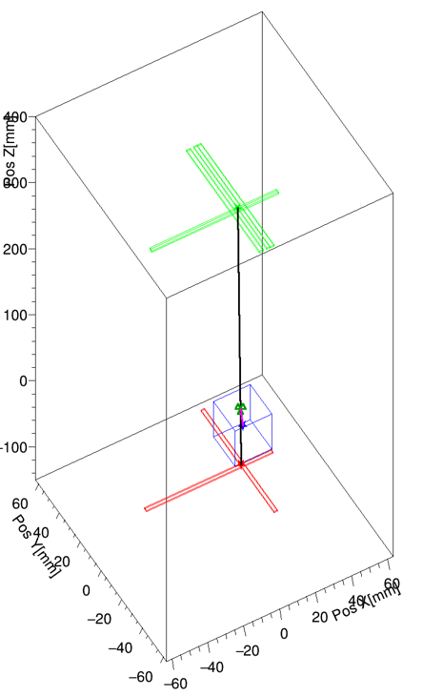
Apply the tracking cut to filter the noise
Do the Gain calibration of channel by JP BT config.
Has track: the event pass detector2,3,4 (2 BM+PbWO4).
nH2 A&B<=3: Number of fire hit on each BM1 layer <=3.
nH3 A&B<=3: Number of fire hit on each BM2 layer <=3.
nCry = 1: Number of fire crystal on PbWO only 1.
Emax > 0: filter the noise.
|Δ| cut = residual cut.
BM2 layer
The cut means:
Low nHits on BM = accurate track, no shower.
Single crystal cut: no share, shower.
|Δ| cut: precision of track.
PbWO layer
Residual
BM1 layer

Slide 7
The Emax after the cut
Try 3 range for |Δ|, >10, <10, >25. The |Δ|<10 have a little different between the other case, which is sharper between 2 peaks.
|Δ|
Track θ

Slide 8
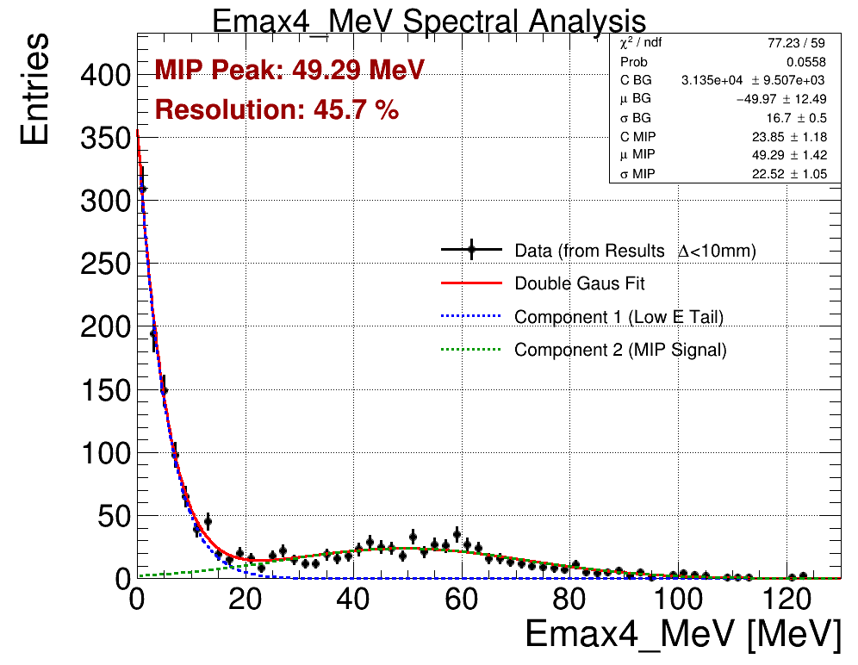
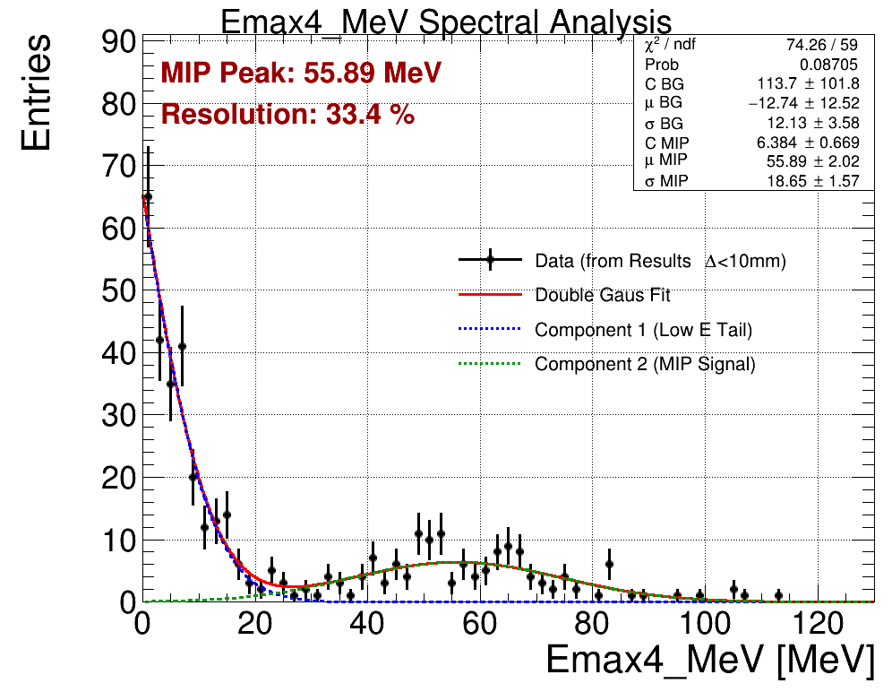
The Emax after the cut(fit)
Using Gaussian tail to fit the lower energy spectrum, and gaussian to fit the MIP.
The |Δ| < 10 is more reasonable and have a better fit.
The fitting shows the of golden events MIP = 55.89(2.02)MeV.
|Δ| > 10
|Δ| < 10

Slide 9
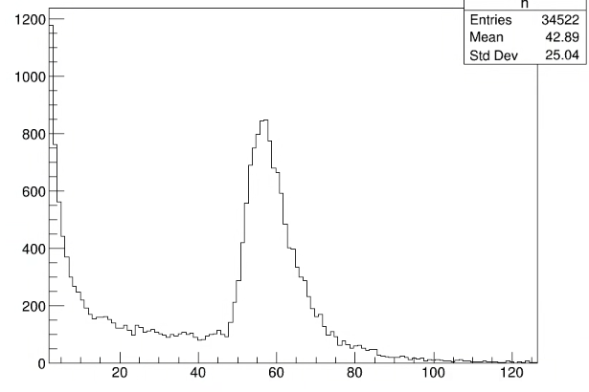
The Emax after the cut(fit)
Using Gaussian tail to fit the lower energy spectrum, and gaussian to fit the MIP.
The |Δ| < 10 is more reasonable and have a better fit.
The fitting shows the of golden events MIP = 55.89(2.02)MeV.
|Δ| < 10
MC

Slide 10
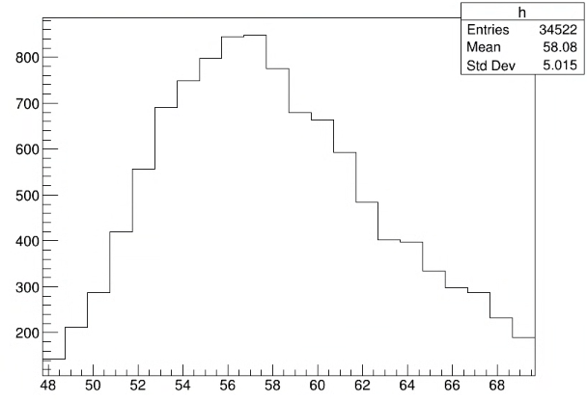
The Emax after the cut(fit)
Using Gaussian tail to fit the lower energy spectrum, and gaussian to fit the MIP.
The |Δ| < 10 is more reasonable and have a better fit.
The fitting shows the of golden events MIP = 55.89(2.02)MeV.
|Δ| < 10
MC
~57MeV

Slide 11
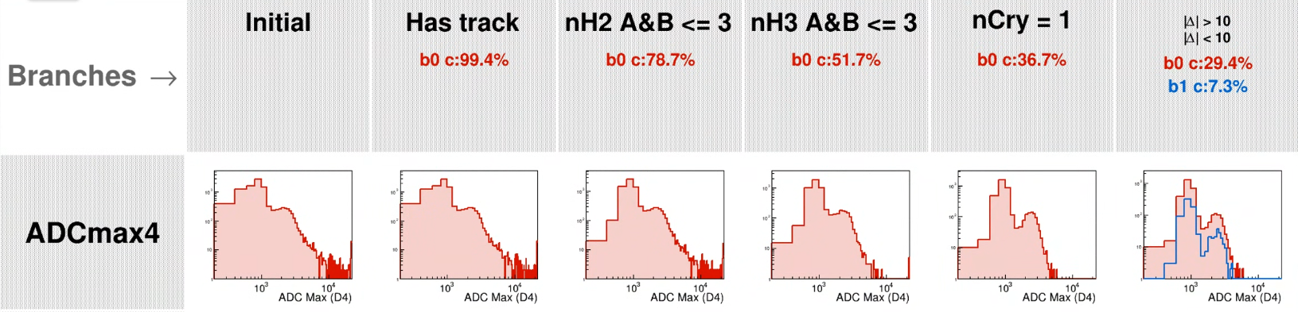
Why the spectrum contains 2 peak in ADC
The lower ADC peak ~ 40~50%(1K ADC/2K ADC) ADC of MIP peak Could because:
Emax crystal only fire 1 channel. => In this cases, nHits PbWO4 = 1 & nCrys = 1.
Two crystals share the MIP. => nCrys = 2 or large θ pass 2 crystal.
2 crystal share energy on different ROC but 1 ROC no data. => check track not on the boundary of ROCs.

Slide 12
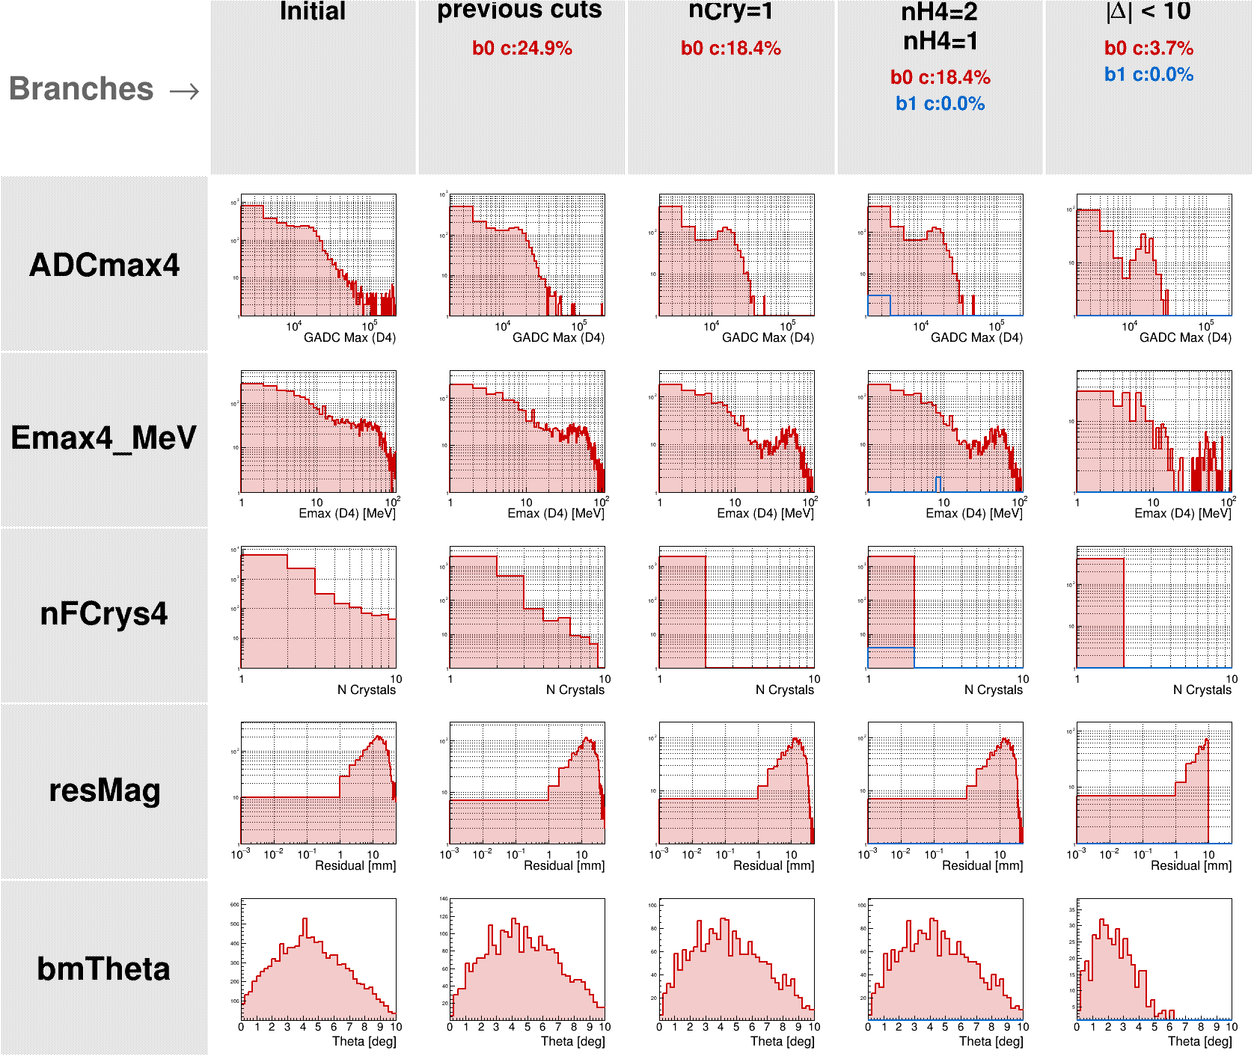
Emax crystal only fire 1 channel.
Previous cuts:
has track, nHs of BM x/y layers <=3, and Emax > 0MeV
Using selection: nHits PbWO4 = 1 or 2 to do comparision.
It’s appearance that no more event in this case.
No way by this reason! Which only fire 1 channel in the only crystal.

Slide 13
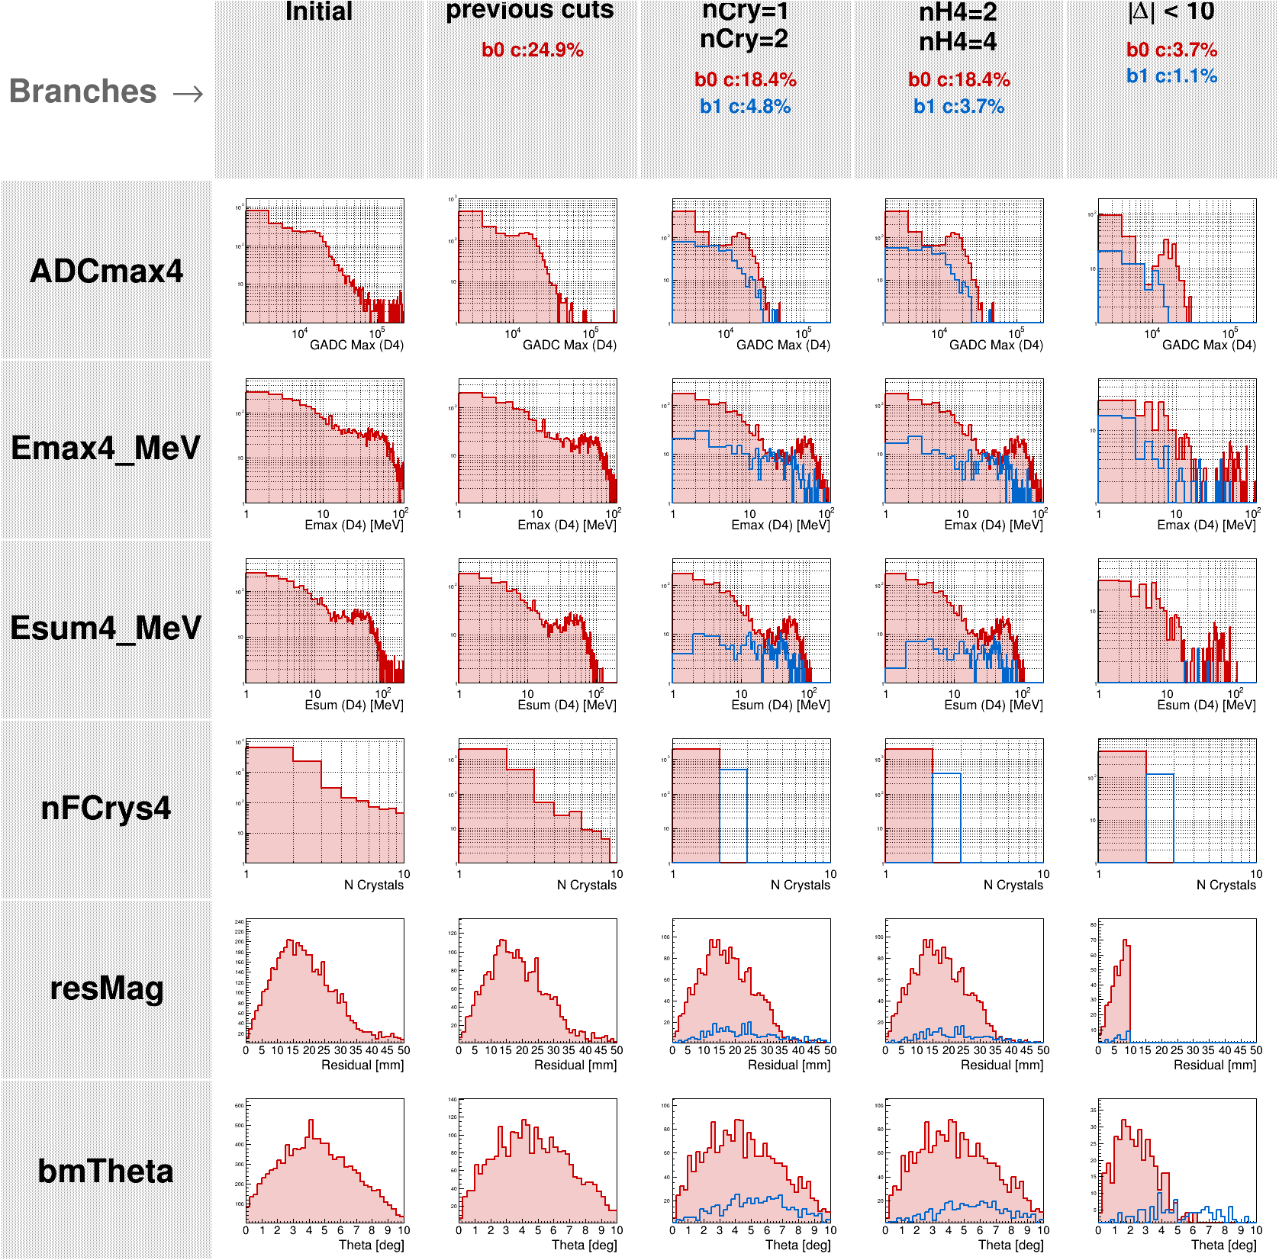
Two crystals share the MIP.
Previous cuts:
has track, nHs of BM x/y layers <=3, and Emax > 0MeV.
Case cut : nCrys PbWO4 = 1 or 2 and fire all channel.
In the E_{max}, the 2 crystal is surely to share the MIP energy.
The peak is lower than MIP.
The θ distribution is wider!
But isn’t contribute on lower energy tail.

Slide 14
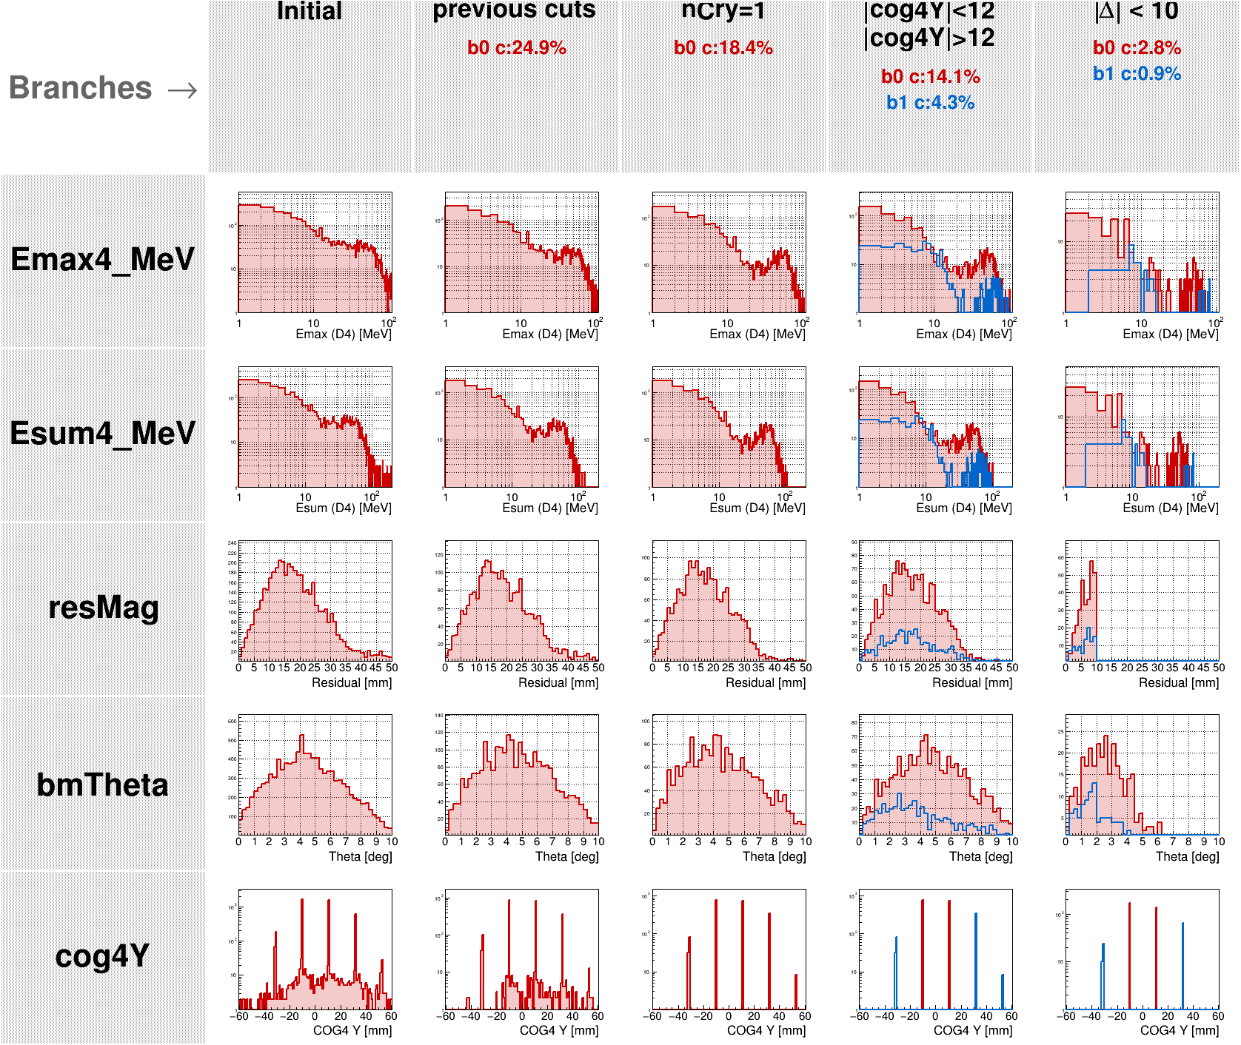
Two crystal share energy on different ROC but 1 ROC no data
Previous cuts:
has track, nHs of BM x/y layers <=3, and Emax > 0MeV.
Case cut : check if the Emax crystal at the boundary or not.
Abs(COG Y)<12mm: center 2 row crystals.
>12mm: outer 2 rows.
The spectrum has no more change on the lower peak.

Slide 15
Why the spectrum contains 2 peak in ADC
The lower ADC peak ~ 40~50%(1K ADC/2K ADC) ADC of MIP peak Could because:
Emax crystal only fire 1 channel. => In this cases, nHits PbWO4 = 1 & nCrys = 1.
Two crystals share the MIP. => nCrys = 2 or large θ pass 2 crystal.
2 crystal share energy on different ROC but 1 ROC no data. => check track not on the boundary of ROCs.
Still don’t know why the MIP selection contain a lots the half ADC event.

Slide 16
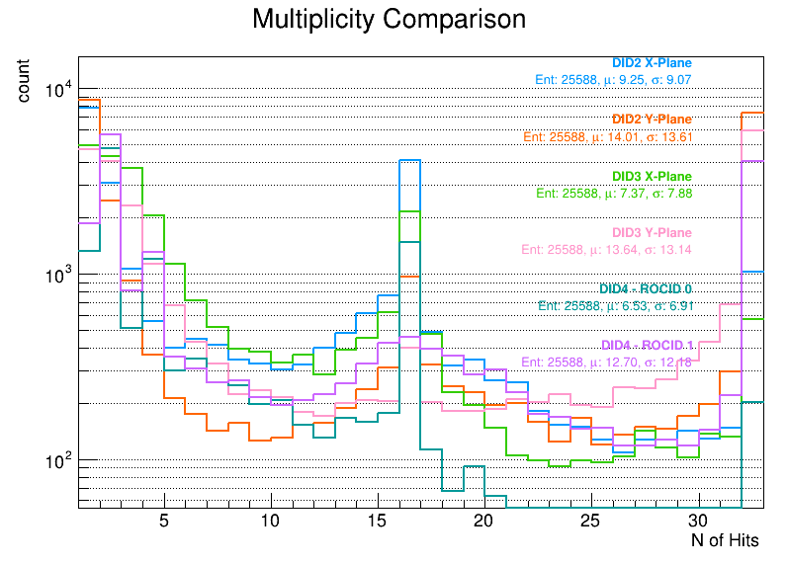
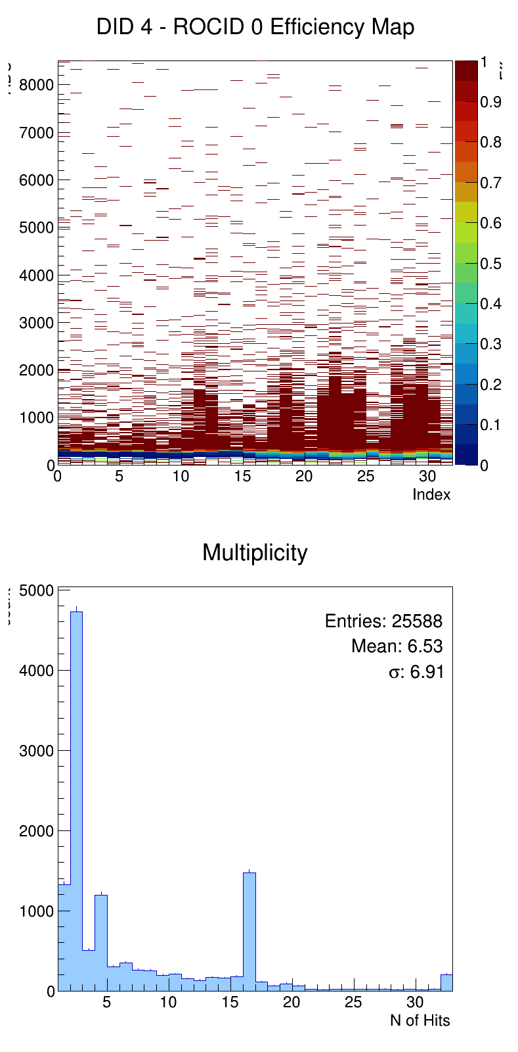
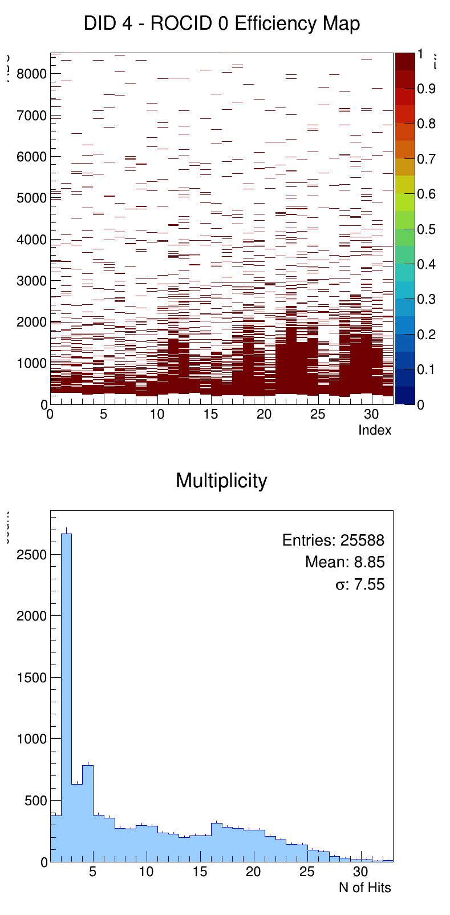
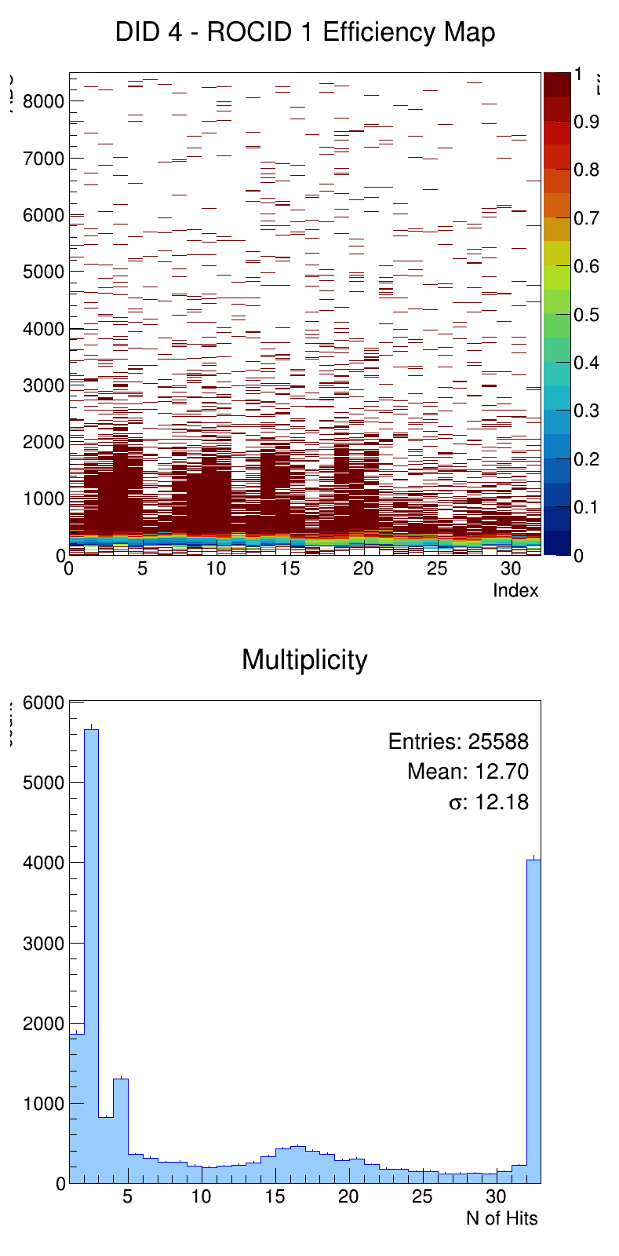
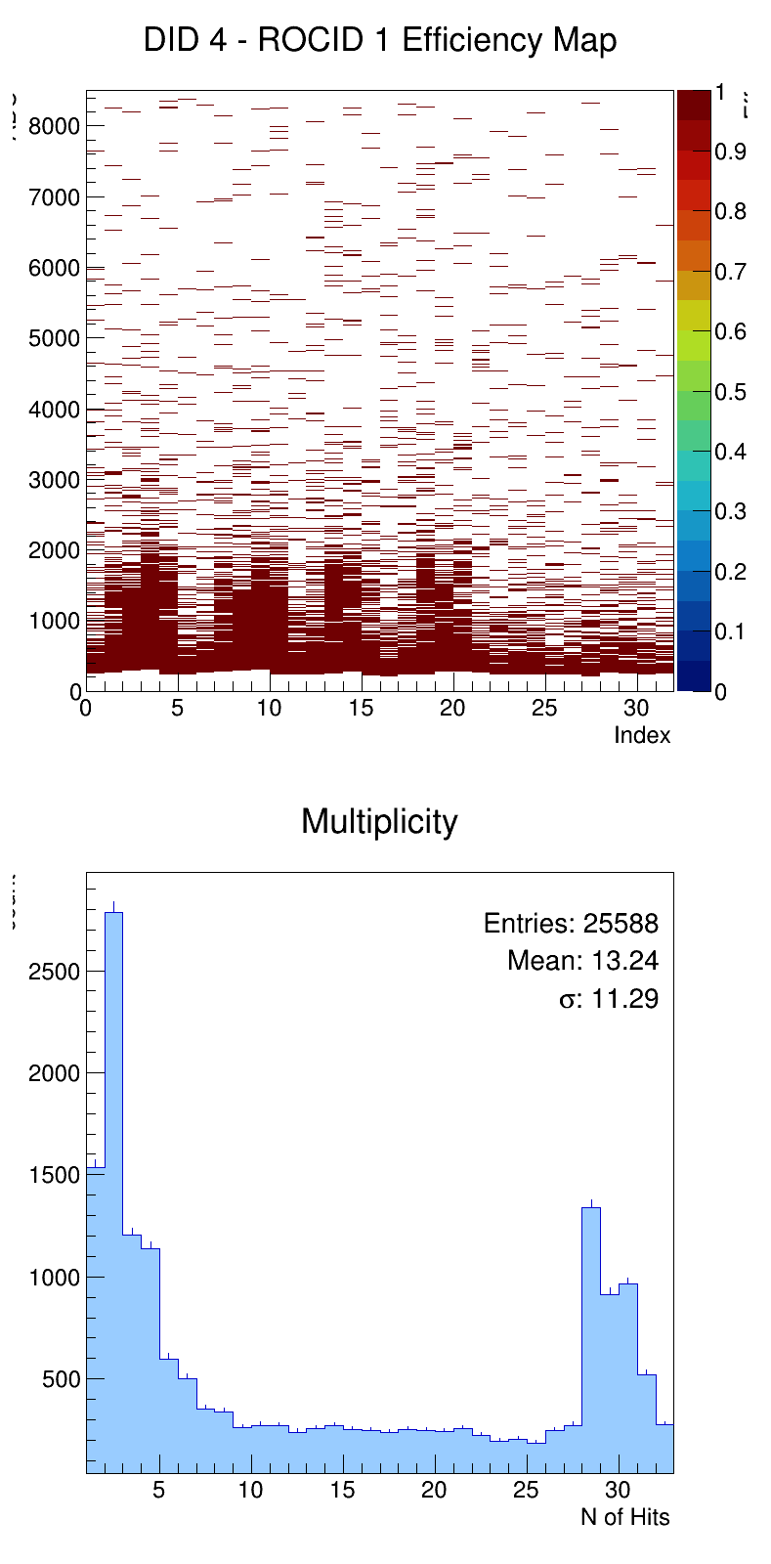
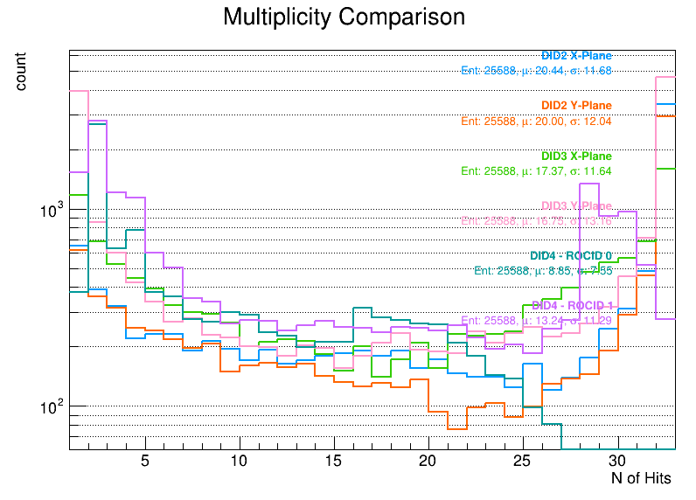
Apply the best ADC cut value on matching data.
Last week nHits problem:
Why nHits of 1 ROC often to be 16? Has any rule?
Take PbWO4 data for example:
The new cut make the raw data look better.
ROC A: The peak (nHits=16) become flat.
Could mean the signal is not large enough could be calculate in containment.
ROC A&B: The peak (nHits=2) is lower.
The event which is the single crystal under high cut could be solve.
Best cut
ROCA
Best cut
ROCB
Best cut

Slide 17
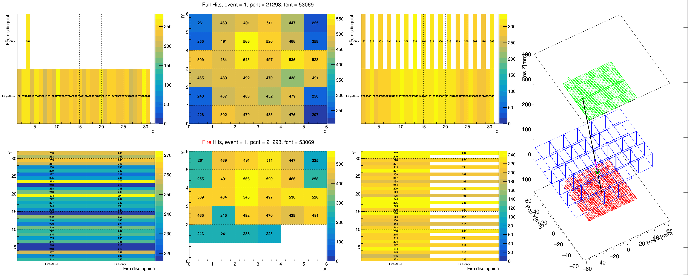
Ask of the nHits = 16 question
I take the BM2 for nHits of ROC A and B both equal 16, the fire channels occupy the odd or even channels.
The BM1 ROCB even fire all channels.

Slide 18
The cosmic ray moun analysis to do
Remove the data from Feb. 14~24(the low THR cause higher event rate, and matching rate).
PS: the high fire rate noise should not increase too much event like the data.
Trying the best cut result data to do the reconstruction and selection of timing matching data.

Slide 19
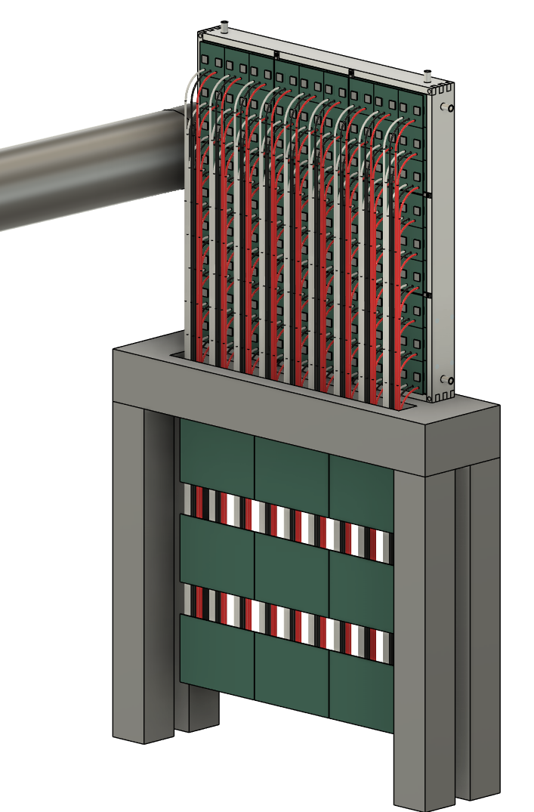
ZDC EMCal Design
60 cm
6 cm
The EMCal is shown with the following specifications:
PbWO₄ crystal array：
Crystal size 20.5 mm × 20.5 mm × 6X₀
Allow an additional ~0.5mm for the reflector and crystal wrapping
One Super Module (SM)：9 × 9 crystals
Allow 1mm of stainless for the SM wrapping.
SM size : (21.0×9+2)² cm²
Full array: 3x3 SM = (3×191)² cm²
Total number of crystal modules： 3x3x3x3 = 729
SiPM： S14160-3015PS_HAMAMATSU
16 MPPC channels for each crystal
Total number of MPPC channels： 11,664
Support and Cooling design： aluminum + copper tube
Use a 13mm thick aluminum plate
Coolant is circulated through copper tubing.
Cable routing：
The cables go downward and pass through the table
60 cm
80 cm
20 cm
Super Module readout hubs

Slide 20
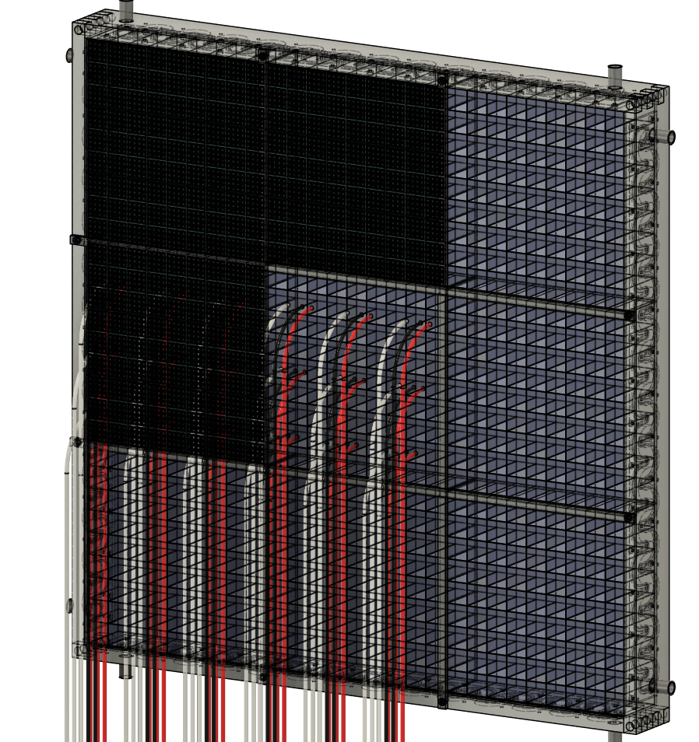
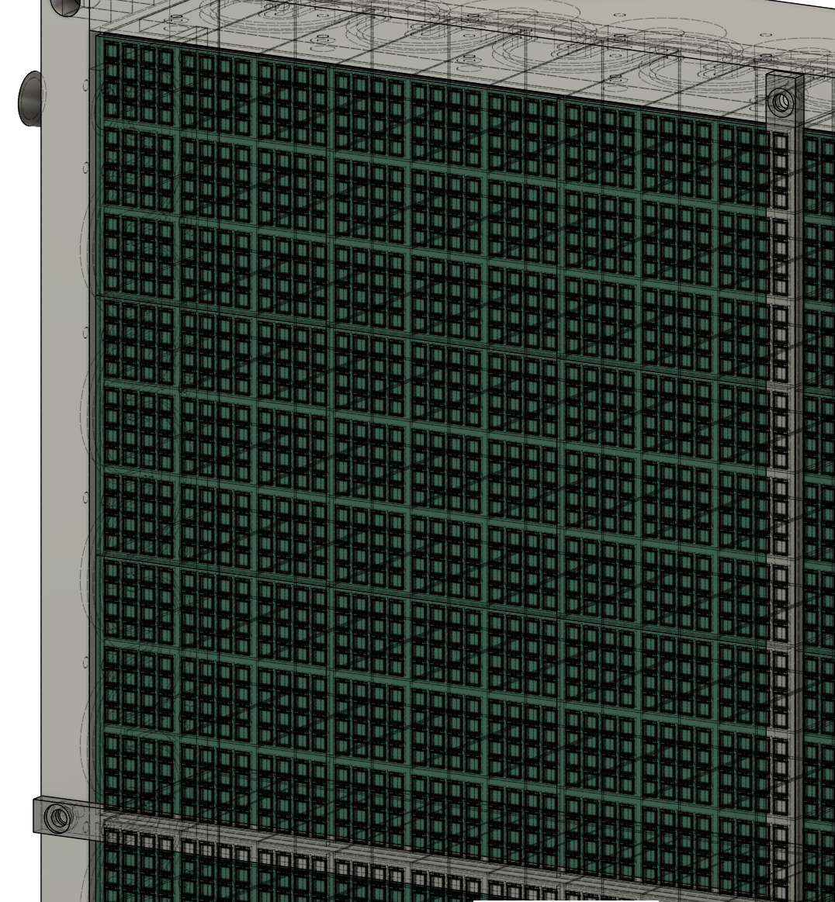
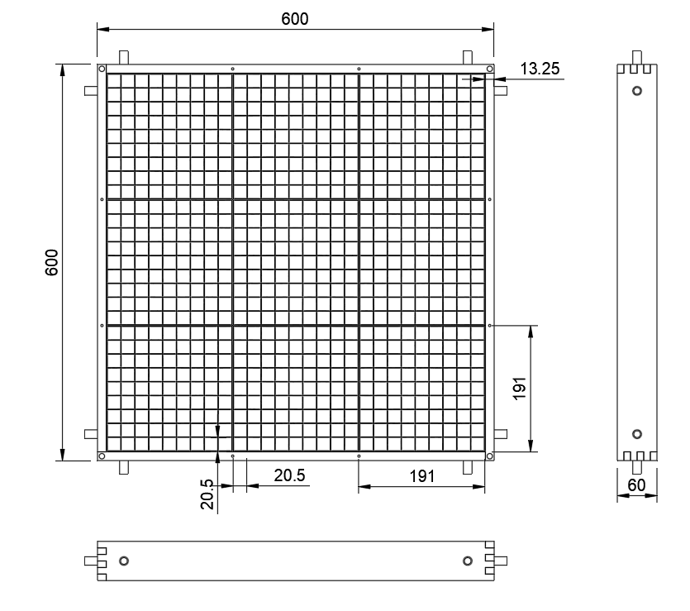
Supper Module
One SM contains :
9 × 9 PbWO₄ crystals
16 × 9 × 9 SiPM channels = 1,296 channels
Zoom in

Slide 21
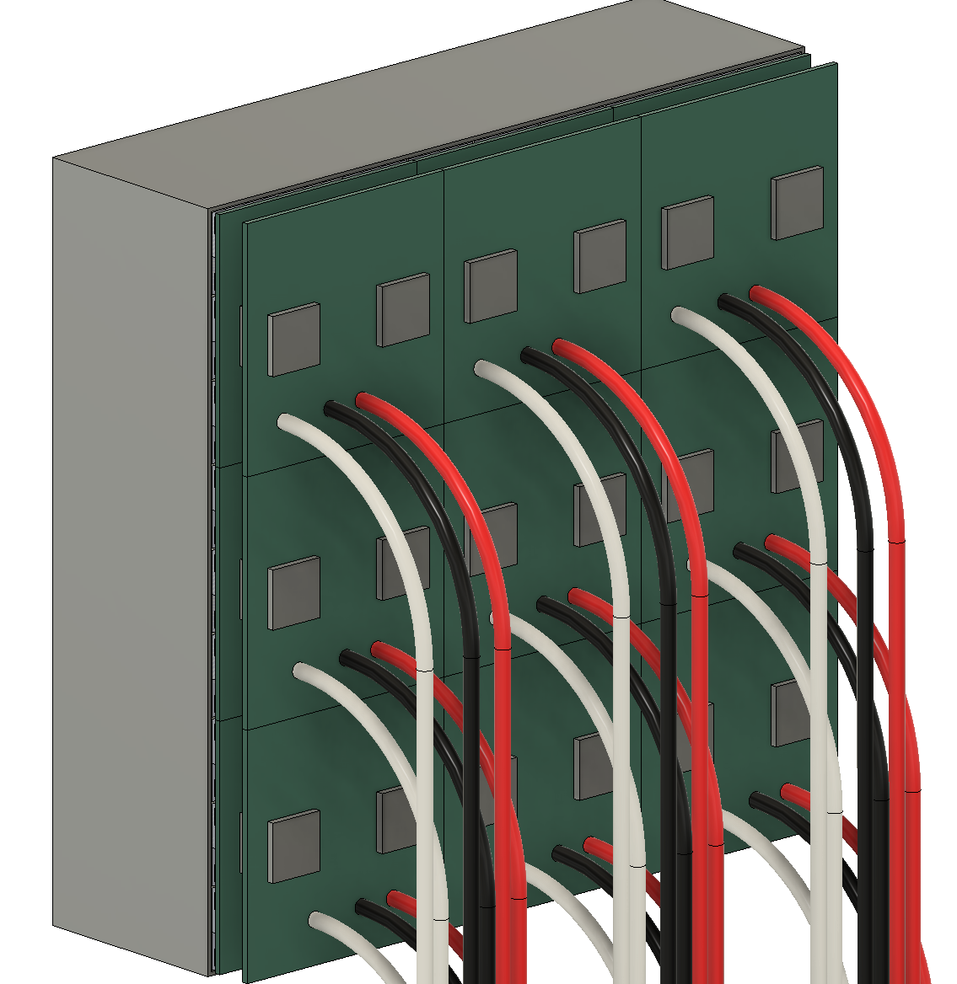
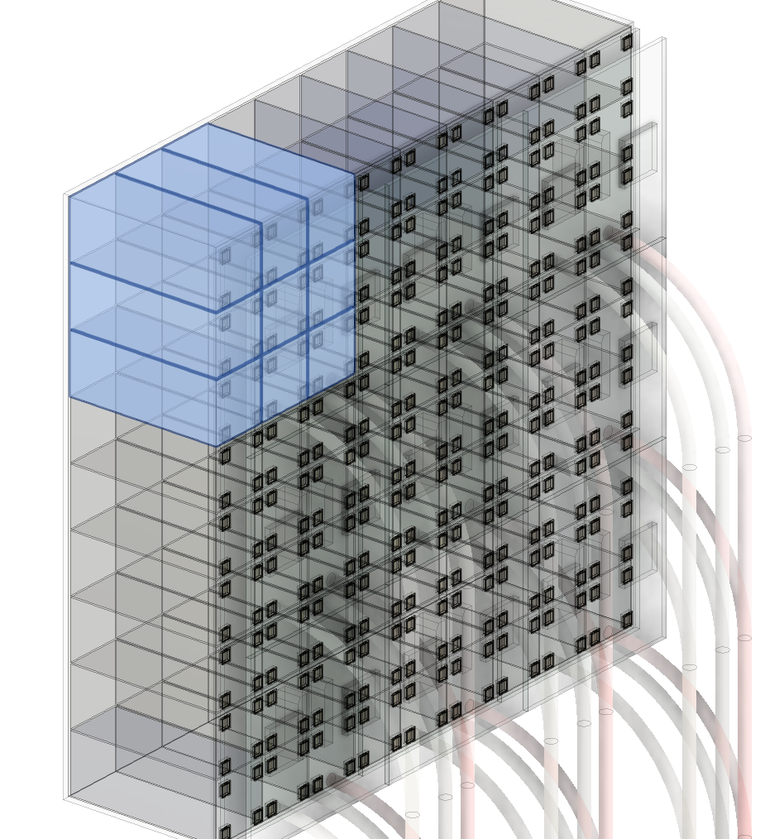
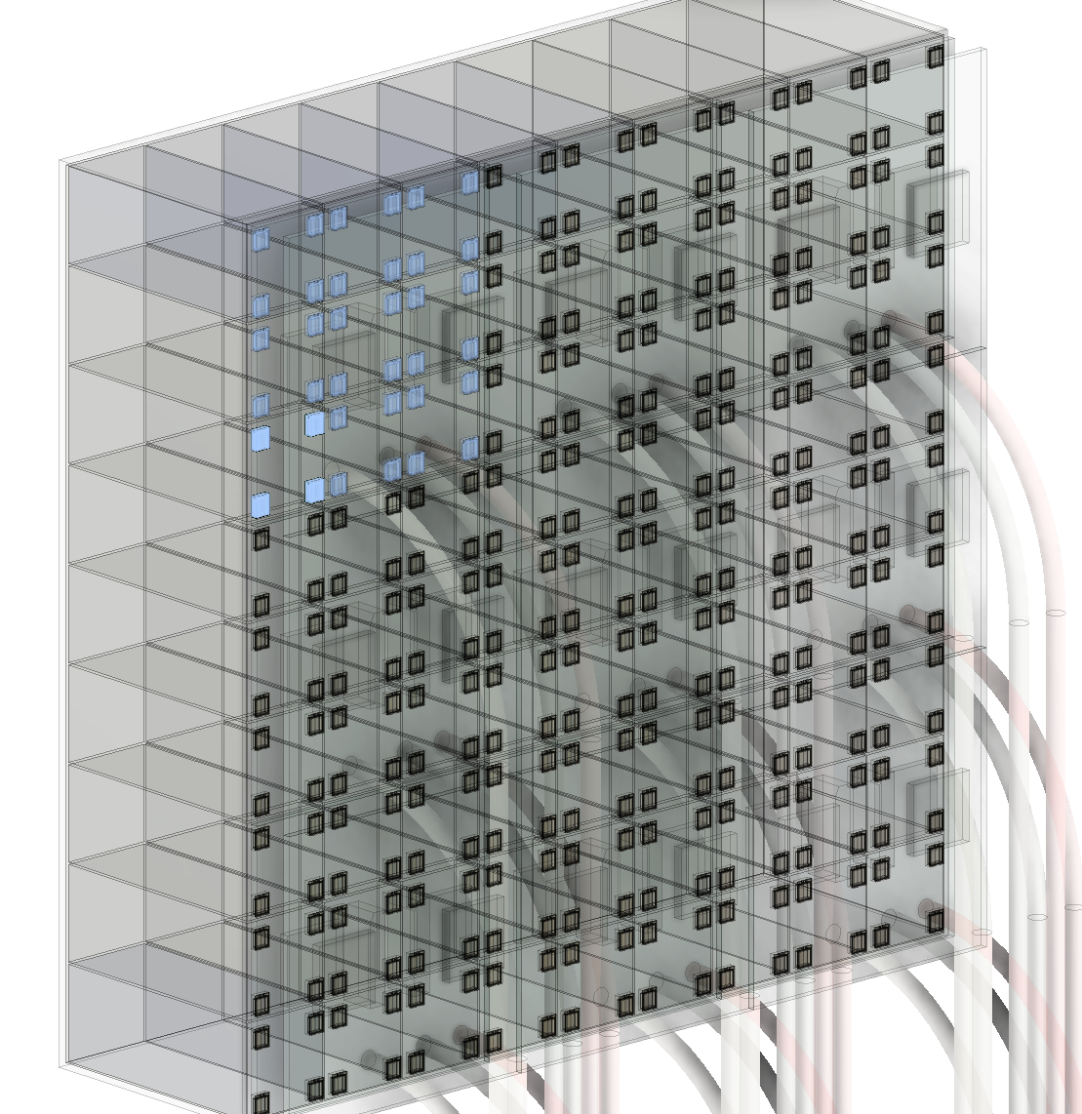
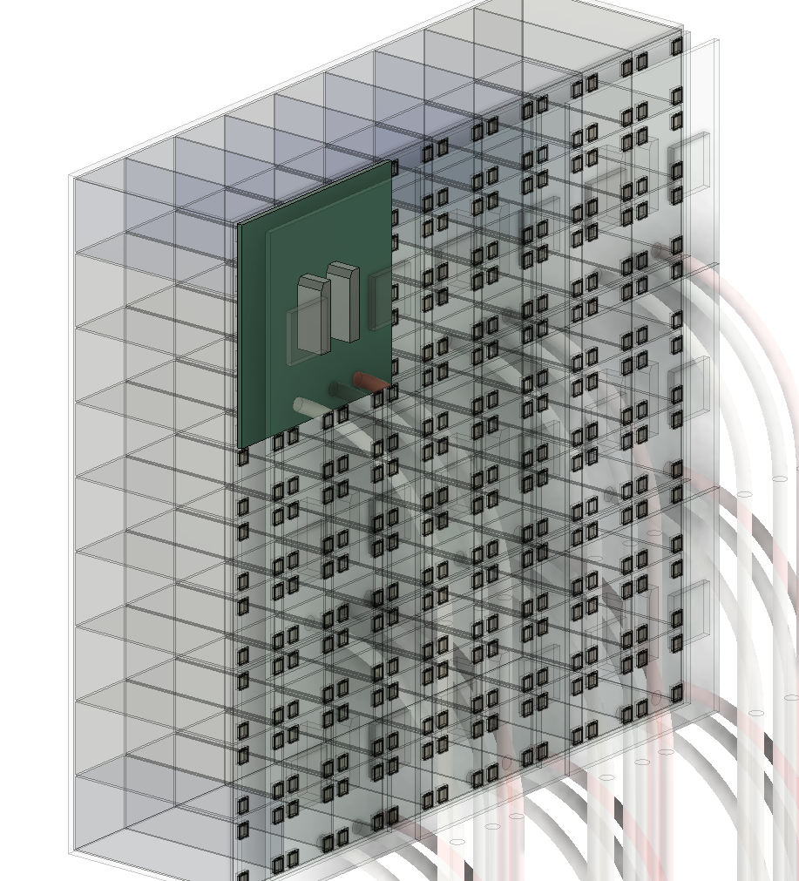
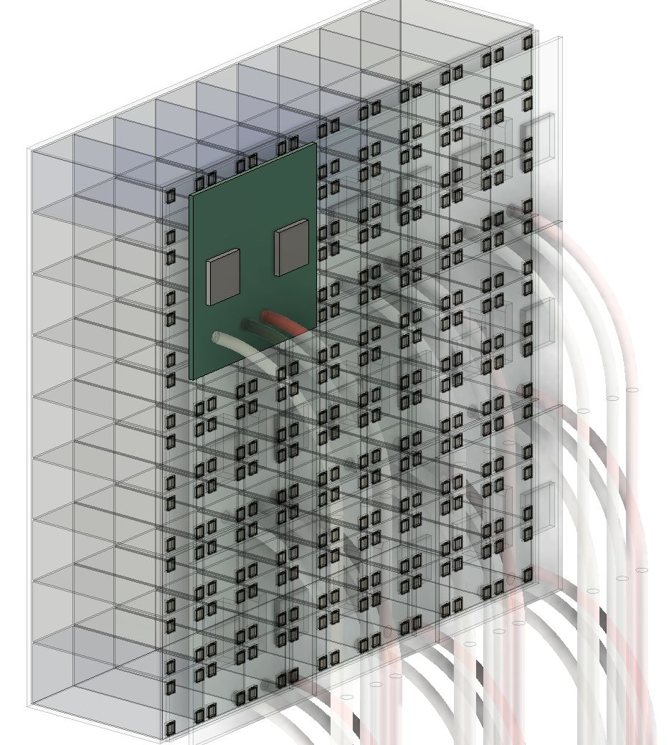
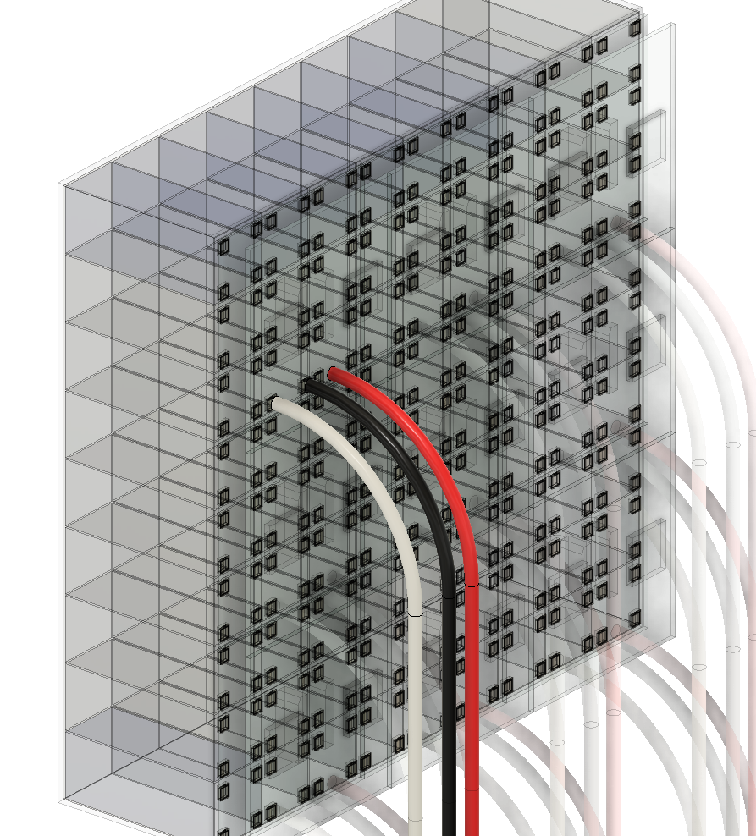
SiPM Readout Module
63 cm
1 Super Module
The current design contains 3 × 3 readout modules per Super Module
One readout module contains :
144 MPPC channels
2 ROCs
Thermal contact
63 cm
Readout module
1
3 × 3 = 9 crystals
(4×4)×3×3 = 144 MPPCs
(reduce the display chips by 75%)
MPPC board
MPPC ROC board
2 ROCs: (72 × 2=144 channels)
HV, GND, and Signal
cables

Slide 22
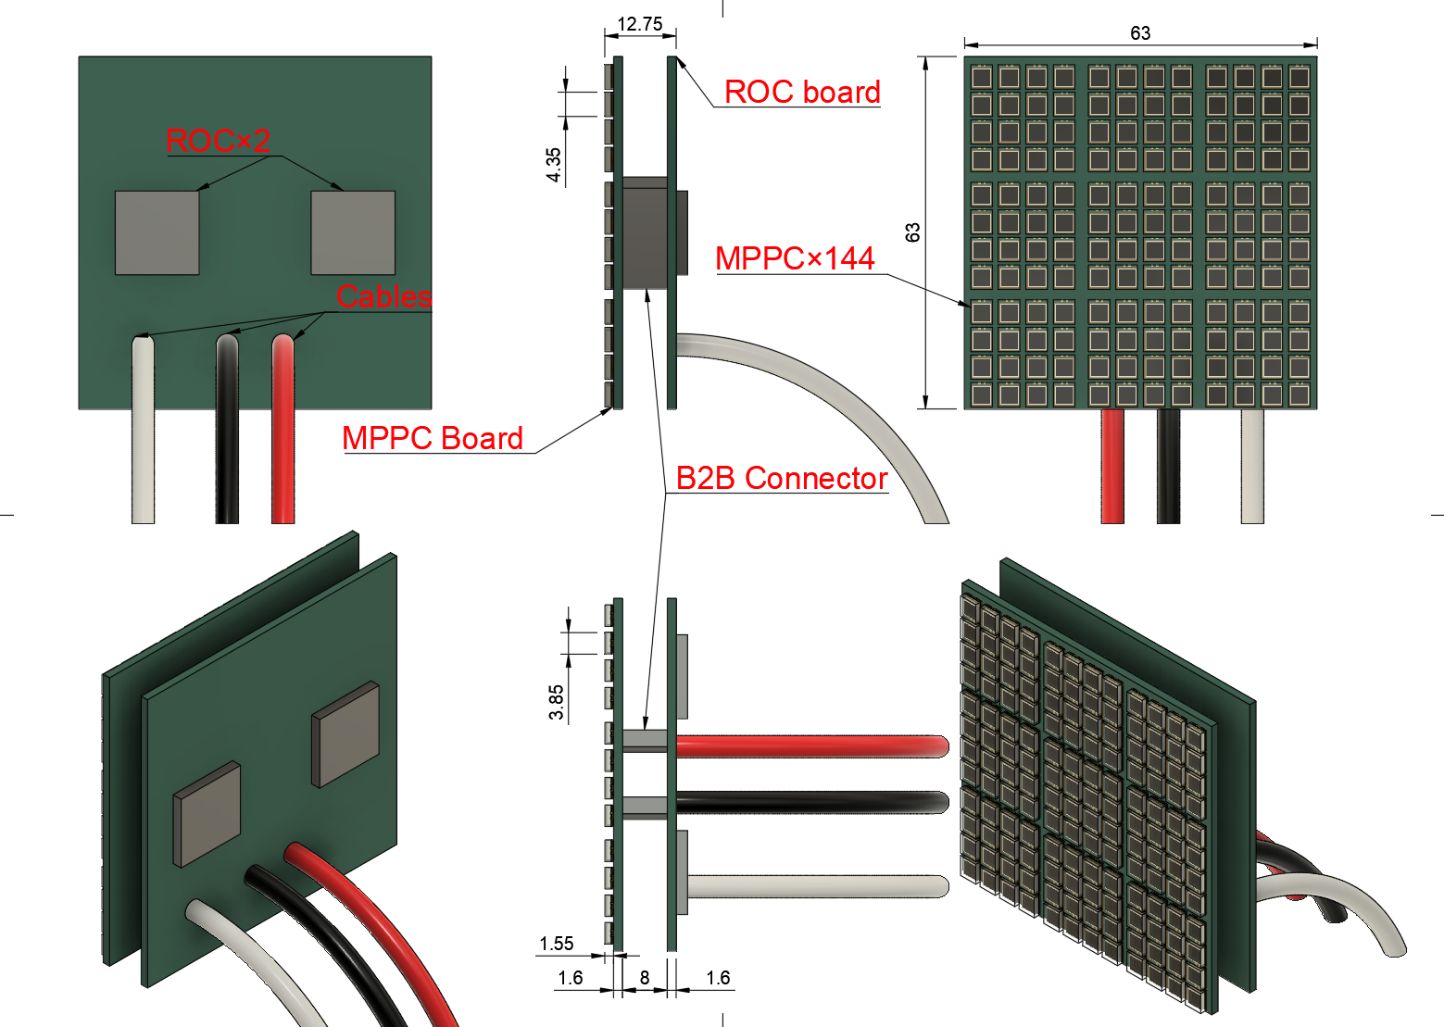
The readout module boards
High-Density Integration: Accommodates 144 MPPC sensors within a compact 63 × 63 mm.
Dual-Layer PCB Stack:
MPPC Board (Front): Dedicated to photon detection and signal interface with the crystal array.
ROC Board (Back): Equipped with two Readout Chips (ROCs) for signal processing and digitization.
Interconnect & Connectivity
Board-to-Board (B2B) Connector:
Utilizes an 8 mm standoff height.
Benefit: Minimizes analog trace length between sensors and ROCs to ensure signal integrity and low noise.
External Cabling:
Features three robust rear-exit cables for High Voltage (HV) bias and high-speed data transmission.

Slide 23
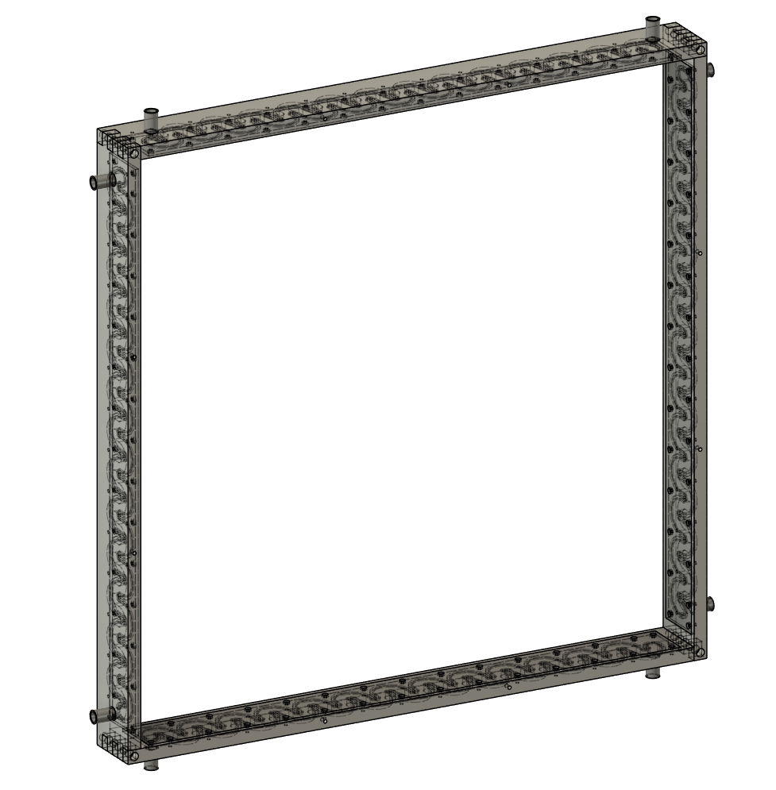
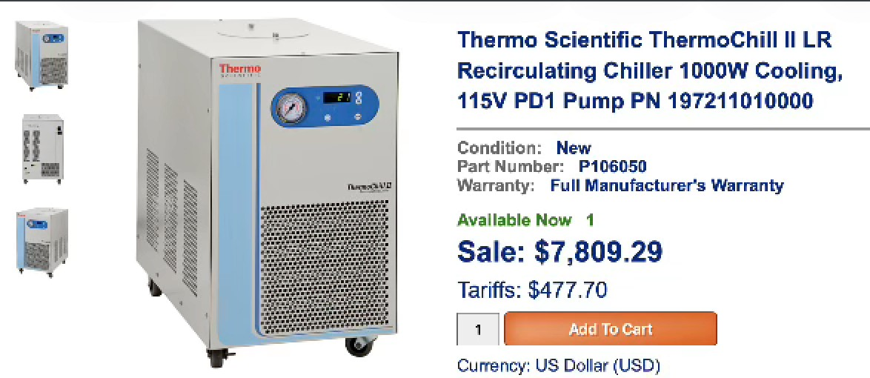
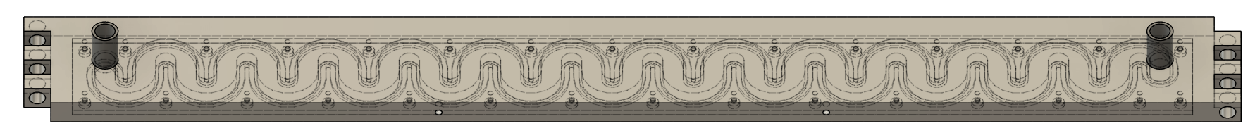
Cooling & Support System
Use 4 cooling modules to collect the heat from SiPMs
The coolant circulates through copper tubing

Slide 24
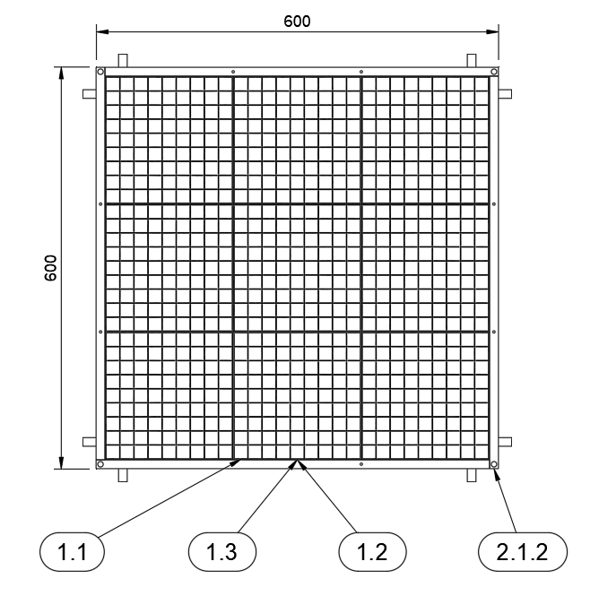
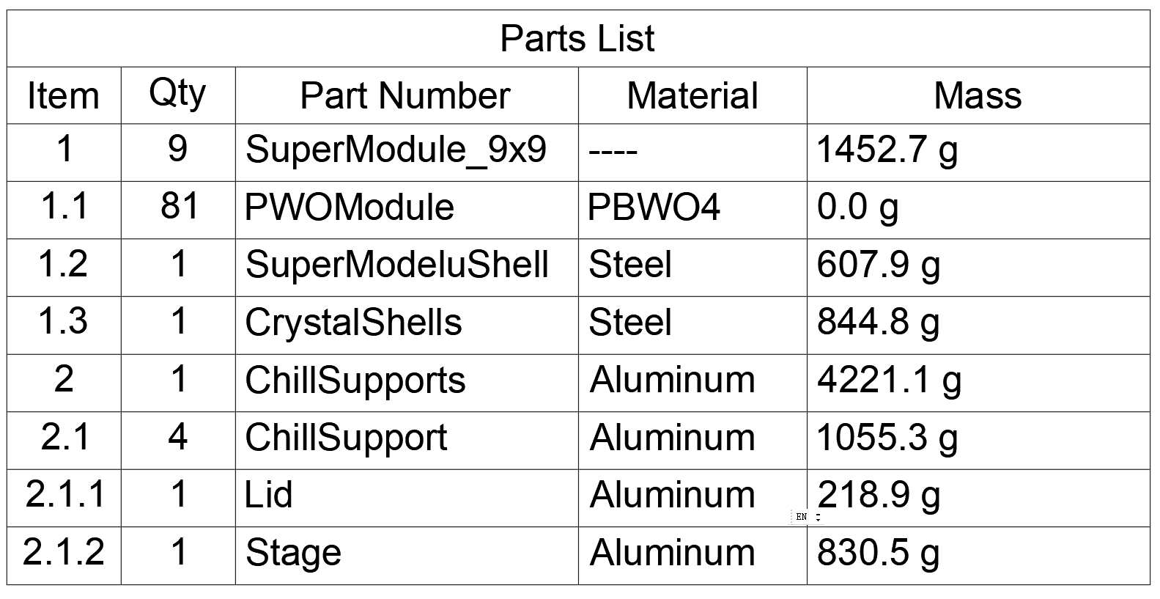
Mass Calculation
Super module： 16.4 kg
Cooling support： 4.2 kg
Total ： 16.4 × 9 + 4.2 = 151.8 kg
Cables and PCBs have not yet been included in the calculation
16405.3 g
184.6 g

Slide 25
End

Slide 26
backup

Slide 27

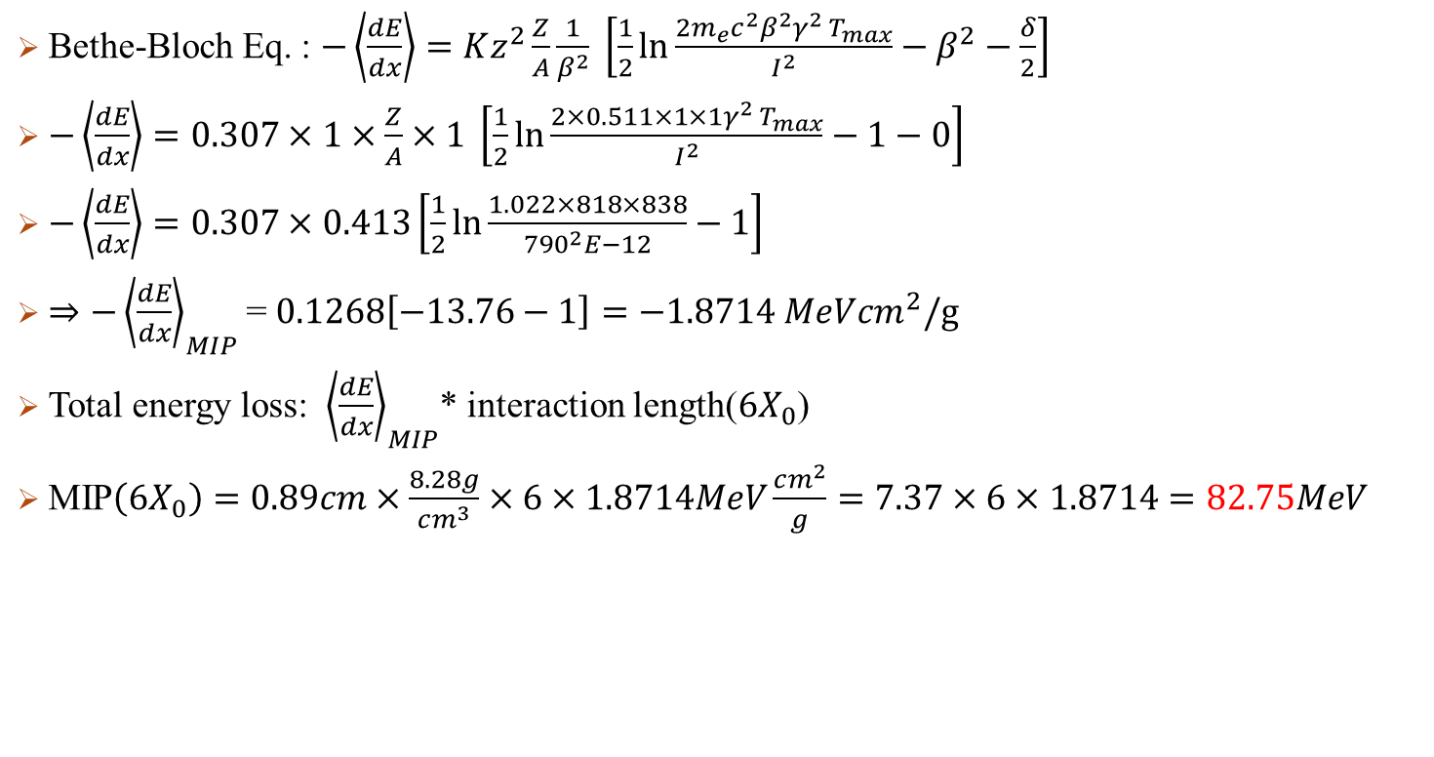
MIP Calculation
Bethe-Bloch Eq. : $−\left\langle \frac{dE}{dx}\right\rangle =Kz^{2}\frac{Z}{A}\frac{1}{β^{2}} \left[\frac{1}{2}\ln{\frac{2m_{e}c^{2}β^{2}γ^{2} T_{max}}{I^{2}}}−β^{2}−\frac{δ}{2}\right]$
$−\left\langle \frac{dE}{dx}\right\rangle =0.307×1×\frac{Z}{A}×1 \left[\frac{1}{2}\ln{\frac{2×0.511×1×1γ^{2} T_{max}}{I^{2}}}−1−0\right]$
$−\left\langle \frac{dE}{dx}\right\rangle =0.307×0.413\left[\frac{1}{2}\ln{\frac{1.022×818×838}{{790}^{2}E−12}}−1\right]$
$⇒−{\left\langle \frac{dE}{dx}\right\rangle }_{MIP}$= $0.1268\left[−13.76−1\right]=−1.8714 MeVcm^{2}/g$
Total energy loss: ${\left\langle \frac{dE}{dx}\right\rangle }_{MIP}$* interaction length($6X_{0}$)
MIP$\left(6X_{0}\right)=0.89cm×\frac{8.28g}{cm^{3}}×6×1.8714MeV\frac{cm^{2}}{g}=7.37×6×1.8714=82.75MeV$
$$K=0.307MeV cm^{2}/g$$
$$z=1(muon)$$
$$Z,A:Properity of meterial, for PbWO4=0.413$$
$$δ:density revise factor \sim 0\sim 0.1$$
$$T_{max}\left(3GeVμ\right)=2m_{e}c^{2}β^{2}γ^{2}\sim 838MeV$$
$β:For GeV level muon, 0.999…\sim 1$
$$γ\left(3GeVμ\right)=28.6$$
$$I:Mean Excitation Energy:790eV$$

