Slide 1
Combine DY Cross Section w/ LL and LO Trigger w/ Correlation of Systematics 20260206
Chia-Yu Hsieh
Academia Sinica, Taiwan

Slide 2
Review : Correlation Matrix
C_stat : ok
C_sys_acc (sys_acc = 3* MC_stat)
Same bin, same trig : 1
others: 0.8
C_sys_purity
Same bin, same trig : 1
others: 0.8
C_sys_trig
Same bin, same trig : 1
Same bin, different trigger : -1
Different bin, same trigger : 1
Different bin, different trigger : -1
size = W : 13%, Al : 5%, NH3 : 0%
sys_trig_LL = size * Xsection_LL
sys_trig_LO = size * Xsection_LO
2N * 2N Matrix
LL (N)
LO (N)
LL (N)
LL x LL (NxN)
LO x LL (NxN)
LO (N)
LL x LO (NxN)
LO x LO (NxN)

Slide 3
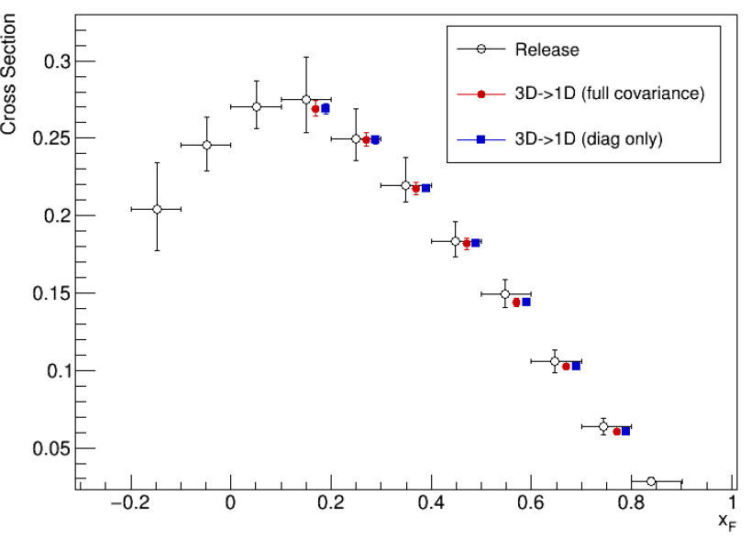
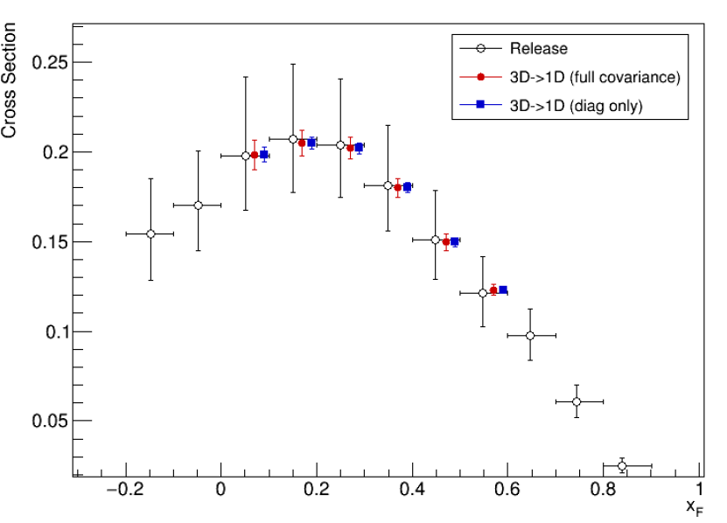
Review : Integrate to 1D in xF (Results)
😱
W
NH3
Release 1D :
Fill event by event into 1D histogram with factor
1*purity/( acc* DAQ_LT* Veto_LT * tarAtt *rhoT)
where purity and acc are 5D histogram (target, trig, mass, pt, xf).
Release 3D apply the same idea for release 1D, just event by event fill into 3D histogram.
3D->1D : integrate 3D xsc over mass and pt, considering covariance matrix.
3D->1D : integrate 3D xsc over mass and pt, DO NOT considering covariance matrix.

Slide 4
Extend xf Region to Combine
xf = [0.2-0.9] => xf = [-0.2, 0.9]
For the region has only one trigger,
Mean = 1e-3
err_[stat, acc, pur, trig] = 100

Slide 5
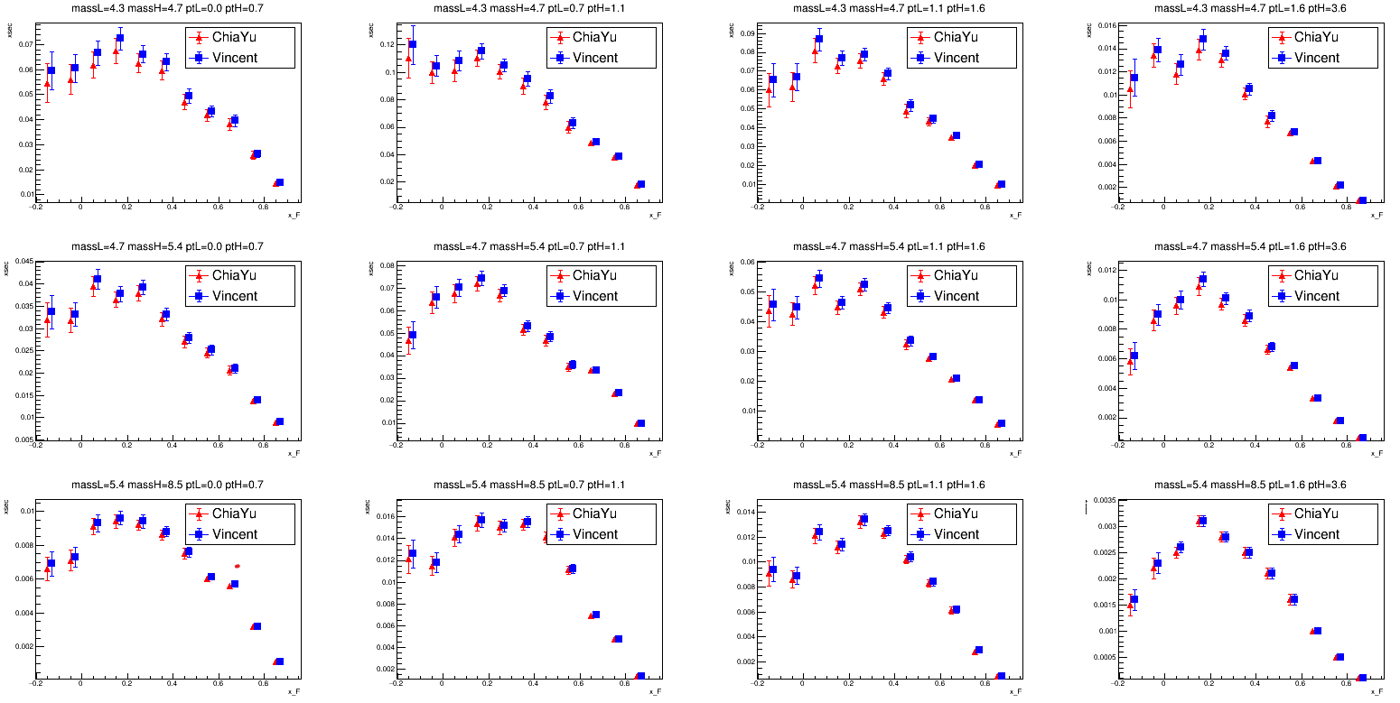
Compare to Vincent
W target

Slide 6
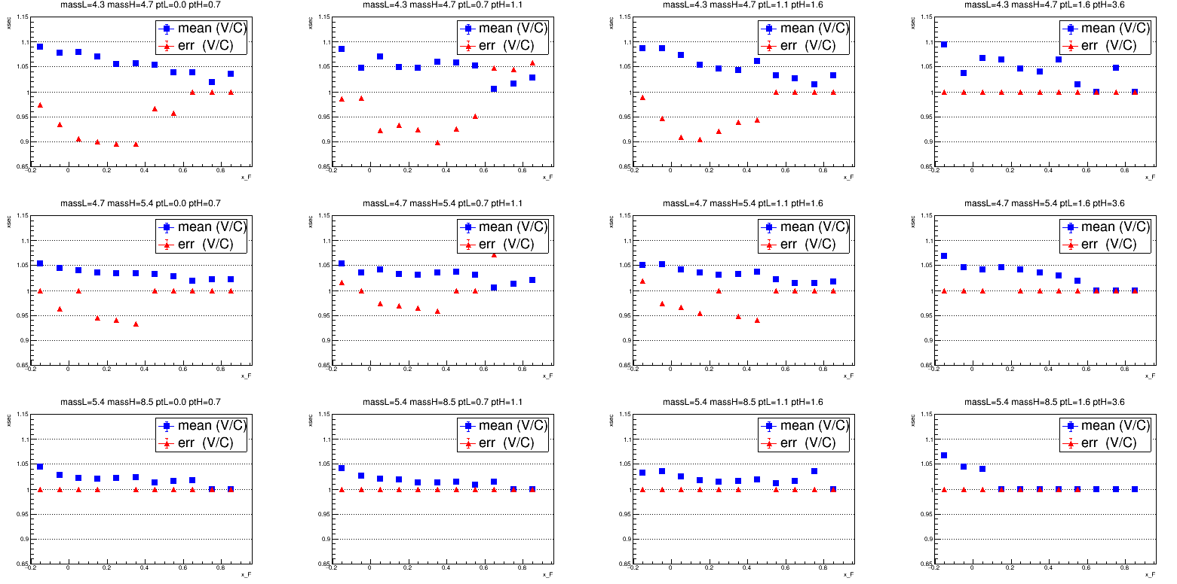

Slide 7
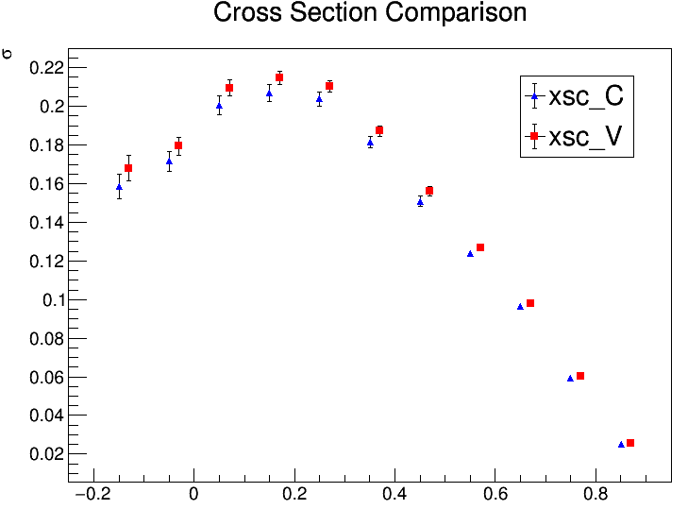
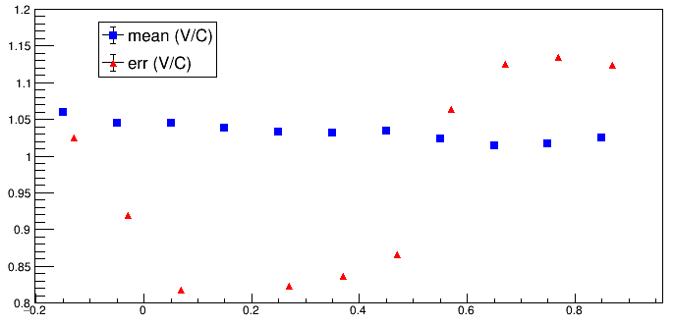
More detailed cross check is needed.

Slide 8
To Do
3D combine need more detailed cross check.
Why integrated cross section in xf has much smaller size compare to the one directly obtained from event by event evaluated cross section.
How to deal with 1D/2D cross section in pt and mass.

