Slide 1

PDF/TMD/GPD for EIC (Theory)
Chung-Wen Kao
Chung-Yuan Christian University
2022.8 .18. TIDC workshop, NCKU

Slide 2

How are the sea quarks and gluons, and their spins, distributed in space
and momentum inside the nucleon?
How are these quark and gluon distributions
correlated with overall nucleon properties, such as spin direction?
What is the role of
the orbital motion of sea quarks and gluons in building the nucleon spin?

Slide 4
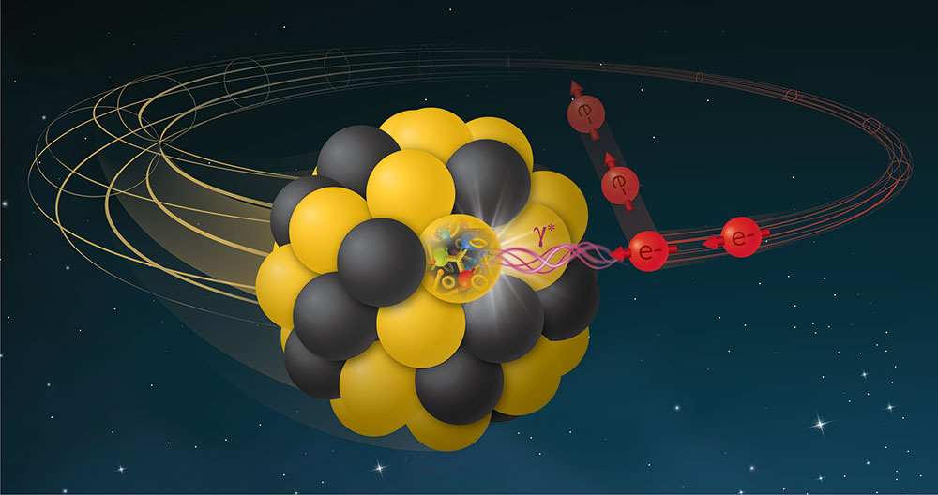
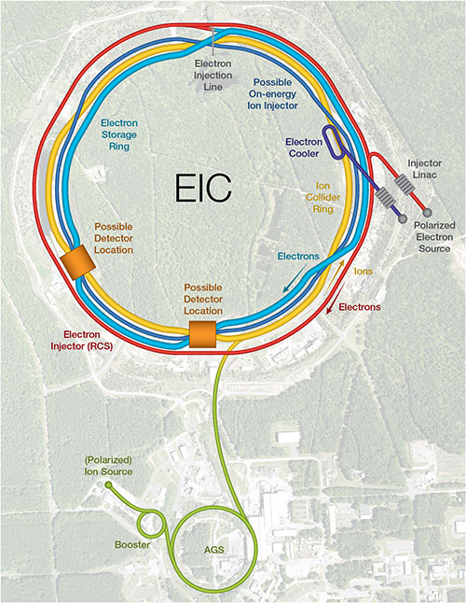
What is EIC?
The construction of an Electron-Ion Collider (EIC) has been recently approved by the United States Department of Energy at Brookhaven National Laboratory, and could record the first scattering events as early as 2030. By colliding (polarized) electron, and potentially positron, beams with proton or ion beams at a center-of-mass energy of up to E≦140 GeV, the EIC will perform key measurements to investigate QCD at the Intensity Frontier.

Slide 5
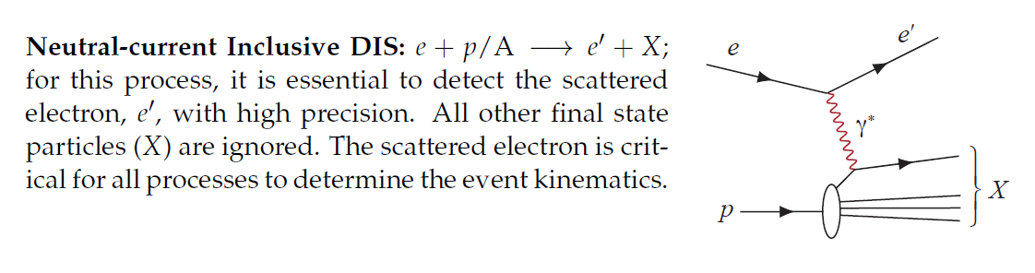
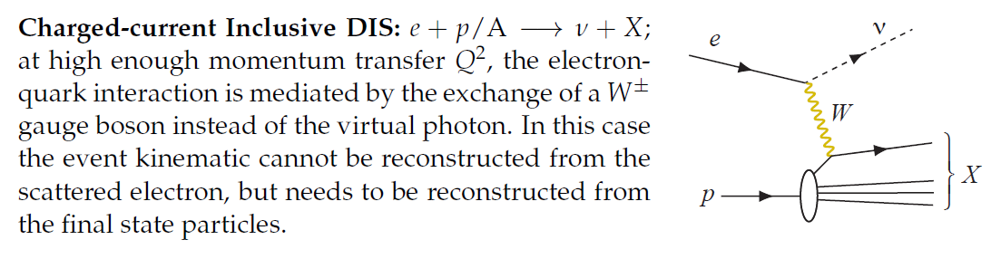
What EIC will do?

Slide 6
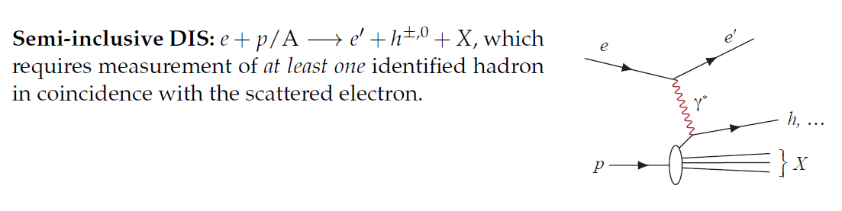
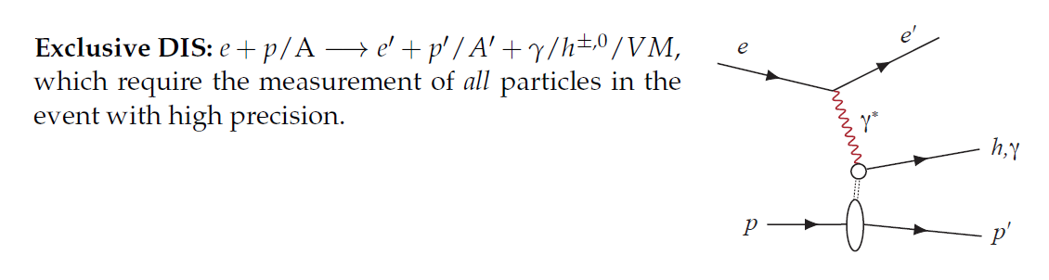
What EIC will do?

Slide 7
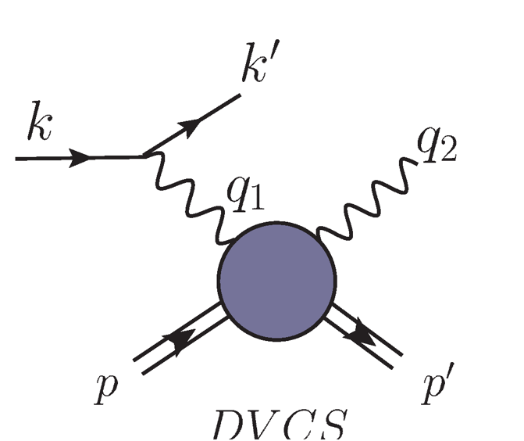


What EIC will do?
Deeply Virtual Compton Scattering:
Exclusive process, whoch requires to measure all
the particles in the final state.
Electrproduction of vector meson
Exclusive process, whoch requires to measure all the particles in the final state.

Slide 8
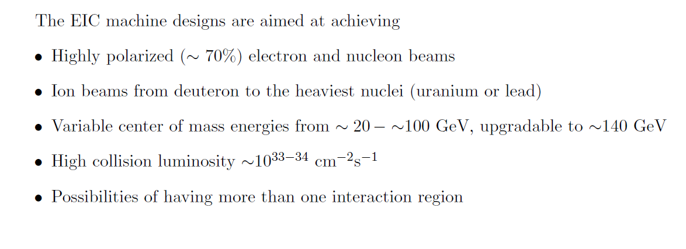
What makes EIC special?

Slide 9


IN QCD WE TRUST
We hold these truths to be self-evident, that QCD are the true theory of the strong interaction.

Slide 10

EIC and QCD
These measurements will be fundamental to understand how partons are distributed in position and momentum spaces within a proton, how the proton spin originates from the spin and the dynamics of partons, how the nuclear medium modifies parton-level interactions and substructure, and whether gluons saturate within heavy nuclei. In addition, the EIC will be capable of a range of PDF-related precision measurements in fundamental QCD and electroweak phenomenology.

Slide 11

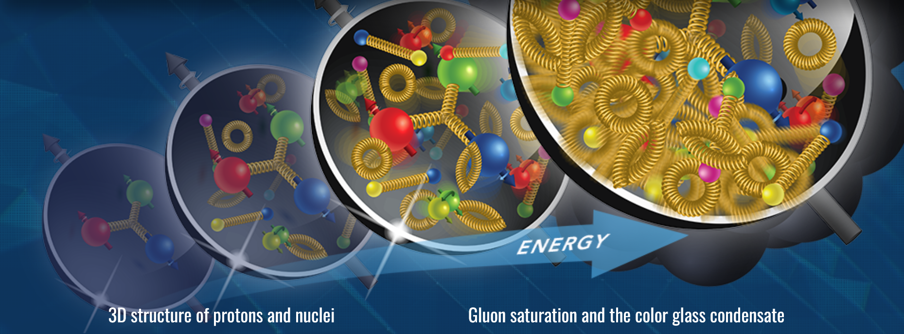


Slide 12
From 1D to 3 D
Parton distributions functions are the main sources of the structure of the nucleon, however essentially they are 1D objects carrying only 1D information.
Parton distrubution functions are the matrix elements of the non-local operators sandwiched between the proton states.
Only at the leading twist level, the parton distribution functions have the probability interpretation, higher twist objects are well-defined in terms of field theory, but ambguious in term of probabilty imterpretation.
So, what kind of objects will provide the 3-D information of the nucleon and in general, of hadrons?

Slide 13

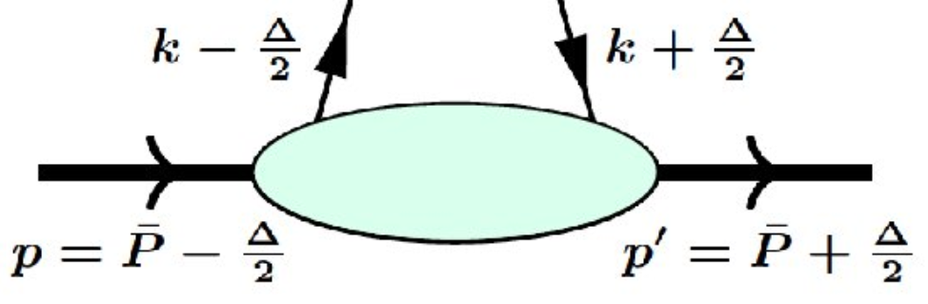
What are GTMDs ?

Slide 14
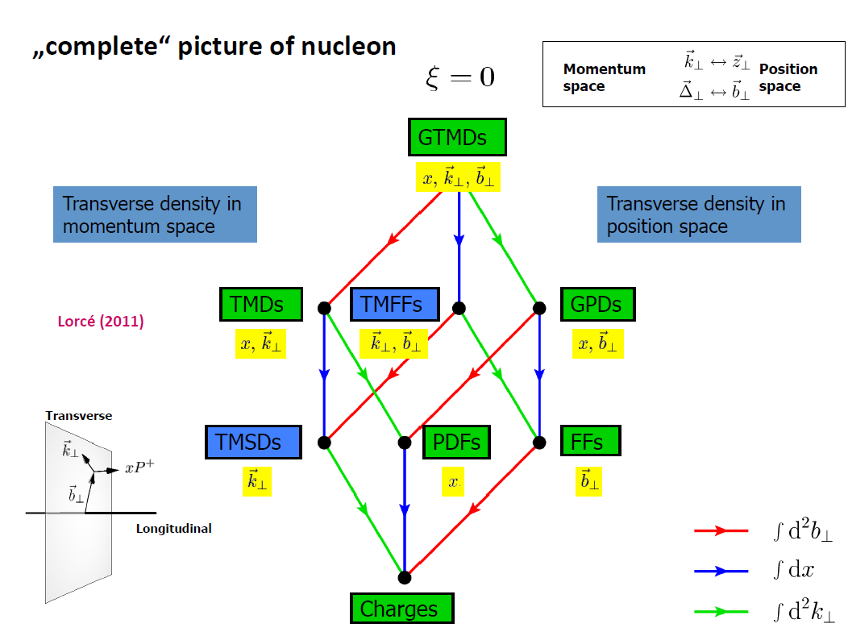
Complete picture of nucleon

Slide 15
Wigner Functions
Example:Γ=γ⁺
one obtains the Generalized Parton Distributions GPDs

Slide 16
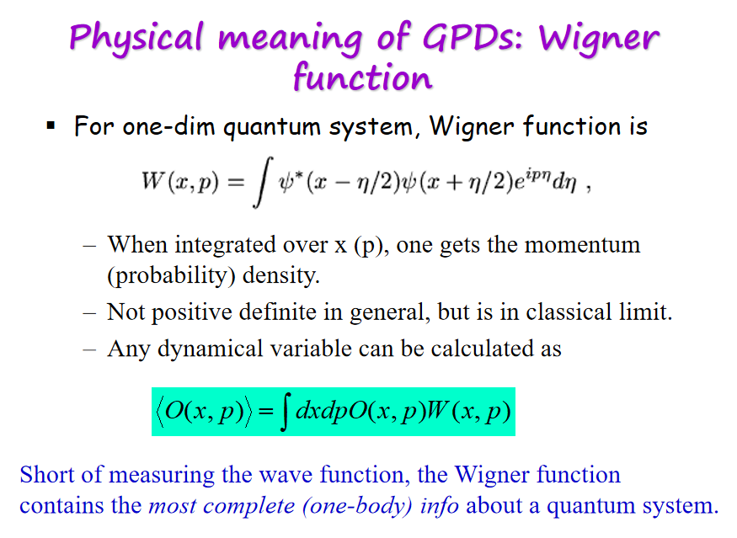
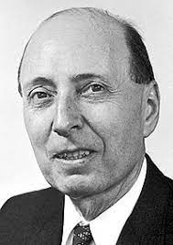
Wigner Functions

Slide 17
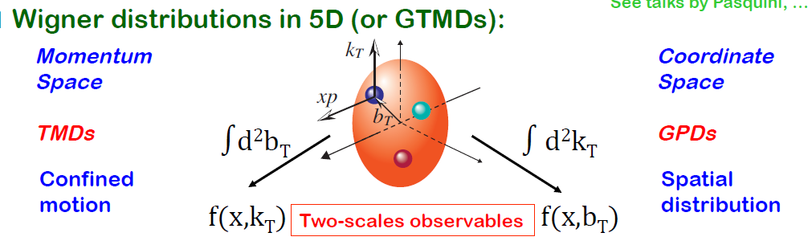
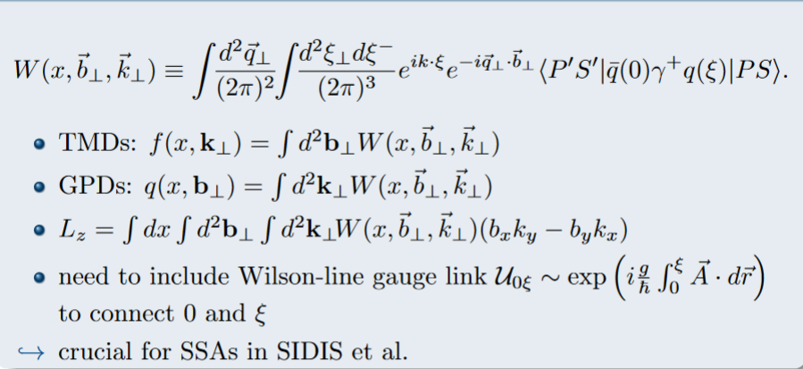

Slide 18
Multi-Scalar Structure
The transverse information of the nucleon structure is difficult to obtain is due to
the emergence of the multi-scalar hierachy which makes the factorization ambiguous
Another complication is due to the corelation between transverse momentum and spin.

Slide 19
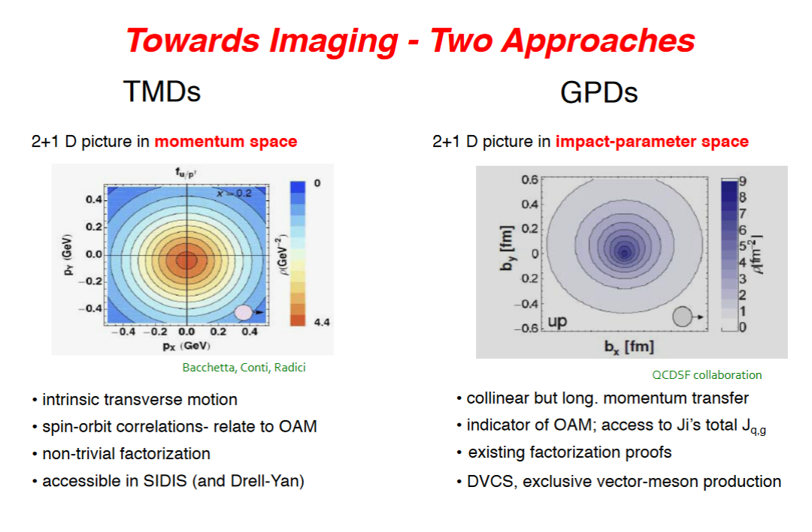
Two pictures: GPDs and TMDs

Slide 20
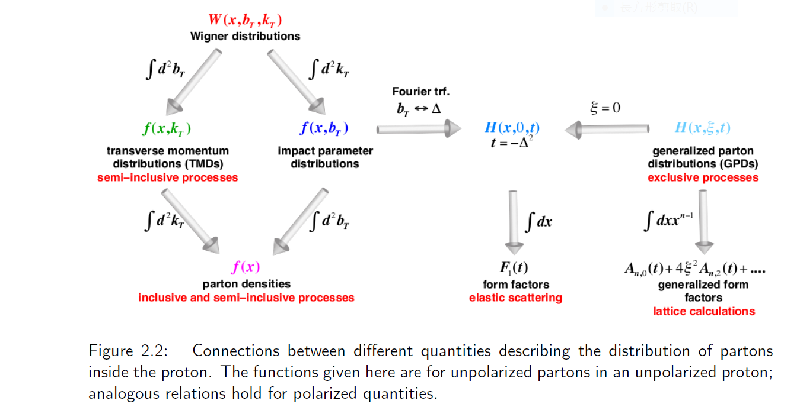
Extraction of PDFs, GPDs and TMDs from the data of
various processes is an huge industry!

Slide 21
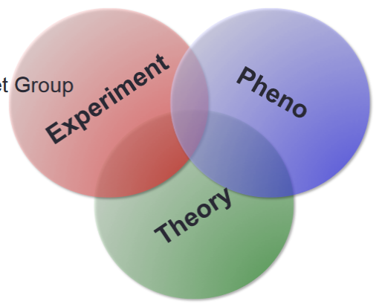
Rich physics of GPDs and TMDs
The experiment data can hardly completely determine the many-variable objects. Phenomology
is definely required.
Furthermore, the data taken at different kinematic conditions are not be integrated trivially.

Slide 22
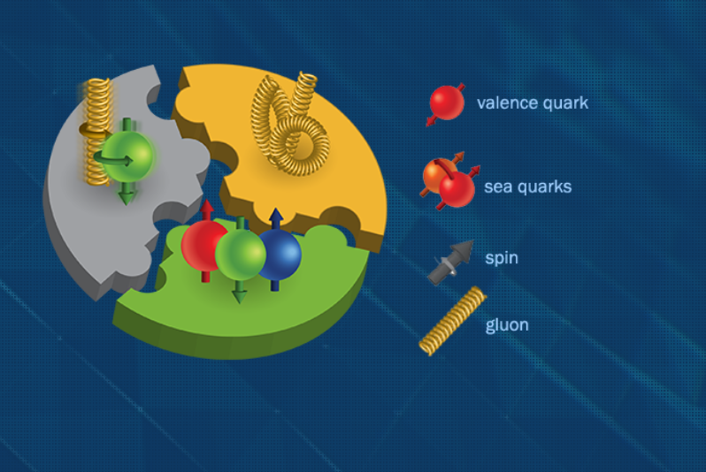
Study of
Parton Distribution Functions in Electron-Ion Colliders

Slide 23
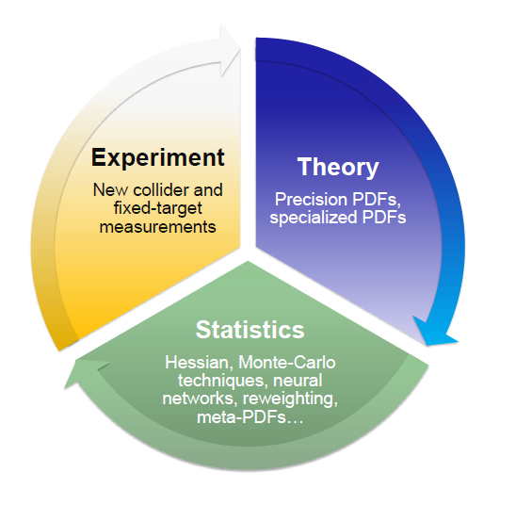
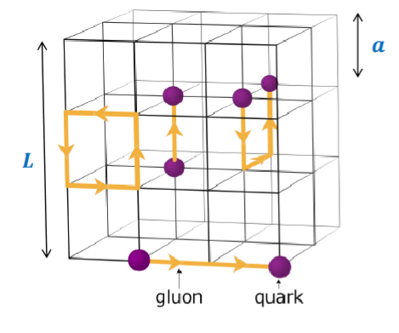
Parton Distribution Functions

Slide 24
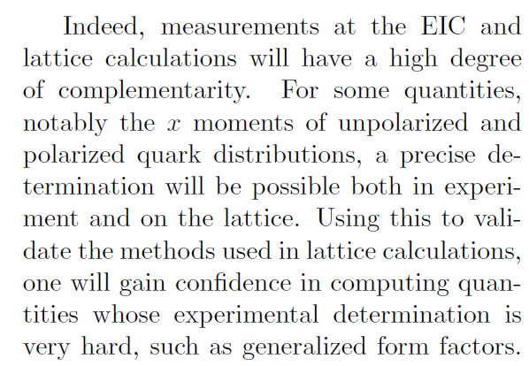
EIC and Lattice QCD

Slide 25
e-p scattering: From Low to High
Low Q², elastic, exclusive
High Q², deeply inelastic, inclusive
hadronization
Parton distribution
Form factors, resonance
2
PD

Slide 26
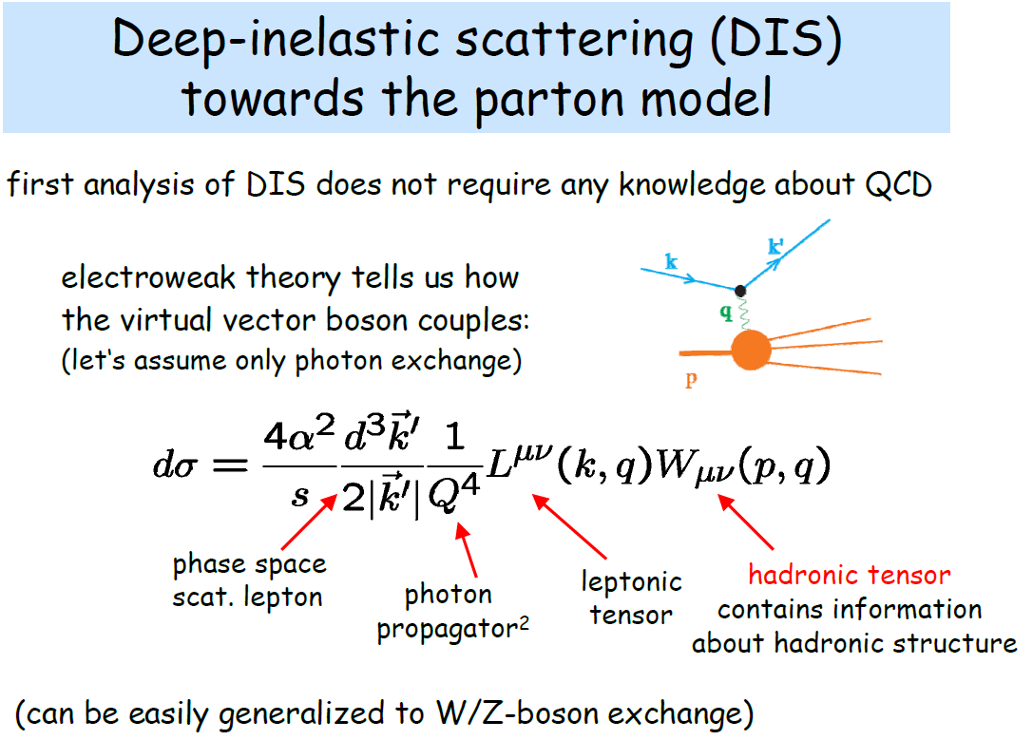

Slide 27
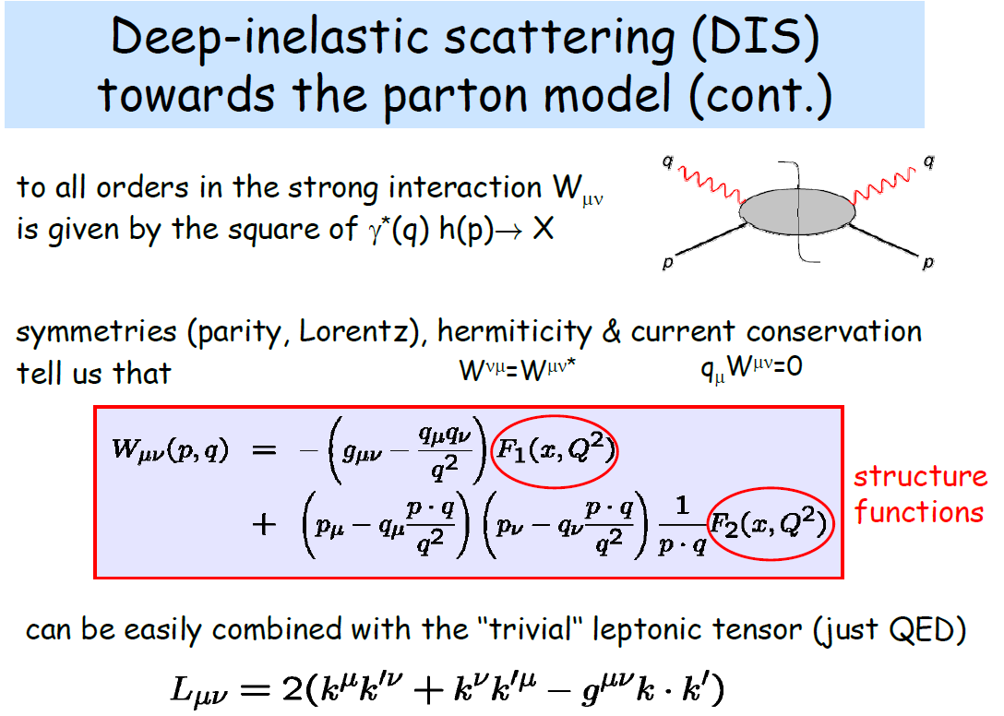

Slide 28
Variables of DIS

Slide 29
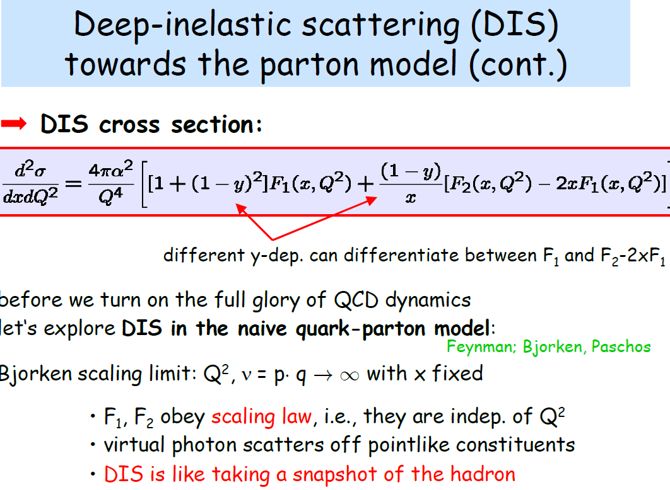

Slide 30

Bjorken scaling
Compared with the e-q case:

Slide 31
Parton model in IMF
No Transverse Momentum Here

Slide 32
Parton Distributions Functions

Slide 33
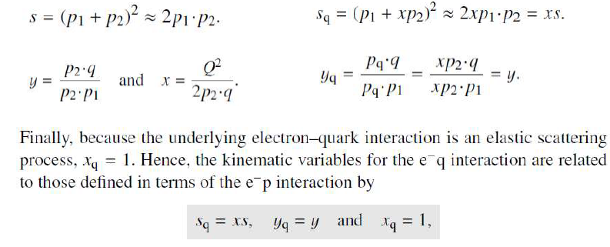




Parton Distribution Functions

Slide 34
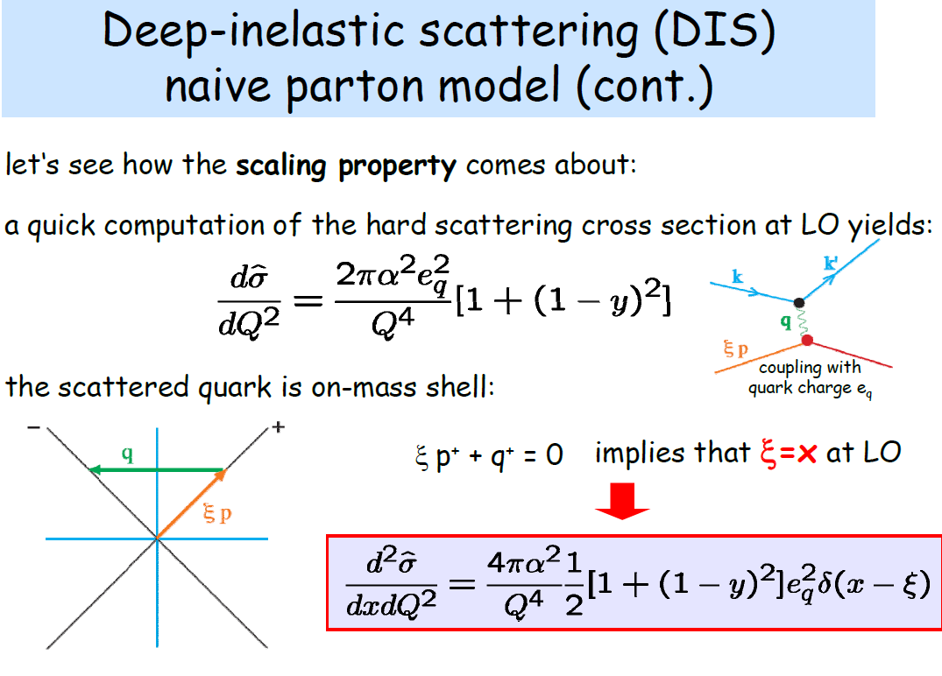
In the infinite momentum frame and in the Bjorken limit, one find the cross section of the e-p DIS is the incoherent sum of the cross section of the e-quark elastic scattering. The F(x) is related with the probability of finding a parton with xp

Slide 35
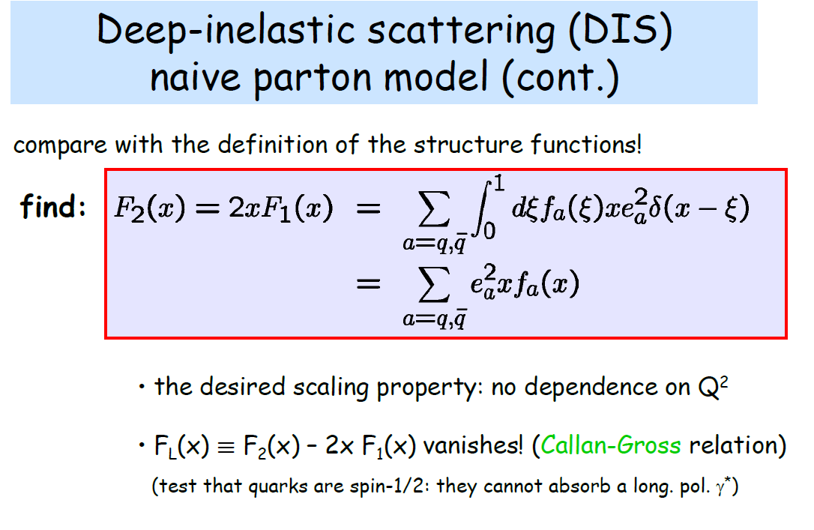
In the Bjorken limit and the infinite momentum frame, we can identify the sstructure function as the probability of find a parton carrying with the momentum xp inside the proton.

Slide 36
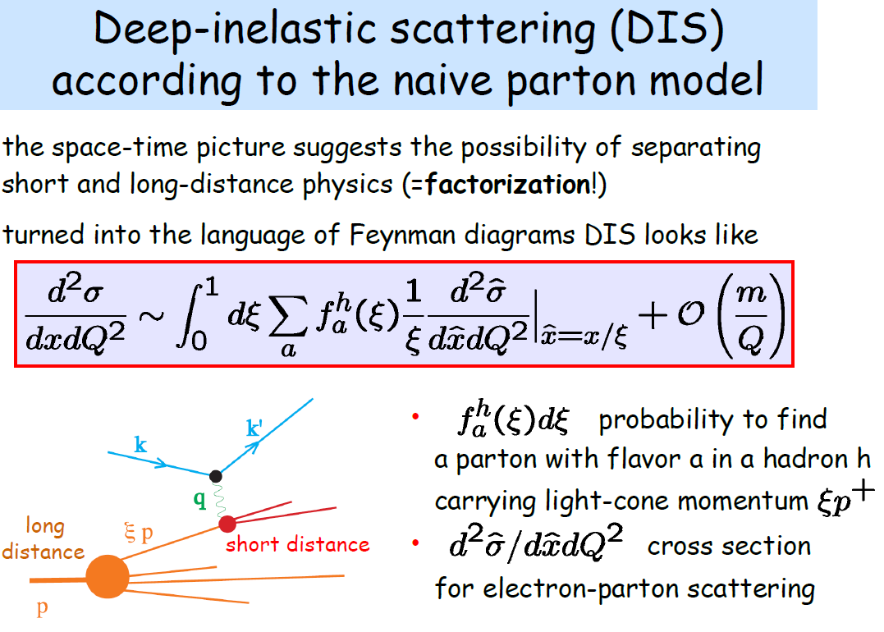
Parton model is not just a model. It is exact result of the QCD at LO in Bjorken limit and in the infinite momentum frame. In this situation, quark is free because the strong coupling constant is zero. This is the consequence of asymptotic freedom.

Slide 37

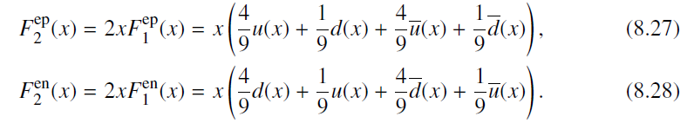
Parton distribution functions

Slide 38
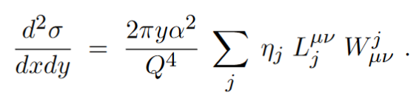
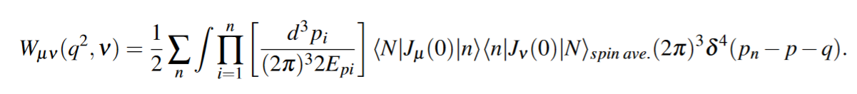
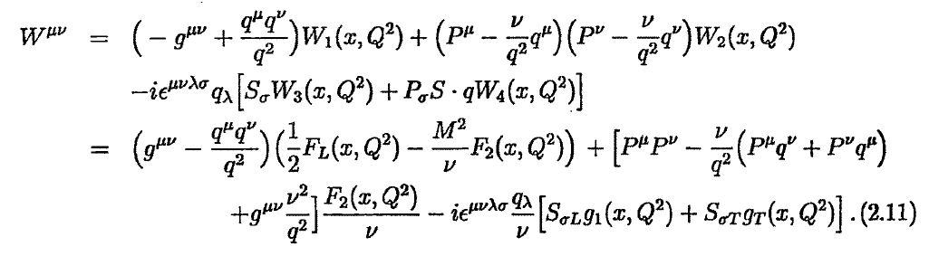
Parton Distribuitons Functions as matrix elements
2
PD
Hadronic Tensor:
Hadronic Tensor in term of the structure functions:

Slide 39
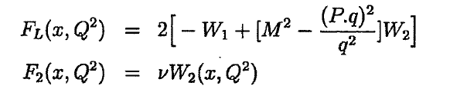

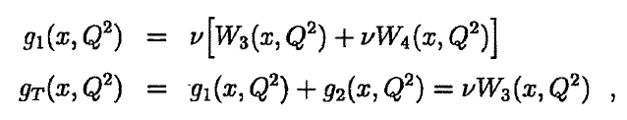

Parton Distribuitons Functions as matrix elements

Slide 40
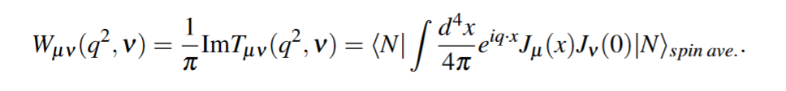
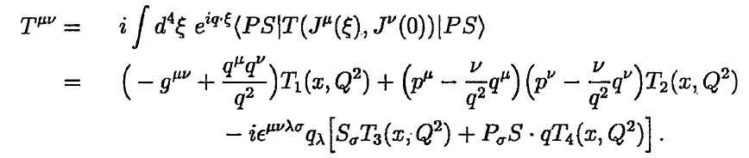
Parton Distribuitons Functions as matrix elements
2
PD
Forward Compton Amplitude:
Forward Compton Amplitude:

Slide 41
Operator Product Expansion

Slide 42
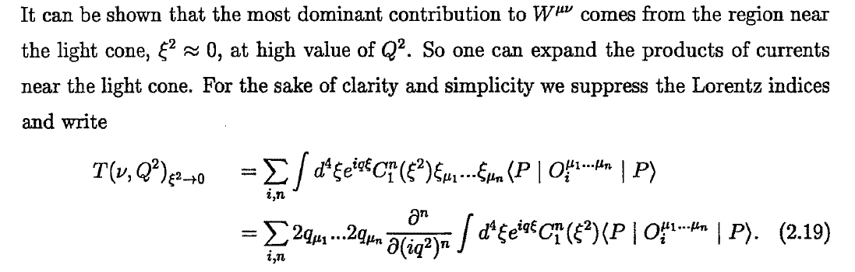
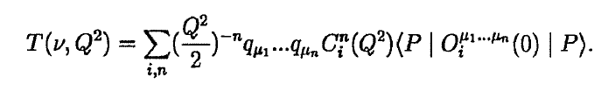

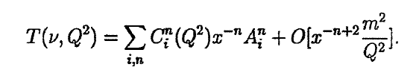
Parton Distribuitons Functions as matrix elements

Slide 43
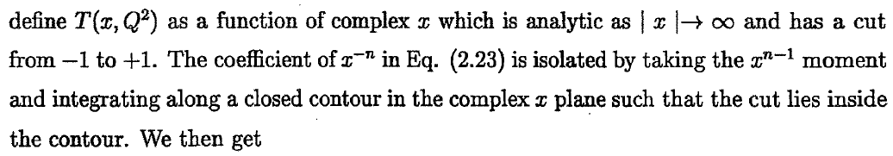


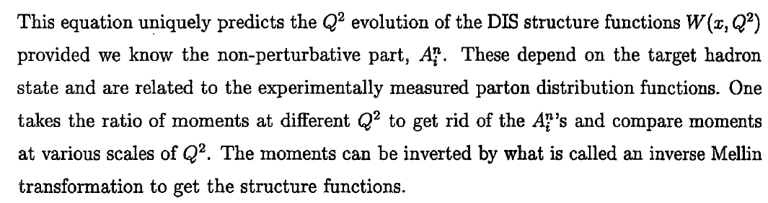

Slide 44
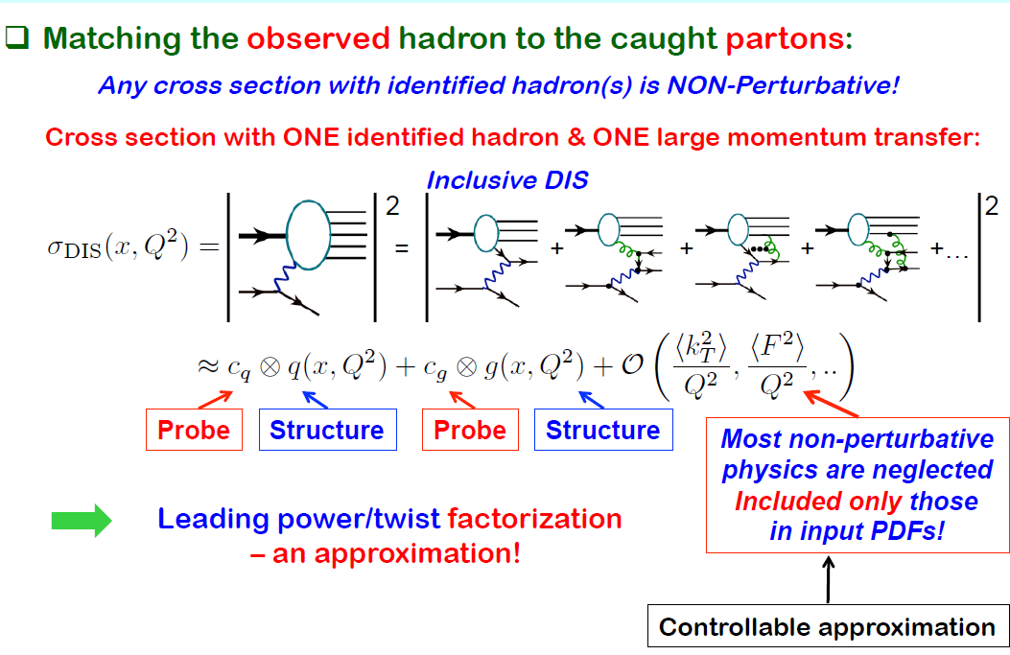
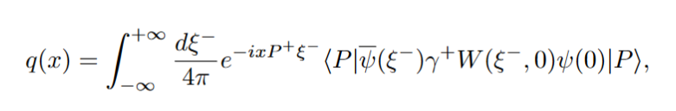



Slide 45
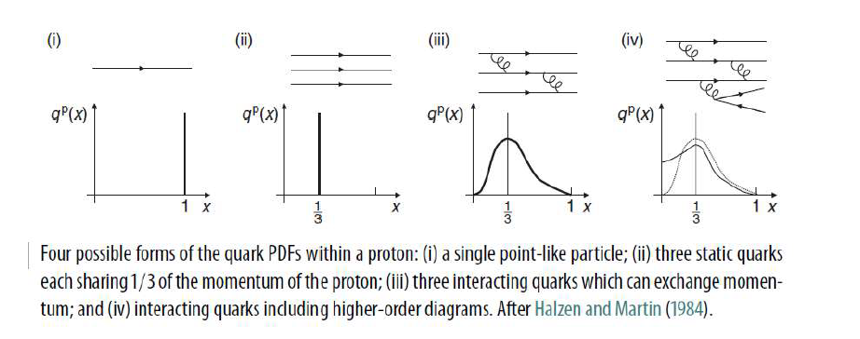

Slide 46
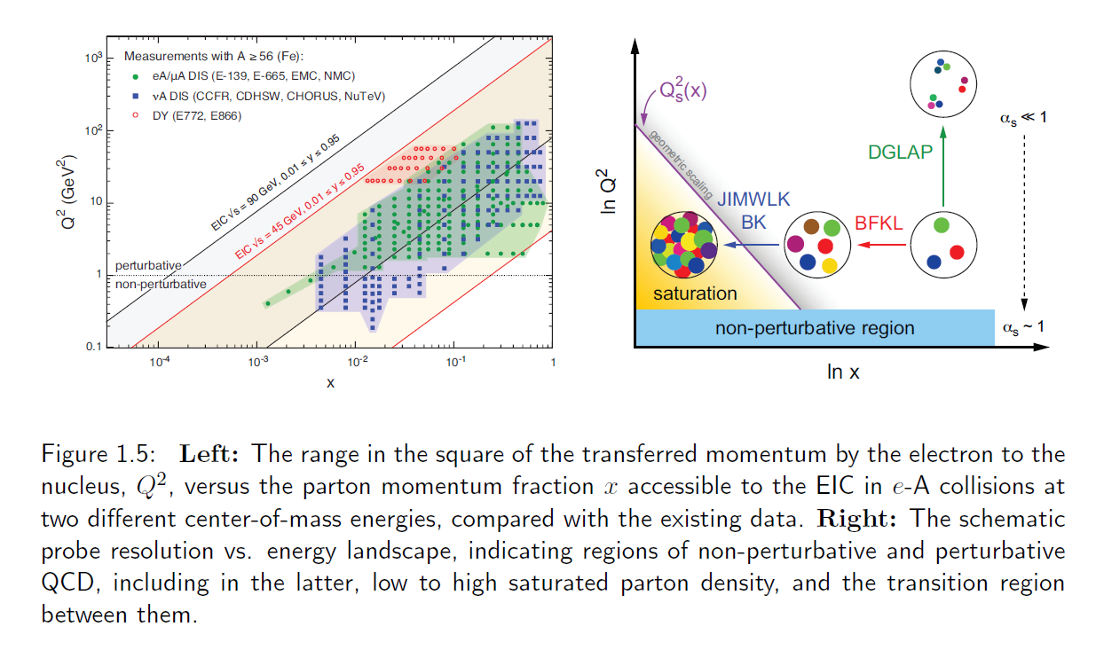
DGLAP evoltuion

Slide 48

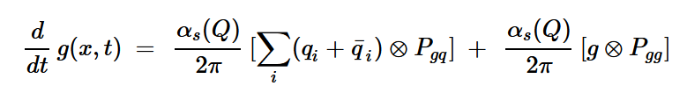

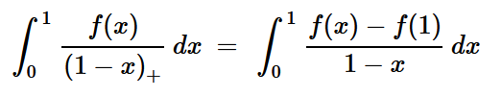
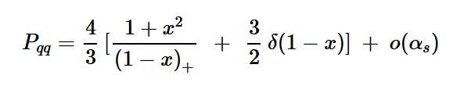
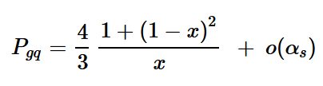


DGLAP evolution equation

Slide 49



Gluon PDFs

Slide 50

Wislon Link vanishes if the light-cone gauge is taken: A⁺=0

Slide 51




Parton Distribution Functions and Charges

Slide 52


Slide 53
Study of
Parton Distribution Functions in Electron-Ion Colliders (A)
Unpolarized Parton Distribution Functions
of proton at leading twist:
Valence quarks
Sea light quarks
Gluons

Slide 54


Unpolarized Proton PDFs in EIC
A large quantity of EIC data sensitive to the unpolarized PDFs will be supplied through inclusive neutral-current (NC) and charged-current (CC) DIS cross section measurements involving electron-DIS collisions with protons and light nuclei like the deuteron, ³He, ⁴He. In the latter case, measurements involving light nuclei could be used to determine proton PDFs, including a correction or an uncertainty that takes into account nuclear effects, or nuclear PDFs themselves .

Slide 55

HERA and EIC
The inclusive NC and CC DIS cross section measurements taken at the EIC are expected to cover a broad kinematic region significantly overlapping with that probed by HERA, although with instantaneous luminosities potentially three orders of magnitude larger. In comparison to their HERA counterparts, these probes of the x-Q² plane will stretch to much higher values of x, typically up to x ~ 0.6-0.7.

Slide 56
HERA and EIC
At suffciently high center-of-mass energies, this region is expected to be rather insensitive to higher-twist effects which can be significant at W² ~ 15-20 GeV²; these measurements will therefore cleanly constrain PDFs at relatively large x. At the same time, EIC coverage will also extend to softer values of Q², allowing a rich phenomenological program to examine power-suppressed corrections like the higher-twist effects. In comparison to previous DIS experiments, systematic uncertainties will be small, possibly not exceeding 1%; statistical uncertainties will be even smaller.

Slide 57

EIC will provide access to entirely new regions in both x and Q² in a
polarized e+p collider and e+A collider mode, such as the low-x region, providing critical information about the gluon-dominated regime.

Slide 58


Slide 59


Note that the ratios are not bound to be less than one since the inclusion of new data can change the relative strength of the flavor channels on the differential cross sections.

Slide 60

Positron beam to measure NC and CC is a relevant complementarity
that boosts the exploration of the nucleon flavor structure. In particular, the different
charge of the exchangedW+ boson is such that positron CC interactions are
capable of probing a unique combination of flavor currents inside the nucleon relative
to the case of an electron beam. This potentially offers significant additional
constraints on the d-type PDFs, further constraining the d/u ratio. Beyond this,
positron beams may also allow for access to other effects, such as the breaking of
the strange-antistrange symmetry, (s = ¯s), or parton-level charge-symmetry violation

Slide 61

Tagged DIS of the proton
Tagged DIS (TDIS) data offer a way to probe the structure of a barely off-shell neutron via semi-inclusive tagging of a slow spectator proton in
e + d→ e+ p + X events.
These measurements may complement those planned at JLab by extending their kinematic reach to higher energies.

Slide 62

Tagged DIS of the proton

Slide 63
SIDIS of the proton
SIDIS data offer a way to access PDFs for individual quark flavors, given that the valence parton content of the hadron detected in the final state relates to the fragmenting parton flavor. By means of EIC pseudo-data (for L = 10 fb⁻¹ and s^{1/2}=45 and 140 GeV) it was shown that the impact of pion production SIDIS data on up, down, anti-up and anti-down quark PDFs is moderate, as they are already very well determined. Conversely, the far less known strange PDFs could be constrained substantially by kaon production SIDIS data, particularly at low x. The analysis of SIDIS data requires the simultaneous knowledge of fragmentation functions (FFs) , whose determination will be concurrently improved at the EIC

Slide 64


Slide 65


Slide 66

Charm jets in the proton
CC DIS production of charm jets was observed depending on the input strange PDFs. This dependence suggests that charm-jet production may be a sensitive channel to constrain nucleon strangeness and disentangle patterns of SU(3) symmetry breaking in the light-quark sea.

Slide 67



Beside the parity conserving longitudinal double-spin asymmetry, the EIC will access also the parity-violating asymmetry. In the numerator of the latter observable, the parity-conserving contributions from the photon exchange and the vector part of the Z-boson exchange cancel exactly, leaving the dominant contribution from the interference between the photon exchange and the axial-vector part of the Z-boson exchange.

Slide 68


Slide 69


Polarized Proton PDFs

Slide 70
Extraction of gluon PDF

Slide 72
Study of
Parton Distribution Functions in Electron-Ion Colliders (B)
Polarized Parton Distribution Functions
of Prton:
Valence quarks
Sea light quarks
Gluons

Slide 73

Polarized beams and targets
The EIC will allow for the longitudinal polarization of both the colliding nucleon (and light nuclei) and lepton beams, i.e., along their direction of motion. This is a feature unique to the EIC, specifically designed to probe the longitudinal spin structure of the proton.

Slide 74



Polarized structure functions
g1(x,Q²) and g2(x,Q²) are polarized structure functions

Slide 75





DIS with polarized beam and target
Unpolaried DIS
Reduced Cross Secton
Probability interpretation:
Longitudinal Spin Asymmetry

Slide 76


Slide 77


Slide 78


SU(3) breaking effect

Slide 79

Gluon polarization
1st moment of the polarized gluon distribution
Operator definition

Slide 80


Slide 81


Slide 82




Determination of
Longitudinal double spin asymmetry
in pp collisions at RHIC
central

Slide 83

RHIC
Spin
program

Slide 84


Slide 85


Longitudinal spin “puzzle”

Slide 86




Jaffe-Manohar decomposition (1990)
Based on the canonical angular momentum tensor. Operators are NOT gauge invariant.
Partonic interpretation in the light-cone gauge

Slide 87
Ji decomposition (1997)
Improved (Belinfante) energy momentum tensor
← One can add a total derivative.
Further decomposition in the quark part possible (but not in the gluon part)

Slide 88
Jaffe-Manohar Sum
Because of gauge dependence, one might outright dismiss the physical relevance of Jaffe-Manohar sum rules. However, the gluon helicity contribution in the IMF is actually physical. This prompts speculations that the quark and gluon canonical OAM might be measurable as well under such condition.
Therefore, Jaffe and Manohar proposed a canonical spin sum rule in a nucleon state with P_{z} = ∞
The difference between two OAM’s, the so-called potential angular momentum, comes from two different ways to define gauge links in the Wigner functions, one of which can be interpreted as final-state interaction effects in scattering experiments。

Slide 89
Canonical OAM from the light-cone Wilson line
YH (2011)
Kinetic (Ji’s) OAM from the straight Wilson line
Ji, Xiong, Yuan (2012)
`Potential’ OAM
Torque acting on a quark
Burkardt (2012)

Slide 90


Slide 91



parity-violating single-longitudinal spin asymmetry

Slide 92



Polarized Sea Quark PDFs
While the parity-conserving asymmetry probes the sum of polarized quark and antiquark distributions, the parity violating asymmetry probes their difference. The combination of the two is one of the cleanest ways to separate quark and antiquark polarizations.

Slide 93

Polarized Sea Quark PDFs
Parity-conserving and parity-violating polarized DIS asymmetries are expected to expand the kinematic coverage of current DIS measurements significantly, roughly by one order of magnitude or more, down to x~ 10⁻⁴ and up to Q² ~1000 GeV² 。In addition to the increased sensitivity to quark, antiquark and gluon polarized PDFs at small values of x, the wide Q²-coverage of the EIC will probe scaling violations in the g1 polarized structure function, offering significant additional constraints on the gluon polarized PDF.

Slide 94


Slide 95


Gluon helicty PDFs in EIC
Concerning the gluon polarized PDF, processes such as photon-gluon fusion in the production of back-to-back partonic jets with large transverse momentum have been shown to be feasible at the EIC。Dijet longitudinal double-spin asymmetries could be measured with a moderate integrated luminosity; these could be used as a cross-check of the more stringent constraint on the gluon polarized PDF provided by the evolution of the polarized structure function g1.

Slide 96


Slide 97


Slide 98


Slide 99


Slide 100




Slide 101


Slide 102

Spin program in EIC

Slide 103
Study of
Parton Distribution Functions in Electron-Ion Colliders (C)
Polarized Parton Distribution Functions
of Prton at higher twist

Slide 104





Higher-Twist PDFs
longitudinally polarized electron beam and a transversely polarized target
target polarization pointing in a direction given by spherical polar angles θ * and φ*relative to the direction of the momentum transfer vector q

Slide 105









Higher-Twist PDFs
target polarization is either along (⇑) or perpendicular to (⇒) the beam direction,

Slide 106









Color Polarizabilities d₂
Wandzura-Wilczek (WW)
Approximation

Slide 107

Higher-Twist PDFs

Slide 108
Study of
Parton Distribution Functions in Electron-Ion Colliders (D)
Unpolarized Parton Distribution Functions
of mesons :

Slide 109

Pion as Janus
Pion has two faces:
As the Goldstone Boson of Chiral symmetry which is supposed to be broken spontaneously. Its interactions are determined by dynamic Chrial Symmetry Breaking.
Another face is the bound state of quark-antiqaurk pair. In this sense, pion is the most simple case.

Slide 110

Parton Content of Pion
The quark content of the pion is most simple if the isospin symmetry is assumed.
There is no stable pion target, therefore one cannot extract the information of parton distributions of valence quarks by DIS as the nucleon.
The gluon content of the pion is unknown which is interesting object by itself since it will shed light on the role of gluon in the dynamics chiral symmetry breaking.

Slide 111
Three ways are all necessary!
Dell-Yan
DIS
...
Parametirzations
GRS,SMAS
Global fit
JAM
Lattice QCD
Perturbative QCD
NJL type Models,
Dyson-Schwinger equation

Slide 112



Drell-Yan Process
h_{A}=π⁺, h_{B}=p
Valence anti-d quark (pion) x Valence d quark (proton)
Valence u quark (pion)x Sea anti-u quark (proton)
Sea anti-u quark (pion)x Valence quark u quark (proton)
Sea d quark (pion)x Sea anti-d quark (proton)
h_{A}=π⁻, h_{B}=p
Valence anti-u quark (pion) x Valence u quark (proton)
Valence d quark (pion)x Sea anti-d quark (proton)
Sea anti-d quark (pion)x Valence quark d quark (proton)
Sea u quark (pion)x Sea anti-u quark (proton)

Slide 113


Drell-Yan Process

Slide 114


Valence qaurk of pion

Slide 115

Previous Study on β_{v}
Some people even claimed that if β≠2 then the QCD is in danger!
Well, it is exaggration for sure...

Slide 116
Update of study on β_{v}
arXiv:2108.05822 JAM collaboration

Slide 117
Various Schemes of resummation
arXiv:2108.05822 JAM collaboration

Slide 118
Electroproduction of neutron

Slide 119


Global Fit of Pion PDFs
Phys.Rev.Lett. 121 (2018) 15, 152001
Jefferson Lab Angular Momentum
(JAM) Collaboration
Data:E615 (DIS) 61 points
NA10 (DIS) 56 points
H1 (LN) 58 points
ZEUS (LN) 50 points

Slide 120

Global Fit of Pion PDFs
Phys.Rev.Lett. 121 (2018) 15, 152001
Jefferson Lab Angular Momentum
(JAM) Collaboration
Data:E615 (DIS)
NA10 (DIS)
H1 (LN)
ZEUS (LN)

Slide 121




Pion and Kaon: SU(3) symmetry
Kaons are also Goldstone bosons of DCSB in QCD.

Slide 122
Parton content of Kaon
Kaon contains one valence quark with strangness, this is interesting since there is no other place one can study the strange valence quark.
Although one does know there is SU(3) breaking among the sea quark of the proton, but there are still many mystery about SU(3) breaking there.

Slide 123



Three ways becomes one!
Very little
data about Kaon
PDFs
No data, No fitting
Lattice QCD
Perturbative QCD
NJL type Models,
Dyson-Schwinger equation

Slide 124
From non-strange to strange
Confirm
Pion PDFs
Global fit, parametrizations,
experimental Data
Any Theoretical ways which can extend the result of pions to kaons such as lattice QCD,
chiral-related models, constituent models, Dyson-Scwinger equations, and something else in the future.....
Predict
Kaon PDFs.
Future experimental
possibilities.
SU(3) breaking

Slide 125

PDFs of mesons in EIC
h=π,K
P’=n,Λ

Slide 126

PDFs of Pions and Kaons

Slide 127

PDFs of Pions and Kaons
Science questions related to pion and kaon structure and the understanding of the EHM mechanism accessible at the EIC, with the key measurements and some key requirements listed.

Slide 128


Slide 129



Slide 130
Study of
Traverse-Momentum-Dependent Parton Distribution Functions in Electron-Ion Colliders

Slide 131

Transverse-Momentum-dependent Parton distributions

Slide 132

Transverse-Momentum-dependent Parton distributions

Slide 133

Transverse-Momentum-dependent Parton distributions

Slide 134

Transverse-Momentum-dependent Parton distributions
In more general term, one can define the coorelation along with the certain arbitrary light-like vector n , n²=0. Similarly one can define the gluon ones.

Slide 135

Leading Twist TMDs of quark

Slide 136


Slide 137



Transverse-Momentum-dependent Parton distributions

Slide 138









Transverse-Momentum-dependent Parton distributions
Leading Twsit TMDs:

Slide 139


Slide 140



Transverse-Momentum-dependent Parton distributions

Slide 141

Extraction of TMDs

Slide 142


Fragmentation functions

Slide 143

Properties of TMDs and FF

Slide 144


Slide 145


Slide 146


Slide 147


Slide 148

Semi-inclusive DIS

Slide 149


Slide 153
Study of
Traverse-Momentum-Dependent Parton Distribution Functions in Electron-Ion Colliders (A)
Unpolarized SIDIS:
Valence quark unpolarized TMDPDF
Unpolzaried FF
Valence quark Boer-Mulder functions

Slide 154


Slide 155







Unpolarized SIDIS

Slide 156


Slide 157


Slide 158




Slide 159
Study of
Traverse-Momentum-Dependent Parton Distribution Functions in Electron-Ion Colliders (B)
Polarized SIDIS:
Valence quark Sivers TMDPDF
Collins TMDFF

Slide 160


Slide 161

Measure the single-spin asymmetry one can separate
the Sivers and Collins functions.

Slide 162

Sivers and Collins

Slide 163

Sivers and Collins

Slide 164

Sivers and Collins

Slide 165
TMD Evolution and EIC
An essential aspect of TMDs concerns their scale-dependence (evolution) as predicted in QCD, which is considerably more involved than the evolution of the 1D PDFs. There is, therefore, substantial interest in a quantitative understanding of the TMD evolution. The EIC will be ideal for such studies, complementing the high precision data becoming available from JLab at larger values of x. It allows to explore SIDIS observables over an extensive range in Q² while covering transverse momenta of the final-state hadrons over a wide range from low (nonperturbative) to high (perturbative) values.

Slide 166


Slide 167


Slide 168


Slide 169


Slide 170

Sivers in SIDIS and DY

Slide 171
TMDs for EIC
Looking at the future of TMD physics, the EIC will be of paramount importance. At the EIC, the main access to TMDs will be through semi-inclusive DIS. What will make the EIC a unique accelerator is the fact that it will be colliding polarized electrons (and potentially positrons) with polarized protons and light nuclei at various energies and with unprecedented luminosity for a lepton-hadron collider. Together this will yield the precision and the spin degrees of freedom necessary to pursue an ambitious physics program driven by the exploration of the spin structure and the acquisition of new information on multi-dimensional tomographic images of protons and nuclei.

Slide 172
TMDs in EIC
In the future EIC era, the possibility to produce precise theoretical predictions is going to be crucial in the study of future experimental data, especially considering the foreseen luminosity of the new accelerator, coupled with its energy variability and reach.The EIC will certainly contribute to better determine TMDs, as it will provide very precise measurements in
kinematic regions where at the present moment no data are available: for example, EIC data will be able to cover the before mentioned large gap between the low-energy fixed-target experiments and the high-energy experiments at the LHC.

Slide 173


Slide 174
Study of
Traverse-Momentum-Dependent Parton Distribution Functions in Electron-Ion Colliders (C)
Polarized SIDIS:
Transversity
Collins TMDFF

Slide 175

Collins

Slide 176
Transversity: least known leading twist structure function

Slide 177


How to measure Transversity?

Slide 178


Slide 179

Collins and Transversity

Slide 181

Extended dihadron fragmentation function

Slide 182


Extended dihadron fragmentation function

Slide 183
Extended dihadron fragmentation function

Slide 185

A. Courtoy, A.Bacchetta, M.Radici and A.Bianconi,
PRD 85, 114023 (2012)

Slide 186


Slide 187


Slide 188
Study of
Traverse-Momentum-Dependent Parton Distribution Functions in Electron-Ion Colliders (D)
Polarized SIDIS:
Gluon Sivers TMDPDF

Slide 189


Slide 190


Slide 192


Slide 193


Slide 194


Slide 195


Slide 196


Slide 197


Slide 198
TMDs in EIC
While the current knowledge about the Sivers function in the valence region still has considerable uncertainties, the situation is even worse for sea quarks and gluons where hardly any experimental information exists. At the EIC, the gluon Sivers function can be addressed through transverse single-spin asymmetries for the production of nearly back-to-back pairs of jets or heavy-flavor hadrons. We note that, qualitatively, the above discussion of the Sivers function applies also to the other TMDs. Generally, the EIC has transformative potential in the field of the nucleon’s 3D structure in momentum space.

Slide 199


Slide 200

Study of
Generalized Parton Distribution Functions in Electron-Ion Colliders

Slide 201


Slide 202

Generalized Parton Distributions

Slide 203


Slide 204

DGLAP and ERBL region

Slide 205
Generalized Parton Distributions
Form factors: matrix elements of the current operators
Integrate over the bjorken variable x:

Slide 206
Higher moment of GPDs

Slide 207

Generalized Parton Distributions

Slide 208



Slide 209


Slide 210


Impact Parameters Distributions

Slide 211


Slide 212

Generalized Parton Distributions

Slide 213


Slide 214


Slide 215


Slide 216

DVCS and GPDs

Slide 217


Slide 218
with
F₁H dominance with a proton target
F₂E dominance with a neutron target (F1<<) (studied at JLab)
very attractive for Ji’s sum rule study

Slide 219


Slide 220


Slide 221




Asymmetry and GPDs

Slide 222


Slide 223


Slide 224


Slide 225


Slide 226


Slide 227




GPD and mechanical property of the nucleon

Slide 228




Pressure inside the ncuelon
Dispersion Relation:

Slide 229





Slide 230


Slide 231
DVCS for EIC
Our knowledge of GPDs from DVCS is currently limited and is based on fixed target experiments at intermediate to high-x or on the HERA collider measurements at low-x. The polarized beams and higher luminosity at EIC, along with forthcoming data from JLab at 12 GeV, will make a very significant impact on those measurements. It is anticipated that measurements made for protons in the range 0.04 < t < 1.5 GeV² will enable maps of parton distributions all the way down to 0.1 fm . Such exclusive measurements performed on nuclei will enable us to understand the transverse quark and gluon distributions within.

Slide 232


Slide 233

GPDs in EIC

Slide 234


Slide 235


Slide 236

Conclusion: Fire!

