Slide 1
Mini-review of PDFs and TMDs (experimental aspect)
Wen-Chen Chang
Institute of Physics, Academia Sinica

Slide 2
Mass/Spin Decomposition of Proton (Lattice QCD)
PRL 116, 252001 (2016)
PRL 119, 142002 (2017)
PRL 119, 142002 (2017)
Mass
Spin
Intrinsic spin
Orbital motion
Quark mass
Gluon energy
Quark energy
Trace Anomaly
Can the origin of nucleon mass and spin be understood by its partonic structure?
Notes:
For example, when we go to the decomposition of proton mass, the well-known Higgs mechanism only contributes about 16% via the Quark mass. The majority of proton mass comes from the dynamics of quarks and gluons inside the bound system. Another significant 20% contribution called “trace anomaly” is a quantum field effect due to the symmetry breaking. For the spin decomposition, there are strong flavor dependence of up, down and strange quarks in terms of their contributions of intrinsic spin and orbital motions.

Slide 3
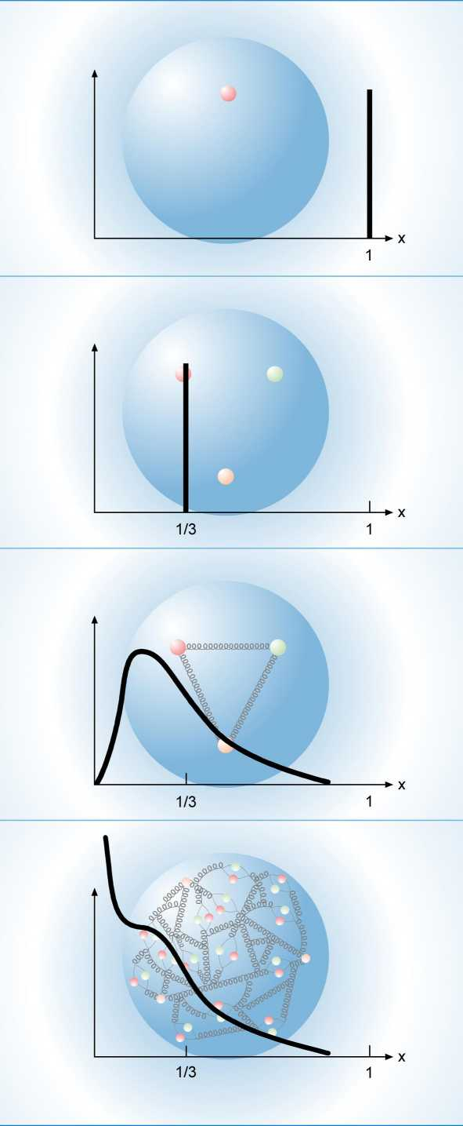
Multi-dimensional Partonic Structures
http://www.int.washington.edu/PROGRAMS/17-3/

Slide 4
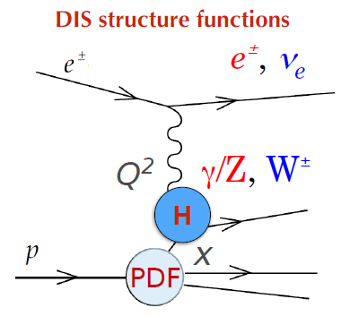
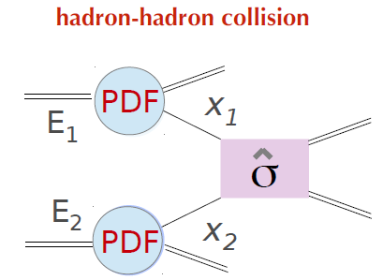
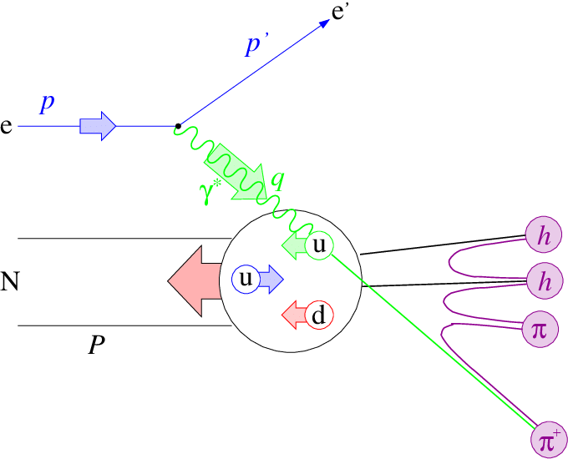
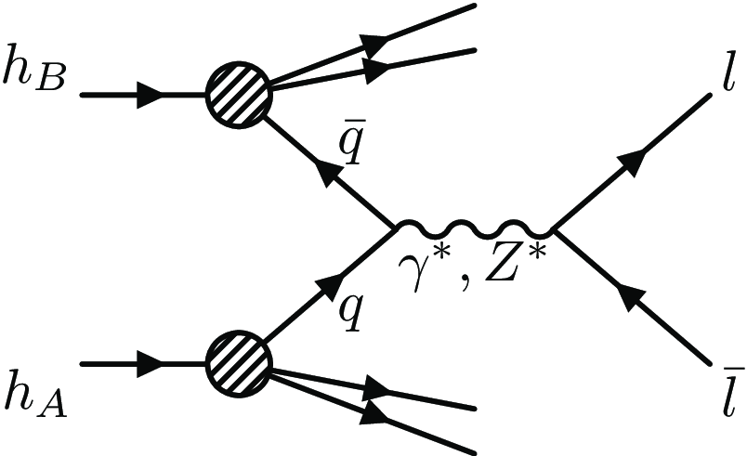
Experimental Approach
DIS
Hadron-hadron
Jets, heavy quarks, $γ$
Semi-inclusive DIS
Drell-Yan
quark flavor sensitive

Slide 5
Unpolarized PDF Analysis Eur. Phys. J. C (2009) 63:189
DIS, Drell-Yan, Jets

Slide 6
https://arxiv.org/abs/2001.07722

Slide 7
Unpolarized and Polarized PDFs
Much larger uncertainties!
https://arxiv.org/abs/2001.07722

Slide 8
Polarized Sea
https://arxiv.org/abs/2001.07722

Slide 9
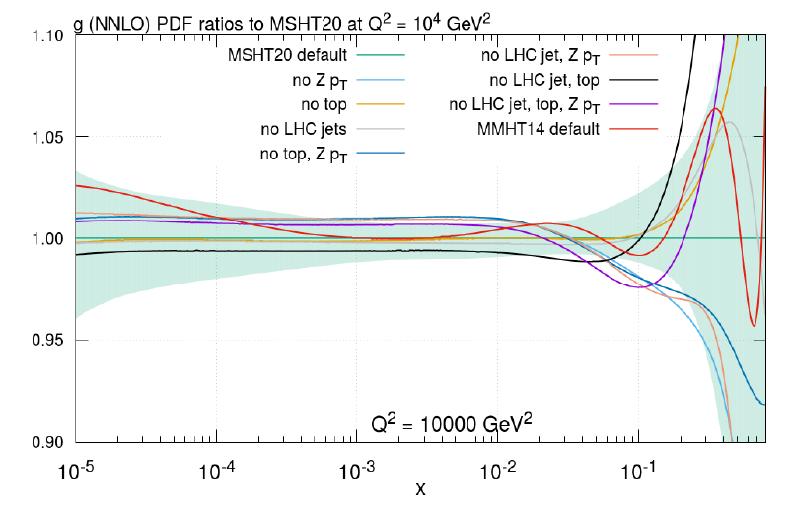
Gluons
NNPDF 4.0: https://arxiv.org/abs/2109.02653
single-inclusive jet
dijets
MHST20: https://arxiv.org/abs/2012.04684
Top pair

Slide 10
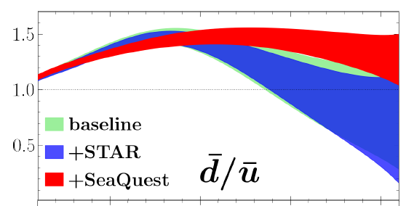
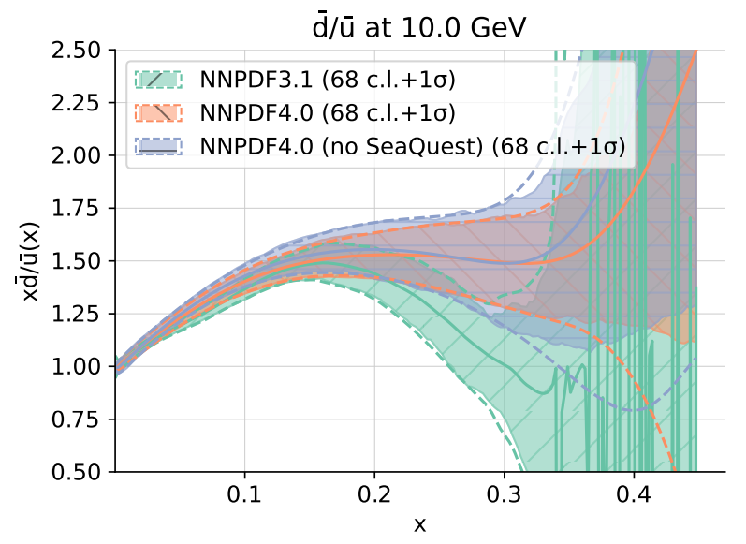
Light Sea Asymmetry
JAM (NLO) https://arxiv.org/abs/2109.00677
LHC gauge boson data provide constrains of $\overline{d}/\overline{u}(x)$.
NNPDF4.0 (NNLO) https://arxiv.org/abs/2109.02653

Slide 11
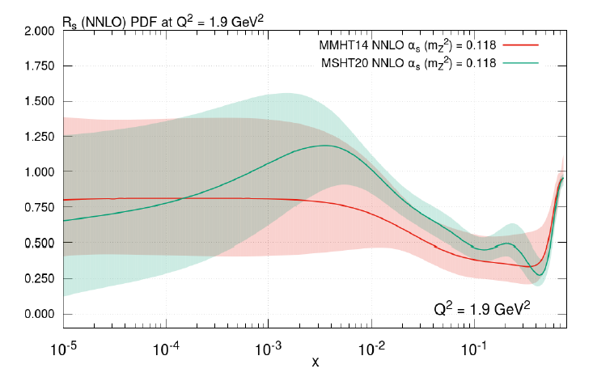
Strange Sea
Is SU(3) symmetry valid for light sea quarks?
LHC: W, Z, V+jet
https://arxiv.org/abs/2112.11266
MHST20: https://arxiv.org/abs/2012.04684

Slide 12
Polarized Gluons and Quarks
Double longitudinal spin asymmetries A_{LL}
Much larger uncertainties, in comparison with the unpolarized PDFs!
JAM: https://arxiv.org/abs/2201.02075
Not sensitive to the sign of $Δg$!

Slide 13
Uncertainties of EIC for DIS
EIC Yellow report: https://arxiv.org/abs/2103.05419

Slide 14
Unpolarized PDFs
Relative uncertainties ratios with and without EIC
“Note that the ratios are not bound to be less than one since the inclusion of new data can change the relative strength of the flavor channels on the differential cross sections.”
Improved valence quarks and gluon at small x.
EIC Yellow report: https://arxiv.org/abs/2103.05419
Notes:
Note that the ratios are not bound to be less than one since the inclusion of new data can change the relative strength of the flavor channels on the differential cross sections.

Slide 15
SIDIS: Unpolarized Sea
Improved sea quarks with SIDIS.
EIC Yellow report: https://arxiv.org/abs/2103.05419

Slide 16
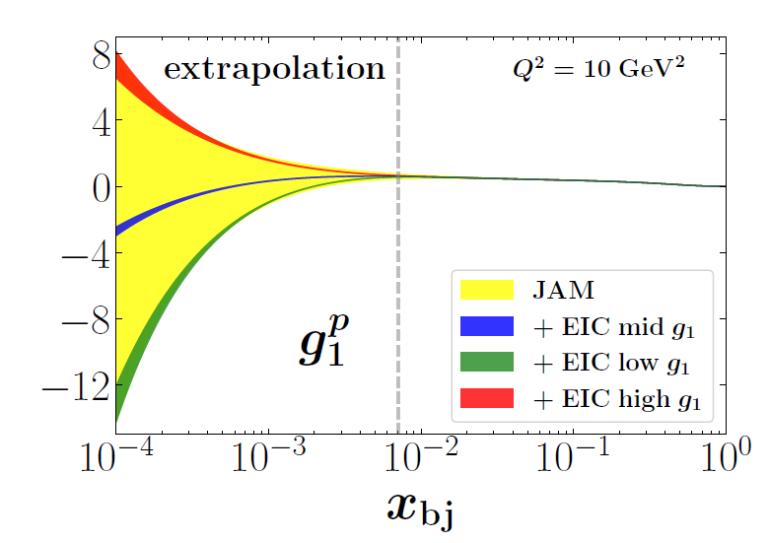
Polarized Gluon and Quark
Significantly improved uncertainties of gluons and quarks helicities
EIC Yellow report: https://arxiv.org/abs/2103.05419

Slide 17
SIDIS: Polarized Sea
Significantly improved uncertainties of sea quarks helicities
EIC Yellow report: https://arxiv.org/abs/2103.05419

Slide 18
Room for Orbital Angular Momentum (OAM)
Significantly improved constraints of OAM contribution
EIC Yellow report: https://arxiv.org/abs/2103.05419

Slide 19
Multi-dimensional Partonic Structures
http://www.int.washington.edu/PROGRAMS/17-3/

Slide 20
State-of-Art pQCD Calculations PRL, 128, 252001 (2022)
Why TMDs?
At large pT, fixed-order pQCD describes the data very well.
At small pT, pQCD calculation fails due to non-perturbative QCD effect.
<5% deviation for pT>5 GeV!

Slide 21
Unpolarized Quark Transverse Momentum distributions $f_{1}^{q}(x,k_{T}^{2})$
SIDIS
FF
Difficult to separate $k_{⊥}$ and $P_{⊥}$ in SIDIS only.
Drell-Yan

Slide 22
Parameterizations of TMDs
a: parton flavor
FF
Bacchetta et al., https://arxiv.org/abs/1703.10157

Slide 23
SIDIS
HERMES: PRD 87, 074029 (2013) [arXiv:1212.5407]

Slide 24
Fixed-Target Drell-Yan
800 GeV
E615, Phys. Rev. D43, 2815 (1991)
E288, Phys. Rev. D23, 604 (1981)

Slide 25
Collider Z Production
Bacchetta et al., https://arxiv.org/abs/1703.10157

Slide 26
Global Analysis of $f_{1}^{q}(x,k_{T}^{2})$
FFs for SIDIS: NLO DSEHS for $π$; LO DSS for K.
$\left\langle P_{⊥}^{2}\right\rangle$ and $\left\langle k_{⊥}^{2}\right\rangle$ are correlated in the extraction.
average values
arXiv:1309.3507
arXiv:1003.2190
arXiv:1312.6261
arXiv:1312.6261
arXiv:1312.6261
arXiv:1312.6261
arXiv:1401.5078
Signals of intrinsic $\left\langle k_{⊥}^{2}\right\rangle$ in DY and SIDIS processes. No flavor dependence.
Bacchetta et al., https://arxiv.org/abs/1703.10157

Slide 27
Global Analysis of $f_{1}^{q}(x,k_{T}^{2})$
Drell-Yan ONLY
https://arxiv.org/abs/1912.07550

Slide 28
Leading-Twist Transverse-momentum Dependent Parton Density Function (TMDs)
Quark, Gluon Nucleon | U | L | T
U | number density $$f_{1}^{q,g}(x,k_{T}^{2})$$ |  | Boer-Mulders $$h_{1}^{⊥q,g}(x,k_{T}^{2})$$
L |  | Helicity $$g_{1L}^{q,g}(x,k_{T}^{2})$$ | worm-gear L $$h_{1L}^{⊥q,g}(x,k_{T}^{2})$$
T | Sivers $$f_{1T}^{⊥q,g}(x,k_{T}^{2})$$ | Kotzinian-Mulders worm-gear T $$g_{1T}^{⊥q,g}(x,k_{T}^{2})$$ | Transversity $$h_{1}^{q,g}(x,k_{T}^{2})$$ Pretzelosity $$h_{1T}^{⊥q,g}(x,k_{T}^{2})$$
spin of the nucleon
spin of the parton
$k_{T}$ of the parton

Slide 29
Transverse Single Spin Asymmetry
Left/Right Asymmetry
https://arxiv.org/abs/1510.06783

Slide 30
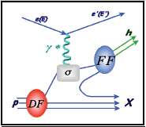
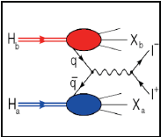
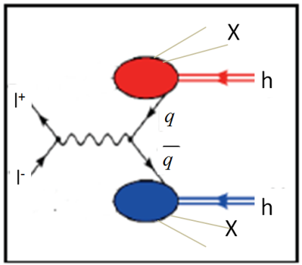
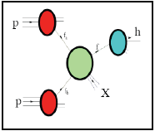
Accessing TMDs
SIDIS: ep → ehX
Drell-Yan: pp → e⁺e⁻X
Dihadron in e+e-: e⁺e⁻ →h₁ h₂ X
Hadron production in pp: pp → hX

Slide 31
Collins Azimuthal Asymmetry off Polarized Protons
PRL 94, 012002 (2005) [hep-ex/0408013]
PLB 693, 11 (2010) [arXiv:1006.4221]

Slide 32
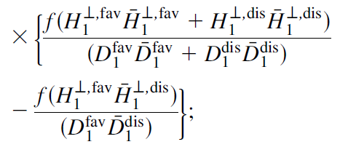
Belle: Two-pion Azimuthal Correlation
$H_{1q}^{⊥h}$:Collins FFs

Slide 33
Extraction of Transversity and Collins FFs from SIDIS, Belle and Barbar data
Transversity
Collins FFs
Favored
u quark
d quark
Unfavored
Anselmino et al., PRD 92, 114023 (2015) [arXiv:1510.05389]
Signals of transversity and Collins FFs s in SIDIS and ee processes.
Flavor dependence.

Slide 34
Nucleon Tensor Charge from Extracted Transversity
Tensor charges:
1 : Extractions from global fits (using two different Collins FF parameterizations)
2-10: Predictions from various models (including LQCD)
Discrepancy could be caused by neglecting sea quark transversity in the fit
Tensor charges are smaller than axial charge.
Δu = 0.787
Δd = −0.319

Slide 35
TMD Sivers Function
Unpolarized proton
Transversely-polarized proton
$$k_{y}$$
$$k_{y}$$
$$k_{x}$$
$$k_{x}$$
A nonzero Sivers function is considered to be strong evidence for the presence of quark orbital angular momentum.

Slide 36
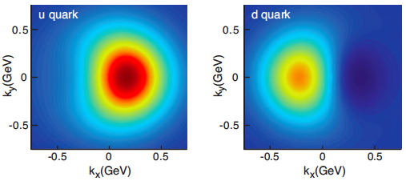
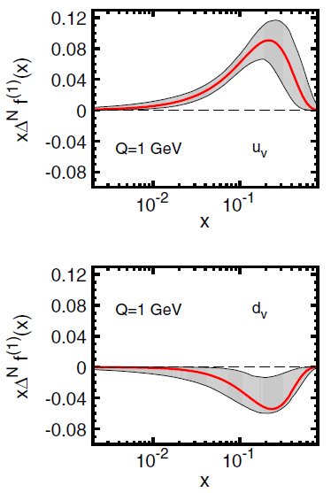
Nonzero Sivers Asymmetries from SIDIS
COMPASS, PLB 744 (2015) 250
Sivers Functions
Signals of Sivers functions in SIDIS.
Flavor dependence.
PRD 86, 014028 (2012) [arXiv:1204.1239]

Slide 37
Sivers Asymmetry in Drell-Yan:
$$\frac{dσ^{LO}}{d^{4}qdΩ}=\frac{α_{em}^{2}}{Fq^{2}}{\hat{σ}}_{U}^{LO}\left\{\left(1+D_{\left[\sin^{2}{θ}\right]}^{LO}A_{U}^{\cos{2φ}}\cos{2φ}\right)+\left|{\vec{S}}_{T}\right|\left[A_{T}^{\sin{φ_{s}}}\sin{φ_{s}}+D_{\left[\sin^{2}{θ}\right]}^{LO}\left(A_{T}^{\sin\left(2φ+φ_{s}\right)}\sin\left(2φ+φ_{s}\right)+A_{T}^{\sin\left(2φ−φ_{s}\right)}\sin\left(2φ−φ_{s}\right)\right)\right]\right\}$$
COMPASS, PRL 119 (2017) 112002

Slide 38
Unpolarized TMDs at EIC (SIDIS)
Unpolarized TMD of $u$
TMD FF of $u→π^{+}$
Significantly Improved uncertainties of unpolarized TMDs at small x
EIC Yellow report: https://arxiv.org/abs/2103.05419

Slide 39
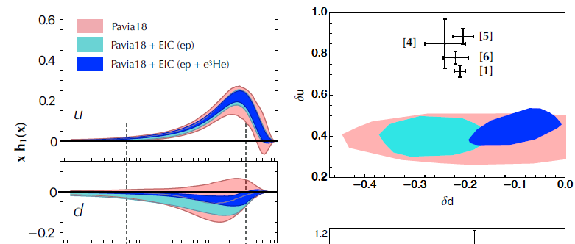
Polarized TMDs at EIC (SIDIS)
Significantly Improved uncertainties of transversity
Transversity
Collins FF
Transversity
Tensor charge
EIC Yellow report: https://arxiv.org/abs/2103.05419

Slide 40
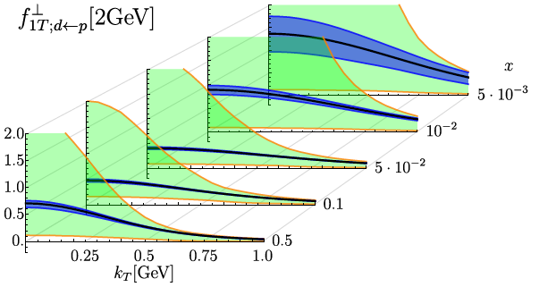
Quark Sivers at EIC (SIDIS)
Uncertainty with EIC
Current uncertainty
Significantly improved uncertainties of quark Sivers
EIC Yellow report: https://arxiv.org/abs/2103.05419

Slide 41
What EIC could help PDFs & TMDs MOST?
Unpolarized Nuclear PDFs (DIS)
Sea quark and gluon at small x
Polarized Nucleon PDFs (SIDIS)
Quark, sea quark and gluon at small x
TMDs (SIDIS)
Transversity and Sivers
Pion and Kaon PDFs (tagged-DIS)
Trace anomaly (threshold Jpsi and Upsilon photoproduction)

Slide 42
Review Articles
Unpolarized PDFs:
https://arxiv.org/abs/1709.04922
https://arxiv.org/abs/1905.06957
https://arxiv.org/abs/2001.07722
Polarized PDFs:
https://arxiv.org/abs/1209.2803
https://arxiv.org/abs/1807.05250
TMDs:
https://arxiv.org/abs/1507.05267
https://arxiv.org/abs/1510.06783
https://arxiv.org/abs/1607.02521
https://arxiv.org/abs/2001.05415
GPDs:
https://arxiv.org/abs/hep-ph/0106012
https://arxiv.org/abs/hep-ph/0307382
https://arxiv.org/abs/1303.6600
https://arxiv.org/abs/1602.02763

