Slide 1
EPIC ZDC EMCal design
Yu-Siang Xiao (蕭宇翔)
2026 04/01

Slide 2
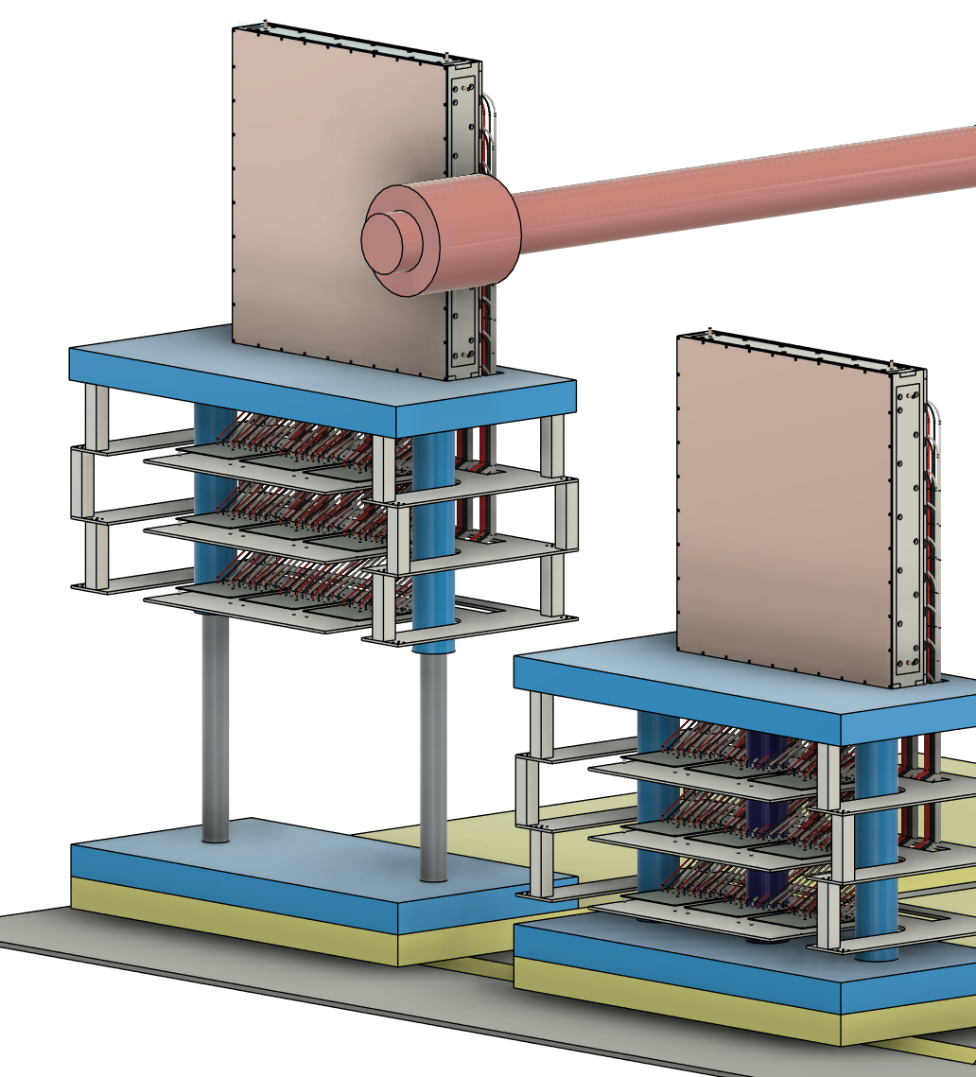
ZDC EMCal Design
8.87
59
Unit: cm
The EMCal is shown with the following specifications:
PbWO₄ crystal array：
Crystal size 20.5 mm × 20.5 mm × 7.0 mm (7.87 X₀ )
Allow an additional ~0.5mm for the reflector and crystal wrapping
One Super Module (SM)：9 × 9 crystals
Allow 1mm of stainless for the SM wrapping.
SM size : (21.0×9+2)² cm²
Full array: 3x3 SM = (3×191)² cm²
Total number of crystal modules： 3x3x3x3 = 729
SiPM： S14160-3015PS_HAMAMATSU
16 MPPC channels for each crystal
Total number of MPPC channels： 11,664
Support and Cooling design: Aluminum + copper tube + copper board.
Side part: Use 8 mm thick aluminum plates
Coolant is circulated through copper tubing in aluminum plates .
Front part: Cover by a 3 mm copper plate.
Cable routing：
The cables go downward and pass through the table
Max length ~ 95 cm
59
p/A beam pipe
stage
39
EMCal
6
90
45
170
88
Readout hubs
6
6
Operation position
Maintenance position
2.5

Slide 3
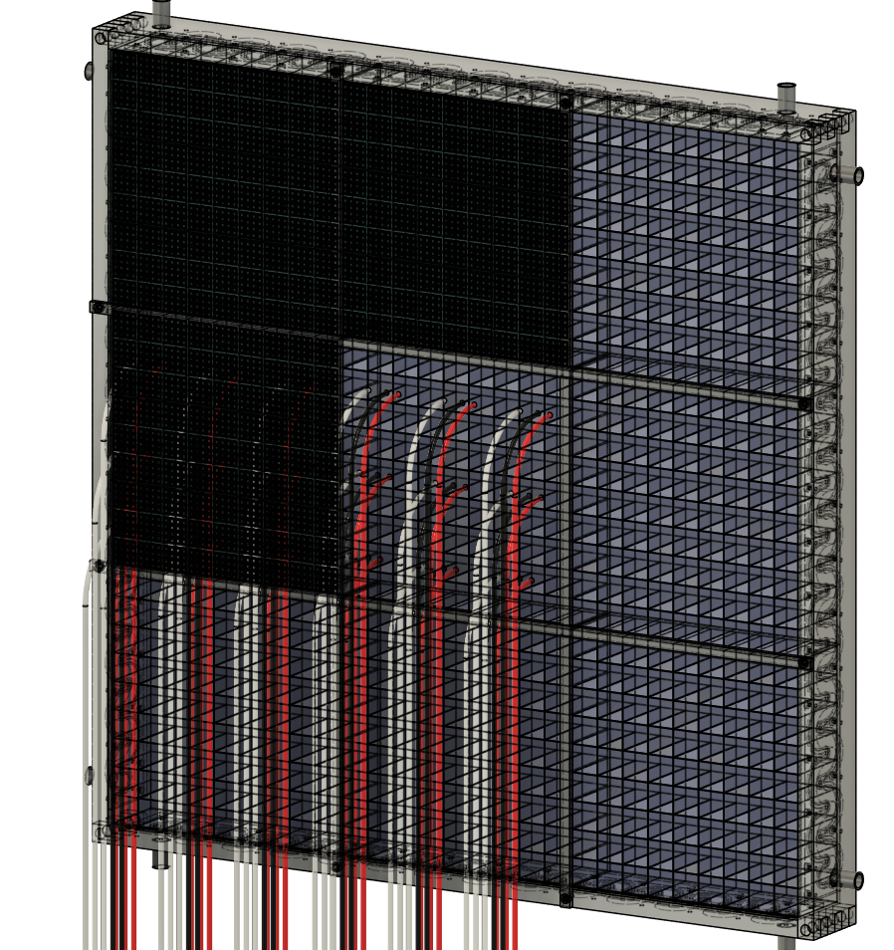
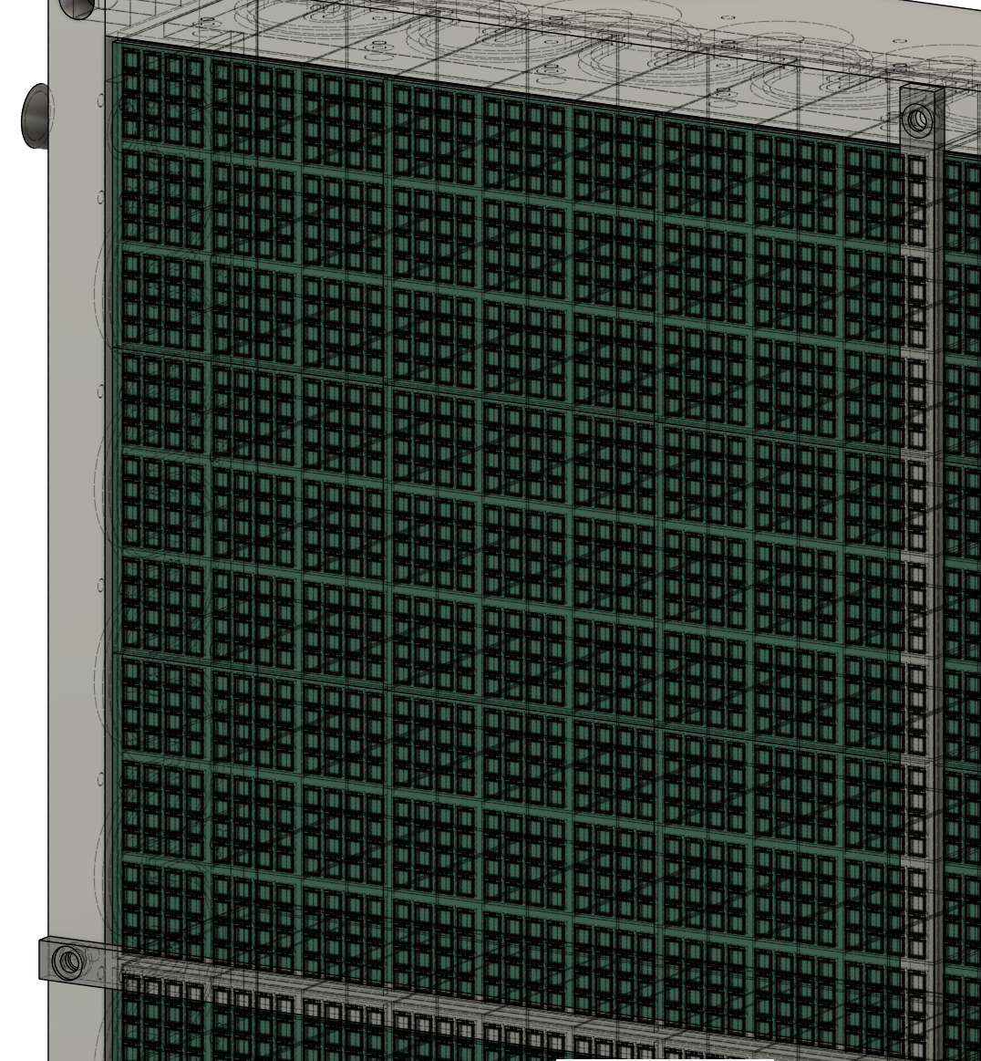
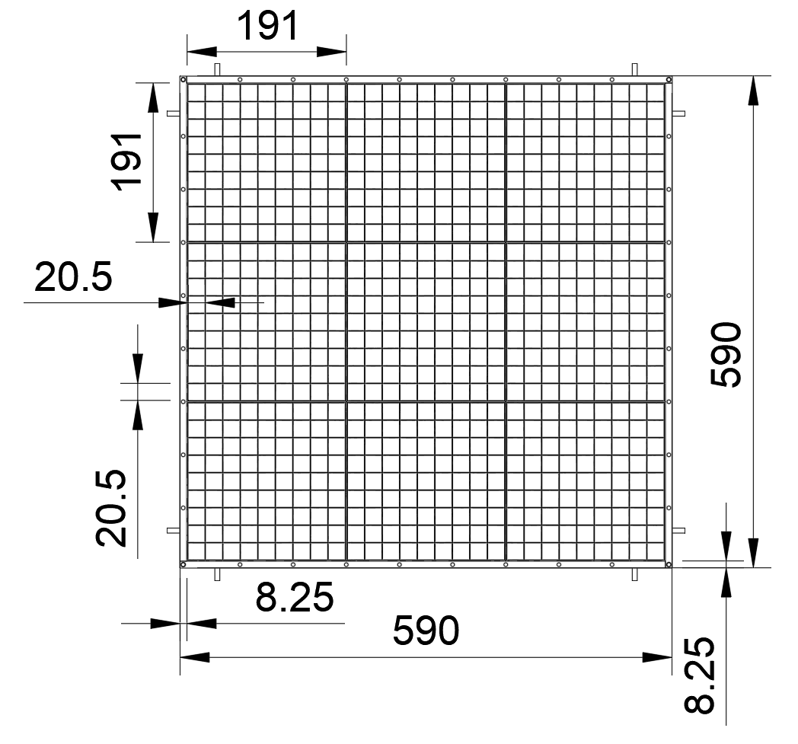
Supper Module
One SM contains :
9 × 9 PbWO₄ crystals
16 × 9 × 9 SiPM channels = 1,296 channels
Zoom in

Slide 4
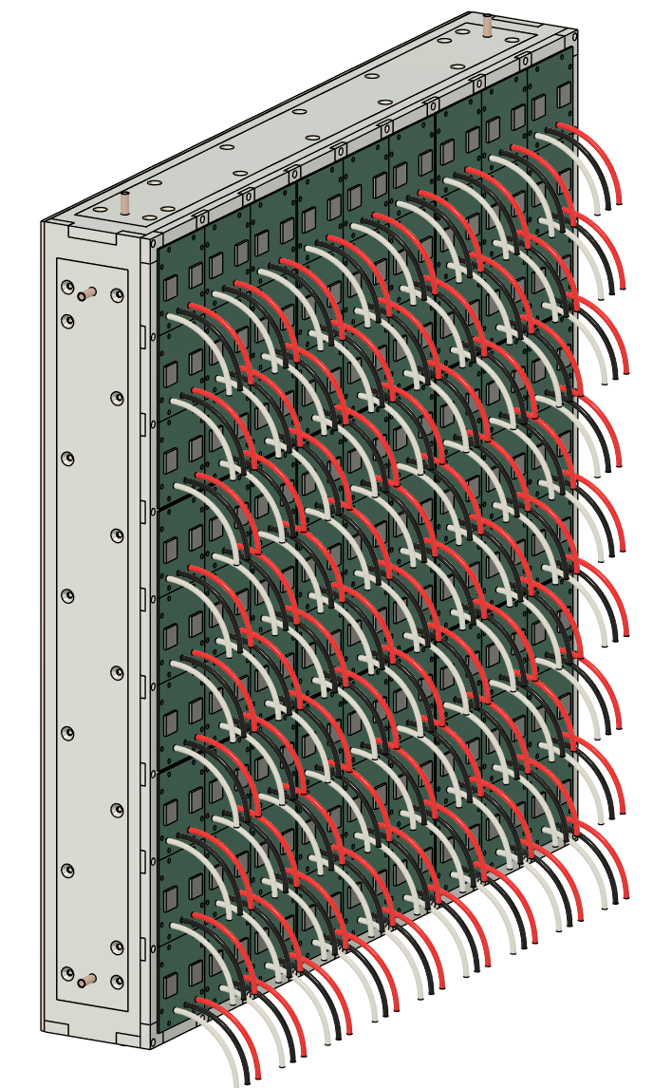
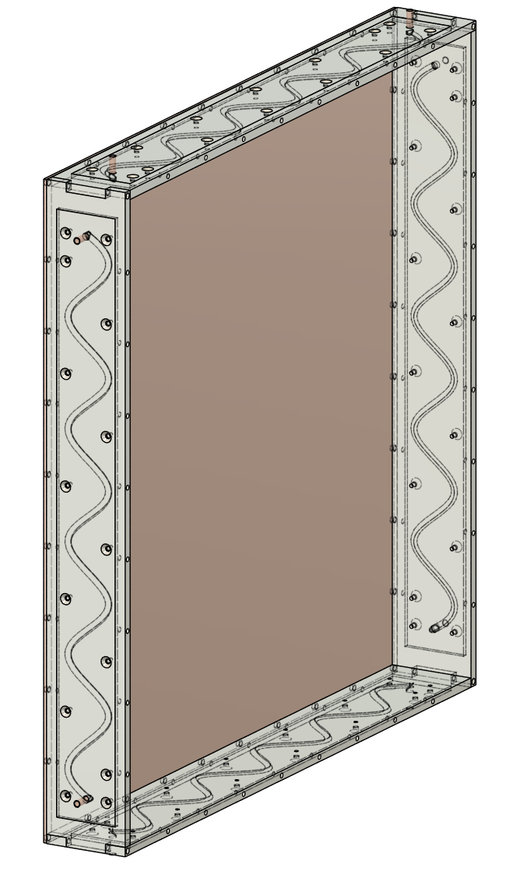
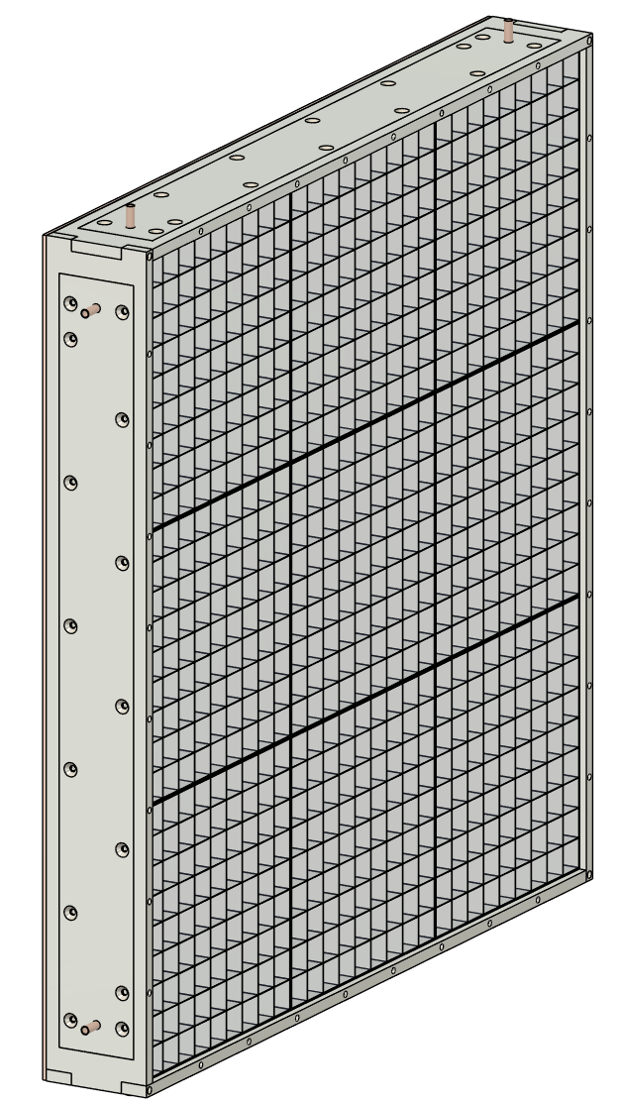
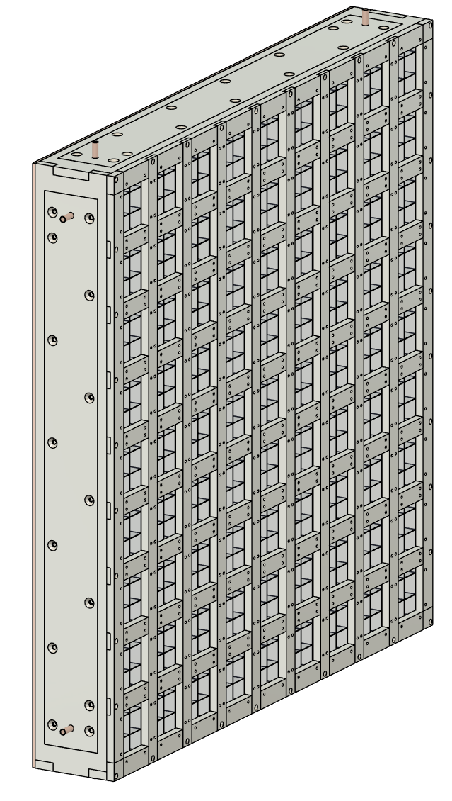
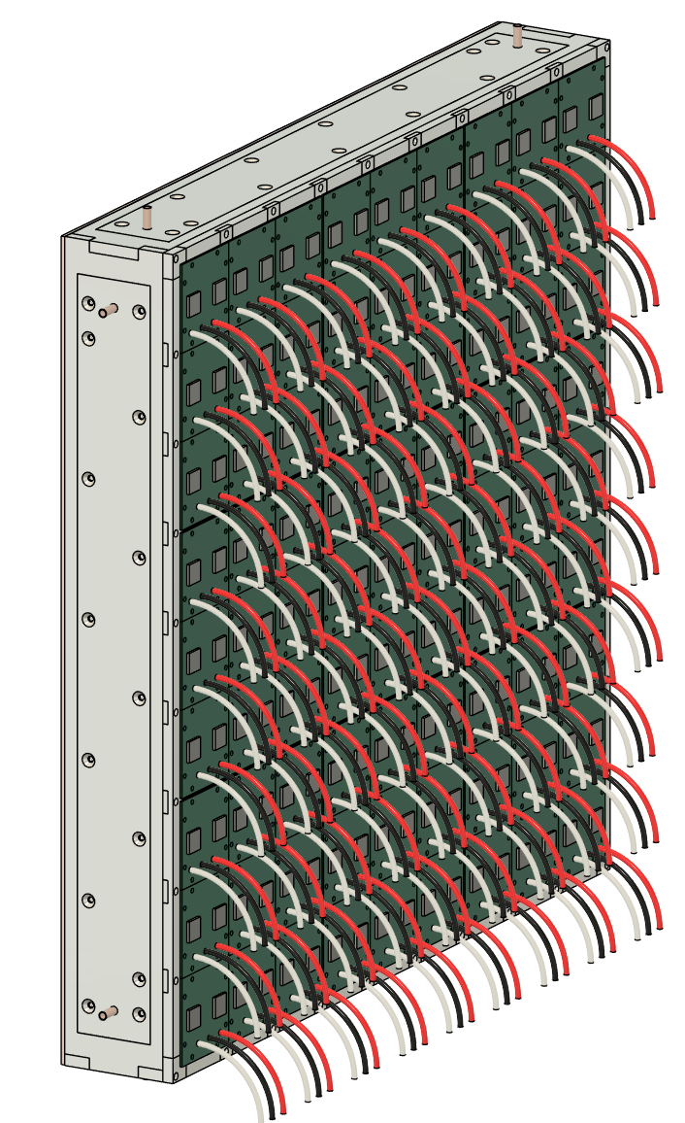
The compose system of EMCal
This is the assemble sequence.
1. The Cooling & support
2. The crystal modules
3. PCB support frame
4. The sensor and ROC board, and the cables.
Cooling & support
Crystal modules
PCB support
ROC & SiPM PCB

Slide 5
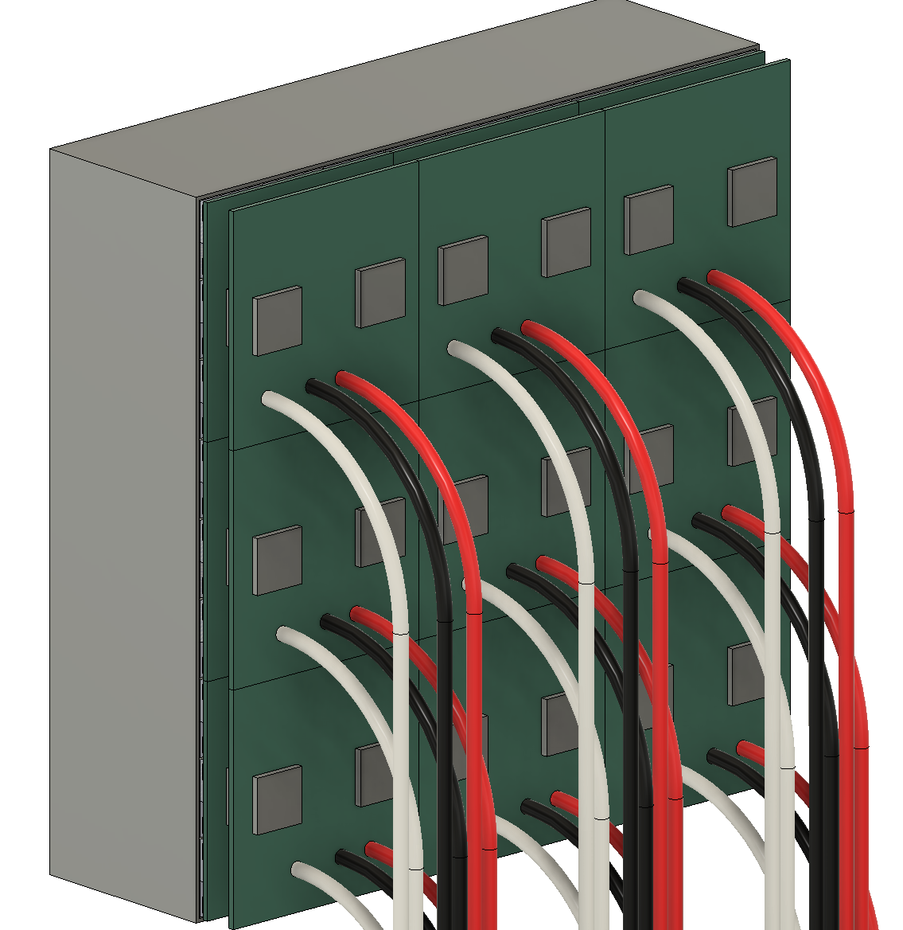
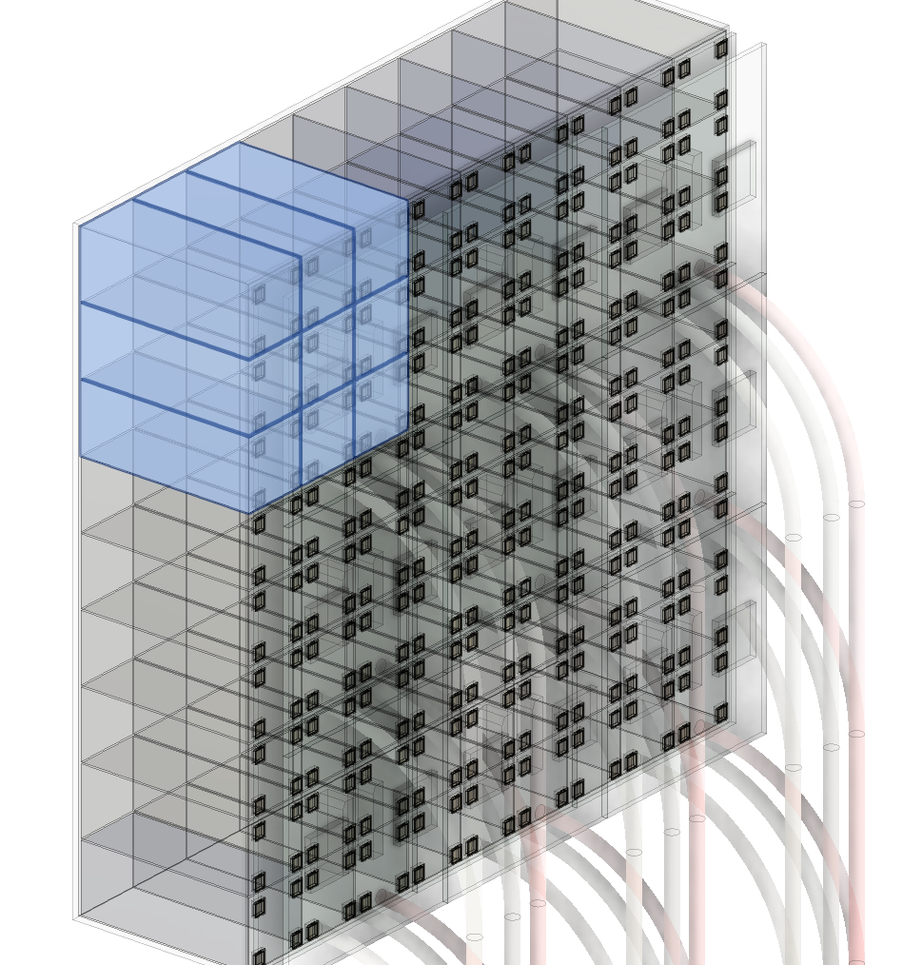
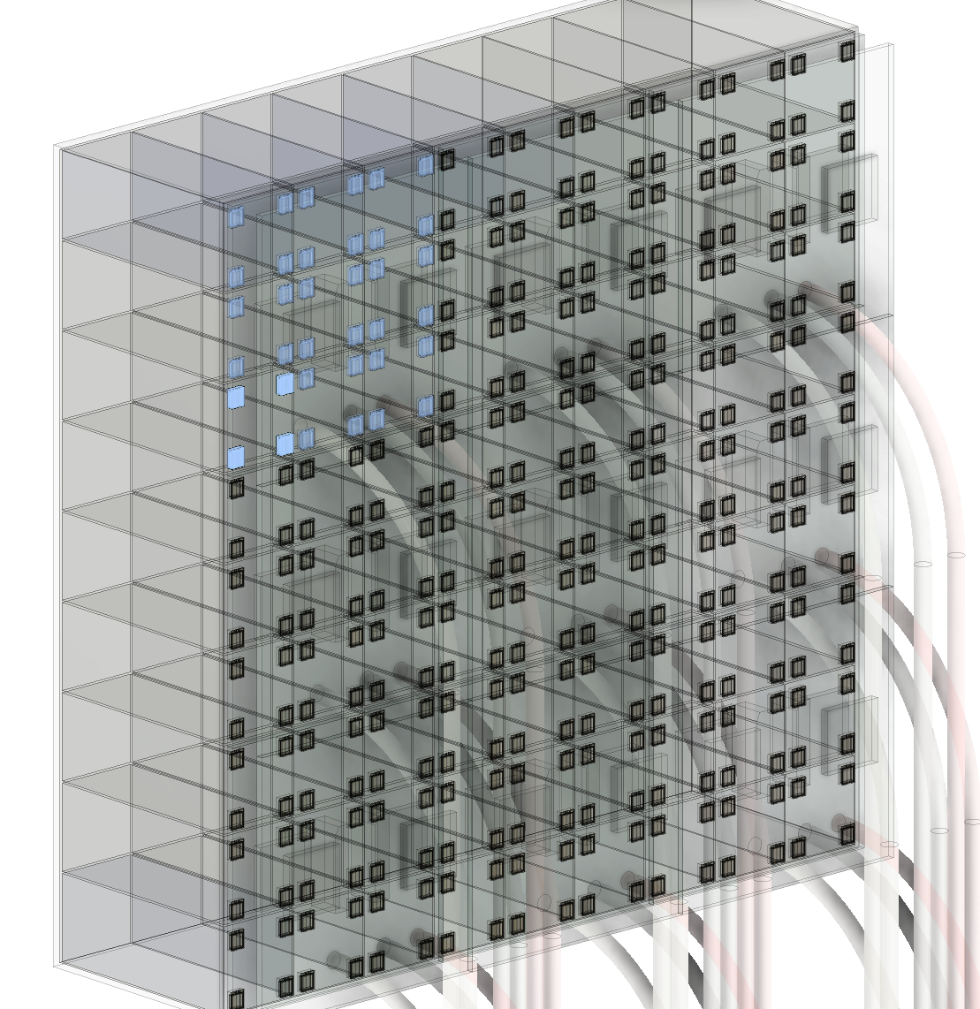
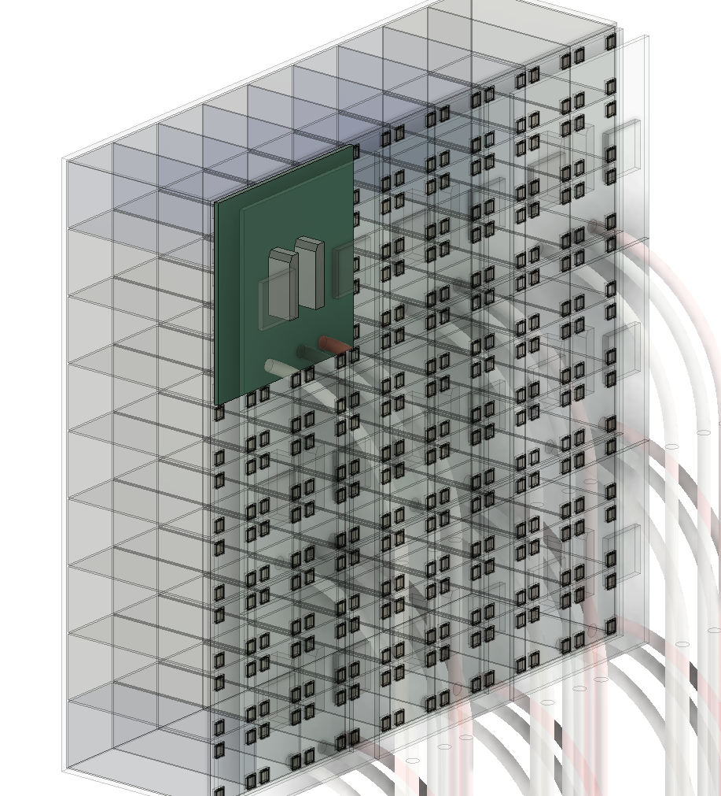
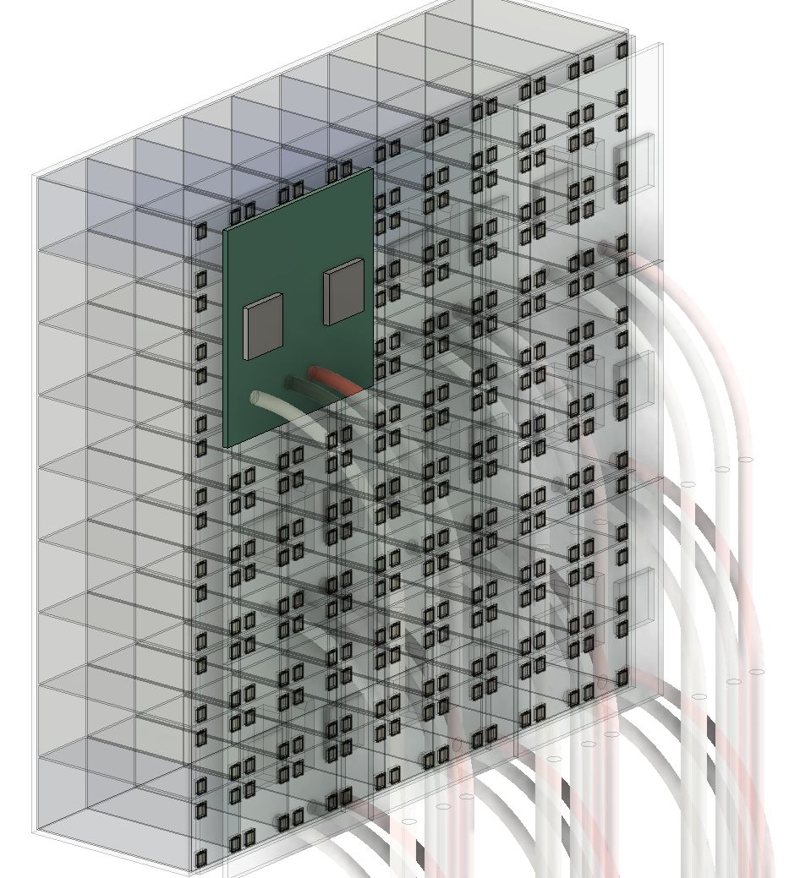
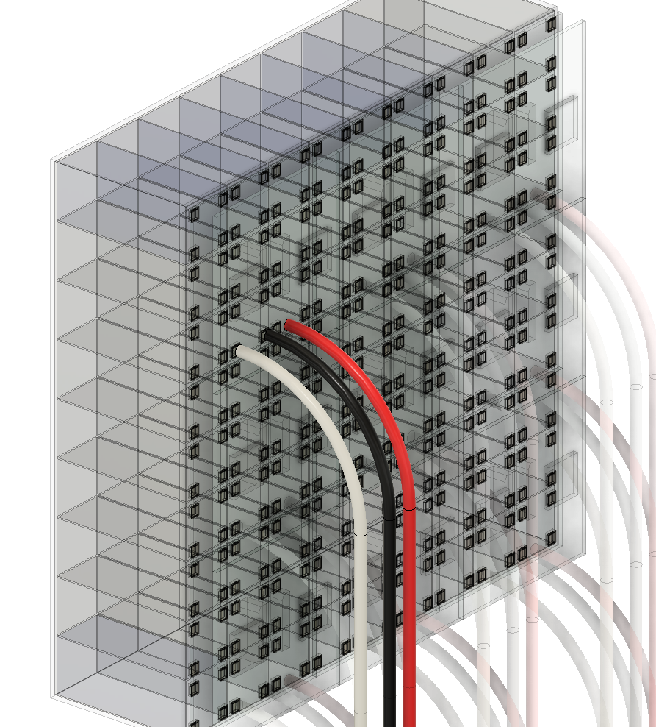
SiPM Readout Module
19.1 cm
1 Super Module
The current design contains 3 × 3 readout modules per Super Module
One readout module contains :
144 SiPM channels
2 ROCs
Thermal contact
19.1cm
Readout module
1
3 × 3 = 9 crystals
(4×4)×3×3 = 144 SiPMs
(reduce the display chips by 75%)
SiPM board
ROC board
2 ROCs: (72 × 2=144 channels)
HV, GND, and Signal
cables

Slide 6
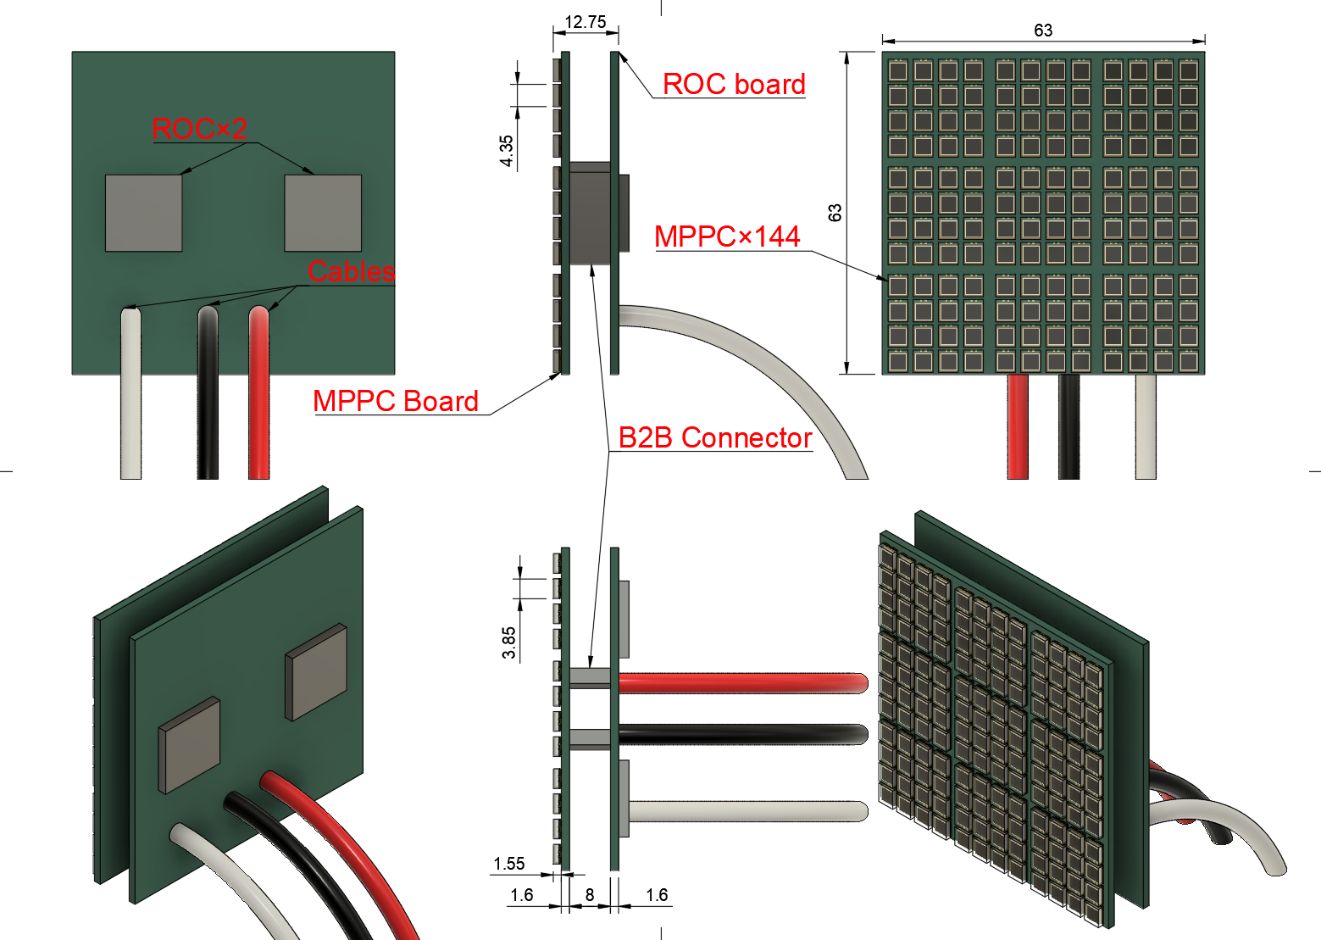
The readout module boards
High-Density Integration: Accommodates 144 SiPM sensors within a compact 63 × 63 mm.
Dual-Layer PCB Stack:
SiPM Board (Front): Dedicated to photon detection and signal interface with the crystal array.
ROC Board (Back): Equipped with two Readout Chips (ROCs) for signal processing and digitization.
Interconnect & Connectivity
Board-to-Board (B2B) Connector:
Utilizes an 8 mm standoff height.
Benefit: Minimizes analog trace length between sensors and ROCs to ensure signal integrity and low noise.
External Cabling:
Features three robust rear-exit cables for High Voltage (HV) bias and high-speed data transmission.
SiPM
SiPM

Slide 7
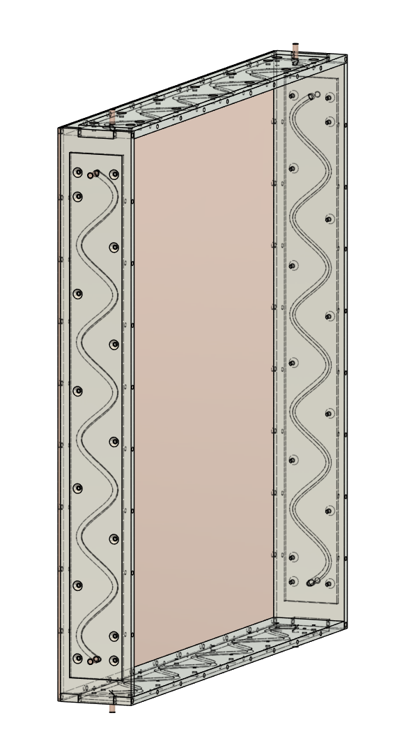

Cooling & Support System
Use 1 cooling modules, 4 cooling support, and 3mm copper plate to maintain the thermal condition of crystals.
The coolant circulates through 6mm copper tubing.
Copper plate
T=3 mm
1x
Assemble
4x
Cooling support

Slide 8
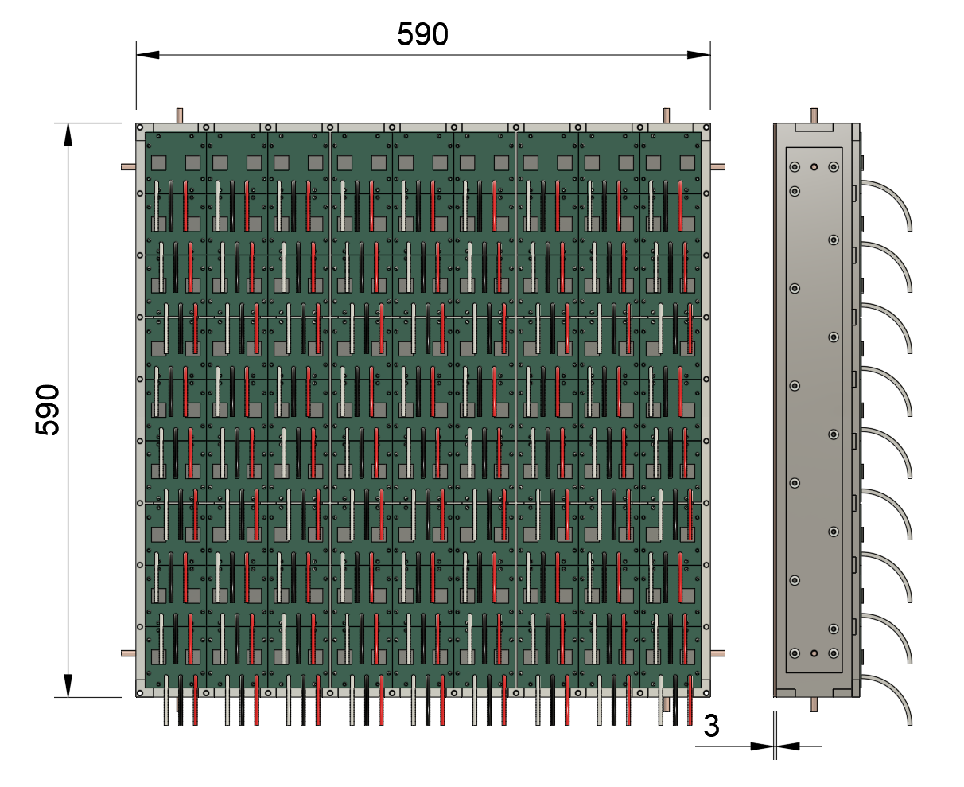
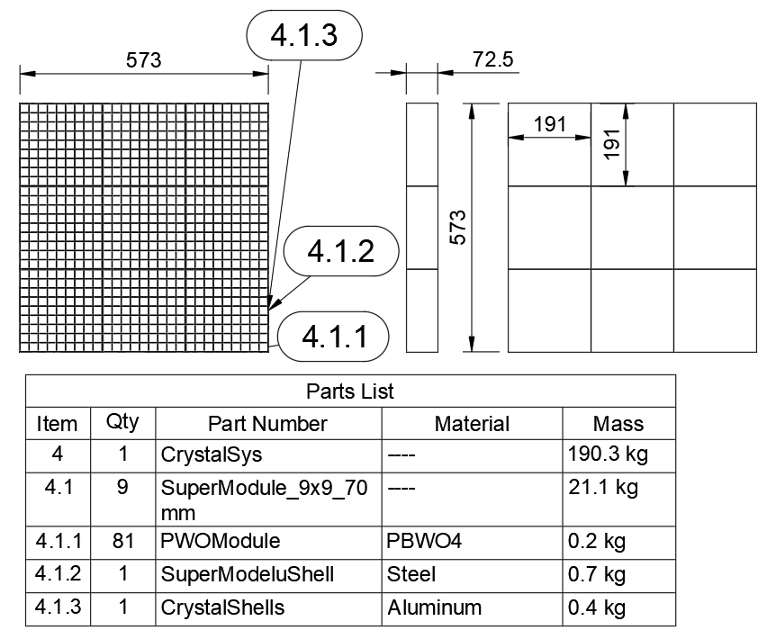
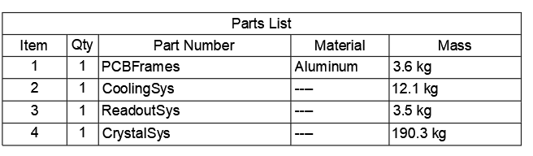
Mass Calculation
Super module：21.1 kg, and SM x 9：190.3 kg
Cooling system：12.1 kg
PCB support frame：3.6 kg
PCB of ROC and SiPM：3.5 kg
Total ： 209.5 kg
Super module

Slide 9
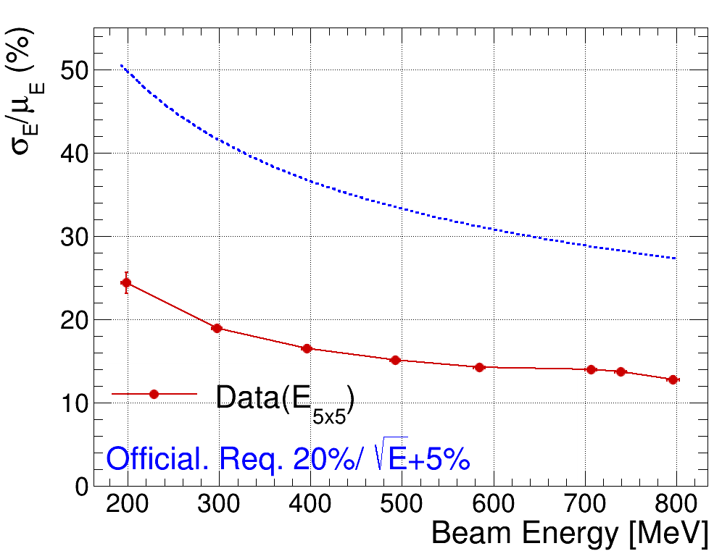
Energy resolution

