Slide 1
Combine DY Cross Section w/ LL and LO Trigger w/ Correlation of Systematics 20260206
Chia-Yu Hsieh
Academia Sinica, Taiwan

Slide 2
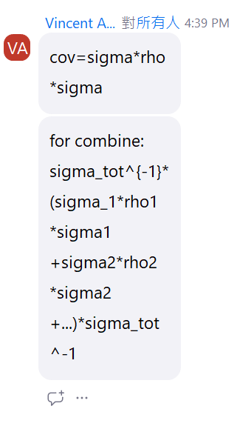
To Do
3D combine need more detailed cross check.
Why integrated cross section in xf has much smaller size compare to the one directly obtained from event by event evaluated cross section.
How to deal with 1D/2D cross section in pt and mass : correlation is flat, might be able to have have rho matrix in 1D and 2D?
Check 3D combine released and the BLUE combine
Check how do we assign systematics before
Check correlation matrix by reversed calculation (same plot as Vincent, is it even legal/possible to do so?)
1) combine in 3D 2) integrate 3D->1D xsc combine 3) sigma_tot is accessed by the diagonal term.

Slide 3
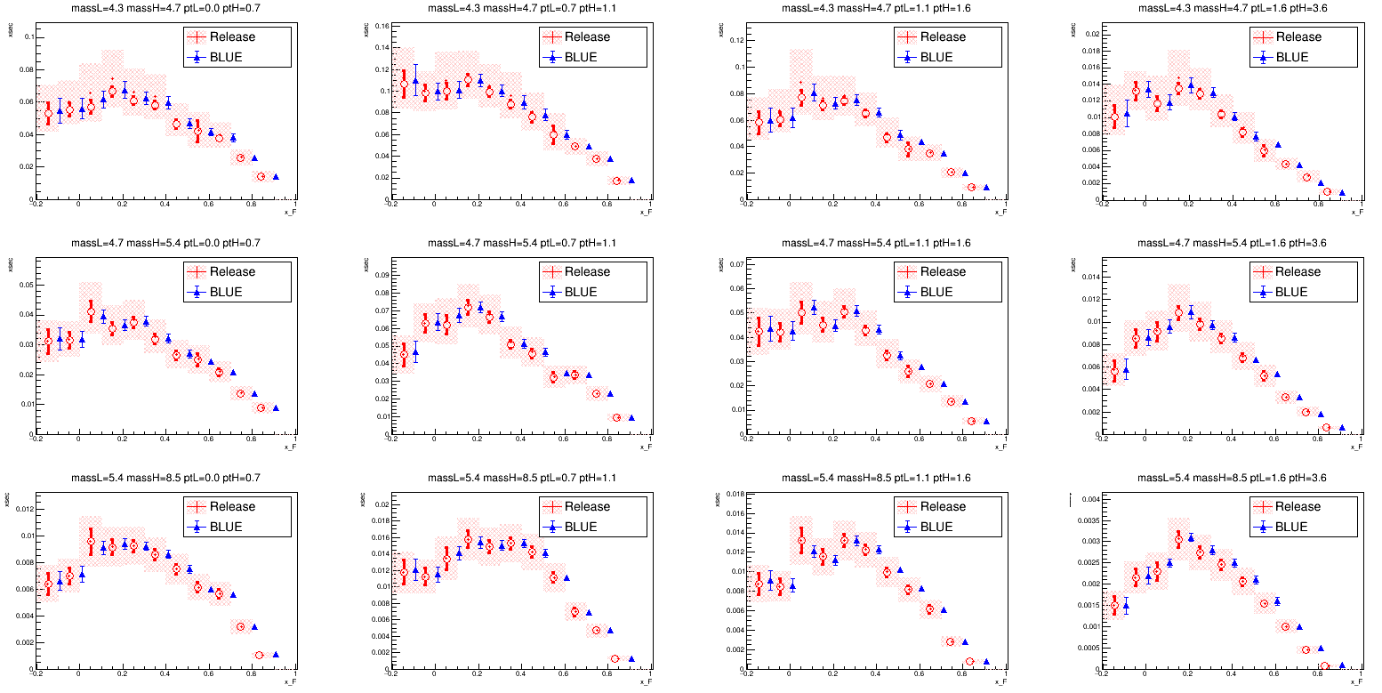
Released VS BLUE in 3D
BLUE’s systematics are way to small ~ the size of statistics only in release.
mean values are similar.

Slide 4
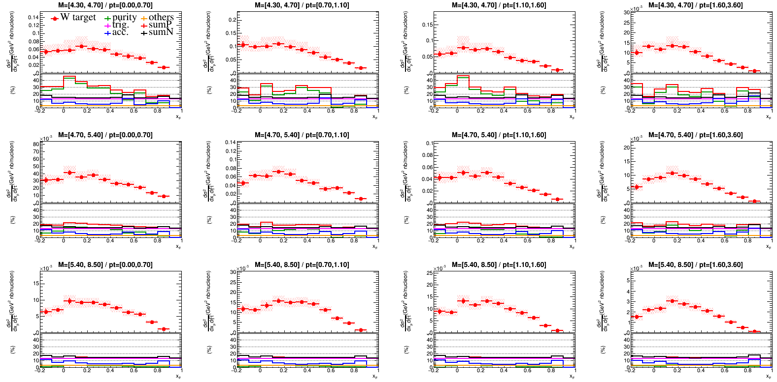
Check systematics in Release(1)

Slide 5
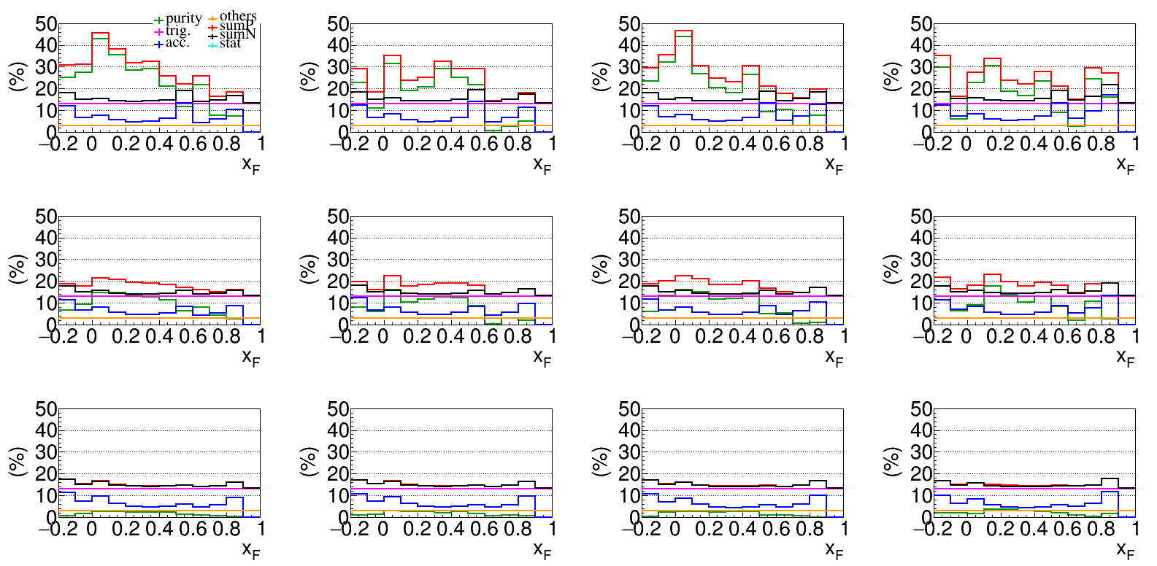
Check systematics in Release(2)
Sum^2 = stat^2 + purity^2 + acc^2 + trig^2 + others^2
(no bin correlations, no correlation between different systematics)

Slide 6
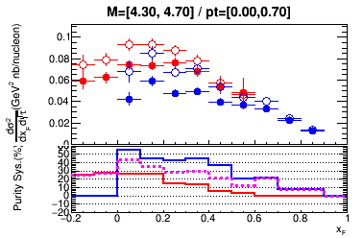
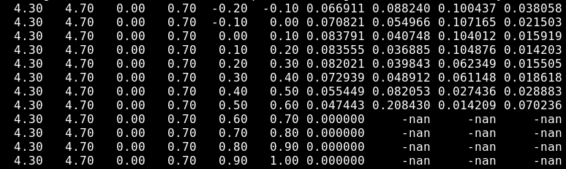
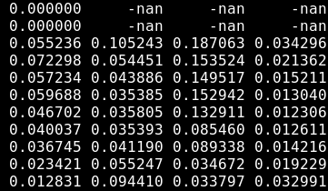
Purity Systematics
Released results : “ratio”
red line : cross section ratio between Vincent’s purity and Catarina’s purity for LL trigger.
=> LL_ratio
blue line : cross section ratio between Vincent’s purity and Catarina’s purity for LO trigger.
=> LO_ratio
magenta line : average of two, which is size of purity error after combine. (LL_ratio + LO_ratio)/2
Input for BLUE : “ratio/2”
LL_ratio/2
LO_ratio/2
xsc stat pur acc
(abs) (%) (%) (%)
xsc stat pur acc
(abs) (%) (%) (%)

Slide 7
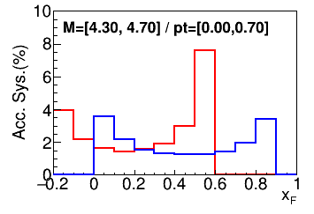
Acc Systematics
Released results
red line : cross section ratio
xsc_(acc+1*sigma)/xsc_acc for LL
blue line :
xsc_(acc+1*sigma)/xsc_acc for LO
Final =>? check
3* (LL+LO)/2
Input for BLUE : => same definition as release
LL => 3* LL
LO=> 3* LO
xsc stat pur acc
(abs) (%) (%) (%)
xsc stat pur acc
(abs) (%) (%) (%)

Slide 8
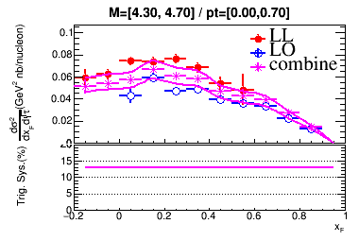
Trig Systematics
Released results
W target :
Const. = 13% everywhere
Input for BLUE : same definition as release

Slide 9
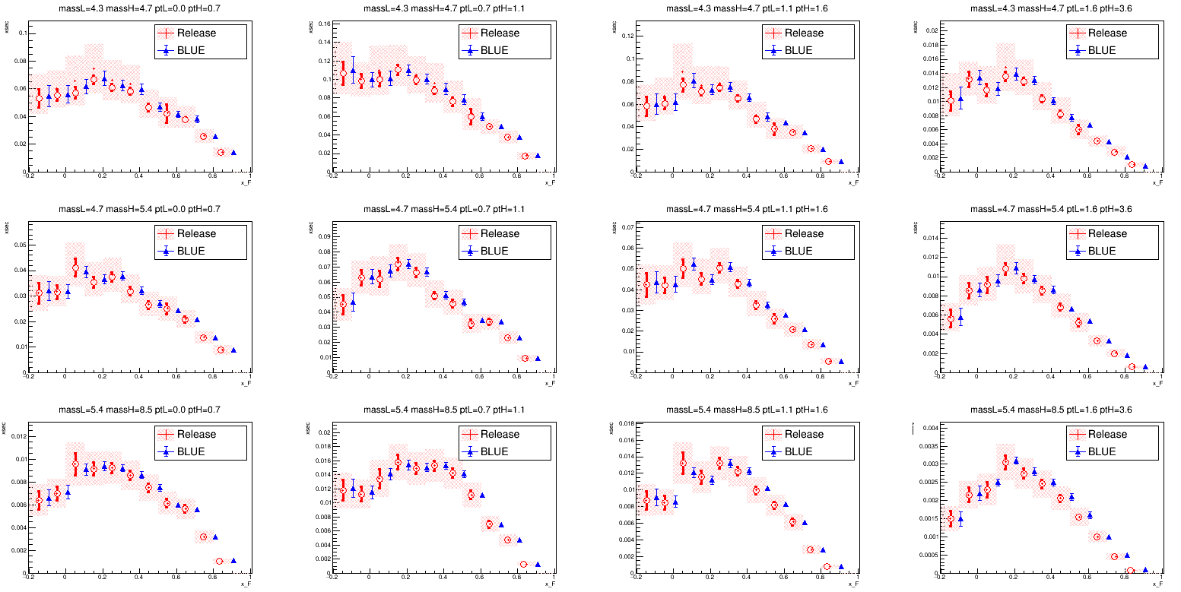
Released VS BLUE in 3D w/ Corr CorrP, CorrA, CorrT

Slide 10
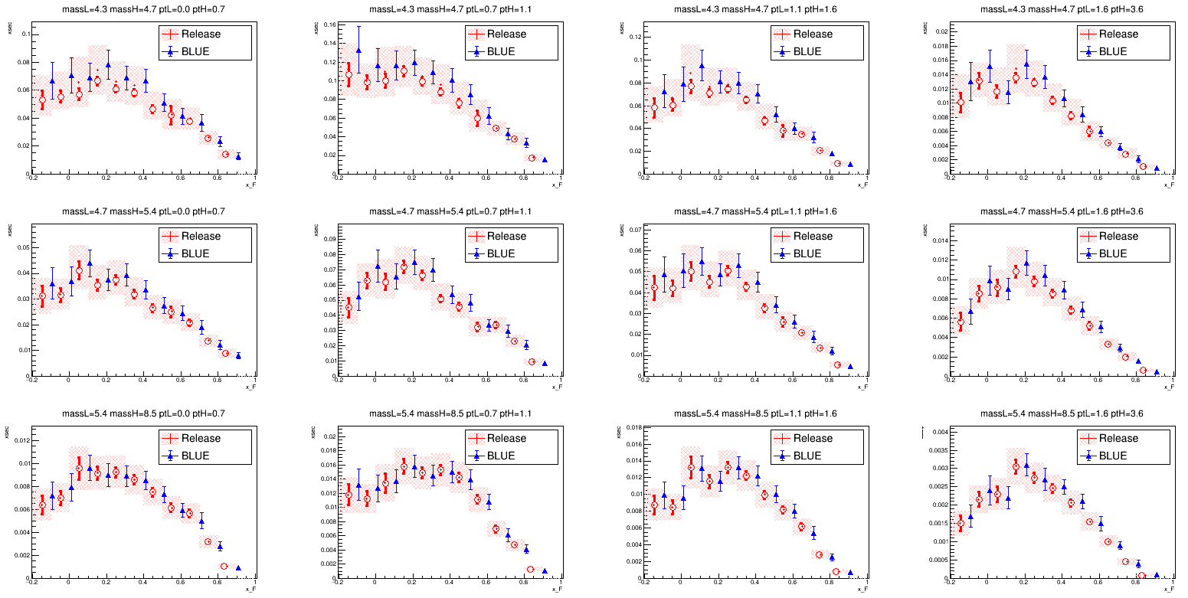
Released VS BLUE in 3D w/ Corr CorrP, CorrA, CorrT

Slide 11
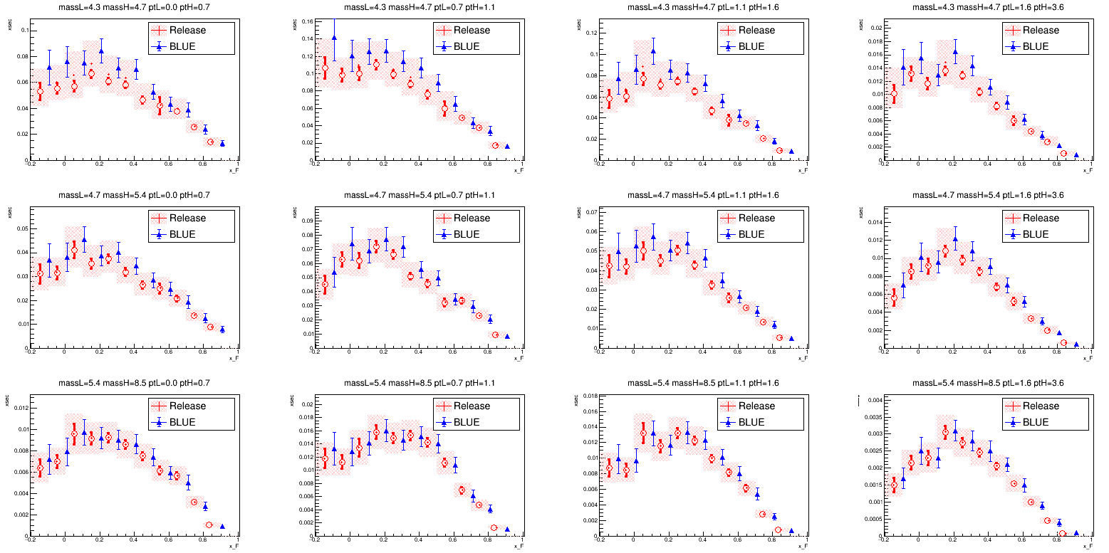
Released VS BLUE in 3D w/ Corr CorrP, CorrA, CorrT

Slide 12
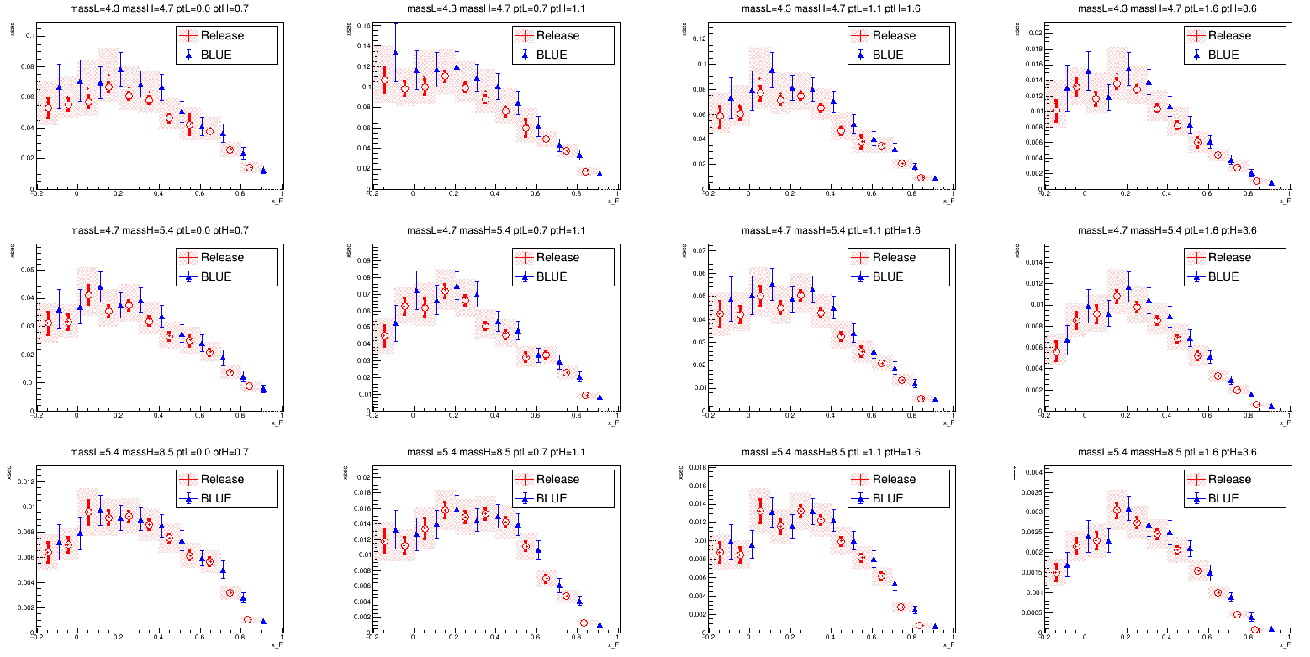
Released VS BLUE in 3D w/o Corr
w/o corr = only diagonal term = 1
Kind of confirmed, problem is coming from the correlation itself

Slide 13
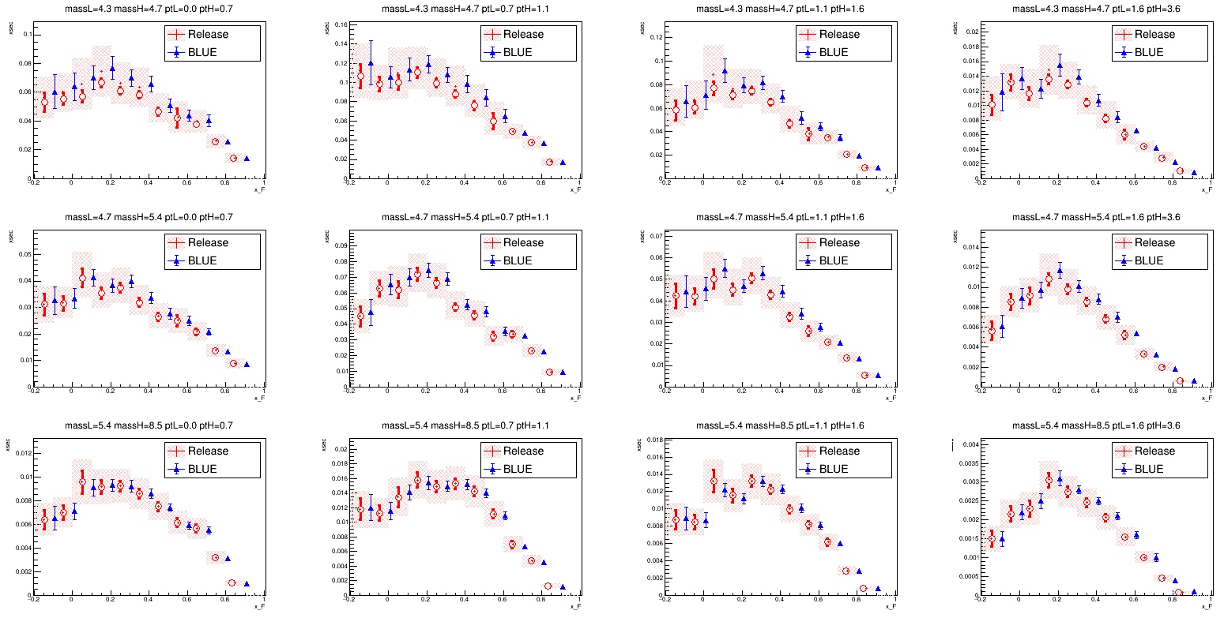
Released VS BLUE in 3D w/ Corr CorrP, CorrA, CorrT
Trigger correlation brings effect to reduce the systematics, but not all the contributions are all from trigger acceptance and purity also affects.

Slide 14
Email from Marcin
-1 correlation in trigger covariance is artificial effect.
+1 correlation should be more correct since thy share the same hodoscopes. (=> similar to acceptance sysmetics?)
New correlation = 1 for everywhere?
Correlation w/ acc covariance matrix?
R_purity + R_trig + rho*R_purity*R_trig?
(R = covariance matrix)

Slide 15
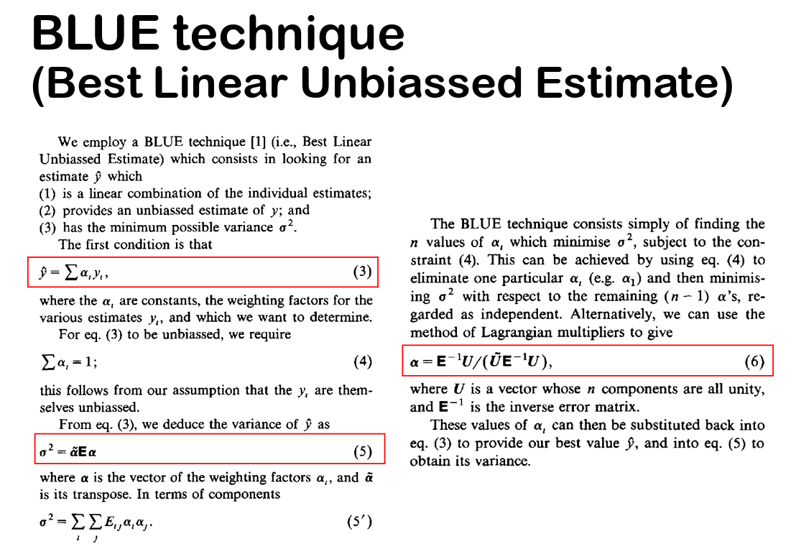
Email from Wen-Chen(1)

Slide 16
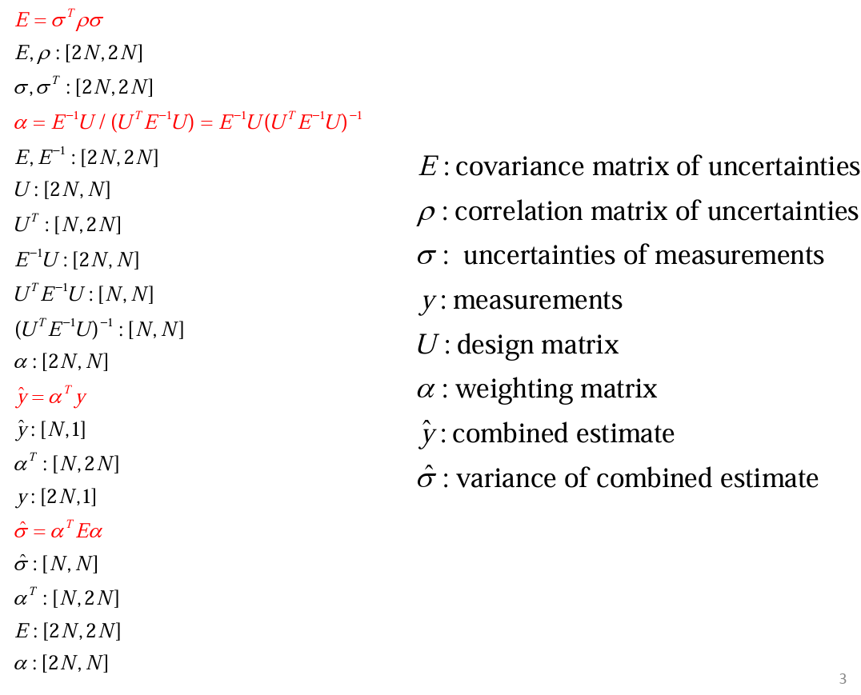
Email from Wen-Chen(2)
UNDER PROGRESS….

Slide 17
To Do
How to define systematic of purity, acceptance, and trigger?
Purity : Vincent will do bootstrapping and provide us the input files! Review purity extraction(pending)
Acceptance(pending)
Trigger(pending)
Correlation between different systematics
Trig VS Acc (pending)
Purity VS Acc (pending)
BLUE, only sta error, input file update xsc w/ Vincent’s input
Trigger rho=1
trigger systematic error same for LL and LO
New binning for the convenience of integration (pending)
Combine at 2D and 1D level and compare.
Next meeting : April 23th (Thursday)
Check slides : https://twiki.cern.ch/twiki/pub/Compass/Drell_Yan/Subgroupmeeting/Andrieux_20240123.pdf

