Slide 1
Weekly meeting
Yu-Siang Xiao (蕭宇翔)
2026 04/17

Slide 2
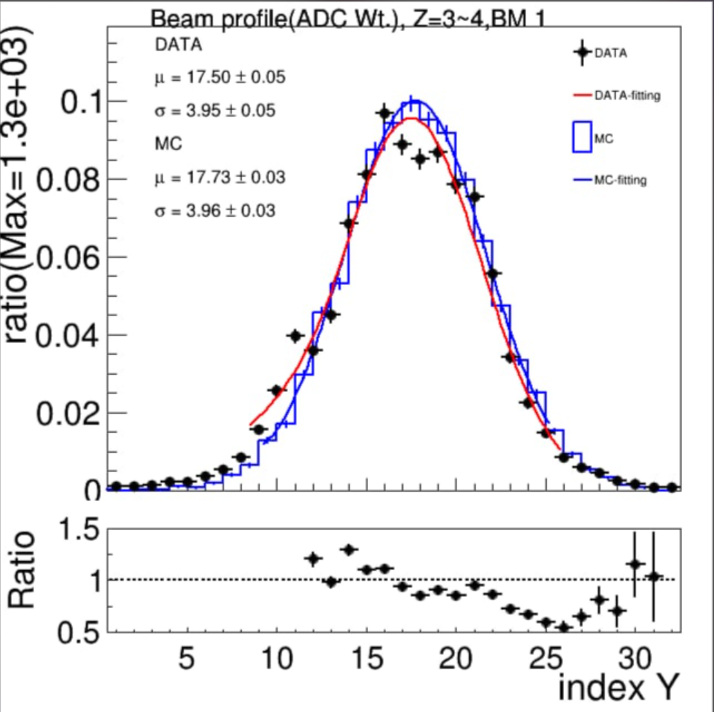
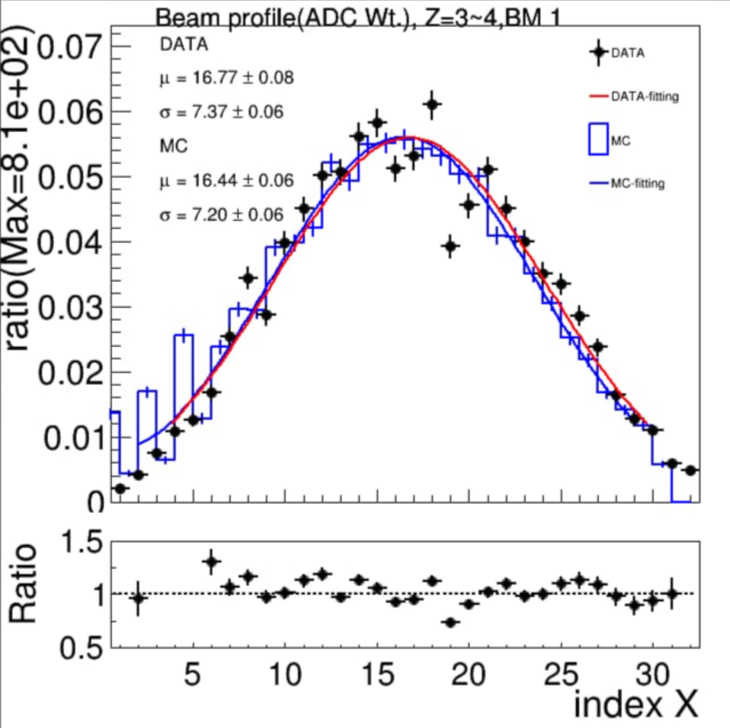
New MC for data conversion factors(ADC to MeV)
SY make the MC reconstructed beam profile to correspond the data in this new MC.

Slide 3
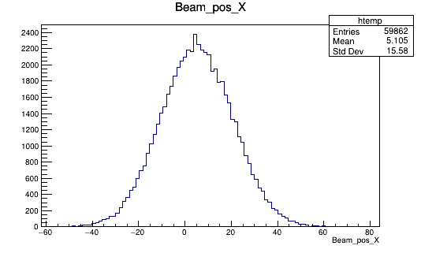
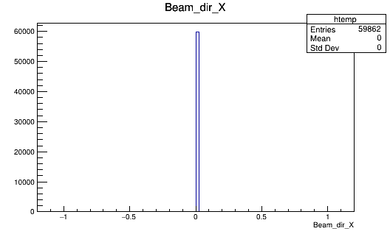
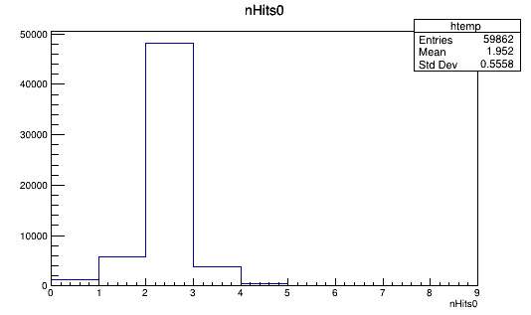
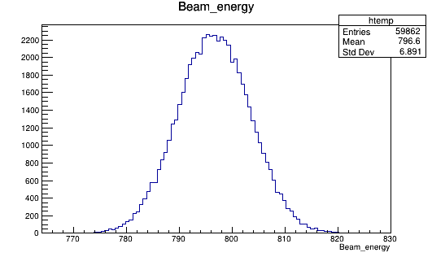
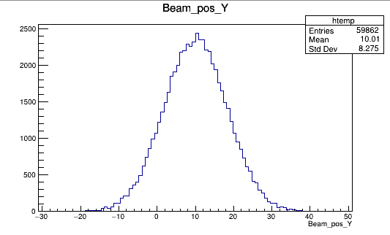
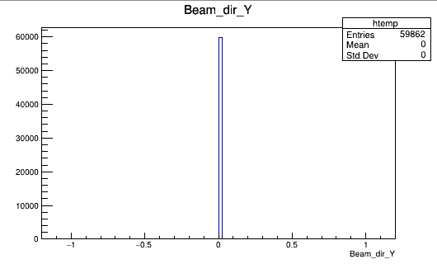
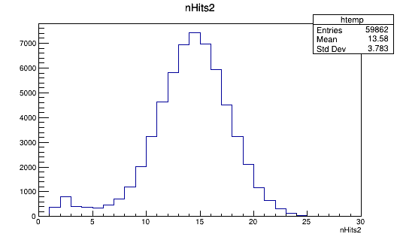
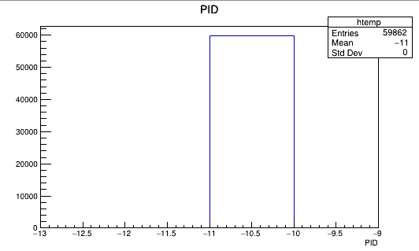
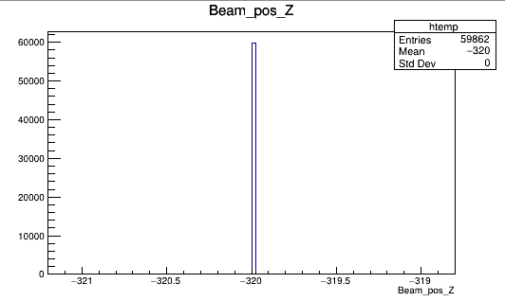
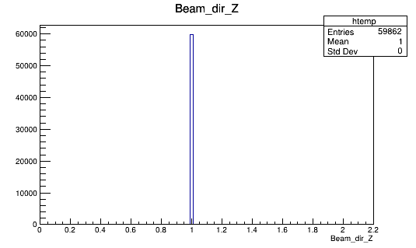
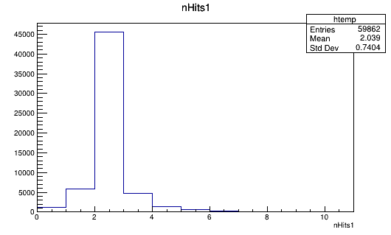
New MC for data conversion factors(ADC to MeV)
Initial condition, position X
Initial condition, direction V / |V |
Multiplicity on detectors
Take 796 MeV for example:
Initial condition, momentum(|p|)
X
dX
BM2
Y
dY
PbWO
PID=-11, positron
Z
dZ
BM1

Slide 4
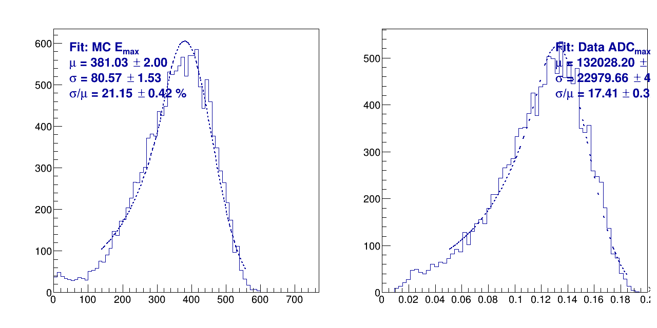
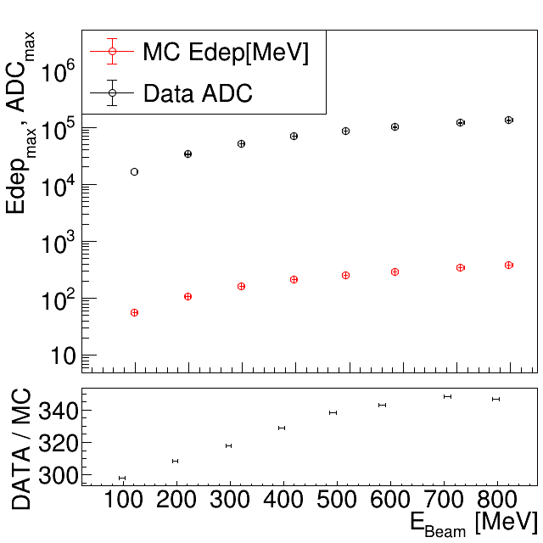
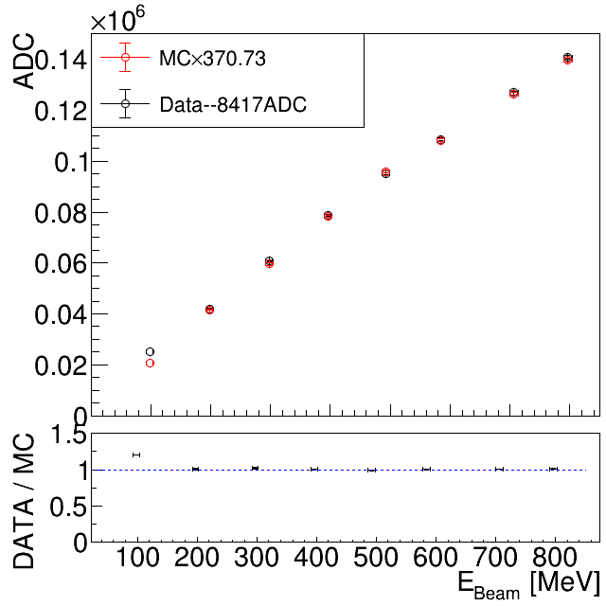
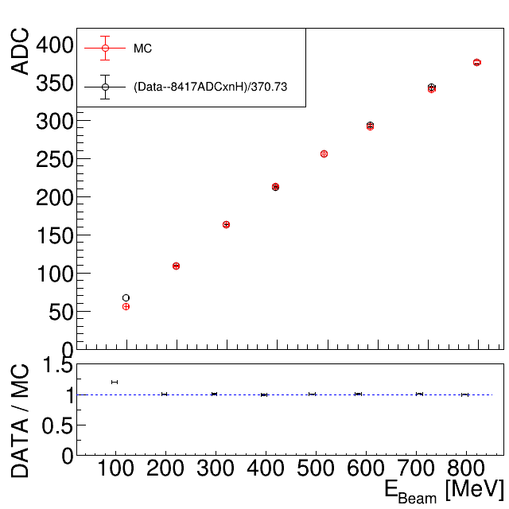
Data MC consistency, and conversion factor
Fit the peak of MC(MeV) and data(ADC) in E_{max}.
Using MC to fit data by TΜnuit, the fcn χ² = ((data – offset)/gain – MC)².
The fitting parameters:
Gain = 370.73 ± 7.50, ADC offset = -8417 ± 2181
Chi2 = 1.702, ndf = 6, Chi2/ndf = 0.284(very high correlation).
Draw the MC in data form( Edep->ADC ) and do the data/MC comparison.
Scan on E
Energy[MeV]
MeV form
fitting

Slide 5
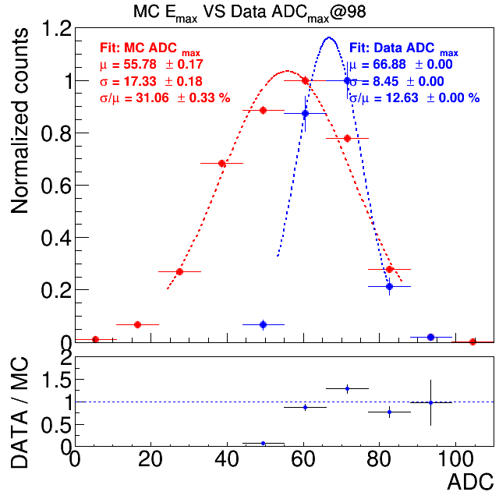
Neglect the 98 MeV point
High THR. make the signal in E_{max} crystal are not always fire 2 SiPM channels in data.

Slide 6
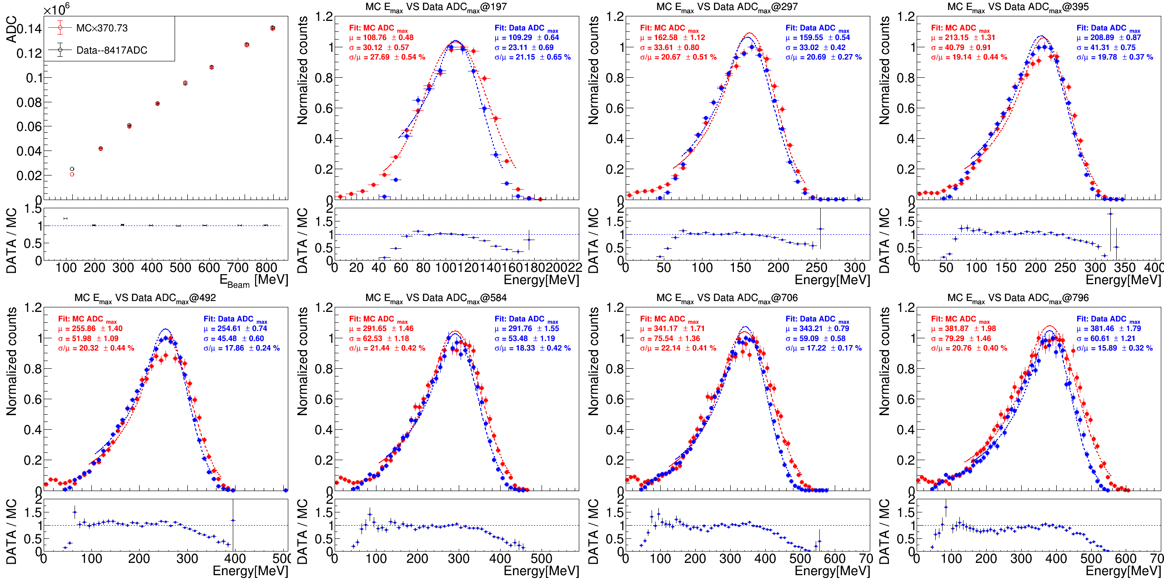
Data MC consistency on different energy (E_{max})
Different energy graph
MC and data are well fitted.
I will check statistic asap…

Slide 7
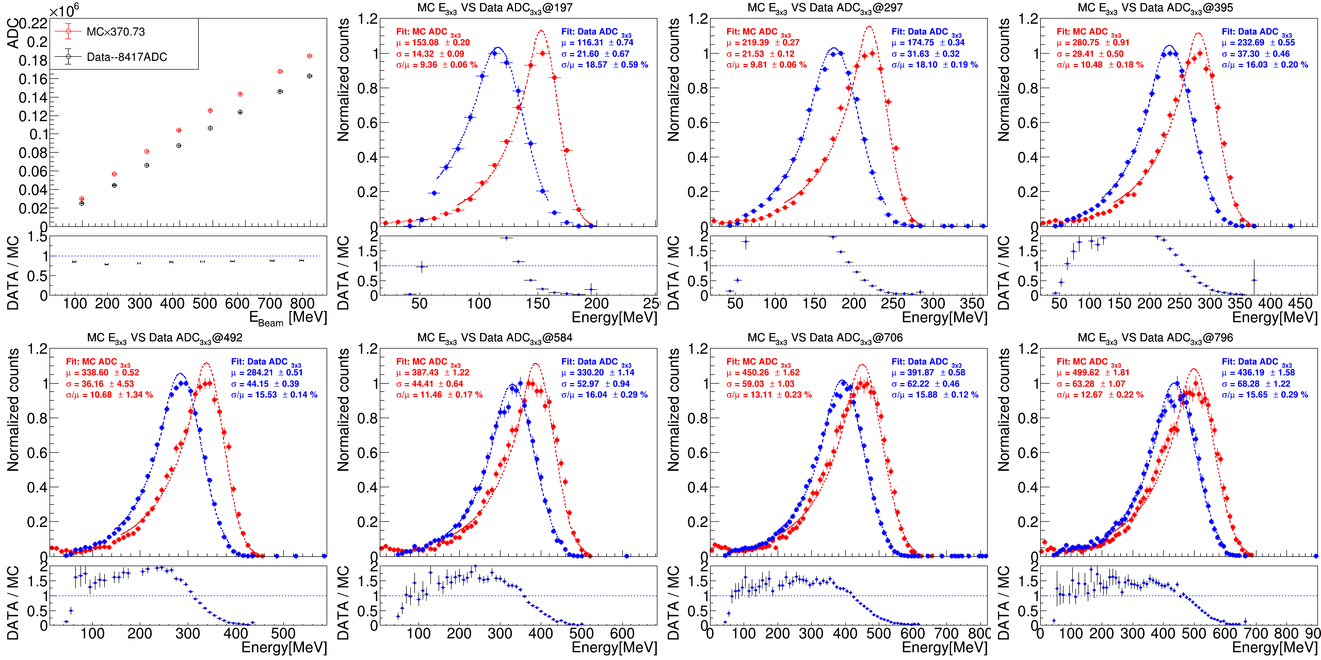
Data MC consistency on different energy (E_{3x3})
Different energy graph
Need to check the apply THR. cases.
I will check statistic asap…

Slide 8
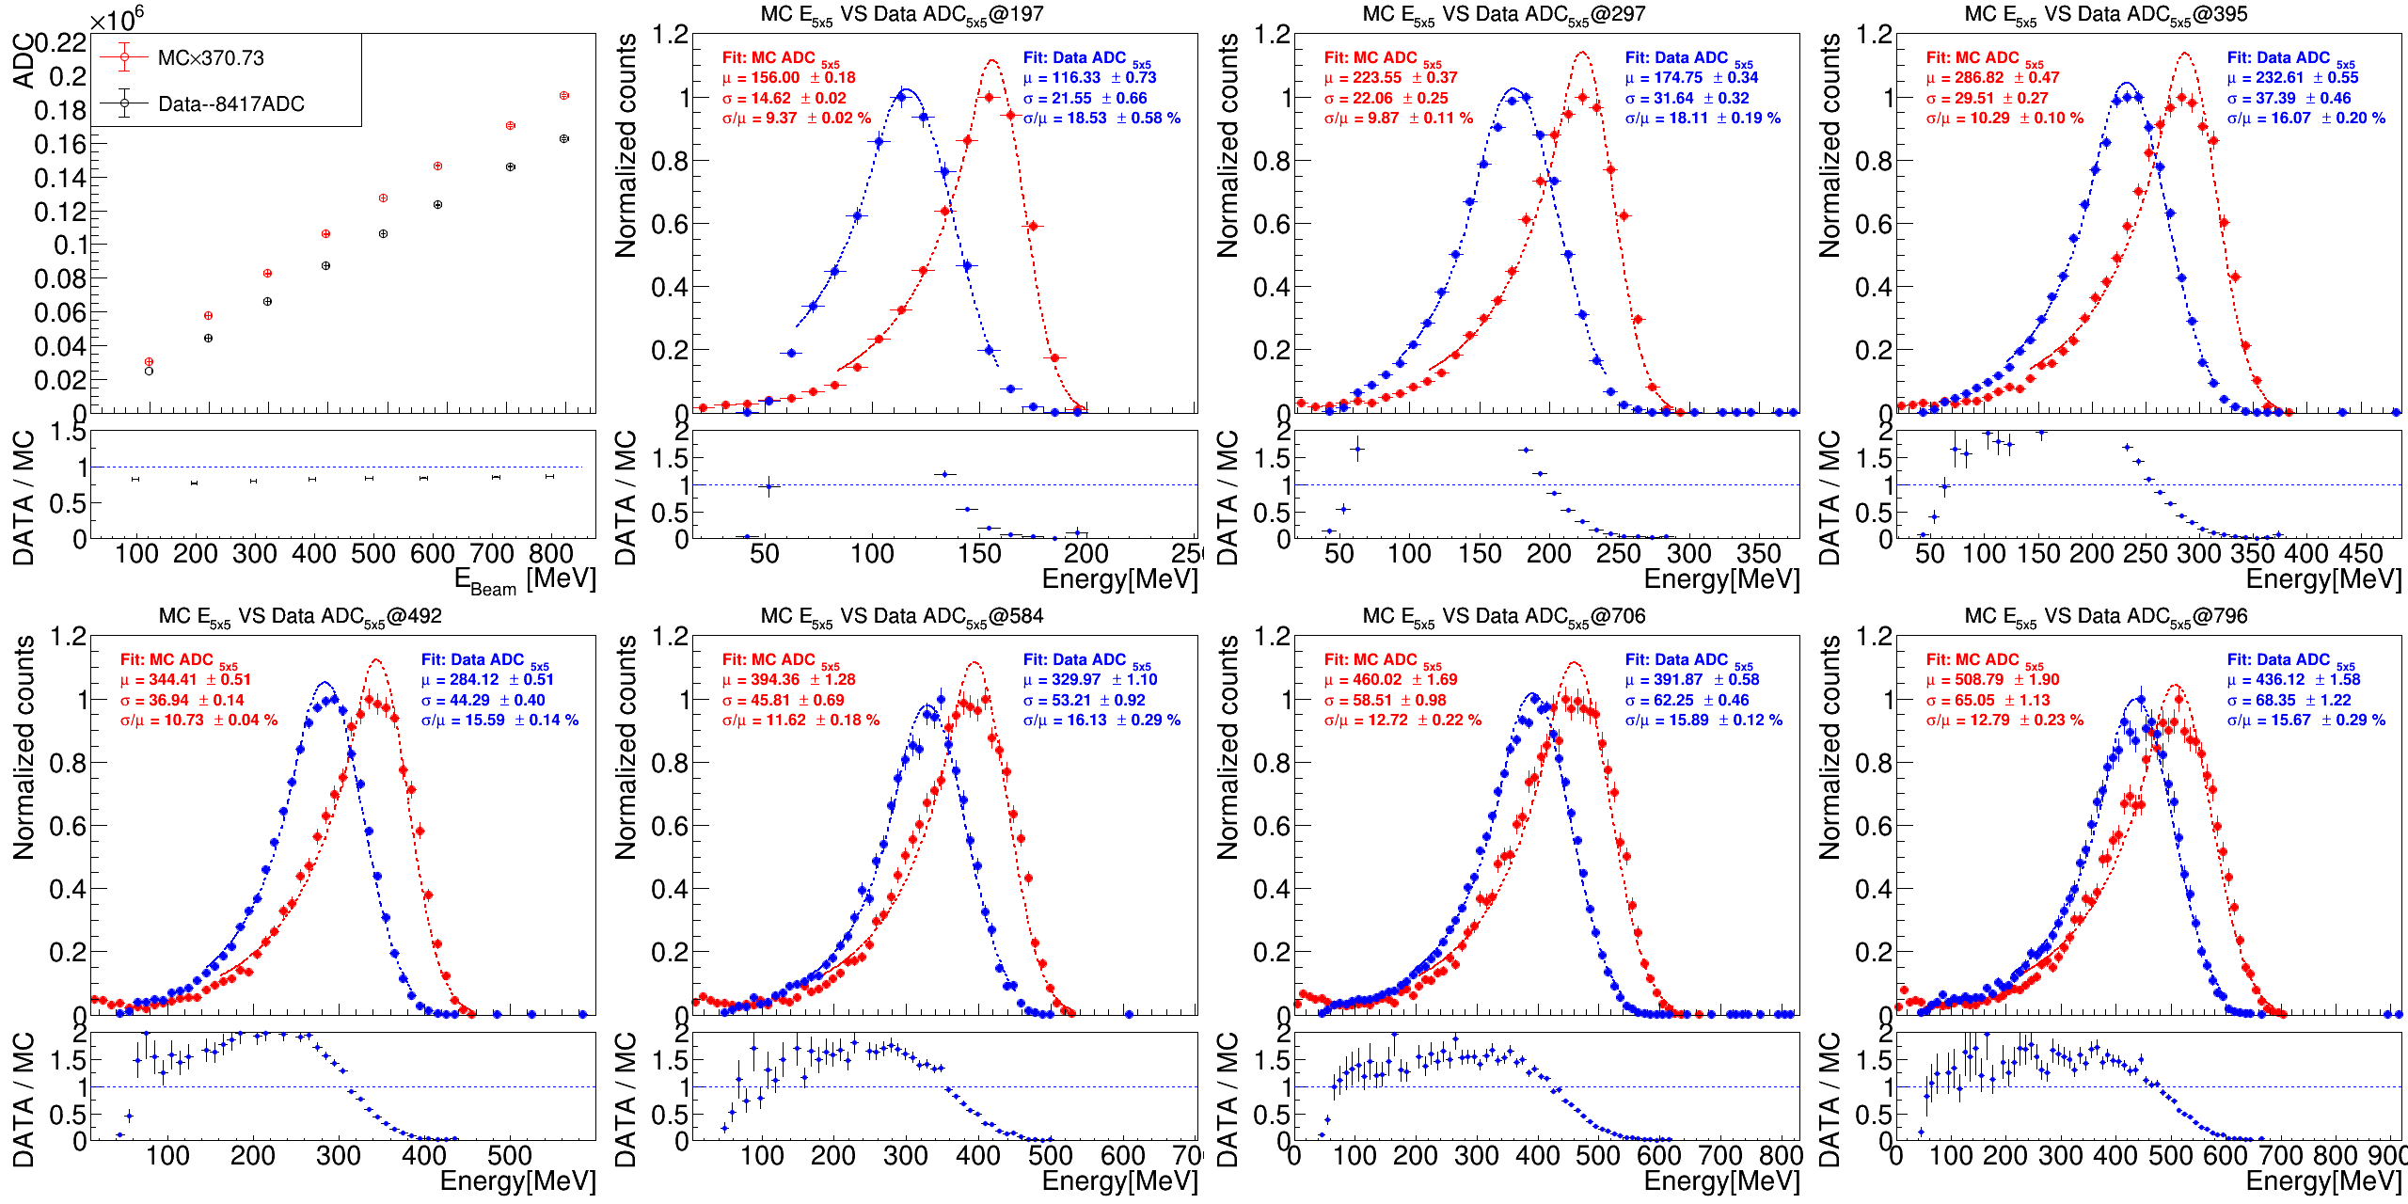
Data MC consistency on different energy (E_{5x5})
Different energy graph
Need to check the apply THR. cases.

Slide 9
End

Slide 10
backup

