Slide 1
796 MeV e⁺ on PbWo4
Testbeam MC

Slide 2
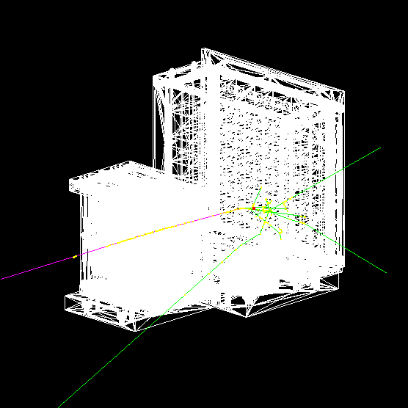
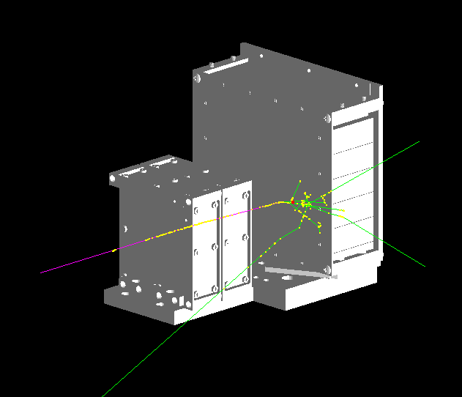
Simulation setting:
[50-796]MeV positron
X: Gauss Random shoot(-2, 14.1)*mm->(11.4, 15.6) Y: Gauss Random shoot(8, 8.93)*mm ->(-4.98, 8.62)
θ: 5° uniform random φ: 360° uniform random
perpendicular beam with XY distribution
pencil beam
PbWO4 crystal array is shifted by +10mm on X-axis & -1mm on Y-axis.
Data
/data8/ZDC/EMCal/PbWO4SiPM/AnaCode1/Save/EScanTypicalRuns/…

Slide 3
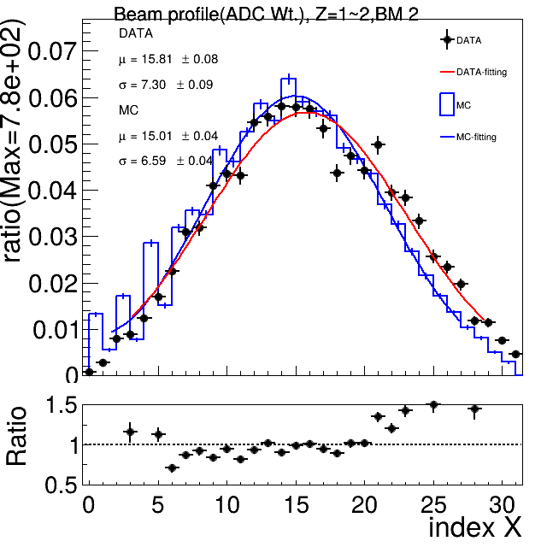
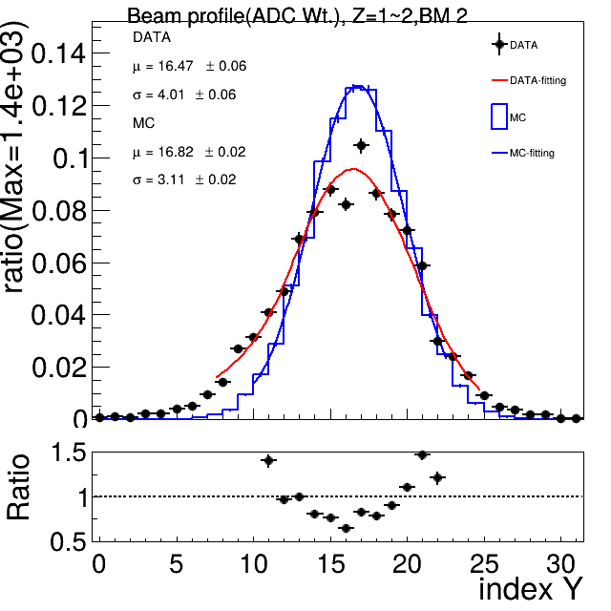
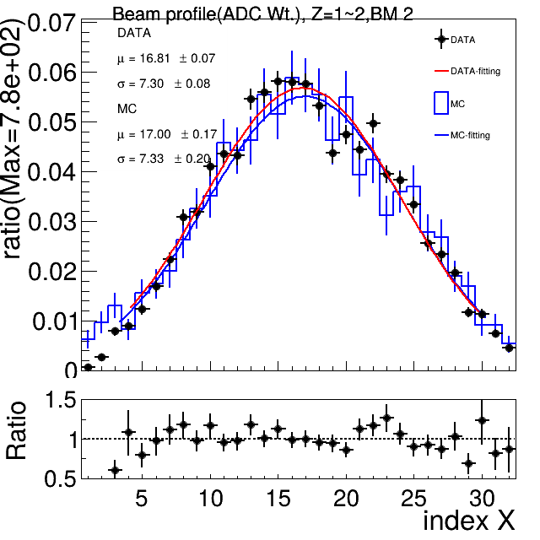
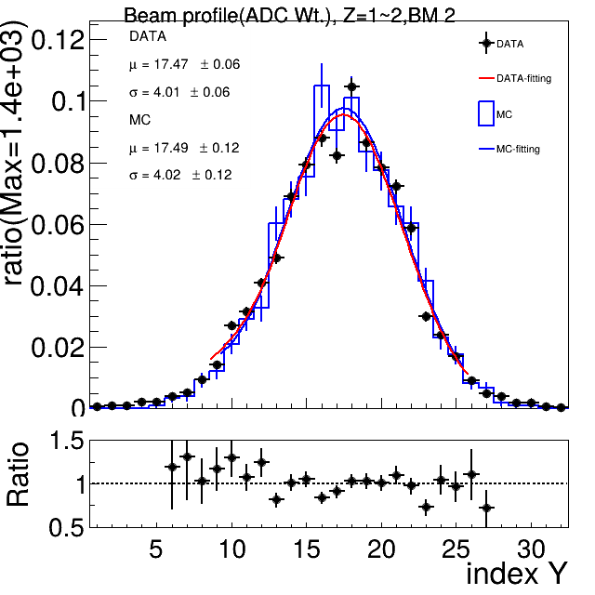
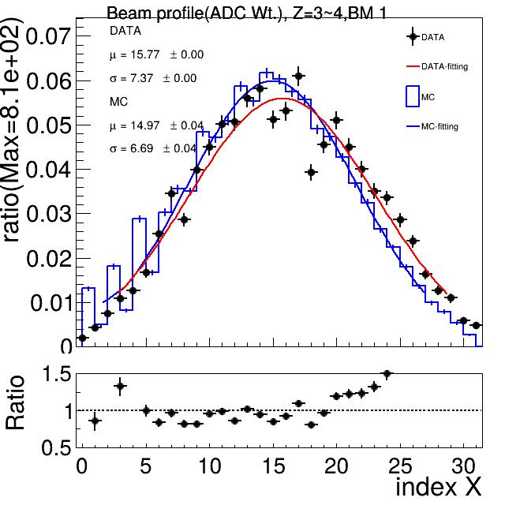
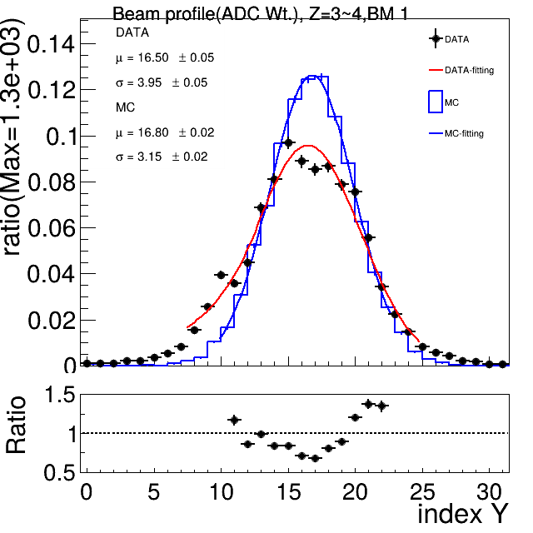


Beam profile on BeamMonitor
BM selection: each layer has at least one hit
Data Run2013(796MeV)
X: Gauss Random shoot(-2, 14.1)*mm->(11.4, 15.6) Y: Gauss Random shoot(8, 8.93)*mm ->(-4.98, 8.62)
Equal weight is used on MC.

Slide 4
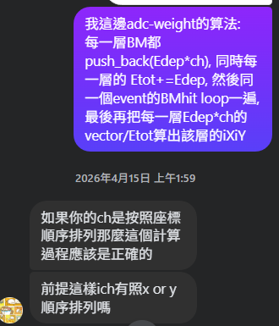
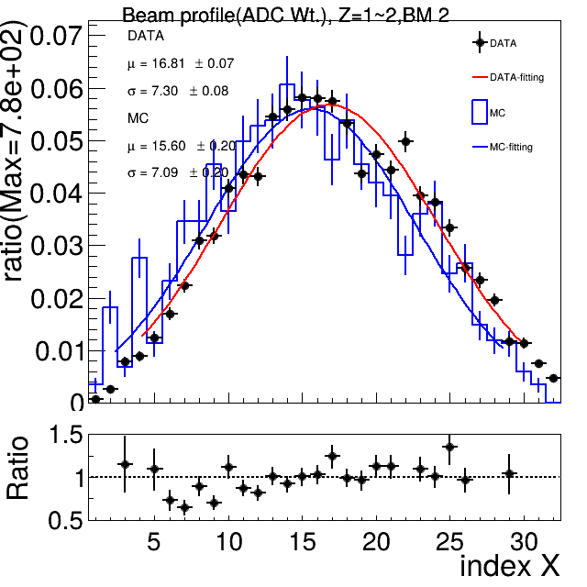
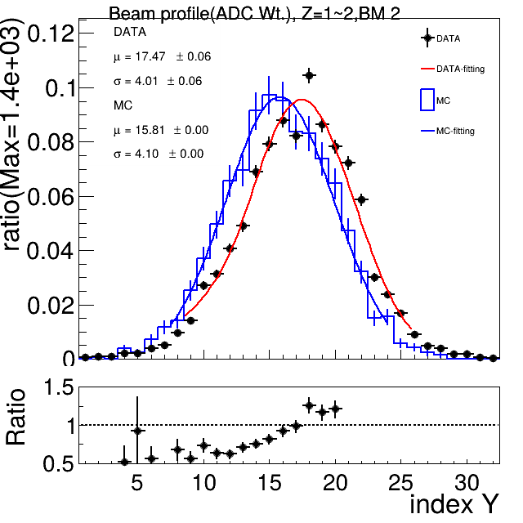
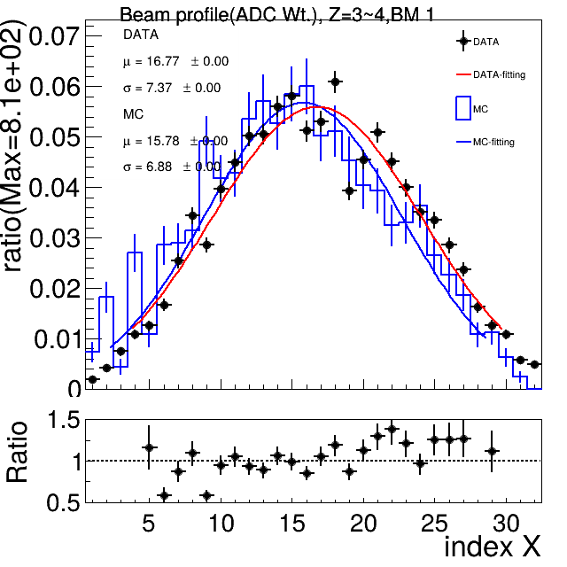
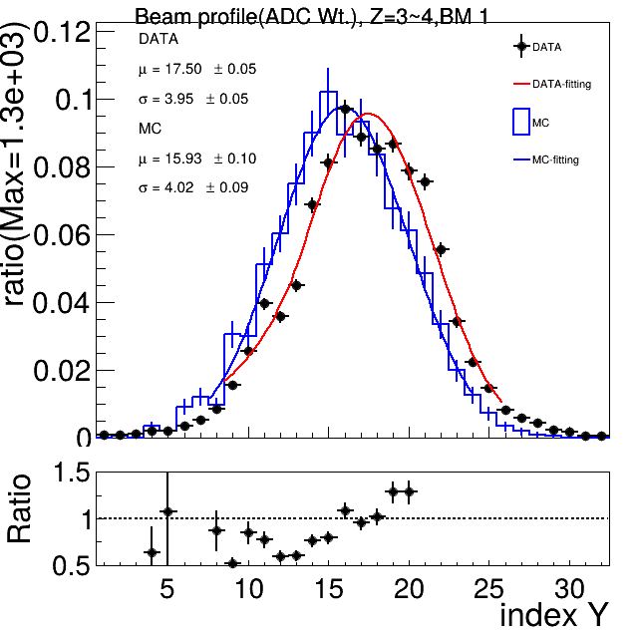
Beam profile on BeamMonitor
BM selection: each layer has at least one hit
Data Run2013(796MeV)
X: Gauss Random shoot(-2, 14.1)*mm->(11.4, 15.6) Y: Gauss Random shoot(8, 8.93)*mm ->(-4.98, 8.62)
Equal wt. is used on MC.
ADC wt. is used on MC.
Spikes also occur on low index-Y

Slide 5
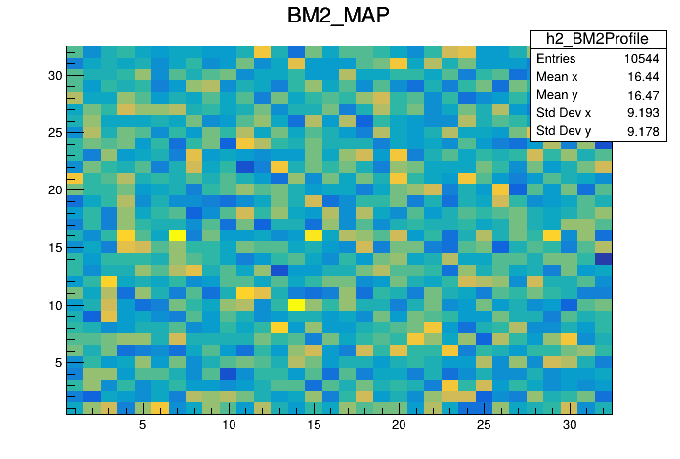
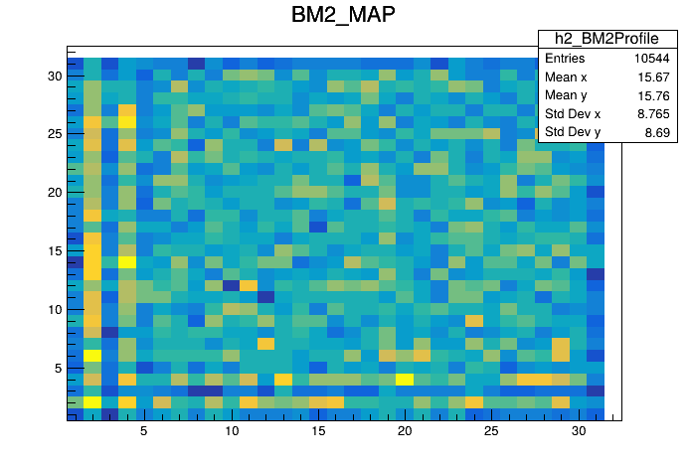
Beam profile on BeamMonitor
BM selection: each layer has at least one hit
Data Run2013(new)
MC:
PbWO4 crystal array is shifted by +10mm on X-axis & -1mm on Y-axis. X: uniform Random(15cm) Y: uniform Random(15cm)
BM surface ~ 7cm*7cm
Equal wt. is used on MC.
ADC wt. is used on MC.
Weird structure ->check event by event…

Slide 6
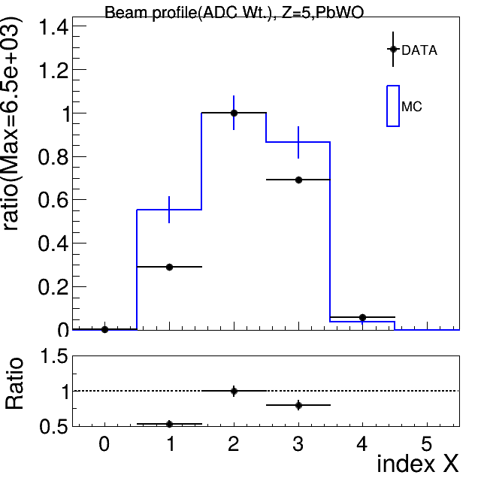
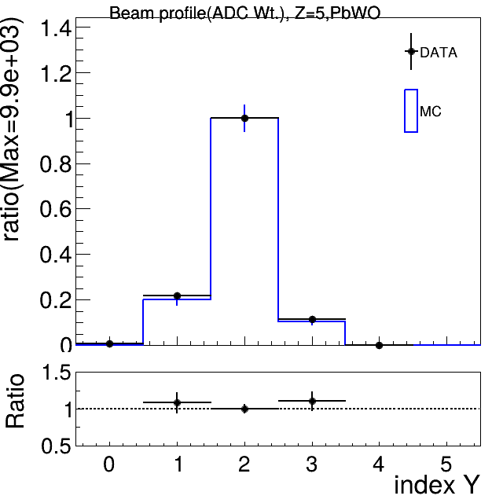
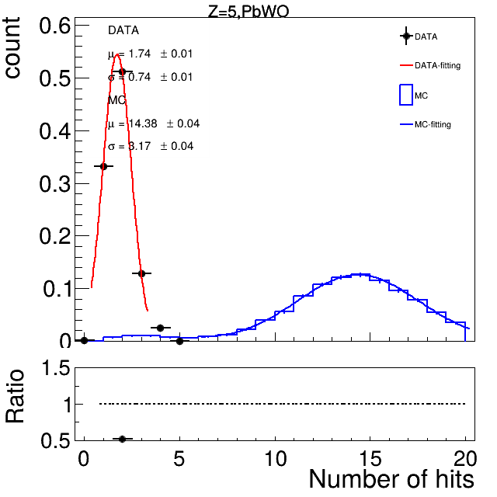
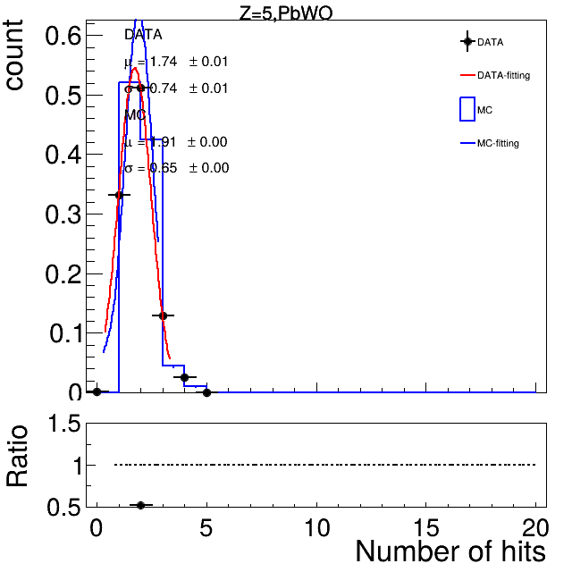
Beam profile on PbWo4 crystal
Data Run2013(new)
MC:
PbWO4 crystal array is shifted by +10mm on X-axis & -1mm on Y-axis. X: Gauss Random shoot(-2, 14.1)*mm->(11.4, 15.6) Y: Gauss Random shoot(8, 8.93)*mm ->(-4.98, 8.62)
Threshold 0MeV
Threshold 50MeV
Todo:
Threshold adjustment.

Slide 7
backup

Slide 8
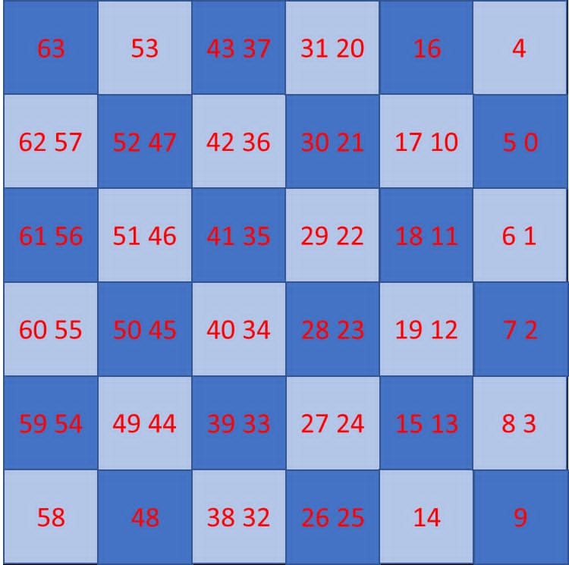
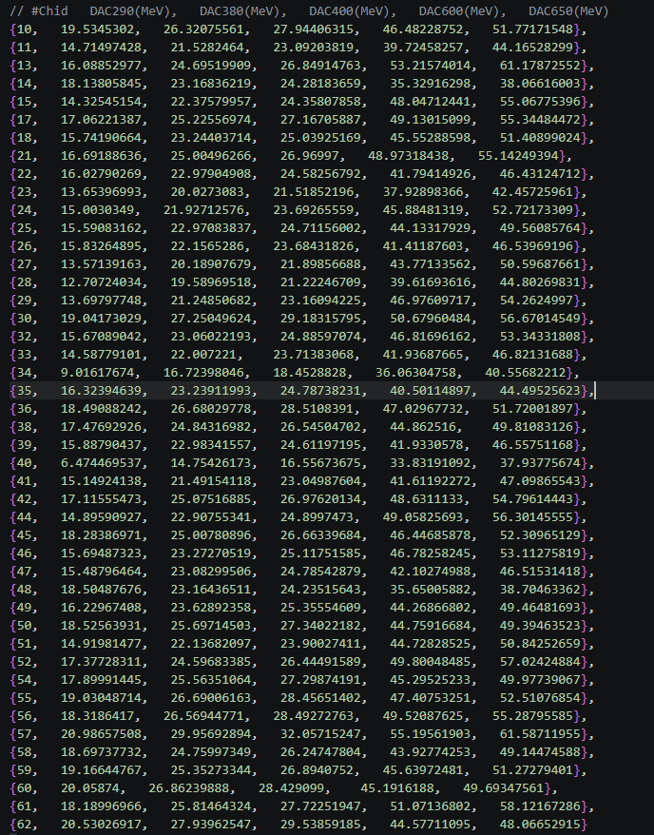
Threshold dead channel

