Slide 1
ZDC Crystal ECAL Development
20260501 @ ePIC General Meeting
Chia-Yu Hsieh
Institute of Physics, Academia Sinica, Taiwan
on behalf of the ZDC Crystal ECAL Group

Slide 2
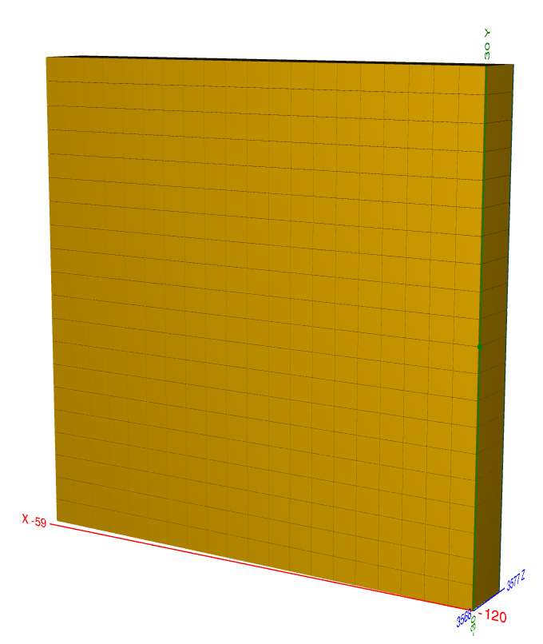
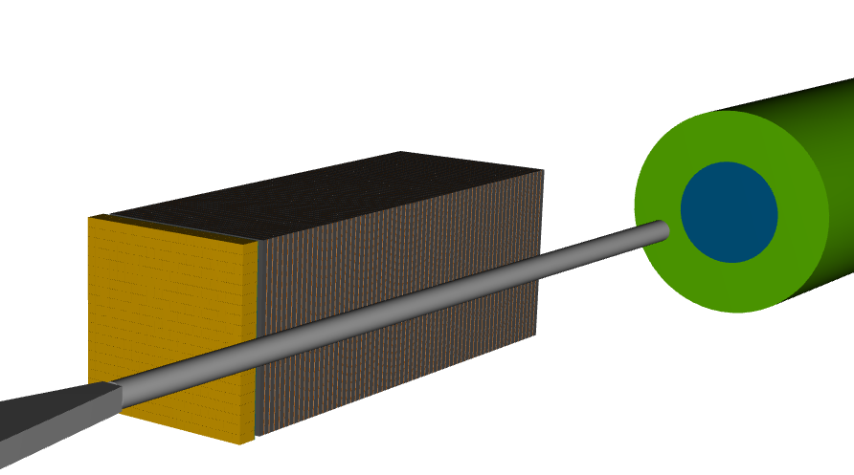
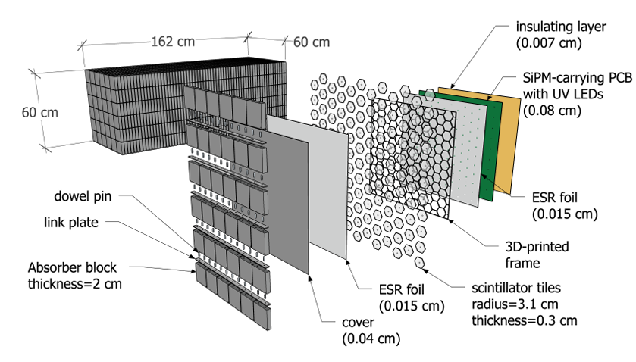
ZDC Design
ECAL
LYSO Crystal
20*20 cells
3cm*3cm*7cm / cell
60cm*60cm
7cm ~ 6.5X0 in Z
ZDC = ECAL + HCAL
Beam line
ECAL
crystal calorimeter
provide good energy resolution
HCAL
Sampling calorimeter
provide good position resolution
Requirements of energy resolution are for hadrons and photons are 50%/sqrt(E) + 5% and 20%/sqrt(E) + 5%, respectively. Furthermore, ECAL has sensitivity to photon down to 100 MeV.
HCAL : sampling calorimeter
1 layer = steel + scintillator tile + SiPM
64 layers, 8 slice/layer
65cm in X, 60cm in Y, 163cm in Z

Slide 3
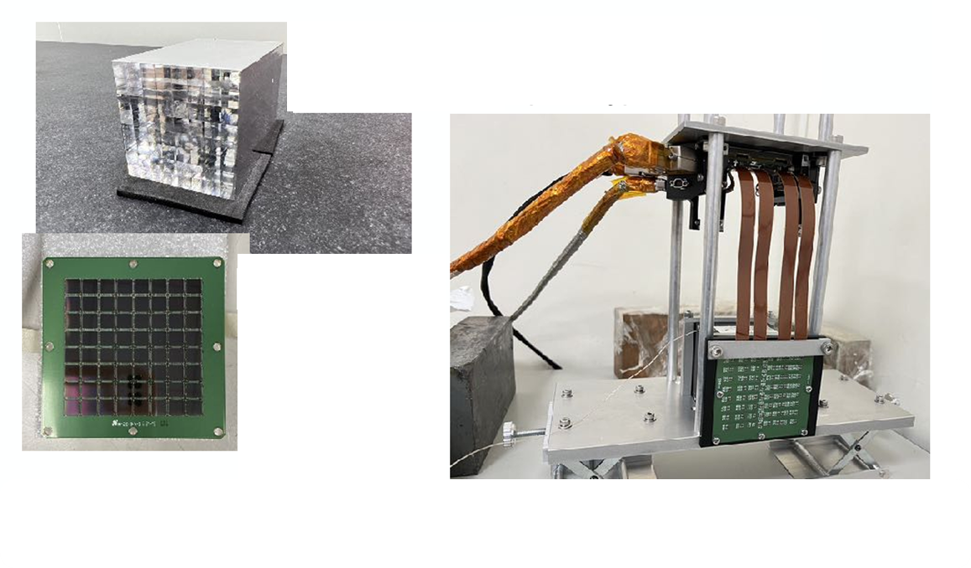
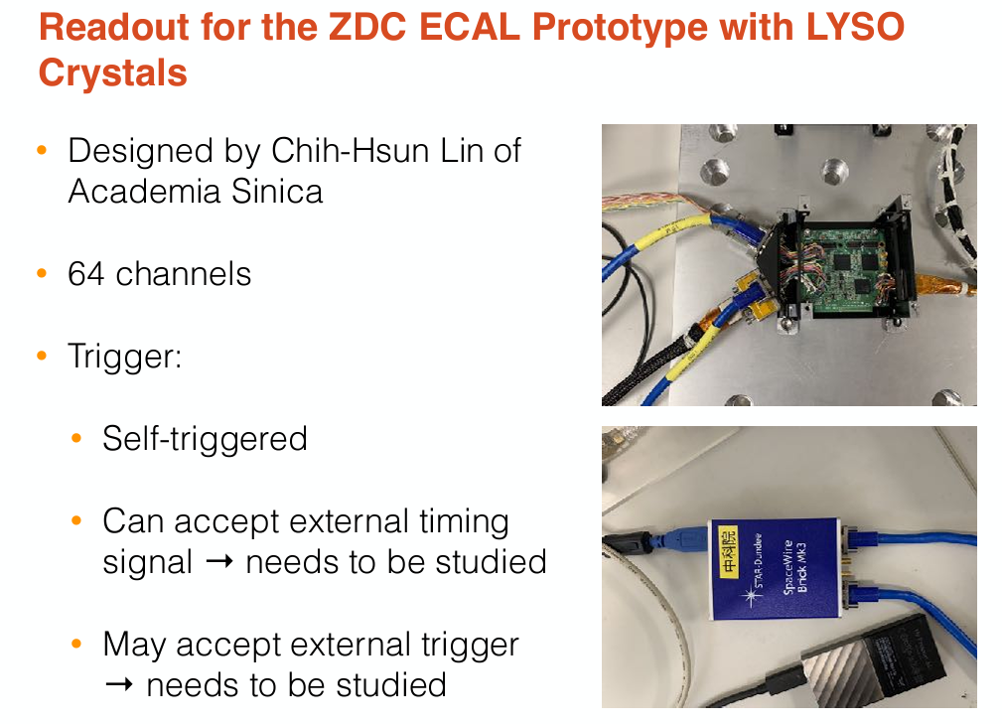
1st Prototype of ZDC ECAL
CITIROC (160-400pC)
LYSO crystal
(8x8 , 8X0, ESR)
Onsemi SiPM
 | Detector | Crystal |  |  |  | Sensor |  | DAQ
 |  | name | Size of one cell | Length | Array | Type | Sensor /crystal
1st prototype 2023-2024 | LYSO + SiPM | LYSO | 0.7cm*0.7cm | 8cm (8X0) | 8x8 | SiPM Onsemi MICROFC-60035 | 1 | CITIROC

Slide 4
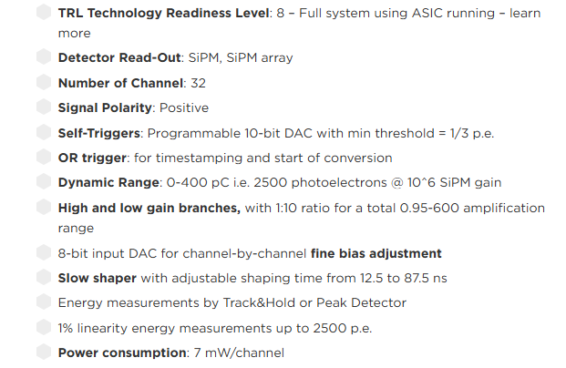
CITIROC DAQ
LYSO +SiPM (64ch)
CITIROC_A (32ch) CITIROC_B (32ch)
Data
Laptop
Data taking
Control
Monitor
SpaceWire Mk4
Control
UART
Low voltage (12V)
Temperature
CITIROC spec.
CITIROC is a 32-channel front-end ASIC designed to readout silicon photo-multipliers.
Dynamic range up to 400pC
Shaper
Peak Sensenig ADC
Data, slow control (threshold, gain, etc setup), online monitoring (DAQ deadtime, temperature) are all through laptop interface.

Slide 5
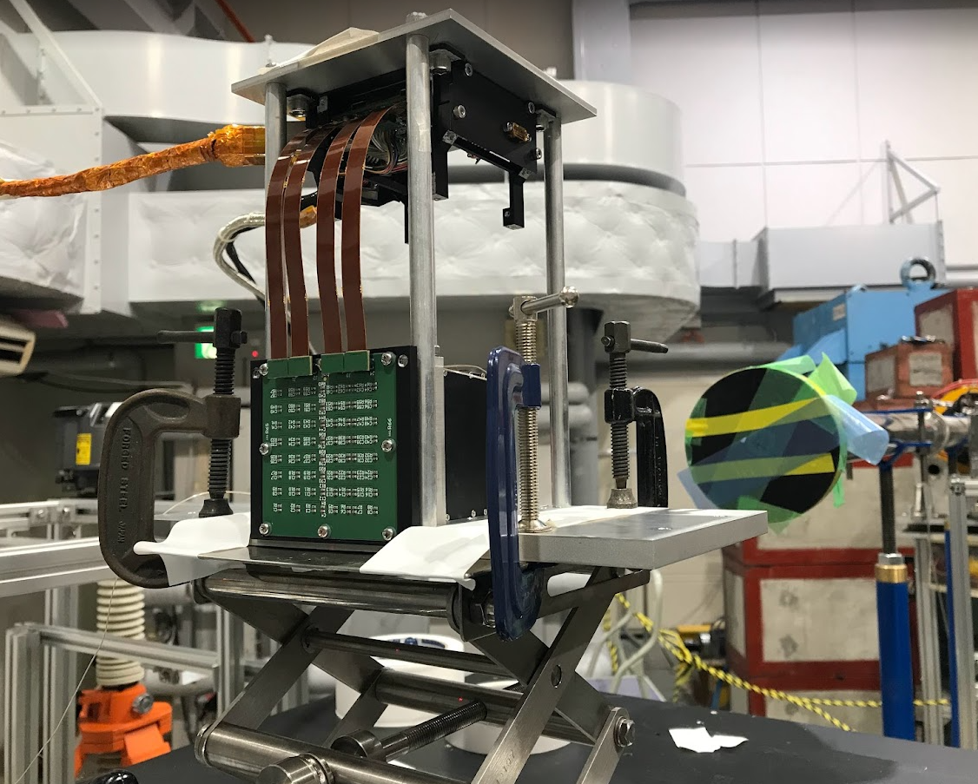
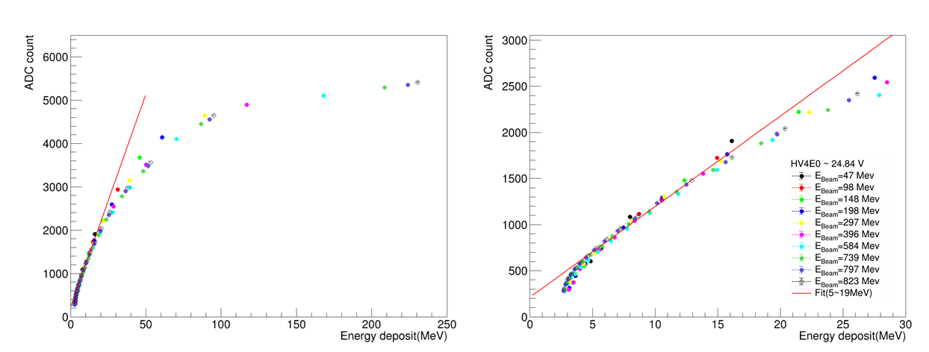
1st Prototype : SiPM Saturation
50-800 MeV
positron beam
Non-linearity
Test beam at RARiS on 2024 Feb, using 50MeV - 800MeV positron beam.
Most of data points lying in the non-linear region
only the 47 MeV data set retaining about 60% of events within the linear range.

Slide 6
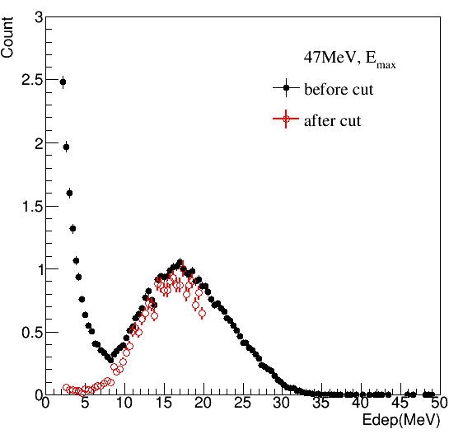
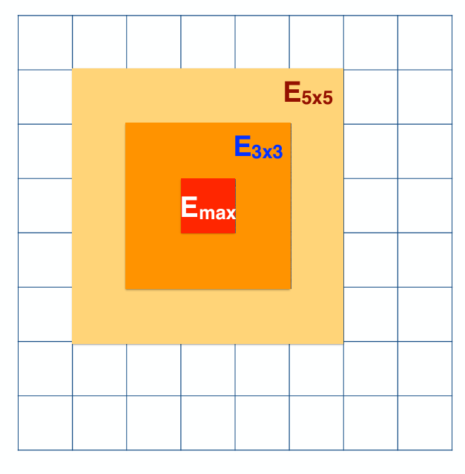
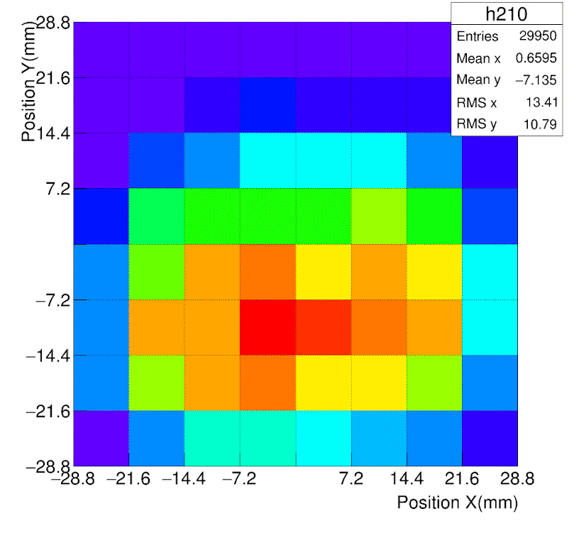
1st Prototype : Selection Criteria
clustering
Beam profile @ 47MeV
Cut Criteria
2.5 MeV < Eₘₐₓ < 20 MeV
  Selects data within the linear response range.
  Removes low-momentum photons originating from the beam.
Both Left and Right Crystals Fired
  Requires hits in both FEE-left and FEE-right channels.
  Eliminates events containing only noise.
FEE left
FEE right

Slide 7
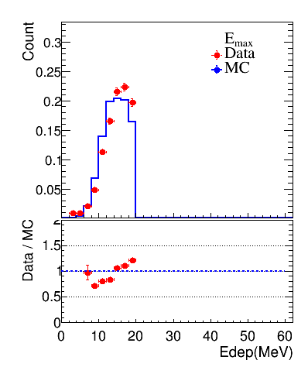
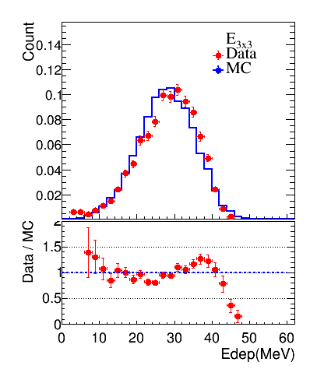
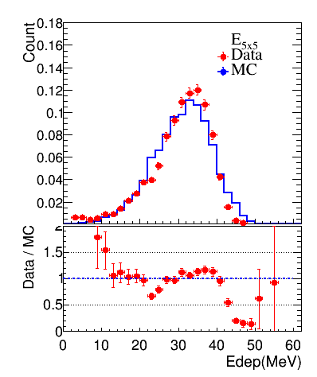
1st Prototype : Data and MC Comparison
The comparison between data and MC for the 47 MeV positron beam shows good overall consistency.
clustering

Slide 8
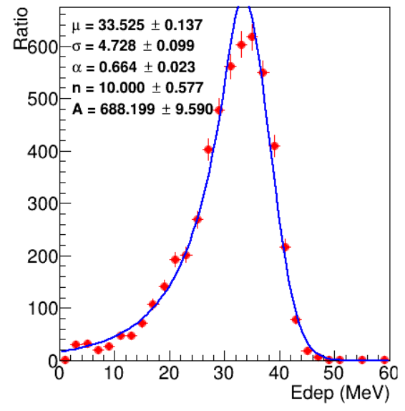
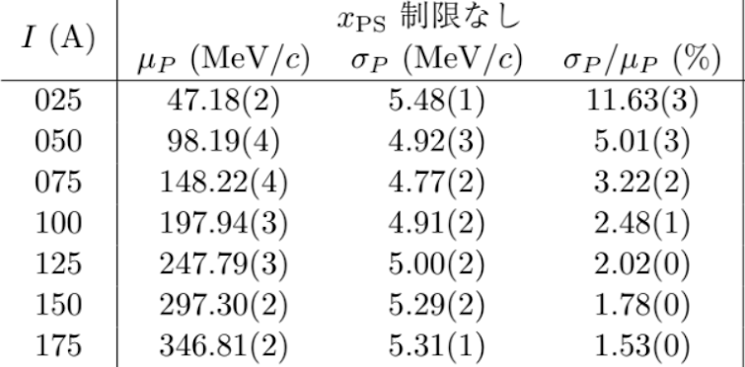
1st Prototype :
Energy Resolution w/o Energy Regression
47MeV positron
E5x5
Data
Fettig
Energy resolution of 47MeV momentum resolution = 11.6%
Energy resolution without energy regression is 14% for the 47 MeV beam. After accounting for the beam momentum resolution provided, the energy resolution improves to approximately 11%.

Slide 9
Design of 2nd Prototype
Choice of crystal
Material | Light yield (photons/MeV) | Relative to LYSO
LYSO | ~32,000 – 38,000 | 1.0
PbWO₄ | ~200 – 400 | ≈ 1/100 of LYSO
Choice of sensor
Sensor | Typical Gain | Relative
SiPM | ~10⁵ – 10⁶ | 1.0
APD | ~10² – 10³ | ≈ 1/1000 – 1/10,000 of SiPM
1st prototype @ 2023-2024 : LYSO + SIPM, saturation
2nd prototype @ 2024-2025 : reduce the gain.
LYSO + APD
The gain of an APD is about 1000 times lower than that of a SiPM.
PbWO₄ + SiPM
The light yield of PbWO₄ is about 100 times lower than that of LYSO.
We continue using CITIROC as DAQ system.

Slide 10
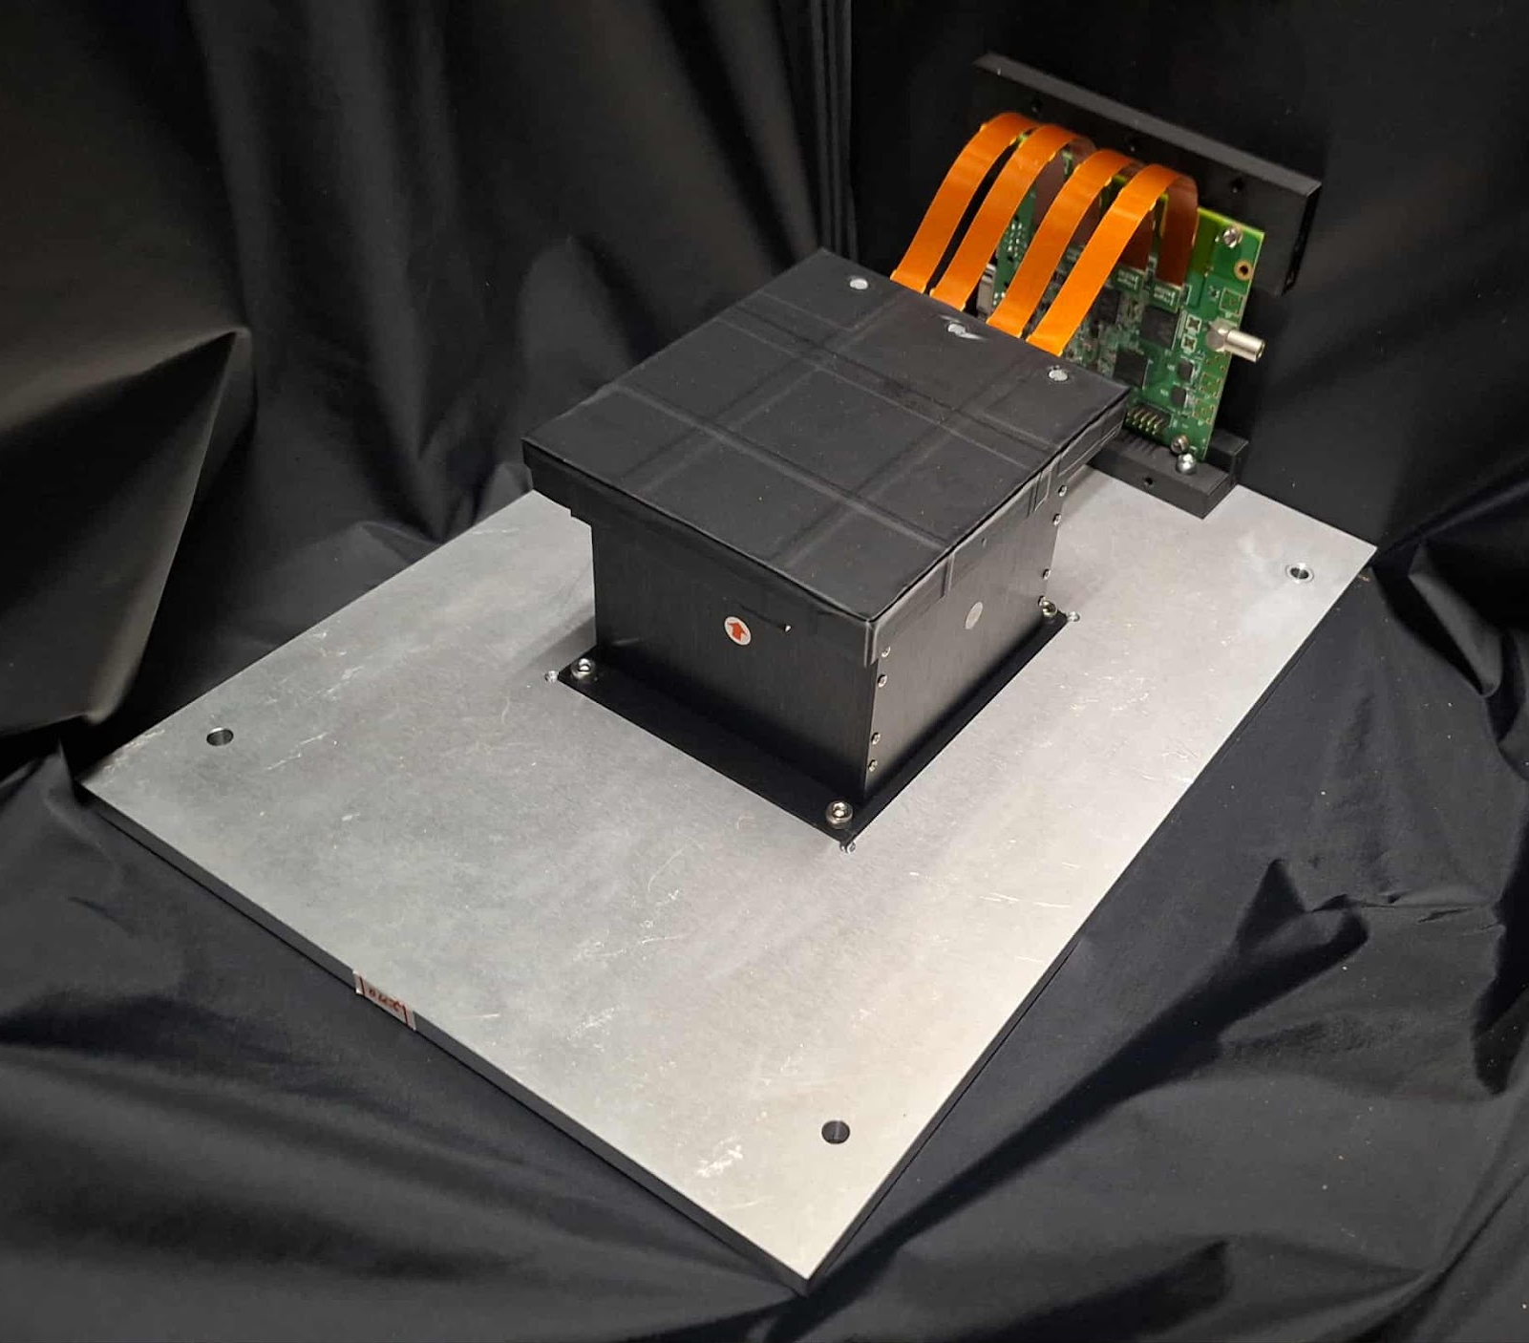
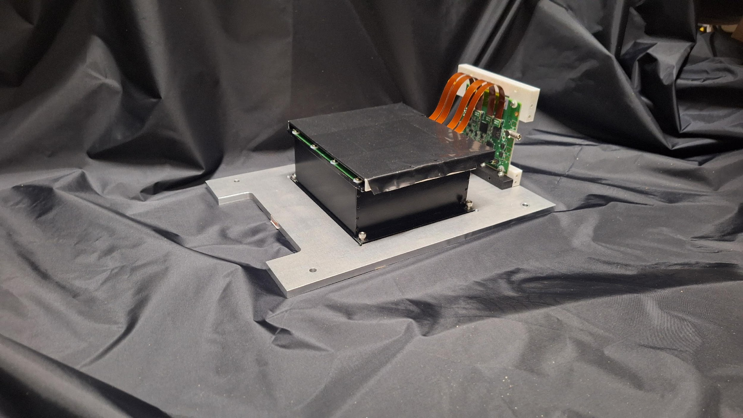
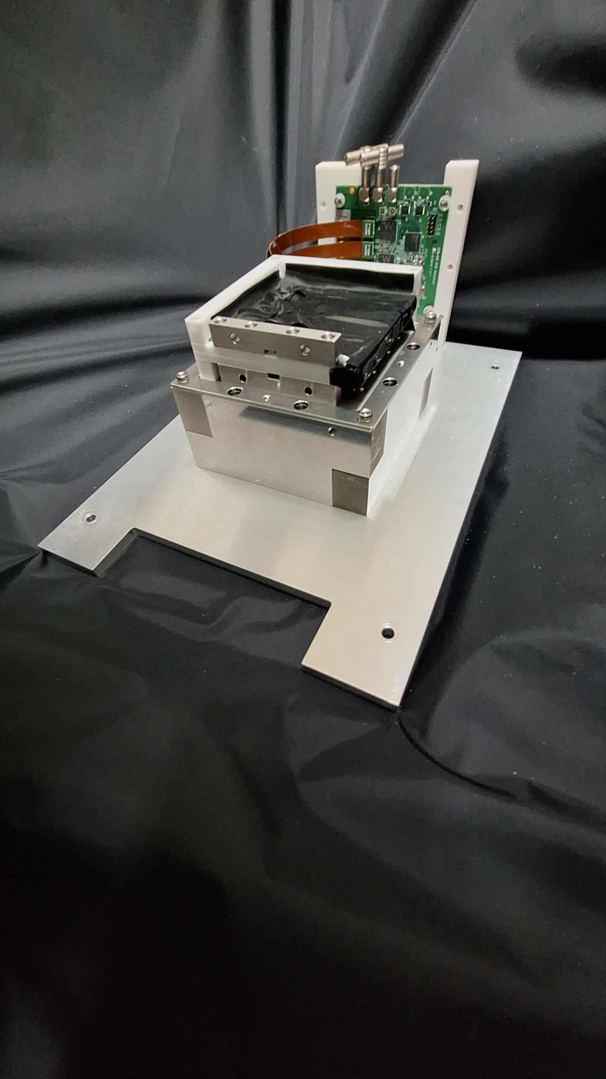
2nd ZDC ECAL Prototype
LYSO + APD
PbWO4 + SiPM
Beam Monitor
 | Detector | Crystal |  |  |  | Sensor |  | DAQ
 |  | name | Size of one cell | Length | Array | Type | sensor/crystal
2nd prototype 2024-2025 | LYSO + APD | LYSO | 1cm*1cm | 6.6cm (6X0) | 8x8 8cm*8cm | APD C30739ECERH | 1 | CITIROC
 | PbWO4 + SiPM | PbWO4 | 2cm*2cm | 5.3cm (6X0) | 6x6 12cm*12cm | SiPM Onsemi MICROFC-60035 | 2 | CITIROC

Slide 11
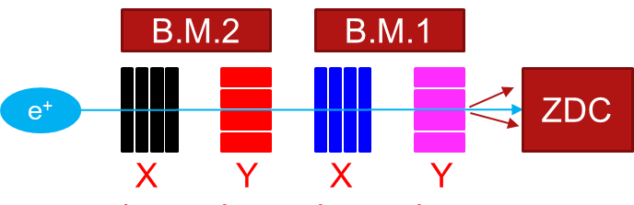
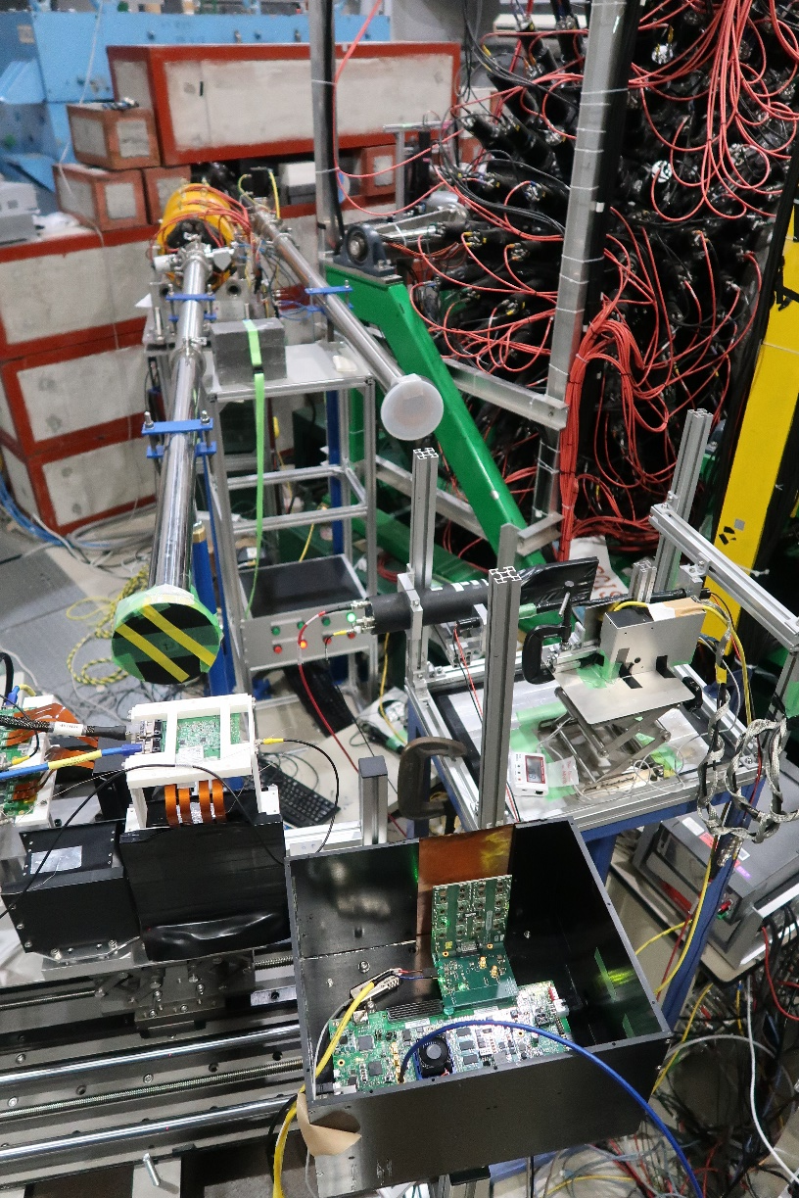
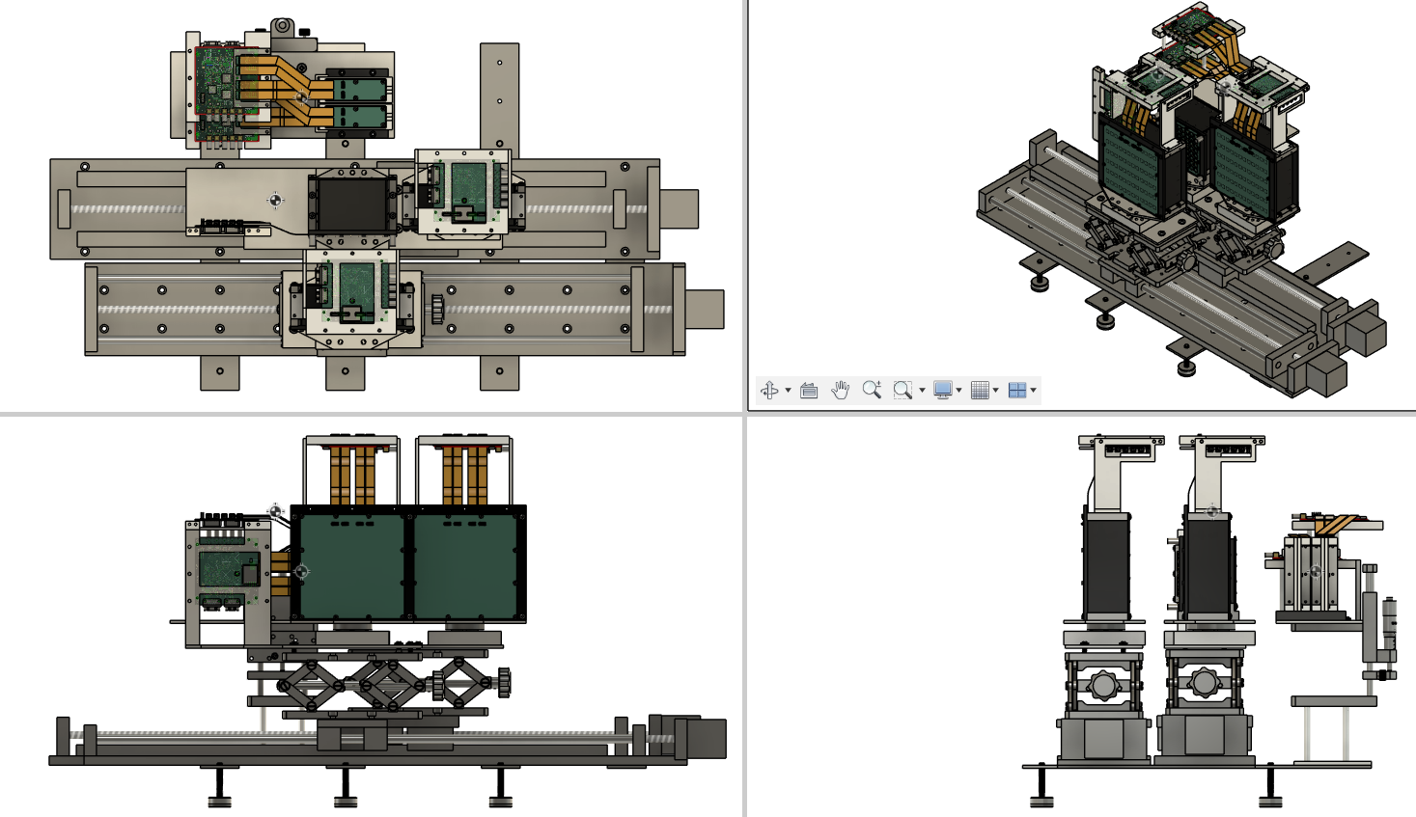
2nd Prototype : Test Beam
50-800 MeV
positron beam
50-800MeV positron beam
Beam monitor
LYSO + APD
PbWO4+SiPM
We add beam monitor system in order to evaluate position resolution.

Slide 12
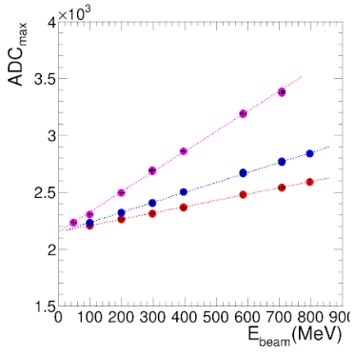
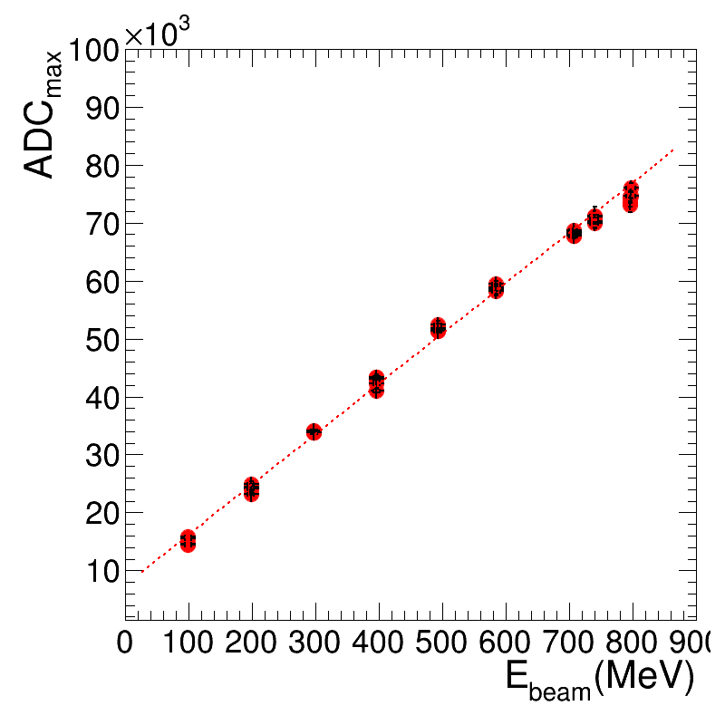
2nd Prototype : Linearity
LYSO + APD
PbWO4 + SiPM
APD HV
405 V
395 V
385 V
SiPM HV
32.6V
Linearity: The detectors showed good linearity when tested with an electron beam from 50 MeV to 800 MeV.

Slide 13
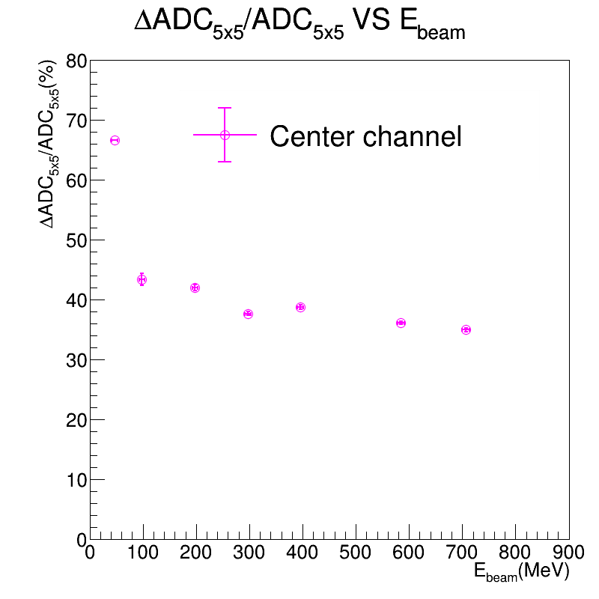
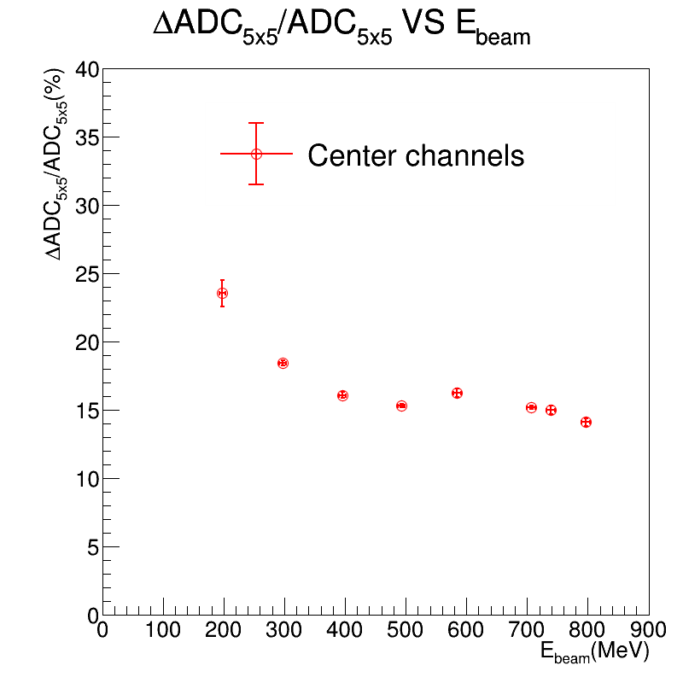
2nd Prototype : Energy Resolution
(w/o Energy Regression)
LYSO + APD (APD=405V)
PbWO4 + SiPM (SiPM=32.6V)
LYSO + APD : Poor performance ~ 35% energy resolution with 700MeV positron beam.
PbWO4 + SiPM : Reasonable performance ~ 15% energy resolution with 700MeV positron beam.
The energy regression is not performed.

Slide 14
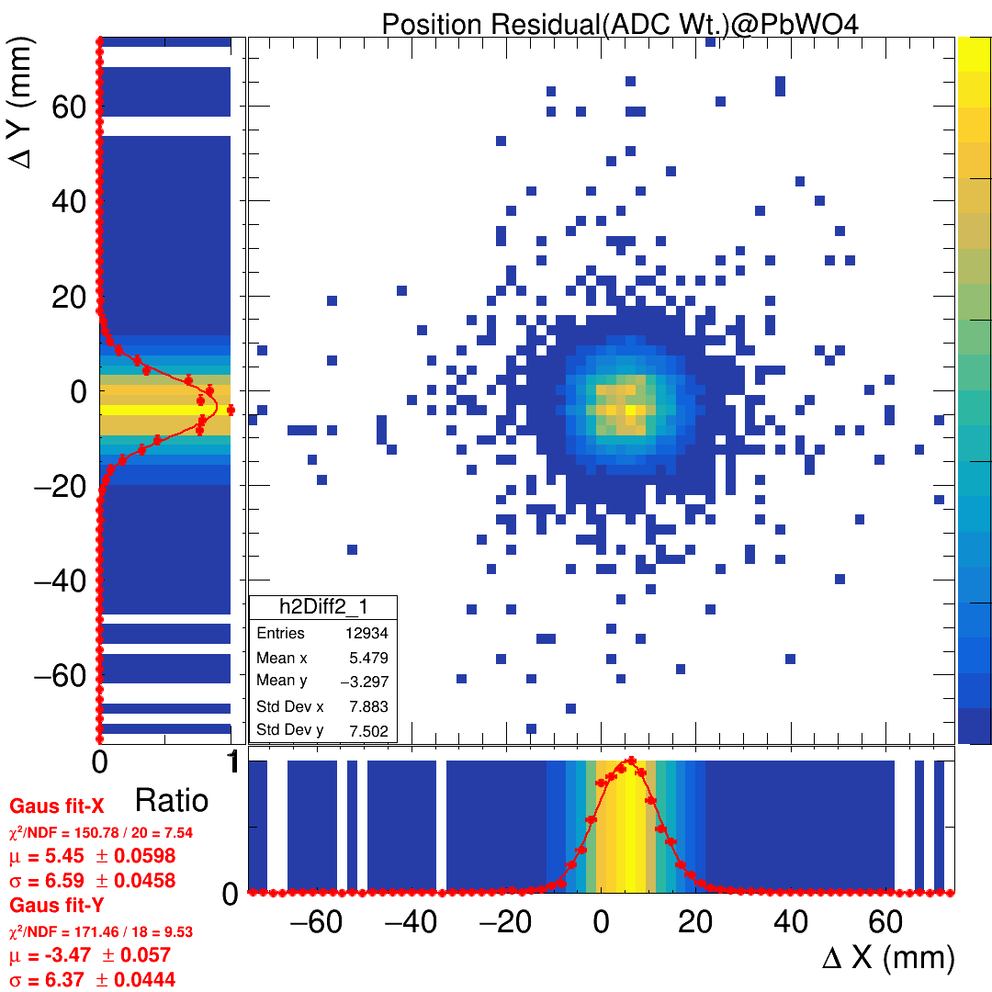
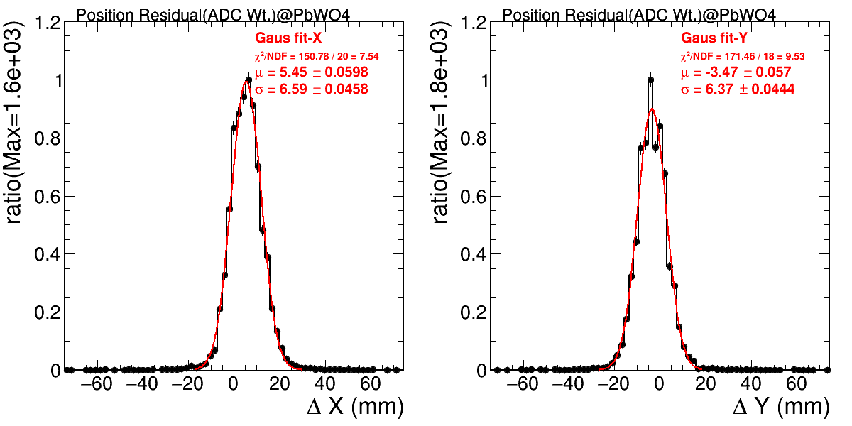
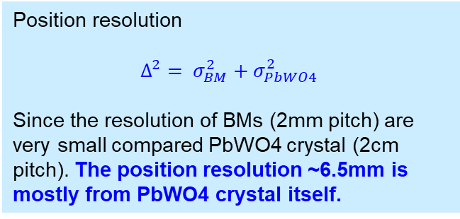
Residual of “PbWO4 + SiPM”
PbWO4 system @ 739 MeV
Residual
Residual in X
Residual in Y
Position resolution
$$Δ^{2}= σ_{BM}^{2}+σ_{PbWO4}^{2}$$
Since the resolution of BMs (2mm pitch) are very small compared PbWO4 crystal (2cm pitch). The position resolution ~6.5mm is mostly from PbWO4 crystal itself.

Slide 15
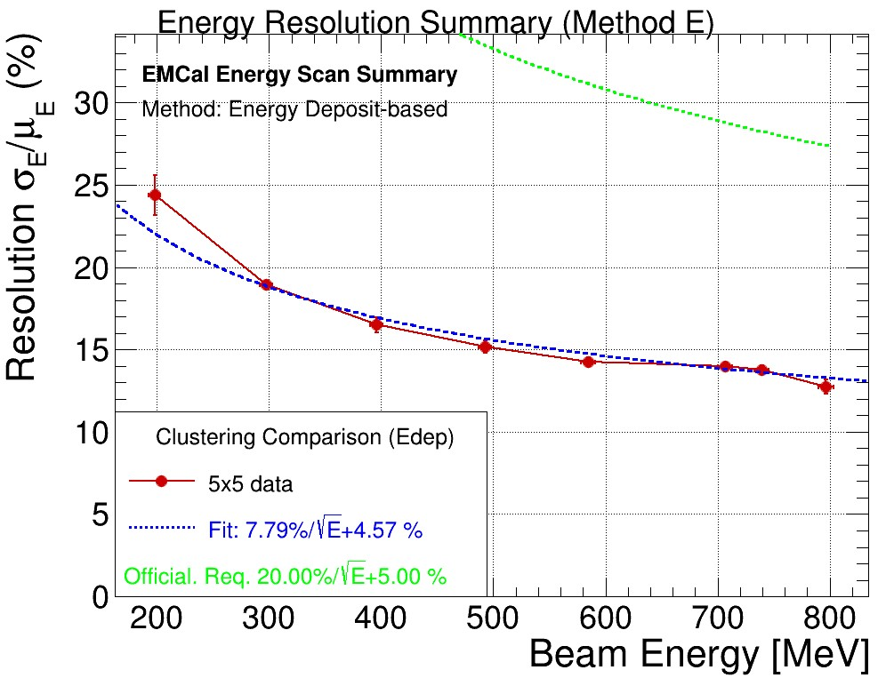
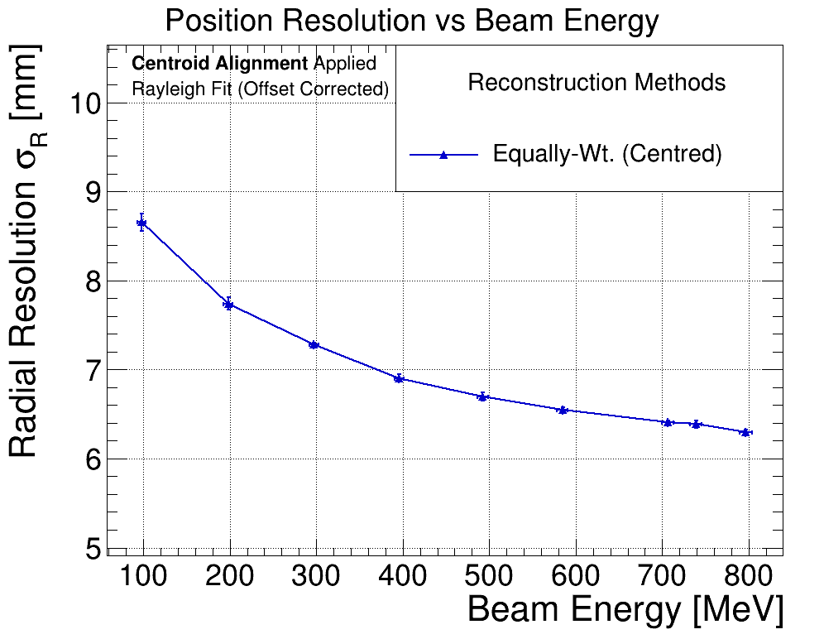
Performance of “PbWO4 + SiPM”
Energy resolution
Position resolution
(Chi2/NDF = 13.56/6)
For 2nd prototype, only PbWO4 + SiPM system gives reasonable performance.
  Energy resolution : ~15% @ 800MeV positron beam
  Position resolution : ~ 6.5mm @ 800MeV positron beam
Satisfy the requirement, but we need to measure with higher energy beam to have full picture.

Slide 16
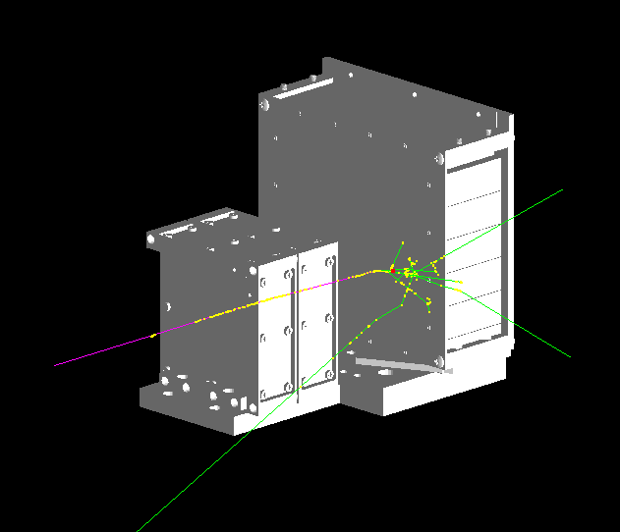
MC Simulation Condition
PbWO4
50MeV ~ 796 MeV positron beam
Beam spread
perpendicular beam
gaussian random
Center (x, y) = (11.4, -4.98) mm
Sigma (x, y) = (-4.98, 8.62) mm
PbWO4 crystal array is shifted
(x, y) = (10, -1) mm, compare to alignment
BM1
BM2

Slide 17
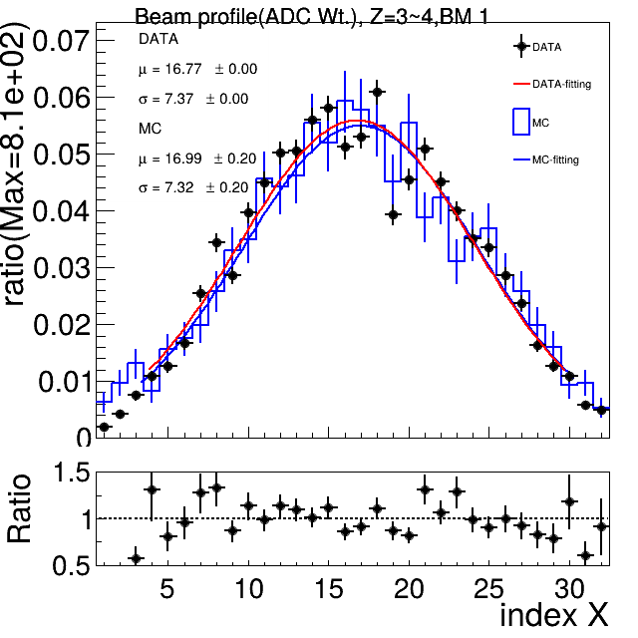

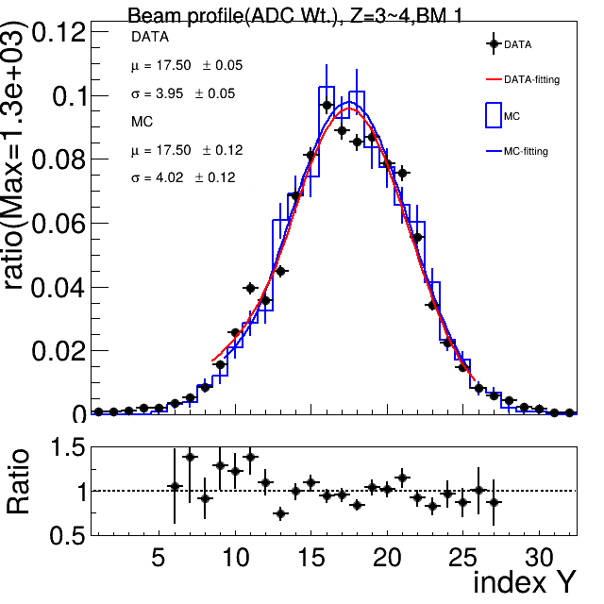

Beam Profile
BM1
BM2
Profile in X
Profile in Y
Nice consistency

Slide 18
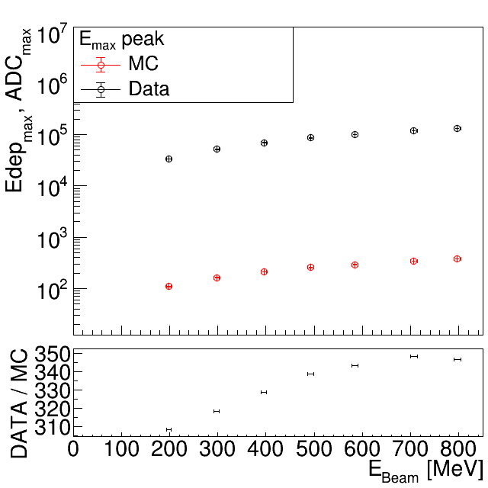
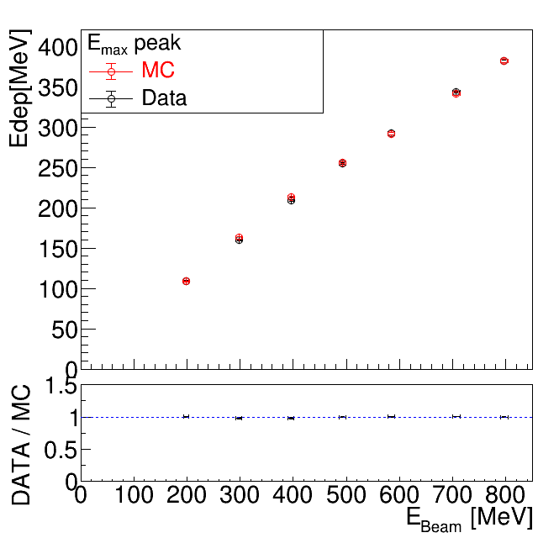
ADC to MeV Conversion
  Data (ADC) = MC (MeV) * 370.73 + 8417

Slide 19
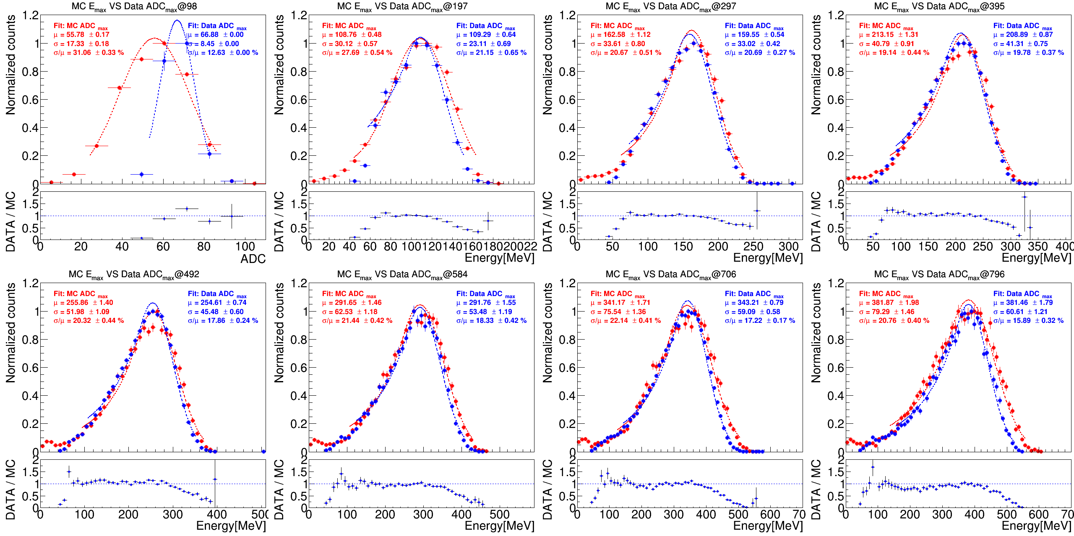
Data and MC Comparison : Emax
Nice consistency except for 98MeV because of 50MeV threshold cut

Slide 20
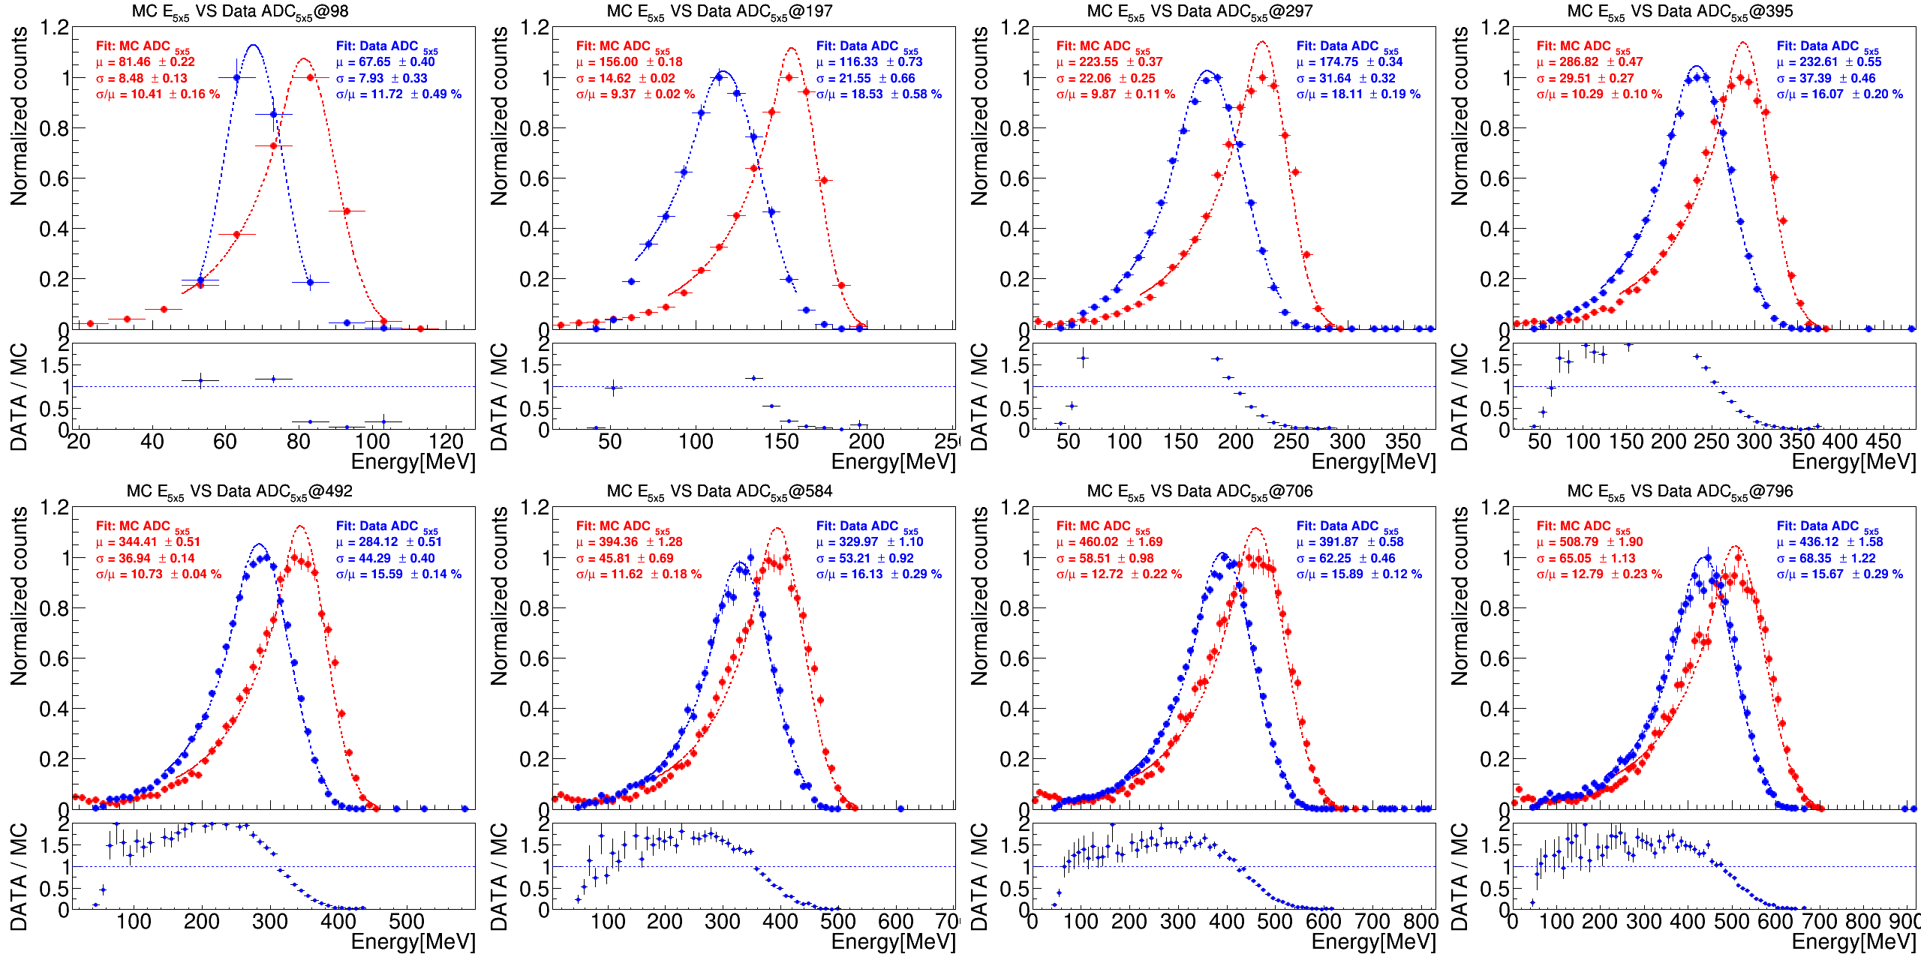
Data and MC Comparison : E5x5 w/o threshold cut

Slide 21
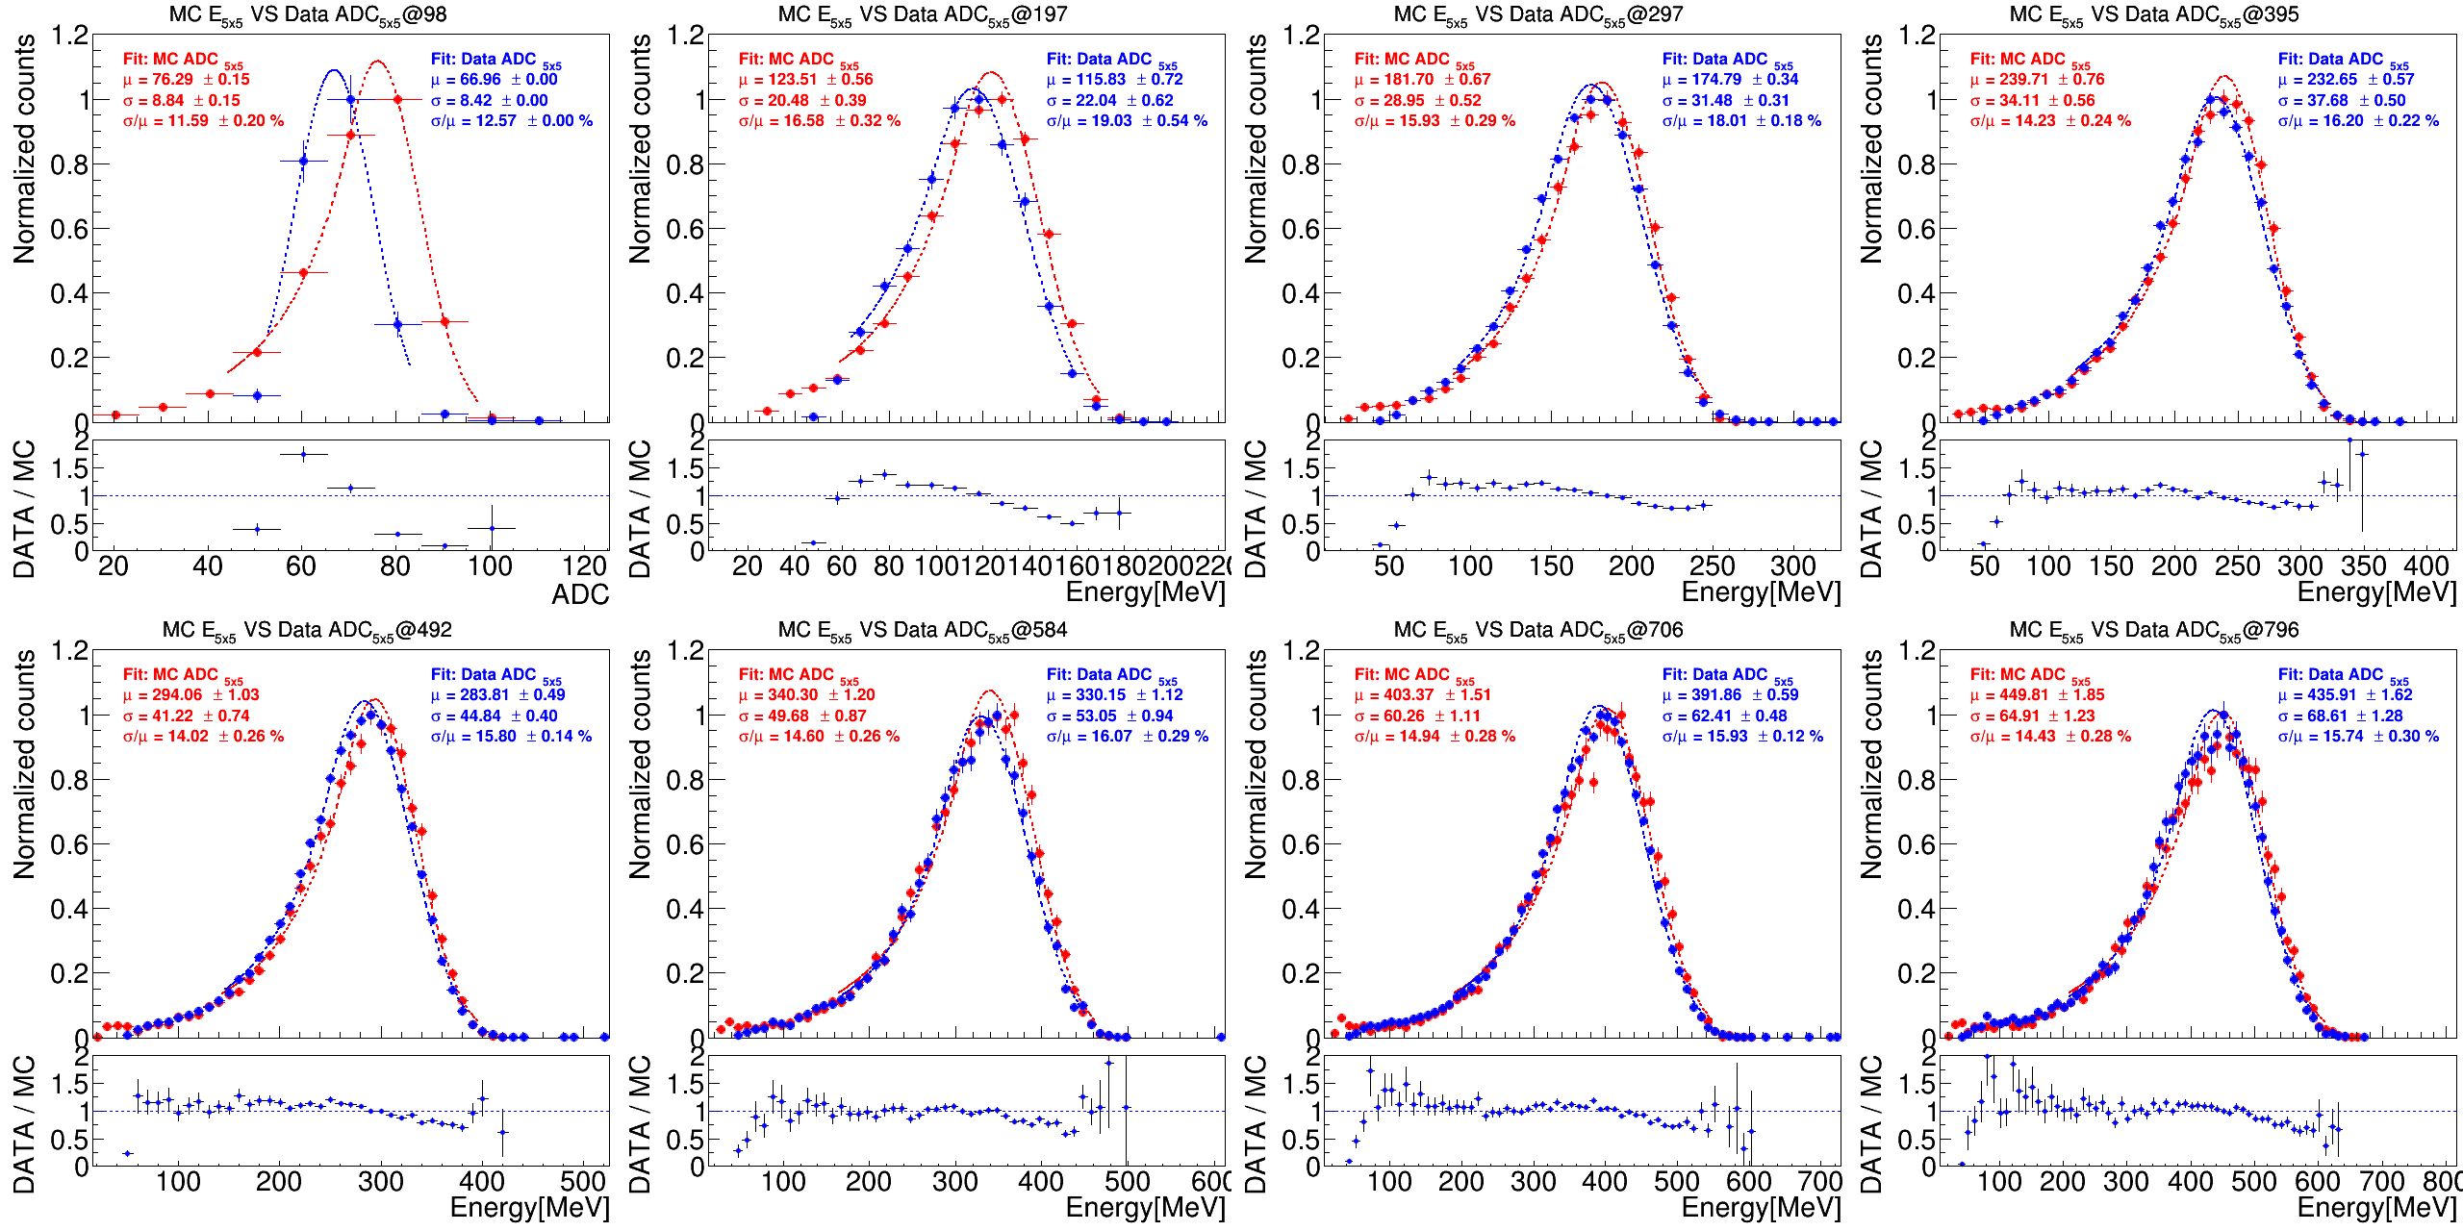
Data and MC Comparison : E5x5 w/ threshold cut

Slide 22
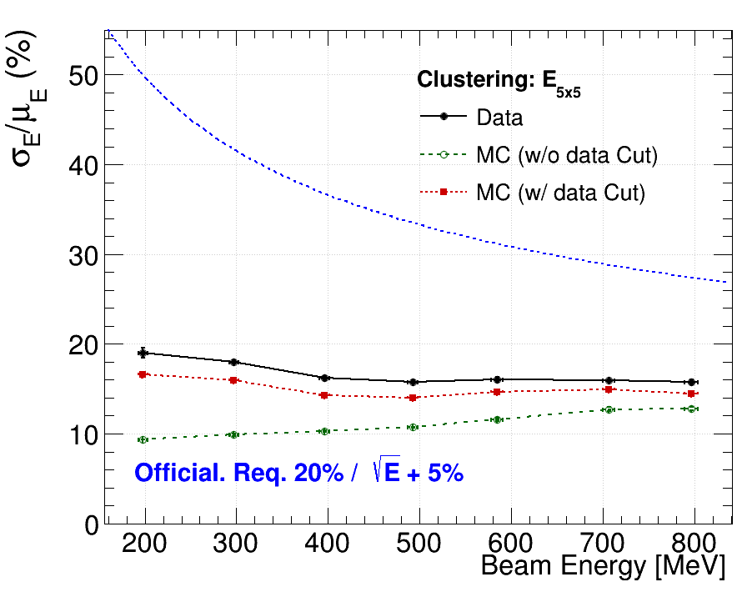
Data and MC Comparison :
Energy Resolution (sigma)
Notice that MC and Data are w/o energy regression.
But they both satisfied the requirement.
Performance of MC is around 2% better than Data.
We might need to push to higher beam energy to see >1GeV performance.

Slide 23
Data and MC Comparison :
Position Resolution (sigma) and Bias (mean)

Slide 24
Photon Sensors
Onsemi SiPM (MICROFC-60035) : https://www.onsemi.com/pdf/datasheet/microc-series-d.pdf
Hamamatsu SiPM (S14160-3015PS) : https://www.hamamatsu.com/us/en/product/optical-sensors/mppc/mppc_mppc-array/S14160-3015PS.html
Feature | onsemi SiPM (MICROFC-60035) | Hamamatsu SiPM (S14160-3015PS)
Active area | 6 × 6 mm² | 3 × 3 mm²
Gain | ~10⁶ | ~10⁶
Bias voltage | ~24–30 V | ~38–55 V
PDE (peak) | ~40–50% | ~45–55%
Dynamic range (p.e.) | 1 – ~1.5×10⁴ p.e./cell 527 cells/mm² | 1 – ~3×10⁴ p.e./cell 4,443 cells/mm²
Limiting factor | Microcell saturation | Microcell saturation
Next prototype, we will move to Hamamatsu SiPM.
Smaller area (more microcells per unit area) and larger dynamic range gives the Hamamatsu SiPM better linearity than the onsemi device. We expect to keep the linearity up to 29 GeV.

Slide 25
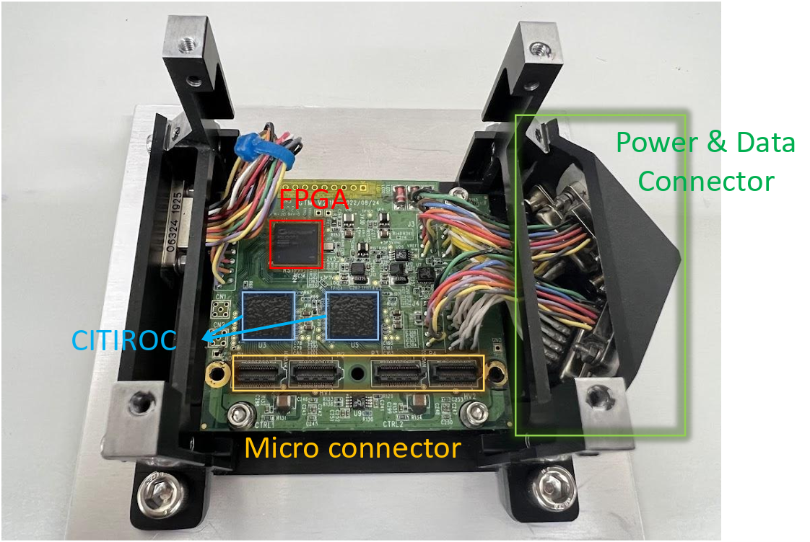
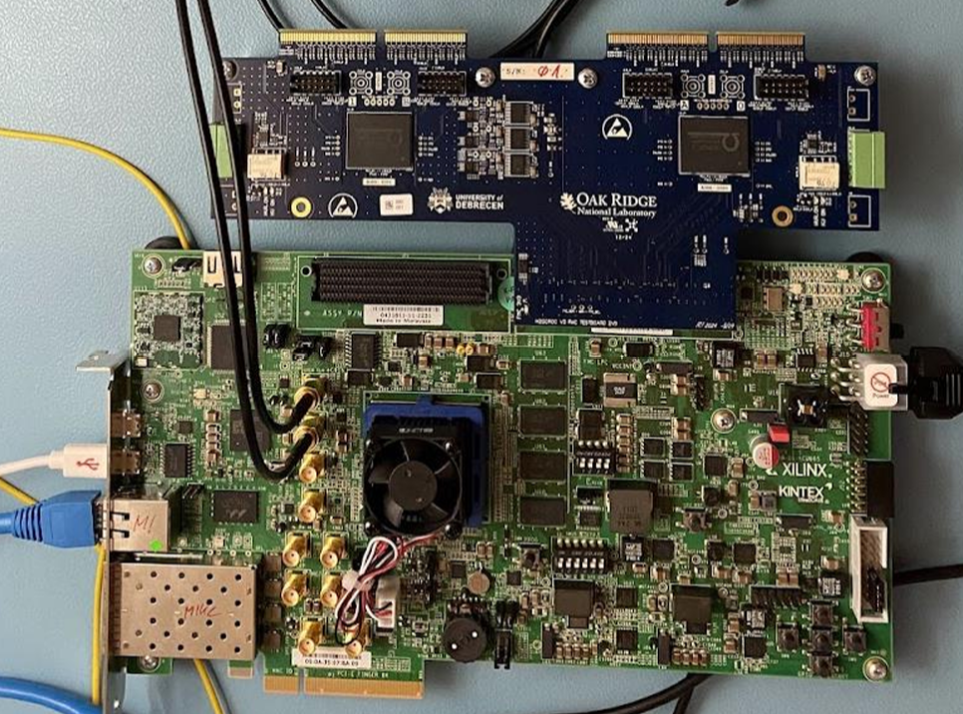
CITIROC VS H2GCROC
CITIROC
Dynamic Range: 160 fC – 400 pC
Per-Channel Bias Control:
0–4 V, 8-bit DAC for SiPM gain equalization
Dual-Gain Preamplifier:
  Low Gain: ×1–×60
  High Gain: ×10–×600
  (higher resolution, smaller range)
Signal Shaping
Self trigger
Automatic Gain Selection:
Auto HG/LG switching or LG-only mode
H2GCROC
H2GCROC
Dynamic Range: 160 fC – 320 pC
Digitization:
  10-bit ADC @ 40 MHz (integrated charge)
  12-bit TOA (TDC 24 ps)
  12-bit TOT (TDC 50 ps)
  If ADC is saturated, then automatically switch to TOA and TOT mode.
Trigger & Data Flow:
  FPGA supports self-trigger or external-trigger mode

Slide 26
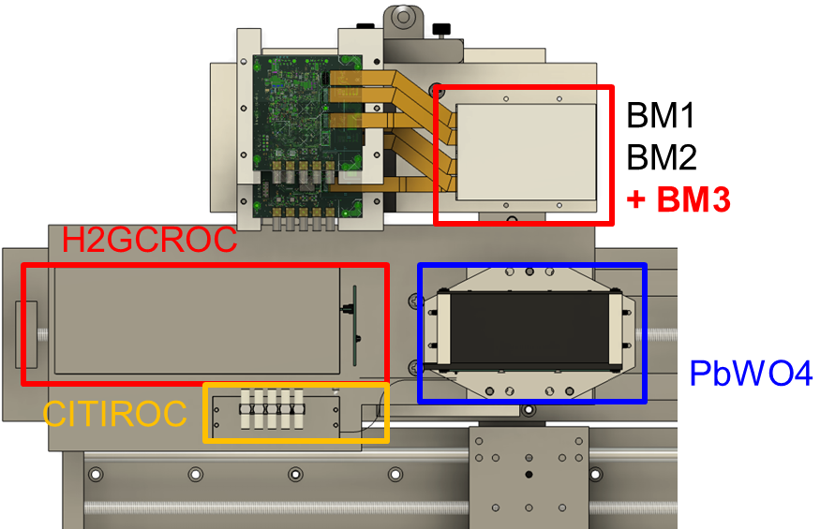
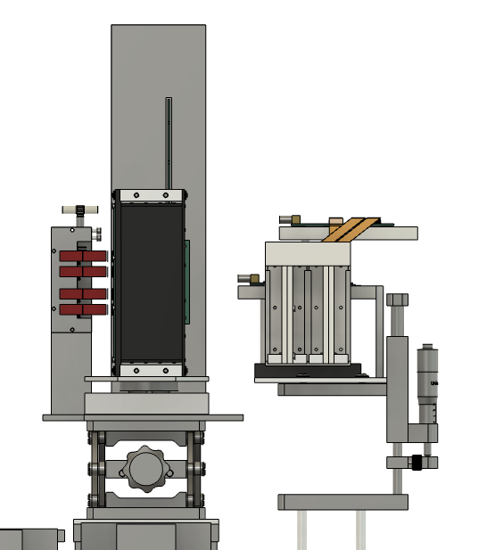
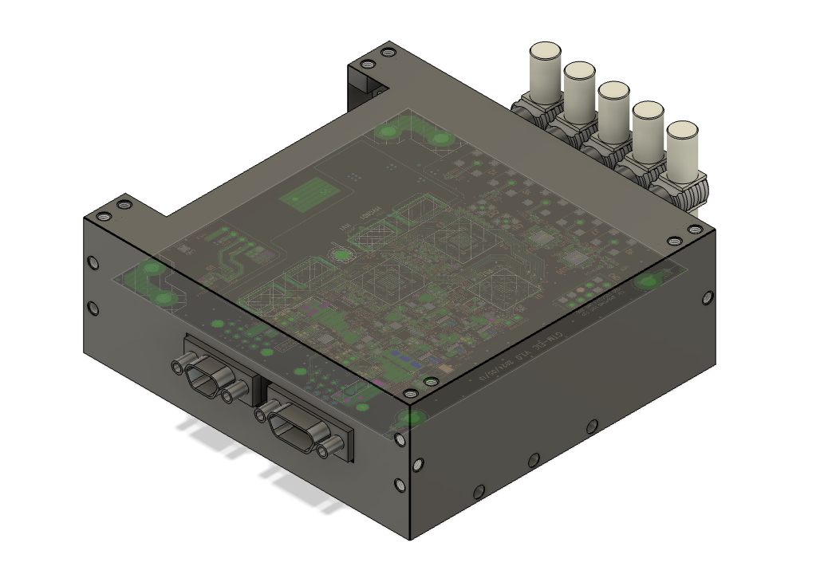
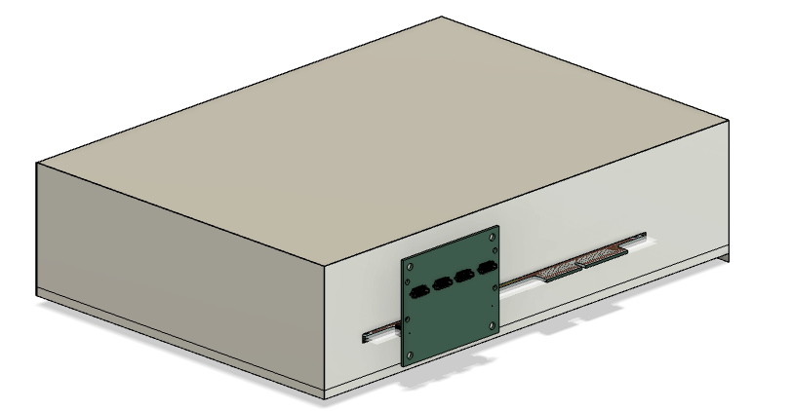
3rd Prototype : Mechanical Support
Add H2GCROC
Potentially adding one more BM.
Add shielding boxes for all electronics.
H2GCROC
CITIROC

Slide 27
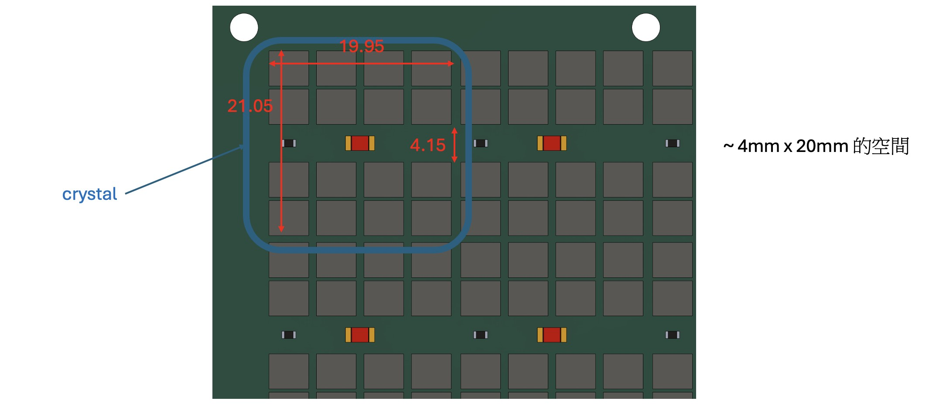
3rd Prototype : new SiPM Board
Location of laser and receiver?

Slide 28
Planning for 3rd Prototype
 | Detector | Crystal |  |  |  | Sensor |  | DAQ
 |  | name | Size of one cell | Length | Array | Type | sensor/crystal
1st prototype 2023-2024 | LYSO + SiPM | LYSO | 0.7cm*0.7cm | 8.8cm (8X0) | 8x8 | SiPM Onsemi MICROFC-60035 | 1/crystal | CITIROC
2nd prototype 2024-2025 | LYSO + APD | LYSO | 1cm*1cm | 6.6cm (6X0) | 8x8 | APD C30739ECERH | 1/crystal | CITIROC
 | PbWO4 + SiPM | PbWO4 | 2cm*2cm | 5.3cm (6X0) | 6x6 | SiPM Onsemi MICROFC-60035 | 2/crystal | CITIROC
3rd prototype 2025-2026 (developing) | PbWO4 + SiPM | PbWO4 | 2cm*2cm | 5.3cm (6X0) | 6x6 | SiPM Hamamatsu S14160-3015PS | 16/crystal | CITIROC HGCROC
The 3rd prototype will use the same crystals
  SiPM will be changed from Onsemi → Hamamatsu
  DAQ will be upgraded from CITIROC → H2GCROC
Possible test beam opportunities:
  DESY in Germany @ June : 1GeV - 6GeV electron/positron beam
  RARiS in Japan @ July : 50MeV - 1 GeV electron/positron beam
System to be tested in the coming test beam
  PbWO4 + Onsemi SiPM board + CITIROC : reduce noise and test again
  PbWO4 + Onsemi SiPM board + H2GCROC : 1st try to use H2GCROC
  PbWO4 + Hamamatsu SiPM board + H2GCROC : test new SiPM board + new DAQ system
  LYSO + Hamamatsu SiPM board + H2GCROC : redo LYSO

Slide 29
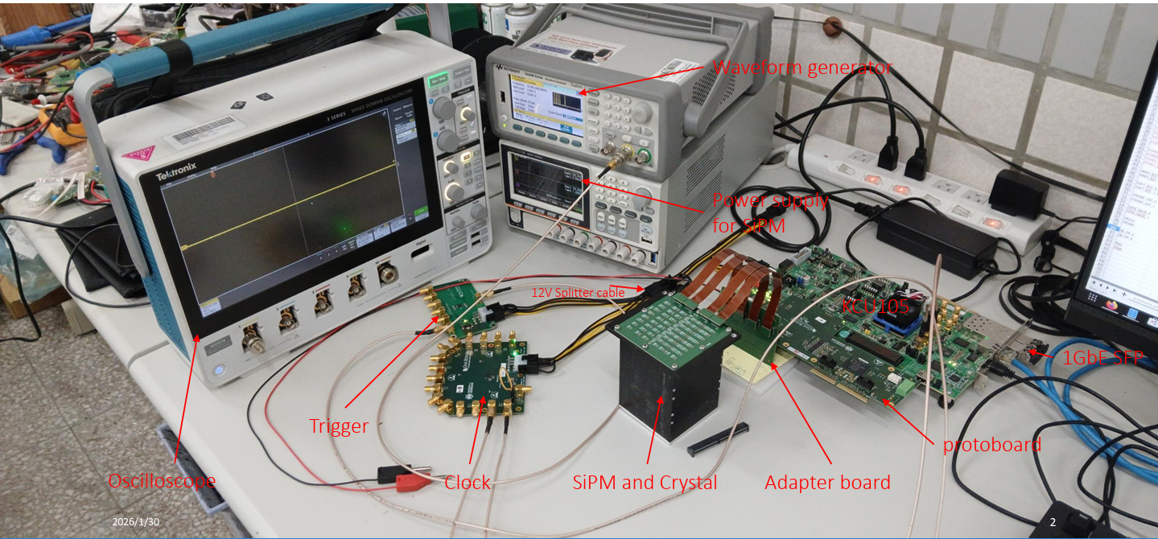
Lab Test of H2GCROC
Pedestal calibration (OK)
Decoding (OK)
Gain calibration with LYSO + SiPM + H3GCROC : connector issue (pending)
CR test with LYSO + SiPM + H3GCROC : connector issue (pending)

Slide 30
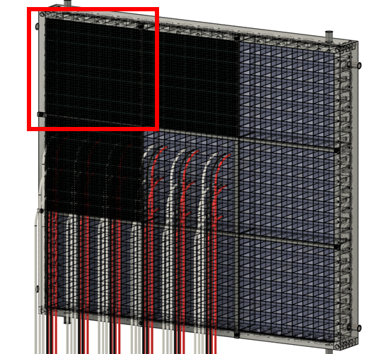
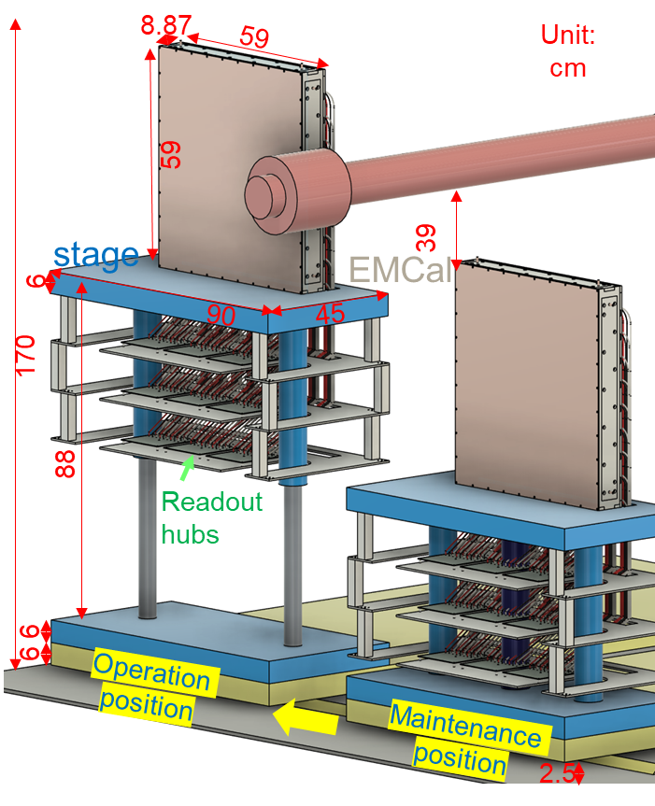
Plan for Final Design
Super module
Crystal : PbWO4
SiPM : S14160-3015PS_HAMAMATSU
One crystal = 20.5 mm*20.5 mm*7.0 mm (7.87 X₀)
Active area = 59cm*59cm
One Super Module (SM) = 9 x 9 crystals
Num. of crystals = 3x3 SMs = 729 crystals
16 SiPMs / crystal
Num. of SiPMs = 729 * 16 = 11, 664

Slide 31




Plan for Final Design : Frame
Cooling & support
Crystal modules
PCB support
SiPM PCB + ROC PCB

Slide 32

Plan for Final Design : PCB

Slide 33


Plan for Final Design : Cooling
Copper plate
T=3 mm
Heat flow simulation is undergoing.

Slide 34
Backup

Slide 35
To Do List for Coming Test Beam
PbWO4 + Onsemi SiPM board + CITIROC : reduce noise and test again
  Data analysis (online plot) : Done
  Data and MC comparison : Done
  New mechanical support : Done
  Noise test : Done
  BM calibration : Done
  CR test : Analysis undergoing
PbWO4 + Onsemi SiPM board + H2GCROC : 1st try to use H2GCROC
  Data analysis (online plot) : Undergoing
  Mechanical support : Undergoing
  LED test (SiPM gain calibration) : Undergoing
  External trigger from two BM systems : Undergoing
  Radiation source test (ADC to Energy conversion) : To do
  CR test : To do
PbWO4 + Hamamatsu SiPM board + H2GCROC : test new SiPM board + new DAQ system
  SiPM board layout and production : Undergoing
  Data analysis (online plot) : Undergoing
  Mechanical support : Undergoing
  LED test (SiPM gain calibration) : To do
  Radiation source test (ADC to Energy conversion) : To do
  CR test : To do

Slide 36

Noise Test and Cosmic Ray Test
Mk4
Data
Laptop
CR test setup @ NCU
BM1/BM2
LYSO/PbWO4
GTM (2*CITIROCs)
UART
Control
Power supply(12V)
BM1/BM2/LYSO/PbWO4 all have several components need to be grounded.
Box for crystal/scintillators
Ground of SiPM board
Ground of GTM board (CITIROC)
Box of MK4 module (data stream)
Box of UART module (slow control)
Support frame
Grounding choices
Negative bias of power supply
Ground of power supply
Ground from the wall
BM1
LYSO
PbWO4
BM2
Noise level is currently at 12 MeV ~ 18MeV. During 2025 test beam, it was 50 MeV.

Slide 37







Beam Monitor Calibration
Using flux of ²²Na source to do the beam monitor calibration.
$Channel flux∝Ω∝\iint{\frac{d}{{{((x−x_{0})}^{2}+{(y−y_{0})}^{2}+d^{2})}^{3/2}}dxdy}$
Flux distribution results with source placed at different positions after calibration
r
d
$$y$$
$$x$$
Before
After
Flux
Y-axis
Position 1
Position 2
Position 3
Flux
X-axis

Slide 38
CR Analysis?

