Slide 1
ZDC MC Status (Taiwan Group) 20260420
Chia-Yu Hsieh
Academia Sinica, Taiwan

Slide 2
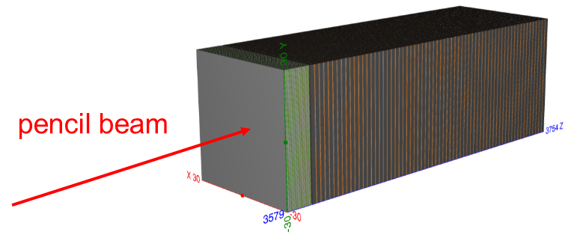
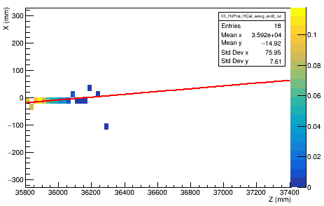
Review : Setup and Track Reconstruction
40GeV gamma, xz plane, one evt
Setup
ZDC = ECAL crystal + HCAL SiPM-on-tile
Put detector straight along z-dir
Pencil beam along z-dir @ (-15mm, -15mm, z)
0.1 GeV – 40 GeV gamma (pencil beam)
10 GeV – 300 GeV neutron beam (pencil beam)
Linear energy regression : E_mc = p0 + p1 * E_ECAL + p1* E_HCAL
Track reconstruction (Only HCAL is included in track reconstruction)
Step 1 — Layer by layer to find energy-weighted position For each detector layer, a single representative hit position is calculated by averaging all hit positions in that layer, weighted by their deposited energy.
Step 2 — Fitting xz and yz planes with pol1 with energy weight of each layer Each layer contributes one position to the track fit, with a weight proportional to the total energy deposited in that layer. As a result, layers with larger energy deposition have a stronger influence on the fit. Linear fits (pol1) are performed independently in the XZ and YZ planes to obtain the track parameters.

Slide 3
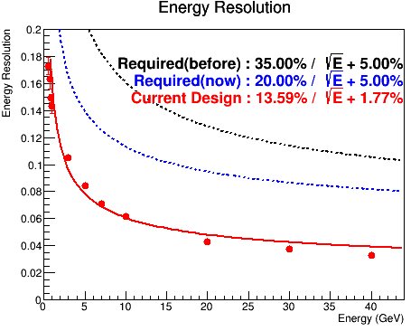
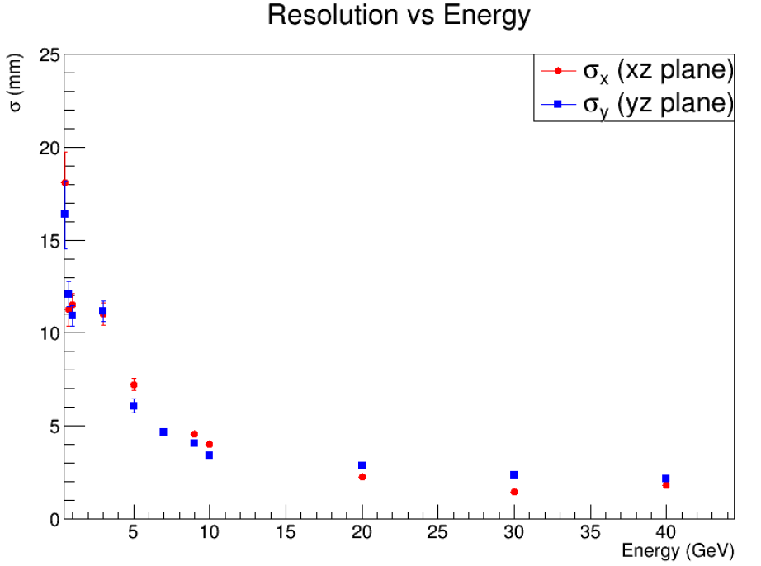
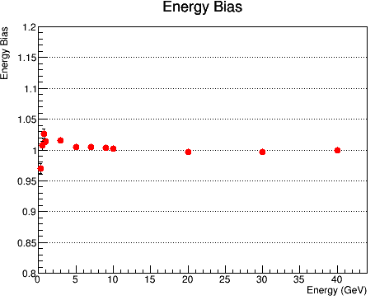
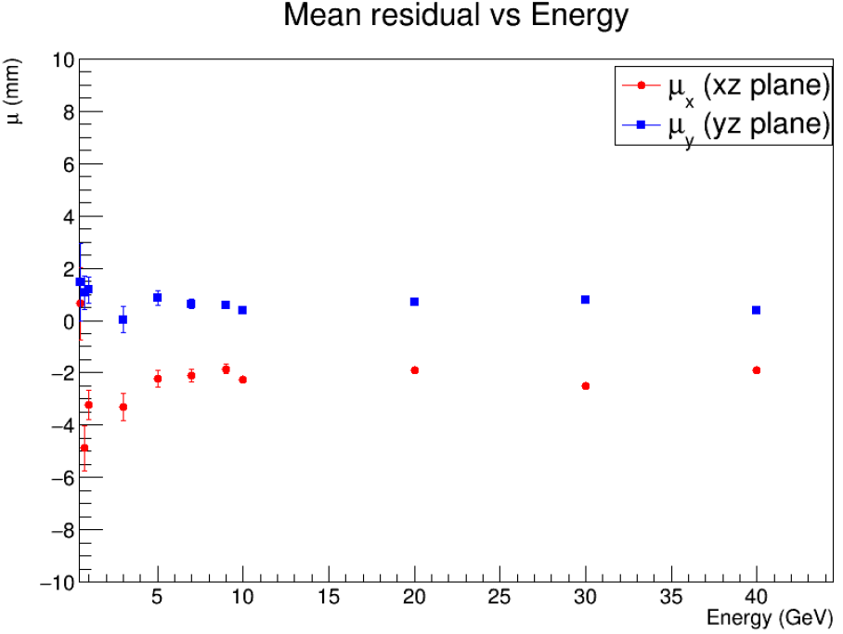
Review : Panceil Beam w/ 0.1 GeV – 40 GeV Gamma
Energy Resolution(%)
Position Resolution(mm)
Energy Bias(%)
Position Bias(mm)
2mm bias
Notes:
Energy resolution
3% bias in low energy
5% resolution achieved for 40GeV gamma
Position resolution
2mm bias in x, no bias in y
2mm resolution achieved for 40GeV gamma

Slide 4
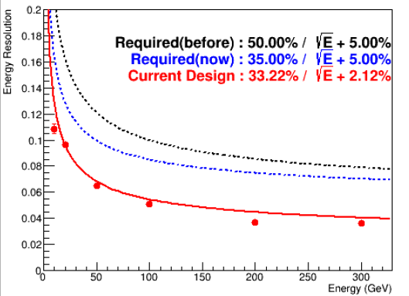
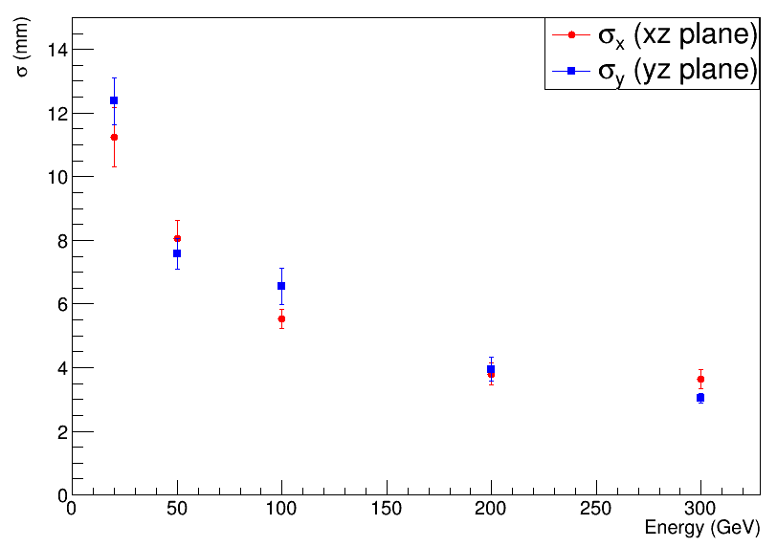
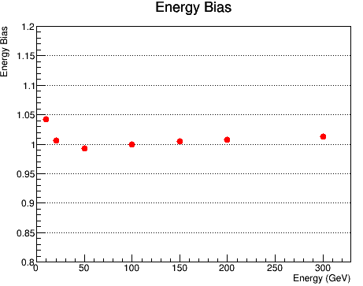
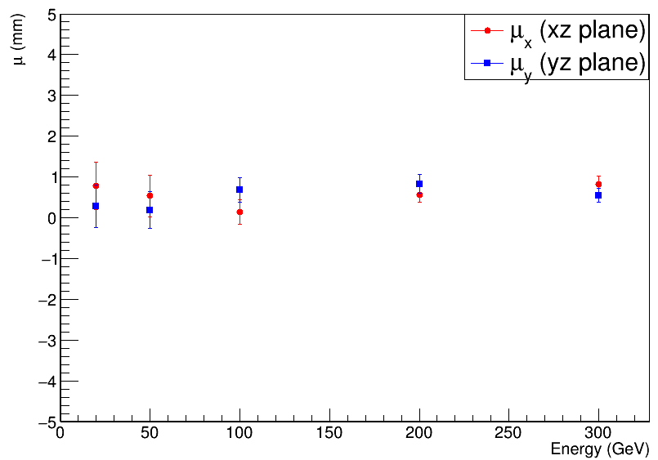
Review : Panceil Beam w/ 10 GeV – 300 GeV Neutron
Energy Resolution(%)
Position Resolution(mm)
Energy Bias(%)
Position Bias(mm)

Slide 5
Suggestions
Only HCAL
Beam with different angles.
Track reconstruction w/ logE weight.

Slide 6
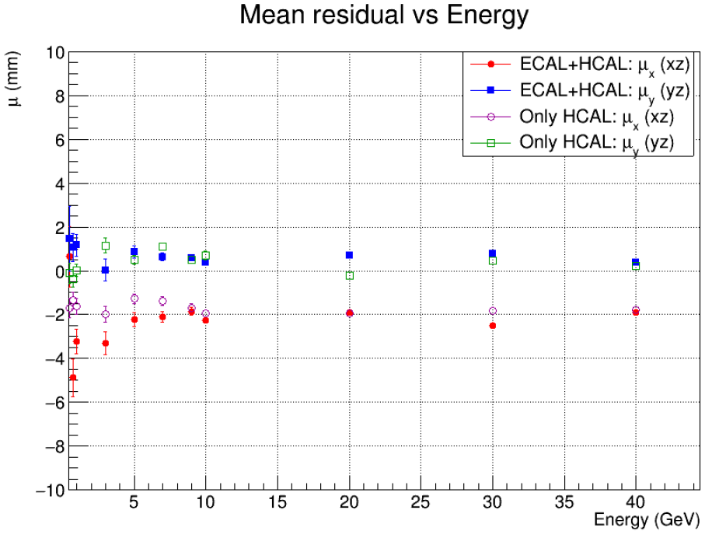
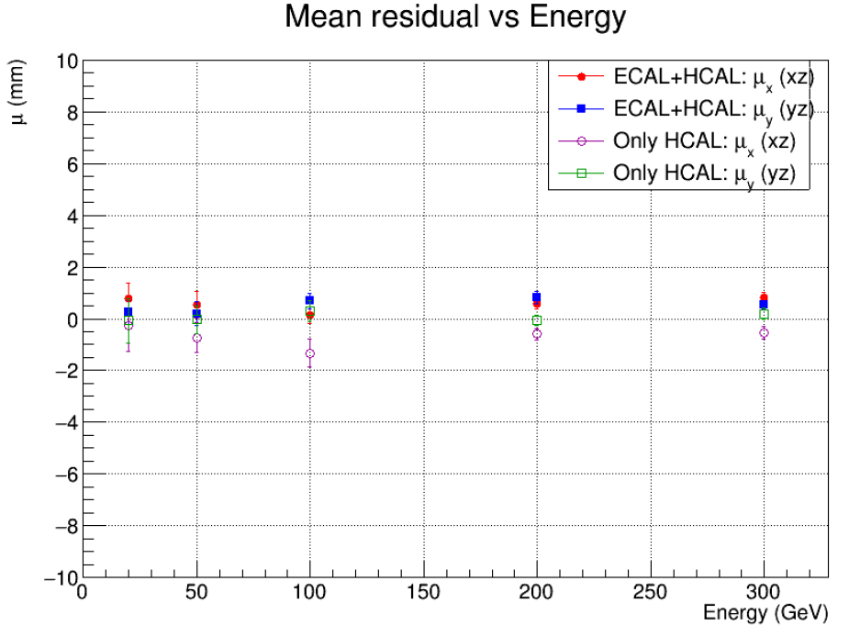
Test Position Bias w/ Only HCAL
Position Bias(mm)
0.1 GeV – 40 GeV Gamma
Position Bias(mm)
10 GeV – 300 GeV Neutron
Still observing position bias ~ 200 on xz plane w/ gamma beam.

Slide 7
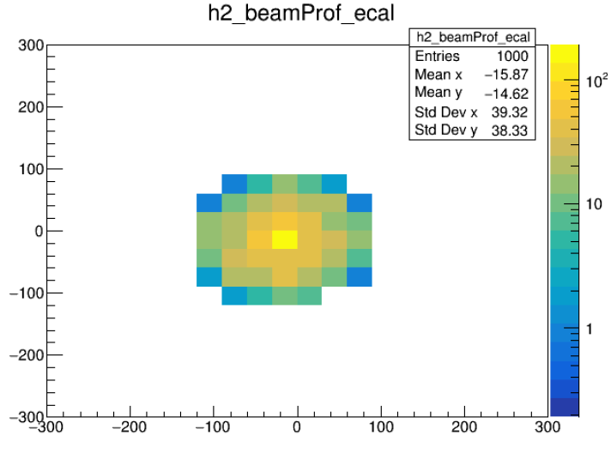
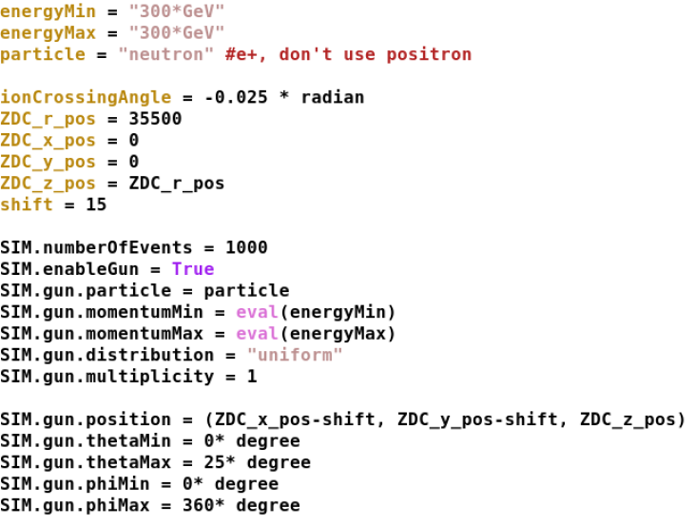
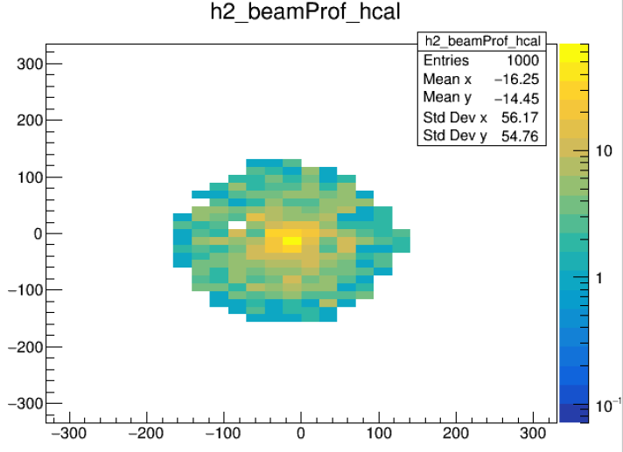
Beam with Different Angles (Spread Beam)
Steering file
Beam profile on ECAL surface
Beam profile on HCAL surface
Extrapolate beam track based on its momentum to the surface of ECAL/HCAL to make sure beam profile given spread beam.

Slide 8
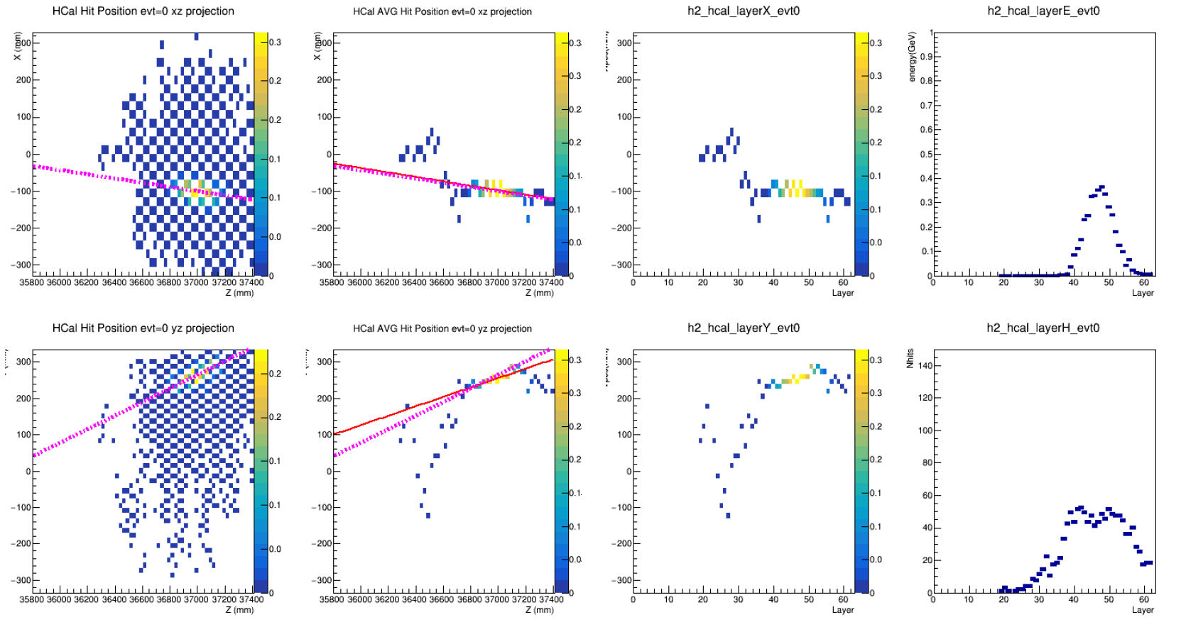
Beam Track Reconstruction Use One Event of 300GeV Neutron As Example
Hit Position
(color = hit energy)
Avg Hit Position in mm
(color = layer energy)
Avg Hit Position in layer
(color = layer energy)
Energy and Nhits
on each layer
XZ Projection
YZ Projection
Magenta = MC truth (extrapolation by beam momentum from starting point)
Red = Reconstruction (pol1 fit on average hit position weighted by layer total energy )

Slide 9
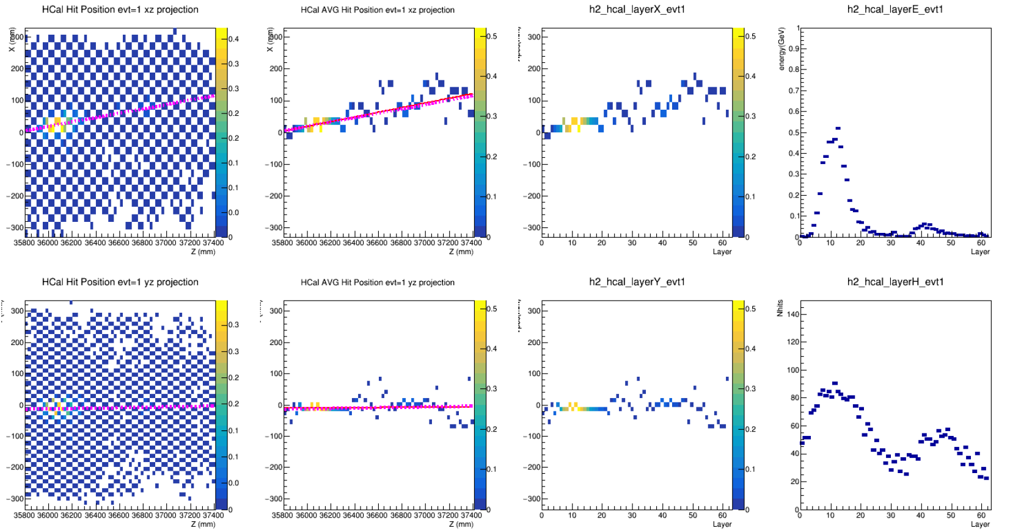
Hit Position
(color = hit energy)
Avg Hit Position in mm
(color = layer energy)
Avg Hit Position in layer
(color = layer energy)
Energy and Nhits
on each layer
XZ Projection
YZ Projection
Event by event, the shower shape is quite different.

Slide 10
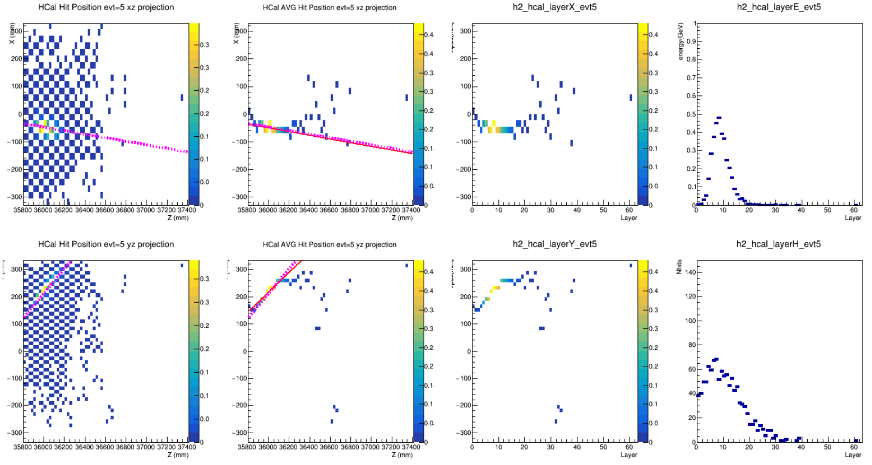
Hit Position
(color = hit energy)
Avg Hit Position in mm
(color = layer energy)
Avg Hit Position in layer
(color = layer energy)
Energy and Nhits
on each layer
XZ Projection
YZ Projection

Slide 11
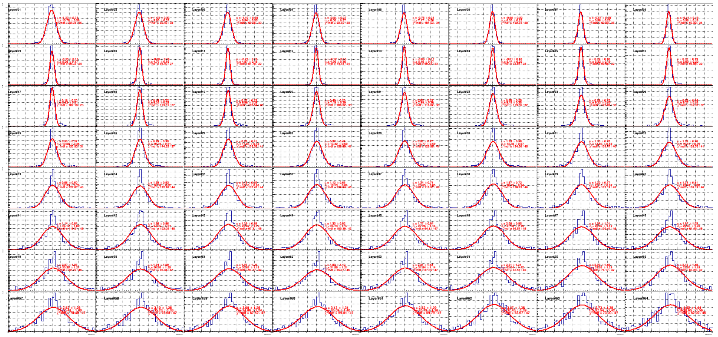
Residual of All Layers on XZ 300 GeV Neutron Beam (1000 evts)
Residual distribution is wider in more downstream layers.

Slide 12
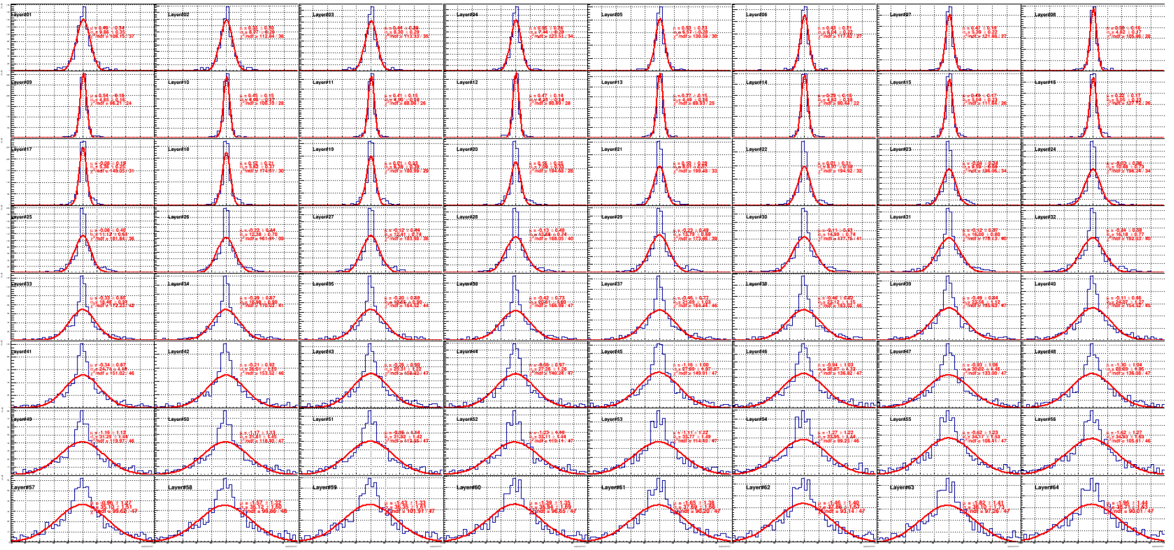
Residual of All Layers on YZ 300 GeV Neutron Beam (1000 evts)
Residual distribution is wider in more downstream layers.

Slide 13
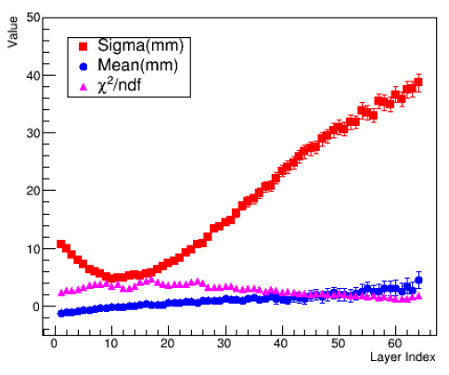
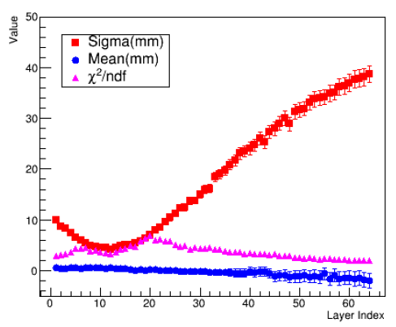
300 GeV Neutron Beam Position Reconstruction
XZ Plane
YZ Plane
Resolution (mm)
Bias(mm)
chi2/NDF
The resolution and bias are sensitive to the layer chosen for reconstruction, with the best resolution reaching about 6 mm. Generally, resolution degrades the further the Z position is from the most energetic layer.

Slide 14
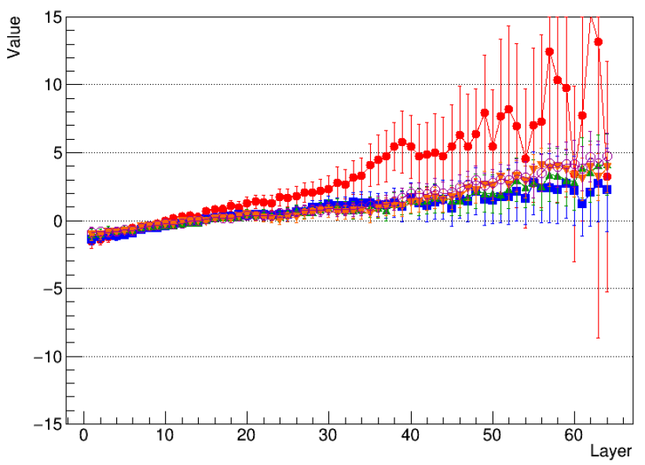
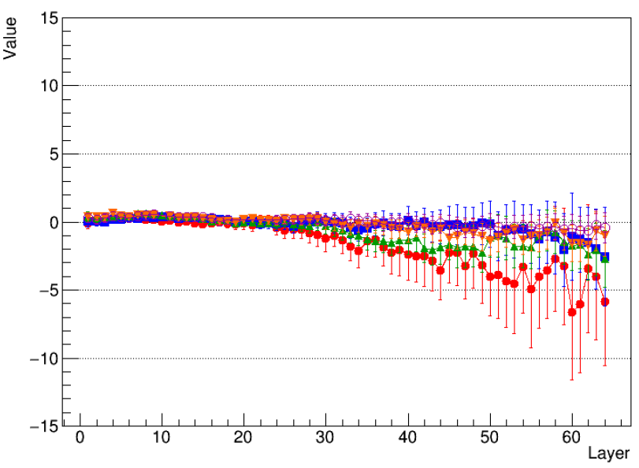
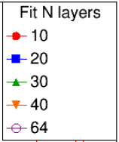
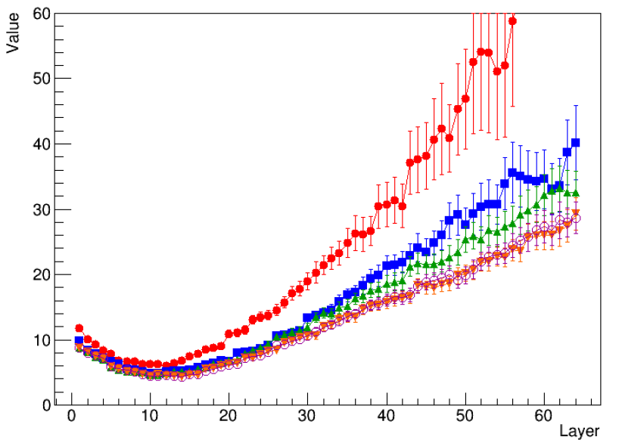
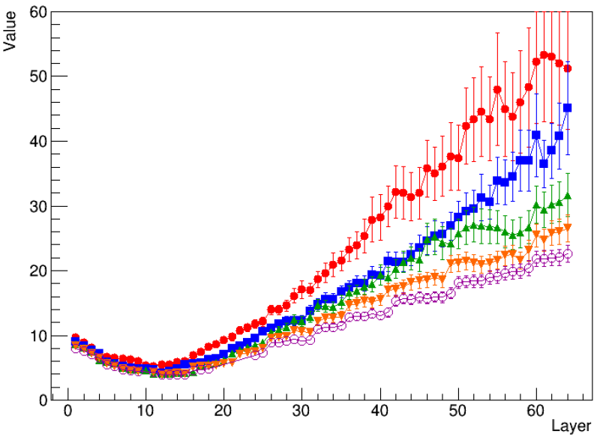
Fit Different Number of Layers
XZ plane
Bias(mm)
YZ plane
Bias (mm)
XZ plane
Resolution (mm)
YZ plane
Resolution (mm)
Better results with more planes included (still energy weighted).

Slide 15
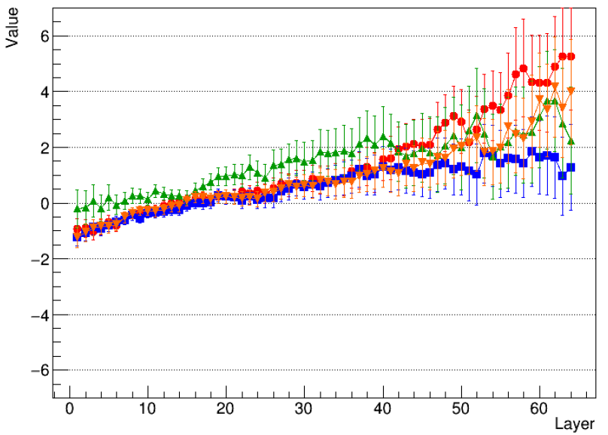
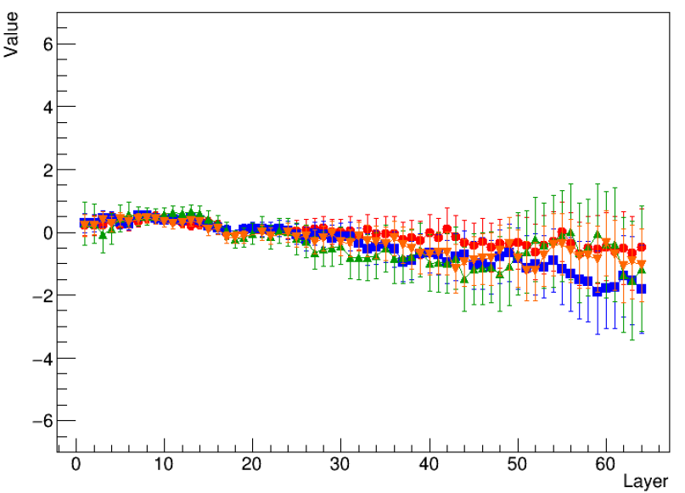
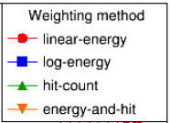
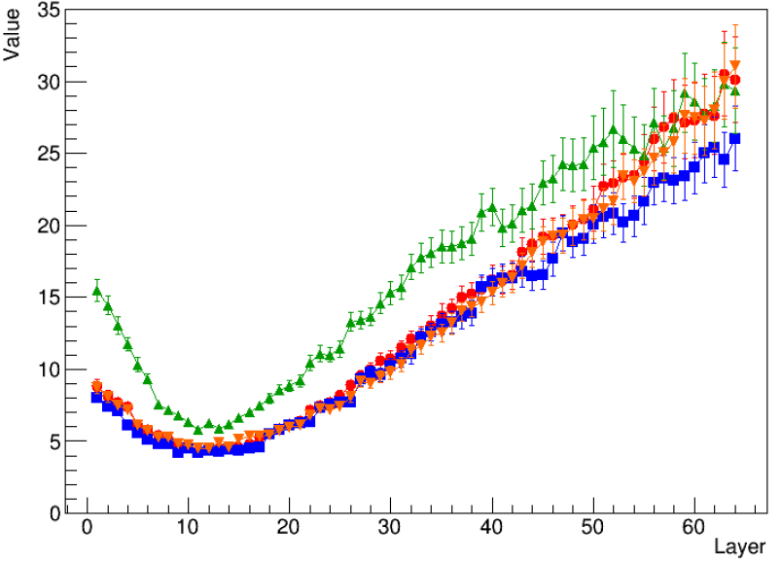
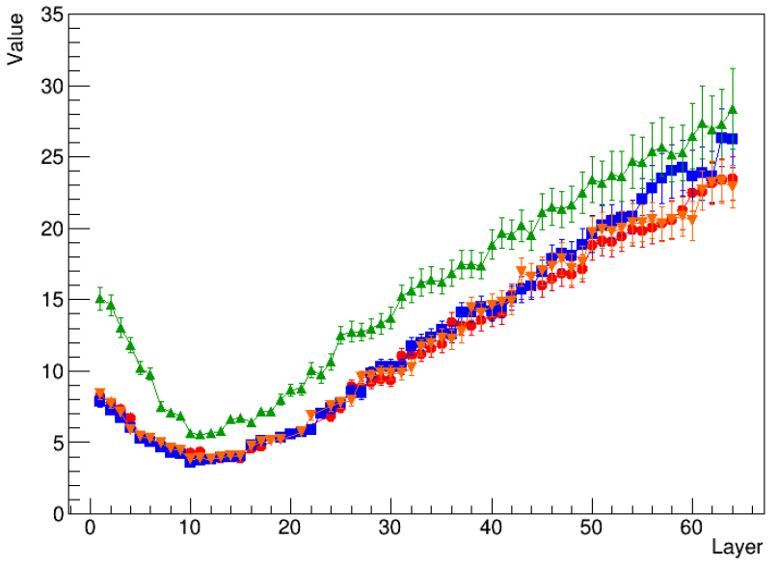
Different Weighting
XZ plane
Bias(mm)
YZ plane
Bias (mm)
XZ plane
Resolution (mm)
YZ plane
Resolution (mm)
Best : Log-energy weighted, Worse : Hit-count weighted. But none of them are very satisfied.

Slide 16
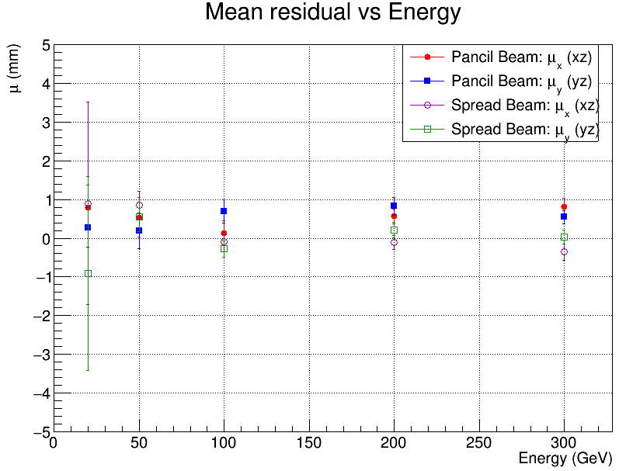
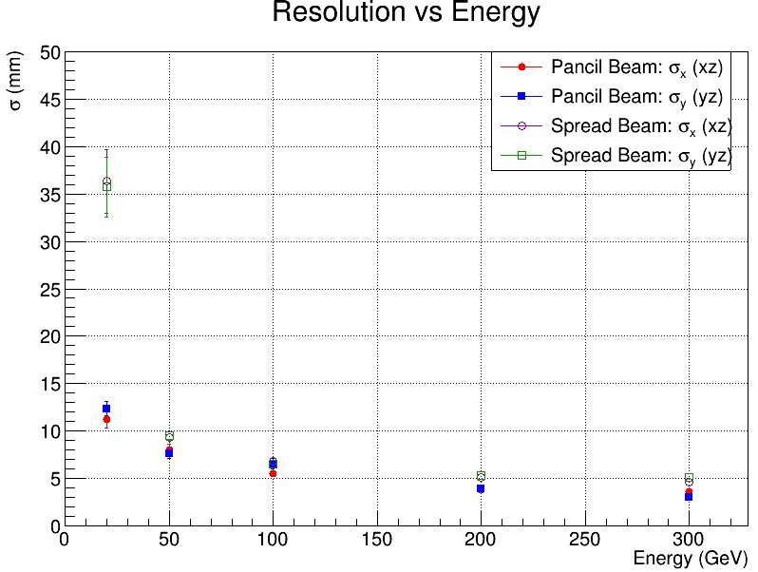
Position Resolution @ Weighted Z (Most energetic layer)
Use log weighted method.
Position Bias(mm)
10 GeV – 300 GeV Neutron
Position Resolution (mm)
10 GeV – 300 GeV Neutron
Except for low energy neutron, the position resolution between pencil beam and spread beam are consistent.

Slide 17
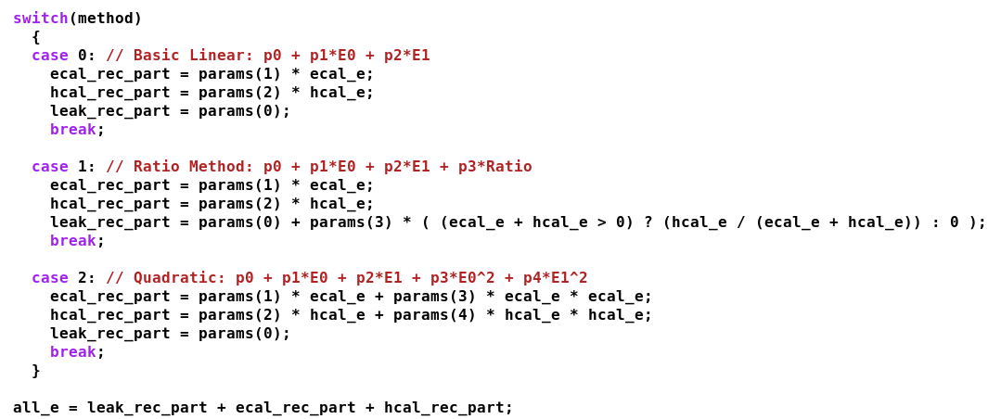
Energy Reconstruction : Method
3 fitting functions were tested.

Slide 18
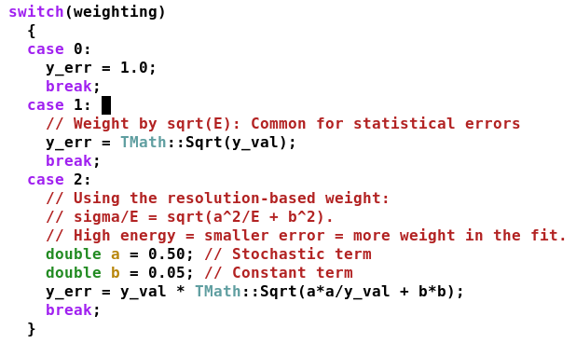
Energy Reconstruction : Weight
y_val = beam energy
3 kids of weighting tested.

Slide 19
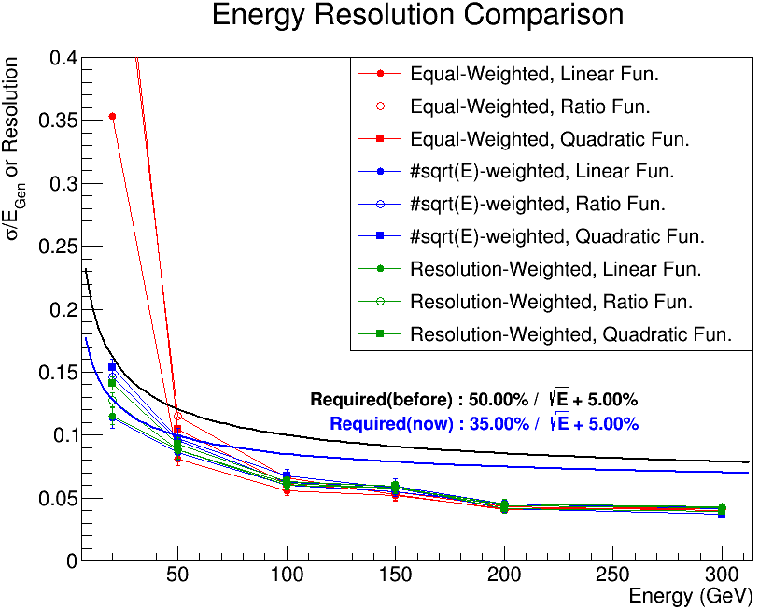
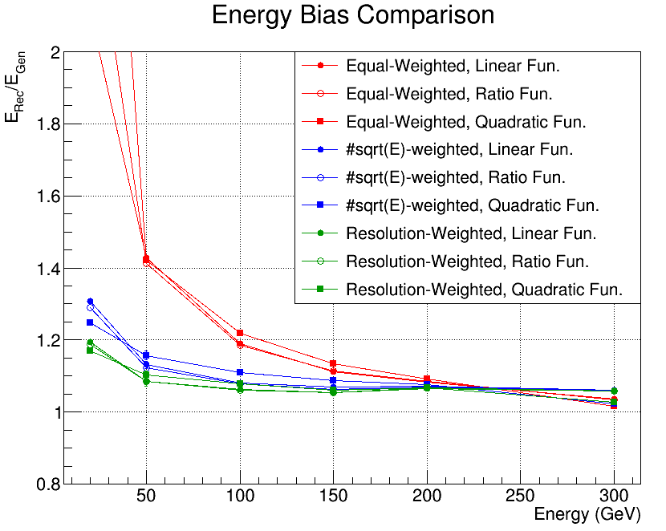
Energy Resolution/Bias 20GeV – 300GeV Neutron
Neutron > 50GeV, requirement satisfied.
~ 2% bias @ high energy ;(
Previously, I was using equal-weighted and linear function, which is the worse choice.
Compare all the weighting and fitting method.
Fitting function : Doesn’t really matter.
Weighting : Equal-weight performs the worse. Resolution-weighted performs the best.

Slide 20
Summary and To Do
Summary
MC sample :
20GeV-300GeV neutron
spread beam
crystal ECAL + SiPM-on-tile HCAL.
Track Reconstruction (only SiPM-on-tile HCAL) :
I tested several ways to weight the data, and using the logarithm-weighting works the best. Includes more layers in fitting is also better. However, the results are not yet good enough.
Generally, resolution degrades the further the Z position is from the most energetic layer. It is clear that we can’t simply use ZDC to do track reconstruction; we must combine it with other detectors more upstream to get better results.
Energy Reconstruction :
Fitting function : Doesn’t really matter.
Weighting : Equal-weight performs the worse. Hit-energy-weighted perform the best.
To Do
Run the same tests with photon beams

Slide 21
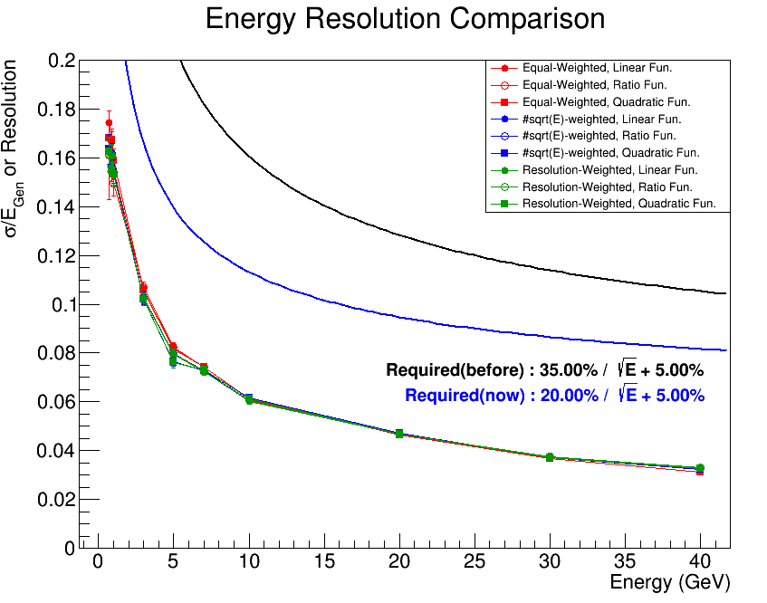
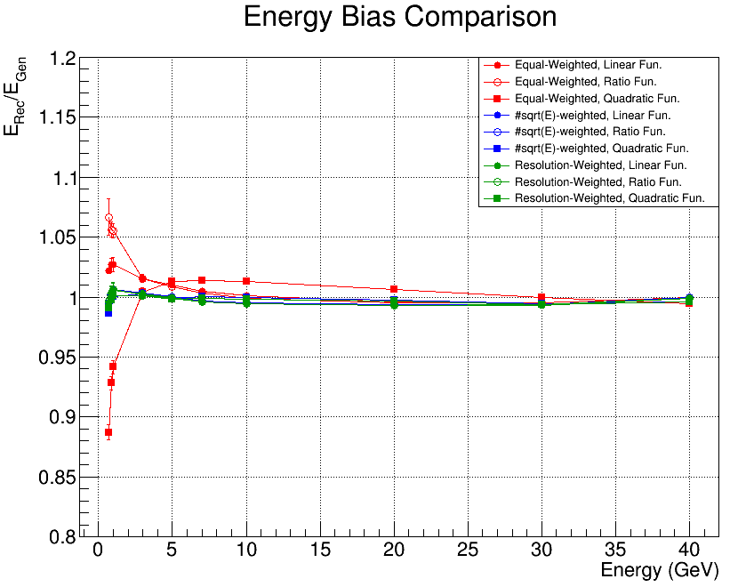
Photon : Energy
Neutron > 50GeV, requirement satisfied.
No bias if not using equal weighted method.

Slide 22
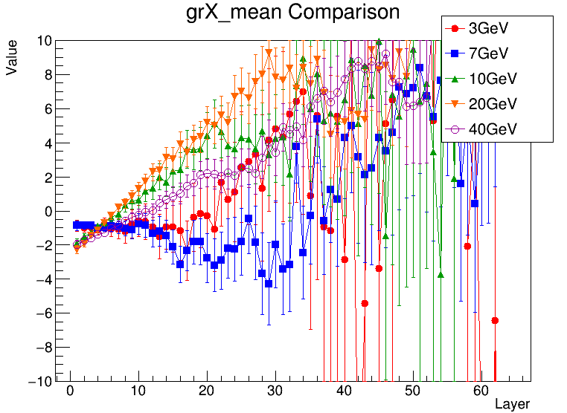
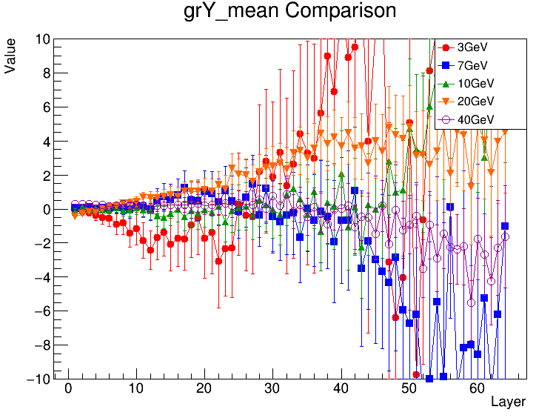
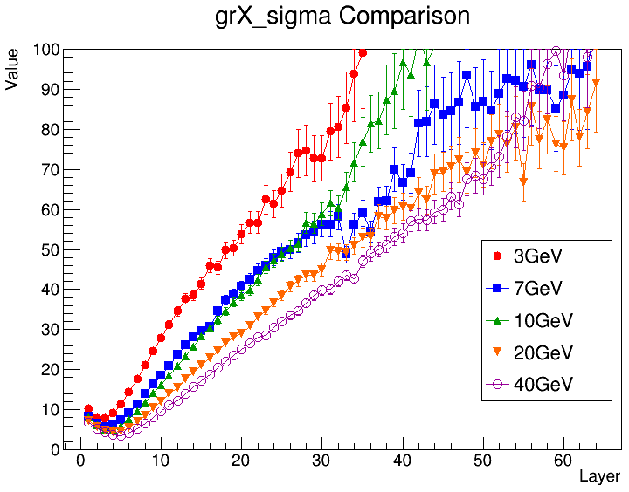
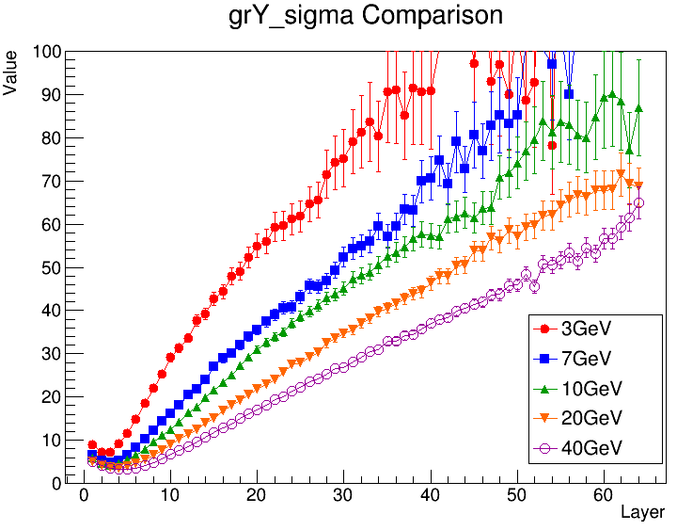
Photon : Track (Residual Layer by layer)
Log weight
Fit all layers

Slide 23
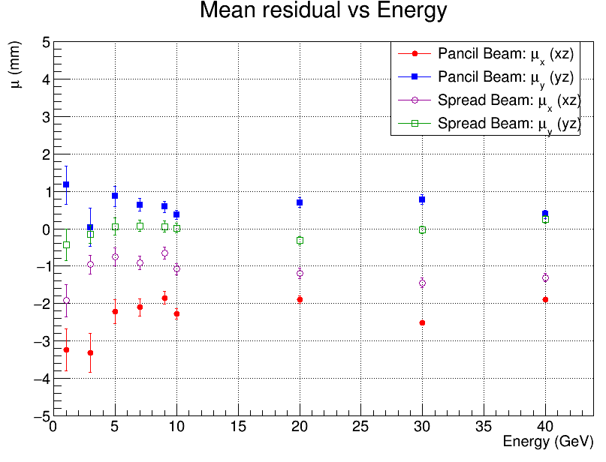
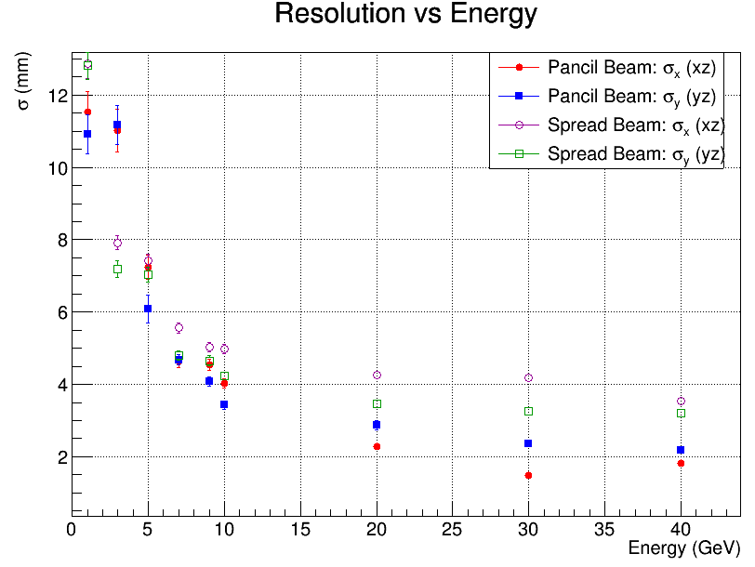
Track Resolution @ Zweight
Check again pencil beam

Slide 24
Back up

Slide 25
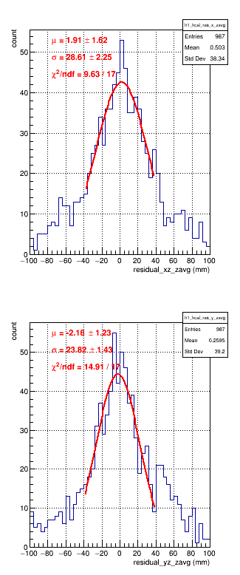
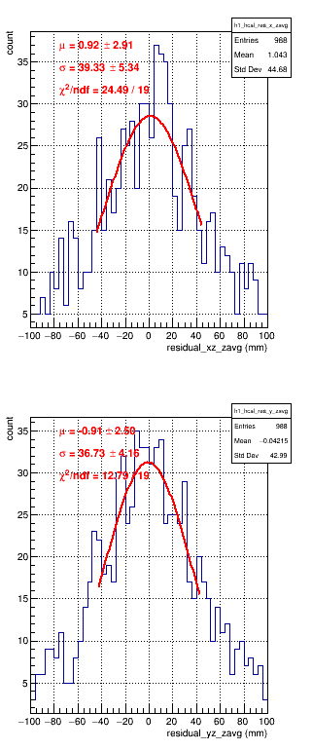
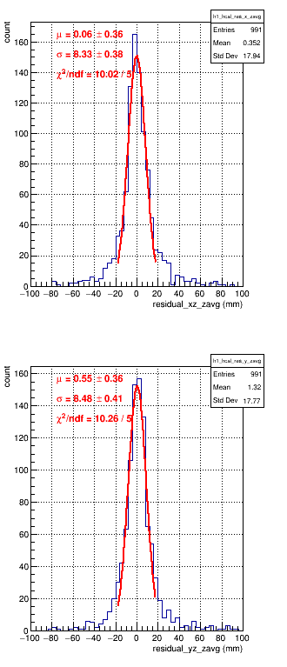
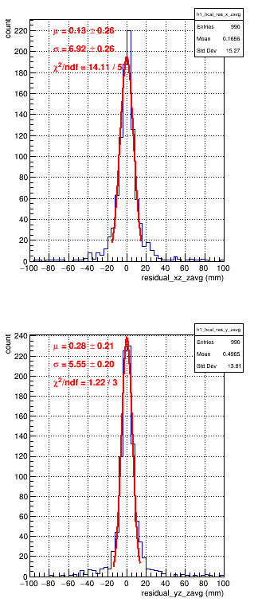



Position Resolution @ Weighted Z (Most energetic layer)
10 GeV
20 GeV
50 GeV
100 GeV
150 GeV
200 GeV
300 GeV
XZ
YZ

Slide 26









Position Resolution @ Weighted Z (Most energetic layer)
1 GeV
3 GeV
5 GeV
7 GeV
9 GeV
10 GeV
20 GeV
30 GeV
40GeV
XZ
YZ

