Slide 1
H2GCROC
2025 - 2026

Slide 2
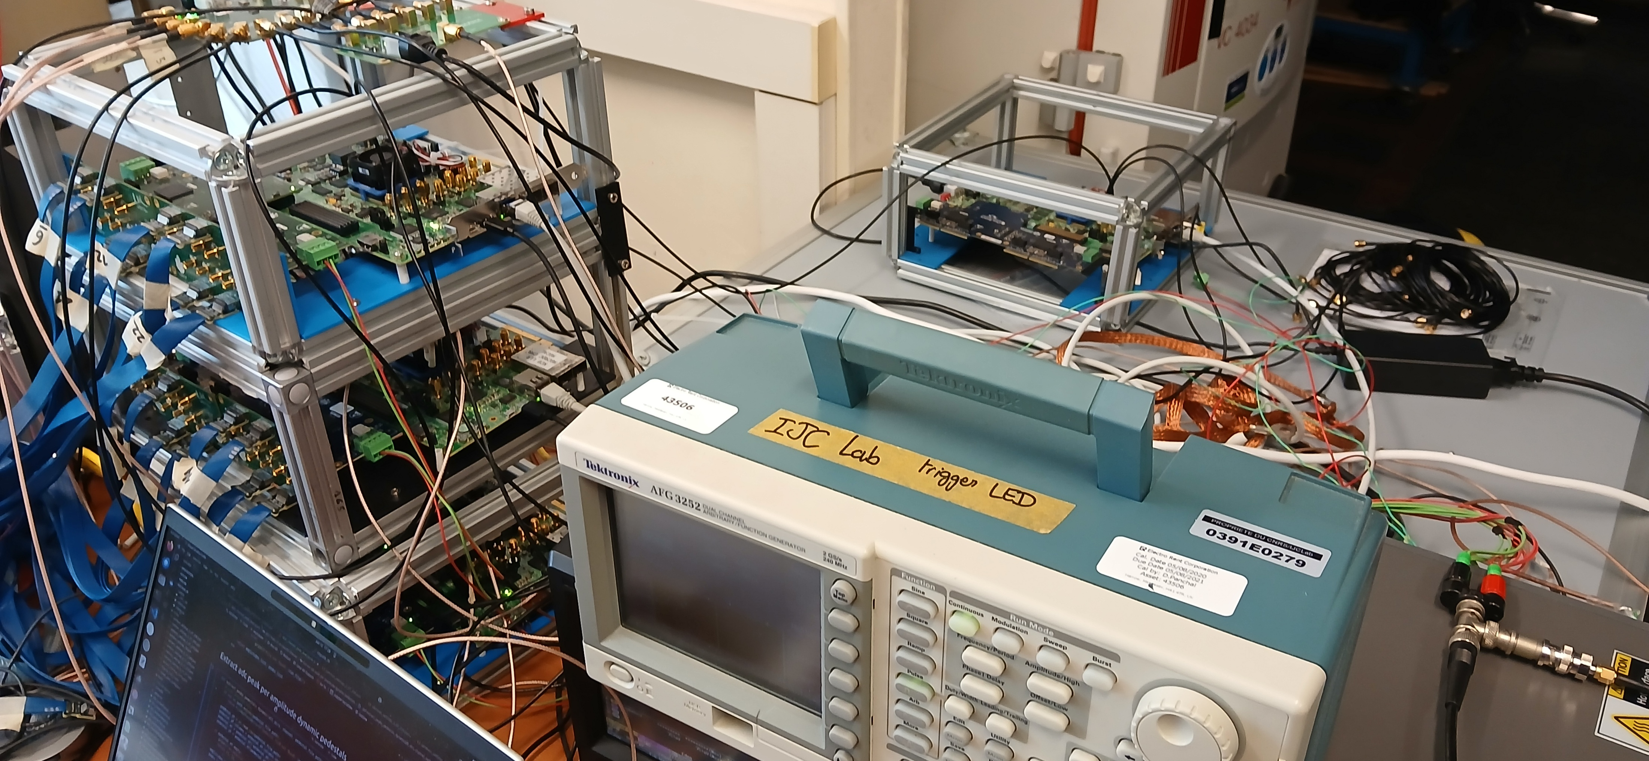
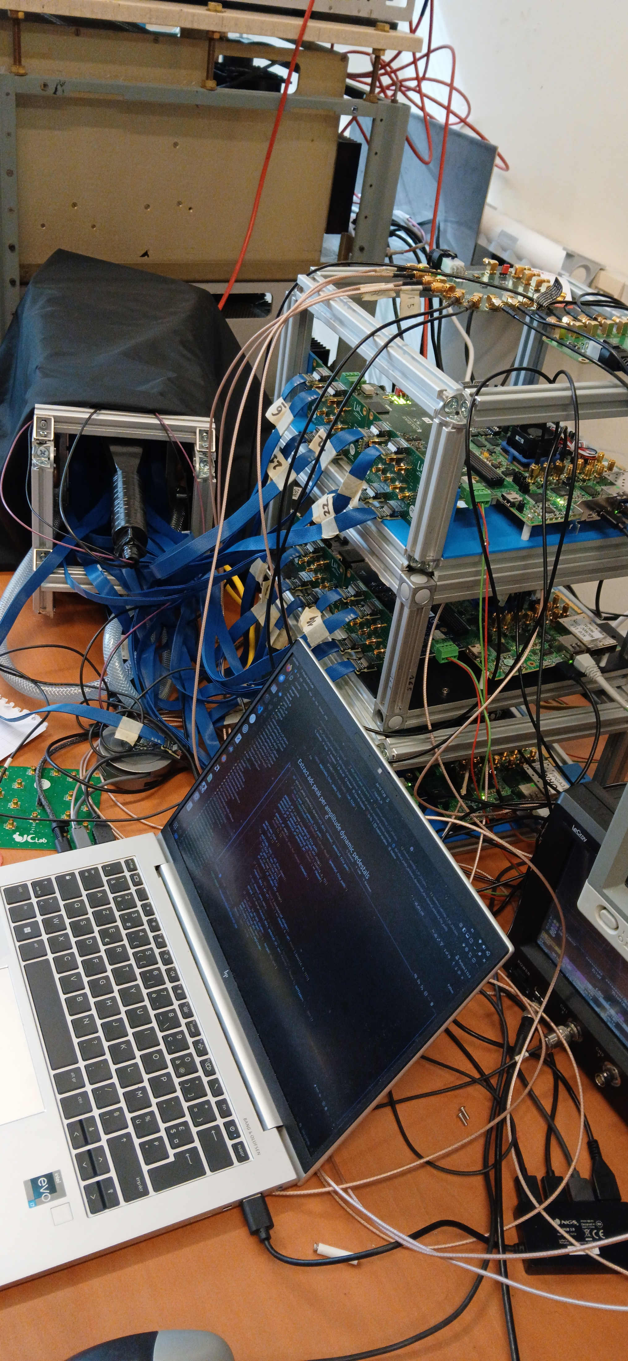
Hardware
Common clock board
Trigger fan out board
KCU105 & protoboard x4
Crystal
Adapter board
Clock & Trigger & Power cable xN
Signal generator x1
High Voltage Supply

Slide 3
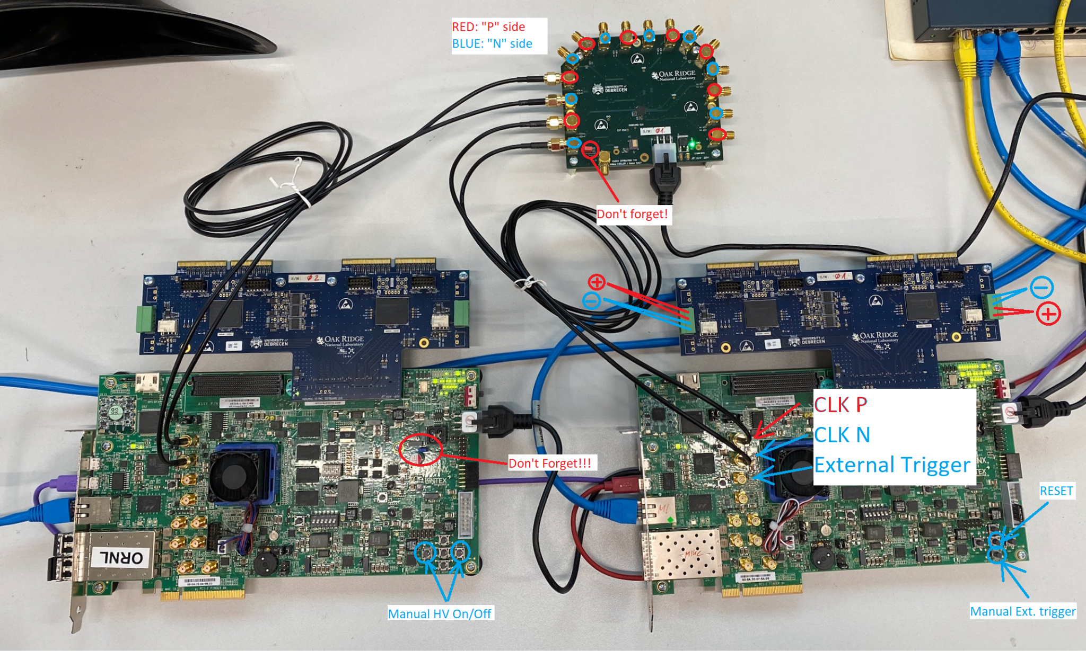
FAQ
Must insert jumper J14 on the FPGA board
If you have multiple protoboard and FPGA board, you need a common clock input

Slide 4
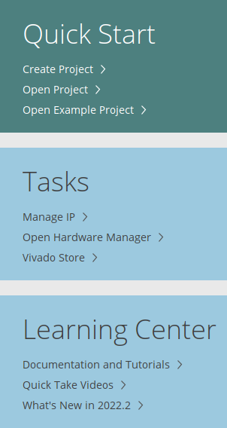
Programming FPGA
Install & Launch Vivado (no need license key)
Open Hardware Manager
Connect JTAG to PC and power on FPGA board
  Click Open target on the left Panel
  Open the device
  Right click on it and Click “Add Configuration Memory Device”
  Select device “mt25qu256-spi-x1_x2_x4” and continue
  Select file “frame_protoboard_v2.mcs” (version v4.11)
  Program it
Firmware: v4.11
  https://web.tresorit.com/l/86zmA#BE8fqp4of3N8pFNz-cXpgg&ZZ8bIfjDltJSr5qvdDoZYuGsgz6LDm0Q
Programming guide: KCU_Flashing.pdf
  https://web.tresorit.com/l/86zmA#BE8fqp4of3N8pFNz-cXpgg&GYtZ9jQtioHk1QwqwK5nizBt2rLRRpSt

Slide 5
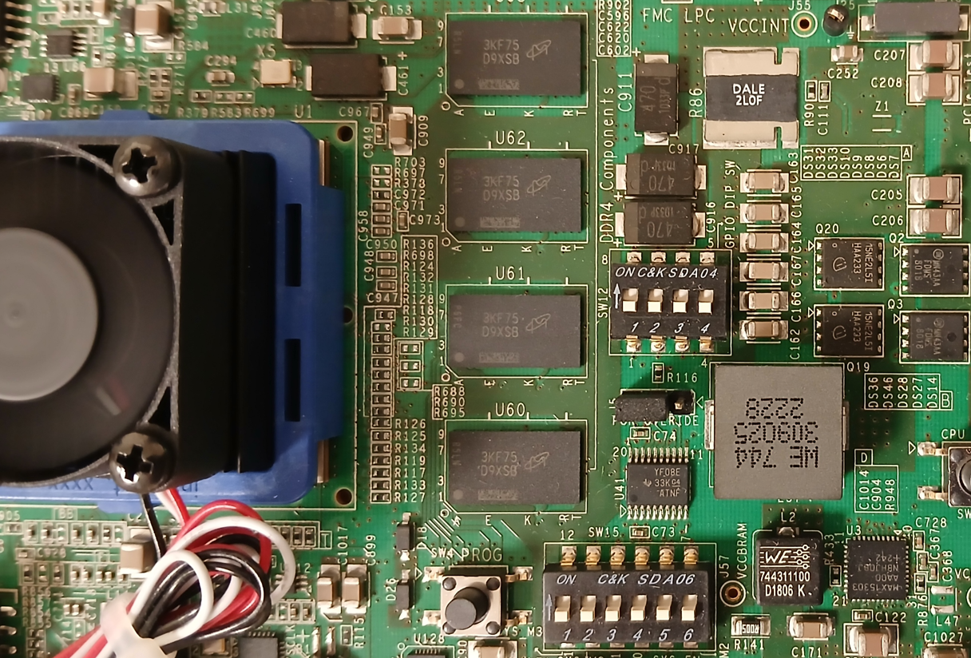
FPGA IP address
DIP Switch on KCU105
FPGA IP address = 10.1.2.208 + DIP SWITCH[2:0]
DIP SWITCH[2:0]
210

Slide 6
Software environ
AlmaLinux 9.5, Use AnaConda
  conda create -n hgc
  conda activate hgc
  conda install -c conda-forge pygame pyside6 numpy matplotlib loguru pandas tqdm
Ubuntu 24.04, Use python venv
  sudo apt-get install python3-pip python3-venv libxcb-cursor-dev net-tools
  mkdir myenv
  python3 -m venv myenv
  source myenv/bin/activate
  pip install pyside6 numpy matplotlib loguru pygame pandas tqdm
Windows 11, Use AnaConda
  the same as AlmaLinux 9.5, Use AnaConda, you can install git with conda
baremetal, other ...

Slide 7
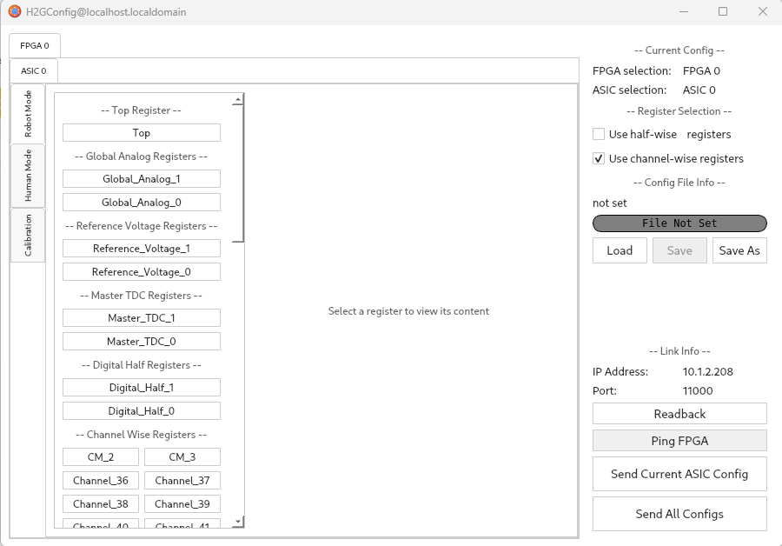
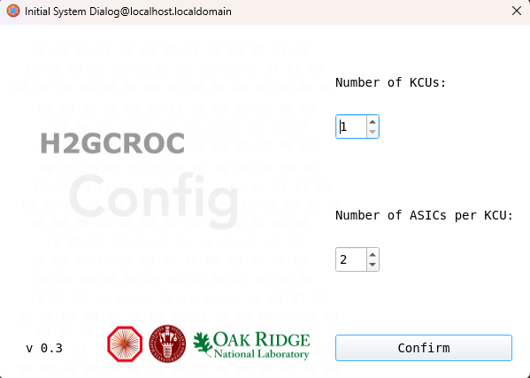
Software H2GConfig
H2GConfig
  conda activate hgc
  cd workspace
  git clone https://gitlab.cern.ch/sjia/H2GConfig.git
  cd ~/workspace/H2GConfig
  python H2GConfig.py
5e478442b 2025/2/26

Slide 8
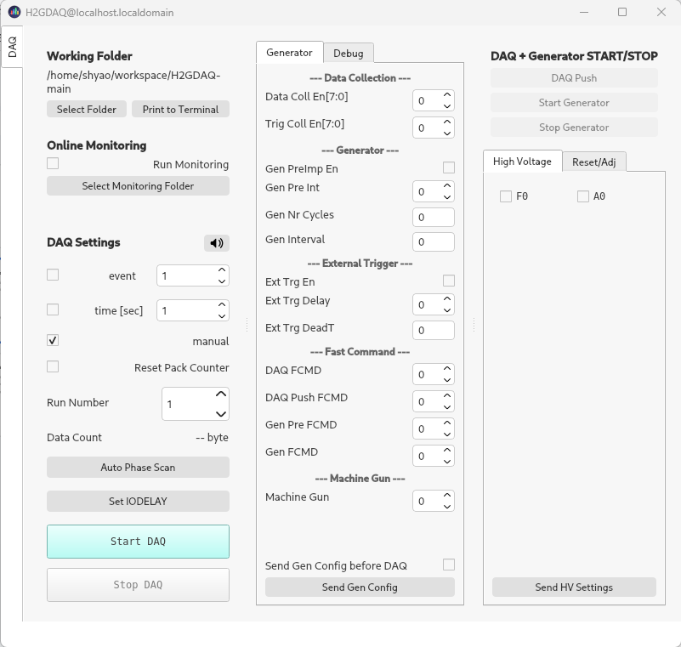
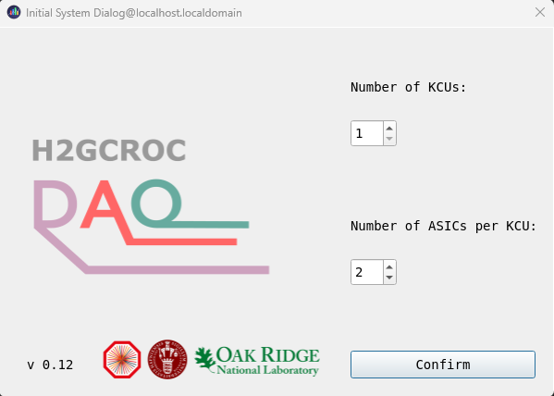
Software H2GDAQ
The same virtual environ work for H2GDAQ
  conda activate hgc
  cd workspace
  git clone https://gitlab.cern.ch/sjia/H2GDAQ.git
  cd ~/workspace/H2GDAQ
  git checkout dev-0v12
  python H2GDAQ.py
8a17963 2025/4/25

Slide 9
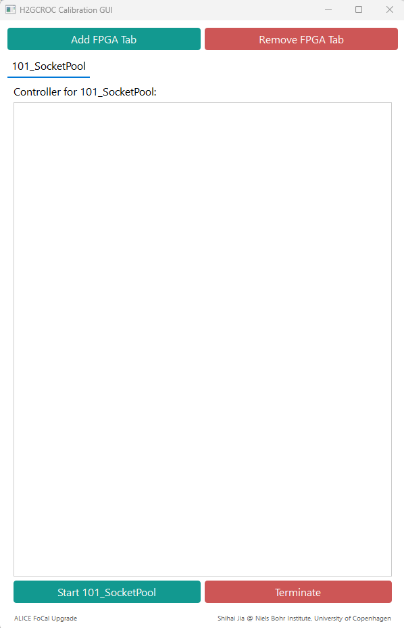
Software H2GCalib
Create a virtual environ for H2GCalib or add package to hgc environ
  conda activate hgc
  conda install -c conda-forge pygame pyside6 numpy matplotlib loguru tqdm pandas
  cd workspace
  git clone https://gitlab.cern.ch/sjia/H2GCalib_3B
  cd ~/workspace/H2GCalib_3B
Usage 1: GUI mode
  python 100_UI.py
Usage 2: console mode
  Python 000_SocketPool.py
  ...
  Python 010_ToTCalib.py
8dce2723fb 2025/5/9

Slide 10
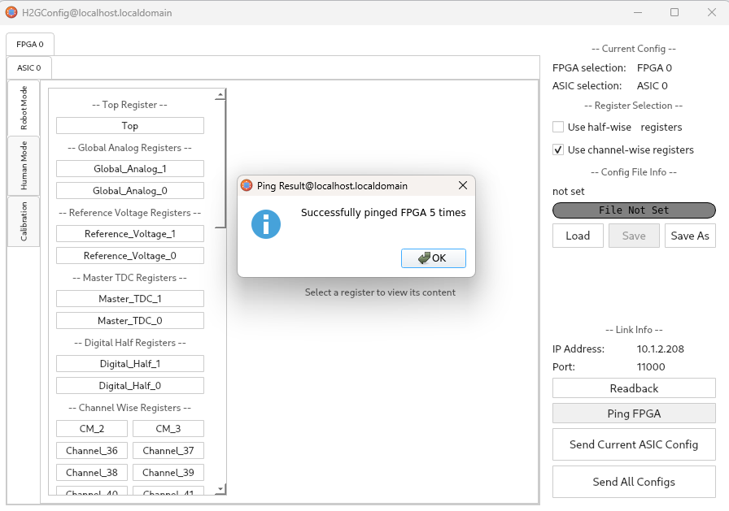
Ethernet communication
Connect ethernet cable between PC & FPGA board
Set PC IP address to 10.1.2.207
  $ IF=enp4s2
  $ sudo ifconfig ${IF} 10.1.2.207 netmask 255.255.255.0
  $ sudo ifconfig ${IF} mtu 9000 up
make sure your switch, cable and network card support 1 Gbps speed, 100 Mbps will not work
  $ sudo ethtool ${IF} | grep Speed
  Speed: 1000Mb/s
H2GConfig has a button “Ping FPGA” can test the connection, it don’t support under windows
Ping
  On Linux: ping 10.1.2.208 -s 32
  On Windows: ping 10.1.2.208 -l 32

Slide 11
Ethernet communication
Network Optimization (optional)
Create config file 50-h2gcroc.conf and add the following lines:
  net.core.rmem_max=8388608
  net.core.wmem_max=8388608
  net.core.rmem_default=8388608
  net.core.wmem_default=8388608
  net.core.netdev_max_backlog=250000
  net.ipv4.udp_mem=8388608 8388608 8388608
  net.ipv4.udp_rmem_min=16384
  net.ipv4.udp_wmem_min=16384
Then run the following command to apply the changes:
  sudo cp 50-h2gcroc.conf /etc/sysctl.d/
  sudo sysctl -p

Slide 12
Ethernet firewall 2
Almalinux 9.5
Use external and internal firewall zone
$ firewall-cmd --zone=public --remove-interface=enp87s0
$ firewall-cmd --zone=internal --add-interface=enp87s0
$ firewall-cmd --zone=internal --add-port=11000-11100/udp
$ firewall-cmd --runtime-to-permanent
$ firewall-cmd --zone=internal --list-all
internal (active)
target: default
icmp-block-inversion: no
interfaces: enp87s0
sources:
services: cockpit dhcpv6-client mdns mountd nfs nfs3 rpc-bind samba samba-client ssh
ports: 11000-11100/udp
protocols:
forward: yes
masquerade: no
forward-ports:
source-ports:
icmp-blocks:
rich rules:
Note interface enp86s0 connect to office network
interface enp87s0 is for h2gc data transfer

Slide 13
multiple IP
Setting PC IP address for 10G device
For testing, assign multiple IP addresses to a single interface
$ nmcli con down "enp87s0"
$ nmcli con modify "enp87s0" ipv4.addresses "10.1.2.207/24" ethernet.mtu 9000 ipv4.method manual
$ nmcli con up "enp87s0"
$ nmcli con down "enp87s0"
$ nmcli con modify "enp87s0" ipv4.addresses "10.1.2.207/24,10.1.2.206/24,10.1.2.205/24,10.1.2.204/24" ethernet.mtu 9000 ipv4.method manual
$ nmcli con up "enp87s0"
$ nmcli dev status
$ nmcli con show
AlmaLinux 9.5

Slide 14
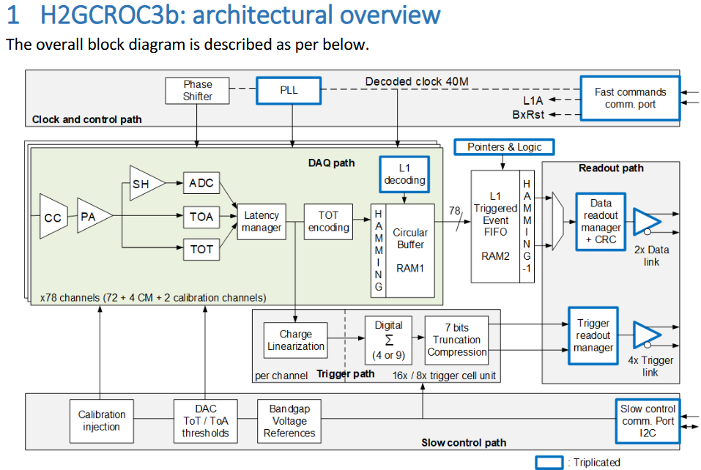
Architectural
320MHz Clock input
Command link (L1A is trigger input)
Two lane for data output:
  Speed 1.28Gbps
  Charge info, Time info…
Four lane for trigger generation
  1.28Gbps x4
I2C interface read/write 7900 parameters
72 channels of analog signals input
4 CM (only connect to ADC internally)
2 Calibration channel
CC: Current conveyor (VFE), calibration SiPM gain variation
PA: Preamplifier
TOT: Time Over Threshold, dedicated discriminator and TDC (50ps), 12 bit
TOA: Time Of Arrival, dedicated discriminator and TDC (24ps), 12 bit
SH: Shaper
ADC: 10bit 40MHz SARADC

Slide 15
Default register value
The default config value of H2GCROC after power up
"Channel_0-71 ": "00 00 00 00 00 00 00 00 00 00 00 00 00 00 00",
"CM_0-3 ": "00 00 00 00 00 00 00 00 00 00 00 00 00 00 00",
"CALIB_0-1 ": "00 00 00 00 00 00 00 00 00 00 00 00 00 00 00",
"Global_Analog_0-1 ": "cf d3 83 28 28 00 9a 9a a2 8a 50 4b 4b 68 6f",
"Reference_Voltage_0-1 ": "dc 00 3c 1c 58 d0 00 00 00 00 00 00 00",
"Master_TDC_0-1 ": "37 d4 40 80 08 b0 02 00 00 80 08 b0 02 00 00 00",
"Digital_Half_0-1 ": "00 00 00 00 80 00 00 00 00 00 00 00 00 19 00 08 cc cc cc 0c cc cc cc cc 0f 01 00",
"HalfWise_0 ": "00 00 00 00 00 00 00 00 00 00 00 00 00 00 00",
"Top ": "08 0f 40 31 00 03 85 00 00 00 00 00 00 00 00 00 00 00 00 00 00"
Total 1363 Bytes

Slide 16
Operation Procedure
H2GCROC can generate a pulse signal internally and inject it to input channel, with adjustable amplitude
H2GCalib_3B
  Set IODELAY – adjust the data/trigger line delay between FPGA and H2GCROC, this parameter is provided for FPGA, not for H2GCROC.
  ADC pedestal
  TOA calibration – adjust the channel threshold to make the output value close to the user's target value
  TOT calibration – adjust the channel threshold to make the output value close to the user's target value
Repeat this procedure for all FPGA and H2GCROC combination and generate configuration files

Slide 17
Operation Procedure
H2GDAQ
  Set IODELAY – this step is the same as calibration
H2GConfig
  Send All configs – upload all calibration values to all H2GCROC
H2GDAQ
  Start DAQ
Decode data or Online Monitoring

Slide 18
H2GCalib_3B
Modify file H2GCalib_3B/config/common_settings_3B.json
{
"udp": {
"h2gcroc_ip": "10.1.2.208",
"pc_ip": "10.1.2.207",
"h2gcroc_port": 11000,
"pc_cmd_port": 11000,
"pc_data_port": 11001
}
}

Slide 19
H2GCalib_3B – Socket Pool
python H2GCalib_3B/ 000_SocketPool.py
This program maintains multiple network connections, and other calibration programs use this as a relay, keep this program running in the background
[Pool] Control → 127.0.0.1:6002
[Pool] Data → 127.0.0.1:6001
...

Slide 20
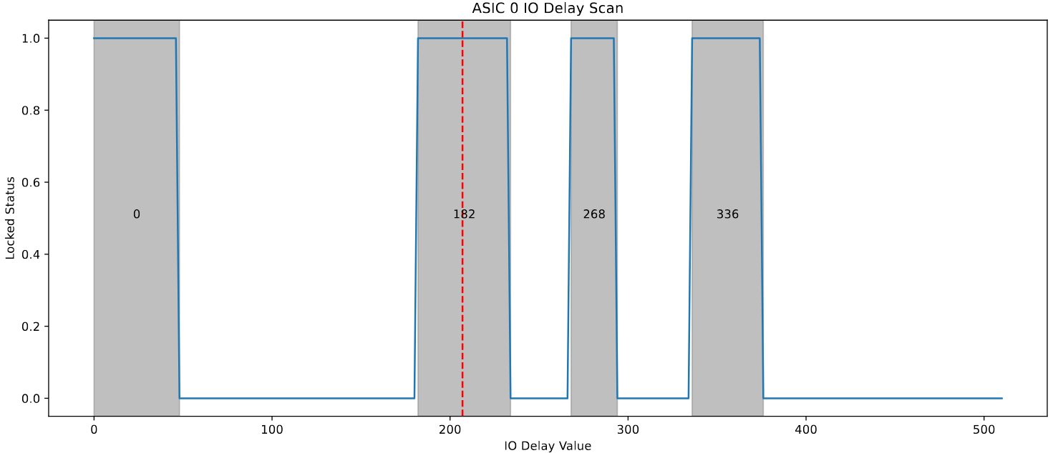
H2GCalib_3B – IO delay
python 007_IODelay.py
You can also use H2GDAQ’s IO Delay button to do this, but it don’t generate report

Slide 21
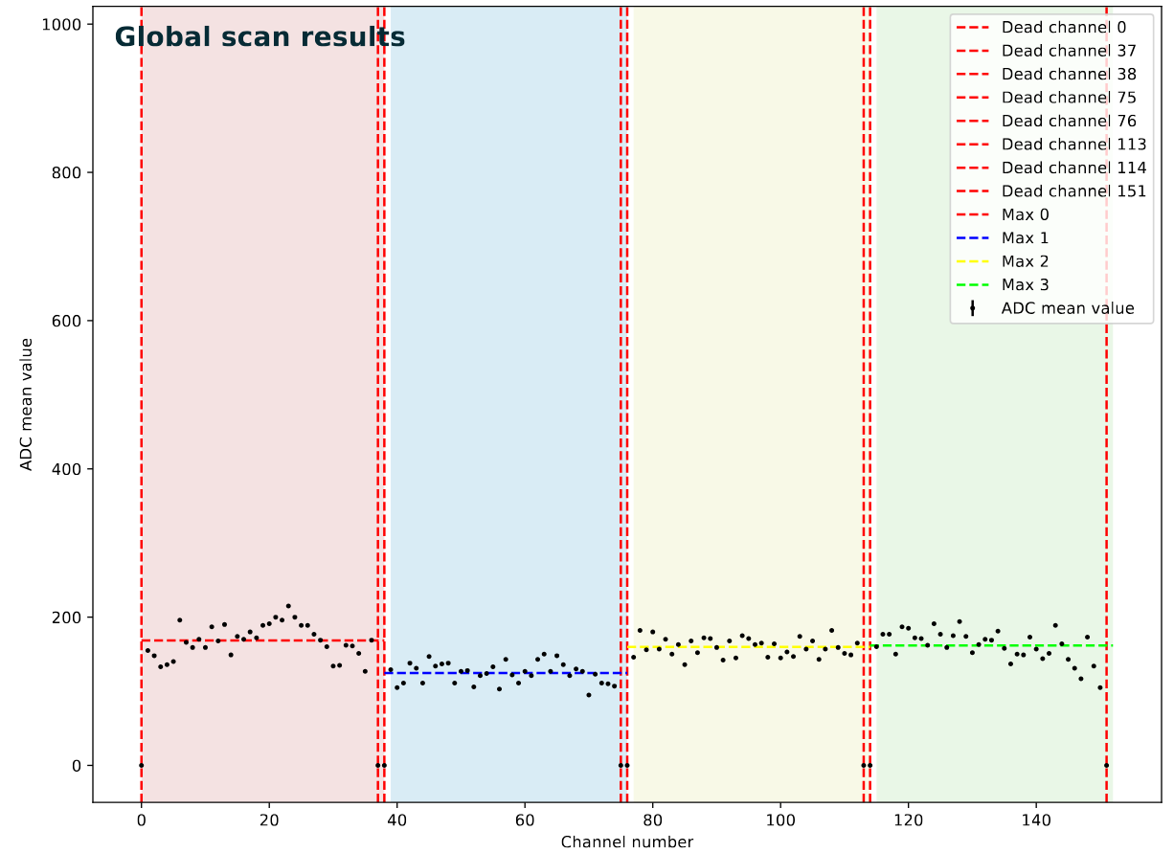
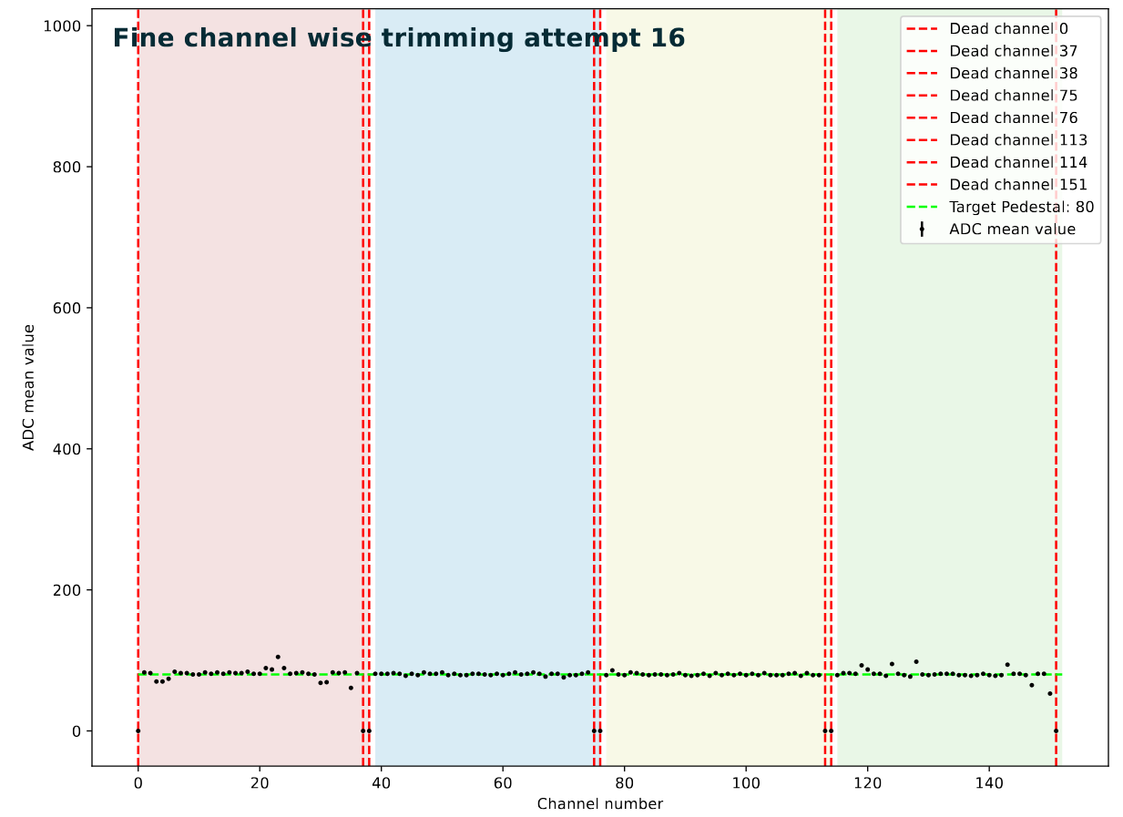
H2GCalib_3B – ADC pedestal calibration
This program try to get the best pedestal value, it start from config “default_2024Aug_config.json”
python 005_PedestalCalib.py
avg
target
Before calibration ADC pedestal
After calibration ADC pedestal

Slide 22
H2GCalib_3B – ADC pedestal calibration
Run calibration again but base on the previous output but it don’t work, TODO
python 005_PedestalCalib.py -i python 005_PedestalCalib.py -i dump/005_PedestalCalib_data_20250625_135655/config_pede_a0_20250625_135817.json,dump/005_PedestalCalib_data_20250625_135655/config_pede_a1_20250625_135817.json
previous ADC pedestal calibration result
final ADC pedestal calibration result

Slide 23
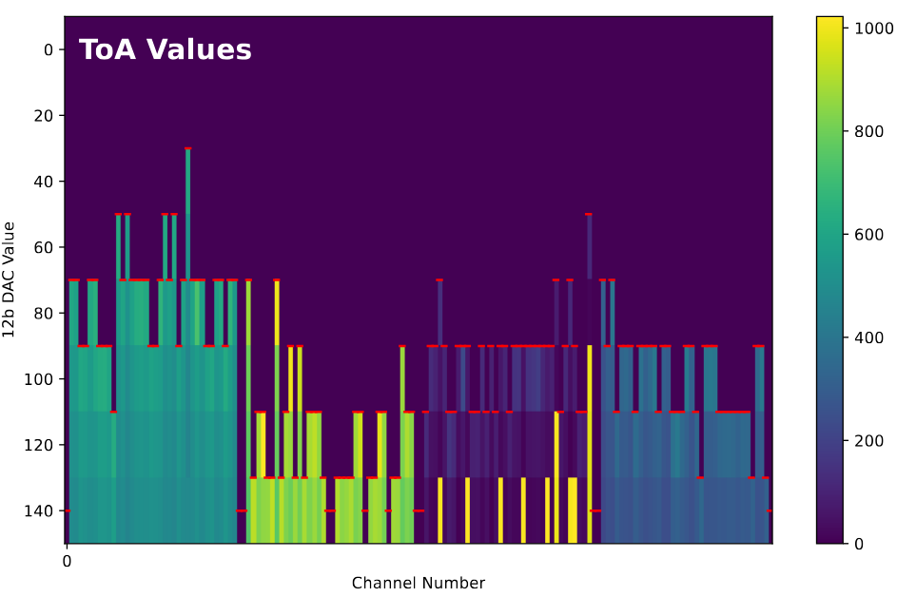
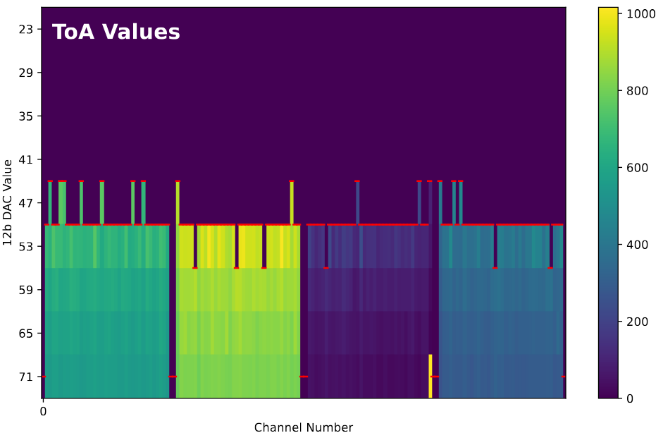
H2GCalib_3B – ToA Calibration
python 006_ToACalib.py -t 50 -i dump/005_PedestalCalib_data_20250625_135655/config_pede_a0_20250625_135817.json,dump/005_PedestalCalib_data_20250625_135655/config_pede_a1_20250625_135817.json
Before calibration ToA
After calibration ToA

Slide 24
H2GCalib_3B – ToA Calibration
Run calibration again but base on the previous output TODO
python 006_ToACalib.py -t 50 -i dump/006_ToACalib_data_20250625_143708/config_toa_a0_20250625_151028.json,dump/006_ToACalib_data_20250625_143708/config_toa_a1_20250625_151028.json
previous ToA calibration result
final ToA calibration result

Slide 25
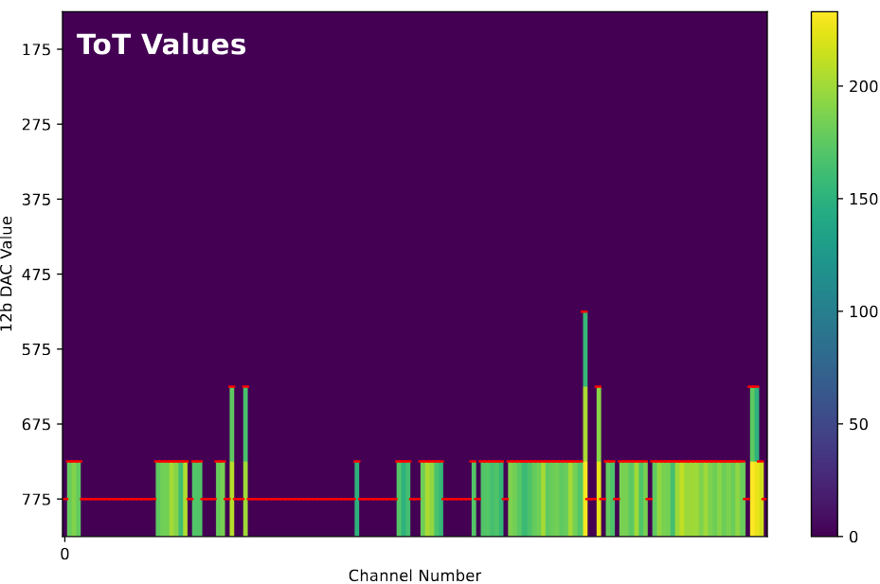
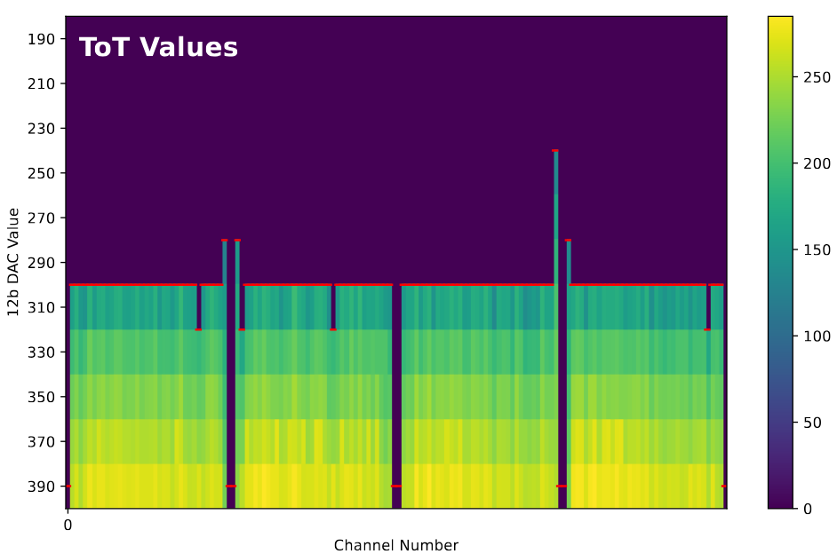
H2GCalib_3B – ToT Calibration
python 010_ToTCalib.py -t 300 -i dump/006_ToACalib_data_20250625_143708/config_toa_a0_20250625_151028.json,dump/006_ToACalib_data_20250625_143708/config_toa_a1_20250625_151028.json
Before calibration ToT
After calibration ToT

Slide 26
H2GCalib_3B – ToT Calibration
Run calibration again but base on the previous output TODO
python 010_ToTCalib.py -t 300 -i dump/006_ToACalib_data_20250625_143708/config_toa_a0_20250625_151028.json,dump/006_ToACalib_data_20250625_143708/config_toa_a1_20250625_151028.json
previous ToT calibration result
final ToT calibration result

Slide 27
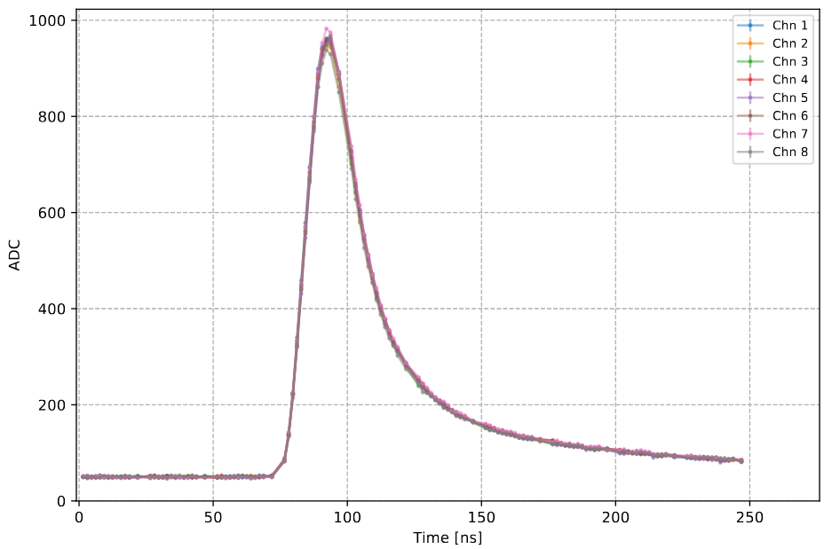
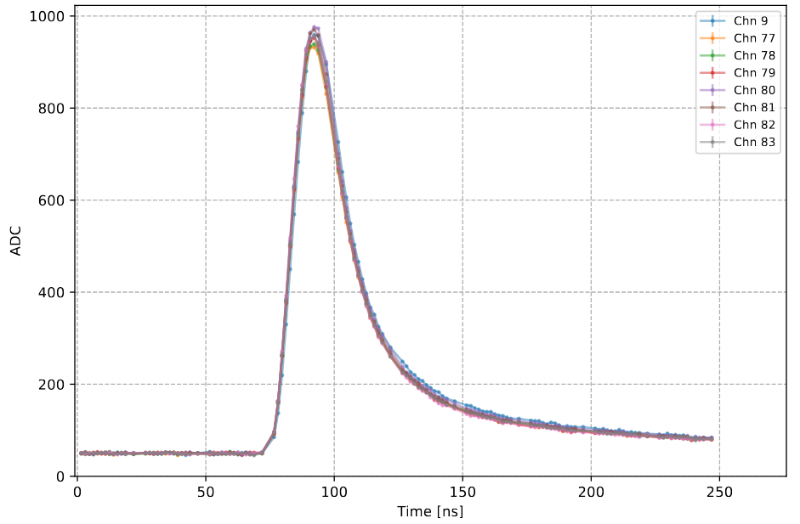
H2GCalib_3B – inject 2V5 signal
modify file , line 282
python 009_IntInjection_2V5.py -i dump/010_ToTCalib_data_20250625_152005/config_tot_a0_20250625_155055.json,dump/010_ToTCalib_data_20250625_152005/config_tot_a1_20250625_155055.json
phase_settings = [0, 1, 2, 3, 5, 8, 9, 10, 11, 12, 13, 14, 15]
ASIC 0 (ch 1 ~ 9)
ASIC 1 is fine (ch 77 ~ 85)

Slide 28
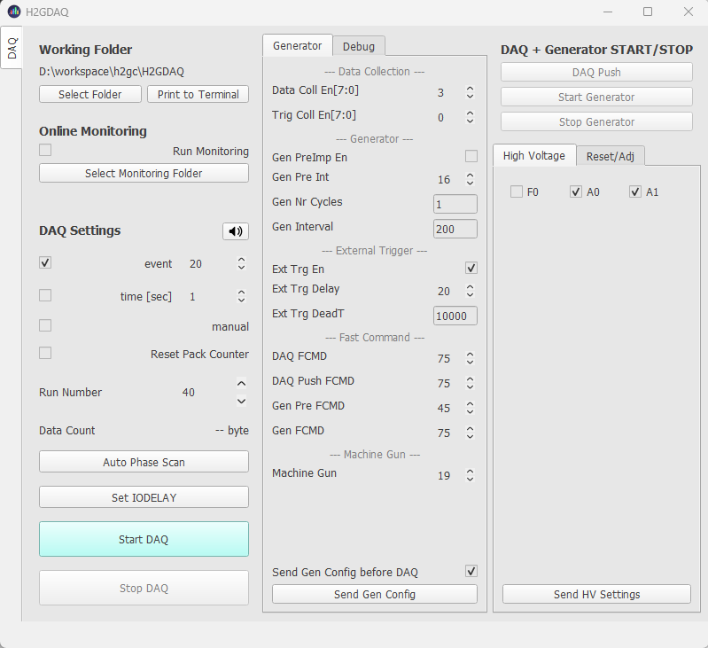
Operation Procedure - DAQ
Directory to store data
high voltage relay setting
A0 = ASIC 0 only
A1 = ASIC1 only
F0 = ASIC0 and ASIC1 both
DAQ stop condition: By event count, by time or manual
Output Run040.h2g
1
Send command to turn On/Off the relay base on the settings above. You also need to turn on your power supply
Start/Stop DAQ button
6
5

Slide 29
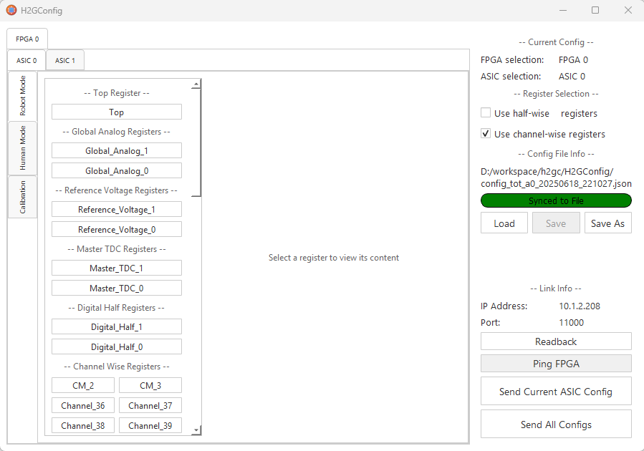
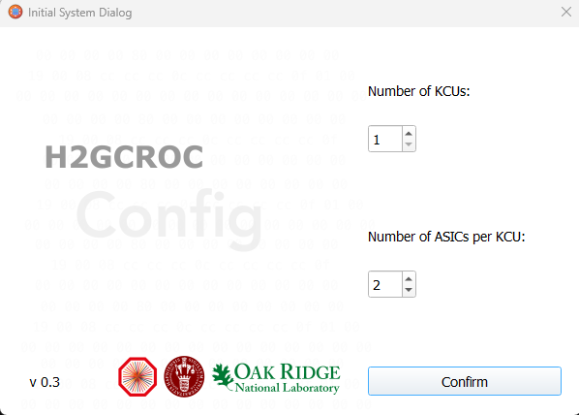
Operation Procedure - Config
H2GConfig
  The GUI can read the configuration file and display it graphically. It allow you to modify register bit by bit
  It can upload configuration to the ASIC
  There is also a Ping FPGA button for you to test the ethernet connection
2
3
Load configuration
Test network connection
4
Upload to ASIC

Slide 30
Operation Procedure - online_monitoring
$ cat eeemcal_20sample.cfg
MAX_SAMPLES=20
NUM_FPGA=4
DETECTOR_ID=2
https://github.com/tlprotzman/h2g_online_monitoring
  dependence: ROOT
  developed by Tristan Protzman from Lehigh University
$ git clone https://github.com/tlprotzman/h2g_online_monitoring.git
$ cd ~/workspace/h2g_online_monitoring
$ make
$ export DATA_DIRECTORY=~/workspace/H2GDAQ
$ export MONITORING_PORT=12345
$ root -q -b -x -l RunMonitoring.c\(RunNumber\)
Processing RunMonitoring.c(9)...
Parsing config file eeemcal_20sample.cfg
Key: MAX_SAMPLES, Value: 20
Key: NUM_FPGA, Value: 4
Key: DETECTOR_ID, Value: 2
Configuring for detector ID 2: EEEMCal
Configuration values:
NUM_LINES: 5
NUM_FPGA: 4
NUM_CHANNELS: 72
NUM_LINES: 5
MAX_SAMPLES: 20
MACHINE_GUN_MAX_TIME: 600
PACKET_SIZE: 1452
Configuring for detector ID 2: EEEMCal
Configuration values:
NUM_LINES: 5
NUM_FPGA: 4
NUM_CHANNELS: 72
NUM_LINES: 5
MAX_SAMPLES: 20
MACHINE_GUN_MAX_TIME: 600
PACKET_SIZE: 1452
huh??
Info in <THttpEngine::Create>: Starting HTTP server on port 12345
Attempting to open file /home/shyao/workspace/H2GDAQ/Run009.h2g
Starting at byte 828
Building events... done!
Updating canvases... done!
.....

Slide 31
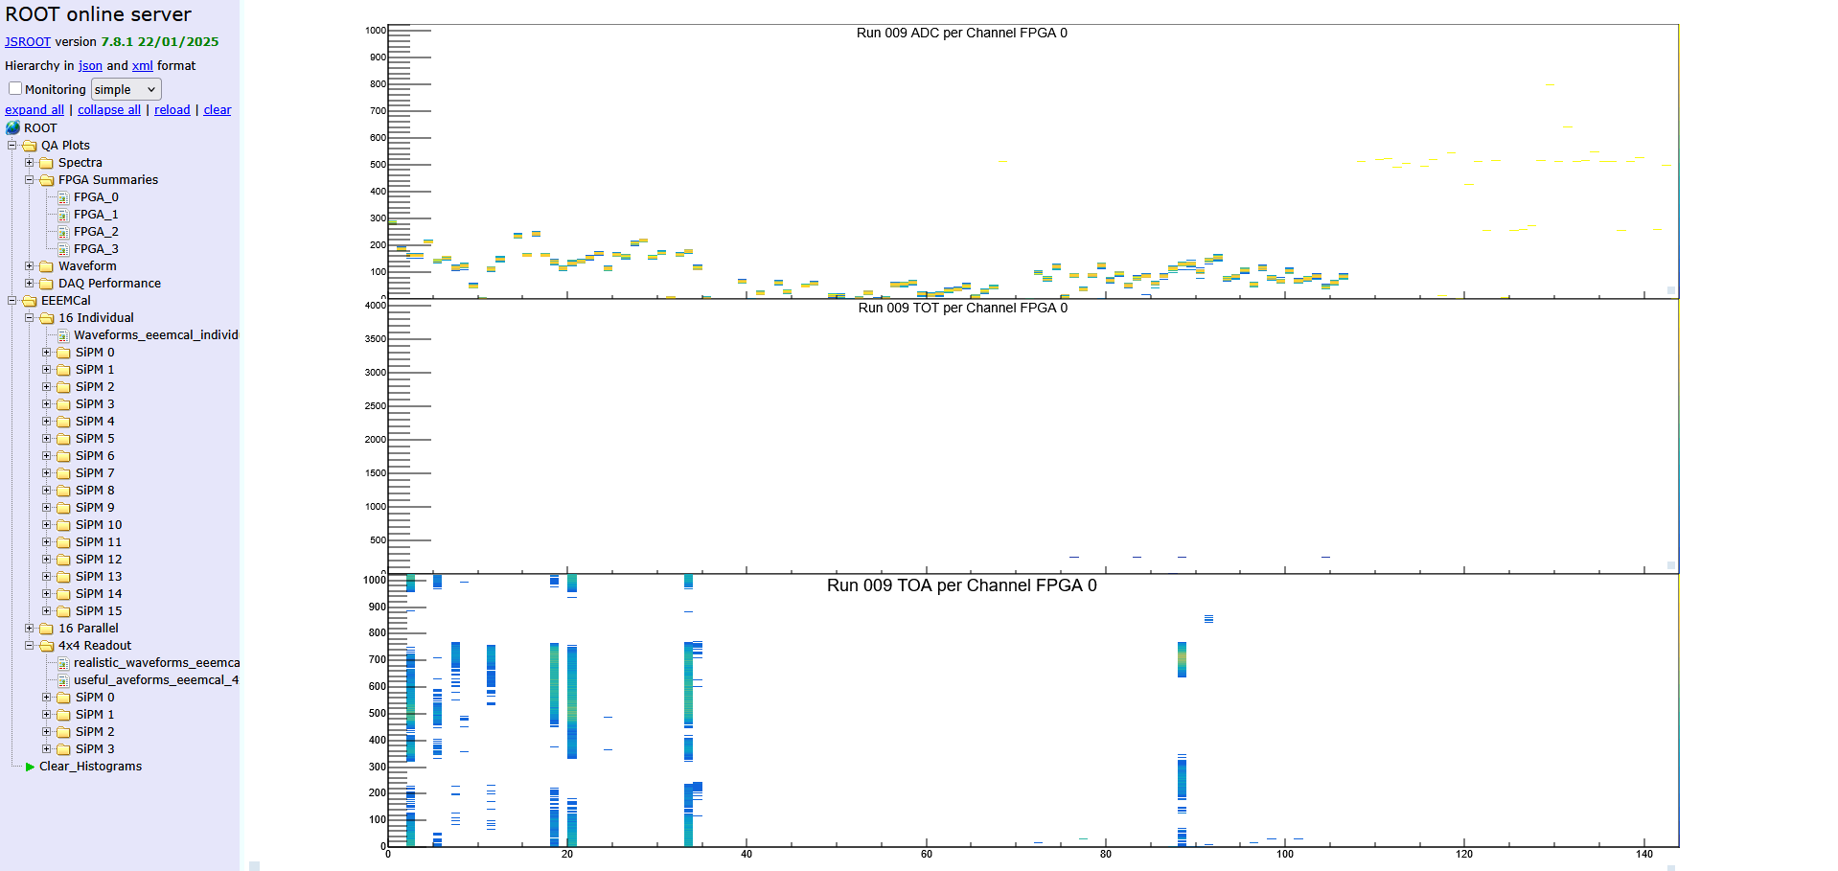
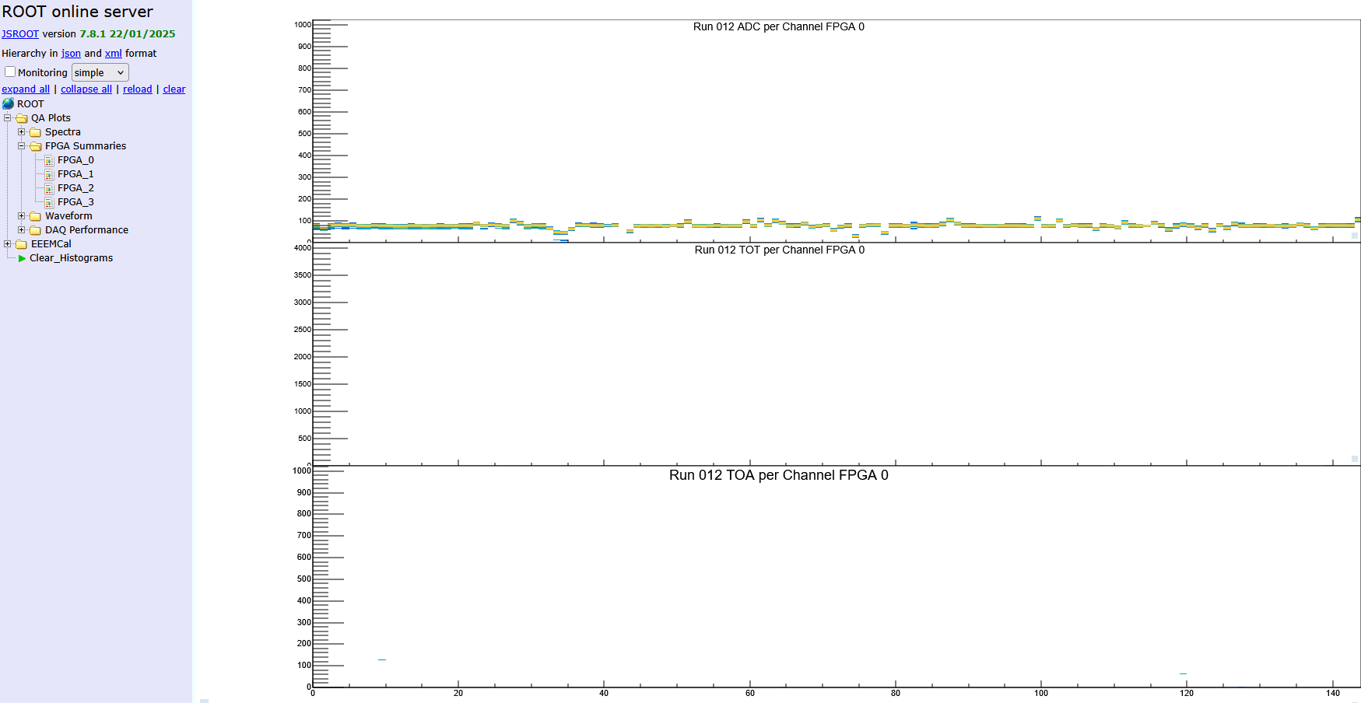
Operation Procedure - online_monitoring
Launch web browser and connect to localhost:12345
before calibration
After calibration

Slide 32
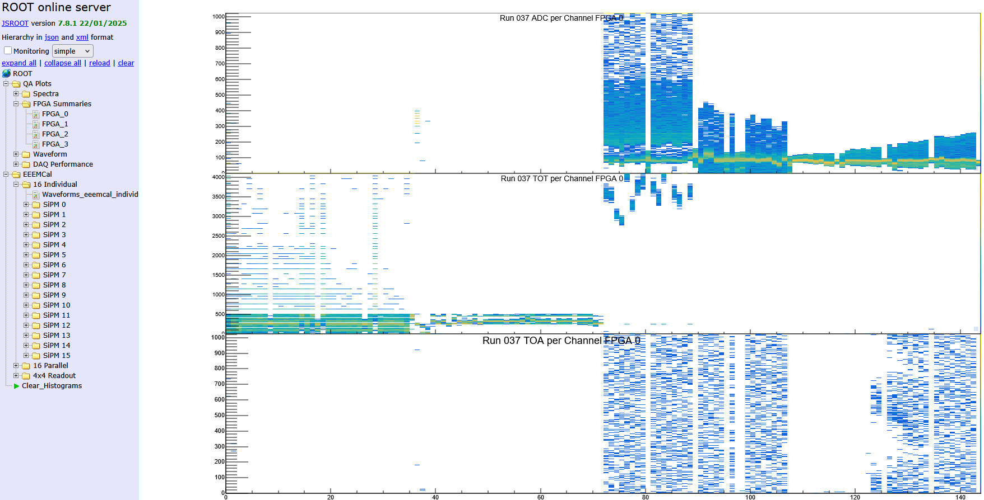
Operation Procedure - online_monitoring
Inject light to crystal, each crystal use 4x4 SiPM. The light comes from an LED with a pulse width of 100ns
Light inject to this 16 channels
Crosstalk and Light leaking
Light leaking to other crystal, must improve isolation

Slide 33
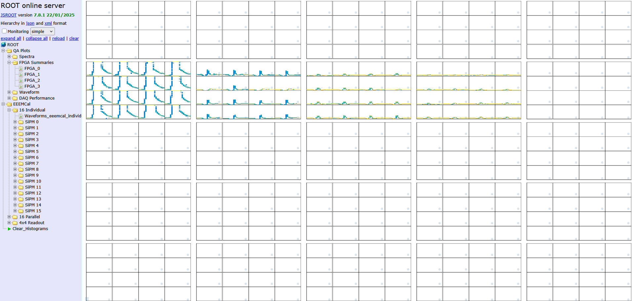
Operation Procedure - online_monitoring
Draw in crystal Array, it depend on your channel mapping
Light inject to this crystal
Light leaking to other crystal, must improve isolation
Other channel is not connected during test

Slide 34
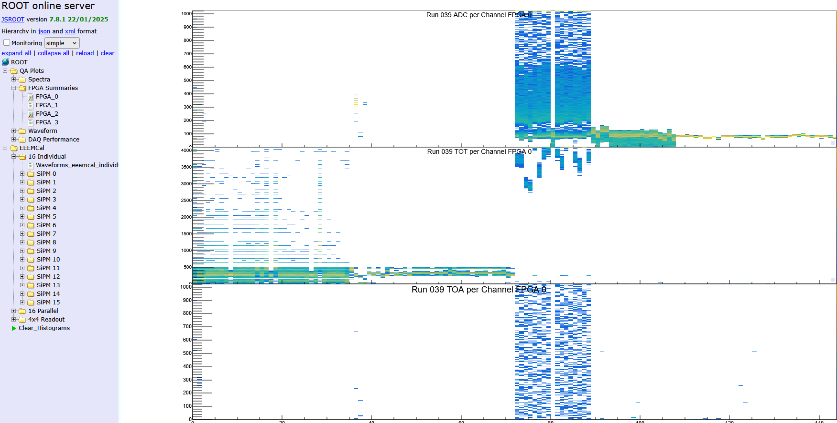
Operation Procedure - online_monitoring
Inject light to crystal, without leaking
Light inject to this 16 channels
Crosstalk (in H2GCROC)

Slide 35
Operation Procedure - decode
https://github.com/tlprotzman/h2g_decode
  dependent ROOT , developped by Tristan Protzman from Lehigh University
  It provide a library h2g_decode and a executable h2g_run
$ cd ~/workspace
$ git clone https://github.com/tlprotzman/h2g_decode.git
$ cd ~/workspace/h2g_decode
$ mkdir data build; cd build; cmake ..; make
$ export DATA_DIRECTORY=~/workspace/H2GDAQ
$ export OUTPUT_DIRECTORY=~/workspace/h2g_decode
$ ./build/h2g_run
Usage: h2g_decode -r <run_number> [-d <detector_id>] [-n <num_kcu>] [-g] [-G LEVEL] [-T]
-r, --run Run number (required)
-d, --detector Detector ID (default: 0, LFHCAL: 1, EEEMCAL: 2)
-n, --num-kcu Number of KCUs (default: 4)
-g, --debug Enable debug output with INFO level
-G, --debug-level Set debug level explicitly:
0: OFF, 1: ERROR, 2: WARNING, 3: INFO, 4: DEBUG, 5: TRACE
-T, --truncate Enable ADC truncation
-h, --help Show this help message
** Data file is named with “Run%03d.h2g”

Slide 36
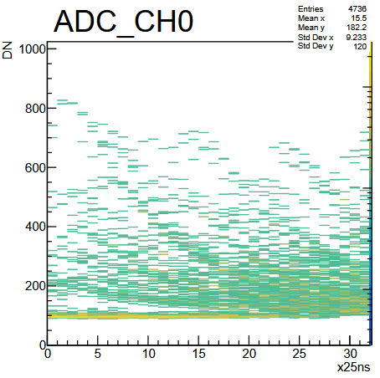
Operation Procedure - decode
Convert rawdata to root file for future analysis.
$ ./build/h2g_run -r 14 -d 0 -n 1
$ root
root [1] TFile f(“Run014.root”)
root [2] events->Print()
******************************************************************************
*Tree :events : Events *
*Entries : 98258 : Total = 7360953537 bytes File Size = 492028194 *
* : : Tree compression factor = 14.96 *
******************************************************************************
*Br 0 :event_number : event_number/i *
*Entries : 98258 : Total Size= 395183 bytes File Size = 138994 *
*Baskets : 18 : Basket Size= 51200 bytes Compression= 2.84 *
*............................................................................*
*Br 1 :timestamps : timestamps[1]/i *
*Entries : 98258 : Total Size= 395145 bytes File Size = 114179 *
*Baskets : 18 : Basket Size= 51200 bytes Compression= 3.45 *
*............................................................................*
*Br 2 :num_samples : num_samples/i *
*Entries : 98258 : Total Size= 395161 bytes File Size = 4019 *
*Baskets : 18 : Basket Size= 51200 bytes Compression= 98.15 *
*............................................................................*
*Br 3 :adc : adc[144][32]/i *
*Entries : 98258 : Total Size= 1811620311 bytes File Size = 408563585 *
*Baskets : 5745 : Basket Size= 7088128 bytes Compression= 4.43 *
*............................................................................*
*Br 4 :toa : toa[144][32]/i *
*Entries : 98258 : Total Size= 1811620311 bytes File Size = 22647543 *
*Baskets : 5745 : Basket Size= 7088128 bytes Compression= 79.99 *
*............................................................................*
*Br 5 :tot : tot[144][32]/i *
*Entries : 98258 : Total Size= 1811620311 bytes File Size = 8514786 *
*Baskets : 5745 : Basket Size= 7088128 bytes Compression= 212.75 *
*............................................................................*
*Br 6 :hamming : hamming[144][32]/i *
*Entries : 98258 : Total Size= 1811643307 bytes File Size = 8529147 *
*Baskets : 5745 : Basket Size= 7089664 bytes Compression= 212.39 *
*............................................................................*
*Br 7 :hit_max : hit_max[144]/i *
*Entries : 98258 : Total Size= 56630819 bytes File Size = 21343750 *
*Baskets : 353 : Basket Size= 221184 bytes Compression= 2.65 *
*............................................................................*
*Br 8 :hit_pedestal : hit_pedestal[144]/i *
*Entries : 98258 : Total Size= 56632604 bytes File Size = 22016214 *
*Baskets : 353 : Basket Size= 221696 bytes Compression= 2.57 *
*............................................................................*
ADC waveform
x-axis: time
y-axis: amplitude

Slide 37
Q/A
WWW

Slide 38
Operation Procedure - online_monitoring
To modify channel mapping: online_monitor.cxx
// EEEMCal mapping - instead of "layers", we have a single plane, where each crystal is one connector
// FPGA IP | ID
// 208 | 0
// 209 | 1
// 210 | 2
// 211 | 3
int eeemcal_fpga_map[25] = {0, 0, 0, 0, 2,
0, 0, 0, 0, 2,
1, 1, 1, 1, 2,
1, 1, 1, 1, 2,
2, 2, 2, 2, 3};
// ASIC | ID
// 0 | 0
// 1 | 1
int eeemcal_asic_map[25] = { 0, 0, 0, 0, 1,
1, 1, 1, 1, 1,
0, 0, 0, 0, 1,
1, 1, 1, 1, 1,
0, 0, 0, 0, 0};
// Connector | ID
// A | 0
// B | 1
// C | 2
// D | 3
int eeemcal_connector_map[25] = { 0, 1, 2, 3, 0,
0, 1, 2, 3, 1,
0, 1, 2, 3, 2,
0, 1, 2, 3, 3,
0, 1, 2, 3, 0};
int eeemcal_16i_channel_a_map[16] = { 0, 1, 2, 3, 4, 5, 6, 7,
9, 10, 11, 12, 13, 14, 15, 16};
int eeemcal_16i_channel_b_map[16] = {19, 20, 21, 22, 23, 24, 25, 26,
27, 28, 29, 30, 31, 32, 33, 34};
int eeemcal_16i_channel_c_map[16] = {55, 56, 57, 58, 59, 60, 61, 62,
63, 64, 65, 66, 67, 68, 69, 70};
int eeemcal_16i_channel_d_map[16] = {36, 37, 38, 39, 40, 41, 42, 43,
45, 46, 47, 48, 49, 50, 51, 52};
/*
int eeemcal_16i_channel_a_map[16] = { 2, 6, 11, 15, 0, 4, 9, 13,
1, 5, 10, 14, 3, 7, 12, 16};
int eeemcal_16i_channel_b_map[16] = {20, 24, 29, 33, 18, 22, 27, 31,
19, 23, 28, 32, 21, 25, 30, 34};
int eeemcal_16i_channel_c_map[16] = {67, 63, 59, 55, 69, 65, 61, 57,
70, 66, 60, 56, 68, 64, 58, 54};
int eeemcal_16i_channel_d_map[16] = {50, 46, 40, 36, 52, 48, 42, 38,
51, 47, 43, 39, 49, 45, 41, 37};
*/

Slide 39
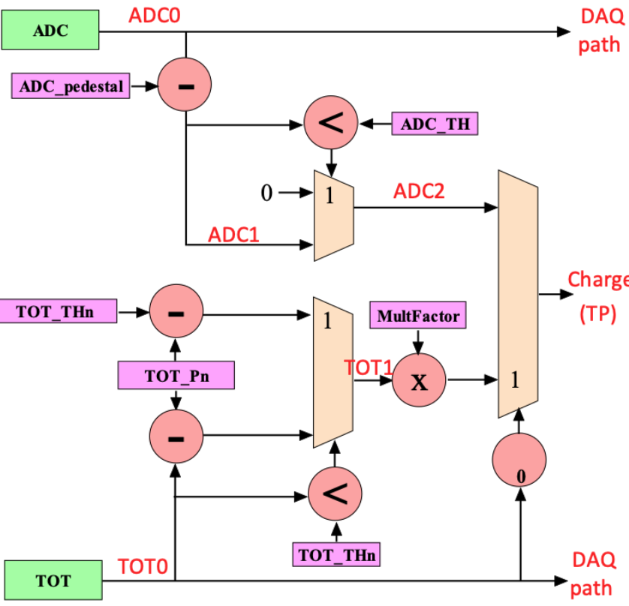
Trigger path
10 bit
ADC1 = ADC0 – ADC_pedestal
ADC2 = (ADC1 < ADC_TH) ? 0: ADC1
  ***if set ADC_pedestal = ADC_TH = 0
  ***ADC2 = ADC0
TOT1 = (TOT0 < TOT_THn) ? (TOT_THn – TOT_Pn) : (TOT0 – TOT_Pn)
  *** if set TOT_THn = TOT_Pn = 0
  *** TOT1 = TOT0
Charge = (TOT0 != 0) ? TOT1 * MultFactor : ADC2
4 bit
8 bit
5 bit
7 bit
8 bit
12 bit

Slide 40
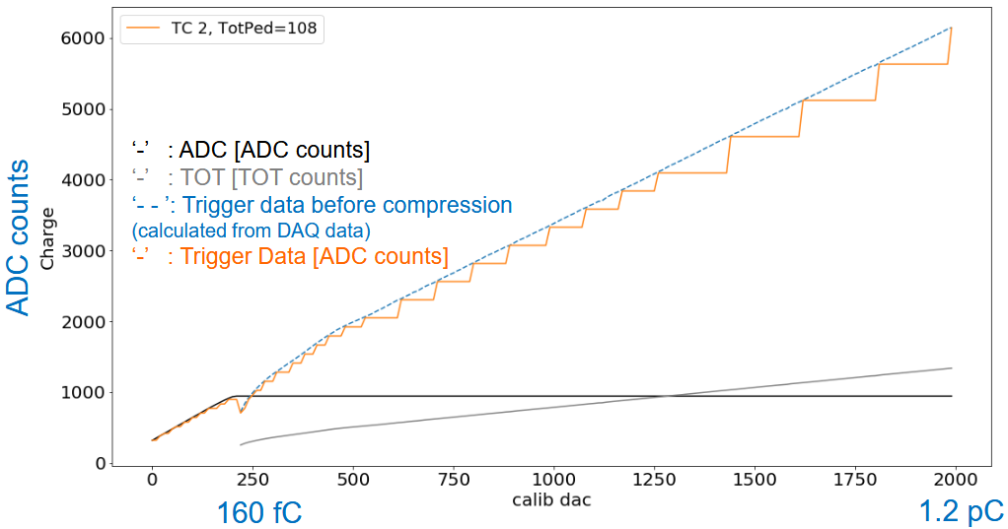
Trigger path
ADC [ADC counts] is 10 bit
TOT [TOT counts] is 12 bit
linearization
MultFactor
TOT_THn
TOT_
Ref. TIPP21_HGCROC.pdf

Slide 41
Local R&D
WWW

Slide 42
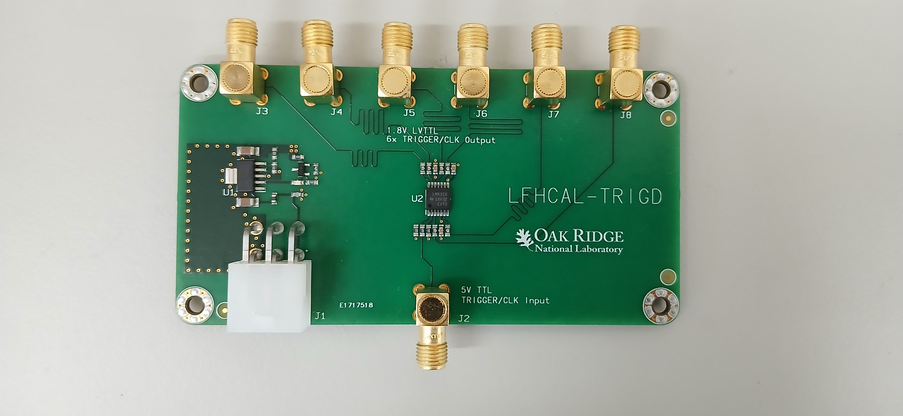
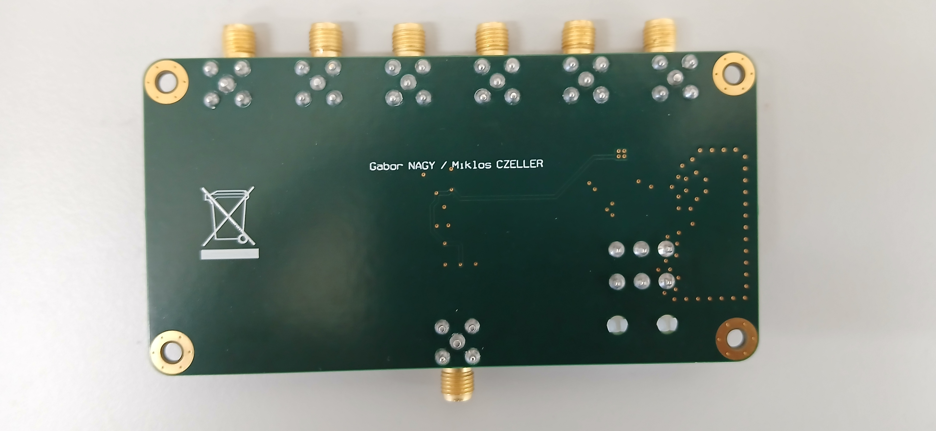
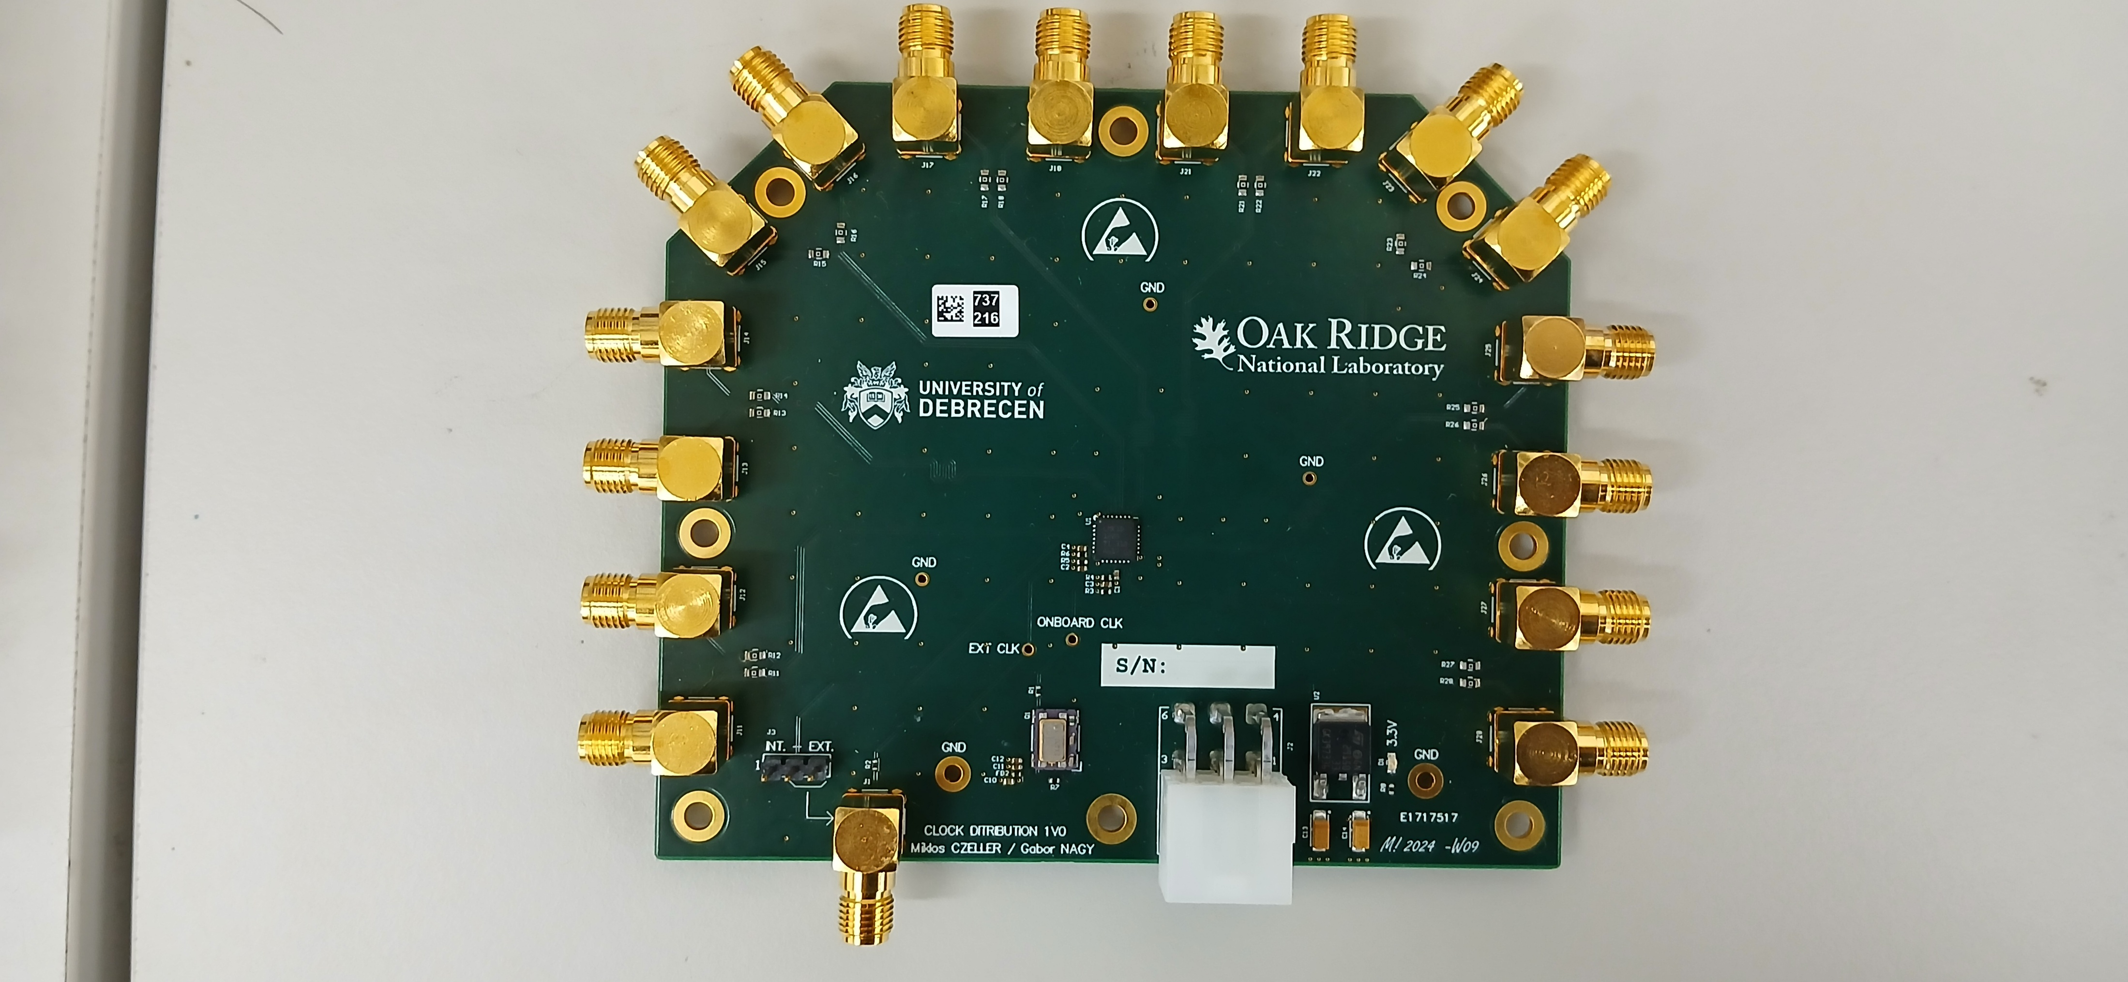
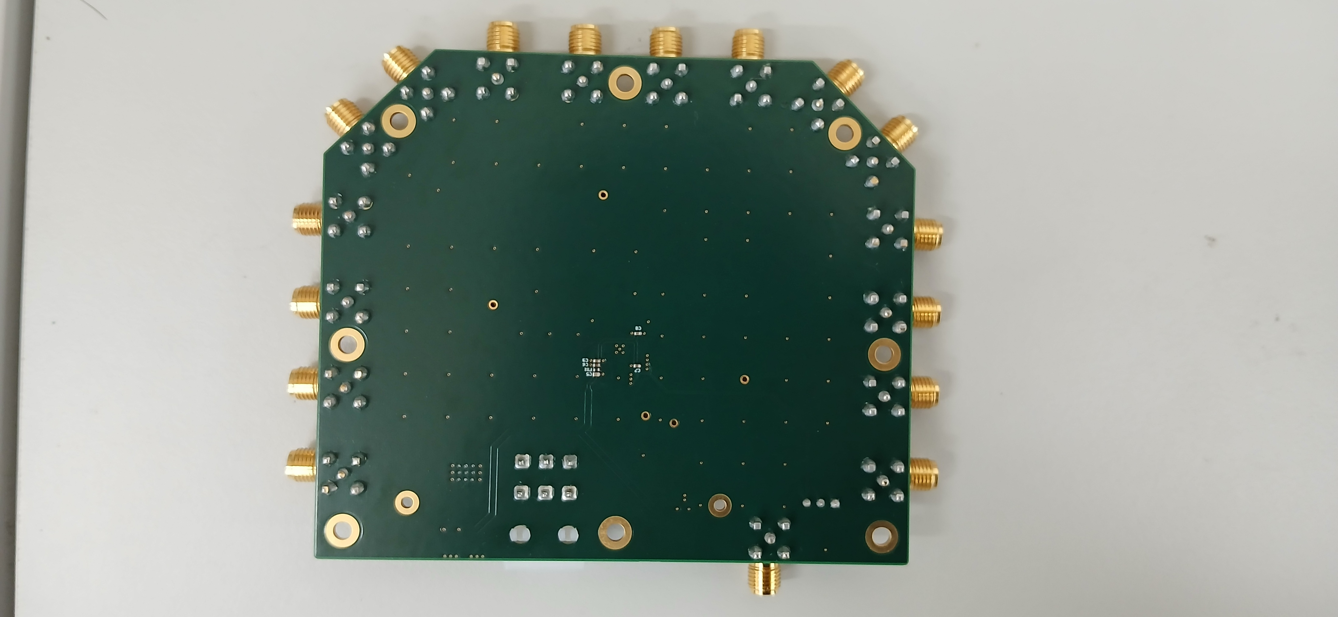
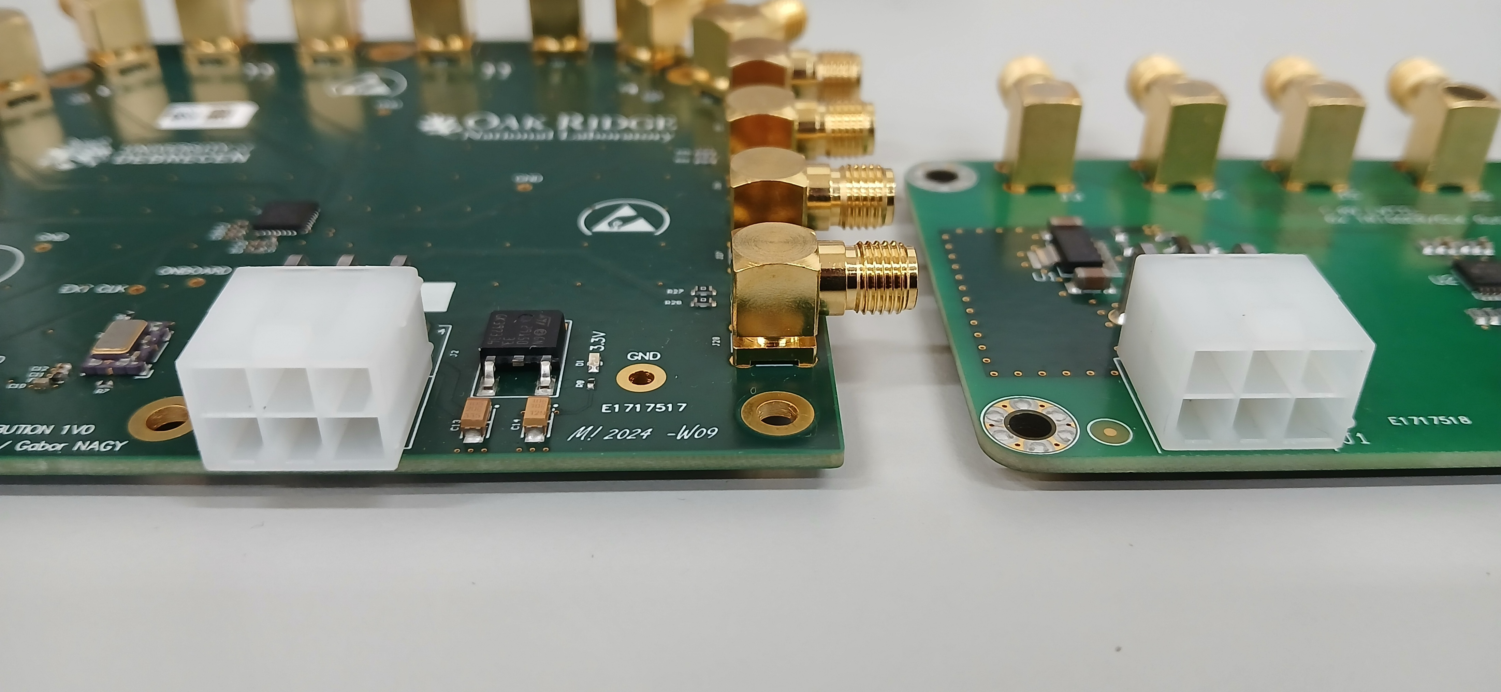
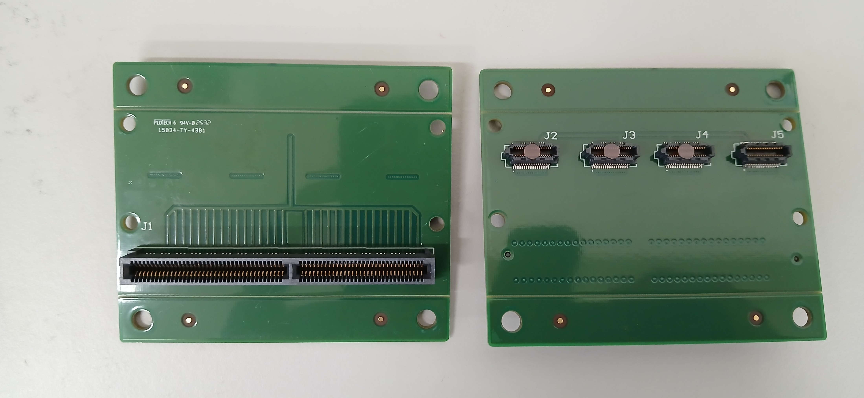
Trigger board front
Trigger board back
Clock board front
Clock board back
Clock board power
Trigger board power
Adapter board

Slide 43
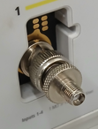
Hardware @NCU
Device
  PbWO/LYSO Crystal 1/1
  SiPM board 1/1
  Adapter board 2/4
  protoboard 3/4
  KCU105 1/2
  Clock board 1/1
  Trigger board 1/1
Equip
  PC 1/1
  Power supply (for Clock distribution board and Trigger board) 1/1
  Signal generator 1/1
  Network Switch 1GbE 1/1
Cable
  SMA male to male cable 3/8
  SMA to BNC connector 2/6
  SMA to <unknown> cable for clock board connect to <unknown input> 0/1
  SMA to <unknown> cable for trigger board connect to signal generator 0/1
  Power cable for Clock distribution board 1/1
  Power cable for Trigger board 1/1
  SiPM board to Adapter board ?/? not sure
  Network Cable 1GbE 1/2
Assume 2 KCU105 and 4 protoboard setup

Slide 44
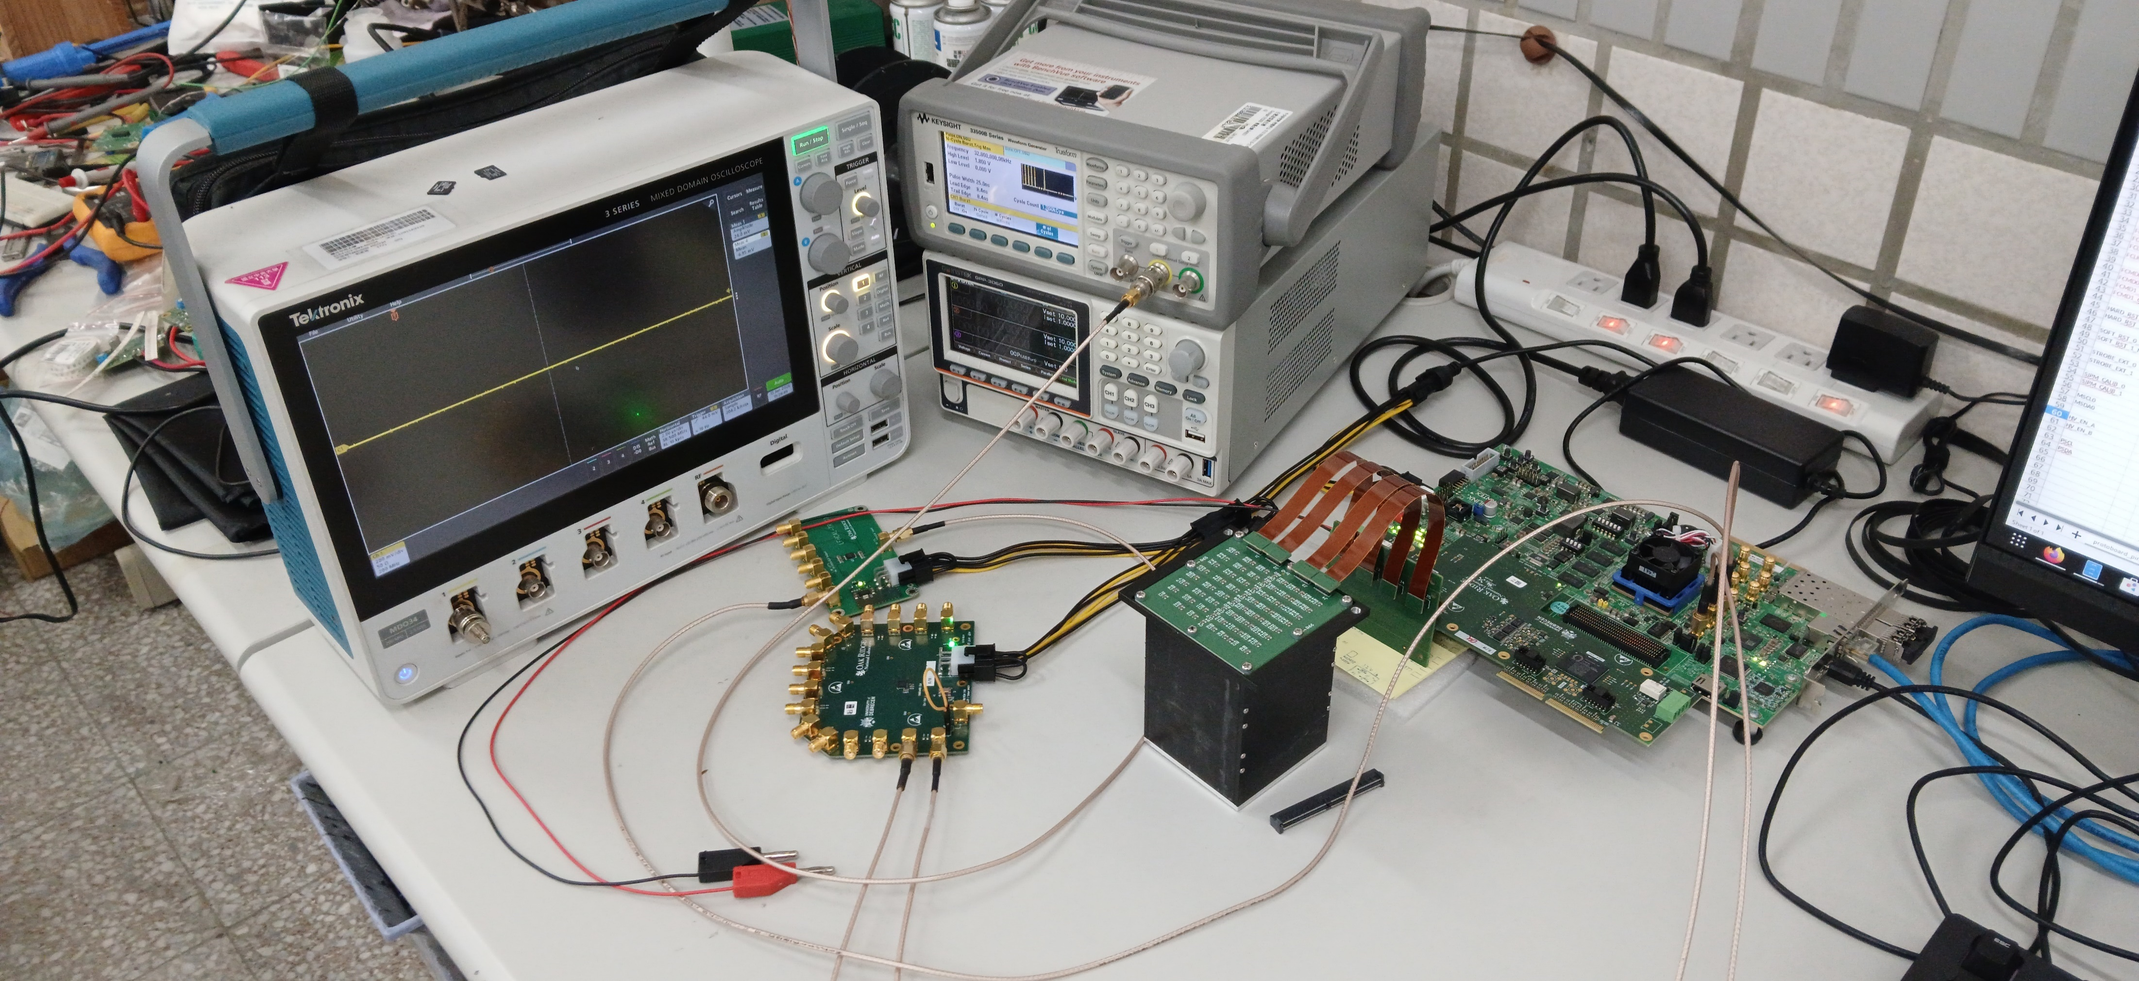
Current environment
Waveform generator
Power supply
Splitter cable
Oscilloscope
Clock
Clock
SiPM and Crystal
Adapter board

Slide 45
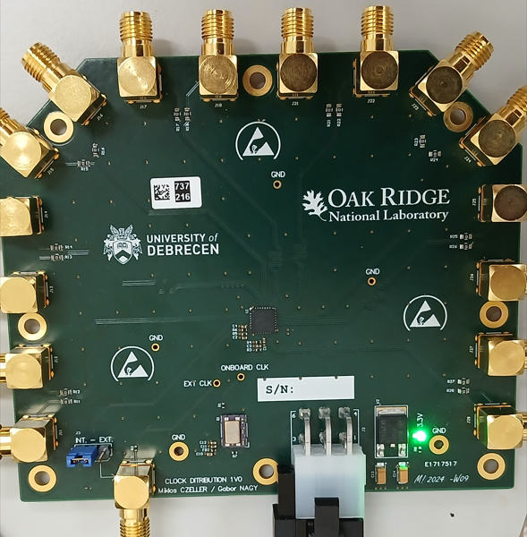
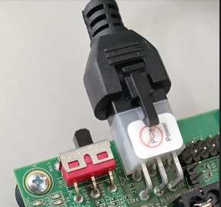
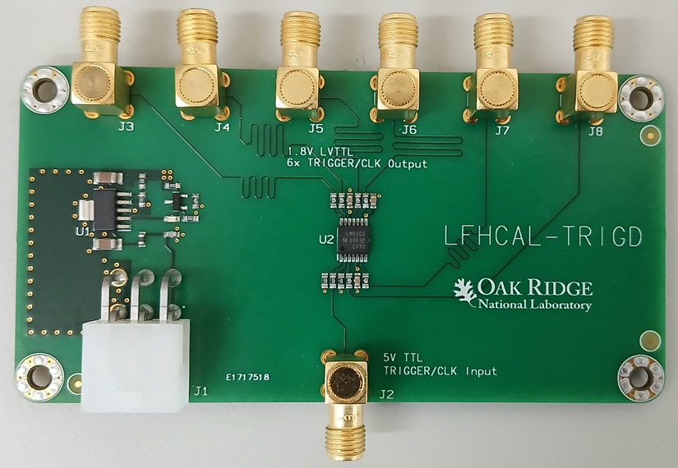
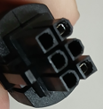
About 12V Power
Clock board
Shared FPGA evaluation board power supply via splitter
KCU 105
Trigger board
KCU105 Power supply
GND
GND
12V
GND
GND
12V
12V
12V
NC | NC | NC
GND | NC | 12V
GND | NC | 12V
GND | NC | 12V
GND | NC | 12V
GND | NC | 12V
GND | GND | NC
NC | 12V | 12V
GND | GND | 12V
GND | 12V | 12V
⬅ Connect all them together, your cable will be

Slide 46
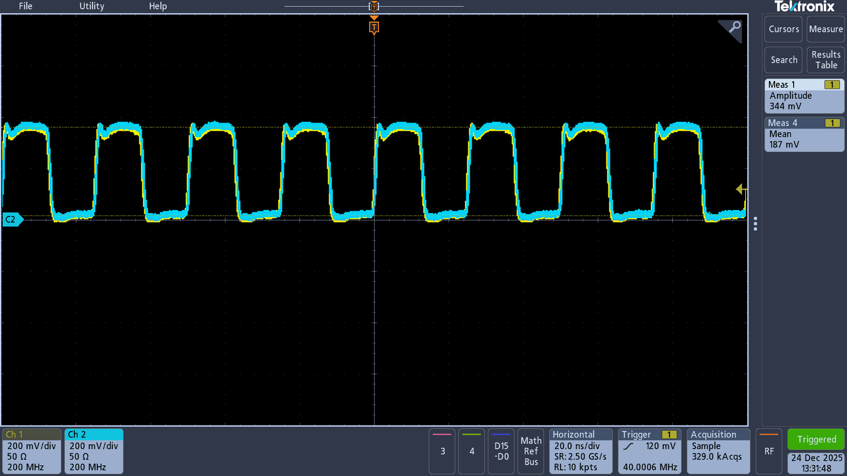
Clock board
4 N
4 P
3 N
3 P
2 N
5 P
2 P
5 N
.
1 N
6 P
6 N
1 P
7 P
0 N
0 P
7 N
40MHz
The output of 7P and 6P
Jumper select:
Int: On board 40MHz 0.5ppm clock
Ext: External input

Slide 47
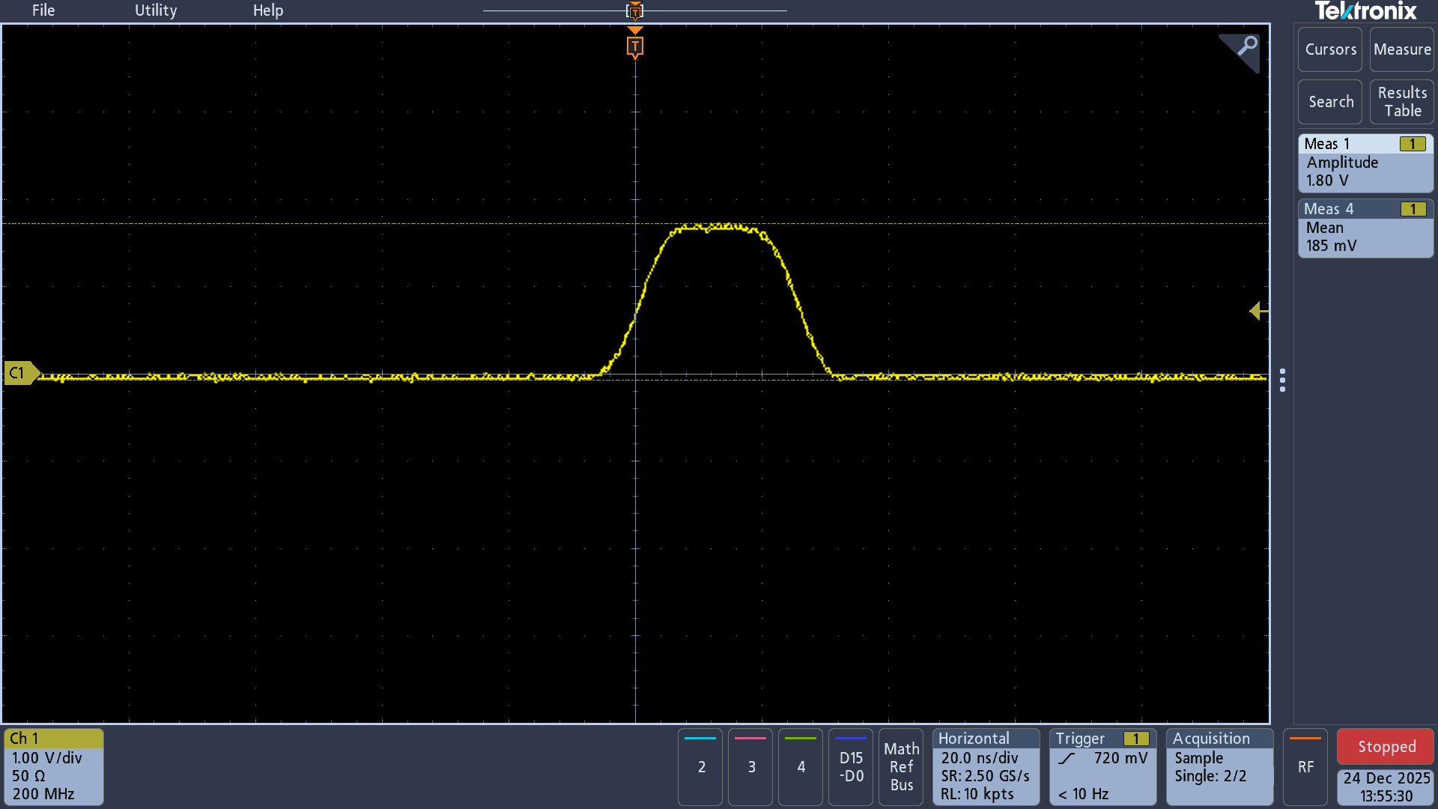
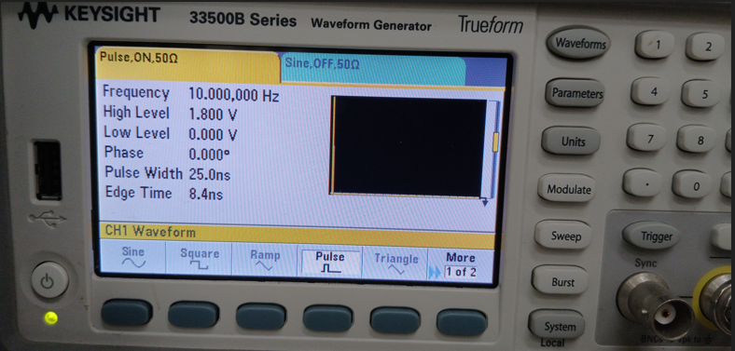
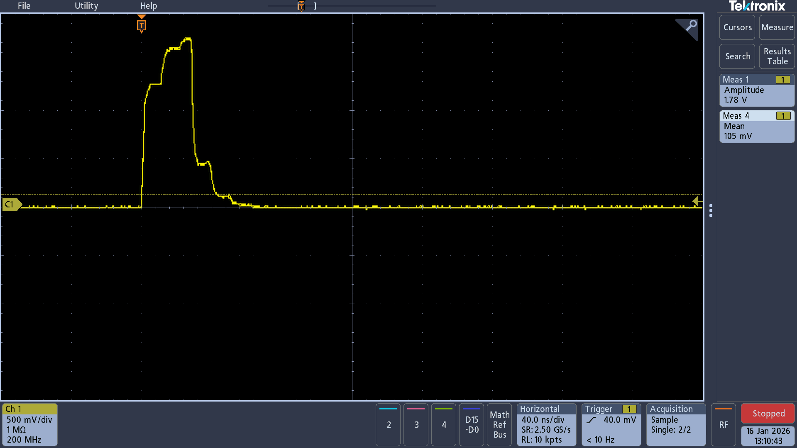
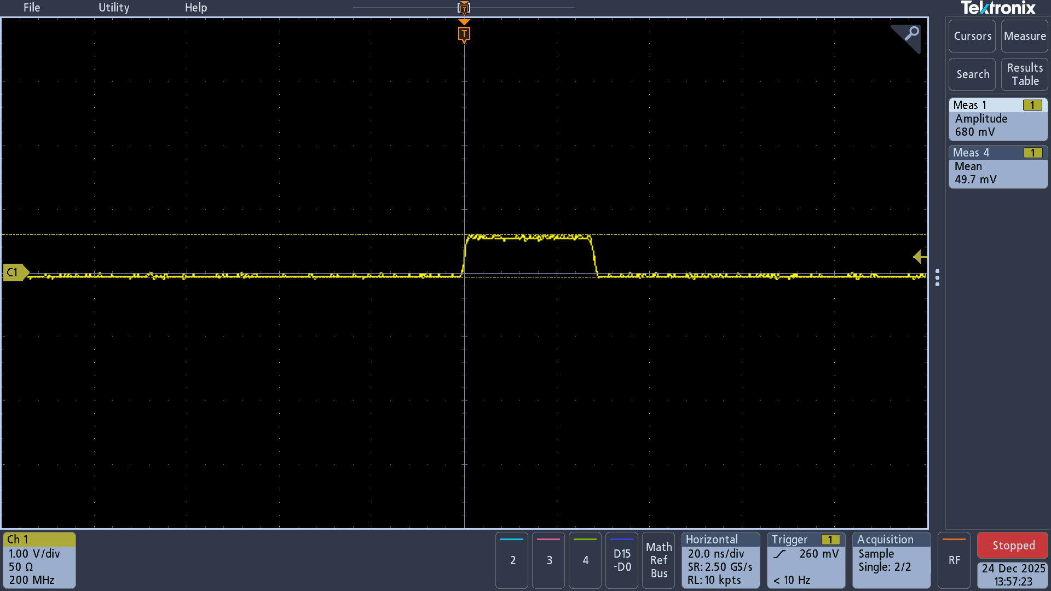
external trigger signal
1.8V output, 10Hz, Pulse width 25ns
Send to Trigger input
Input
If the input signal voltage decreases, the output width will decrease. Smaller than 0.8V output disappears
Output
1MΩ

Slide 48
UDP packet format (FPGA -> PC)
V4.11
Normal frame N = 0 ~ 36
JUMBO frame N = 0 ~ 224
1452 or 8972 Bytes
a UDP packet
Ethernet, IP, UDP Header | UDP Header (12B) | Data (40B) | Data (40B) | Data (40B) | ... | ... | ... |  | Data (N * 40B)
UDP header:
2B | Byte Counter | (0 ~ 36) *40
2B | Packet Counter | 0 ~ 65535
8B | String (“0”)
Data (40B):
Header | Timestamp | Data (4B) | Data (4B) | Data (4B) | Data (4B) | Data (4B) | Data (4B) | Data (4B) | Data (4B)
Data format header:
Timestamp:
1B | Header | b0-3: Asic address. b4-7: 0xA0
1B | Fpga board address | 0x00 ~ 0x07
1B | packet type | TR0: 0x20, TR1: 0x21, TR2: 0x22, TR3: 0x23, DQ0: 0x24, DQ1: 0x25
1B | packet id | 0 ~ 4
32B | Timestamp | Guess: Unit 25ns, for time sync between FPGAs

Slide 49
UDP packet format (FPGA -> PC)
V4.11
One read command generate ten of 40B packet (400Bytes), Two ASIC is 800 Bytes
Timestamp field is duplicated
Header | Timestamp | Data (4B) | Data (4B) | Data (4B) | Data (4B) | Data (4B) | Data (4B) | Data (4B) | Data (4B)
0, 0, 0x24, 0 | Timestamp | DaqH | CM | CH0 | CH1 | CH2 | CH3 | CH4 | CH5
0, 0, 0x24, 1 | Timestamp | CH6 | CH7 | CH8 | CH9 | CH10 | CH11 | CH12 | CH13
0, 0, 0x24, 2 | Timestamp | CH14 | CH15 | CH16 | CH17 | Calib | CH18 | CH19 | CH20
0, 0, 0x24, 3 | Timestamp | CH21 | CH22 | CH23 | CH24 | CH25 | CH26 | CH27 | CH28
0, 0, 0x24, 4 | Timestamp | CH29 | CH30 | CH31 | CH32 | CH33 | CH34 | CH35 | CRC-32
0, 0, 0x25, 0 | Timestamp | DaqH | CM | CH0 | CH1 | CH2 | CH3 | CH4 | CH5
0, 0, 0x25, 1 | Timestamp | CH6 | CH7 | CH8 | CH9 | CH10 | CH11 | CH12 | CH13
0, 0, 0x25, 2 | Timestamp | CH14 | CH15 | CH16 | CH17 | Calib | CH18 | CH19 | CH20
0, 0, 0x25, 3 | Timestamp | CH21 | CH22 | CH23 | CH24 | CH25 | CH26 | CH27 | CH28
0, 0, 0x25, 4 | Timestamp | CH29 | CH30 | CH31 | CH32 | CH33 | CH34 | CH35 | CRC-32
DQ0, Half H2GCROC
Possibly crosses UDP packet boundaries
DQ1, Half H2GCROC
A DAQ frame (Next page)
(fpga id, asic id, packet type, packet id)

Slide 50
DAQ frame (H2GCROC->FPGA)
V4.11
A read command, send a DAQ frame (From datasheet)
40 * 32bit = 1280 bits
41 x 32bits
DaqH | CM | CH0 | CH1 | ... | CH17 | Calib | CH18 | ... | CH35 | CRC-32 | IDLE
DaqH:
CH#, Calib:
4b | hd | 0b1111
12b | BxCounter | Value of the Bunch Crossing Counter (BCD) on 12 bits. (40MHz). Range: 1 - 3564. Reset value: 1
6b | Event | Value of the Event Counter (EC) , to detect if a L1 trigger has been sent but related data wasn't saved (RAM2 full). Range: 0 - 63. Reset value: 1
3b | Orbit | Value of the Orbit Counter (OC). Range: 0 - 7. Reset value: 0. Increase 1 when BCD wrapping
1b | H1 | Error during hamming decoding in Header
1b | H2 | Error during hamming decoding in channels from CM to CH17 (1st Quarter)
1b | H3 | Error during hamming decoding in channels from Calib to CH35 (2nd Quarter)
4b | tr | 0b0101: no first event flag 0b0010: first event flag
 | CASE1, CASE2 | CASE3 | CASE4
10b | TOA | TOA | TOA
10b | ADC | TOT | TOT
10b | ADC-1 | ADC-1 | ADC
1b | Tp | Tp | Tp
1b | 0 | 1 | Tc
CASE1: Charge Q < TOA Threshold, TOA = 0
CASE2: Charge Q < TOT Threshold, TOA > 0
CASE3: Charge Q > TOT Threshold
CASE4: Debug mode
Tp: TOT-In-Progress
Tc: TOT Complete
-1: Previous BX ?
CM:
~ 89us BxCounter wrapping
~ 712us OC wrapping
10b | CM1 ADC
10b | CM0 ADC
12b | 0b000

Slide 51
Decode
V4.11
UDP_TX_Packet_Counter: 57 ByteCounter: 1440
hd: 15 H1: 0 H2: 0 H3: 0 tr: 5 BxCounter: 2827 Event: 13 Orbit: 0
FPGA: 0 ASIC: 0 packet_type: 25 packet_id: 00 timestamp: 0ad3daca Data: fb0b3405 00017000 06800000 09600000 08b00000 06600000 07800000 07800000
FPGA: 0 ASIC: 0 packet_type: 25 packet_id: 01 timestamp: 0ad3daca Data: 06500000 07100000 06200000 06800000 07900000 05f00000 06200000 07900000
FPGA: 0 ASIC: 0 packet_type: 25 packet_id: 02 timestamp: 0ad3daca Data: 08000000 05a00000 04600000 07a00000 05800000 06f00000 07a00000 07b00000
FPGA: 0 ASIC: 0 packet_type: 25 packet_id: 03 timestamp: 0ad3daca Data: 09e00000 06e00000 06700000 09200000 06f00000 05500000 09300000 07200000
FPGA: 0 ASIC: 0 packet_type: 25 packet_id: 04 timestamp: 0ad3daca Data: 07000000 08500000 05b00000 07d00000 06e00000 08b00000 05100000 ec0d330c
timestamp differ 181656266
hd: 15 H1: 0 H2: 0 H3: 0 tr: 5 BxCounter: 3130 Event: 13 Orbit: 7
FPGA: 0 ASIC: 1 packet_type: 24 packet_id: 00 timestamp: 0ad3daca Data: fc3a3785 0001c400 09200000 03b00000 07200000 05b00000 08100000 05c00000
FPGA: 0 ASIC: 1 packet_type: 24 packet_id: 01 timestamp: 0ad3daca Data: 06900000 08500000 08e00000 08400000 08200000 08600000 08000000 0830019b
FPGA: 0 ASIC: 1 packet_type: 24 packet_id: 02 timestamp: 0ad3daca Data: 09800000 08100000 09600000 08b00000 05900000 09000000 07800000 07d00000
FPGA: 0 ASIC: 1 packet_type: 24 packet_id: 03 timestamp: 0ad3daca Data: 05f00000 08500000 08600000 08c00000 06b00000 07800000 07400000 07900000
FPGA: 0 ASIC: 1 packet_type: 24 packet_id: 04 timestamp: 0ad3daca Data: 08900000 07200000 07b00000 08100000 07100000 07100000 06200000 5133d9f4
hd: 15 H1: 0 H2: 0 H3: 0 tr: 5 BxCounter: 2827 Event: 13 Orbit: 0
FPGA: 0 ASIC: 0 packet_type: 24 packet_id: 00 timestamp: 0ad3daca Data: fb0b3405 00013000 06100000 06400000 08d00000 07d00000 0a500000 06000000
FPGA: 0 ASIC: 0 packet_type: 24 packet_id: 01 timestamp: 0ad3daca Data: 06400000 07900000 05900000 07800000 03f00000 07c00000 04900000 07f00000
FPGA: 0 ASIC: 0 packet_type: 24 packet_id: 02 timestamp: 0ad3daca Data: 04e00000 06600000 05700000 05700000 05600000 03100000 04a00000 03200000
FPGA: 0 ASIC: 0 packet_type: 24 packet_id: 03 timestamp: 0ad3daca Data: 03100000 04700000 05200000 06300000 05800000 03e00000 04e00000 05a00000
FPGA: 0 ASIC: 0 packet_type: 24 packet_id: 04 timestamp: 0ad3daca Data: 06000000 07600000 3ff00000 06b00000 05e00000 05800000 04400000 ec98fb1f
hd: 15 H1: 0 H2: 0 H3: 0 tr: 5 BxCounter: 3130 Event: 13 Orbit: 7
FPGA: 0 ASIC: 1 packet_type: 25 packet_id: 00 timestamp: 0ad3daca Data: fc3a3785 00017800 06a00000 05500000 03600000 05f00000 06100000 07000000
FPGA: 0 ASIC: 1 packet_type: 25 packet_id: 01 timestamp: 0ad3daca Data: 05d00000 05a00000 06d00000 05300000 06d00000 06000000 05600000 04900000
FPGA: 0 ASIC: 1 packet_type: 25 packet_id: 02 timestamp: 0ad3daca Data: 04f00000 08000000 06900000 06400000 07000000 04600000 07500000 05600000
FPGA: 0 ASIC: 1 packet_type: 25 packet_id: 03 timestamp: 0ad3daca Data: 07600000 06300000 03f00000 05600000 05c00000 05c00000 04200000 03a00000
FPGA: 0 ASIC: 1 packet_type: 25 packet_id: 04 timestamp: 0ad3daca Data: 05d00000 08e00000 07a00000 01900000 06a00000 02b00000 05a00000 dedc3d7c
...

Slide 52
Raw Data
V4.11
[shyao@cats myprj]$ od -Ax -t x4 -N 12 data/rawdata.10.bin
000000 5300a005 00000000 00000000
00000c
[shyao@cats myprj]$ od -Ax -t x4 -j 12 -w40 -N 1452 data/rawdata.10.bin
00000c 002400a0 9c626808 85ad3cf5 00280100 00009005 0000d005 00006008 00001001 0000d009 0000b005
000034 012400a0 9c626808 0000a005 0000a00f 0000b005 00004007 0000b003 00005007 0000f003 00008007
00005c 022400a0 9c626808 00006004 00002006 0000f03f 0000f03f 00004005 0000f03f 00002004 0000e002
000084 032400a0 9c626808 00008002 00005004 0000a004 0000f005 00002005 00009003 0000c004 00005005
0000ac 042400a0 9c626808 0000b005 0000f03f 0000f03f 00005006 00006005 0000f03f 0000d003 cb3a5347
0000d4 002500a1 9c626808 05ad6bf6 00780100 0000c006 00005005 00008003 0000e005 0000c005 00002007
0000fc 012500a1 9c626808 0000f005 0000a005 0000d006 00004005 0000e006 00001006 00009005 00009004
000124 022500a1 9c626808 0000f004 00004008 0000a006 00002006 00003007 00005004 00002007 00006005
00014c 032500a1 9c626808 00008007 00006006 00002004 0000a005 0000d005 0000d005 00001004 0000d003
000174 042500a1 9c626808 0000d005 00002009 0000a007 00009001 0000a006 0000d002 0000e005 da35dee7
00019c 002500a0 9c626808 85ad3cf5 41010400 00001010 00000000 00009000 00001000 00000010 00001000
0001c4 012500a0 9c626808 00001000 00000000 00001000 00000000 00001000 00009017 00001000 00006015
0001ec 022500a0 9c626808 00009018 00001015 00000000 00001000 00001010 00001000 00001010 0000f017
000214 032500a0 9c626808 00000000 00003018 00001000 00001001 00000000 00000000 00000019 00001010
00023c 042500a0 9c626808 0000d016 00001010 00000010 00008019 fc010000 00001019 00002010 625b12cb
000264 002400a1 9c626808 05ad6bf6 00c80100 00000009 0000d003 00002007 0000a005 00002008 00009005
00028c 012400a1 9c626808 0000a006 00004008 0000f008 00006008 00001008 00008008 0000f007 00004008
0002b4 022400a1 9c626808 00006009 00000008 00003009 0000a008 00007005 0000f008 00008007 0000b007
0002dc 032400a1 9c626808 00000006 00003008 00006008 00008008 0000a006 00007007 00005007 00009007
000304 042400a1 9c626808 0000a008 00001007 0000d007 0000f007 0000f006 0000f006 0000f005 ce6c3496
00032c 002400a0 c5626808 85b13df5 00300100 0000a005 0000c005 00008008 00001001 0000c009 0000b005
000354 012400a0 c5626808 0000c005 0000600f 0000a005 00004007 0000b003 00005007 00000004 00006007
00037c 022400a0 c5626808 00008004 00002006 0000f03f 0000f03f 00002005 0000f03f 00006004 0000f002
0003a4 032400a0 c5626808 0000b002 00004004 0000c004 0000e005 00003005 0000a003 0000f004 00008005
0003cc 042400a0 c5626808 0000e005 0000f03f 0000f03f 00005006 00006005 0000f03f 0000f003 808acca5
0003f4 002500a1 c5626808 05b16cf6 00780100 0000d006 00004005 00009003 0000e005 0000e005 00001007
00041c 012500a1 c5626808 00000006 00009005 0000d006 00004005 0000f006 00001006 0000a005 0000b004
000444 022500a1 c5626808 00000005 00004008 0000a006 00005006 00002007 00004004 00005007 00006005
00046c 032500a1 c5626808 00008007 00008006 0000f003 0000a005 0000f005 0000e005 0000f003 0000d003
000494 042500a1 c5626808 0000d005 00000009 00009007 00008001 0000c006 0000d002 0000d005 f1be7c7b
0004bc 002500a0 c5626808 85b13df5 41010400 00001010 00000000 00009000 00001000 00000010 00001000
0004e4 012500a0 c5626808 00001000 00000000 00001000 00000000 00001000 00009017 00001000 00006015
00050c 022500a0 c5626808 00009018 00001015 00000000 00001000 00001010 00001000 00001010 0000f017
000534 032500a0 c5626808 00000000 00003018 00001000 00001001 00000000 00000000 00000019 00001010
00055c 042500a0 c5626808 0000d016 00001010 00000010 00008019 00000000 00001019 00002010 70dc1c4d
000584 002400a1 c5626808 05b16cf6 00c40100 00001009 0000d003 00001007 0000b005 00002008 0000c005
0005ac 5400a005 00000000 00000000
0005b8
------ 00000000 00000000 00000000 00000000 00000000 00000000 00000000 00000000 00000000 00000000
UDP Header
A custom program can send start_daq and store UDP packet
red boxed fields require byte swapping, i.e. Big-endian
For firmware V4.11, the last UDP packet is truncated. And it also send a full zero packet when stopping DAQ.
Next UDP Header

Slide 53
DAQ mode
V4.11
In practice, the external trigger signal is sent to the FPGA.
Four possible mode
  DAQ Push
  Generator
  Internal trigger
  External trigger
Common parameter - Machine Gun
  The FPGA firmware generates a series of read commands and sends them to H2GCROC.
  The real number of fast read commands sent will be the setting value plus 1.
  This field has 8 digits, but the reasonable value range is 1 to 31.

Slide 54
DAQ Push
V4.11
Software trigger
Send this trigger by user interface

Slide 55
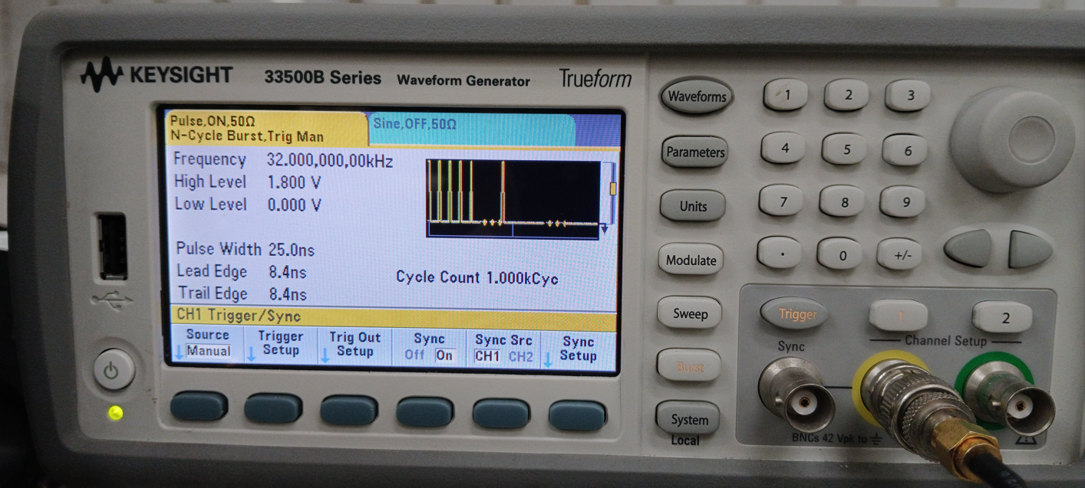

External trigger
V4.11
test signal : 32KHz, 1000 pulse
test signal : 1MHz, 10 pulse

Slide 56
Generator
The generator function is enabled by user commands and is executed once after being enabled.
Three parameters
  Pre Interval – delay before the first fire, 16 bit, Unit 25ns
  Generator Cycle - fire how many time, 32 bit
  Generator Interval – Time between two fires, 32 bit, Unit 25ns
Number of fast read command send = (Generator Cycle) * (Machine Gun + 1)
t
Pre Interval
Generator Cycle
Generator Interval + 1
Machine Gun + 1
Notes:
Simply say, let the FPGA generates periodic read signals for testing.

Slide 57
Internal trigger
No way was found to enable this feature from the user interface. Try using custom code.
FPGA firmware manual say it only support ASIC 0

Slide 58
Data rate / trigger rate
Each channel generates 4 bytes of data (include TOA, TOT, ADC) every 25 nanoseconds.
A DAQ Frame is 1280+32 bits, 38 channels, it takes 1.025 microseconds to transmit data to FPGA.
If maximum consecutively read (Machine Gun = 31, 800ns window)
  H2GCROC takes 32.8 microseconds to transmit data to FPGA.
  FPGA takes 163.8 microseconds to transmit data to PC.
  Maximum trigger rate is about 6kHz
ASIC 0
1.28Gbps
FPGA 0
Buffer
1.28Gbps
Buffer
Network Switch 0
PC
Buffer
1 Gbps
1 Gbps
ASIC 1
1.28Gbps
Buffer
Buffer
1.28Gbps
Buffer
Buffer
Other FPGAs
Trigger
Other PCs
Data transfer in parallel, Each lane handle half channels. ~5 Gbps
Any bottleneck will lead to longer dead time or potential data loss.
1312 bits = header + half channel + crc + idle

Slide 59


DAQ test
Set generator parameter to 1KHz rate, 100k cycles. Set machine gun to 32 read
Set High voltage to 28V.
ADC waveform
x-axis: time
y-axis: amplitude
All other connected 63 channels is similar.

Slide 60

TOT
TOT is 12 bit in ASIC, but send 10 bit only
In ASIC:
b11 | b10 | b9 | b8 | b7 | b6 | b5 | b4 | b3 | b2 | b1 | b0
if all are zero
decode
Send:
0 | b8 | b7 | b6 | b5 | b4 | b3 | b2 | b1 | b0
Otherwise send:
1 | b11 | b10 | b9 | b8 | b7 | b6 | b5 | b4 | b3

Slide 61



TOA
TOA output is not zero when signal over the threshold
  I use it as the filter
28V, Efficiency: 4736/32/98258 = ~ 0.1% ~ 0.3%

Slide 62

Noise
28V. Event Filter: (TOA == 0)
pedestal calibration is wrong
28V Noise

Slide 63




Noise
Event Filter: (TOA == 0)
float
0V
10V
28V

Slide 64


Count
28V

Slide 65


ProjectionY
28V. Event Filter: (TOA > 0)
All channel there is a peak.

Slide 66











LDE TEST layout
1GbE Ethernet
Switch
1GbE Ethernet
PC
Almalinux 9.5
10.1.2.207
SCPI programming
4P PCB3.81
端子台
SMA to SMA
-
SMA to SMA
+
70
0
Ch 1
(BNC to SMA)
Clock board
ASIC1
waveform generator
KEYSIGHT 33520B
10.1.2.2
0
63
to scope
Adapter board (frontside)
SiPM Array & Led in dark box
70
Power cable splitter
ASIC0
Ch 2
SMA to SMA
0
Adapter board (backside)
Trigger board
KCU105 10.1.2.208
Protoboard
KCU105 Power adapter 12V
LED signal
Ch 1
SiPM Bias voltage 25 ~ 32V
Power supply
GWINSTEK GPP-3060
10.1.2.30

Slide 67

LED test signal
Unknown delay between Led light and Trigger
Tune signal delay or firmware parameter
Ch2: To Led
Amp (Tunable)
Signal delay (Tunable)
Ch1: Trigger

Slide 68


LED test result
ADC waveform. Use online_monitor
run27
signal delay 0
Bias 29V
LED 1.3V, 32ns
Ext trig. delay 10
run28
signal delay 0
Bias 29V
LED 1.3V, 32ns
Ext trig. delay 0

Slide 69


LED test result
run29
signal delay 0
Bias 29V
LED 1.5V, 32ns
Ext trig. delay 10
run30
signal delay 0
Bias 29V
LED 1.4V, 32ns
Ext trig. delay 0

Slide 70


LED test result
run31
signal delay 0
Bias 29V
LED 1.4V, 25ns
Ext trig. delay 10
run32
signal delay 0
Bias 29V
LED 1.45V, 25ns
Ext trig. delay 10

Slide 71


LED test result
run33
signal delay 0
Bias 28V
LED 1.4V, 25ns
Ext trig. delay 10
run34
signal delay 0
Bias 30V
LED 1.45V, 25ns
Ext trig. delay 10

Slide 72
Channel mapping
Multiple stage....
  SiPM board layout
  Cable reverse order
  Protoboard layout
  ASIC 0/1?
  FPGA 0
Lookup table
  https://docs.google.com/spreadsheets/d/1VDs9stUrkrNTq3McJMH1bralzvcX4AuQ8HcpJwmnNY8/edit?usp=drive_link

Slide 73



More
Run 32, ASIC1, CH10 ADC waveform
Is this jitter or photon count?
adc waveform
0
20
histogram
0
300

Slide 74
decoder broken
ASIC 0 disable?
$ ./build/h2g_run -r 28 -d 0 -n 1
$ root
root [1] TFile f(“Run28.root”)
root [2] events->Print()
******************************************************************************
*Tree :events : Events *
*Entries : 0 : Total = 8669 bytes File Size = 1057 *
* : : Tree compression factor = 1.00 *
******************************************************************************
*Br 0 :event_number : event_number/i *
*Entries : 0 : Total Size= 513 bytes One basket in memory *
*Baskets : 0 : Basket Size= 32000 bytes Compression= 1.00 *
*............................................................................*
*Br 1 :timestamps : timestamps[1]/i *
*Entries : 0 : Total Size= 511 bytes One basket in memory *
*Baskets : 0 : Basket Size= 32000 bytes Compression= 1.00 *
*............................................................................*
*Br 2 :num_samples : num_samples/i *
*Entries : 0 : Total Size= 509 bytes One basket in memory *
*Baskets : 0 : Basket Size= 32000 bytes Compression= 1.00 *
*............................................................................*
*Br 3 :adc : adc[144][32]/i *
*Entries : 0 : Total Size= 495 bytes One basket in memory *
*Baskets : 0 : Basket Size= 32000 bytes Compression= 1.00 *
*............................................................................*
*Br 4 :toa : toa[144][32]/i *
*Entries : 0 : Total Size= 495 bytes One basket in memory *
*Baskets : 0 : Basket Size= 32000 bytes Compression= 1.00 *
*............................................................................*
*Br 5 :tot : tot[144][32]/i *
*Entries : 0 : Total Size= 495 bytes One basket in memory *
*Baskets : 0 : Basket Size= 32000 bytes Compression= 1.00 *
*............................................................................*
*Br 6 :hamming : hamming[144][32]/i *
*Entries : 0 : Total Size= 511 bytes One basket in memory *
*Baskets : 0 : Basket Size= 32000 bytes Compression= 1.00 *
*............................................................................*
...
?
ADC waveform
x-axis: time
y-axis: amplitude

Slide 75
SCPI programming
import pyvisa
rm = pyvisa.ResourceManager()
#KEYSIGHT 33520B waveform generator
wavegen = rm.open_resource('TCPIP0::10.1.2.2::inst0::INSTR')
wavegen.read_termination = '\n'
wavegen.write_termination = '\n'
wavegen.write('*RST')
wavegen.write('SOURCE1:FUNCTION PULSE')
wavegen.write('SOURCE1:FUNCTION:PULSE:TRANSITION:LEADING 8.4 ns') # instrument minimum is 8.4 ns
wavegen.write('SOURCE1:FUNCTION:PULSE:TRANSITION:TRAILING 8.4 ns')
wavegen.write('SOURCE1:FUNCTION:PULSE:WIDTH 25 ns') # instrument minimum is 16 ns
wavegen.write('SOURCE1:FREQUENCY 1000')
wavegen.write('SOURCE1:VOLTAGE:HIGH 1.3')
wavegen.write('SOURCE1:VOLTAGE:LOW 0')
wavegen.write('OUTPUT1 ON')
wavegen.write('SOURCE2:FUNCTION PULSE')
wavegen.write('SOURCE2:FUNCTION:PULSE:WIDTH 25 ns')
wavegen.write('SOURCE2:FUNCTION:PULSE:TRANSITION:LEADING 8.4 ns')
wavegen.write('SOURCE2:FUNCTION:PULSE:TRANSITION:TRAILING 8.4 ns')
wavegen.write('SOURCE2:FREQUENCY 1000')
wavegen.write('SOURCE2:VOLTAGE:HIGH 1.45') # voltage
wavegen.write('SOURCE2:VOLTAGE:LOW 0')
wavegen.write('OUTPUT2 ON')
# let both channel's pulse synchronized, this channel phase is independent to burst mode phase
wavegen.write('SOURCE2:PHASE:SYNCHRONIZE')
wavegen.write('SOURCE2:PHASE:REFERENCE')
wavegen.write('UNIT:ANGLE SECOND')
wavegen.write('SOURCE1:PHASE 0.0000003') # 300ns
print("ERROR: ", wavegen.query('SYSTEM:ERROR?'))
wavegen.close()
pip install pyvisa pyvisa-py
import pyvisa
rm = pyvisa.ResourceManager()
#GWINSTEK GPP-3060 Programmable DC Power Supply
ps = rm.open_resource('TCPIP0::10.1.2.30::1026::SOCKET')
ps.read_termination = '\n'
ps.write_termination = '\n'
ps.write('*RST')
ps.write(':VSET1:28') # CH1 voltage range = 0 ~ 32V
ps.write(':ISET1:1') # CH1 current range = 0 ~ 6.2A
ps.write(':OUTPUT1:STATE ON')
#ps.write(':ALLOUTOFF')
ps.close()

Slide 76

Two FPGA
mechanism needed
  Is there enough space on the trigger board and clock board?
  Is the SMA to SMA cable long enough?
  space for 10G switch and network cable length?
Power cable for SiPM?
Prepare PC for beam test

Slide 77

decoder
$ ./build/h2g_run -r 40 -d 0 -n 2
$ root
root [1] TFile f(“Run040.root”)
root [2] events->Print()
******************************************************************************
*Tree :events : Events *
*Entries : 9824 : Total = 1472807942 bytes File Size = 77986302 *
* : : Tree compression factor = 18.91 *
******************************************************************************
*Br 0 :event_number : event_number/i *
*Entries : 9824 : Total Size= 40052 bytes File Size = 14069 *
*Baskets : 3 : Basket Size= 51200 bytes Compression= 2.81 *
*............................................................................*
*Br 1 :timestamps : timestamps[2]/i *
*Entries : 9824 : Total Size= 79340 bytes File Size = 26918 *
*Baskets : 3 : Basket Size= 51200 bytes Compression= 2.93 *
*............................................................................*
*Br 2 :num_samples : num_samples/i *
*Entries : 9824 : Total Size= 40045 bytes File Size = 543 *
*Baskets : 3 : Basket Size= 51200 bytes Compression= 72.81 *
*............................................................................*
*Br 3 :adc : adc[288][32]/i *
*Entries : 9824 : Total Size= 362491179 bytes File Size = 65978440 *
*Baskets : 3684 : Basket Size= 7088640 bytes Compression= 5.49 *
*............................................................................*
*Br 4 :toa : toa[288][32]/i *
*Entries : 9824 : Total Size= 362491179 bytes File Size = 2064431 *
*Baskets : 3684 : Basket Size= 7088640 bytes Compression= 175.55 *
*............................................................................*
*Br 5 :tot : tot[288][32]/i *
*Entries : 9824 : Total Size= 362491179 bytes File Size = 2036343 *
*Baskets : 3684 : Basket Size= 7088640 bytes Compression= 177.97 *
*............................................................................*
*Br 6 :hamming : hamming[288][32]/i *
*Entries : 9824 : Total Size= 362505931 bytes File Size = 2466907 *
*Baskets : 3684 : Basket Size= 7089152 bytes Compression= 146.92 *
*............................................................................*
*Br 7 :hit_max : hit_max[288]/i *
*Entries : 9824 : Total Size= 11333891 bytes File Size = 2611281 *
*Baskets : 170 : Basket Size= 221696 bytes Compression= 4.34 *
*............................................................................*
*Br 8 :hit_pedestal : hit_pedestal[288]/i *
*Entries : 9824 : Total Size= 11334761 bytes File Size = 2682917 *
*Baskets : 170 : Basket Size= 221696 bytes Compression= 4.22 *
*............................................................................*
root [1] .q
ASIC 0 must work
1KHz, 10000 trigger => 9821 event
2 FPGA * 2 ASIC = 288 channel

Slide 78
Discuss
Practical limitations
  LEDs are not ideal light sources; as point sources, their brightness varies with distance.
  Is it possible to use an integrating sphere, or is there a better method?
  The waveform generator's rising and falling edges are too slow.
  SIPM is affected by temperature and currently does not have any temperature control in laboratory.

Slide 79
# Events vs Trigger frequency
 | 1KHZ | 2KHZ | 3KHZ | 4KHZ | 5KHZ | 6KHZ | 7KHZ | 8KHZ | 9KHZ | 10KHZ
4 ASIC Gun=31 | 9818 | 9494 | 6078 | 4471 | 87 crash | 61 crash | 44 crash
4 ASIC Gun=15 | 9915 | 9911 | 9911 | 9905 | 7624 | 6365 | 5483 | 4765 | 4311
2 ASIC Gun=31 | 9822 | 9821 | 9823 | 9826 | 129 crash | 64 crash | 42 crash | 30 crash | 25 crash | 19 crash
2 ASIC Gun=15 | 9910 | 9917 | 9910 | 9902 | 9927 | 9919 | 9895 | 9930 | 8488 | 264 crash
A0
1.28 Gbps
F0
1.28 Gbps
1 Gbps
A1
1.28 Gbps
1.28 Gbps
Network Switch 0
2.5 Gbps
PC
A0
1.28 Gbps
F1
1.28 Gbps
4 ASIC = 2 KCU x 2 ASIC
2 ASIC = 1 KCU x 2 ASIC
Crash = decoder error
A1
1.28 Gbps
1 Gbps
1.28 Gbps
Trigger

Slide 80
To be continue...

