Slide 1
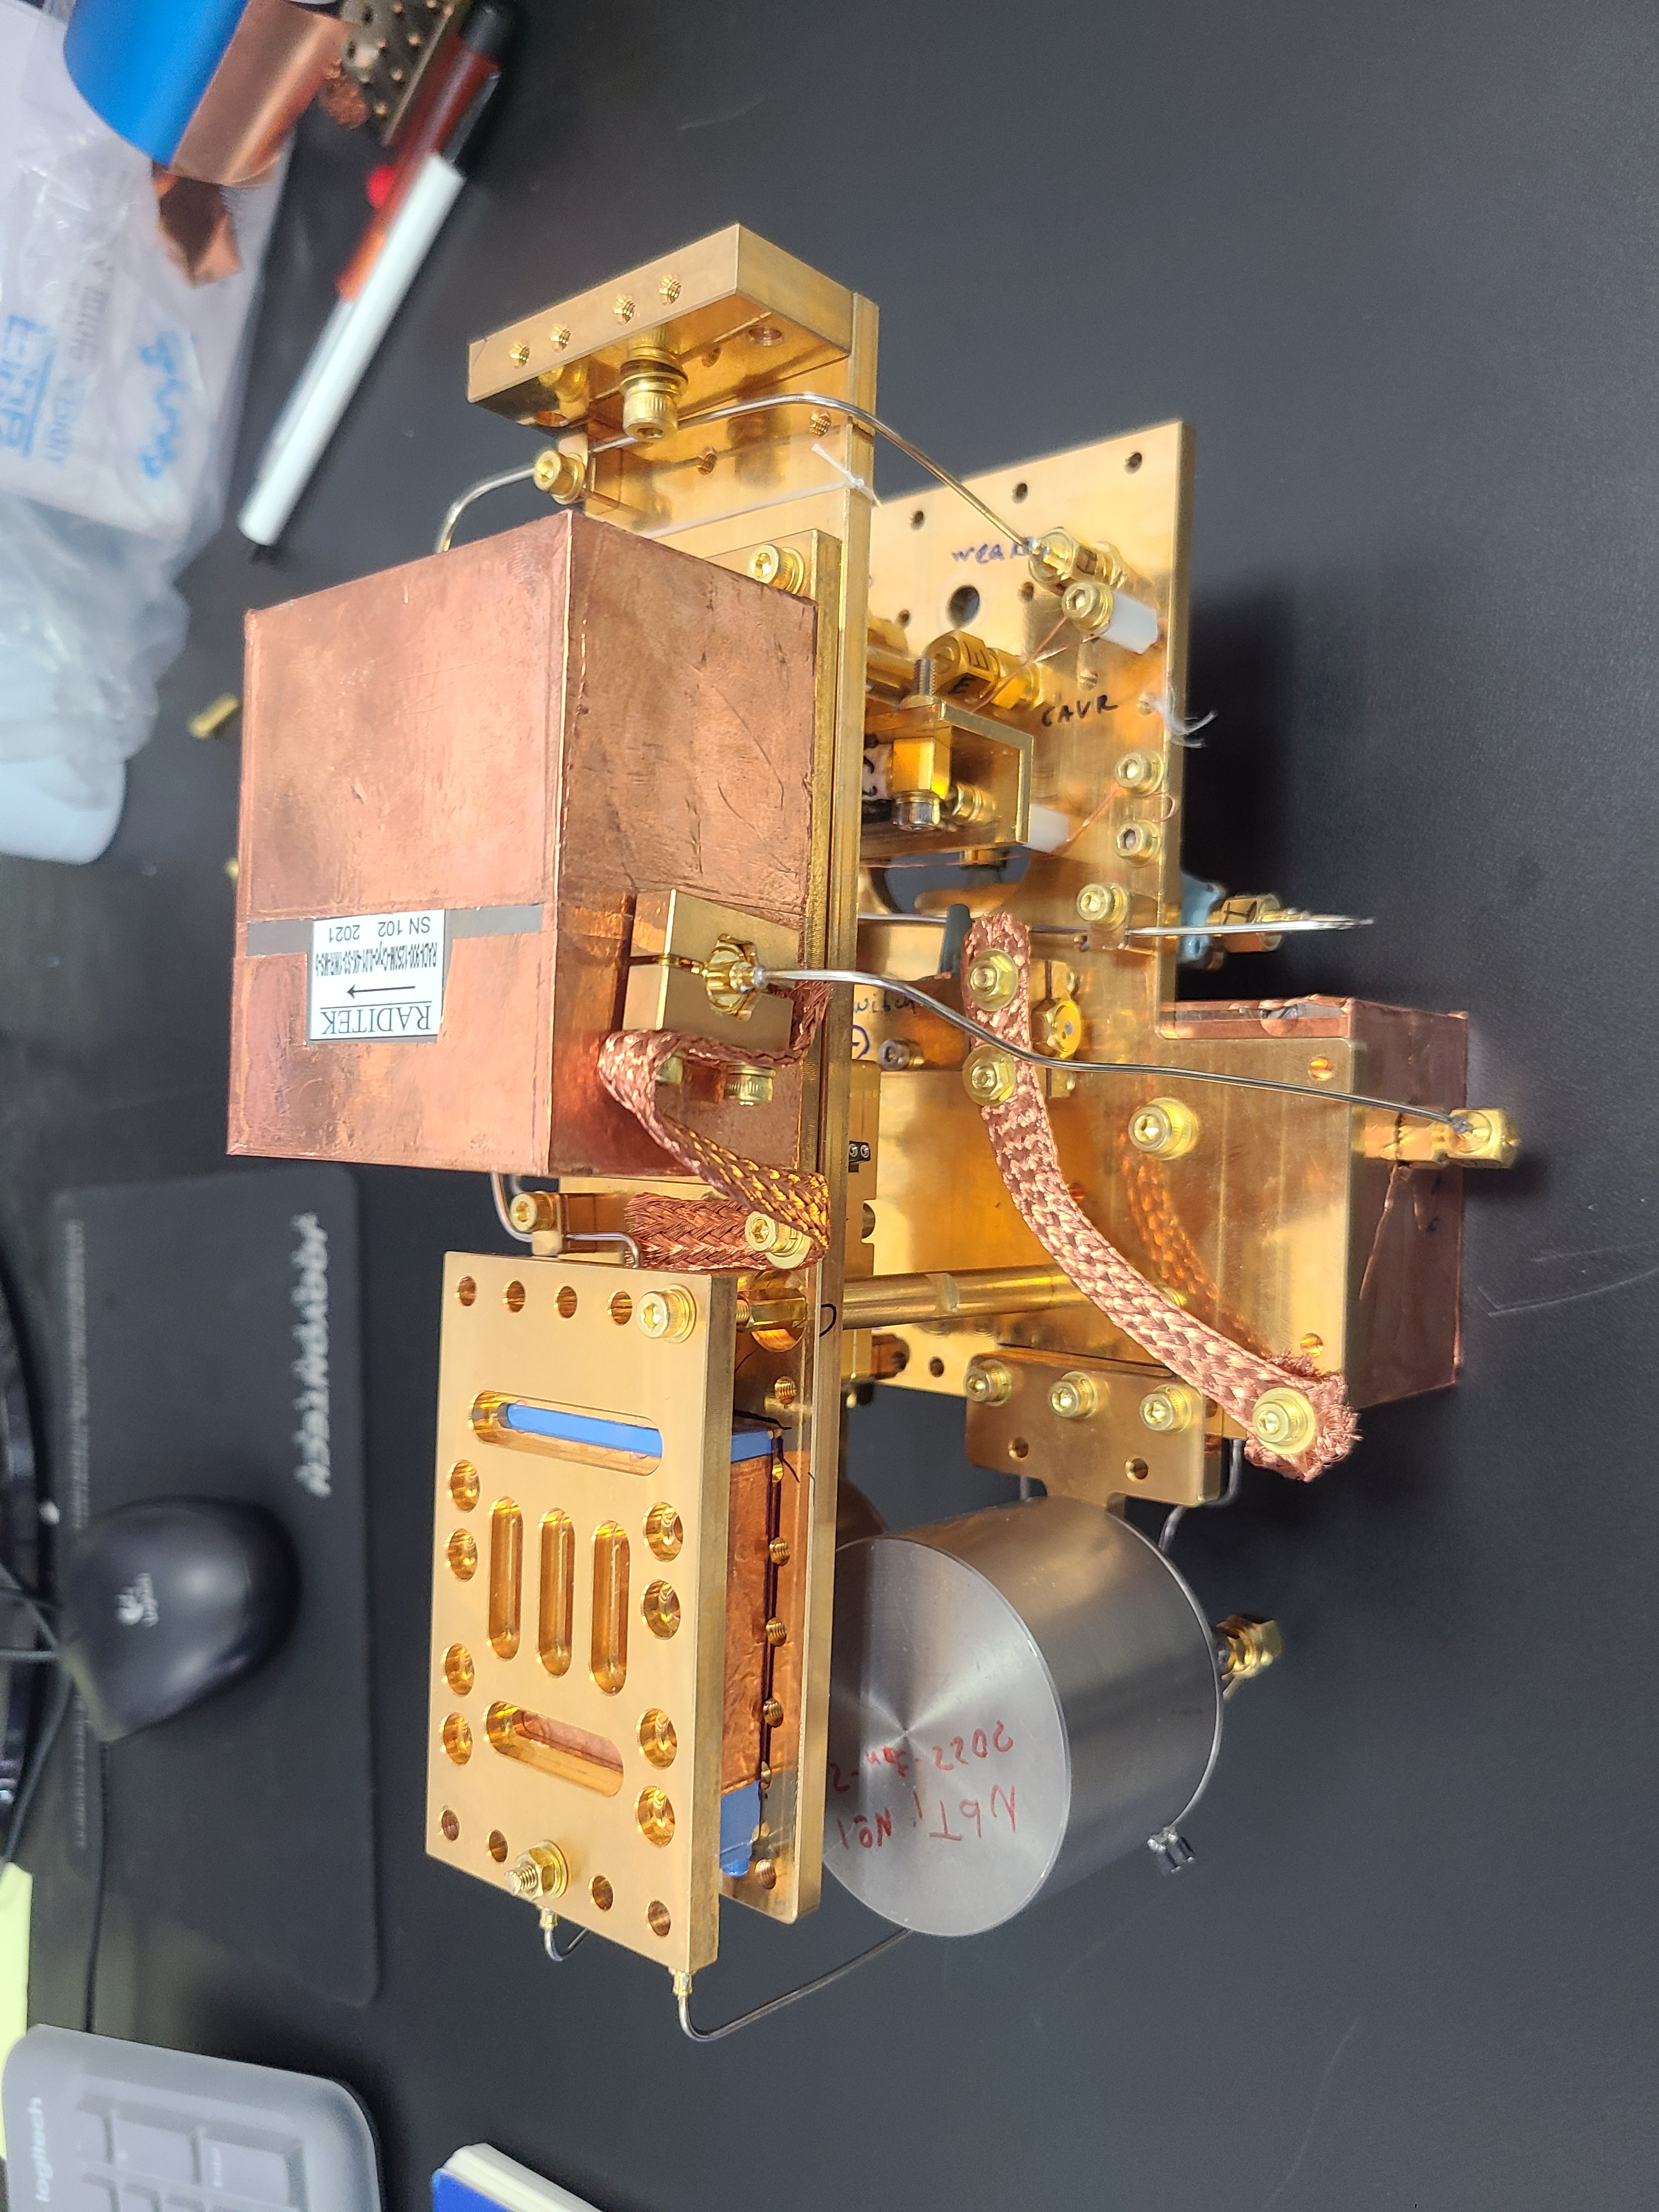




Near-Quantum-Limited Readout Development for Axion Haloscopes in DMAG
Uchaikin Sergey for QS team
IBS/Dark Matter Axion Group
2026-09-02
Notes:
Good afternoon, my name is Sergey Uchaikin, I represent QS team of DMAG. I will talk today about our read-out development.

Slide 2

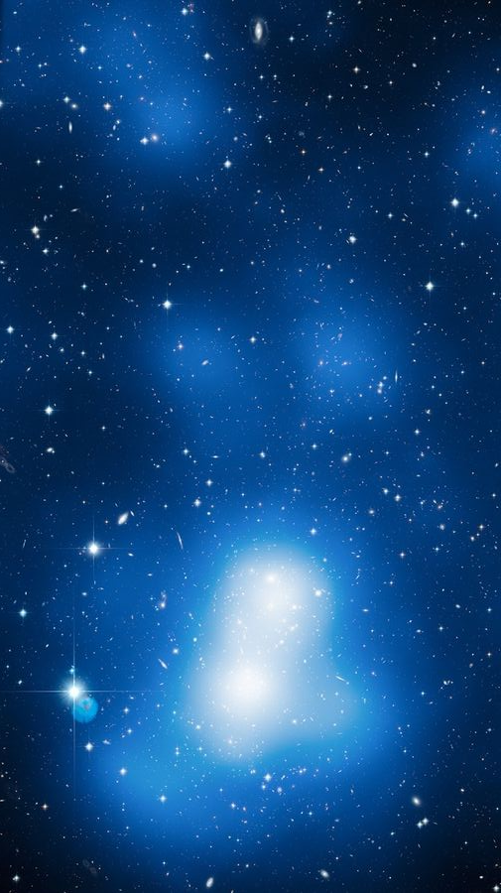

Galaxy Cluster MACS J0717 Dark Matter Map
NASA, ESA, Harald Ebeling (University of Hawaii at Manoa) & Jean-Paul Kneib (LAM)
Introduction
Axion Dark Matter
A promising candidate to explain the universe's missing mass
and CP violation.
DMAG’s Challenge
Detecting extremely weak signals across a vast frequency range:
our goal: energy range 4-40 µeV =>1-10 GHz
Notes:
Axion Dark Matter is a promising candidate to explain the universe's missing mass and CP violation
Axion mass is unknown and it is searched in a wide range of mass.
Our goal is energy range between 4 and 40 microeV

Slide 3


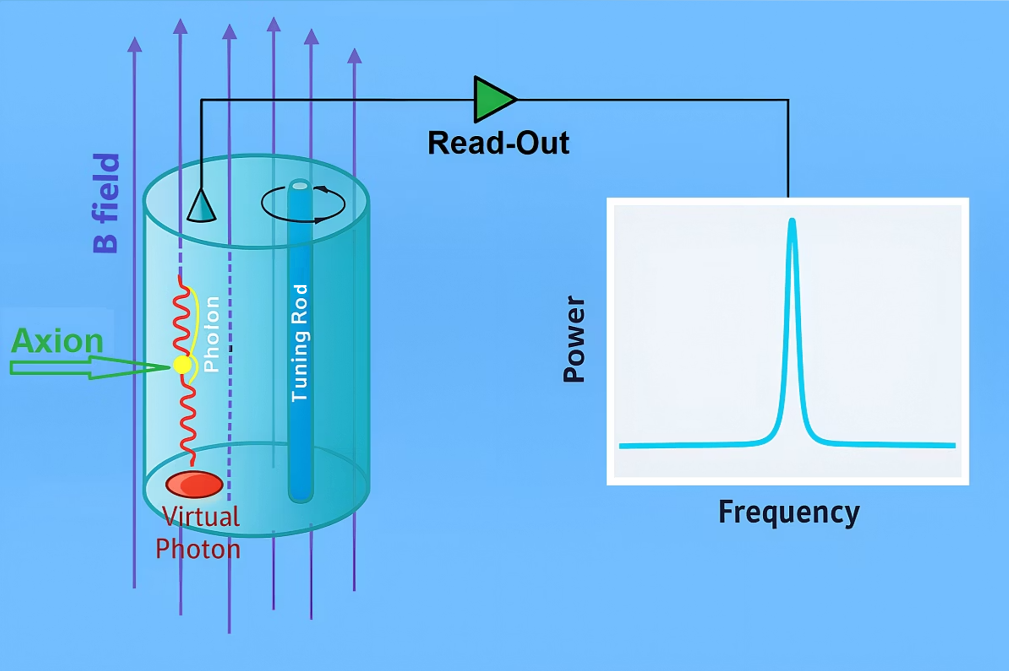

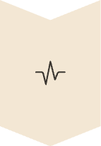
Axion Haloscope Detection Principle
Axion Conversion
Axions convert to photons in cavity (Q is in the range of 30000-300000).
Magnetic Field
Strong field creates conversion environment (in DMAG 8T, 8TB, 12T and 12TB) .
Signal Detection
Low-noise systems capture faint photon signals (noise is a few units of the SQL).
Frequency range
Extremely wide due to unknown axion mass
Notes:
We use haloscope method to search axions. Haloscope is a high-Q cavity resonator immersed in a high magnetic field of a strong magnet.
The signal we need to detect is between 10^{-24} and 10^{-23} W.
It is the same as we want to find a stealth fighter like F-35 from a distance of the moon.

Slide 4
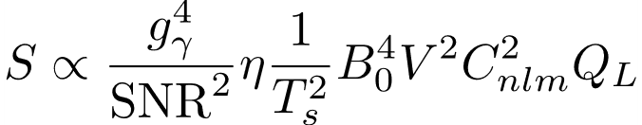
Motivation: Increasing scan rate in axion experiment
Scanning rate:
Axion mass is unknown, so large frequency range should scanned (from hundredth kHz to hundredth GHz)
Expected signal is about 10-100^{t}of yoctoW (10^(-24))
Model constant
(KSVZ/DFSZ)
Detector Efficiency
With best cold HEMT amplifier (1-2K noise temperature) → ≈100 years per 1GHz
Lowest T_{s} → JPAs @ TWPAs
Notes:
The axion signal is extremely weak, around \(10^{-24}\) W. Since the scan rate scales inversely with the square of the system noise, reducing noise is essential. For this reason, we use amplifiers based on JJ, whose added noise approaches the quantum limit.

Slide 5
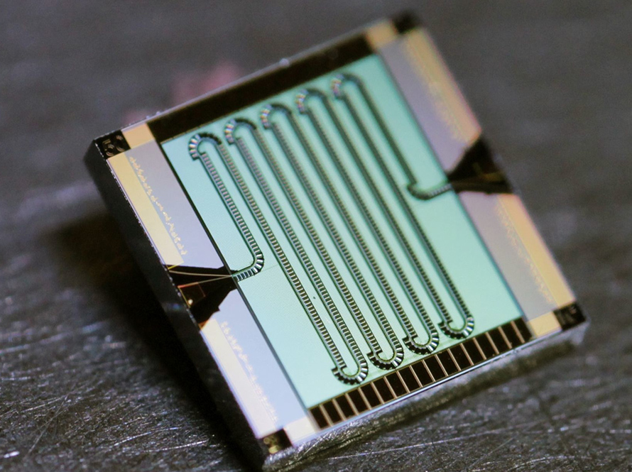
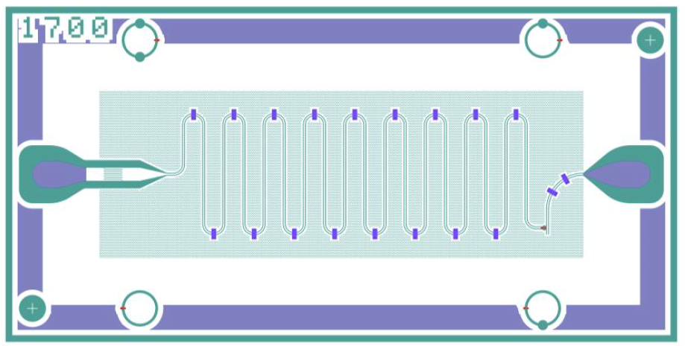
Optimal read-out for axion search: TWJPA or Flux-Driven JPA?
TWPA – wide band
C. Macklin et al. Science350,307-310(2015).
Flux-Driven JPA – tunable narrow band
Cavity for 1-10 GHz range
Tuning cavity range about 300 MHz
Need to fit amplifier band or tuning range with cavity range >300 MHz
Notes:
Two types of amplifiers can approach the SQL: broadband JTWPAs and narrowband flux-driven JPAs.
Conventional flux-driven JPAs typically use a quarter wave resonator with a SQUID, limiting their tuning range.
Since our cavity tuning range can reach about 300 MHz, we need an amplifier with a tuning range exceeding 300 MHz.

Slide 6
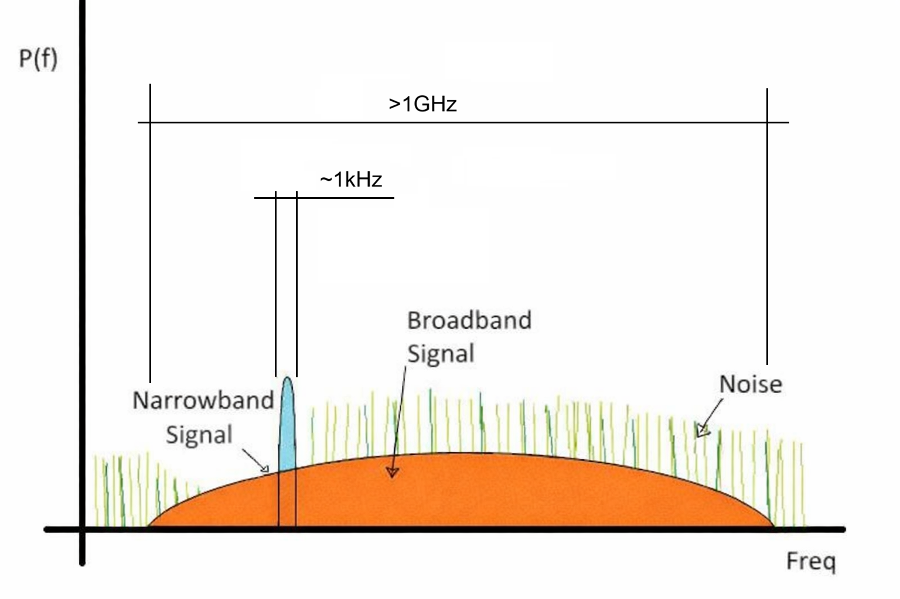
Wide-band TWJPA vs Narrow-band JPA
TWJPA
Pro:
wide range cover a few cavity ranges
wide dynamic range
Cons:
Mismatch of bandwidth
Axion signal: ultra-narrowband & broadband amplification => excess noise integration
JPA
Pro:
More smooth band and noise vs frequency
less noise band
Cons:
Need many JPA to cover a cavity tuning range
Both types of amplifiers enable operation near the Standard Quantum Limit (SQL) sensitivity.
Important: Operating parameters, specifically pump power and DC bias, must be optimized for each frequency point (at increments of approximately 10~kHz)
Notes:
Both TWJPA and JPA can operate near the Standard Quantum Limit.
TWJPA provides more than 1 GHz bandwidth and can cover several cavity tuning ranges,
but its bandwidth is much wider than the very narrow axion signal, resulting in excess noise integration.
A JPA has a narrower and smoother amplification band with less integrated noise,
but several JPAs may be required to cover the full cavity tuning range.
In both cases, pump power and DC bias must be optimized at each frequency step.

Slide 7
READOUT BASED ON
FLUX-DRIVEN JOSEPHSON PARAMETRIC AMPLIFIER
WITH λ/4 RESONATOR
Notes:
The first amplifier we used was FLUX-DRIVEN JOSEPHSON PARAMETRIC AMPLIFIER with quarter wave resonator, specialy designed for our axion search produced by RIKEN

Slide 8
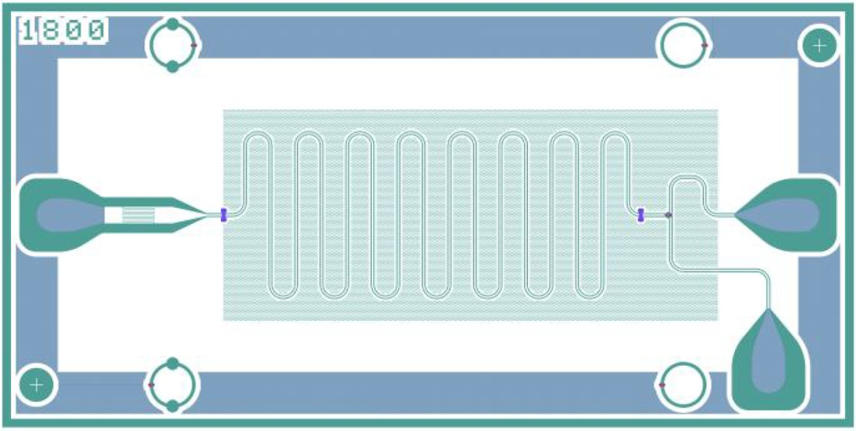
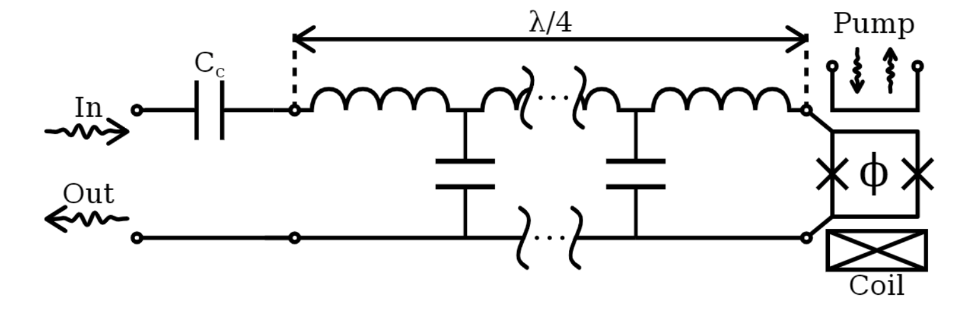
Flux-driven Josephson Parametric Amplifiers (JPA)
JPA is a coplanar waveguide 𝜆/4 Nb resonator terminated with SQUID
To tune frequency we use dc flux bias Φ which change average inductance of a SQUID
RF pump signal is applied to modulate nonlinear inductance of SQUID
Our JPAs: Central frequency 1-6 GHz
Instantaneous bandwidth ~200 kHz
Tunable range 45-60 MHz
Noise 1-3 QNL (quantum noise limit)
Notes:
A flux-driven JPA is a type of microwave transmission line that incorporates a non-hysteretic SQUID with nonlinear inductance shorted to the ground.
By inputting a microwave signal, and a pump signal we can achieve parametric amplification of the reflected signal.
The JPA operates as a resonance amplifier, where the resonance frequency can be adjusted by applying a DC field using a coil that alters the average inductance of the squid.
We design amplifier for a range 1 to 6 GHz, they have Instantaneous bandwidth ~200 kHz, tunable range 45-60 MHz, noise 1-3 QNL (quantum noise limit). Tunable range is lower than cavity tunable range in 4-5 times. so we worked a couple years to increase it by combining a few JPAs together to fit it to cavity range.

Slide 9
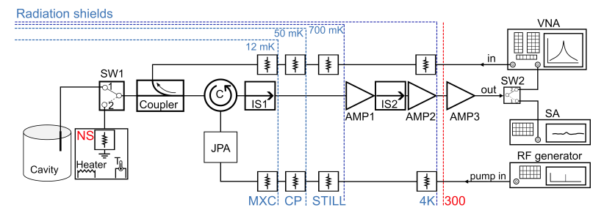
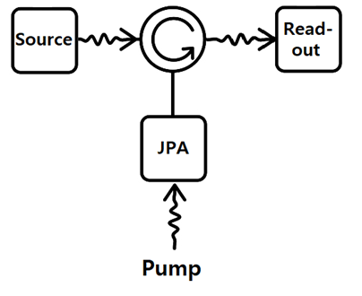
JPA read-out
Notes:
Here is the scheme for the read-out based on JPA. It is pretty standard, one can choose as a signal source, a cavity for experiment or a noise source for the test, with a coupler one can apply the VNA signal for testing and calibration.
The signal passes through a circulator with a JPA, an isolator, two cold amplifiers, and finally, one room temperature amplifier. Output is connected with VNA for tests or SA in experiments.
All input lines are equipped with attenuators to protect from Jonson noise from warm stages.
The simplified diagram of read-out you can see on the right.
Tout=T_(n-1)*A+T_n*(1-A).

Slide 10
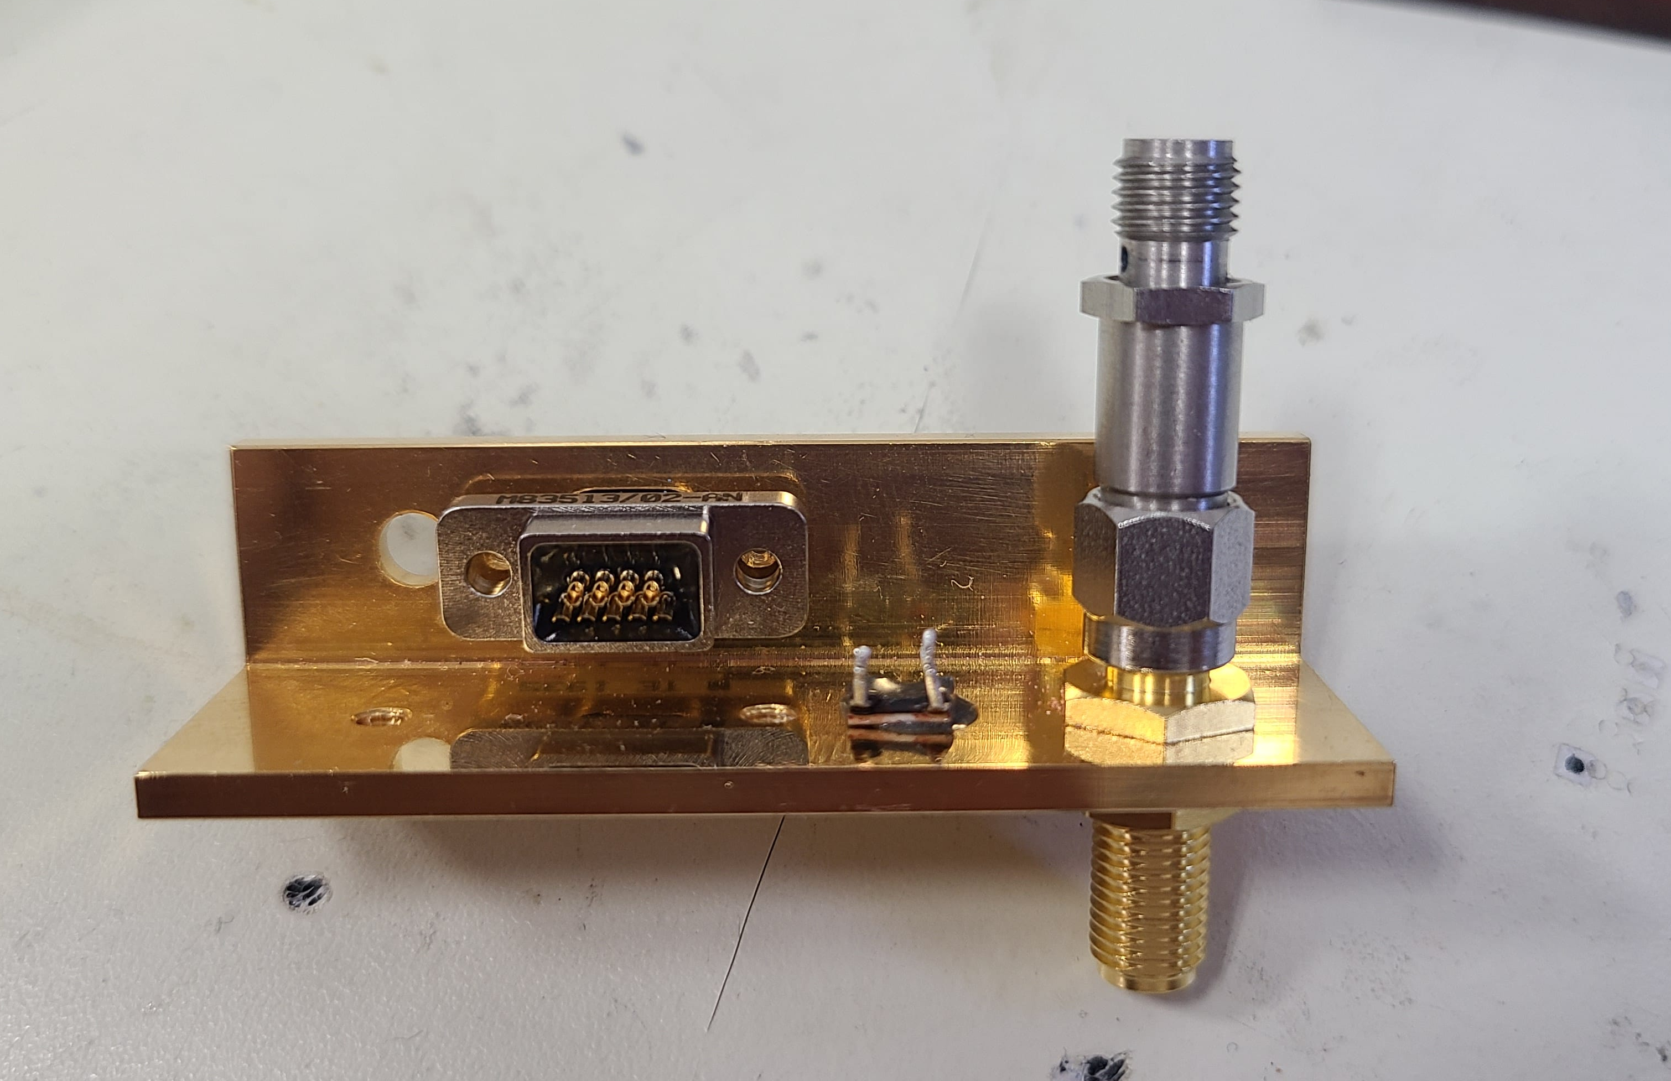
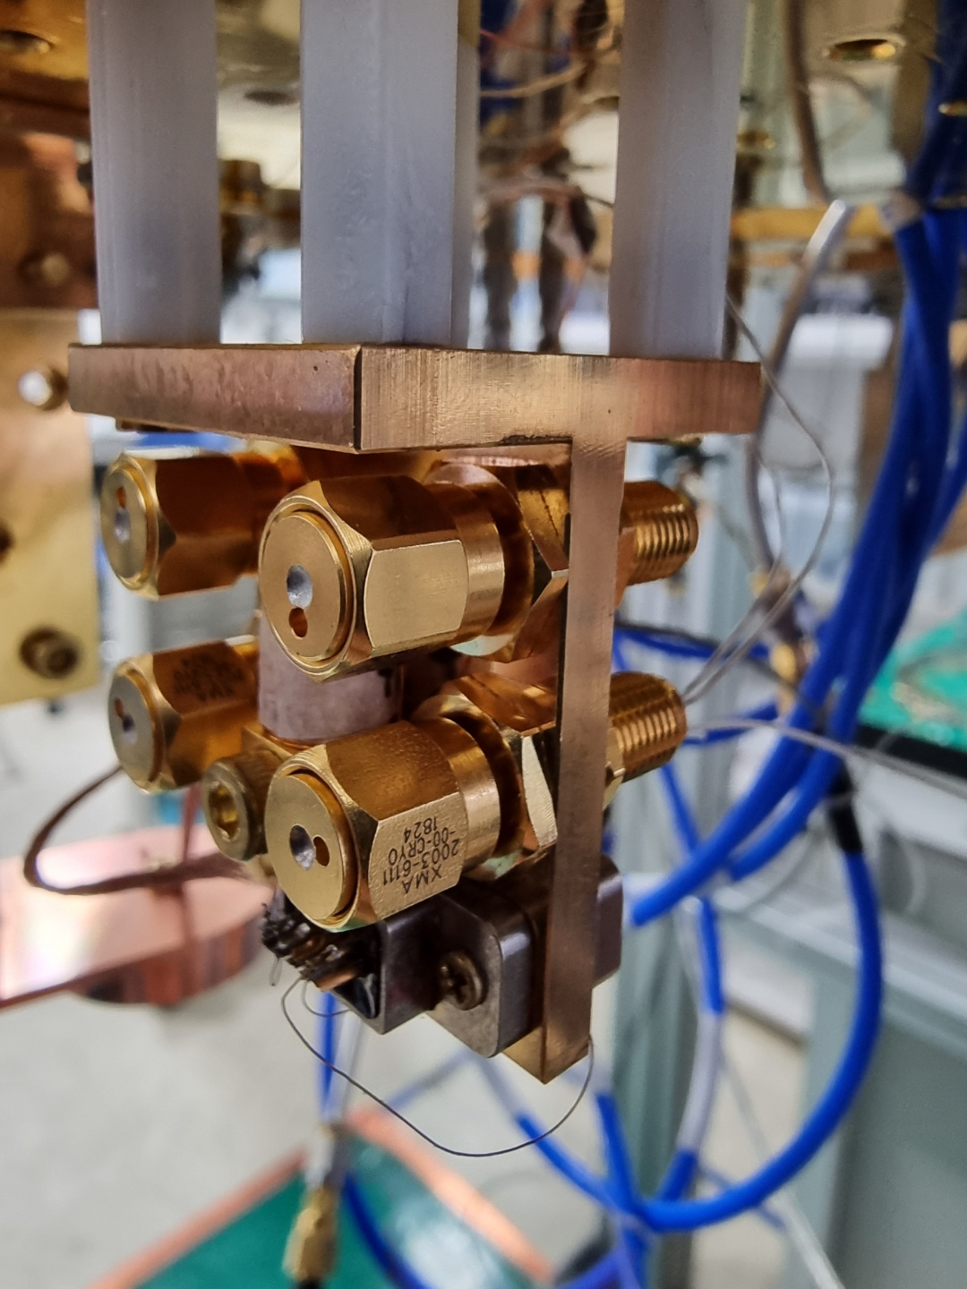
Noise sources
Requirements:
50 Ohm impedance
Isolated thermally from MXC
Do not effect on the MXC temperature
Quick setting time
Insensitive to interference
Operates at wide temperature range
Our source:
Temperature control 30mK- 1K without effect on MXC temperature
Notes:
For noise measurement with Y-factor method we use self-made noise sources. A noise source is mounted on a copper platform on MXC through plastic stands. A weak thermal connection to the MXC is made with a piece of copper wire. As a source we use 50-Ohm terminator or attenuator. We mount a heater and a thermometer on the platform and can control its temperature with a PID controller. For the test system we developed 4–channel version of noise source to use it in our new multichannel test setup. Using one PID controller we can control 4 noise sources temperature simultaneously. Our usual temperature range of noise source is between 30 mK and 800 mK.

Slide 11
JPA Characterization
Finding passive resonance vs DC bias
Gain paramap (gain vs pump power and detuning)
Noise paramap (Tn vs pump power and detuning)
P1dB measurement
Notes:
Because of spread of parameters and a wide range of сentral frequencies of JPAs we need carefully characterize each of our amplifier. We developed a special procedure to do it. The procedure consists of a number steps, nowadays a big fraction of it is going automatically. In the beginning of the procedure we 1) Finding passive resonance, after that we measure Gain and Noise paramap and doing P1dB measurement other word we measurement JPA dynamic range.

Slide 12
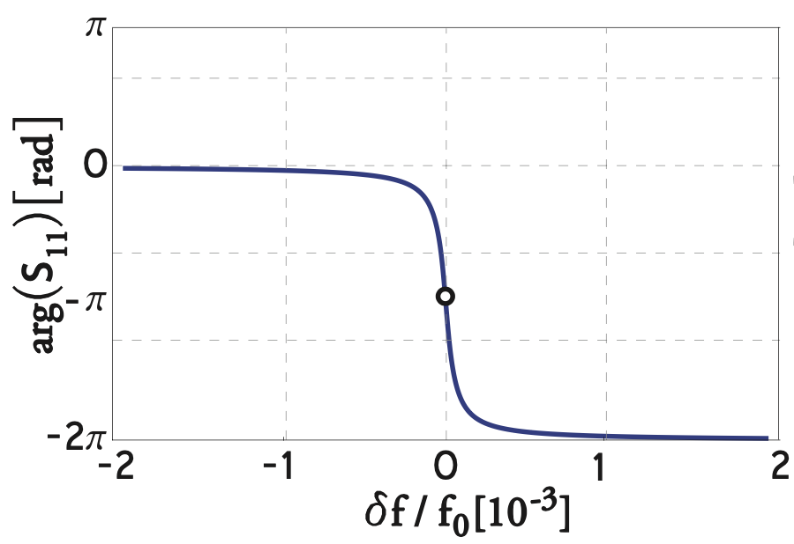
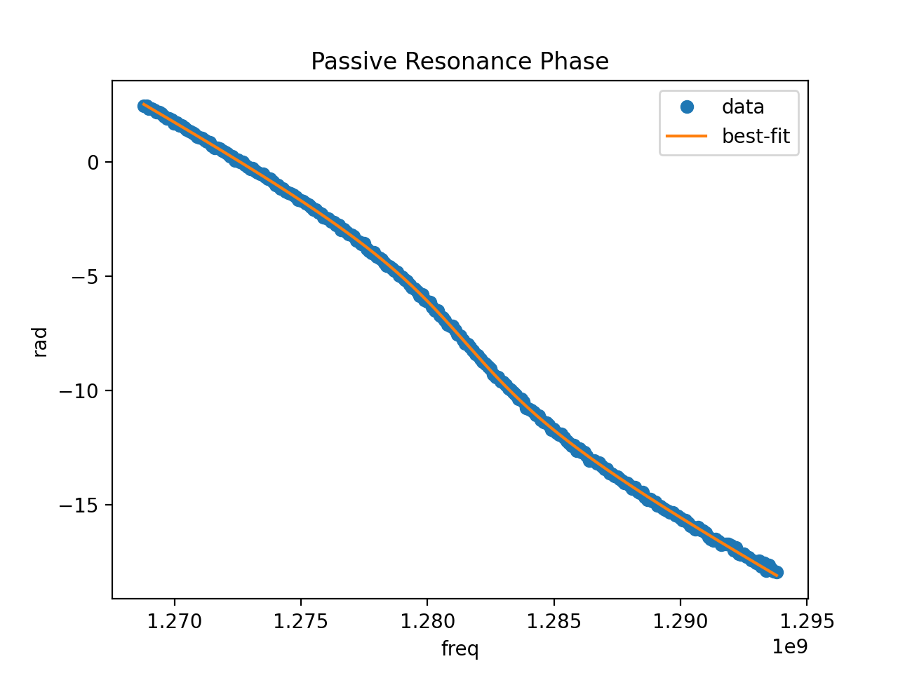
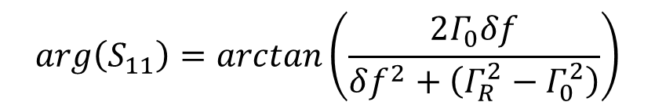
JPA passive resonance
To find the passive resonance we
look for phase characteristics
$$arg\left(S_{11}\right)=arctan⁡\left(\frac{2Γ_{0}δf}{δf^{2}+\left(Γ_{R}^{2}−Γ_{0}^{2}\right)}\right)$$
Real SA signal
Notes:
To find the passive resonance we use phase to frequency characteristics. Here is the theoretical dependence of the quarter wave resonator phase from frequency. The real signal on the input of VNA also depends from many frequency depended component of the chain and looks like you see on the bottom picture.

Slide 13
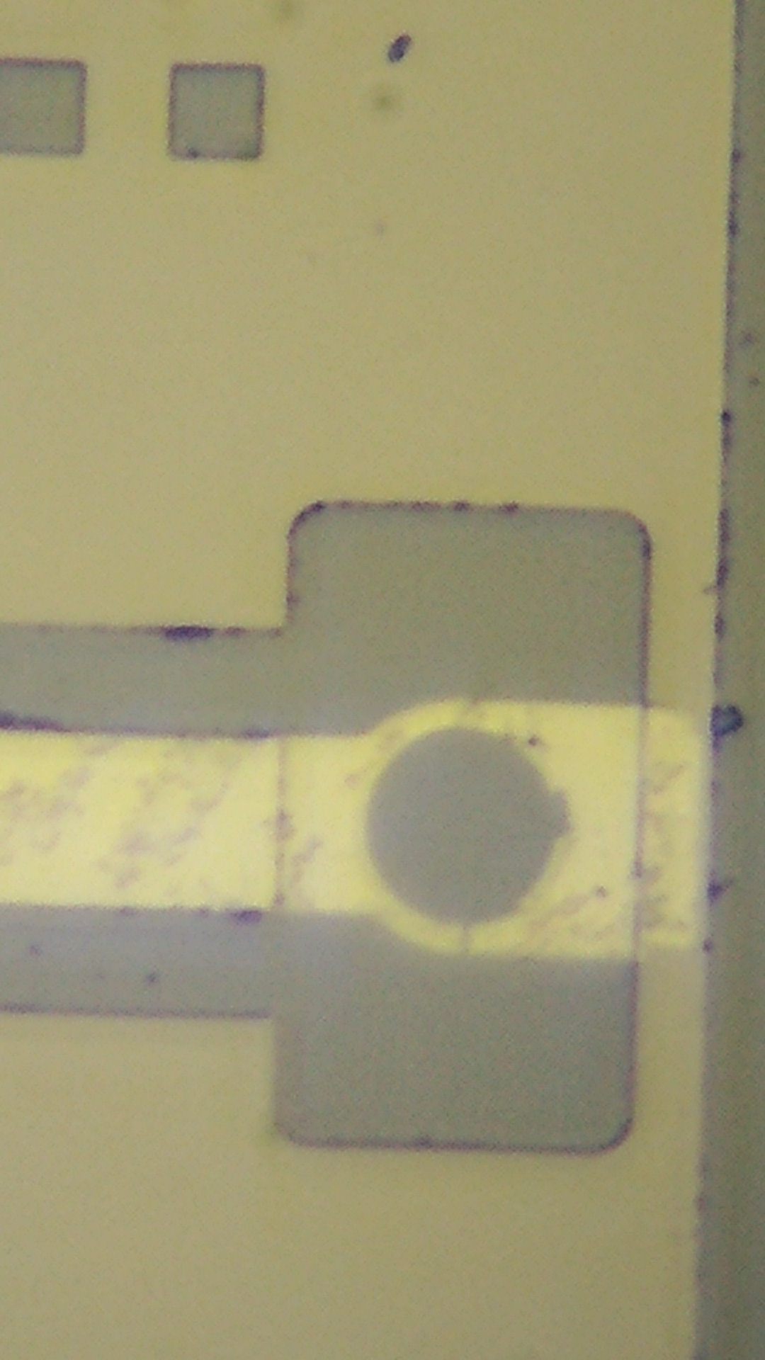
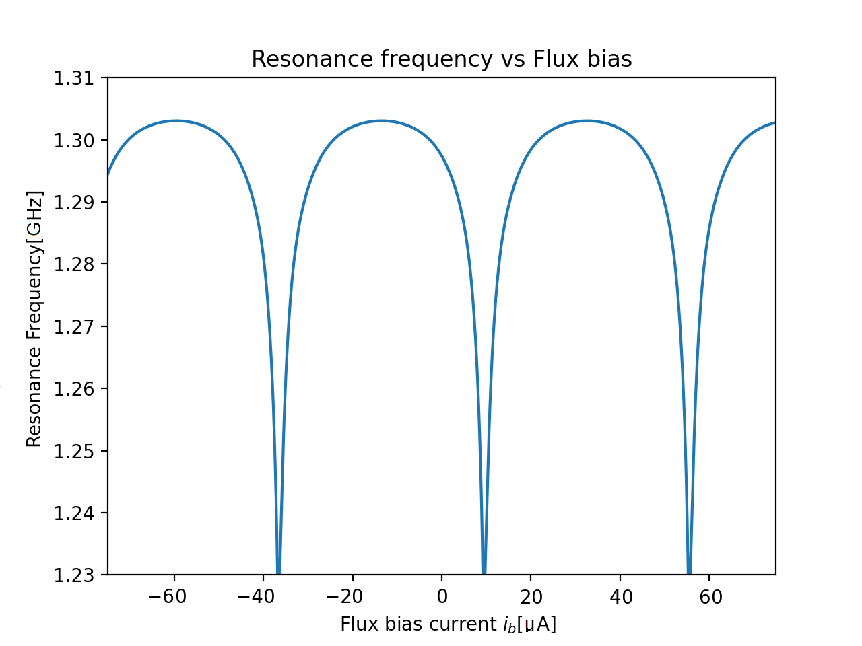
1.3 GHz JPA Passive Resonance Frequency vs. Applied DC Bias Flux
Φ
45-60 MHz
Apply flux into SQUID loop to get
operating range
45-60 MHz
Notes:
The working frequency of the JPA is determined by the transmission line and the inductance of the SQUID, which can be adjusted within a certain range using an inductively coupled DC flux bias coil. In the picture, you can see the dependence of the passive resonance frequency on the flux bias for one of our JPAs. The full tuning range is quite wide, but only 45 MHz is useful, as beyond that range we experience higher noise or lower gain.

Slide 14
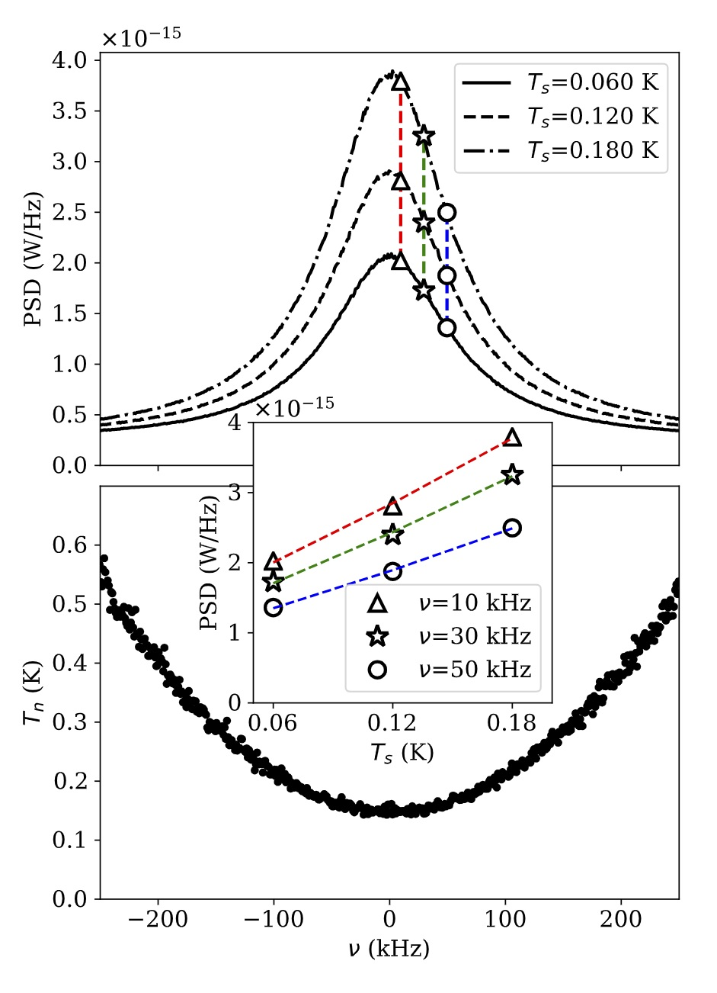
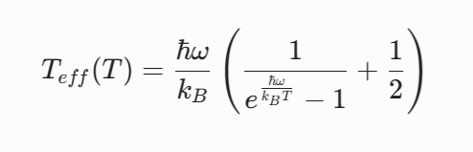
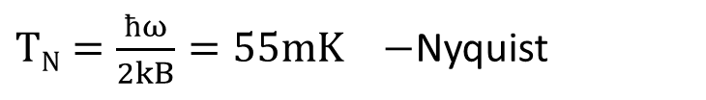

Noise measurements
1) Y-method: applying a noise source to the input
Quantum limit for amplifier added noise for 2.3 GHz:
$TN=\frac{ħω}{2kB}=55mK −$Nyquist
$−$Planck
Measured added noise of 2.3 GHz JPA: 120 mK
2) Spectrum comparison method: Comparing improvement of SNR with and without JPA
Notes:
To measure noise temperature we use 2 methods. The first is Y-factor method. We connect the JPA input with the noise source and measure its output for different temperature of the noise source. Here your see the result, three output spectrum for noise source temperature of 60, 120 and 180 mK. With measured point we can build lines and get noise temperature of JPA. For that particular JPA with a central frequency about 2.3 GHz we got a minimum added temperature of 120 mK, which is the lowest noise of amplifier for this frequency range. To reduce measurement time, which is the bad side of Y-method, we also use another method to measure noise, where we compare Spectrum noise with and without JPA. This method is faster and can be use when JPA has low dynamic range

Slide 15
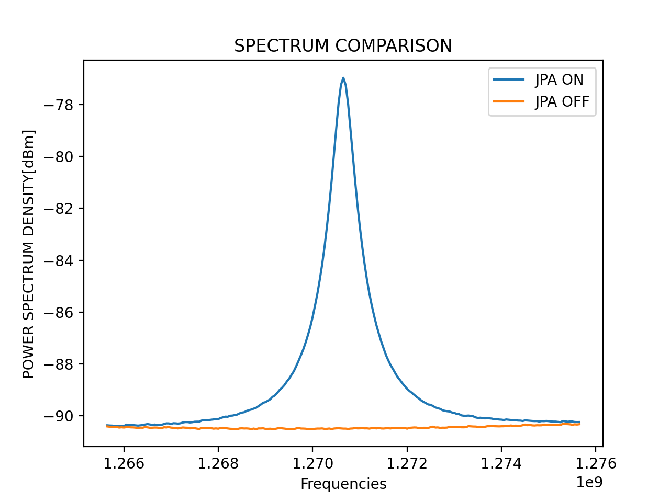
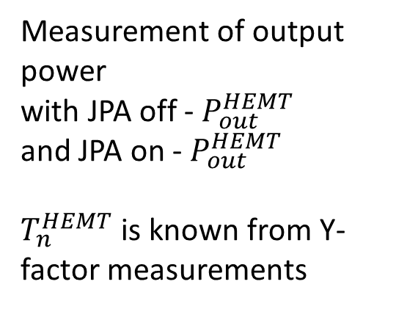
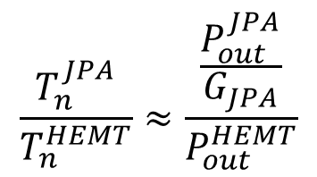

Spectrum comparison noise measurement
Faster than standard Y-method
Can be used for JPAs with low dynamic range
Measurement of output power
with JPA off - $P_{out}^{HEMT}$
and JPA on - $P_{out}^{HEMT}$
$T_{n}^{HEMT}$ is known from Y-factor measurements
$$\frac{T_{n}^{JPA}}{T_{n}^{HEMT}}≈\frac{\frac{P_{out}^{JPA}}{G_{JPA}}}{P_{out}^{HEMT}}$$
$$T_{n}=\frac{P_{on}}{G_{J}P_{off}}\left(P_{in}+T_{n}^{′}\right)−P_{in}$$
Notes:
With a signal from noise source we can measure the gain and noise spectrum of the system with JPA ON (blue curve) and JPA off when pump is of and JPA resonance frequency is shifted from the measurement frequency, so JPA is OFF. With those two series of measurements we can get noise of JPA. This method is sensitive to the JPA gain measurement and we need to be sure we measure it correct and there is no drift during measurements. So, we confirm our noise temperature measurement with 2 methods.

Slide 16
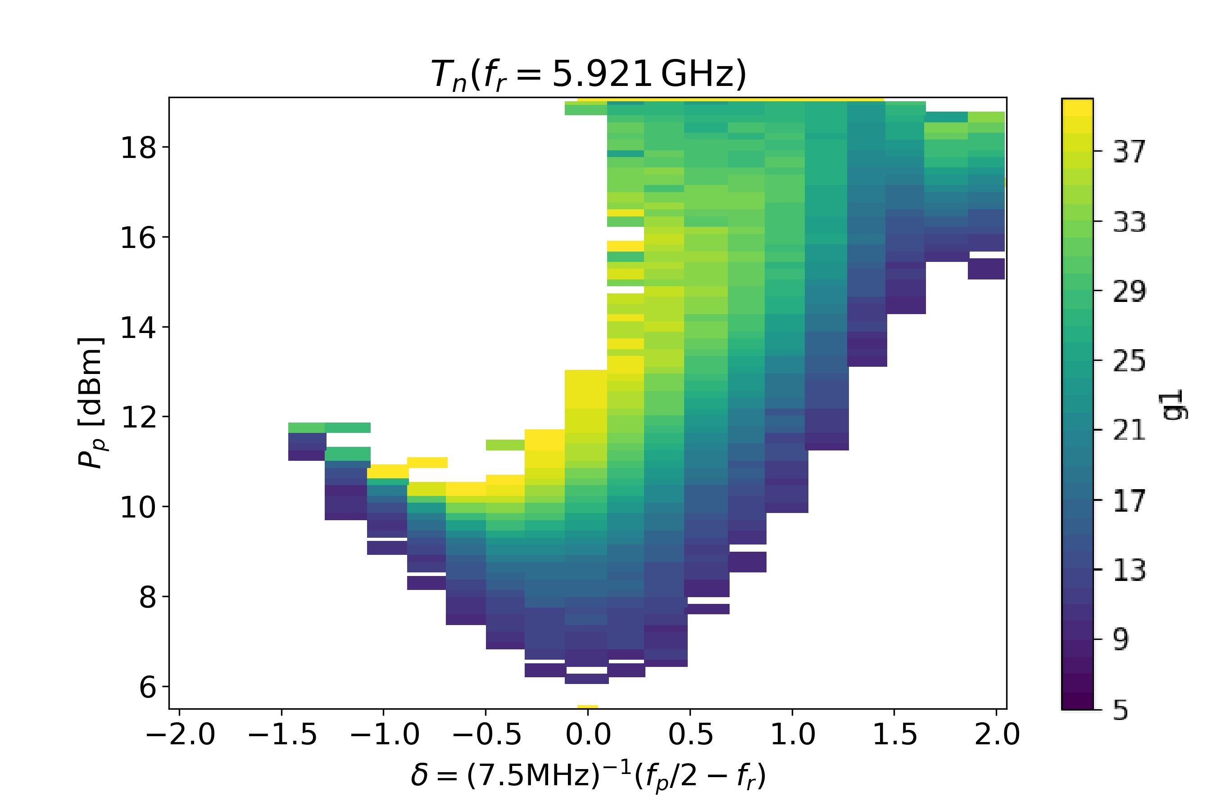
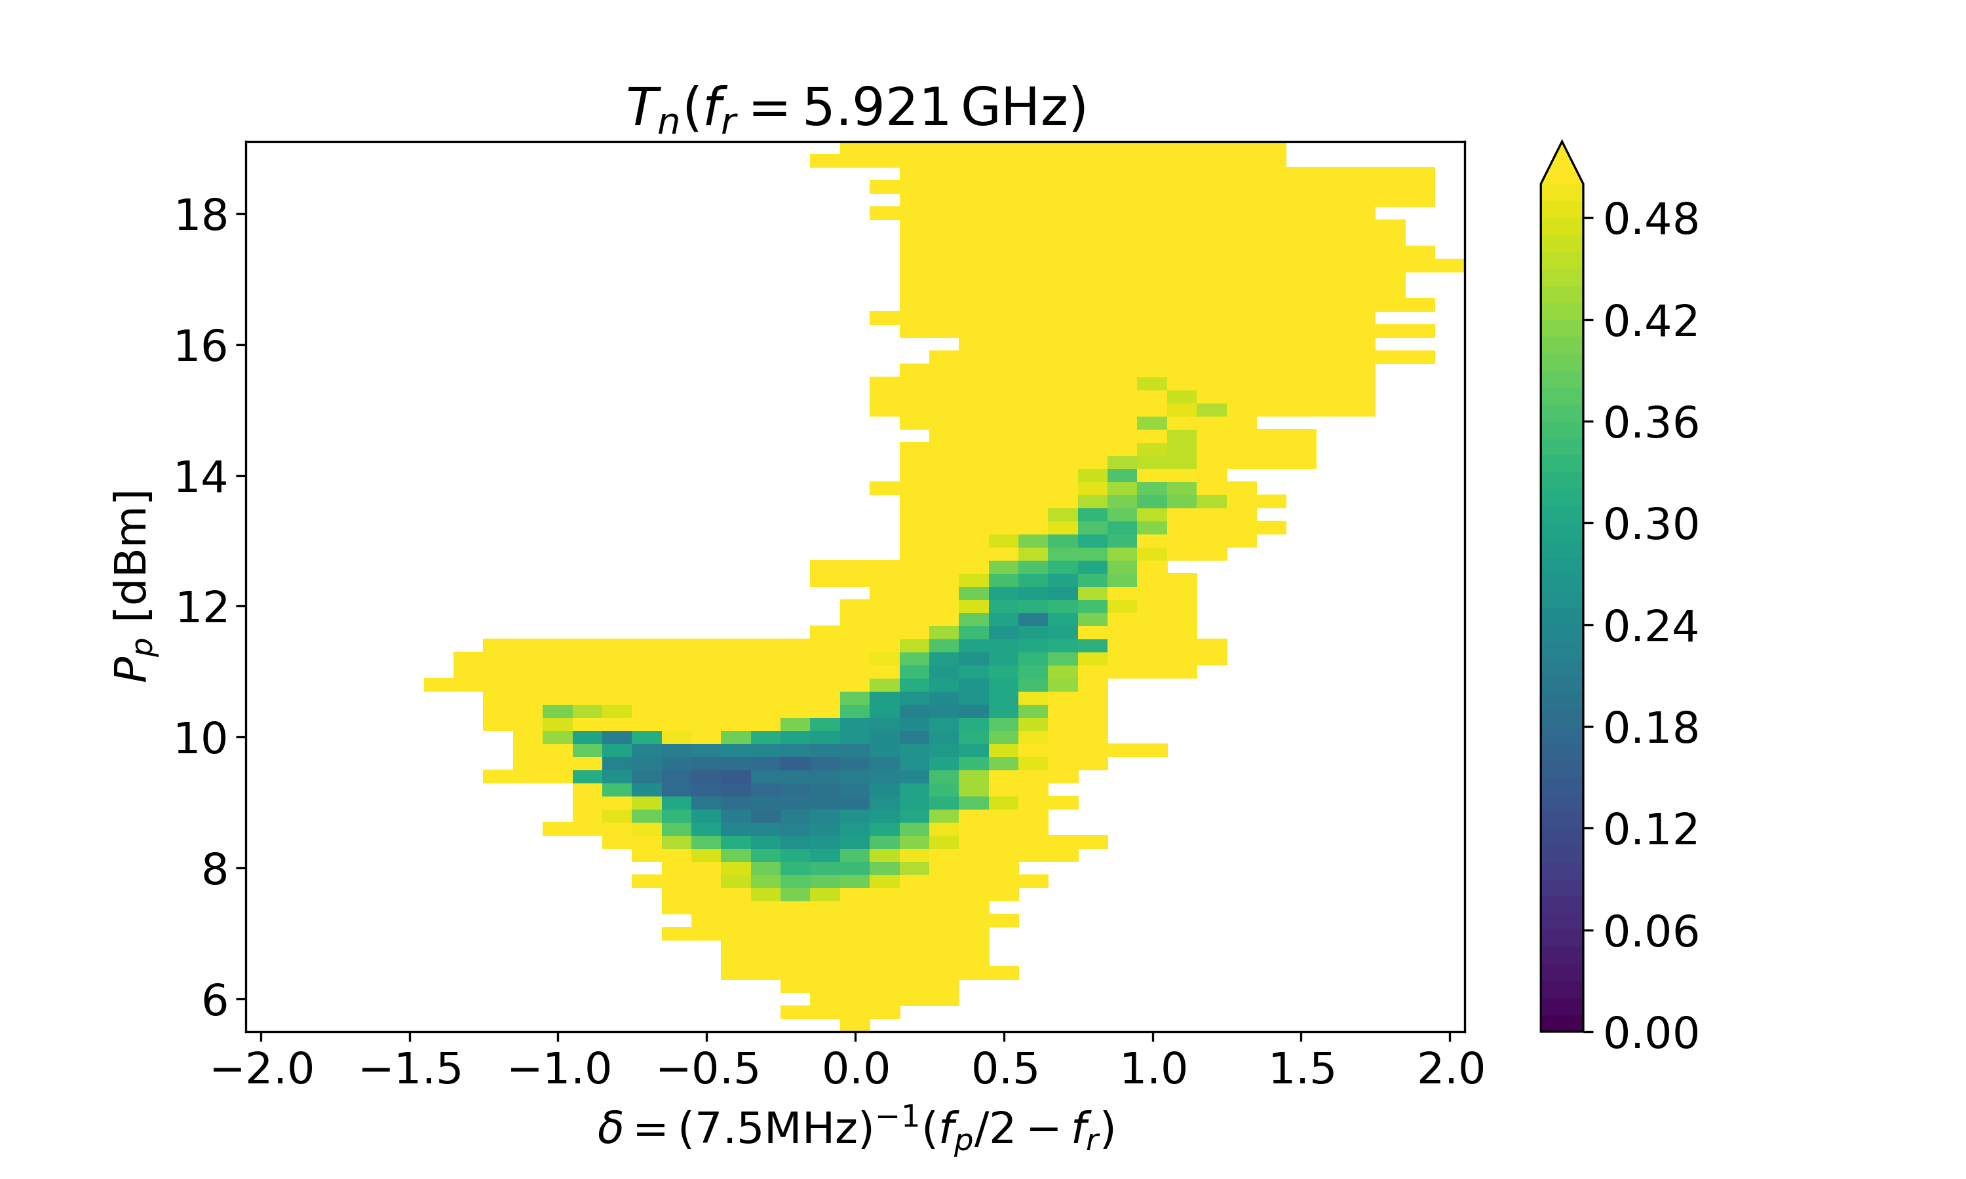
Paramaps: search for operation point
Gain paramap
Noise paramap
Working point corresponds to minimal noise temperature. Gain at working point about 20 dB
Measured added noise:
About 150 mK or 1.07 of (added QLN=139mK)
Çağlar Kutlu et al 2021 Supercond. Sci. Technol. 34 085013
Notes:
To find working points in all frequency range we developed two step procedure. In the beginning we build a gain paramap, a dependence of JPA gain from pump power and detuning. Detuning is the difference between a half pump frequency and signal frequency. Our optimal gain is about 20 dB. This gain allow us to make noiseless amplification of the output of JPA with HEMT. For all of operation frequency range we build such a map.
Based on data we get from the gain paramap we define area of interest, and measure a noise paramap in that area. Here you see gain and noise paramap for a 6GHz JPA. As you see for this amplifier we measured noise about 150 mK which is slightly above quantum limit for amplifier added noise for this frequency.

Slide 17
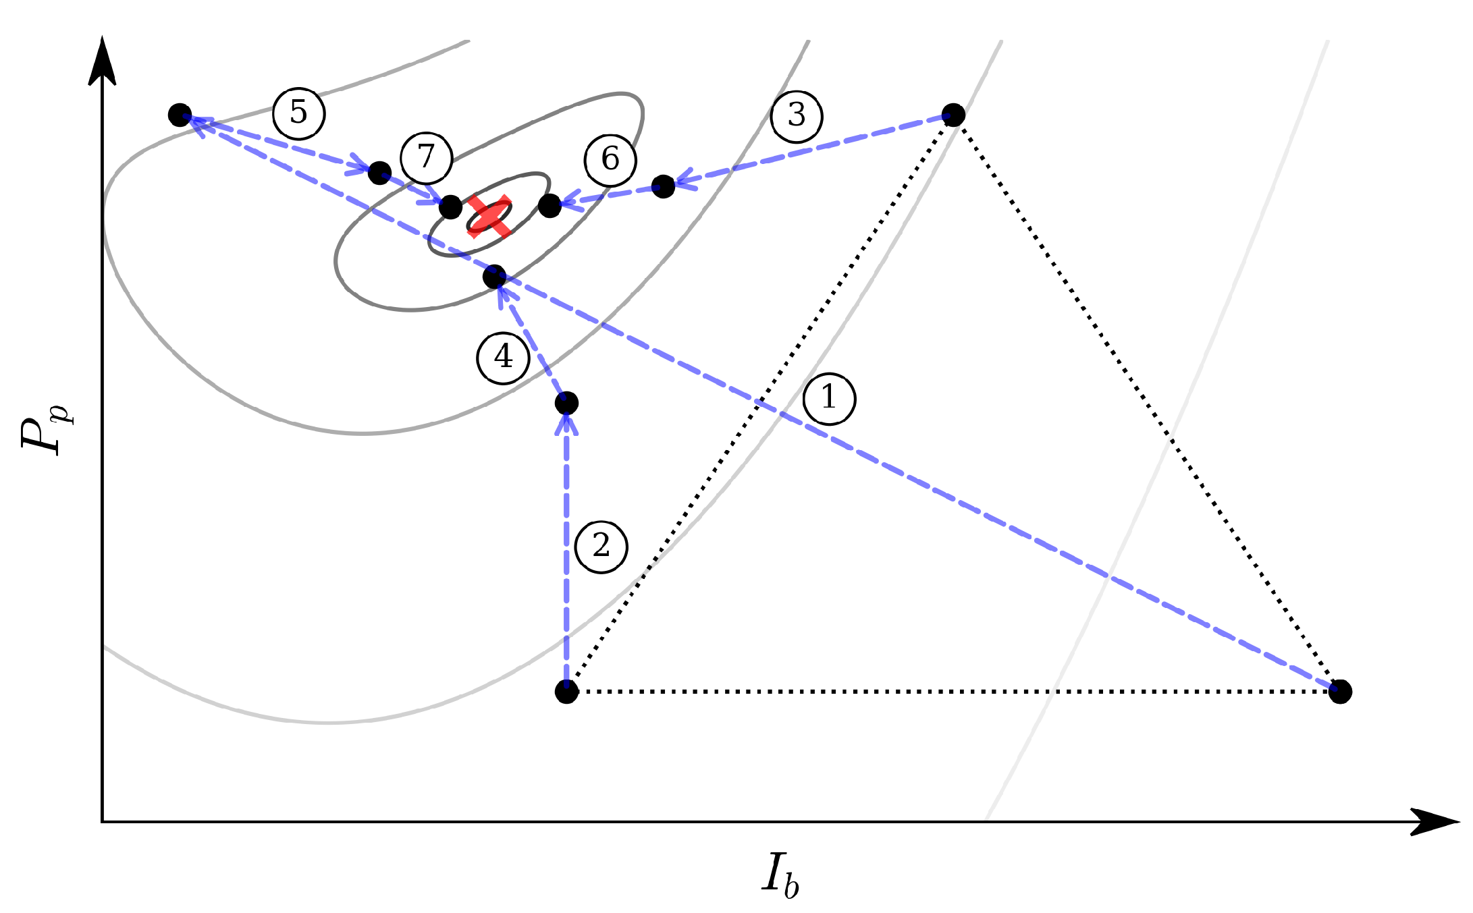
Nelder-Mead method: search for operation point
Nelder–Mead search for the optimum JPA operating point in the (Ib,Pp) space.
The algorithm iteratively transforms the initial simplex (black dotted triangle) toward the minimum noise temperature (red cross).
Notes:
To determine the optimal JPA operating point, we also use the Nelder–Mead algorithm in the two-dimensional parameter space of bias current IbI_b and pump power PpP_p.
The method does not require derivatives: starting from an initial simplex, it iteratively evaluates the noise temperature and moves the simplex toward lower-noise regions.
The process continues until it converges to the operating point corresponding to the minimum noise temperature.
This approach allows the JPA tuning procedure to be automated and significantly reduces the number of measurements compared with a full two-dimensional scan.

Slide 18
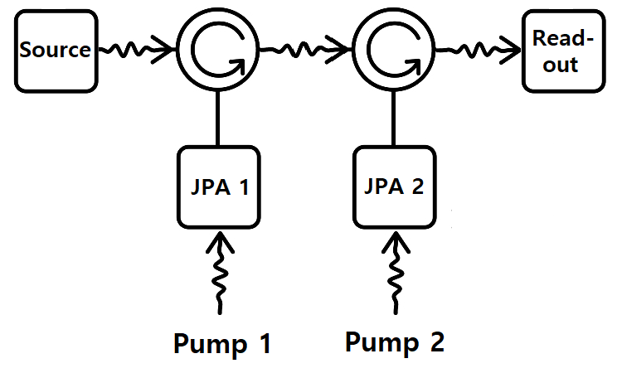
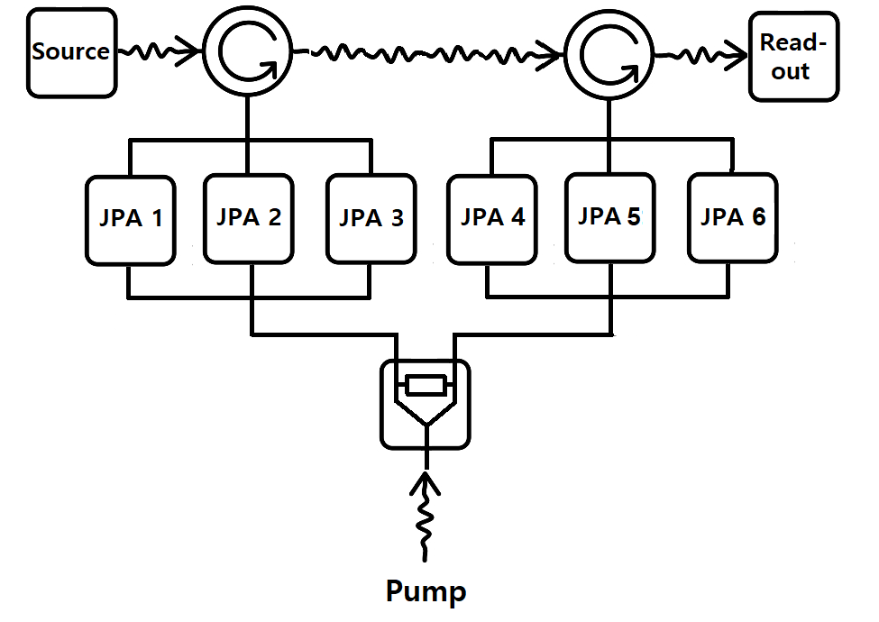
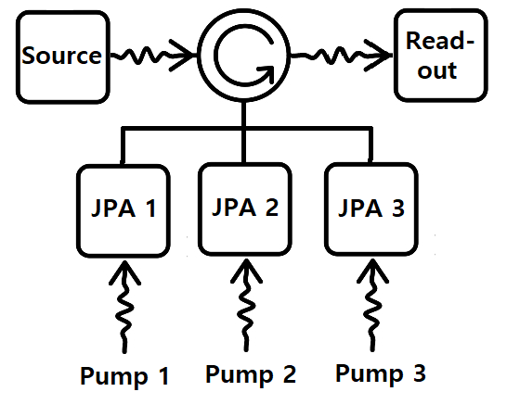
JPA readout
Serial JPA readout (2 JPAs)
Split-band (Dulcimer) Amplifier (up to 6 JPAs)
One JPA readout
Parallel JPA readout (3 JPAs)
In Proceedings of LTD20 conference
Uchaikin S.V. et al. Front. Phys., v.12-2024 https://doi.org/10.3389/fphy.2024.1437680
Notes:
As I told, the cavity tunable range in 4-5 times higher than range a JPAs, so a couple years we learned how to extend the tunable range.
We used two ideas serial and parallel connections connection to connect 2 or 3 JPA with different operation frequency. In these circuits only one of JPAs operates in a time, the resonance frequency of others detune with DC biases away from operation range.
Non-used JPAs just reflect the signal.
After successful tests, we combined these two ideas and make parallel-series connection. We combine 6 JPA in one assembly and extend the tunable range up to 300 MHz.

Slide 19
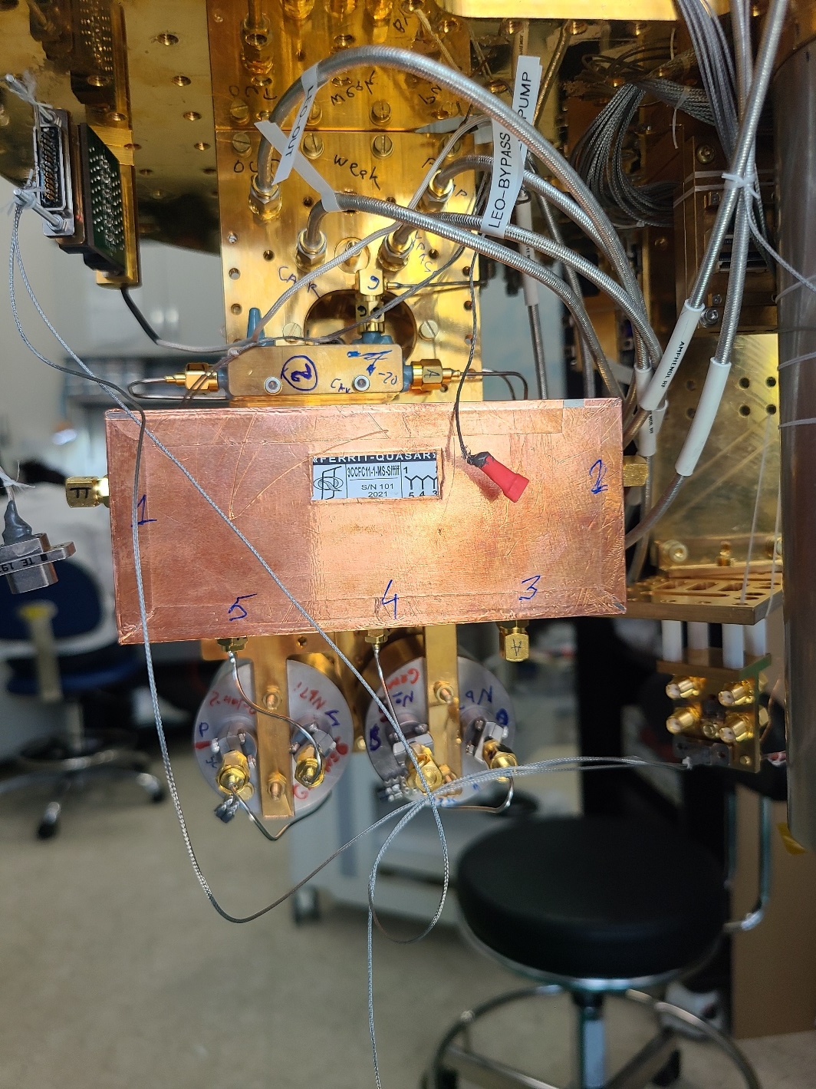
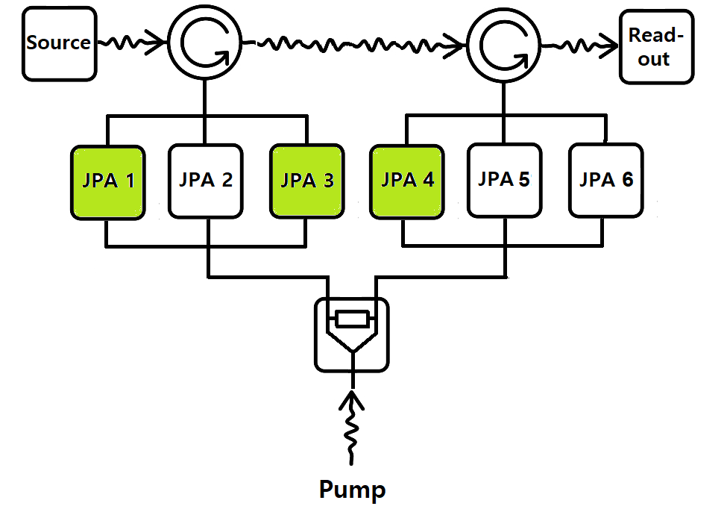
Run 6: Leo I amplifier, 3 JPAs
Run 6: 130 MHz (DSVZ) with 3 JPAs
S. Ahn et al. Phys. Rev. X 14, 031023, 12 August 2024
Notes:
Here you see Leo I mixing chamber assembly.
On the front you see 3-junction circulator and 2 cylindrical holders of JPAs.
The assembly combine all of cold RF component: JPA, circulators, couplers, switch, noise source and so on.
The assembly can be mounted in any of our dry fridges for preliminary test. without loose of expensive liquid helium in our experimental fridge.
This assembly was used in the last year, Run 6, with two JPA in the left holder and 1 JPA in the right holder.
to scan 130 MHz with DSVZ level of sensitivity. Results are published in PRX this year.

Slide 20
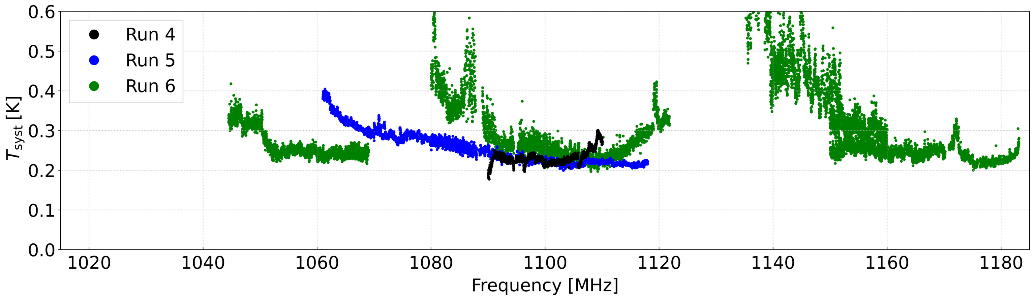
System noise vs frequency for single JPA and three JPA set
Run 4 – One JPA
Run 5 – One JPA
Run 6 – Three JPA
Notes:
Here is results of system noise measurement for 3 experimental runs. In two of them Run 4 and Run 5 only one JPA was used. In Run 6 we used 3 JPAs in assembly shown in previous slide.
As we can see the bottom level of noise is the same, which confirm that usage of multiple JPAs assembly does not affect the system noise.
.

Slide 21
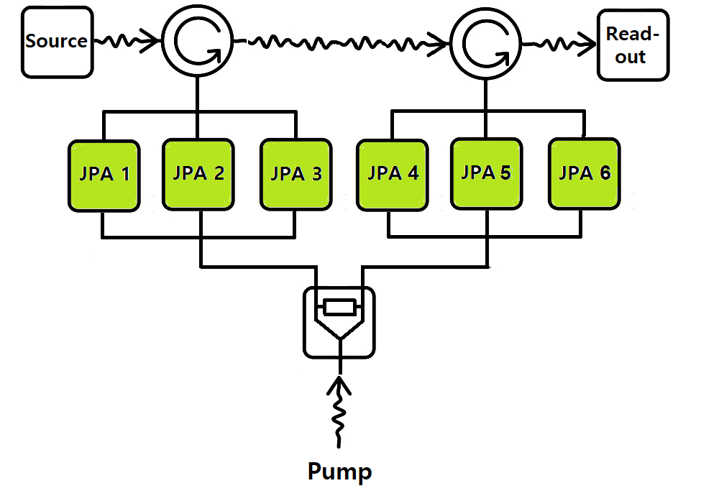
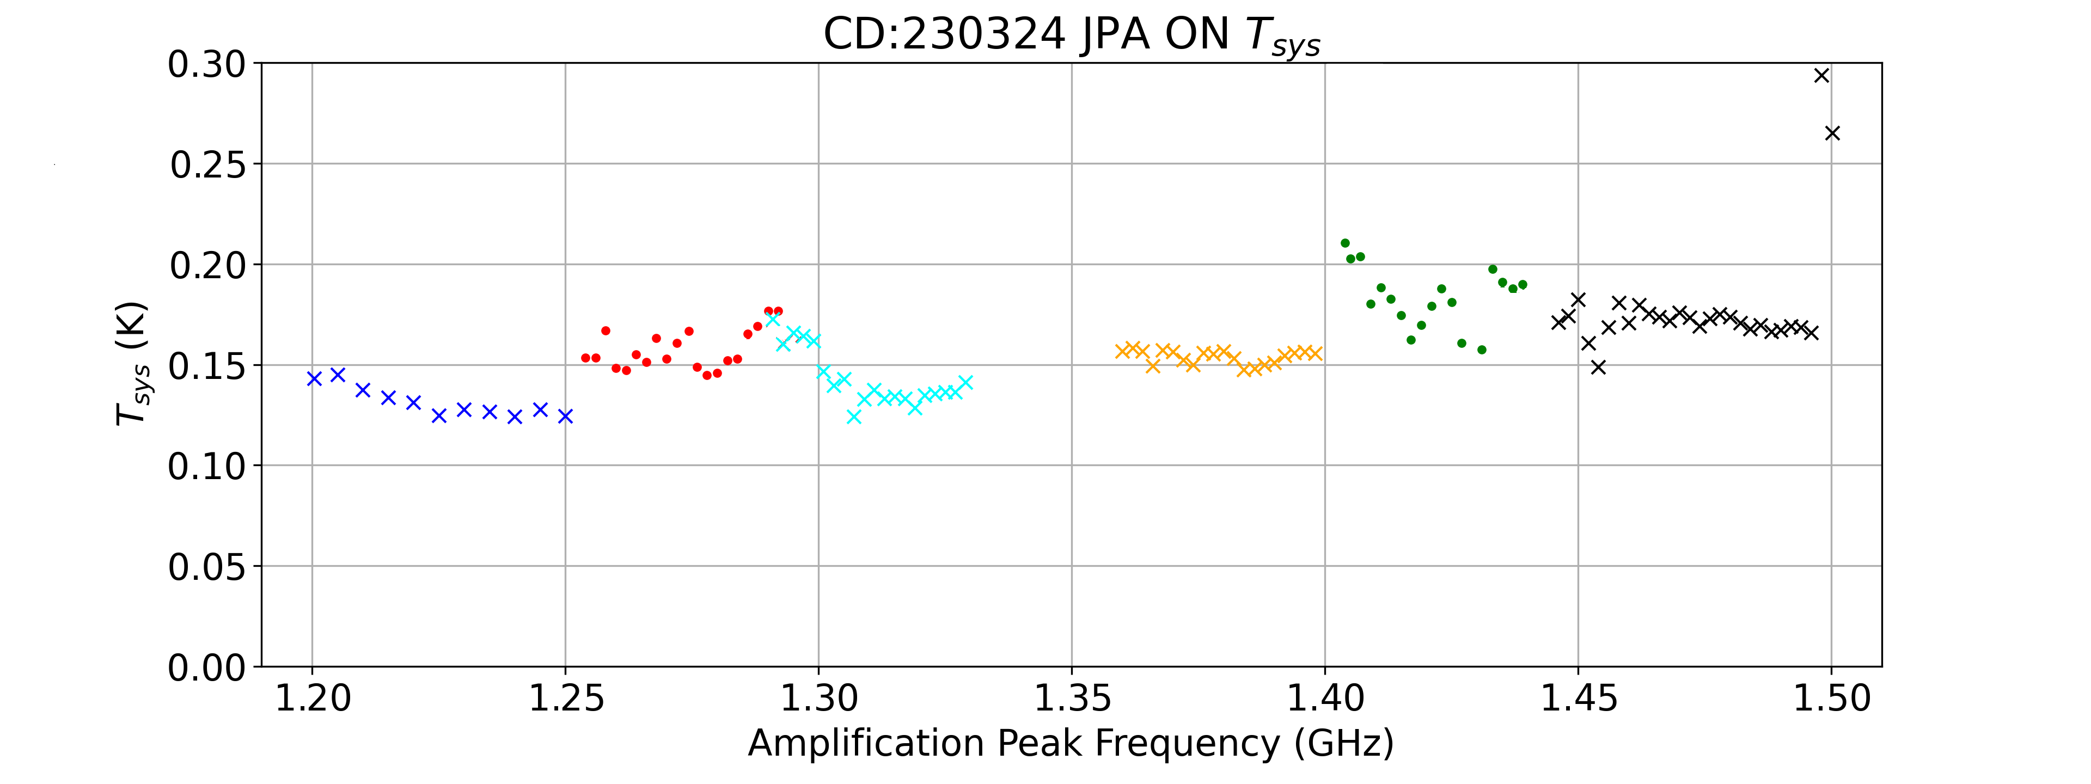
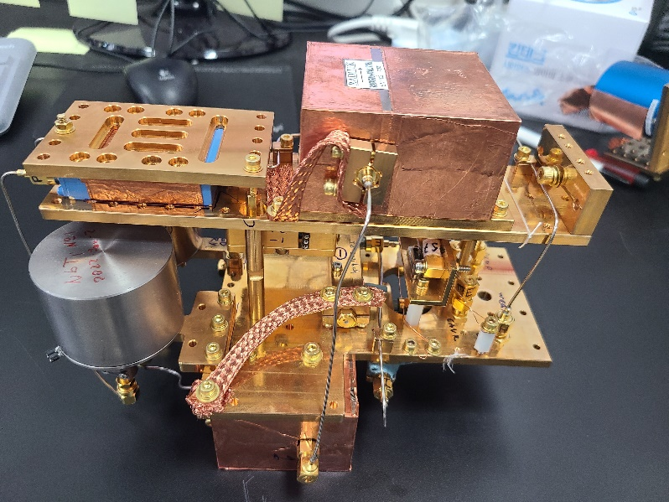
Leo II (Current run): 6 JPA assembly
In the current Run we use 6 JPA (3+3), 1.2-1.5 GHz
1 photon
½ photon
Notes:
Currently, we have 6 JPA in the fridge. You see the assembly photo on the photo.
It works fine and we will able to scan up to 300 MHz in one cooldown. The result of noise measurements of 6 JPAs are shown on the left graph. Added noise values are between 75 and 135 mK.

Slide 22
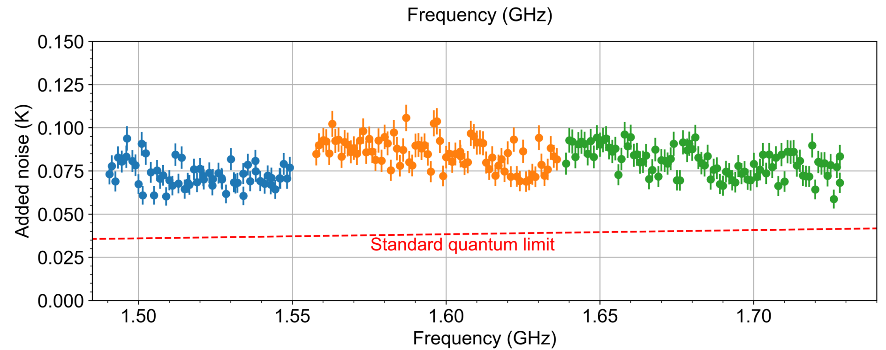
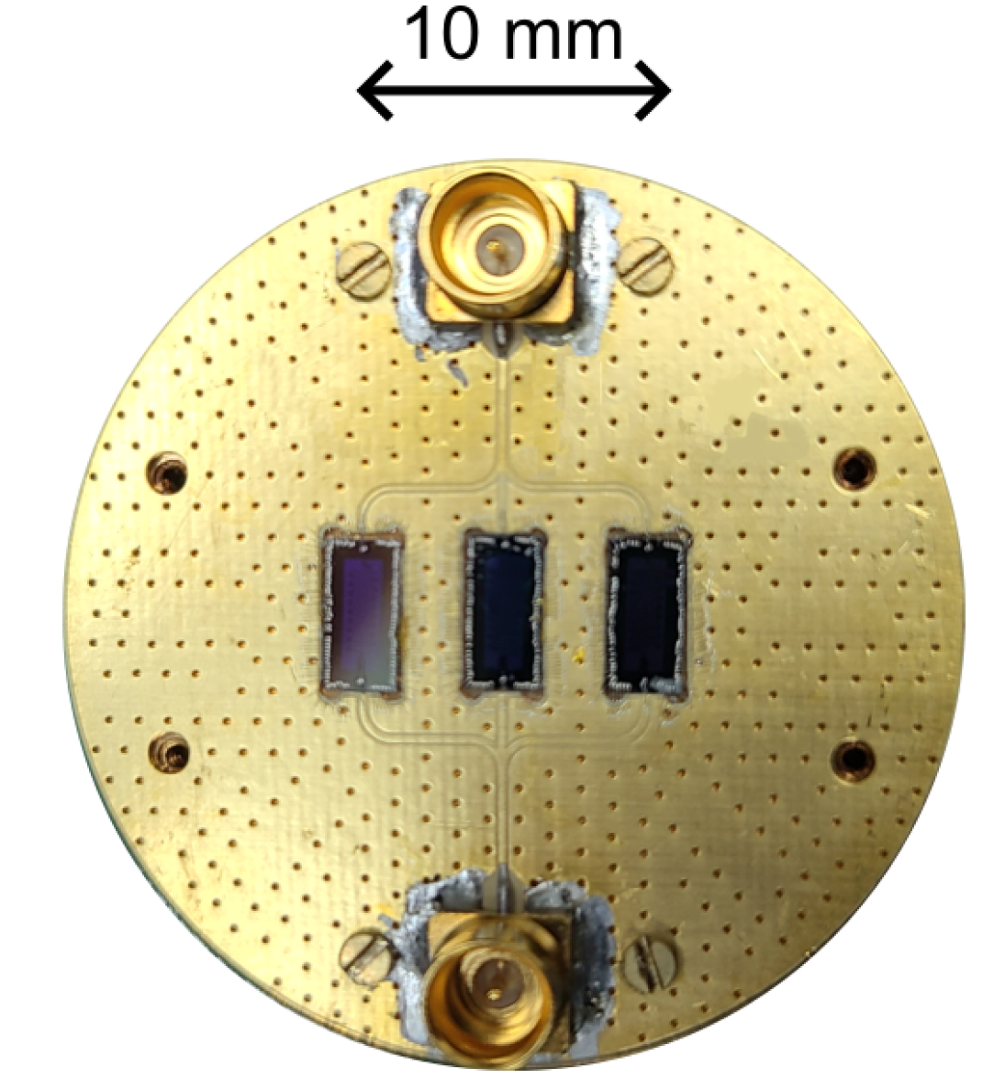
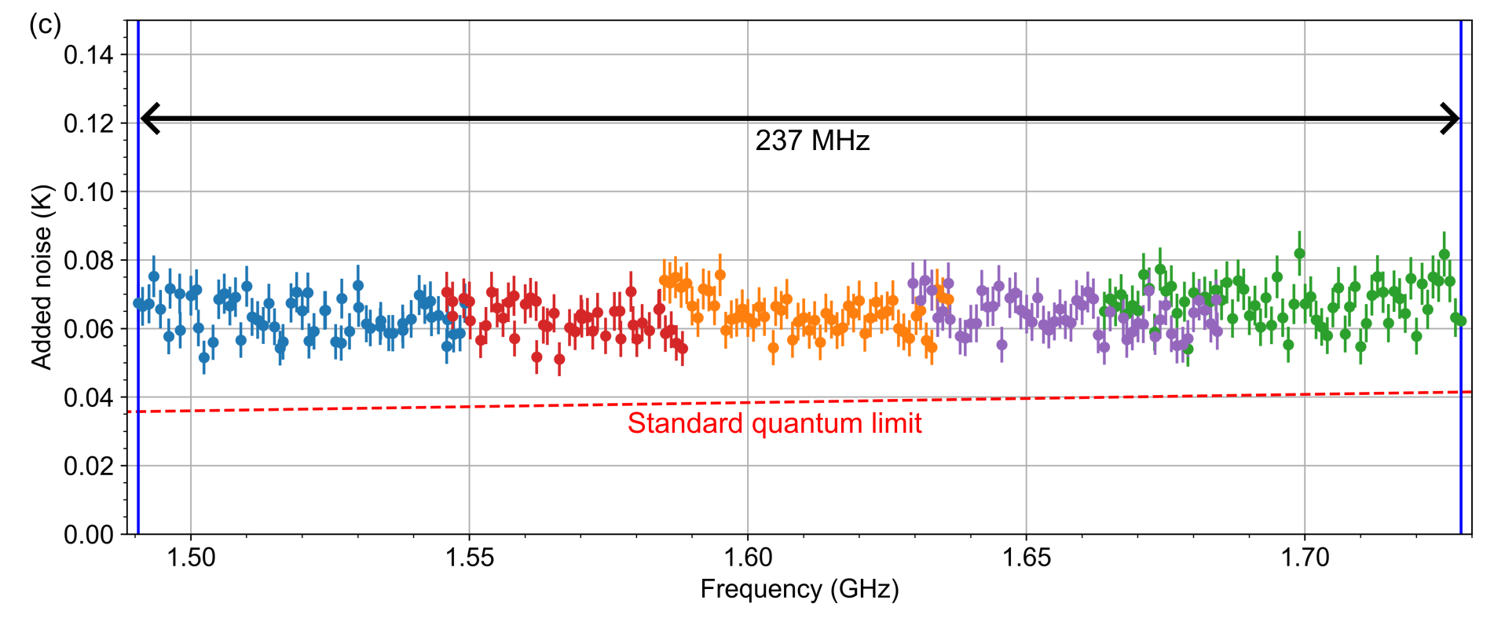
Multi-JPA Systems – Leo-3 (1.5-1.75 GHz)
Three JPAs
Frequency multiplexing
Combined in parallel in single read-out line.
JPA is selected by chose of pump frequency f_{PUMP},
f_{PUMP}~ 2f_{SIGNAL}.
237 MHz with gaps
Up to Six JPAs
Parallel/series arrangements for full band.
Performance
237 MHz
300 MHz bandwidth without noise penalty.
½ photon line
Notes:
We successfully implemented three of these devices for different frequencies in the 'Gorynych' setup.
This configuration utilizes frequency multiplexing, where the active JPA is selected by choosing the appropriate pump frequency.
With three JPAs, we can tune over a range of more than 200 MHz, but some gaps remain.
The noise performance for these three JPAs is shown here, color-coded by frequency.
By adding three more devices in a parallel-series connection, we can reliably fill these gaps.
This setup is designed for a prospective experiment in the 1.5 to 1.75 GHz range.
Currently, we are using these six JPAs to scan the 1.2 to 1.5 GHz range."

Slide 23
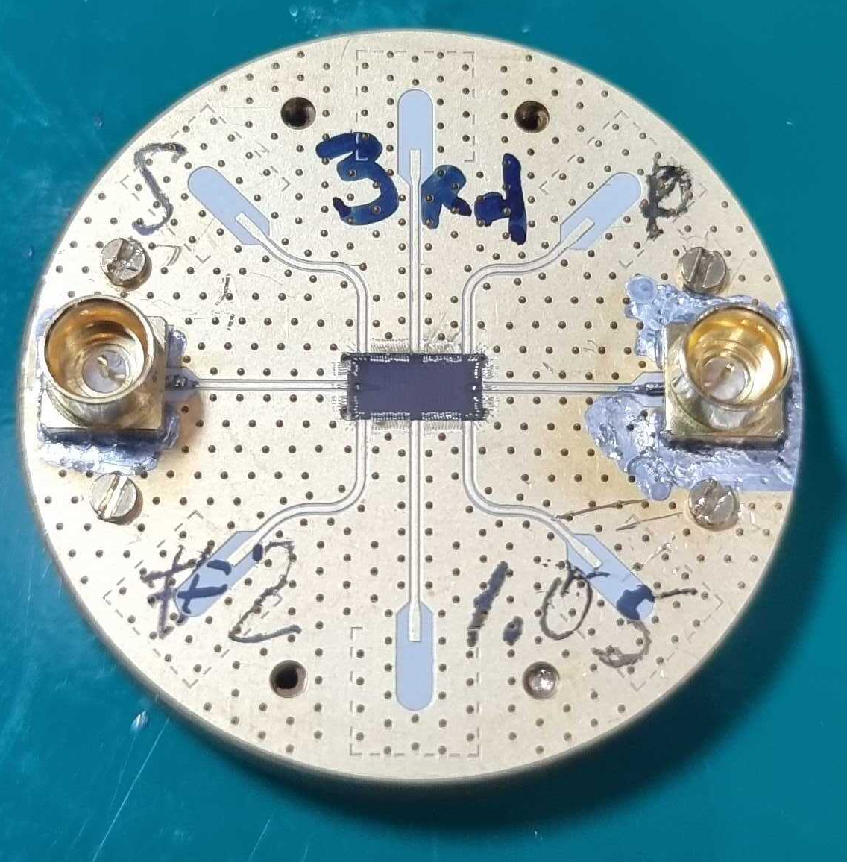
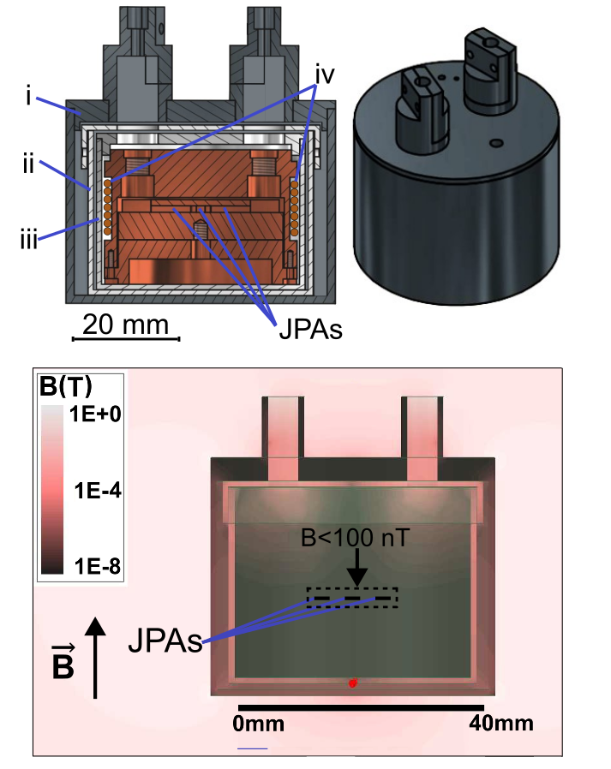
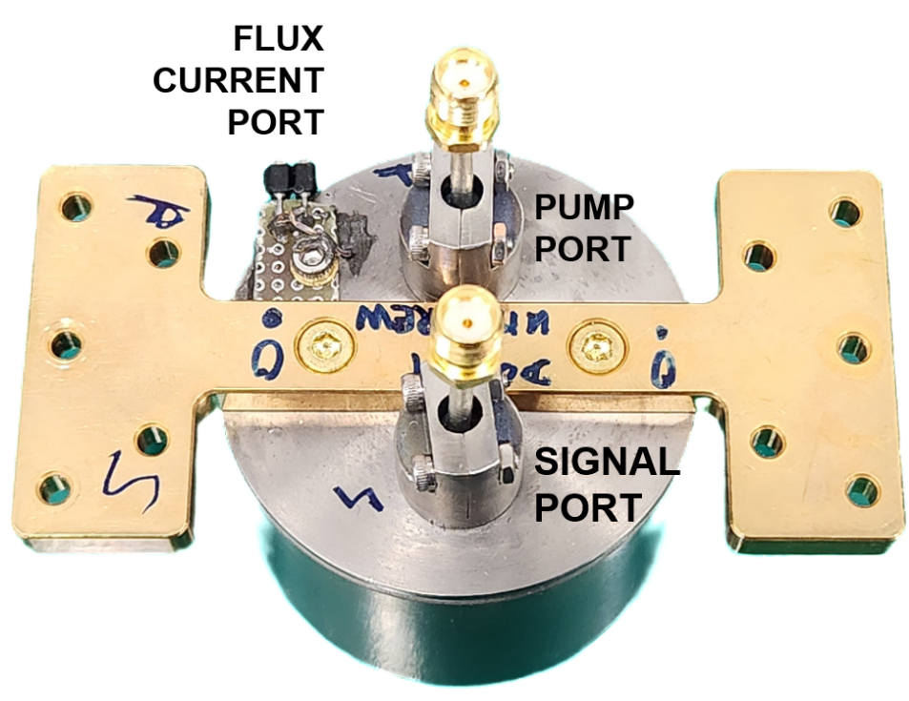
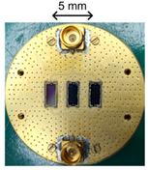
JPA holder
Single JPA chip PCB
The JPA holder
Cross section of the three layer magnetic shield and 3D simulation with the field strength of 50 mT
Triple JPA chip PCB
Notes:
The JPAs operating is very strongly depends from magnetic field. Residual field of magnet in the place of the JPA is about 50 mT.
To protect it, we developed three-layer magnetic field to exclude influence of the external field on the JPA operation. It can be used with one or up to 3 JPAs in a holder.
The external shield is produced from superconducting NbTi and during cooldown freeze the Earth magnetic field.
The second shield is made from mu-metal and serve to shield frozen field of NbTi shield down to level about a few tenth nT.
The most inner layer is manufactured from superconducting Al alloy and freeze the residual field of the mu-metal shield after cooldown below 1.2 K.
As results, the JPAs operates in stable field with strength below 100 nT.

Slide 24
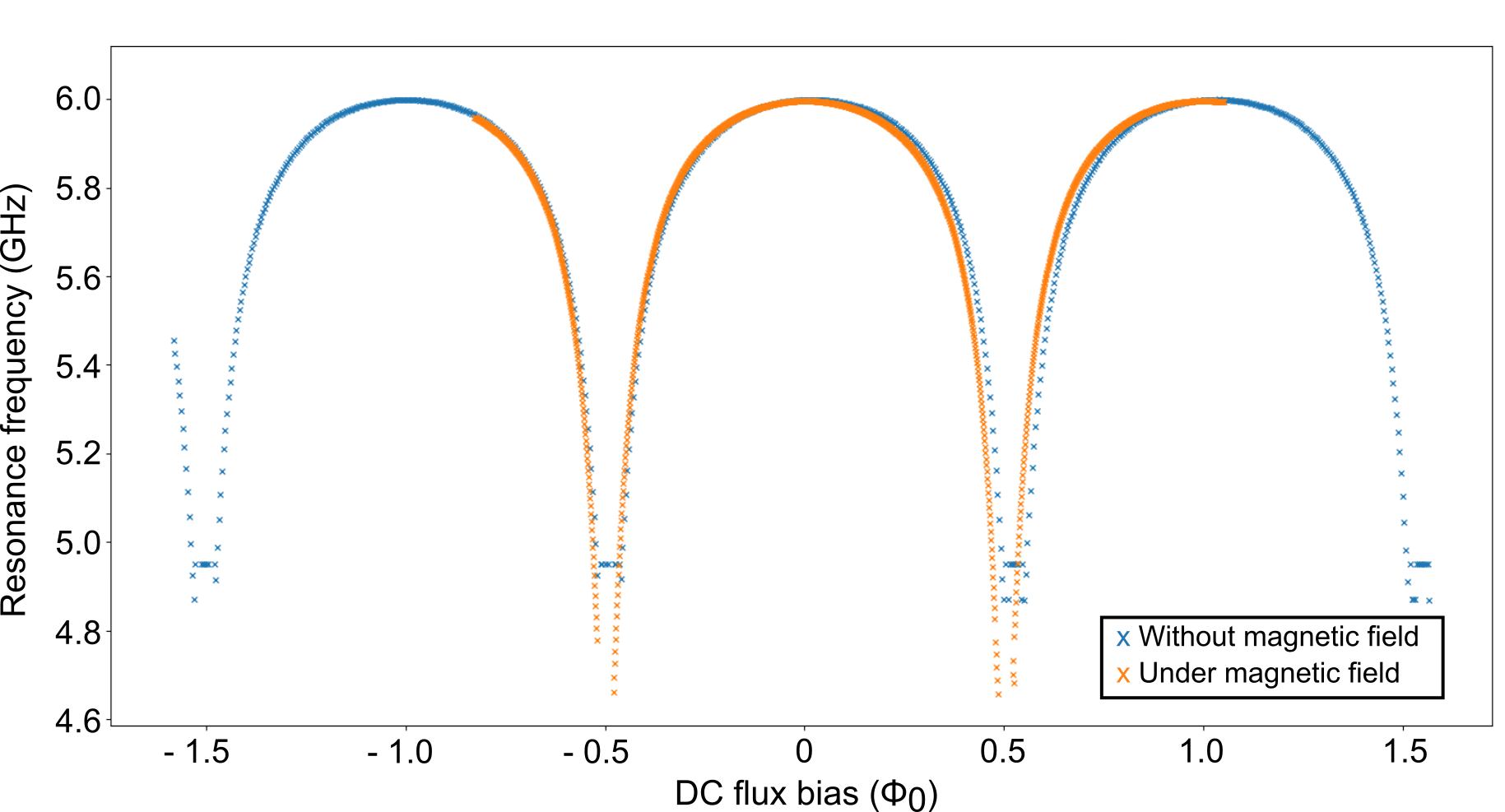
JPA 3-layer magnetic shield
The flux sweep response with 0 T and 0.1 T
[7] S.V. Uchaikin, et al. JPS Conf. Proc. 38, 011201 (2023)
Notes:
Because the JPA is based on a dc SQUID, its effective inductance—and therefore its resonance frequency—is controlled by magnetic flux.
This makes the device extremely sensitive to external magnetic fields, which is a serious issue when operating close to a high-field axion magnet.
We therefore developed a three-layer magnetic shield around the JPA. The lower plot compares flux-sweep measurements at zero external field and at 0.1 T.
The two responses almost completely overlap, demonstrating that the shield preserves normal SQUID tuning even in a strong external magnetic field.

Slide 25
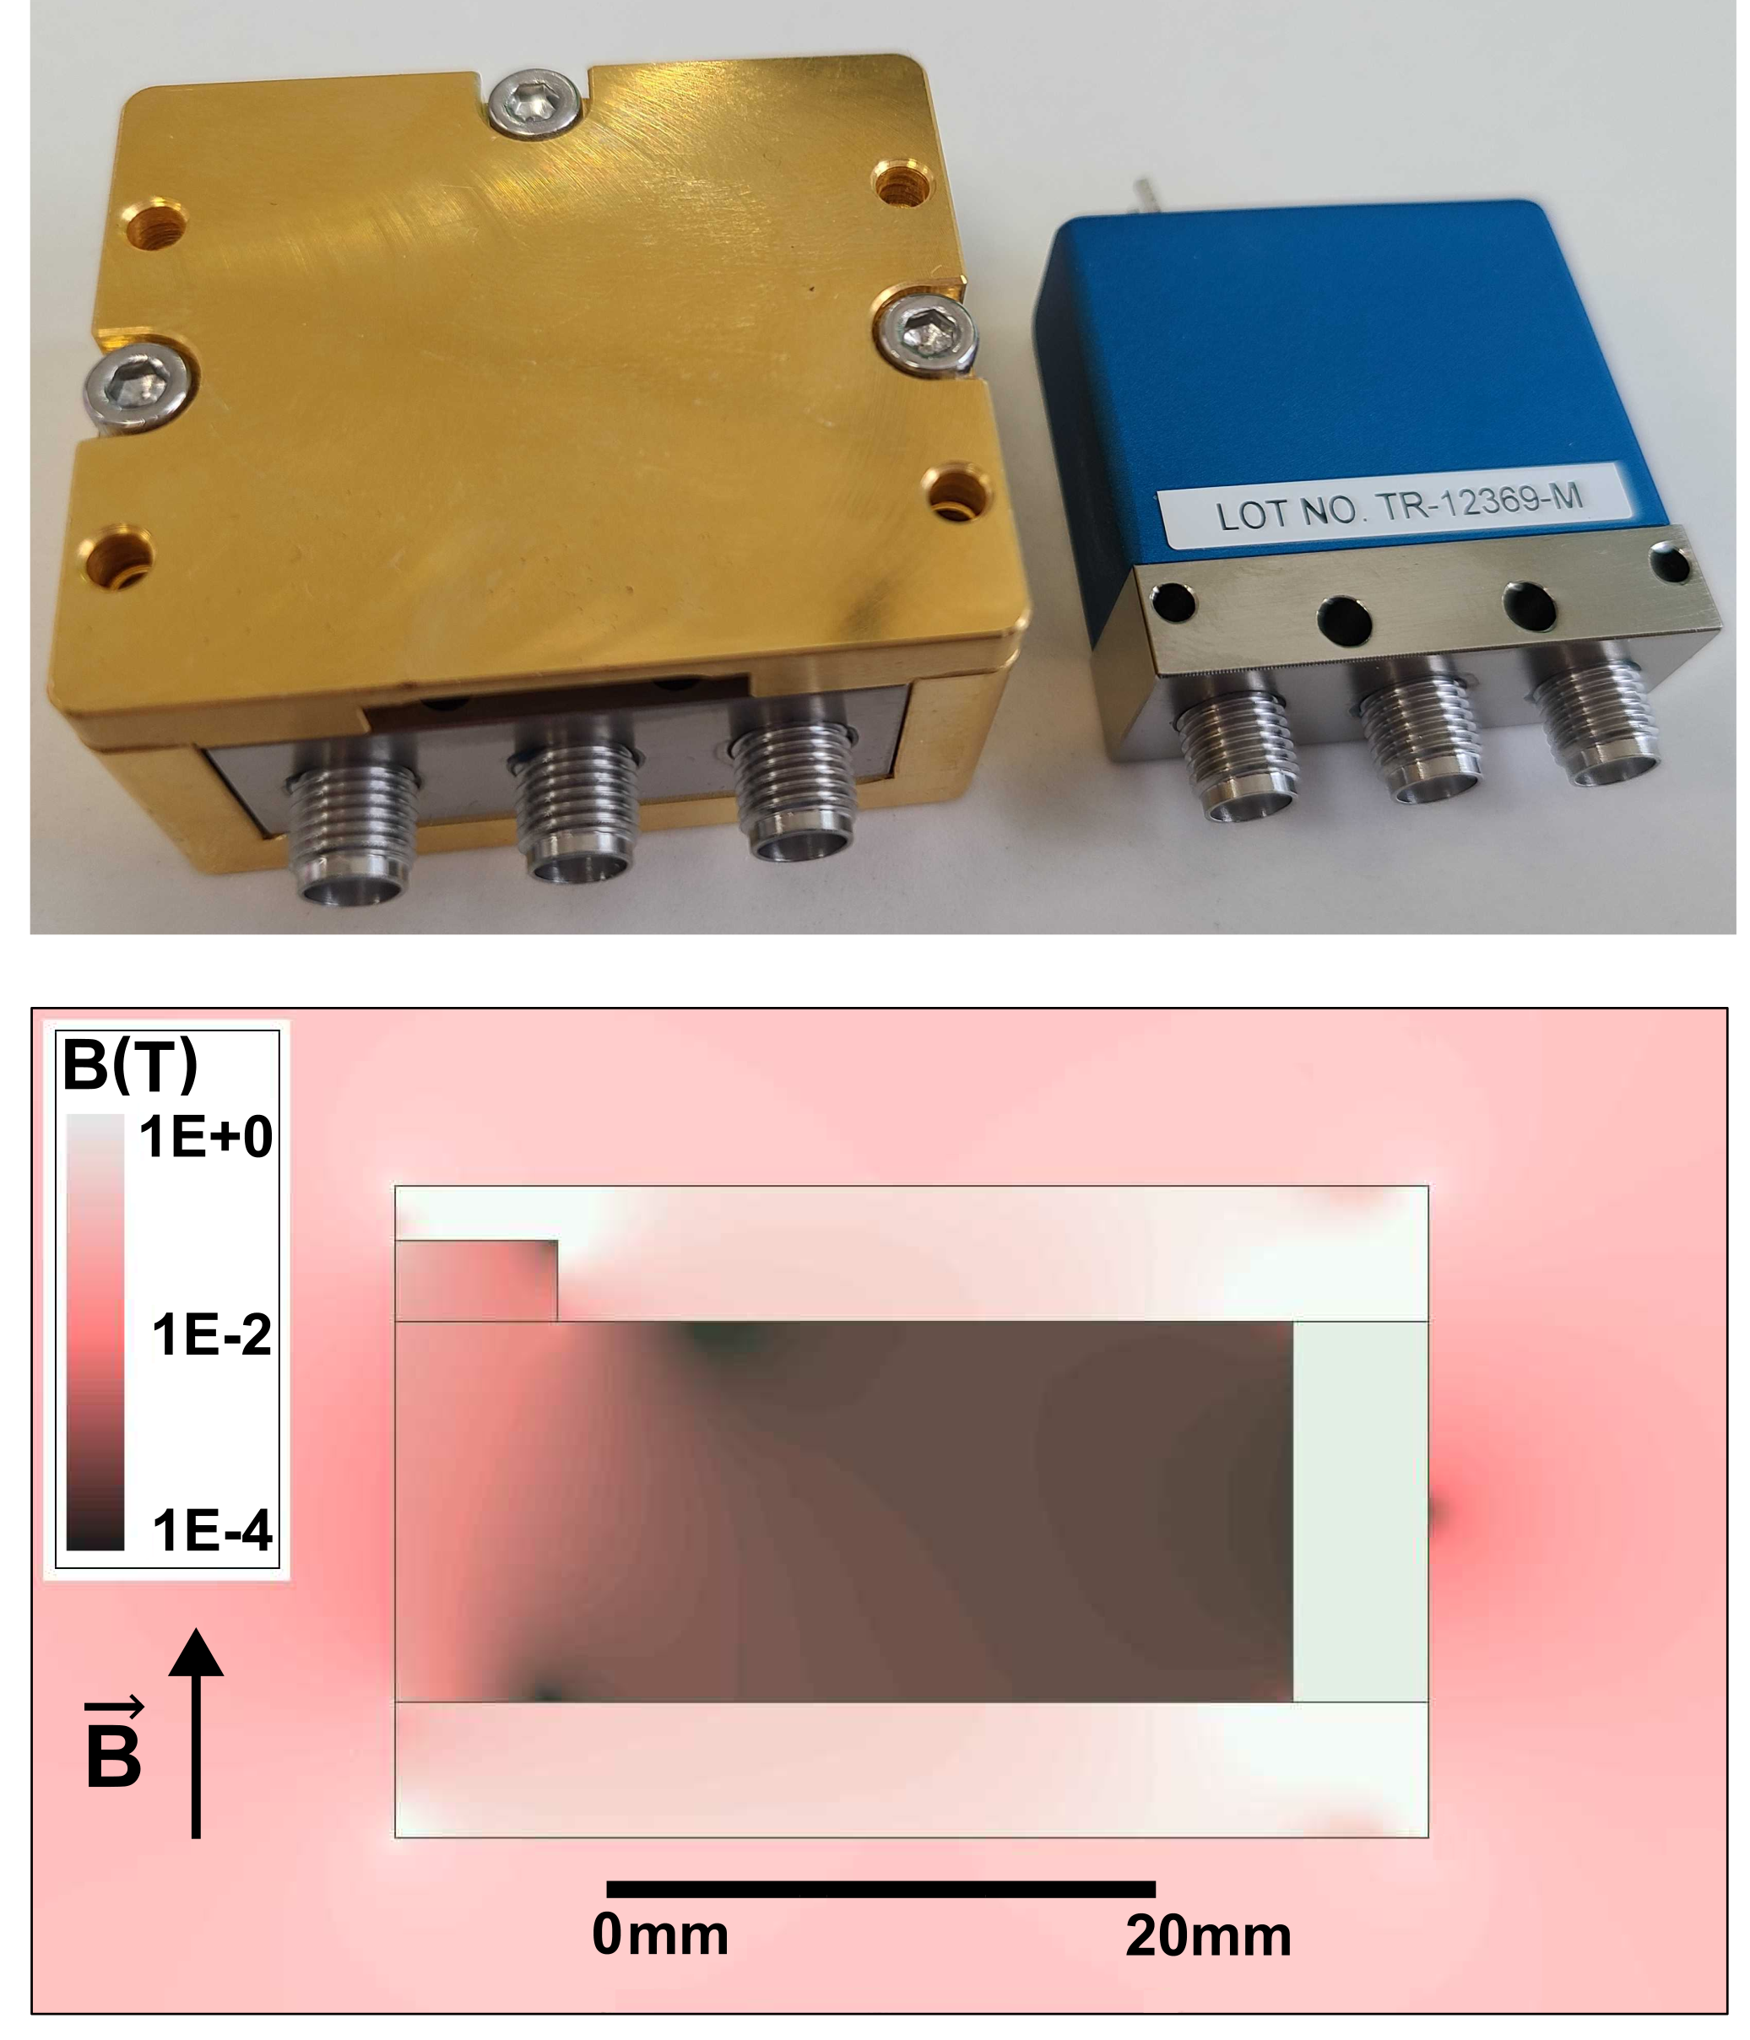
Cryogenic RF switch shield
2 position RF switch
Notes:
Other component requires magnetic protection is the cryogenic two-position RF switch used in the receiver chain.
The switch allows us to select between the cavity signal and the calibrated noise-source path during system-noise measurements.
Since it operates relatively close to the magnet, the external field can affect its reliable operation. We therefore developed a compact magnetic shield specifically for the RF switch.
The photograph shows the shielded and unshielded switch, while the simulation below demonstrates a strong suppression of the magnetic field inside the shielded volume.

Slide 26
READOUT BASED ON FLUX-DRIVEN JOSEPHSON PARAMETRIC AMPLIFIER
WITH LUMP ELEMENT TANK CIRCUIT

Slide 27

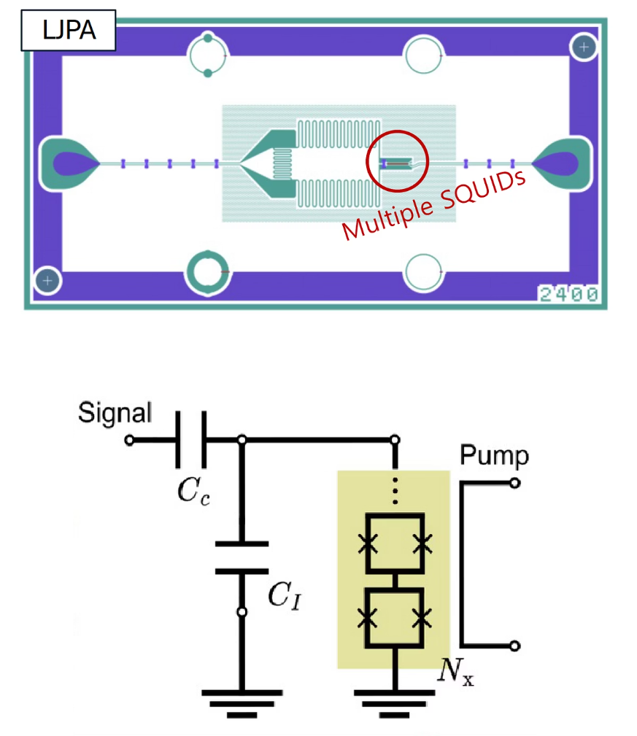
Flux-Driven Lumped Element JPA (L-JPA)
Design
Discrete components replace distributed elements.
No transmiting line is necessary
Need big interdigital capacitance.
Need higher inductance - a 5-10 SQUIDs in Series
Enhanced Tunability
No transmition line → Wider frequency range accessible with one device
Reduced need for multiple amplifiers.
Integration
No change in RF lines is necessary – same RF circuit
Notes:
Now we have a next generation of FD JPA: Lumped-element JPA concept: no transmission line. For low frequency it is acceptable.
Discrete Components: Replaces distributed elements with a compact footprint.
Capacitance: is made from interdigital capacitors.
Inductance: Increased via a series of 5–10 SQUIDs.
Eliminating the transmission line resonance allows a broader frequency range within a single device.
Reduces the reliance on multiple narrow-band amplifiers.
No modification of the main transmission (TF) line required.

Slide 28
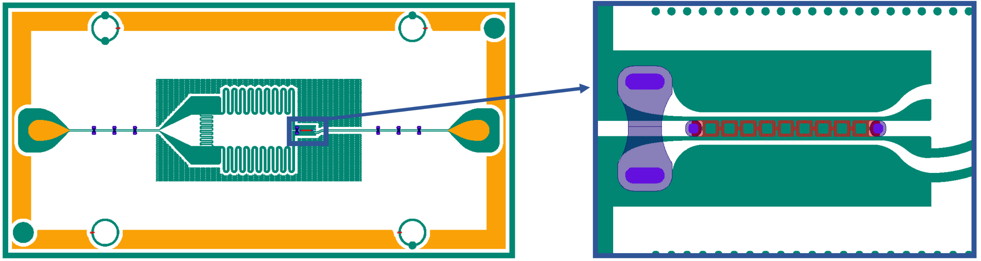
Lump-element JPA
Lump-JPA for a range 1.7-7 GHz
Notes:
Here is one of Lump-JPA design we tested last week. It has interdigital coupling and resonator capacitors and a line of SQUIDs as an inductance.
We have about 15 JPAs of such design.

Slide 29
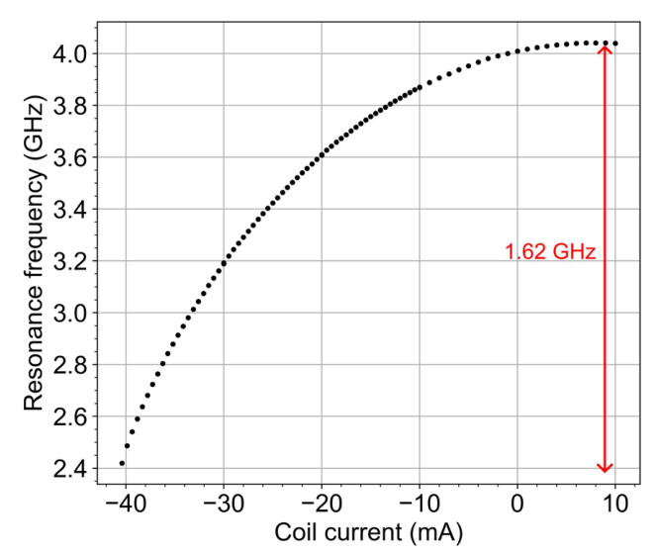
L-JPA Flux-to-Frequency
Tunable range - 0.8-1.6 GHz
Gain >20dB
Notes:
Before cooldown, we expected a higher resonance frequency and test the JPA in a test setup intended for JPA in the range of 4-8 GHz.
Also our dc bias current sensitivity was lower than for our usual JPA. 10 mA was maximum current we can apply.
So, we cannot characterize the JPA in full working range. We will do it in the next cooldown.

Slide 30
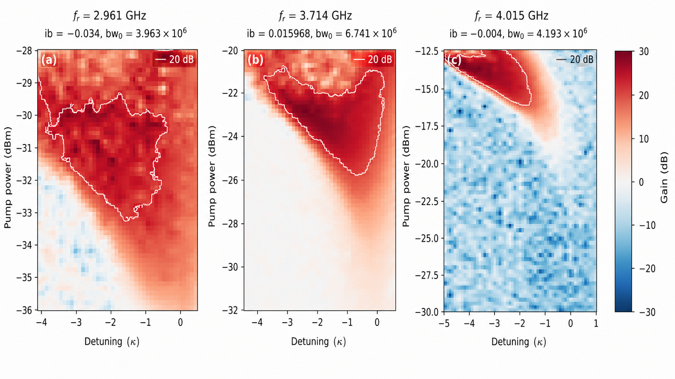
Gain Paramaps for 3 Frequencies
20 dB
In the frequency range >1 GHz, a gain of more than 20 dB is obtained
Notes:
These gain maps illustrate the LJPA behavior at three representative resonance frequencies: about 2.96, 3.71, and 4.02 GHz.
For each frequency, we scan pump power and detuning and identify the region where the parametric gain exceeds 20 dB, marked by the white contour.
The shape and size of this high-gain region change with frequency, but a stable >20>20 dB operating region is preserved across more than 1 GHz of tuning.
This demonstrates that the wide tuning range is not simply a resonance shift—the amplifier maintains practically useful parametric gain throughout the band.

Slide 31

Amplitude-Frequency Characteristics @ 20 dB gain
Maximum gain
Mean gain for G>20 dB
Plot area where G>20 dB,
In MHz*dBm
and
and
Notes:
This plot summarizes the LJPA performance over the full measured tuning range, from about 2.9 to 4.0 GHz.
The maximum gain remains typically above 25–30 dB, reaching about 37 dB, while the mean gain within the region where G>20G>20 dB stays relatively stable at approximately 22–25 dB.
The A20A_{20} metric characterizes the size of the operating region with gain above 20 dB and remains substantial over most of the tuning range.
Thus, high gain is not obtained only at isolated frequencies—the LJPA provides a broad and usable high-gain operating region across most of its tuning range.

Slide 32

LJPA noise temperature measurements
At low frequency more sensitive
Some temperature drift can have be a reason of noise worsening
½ photon
Notes:
This slide shows the measured added noise temperature of the LJPA across the same tuning range.
Over most of the 3–4 GHz band, the added noise is about 200–300 mK, with the lowest values close to 200 mK. The red line shows the standard quantum limit, hf/2kBhf/2k_B.
Thus, the LJPA operates within a few times the quantum limit over most of the band, while maintaining the very broad tunability shown on the previous slide.

Slide 33


Passive resonance: ZFC vs ZC
ZFC
FC
FC method allows extending tuning range of L-JPA
Notes:
Recent Observation: Bandwidth enhancement was observed through the application of field cooling.
The device was cooled under two conditions: Zero-Field Cooling (ZFC) and cooling in a field of approximately 10 Earth fields.
The resonance frequency vs. DC bias dependence shifted.
For instance At a constant 8 mA bias, the resonance frequency shifted from 4.87 GHz (ZFC) to 4.45 Ghz

Slide 34
FUTURE DMAG READOUTS
TWPA (above 6-8 GHz)
Nanobolometer
SPD
Notes:
For future DMAG readouts, we are considering three complementary approaches: broadband TWPAs above 6–8 GHz, ultra-sensitive nanobolometers, and single-photon detectors.

Slide 35


TWPA from SKKU (Sungkyunkwan University)
  Kinetic inductance
  2980 Junctions
  ~8 GHz pump
  ~19.8 Gain
From Prof.Yonuk Chong, SKKU, Suwon, Korea
Notes:
This slide shows the TWPA and its manufacturer-provided characterization. With the pump at 8.335 GHz, the device demonstrates broadband parametric gain over several gigahertz. Our goal is to optimize this technology for near-quantum-limited 6–10 GHz axion readout.

Slide 36


Zeptojoule nanobolometer
Motivation:
J. Omarov, J. Jeong and Y.K. Semertzidis, Phys. Rev. D. 107, 103005 (2023)
Speeding axion haloscope experiments using heterodyne-variance-based detection with a power meter
290 aW at a probing frequency of 752 MHz
66 aW at a probing frequency of 762 MHz
2 aW at a probing frequency of 770 MHz
The noise equivalent power is roughly 20 zW/Hz
[11] R. Kokkoniemi et al., Communications Physics 2, 124 (2019).
[12] J. Govenius et al., Phys. Rev. Lett. 117, 030802 (2016)
Notes:
This is an ultra-sensitive microwave detector based on the zeptojoule nanobolometer developed at Aalto University. It converts absorbed microwave power into electron heating. With a noise-equivalent power of about 20 zW/Hz20~\mathrm{zW}/\sqrt{\mathrm{Hz}}, it is a promising alternative to quantum-limited amplifiers for axion detection.

Slide 37







Zeptojoule nanobolometer. Principle of operation
$L_{eff}=$ $\frac{Φ_{0}}{2πI_{c}\left|cos⁡(π\frac{Φ_{ext}}{Φ_{0}})\right|}$
$$36 Ohm$$
Metallic Au_{x}Pd_{1-x} nanowire contacted by three Al leads (H,P,G) and 7 Al islands.
S/N/S wire from H to G is used for the thermal radiation detection
Shorter junctions P-G are used as a proximity Josephson sensors
L_{Jjs} increases with electron temperature T_{e}, the resonance frequency shifts down as the heating power P_{h} increases
Effective L and R of the S/N/S for P_{p}<<P_{h,}
T_{bath} = 12 mK (BF4)
$$LJjs\sim Te(Pdiss)$$
$$LC$$
Notes:
The ZNB converts absorbed microwave power into electron heating. This changes the Josephson inductance of the proximity junctions and shifts the resonance frequency of the coupled LCLC circuit. The shift provides a sensitive measure of very small absorbed power.

Slide 38




Zeptojoule nanobolometer
IBS – CAPP, BF
Reference signal
Probing signal
30 dB cryogenic LNA is required
ZNB sample
38
Notes:
This slide shows the ZNB implementation at IBS–CAPP. The sample has separate heater and probe lines and is installed in a BlueFors dilution refrigerator. A reference signal heats the detector, while a weak probe monitors the resonance response. A cryogenic low-noise amplifier provides about 30 dB gain for the output signal.

Slide 39
Zeptojoule nanobolometer
The probing frequency response at the testing signal around 6 GHz
Notes:
Here we show the measured ZNB probe response for a test signal near 6 GHz. As the probe power increases, the resonance shifts clearly in frequency, demonstrating the expected power-dependent response of the nanobolometer.

Slide 40


Current Biased JJ (CBJJ)
• Direct threshold detection: a photon can trigger escape into a measurable voltage state.
• No linear-amplifier quantum limit: output is a switching event.
• Bias-current tuning: higher Ib gives better sensitivity, but shorter lifetime.
Main limitation
Near-threshold bias also increases spontaneous escape → dark counts.
D. Alesini et al. SIMP: SIngle Microwave Photon detection, INFN
Current-voltage characteristics of the junction for a different pump powers at pump frequency of 8 GHz. The Ic corresponds to 3.19 uA
Notes:
Here the Josephson junction is operated as a threshold detector rather than as a linear amplifier. A microwave photon can induce escape from the zero-voltage state into the measurable voltage state, so the output is a switching event. By increasing the bias current IbI_b, the junction is brought closer to the switching threshold and the photon-detection sensitivity improves. The trade-off is that spontaneous switching also becomes more probable, which increases the dark-count rate and shortens the effective detector lifetime. The curves on the left show how the current-voltage characteristic changes with applied microwave power at 8 GHz.
For each RF power, the DC bias current is swept while the junction voltage is measured. Microwave excitation lowers the switching current: the stronger the RF signal, the earlier the junction escapes from the zero-voltage state. This switching-current shift is the basis of microwave-photon detection with a CBJJ.

Slide 41

CBJJ / diffusion regime
Diffision regime
Why it an advantages for axions search
Demonstrated performance
Use a current‑biased Al SIS Josephson junction as a threshold microwave counter: absorbed photons trigger switching to a finite‑voltage resistive state.
10 GHz operation
5‑photon detection with efficiency ≈ 1
dark count time > 10 s
1‑photon sensitivity: η ≈ 0.02
Phase diffusion increases junction lifetime beyond simple escape theory
A. L. Pankratov et al., “Towards a microwave single‑photon counter for searching axions,” npj Quantum Inf. 8, 61 (2022).
Notes:
Here we introduce the SPC concept from Pankratov et al. The device is a current-biased Al SIS Josephson junction.
Photon detection can be done by switching alone. Phase diffusion mainly adds retrapping, suppressing false counts.
“For each bias current, the junction was initialized in the zero-voltage state, a strongly attenuated 10-GHz pulse was applied, and we recorded whether the junction switched or not. Repeating this 10310^3–10410^4 times gave the switching probability. We then varied microwave power. Since the attenuated coherent signal follows Poisson statistics, the slope of the switching probability versus photon number identifies the one-, two-, up to five-photon switching regimes.”
When one or several photons are absorbed, the junction can switch from the zero-voltage state to the resistive state, producing a measurable voltage pulse. The important physical point is that the underdamped junction operates in the phase-diffusion regime, which substantially decreases the lifetime of the voltage state. The demonstrated result is detection of an energy equivalent to five photons at 10 GHz with efficiency close to unity and dark-count time above 10 seconds. The paper also reports single-photon sensitivity, but with lower efficiency, around 0.02, so further optimization is needed before this becomes a practical axion detector.
“The green dashed line indicates the onset of the dark-count floor. Below this level, further reduction of the microwave power no longer reduces the switching probability because spontaneous junction switching starts to dominate.”

Slide 42
Summary
IBS/DMAG has proven expertise in the development, characterization, and integration of quantum devices for axion readout.
Quantum readout has been successfully implemented in several DMAG/CAPP experiments, addressing key challenges including cryogenic cooling and thermalization, operation near strong magnetic fields, and suppression of environmental interference.
We are open to testing, characterizing, and integrating new quantum devices into axion search experiments.
We welcome collaboration on the development and implementation of next-generation quantum sensors and amplifiers for axion detection.
Notes:
Smooth Readout: Flux-driven JPAs ensure uniform gain and noise characteristics.
Full Coverage: Split-band design matches the complete cavity tuning range.
Enhanced Bandwidth: Flux-driven transformerless L-JPAs cover multiple cavity ranges simultaneously.
Range Extension: Novel field cooling method further expands L-JPA tunability.

