Slide 1
Weekly meeting
Yu-Siang Xiao (蕭宇翔)
2026 06/30

Slide 2
Trigger Matching Between H2GCROC and CITIROC
Goal: Match events recorded by two DAQ systems.
Method based on inter-event time intervals.
Different DAQ systems have different event numbering.
Timestamp comparison is more robust than raw event ID.

Slide 3
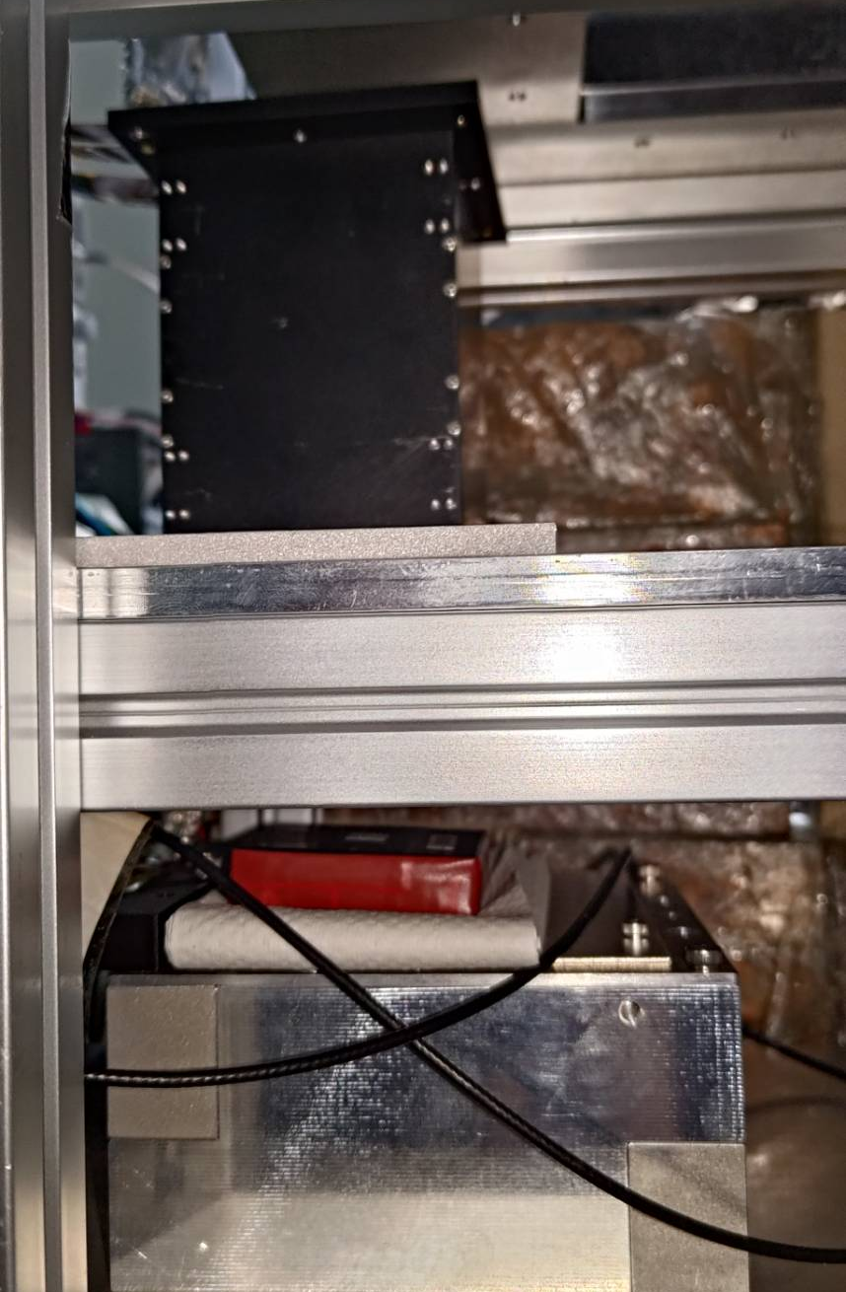
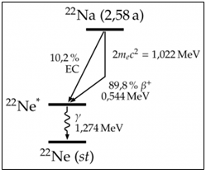
Experiment setup
511 keV γ
LYSO
Det1: LYSO 8.0X₀
SiPM(Osemi 60035 @ 29.0V)
H2GCROC
  External trigger by CITIROC
Det2: GAGG 0.5X₀
SiPM(Hamamatsu @ HV: 29|₁₀ ~ 56V)
GTM-EIC-CITIROC
  Self-trigger
Source: ²²Na:
2 x 511 keV(e⁺-e⁻ back to back γ)
1274 keV γ
1274 keV γ
Trigger
signal
Det1
H2GCROC
LYSO 8X₀
GAGG
511 keV γ
Trigger
signal
Det2
CITIROC
GAGG 0.5X₀
May get signal on each detector in same time, to try the event matching!

Slide 4

Procedure
LYSO
LYSO
1
2
To make sure 2 detector take the same events. ex: 30 sec
1. Set the high THR(DEC=1k) of trigger detector:
  Cut all of the data, make the trigger index reset.
2. Open the data taking of H2GCROC and CITIROC.
  Now, the data flow, and trigger signal is clear!
3. Set the lower THR of trigger detector:
  Start to detector signal and sent the trigger.
  The CITIROC(self trigger) and H2GCROC(external trigger) start to take the data save.
4. Wait for 30 sec!
5. Set the high THR of trigger detector:
  Close the trigger and stop the data flow.
6. Close and save the data flow.
The event # of CITIROC should equal to trigger # of H2GCROC.
Trigger
signal
GAGG
GAGG
3,4
LYSO
5,6
LYSO
Trigger
signal
Trigger
signal
GAGG
GAGG

Slide 5
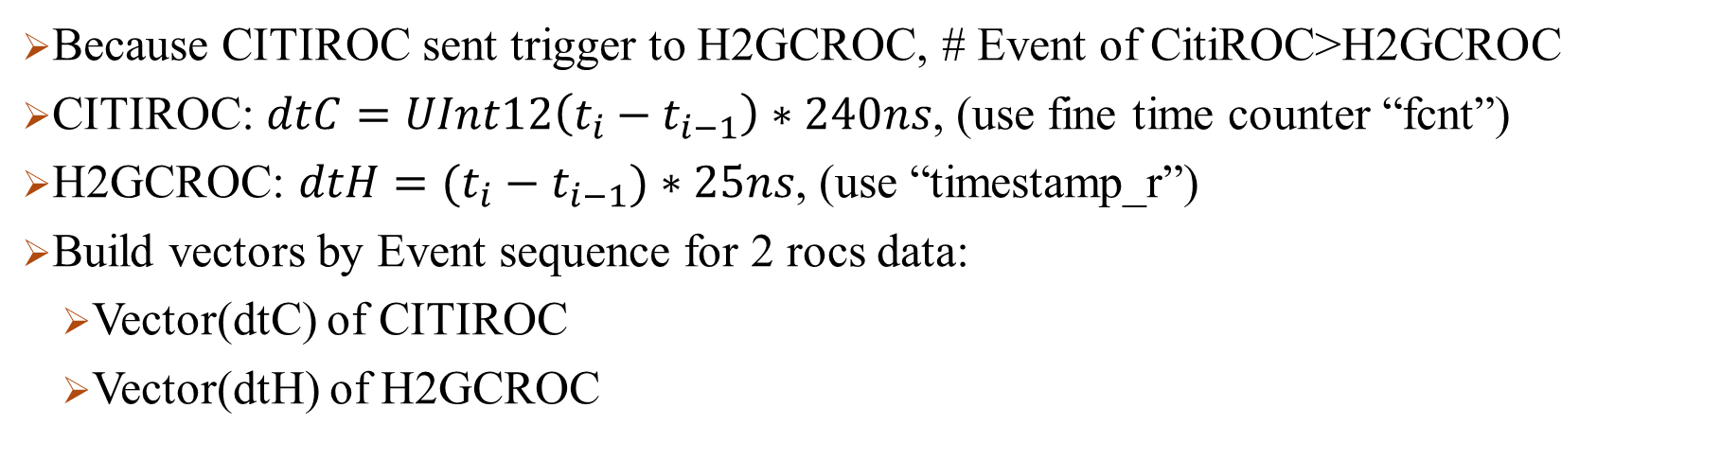
Time Interval Extraction
Because CITIROC sent trigger to H2GCROC, # Event of CitiROC>H2GCROC
CITIROC: $dtC=UInt12\left(t_{i}−t_{i−1}\right)∗240ns$, (use fine time counter “fcnt”)
H2GCROC: $dtH=(t_{i}−t_{i−1})∗25ns$, (use “timestamp_r”)
Build vectors by Event sequence for 2 rocs data:
  Vector(dtC) of CITIROC
  Vector(dtH) of H2GCROC
tC0
tH0
dtC0
dtH0
tC1
tH1
dtC1
dtH1
tC2
dtC2
tC3
tH3
dtC3
dtH2
tC4
tH4
dtC4
dtH3
tC5
tH5

Slide 6
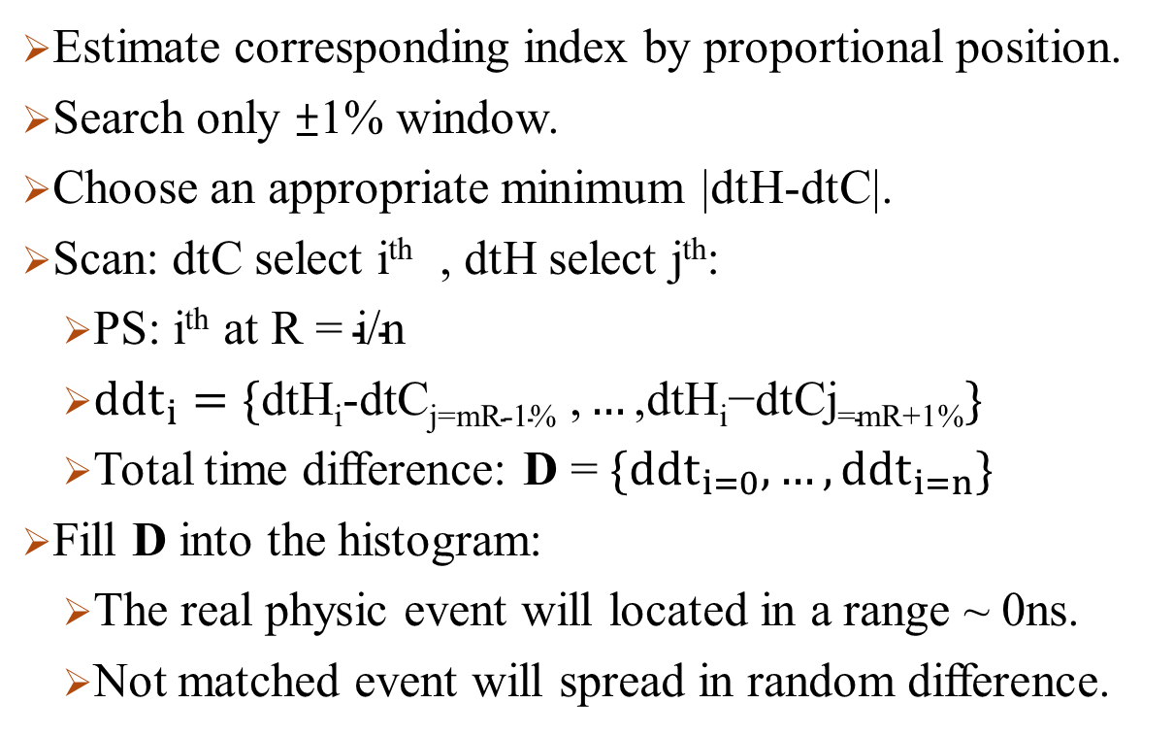
Best time window Search
dtC0
dtH0
Estimate corresponding index by proportional position.
Search only ±1% window.
Choose an appropriate minimum |dtH-dtC|.
Scan: dtC select i^{th} , dtH select j^{th}:
  PS: i^{th} at R = $\text{i}\text{/}\text{n}$
  ${ddt}_{i}=\{\text{dtH}\text{i}\text{-}\text{dtCj}\text{=}\text{mR}\text{-1\% ,}…\text{,}\text{dtH}\text{i}\text{−}\text{dtCj}\text{=}\text{mR}\text{+1\%}\}$
  Total time difference: D = $\{{ddt}_{i=0},…,{ddt}_{i=n}\}$
Fill D into the histogram:
  The real physic event will located in a range ~ 0ns.
  Not matched event will spread in random difference.
dtC1
dtH1
dtC2
dtC3
dtH2
dtC4
dtH3
…
…
dtCn
dtHm
ddt~0=real event, matched i,j
ddt=reandom number
Not matched i,j

Slide 7
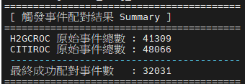
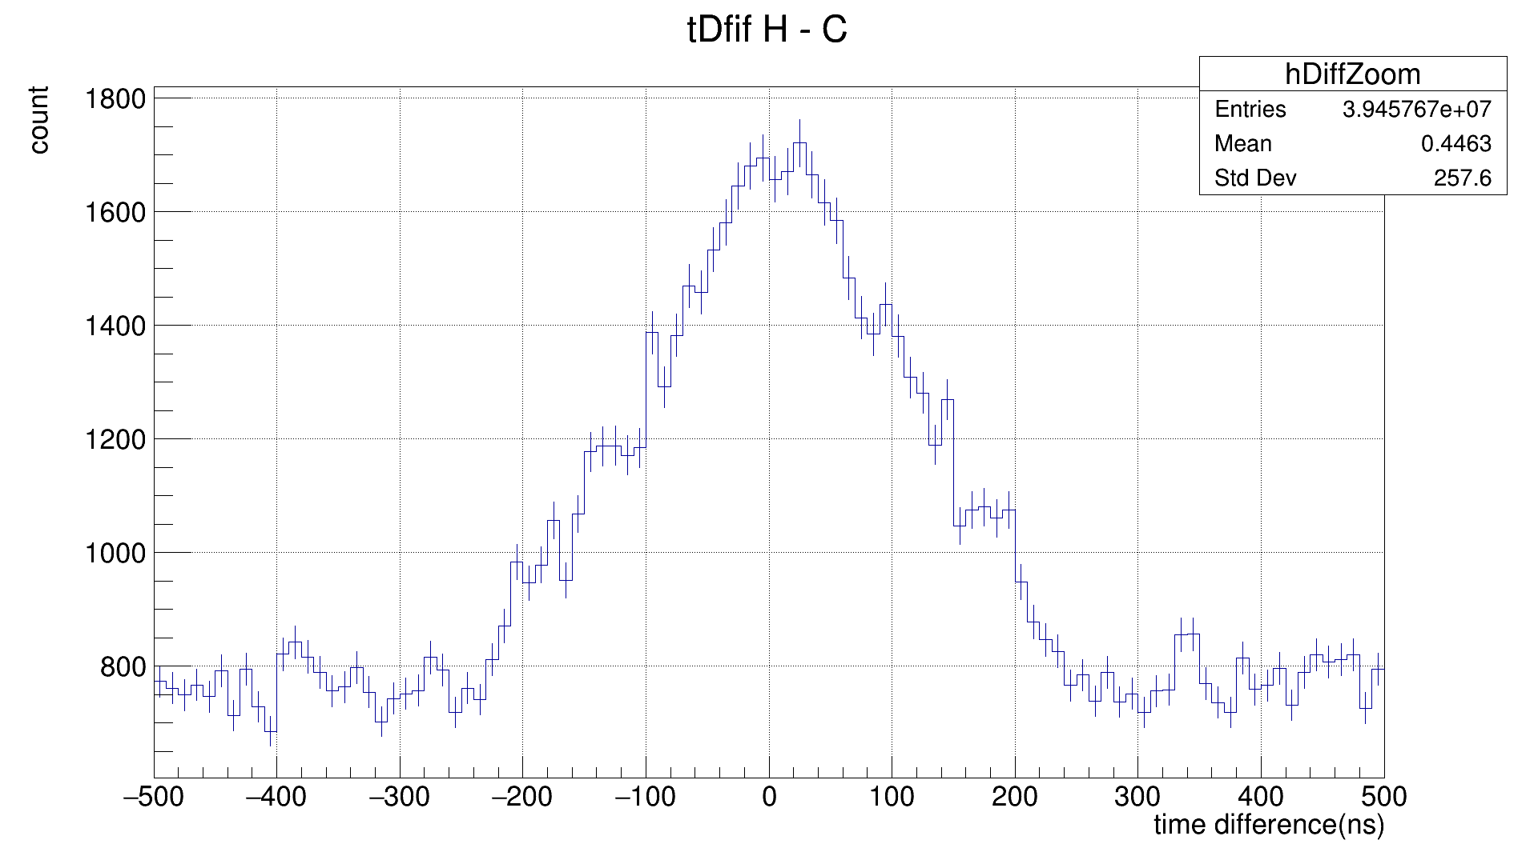
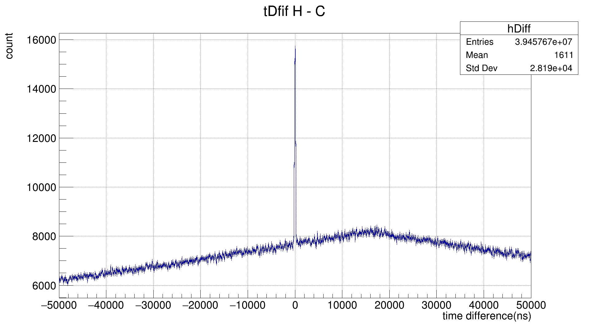
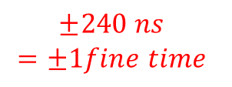
Matching Conditions
Take the matched event: |Δt difference| < 240 ns.
Prevent duplicate matches using used_H / used_C.
Store both previous and current events to be matched event.
Zoom in
$$±240 ns$$
$$=±1fine time$$

Slide 8
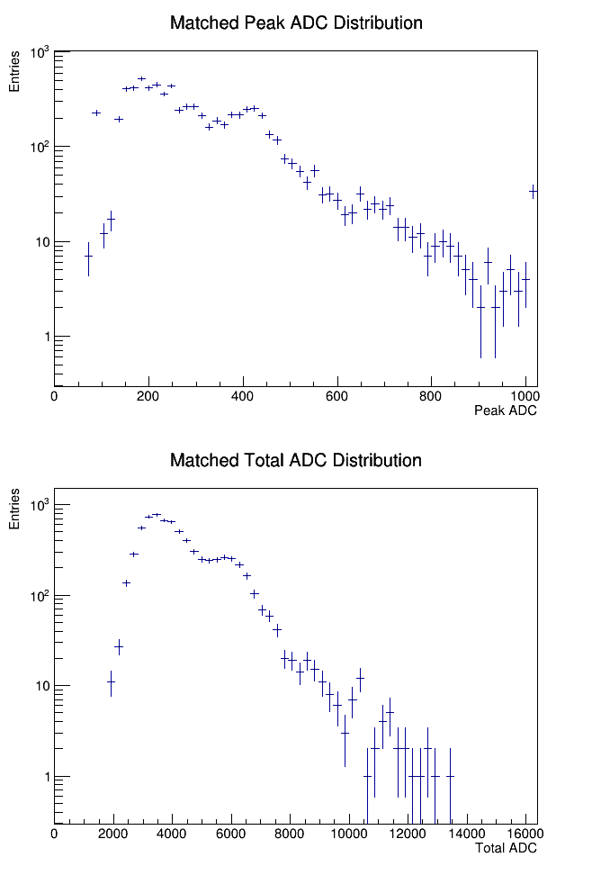
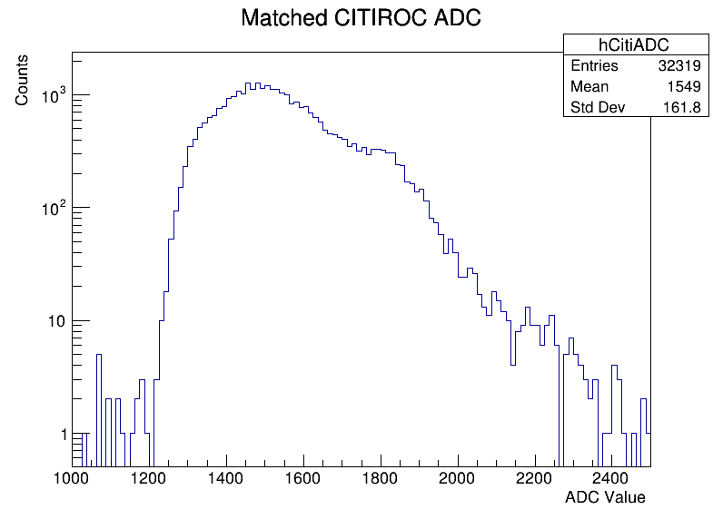
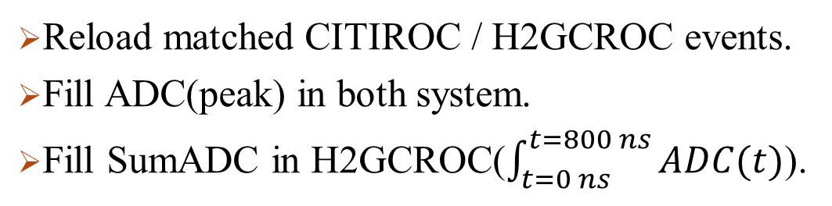
ADC Extraction
1274keV
Reload matched CITIROC / H2GCROC events.
Fill ADC(peak) in both system.
Fill SumADC in H2GCROC($\int_{t=0 ns}^{t=800 ns}{ADC(t)}$).
511keV
H2GCROC
1274keV
1274keV
511keV
511keV

Slide 9
QA for the spectrum
511 keV γ
LYSO
Why the second peak(1274keV) has a large difference statistics?
  The total length between LYSO(8X₀) and GAGG(0.5X₀), Cause different interaction rate of 1274 keV
Why does the H2CROC system has a lower efficiency?
  The solid angle between detectors. And the ROCs data matching problem will loss the data.
GAGG
QA for the matching algorithm
+-240 is 48 bins
Signal ~ 48*(1700-800)/2
BG ~ 48*800
S/N = 450/800=56%
Real event ratio: 450/1250=36%
Need to improve the algorism?
Or maybe the 2 trigger system could reject BG?
How much background we label them to be matched?
+-240ns
signal
signal
Zoom in
and select
+-240 ns
background
background

