Slide 1
Weekly meeting
Yu-Siang Xiao (蕭宇翔)
2026 07/09

Slide 2
Trigger Matching Between H2GCROC and CITIROC
Goal: Match events recorded by two DAQ systems.
Method based on inter-event time intervals.
Different DAQ systems have different event numbering.
Timestamp comparison is more robust than raw event ID.

Slide 3
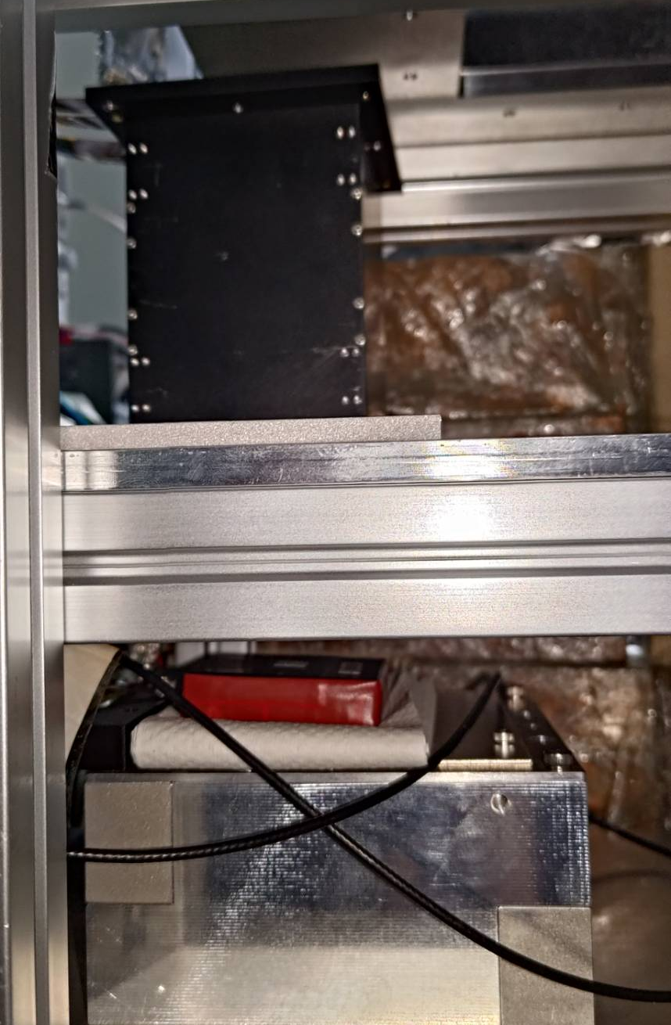
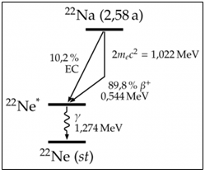
Experiment setup
511 keV γ
LYSO
Det1: LYSO 8.0X₀
SiPM(Osemi 60035 @ 29.0V)
H2GCROC
  External trigger by CITIROC
Det2: GAGG 0.5X₀
SiPM(Hamamatsu @ HV: 29|₁₀ ~ 56V)
GTM-EIC-CITIROC
  Self-trigger
Source: ²²Na:
2 x 511 keV(e⁺-e⁻ back to back γ)
1274 keV γ
1274 keV γ
Trigger
signal
Det1
H2GCROC
LYSO 8X₀
GAGG
511 keV γ
Trigger
signal
Det2
CITIROC
GAGG 0.5X₀
May get signal on each detector in same time, to try the event matching!

Slide 4

Procedure
LYSO
LYSO
1
2
To make sure 2 detector take the same events. ex: 30 sec
1. Set the high THR(DEC=1k) of trigger detector:
  Cut all of the data, make the trigger index reset.
2. Open the data taking of H2GCROC and CITIROC.
  Now, the data flow, and trigger signal is clear!
3. Set the lower THR of trigger detector:
  Start to detector signal and sent the trigger.
  The CITIROC(self trigger) and H2GCROC(external trigger) start to take the data save.
4. Wait for 30 sec!
5. Set the high THR of trigger detector:
  Close the trigger and stop the data flow.
6. Close and save the data flow.
The event # of CITIROC should equal to trigger # of H2GCROC.
Trigger
signal
GAGG
GAGG
3,4
LYSO
5,6
LYSO
Trigger
signal
Trigger
signal
GAGG
GAGG

Slide 5
The known information for matching
The CitiROC firmware update:
  Fine time -> 12-bit(4096) recover to be 18-bit(262144) in trigger BM.
CitiROC:
  Fine time: “240ns”.
  CitiROC pcnt reset the fine time count (but not always).
H2GCROC:
  Will not catch the trigger signal when time gap off two signal < 36000ns.
  H2GCROC time stamp “25ns”.
  Reset the time_stamp when time_stamp > 30-bit unsigned int.

Slide 6
New algorithm for matching
The first event will not lost catch by both 2 detector. Because the 1st event don’t have busy problem.
=> Use 1st event of both detector to get the initial time difference tC₀-tH₀ = dT₀.
Because H2GCROC loss data, we could find all matching event by search the H2GCROC event time in CitiROC event.
Using map comparison to find out the most approach events by difference:
  |tC_{j}-tH_{i}| = |dT_{i,j} - dT₀| to be minimum dT_{i}.
tC0
tH0
tC1
tH1
tC2
tC3
tH3
tC4
tH4
tC5
tH5

Slide 7
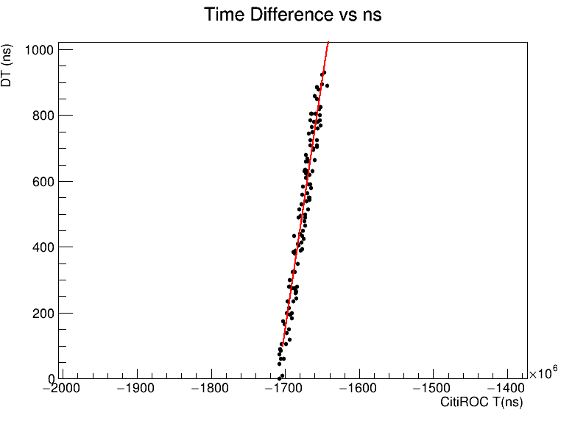
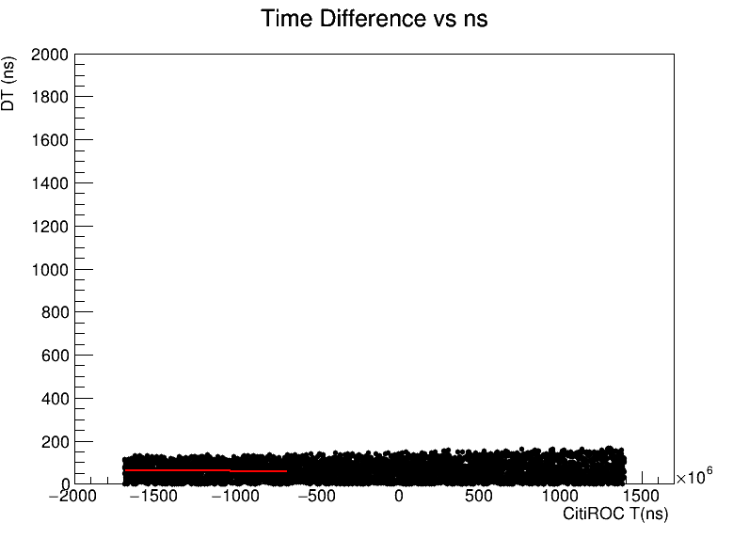
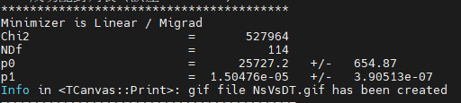
dT_{i} is changing
During fine time count and pcnt pass pass, the dT_{i} of matching event become larger and larger: linear
Maybe is the clock frequency of 2 ROCs are not correct: I use the linear slope to correct the frequency!
In this example: CITIROC frequency slower then H2GCROC by 1.504E-5.
Revise the fcnt, pcnt scale by frequency ratio.

Slide 8
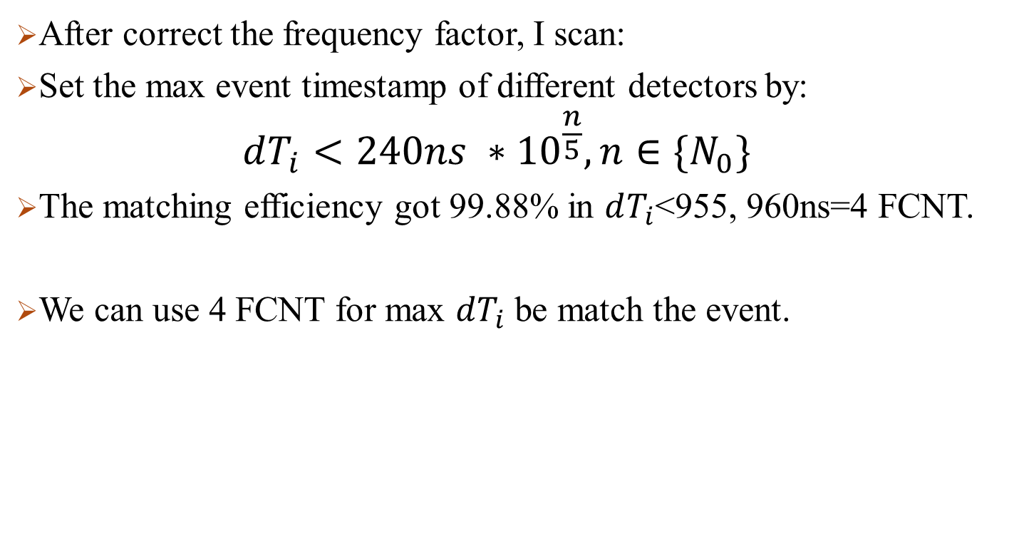
The final matching result of new algorithm
After correct the frequency factor, I scan:
Set the max event timestamp of different detectors by:
  $$dT_{i}<240ns ∗{10}^{\frac{n}{5}},n∈\{N_{0}\}$$
The matching efficiency got 99.88% in $dT_{i}$<955, 960ns=4 FCNT.
We can use 4 FCNT for max $dT_{i}$ be match the event.

