Slide 1
Fast sim weekly work

Slide 2
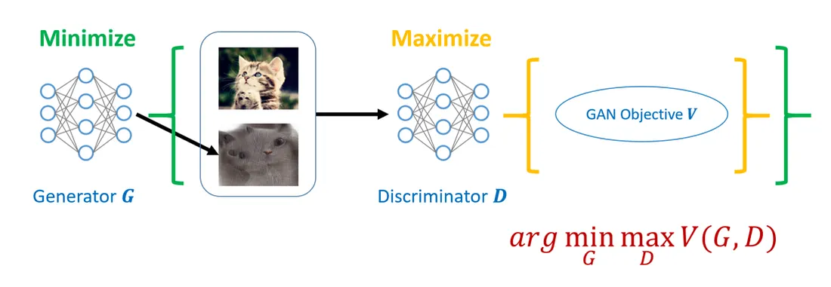
GAN
The idea of GAN is quite simple. Since we can't calculate divergence ourselves, we'll just hand this problem over to another network (called the discriminator) to solve. In short, through some tricky designs, the discriminator can actually measure divergence.
https://aws.amazon.com/tw/what-is/gan/

Slide 3
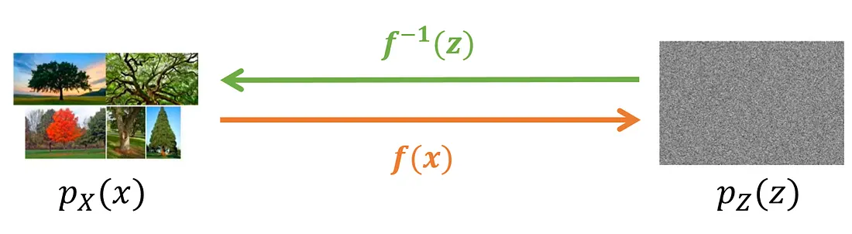
NF
The idea behind Normalizing Flow is to find an invertible function f that can transform the distribution of a set of images X into a certain simple distribution (such as a Gaussian distribution). Then generating images becomes very simple. All you need to do is sample points from the known simple distribution and then use the inverse function of f to generate the images.
https://medium.com

Slide 4
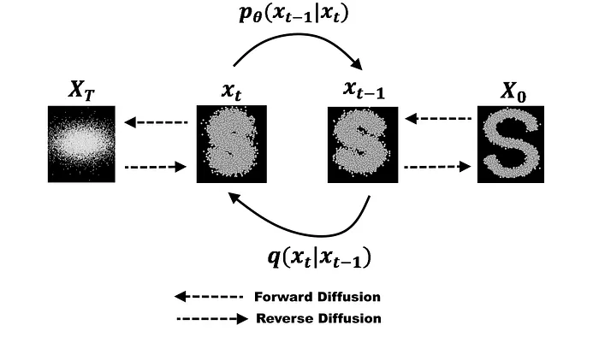
Diffusion
The Diffusion model (diffusion algorithm) is like the "sculptor" in the AI world. It first practices destroying photos into pure noise, and then learns how to clean up this mass of noise and restore it to the original image. Therefore, as long as it is given a pile of random sand (noise), it can produce the most exquisite result.
https://medium.com

Slide 5
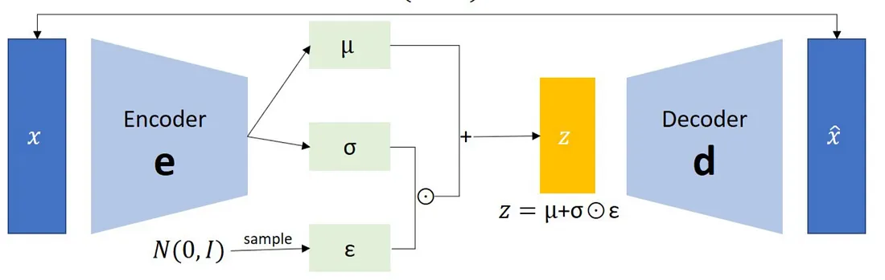
VAE
VAE is based on auto-encoder. Through one network, the input x is transformed into a set of codes, and then through another network, it is decoded back to x to achieve an unsupervised target. In addition, during the encoding process, VAE additionally involves the known probability distribution, restricting the range of encoding. After training is completed, different random values can be generated by sampling to produce data.
https://vocus.cc/article/66a21262fd897800017ae2ba

Slide 6
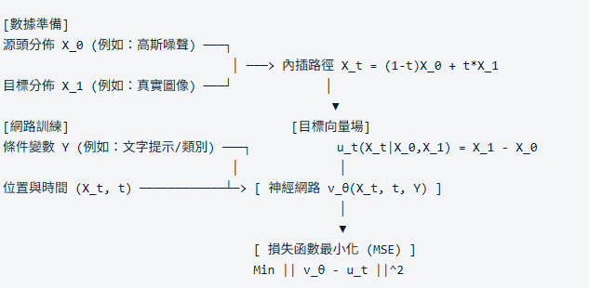
CFM

Slide 7
Model | Generation Speed | Math / Visual Accuracy | Major Disadvantage (Pain Point) | Best Use Cases
VAE (Variational Autoencoder) | ⭐⭐⭐⭐⭐ Extremely Fast (One-step) | ⭐⭐ Blurry details | ❌ Severe feature compression Loses fine-grained details | Data dimensionality reduction, fast prototyping, feature extraction & classification
GAN (Generative Adversarial Network) | ⭐⭐⭐⭐ Fast (One-step) | ⭐⭐⭐⭐ Highly realistic | ❌ Unstable training Prone to mode collapse | Face swapping (Deepfake), image style transfer, anime generation
NF (Normalizing Flows) | ⭐⭐⭐⭐ Fast (One-step) | ⭐⭐⭐⭐⭐ Mathematically exact | ❌ Rigid architecture Struggles with complex, high-res images | Anomaly detection (fraud/industrial defects), precise physical & scientific simulations
Diffusion (Diffusion Models) | ⭐ Extremely Slow (Requires multi-steps) | ⭐⭐⭐⭐⭐ Highest image quality | ❌ High computational cost Iterative denoising takes time | High-end image generation (Midjourney, Stable Diffusion), commercial posters, digital art
CFM (Conditional Flow Matching) | ⭐⭐⭐⭐⭐ Extremely Fast (Straight-path) | ⭐⭐⭐⭐⭐ Quality matches Diffusion | ❌ Emerging technology Open-source ecosystem still growing | Next-gen audiovisual generation, real-time voice cloning, rapid high-res image synthesis

Slide 8
The phase of fast sim
[Geant4 ROOT 檔]
▼
【 Phase -1: 幾何與資料正確性 (ROOT Inspection & Mapping) 】
▼
【 Phase 0: 資料工程與前處理 (Data Engineering) 】
▼ (train.h5, val.h5, test.h5, metadata.json)
【 Phase 0.5: 資料集基準與品質保證 (Dataset Characterization & QA) 】
▼ (12 項 Baseline Figures, JSON 指紋, CSV 統計)
【 Phase 1: 建立工程基線 (Vanilla AutoEncoder) 】
│ ➔ Phase 1.0: 基礎訓練 (MSE Loss)
│ ➔ Phase 1.5: 物理損失函數優化 (引入 ZI-MSE 解決稀疏性)
│ ➔ Phase 1.6: 潛在空間缺陷診斷 (證明潛在空間膨脹且離散)
▼ (確認 3D Shower 可精準重建，確立需引入 VAE 的動機)
【 Phase 2: 建立生成友善潛在空間 (β-VAE) 】
│ ➔ Phase 2.0: 架構設立 (雙頭 Encoder 與 Reparameterization Trick)
│ ➔ Phase 2.1: 健全度測試 (β=0 Sanity Check，確保無梯度 Bug)
│ ➔ Phase 2.2: 參數消融訓練 (β Sweep 0.01~1.0)
│ ➔ Phase 2.3: 物理驗證與診斷 (6 大物理指標、鎮壓 Background Glow)
│ ➔ Phase 2.4: 空間剖析 (PCA, t-SNE, Latent Norm 幾何特徵)
│ ➔ Phase 2.5: 最佳 β 決選與模型凍結 (綜合物理與數學的折衷點)
▼ (Frozen Encoder/Decoder & Continuous, Smooth Latent Space)
【 Phase 3: 條件式生成 (Latent Diffusion) 】
▼ (Generated Shower Tensor)
【 Phase 4: 模型與物理驗證 (Physics Validation - GT vs Generated) 】

Slide 9
Phase -1: ROOT Inspection & Mapping
Divide the files train/val/text
Convert cellid from 1D to 2D (output: figures/event0_2D_display.png) Upgrade the hit scatter plot to a 20 * 20 matrix image as the input for the neural network
Convert "cellid_to_index" to a 2D matrix (row, col), and then convert it back to 20 * 20 through "index_to_cellid".

Slide 10
Phase 0 Data Engineering
Convert the root file to the HDF5 format that can be efficiently and parallelly read by neural networksVerify HDF5 reading, tensor transformation, deadlock stress testing, geometry and visualization

Slide 11
Phase 0.5: Dataset Characterization & Quality Assurance (Dataset QA)
Before feeding the data into the neural network for training, we first "confirm the true appearance of the data from a physical perspective and define the benchmark characteristics"

Slide 12
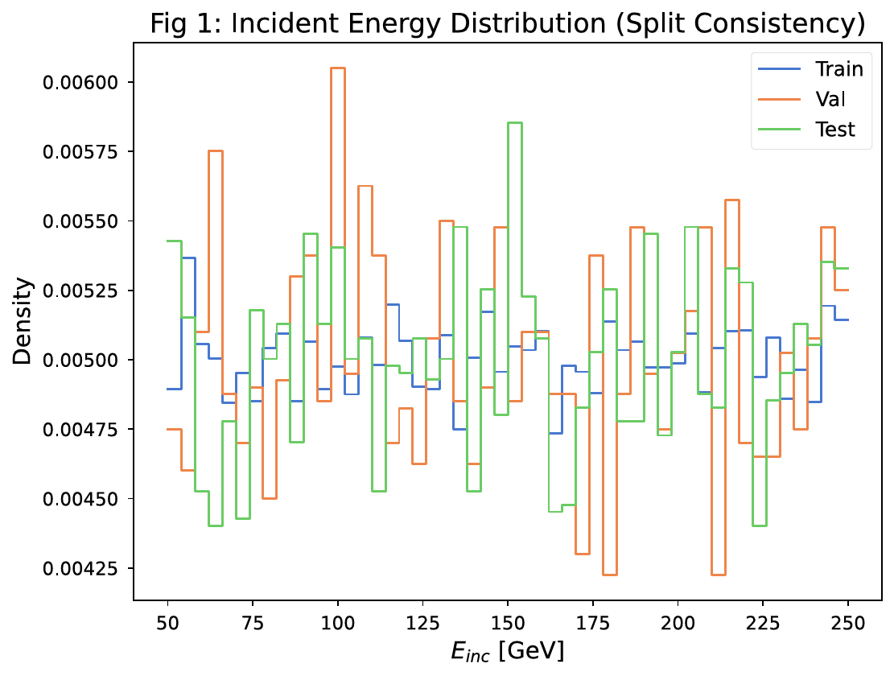
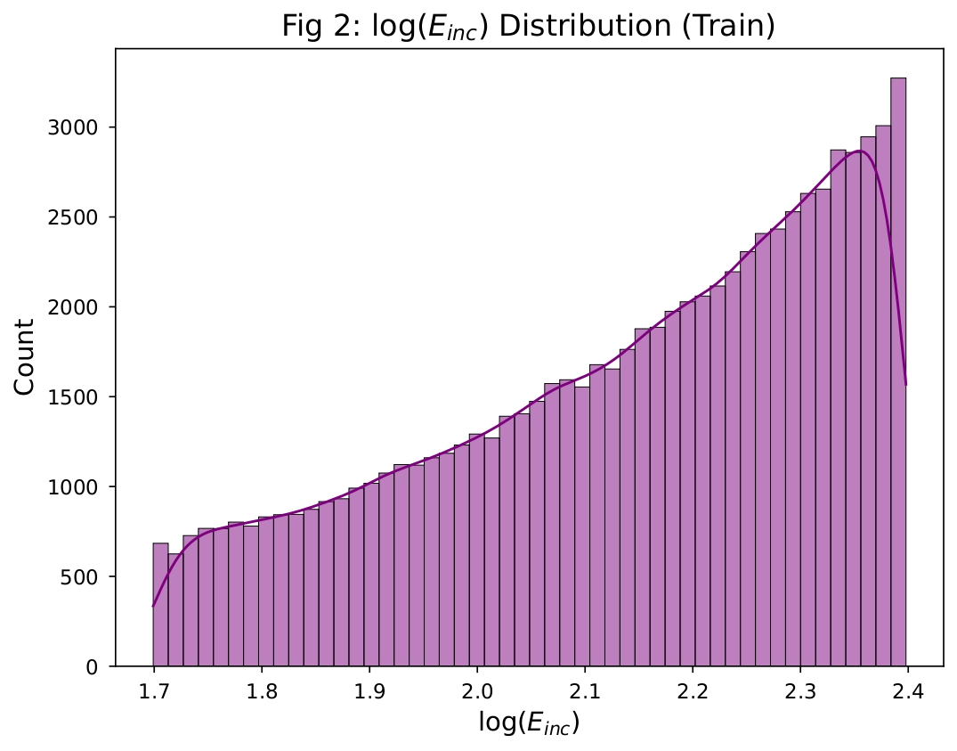
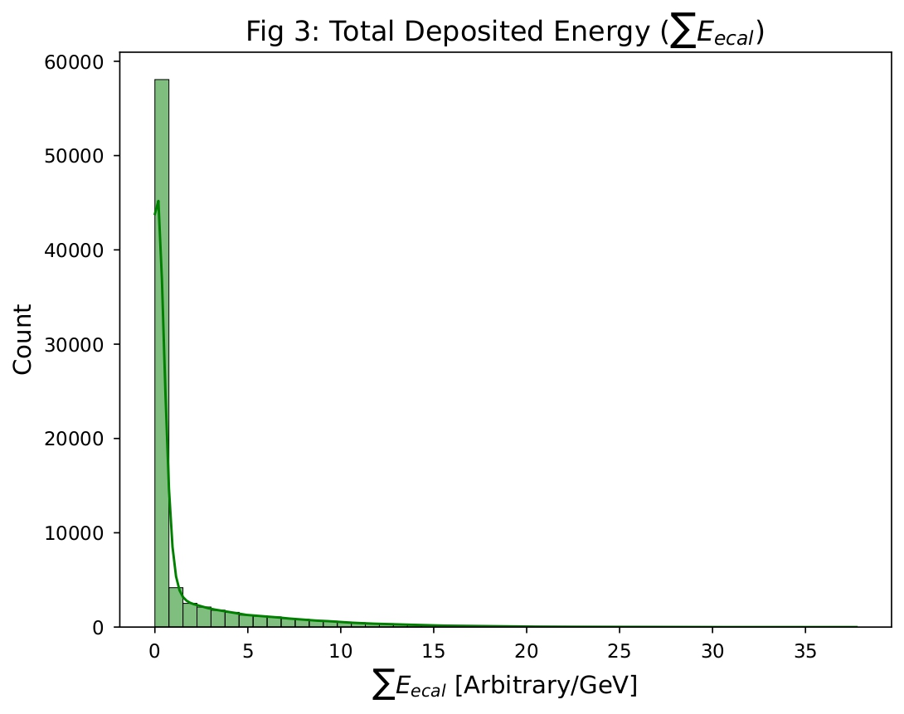
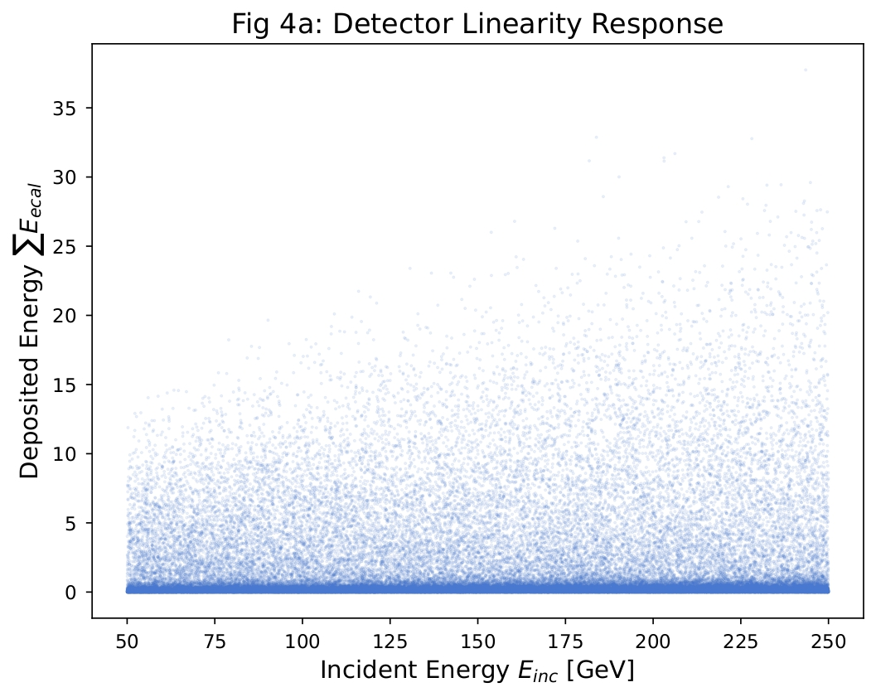
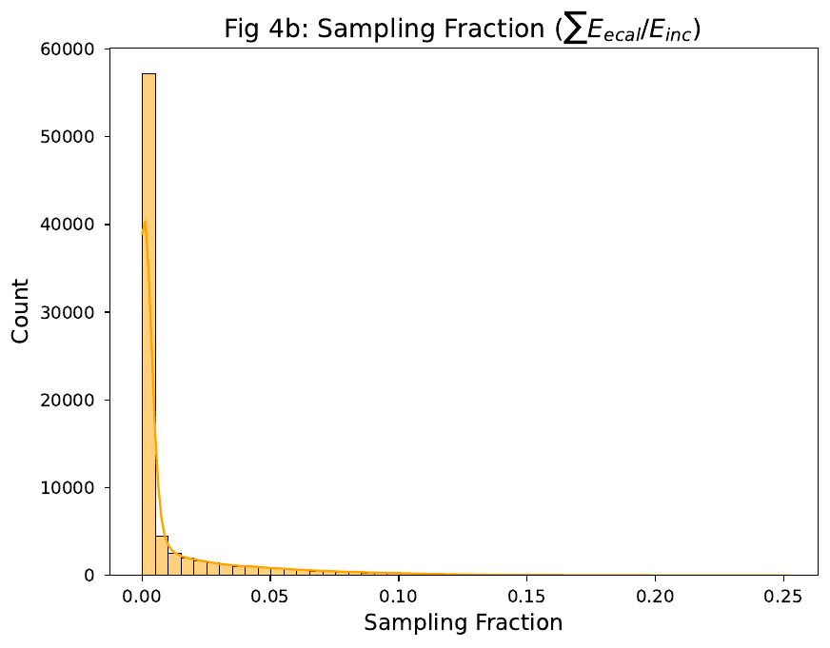
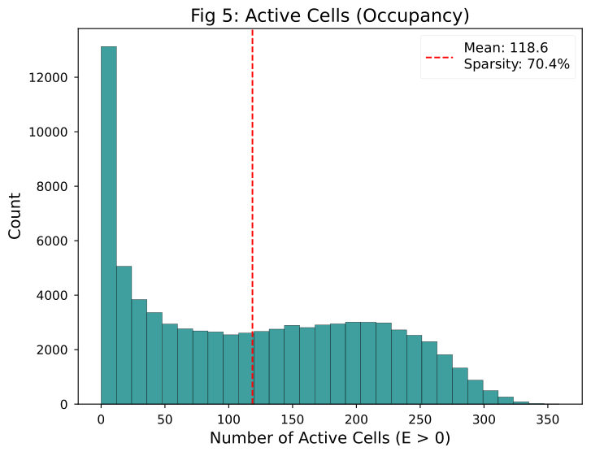

Slide 13
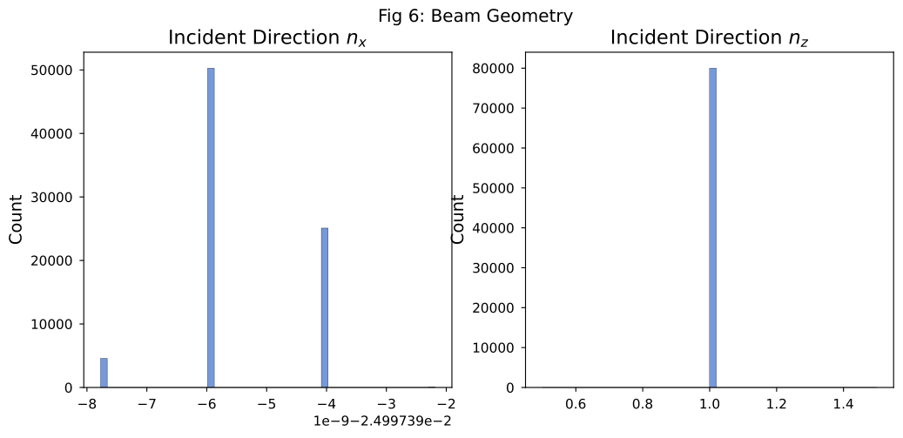
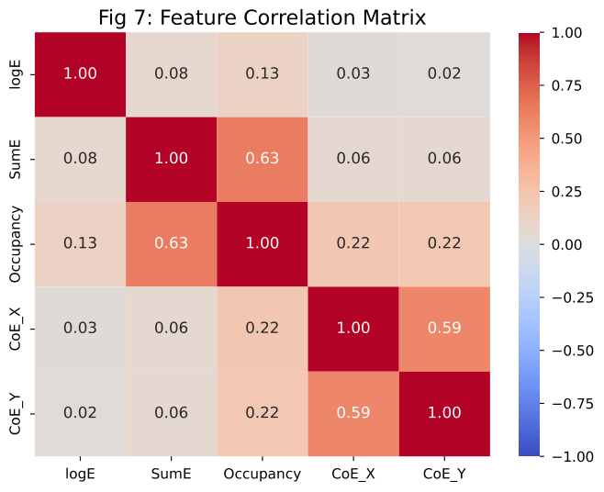
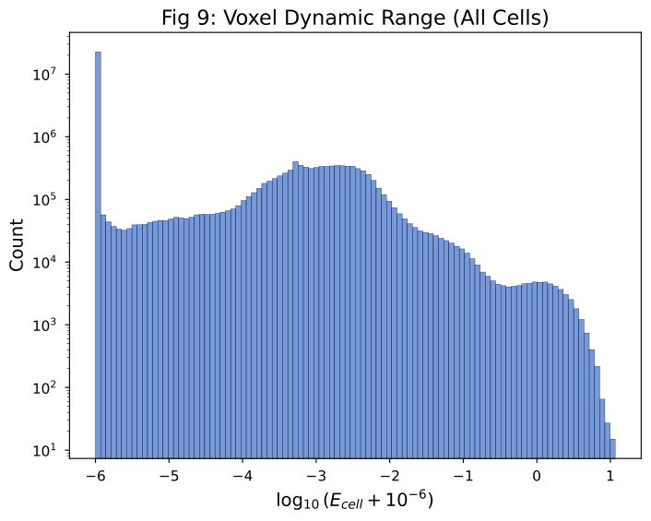
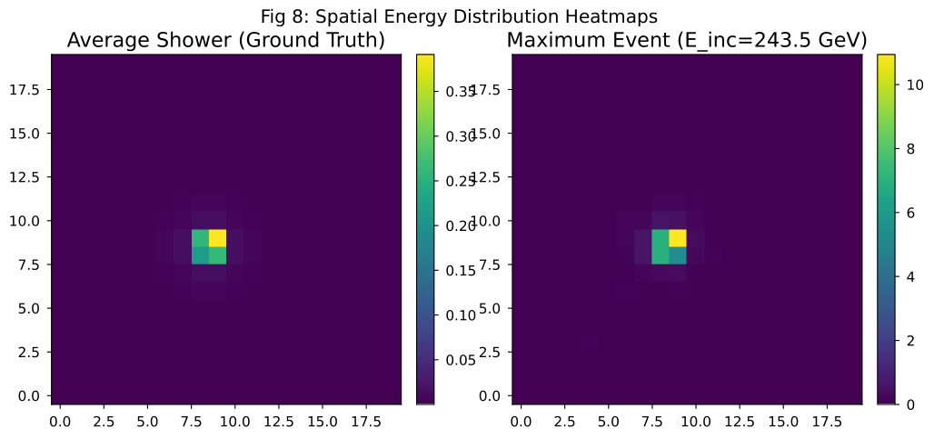

Slide 14
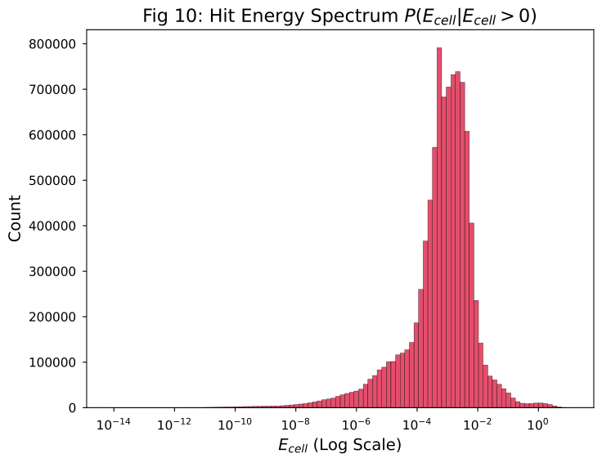
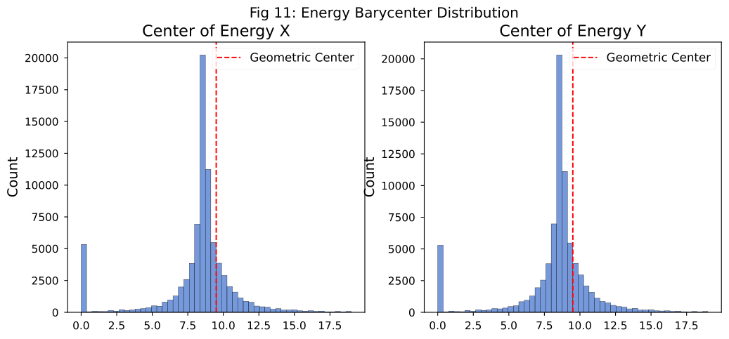

Slide 15
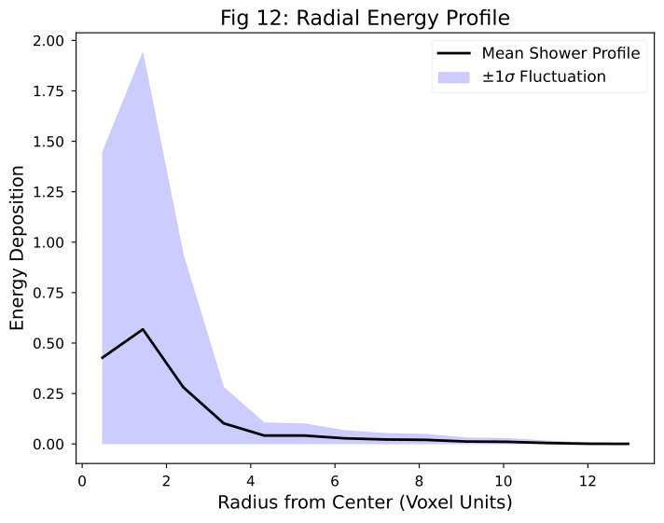

Slide 16
Phase 1: Vanilla AutoEncoder
【 Input a real "Shower”】
▼
【 Compression】
▼
【 Decompression】
▼
【 Output a picture that looks very similar to "Shower"】

Slide 17
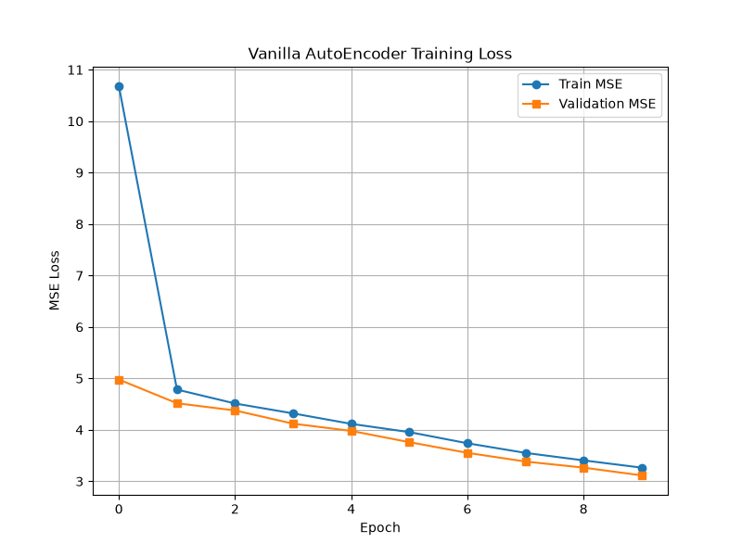
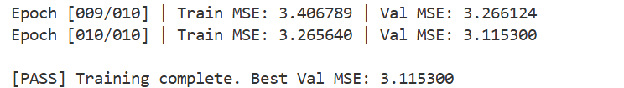

Compression
Input: $x=log\left(E+ε\right)$，其中 $ε={10}^{−6}$，避開 $log\left(0\right)$的 $−∞$
Loss:先不使用zi-mse， 使用nn.MSELoss()看模型基本的收斂能力
Decoder: Identity
Latent Size:128
Metrics:

Slide 18
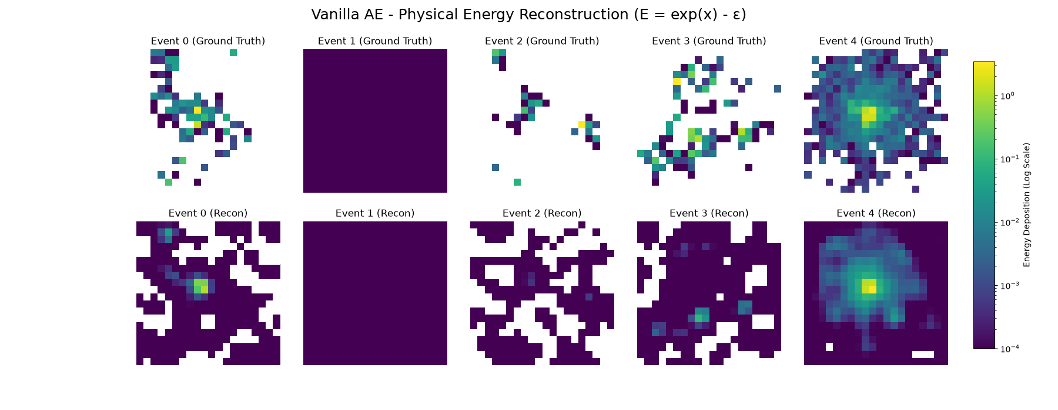
The model was designed to address the problem of "being unable to determine exactly which specific lattice has energy", by distributing the energy evenly across the surrounding pixels, thereby minimizing the global Mean Squared Error.

Slide 19
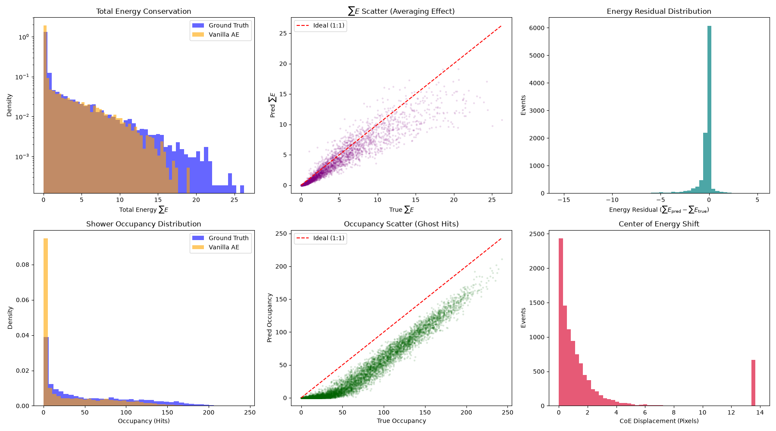
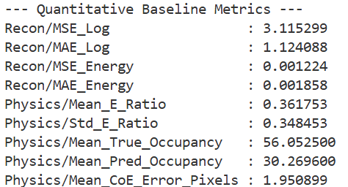
Phase 1.5 Vanilla AE Baseline
The reconstructed total energy is only 36.1% of the actual event's energy on average.
10% of the space error

Slide 20
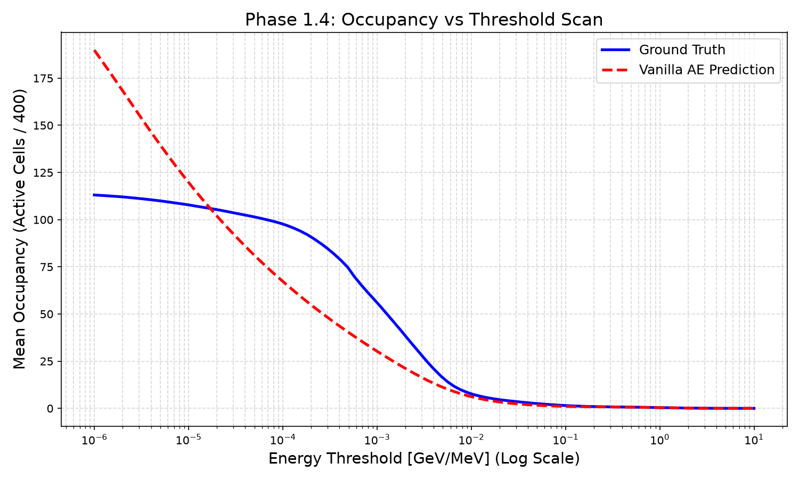

Slide 21
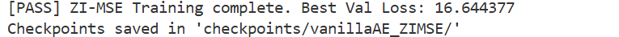
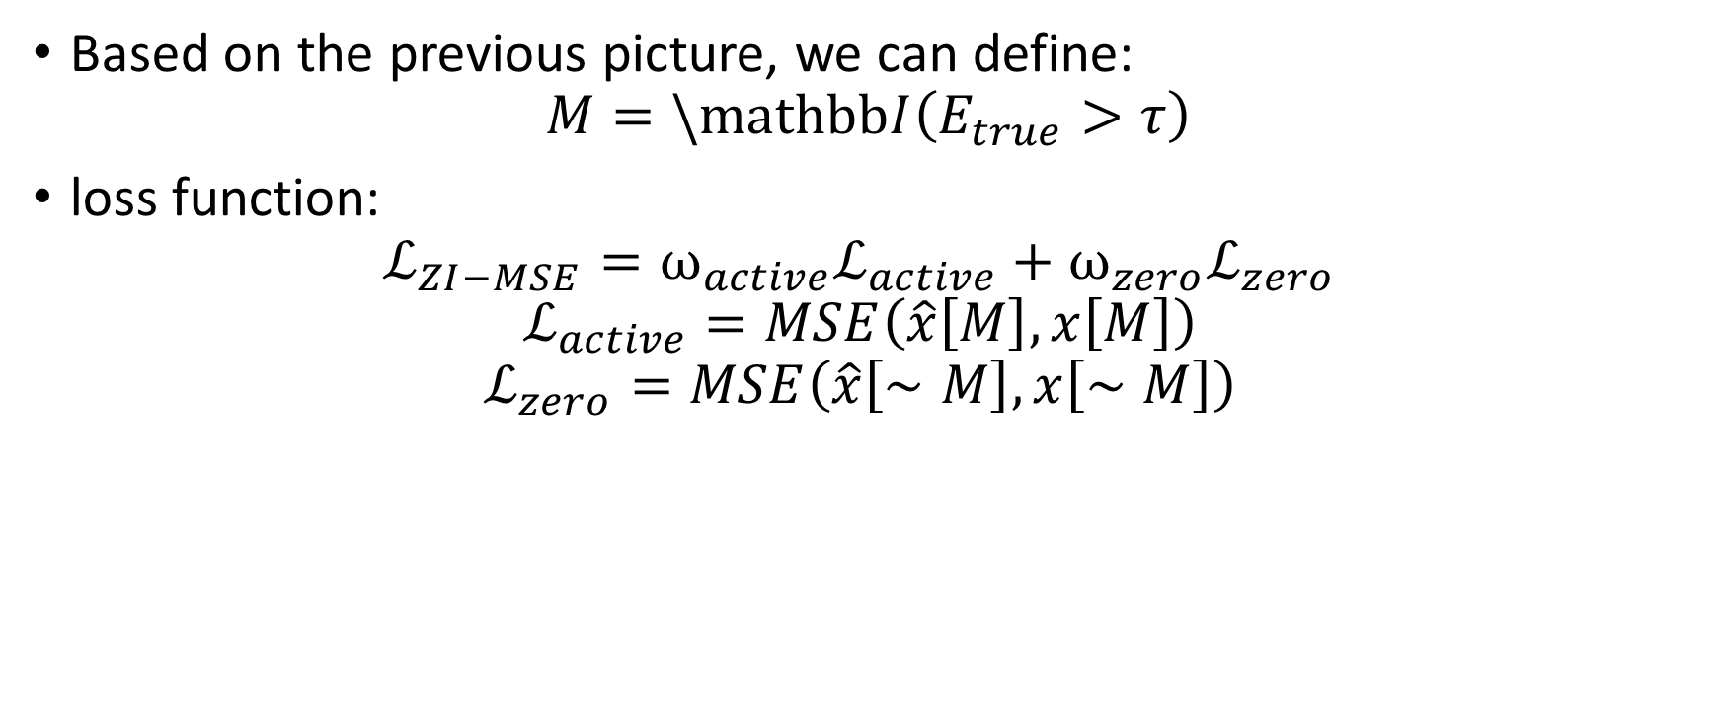
Zero-Inflated MSE (ZI-MSE) Loss Design
Based on the previous picture, we can define:
$$M=\backslash mathbbI\left(E_{true}>τ\right)$$
loss function:
$$ℒ_{ZI−MSE}=ω_{active}ℒ_{active}+ω_{zero}ℒ_{zero}$$
$$ℒ_{active}=MSE\left(\hat{x}\left[M\right], x\left[M\right]\right)$$
$$ℒ_{zero}=MSE\left(\hat{x}\left[∼M\right],x\left[∼M\right]\right)$$

Slide 22
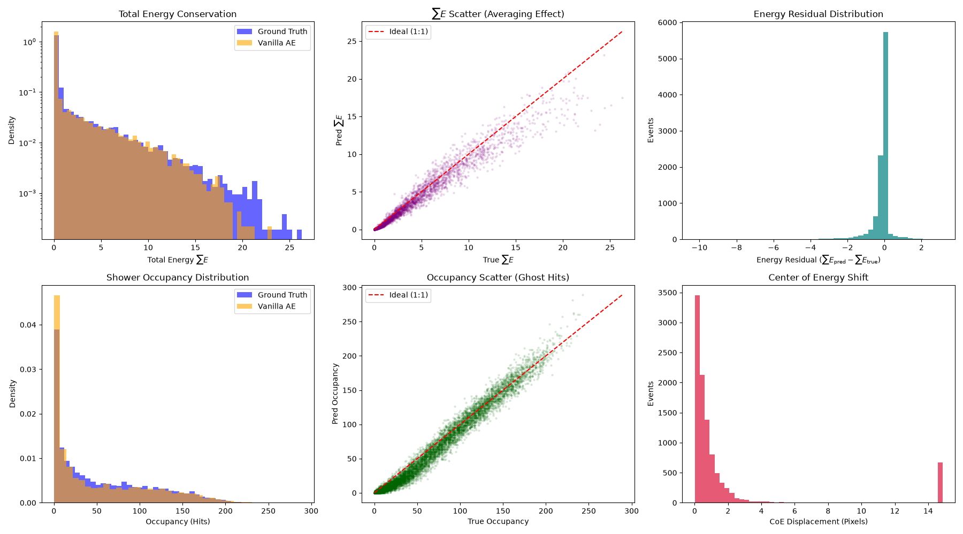
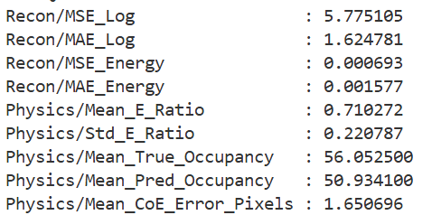
Zero-Inflated MSE (ZI-MSE) Loss Design
The total energy after reconstruction was increased to 71% of the event energy on average.
The spatial error has decreased to 8.2%.

Slide 23
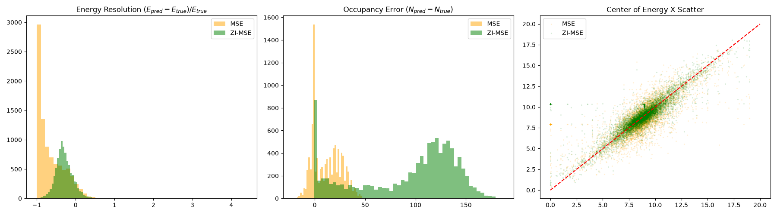
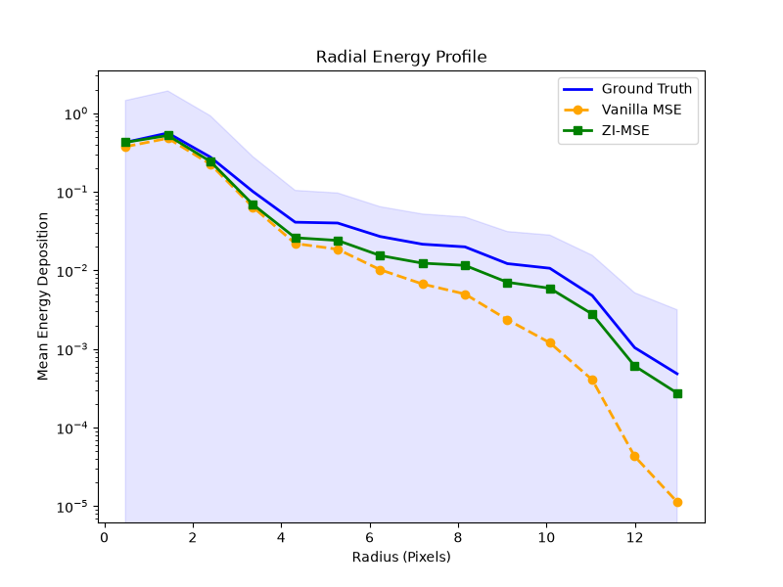
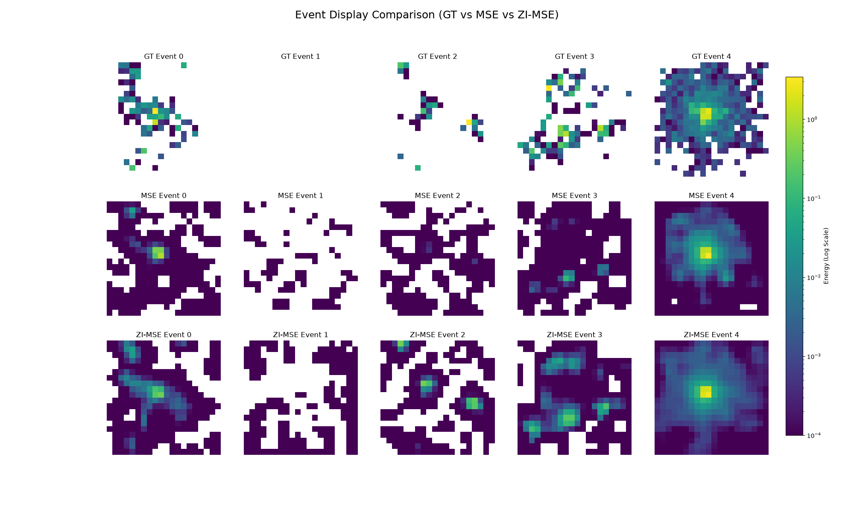
MSE V.S ZI-MSE

