Slide 1
7/29 Report

Slide 2
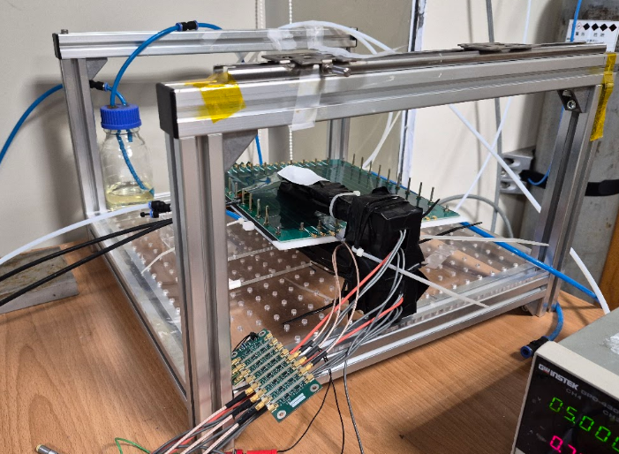
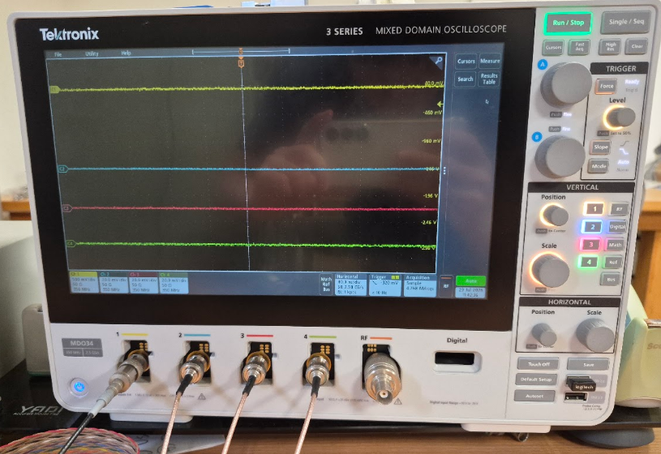
RPC Testing
When the trigger detects a cosmic ray, the oscilloscope records the signal from the RPC.
RPC
trigger

Slide 3
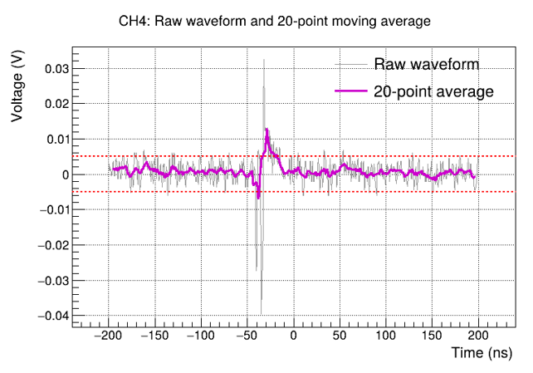
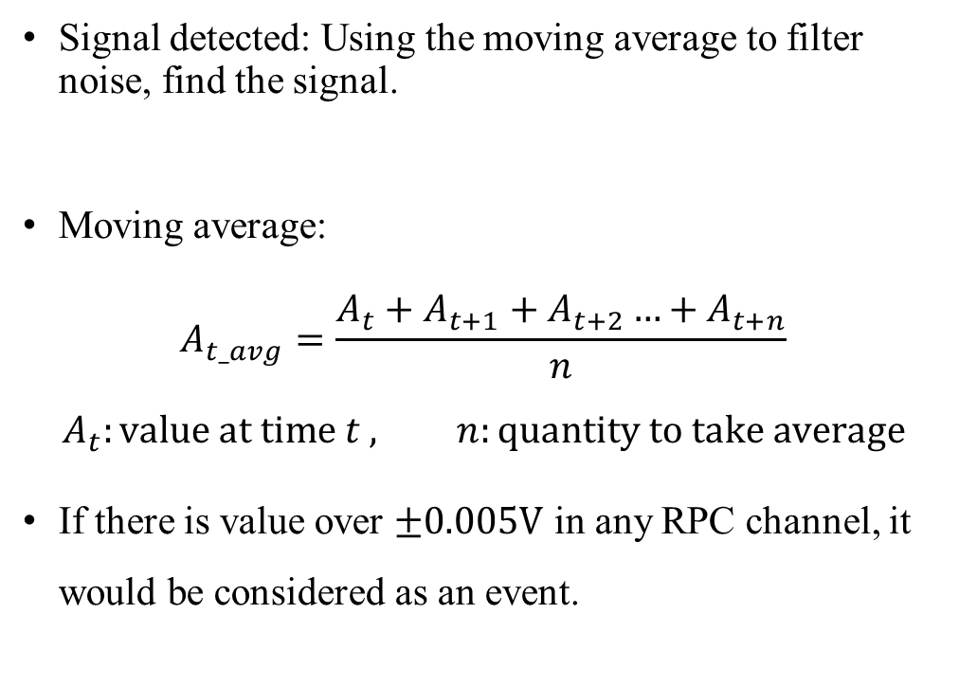
Signal Search
Signal detected: Using the moving average to filter noise, find the signal.
Moving average:
$$A_{t_avg}=\frac{A_{t}+A_{t+1}+A_{t+2}…+A_{t+n}}{n}$$
$$A_{t}:value at time t , n:quantity to take average$$
If there is value over $±0.005V$ in any RPC channel, it would be considered as an event.

Slide 4
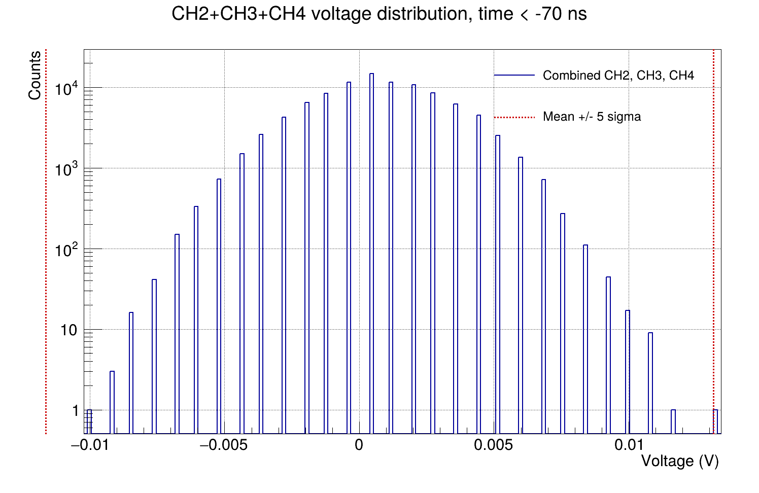
Signal Search
Calculate the voltage-value distribution before 70 ns and determine the fifth standard-deviation threshold.
Any value exceeding this threshold is identified as an event .

Slide 5
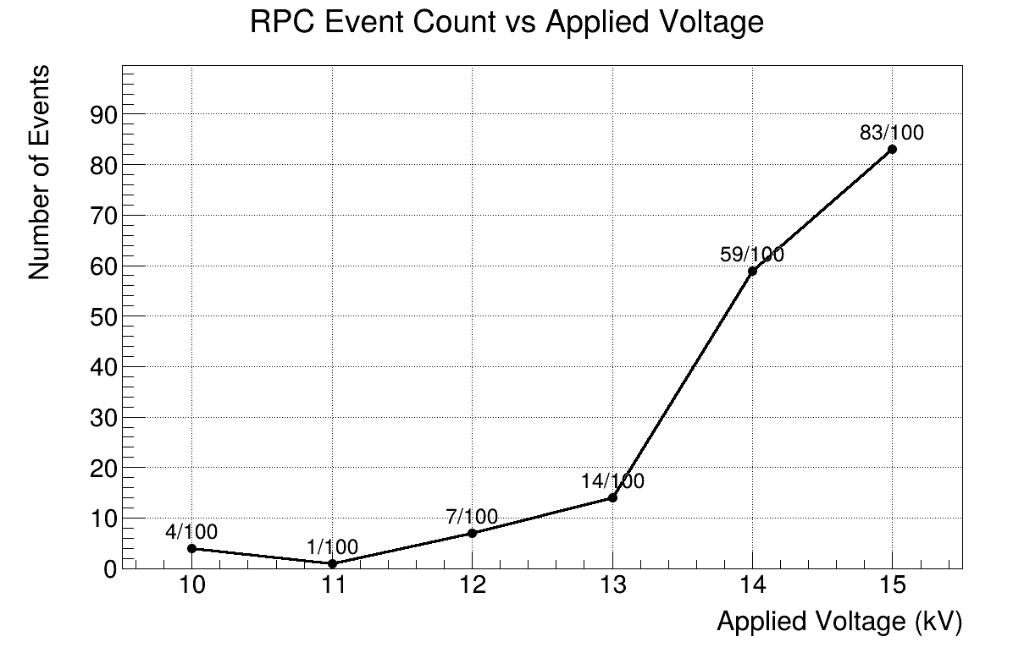
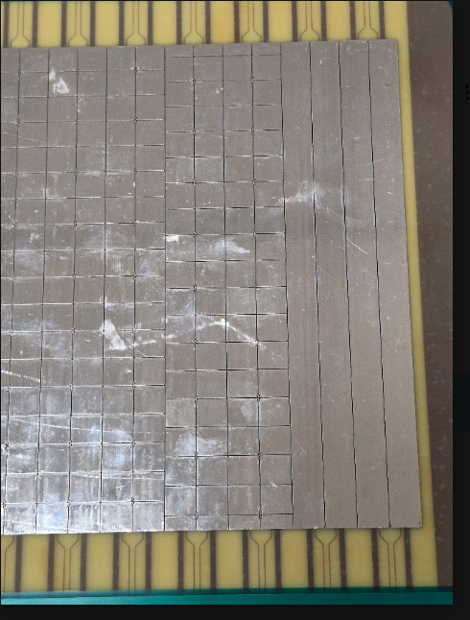
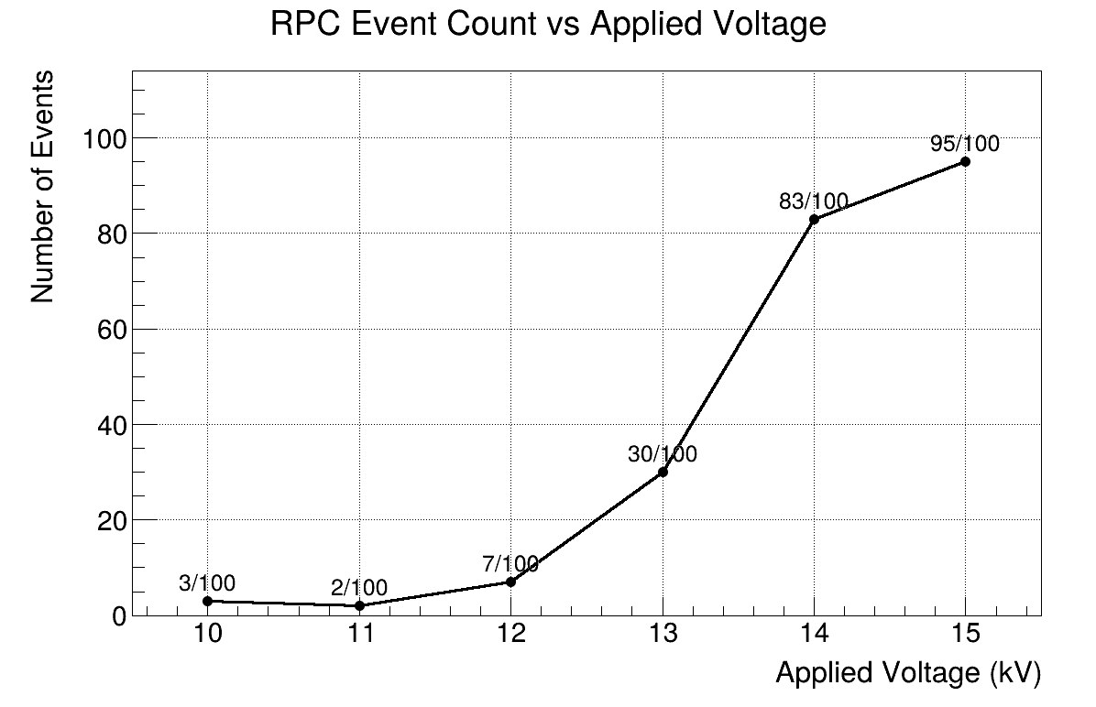
RPC Efficiency
Applied voltagev | Efficiency (Moving avg) | Efficiency (Sigma)
10 kV | 4% | 3%
11kV | 1% | 2%
12kV | 7% | 7%
13kV | 14% | 30%
14kV | 59% | 83%
15kV | 83% | 95%
Measure channels

Slide 6
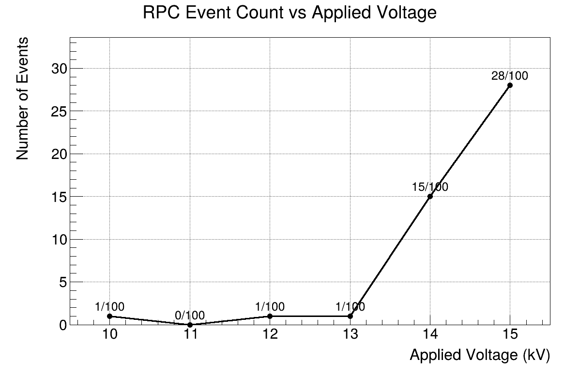
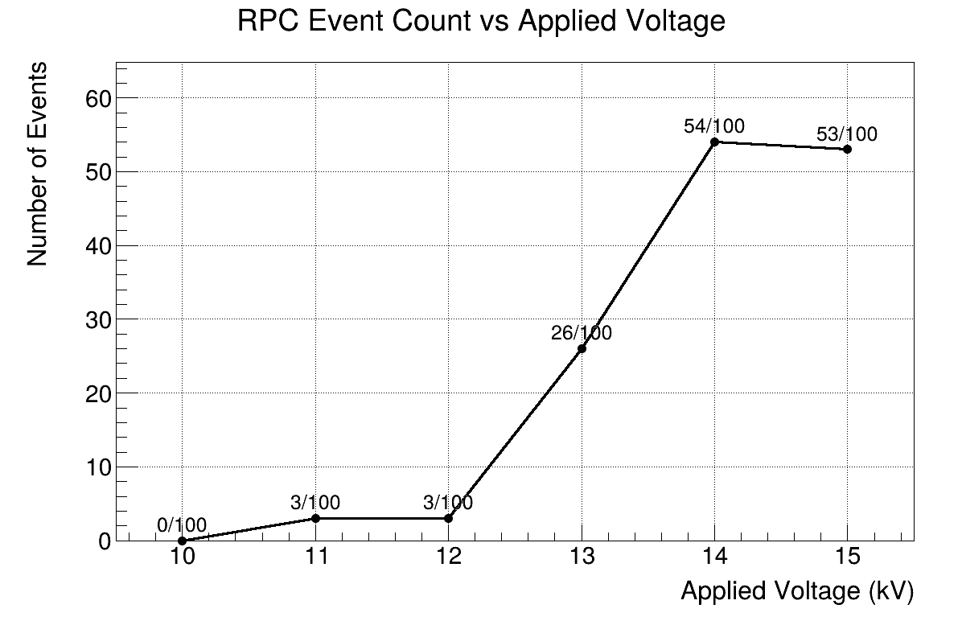
RPC Efficiency
Applied voltage | Efficiency (Moving avg) | Efficiency (Sigma)
10 kV | 1% | 0%
11kV | 0% | 3%
12kV | 1% | 3%
13kV | 1% | 26%
14kV | 15% | 54%
15kV | 28% | 53%
Measure channels

Slide 7
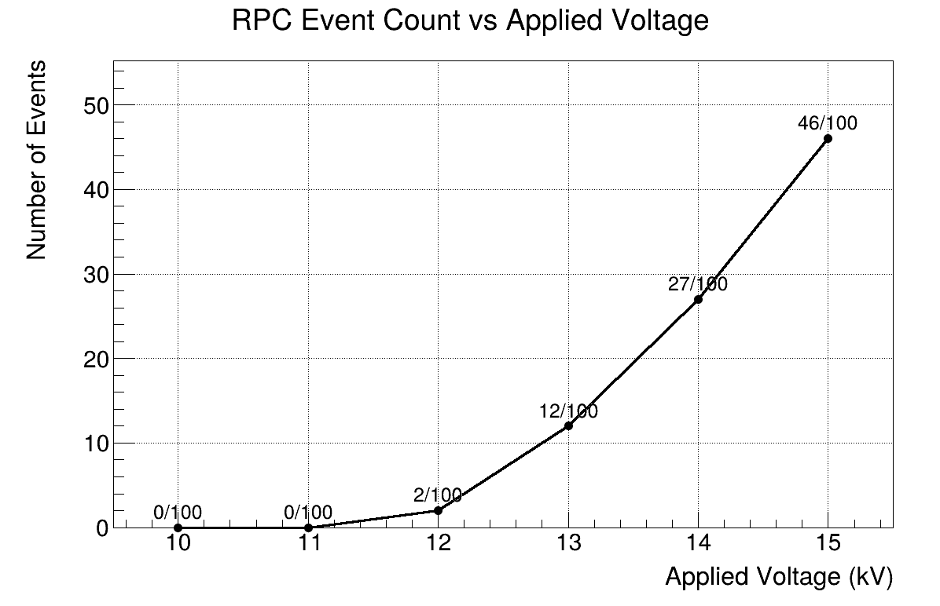
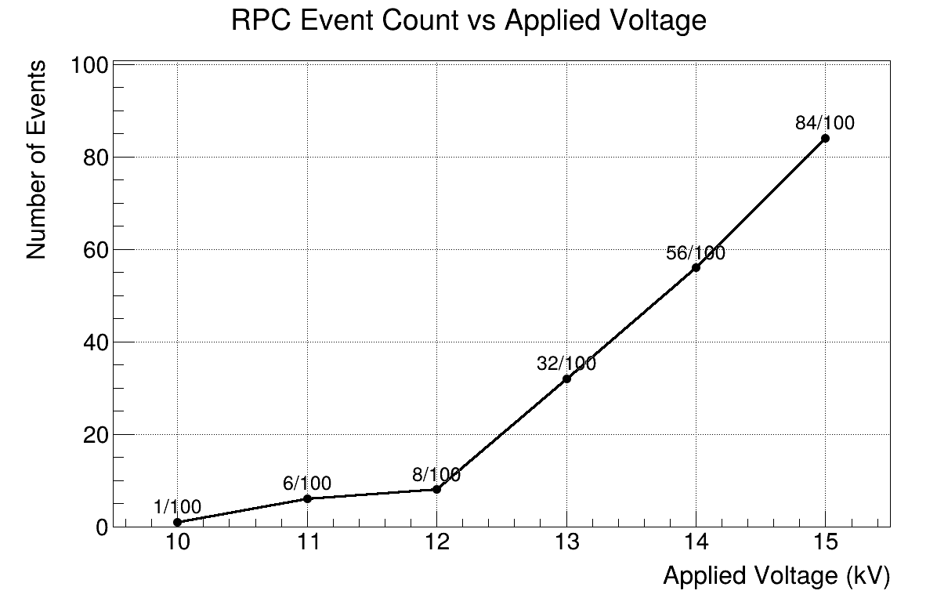
RPC Efficiency
Applied voltage | Efficiency (Moving avg) | Efficiency (Sigma)
10 kV | 0% | 1%
11kV | 0% | 6%
12kV | 2% | 8%
13kV | 12% | 32%
14kV | 27% | 56%
15kV | 46% | 84%
Measure channels

Slide 8
Applied voltage | Efficiency (Moving avg) | Efficiency (Sigma)
10 kV | 4% | 3%
11kV | 1% | 2%
12kV | 7% | 7%
13kV | 14% | 30%
14kV | 59% | 83%
15kV | 83% | 95%
Applied voltage | Efficiency (Moving avg) | Efficiency (Sigma)
10 kV | 1% | 0%
11kV | 0% | 3%
12kV | 1% | 3%
13kV | 1% | 26%
14kV | 15% | 54%
15kV | 28% | 53%
Applied voltage | Efficiency (Moving avg) | Efficiency (Sigma)
10 kV | 0% | 1%
11kV | 0% | 6%
12kV | 2% | 8%
13kV | 12% | 32%
14kV | 27% | 56%
15kV | 46% | 84%

